Slide 1
Build Mobile Applications
With Ionic + Laravel
Presenters:
Justin James
Michael Iglesias

Slide 2

"Hello."
ionicframework.com

Slide 3



Web Technologies You Already Know & Love

Slide 4





Your App
Ionic
Angular
Webview (Cordova)
Native SDK

Slide 5

Supported Devices
iOS 6+ Android 4+

Slide 6
Ionic Built-In UI Elements
i.e. Web SDK

Slide 7

Ionicons
Over 600 MIT licensed font-icons included
ionicons.com

Slide 8
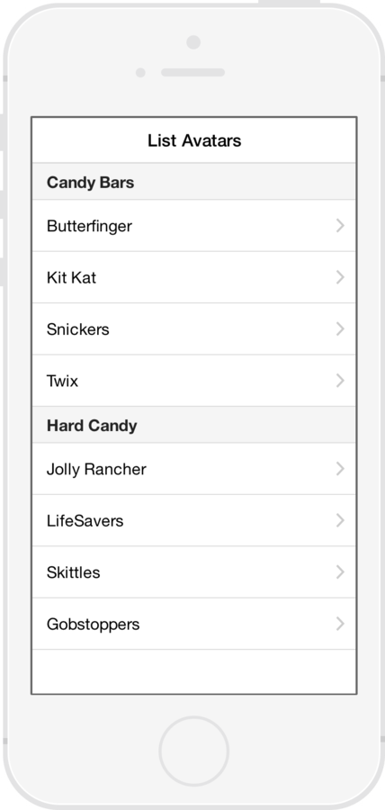
List Views
Simple List
Data Only
Complex List
Edit / Delete / Reorder
Long List
> 1000 items.

Slide 9
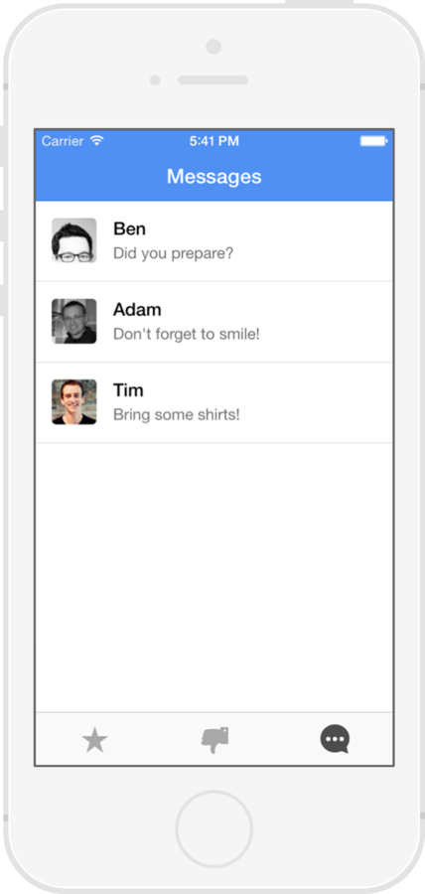
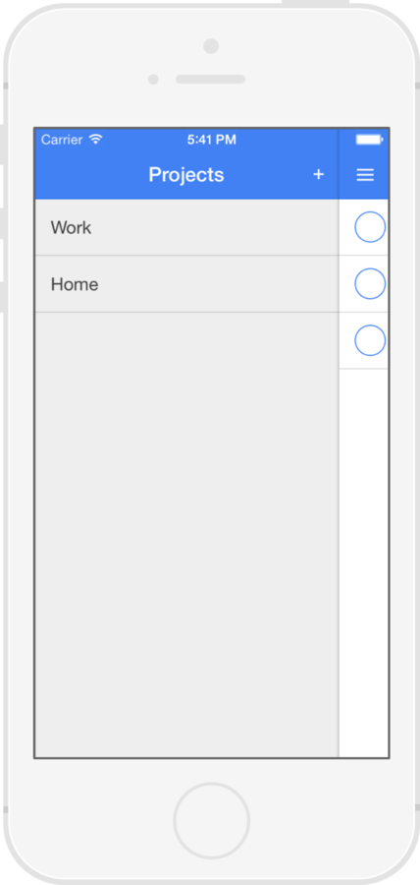
Menu

Slide 10
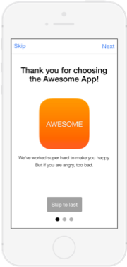
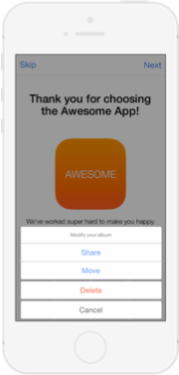
Slide Box
Action Sheet

Slide 11

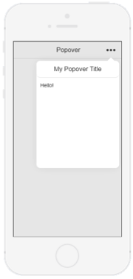
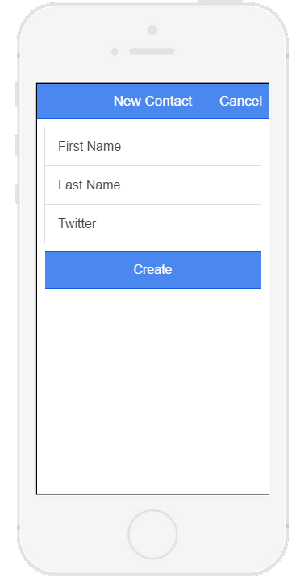
Modal
Popover

Slide 12
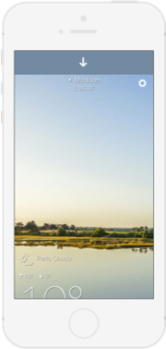
Pull to Refresh

Slide 13
How to get started?

Slide 14
Ionic Setup Details
digitaldrummerj.me/Ionic-Setup-Windows/
digitaldrummerj.me/ionic-setup-osx/
​​
github.com/nraboy/ubuntu-ionic-installer
github.com/nraboy/ubuntu-ionic-installer

Slide 15
What's building an app like?

Slide 16
Create ionic app
Create new project
ionic start myApp [blank/tabs/sideMenu]
Test on web browser
ionic serve --lab
Add mobile platform (Android or iOS)
ionic platform add [android/ios]
Run test on device/emulator
ionic [run/emulate] [android/ios]

Slide 17
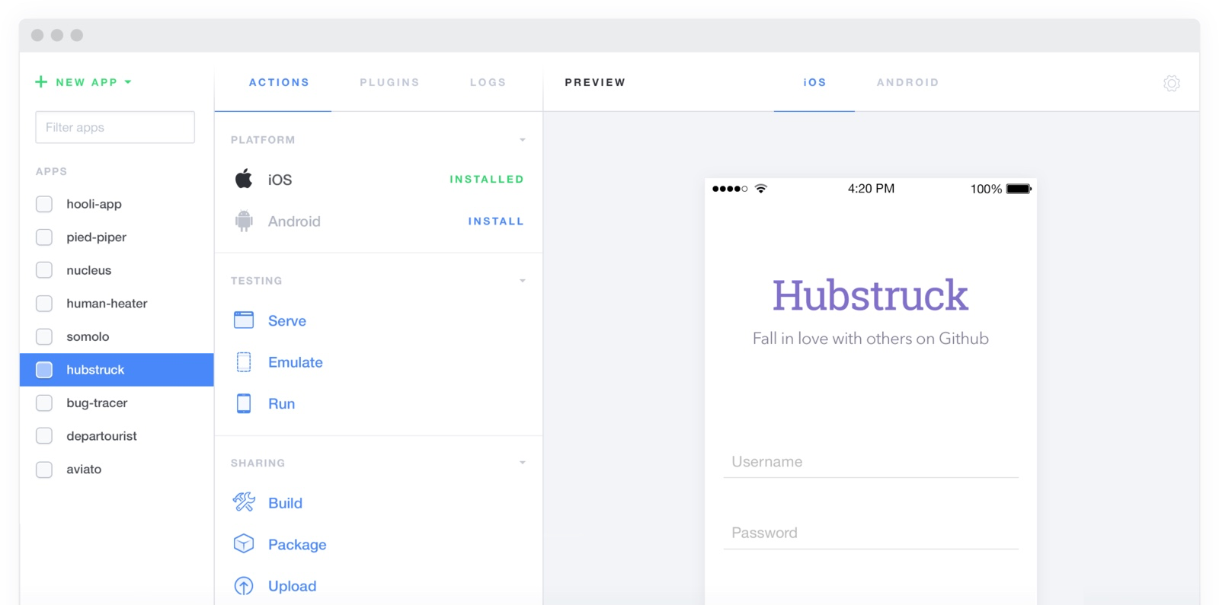
Ionic Lab / UI
http://lab.ionic.io/
$ ionic serve --lab

Slide 18
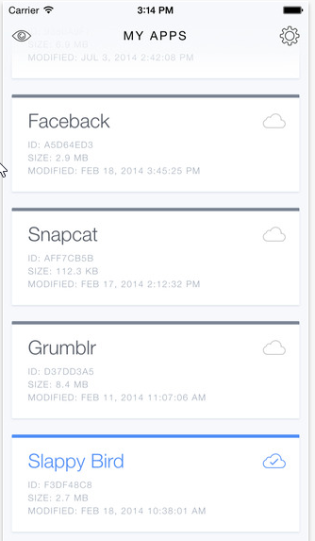
Ionic View
App Store
$ ionic start myApp tabs
$ cd myApp
$ ionic upload
$ ionic share [email address]

Slide 19
Icons and Splash Screens
Automatically generate icons and splash screens
Creates size needed for each platform
$ ionic resources
$ ionic resources --icon
$ ionic resources --splash

Slide 20
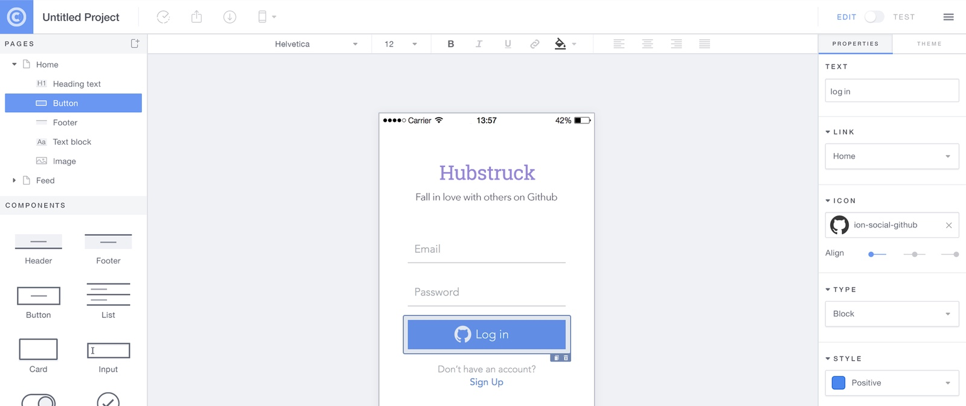
Ionic Creator
https://creator.ionic.io

Slide 21
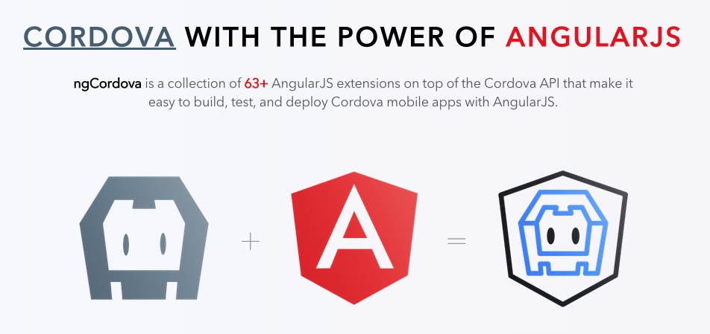
ngCordova
http://ngcordova.com

Slide 22
List of ngCordova Plugins
ngCordova Provides Angular Services for Cordova Plugins
AdMob
App Availability
BackgroundGeolocation
Battery Status
Barcode Scanner
Camera
Capture
Clipboard
Contacts
DatePicker
Device
Device Motion
Device Orientation
Dialogs
File
Flashlight
Geolocation
Globalization
GoogleAnalytics
Keyboard
Keychain
NativeAudio
Media
Local Notiﬁcation
Network
Pin Dialog
Printer
Progress Indicator
Push Notiﬁcations
Social Sharing
Spinner Dialog
Splashscreen
SQLite
Statusbar
Toast
Vibration
Zip

Slide 23
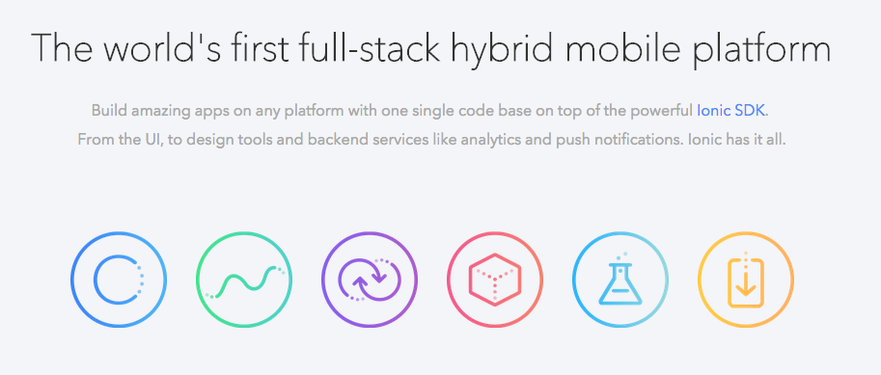
Ionic IO
http://ionic.io

Slide 24
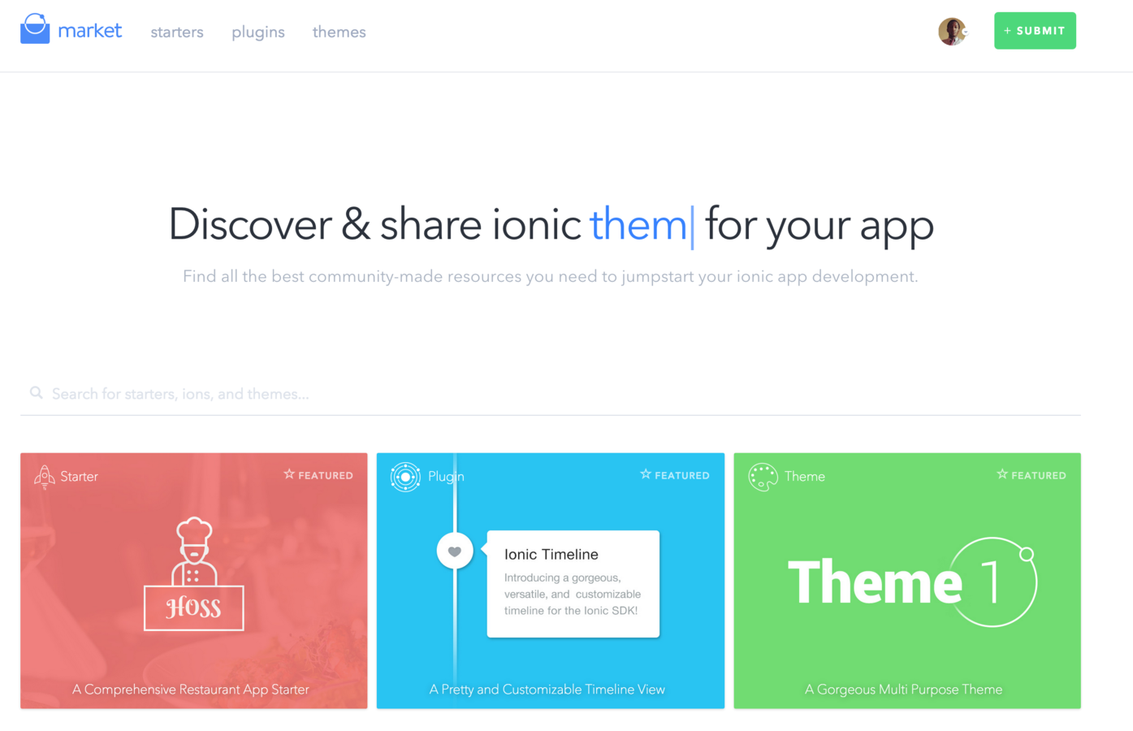
Ionic Market
http://market.ionic.io

Slide 25
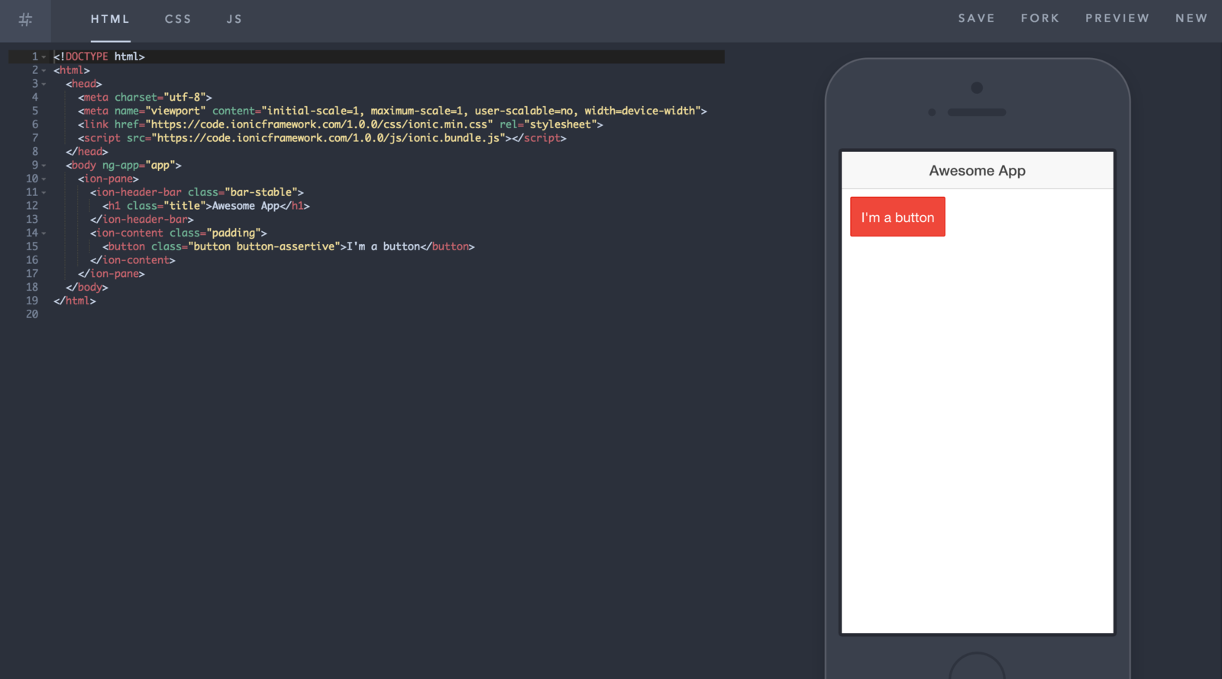
Ionic Playground
The Plunker/Codepen for Ionic
http://play.ionic.io

Slide 26
Demo Time
Todo application
With Laravel Rest Api

Slide 27
http://laraveltodo.herokuapp.com/api/
API Url | Rest Verb
/authenticate | Post
/authenticate/user | Get
/register | Post
/projects | Get/Post
/project/{id} | Get/Delete
/project/{id}/tasks | Get/Post
/project/{id}/task{taskid} | Get/Delete

Slide 28
Ionic Meetup
When: last Tuesday of the month
Time: 6:30-9pm
Location: Scottsdale and Chaparral
http://meetup.com/ionic-az

Slide 29
thank you
Justin James
@digitaldrummerj - digitaldrummerj@gmail.com
http://digitaldrummerj.me
Michael Iglesias
Mike.Iglesias11@gmail.com
http://bit.ly/iglesias_linkedin

Slide 30
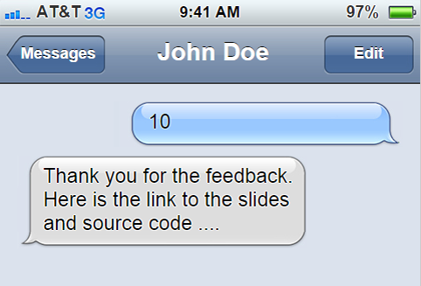
1 480 269 6891

