Slide 1
Systems and Architectures for Big Data
D’Aniello Simone
Ionita Marius Dragos

Slide 2
Introduction
Data Flow
Queries resolution
Testing

Slide 3
DATA FLOW

Slide 4





Data Flow
data <- read.csv(’’path/d14_filtered.csv’’)
type_attribute <- lapply(data, class)
data_rows <- nrow(data)
data_cols <- ncol(data)
n_duplicate <- sum(duplicated(data))
n_complete <- sum(complete.cases(data))
numeric.attribute <- name(Filter(is.numeric, data))

Slide 5
Data Flow
data <- read.csv(’’path/d14_filtered.csv’’)
type_attribute <- lapply(data, class)
data_rows <- nrow(data)
data_cols <- ncol(data)
n_duplicate <- sum(duplicated(data))
n_complete <- sum(complete.cases(data))
numeric.attribute <- name(Filter(is.numeric, data))

Slide 6
Data Flow
data <- read.csv(’’path/d14_filtered.csv’’)
type_attribute <- lapply(data, class)
data_rows <- nrow(data)
data_cols <- ncol(data)
n_duplicate <- sum(duplicated(data))
n_complete <- sum(complete.cases(data))
numeric.attribute <- name(Filter(is.numeric, data))

Slide 7
Data Flow
data <- read.csv(’’path/d14_filtered.csv’’)
type_attribute <- lapply(data, class)
data_rows <- nrow(data)
data_cols <- ncol(data)
n_duplicate <- sum(duplicated(data))
n_complete <- sum(complete.cases(data))
numeric.attribute <- name(Filter(is.numeric, data))

Slide 8
Data Flow
data <- read.csv(’’path/d14_filtered.csv’’)
type_attribute <- lapply(data, class)
data_rows <- nrow(data)
data_cols <- ncol(data)
n_duplicate <- sum(duplicated(data))
n_complete <- sum(complete.cases(data))
numeric.attribute <- name(Filter(is.numeric, data))

Slide 9
Data Flow
data <- read.csv(’’path/d14_filtered.csv’’)
type_attribute <- lapply(data, class)
data_rows <- nrow(data)
data_cols <- ncol(data)
n_duplicate <- sum(duplicated(data))
n_complete <- sum(complete.cases(data))
numeric.attribute <- name(Filter(is.numeric, data))

Slide 10
Data Flow
data <- read.csv(’’path/d14_filtered.csv’’)
type_attribute <- lapply(data, class)
data_rows <- nrow(data)
data_cols <- ncol(data)
n_duplicate <- sum(duplicated(data))
n_complete <- sum(complete.cases(data))
numeric.attribute <- name(Filter(is.numeric, data))

Slide 11
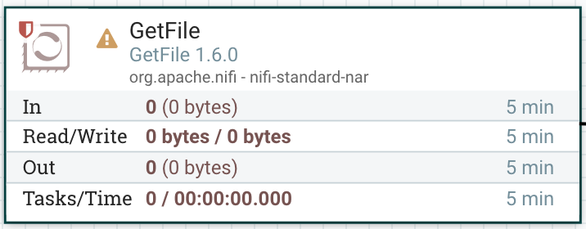
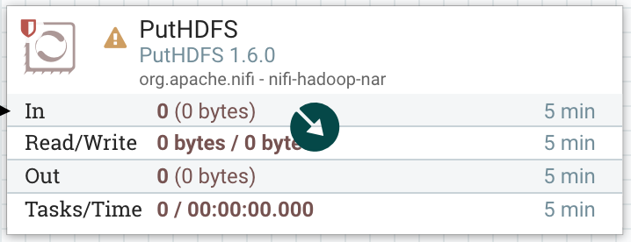
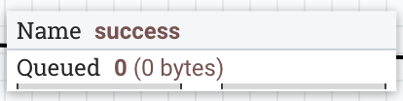
Data Flow

Slide 12
Data Flow

Slide 13
Data Flow

Slide 14
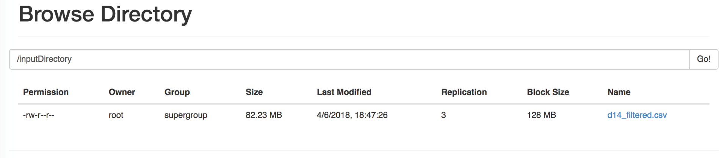
Data Flow

Slide 15
Data Flow
public static void main(String[] args) {…}
private static void query1() {…}
private static void query2() {…}
private static void query3() {…}

Slide 16
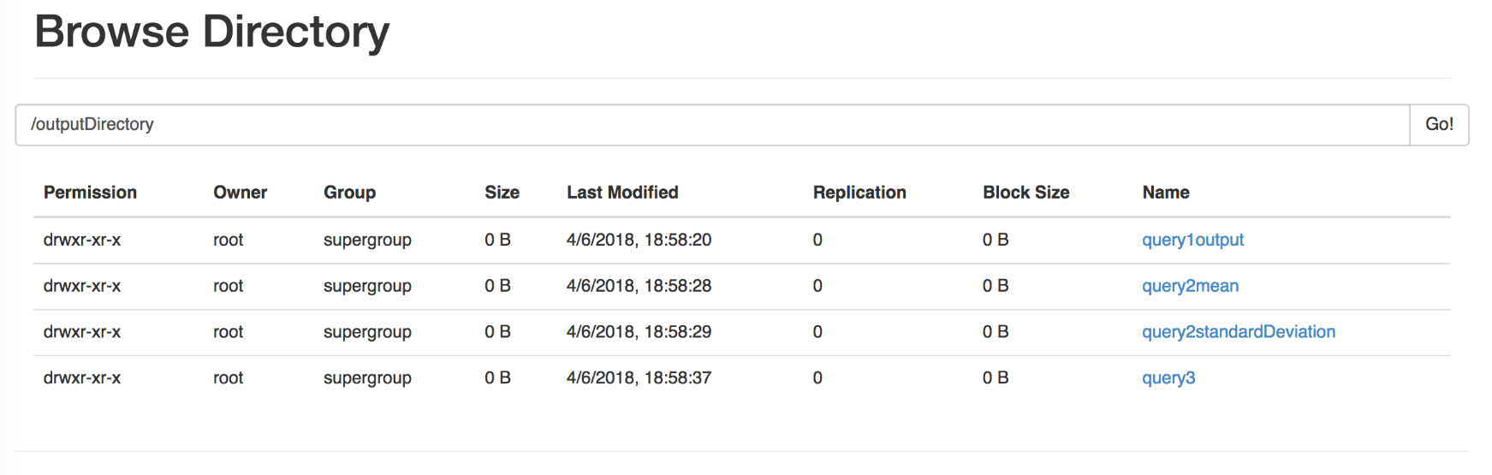
Data Flow

Slide 17
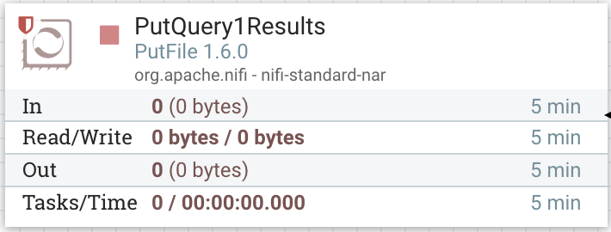
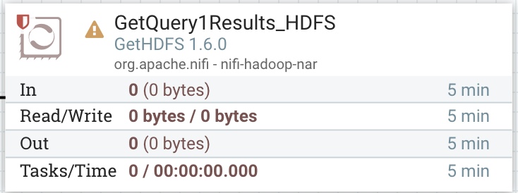

Data Flow

Slide 18
Data Flow

Slide 19
Data Flow

Slide 20
Data Flow
{
"_id" : ObjectId("5b1019429b4bf32db9851445"),
"houseID" : 1,
"plugID" : 0,
"standardDeviationValue" : 0.363651215997626
}

Slide 21
QUERY 1

Slide 22
Query 1
CSV
JavaRDD<SorterClass> data = SparkWorker.getInstance()
.parseFile(INPUT_DIRECTORY);
data
.filter(x -> x.isProperty() == 1) .mapToPair(x -> new Tuple2<>(
new Tuple2<>(x.getHouseid(),
x.getTimestamp()),
x.getValue())) .reduceByKey((x, y) -> x + y)
.filter(x -> x._2 >= 350) .mapToPair(x -> new Tuple2<>(x._1._1, x._2)) .reduceByKey(Math::max);
SorterClass
SorterClass
SorterClass

Slide 23
SorterClass
SorterClass
- id: Integer
- timestamp: Integer
- value: Double
- property: Integer
- plug_id: Integer
- household_id: Integer
- house_id: Integer
- timezone: Integer
- day: Integer

Slide 24
Query 1
CSV
JavaRDD<SorterClass> data = SparkWorker.getInstance()
.parseFile(INPUT_DIRECTORY);
data
.filter(x -> x.isProperty() == 1) .mapToPair(x -> new Tuple2<>(
new Tuple2<>(x.getHouseid(),
x.getTimestamp()),
x.getValue())) .reduceByKey((x, y) -> x + y)
.filter(x -> x._2 >= 350) .mapToPair(x -> new Tuple2<>(x._1._1, x._2)) .reduceByKey(Math::max);
SorterClass
SorterClass
SorterClass
SorterClass
SorterClass
SorterClass

Slide 25
Query 1
SorterClass
SorterClass
SorterClass
JavaRDD<SorterClass> data = SparkWorker.getInstance()
.parseFile(INPUT_DIRECTORY);
data
.filter(x -> x.isProperty() == 1) .mapToPair(x -> new Tuple2<>(
new Tuple2<>(x.getHouseid(),
x.getTimestamp()),
x.getValue())) .reduceByKey((x, y) -> x + y)
.filter(x -> x._2 >= 350) .mapToPair(x -> new Tuple2<>(x._1._1, x._2)) .reduceByKey(Math::max);
<10, 1345>, 100
<9, 1347>, 200
<10, 1345>, 300

Slide 26
Query 1
SorterClass
SorterClass
SorterClass
JavaRDD<SorterClass> data = SparkWorker.getInstance()
.parseFile(INPUT_DIRECTORY);
data
.filter(x -> x.isProperty() == 1) .mapToPair(x -> new Tuple2<>(
new Tuple2<>(x.getHouseid(),
x.getTimestamp()),
x.getValue())) .reduceByKey((x, y) -> x + y)
.filter(x -> x._2 >= 350) .mapToPair(x -> new Tuple2<>(x._1._1, x._2)) .reduceByKey(Math::max);
<10, 1345>, 100
<9, 1347>, 200
<10, 1345>, 300
<10, 1345>, 400
<9, 1347>, 200
<10, 1349>, 370

Slide 27
Query 1
SorterClass
SorterClass
SorterClass
JavaRDD<SorterClass> data = SparkWorker.getInstance()
.parseFile(INPUT_DIRECTORY);
data
.filter(x -> x.isProperty() == 1) .mapToPair(x -> new Tuple2<>(
new Tuple2<>(x.getHouseid(),
x.getTimestamp()),
x.getValue())) .reduceByKey((x, y) -> x + y)
.filter(x -> x._2 >= 350) .mapToPair(x -> new Tuple2<>(x._1._1, x._2)) .reduceByKey(Math::max);
<10, 1345>, 100
<9, 1347>, 200
<10, 1345>, 300
<10, 1345>, 400
<9, 1347>, 200
<10, 1349>, 370
<10, 1345>, 400
<10, 1349>, 370
<9, 1353>, 900

Slide 28
Query 1
<10, 1345>, 100
<9, 1347>, 200
<10, 1345>, 300
JavaRDD<SorterClass> data = SparkWorker.getInstance()
.parseFile(INPUT_DIRECTORY);
data
.filter(x -> x.isProperty() == 1) .mapToPair(x -> new Tuple2<>(
new Tuple2<>(x.getHouseid(),
x.getTimestamp()),
x.getValue())) .reduceByKey((x, y) -> x + y)
.filter(x -> x._2 >= 350) .mapToPair(x -> new Tuple2<>(x._1._1, x._2)) .reduceByKey(Math::max);
<10, 1345>, 400
<9, 1347>, 200
<10, 1349>, 370
<10, 1345>, 400
<10, 1349>, 370
<9, 1353>, 900
10, 400
10, 370
9, 900

Slide 29
Query 1
<10, 1345>, 400
<9, 1347>, 200
<10, 1349>, 370
JavaRDD<SorterClass> data = SparkWorker.getInstance()
.parseFile(INPUT_DIRECTORY);
data
.filter(x -> x.isProperty() == 1) .mapToPair(x -> new Tuple2<>(
new Tuple2<>(x.getHouseid(),
x.getTimestamp()),
x.getValue())) .reduceByKey((x, y) -> x + y)
.filter(x -> x._2 >= 350) .mapToPair(x -> new Tuple2<>(x._1._1, x._2)) .reduceByKey(Math::max);
<10, 1345>, 400
<10, 1349>, 370
<9, 1353>, 900
10, 400
10, 370
9, 900
10, 400
9, 900
8, 600

Slide 30
QUERY 2

Slide 31
Query 2
CSV
JavaRDD<SorterClass> data = SparkWorker.getInstance().parseFile(INPUT_DIRECTORY);
JavaRDD<SorterClass> dataFiltered =
data.filter(x -> x.isProperty() == 0);
JavaPairRDD<Tuple3<Integer, Integer, Integer>, Double> plugsStarterValue = q2.q2_getPlugsMinTimestampValue(dataFiltered);
JavaPairRDD<Tuple3<Integer, Integer, Integer>, Double> plugsFinalValues = q2.q2_getPlugsMaxTimestampValue(dataFiltered);
JavaPairRDD<Tuple3<Integer, Integer, Integer>, Double> dailyValues =
q2.q2_getDailyValue(plugsStarterValue, plugsFinalValues);
JavaPairRDD<Tuple2<Integer, Integer>, Double> averageThroughDays = q2.q2_computeAverage(dailyValues);
JavaPairRDD<Tuple2<Integer, Integer>, Double> standardDeviation = q2.q2_computeStandardDeviation(dailyValues, averageThroughDays);
SorterClass
SorterClass
SorterClass

Slide 32
Query 2
CSV
JavaRDD<SorterClass> data = SparkWorker.getInstance().parseFile(INPUT_DIRECTORY);
JavaRDD<SorterClass> dataFiltered =
data.filter(x -> x.isProperty() == 0);
JavaPairRDD<Tuple3<Integer, Integer, Integer>, Double> plugsStarterValue = q2.q2_getPlugsMinTimestampValue(dataFiltered);
JavaPairRDD<Tuple3<Integer, Integer, Integer>, Double> plugsFinalValues = q2.q2_getPlugsMaxTimestampValue(dataFiltered);
JavaPairRDD<Tuple3<Integer, Integer, Integer>, Double> dailyValues =
q2.q2_getDailyValue(plugsStarterValue, plugsFinalValues);
JavaPairRDD<Tuple2<Integer, Integer>, Double> averageThroughDays = q2.q2_computeAverage(dailyValues);
JavaPairRDD<Tuple2<Integer, Integer>, Double> standardDeviation = q2.q2_computeStandardDeviation(dailyValues, averageThroughDays);
SorterClass
SorterClass
SorterClass
SorterClass
SorterClass
SorterClass

Slide 33
Query 2
SorterClass
SorterClass
SorterClass
JavaRDD<SorterClass> data = SparkWorker.getInstance().parseFile(INPUT_DIRECTORY);
JavaRDD<SorterClass> dataFiltered =
data.filter(x -> x.isProperty() == 0);
JavaPairRDD<Tuple3<Integer, Integer, Integer>, Double> plugsStarterValue = q2.q2_getPlugsMinTimestampValue(dataFiltered);
JavaPairRDD<Tuple3<Integer, Integer, Integer>, Double> plugsFinalValues = q2.q2_getPlugsMaxTimestampValue(dataFiltered);
JavaPairRDD<Tuple3<Integer, Integer, Integer>, Double> dailyValues =
q2.q2_getDailyValue(plugsStarterValue, plugsFinalValues);
JavaPairRDD<Tuple2<Integer, Integer>, Double> averageThroughDays = q2.q2_computeAverage(dailyValues);
JavaPairRDD<Tuple2<Integer, Integer>, Double> standardDeviation = q2.q2_computeStandardDeviation(dailyValues, averageThroughDays);
<10, 1, 1, 15>, <80, 13300>
<10, 1, 1, 15>, <100, 13320>
<9, 1, 2, 16>, <100, 13300>
<10, 1, 1, 15>, <80, 13300>
<10, 2, 1, 15>, <10, 13300>
<9, 1, 2, 16>, <100, 13300>
<10, 1, 15>,
90
<9, 2, 16>,
100
<8, 2, 13>,
0
Notes:
House_id
Plug_id
Timezone
Day

Slide 34
Query 2
SorterClass
SorterClass
SorterClass
JavaRDD<SorterClass> data = SparkWorker.getInstance().parseFile(INPUT_DIRECTORY);
JavaRDD<SorterClass> dataFiltered =
data.filter(x -> x.isProperty() == 0);
JavaPairRDD<Tuple3<Integer, Integer, Integer>, Double> plugsStarterValue = q2.q2_getPlugsMinTimestampValue(dataFiltered);
JavaPairRDD<Tuple3<Integer, Integer, Integer>, Double> plugsFinalValues = q2.q2_getPlugsMaxTimestampValue(dataFiltered);
JavaPairRDD<Tuple3<Integer, Integer, Integer>, Double> dailyValues =
q2.q2_getDailyValue(plugsStarterValue, plugsFinalValues);
JavaPairRDD<Tuple2<Integer, Integer>, Double> averageThroughDays = q2.q2_computeAverage(dailyValues);
JavaPairRDD<Tuple2<Integer, Integer>, Double> standardDeviation = q2.q2_computeStandardDeviation(dailyValues, averageThroughDays);
<10, 1, 1, 15>, <80, 13300>
<10, 1, 1, 15>, <100, 13320>
<9, 1, 2, 16>, <100, 13300>
<10, 1, 1, 15>, <100, 13320>
<10, 2, 1, 15>, <100, 13380>
<9, 1, 2, 16>, <100, 13300>
<10, 1, 15>,
200
<9, 2, 16>,
100
<8, 2, 13>,
200
Notes:
House_id
Plug_id
Timezone
Day

Slide 35
Query 2
<10, 1, 15>,
90
<10, 1, 15>,
200
<8, 2, 13>,
200
JavaRDD<SorterClass> data = SparkWorker.getInstance().parseFile(INPUT_DIRECTORY);
JavaRDD<SorterClass> dataFiltered =
data.filter(x -> x.isProperty() == 0);
JavaPairRDD<Tuple3<Integer, Integer, Integer>, Double> plugsStarterValue = q2.q2_getPlugsMinTimestampValue(dataFiltered);
JavaPairRDD<Tuple3<Integer, Integer, Integer>, Double> plugsFinalValues = q2.q2_getPlugsMaxTimestampValue(dataFiltered);
JavaPairRDD<Tuple3<Integer, Integer, Integer>, Double> dailyValues =
q2.q2_getDailyValue(plugsStarterValue, plugsFinalValues);
JavaPairRDD<Tuple2<Integer, Integer>, Double> averageThroughDays = q2.q2_computeAverage(dailyValues);
JavaPairRDD<Tuple2<Integer, Integer>, Double> standardDeviation = q2.q2_computeStandardDeviation(dailyValues, averageThroughDays);
<10, 1, 15>,
110
<9, 2, 16>,
0
<8, 2, 13>,
200

Slide 36
Query 2
<10, 1, 15>,
110
<10, 1, 16>,
130
<10, 1, 17>,
120
JavaRDD<SorterClass> data = SparkWorker.getInstance().parseFile(INPUT_DIRECTORY);
JavaRDD<SorterClass> dataFiltered =
data.filter(x -> x.isProperty() == 0);
JavaPairRDD<Tuple3<Integer, Integer, Integer>, Double> plugsStarterValue = q2.q2_getPlugsMinTimestampValue(dataFiltered);
JavaPairRDD<Tuple3<Integer, Integer, Integer>, Double> plugsFinalValues = q2.q2_getPlugsMaxTimestampValue(dataFiltered);
JavaPairRDD<Tuple3<Integer, Integer, Integer>, Double> dailyValues =
q2.q2_getDailyValue(plugsStarterValue, plugsFinalValues);
JavaPairRDD<Tuple2<Integer, Integer>, Double> averageThroughDays = q2.q2_computeAverage(dailyValues);
JavaPairRDD<Tuple2<Integer, Integer>, Double> standardDeviation = q2.q2_computeStandardDeviation(dailyValues, averageThroughDays);
<10, 1>,
<110,1>
<10, 1>,
<130,1>
<10, 1>,
<120,1>
<10, 1>,
<360,3>
<10, 3>,
<300,3>
<9, 1>,
<180,2>
<10, 1>,
120
<10, 3>,
100
<9, 1>,
90

Slide 37
Query 2
<10, 1, 15>,
110
<10,1, 16>,
130
<8, 2, 13>,
200
JavaRDD<SorterClass> data = SparkWorker.getInstance().parseFile(INPUT_DIRECTORY);
JavaRDD<SorterClass> dataFiltered =
data.filter(x -> x.isProperty() == 0);
JavaPairRDD<Tuple3<Integer, Integer, Integer>, Double> plugsStarterValue = q2.q2_getPlugsMinTimestampValue(dataFiltered);
JavaPairRDD<Tuple3<Integer, Integer, Integer>, Double> plugsFinalValues = q2.q2_getPlugsMaxTimestampValue(dataFiltered);
JavaPairRDD<Tuple3<Integer, Integer, Integer>, Double> dailyValues =
q2.q2_getDailyValue(plugsStarterValue, plugsFinalValues);
JavaPairRDD<Tuple2<Integer, Integer>, Double> averageThroughDays = q2.q2_computeAverage(dailyValues);
JavaPairRDD<Tuple2<Integer, Integer>, Double> standardDeviation = q2.q2_computeStandardDeviation(dailyValues, averageThroughDays);
<10, 1>,
<110,15>
<10, 1>,
<130,16>
<8, 2>,
<200,13>
<10, 1>,
<110,120>
<10, 1>,
<130,120>
<8, 2>,
<200,150>

Slide 38



Query 2
<10, 1>,
<110,120>
<10, 1>,
<130,120>
<8, 2>,
<200,150>
JavaRDD<SorterClass> data = SparkWorker.getInstance().parseFile(INPUT_DIRECTORY);
JavaRDD<SorterClass> dataFiltered =
data.filter(x -> x.isProperty() == 0);
JavaPairRDD<Tuple3<Integer, Integer, Integer>, Double> plugsStarterValue = q2.q2_getPlugsMinTimestampValue(dataFiltered);
JavaPairRDD<Tuple3<Integer, Integer, Integer>, Double> plugsFinalValues = q2.q2_getPlugsMaxTimestampValue(dataFiltered);
JavaPairRDD<Tuple3<Integer, Integer, Integer>, Double> dailyValues =
q2.q2_getDailyValue(plugsStarterValue, plugsFinalValues);
JavaPairRDD<Tuple2<Integer, Integer>, Double> averageThroughDays = q2.q2_computeAverage(dailyValues);
JavaPairRDD<Tuple2<Integer, Integer>, Double> standardDeviation = q2.q2_computeStandardDeviation(dailyValues, averageThroughDays);
<10, 1>, <${(110−120)}^{2},$1>
<10, 1>, <${(130−120)}^{2},$1>
<8, 2>, <${(200−150)}^{2},$1>
<10, 1>,
<200,2>
<8, 2>,
<2500,2>
<9, 1>,
<81,2>
<10, 1>,
14.14
<8, 2>,
50
<9, 1>,
9

Slide 39
QUERY 3

Slide 40
Query 3
CSV
data = SparkWorker.getInstance().parseFile(INPUT_DIRECTORY);
dataFiltered =
data.filter(x -> x.isProperty() == 0);
plugsStarterValue = q3.q3_getPlugStarterValue(dataFiltered);
plugsFinalValues = q3.q3_getPlugFinalValue(dataFiltered);
dailyvalue =
q3.q3_getDailyValue(plugsStarterValue, plugsFinalValues);
averageTopTime =
q3.q3_getAverageForTimeFrame(1,dailyvalue);
averageDownTime =
q3.q3_getAverageForTimeFrame(0,dailyvalue);
sorting =
q3.q3_sortData(averageDownTime,averageTopTime);
SorterClass
SorterClass
SorterClass

Slide 41
Query 3
CSV
data = SparkWorker.getInstance().parseFile(INPUT_DIRECTORY);
dataFiltered =
data.filter(x -> x.isProperty() == 0);
plugsStarterValue = q3.q3_getPlugStarterValue(dataFiltered);
plugsFinalValues = q3.q3_getPlugFinalValue(dataFiltered);
dailyvalue =
q3.q3_getDailyValue(plugsStarterValue, plugsFinalValues);
averageTopTime =
q3.q3_getAverageForTimeFrame(1,dailyvalue);
averageDownTime =
q3.q3_getAverageForTimeFrame(0,dailyvalue);
sorting =
q3.q3_sortData(averageDownTime,averageTopTime);
SorterClass
SorterClass
SorterClass
SorterClass
SorterClass
SorterClass

Slide 42
Query 3
SorterClass
SorterClass
SorterClass
data = SparkWorker.getInstance().parseFile(INPUT_DIRECTORY);
dataFiltered =
data.filter(x -> x.isProperty() == 0);
plugsStarterValue = q3.q3_getPlugStarterValue(dataFiltered);
plugsFinalValues = q3.q3_getPlugFinalValue(dataFiltered);
dailyvalue =
q3.q3_getDailyValue(plugsStarterValue, plugsFinalValues);
averageTopTime =
q3.q3_getAverageForTimeFrame(1,dailyvalue);
averageDownTime =
q3.q3_getAverageForTimeFrame(0,dailyvalue);
sorting =
q3.q3_sortData(averageDownTime,averageTopTime);
<10, 1, 1, 15,1>, <80, 13300>
<10, 1, 1, 15,1>, <100, 13320>
<9, 1, 2, 16,0>, <100, 13300>
<10, 1, 1, 15,1>, <80, 13300>
<7, 2, 1, 15,0>, <10, 13300>
<9, 1, 2, 16,0>, <100, 13300>

Slide 43
Query 3
SorterClass
SorterClass
SorterClass
data = SparkWorker.getInstance().parseFile(INPUT_DIRECTORY);
dataFiltered =
data.filter(x -> x.isProperty() == 0);
plugsStarterValue = q3.q3_getPlugStarterValue(dataFiltered);
plugsFinalValues = q3.q3_getPlugFinalValue(dataFiltered);
dailyvalue =
q3.q3_getDailyValue(plugsStarterValue, plugsFinalValues);
averageTopTime =
q3.q3_getAverageForTimeFrame(1,dailyvalue);
averageDownTime =
q3.q3_getAverageForTimeFrame(0,dailyvalue);
sorting =
q3.q3_sortData(averageDownTime,averageTopTime);
<10, 1, 1, 15,1>, <80, 13300>
<10, 1, 1, 15,1>, <100, 13320>
<9, 1, 2, 16,0>, <100, 13300>
<10, 1, 1, 15,1>, <100, 13320>
<7, 2, 1, 15>, <100, 13380>
<9, 1, 2, 16,0>, <100, 13300>

Slide 44
Query 3
<10, 1,1, 15,1>,
80
<10, 1,1, 15,1>,
100
<8, 2,1, 13>,
200
data = SparkWorker.getInstance().parseFile(INPUT_DIRECTORY);
dataFiltered =
data.filter(x -> x.isProperty() == 0);
plugsStarterValue = q3.q3_getPlugStarterValue(dataFiltered);
plugsFinalValues = q3.q3_getPlugFinalValue(dataFiltered);
dailyvalue =
q3.q3_getDailyValue(plugsStarterValue, plugsFinalValues);
averageTopTime =
q3.q3_getAverageForTimeFrame(1,dailyvalue);
averageDownTime =
q3.q3_getAverageForTimeFrame(0,dailyvalue);
sorting =
q3.q3_sortData(averageDownTime,averageTopTime);
<10, 1,1, 15,1>,
110
<9, 2,2, 16,0>,
0
<8, 2,1, 13,0>,
200

Slide 45
Query 3
<10, 1, 1,15,1>,
110
<10, 1,1, 16,1>,
130
<10, 1,1, 17,0>,
100
data = SparkWorker.getInstance().parseFile(INPUT_DIRECTORY);
dataFiltered =
data.filter(x -> x.isProperty() == 0);
plugsStarterValue = q3.q3_getPlugStarterValue(dataFiltered);
plugsFinalValues = q3.q3_getPlugFinalValue(dataFiltered);
dailyvalue =
q3.q3_getDailyValue(plugsStarterValue, plugsFinalValues);
averageTopTime =
q3.q3_getAverageForTimeFrame(1,dailyvalue);
averageDownTime =
q3.q3_getAverageForTimeFrame(0,dailyvalue);
sorting =
q3.q3_sortData(averageDownTime,averageTopTime);
<10, 1>,
<110,1>
<10, 1>,
<130,1>
<10, 1>,
<120,1>
<10, 1>,
<360,3>
<10, 3>,
<300,3>
<9, 1>,
<180,2>
<10, 1>,
120
<10, 3>,
100
<9, 1>,
90

Slide 46
Query 3
<10, 1,1, 15,0>,
50
<10, 1,1,16,0>,
50
<10, 1, 1,17,1>,
130
data = SparkWorker.getInstance().parseFile(INPUT_DIRECTORY);
dataFiltered =
data.filter(x -> x.isProperty() == 0);
plugsStarterValue = q3.q3_getPlugStarterValue(dataFiltered);
plugsFinalValues = q3.q3_getPlugFinalValue(dataFiltered);
dailyvalue =
q3.q3_getDailyValue(plugsStarterValue, plugsFinalValues);
averageTopTime =
q3.q3_getAverageForTimeFrame(1,dailyvalue);
averageDownTime =
q3.q3_getAverageForTimeFrame(0,dailyvalue);
sorting =
q3.q3_sortData(averageDownTime,averageTopTime);
<10, 1>,
<50,1>
<10, 1>,
<50,1>
<10, 1>,
<50,1>
<10, 1>,
<150,3>
<10, 3>,
<300,3>
<9, 1>,
<180,2>
<10, 1>,
50
<10, 3>,
100
<9, 1>,
90

Slide 47
Query 3
<10, 1>,
50
<10, 1>,
120
<9,3>,
80
data = SparkWorker.getInstance().parseFile(INPUT_DIRECTORY);
dataFiltered =
data.filter(x -> x.isProperty() == 0);
plugsStarterValue = q3.q3_getPlugStarterValue(dataFiltered);
plugsFinalValues = q3.q3_getPlugFinalValue(dataFiltered);
dailyvalue =
q3.q3_getDailyValue(plugsStarterValue, plugsFinalValues);
averageTopTime =
q3.q3_getAverageForTimeFrame(1,dailyvalue);
averageDownTime =
q3.q3_getAverageForTimeFrame(0,dailyvalue);
sorting =
q3.q3_sortData(averageDownTime,averageTopTime);
70
<10,1>
80,
<9,3>
10,
<7,0>
10,
<7,0>
70,
<10,1>
80,
<9,3>
<7,0> ,
10
<10,1> ,
70
<9,3>,
80

Slide 48
TESTING

Slide 49
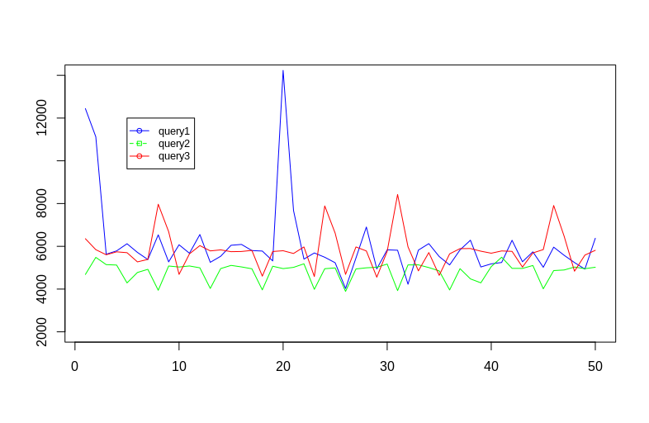
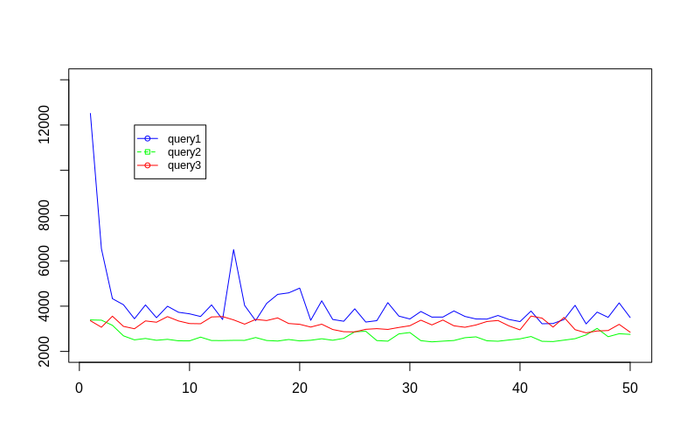
Testing

Slide 50
Testing
Memory: 7.7 Gb
Processor: Intel Core i7-7500U @2.7 GHz x4
OS: Ubuntu 18.04 LTS
OS type: 64 bit

Slide 51
Testing
Memory: 8.0 Gb
Processor: Intel Core i5 2.7 GHz
OS: OSX El Capitan
OS type: 64 bit

Slide 52
Testing

Slide 53
Thank you for attentions!

