Slide 1
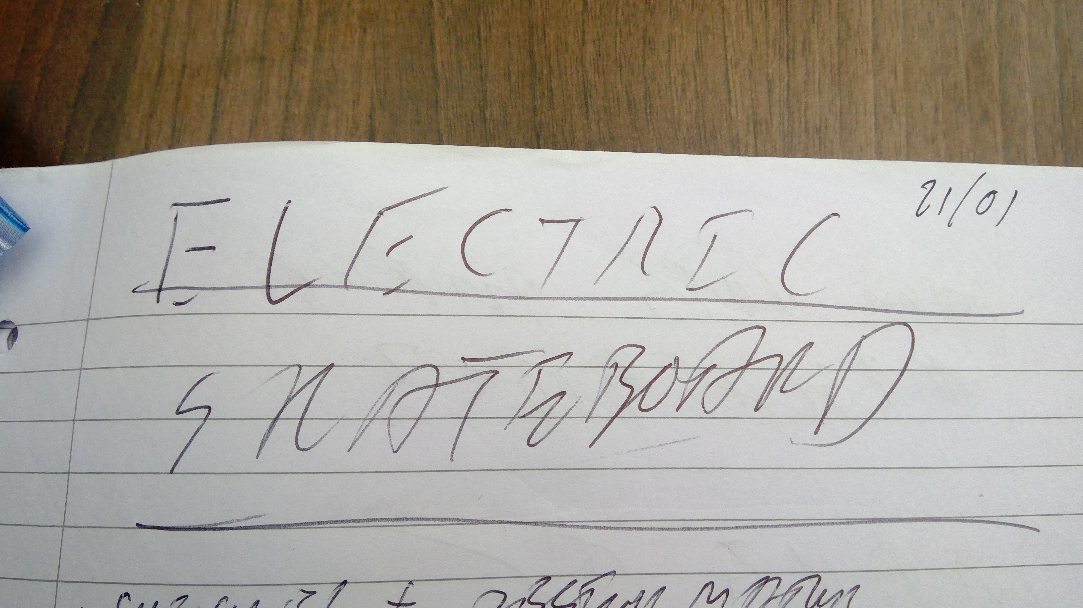

Slide 2
Range specification
Specification
Charge every week (7 days)
Days being used:5 days (commute)
Distance each day: 3km
Estimated vertical distance: 80m
This means:
Estimated Watt-hours per mile: 10Wh/mile

Slide 3
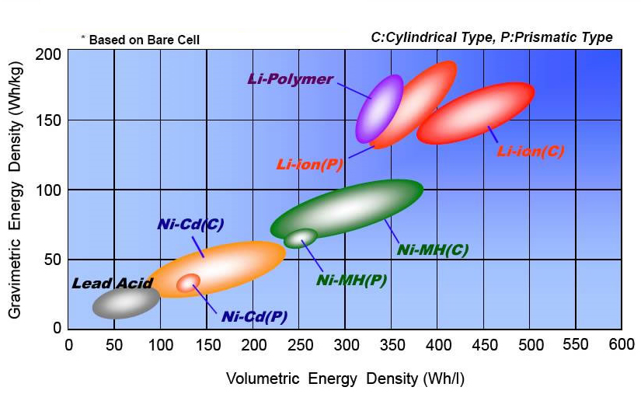
Battery specification
Lithium polymer chemistry
Watt-hour capacity: 180Wh
Supply voltage:22.2V
Amp-hour capacity: 8100Ah
Mass: 1.7kg
Supply voltage: 50v
2 batteries in parallel required

Slide 4
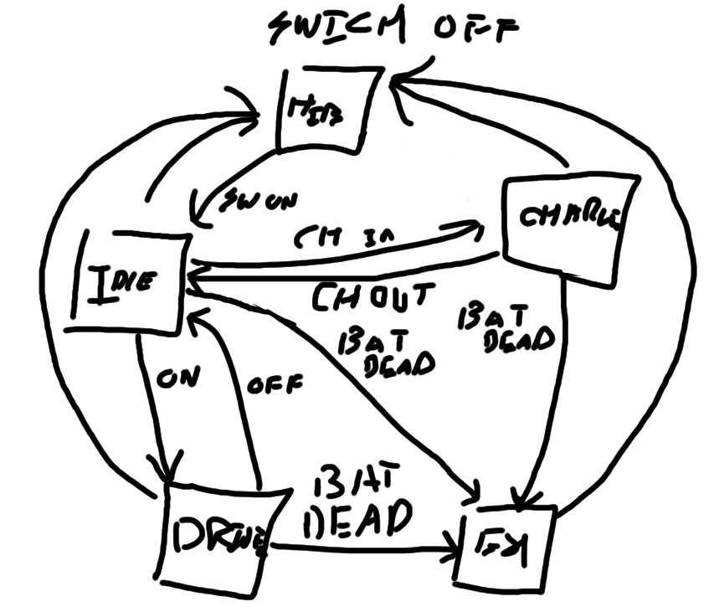
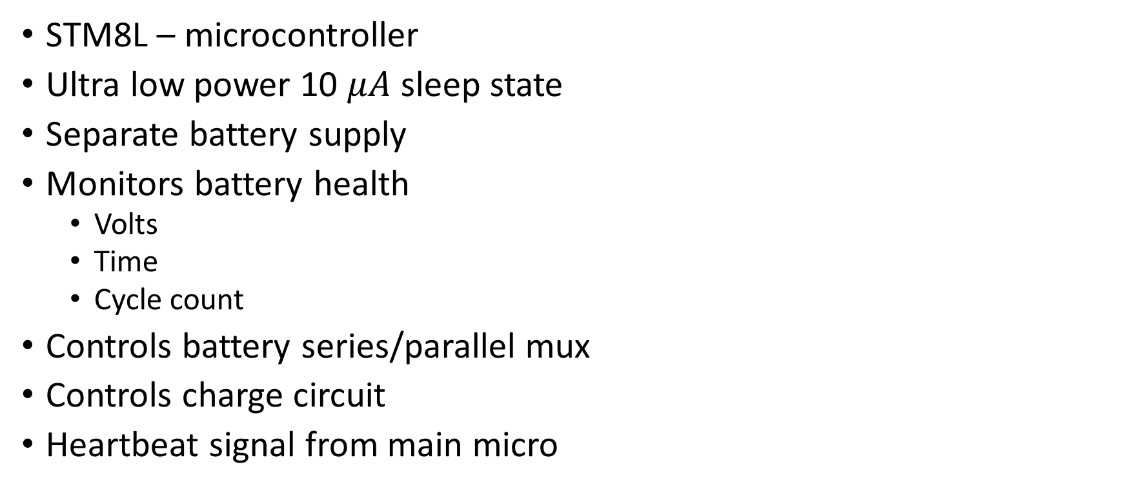
Battery embedded controller
STM8L – microcontroller
Ultra low power 10 $μA$ sleep state
Separate battery supply
Monitors battery health
Volts
Time
Cycle count
Controls battery series/parallel mux
Controls charge circuit
Heartbeat signal from main micro

Slide 5
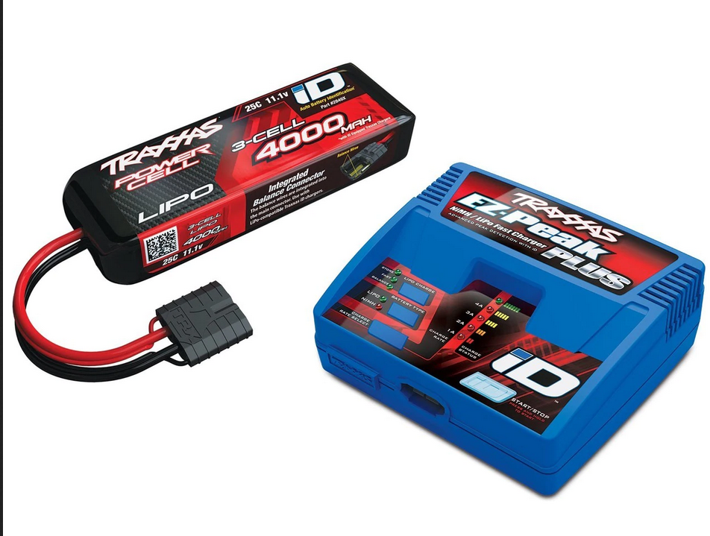
Battery charging
Lithium polymer can be dangerous:
Overcharging
Unbalanced charging
Use an off the shelf solution
Use hobby/RC charger
Charge batteries in parallel
Battery isolated from charger by MOSFET mux

Slide 6
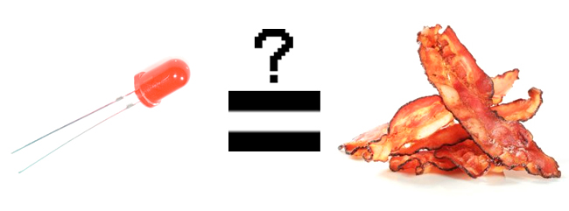
Battery error state
LED binary error code report
Flashes on when power button is hit
Lookup table in manual

