Slide 1
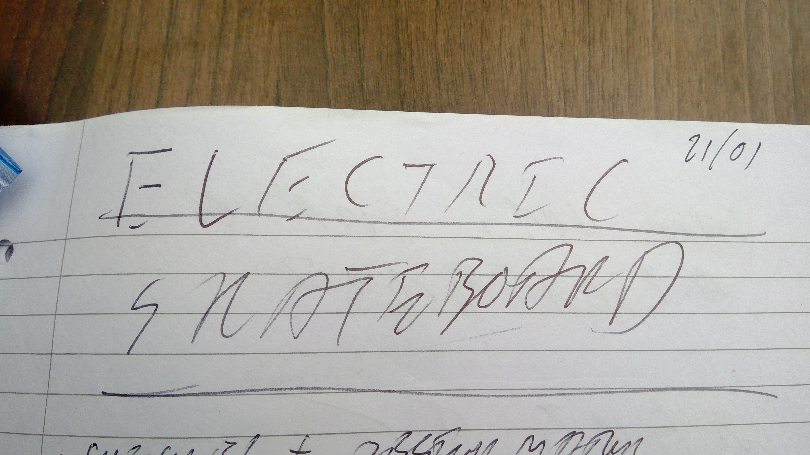

Slide 2
Into - toby

Slide 3
BOARD - ED

Slide 4
TRUCKS - TOBY

Slide 5
Wheels - HUGO

Slide 6
Battery – SAM

Slide 7
Range specification
Specification
Charge every week (7 days)
Days being used:5 days (commute)
Distance each day: 3km
Estimated vertical distance: 80m
This means:
Estimated Watt-hours per mile: 10Wh/mile

Slide 8
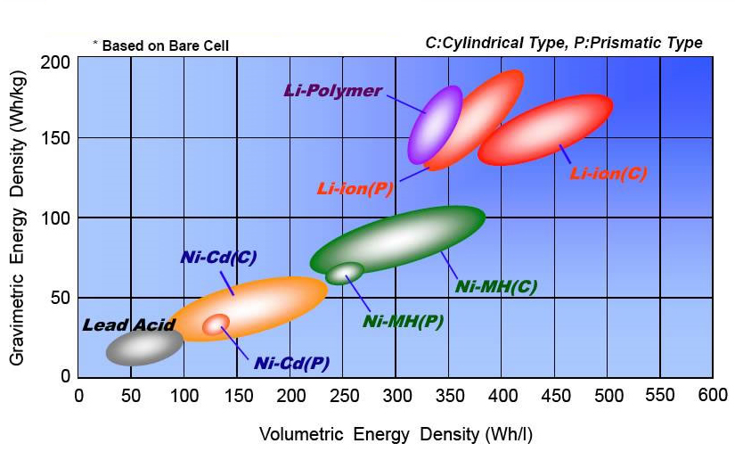
Battery specification
Lithium polymer chemistry
Watt-hour capacity: 180Wh
Supply voltage:22.2V
Amp-hour capacity: 8100Ah
Mass: 1.7kg
Supply voltage: 50v
2 batteries in parallel required

Slide 9
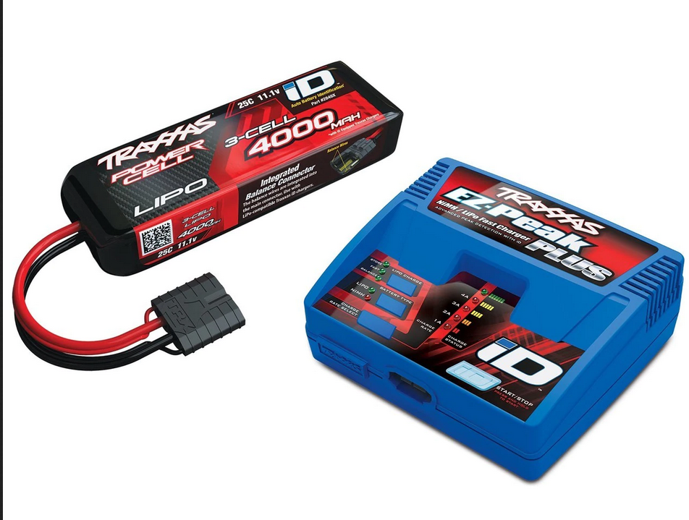
Battery charging
Lithium polymer can be dangerous:
Overcharging
Unbalanced charging
Use an off the shelf solution
Use hobby/RC charger
Charge batteries in parallel
System to switch between series and parallel

Slide 10
Battery control overview

Slide 11
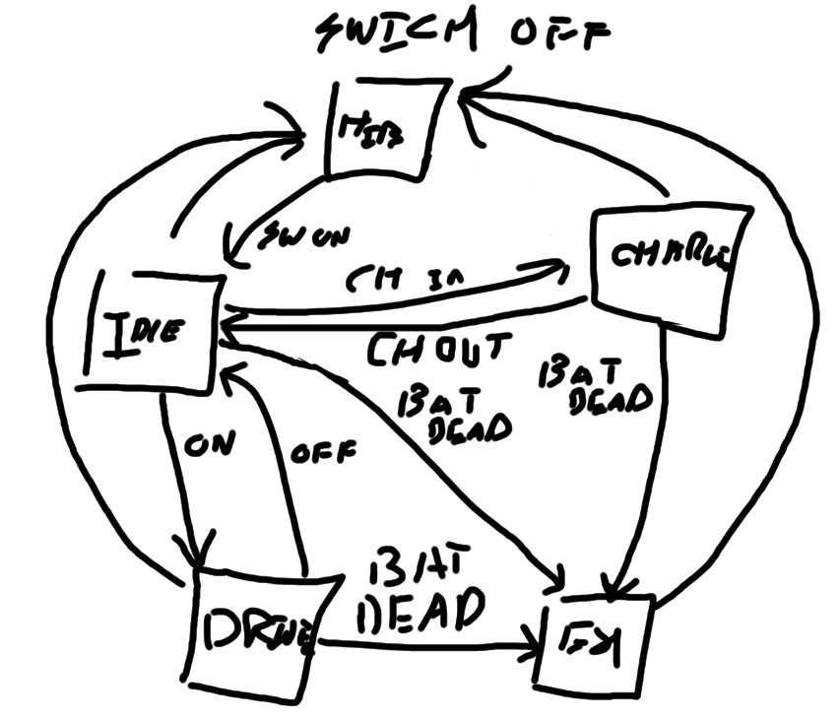
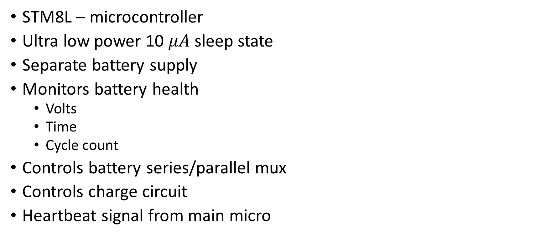
Battery embedded controller
STM8L – microcontroller
Ultra low power 10 $μA$ sleep state
Separate battery supply
Monitors battery health
Volts
Time
Cycle count
Controls battery series/parallel mux
Controls charge circuit
Heartbeat signal from main micro

Slide 12

Battery error state
LED binary error code report
Flashes on when power button is hit
Lookup table in manual

Slide 13
Battery mux
Two large batteries
States:
Charge in parallel
Discharge in series
Electrically controlled path switching
Vibration resistant
Short resistant
Bidirectional current flow (balanced charging)

Slide 14
Switching technology
Relay:
Mechanical switch
Very High voltage
Very High current
Low standby draw
Bipolar power switch(BPS):
Solid state system
MOSFET switching
Higher power dissipation
Fast switching

