Slide 1
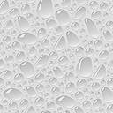





$$E_{S}, υ_{S}$$
$$w$$
SEI
$$R_{P}$$
$$R$$
Active Material
$$E_{P}, υ_{P},Ω_{P}$$

Slide 2


$$l_{crack}$$
x
$$w$$
$$New area$$

Slide 3
Resistance
Separator
Anode
Cathode
Anode current collector
Cathode current collector
Lithium ion
Anode particle
SEI
Electrolyte

Slide 4

SEI crack
SEI
Active Material
Lithiation
Re-healing
Electrode
particle

