Slide 1






$$E_{S}, υ_{S}$$
$$w$$
SEI
$$R_{P}$$
$$R$$
Active Material
$$E_{P}, υ_{P},Ω_{P}$$

Slide 2


$$l_{crack}$$
x
$$w$$
$$New area$$

Slide 3
Resistance
Separator
Anode
Cathode
Anode current collector
Cathode current collector
Lithium ion
Anode particle
SEI
Electrolyte

Slide 4

SEI crack
SEI
Active Material
Lithiation
Re-healing
Electrode
particle

Slide 5
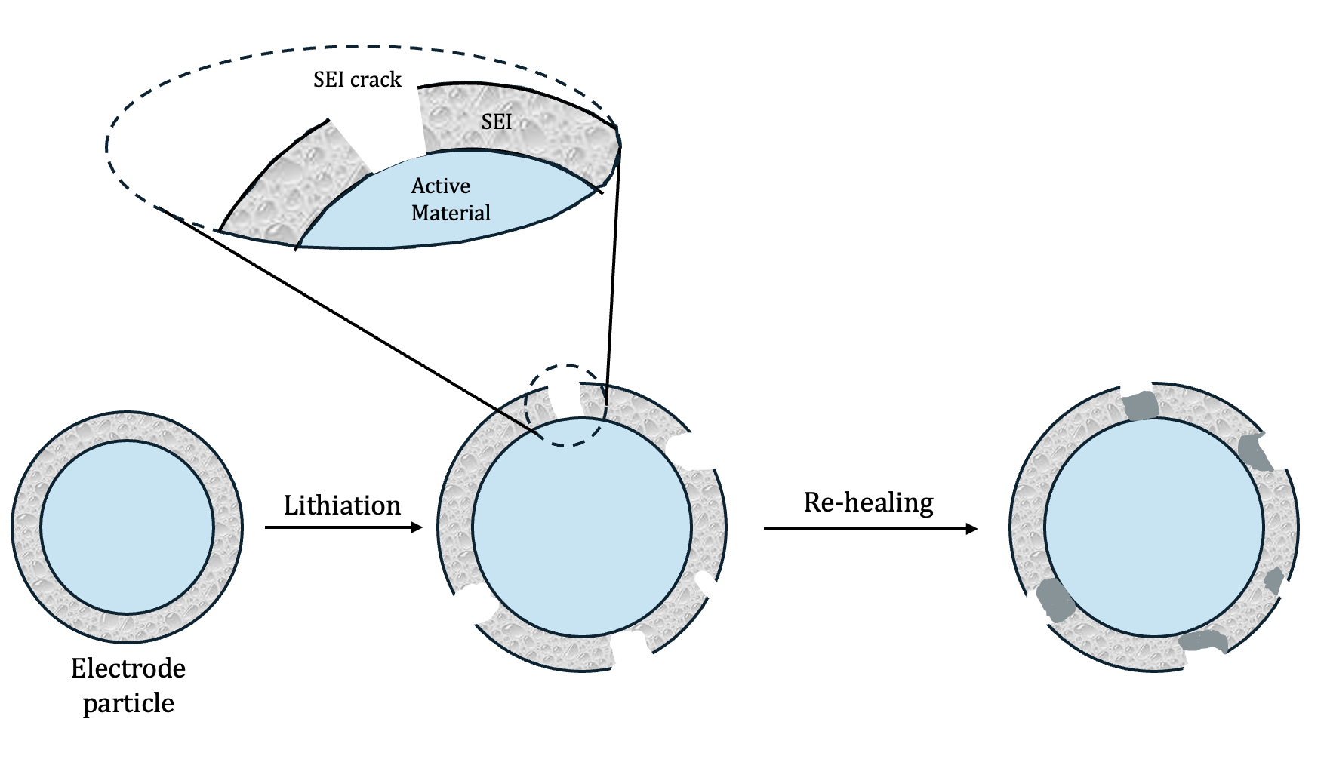
Battery Structure
Degardation of SEI layer during cycling
Resistance
Anode
Separator
Cathode
Anode current collector
Cathode current collector
Consequneces
Structural integrity of the battery
Lithium ion
Anode particle
SEI
Electrolyte
Cycle life
Capacity of battery

