Slide 1
Intro

Slide 2
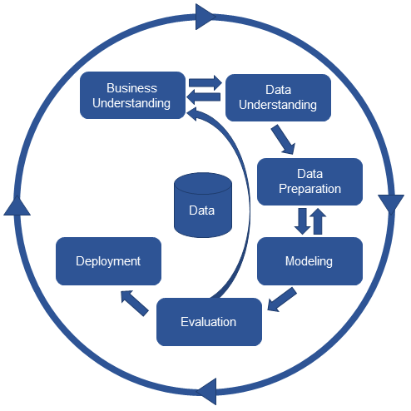
CRISP-DM

Slide 3
General overview of ML tasks
ML
Supervised Learning
Semi-supervised
Learning
Unsupervised
Learning
regression
classification
learning to rank
clustering
dimension reduction

Slide 4
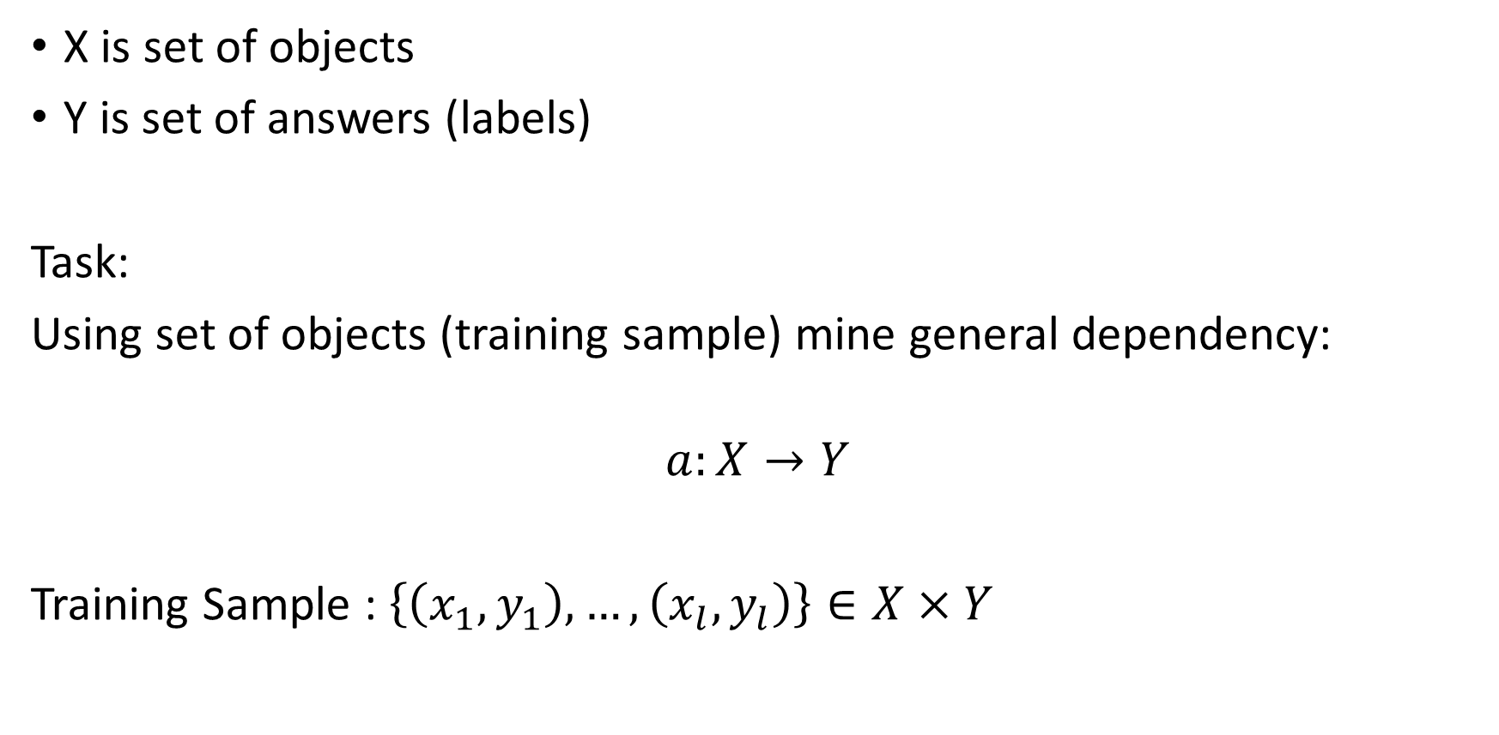
General task of supervised learning
X is set of objects
Y is set of answers (labels)
Task:
Using set of objects (training sample) mine general dependency:
$$a:X→Y$$
Training Sample : $\left\{\left(x_{1},y_{1}\right),…,\left(x_{l},y_{l}\right)\right\}∈X×Y$

Slide 5
Features
Each object has set of features which could be considered as a representation of the object itself
Types of features:
Binary
Categorical
Ordinal
Numerical

Slide 6
Types of task – supervised learning
Classification (binary, multi-class, multi-label)
Regression
Ranking

Slide 7

Learning algorithm
$$μ:\left(X×Y\right)→A$$
Which map sample $X^{l}$ of $\left(x_{i},y_{i}\right)$ to algorithm $a ∈A$
Training step: $μ$ builds $a=μ\left(X^{l}\right)$
Testing step: $a$ produces answers for new objects

Slide 8
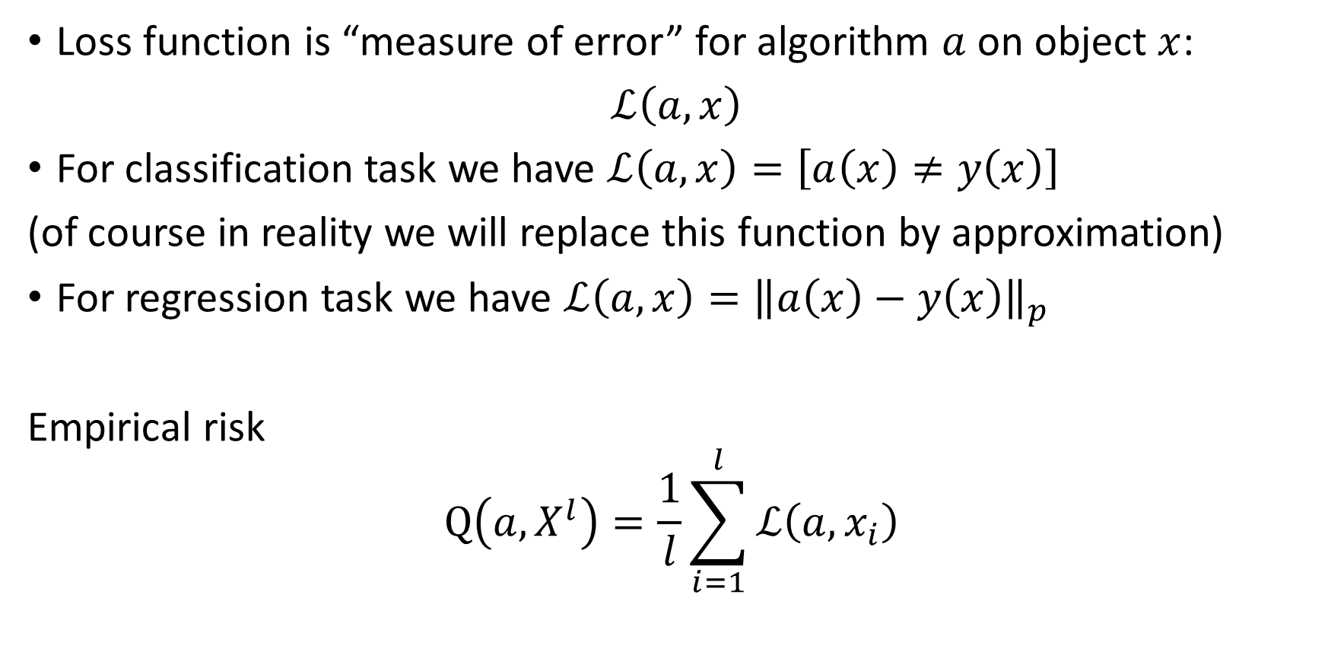
Definitions
Loss function is “measure of error” for algorithm $a$ on object $x$:
$ℒ\left(a,x\right)$
For classification task we have $ℒ\left(a,x\right)=\left[a\left(x\right)≠y\left(x\right)\right]$
(of course in reality we will replace this function by approximation)
For regression task we have $ℒ\left(a,x\right)={\left\|a\left(x\right)−y\left(x\right)\right\|}_{p}$
Empirical risk
$$Q\left(a,X^{l}\right)=\frac{1}{l}\sum_{i=1}^{l}{ℒ\left(a,x_{i}\right)}$$

Slide 9
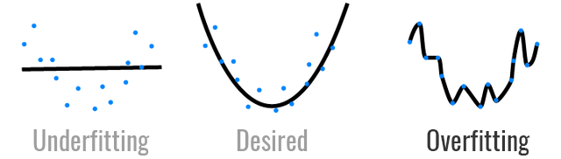

Learning -> Optimization
Key idea of ML is minimization of empirical risk
$$μ\left(X^{l}\right)=arg\min_{a∈A}{Q\left(a,X^{l}\right)}$$
Potential problems
Overfitting
Underfitting

Slide 10

Example
Classical linear regression
$$ℒ\left(a,x\right)=ℒ\left(θ,x\right)={\left\|θ^{T}x−y\right\|}^{2}$$
$$Q\left(a,X^{l}\right)=\frac{1}{l}\sum_{i=1}^{l}{{\left\|θ^{T}x_{i}−y_{i}\right\|}^{2}}$$
$$μ\left(X^{l}\right)=arg\min_{θ}{\frac{1}{l}\sum_{i=1}^{l}{{\left\|θ^{T}x_{i}−y_{i}\right\|}^{2}}}$$

Slide 11
Fight against overfitting
Regularization
Minimization of risk on test data

Slide 12
Empirical estimations of generalization ability
Hold-out (estimate empirical risk on test data)
LOO (leave-one-out)
Cross-validation
….

Slide 13
Samples for ML task
Price for the flat
Credit scoring
Fraud detection
Image classification
Recommendation system
…..

