Slide 1


EECS-6690
Multiple ML Models on Prediction of Online Shoppers Purchasing Intension
Kangrui Li kl3350
Yuhang Wang yw3733
Linyang Han lh3096
Zheyuan Song zs2527
Notes:
Good afternoon everyone. Now it's our group's presentation. Our project is Multiple Machine Learning Models on Prediction of Online Shoppers Purchasing Intention.

Slide 2
I.Introduction

Slide 3

Consumers’ behavioral data purchase intentions
"visitors" "buyers"
Our Goal:
find a better model for predicting a visitor's purchase intent and to identify important features that contribute to the prediction.
Notes:
1.As you know, with the continuous rise of the Internet shopping industry, more and more consumers choose to shop online. Therefore, it is very important to use the consumers’ behavioral data to predict purchase intentions and convert more "visitors" into “buyers”.
2.The goal of our project is to find a better model for predicting a visitor's purchase intention and to identify important features that contribute to the prediction.

Slide 4
II.Dataset

Slide 5
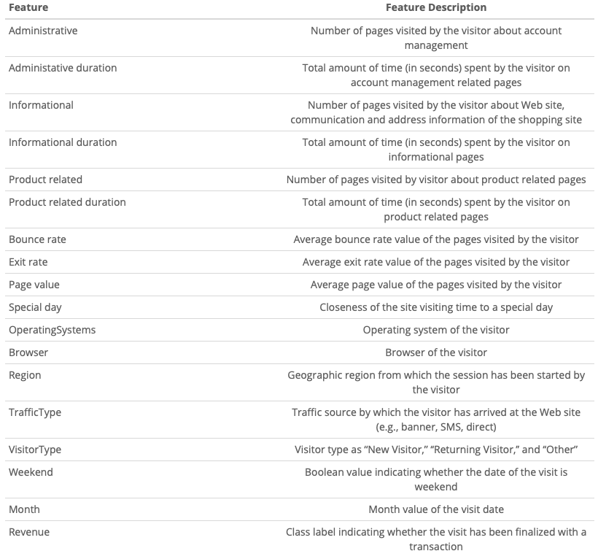
Extract datas from access logs of online shopping sites.
12330 sessions User visits
18 features.
10 continuous features:
Administrative;Administrative_Duration;Informational;Informational_Duration;ProductRelated;ProductRelated_Duration;BounceRates;ExitRates;PageValues;SpecialDay
8 discrete features:
Month; OperatingSystems; Browser;
Region; TrafficType; VisitorType;
Weekend; Revenue.
Binary classification problem.
Notes:
1.We extract datas from access logs of online shopping sites.
2.The data we use in our project includes 18 features you can see here, According to these we can predict whether a visit will be converted into a valid order.
3.The data set contains a total of 12330(twelve thousand, three hundred and thirty) sessions and 18 features, 10 continuous features and 8 discrete features.
4.A session can be understood as a user visit.
5.It is essentially a binary classification problem.
(starting from entering the landing page until the user completes the final operation (such as leaving the webpage, closing the browser, etc.), this period is recorded as a session.)

Slide 6
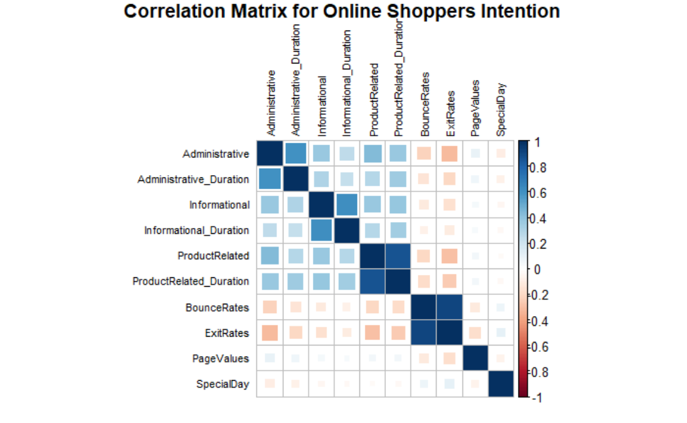
Clear the environment
Import the Library and Data
Check the Data type and structure
Heatmap : correlation between 10 numerical variables
A relatively high correlation between the type of page and the time spent on that page.
EDA & Data visualization
Notes:
1.Then we can process these data.
2.First clear the environment, import the library and data, then check the data type and structure,which means convert the discrete feature from int to factor. After doing this, we can make EDA and Data visualization.
3.In the data visualization section we created a heatmap to see the correlation between 10 numerical variables.
4.We found a relatively high correlation between the type of page and the time spent on that page.

Slide 7
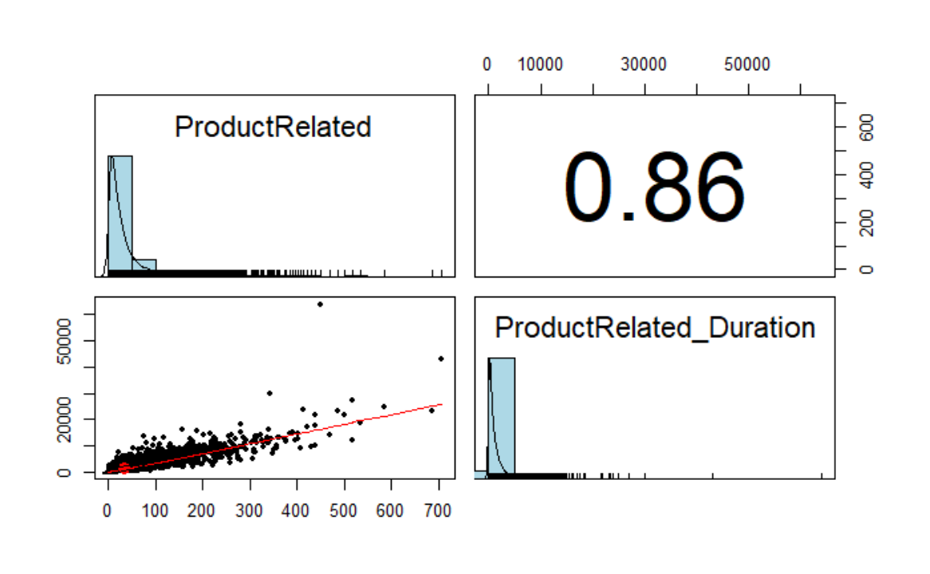
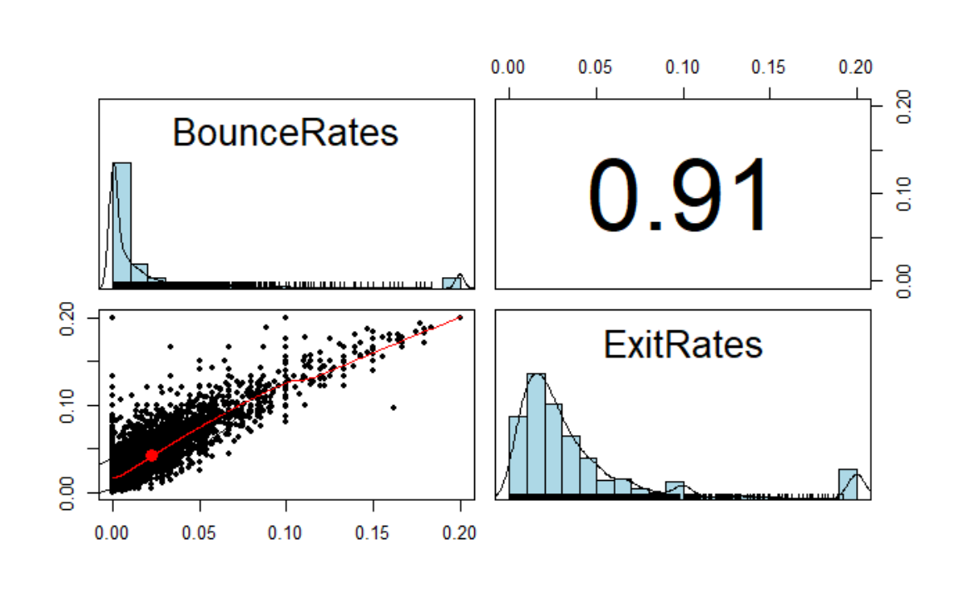
Correlation, density and histogram of the two features
pairs.panels
ProductRelated&ProductRelated_Duration
have the second highest correlation value.
BounceRates&ExitRates
have the highest correlation value.
Notes:
1.Then we use pairs.panels to create the correlation, density and histogram of the two features.
2.At this point we find that ProductRelated&ProductRelated_Duration, have the second highest correlation value.
3.BounceRates and ExitRates, have the highest correlation value. cor

Slide 8
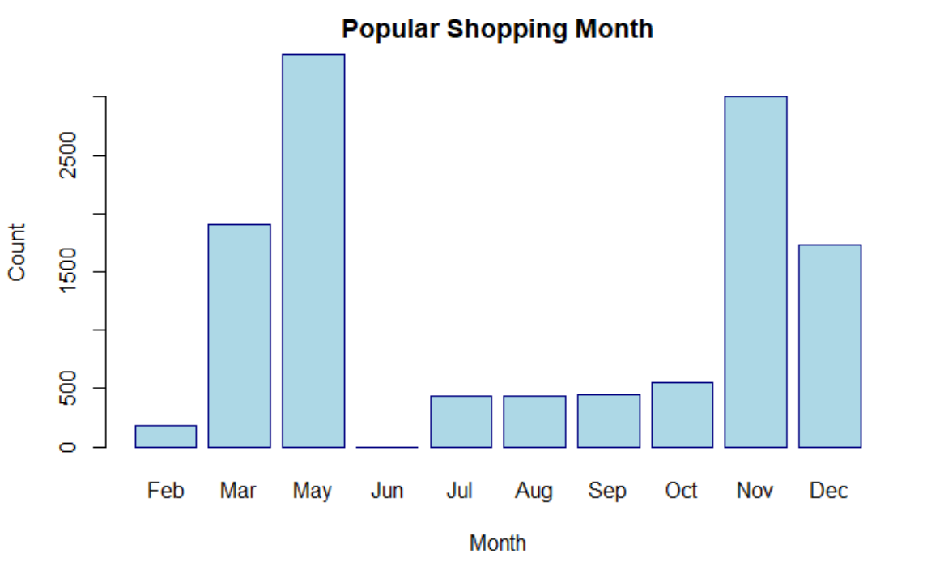
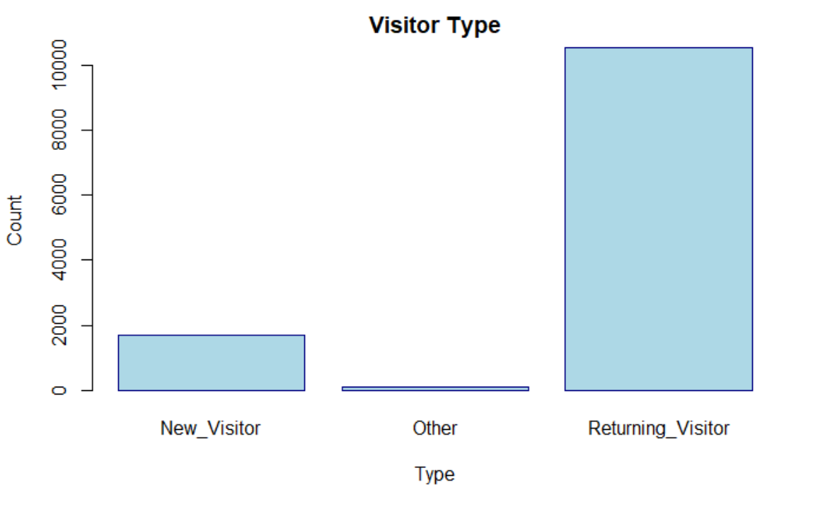
barplot
“May” is the most popular shopping month.
“returning_visitor” has many more numbers.
Notes:
1.Then we used barplot to display popular shopping months and found out “May” is the most popular one.
2.Another figure displayed the different types of visitors and found out “returning_visitor” has many more numbers.

Slide 9
III.Original Paper Reproduction

Slide 10
Original Paper
Real-time online shopper behavior analysis system
Module: RF; SVM; MLP
Predict a visitor's purchase intent
Identify visitors who are in-market but likely to leave shopping site
Notes:
1.Then we will talk about original paper reproduction.
2.The original paper discusses a real-time online shopper behavior analysis system that predicts a visitor's shopping intent and the possibility of giving up.
3.The system used RF,SVM,MLP to predict a visitor's purchase intent and finally can identify visitors who are in-market but likely to leave shopping site.

Slide 11
Model Evaluation
Accuracy: (TP+TN)/(TP+FP+TN+FN)
True Positive Rate: TP/(TP+FN)
True Negative Rate: TN/(FP+TN)
F1 Score = 2*(precision*recall)/(precision+recall)
TP:# of true positives TN:# of true negatives precision = TP/(TP+FP)
FP:# of false positives FN:# of false negatives recall = TP/(TP+FN)

Slide 12
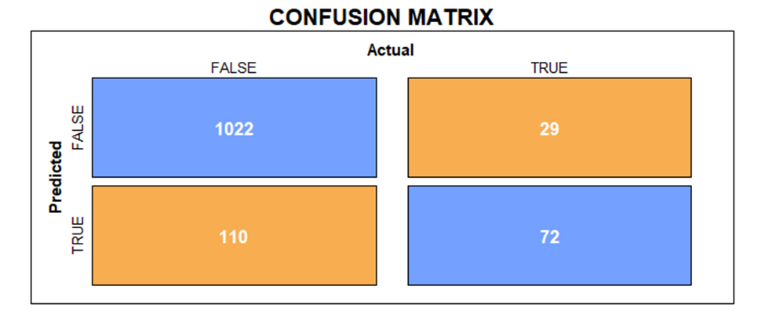
SVM(without oversampling)
SVM vanilla
Classifier | Accuracy (%) | True-positive rate (TPR) | True-negative rate (TNR) | F1 Score
Original paper | 88.3 | 0.42 | 0.97 | 0.52
Reproduced | 88.7 | 0.79 | 0.90 | 0.51

Slide 13

SVM(with oversampling)
SVM vanilla
Classifier | Accuracy (%) | True-positive rate (TPR) | True-negative rate (TNR) | F1 Score
Original paper | 84.3 | 0.75 | 0.93 | 0.82
Reproduced | 87.5 | 0.54 | 0.95 | 0.63

Slide 14
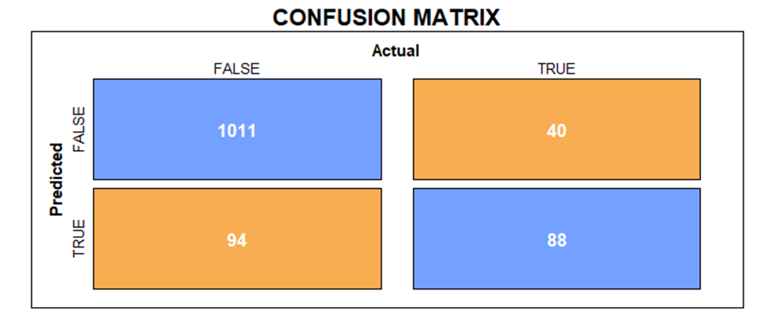
SVM(without oversampling)
SVM rbf
Classifier | Accuracy (%) | True-positive rate (TPR) | True-negative rate (TNR) | F1 Score
Original paper | 86.1 | 0.46 | 0.92 | 0.53
Reproduced | 89.1 | 0.69 | 0.91 | 0.57

Slide 15
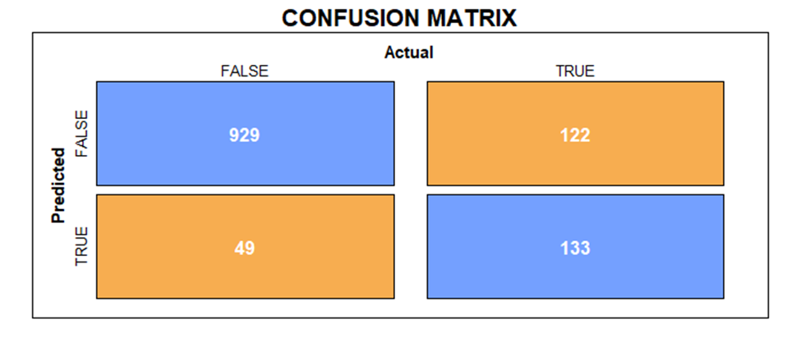
SVM(with oversampling)
SVM rbf
Classifier | Accuracy (%) | True-positive rate (TPR) | True-negative rate (TNR) | F1 Score
Original paper | 84.9 | 0.75 | 0.94 | 0.82
Reproduced | 86.1 | 0.52 | 0.95 | 0.61

Slide 16

Random Forest(without oversampling)
Random Forest
Classifier | Accuracy (%) | True-positive rate (TPR) | True-negative rate (TNR) | F1 Score
Original paper | 89.5 | 0.57 | 0.96 | 0.58
Reproduced | 89.5 | 0.66 | 0.93 | 0.63

Slide 17
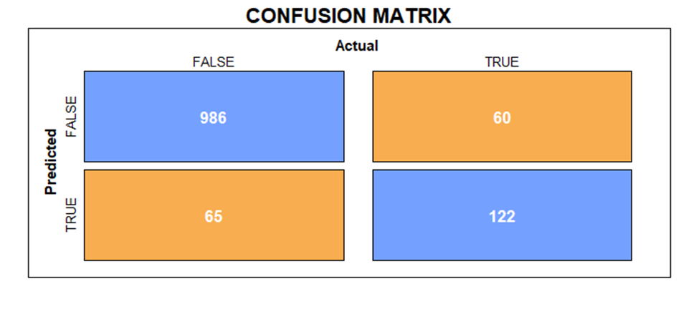
Random Forest(with oversampling)
Random Forest
Classifier | Accuracy (%) | True-positive rate (TPR) | True-negative rate (TNR) | F1 Score
Original paper | 82.3 | 0.74 | 0.90 | 0.81
Reproduced | 89.9 | 0.67 | 0.94 | 0.66

Slide 18
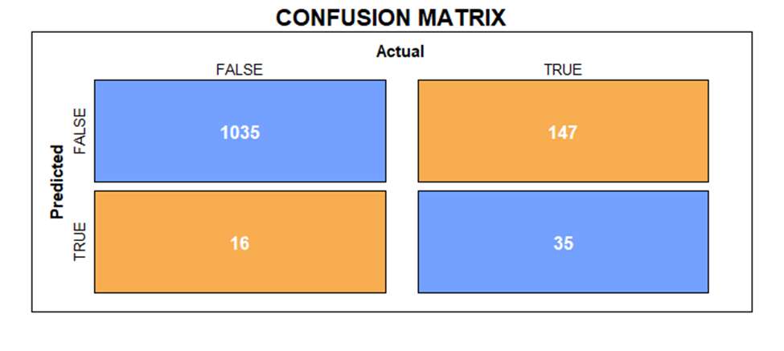
Multiple Layer Perceptron(without oversampling)
MLP(# of hidden layers: 40)
Classifier | Accuracy (%) | True-positive rate (TPR) | True-negative rate (TNR) | F1 Score
Original paper | 87.1 | 0.54 | 0.93 | 0.56
Reproduced | 86.7 | 0.19 | 0.98 | 0.30

Slide 19
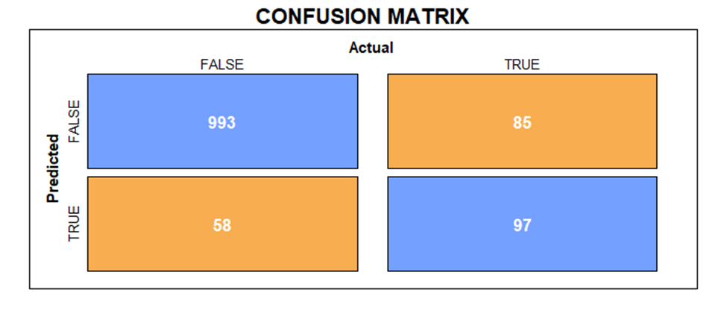
Multiple Layer Perceptron(with oversampling)
MLP(# of hidden layers: 40)
Classifier | Accuracy (%) | True-positive rate (TPR) | True-negative rate (TNR) | F1 Score
Original paper | 82.2 | 0.82 | 0.83 | 0.82
Reproduced | 88.4 | 0.53 | 0.94 | 0.58

Slide 20
IV.Other Methods beyond Original Paper

Slide 21
Decision Tree
K-Nearest Neighbors
Deep Neural Net
Naive Bayes
Adaboost
LDA
Bagging
Ensembled Model
Methods

Slide 22

Decision Tree (without pruning)
Decision Tree
Classifier | Accuracy (%) | True-positive rate (TPR) | True-negative rate (TNR) | F1 Score
Proposed | 84.8 | 0.68 | 0.88 | 0.56

Slide 23
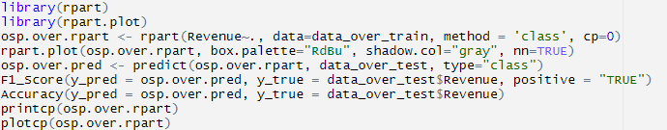
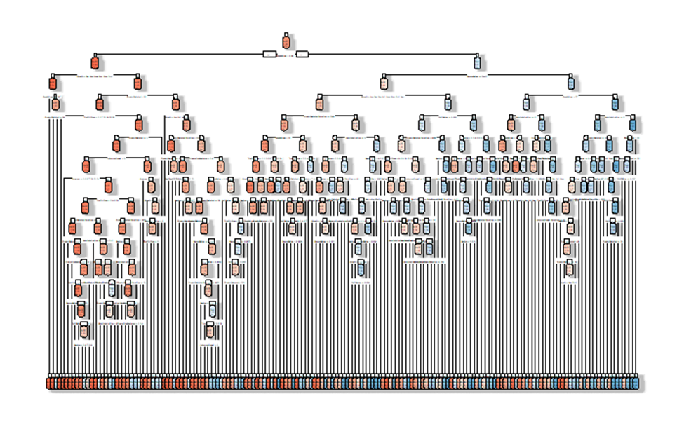
Decision Tree (without pruning)

Slide 24
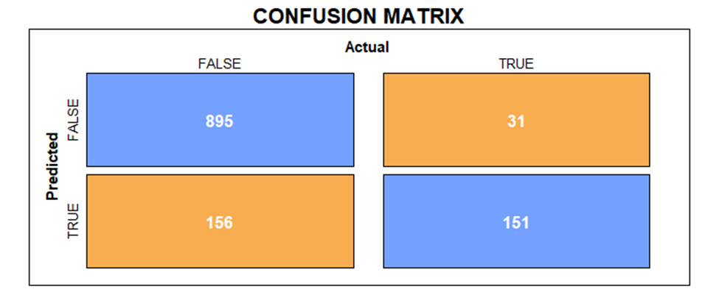
Decision Tree (with pruning)
Decision Tree
Classifier | Accuracy (%) | True-positive rate (TPR) | True-negative rate (TNR) | F1 Score
Proposed | 86.2 | 0.85 | 0.83 | 0.61

Slide 25

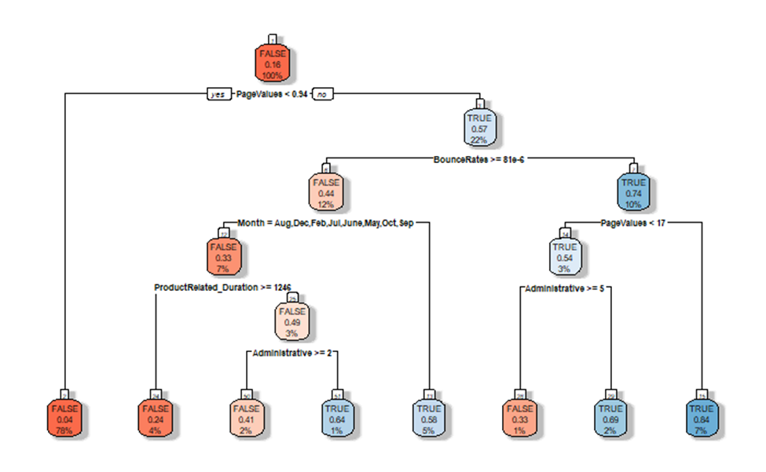
Decision Tree (with pruning)

Slide 26
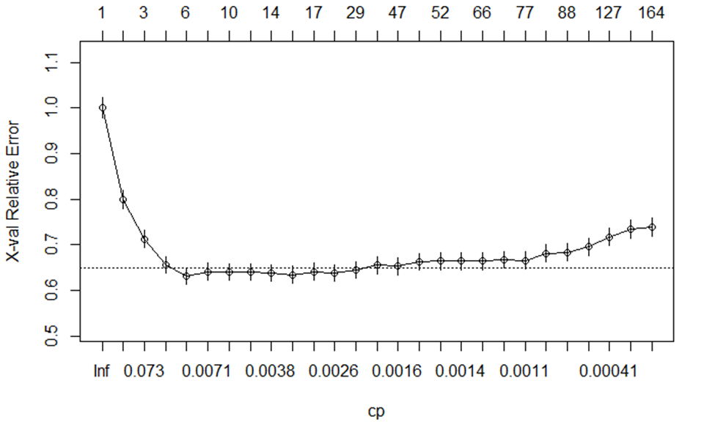
Decision Tree (with pruning)

Slide 27

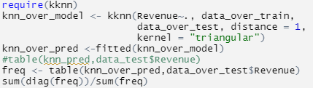
K-nearest Neighbors
KNN
Classifier | Accuracy (%) | True-positive rate (TPR) | True-negative rate (TNR) | F1 Score
Proposed | 84.2 | 0.47 | 0.92 | 0.62

Slide 28

Deep Neural Network
Neural Net
Classifier | Accuracy (%)
Proposed | 90.2

Slide 29
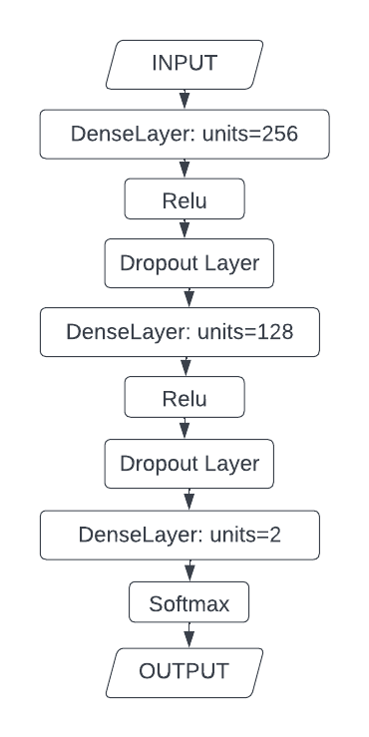
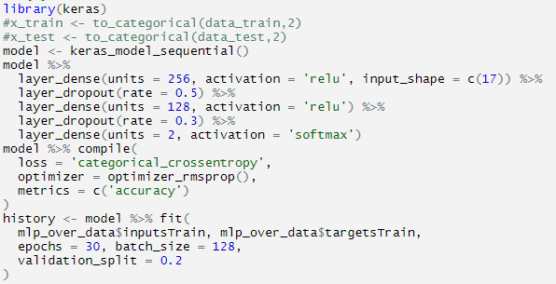
Deep Neural Network

Slide 30
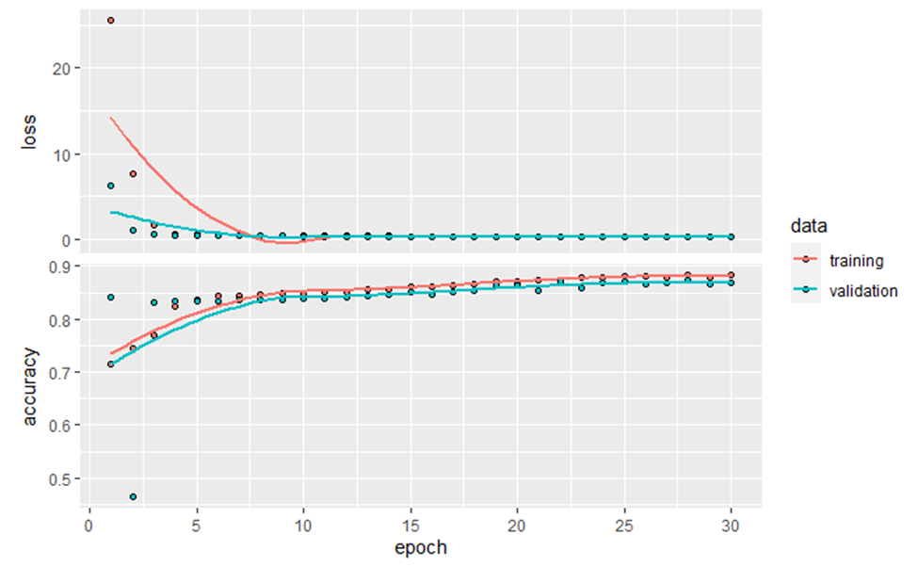
Deep Neural Network

Slide 31
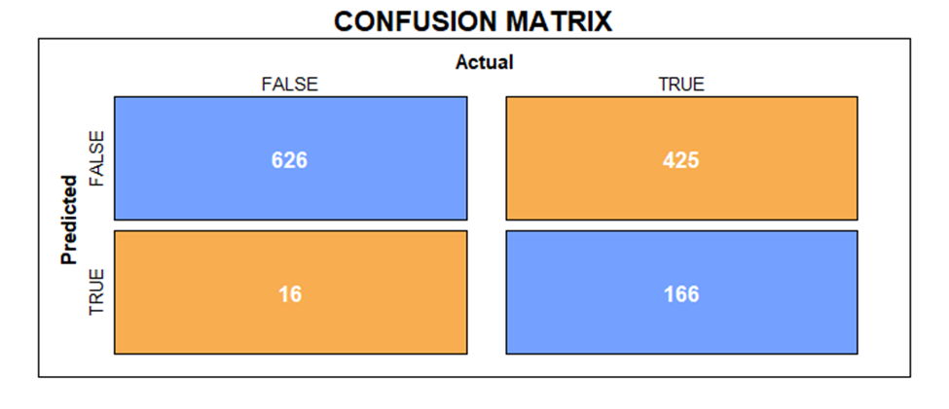
Naive Bayes
Bayes
Classifier | Accuracy (%) | True-positive rate (TPR) | True-negative rate (TNR) | F1 Score
Proposed | 64.2 | 0.29 | 0.98 | 0.42
Notes:
1

Slide 32
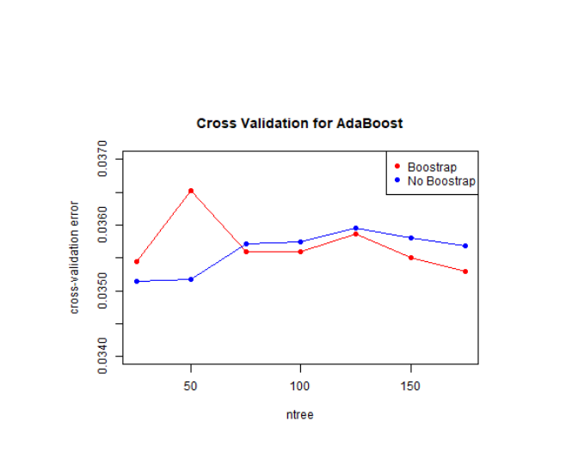
Adaboost(with Freund coefficient)

Slide 33

Adaboost(with Freund coefficient)
Adaboost
Classifier | Accuracy (%) | True-positive rate (TPR) | True-negative rate (TNR) | F1 Score
Proposed | 89.1 | 0.65 | 0.93 | 0.61

Slide 34

LDA
LDA
Classifier | Accuracy (%) | True-positive rate (TPR) | True-negative rate (TNR) | F1 Score
Proposed | 77.9 | 0.38 | 0.95 | 0.51

Slide 35
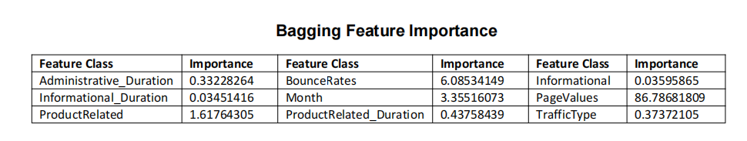
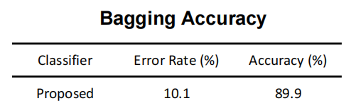
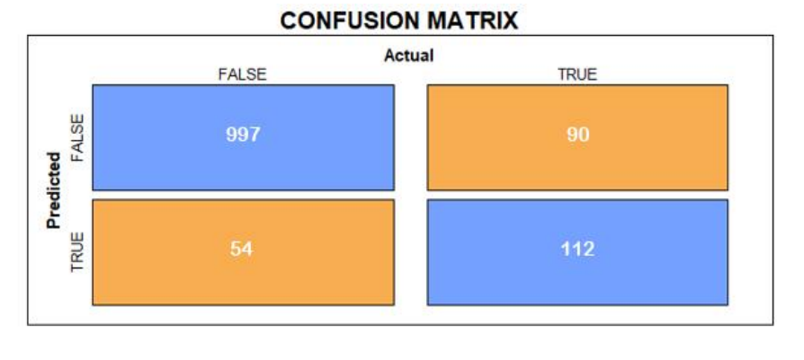
Bagging

Slide 36
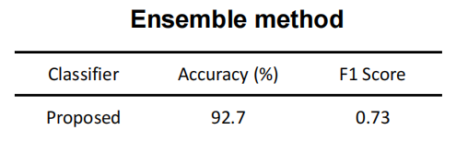
Ensembled Method
Average method (Bagging)
Boosting method (Adaboosting)
Support vector machine + Random forest + Multilayer perceptron (ANN)

Slide 37
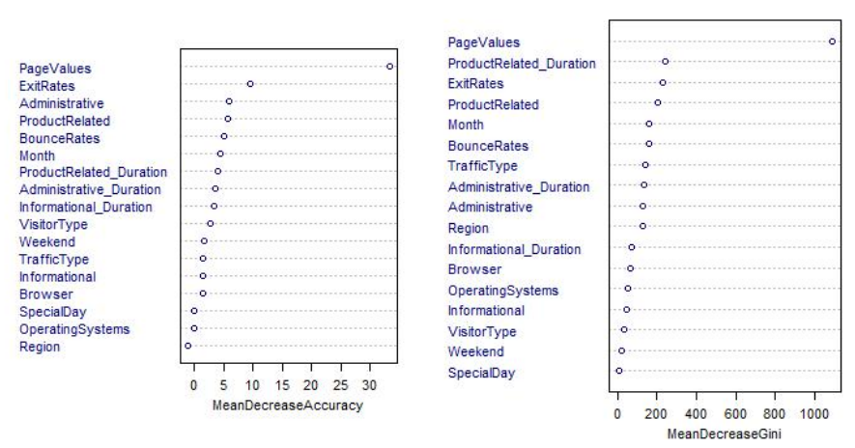
Feature Selection

Slide 38
V. Conclusion and Future Work

Slide 39
Results Comparison

Slide 40
 | Without Sampling |  | With Sampling
Model | Accuracy (%) | F1 Score | Accuracy (%) | F1 Score
SVM (rbf) | 89.1 | 0.57 | 86.1 | 0.61
Random Forest | 89.5 | 0.58 | 89.9 | 0.66
MLP | 86.7 | 0.56 | 88.4 | 0.58
Decision Tree | 89.8 | 0.65 | 84.8 | 0.56
KNN | 87.4 | 0.64 | 84.2 | 0.62
Deep Neural Net | 90.2 | * | 87.3 | *
Naïve Bayes | 81.8 | 0.54 | 64.2 | 0.42
Adaboost | 89.1 | 0.61 | 89.1 | 0.61
LDA | 88.8 | 0.49 | 77.9 | 0.51
Bagging | * | * | 89.9 | 0.67
Ensembled Model | * | * | 92.7 | 0.73

Slide 41
Conclusion
Model Prediction
Oversampling may help with improving the performance of the models.
The Ensemble using the prediction of the three models yield the best accuracy and f1 score among all.
Feature Selection
Salient features are: Page Value; Product Related (number of related pages have viewed); Product Related Duration(total time spent on related pages).
We can hypothesize that more attractive the pages are, the more pages the viewer reads, the more time the viewer spends on the pages, the more likely they are going to make a purchase.

Slide 42
Future work
For future research, different methods of data augmentation should be experimented to improve model performance.
Do more feature importance analysis in different models.
More parameter tuning should be done to improve the performance of the models.
We could try more ensemble strategies and combination of models to reach a better score and accuracy.

Slide 43
Reference
[1] Dinov, Ivo D. (2018). Data Science and Predictive Analytics Biomedical and Health Applications using R /. Cham : Springer International Publishing : Imprint: Springer.
[2] Sakar, C Okan, Sakar, C Okan, Polat, S Olcay, Polat, S Olcay, Katircioglu, Mete, Katircioglu, Mete, Kastro, Yomi, et al. (2019). Real-time prediction of online shoppers’ purchasing intention using multilayer perceptron and LSTM recurrent neural networks. Neural Computing and Applications, 31(10), 6893–6908. London: Springer London.
[3] Fix, Evelyn; Hodges, Joseph L. (1951). Discriminatory Analysis. Nonparametric Discrimination: Consistency Properties (PDF) (Report). USAF School of Aviation Medicine, Randolph Field, Texas. Archived from the original on September 26, 2020.
[4] Tan PN (2006) Introduction to data mining. Pearson Education, New Delhi
[5] Breiman L (2001) Random forests. Mach Learn 45(1):5–32

Slide 44
Thanks For Listening
Thanks to Professor Predrag Jelenkovic and all TAs~
Kangrui Li kl3350
Yuhang Wang yw3733
Linyang Han lh3096
Zheyuan Song zs2527

