Slide 1

Lecture 21: C Basics
CSCI 260 Computer Systems & Architecture
Fall 2022
Andy Siyuan Feng
10/19/2022

Slide 2
Your First Ever C Program
Almost everything is quite similar to that in Java, and also simpler.
#include <stdio.h> <-- [Similar to import in java, known as a header. Contains function/variable definitions or code.
“Standard Input/Output”, needed for printf.]
int main() { <-- [The main function: has a return and can have args.]
printf(“Hello World!\n”); <-- [Uses \n as newline within “”.]
return 0; <-- [The return value. Conventionally return 0 in main.]
} <-- [end with ; and embraced by {}.]

Slide 3
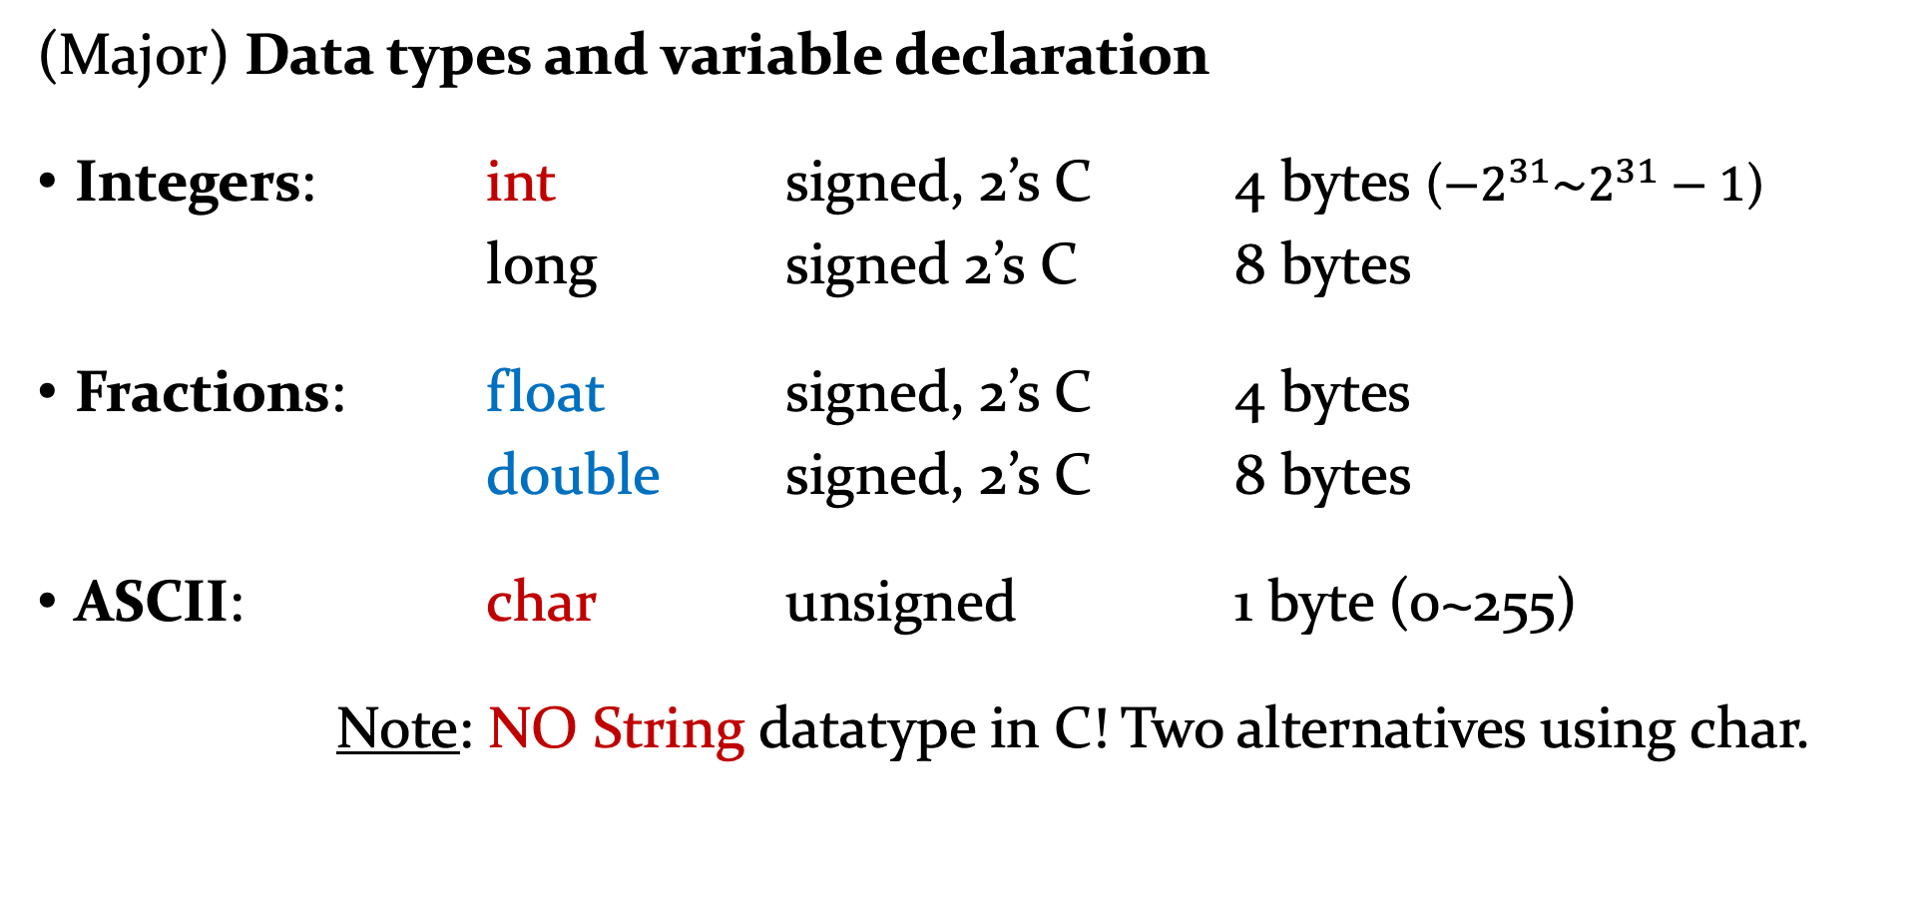
Variables and Operations
(Major) Data types and variable declaration
Integers: int signed, 2’s C 4 bytes ($−2^{31}\sim 2^{31}−1$)
long signed 2’s C 8 bytes
Fractions: float signed, 2’s C 4 bytes
double signed, 2’s C 8 bytes
ASCII: char unsigned 1 byte (0~255)
Note: NO String datatype in C! Two alternatives using char.

Slide 4
Variables and Operations
Var. names at most 31 chars.
Not same as reserved words.
Not starting with a number.
(Major) Data types and variable declaration
int num;
int bin_pos = 0b100111; [39. Add – make -39.]
int Location = 0x3000;
float pi = 3.14159;
double avogadro = 6.02e23; // 6.02 x 10^23
char mode_c = ‘C’; char mode_d = 67;
char mode_h = 0x43; char mode_h = ‘\x43’;

Slide 5
Variables and Operations
(Major) Data types and variable declaration
Variables defined with constant values that are final:
#include <stdio.h> … …
#define NUM 30 const int LENGTH = 5;
#define DIV 6 const int HEIGHT = 12;
int main() { … …
… …
}

Slide 6
Variables and Operations
Printing variables
In Java, mixing strings with variables to print:
System.out.println( “res = a x b = ” + …
num_a + “ x ” + num_b + “= ” + res + “.” );
In C, specifiers are used (in fact Java also has this mode):
printf(“res = a x b = %d x %d = %d.”, num_a, num_b, res);

Slide 7
Variables and Operations
Printing variables
Integers: int %d
long %ld
Fractions: float %f %.nf
double %lf %.nlf
ASCII: char %c
Note: NO String datatype in C! Two alternatives using char.
String %s
Num. of digits to the right of the decimal point that will be printed out.

Slide 8
Variables and Operations
Scope of variables
#include <stdio.h>
int itsGlobal = 5; // global
int main () {
int itsLocal = 1; // local to main function
{
int itsLocal = 2; // local to this block!!
itsGlobal = 10; // changes globally!
printf(“Global=%d Local=%d\n”, itsGlobal, itsLocal);
}
printf(“Global=%d Local=%d\n”, itsGlobal, itsLocal);
return 0; }

Slide 9
Variables and Operations
Printing variables
int counter = 0;
int Location = 0x3000;
printf(“Current PC: %x, counter = %d\n”, Location, counter);
const float pi = 3.14159; printf(“pi = %f\n”, pi);
char mode_c = ‘C’; char mode_d = 67;
char mode_h = 0x43; char mode_h = ‘\x43’;
printf(“Mode: %c\n”, mode_?);

Slide 10
Variables and Operations
Operations
Arithmetic: +, -, * Assignment: =, +=, -=, *=, /=, %=
Division / int q = 245/10 = 24
double q = 245/10 = 24.00000
double q = (double) 245/10 = 24.500000
[Type Casting]
Remainder (Mod) % 245%10 = 5

Slide 11
Variables and Operations
Operations
Increment ++ and Decrement --
x++ post-increment: use value then increment. x-- same idea
++x pre-increment: increment then new use value. --x same idea
x = 4; x = 4;
y = x++; y = ++x;
Results:
x = 5 x = y = 5
y = 4

Slide 12
Variables and Operations
Operations
Bitwise Logic: treat operand(s) as in 2’s complement.
NOT ~x ~2 = -3
AND x & y 7 & 8 = 0
OR x | y 7 | 8 = 15
XOR x ^ y 7 ^ 9 = 14
left shift x << y 2 << 1 = 4
right shift x >> y 8 >> 1 = 4
Note: ^ is not exponentiation.
Note: These are different from
&& (AND), || (OR), ! (NOT)
for logical conditions in loops
and if statement.

Slide 13
Variables and Operations
Operations
Logical Operators: treat operand(s) as either True or False statement(s).
NOT !x !(x <= 2)
AND x && y ((mode == ‘E’) && (key != 0))
OR x || y ((counter > 0) || (input_char > 0x40 ))
Relational: >, >=, <, <=, ==, !=
Results in True of False that can then be used with logical operators.

Slide 14
Variables and Operations
Operations
Operations from Library:
#include <math.h>
pow(base, exponent) double x = pow(2,4);
sqrt(x) double y = sqrt(10);
printf(“x=%lf\n”, y); 3.162278
printf(“x=%.20lf\n”, y); 3.16227766016837952279

Slide 15
Variables and Operations
Arrays
In Java, to declare an empty array: int[] anArray = new int[20];
In C, to declare an empty array: int anArray[20]; any datatype
Similarly, can initialize an array with its elements: int Primes20[] = {2, 3, 5, 7, 11, 13, 17, 19};
Array elements are accessed through bracket and index: Primes20[0] = 2, Primes20[6] = 17, etc.
Can also declare multi-dimensional arrays: float fractions[5][10]…

Slide 16
Variables and Operations
Arrays
Speaking of array, what is an array made of chars? A String!!
Recall, a string in LC-3 is a bunch of chars in consecutive memory locations terminated with null.
This is exactly (one way) what a string is in C as well.
Can simply initialize as: char myString[] = “Hello there!”;
Each array location is the corresponding char: myString[0] = ‘H’
Or, .STRINGZ #20 → char myString[20];

