Slide 1

Lecture 24: IDE and Debugging
CSCI 260 Computer Systems & Architecture
Fall 2022
Andy Siyuan Feng
10/31/2022

Slide 2
The CLion IDE
Similar to Eclipse to Java, requires as to first create a Project.
Menu → File → New → Project…
C Executable → Choose project location and Project Name →
Language Standard C99 → Create.
Opens the project window. Can now build and run the Hello World program.
Now is time to test.
If not working, try methods on next page.

Slide 3
The CLion IDE: If not working
If you can build and run, ignore this page.
If CANNOT build or run:
  MAC: Probably haven’t accepted latest Xcode User Agreement.
  Need to do so, and once done, Tools → CMake → Reload CMake Project.
  Windows: It is unlikely, but could be due to lack of C Compiler.
  To check if that’s the case:
  Preference → Build, Execution, Deployment → Toolchains → Check if CMake, Build Tool, C Compiler, and Debugger are all detected. If not, reinstall CLion might resolve.
  Otherwise, let me know; need to manually install one.

Slide 4
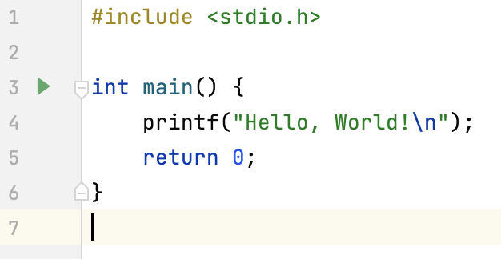
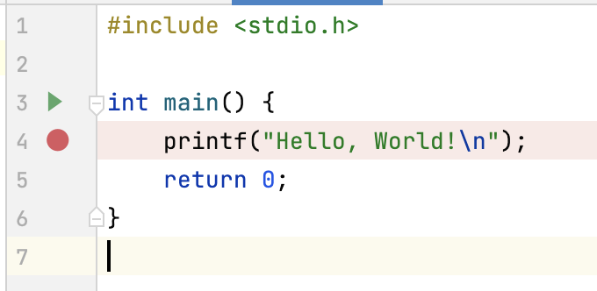
Debugging Mode in CLion
To make a breakpoint: Click gray area with line numbers; red dot appears.
To cancel a breakpoint: Click red dot.
To enter debugging mode: Click bug icon on top-right corner.

Slide 5
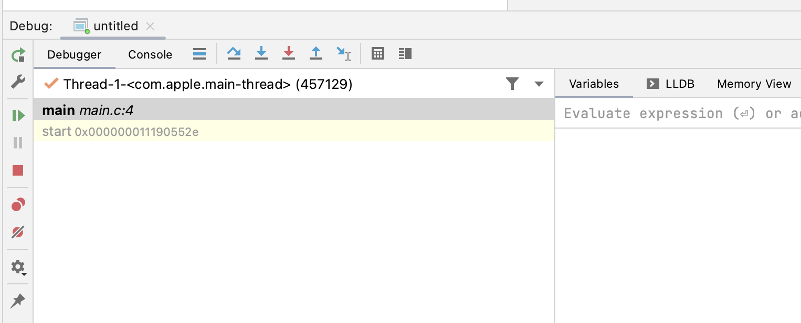
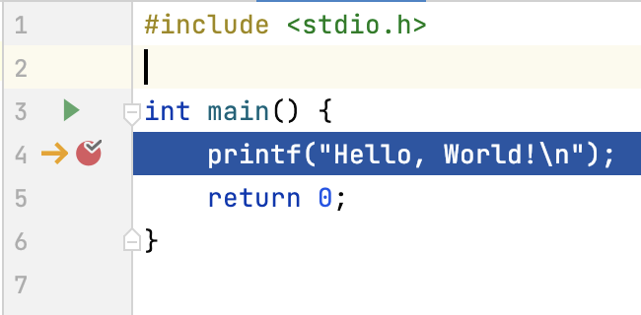
Debugging Mode in CLion
Should now be in debugging mode.
Debugging window on lower-left: The program now: indicating
current line.
Now is time to test.
If NOT working (breakpoint is NOT hit), try method on next page.

Slide 6
Debugging Mode in CLion
If debugging mode is entered, ignore this page.
If NOT working (breakpoint is NOT hit):
Preference → Build, Execution, Deployment → CMake → under CMake options, copy and paste -DCMAKE_BUILD_TYPE=Debug → click OK.
Test again; should now work.
Otherwise, delete/uninstall CLion and re-install.

Slide 7
Debugging Actions
Again, similar to that in Eclipse, there are:
For more detail: https://www.jetbrains.com/help/clion/running-and-debugging-shortcuts.html
  Step over
  Step Into
  Step Out
  Resume Program
  Pause Program
  Stop Program

Slide 8
Debugging Actions
  Step over: Execute a single statement currently at; if function, fully execute it without getting into it (unless breakpoints in func.)
  Step Into: Get into the function currently being called.
  Step Out: (When inside a function) finish executing current function.
  Resume Program: Execute all statements from now on, until a breakpoint is hit or program halts.
  Pause Program: Pause the program while it is running.
  Stop Program: Abort program.

Slide 9
Types of Bugs
  Syntactic Errors: Input code is not legal. Can be caught by compiler and return error message without a successful build.
    Ex.: Missing semicolon; calling a function not defined or not defined as how it is called; etc.
  Semantic Errors: Code is legal, but not what is intended. Cannot be caught by compiler; hence, will need to debug.
    Ex.: for (…) factorial *= i; printf(“%d\n”, factorial);
    Here printf is executed once due to lack of {} to the for-loop.
  Algorithmic Errors: Code is legal and does what is intended, but logic for problem solving is wrong. Cannot be caught by compiler; hence, need to debug AND check structure/flowchart.

Slide 10
Questions?
Now:
  Arrays, and Pointers! – the quintessential of C programming
  HW5 due on 11/11 (F).

