Slide 1

Lecture 23: Functions in C
CSCI 260 Computer Systems & Architecture
Fall 2022
Andy Siyuan Feng
10/28/2022

Slide 2
Functions
Equivalent to Methods in Java, Subroutines in Assembly.
Building blocks of a program: something used repeatedly.
Provides abstractions
// tic-tac-toe machine
int main() {
clearBoard();
do {
Xturn(); Oturn();
} while (noWinnerYet());
}

Slide 3
Functions
A function may have
  Zero or more arguments passed in as input to the function (scope!).
  Zero or one returned value/variable.
Declaration of function: returnDataType funcName(args.)
where args. is of the form dataType varName, etc.
Ex.: char Int2ASCII (int input) void swap(int num1, int num2)
(Scope!!)
(Will see how this is done next week.)

Slide 4
Functions
Declaration
Ways to declare/define a function:
int Factorial (int n) { OR int Factorial (int n);
/* …
all the details in here int main() {
*/ …
} }
… int Factorial (int n) {
int main() { // now, all the details!
… }
}
Definition

Slide 5
Functions
Ways to declare/define a function: But why?
Declare and call first, implement details of the definition later.
Definition may be in another file.
#include funcDef.c
Can also put all the declarations in another file.
#include funcDecl.h

Slide 6
Functions
To return a function: returned value (result) must match the return type (int) (or its equivalence).
int Factorial (int n) {
/*
all the details in here
*/
return result;
}

Slide 7
Functions
To call a function: again, need to match data types for args and for return.
int n_Fac = Factorial(input_n());
int input_n() is executed first and passed as the input to Factorial().
Factorial(input_n()) is executed and a value is returned from within.
The return type is int and is assigned to int n_Fac.

Slide 8
Two Special Functions: I/O
Talked about how printf() works for all data types, except for pointers which is a special data type. Next week
What about input? To scan from keyboard, we use scanf().
Uses the same formatting mechanism as printf().
Ex.: To scan any number datatype or char: must add & (ampersand) before the variable!!
scanf(“%d”, &num); scanf(“%c”, &mode);
Again, has something to do with pointers. Next week

Slide 9
Two Special Functions: I/O
When scanning strings, a bit different. And need to BE CAREFUL!
Ex.: To scan a string: no need for &.
scanf(“%s”, myName);
Note: Recall, to declare a String, we used char array: char myName[20].
Here, must ensure input has at most (<=) 19 chars.
Otherwise, overflow!! Will overwrite data in other places.
Also, not allowing spaces. Will treat “Hello World” as two strings.

Slide 10
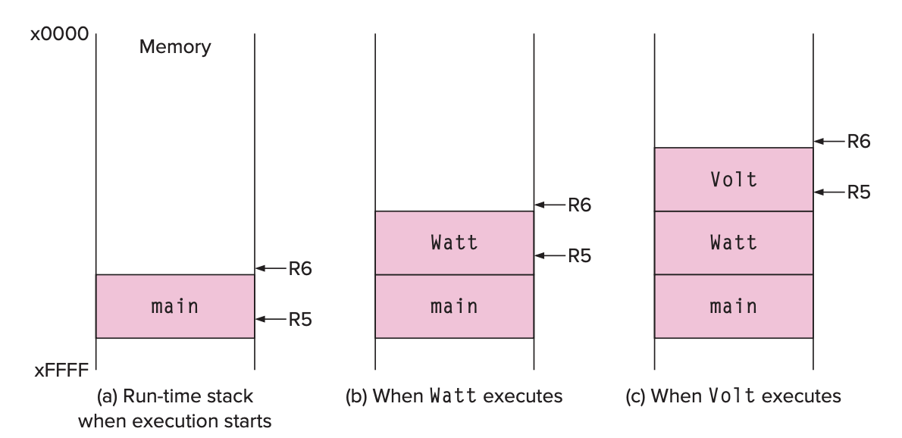
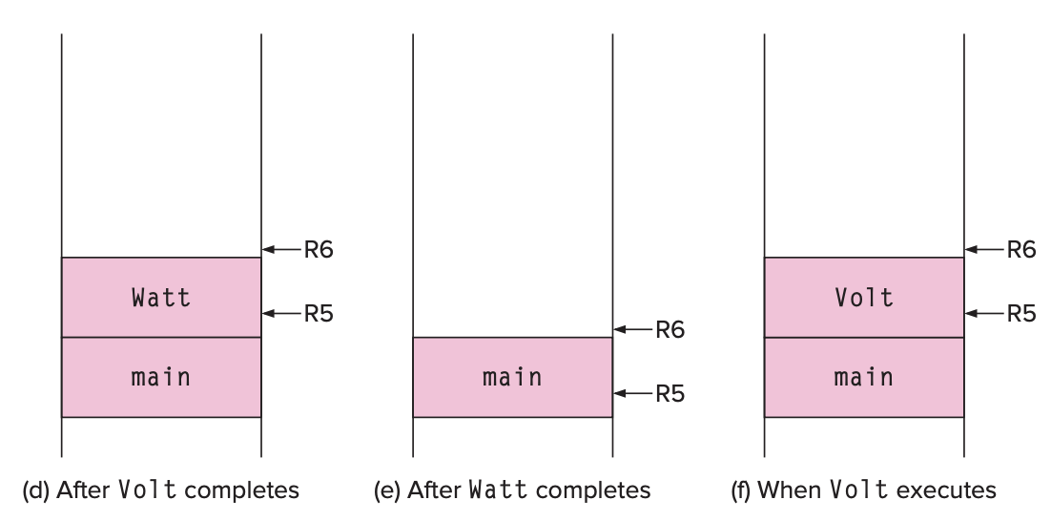
Runtime Stack
Recall talked about runtime stack.
int Volt(int q, int r) { … }
int Watt(int a) { … w = Volt(w, 10); …}
int main () { … int b = Watt(a); b = Volt(a, b); … }

Slide 11
Questions?
Next Week:
  Debugging in C using IDE.
  Arrays, and
  Pointers! – the quintessential of C programming
  HW5 will be given on M and due on 11/11 (F).

