Slide 1

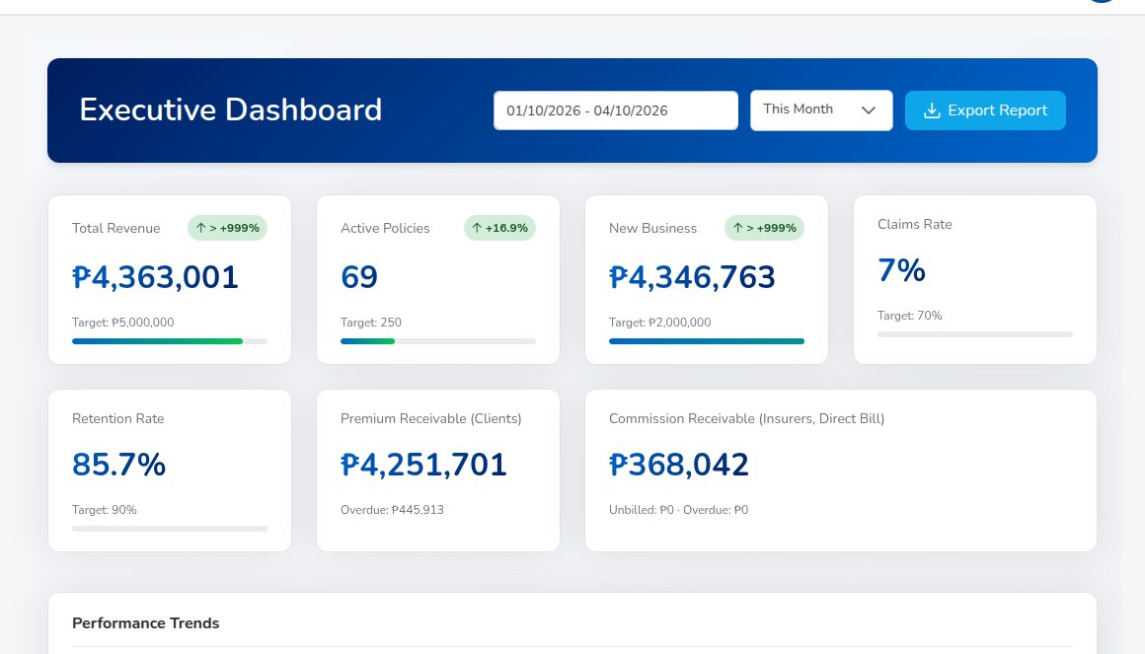
CLIENT PRESENTATION
iNXT BrokerVerse
The insurance broking platform for Philippine non-life brokers, from prospect to renewal to month-end close
Out-of-the-box (OOTB) version
Prepared for: [Client name]
Date: [03 October 2026]
Executive Dashboard: premium, active policies, new business, claims rate, retention and receivables, live from the transactions
iorta TechNXT | Confidential: for the named recipient
Notes:
Opening (2 minutes). Thank the attendees by name and confirm the time available.
Purpose of the session: show how iNXT BrokerVerse runs a Philippine non-life broker from the first prospect to the
month-end close, in one system, and agree the next step.
Ask who owns the decision and who will use the system day to day, so the walk-through can stress the right modules.
Fill in the client name and the date on this slide before sending the file.

Slide 2
Agenda
1
Who we are
5
Controls, data privacy and security
iorta TechNXT and iNXT BrokerVerse
Maker-checker, authority limits, approval notifications
2
What a Philippine broker has to handle
6
Who does what
Market, regulation and the daily work
The eight delivered roles
3
The platform
7
Delivery
Module map and the end-to-end journey
Technology, deployment, implementation timeline, support
4
Module walk-through
8
Commercials and next steps
From sales and placement to accounting, BIR tax and reinsurance
Perpetual or subscription, then demo, workshop, proposal
iNXT BrokerVerse | Client presentation
2
Notes:
Walk through the agenda in under a minute. The core of the session is parts 3 and 4: the modules and the controls.
If time is short, offer to skip the persona view and go from the controls straight to deployment and commercials.
Ask whether there is a topic the audience wants first, for example accounting and BIR for a finance-led audience.

Slide 3
WHO WE ARE
About iorta TechNXT
Who we are
What we deliver
How we work
References
Insurance technology company and publisher of iNXT BrokerVerse
Founded: [to confirm]
Head office and Philippine presence: [to confirm]
Team size and delivery centres: [to confirm]
The iNXT BrokerVerse platform, OOTB version for Philippine non-life brokers
Implementation: configuration, data load, training, UAT, go-live and hypercare
Production support: L2 application support and L3 engineering
Optional hosting on AWS, Azure or with a local partner
Configure, do not customise: the broker is fitted to the product through masters and settings
Written acceptance at the end of each phase
One service desk, severity targets, monthly service report
Changes priced openly at published day rates
Client references that may be named: [to confirm]
Other insurance products of iorta TechNXT: [to confirm]
Certifications held: [to confirm]
Contact: [account manager, mobile, e-mail]
iNXT BrokerVerse | Client presentation
3
Notes:
Replace every item marked [to confirm] with approved company facts before the file leaves the office.
The facts that are already firm: iorta TechNXT publishes iNXT BrokerVerse, implements it with a configure-not-customise
approach, provides L2 application support and L3 engineering, and can host the test and production environments.
Keep this slide short (1 to 2 minutes). The audience cares more about what the system does for their team.

Slide 4
THE MARKET AND THE WORK
What a Philippine non-life broker has to handle
The market
What the system has to get right every day
Many insurers per risk
Offers from several insurers, co-insurance shares that total 100%, a lead insurer, confirmations
About 67
licensed insurance brokers (IC key data 2024, preliminary)
Premium taxes
VAT 12%, documentary stamp tax 12.5%, local government tax by city or municipality, fire service tax 2%
PHP 20 million
Client money
Collect premium, issue the official receipt, remit to each insurer on its terms, watch the premium warranty
minimum paid-up capital for a broker, PHP 50 million for an insurance and reinsurance broker
Commission
Broker-billed and direct-bill business, debit notes to insurers, BIR Form 2307 received, referrer payouts net of EWT
PHP 149.11 billion
non-life gross premiums written in 2025; the top three insurers hold about a third
BIR and the books
Form 2307, VAT Summary, SAWT, QAP and SLSP; month-end close, bank and insurer reconciliation
Controls
Maker-checker on money and configuration, signing authority, segregation of duties, audit trail
Under PHP 100 million
commission income of most brokers; three earn more than PHP 2 billion each
Data Privacy Act
Consent per purpose, data subject requests on time, breach notice within 72 hours
iNXT BrokerVerse | Client presentation
4
Notes:
Market facts come from the Insurance Commission key data for 2024 (preliminary) and the 2025 non-life premium ranking,
as summarised in our commercial note. Check them against the published originals before quoting them outside the
meeting.
Message: most brokers are small or mid-size, every broker places with many insurers, and the work is as much accounting
and compliance as it is sales. A sales tool or a CRM covers only the left half of this slide.
Ask: which of these points costs your team the most time today. Note the answer for the demo.

Slide 5
ONE SYSTEM FOR THE WHOLE BROKER
The platform at a glance
Front office
Sales & Marketing
Placement
Policy servicing
Claims
Renewals
Connects to
Prospects, Quick Quote, Quotations
Broker Slips, Placement Slips
Issue, endorsements, client view
Registration to settlement
Queue, notices, negotiations
E-mail (SMTP); SMS and Viber
Money and insurers
CTPL authentication; LTO feed
Billing and receipts
Collections
Remittance
Commission
Reinsurance
Invoices, official receipts, e-mail
Ageing, reminders, credit control
To insurers, direct bill
Referrers and incentive programmes
Treaties, cessions, recoveries
Insurer APIs; insurer statement files
Finance and compliance
General ledger
Period end
Reconciliation
BIR and AML
Reports
Bank payment and statement files
Posting rules, journals
Month-end and year-end close
Bank and insurer statements
Returns, EOPT, AMLC reports
Dashboards, Report Builder, My Work
BIR EIS and DAT files; AMLC report files
Foundation shared by every module
PayMongo and Dragonpay links
Product Configurator
Masters and Configuration
Users, roles, Authority Matrix
Segregation of Duties
REST API with OpenAPI
Maker-checker
Audit Trail
Notifications
E-mail Outbox
Data Privacy
Document Numbering
Schedules
Upload templates
iNXT BrokerVerse | Client presentation
5
Notes:
Read the map from top to bottom: the front office creates the business, the money layer moves premium and commission,
the finance layer closes the books and files BIR, and everything sits on one set of masters, roles and controls.
Stress that accounting is inside the product: every business event posts to the general ledger through posting rules
the broker can see and approve. There is no separate accounting package to reconcile.
Integrations run through one monitored outbox: SMS and Viber, CTPL authentication and the LTO feed, insurer APIs with
a mapping per insurer, bank payment files, the BIR EIS, plus e-mail, payment links and statement files. Every connector is
delivered in test mode; each partner accepts its side during onboarding.
The compliance layer is in the product too: the AML/CFT toolkit, the IC registers and the BIR returns.

Slide 6
HOW THE WORK FLOWS
The end-to-end journey: prospect to renewal to month-end
1 Lead
2 Broker Slip
3 Quotation Slip
4 Placement Slip
5 Policy issue
6 Payment capture
7 Official receipt
LD-
BS- OFR-
QT-
PS-
POL- CL- INV-
OR-
Sales, Operations
Processing
Sales, Processing
Processing
Processing
Front office
Accounting
2
8 Commission
9 Remittance
10 Endorsement
11 Claim
12 Renewal
13 Month-end
PV-
REM- SET-
END-
CLM-
new term
BRC- MEC-
Accounting, two users
Accounting, two users
Operations, Processing
Claims, two users
Operations, Sales
Accounting, Manager
2
2
2
2
2
2 marks a step that a second user approves (maker-checker).
Placement journey by line. Motor: quotation straight to policy. Fire, IAR, Marine, Casualty, Engineering: Placement Slip required. Set per line in Master > Configuration.
One trail. Every step posts to the ledger by posting rule and is kept in the Audit Trail, so a policy can be followed from lead to remittance and claim.
iNXT BrokerVerse | Client presentation
6
Notes:
This is the backbone of the demo. Each step is its own screen, usually done by a different team, and each leaves a
numbered document behind, so anyone can follow a policy from the lead to the money and back.
Point out the two blue approval markers: money and period close always need a second person.
The journey per line is configurable: a private car is quoted and issued straight from the quotation; fire, IAR,
marine, casualty and engineering need a Placement Slip confirmed by every insurer before the policy can be issued.

Slide 7
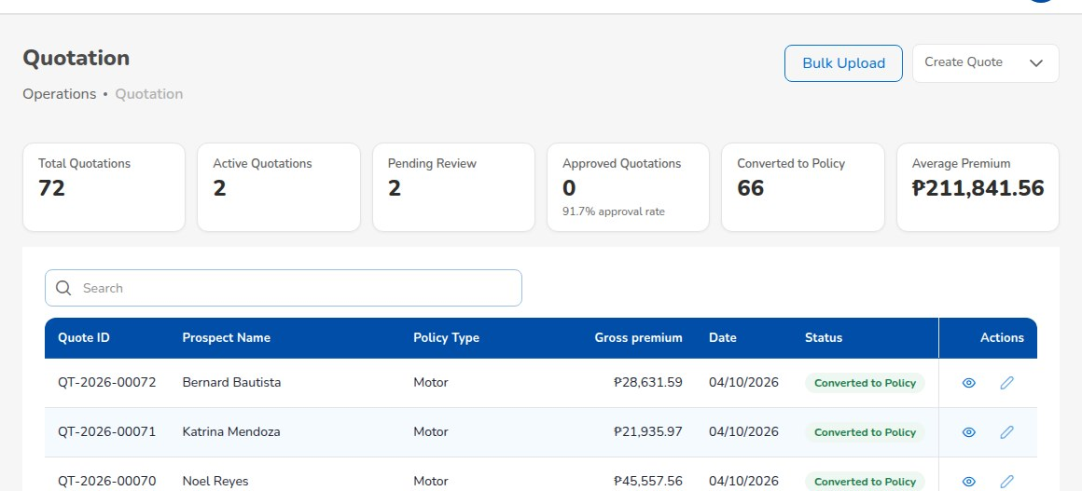
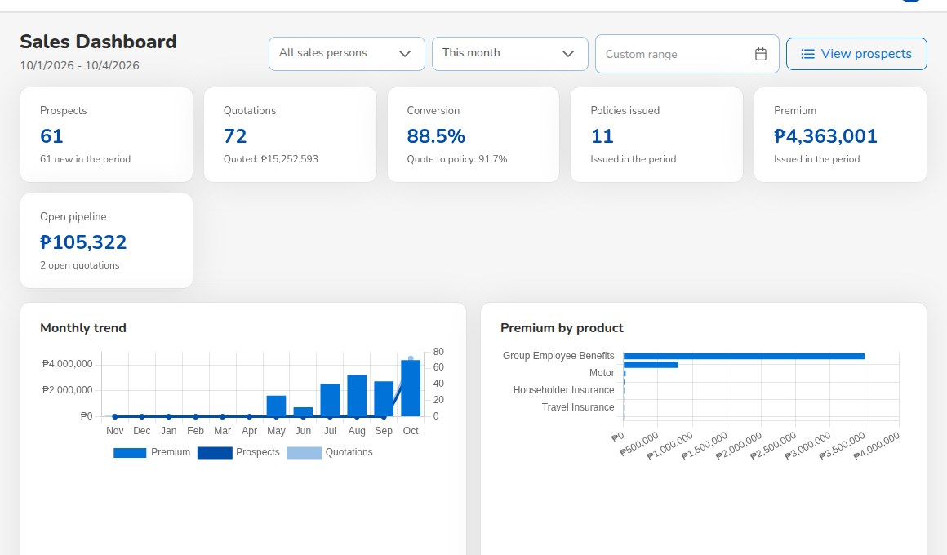
MODULE WALK-THROUGH: FRONT OFFICE
Sales and quotation
Who
Sales & Marketing
Operations
Processing Team
Prospects individual or corporate (TIN required for corporate), one by one or by Excel upload
Quick Quote and Compare Insurers prices a package from each insurer's rate table and prints a comparison without commission
Motor quotation in five steps vehicle, plan, covers including CTPL and Auto Passenger PA, accessories, discount and commission
Server-side pricing every quotation is priced again from the configured rates and taxes; a premium changed in the browser is refused
Client approval online a signed link valid for 168 hours; the client accepts and the Processing Team is told
Payment links PayMongo or Dragonpay; a paid link creates the official receipt
Sales Dashboard prospects, quotations, conversion, policies issued and premium per account executive
Operations > Quotation: status of every quotation
Outputs Quotation PDF, insurer comparison, Lead Conversion Funnel report
Dashboard > Sales Dashboard
iNXT BrokerVerse | Client presentation
7
Notes:
Show this from the account executive's point of view: one list of prospects, a quotation in minutes, the client
accepts from a link, and the payment link takes the money.
Key control to mention: the server recalculates every premium from the configured rate tables and taxes, so a premium
typed over in the browser is refused. Discounts are limited by the Authority Matrix.
Question for the audience: how many quotations per month, and which lines are quoted most. Motor and fire usually lead.

Slide 8
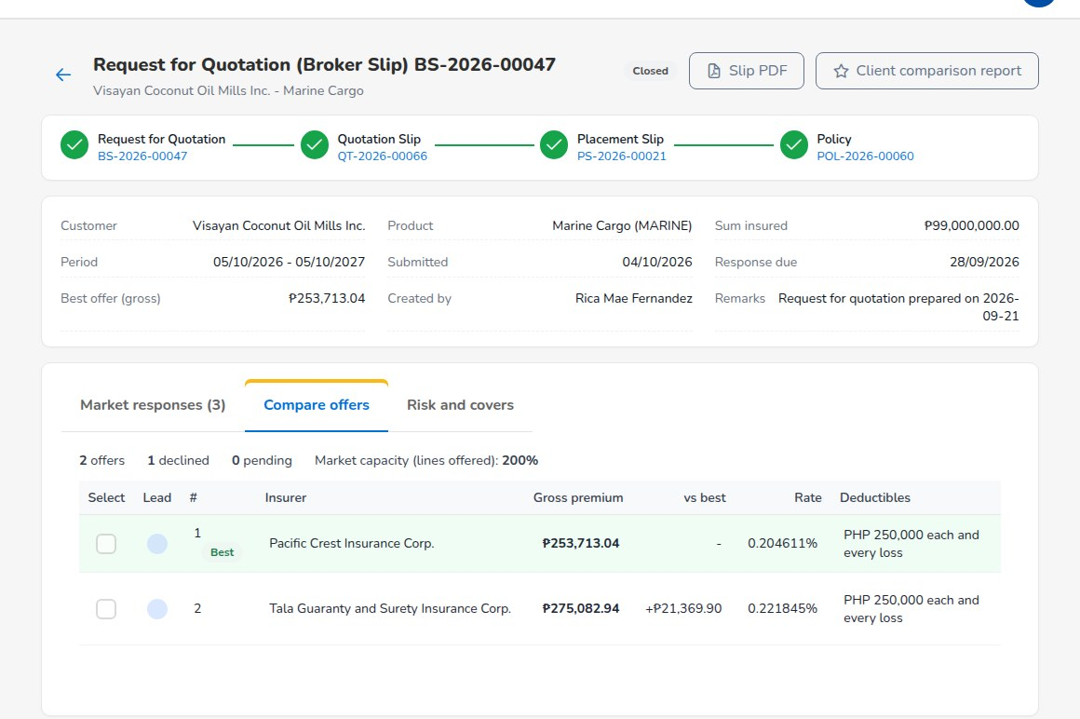
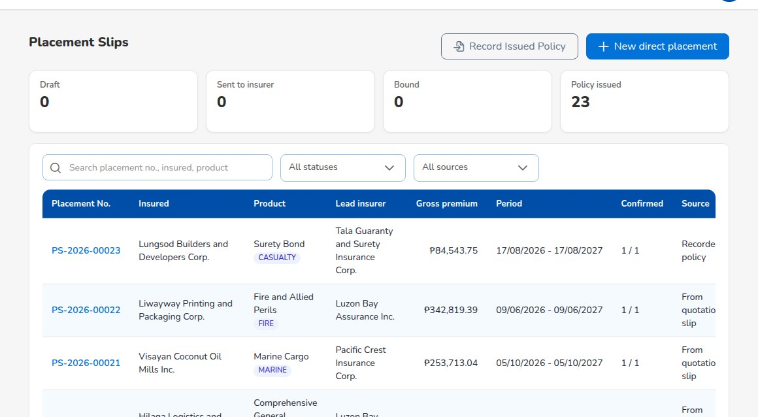
MODULE WALK-THROUGH: FRONT OFFICE
Placement with insurers
Who
Processing Team
Broker Slip (Request for Quotation) presents one risk to several insurers; each offer or decline is recorded
Compare offers side by side: gross premium, rate, deductibles, difference to the best offer; choose the security
Placement Slip the firm order to the lead and the co-insurers; each confirms its share with its policy or certificate number
Co-insurance shares must total exactly 100% with one lead; premium, commission, remittance and claims follow the shares
Journey per line a line that requires a Placement Slip cannot be issued until every insurer has confirmed
Record Issued Policy and direct placement for business the insurer has already issued
Broker Slip: Compare offers
Outputs Broker Slip and Placement Slip PDFs, Placement Pipeline, Market Response (hit ratio), Co-insurance Register
Operations > Placement Slips: draft, sent, bound, issued
iNXT BrokerVerse | Client presentation
8
Notes:
This is where most broker systems stop being useful for commercial lines. Walk through one fire or IAR risk:
the Broker Slip goes to three insurers, two offer and one declines, the comparison picks the lead, and the Placement
Slip records each insurer's share and confirmation.
The money trail follows the shares automatically. In the manual example (IAR, PHP 125,000,000.00 sum insured, 60/40
co-insurance) one client bill is split into payables per insurer, and the Co-insurance Register shows each share.
Question: what share of your premium is co-insured, and how many insurers do you place with in a typical month.

Slide 9
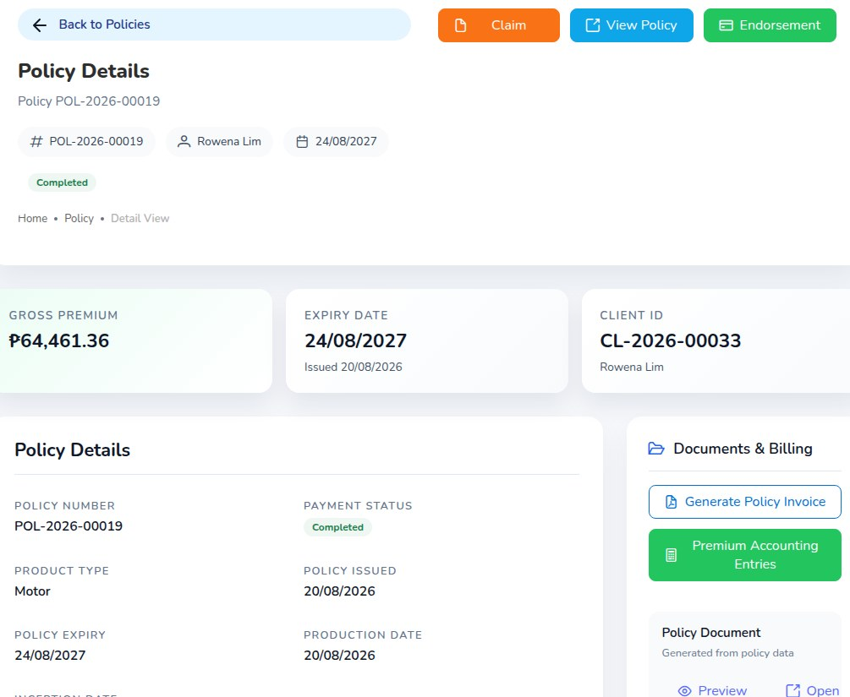
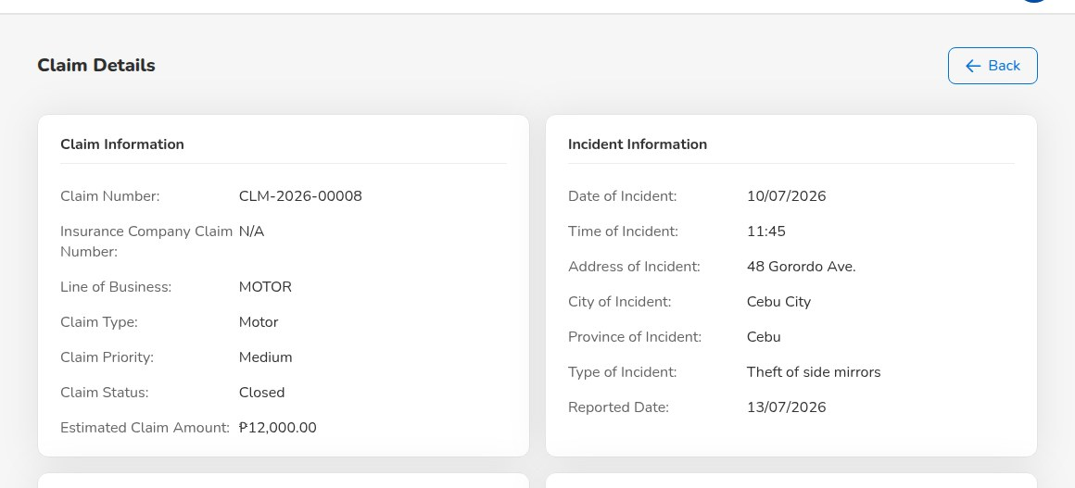
MODULE WALK-THROUGH: FRONT OFFICE
Policy servicing, endorsements and claims
Who
Operations
Processing Team
Claims
Policy issue from the Placement Slip, or Convert Policy for motor; client record and premium bill created
Motor KYC government ID (type, number and image), chassis, motor and plate or MV file number before issue
Policy detail policy schedule PDF, invoice, accounting entries, documents and related records in one place
Endorsements personal details, motor details, coverage change, extension, cancellation; extra or return premium billed
Claims registration checks the loss date against the policy period and unpaid premium
Preliminary Loss Advice e-mail to the insurer; acknowledgement letter, claims data sheet, discharge voucher
settlement approved by a second Claims user; settlement cash through the broker tracked by insurer share
Claims Dashboard open and overdue claims, claims by line and region
Operations > Policy: policy detail
Outputs Policy schedule, endorsement, claim documents, Claims Position and Claims Ageing reports
Operations > Claims: claim detail
iNXT BrokerVerse | Client presentation
9
Notes:
Servicing is where client satisfaction is won or lost. Show the policy detail first: everything about the policy on
one screen, including the accounting entries it created.
For claims, two controls matter to management: a claim is refused when the loss date is outside the policy period or
the premium is unpaid (both configurable), and the settlement needs a second Claims user.
Question: how many claims a month, and do you pay any claims through your own account.

Slide 10
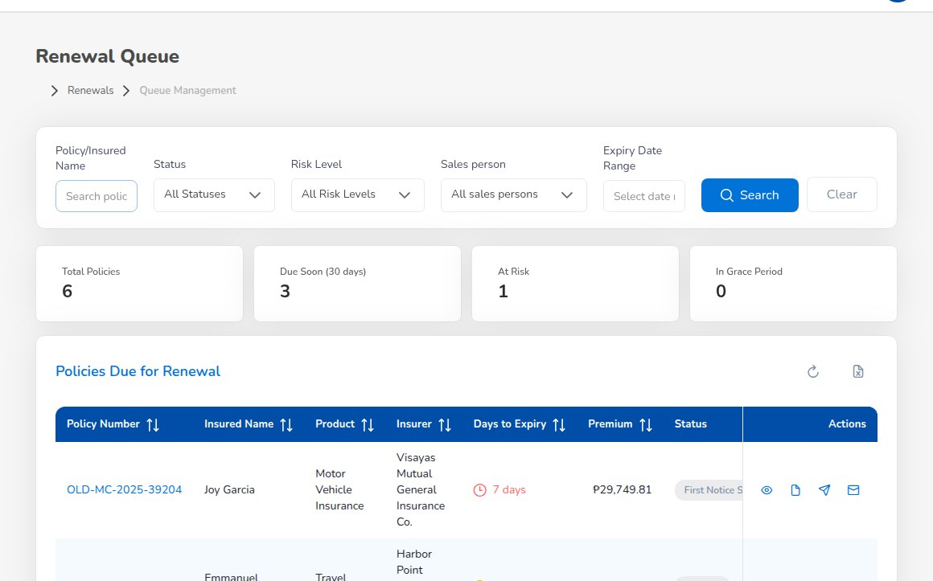
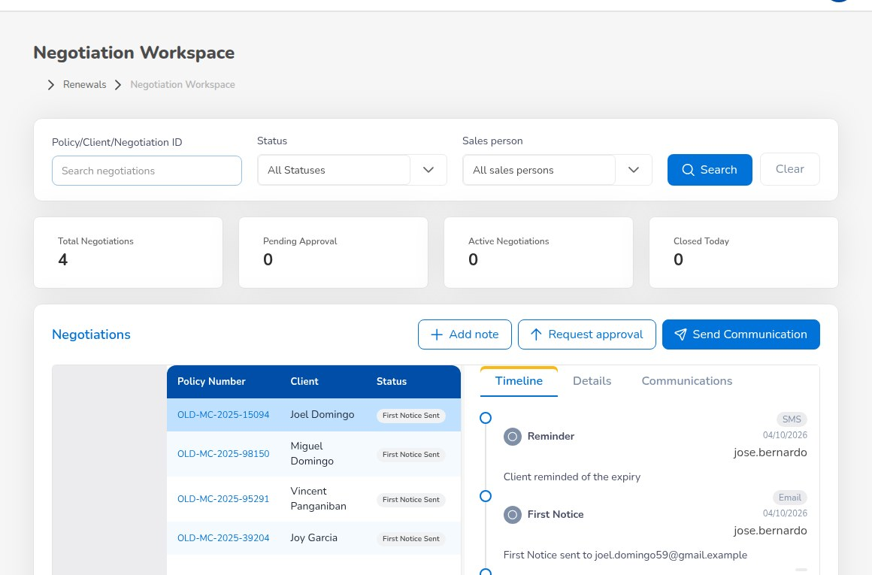
MODULE WALK-THROUGH: RETENTION
Renewals
Who
Operations
Sales & Marketing
Processing Team
Pipeline every policy enters the renewal pipeline 90 days before expiry
Notices first, second and final notice at 60, 30 and 15 days, in order
Renewal Queue days to expiry, status, risk level, owner and contact attempts
Renewal Batch notices for up to 500 policies at once
Negotiations contacts with the client recorded; renewal terms approved by the Processing Team
At-Risk Policies and Lapse Management retention risk score, grace period, win-back campaigns
Renewal issue the accepted renewal quotation becomes the next term; commission accrues to the original referrer
Retention Analytics and Performance renewal rate, premium retention and cycle time against target
Operations > Renewals > Renewal Queue
Outputs Renewal notices, Renewal Retention report, retention rate on the Executive Dashboard
Operations > Renewals > Negotiations
iNXT BrokerVerse | Client presentation
10
Notes:
Renewals are the cheapest premium a broker writes. The point of this slide is that nothing expires unnoticed:
the pipeline starts at 90 days, notices go at 60, 30 and 15 days, and an unrenewed policy lapses 30 days after expiry.
All of these day counts are settings, not code.
Question: what is your current retention rate, and how do you follow up renewals today.

Slide 11
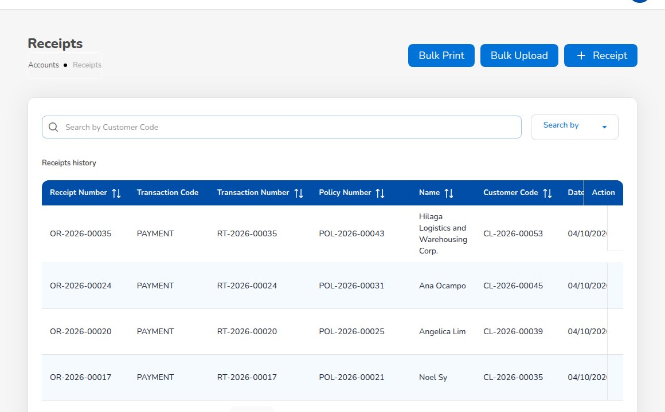
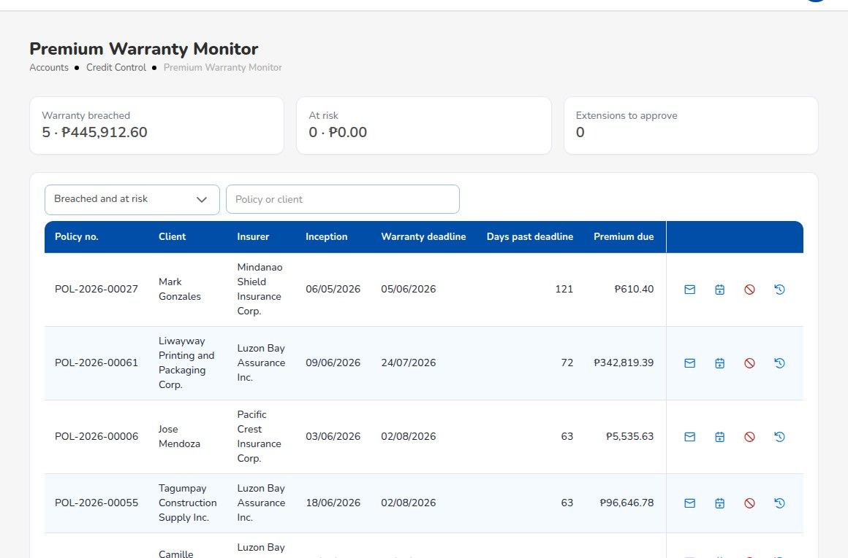
MODULE WALK-THROUGH: MONEY
Billing, official receipts and collections
Who
Accounting
Front office
Billing the bill is raised when the policy, endorsement or renewal is issued; billing statement PDF with payment instructions
Payment capture and official receipt front office records the payment; only Accounting posts the official receipt
New: documents by e-mail E-mail receipt and E-mail invoice send the PDF as an attachment, with To, Cc and a note
optional automatic e-mail when a receipt is recorded or a bill is issued (off until switched on)
attachment size guard; attachment names shown in the E-mail Outbox
Collections ageing by bucket, payment reminders before the due date and then on repeat
Credit Control Instalment Plans, Premium Warranty Monitor, Client Credit Limits, Remittance Ageing
Open entry matching match, unmatch and write off small differences
Accounts > Receipts
Outputs Official receipt, premium invoice, SOA / Premium Receivable, Receivables Ageing, Collection Report
Accounts > Credit Control > Premium Warranty Monitor
iNXT BrokerVerse | Client presentation
11
Notes:
Two messages. First, segregation: the front office records the client's payment, but only Accounting issues the
official receipt. Second, new in this release: the official receipt and the premium invoice go to the client by e-mail
with the PDF attached, either from the screen (E-mail receipt, E-mail invoice) or automatically when the broker
switches it on. The commission debit note e-mail to insurers now carries the debit note PDF, and the policy issued
e-mail carries the policy schedule.
The Premium Warranty Monitor shows broker-billed policies whose premium is unpaid near or past the insurer's payment
warranty, so Accounting can remind the client or ask for an extension.
Question: how do you send official receipts today, and how many receipts a month.

Slide 12
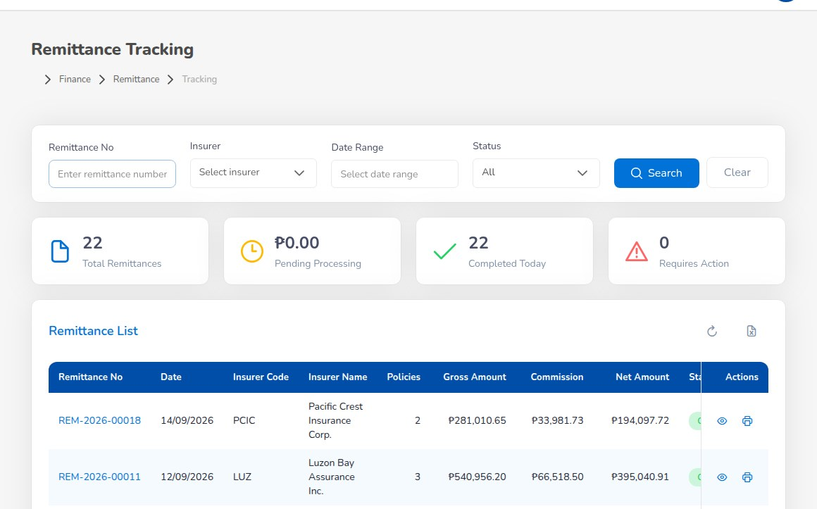
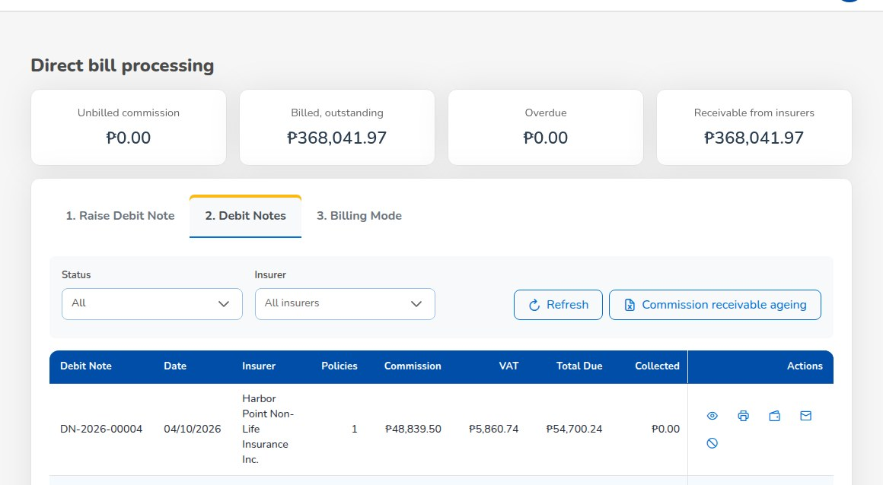
MODULE WALK-THROUGH: MONEY
Remittance to insurers and direct bill
Who
Accounting
Second approver
Automated Processing draft remittances per insurer from collected, unremitted premium, net of commission, by share
Due dates from each insurer's remittance terms (days after collection)
Approval Workflow remittances, settlements, transfers and adjustments approved by another user, levels by amount
Settlement raises the insurer payment voucher; bank result of the transfer recorded
Statements and reconciliation remittance statements for insurers; matching with the bank
Direct bill the client pays the insurer; the broker bills commission plus 12% VAT on a debit note
the insurer pays net of 10% EWT and issues BIR Form 2307; the debit note e-mail carries the PDF
Accounts > Remittance > Tracking
Outputs Remittance statement, Remittance Summary, Due to Insurers by Co-insurer, Aged Payables to Insurers, Commission Receivable (Direct Bill)
Accounts > Remittance > Direct Bill Processing > Debit Notes
iNXT BrokerVerse | Client presentation
12
Notes:
This is the part insurers audit. The system knows, per policy and per insurer share, how much was collected and how much
is still held, so the remittance is built from the collections rather than from a spreadsheet.
Every remittance needs a second user, and the approval level depends on the amount.
For direct bill, explain that no premium bill or collection reminder is raised; the broker bills its commission with
VAT on a debit note and records the insurer's payment and Form 2307.
Question: how many insurers do you remit to each month, and which are on direct bill.

Slide 13
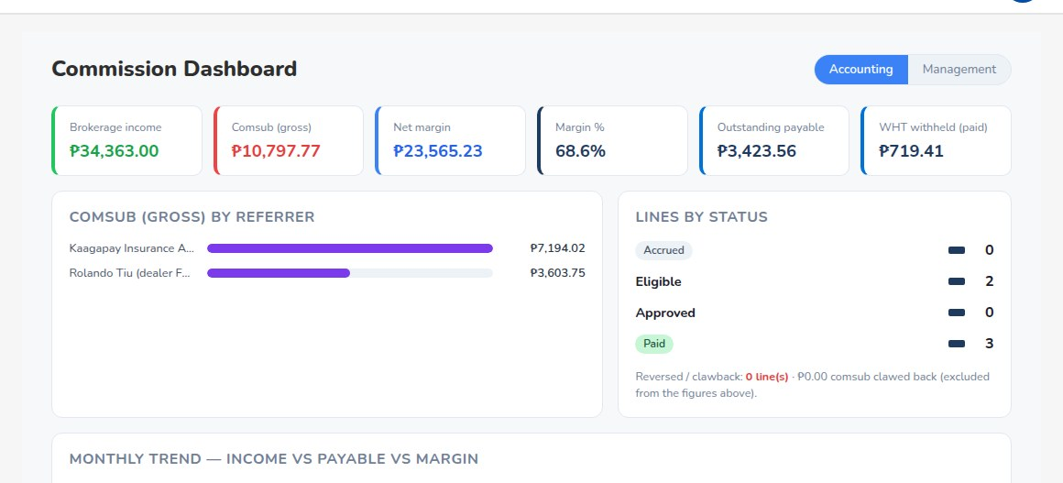
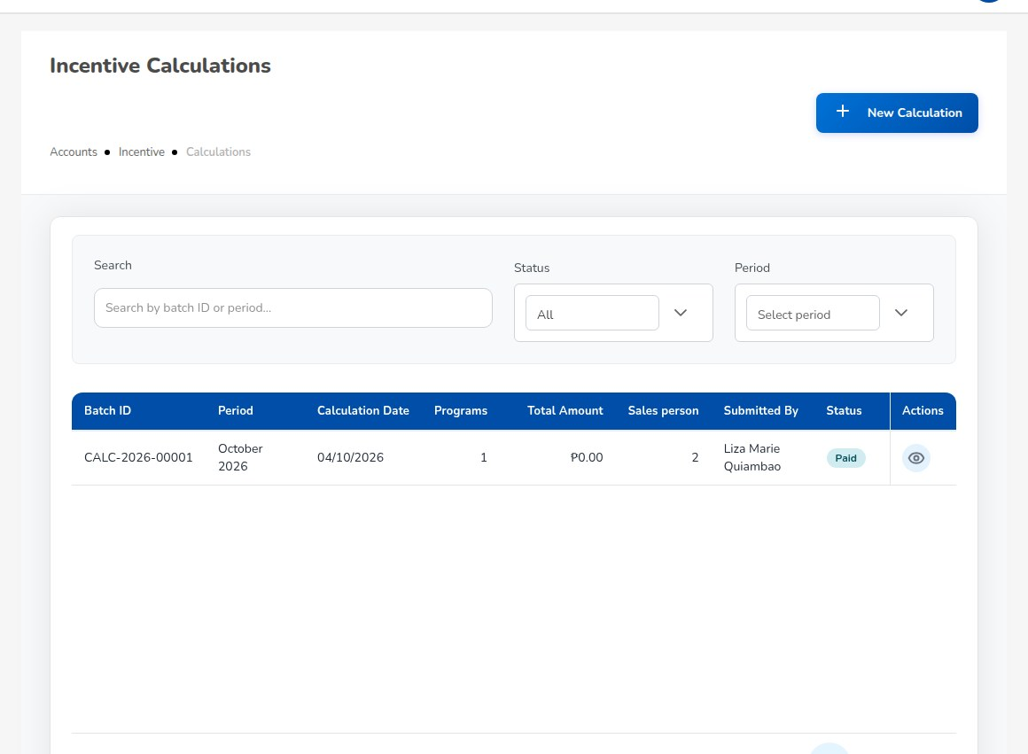
MODULE WALK-THROUGH: MONEY
Commission and incentives
Who
Accounting
Sales & Marketing
Commission Rate Matrix commission rates by insurer and product, with referrer sharing
Commission Dashboard brokerage income, commission to referrers, net margin, outstanding payable, WHT
Referrer payouts payable only when the premium is fully collected and the referrer has a bank account on file
paid by payment voucher less EWT (5% individual, 10% corporate), approved by a second user
Referrers do not sign in Sales & Marketing enter their business; they are paid from the referrer master
Incentive programmes premium volume, policy count, renewal rate or conversion targets for account executives
Accounting calculates, a second Accounting user approves; Accounting cannot change the programmes it pays
Commission > Commission Dashboard
Outputs Broker Commission Statement, Incentive Results, BIR Form 2307 for payees
Accounts > Incentive > Calculations
iNXT BrokerVerse | Client presentation
13
Notes:
Commission is the broker's revenue, so show it as a dashboard first: income, what goes to referrers, the margin.
Two rules prevent the most common leak: referrer commission becomes payable only when the premium is fully collected,
and only to a referrer with a bank account on file. Payouts are net of expanded withholding tax and need a second user.
Question: how many referrers or sub-agents do you pay, and how often.

Slide 14
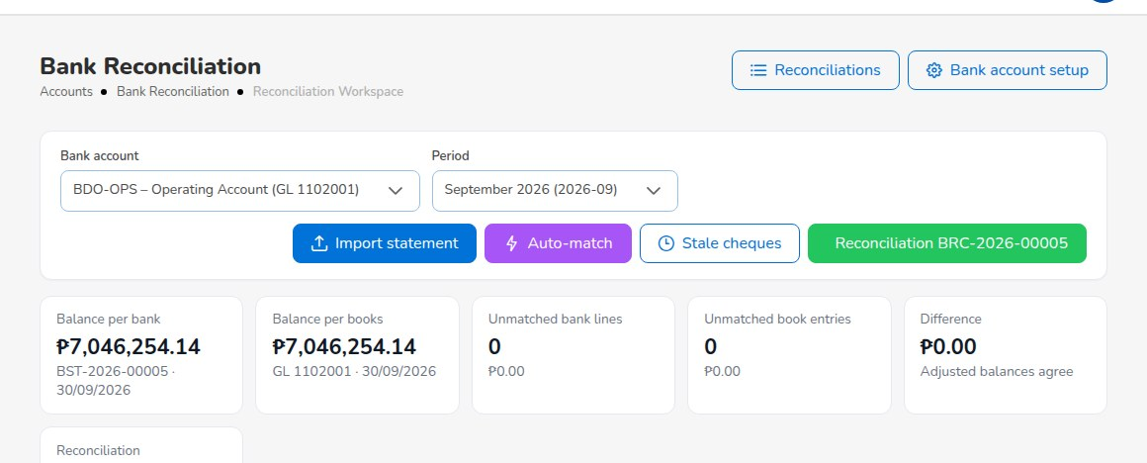
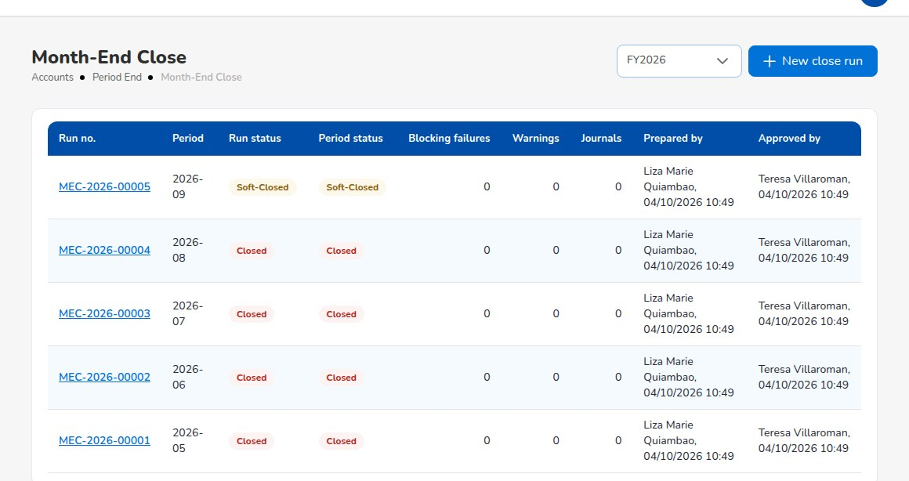
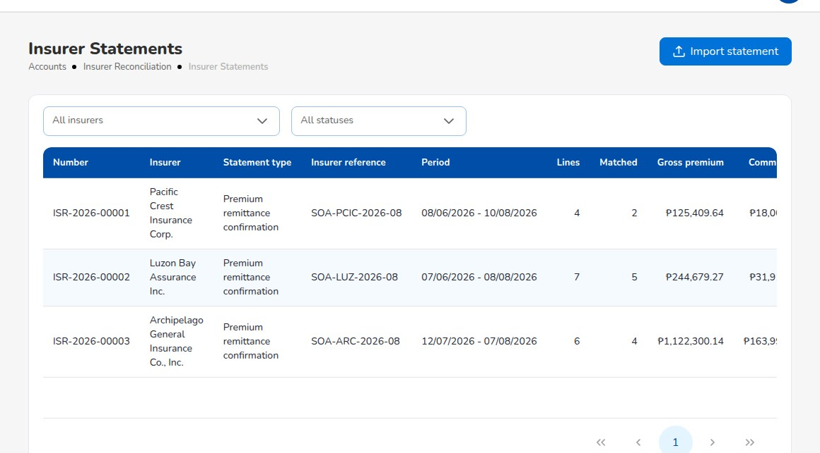
MODULE WALK-THROUGH: FINANCE
Accounting, period end and reconciliation
Posting rules and account determination each business event posts by its rule; changes approved in Configuration Approvals
Journals journal vouchers, correction and reversal JVs, recurring journals, all with maker-checker
Month-End Close one run per period: accruals, recurring journals, commission deferral, FX revaluation, then the close checklist
Period control soft close, close and lock; postings into a soft-closed period only by the Accounting Manager
Year-End Close income and expense to retained earnings in adjustment period 13; financial statements
Bank Reconciliation statement import (BDO, BPI, Metrobank, generic formats), auto-match, bank items, stale cheques
Insurer Reconciliation insurer statements of account imported and matched to the broker's remittances
Go-live balances opening trial balance and open items imported with templates
Accounts > Bank Reconciliation > Reconciliation Workspace
Period End > Month-End Close
Insurer Reconciliation
iNXT BrokerVerse | Client presentation
14
Notes:
For a finance audience this is the most important slide. The general ledger is inside the platform: each business event
(policy issued, receipt applied, remittance, direct-bill commission) posts through a posting rule that the broker can
read and simulate, and a change to a rule needs a second user's approval before it reaches the ledger.
Month-end close is one run per period with fixed steps and a checklist; the Accounting Manager approves it.
Bank reconciliation imports the bank file, auto-matches, and is prepared by Accounting and approved by the Accounting
Manager. Insurer statements are imported and matched against the remittances.
Question: how many days does your month-end close take today, and how many bank accounts do you reconcile.

Slide 15
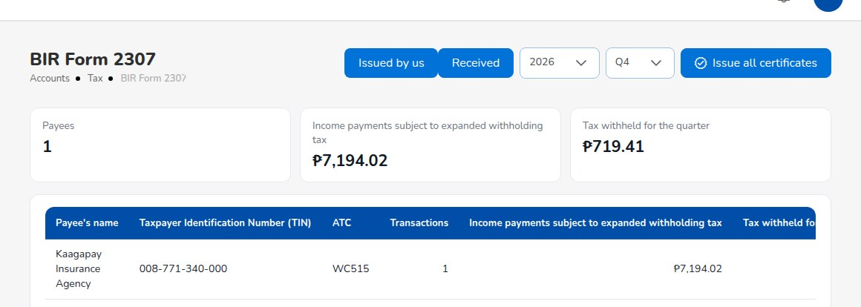
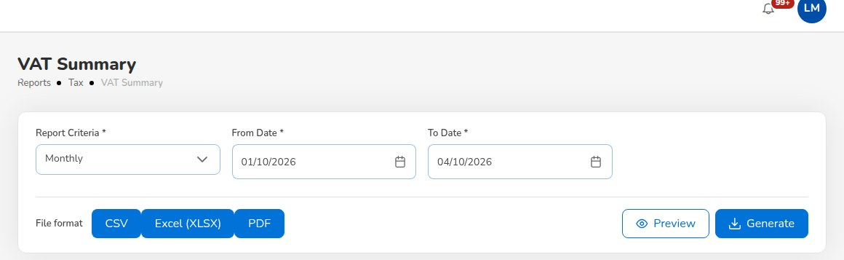
MODULE WALK-THROUGH: COMPLIANCE
BIR tax working papers
BIR return or attachment | Report in iNXT BrokerVerse | Period
2550M / 2550Q VAT return | VAT Summary | Month or quarter
SLSP | SLSP Sales, SLSP Purchases | Quarter
1601-EQ with QAP | QAP | Quarter
Income tax return with SAWT | SAWT | Quarter
Form 2307 to payees | BIR Form 2307, Issued by us | Quarter
Form 2307 from insurers, clients | BIR Form 2307, Received | Quarter
Accounts > Tax > BIR Form 2307
Premium taxes VAT, documentary stamp tax, local government tax per city or municipality and fire service tax, set per line
Tax codes with ATC Master > Finance > Taxation
Withholding EWT on commission paid to referrers; 10% withheld by insurers on direct-bill commission
Output every report as Excel, CSV or PDF on the company letterhead
Accounts > Tax > VAT Summary
iNXT BrokerVerse | Client presentation
15
Notes:
The tax outputs are built from the same ledger lines and vouchers, so the working papers agree with the books.
Form 2307 works both ways: certificates the broker issues to its payees, and certificates received from insurers and
clients, which feed the SAWT.
Filing deadlines are the BIR's, not settings of the system; the broker's tax adviser confirms them.
Question: who prepares your BIR returns today, in-house or an external accountant.

Slide 16
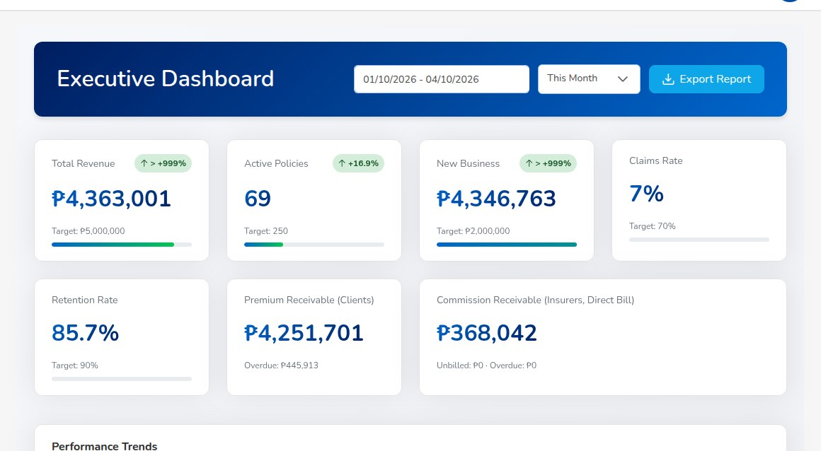
MODULE WALK-THROUGH: MANAGEMENT INFORMATION
Reports and dashboards
Catalogue reports, plus the Report Builder
Production and placement
Production Register, Premium by Product / Month / Insurer, New Business vs Renewals, Lead Conversion Funnel, Placement Pipeline, Market Response, Co-insurance Register, Cession Register
Claims and renewals
Claims Position, Claims Ageing, Renewal Retention
Insurers and commission
Remittance Summary, Broker Commission Statement, Commission Receivable (Direct Bill), Due to Insurers by Co-insurer, Aged Payables to Insurers, Incentive Results
Dashboard > Executive Dashboard
Receivables and cash
SOA / Premium Receivable, Receivables Ageing, Collection Report, Receipts Register, Payables / Disbursement Register
Dashboards
Executive, Sales, Processing, Claims and Commission dashboards, plus the collections, renewal, remittance, reinsurance and product analytics screens. Figures are live and filtered by period.
Ledger and period end
Journal Register, Trial Balance, Trial Balance Movement, General Ledger Detail, Income Statement, Balance Sheet, Month-End Close Status
BIR tax and bank
Every report Preview on screen with totals, then Excel, CSV or PDF on the letterhead. Access by role. The Production Register, Collection Report and Claims Position are generated every morning.
VAT Summary, SAWT, QAP, SLSP Sales and Purchases; Bank Reconciliation Statement, Outstanding Cheques, Deposits in Transit, Unmatched Bank Lines, Bank Book
iNXT BrokerVerse | Client presentation
16
Notes:
The catalogue reports in seven groups, each with a preview on screen and a download as Excel, CSV or PDF with the
letterhead. Users see only the reports their role allows.
Dashboards read live figures: they change as soon as a transaction is saved. The Executive Dashboard compares the
key figures with targets set in configuration.
Question: which management reports does your board or principal ask for every month. Note any that are not in the list
for the workshop.

Slide 17
MODULE WALK-THROUGH: WHAT THIS RELEASE ADDS
Compliance, connections and your brand
AML/CFT toolkit
IC and NPC registers
BIR and EOPT
Client onboarding, risk rating and EDD, list screening, covered and suspicious transaction alerts, cases and AMLC report files; a Compliance Officer role
Licence register with the commission hold, fit and proper, insurer certificate check, complaints register (RA 11765), IC working papers, breach register on the 72-hour clock
0619-E, 1601-EQ, 1604-E and 2551Q reconciled to the ledger, DAT files, EOPT sales invoices, EIS connector, CAS books pack, overriding commission from insurers
Integrations
Distribution
Your brand, your day
SMS and Viber, CTPL authentication and COC series, LTO feed, insurer APIs, bank payment files; one outbox with retries; delivered in test mode
Lead assignment, channels, dealer programmes with bank letters, fleets, marine open covers, facultative placements, comparison reports, campaigns
Theme, logo and sign-in page; branded documents and e-mails; e-signatures; My Work for each person; Report Builder and BI extract
iNXT BrokerVerse | Client presentation
17
Notes:
Six areas that a Philippine broker asks about since this release. Each has an optional segment in the Demo Script.
Keep the honest line for each: the compliance officer confirms the AML thresholds and the AMLC file codes; the
accountant confirms the IC working papers; the tax adviser confirms ATCs, invoice wording and VAT treatment; each
partner (SMS gateway, CTPL provider, insurer, bank, BIR EIS) accepts its side of the connection during onboarding.
The IC and NPC registers come with the compliance package of this release.

Slide 18
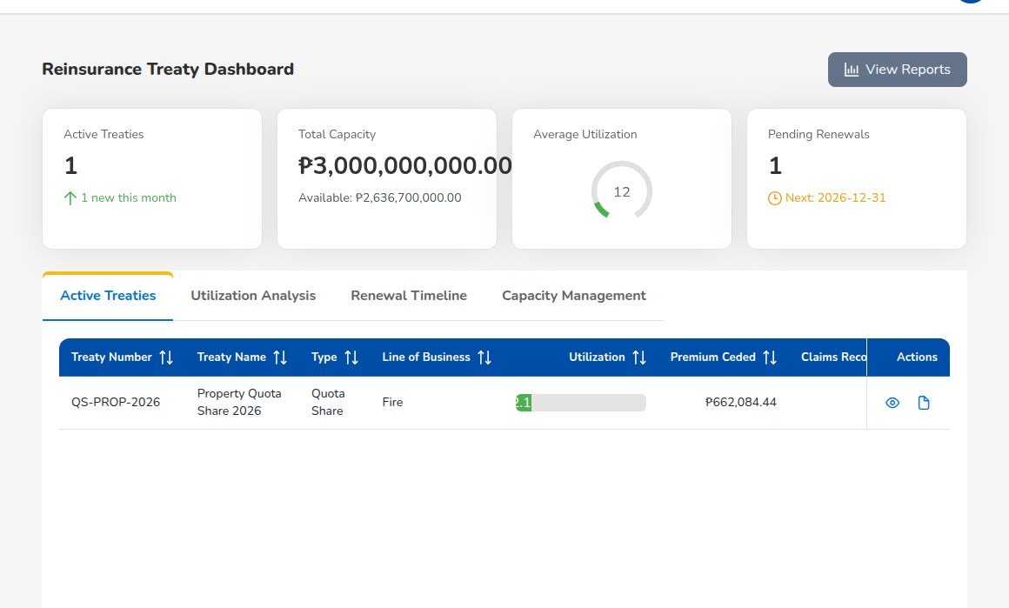
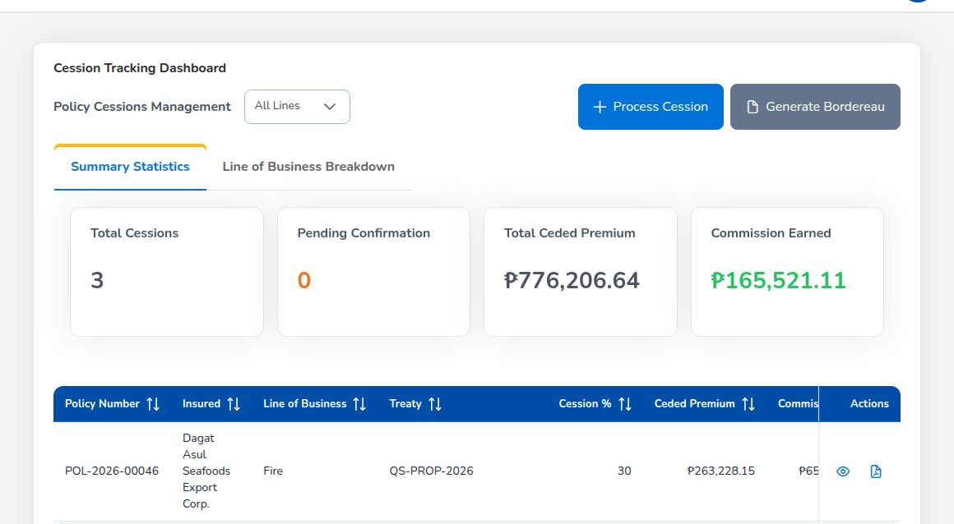
MODULE WALK-THROUGH: SPECIALTY
Reinsurance
Who
Processing Team
Claims
Accounting
Treaty master quota share, surplus, excess of loss and stop loss; reinsurers, shares and period
a new or changed treaty needs a second user's approval; reinsurers rated A- or better
Treaty Dashboard active treaties, capacity, utilisation, premium ceded and claims recovered
Cession Tracking policies ceded per treaty with cession %, ceded premium and commission; bordereau
Claims Recovery amounts recoverable under treaties; register the recovery
Reconciliation our figures against the reinsurer's statement; variances above 1% flagged for review
Posting confirmed cessions and settled recoveries post through their posting rules
Reinsurance > Treaty Dashboard
Outputs Reinsurance Cession Register, bordereaux (CSV), reinsurance analytics
Reinsurance > Cession Tracking
iNXT BrokerVerse | Client presentation
18
Notes:
Relevant mainly to insurance and reinsurance brokers. If the prospect does not place reinsurance, spend 30 seconds here
and move on.
For a reinsurance broker: treaties are approved by a second user, cessions are tracked per policy, recoveries are
registered against claims, and the reinsurer's statement is reconciled with a 1% variance threshold.

Slide 19
GOVERNANCE
Controls built in: maker-checker and signing authority
Transaction | Maker | Checker
Quotation approval | Quotation creator | Another user
Renewal terms | Operations, Sales | Processing Team
Claim settlement | Claims user | Another Claims user
Journal voucher | Accounting | Another Accounting user
Payment voucher, cheque, commission payout | Accounting | Another Accounting user
Remittance, settlement, adjustment | Accounting | Another user, level by amount
Direct-bill debit note | Accounting | Another Accounting user
Month-end and year-end close | Accounting | Accounting Manager
Bank and insurer reconciliation | Accounting | Accounting Manager
Posting rule, account determination | Accounting, Admin | Second approver
Reinsurance treaty, incentive batch | Creator | Another user
Authority Matrix
approval limits in PHP per transaction type and role or user; a new limit needs a second administrator
Delegations
time-bound, revocable delegation of approval authority for leave or travel
Segregation of Duties
rules on pairs of roles checked at assignment: block or warn
Access Reviews
recertification of every active user; revoke signs the user out
Period control
no posting into closed or locked periods
iNXT BrokerVerse | Client presentation
19
Notes:
This slide is for the compliance officer, the internal auditor and the CFO.
Maker-checker: the person who enters a transaction cannot approve it, and the system refuses if they try.
The Authority Matrix sets approval limits per transaction type and per role or user, in PHP; a new limit takes effect
only after another administrator approves it. Replace the seeded defaults with the board-approved signing authority.
Segregation of duties is checked when roles are assigned: the seeded rules block placement with payment and claims
with payment, and warn on sales with collection.
Question: who signs payments today, and up to what amount.

Slide 20
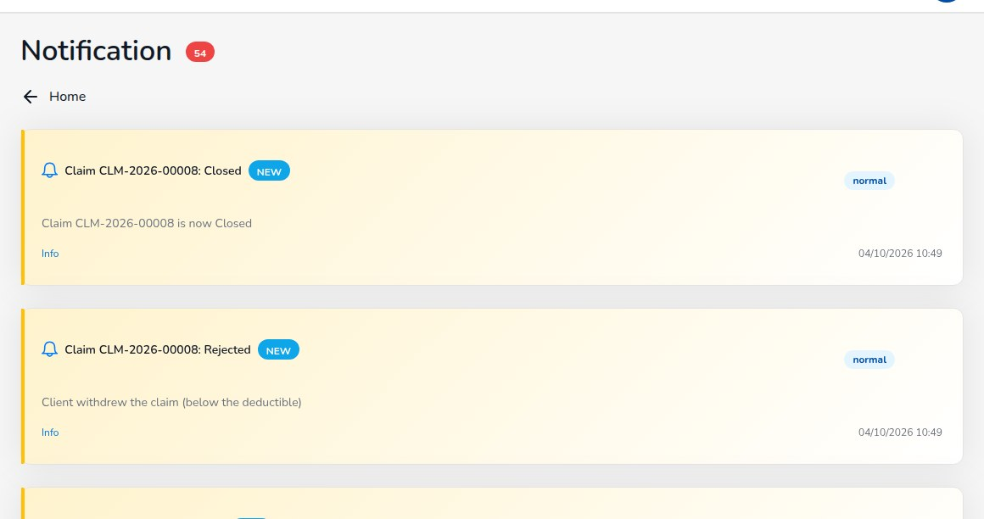
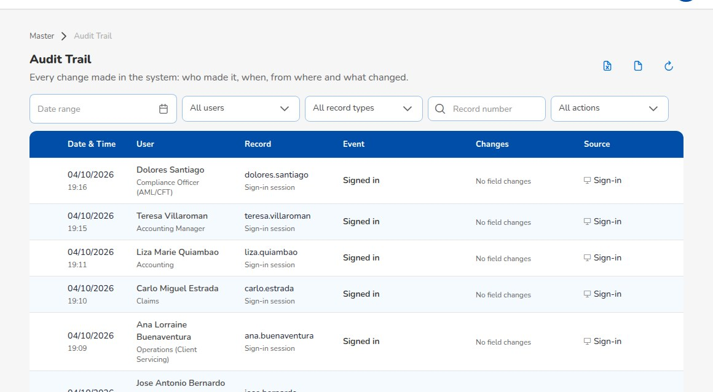
GOVERNANCE
Approval notifications and audit trail
1 Maker submits
2 Approvers notified
3 Checker decides
4 Maker told
payment voucher, JV, remittance, close run, rule change ...
bell notification to every user who can approve
approve or reject with a reason; never the maker
approved and in effect, or rejected with the reason
New in this release: every maker-checker flow
One switch: notification.approval_requests (on in the delivered set-up)
Audit Trail user, record, action, before and after values, IP and time
Sign-in history every attempt with result and reason
E-mail Outbox every e-mail queued and sent, with attachments
User Access Matrix roles, status, last sign-in, two-factor, downloadable
Notification page: requests and decisions
Master > Audit Trail
iNXT BrokerVerse | Client presentation
20
Notes:
New in this release: every maker-checker flow now notifies the people who can approve, and tells the maker the
decision, with the reason when rejected. That covers payment vouchers and cheques, journal vouchers including bank and
year-end adjustments, posting rule and account determination changes, authority limits and access reviews, commission
payouts, insurer and bank reconciliations, month-end close, warranty extensions, remittance settlements, adjustments
and transfers, treaty changes and captured premium payments.
One setting switches all approval notifications on or off. A notification that cannot be created is logged and never
blocks the transaction.
The Audit Trail records who changed what, with the values before and after, for every create, update, approval and
sign-in.

Slide 21
DATA PRIVACY ACT OF 2012 (RA 10173)
Data privacy and security
Data privacy: new in this release
Security
Consent
per purpose: processing, marketing, sharing with insurers; channel, notice version, evidence; withdrawals kept in the history
Named users only no shared or referrer sign-in
Passwords 8+ characters, mixed case, digit and symbol, history of 5, 90-day age; lockout after 5 tries
Two-factor TOTP authenticator app, compulsory per role when set
Sessions 30-minute access token, idle sign-out, sessions ended on password or role change
Permissions checked by the server on every request, not only hidden in the menu
Encryption TLS in transit; storage encryption of database, files and backups recommended on every option
Application controls mapped to the OWASP Top 10; signed, expiring file links
Breach support facts from logs and audit data so the DPO can notify within 72 hours
Consent Register
consents given, refused and withdrawn across clients and prospects
Data Subject Requests
access, rectification, erasure or blocking, objection, portability, withdrawal of consent; numbered, due date, assignee
Export personal data
everything held about a client or prospect, as JSON or Excel, noted on the request
Anonymise
personal fields overwritten in the party, its policies, quotations, claims and slips; refused while records must be kept
A data subject request in the system
Logged
DSR- number
Assigned
notified
Export, correct
or anonymise
Closed
with outcome
Overdue requests reminded daily. Retention years, due days and notice version are settings for the broker's DPO.
iNXT BrokerVerse | Client presentation
21
Notes:
New in this release, the data privacy functions under Master > Data Privacy:
Consent is recorded per purpose (processing, marketing, sharing with insurers and reinsurers), with the channel, the
privacy notice version and the evidence. A withdrawal is stamped on the record, never deleted, so the history is the
evidence.
Data Subject Requests: access, rectification, erasure or blocking, objection, portability and withdrawal of consent,
numbered DSR-, due a set number of days after receipt (15 calendar days in the delivered set-up, for the DPO to
confirm), assigned with a notification, and a daily job reminds the privacy team of overdue requests.
Export gives the personal data held about a client or prospect as JSON or Excel. Anonymise overwrites the personal data
once the retention period is over; it is refused while there is open business or the records must still be kept.
Amounts, numbers and dates stay for the books.
The broker remains the personal information controller and its DPO decides the purposes, the retention and the breach
notices. iorta TechNXT acts as processor when it hosts or supports.

Slide 22
PERSONA VIEW
Who does what: the eight delivered roles
Role | Daily work in iNXT BrokerVerse | Approves
System Administrator | Users and roles, masters, configuration, document numbering, schedules, data privacy | Authority limits (second admin), configuration
Sales & Marketing | Prospects, quotations, payment capture, referrer business, renewal follow-up | Takes part in incentive programmes
Processing Team | Broker Slips, Placement Slips, policy issue, endorsements, reinsurance, product configurator | Quotations, renewal terms, treaties
Operations | Client servicing, endorsements, renewals, payment capture, data subject requests | -
Claims | Claim registration, follow-up with insurers, settlement, reinsurance recoveries | Settlements of another Claims user
Accounting | Receipts, collections, disbursements, remittance, commission, journals, reconciliation, BIR | Vouchers, JVs, remittances, debit notes, incentives
Accounting Manager | Everything Accounting does, plus period control | Month-end and year-end close, bank and insurer reconciliation, credit control, posting rules
Compliance Officer | AML/CFT: client due diligence, screening, transaction alerts, cases, AMLC report files | EDD reviews, screening decisions, cases for filing
Each role lands on its own dashboard. Roles can be added or adjusted in Master > Generals > User Management, with Role Permissions and the User Access Matrix for review.
iNXT BrokerVerse | Client presentation
22
Notes:
The role model is delivered ready to use. Each user holds a role; the menus and the server permissions follow it.
Referrers and sub-agents do not sign in: Sales & Marketing enter their business and they are paid from the referrer
master. That keeps the user count, and the licence cost, to the broker's own staff.
The System Administrator and Operations roles hold the data privacy permissions in the delivered set-up; the broker
can move them to its DPO's role.
Ask the audience to map their own teams to these roles. The answer drives the user count for the proposal.

Slide 23
DELIVERY
Technology and deployment options
Technology
Deployment options
Web application
AWS
Microsoft Azure
Local partner
On-premise
React 18 single-page application in the browser; no client install
Singapore region
Southeast Asia (Singapore)
Data held in the Philippines
Broker's data centre
API
Node.js 22 with Express; stateless REST API, OpenAPI and Postman collection
ECS Fargate, RDS PostgreSQL Multi-AZ, S3 and CloudFront, WAF
Container Apps, PostgreSQL Flexible Server, Front Door
VMs with a Philippine hosting partner, second site for DR
Broker hosts at no fee; deployment guide and set-up support
Database
PostgreSQL 16, time zone Asia/Manila; file store for documents
Scheduler
built-in jobs in Manila time: expiries, notices, reminders, e-mail, reports
Indicative hosting per month, full environment set (optional, PHP, excl. VAT)
Run as
Tier (named users) | AWS | Azure | Local partner
Small (1 to 25) | 43,000.00 | 46,000.00 | 42,000.00
Medium (26 to 100) | 69,000.00 | 73,000.00 | 67,000.00
Large (101 to 300) | 143,000.00 | 150,000.00 | 135,000.00
Enterprise (above 300) | 256,000.00 | 269,000.00 | 242,000.00
containers (Docker) or Node.js with a process manager
Every option separate Dev, UAT and production environments (and SIT for large brokers), HTTPS, daily backups with point-in-time restore, monitoring, and production with two API instances and a standby database.
Small and medium: Dev, UAT, Production. Large: Dev, SIT, UAT, Production. Temporary Pre-Prod billed per month of use. Self-hosting has no hosting fee.
iNXT BrokerVerse | Client presentation
23
Notes:
The stack is mainstream and portable: a React web application, a Node.js API and PostgreSQL 16. No proprietary
middleware, no per-CPU database licence.
Four hosting options. On AWS and Azure the region is Singapore, which is a cross-border transfer the broker documents
under the Data Privacy Act; AWS has a Manila Local Zone with a limited set of services. A broker that wants the system of
record in the Philippines uses a local partner or its own data centre.
Infrastructure is optional and priced separately; the broker may host itself at no fee, with our deployment guide and
set-up support at day rates. The monthly prices are indicative estimates from public list prices and cover the standing
environment set of the tier: Dev, UAT and Production for small and medium brokers; Dev, SIT, UAT and Production with high
availability for large brokers. A temporary Pre-Prod, restored from a production backup for the go-live rehearsal and
each major release, is billed per month of use. Daily backups, monitoring and patching are included; hosting fees do not
increase yearly. Confirm with the provider before quoting.

Slide 24
DELIVERY
Implementation approach and timeline
Mobilise, discovery and fit-gap
Environments and configuration
Data migration and integrations
Training, system test and UAT
Cutover and go-live
Hypercare to first month-end
Week
1
2
3
4
5
6
7
8
9
10
11
12
13
14
15
16
17
18
19
20
Small
Mobilise to cutover
Hypercare
8 weeks
up to 25 users, 1 office
Medium
Mobilise to cutover
Hypercare
12 weeks
26 to 75 users, up to 3 offices
Large (variant)
Mobilise to cutover
Hypercare
16 weeks
one office cluster, simple mix
Large
Mobilise to cutover
Hypercare
20 weeks
more than 75 users, many insurers
Configure, do not customise
Data drives the timeline
Key users own the result
Evidence for every acceptance
masters, settings and templates; gaps go to a register
data requests in week 1; templates for every load
one key user per team tests, signs and trains
written sign-off at the end of each phase
iNXT BrokerVerse | Client presentation
24
Notes:
Configure, do not customise: the broker is fitted to the product through masters and settings, not code changes.
A requirement that configuration cannot meet goes into the fit-gap register and becomes a change request only if the
steering committee approves it; it does not move the go-live by default.
Data drives the timeline. The data requests go out in week 1: insurer agreements, commission rates, chart of accounts,
in-force policies, open receivables and the trial balance. Every load uses the delivered upload templates and is
rehearsed before cutover.
The size is agreed at mobilisation: small 8 weeks, medium 12 weeks, large 16 to 20 weeks to hypercare exit. Hypercare
always covers the first month-end close.

Slide 25
AFTER GO-LIVE
Support model
L1
Broker key users and System Administrator
Severity levels and targets (standard proposal)
How-to, users and roles, password and two-factor resets, settings, master data, ticket with evidence
Severity | First response | Restore or workaround | Update
P1 Critical | 30 minutes | 4 service hours | Every hour
P2 High | 2 service hours | 2 business days | Every 4 hours
P3 Medium | 1 business day | 5 business days | Every 3 days
P4 Low | 2 business days | Planned | Weekly
L2
iorta TechNXT application support
Triage, reproduction, configuration and data corrections under change control, workarounds, known errors
L3
iorta TechNXT engineering
Code defects, performance, infrastructure, security incidents, root cause, fixes and releases
P1 examples nobody can sign in, official receipts cannot be issued, journals post wrong amounts
One service desk support portal or mailbox for all tickets, telephone for P1
Monthly service report tickets, targets met, problems, releases, backups and DR drills
Releases tested in UAT with a regression run before production
Covered by AMC or subscription corrections, OOTB updates, regulatory form updates, standard support
Service hours
Standard 8:00 to 18:00 Manila time, Monday to Friday, except Philippine regular holidays
Optional 24x7 for Severity 1, reported by telephone
Maintenance window agreed with the broker; default Saturday 20:00 to Sunday 06:00
iNXT BrokerVerse | Client presentation
25
Notes:
Three levels. The broker's key users and System Administrator are the first line: how-to questions, user and password
resets, settings and master data. iorta TechNXT application support is L2: triage, reproduction, configuration and data
corrections under change control. iorta TechNXT engineering is L3: code defects, performance, infrastructure,
security incidents and releases.
Standard hours are 8:00 to 18:00 Manila time, Monday to Friday, except Philippine regular holidays. 24x7 cover for
Severity 1 is an option. The targets shown are our standard proposal; the support agreement fixes the final values.
AMC or the subscription covers corrections, product updates, regulatory form updates released for all customers and
standard support.

Slide 26
COMMERCIALS
Commercial models
Model A: perpetual licence with AMC
Model B: subscription
One-time licence per named user, payable on go-live
Per named user per month, billed monthly in advance
Tier | Licence per user | Implementation, reference
Small (1 to 25) | PHP 90,000.00 | PHP 1,130,000.00 (5 lines)
Medium (26 to 100) | PHP 78,000.00 | PHP 2,090,000.00 (8 lines)
Large (101 to 300) | PHP 66,000.00 | PHP 3,700,000.00 (12 lines)
Enterprise (above 300) | PHP 54,000.00 | PHP 5,800,000.00 (16 lines)
Tier | Per user per month | Minimum billable users
Small (1 to 25) | PHP 3,200.00 | 10
Medium (26 to 100) | PHP 2,800.00 | 26
Large (101 to 300) | PHP 2,400.00 | 101
Enterprise (above 300) | PHP 2,000.00 | 301
AMC 22% of the licence fee a year, from Year 2 (12-month warranty)
AMC increases 5% each year
Lowest cost over five years: 13% to 18% below subscription
Increases 5% at each contract anniversary
Onboarding fee equal to the implementation fee
Lower Year 1 cash; break-even with perpetual in Year 4
Implementation
Infrastructure
Change requests
Base man-days by tier plus 6 per extra line of business, at PHP 16,100.00 a day. Payable 40% signing, 40% UAT sign-off, 20% go-live.
Optional and quoted separately: AWS, Azure or local partner. Self-hosting has no fee.
Day rates: BA PHP 18,000.00, developer PHP 16,000.00, QA PHP 12,000.00, PM PHP 22,000.00. Example: 5 days, PHP 81,050.00.
iNXT BrokerVerse | Client presentation
26
Notes:
Two models, same product. Prices are per named user, in PHP, excluding 12% VAT, on graduated slabs: the first 25 users
at the Small rate, users 26 to 100 at the Medium rate, and so on, so the price never drops when a broker crosses a
tier and the effective price per user falls as it grows.
Perpetual: one-time licence on go-live, AMC at 22% of the licence fee a year from Year 2 after a 12-month warranty,
increasing 5% a year.
Subscription: monthly in advance, increasing 5% at each anniversary, with a minimum number of billable users; the
onboarding fee equals the implementation fee because the set-up work is the same.
Implementation is calculated from base man-days per tier plus 6 man-days per extra line of business, at the blended
day rate of PHP 16,100.00. Quotations are valid 90 days. The pricing workbook governs where figures differ.

Slide 27
COMMERCIALS
Indicative investment for reference brokers
Reference broker | Perpetual, 5 years | Subscription, 5 years | Break-even
Small: 15 users, 5 lines | PHP 3,760,107.00 | PHP 4,312,764.00 | Year 4
Medium: 60 users, 8 lines | PHP 11,792,173.00 | PHP 13,892,748.00 | Year 4
Large: 180 users, 12 lines | PHP 29,767,284.00 | PHP 35,660,251.00 | Year 4
Enterprise: 400 users, 16 lines | PHP 57,817,674.00 | PHP 70,118,348.00 | Year 4
Our recommendation
Small and Medium brokers
Subscription: lower Year 1 cash, no capital approval, about 2% of commission income.
Large and Enterprise brokers
Perpetual: 13% to 18% lower cost over five years for the reference user counts.
Year 1 subscription as a share of estimated commission income
Small
2.3%
Every broker
Medium
1.8%
Infrastructure quoted separately, with self-hosting always shown, so the software price stays comparable.
Large
1.2%
Your figures
Enterprise
0.8%
We run the pricing workbook with your user count and lines of business for the proposal.
Prices in PHP, excluding 12% VAT. Totals include implementation or onboarding and exclude hosting and optional services. Valid 90 days. Income per tier is an estimate.
iNXT BrokerVerse | Client presentation
27
Notes:
These are the reference user counts from the pricing workbook, including implementation or onboarding, excluding VAT
and optional items. They show the shape of the decision rather than a quotation for this prospect.
Our recommendation: subscription for Small and Medium brokers, for lower Year 1 cash and no capital approval;
perpetual for Large and Enterprise brokers, or any broker planning four years or more ahead.
At the recommended prices the Year 1 subscription is about 2.3% of estimated commission income for a Small broker and
0.8% for an Enterprise broker, within the 3% to 7% of revenue that insurers and brokers typically spend on IT.
The income figures per tier are estimates mapped to the IC ranking.
Close the slide by offering to run the workbook with the prospect's own user count and lines of business.

Slide 28
THE CASE
Why iorta TechNXT and iNXT BrokerVerse
1
Built for the Philippines
2
One system, one ledger
3
Controls in the product
Premium taxes by city, BIR returns and DAT files, EOPT invoices, AML/CFT and AMLC reports, IC registers, CTPL authentication, local bank files, Data Privacy Act functions
Prospect, placement, policy, claims and renewals in the same system as billing, remittance, commission, the general ledger and the month-end close
Maker-checker on money and configuration, Authority Matrix, segregation of duties, access reviews, approval notifications, audit trail
4
Predictable delivery
5
Open pricing
6
Ready to hand over
Configure, do not customise; 8, 12 or 16 to 20 weeks; written acceptance per phase; hypercare through the first month-end close
Published per-user prices on graduated slabs, perpetual or subscription, AMC terms and day rates for change requests
497 test cases for release 1.0; user manual with in-screen help and role guides; go-live data workbench; reports book, support runbooks and data dictionary
iNXT BrokerVerse | Client presentation
28
Notes:
Summarise in four points and stop. Each point can be proven in the demo.
1. Built for Philippine non-life broking: taxes, BIR, LGU rates, local banks, local payment gateways, Data Privacy Act.
2. One system: the front office, the money and the books, so there is nothing to reconcile between systems.
3. Controls the auditor expects, already in the product.
4. A predictable project and price: configure-not-customise, 8 to 20 weeks, published prices and day rates.
Evidence to quote: 497 test cases prepared for this release, 480 passed, with the remaining items tracked in the defect
register; a user manual opened per screen with F1 and role guides; the go-live data workbench with its workbooks and the
upload templates.

Slide 29
PROPOSED PATH TO A DECISION
Next steps
1
Demo
2
Discovery workshop
3
Proposal
4
Contract and kick-off
Your team sees its own day in the system: 60 or 30 minutes on the UAT data set
Users, lines of business, insurers, volumes, hosting, integrations, data sources
Commercials from the pricing workbook, implementation plan, hosting option
Licence or subscription, data processing and support agreements; mobilisation
Week 1 [to confirm]
Week 2 to 3 [to confirm]
Within 5 working days of the workshop [to confirm]
On signing
What we ask from you for the demo and workshop
Contact
Two or three recent policies, one claim and one remittance to use as examples
The teams and number of users per team
Lines of business and insurers you place with
[Account manager name], iorta TechNXT
[Mobile number] | [E-mail address]
[Website]
iNXT BrokerVerse | Client presentation
29
Notes:
Agree the next step before the meeting ends, with a date and owner for each.
Demo: 60 minutes for the full team or 30 minutes for management, run on the UAT data set, with the prospect's own
examples where they send them in advance.
Workshop: half a day with the process owners to confirm users, lines of business, insurers, volumes, hosting and
integrations. Its output sizes the implementation.
Proposal: commercials from the pricing workbook with the agreed user count and lines, valid 90 days.
Contract: licence or subscription agreement, data processing agreement, support agreement; then the kick-off.
Durations in weeks are planning assumptions [to confirm with the account manager].

