Slide 1

THIS GUIDE IS FOR
Business Administrator
BrokerVerse — Business Administrator guide
SIGN-IN
bea.admin
ROLE CODE
Out-of-the-box functions, flows, reports and schedules
ba
BDO Insure (BDOI) insurance broking · Philippines · PHP
LANDS ON
Home (business overview dashboard)
Products and rates
Masters
All business menus
Prepared by iorta TechNXT · September 2026

Slide 2
WHO YOU ARE IN BROKERVERSE
Role at a glance
What you do
Sign-in and landing page
User name bea.admin. Lands on Home, the business overview dashboard.
Designs products: templates, coverages, rating factors, underwriting rules and documents.
Keeps masters right: insurers, lines of business, products, covers, signatories, vehicles, locations.
Sets commercial terms: commission masters, incentive programmes and reinsurance treaties.
Oversees the business: every operational and financial menu, dashboards and all 18 reports.
Approves changes: product approval workflows and treaty approvals.
You hand work to
Sales, agents and underwriters use your products and rates; Finance uses your commission, tax and remittance masters; IT administrator owns users and system settings.
Maker-checker partners
Treaties and incentive batches need approval by a second person; you cannot approve your own finance vouchers, claims settlements or renewals.
BrokerVerse | Business Administrator
2

Slide 3
WHAT YOU SEE AFTER SIGN-IN
Menu map
The ba role has every menu (all: true); use it for business configuration, not user administration.
Dashboard
Product Configurator
Master
Operations
Executive Dashboard
Claims Dashboard
Underwriting Dashboard
Agent Dashboard
Dashboard
Product Templates
Coverage Builder
Rating Engine
Underwriting Rules
Document Manager
Approval Workflows
Market / Risk Mapping
Product Analytics
System Settings, Configuration, Schedules, Audit Trail
Generals: Organization, Insurance Mgmt, Location, Commission, Employee Mgmt, User Mgmt
Finance: account setups, transaction codes, currency, FX, bank, accounts, taxation, petty cash, remittance
Incentive Programs
Reinsurance Treaty
Home
Leads/Prospects
Clients
Quotation
Policy
Claims
Renewals: Renewal Policy, Batch, Queue, Retention Analytics, At-Risk, Negotiations, Lapse Mgmt, Performance
Open Items
Payments
Accounts
Commission
Reinsurance
Reports
Receipts, Collections
Accounting Query, All Clients Accounting
Open Entry Matching / Un-Matching
Disbursement
Petty Cash (5 screens)
Journal, Correction and Reversal JV
Remittance (17 screens)
Incentive (4 screens)
Commission Dashboard
Agents/Referrer Accounts
Treaty Dashboard
Cession Tracking
Claims Recovery
Reconciliation
Analytics
Operational: Production, Claims, Renewal, Remittance, Broker Commission
Financial: SOA / Premium Receivable, Collection, Payables, Journal, Trial Balance
BrokerVerse | Business Administrator
3

Slide 4
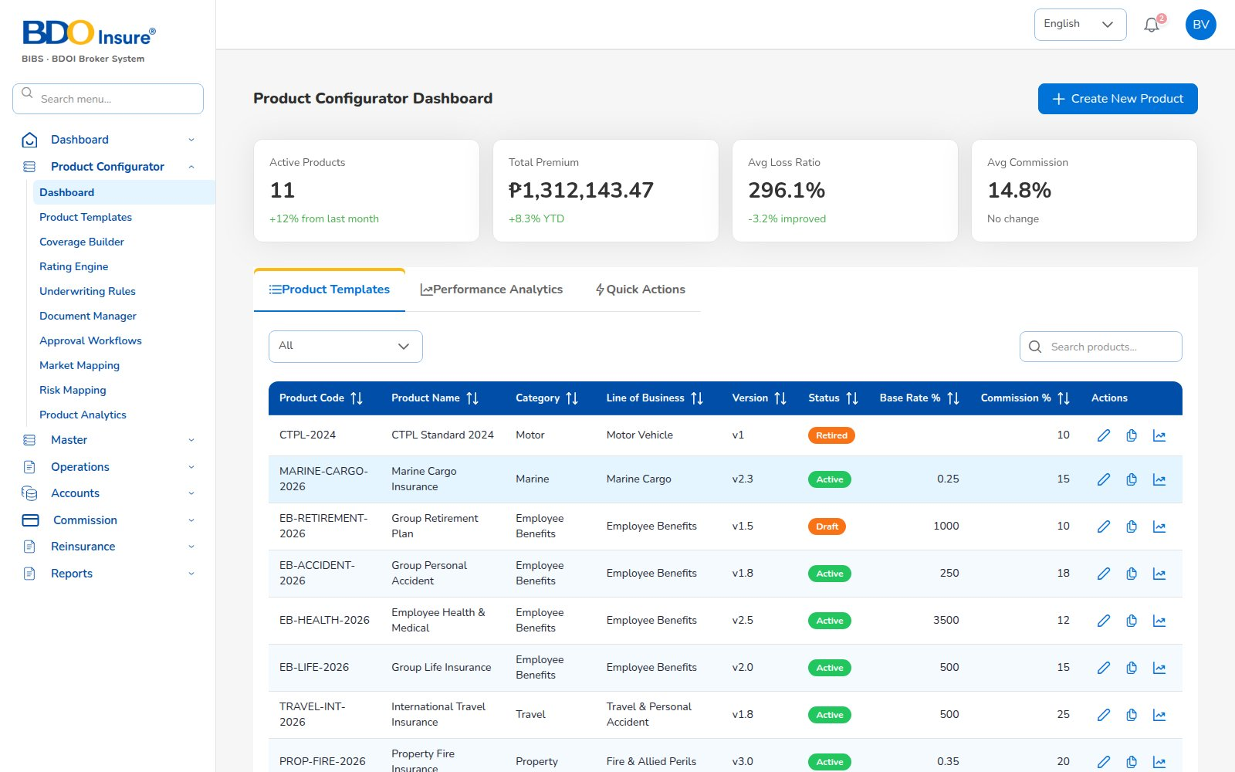
KEY FUNCTION 1 OF 8
Product Configurator dashboard
Product Configurator > Dashboard
Purpose: active products, total premium, average base rate and commission at a glance.
Actions: Create New Product, open templates, analytics and quick actions.
Status: draft, active or archived per product version.
Downstream: active products appear in the quotation wizard.
Live screen — Product Configurator > Dashboard — signed in as bea.admin
BrokerVerse | Business Administrator
4

Slide 5
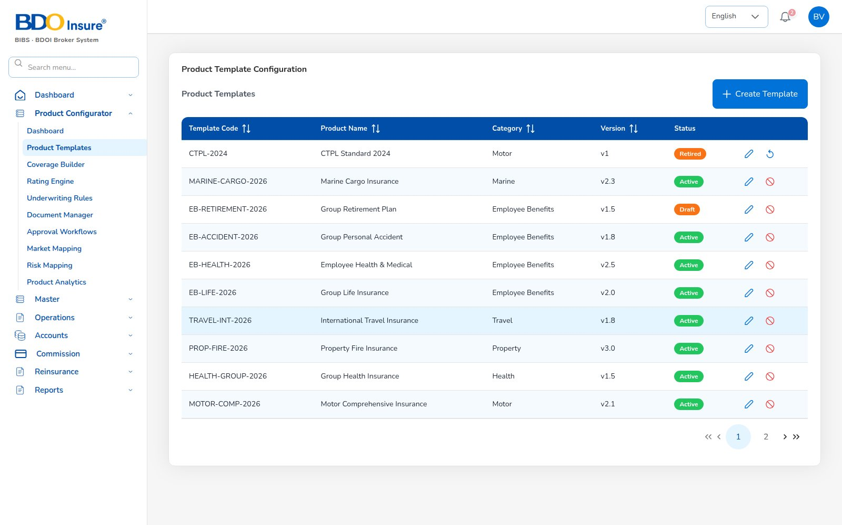
KEY FUNCTION 2 OF 8
Product templates
Product Configurator > Product Templates
Purpose: one template per product: motor, property, travel, group health, marine…
Versioning: each change is a new version; only active versions can be quoted.
Links: coverages, rating factors, rules and documents attach to the template.
Approval: approval workflows control publishing.
Live screen — Product Configurator > Product Templates — signed in as bea.admin
BrokerVerse | Business Administrator
5

Slide 6
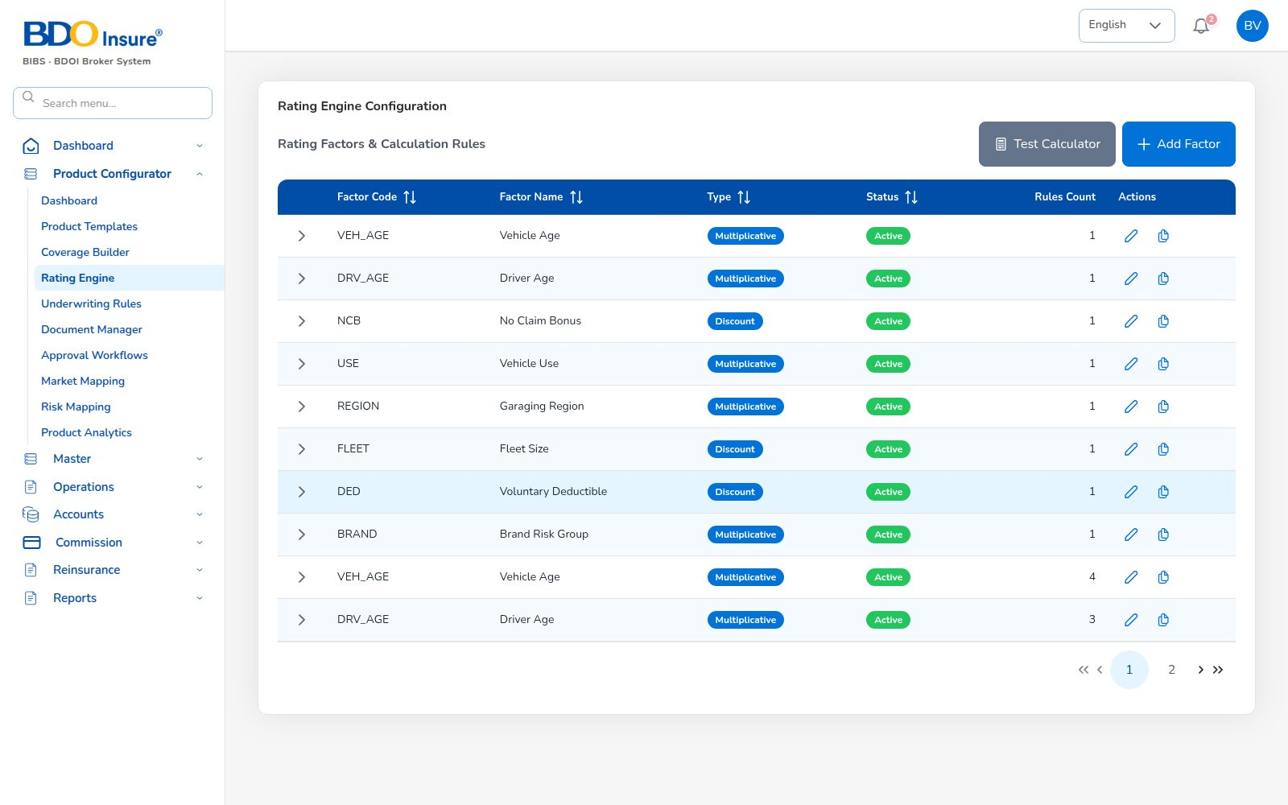
KEY FUNCTION 3 OF 8
Rating engine
Product Configurator > Rating Engine
Purpose: rating factors (vehicle age, driver age, no-claims bonus, region, fleet…).
Types: multiplier or discount, with rules per band.
Test Calculation: try a premium before activating.
Downstream: the server re-prices every quote with these rates and the configured taxes.
Live screen — Product Configurator > Rating Engine — signed in as bea.admin
BrokerVerse | Business Administrator
6

Slide 7
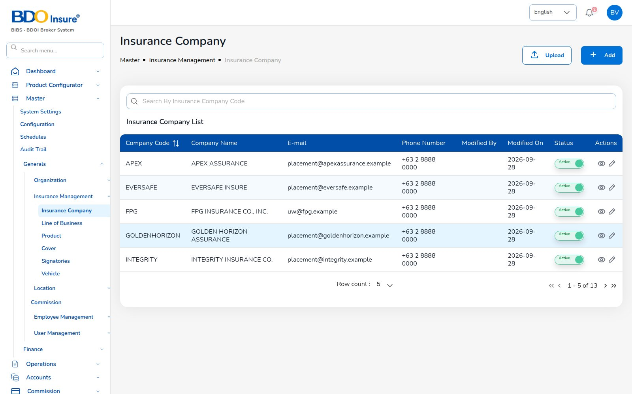
KEY FUNCTION 4 OF 8
Insurance company master
Master > Generals > Insurance Management
Purpose: insurers you place business with: code, name, placement e-mail, phone.
Upload: bulk upload or add one at a time; status switch deactivates.
Downstream: quotes, policies, remittances and statements are per insurer.
Tip: keep the placement e-mail current: claims and endorsements are sent there.
Live screen — Master > Insurance Company — signed in as bea.admin
BrokerVerse | Business Administrator
7

Slide 8
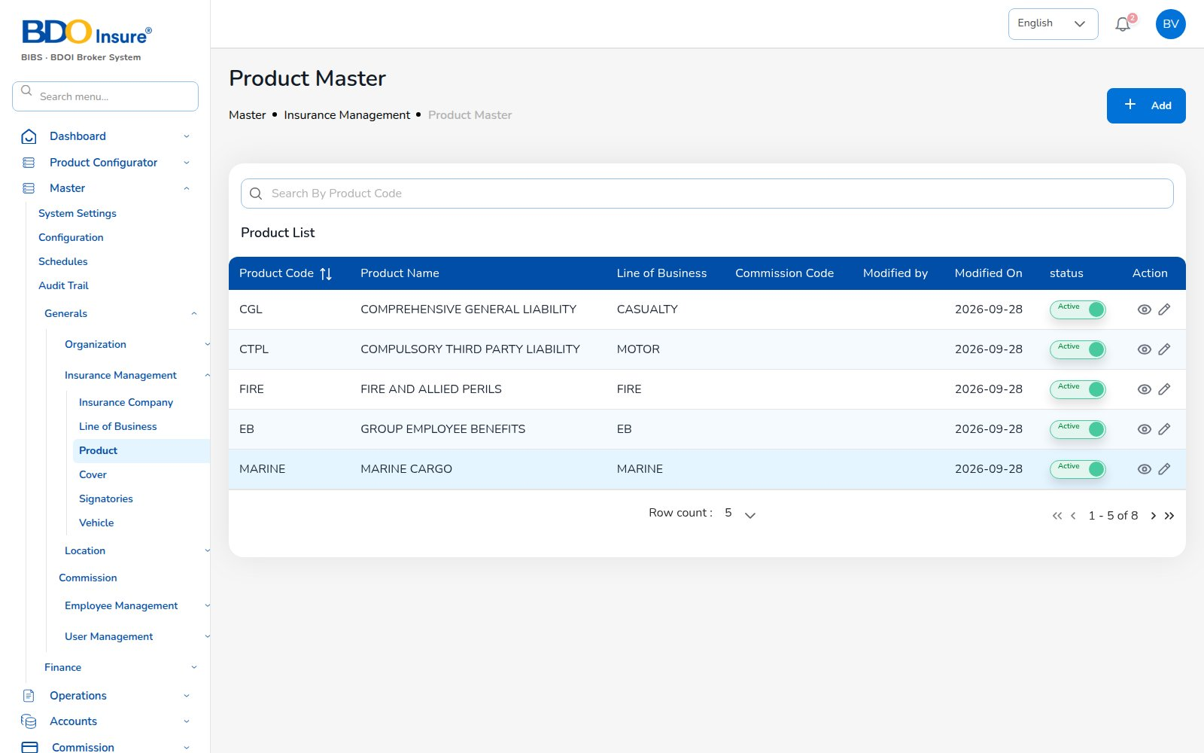
KEY FUNCTION 5 OF 8
Product master
Master > Generals > Insurance Management > Product
Purpose: products by line of business (casualty, motor, fire, EB, marine) with commission code.
Rules: unique product code; commission code must exist.
Downstream: product drives commission accrual and report grouping.
Live screen — Master > Product — signed in as bea.admin
BrokerVerse | Business Administrator
8

Slide 9
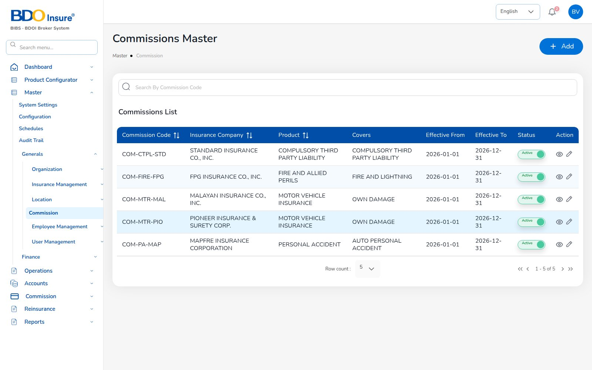
KEY FUNCTION 6 OF 8
Commission master
Master > Generals > Commission
Purpose: brokerage per insurer, product and cover with effective dates.
Rules: one active rate per insurer / product / cover for a date.
Downstream: commission accrues at policy issuance (e.g. 4,200.75 on POL-2026-00001).
WHT: withholding by referrer type (Individual 5%) is applied at payout.
Live screen — Master > Commission — signed in as bea.admin
BrokerVerse | Business Administrator
9

Slide 10
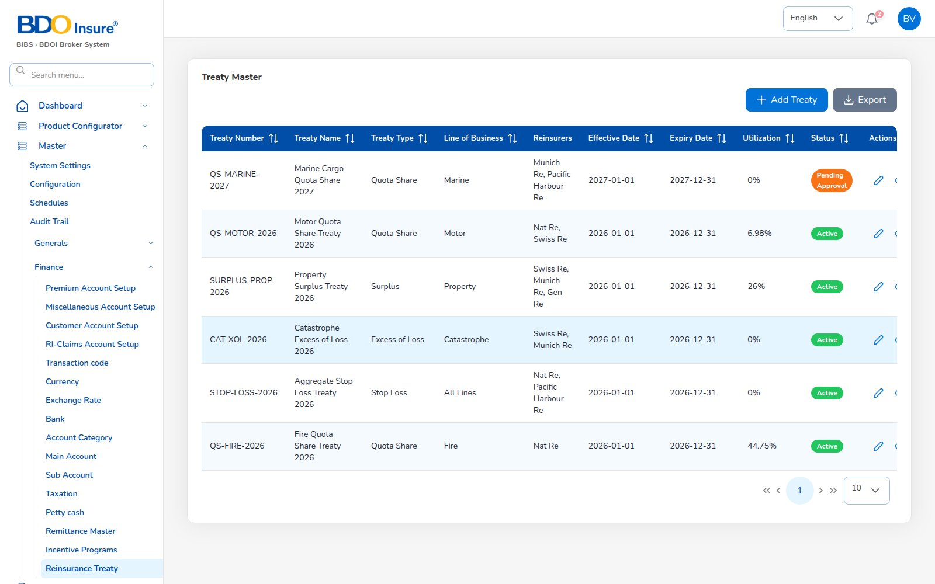
KEY FUNCTION 7 OF 8
Reinsurance treaties
Master > Reinsurance Treaty
Purpose: quota share, surplus, excess of loss, stop loss treaties with reinsurer, share and period.
Approval: a new treaty waits for approval before use (setting).
Downstream: cessions, recoveries and the Cession Register report.
Live screen — Master > Reinsurance Treaty — signed in as bea.admin
BrokerVerse | Business Administrator
10

Slide 11
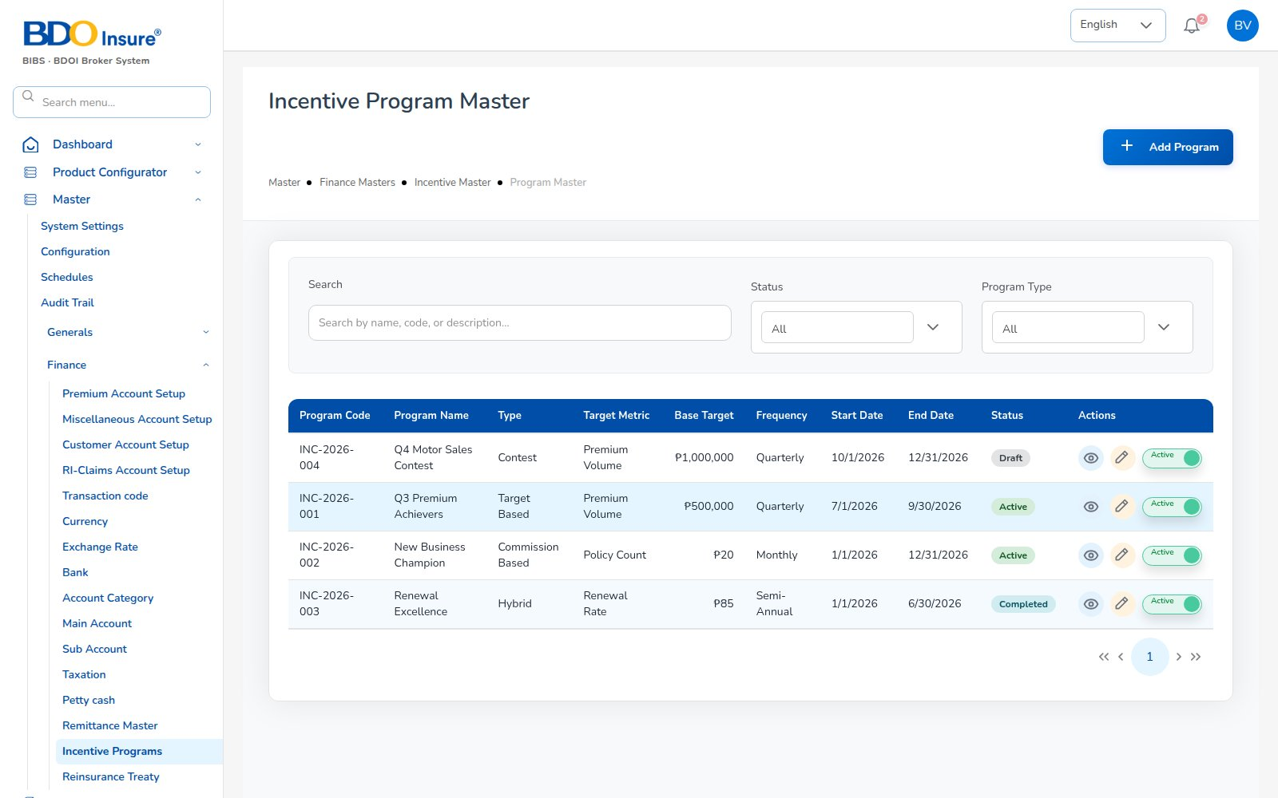
KEY FUNCTION 8 OF 8
Incentive programmes
Master > Incentive Programs
Purpose: agent contests and bonuses: target, base, frequency, dates.
Flow: Finance calculates, a second person approves the batch, statements follow.
Downstream: Incentive Results report.
Live screen — Master > Incentive Programs — signed in as bea.admin
BrokerVerse | Business Administrator
11

Slide 12
LEAD TO RENEWAL
End-to-end flow: your configuration drives every step
1
2
3
4
5
6
Lead
Quote
Customer approval
Policy
Billing
Receipt
Agent / Sales / CS
Agent / Sales / UW
Client (e-mail link)
Agent / Sales / UW
System at issuance
Finance
11
10
9
8
7
Renewal
Claim
Endorsement
Remittance
Commission
UW / Sales + schedules
Claims maker + checker
Customer Services
Finance maker + checker
Finance maker + checker
Your steps
Done by other personas or by the system
Renewal starts the next cycle
Lead and quote: products, coverages, rating and signatories come from your masters.
Policy and billing: product and insurer decide commission and taxes.
Commission and remittance: commission masters and WHT settings.
Claims and renewals: treaties for recoveries; renewal notice settings.
BrokerVerse | Business Administrator
12

Slide 13
REPORTS > OPERATIONAL / FINANCIAL
Reports you use
Output formats
CSV
XLSX
PDF
On screen
Scheduled e-mail
All 18 reports are in your catalogue.
Operational report | What it shows
Production Register | Policies incepted in the period: premium, commission, new or renewal; by agent, insurer or branch
Claims Position | Claims reported: estimate, approved, settled, age; criteria All / Open / Settled / Rejected / Aging
Renewal Retention | Renewals due: retained, lost or pending, old vs new premium, retention rate
Remittance Summary | Remittances to insurers: gross premium, commission retained, net due, status
Broker Commission Statement | Commission per agent and policy: basis, rate, gross, WHT, net, paid status
Premium by Product / Month / Insurer | Policy count, sum insured, premium and commission by month, product or insurer
New Business vs Renewals | Policies and premium split into new business and renewals per month
Claims Ageing | Open claims by ageing bucket (30/60/90/180 days) with estimate and approved
Lead Conversion Funnel | Leads by stage (new to converted / lost) with share and conversion rate
Reinsurance Cession Register | Cessions per treaty and policy: sum insured, ceded sum and premium, share
Financial report | What it shows
SOA / Premium Receivable | Bills issued: amount, paid, balance, age and ageing bucket as of To Date
Collection Report | Bills due: billed, collected, balance and collection rate
Receivables Ageing | Outstanding receivables by bucket (30/60/90/120 days)
Receipts Register | Official receipts: bill, policy, payment mode, bank, reference
Payables / Disbursement Register | Payment vouchers to insurers, agents, clients, vendors with approval and paid dates
Journal Register | Journal lines: account, debit, credit, memo
Trial Balance | Opening, period debits and credits, closing balance per account (approved and posted JVs)
Incentive Results | Programme target, achieved, achievement % and payout per agent
BrokerVerse | Business Administrator
13

Slide 14
MASTER > CONFIGURATION > SCHEDULES
Schedules and automations
Job | When it runs | What it means for you
Daily reports | Every day, 05:00 | Production, collections and claims files each morning
Renewal pipeline | Every day, 05:30 | Retention work starts 90 days before expiry
Renewal notices | Every day, 06:00 | Clients get notices at 60, 30, 15 days
Receivable ageing | Every day, 07:00 | Ageing buckets refreshed for collections
Collection reminders | Every day, 08:00 | Clients reminded 7 days before premium is due
Quotation expiry | Every day, 00:30 | Old quotations expire after the configured validity
Times are server time (Philippine time in production). The IT administrator can change a timetable, switch a job off or press Run now; every run is recorded.
BrokerVerse | Business Administrator
14

Slide 15
BELL ICON, TOP RIGHT
Notifications and approvals
Approval
Treaty awaiting approval
Info
Treaty / incentive approved or rejected
A new reinsurance treaty needs a second person.
Returned to whoever submitted it.
Approval
Incentive calculation awaiting approval
Approval
Journal voucher / remittance
A calculated batch needs approval before payout.
Admin roles can act as checker when finance is short.
BrokerVerse | Business Administrator
15

Slide 16
GOOD TO KNOW
Known limitations and tips
Open items that affect you
Tips
Some date pickers still show month-first dates (MM/DD/YYYY) although the configured format is DD/MM/YYYY.
A few screens use the browser’s own confirm boxes instead of in-app dialogs.
Some quote lists (policy types, vehicle details, signatories) are fixed lists until linked to the masters.
CTPL treatment (separate policy or part of the premium) is awaiting a business decision.
Chart of accounts has no operating-expense accounts yet.
Direct Bill Processing (insured bill vs insurer remittance) awaits a business decision.
Change rates with a new product version, then test with Test Calculation.
Keep signatories and vehicle masters complete: the quote wizard will use them.
Agree commission and WHT changes with Finance before the effective date.
Use the Product Analytics tab to spot products that are not selling.
BrokerVerse | Business Administrator
16

Slide 17
Thank you
BrokerVerse — Business Administrator guide
SUPPORT
Service desk
<to be confirmed by BDOI>
E-mail
<support mailbox to be confirmed>
Hours
<business hours, Manila time, to be confirmed>
Access requests
Your User Access Administrator (Master > User Management)
iorta TechNXT · BrokerVerse insurance-broking platform

