Slide 1

THIS GUIDE IS FOR
Finance / Accounts
BrokerVerse — Finance / Accounts guide
SIGN-IN
liza.finance (maker), fe.approver (checker)
ROLE CODE
Out-of-the-box functions, flows, reports and schedules
finance
BDO Insure (BDOI) insurance broking · Philippines · PHP
LANDS ON
Home (business overview dashboard)
Receipts and collections
Payouts and remittance
Ledger
Prepared by iorta TechNXT · September 2026

Slide 2
WHO YOU ARE IN BROKERVERSE
Role at a glance
What you do
Sign-in and landing page
User names liza.finance and fe.approver. Land on Home, the business overview dashboard.
Collects: official receipts against open bills, partial or full; collections and ageing.
Pays: commission payouts to agents and premium remittances to insurers, by voucher and cheque.
Keeps the ledger: journal vouchers, corrections, reversals, trial balance.
Reports: financial and operational reports; receivables and payables registers.
You hand work to
fe.approver (checker for vouchers, remittances, settlements, JVs), insurers (remittance), agents (payouts).
Maker-checker partners
Maker-checker is on (finance.maker_checker_enabled): the maker cannot approve their own voucher, remittance, settlement or JV.
BrokerVerse | Finance / Accounts
2

Slide 3
WHAT YOU SEE AFTER SIGN-IN
Menu map
Menus and screens granted to this role (menuPermissions); anything else is hidden and blocked by the route guard and the API.
Dashboard
Operations
Accounts
Executive Dashboard
Open Items
Payments
Receipts, Collections
Accounting Query, All Clients Accounting
Open Entry Matching / Un-Matching
Disbursement, Petty Cash (5 screens)
Journal, Correction and Reversal JV
Remittance (17 screens)
Incentive (4 screens)
Commission
Reinsurance
Reports
Commission Dashboard
Agents/Referrer Accounts
Reconciliation
Financial: SOA, Collection, Payables, Journal, Trial Balance
Operational: all five
BrokerVerse | Finance / Accounts
3

Slide 4
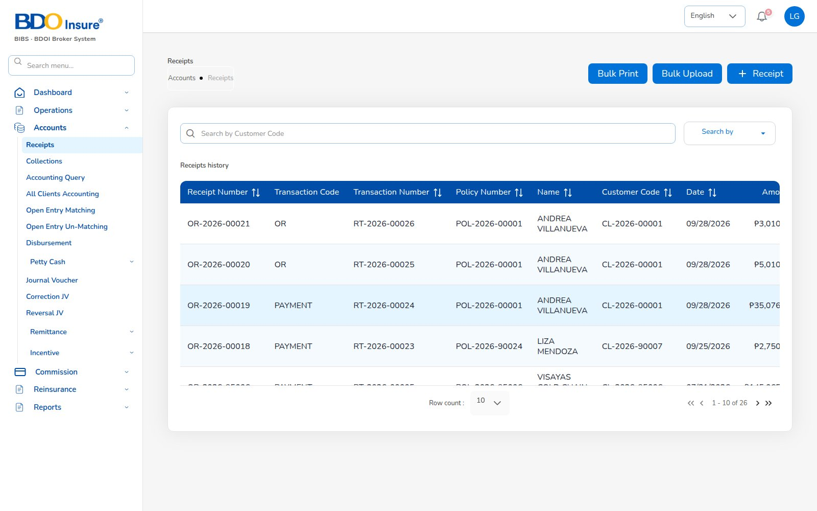
KEY FUNCTION 1 OF 8
Receipts
Accounts > Receipts
Purpose: official receipts (OR) with policy, customer and date.
Actions: + Receipt, Bulk Upload, Bulk Print.
Downstream: JV Dr cash / Cr premium receivable; bill Paid, collection item closed.
Live screen — Accounts > Receipts — signed in as liza.finance
BrokerVerse | Finance / Accounts
4

Slide 5
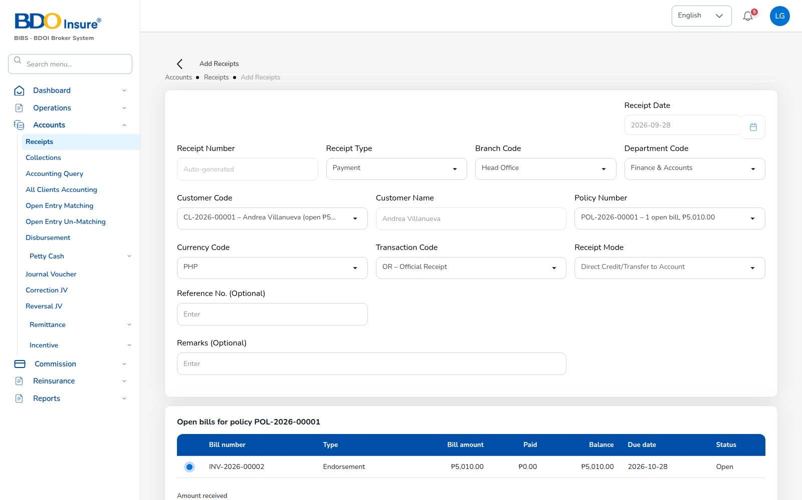
KEY FUNCTION 2 OF 8
Add receipt against open bills
Accounts > Receipts > Add
Pick: customer, policy and the open bill (e.g. INV-2026-00002, 5,010.00).
Rule: payment cannot exceed the balance (4,000 on 3,010 was refused).
Partial: OR-2026-00020 2,000 left 3,010; OR-2026-00021 closed it.
Fields: receipt mode, transaction code OR, reference and remarks.
Screen from the recorded end-to-end run — Add receipt: open bills for POL-2026-00001 — liza.finance
BrokerVerse | Finance / Accounts
5

Slide 6
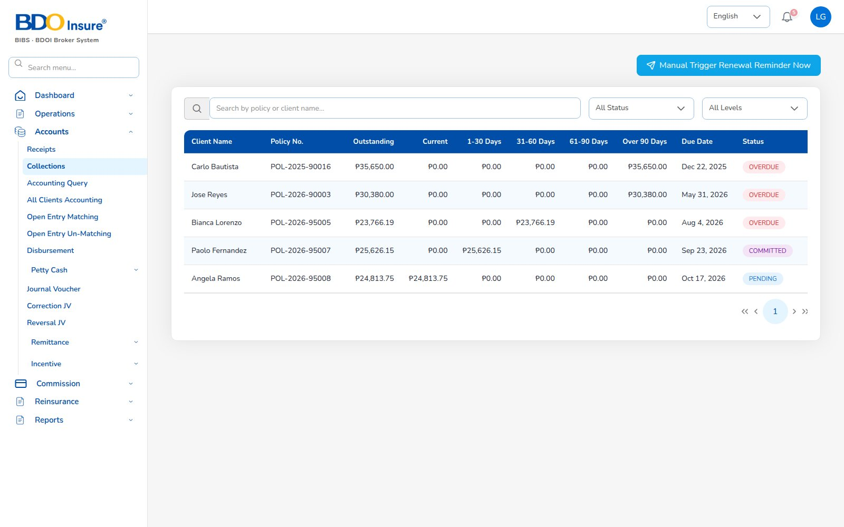
KEY FUNCTION 3 OF 8
Collections
Accounts > Collections
Purpose: outstanding by client and policy, in buckets current / 1-30 / 31-60 / 61-90 / 90+.
Reminders: Manual Trigger Reminder Now, or the 08:00 job.
Report: Receivables Ageing.
Live screen — Accounts > Collections — signed in as liza.finance
BrokerVerse | Finance / Accounts
6

Slide 7
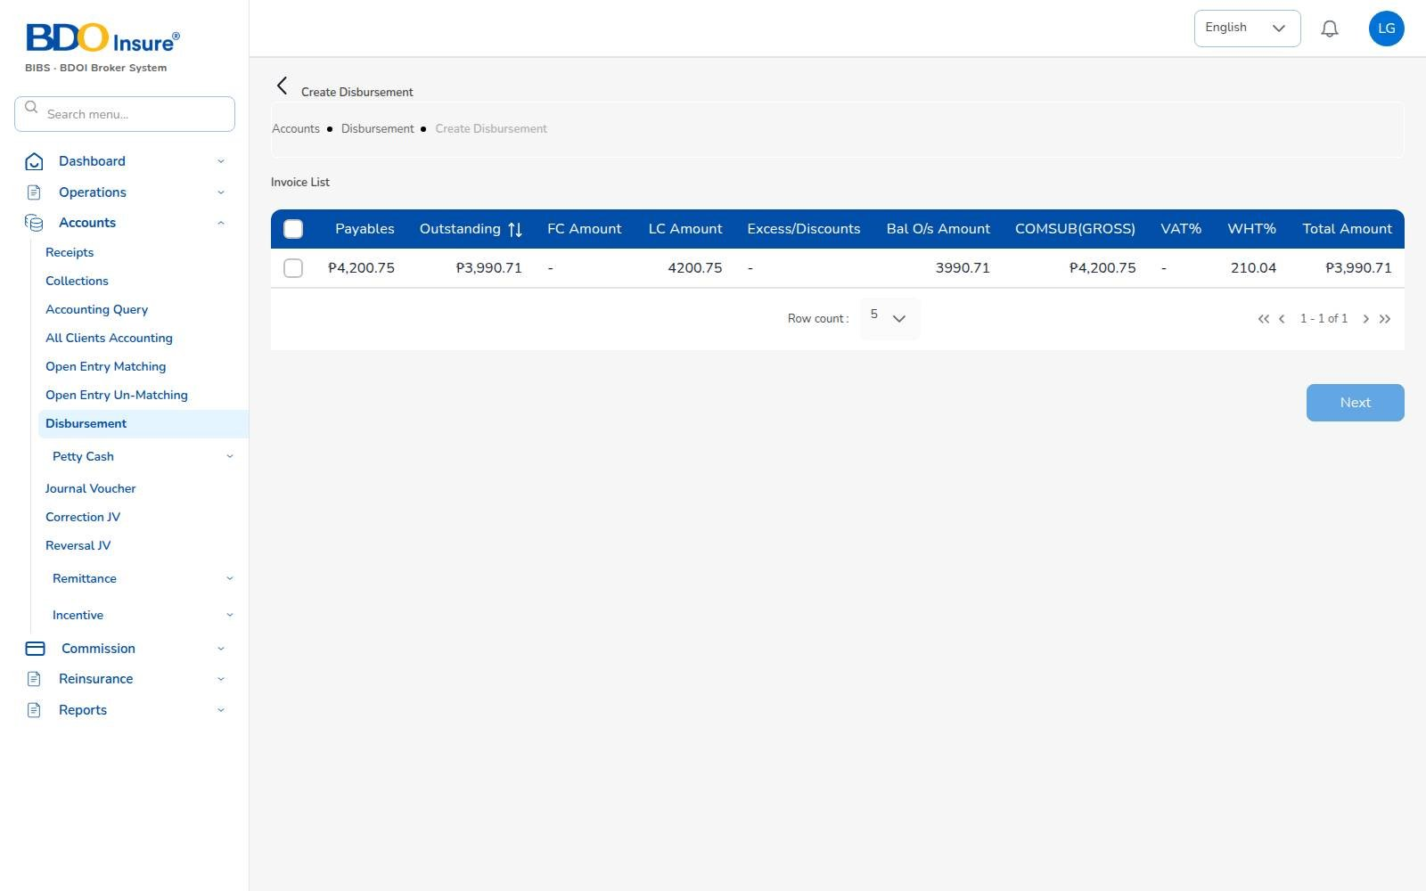
KEY FUNCTION 4 OF 8
Commission payout
Accounts > Disbursement > payout
Amounts: gross 4,200.75, WHT 210.04 (Individual 5%), net 3,990.71.
Rule: maker cannot approve own voucher; fe.approver approved.
Journal: Dr commission payable / Cr cash / Cr WHT payable, balanced.
Screen from the recorded end-to-end run — Agent payout invoice list (PV-2026-00022) — liza.finance
BrokerVerse | Finance / Accounts
7

Slide 8
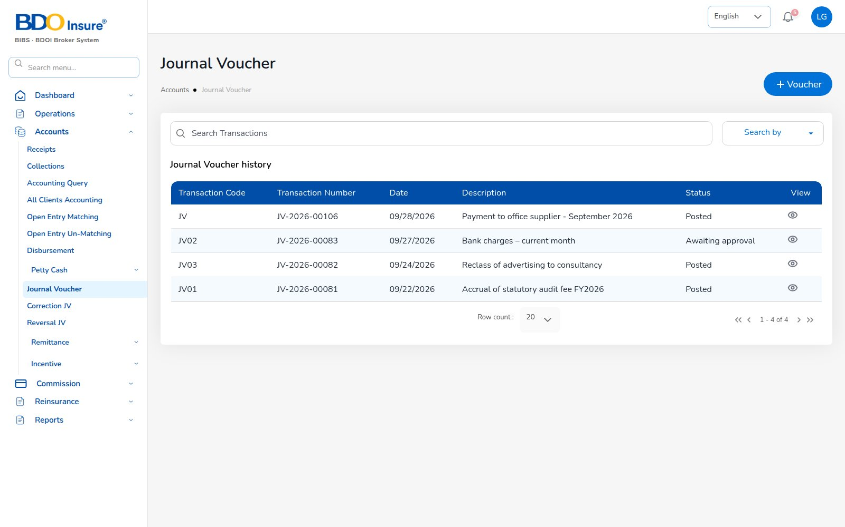
KEY FUNCTION 5 OF 8
Journal voucher
Accounts > Journal Voucher
Rule: debits must equal credits (screen and API refuse unbalanced).
Flow: maker submits, checker approves and posts (JV-2026-00106).
Status: draft, awaiting approval, posted.
Downstream: trial balance counts approved and posted JVs only.
Live screen — Accounts > Journal Voucher — signed in as liza.finance
BrokerVerse | Finance / Accounts
8

Slide 9
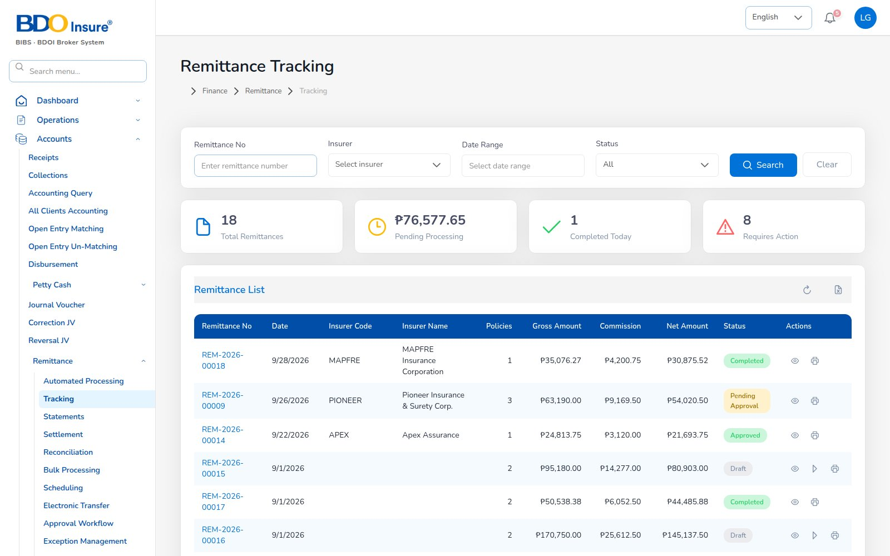
KEY FUNCTION 6 OF 8
Remittance tracking
Accounts > Remittance > Tracking
Purpose: remittances per insurer: gross, commission retained, net due, status.
Example: REM-2026-00018 to MAPFRE, net 30,875.52.
Levels: approval level by amount: up to 100,000; up to 1,000,000; above.
Live screen — Accounts > Remittance > Tracking — signed in as liza.finance
BrokerVerse | Finance / Accounts
9

Slide 10
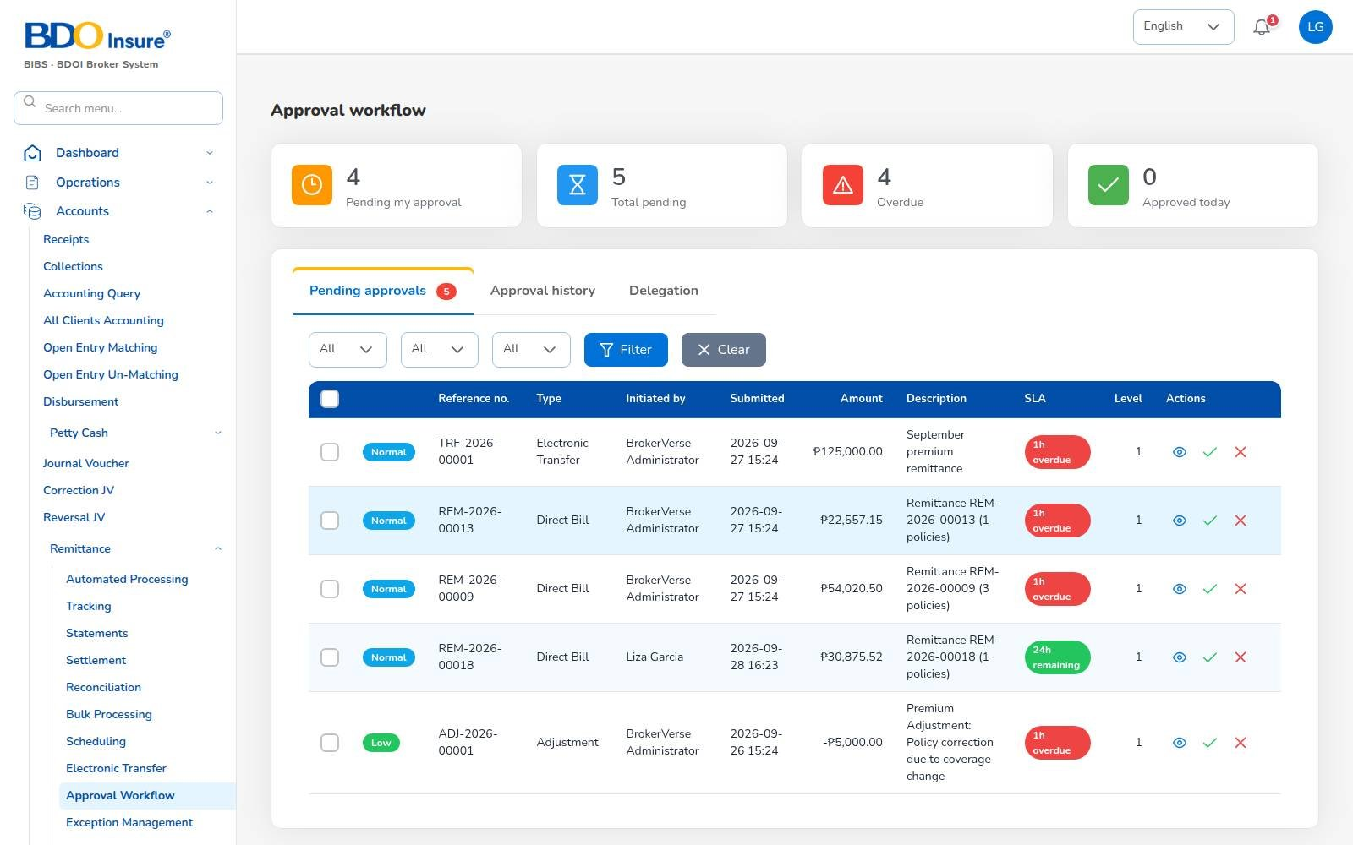
KEY FUNCTION 7 OF 8
Approval workflow
Accounts > Remittance > Approval Workflow
Purpose: pending approvals with SLA, level and amount.
Rule: the initiator is refused; a second finance user approves.
Next: settlement approval raises the insurer voucher; cheque approved, printed, voucher Paid.
Screen from the recorded end-to-end run — Remittance approval queue — fe.approver
BrokerVerse | Finance / Accounts
10

Slide 11
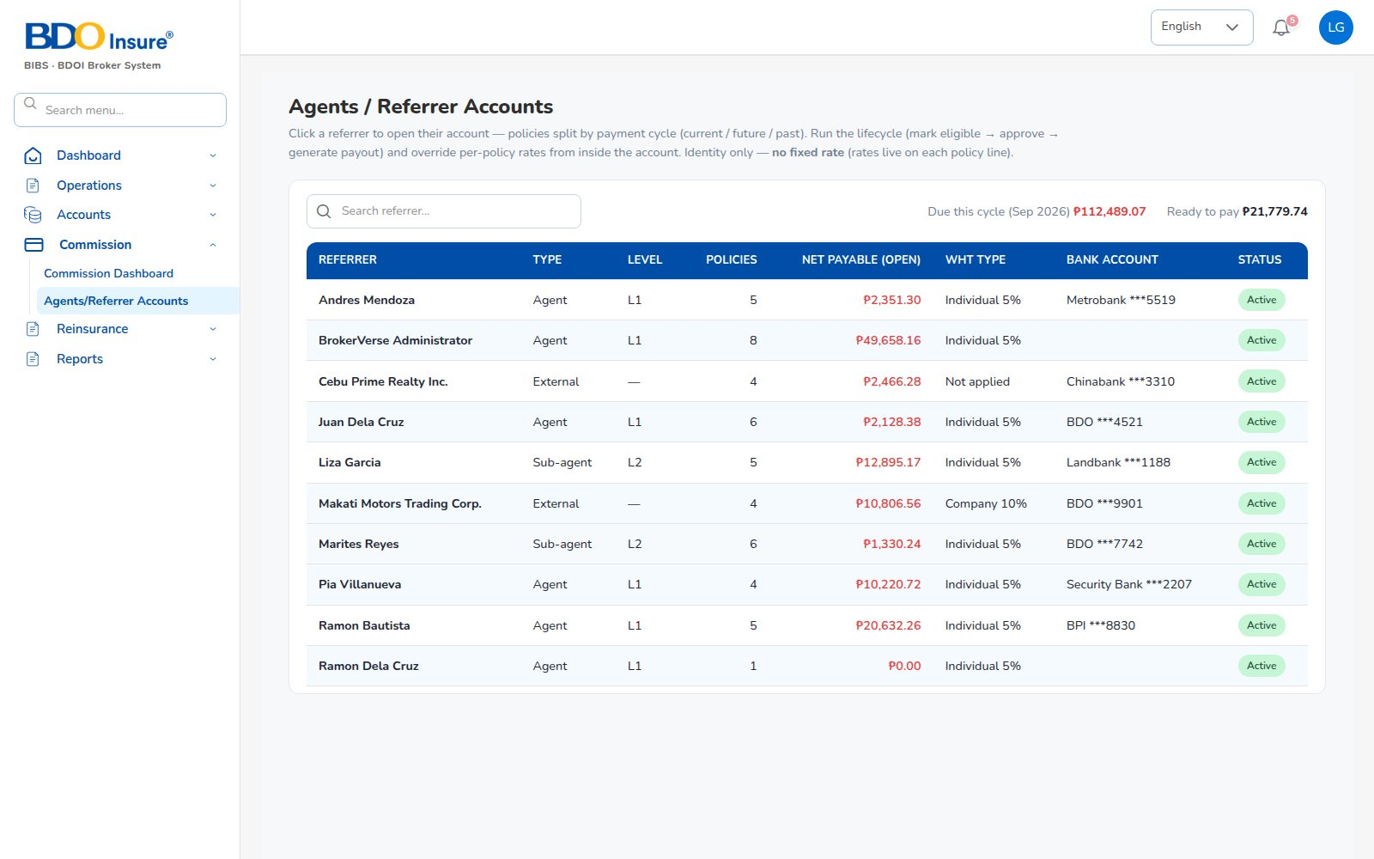
KEY FUNCTION 8 OF 8
Agents / referrer accounts
Commission > Agents/Referrer Accounts
Purpose: referrers with type, level, policies, net payable, WHT type and bank account.
Rule: WHT rate follows the referrer type (Individual 5%).
Next: Generate payout creates a draft disbursement.
Live screen — Commission > Agents/Referrer Accounts — signed in as liza.finance
BrokerVerse | Finance / Accounts
11

Slide 12
LEAD TO RENEWAL
End-to-end flow: your part of the cycle
1
2
3
4
5
6
Lead
Quote
Customer approval
Policy
Billing
Receipt
Agent / Sales / CS
Agent / Sales / UW
Client (e-mail link)
Agent / Sales / UW
System at issuance
Finance
11
10
9
8
7
Renewal
Claim
Endorsement
Remittance
Commission
UW / Sales + schedules
Claims maker + checker
Customer Services
Finance maker + checker
Finance maker + checker
Your steps
Done by other personas or by the system
Endorsement bills come back to you as receipts
5 Billing: booked at issuance (INV + JV + collection item).
6 Receipt: OR against open bills.
7 Commission: payout with WHT, maker and checker.
8 Remittance: net premium to the insurer.
BrokerVerse | Finance / Accounts
12

Slide 13
REPORTS > OPERATIONAL / FINANCIAL
Reports you use
Output formats
CSV
XLSX
PDF
On screen
Scheduled e-mail
Thirteen reports in your catalogue.
Operational report | What it shows
Remittance Summary | Remittances to insurers: gross premium, commission retained, net due, status
Broker Commission Statement | Commission per agent and policy: basis, rate, gross, WHT, net, paid status
Premium by Product / Month / Insurer | Policy count, sum insured, premium and commission by month, product or insurer
New Business vs Renewals | Policies and premium split into new business and renewals per month
Reinsurance Cession Register | Cessions per treaty and policy: sum insured, ceded sum and premium, share
Financial report | What it shows
SOA / Premium Receivable | Bills issued: amount, paid, balance, age and ageing bucket as of To Date
Collection Report | Bills due: billed, collected, balance and collection rate
Receivables Ageing | Outstanding receivables by bucket (30/60/90/120 days)
Receipts Register | Official receipts: bill, policy, payment mode, bank, reference
Payables / Disbursement Register | Payment vouchers to insurers, agents, clients, vendors with approval and paid dates
Journal Register | Journal lines: account, debit, credit, memo
Trial Balance | Opening, period debits and credits, closing balance per account (approved and posted JVs)
Incentive Results | Programme target, achieved, achievement % and payout per agent
BrokerVerse | Finance / Accounts
13

Slide 14
MASTER > CONFIGURATION > SCHEDULES
Schedules and automations
Job | When it runs | What it means for you
Receivable ageing | Every day, 07:00 | Buckets 30/60/90/120 refreshed; overdue flagged
Collection reminders | Every day, 08:00 | Clients e-mailed 7 days before due, then every 7 days
Daily reports | Every day, 05:00 | Collections summary each morning
E-mail outbox | Every 5 minutes | Reminders and statements leave every 5 minutes
Report schedules | Your own timetable | Trial balance or SOA e-mailed on your timetable
Times are server time (Philippine time in production). The IT administrator can change a timetable, switch a job off or press Run now; every run is recorded.
BrokerVerse | Finance / Accounts
14

Slide 15
BELL ICON, TOP RIGHT
Notifications and approvals
Approval
Journal voucher awaiting approval
Info
Direct bill / settlement approved
To finance approvers.
Back to the initiator.
Info
Journal voucher approved / rejected
Approval
Petty cash request
Back to the maker with the reason.
Requester and amount.
Approval
Remittances awaiting approval
Alert
Petty cash below minimum
Batch number and count.
To the fund custodian.
BrokerVerse | Finance / Accounts
15

Slide 16
GOOD TO KNOW
Known limitations and tips
Open items that affect you
Tips
Chart of accounts has no operating-expense accounts yet (rent, salaries, utilities).
Receipts API is shared with the in-app payment step; separation is planned.
Direct Bill Processing wording (insured bill vs insurer remittance) awaits a business decision.
Remittance and settlement dates are shown month-first; the settlement date picker is MM/DD/YYYY.
Commission can accrue to an administrator who issued a policy.
Always pick the bill, not just the policy, when receipting.
Ask the checker to approve the same day (SLA).
Print approved cheques so vouchers become Paid.
Run the trial balance after every posting day.
BrokerVerse | Finance / Accounts
16

Slide 17
Thank you
BrokerVerse — Finance / Accounts guide
SUPPORT
Service desk
<to be confirmed by BDOI>
E-mail
<support mailbox to be confirmed>
Hours
<business hours, Manila time, to be confirmed>
Access requests
Your User Access Administrator (Master > User Management)
iorta TechNXT · BrokerVerse insurance-broking platform

