Slide 1

THIS GUIDE IS FOR
Sales / Relationship Manager
BrokerVerse — Sales / Relationship Manager guide
SIGN-IN
maria.sales
ROLE CODE
Out-of-the-box functions, flows, reports and schedules
sales
BDO Insure (BDOI) insurance broking · Philippines · PHP
LANDS ON
Home (business overview dashboard)
Leads and quotes
Policies
Renewals
Prepared by iorta TechNXT · September 2026

Slide 2
WHO YOU ARE IN BROKERVERSE
Role at a glance
What you do
Sign-in and landing page
User name maria.sales. Lands on Home, the business overview dashboard; the Agent Dashboard is in the Dashboard menu.
Wins business: captures leads, builds and sends quotations, converts accepted quotes to policies.
Looks after clients: client 360 view with policies, claims, renewals and endorsements.
Retains the book: works the renewal queue, at-risk policies and negotiations.
Tracks results: executive and agent dashboards, commission dashboard, operational reports.
You hand work to
Underwriter (quote approval), client (accepts by e-mail link), Finance (receipts, commission), Customer Services (endorsements), Claims.
Maker-checker partners
Quotations are maker-checker: the underwriter is notified when you send one for approval.
BrokerVerse | Sales / Relationship Manager
2

Slide 3
WHAT YOU SEE AFTER SIGN-IN
Menu map
Menus and screens granted to this role (menuPermissions); anything else is hidden and blocked by the route guard and the API.
Dashboard
Product Configurator
Operations
Executive Dashboard
Agent Dashboard
Dashboard
Product Templates
Home
Leads/Prospects
Clients
Quotation
Policy
Claims
Renewals: Renewal Policy, Batch, Queue, Retention Analytics, At-Risk, Negotiations, Lapse Mgmt, Performance
Open Items
Payments
Commission
Reports
Commission Dashboard
Operational Reports: Production, Claims, Renewal, Remittance, Broker Commission
BrokerVerse | Sales / Relationship Manager
3

Slide 4
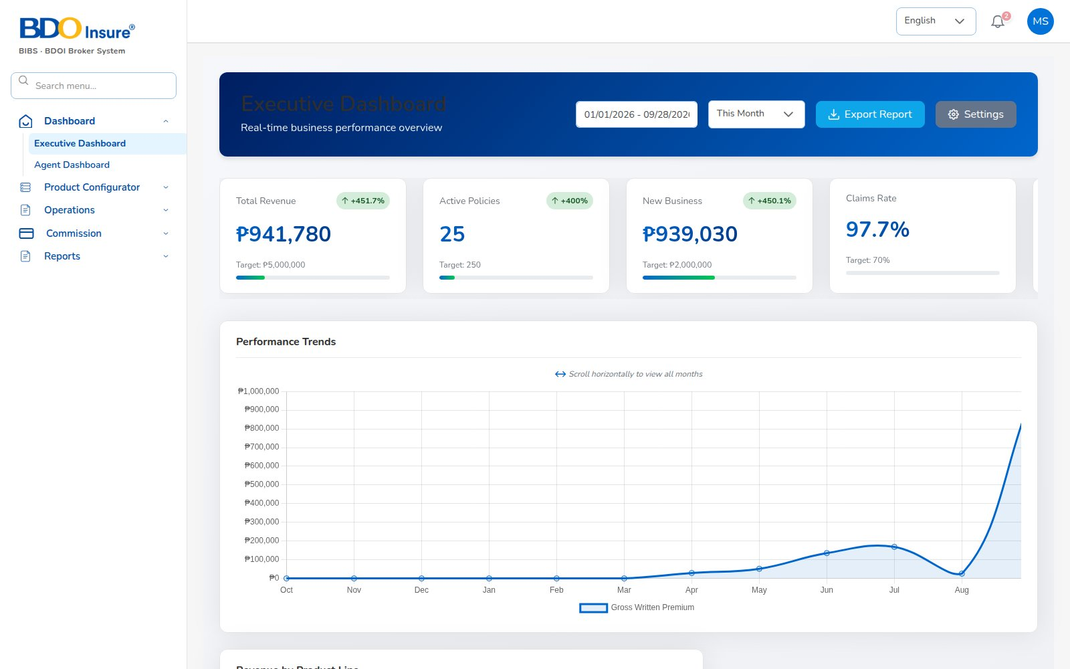
KEY FUNCTION 1 OF 7
Executive dashboard
Dashboard > Executive Dashboard
Purpose: revenue, active policies, new business and claims ratio against target.
Filters: date range and period; Export Report for premium by product.
Source: moves as soon as a policy is issued or a claim is registered.
Live screen — Dashboard > Executive Dashboard — signed in as maria.sales
BrokerVerse | Sales / Relationship Manager
4

Slide 5
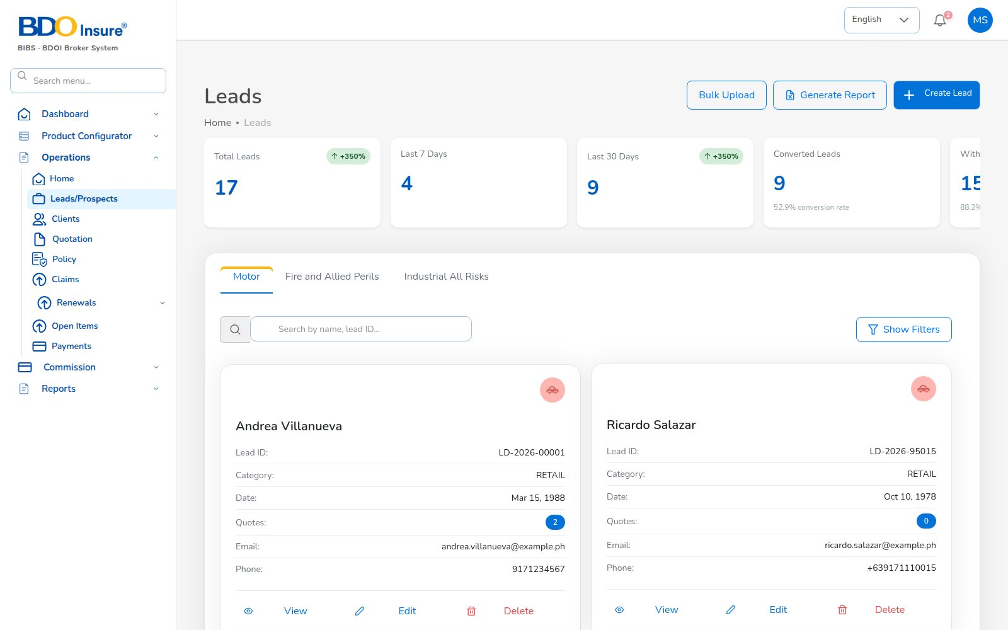
KEY FUNCTION 2 OF 7
Leads / prospects
Operations > Leads/Prospects
Purpose: every prospect by line (Motor, Fire and Allied Perils, Industrial All Risks).
Create Lead: name, category, date of birth, e-mail, 10-digit mobile are validated.
KPIs: total, last 7 / 30 days, converted, conversion rate.
Next: Create Quote straight after saving; Generate Report gives the Lead Conversion Funnel.
Live screen — Operations > Leads/Prospects — signed in as maria.sales
BrokerVerse | Sales / Relationship Manager
5

Slide 6
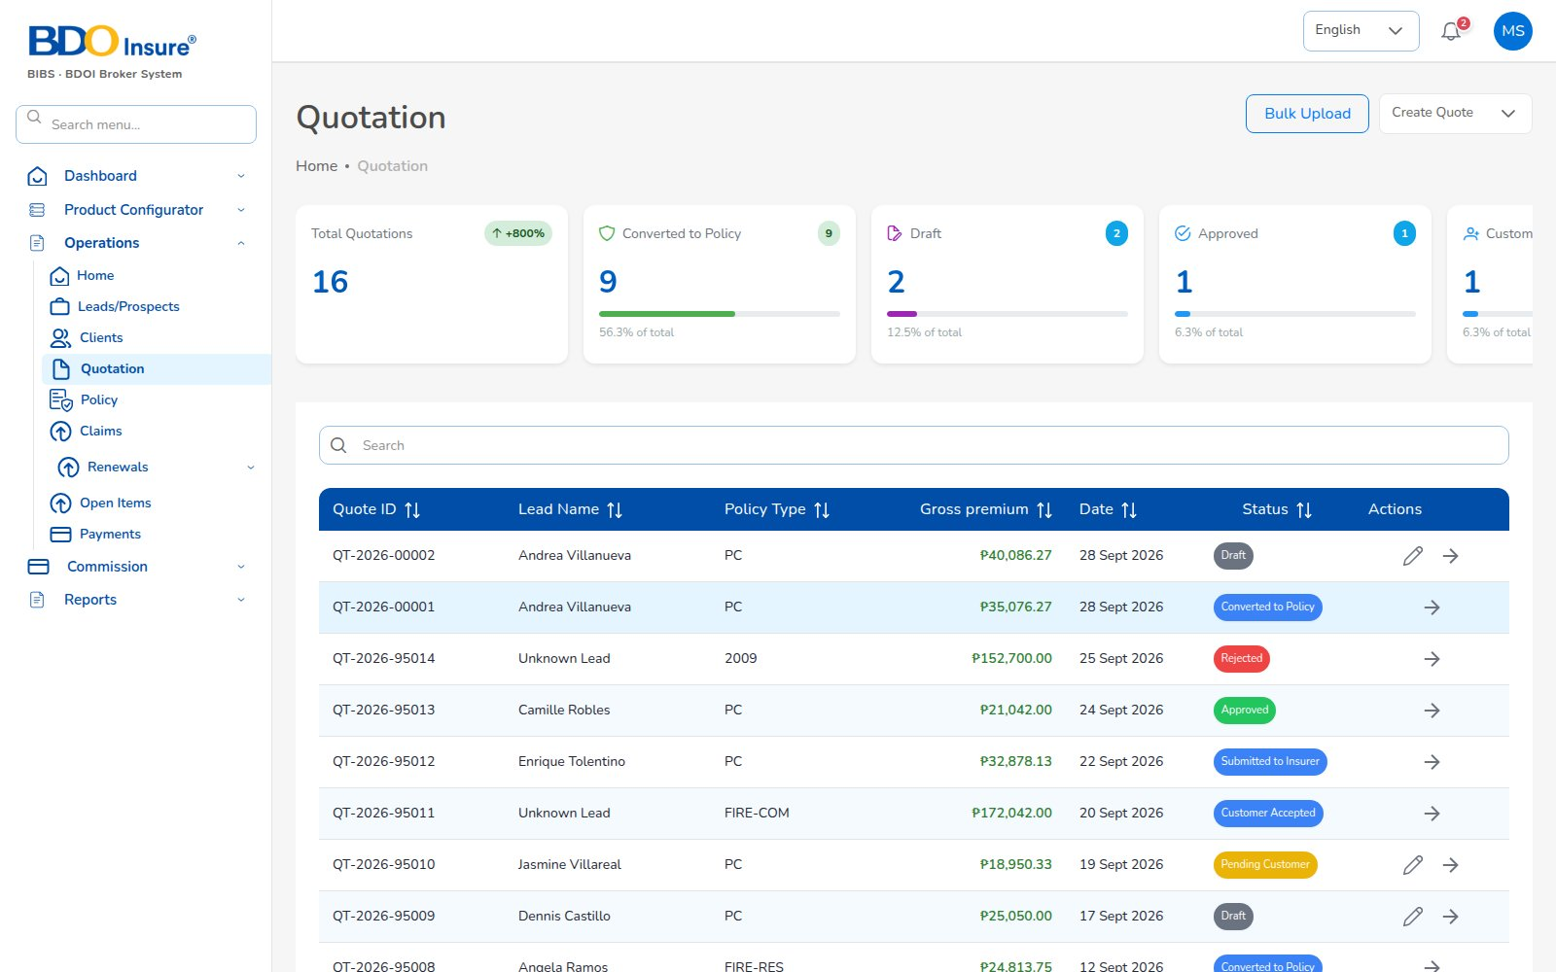
KEY FUNCTION 3 OF 7
Quotation
Operations > Quotation
Purpose: all quotes with status: draft, sent for approval, approved, converted.
Pricing: server re-prices with configured rates: VAT 12%, DST 12.5%, LGT 0.75%.
Approval: sent quotes notify the underwriter; the client accepts by e-mail link (valid 7 days).
Expiry: quotes past validity expire overnight.
Live screen — Operations > Quotation — signed in as maria.sales
BrokerVerse | Sales / Relationship Manager
6

Slide 7
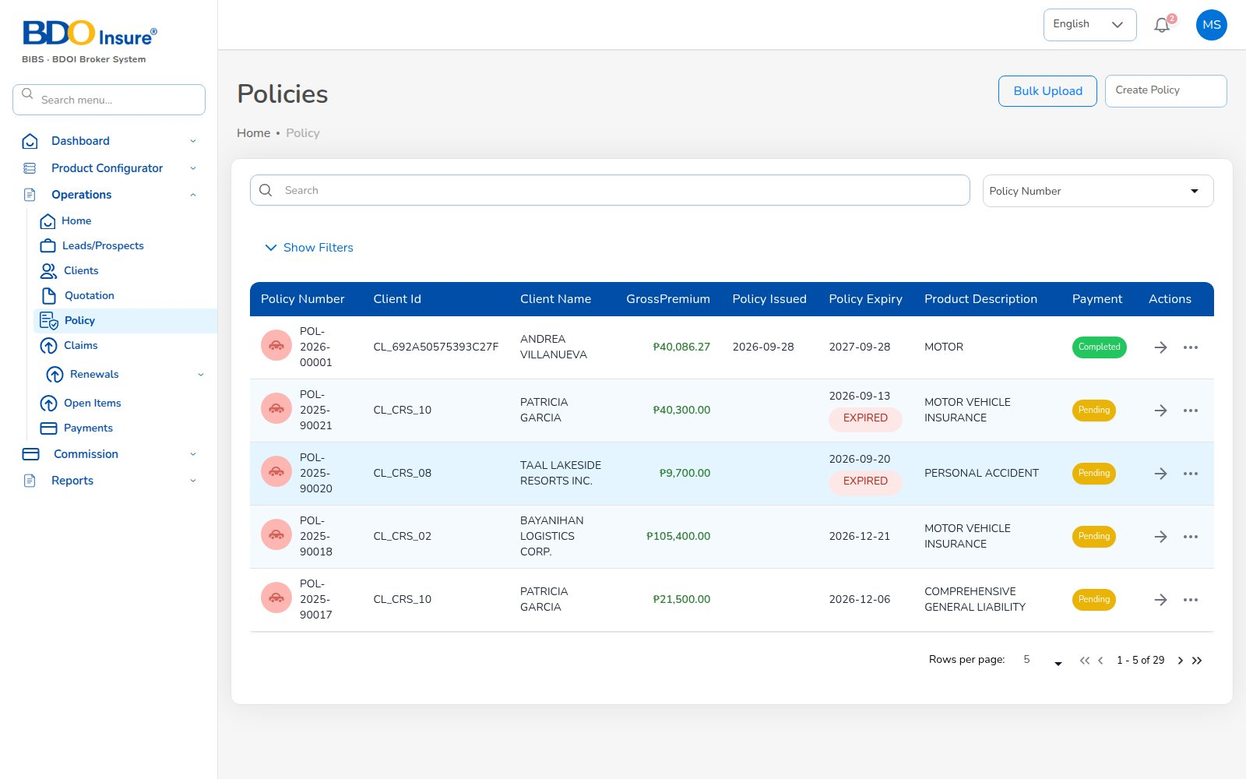
KEY FUNCTION 4 OF 7
Policy
Operations > Policy
Purpose: policies with insurer, premium, dates and payment status.
Convert: an accepted quote becomes a policy with documents and vehicle photos.
Downstream: bill INV + booking journal + collection item + commission accrual.
Actions: endorsement, claim, renewal from the row menu.
Live screen — Operations > Policy — signed in as maria.sales
BrokerVerse | Sales / Relationship Manager
7

Slide 8
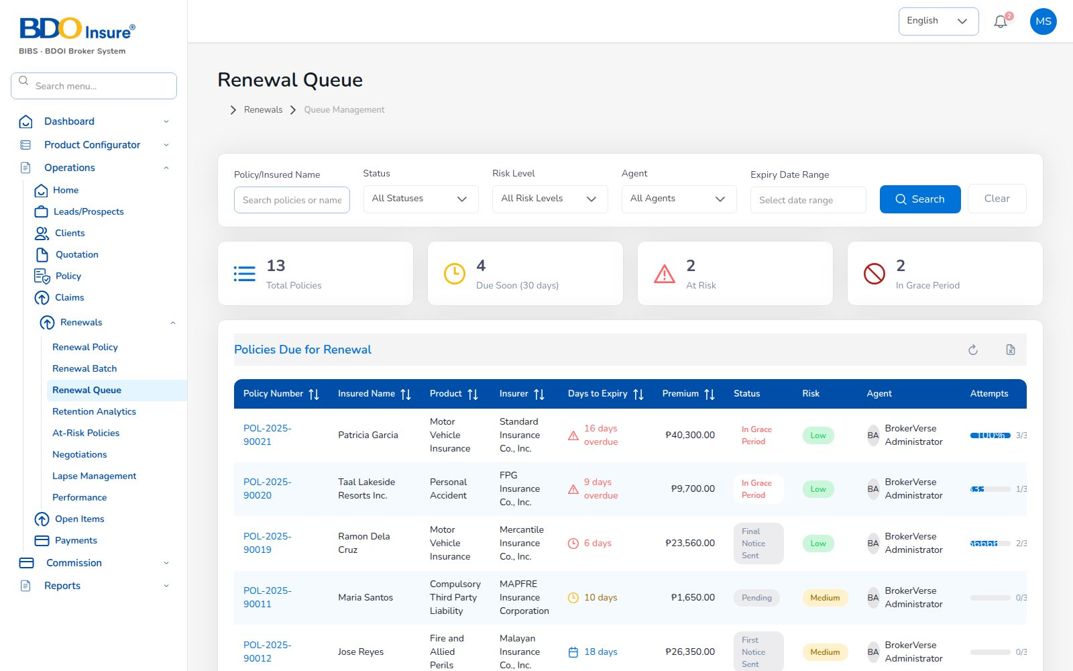
KEY FUNCTION 5 OF 7
Renewal queue
Operations > Renewals > Renewal Queue
Purpose: policies due for renewal with days to expiry, risk level and assigned agent.
Timing: enrolled 90 days before expiry; notices at 60 / 30 / 15 days.
Rules: renewals are maker-checker; lapse after 30 days grace.
Related: At-Risk Policies, Negotiations, Retention Analytics.
Live screen — Operations > Renewals > Renewal Queue — signed in as maria.sales
BrokerVerse | Sales / Relationship Manager
8

Slide 9
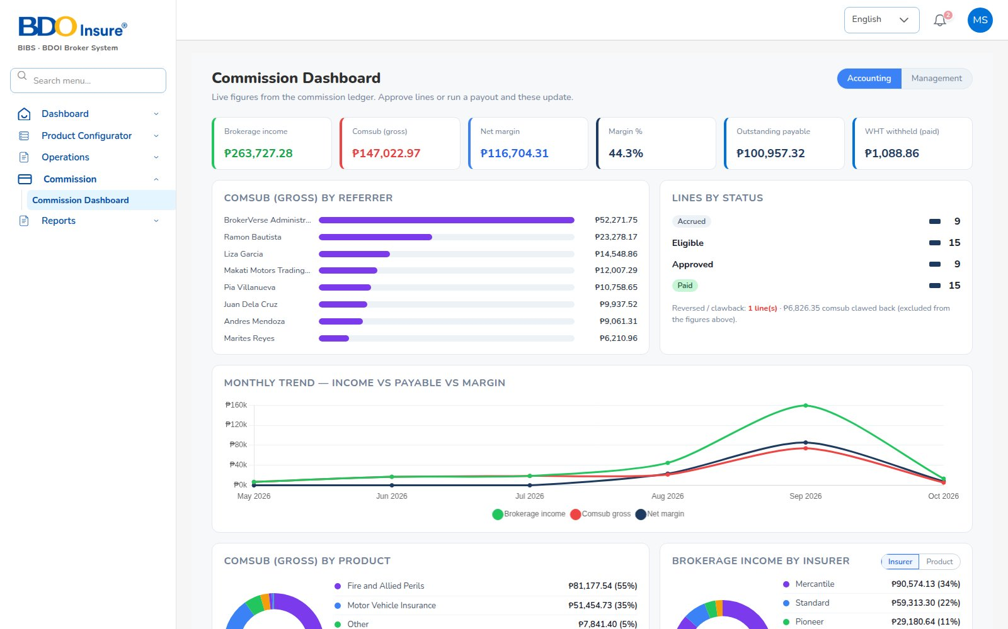
KEY FUNCTION 6 OF 7
Commission dashboard
Commission > Commission Dashboard
Purpose: brokerage income, comsub payable, net margin and outstanding payable.
Views: by referrer, by status, monthly trend, by product and by insurer.
Source: commission accrued at issuance and paid by Finance payouts.
Live screen — Commission > Commission Dashboard — signed in as maria.sales
BrokerVerse | Sales / Relationship Manager
9

Slide 10
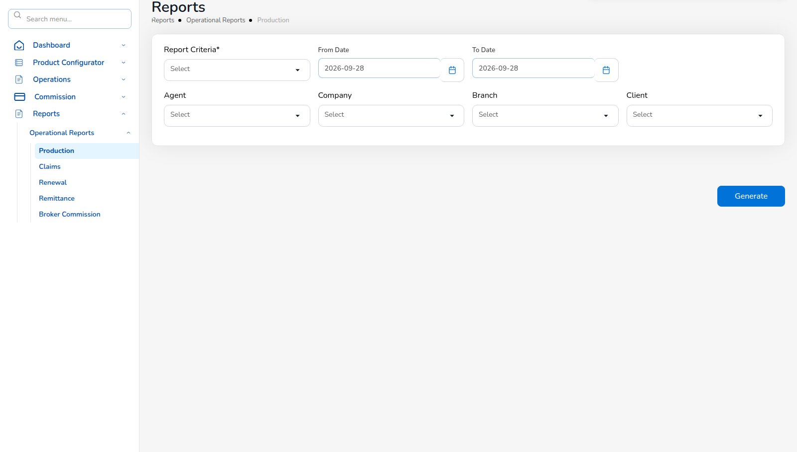
KEY FUNCTION 7 OF 7
Operational reports
Reports > Operational Reports
Purpose: Production, Claims, Renewal, Remittance and Broker Commission.
Criteria: report criteria, from / to date, agent, company, branch, client.
Formats: CSV, XLSX, PDF; generated files are kept in the history.
Live screen — Reports > Operational Reports > Production — signed in as maria.sales
BrokerVerse | Sales / Relationship Manager
10

Slide 11
LEAD TO RENEWAL
End-to-end flow: your part of the cycle
1
2
3
4
5
6
Lead
Quote
Customer approval
Policy
Billing
Receipt
Agent / Sales / CS
Agent / Sales / UW
Client (e-mail link)
Agent / Sales / UW
System at issuance
Finance
11
10
9
8
7
Renewal
Claim
Endorsement
Remittance
Commission
UW / Sales + schedules
Claims maker + checker
Customer Services
Finance maker + checker
Finance maker + checker
Your steps
Done by other personas or by the system
Your renewal starts the next cycle
1 Lead: capture and qualify.
2 Quote: price, send for approval and to the client.
4 Policy: convert the accepted quote, upload documents.
11 Renewal: work the queue and retain.
BrokerVerse | Sales / Relationship Manager
11

Slide 12
REPORTS > OPERATIONAL / FINANCIAL
Reports you use
Output formats
CSV
XLSX
PDF
On screen
Scheduled e-mail
Also via the report API: SOA, Receivables Ageing, Incentive Results.
Report | What it shows | Where
Production Register | Policies incepted in the period: premium, commission, new or renewal; by agent, insurer or branch | Reports > Operational > Production
Claims Position | Claims reported: estimate, approved, settled, age; criteria All / Open / Settled / Rejected / Aging | Reports > Operational > Claims
Renewal Retention | Renewals due: retained, lost or pending, old vs new premium, retention rate | Reports > Operational > Renewal
Remittance Summary | Remittances to insurers: gross premium, commission retained, net due, status | Reports > Operational > Remittance
Broker Commission Statement | Commission per agent and policy: basis, rate, gross, WHT, net, paid status | Reports > Operational > Broker Commission
Premium by Product / Month / Insurer | Policy count, sum insured, premium and commission by month, product or insurer | Executive Dashboard > Export Report
New Business vs Renewals | Policies and premium split into new business and renewals per month | Executive Dashboard > Export Report
Claims Ageing | Open claims by ageing bucket (30/60/90/180 days) with estimate and approved | Claims Dashboard > Export Report
Lead Conversion Funnel | Leads by stage (new to converted / lost) with share and conversion rate | Leads > Generate Report
BrokerVerse | Sales / Relationship Manager
12

Slide 13
MASTER > CONFIGURATION > SCHEDULES
Schedules and automations
Job | When it runs | What it means for you
Quotation expiry | Every day, 00:30 | Your quotes past validity become expired
Renewal pipeline | Every day, 05:30 | Your policies enter the renewal queue 90 days out
Renewal notices | Every day, 06:00 | Clients get notices; you get a reminder per notice
Collection reminders | Every day, 08:00 | Clients reminded before premium is due
Daily reports | Every day, 05:00 | Production register ready each morning
Times are server time (Philippine time in production). The IT administrator can change a timetable, switch a job off or press Run now; every run is recorded.
BrokerVerse | Sales / Relationship Manager
13

Slide 14
BELL ICON, TOP RIGHT
Notifications and approvals
Info
Quotation approved
Reminder
Renewal notice sent
The underwriter approved your quote; you can convert it.
First, second or final notice sent for your policy.
Task
Customer accepted quotation
Info
Renewal approved / returned
The client accepted by e-mail link: proceed to policy.
Result of the renewal checker.
Info
Policy issued
Alert
Policy lapsed
Policy number and first bill number.
Grace period passed with no renewal.
BrokerVerse | Sales / Relationship Manager
14

Slide 15
GOOD TO KNOW
Known limitations and tips
Open items that affect you
Tips
Contact number accepts the 10-digit form (9171234567); 09… and +63… forms are not yet accepted.
An existing lead has no “Create Quote” action yet: create the quote right after saving the lead.
Some quote lists (policy types, vehicle details, signatories) are fixed lists until linked to the masters.
CTPL treatment (separate policy or part of the premium) is awaiting a business decision.
ID card, ID number and vehicle identifiers are not yet mandatory at conversion: check them before Next.
The Clients list can fail to open for this role in the current build: open a client from Policy instead.
Report screens may show a permission message while loading the agent filter; the report still runs.
Create the quote straight after saving the lead.
Check KYC and vehicle details before converting.
Watch the At-Risk Policies view weekly.
Use the Agent Dashboard for your own numbers.
BrokerVerse | Sales / Relationship Manager
15

Slide 16
Thank you
BrokerVerse — Sales / Relationship Manager guide
SUPPORT
Service desk
<to be confirmed by BDOI>
E-mail
<support mailbox to be confirmed>
Hours
<business hours, Manila time, to be confirmed>
Access requests
Your User Access Administrator (Master > User Management)
iorta TechNXT · BrokerVerse insurance-broking platform

