Slide 1

THIS GUIDE IS FOR
Underwriter
BrokerVerse — Underwriter guide
SIGN-IN
jose.uw
ROLE CODE
Out-of-the-box functions, flows, reports and schedules
underwriting
BDO Insure (BDOI) insurance broking · Philippines · PHP
LANDS ON
Home (business overview dashboard)
Quote approval
Rules and rating
Reinsurance
Prepared by iorta TechNXT · September 2026

Slide 2
WHO YOU ARE IN BROKERVERSE
Role at a glance
What you do
Sign-in and landing page
User name jose.uw. Lands on Home; the Underwriting Dashboard is in the Dashboard menu.
Approves risk: reviews quotations sent for approval and referred cases.
Maintains rules: coverages, rating factors, underwriting rules, documents and workflows.
Renews: prices renewal quotations and works the renewal queue.
Reinsures: treaty dashboard, cession tracking, claims recovery, reconciliation.
You hand work to
Sales and agents (approved quotes), client (acceptance), Finance (remittance of reinsurance), Claims (recoveries).
Maker-checker partners
You are the checker for quotations (quotations.approval_notify_roles = underwriting) and a checker for renewals.
BrokerVerse | Underwriter
2

Slide 3
WHAT YOU SEE AFTER SIGN-IN
Menu map
Menus and screens granted to this role (menuPermissions); anything else is hidden and blocked by the route guard and the API.
Dashboard
Product Configurator
Operations
Underwriting Dashboard
Executive Dashboard
Dashboard
Product Templates
Coverage Builder
Rating Engine
Underwriting Rules
Document Manager
Approval Workflows
Market / Risk Mapping
Product Analytics
Home
Leads/Prospects
Clients
Quotation
Policy
Claims
Renewals: Renewal Policy, Batch, Queue, Retention Analytics, At-Risk, Negotiations, Lapse Mgmt, Performance
Open Items
Payments
Reinsurance
Reports
Treaty Dashboard
Cession Tracking
Claims Recovery
Reconciliation
Analytics
Operational Reports: Production, Claims, Renewal, Remittance, Broker Commission
BrokerVerse | Underwriter
3

Slide 4
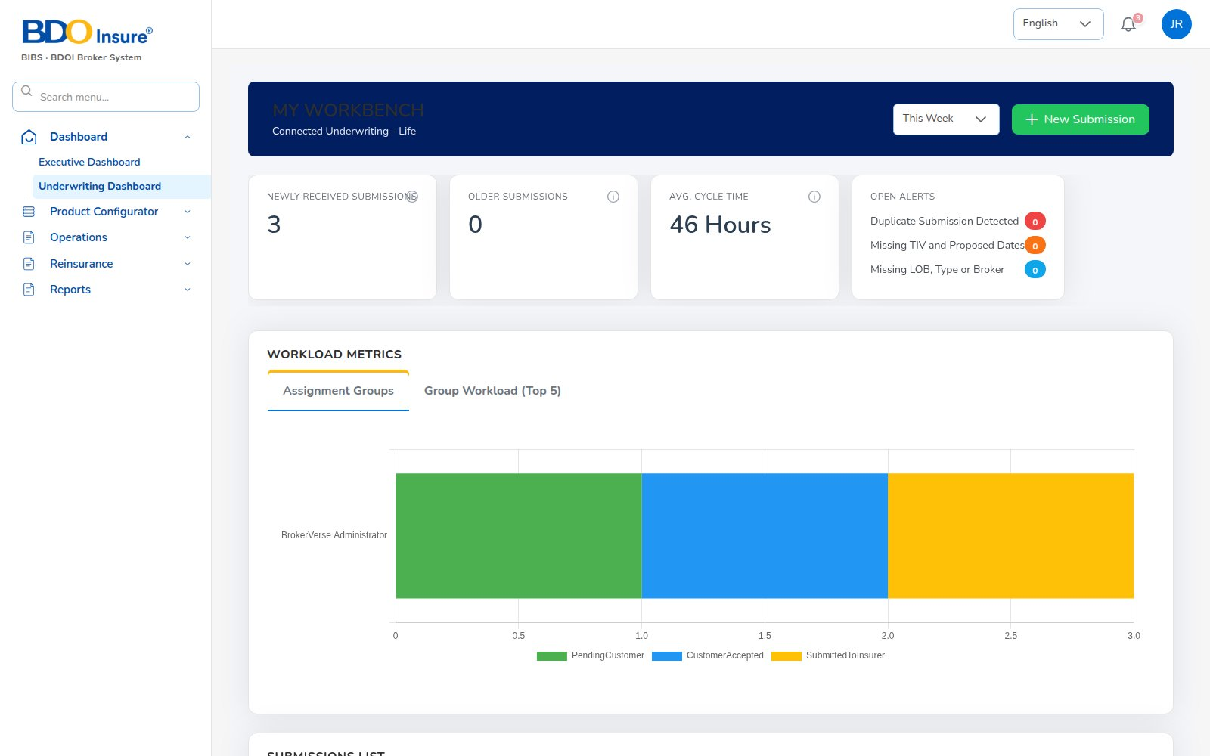
KEY FUNCTION 1 OF 8
Underwriting dashboard
Dashboard > Underwriting Dashboard
Purpose: submissions waiting, referred cases, average turnaround and open alerts.
Workload: assignment groups and workload by underwriter.
Action: New Submission and drill-down into each case.
Live screen — Dashboard > Underwriting Dashboard — signed in as jose.uw
BrokerVerse | Underwriter
4

Slide 5
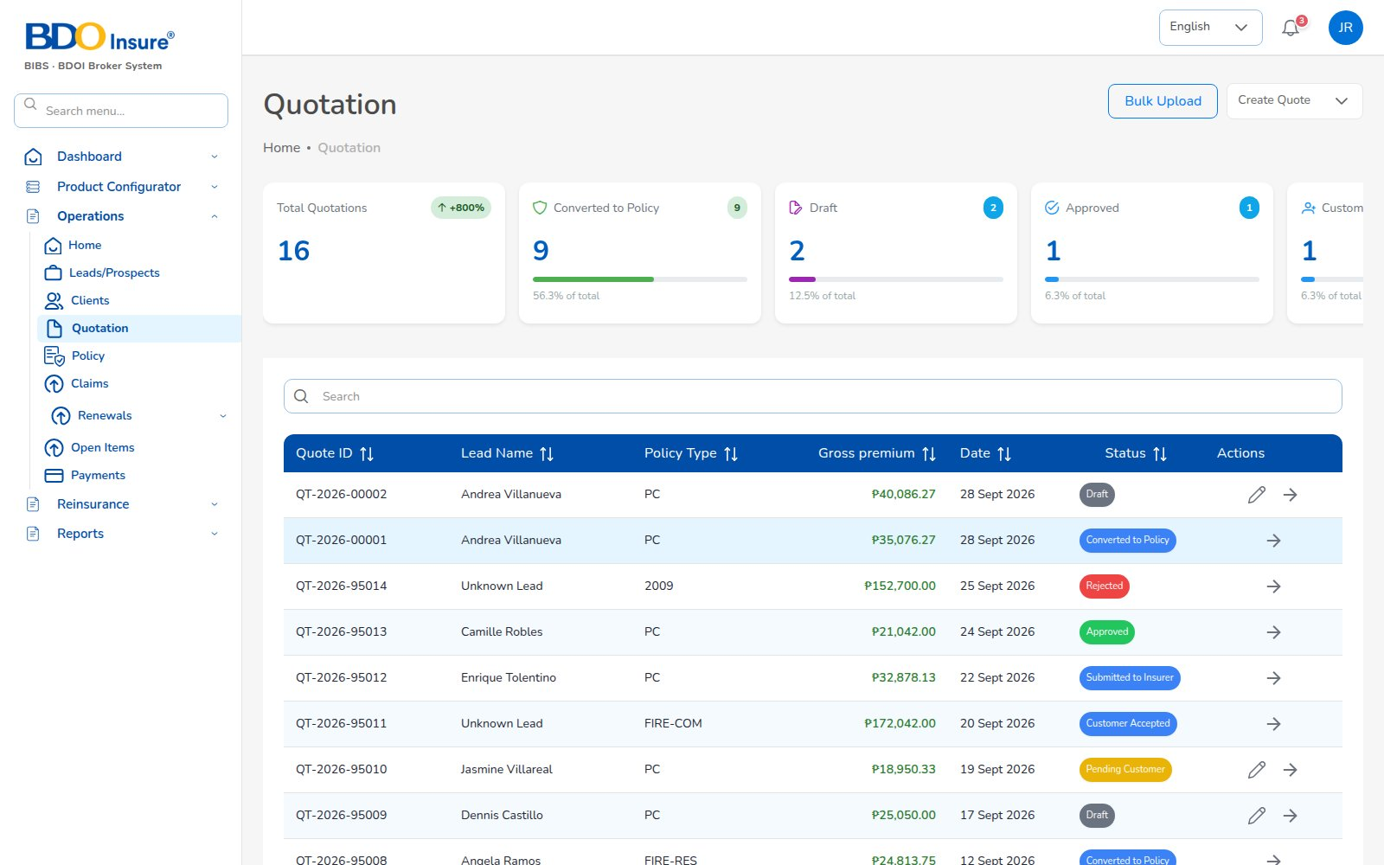
KEY FUNCTION 2 OF 8
Quotation approval
Operations > Quotation
Purpose: quotes by status: draft, sent for approval, approved, converted, expired.
Notified: “Quotation sent for approval” with client and gross premium.
Checks: risk, sum insured, rating and taxes (server-priced).
Downstream: approval lets the maker convert; the client accepts by e-mail.
Live screen — Operations > Quotation — signed in as jose.uw
BrokerVerse | Underwriter
5

Slide 6
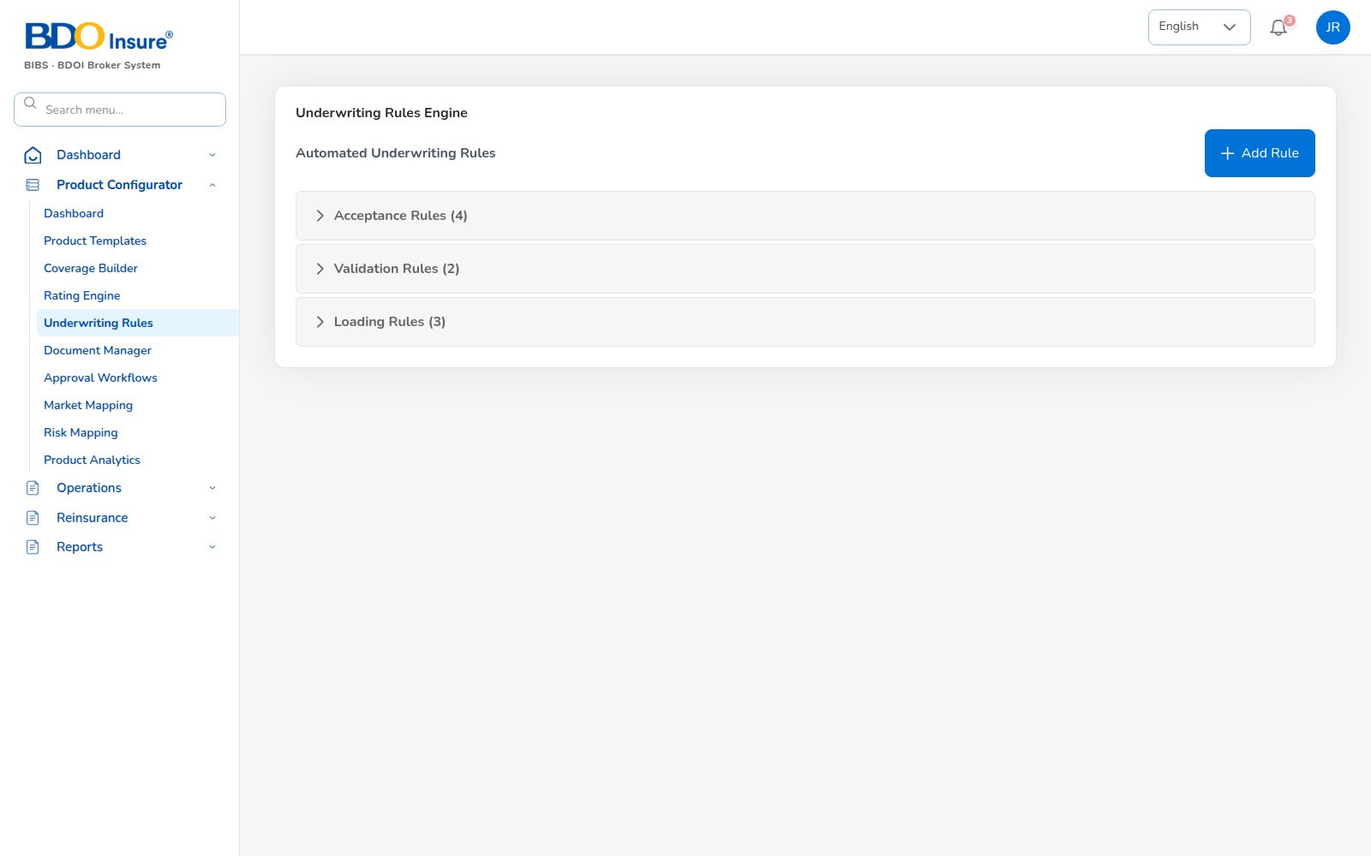
KEY FUNCTION 3 OF 8
Underwriting rules
Product Configurator > Underwriting Rules
Purpose: acceptance, validation and loading rules per product.
Effect: rules refer, decline or load a quote automatically.
Change: Add Rule; publishing follows the approval workflow.
Live screen — Product Configurator > Underwriting Rules — signed in as jose.uw
BrokerVerse | Underwriter
6

Slide 7
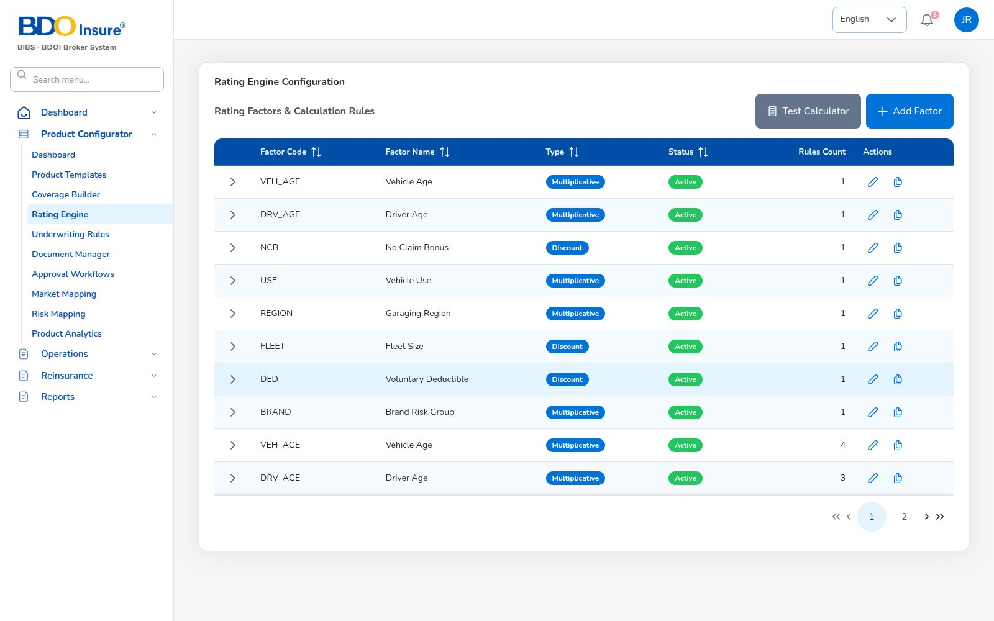
KEY FUNCTION 4 OF 8
Rating engine
Product Configurator > Rating Engine
Purpose: rating factors with multipliers and discounts.
Test Calculation: try a premium before activating.
Downstream: server-side pricing of every new and renewal quote.
Live screen — Product Configurator > Rating Engine — signed in as jose.uw
BrokerVerse | Underwriter
7

Slide 8
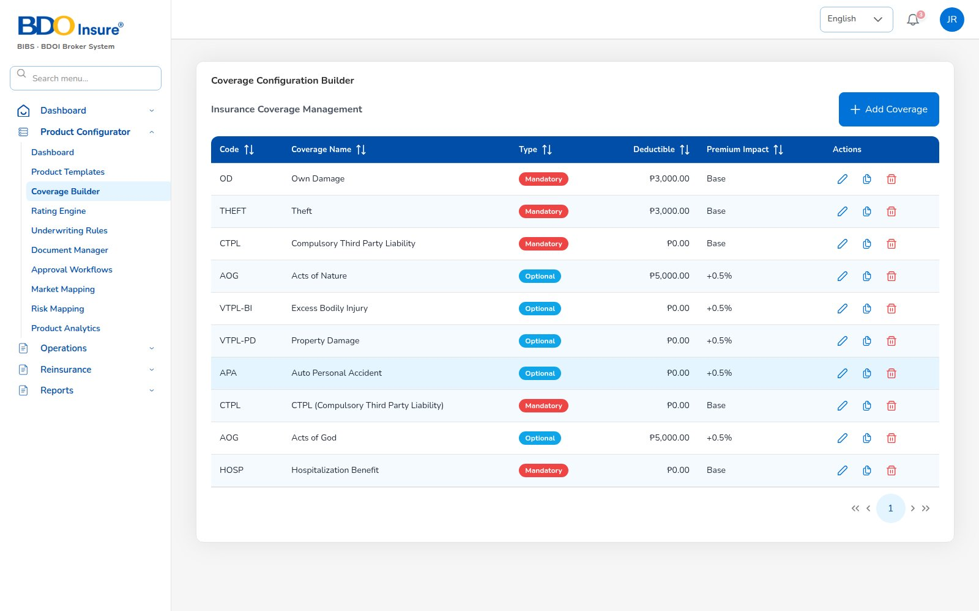
KEY FUNCTION 5 OF 8
Coverage builder
Product Configurator > Coverage Builder
Purpose: coverages (own damage, theft, CTPL, acts of nature, AOG, PA…) with type and deductible.
Types: mandatory or optional; premium impact per coverage.
Downstream: what the quote and endorsement coverage pages offer.
Live screen — Product Configurator > Coverage Builder — signed in as jose.uw
BrokerVerse | Underwriter
8

Slide 9
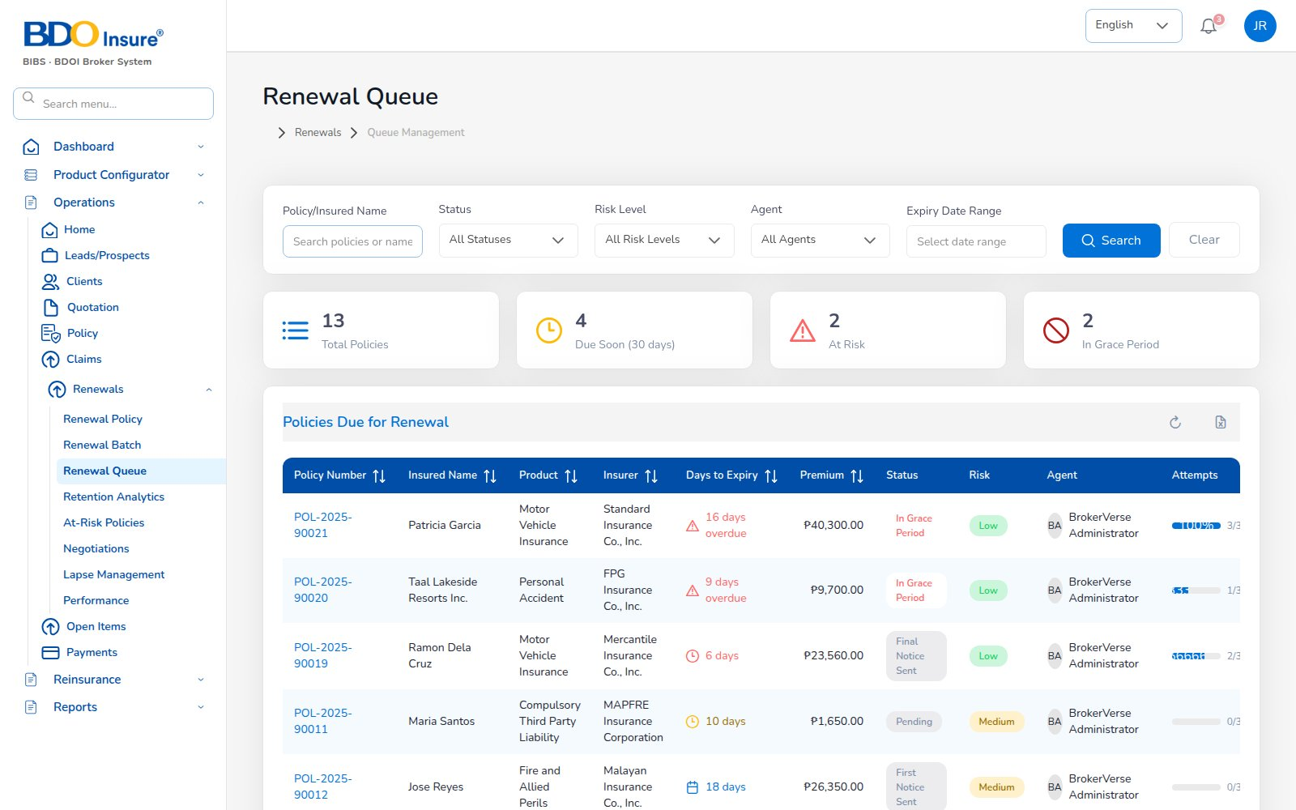
KEY FUNCTION 6 OF 8
Renewal queue
Operations > Renewals > Renewal Queue
Purpose: policies due, days to expiry, risk level, premium and agent.
Rules: renewal maker-checker; notices in order (first, second, final).
Lapse: 30 days after expiry without renewal.
Live screen — Operations > Renewals > Renewal Queue — signed in as jose.uw
BrokerVerse | Underwriter
9

Slide 10
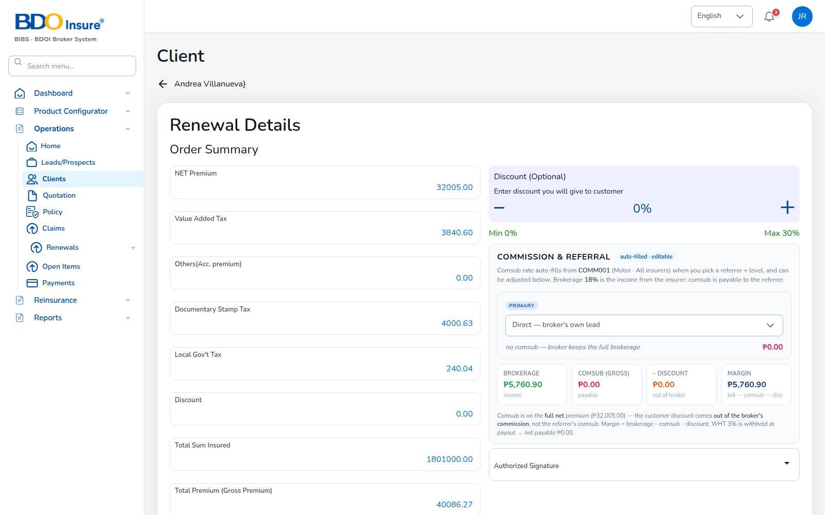
KEY FUNCTION 7 OF 8
Renewal pricing
Policy > Renew > Order Summary
Purpose: renewal quote priced from the expiring policy.
Taxes: VAT 12%, DST 12.5%, LGT 0.75%; discount 0-30% comes out of brokerage.
Commission: brokerage, comsub, discount and margin shown before sending.
Downstream: accepted renewal becomes the new policy term.
Screen from the recorded end-to-end run — Renewal order summary (net 32,005.00, gross 40,086.27) — jose.uw
BrokerVerse | Underwriter
10

Slide 11
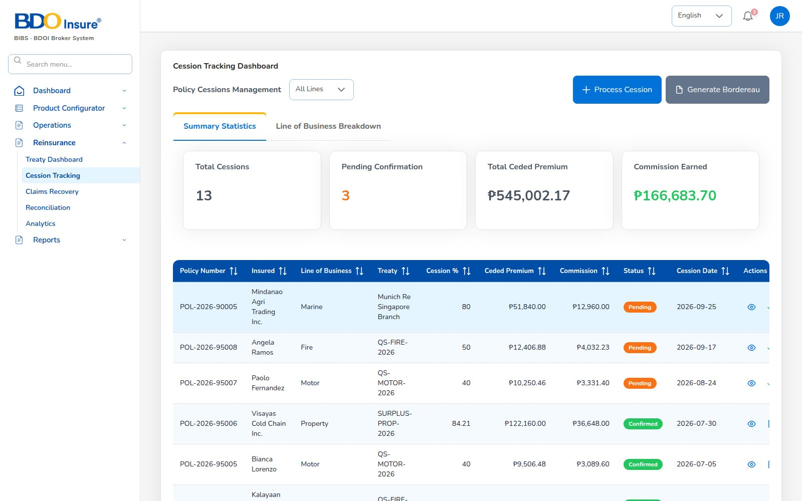
KEY FUNCTION 8 OF 8
Cession tracking
Reinsurance > Cession Tracking
Purpose: policies ceded per treaty: ceded sum, ceded premium, commission earned.
Actions: Process Cession, Generate Bordereaux.
Downstream: Reinsurance Cession Register report and reconciliation.
Live screen — Reinsurance > Cession Tracking — signed in as jose.uw
BrokerVerse | Underwriter
11

Slide 12
LEAD TO RENEWAL
End-to-end flow: your part of the cycle
1
2
3
4
5
6
Lead
Quote
Customer approval
Policy
Billing
Receipt
Agent / Sales / CS
Agent / Sales / UW
Client (e-mail link)
Agent / Sales / UW
System at issuance
Finance
11
10
9
8
7
Renewal
Claim
Endorsement
Remittance
Commission
UW / Sales + schedules
Claims maker + checker
Customer Services
Finance maker + checker
Finance maker + checker
Your steps
Done by other personas or by the system
Renewal pricing feeds the next cycle
2 Quote: approve quotes sent for approval.
4 Policy: rules and rating behind every policy.
11 Renewal: price and approve renewals.
Reinsurance: cessions and recoveries on large risks.
BrokerVerse | Underwriter
12

Slide 13
REPORTS > OPERATIONAL / FINANCIAL
Reports you use
Output formats
CSV
XLSX
PDF
On screen
Scheduled e-mail
Ten reports in your catalogue.
Report | What it shows | Where
Production Register | Policies incepted in the period: premium, commission, new or renewal; by agent, insurer or branch | Reports > Operational > Production
Claims Position | Claims reported: estimate, approved, settled, age; criteria All / Open / Settled / Rejected / Aging | Reports > Operational > Claims
Renewal Retention | Renewals due: retained, lost or pending, old vs new premium, retention rate | Reports > Operational > Renewal
Remittance Summary | Remittances to insurers: gross premium, commission retained, net due, status | Reports > Operational > Remittance
Broker Commission Statement | Commission per agent and policy: basis, rate, gross, WHT, net, paid status | Reports > Operational > Broker Commission
Premium by Product / Month / Insurer | Policy count, sum insured, premium and commission by month, product or insurer | Executive Dashboard > Export Report
New Business vs Renewals | Policies and premium split into new business and renewals per month | Executive Dashboard > Export Report
Claims Ageing | Open claims by ageing bucket (30/60/90/180 days) with estimate and approved | Claims Dashboard > Export Report
Lead Conversion Funnel | Leads by stage (new to converted / lost) with share and conversion rate | Leads > Generate Report
Reinsurance Cession Register | Cessions per treaty and policy: sum insured, ceded sum and premium, share | Reinsurance > Cession Tracking
BrokerVerse | Underwriter
13

Slide 14
MASTER > CONFIGURATION > SCHEDULES
Schedules and automations
Job | When it runs | What it means for you
Quotation expiry | Every day, 00:30 | Unapproved quotes expire after the validity
Renewal pipeline | Every day, 05:30 | Policies 90 days from expiry reach your queue
Renewal notices | Every day, 06:00 | Notices at 60 / 30 / 15 days, in order
Policy expiry | Every day, 00:15 | Expired policies drop out of in-force figures
Daily reports | Every day, 05:00 | Production register each morning
Times are server time (Philippine time in production). The IT administrator can change a timetable, switch a job off or press Run now; every run is recorded.
BrokerVerse | Underwriter
14

Slide 15
BELL ICON, TOP RIGHT
Notifications and approvals
Approval
Quotation sent for approval
Info
Renewal approved / returned
Client, quote number and gross premium.
Sent to the maker with your note.
Approval
Renewal approval
Approval
Treaty awaiting approval
A renewal awaits your decision.
When treaty approval is switched on.
BrokerVerse | Underwriter
15

Slide 16
GOOD TO KNOW
Known limitations and tips
Open items that affect you
Tips
Some quote lists (policy types, vehicle details, signatories) are fixed lists until linked to the masters.
CTPL treatment (separate policy or part of the premium) is awaiting a business decision.
Renewal quotation linking to the expiring policy is being finalised; check insurer, client and vehicle.
Endorsement is still offered on expired policies: do not use it there.
The Clients list can fail to open for this role in the current build.
Use Test Calculation after every rating change.
Keep quotes moving: they expire overnight.
Review at-risk renewals weekly with Sales.
BrokerVerse | Underwriter
16

Slide 17
Thank you
BrokerVerse — Underwriter guide
SUPPORT
Service desk
<to be confirmed by BDOI>
E-mail
<support mailbox to be confirmed>
Hours
<business hours, Manila time, to be confirmed>
Access requests
Your User Access Administrator (Master > User Management)
iorta TechNXT · BrokerVerse insurance-broking platform

