Slide 1

THIS GUIDE IS FOR
Operations
ROLE
BrokerVerse guide for Operations
Operations (Client Servicing)
SIGN-IN
ana.cs
ROLE CODE
operations
Functions, flows, reports and schedules of your role
LANDS ON
BrokerVerse OOTB · insurance broking · Philippines · PHP
Executive Dashboard
Client servicing
Endorsement requests
Open items
Prepared by iorta TechNXT · September 2026

Slide 2
WHO YOU ARE IN BROKERVERSE
Role at a glance
What you do
Sign-in and landing page
User name ana.cs. Lands on the Executive Dashboard. Start the day on Operations > Open Items.
Serves clients: finds the client and answers from one view of policies, claims, renewals and endorsements.
Raises endorsements: personal details, vehicle and coverage changes, extensions and cancellations.
Captures payments: records how the client paid, for Accounting to verify.
Chases open items: expiring policies, pending payments, pending quotes and renewal requests.
Renews: starts renewal quotations and works the renewal screens with Sales.
You hand work to
Processing Team (completes endorsements with the insurer’s document), Accounting (verifies payments), Claims, Sales & Marketing.
Maker-checker partners
Your renewal terms go to the Processing Team for approval. Endorsements become final only when the Processing Team completes them.
BrokerVerse | Operations
2

Slide 3
WHAT YOU SEE AFTER SIGN-IN
Menu map
Menus granted to operations in menuPermissions.js. The role walk opened 27 screens.
Dashboard
Product Configurator
Operations
Reports
Executive Dashboard
Dashboard
Product Templates
Home
Leads/Prospects
Clients
Quotation
Broker Slips
Placement Slips
Policy
Claims
Renewals (8 screens)
Open Items
Payments
All Reports (11 reports)
Operational Reports: Production, Claims, Renewal, Remittance, Broker Commission
BrokerVerse | Operations
3

Slide 4
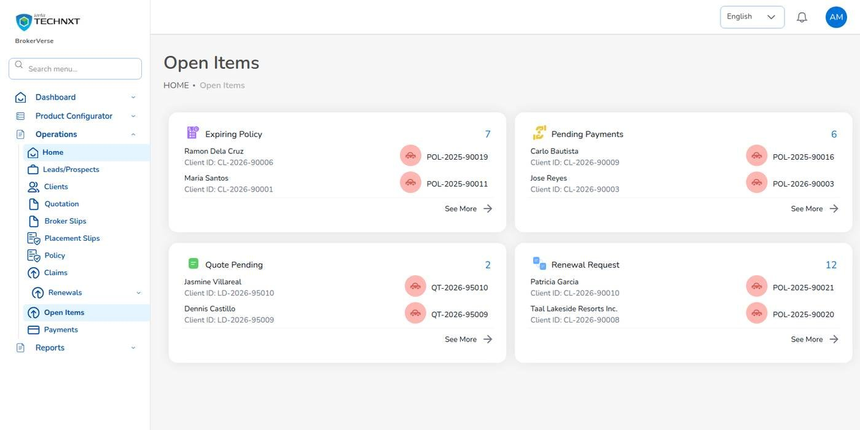
KEY FUNCTION 1 OF 10
Open items
Operations > Open Items
Boxes: Expiring Policy, Pending Payments, Quote Pending and Renewal Request.
See More: opens the full list of a box.
Source: policies, bills and renewals, refreshed by the overnight jobs.
Use: your daily worklist.
Live screen: Operations > Open Items. Signed in as Operations (ana.cs).
BrokerVerse | Operations
4

Slide 5
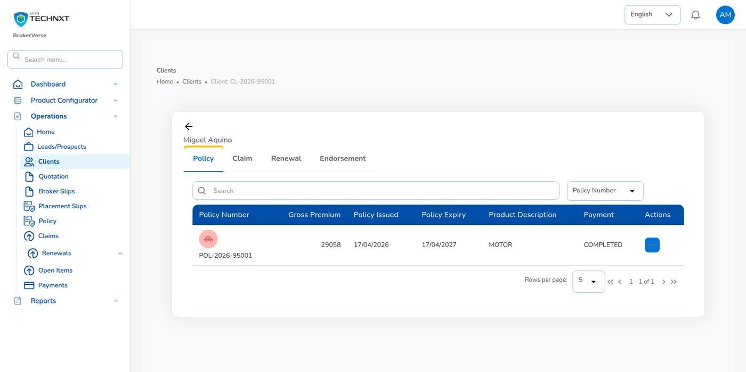
KEY FUNCTION 2 OF 10
Client view
Operations > Clients
Find: tabs All, Individual, Corporate, or search by name.
Tabs: Policy, Claim, Renewal and Endorsement.
Client code: CL- is created when the first policy is issued.
Corrections: name or address on an issued policy: raise a Personal Details Change endorsement.
Live screen: Operations > Clients > client. Signed in as Operations (ana.cs).
BrokerVerse | Operations
5

Slide 6
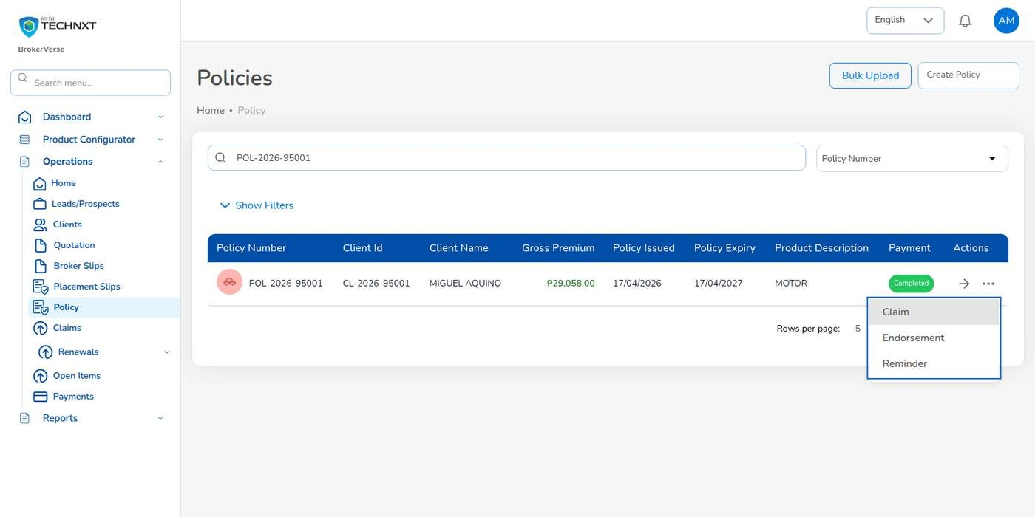
KEY FUNCTION 3 OF 10
Policy list and row actions
Operations > Policy
List: policy number, client, gross premium, dates, product, payment status.
Row menu: Claim, Endorsement, Reminder.
Disabled: while payment is Pending or Reviewing.
Not offered: Endorsement on expired, lapsed, cancelled or renewed policies.
Live screen: Operations > Policy, row actions. Signed in as Operations (ana.cs).
BrokerVerse | Operations
6

Slide 7
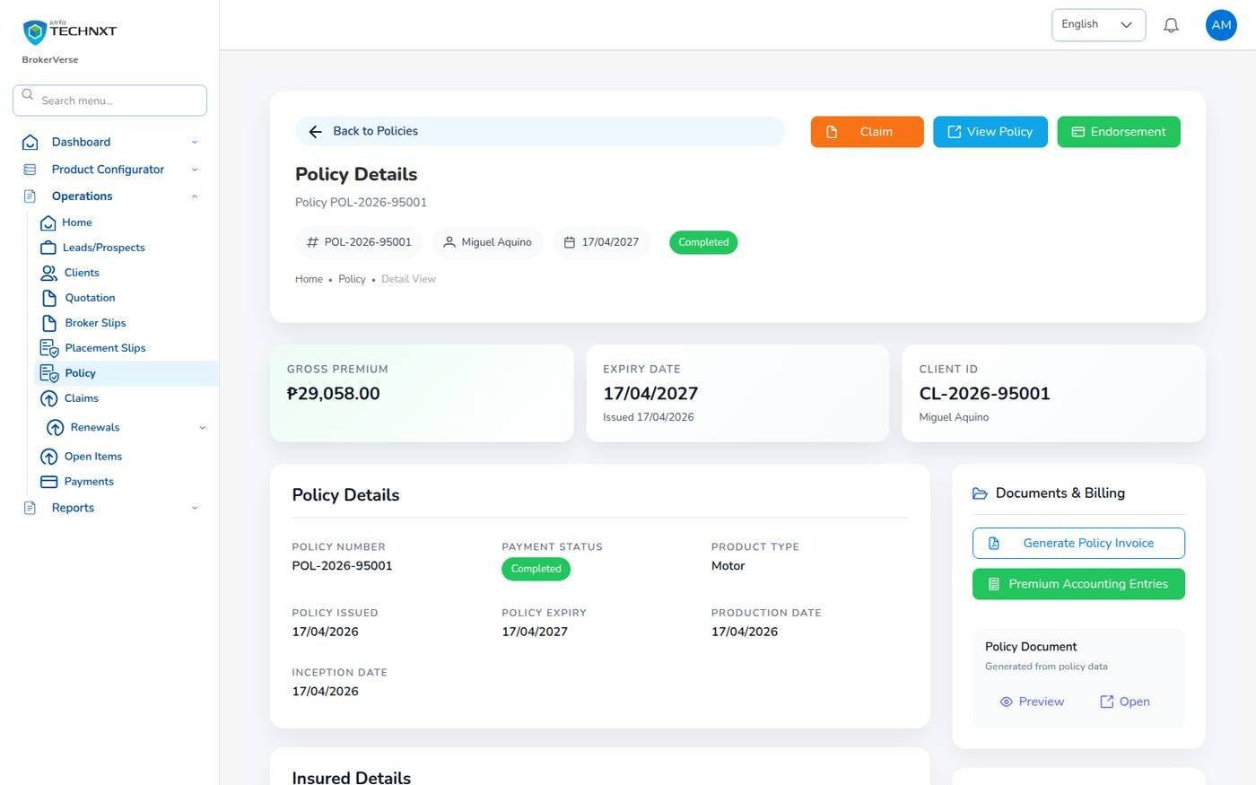
KEY FUNCTION 4 OF 10
Policy details and documents
Operations > Policy > policy
Sections: policy, insured, vehicle and photos, coverage, premium breakdown.
Participants: each insurer with its share on a co-insured policy.
Documents & Billing: Generate Policy Invoice, Premium Accounting Entries, the policy document.
Payment: Proceed to Payment while premium is due.
Live screen: Policy Details. Signed in as Operations (ana.cs).
BrokerVerse | Operations
7

Slide 8
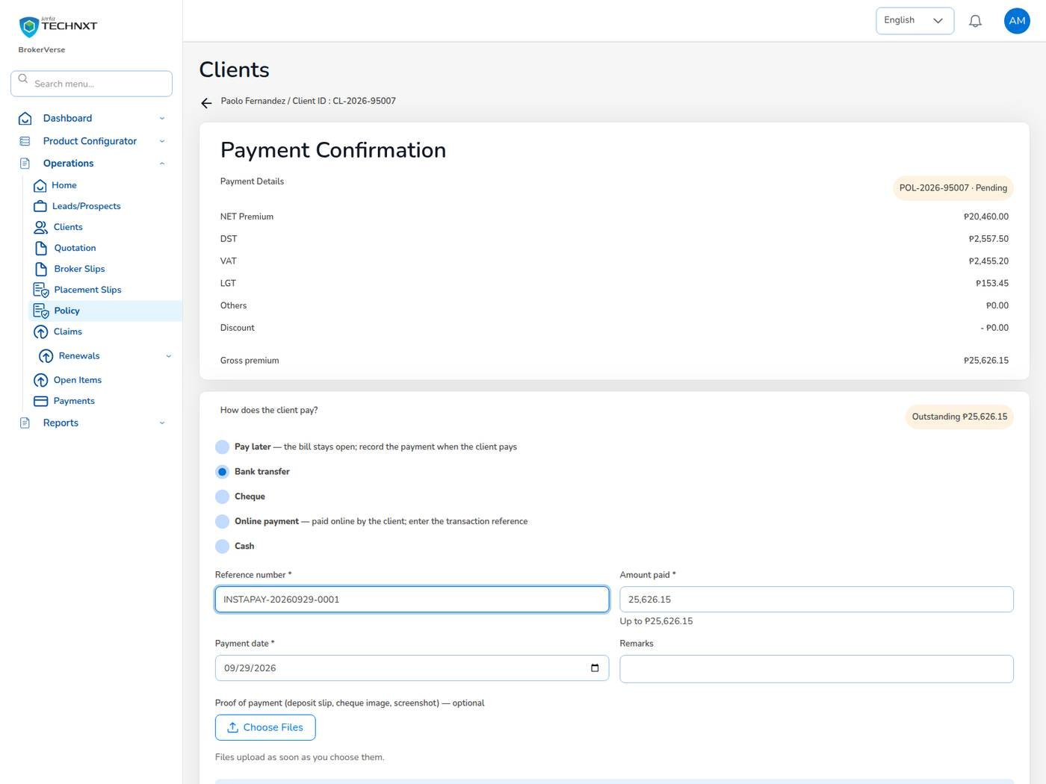
KEY FUNCTION 5 OF 10
Record the client’s payment
Policy > Proceed to Payment
How paid: Pay later, Bank transfer, Cheque, Online payment or Cash.
Details: reference, amount, date, remarks, proof of payment.
Result: payment status Reviewing; Accounting receives Premium payment to verify.
Receipt: Accounting confirms and posts the official receipt, or rejects with a reason.
Live screen: Policy > Proceed to Payment. Signed in as Operations (ana.cs).
BrokerVerse | Operations
8

Slide 9
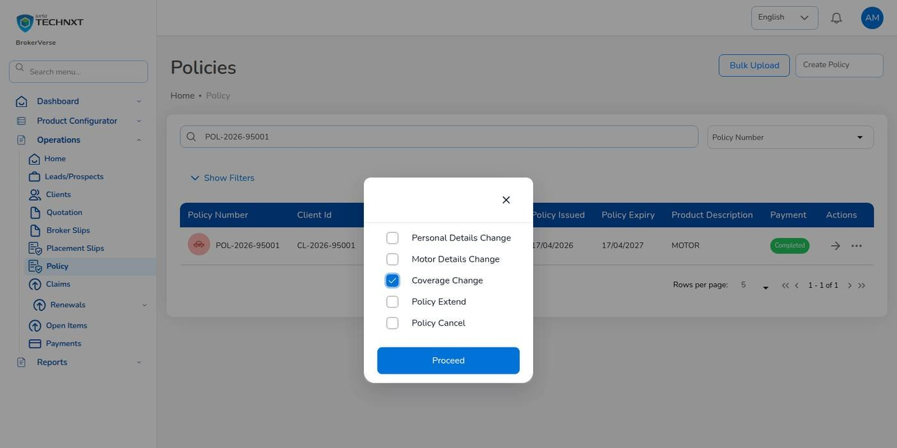
KEY FUNCTION 6 OF 10
Choose the endorsement type
Policy > three dots > Endorsement
Motor: Personal Details, Motor Details, Coverage Change, Policy Extend, Policy Cancel.
Fire: Regular / Premium Change, Policy Cancellation (full, partial, pro-rata).
Proceed: stays disabled until you tick a type.
Number: END- when saved.
Live screen: Policy > Endorsement, type. Signed in as Operations (ana.cs).
BrokerVerse | Operations
9

Slide 10
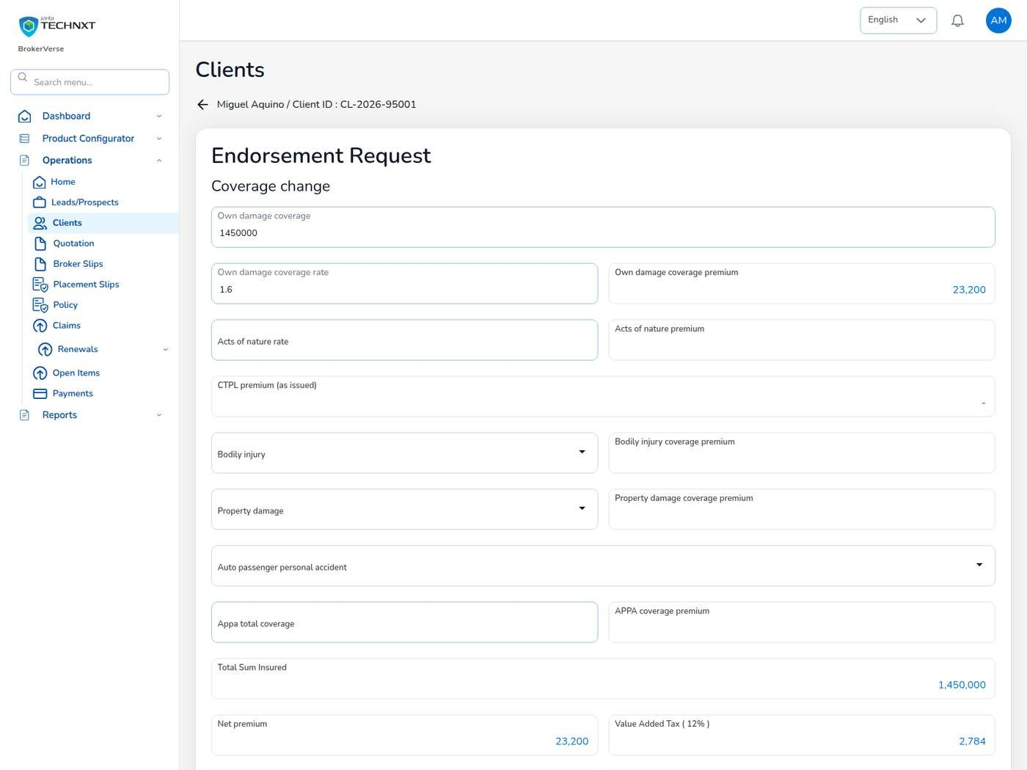
KEY FUNCTION 7 OF 10
Coverage change, priced again
Endorsement Request > Coverage Change
Recalculated: net premium, VAT, DST, LGT, gross premium and Premium change.
CTPL: stays as issued.
Send: Save & Next, check the summary, Send to Insurance Company.
Money: additional premium is billed when the Processing Team completes the endorsement.
Live screen: Endorsement request, coverage change. Signed in as Operations (ana.cs).
BrokerVerse | Operations
10

Slide 11
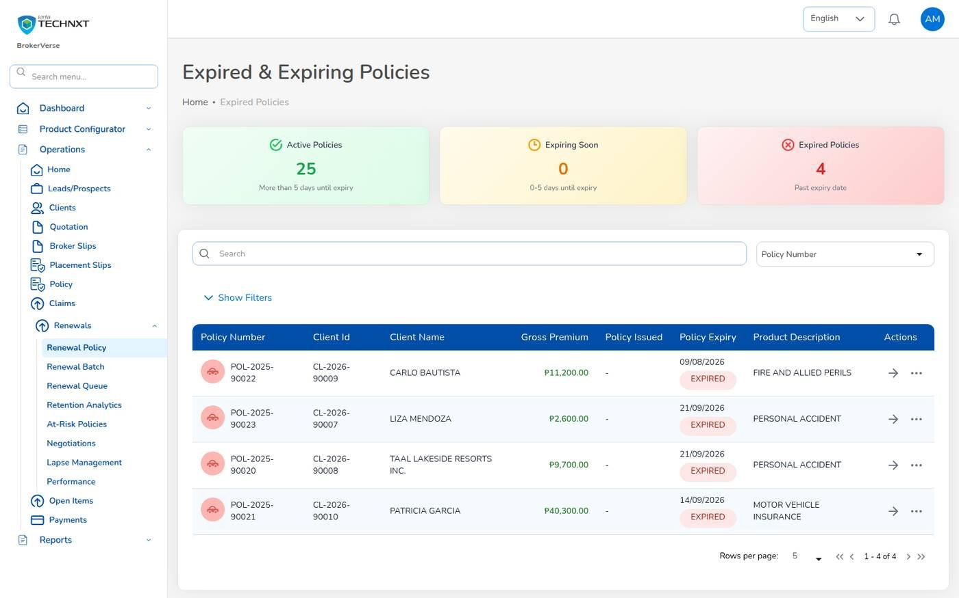
KEY FUNCTION 8 OF 10
Renewal Policy
Operations > Renewals > Renewal Policy
Shows: active, expiring and expired policies.
Renew: three dots > Renewal opens a quotation with the covers of the expiring term.
Then: Calculate, Completed Quote, send for customer approval, Proceed to Policy.
Result: new term issued, old policy Renewed, premium billed.
Live screen: Operations > Renewals > Renewal Policy. Signed in as Operations (ana.cs).
BrokerVerse | Operations
11

Slide 12
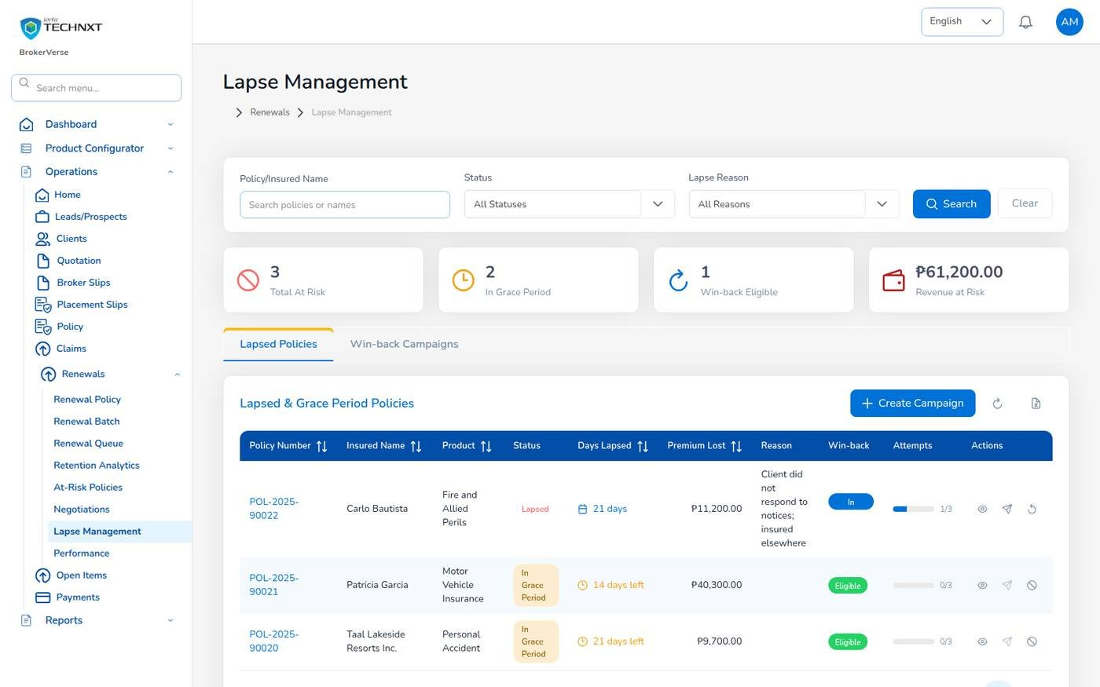
KEY FUNCTION 9 OF 10
Lapse management
Operations > Renewals > Lapse Management
Grace: an unrenewed policy lapses 30 days after expiry (renewals.grace_period_days).
Shows: lapsed policies, policies in the grace period and win-back campaigns.
Batch: Renewal Batch sends notices for up to 500 policies together.
Queue: Renewal Queue lists days to expiry, risk and contact attempts.
Live screen: Operations > Renewals > Lapse Management. Signed in as Operations (ana.cs).
BrokerVerse | Operations
12

Slide 13
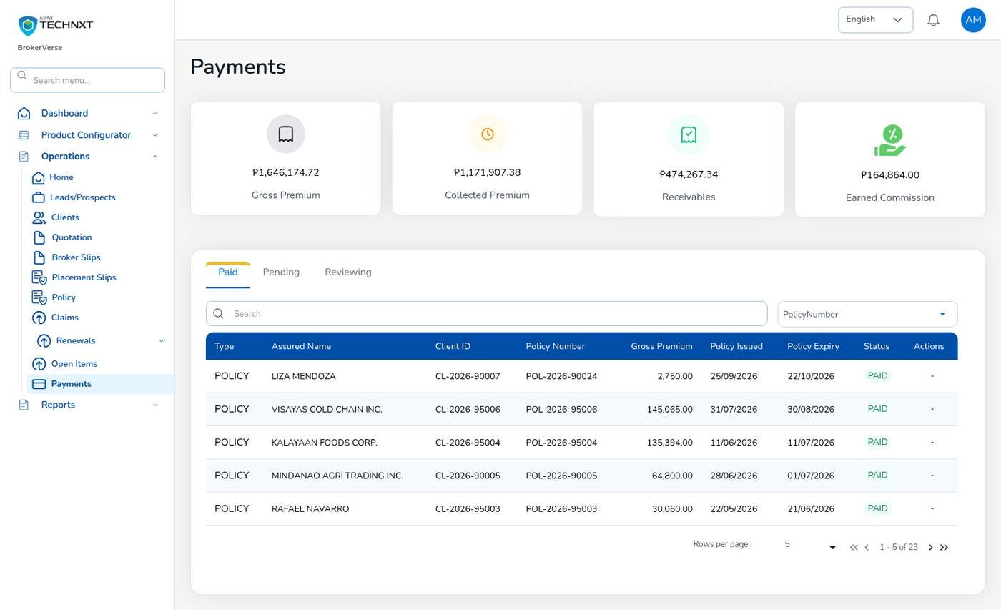
KEY FUNCTION 10 OF 10
Payments
Operations > Payments
Figures: gross premium, collected premium, receivables and earned commission.
Tabs: Paid, Pending, Reviewing.
Type: policy, renewal or endorsement; DIRECT BILL for bills cancelled by direct billing.
Note: Accounting posts the receipts; this screen shows the result.
Live screen: Operations > Payments. Signed in as Operations (ana.cs).
BrokerVerse | Operations
13

Slide 14
LEAD TO RENEWAL
End-to-end flow: your part of the cycle
1
2
3
4
5
6
7
Lead
Broker Slip
Quotation Slip
Placement Slip
Policy issue
Payment capture
Official receipt
Sales, Operations
Processing Team
Sales, Processing
Processing Team
Processing Team
Operations, Sales, Processing
Accounting
13
12
11
10
9
8
Month-end
Renewal
Claim
Endorsement
Remittance
Commission
Accounting, Acct. Manager
Operations, Sales, Processing
Claims, two users
Operations, Processing
Accounting, two users
Accounting, two users
Your steps
Done by other personas or by the system
Renewal follow-up starts the next cycle
1 Lead: you can record prospects like Sales.
6 Payment capture: record how the client paid.
10 Endorsement: raise the request; Processing completes it.
12 Renewal: chase expiring policies.
BrokerVerse | Operations
14

Slide 15
REPORTS > ALL REPORTS
Reports you use (11)
Output formats
CSV
XLSX
PDF
Preview
Scheduled e-mail
Eleven operational reports in Reports > All Reports.
Report | What it shows
Production Register | Policies incepted in the period: premium, commission, new or renewal, billing mode
Premium by Product / Month / Insurer | Policy count, sum insured, premium and commission
New Business vs Renewals | New business and renewals by month or agent
Lead Conversion Funnel | Leads by stage with the conversion rate
Placement Pipeline | Broker Slips and Placement Slips of the period with status, lead insurer, premium and age
Market Response | Insurers approached: offers, declines, pending, response days and hit ratio
Claims Position | Claims reported: estimate, approved, settled and age
Claims Ageing | Open claims by ageing bucket
Renewal Retention | Renewals due: retained, lost or pending, and the retention rate
Remittance Summary | Remittances to insurers: gross premium, commission, net due, status
Broker Commission Statement | Commission per agent and policy: basis, rate, gross, WHT, net, paid status
BrokerVerse | Operations
15

Slide 16
MASTER > CONFIGURATION > SCHEDULES
Schedules and automations
Job | When it runs | What it means for you
Renewal notices | Daily 06:00 | Clients get notices at 60, 30 and 15 days
Collection reminders | Daily 08:00 | Clients reminded 7 days before premium is due
Receivable ageing | Daily 07:00 | Pending payments move to older buckets
Policy expiry | Daily 00:15 | Expired policies show in Open Items
Renewal pipeline | Daily 05:30 | Policies within 90 days enter the renewal queue
E-mail outbox | Every 5 minutes | Client e-mails leave every 5 minutes
Times are Manila time (general.timezone). The System Administrator changes a timetable, switches a job on or off, or runs it now; every run is recorded.
BrokerVerse | Operations
16

Slide 17
BELL ICON, TOP RIGHT
Notifications and approvals
Info
Endorsement completed
Task
Customer accepted quotation
With the premium change, for policies you own.
For quotations you created.
Info
Policy cancelled by endorsement
Reminder
Premium overdue
When a cancellation is completed.
For policies you own.
Reminder
Renewal notice reminders
Alert
Policy lapsed
For each notice on your policies.
No renewal within the grace period.
BrokerVerse | Operations
17

Slide 18
GOOD TO KNOW
Known limitations and tips
Open items that affect you
Tips
The sign-in session is kept in the browser’s local storage: sign out on shared computers and keep the browser up to date.
Two-factor set-up shows a setup key and an app link but no QR code: type the key into the authenticator app.
Filipino is configured as a language but has no screen translation yet.
Endorsement is offered only on policies in force whose premium is not Pending or Reviewing: renew an expired policy instead.
Pick the endorsement type first, then Proceed.
Attach proof of payment when you record it.
Start the day on Open Items.
Tell the Processing Team when the insurer’s endorsement arrives.
BrokerVerse | Operations
18

Slide 19
Thank you
BrokerVerse guide for Operations
SUPPORT
First line
The key user of your team: how-to questions, checking that a role or setting is not the cause
Second line
Your System Administrator: users, roles, passwords, two-step resets, settings and master data
Third line
iorta TechNXT production support, raised by the System Administrator through the support agreement
Access requests
Your System Administrator (Master > Generals > User Management)
When you report a problem, give the menu path, the record number, the time, your user ID, the message and its request ID. Never send a password or a two-step code.
iorta TechNXT · BrokerVerse insurance broking platform

