Slide 1

THIS GUIDE IS FOR
Accounting
ROLE
BrokerVerse guide for Accounting
Accounting
SIGN-IN
liza.finance; fe.approver and fin.approver as second users
ROLE CODE
Functions, flows, reports and schedules of your role
accounting
BrokerVerse OOTB · insurance broking · Philippines · PHP
LANDS ON
Executive Dashboard
Receipts and remittance
Bank reconciliation
Month-end and BIR
Prepared by iorta TechNXT · September 2026

Slide 2
WHO YOU ARE IN BROKERVERSE
Role at a glance
What you do
Sign-in and landing page
User name liza.finance. Lands on the Executive Dashboard. fe.approver and fin.approver hold the same role and act as the second user.
Collects: verifies payments, posts official receipts, follows collections and ageing.
Pays: commission to referrers, net premium to each insurer by share, suppliers by voucher and cheque.
Bills insurers: direct-bill commission on debit notes and records the insurer’s payment.
Keeps the ledger: journal vouchers, write-offs, bank reconciliation, month-end and year-end preparation.
Files tax: BIR Form 2307, VAT Summary, SAWT, QAP and SLSP.
You hand work to
A second Accounting user (vouchers, JVs, remittances, settlements, debit notes, incentive batches), the Accounting Manager (close runs, reconciliations), insurers and referrers.
Maker-checker partners
Maker-checker is on (finance.maker_checker_enabled, journal.require_approval): you cannot approve what you prepared.
BrokerVerse | Accounting
2

Slide 3
WHAT YOU SEE AFTER SIGN-IN
Menu map
Menus granted to accounting in menuPermissions.js. The role walk opened 81 screens.
Dashboard
Operations
Accounts
Master > Finance
Executive Dashboard
Open Items
Payments
Receipts, Collections
Accounting Query, All Clients Accounting
Open Entry Matching / Un-Matching
Disbursement, Petty Cash (5 screens)
Journal Voucher, Correction JV, Reversal JV
Period End (5 screens)
Bank Reconciliation (7 screens)
Tax (6 screens)
Remittance (16 screens)
Incentive (4 screens)
Taxation
Close Checklist
Bank Statement Formats
Bank Transaction Types
Commission
Reinsurance
Reports
Commission Dashboard
Agents/Referrer Accounts
Reconciliation
All Reports (32 reports)
Financial Reports (15 shortcuts)
Operational Reports: Remittance, Broker Commission
BrokerVerse | Accounting
3

Slide 4
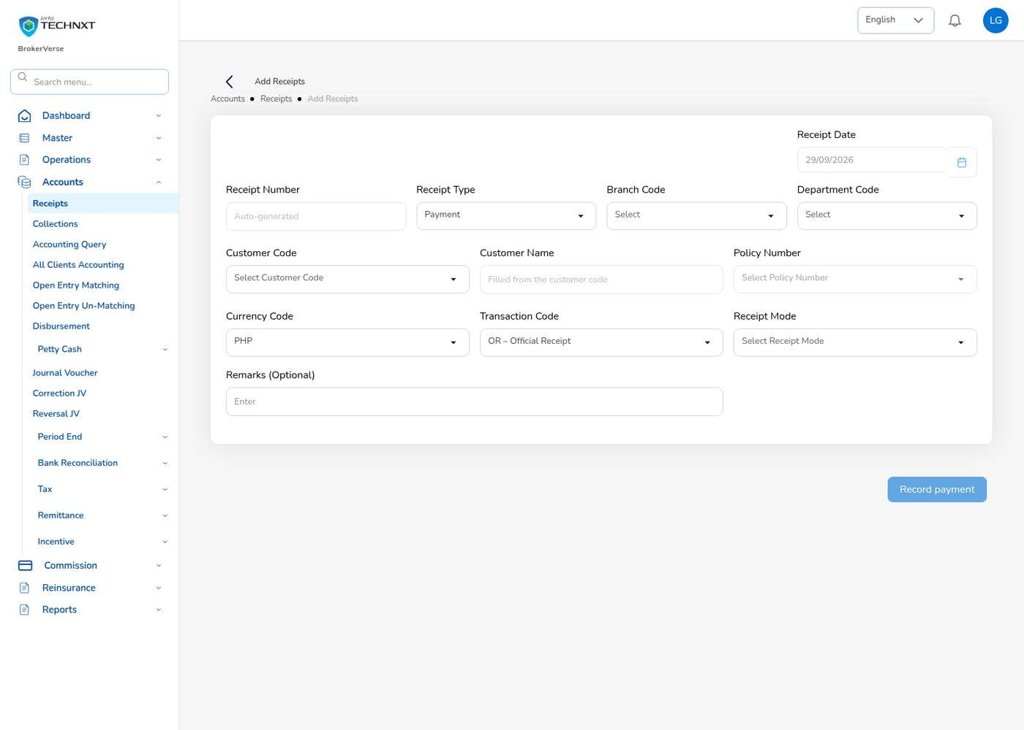
KEY FUNCTION 1 OF 12
Verify a payment and post the receipt
Notification “Premium payment to verify”, or Accounts > Receipts
Verify: check the bank statement, then Confirm (posts the OR) or Reject with a reason.
Direct: pick the client, policy and open bill; enter the amount or Pay full balance.
Journal: Dr Cash in Bank / Cr Premiums Receivable; bill Partial or Paid.
Rule: the amount cannot exceed the bill balance.
Live screen: Accounts > Receipts > Receipt. Signed in as Accounting (liza.finance).
BrokerVerse | Accounting
4

Slide 5
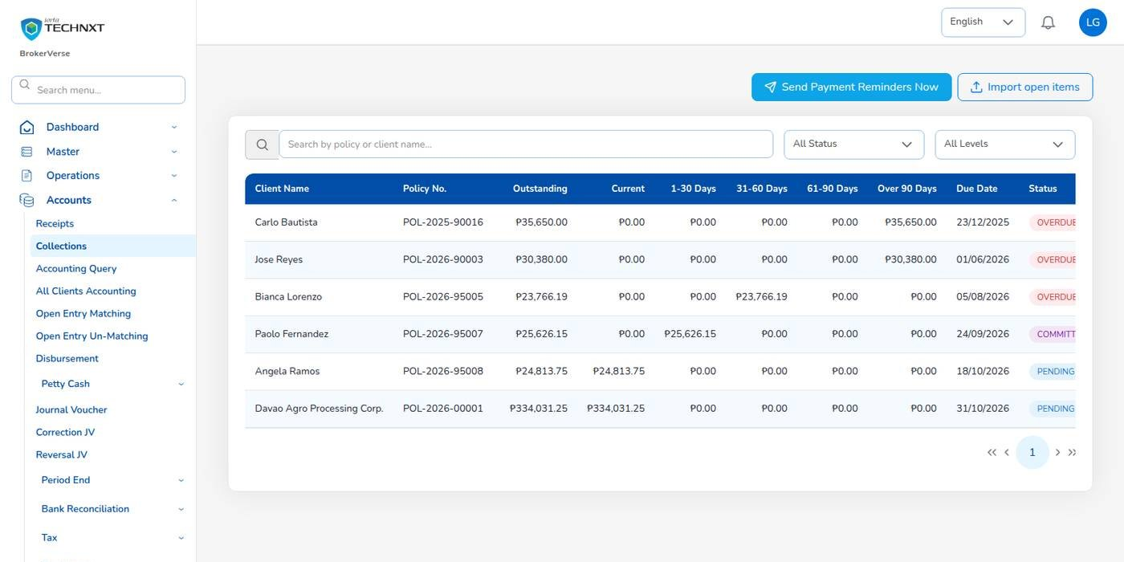
KEY FUNCTION 2 OF 12
Collections and ageing
Accounts > Collections
Buckets: Current, 1-30, 31-60, 61-90, over 90 days.
Due date: the insurer’s premium payment warranty, else 30 days.
Reminders: the 08:00 job, or Send Payment Reminders Now.
Go-live: Import open items loads unpaid bills of the old system, with no journal.
Live screen: Accounts > Collections. Signed in as Accounting (liza.finance).
BrokerVerse | Accounting
5

Slide 6
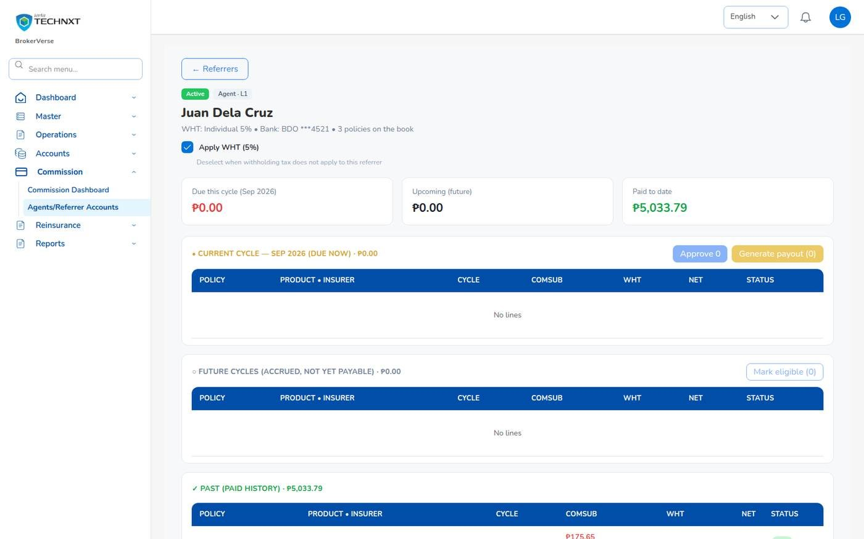
KEY FUNCTION 3 OF 12
Pay commission to a referrer
Commission > Agents/Referrer Accounts
Eligible: when the premium is fully collected and a bank account is on file.
WHT: individual 5%, company 10% (commission.wht_rate_by_type).
Two users: Approve the lines, Generate payout; a second user approves the voucher.
Journal: Dr Commission Payable / Cr Cash in Bank and WHT payable.
Live screen: Commission > Agents/Referrer Accounts > referrer. Signed in as Accounting (liza.finance).
BrokerVerse | Accounting
6

Slide 7
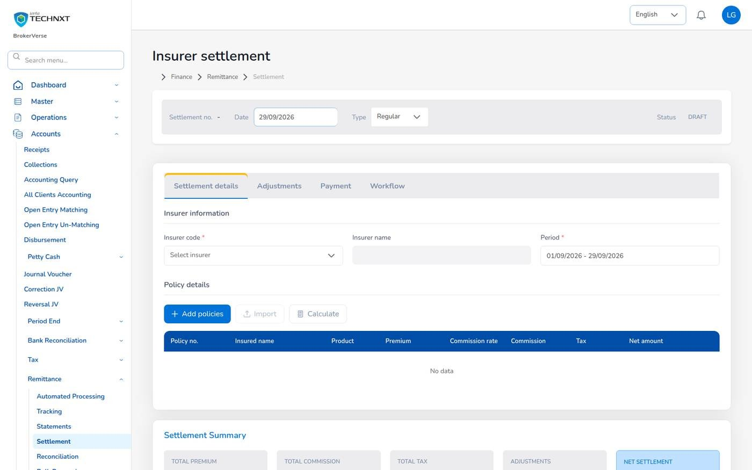
KEY FUNCTION 4 OF 12
Remit premium to insurers
Accounts > Remittance
Draft: Automated Processing creates REM- per insurer from collected premium.
Approve: by a second user; level by amount (₱ 100,000, ₱ 1,000,000, above).
Settle: premium less commission less tax, plus or minus adjustments; SET- raises the insurer PV.
Co-insurance: each insurer is remitted its own share; refunds are netted.
Live screen: Accounts > Remittance > Settlement. Signed in as Accounting (liza.finance).
BrokerVerse | Accounting
7

Slide 8
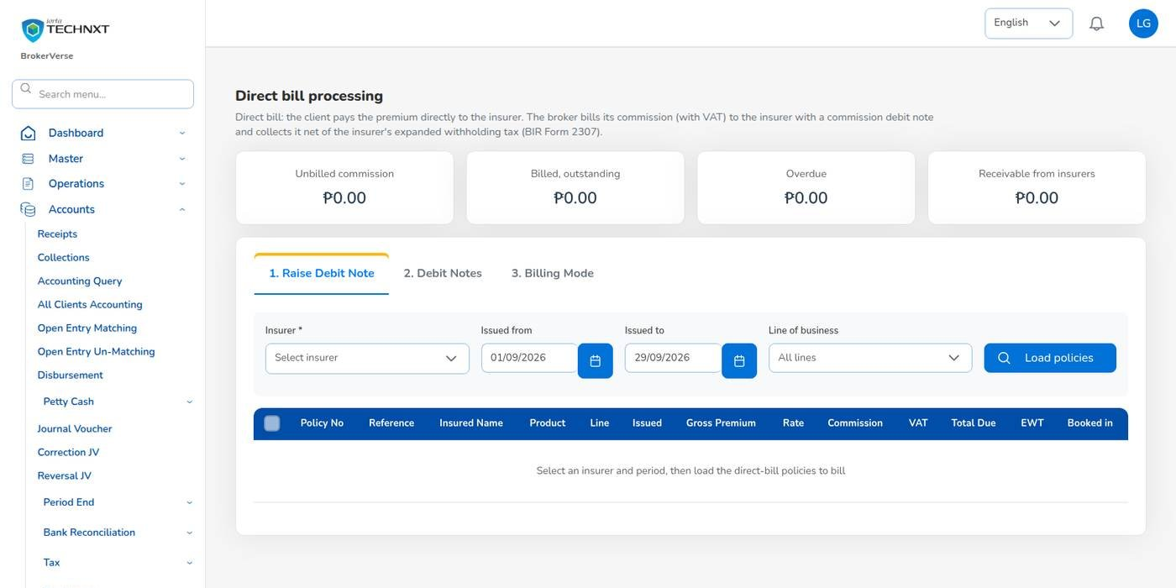
KEY FUNCTION 5 OF 12
Direct bill: commission debit notes
Accounts > Remittance > Direct Bill Processing
Raise: insurer and dates, Load policies, tick them; commission plus 12% VAT, less 10% EWT.
Approve: a second user approves, prints and e-mails the DN-.
Collect: Post collection with cash and tax withheld; partial payments allowed.
Billing Mode tab: switch a policy with a reason, unless premium was collected.
Live screen: Remittance > Direct Bill Processing. Signed in as Accounting (liza.finance).
BrokerVerse | Accounting
8

Slide 9
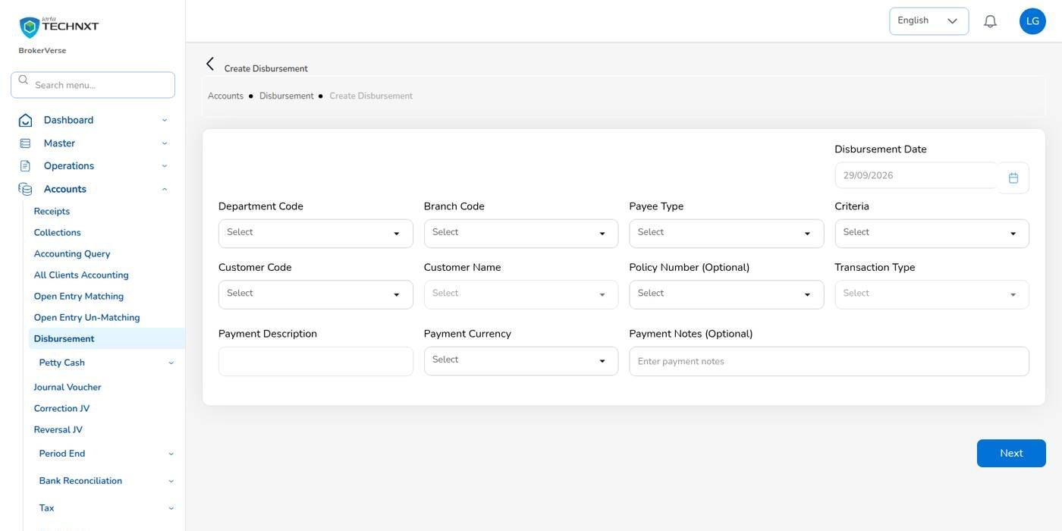
KEY FUNCTION 6 OF 12
Disbursement: vouchers and cheques
Accounts > Disbursement
Payee: customer, insurer, agent or referrer, or supplier; then tick the payables.
Statuses: Draft, For approval, Approved, Paid; Cancelled.
Checker: approves the cheque; print it and the voucher becomes Paid.
Bulk: Bulk Disburse, one payout voucher per referrer with approved commission.
Live screen: Accounts > Disbursement > Create. Signed in as Accounting (liza.finance).
BrokerVerse | Accounting
9

Slide 10
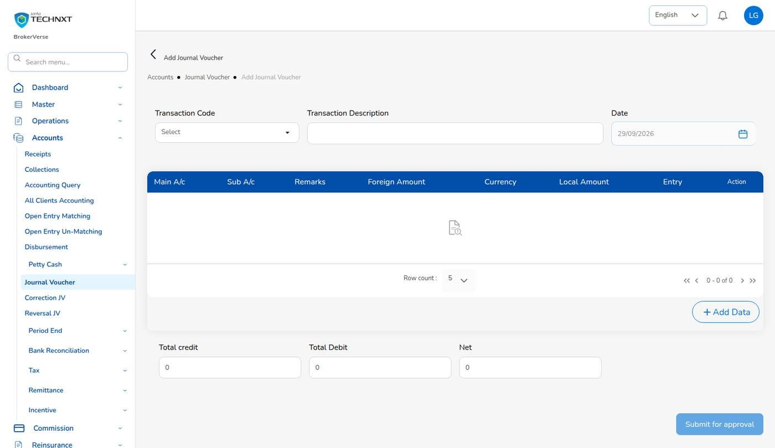
KEY FUNCTION 7 OF 12
Journal vouchers
Accounts > Journal Voucher
Lines: main account, sub account, debit or credit, branch, department, amount.
Balance: an unbalanced voucher is refused with the difference.
Periods: soft-closed only for the Accounting Manager; closed periods refuse it.
Correction and Reversal JV: reverse and repost a posted voucher, after approval.
Live screen: Accounts > Journal Voucher > Voucher. Signed in as Accounting (liza.finance).
BrokerVerse | Accounting
10

Slide 11
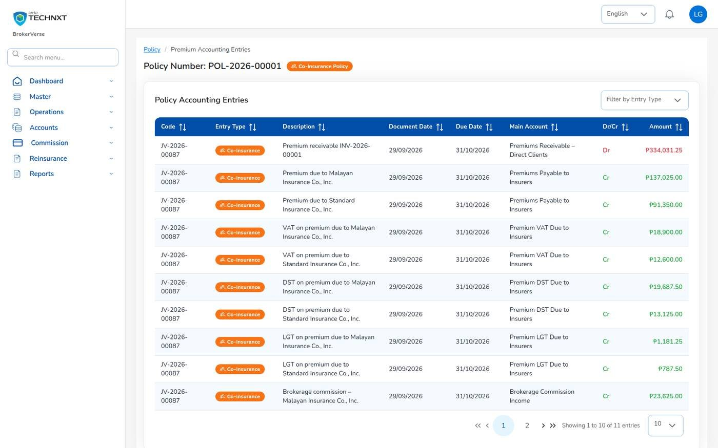
KEY FUNCTION 8 OF 12
What operations post to the ledger
Policy > Documents & Billing > Premium Accounting Entries
Posting rules: every system journal comes from the rule of its business event.
Per insurer: payables and commission of a co-insured policy carry the insurer on each line.
Trail: new business, receipts, commission, remittance, endorsements for one policy.
Changes: posting rules are kept by the System Administrator, with the Accounting Manager.
Live screen: Premium accounting entries of POL-2026-00001. Signed in as Accounting (liza.finance).
BrokerVerse | Accounting
11

Slide 12
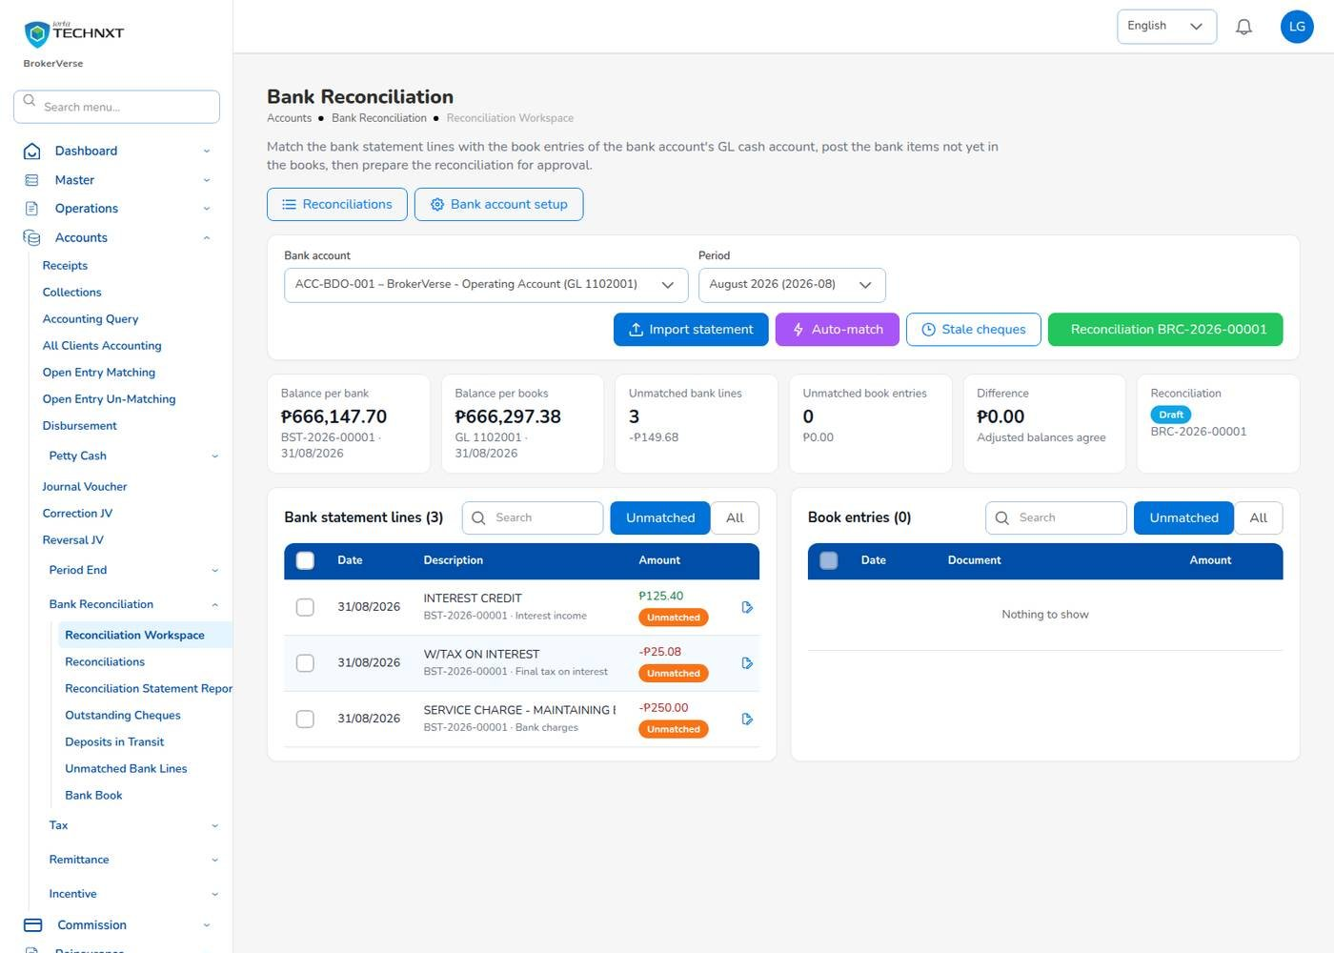
KEY FUNCTION 9 OF 12
Bank reconciliation workspace
Accounts > Bank Reconciliation > Reconciliation Workspace
Import: CSV or XLSX in the bank’s format (BDO, BPI, Metrobank, generic); BST- issued.
Match: Auto-match rules, then Match selected by hand with the treatment of any difference.
Bank items: Create adjustment for charges and interest; Mark as bank error.
Prepare: Start reconciliation (BRC-), difference ₱ 0.00, Prepare; the Accounting Manager approves.
Live screen: Bank Reconciliation workspace, ACC-BDO-001, August 2026. Signed in as Accounting (liza.finance).
BrokerVerse | Accounting
12

Slide 13
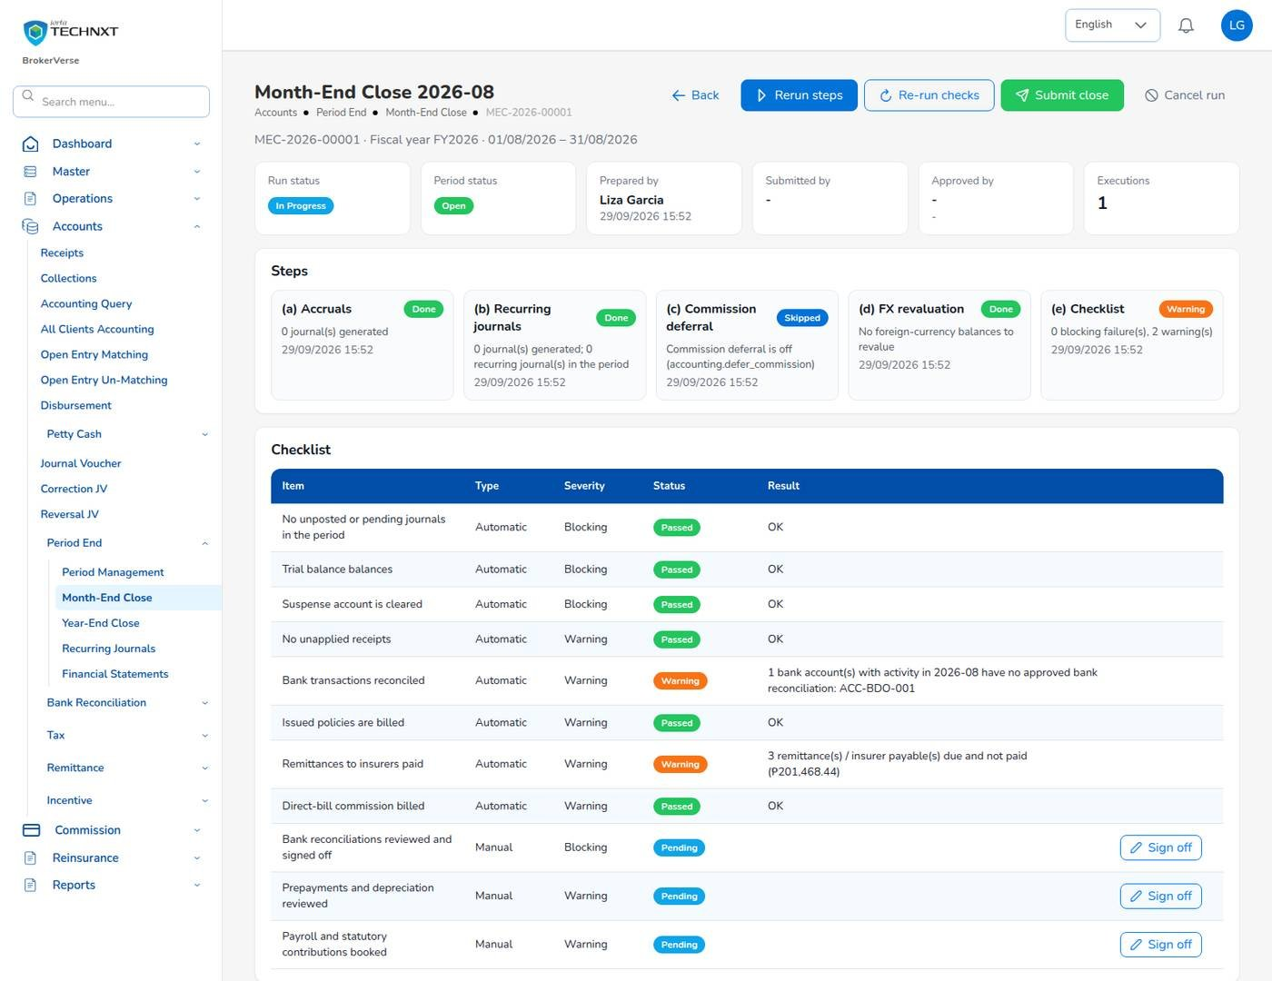
KEY FUNCTION 10 OF 12
Month-end close: prepare
Accounts > Period End > Month-End Close
Steps: accruals, recurring journals, commission deferral, FX revaluation, checklist.
Checklist: automatic checks Passed, Warning or Failed; sign off the manual items.
Submit close: blocked while a blocking item fails or is not signed off.
Approval: the Accounting Manager approves; the period becomes closed.
Live screen: Month-End Close 2026-08, MEC-2026-00001. Signed in as Accounting (liza.finance).
BrokerVerse | Accounting
13

Slide 14
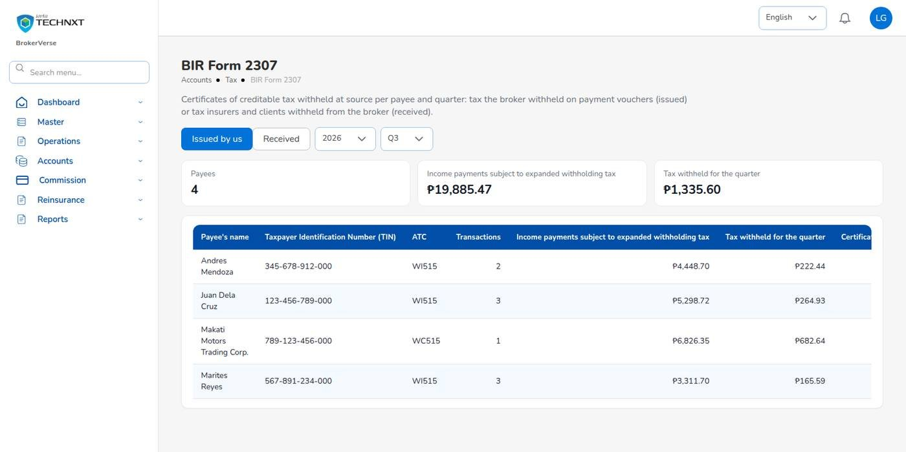
KEY FUNCTION 11 OF 12
BIR Form 2307 and tax reports
Accounts > Tax
2307: Issued by us (payees) or Received (insurers, clients), per quarter; CWT- when issued.
VAT Summary: working paper for 2550M / 2550Q.
SAWT, QAP, SLSP: alphalists in BIR column order.
Before filing: fill in the BIR group of Master > Configuration.
Live screen: Accounts > Tax > BIR Form 2307. Signed in as Accounting (liza.finance).
BrokerVerse | Accounting
14

Slide 15
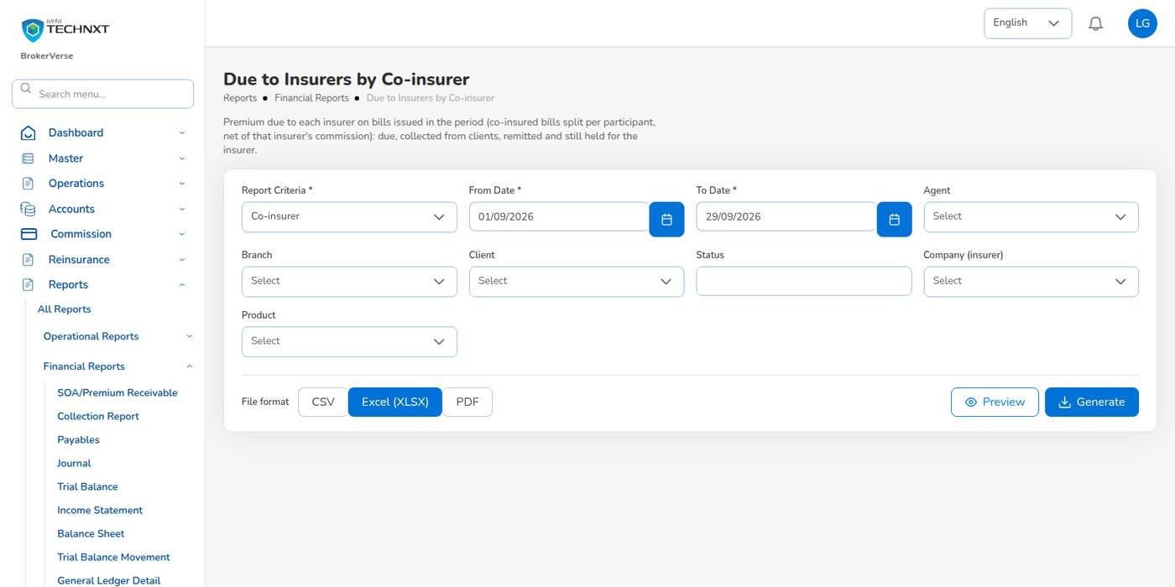
KEY FUNCTION 12 OF 12
Due to insurers by co-insurer
Reports > Financial Reports
Shows: premium due to each insurer on the bills of the period.
Columns: due, collected, remitted and still held, per participant.
With: Co-insurance Register and Aged Payables to Insurers.
Formats: CSV, Excel or PDF on the letterhead.
Live screen: Reports > Financial Reports > Due to Insurers by Co-insurer. Signed in as Accounting (liza.finance).
BrokerVerse | Accounting
15

Slide 16
POSTING RULES (MASTER > FINANCE)
From operations to the ledger
Each business event posts its journal through a posting rule. The main events and their journals:
Event (who) | Journal
Policy issued, broker billed (Processing) | Dr Premiums Receivable / Cr Premiums Payable to Insurers, premium taxes, Brokerage Commission Income (per insurer)
Policy issued, direct bill (Processing) | Dr Commission Receivable - Insurers / Cr Brokerage Commission Income, Output VAT Payable
Official receipt (Accounting) | Dr Cash in Bank / Cr Premiums Receivable
Debit note collected (Accounting) | Dr Cash in Bank, Creditable Withholding Tax (2307) / Cr Commission Receivable - Insurers
Comsub approved and paid (Accounting) | Dr Commission Expense / Cr Commission Payable; then Dr Commission Payable / Cr Cash, WHT
Remittance settled (Accounting) | Dr Premiums Payable to Insurers / Cr Cash in Bank
Endorsement (Operations, Processing) | Additional premium billed, or return premium credited and netted on the next remittance
Claim through the broker (Claims) | Recoverable from each insurer by share / payable to the claimant
Example: POL-2026-00001 (Malayan 60%, Standard 40%) posted JV-2026-00087: receivable 334,031.25; payable to insurers 228,375.00; premium taxes 66,281.25; commission income 39,375.00.
BrokerVerse | Accounting
16

Slide 17
LEAD TO RENEWAL
End-to-end flow: your part of the cycle
1
2
3
4
5
6
7
Lead
Broker Slip
Quotation Slip
Placement Slip
Policy issue
Payment capture
Official receipt
Sales, Operations
Processing Team
Sales, Processing
Processing Team
Processing Team
Operations, Sales, Processing
Accounting
13
12
11
10
9
8
Month-end
Renewal
Claim
Endorsement
Remittance
Commission
Accounting, Acct. Manager
Operations, Sales, Processing
Claims, two users
Operations, Processing
Accounting, two users
Accounting, two users
Your steps
Done by other personas or by the system
Endorsement and renewal bills come back to you as receipts
7 Official receipt: verify the payment and post the OR.
8 Commission: approve lines, pay by voucher.
9 Remittance: net premium to each insurer by share.
13 Month-end: reconcile banks, prepare the close, BIR.
BrokerVerse | Accounting
17

Slide 18
REPORTS > ALL REPORTS
Reports you use (32)
Output formats
CSV
XLSX
PDF
Preview
Scheduled e-mail
32 reports; tax and bank reports also under Accounts.
Production and placement
Insurers and commission
Receivables and cash
Premium by Product / Month / Insurer
New Business vs Renewals
Co-insurance Register
Reinsurance Cession Register
Remittance Summary
Broker Commission Statement
Commission Receivable (Direct Bill)
Due to Insurers by Co-insurer
Aged Payables to Insurers
Incentive Results
SOA / Premium Receivable
Receivables Ageing
Collection Report
Receipts Register
Payables / Disbursement Register
Ledger and period end
BIR tax
Bank
Journal Register
Trial Balance
Trial Balance (Opening / Movement / Closing)
General Ledger Detail
Income Statement
Balance Sheet
Month-End Close Status
VAT Summary
SAWT
QAP
SLSP Sales
SLSP Purchases
Bank Reconciliation Statement
Outstanding Cheques
Deposits in Transit
Unmatched Bank Lines
Bank Book
BrokerVerse | Accounting
18

Slide 19
MASTER > CONFIGURATION > SCHEDULES
Schedules and automations
Job | When it runs | What it means for you
Receivable ageing | Daily 07:00 | Ageing buckets 30, 60, 90, 120 refreshed
Collection reminders | Daily 08:00 | Clients e-mailed 7 days before due, then every 7 days
Recurring journals | Daily 01:15 (off when delivered) | Posts recurring templates on their next run date
Accrual auto-reversal | Day 1 of the month, 00:30 (off when delivered) | Reverses accruals, deferrals and FX revaluation on day 1
Period auto soft-close | Daily 02:00 (off when delivered) | Soft-closes ended periods when no blocking check fails
Bank reconciliation auto-match | Daily 05:45 (off when delivered) | Runs the matching rules on unmatched bank lines
Month-end close reminder | Daily 08:00 (off when delivered) | Reminds Accounting before and after a period ends
Jobs marked off are delivered switched off: ask the System Administrator to switch on the ones you want. Times are Manila time.
BrokerVerse | Accounting
19

Slide 20
BELL ICON, TOP RIGHT
Notifications and approvals
Approval
Premium payment to verify
Approval
Incentive calculation / petty cash request
A payment recorded by another team, with mode, amount and reference.
Not your own.
Approval
Journal voucher awaiting approval
Alert
Petty cash below minimum
To the other Accounting users.
To the fund custodian.
Approval
Remittances awaiting approval
Reminder
Month-end close reminder
Batch and count.
When the job is switched on.
Approval
Commission debit note awaiting approval
Info
Journal voucher approved / rejected
Direct-bill debit notes.
Back to the maker.
BrokerVerse | Accounting
20

Slide 21
GOOD TO KNOW
Known limitations and tips
Open items that affect you
Tips
The Settlement cash panel of a claim paid through the broker sits on the claim screens, which are not in the Accounting menu: the System Administrator records the funds received and the payment to the claimant on Accounting’s instruction.
The BIR reports give the figures in BIR column order: check them against the current BIR format before filing.
A submitted month-end close or a prepared bank reconciliation does not raise a bell notice: check Month-End Close and Reconciliations for items waiting.
Some database queries use the database’s own date: the database time zone must be Asia/Manila.
Pick the bill, not only the policy, when you receipt.
Reconcile each bank account before you submit the close.
Import open items and opening balances with the same go-live date.
Ask the second user to approve on the same day.
Keep the OR series in line with the Authority to Print.
BrokerVerse | Accounting
21

Slide 22
Thank you
BrokerVerse guide for Accounting
SUPPORT
First line
The key user of your team: how-to questions, checking that a role or setting is not the cause
Second line
Your System Administrator: users, roles, passwords, two-step resets, settings and master data
Third line
iorta TechNXT production support, raised by the System Administrator through the support agreement
Access requests
Your System Administrator (Master > Generals > User Management)
When you report a problem, give the menu path, the record number, the time, your user ID, the message and its request ID. Never send a password or a two-step code.
iorta TechNXT · BrokerVerse insurance broking platform

