Slide 1

THIS GUIDE IS FOR
Accounting Manager
ROLE
BrokerVerse guide for Accounting Manager
Accounting Manager (inherits Accounting)
SIGN-IN
acct.manager
ROLE CODE
Functions, flows, reports and schedules of your role
accounting-manager
BrokerVerse OOTB · insurance broking · Philippines · PHP
LANDS ON
Executive Dashboard
Approves the close
Bank reconciliation sign-off
Period control
Prepared by iorta TechNXT · September 2026

Slide 2
WHO YOU ARE IN BROKERVERSE
Role at a glance
What you do
Sign-in and landing page
User name acct.manager. Lands on the Executive Dashboard, with the Accounting menus.
Everything Accounting does: the role includes accounting, so the menus and screens are the same.
Approves the month-end close: reviews the checklist and approves or rejects the submitted run.
Closes the year: closes income and expense to retained earnings and opens the next year.
Signs off bank reconciliations: approves or reopens each reconciliation.
Controls periods: soft-closes, closes and reopens periods; posts into soft-closed periods.
You hand work to
Accounting (rejected runs and reconciliations go back with a reason), the System Administrator (posting rules, GL accounts, jobs), the auditors (statements and reports).
Maker-checker partners
You approve what Accounting prepared. You cannot approve a close run, reconciliation, voucher or batch you prepared yourself.
BrokerVerse | Accounting Manager
2

Slide 3
WHAT YOU SEE AFTER SIGN-IN
Menu map
accounting-manager inherits accounting (roles.inherits) and adds approve:period-end and approve:bank-reconciliation. The role walk opened 81 screens.
Dashboard
Operations
Accounts
Master > Finance
Executive Dashboard
Open Items
Payments
Receipts, Collections
Accounting Query, All Clients Accounting
Open Entry Matching / Un-Matching
Disbursement, Petty Cash (5 screens)
Journal Voucher, Correction JV, Reversal JV
Period End (5 screens)
Bank Reconciliation (7 screens)
Tax (6 screens)
Remittance (16 screens)
Incentive (4 screens)
Taxation
Close Checklist
Bank Statement Formats
Bank Transaction Types
Commission
Reinsurance
Reports
Commission Dashboard
Agents/Referrer Accounts
Reconciliation
All Reports (32 reports)
Financial Reports (15 shortcuts)
Operational Reports: Remittance, Broker Commission
BrokerVerse | Accounting Manager
3

Slide 4
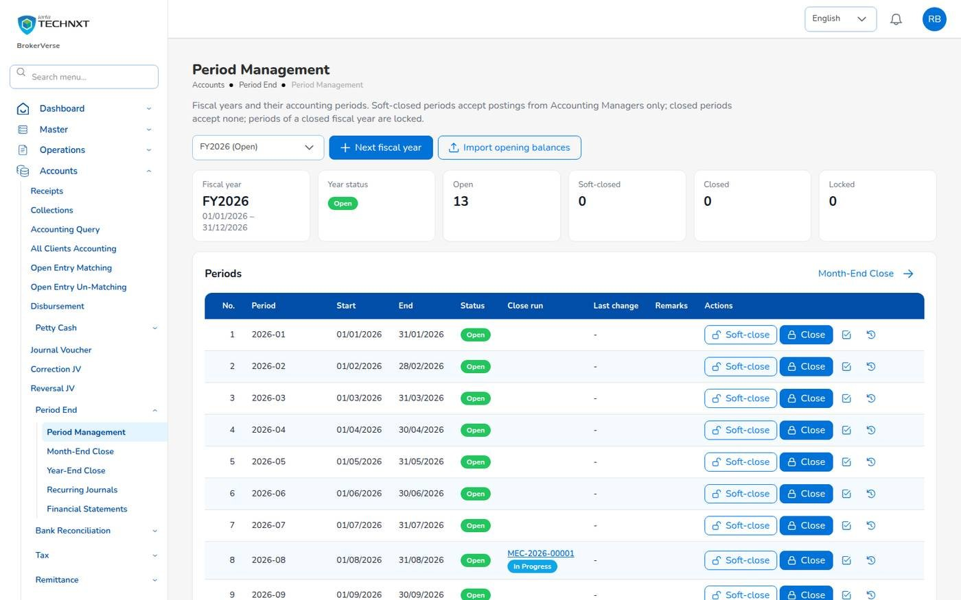
KEY FUNCTION 1 OF 9
Period Management
Accounts > Period End > Period Management
Periods: 12 months plus adjustment period 13 per fiscal year.
Open: everyone with posting rights may post.
Soft-closed: only you may post; others are refused.
Closed, Locked: nobody posts. Reopen needs you and remarks, kept in the period history.
Live screen: Accounts > Period End > Period Management. Signed in as Accounting Manager.
BrokerVerse | Accounting Manager
4

Slide 5
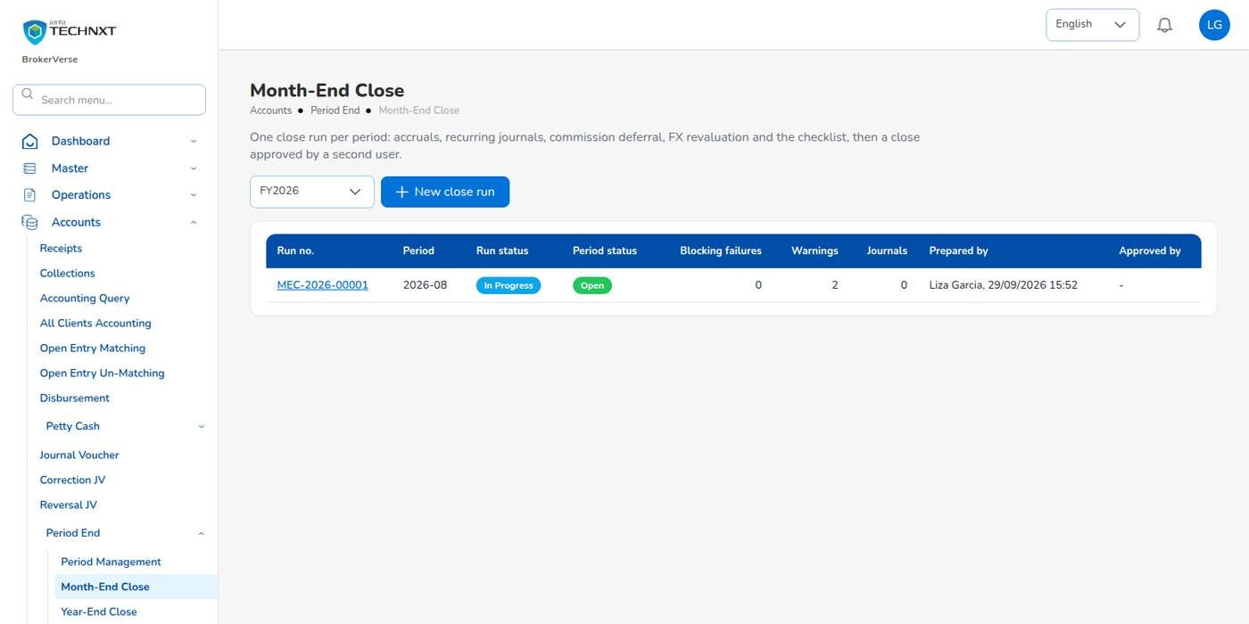
KEY FUNCTION 2 OF 9
Month-end close runs
Accounts > Period End > Month-End Close
List: MEC- run per period, run and period status, failures, warnings, preparer, approver.
Submitted: open the run, read the steps and the checklist.
Approve: closes the period. Reject returns it with a reason.
Rule: the approver must differ from the preparer (accounting.period_close_requires_approval).
Live screen: Accounts > Period End > Month-End Close. Signed in as Accounting (liza.finance).
BrokerVerse | Accounting Manager
5

Slide 6
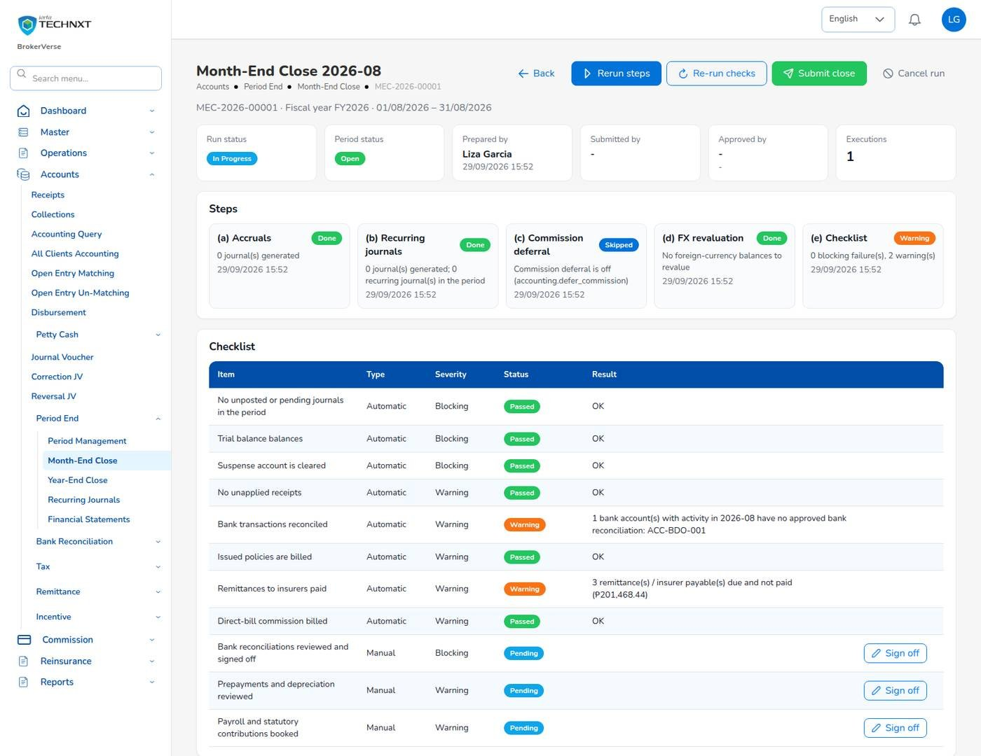
KEY FUNCTION 3 OF 9
What to check before you approve
Month-End Close > run
Blocking items: no pending journals, trial balance balances, suspense cleared, bank reconciliations signed off.
Warnings: unapplied receipts, unreconciled bank lines, unbilled policies, unpaid remittances.
Example: 2026-08 warned that ACC-BDO-001 had no approved reconciliation.
Journals created: reruns reverse their own earlier journals first.
Live screen: Month-End Close 2026-08, MEC-2026-00001. Signed in as Accounting (liza.finance).
BrokerVerse | Accounting Manager
6

Slide 7
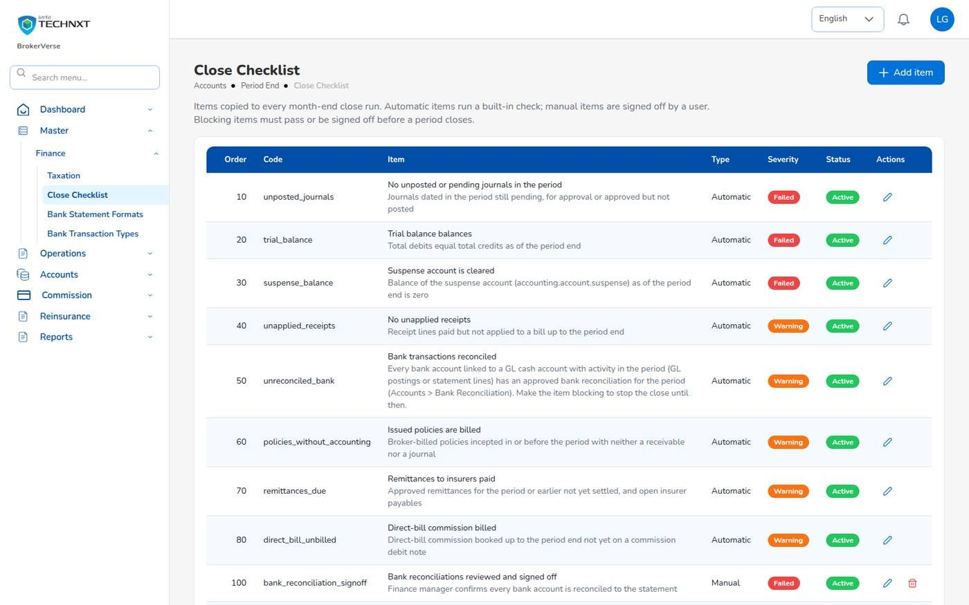
KEY FUNCTION 4 OF 9
Close checklist
Master > Finance > Close Checklist
Items: automatic checks and manual sign-offs, each Blocking or Warning.
Add item: a manual item of your own, e.g. payroll booked.
Severity: make an item blocking to stop the submit.
Bank check: from bank_reconciliation.check_from_period onwards.
Live screen: Master > Finance > Close Checklist. Signed in as Accounting (liza.finance).
BrokerVerse | Accounting Manager
7

Slide 8
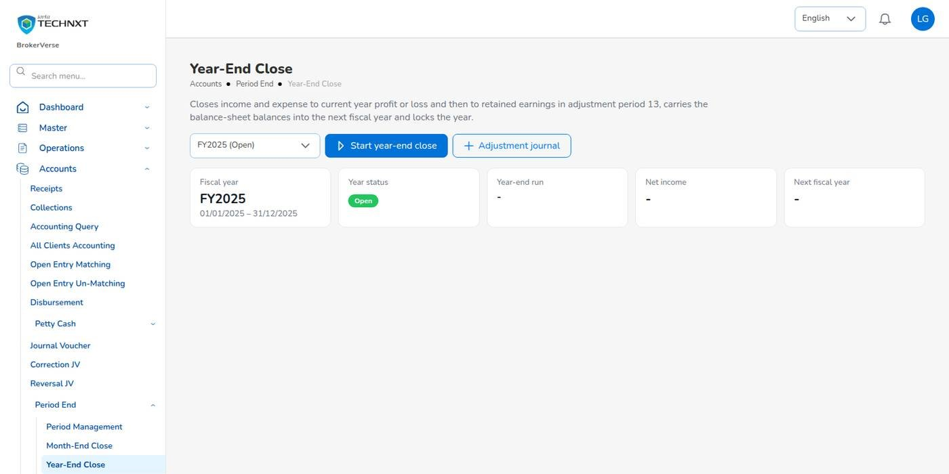
KEY FUNCTION 5 OF 9
Year-end close
Accounts > Period End > Year-End Close
Needs: all twelve periods closed and period 13 open.
Run checks: periods closed and trial balance balances; post audit adjustments in period 13.
Close the year: income and expense to Current Year P/L, then Retained Earnings; next year opened.
Reverse: with a reason, until the first period of the next year is closed.
Live screen: Accounts > Period End > Year-End Close. Signed in as Accounting (liza.finance).
BrokerVerse | Accounting Manager
8

Slide 9
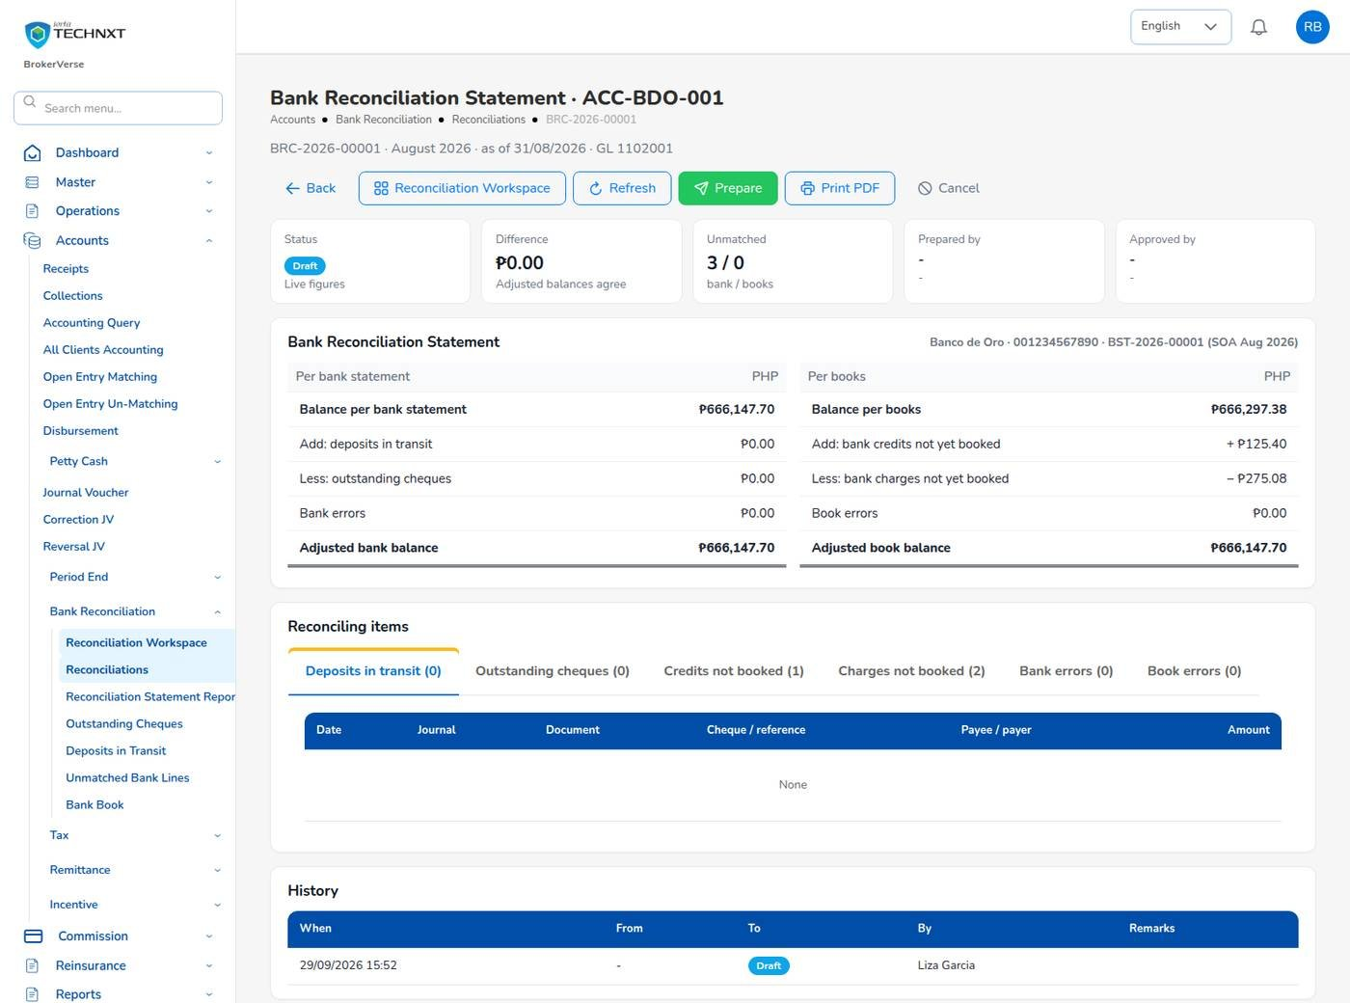
KEY FUNCTION 6 OF 9
Bank reconciliation sign-off
Accounts > Bank Reconciliation > Reconciliations
Statement: bank balance with deposits in transit and outstanding cheques against the books.
Difference: must be ₱ 0.00 before Accounting selects Prepare.
Approve: locks the matches cleared up to the period end.
Reopen: with remarks, to correct a match; every change is in the history.
Live screen: Reconciliation BRC-2026-00001, ACC-BDO-001. Signed in as Accounting Manager.
BrokerVerse | Accounting Manager
9

Slide 10
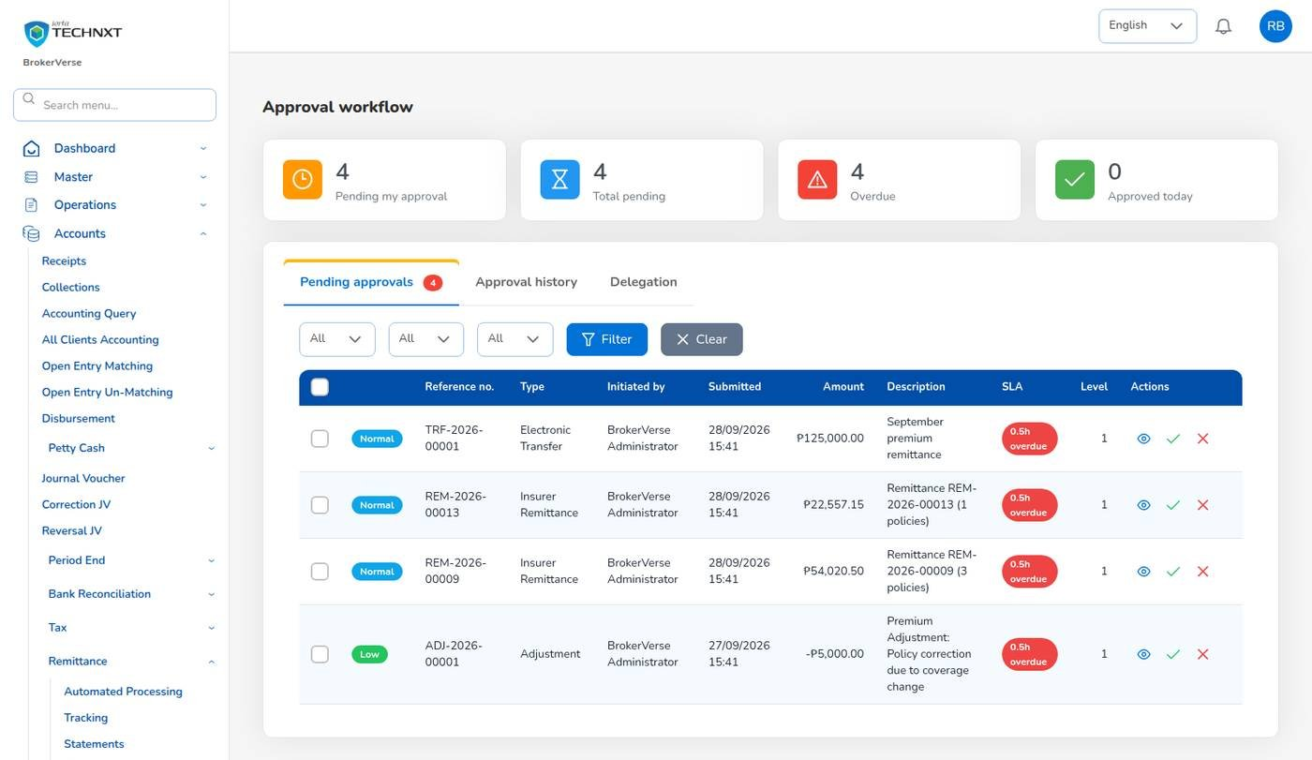
KEY FUNCTION 7 OF 9
Remittance approvals
Accounts > Remittance > Approval Workflow
Queue: remittances, settlements, transfers and adjustments with SLA, level and amount.
Levels: up to ₱ 100,000; up to ₱ 1,000,000; above.
Rule: the initiator is refused.
Next: settlement approval raises the insurer payment voucher.
Live screen: Accounts > Remittance > Approval Workflow. Signed in as Accounting Manager.
BrokerVerse | Accounting Manager
10

Slide 11
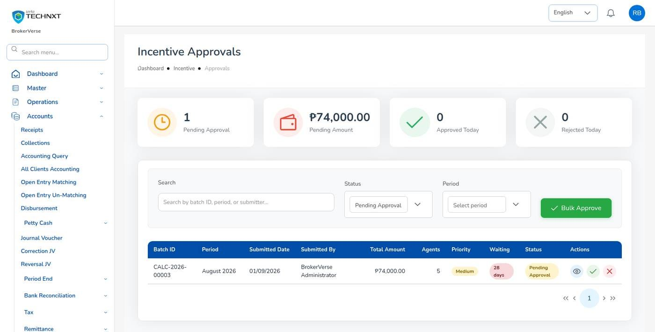
KEY FUNCTION 8 OF 9
Incentive approvals
Accounts > Incentive > Approvals
Batches: CALC- per programme and period with the amount per person.
Actions: approve, reject or Bulk Approve, never your own.
After: approved amounts are accrued and paid through their posting rules.
Report: Incentive Results.
Live screen: Accounts > Incentive > Approvals. Signed in as Accounting Manager.
BrokerVerse | Accounting Manager
11

Slide 12
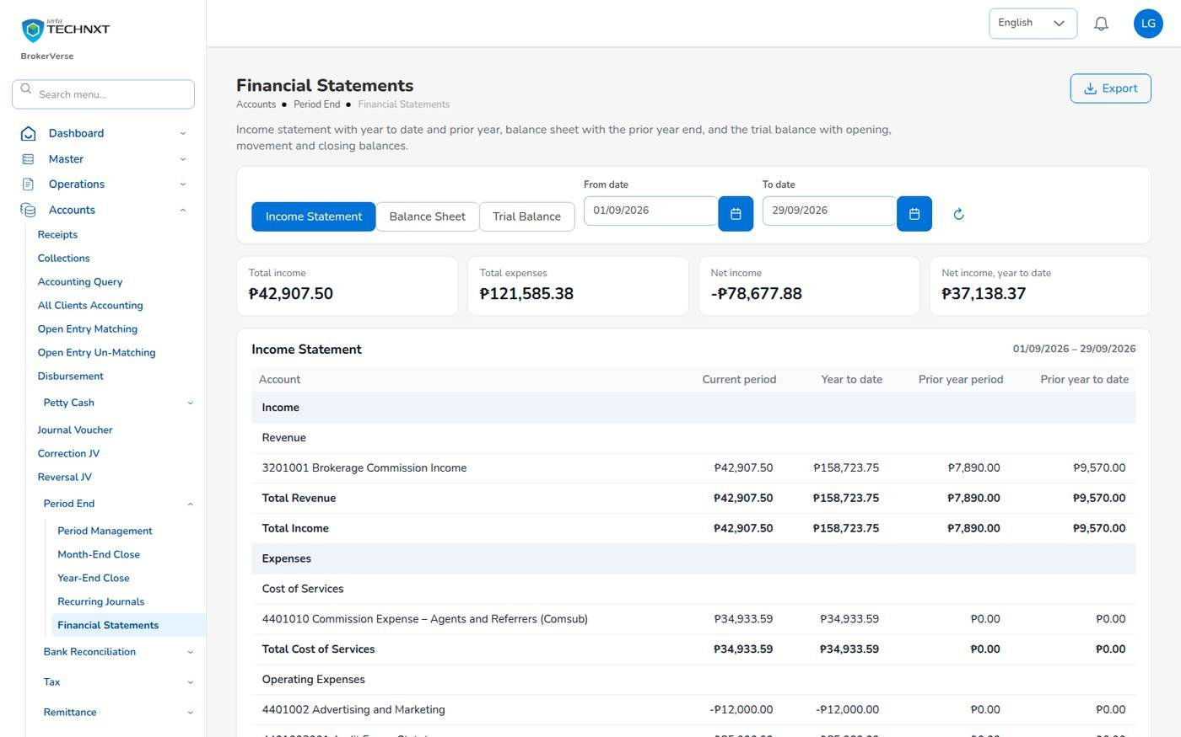
KEY FUNCTION 9 OF 9
Financial statements
Accounts > Period End > Financial Statements
Income Statement: period, year to date, prior year period and prior year to date.
Balance Sheet: balances at the To date against the prior year end.
Trial Balance: opening, movement and closing per account.
PDF: the same statements under Reports > Financial Reports, on the letterhead.
Live screen: Accounts > Period End > Financial Statements. Signed in as Accounting (liza.finance).
BrokerVerse | Accounting Manager
12

Slide 13
WHAT ONLY YOU CAN DO
Your approvals
Approval | Where | Permission
Approve or reject a month-end close | Period End > Month-End Close > run | approve:period-end
Close the year, reverse a year-end close | Period End > Year-End Close | approve:period-end
Soft-close, close and reopen periods | Period End > Period Management | approve:period-end
Post into a soft-closed period | Any posting screen | approve:period-end
Approve or reopen a bank reconciliation | Bank Reconciliation > Reconciliations | approve:bank-reconciliation
Approve vouchers, JVs, remittances, batches of others | The approval screen of each module | as Accounting
Posting rules, GL accounts, tax rates and maker-checker switches change only with your agreement; the System Administrator makes the change on Master.
BrokerVerse | Accounting Manager
13

Slide 14
BANK TO CLOSED PERIOD
Month-end and year-end: your part
1
2
3
4
5
6
Import statements
Match, adjust
Prepare BRC
Approve BRC
Close run
Checklist sign-off
Accounting
Accounting
Accounting
You
Accounting
Accounting
12
11
10
9
8
7
Next year opened
Year-end close
BIR reports
Period closed
Approve close
Submit close
System
You
Accounting
System
You
Accounting
Your steps
Done by other personas or by the system
Each month; the year-end after period 12
Approve each bank reconciliation before the close: it is a blocking checklist item.
Read the warnings as well as the blocking items before you approve.
Reopen a period only with remarks; the history keeps who and when.
Check the Month-End Close Status report across periods.
BrokerVerse | Accounting Manager
14

Slide 15
REPORTS > ALL REPORTS
Reports you use (32)
Output formats
CSV
XLSX
PDF
Preview
Scheduled e-mail
The 32 reports of Accounting.
Production and placement
Insurers and commission
Receivables and cash
Premium by Product / Month / Insurer
New Business vs Renewals
Co-insurance Register
Reinsurance Cession Register
Remittance Summary
Broker Commission Statement
Commission Receivable (Direct Bill)
Due to Insurers by Co-insurer
Aged Payables to Insurers
Incentive Results
SOA / Premium Receivable
Receivables Ageing
Collection Report
Receipts Register
Payables / Disbursement Register
Ledger and period end
BIR tax
Bank
Journal Register
Trial Balance
Trial Balance (Opening / Movement / Closing)
General Ledger Detail
Income Statement
Balance Sheet
Month-End Close Status
VAT Summary
SAWT
QAP
SLSP Sales
SLSP Purchases
Bank Reconciliation Statement
Outstanding Cheques
Deposits in Transit
Unmatched Bank Lines
Bank Book
BrokerVerse | Accounting Manager
15

Slide 16
MASTER > CONFIGURATION > SCHEDULES
Schedules and automations
Job | When it runs | What it means for you
Receivable ageing | Daily 07:00 | Ageing buckets 30, 60, 90, 120 refreshed
Collection reminders | Daily 08:00 | Clients e-mailed 7 days before due, then every 7 days
Recurring journals | Daily 01:15 (off when delivered) | Posts recurring templates on their next run date
Accrual auto-reversal | Day 1 of the month, 00:30 (off when delivered) | Reverses accruals, deferrals and FX revaluation on day 1
Period auto soft-close | Daily 02:00 (off when delivered) | Soft-closes ended periods when no blocking check fails
Bank reconciliation auto-match | Daily 05:45 (off when delivered) | Runs the matching rules on unmatched bank lines
Month-end close reminder | Daily 08:00 (off when delivered) | Reminds Accounting before and after a period ends
Jobs marked off are delivered switched off; you decide with the System Administrator which to switch on.
BrokerVerse | Accounting Manager
16

Slide 17
BELL ICON, TOP RIGHT
Notifications and approvals
Approval
Journal voucher awaiting approval
Approval
Commission debit note awaiting approval
You can approve vouchers of other users.
Direct-bill debit notes.
Approval
Remittances awaiting approval
Reminder
Month-end close: period ends / still open
Batch and count.
When the reminder job is switched on.
Approval
Incentive calculation awaiting approval
Task
Close runs and reconciliations
Batch and period.
No bell notice: check the lists for Submitted and Prepared.
BrokerVerse | Accounting Manager
17

Slide 18
GOOD TO KNOW
Known limitations and tips
Open items that affect you
Tips
A submitted month-end close or a prepared bank reconciliation does not raise a bell notice: check Month-End Close and Reconciliations for items waiting.
The BIR reports give the figures in BIR column order: check them against the current BIR format before filing.
Some database queries use the database’s own date: the database time zone must be Asia/Manila.
The Settlement cash panel of a claim paid through the broker sits on the claim screens, which are not in the Accounting menu: the System Administrator records the funds received and the payment to the claimant on Accounting’s instruction.
Approve reconciliations before close runs.
Reject with a clear reason: it goes back to the preparer.
Keep soft-close for the review days, then close.
Agree posting rule changes and simulate them first.
BrokerVerse | Accounting Manager
18

Slide 19
Thank you
BrokerVerse guide for Accounting Manager
SUPPORT
First line
The key user of your team: how-to questions, checking that a role or setting is not the cause
Second line
Your System Administrator: users, roles, passwords, two-step resets, settings and master data
Third line
iorta TechNXT production support, raised by the System Administrator through the support agreement
Access requests
Your System Administrator (Master > Generals > User Management)
When you report a problem, give the menu path, the record number, the time, your user ID, the message and its request ID. Never send a password or a two-step code.
iorta TechNXT · BrokerVerse insurance broking platform

