Slide 1

THIS GUIDE IS FOR
Claims
ROLE
BrokerVerse guide for Claims
Claims
SIGN-IN
carlo.claims (maker), lisa.claims2 (checker)
ROLE CODE
Functions, flows, reports and schedules of your role
claims
BrokerVerse OOTB · insurance broking · Philippines · PHP
LANDS ON
Claims Dashboard
Register claims
Settle with a checker
Recoveries
Prepared by iorta TechNXT · September 2026

Slide 2
WHO YOU ARE IN BROKERVERSE
Role at a glance
What you do
Sign-in and landing page
User names carlo.claims and lisa.claims2. Both land on the Claims Dashboard.
Registers claims: from the policy, with date, place and cause of loss, the driver and third party.
Follows up: the insurer and the adjuster, documents and the insurer’s claim number.
Settles: submits the settlement; a second Claims user approves it.
Recovers: registers reinsurance recoveries on claims under a treaty.
You hand work to
Insurer (Preliminary Loss Advice by e-mail), the second Claims user (approval), the policy owner (notified), Accounting (settlements paid through the broker).
Maker-checker partners
carlo.claims submits the settlement and lisa.claims2 approves it. The maker is refused when approving (claims.settlement_maker_checker).
BrokerVerse | Claims
2

Slide 3
WHAT YOU SEE AFTER SIGN-IN
Menu map
Menus granted to claims in menuPermissions.js. The role walk opened 12 screens.
Dashboard
Operations
Reinsurance
Reports
Claims Dashboard
Home
Clients
Policy
Claims
Claims Recovery
All Reports (8 reports)
Operational Reports: Production, Claims, Renewal, Remittance, Broker Commission
BrokerVerse | Claims
3

Slide 4
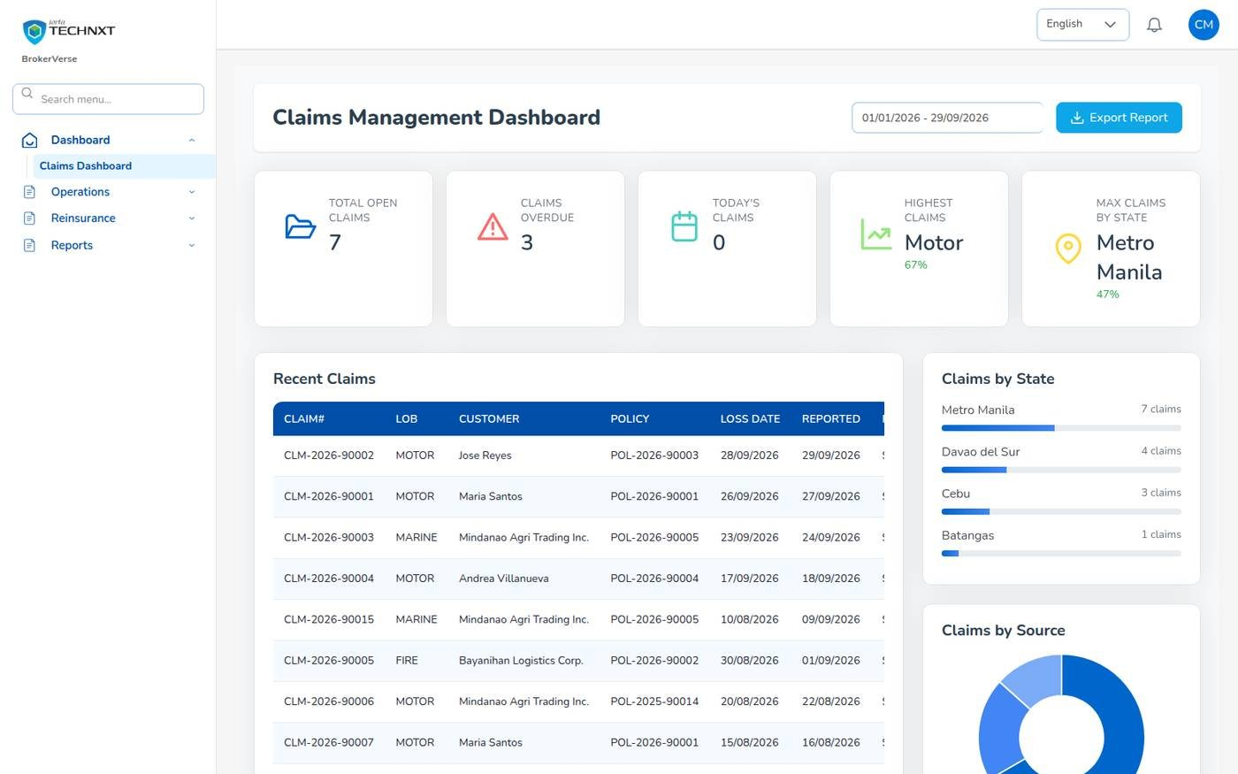
KEY FUNCTION 1 OF 9
Claims Dashboard
Dashboard > Claims Dashboard
Cards: open claims, overdue, today’s claims, highest line, most claims by state.
Overdue: past the handling time of 20 days (claims.sla_days).
Recent claims: open a claim from the list.
Export Report: claims data for the chosen dates.
Live screen: Dashboard > Claims Dashboard. Signed in as Claims (carlo.claims).
BrokerVerse | Claims
4

Slide 5
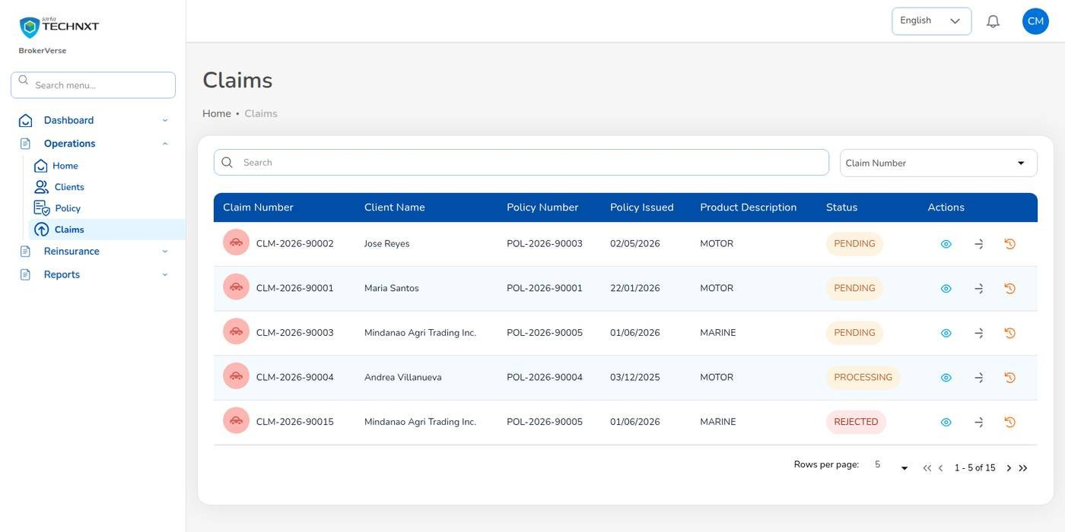
KEY FUNCTION 2 OF 9
Claims list
Operations > Claims
Row: claim number, client, policy, date, product, status.
Icons: Claim Details, the next step for the status, and the audit trail.
Statuses: Pending, Processing, Pending Approval, Approved, Settled, Closed; Rejected.
Number: CLM-YYYY-NNNNN.
Live screen: Operations > Claims. Signed in as Claims (carlo.claims).
BrokerVerse | Claims
5

Slide 6
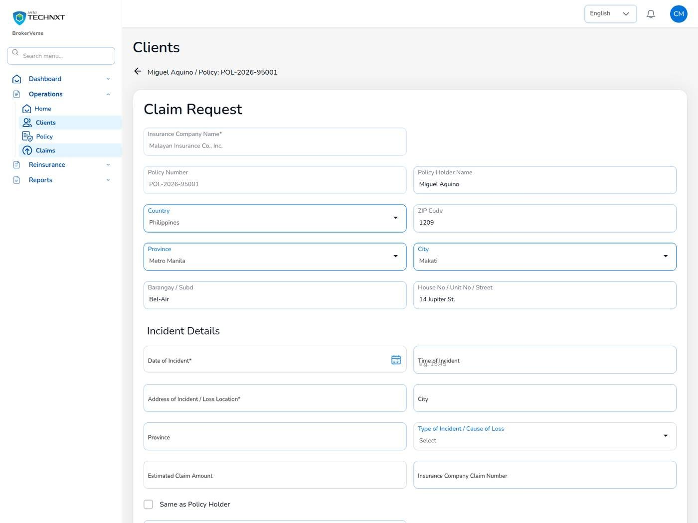
KEY FUNCTION 3 OF 9
Register a claim
Operations > Policy > three dots > Claim
Required: date and address of incident, cause of loss, driver’s name.
Refused: loss date outside the policy period or in the future, and while premium is unpaid.
Documents: police report, photos, estimates; PNG, JPEG or PDF up to 2 MB each.
Saved: claim Pending; Preliminary Loss Advice e-mailed to the insurer.
Live screen: Policy > three dots > Claim. Signed in as Claims (carlo.claims).
BrokerVerse | Claims
6

Slide 7
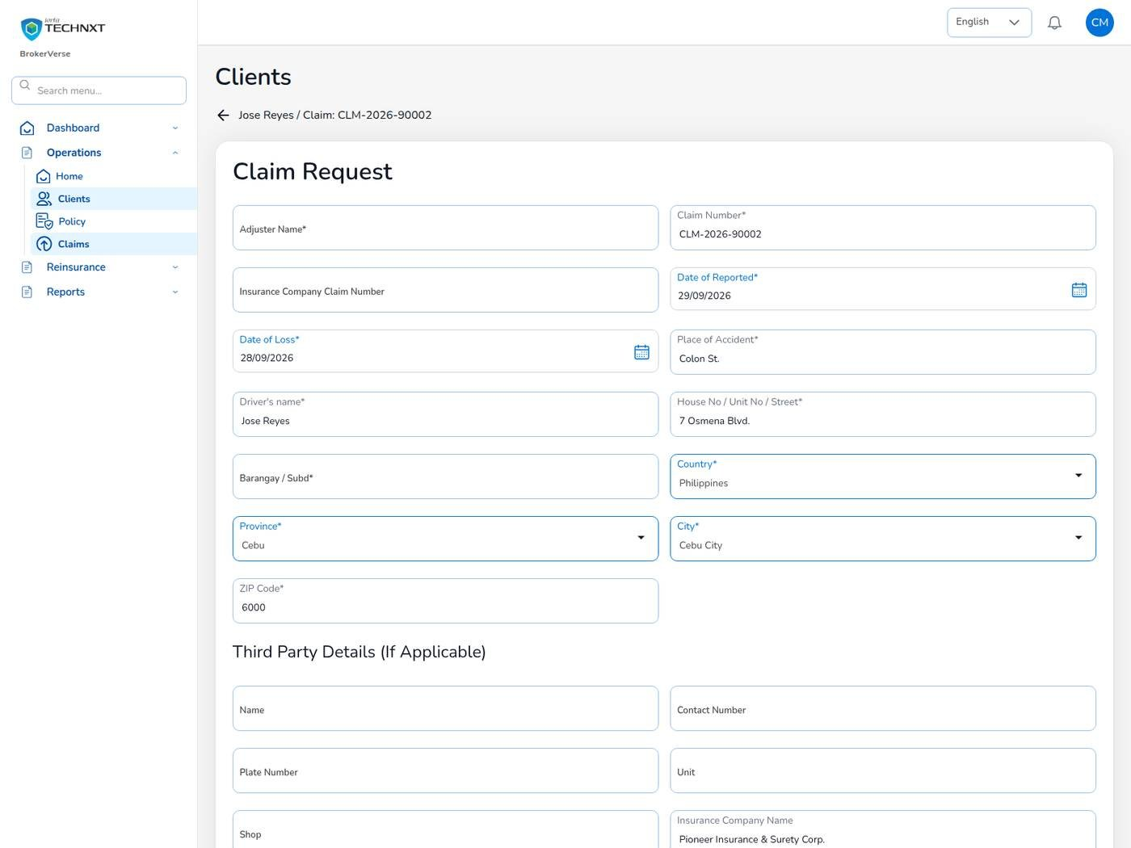
KEY FUNCTION 4 OF 9
Adjuster details
Claims > eye icon > Proceed
When: the insurer has assigned an adjuster.
Enter: adjuster name, insurer claim number, dates, place, driver and third party.
Upload: proof of documents.
Next: status becomes Processing.
Live screen: Claim > Proceed > adjuster details. Signed in as Claims (carlo.claims).
BrokerVerse | Claims
7

Slide 8
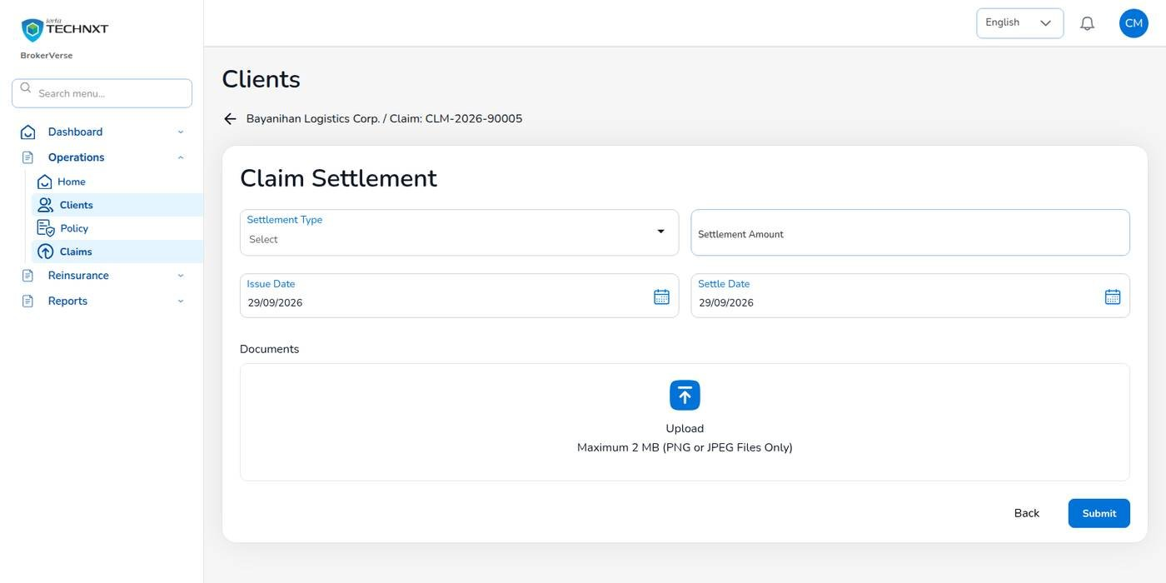
KEY FUNCTION 5 OF 9
Submit the settlement (maker)
Claim > Claim Settlement
Enter: settlement type (Cash, Card, Cheque), amount, issue date, settle date, documents.
Checks: amount above zero; settle date not before the issue date.
Submit: claim goes to Pending Approval; the other Claims users are notified.
Co-insured policy: the settlement is split by each insurer’s share.
Live screen: Claim Settlement. Signed in as Claims (carlo.claims).
BrokerVerse | Claims
8

Slide 9
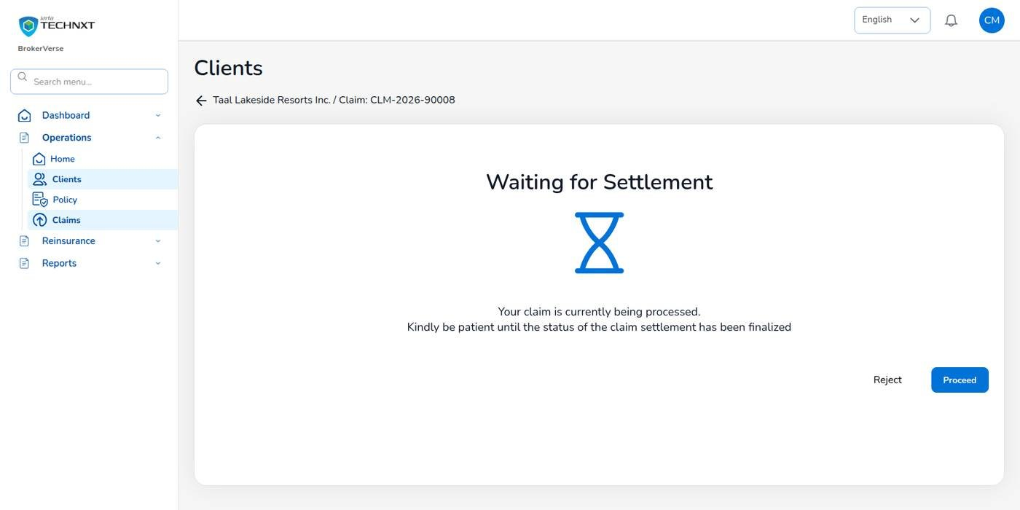
KEY FUNCTION 6 OF 9
Approve the settlement (checker)
Notification, or Claims > Pending Approval
Check: the claim details and the settlement.
Proceed: approves; Reject sends it back to the maker.
Rule: the maker cannot approve his or her own settlement.
Result: claim Settled, maker notified, dashboard and reports updated.
Live screen: Waiting for Settlement, checker view. Signed in as Claims (carlo.claims).
BrokerVerse | Claims
9

Slide 10
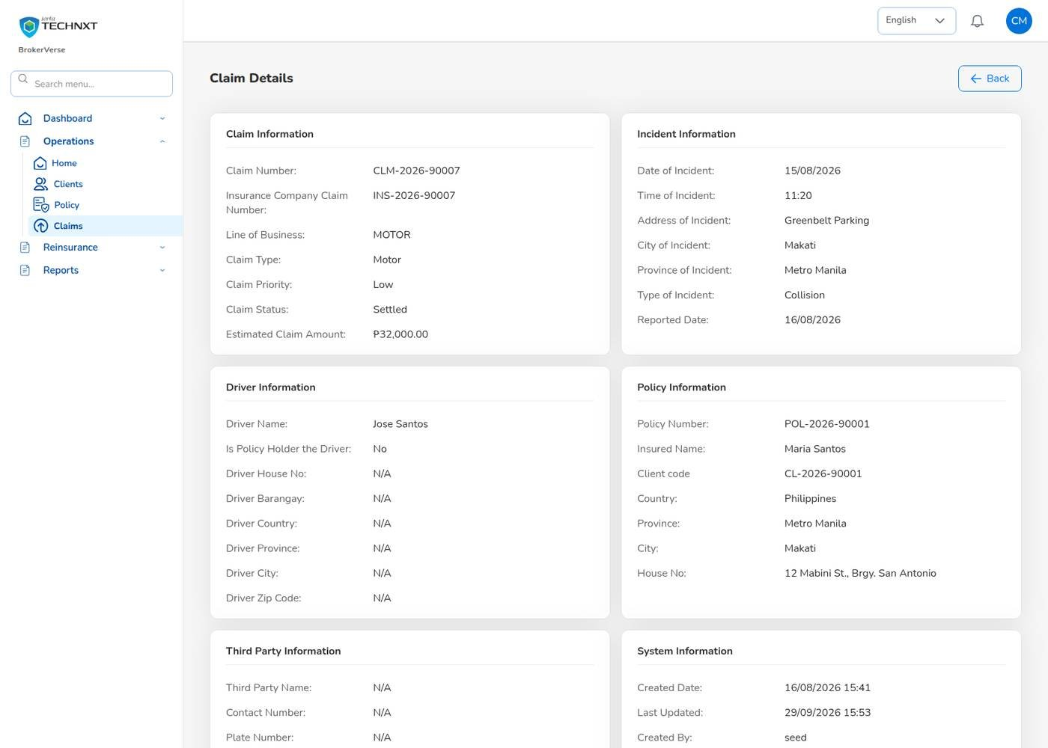
KEY FUNCTION 7 OF 9
Claim details and letters
Operations > Claims > claim
Shows: claim, incident, driver, policy, third party, insurer claim number, due date.
Letters: Acknowledgment letter, Claims Discharge Voucher, Claims Data sheet, FIR on the letterhead.
Audit trail: every status change with user and time.
Co-insurance: each insurer’s share of the claim and of the settlement.
Live screen: Claim Details, CLM-2026-90007. Signed in as Claims (carlo.claims).
BrokerVerse | Claims
10

Slide 11
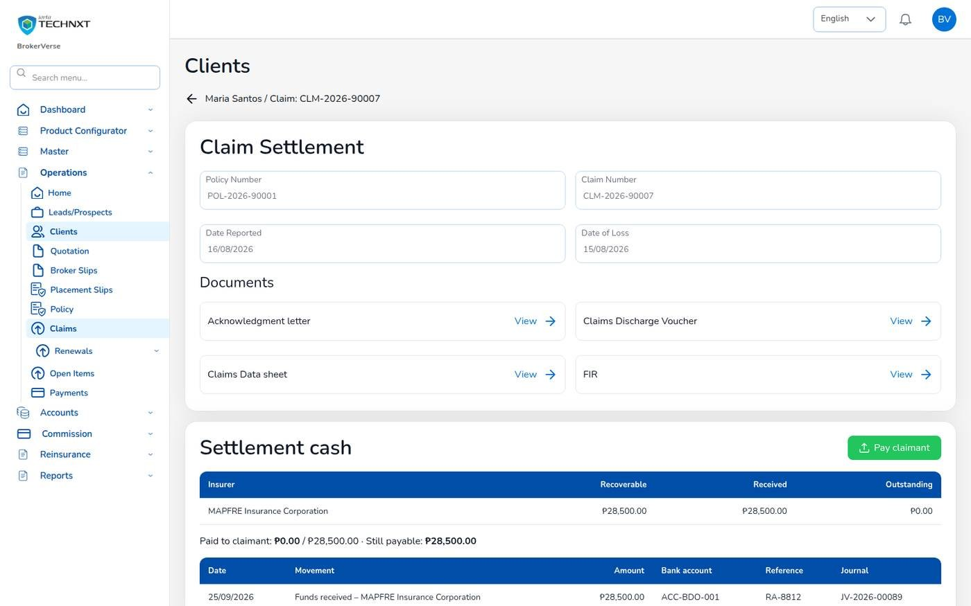
KEY FUNCTION 8 OF 9
Settlement cash (paid through the broker)
Settled claim > Settlement cash
When: the insurer pays the broker and the broker pays the claimant.
Booked at settlement: amount recoverable from each insurer by share, against the amount payable to the claimant.
Recorded by: the System Administrator on Accounting’s instruction in this release.
You: tell Accounting when the insurer’s funds are due.
Live screen: Settlement cash of CLM-2026-90007. Signed in as System Administrator (bea.admin).
BrokerVerse | Claims
11

Slide 12
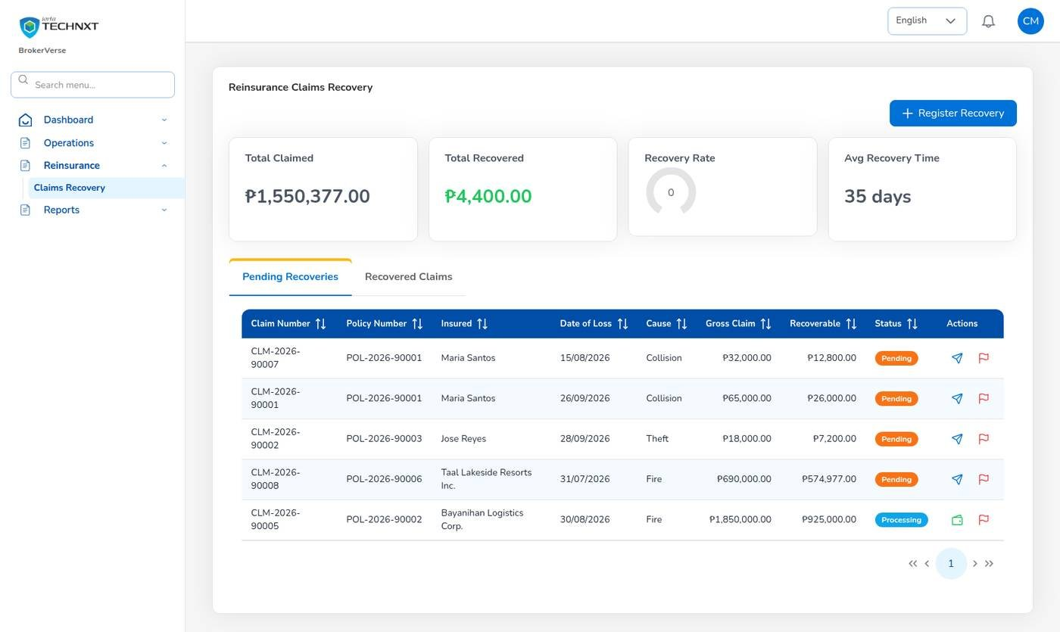
KEY FUNCTION 9 OF 9
Reinsurance claims recovery
Reinsurance > Claims Recovery
Shows: amounts recoverable on claims under treaties.
Register Recovery: record the recovery against the claim.
Posting: a settled recovery is posted through its posting rule.
Report: Reinsurance Cession Register is run by Processing and Accounting.
Live screen: Reinsurance > Claims Recovery. Signed in as Claims (carlo.claims).
BrokerVerse | Claims
12

Slide 13
LEAD TO RENEWAL
End-to-end flow: your part of the cycle
1
2
3
4
5
6
7
Lead
Broker Slip
Quotation Slip
Placement Slip
Policy issue
Payment capture
Official receipt
Sales, Operations
Processing Team
Sales, Processing
Processing Team
Processing Team
Operations, Sales, Processing
Accounting
13
12
11
10
9
8
Month-end
Renewal
Claim
Endorsement
Remittance
Commission
Accounting, Acct. Manager
Operations, Sales, Processing
Claims, two users
Operations, Processing
Accounting, two users
Accounting, two users
Your steps
Done by other personas or by the system
Claims experience feeds the renewal price
11 Claim: register, follow up, settle with a second user.
The policy period and paid premium are checked at registration.
Owners are notified at each status change.
Recoveries go to Reinsurance > Claims Recovery.
BrokerVerse | Claims
13

Slide 14
REPORTS > ALL REPORTS
Reports you use (8)
Output formats
CSV
XLSX
PDF
Preview
Scheduled e-mail
Eight operational reports in Reports > All Reports.
Report | What it shows
Production Register | Policies incepted in the period: premium, commission, new or renewal, billing mode
Premium by Product / Month / Insurer | Policy count, sum insured, premium and commission
New Business vs Renewals | New business and renewals by month or agent
Claims Position | Claims reported: estimate, approved, settled and age
Claims Ageing | Open claims by ageing bucket
Renewal Retention | Renewals due: retained, lost or pending, and the retention rate
Remittance Summary | Remittances to insurers: gross premium, commission, net due, status
Broker Commission Statement | Commission per agent and policy: basis, rate, gross, WHT, net, paid status
BrokerVerse | Claims
14

Slide 15
MASTER > CONFIGURATION > SCHEDULES
Schedules and automations
Job | When it runs | What it means for you
Daily reports | Daily 05:00 | Claims Position generated at 05:00
Policy expiry | Daily 00:15 | Losses after expiry are refused once the policy is Expired
E-mail outbox | Every 5 minutes | Loss advices to insurers leave every 5 minutes
Times are Manila time (general.timezone). The System Administrator changes a timetable, switches a job on or off, or runs it now; every run is recorded.
BrokerVerse | Claims
15

Slide 16
BELL ICON, TOP RIGHT
Notifications and approvals
Task
New claim
Info
Claim status changes
Claim number and policy, to Claims users and the policy owner.
Processing, Pending Approval, Approved, Settled.
Approval
Settlement approval
Info
Settlement approved
Amount and claim, to the other Claims users.
Back to the maker.
BrokerVerse | Claims
16

Slide 17
GOOD TO KNOW
Known limitations and tips
Open items that affect you
Tips
The sign-in session is kept in the browser’s local storage: sign out on shared computers and keep the browser up to date.
Two-factor set-up shows a setup key and an app link but no QR code: type the key into the authenticator app.
Filipino is configured as a language but has no screen translation yet.
A settlement is marked as paid through the broker by its settlement type or through the API; the form offers Cash, Card and Cheque only.
Claims users do not create leads or policies: those buttons are hidden for this role.
Check the policy period before you register.
Attach documents when you register.
Record the insurer’s claim number as soon as you have it.
Ask your checker to approve the same day.
BrokerVerse | Claims
17

Slide 18
Thank you
BrokerVerse guide for Claims
SUPPORT
First line
The key user of your team: how-to questions, checking that a role or setting is not the cause
Second line
Your System Administrator: users, roles, passwords, two-step resets, settings and master data
Third line
iorta TechNXT production support, raised by the System Administrator through the support agreement
Access requests
Your System Administrator (Master > Generals > User Management)
When you report a problem, give the menu path, the record number, the time, your user ID, the message and its request ID. Never send a password or a two-step code.
iorta TechNXT · BrokerVerse insurance broking platform

