Slide 1

THIS GUIDE IS FOR
Processing Team
ROLE
BrokerVerse guide for Processing Team
Processing Team (Placement & Policy Processing)
SIGN-IN
jose.uw
ROLE CODE
Functions, flows, reports and schedules of your role
processing
BrokerVerse OOTB · insurance broking · Philippines · PHP
LANDS ON
Executive Dashboard
Broker and placement slips
Policy issue
Co-insurance
Prepared by iorta TechNXT · September 2026

Slide 2
WHO YOU ARE IN BROKERVERSE
Role at a glance
What you do
Sign-in and landing page
User name jose.uw. Lands on the Executive Dashboard. Your workbench is Dashboard > Processing Dashboard.
Markets risks: Broker Slips to several insurers, offers and declines recorded, offers compared.
Binds cover: Quotation Slips and Placement Slips, firm orders to the lead and co-insurers, confirmations.
Issues policies: from a bound Placement Slip, from a motor quotation, by direct placement or Record Issued Policy.
Completes changes: endorsements with the insurer’s document; approves renewal terms.
Keeps products: motor tariff, templates and acceptance rules; treaties and cessions.
You hand work to
Insurers (requests for quotation, firm orders), Sales & Marketing and Operations (terms and policies), Accounting (bills, commission and remittance by insurer share).
Maker-checker partners
You are notified of quotations sent to clients (quotations.approval_notify_roles) and approve renewal terms (renewals.approver_roles). You cannot approve your own.
BrokerVerse | Processing Team
2

Slide 3
WHAT YOU SEE AFTER SIGN-IN
Menu map
Menus granted to processing in menuPermissions.js. The role walk opened 41 screens.
Dashboard
Product Configurator
Operations
Processing Dashboard
Executive Dashboard
Dashboard, Product Templates
Coverage Builder, Rating Engine
Acceptance Rules, Document Manager
Approval Workflows
Market Mapping, Risk Mapping
Product Analytics
Home
Leads/Prospects
Clients
Quotation
Broker Slips
Placement Slips
Policy
Claims
Renewals (8 screens)
Open Items
Payments
Reinsurance
Reports
Treaty Dashboard
Cession Tracking
Claims Recovery
Reconciliation
Analytics
All Reports (13 reports)
Operational Reports: Production, Claims, Renewal, Remittance, Broker Commission
BrokerVerse | Processing Team
3

Slide 4
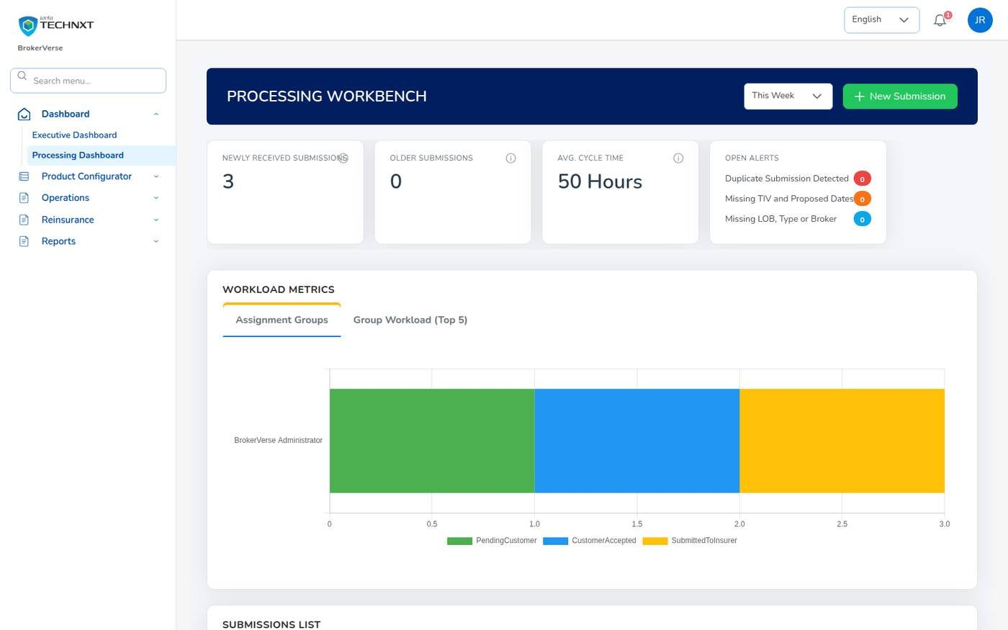
KEY FUNCTION 1 OF 12
Processing Dashboard
Dashboard > Processing Dashboard
Submissions: quotations in progress: new this week and older.
Priority: high from ₱ 5,000,000 sum insured (dashboard.high_sum_insured).
Open alerts: duplicates, missing sums insured or dates, missing line of business.
Also: average cycle time, workload by group, open tasks with due dates.
Live screen: Dashboard > Processing Dashboard. Signed in as Processing Team (jose.uw).
BrokerVerse | Processing Team
4

Slide 5
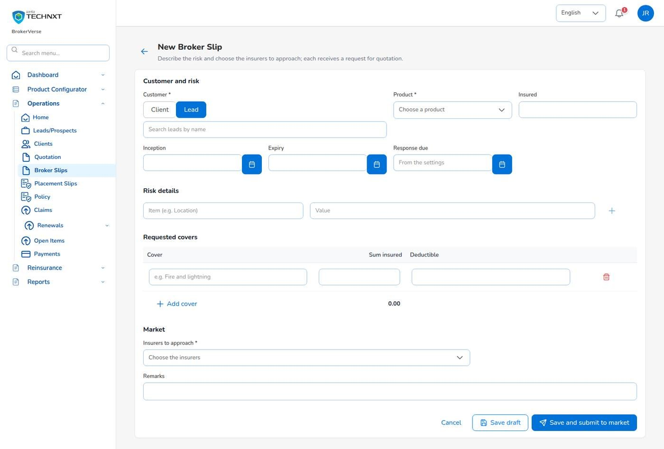
KEY FUNCTION 2 OF 12
New Broker Slip
Operations > Broker Slips > New Broker Slip
Customer: a client or a lead, the product, the insured name and the period.
Risk and covers: location, occupancy, construction; each cover with sum insured and deductible.
Market: the insurers to approach, and remarks such as claims history.
Submit: numbers the slip BS-, creates one offer per insurer and e-mails each a request for quotation.
Live screen: Operations > Broker Slips > New Broker Slip. Signed in as Processing Team (jose.uw).
BrokerVerse | Processing Team
5

Slide 6
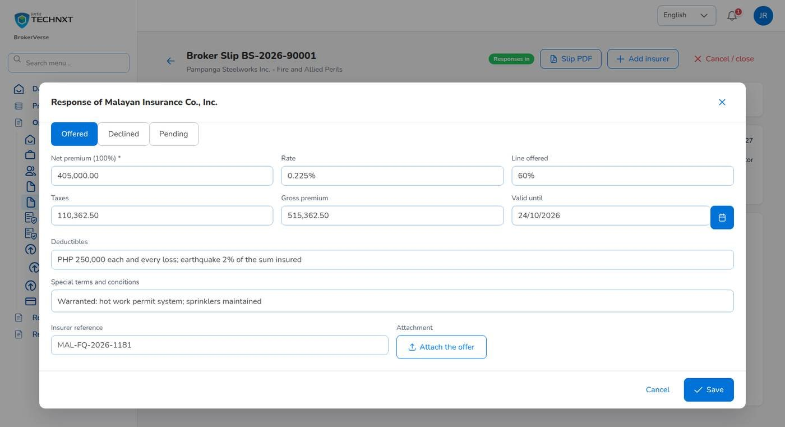
KEY FUNCTION 3 OF 12
Record the insurers’ answers
Broker Slip > Market responses
Offered: net premium at 100%, rate, line offered, taxes, validity, deductibles, special terms, reference.
Declined: record the reason. Declines count in Market Response.
Attach: the insurer’s offer letter.
Add insurer: approach another insurer on an open slip.
Live screen: Broker Slip > Market responses > Record response. Signed in as Processing Team (jose.uw).
BrokerVerse | Processing Team
6

Slide 7
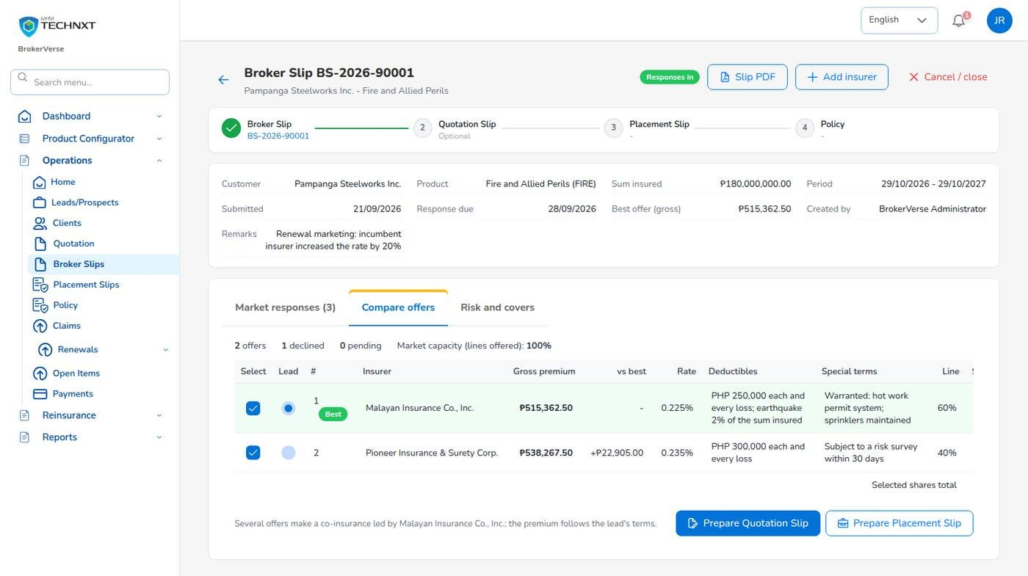
KEY FUNCTION 4 OF 12
Compare offers and choose the security
Broker Slip > Compare offers
Ranking: by gross premium; the cheapest is marked Best, with the difference for each offer.
Select: one offer at 100% for a single insurer, several for a co-insurance.
Lead: choose one lead; its terms apply. Shares must total exactly 100%.
Next: Prepare Quotation Slip (client accepts first) or Prepare Placement Slip.
Live screen: Broker Slip > Compare offers. Signed in as Processing Team (jose.uw).
BrokerVerse | Processing Team
7

Slide 8
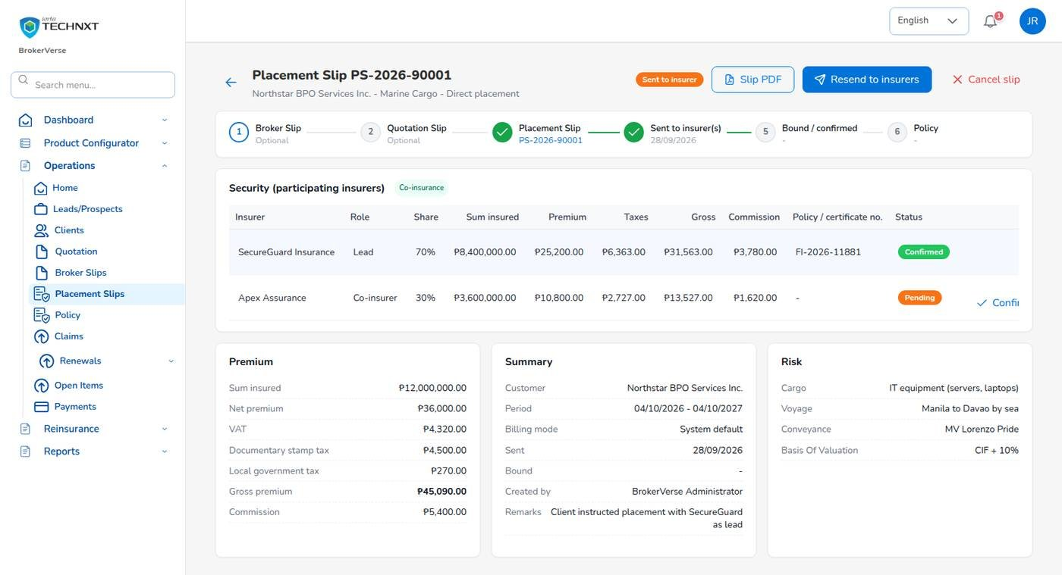
KEY FUNCTION 5 OF 12
Placement Slip: firm order and confirmations
Operations > Placement Slips
Send to insurer(s): each participant gets a placing slip showing its own share.
Confirm: type the insurer’s policy or certificate number on its row.
Declined: record the reason, then Edit participants so the shares total 100% again.
Bound: when every participant has confirmed.
Live screen: Placement Slip PS-2026-90001, sent. Signed in as Processing Team (jose.uw).
BrokerVerse | Processing Team
8

Slide 9
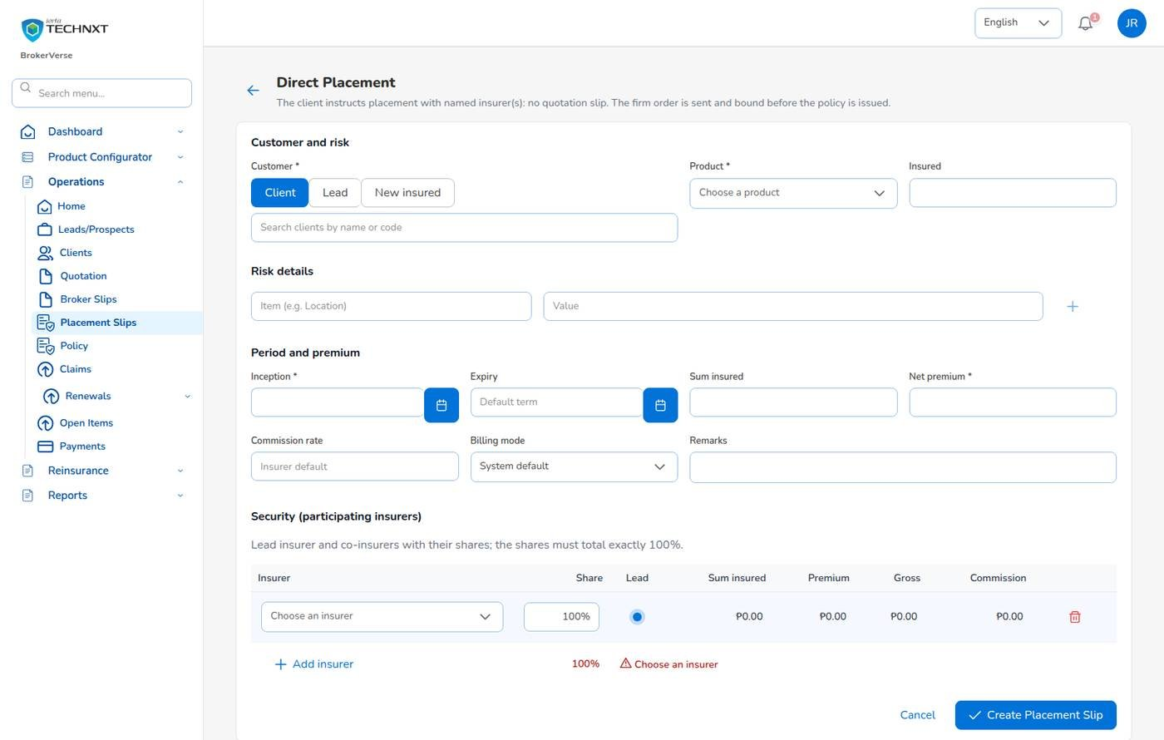
KEY FUNCTION 6 OF 12
Direct placement
Operations > Placement Slips > New direct placement
When: the client instructs placement with named insurers; no quotation is needed.
Enter: customer and risk, period, sum insured, net premium, commission rate, billing mode.
Security: each insurer with its share and one Lead; the line under the table checks 100%.
Then: Create Placement Slip, send, confirm and issue as usual.
Live screen: Placement Slips > New direct placement. Signed in as Processing Team (jose.uw).
BrokerVerse | Processing Team
9

Slide 10
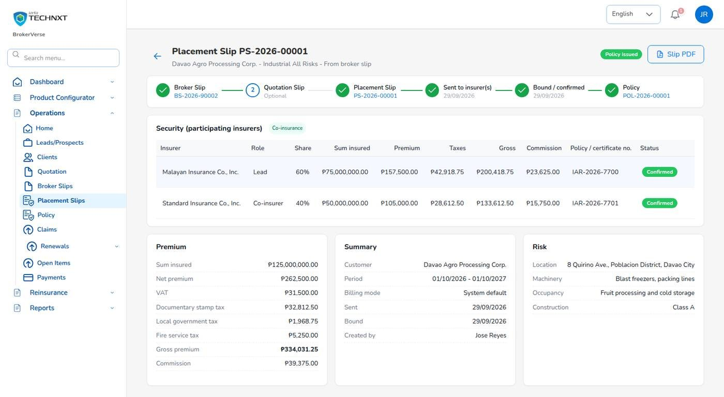
KEY FUNCTION 7 OF 12
Issue the policy from a bound slip
Placement Slip > Issue Policy
Policy: number issued; participants, shares and insurer references copied.
Client: created from the lead if needed.
Money: premium bill to the client (broker billed) or commission due from insurers (direct bill).
Journal: each insurer’s payable and commission on its own line.
Live screen: Placement Slip PS-2026-00001, issued as POL-2026-00001. Signed in as Processing Team (jose.uw).
BrokerVerse | Processing Team
10

Slide 11
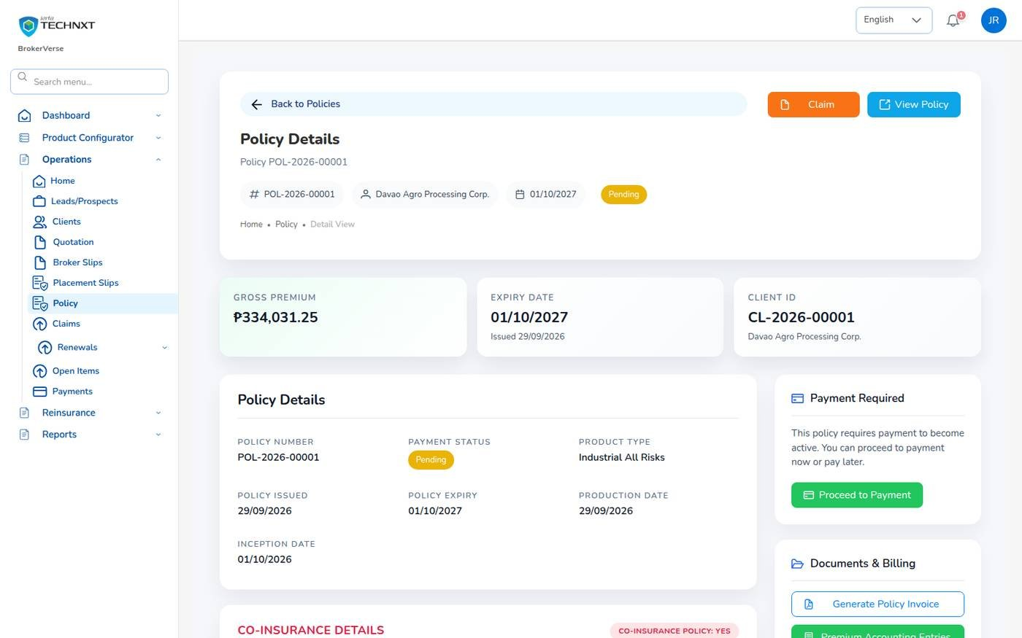
KEY FUNCTION 8 OF 12
Co-insurance on the policy
Operations > Policy > policy > Participants
Example: Malayan lead 60% and Standard 40% on ₱ 125,000,000 sum insured.
Split: sum insured, premium, taxes, gross and commission by share; the rounding remainder goes to the lead.
Used by: the bill journal, remittance per insurer, claim recoveries and the reports.
Rule: shares always total 100% with exactly one lead.
Live screen: Policy POL-2026-00001, participants. Signed in as Processing Team (jose.uw).
BrokerVerse | Processing Team
11

Slide 12
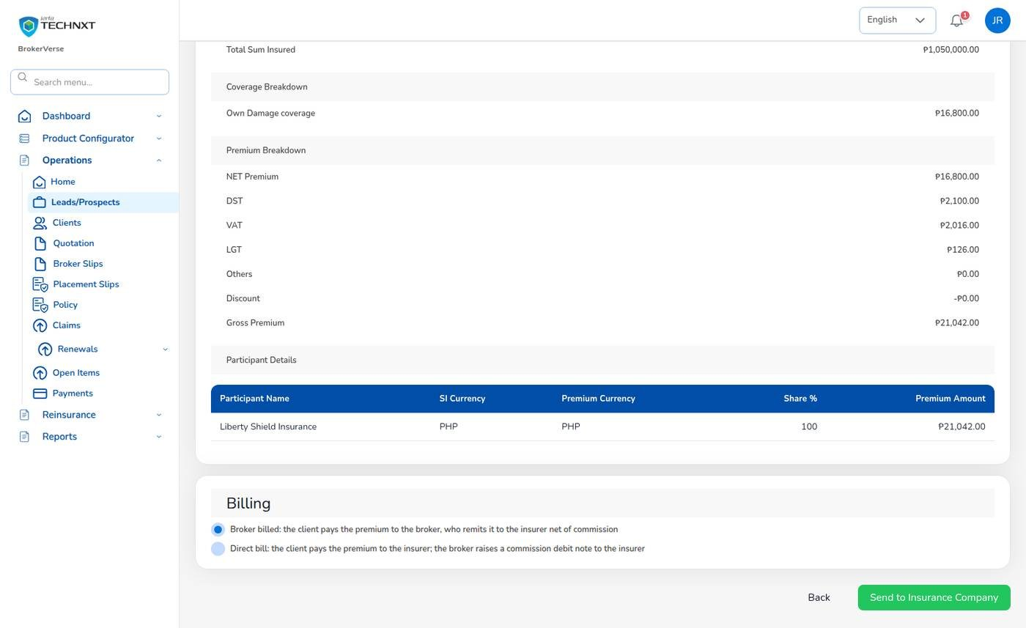
KEY FUNCTION 9 OF 12
Motor: from quotation straight to policy
Quotation > Proceed to Policy
KYC: ID type, number and image, chassis, motor and plate or MV file number are required.
Photos: left, right, front, rear and interior.
Billing mode: broker billed (premium bill INV-) or direct bill (commission due from the insurer).
Send to Insurance Company: issues the policy; then upload the insurer’s policy document.
Live screen: Convert Policy, review with participants and billing mode. Signed in as Processing Team (jose.uw).
BrokerVerse | Processing Team
12

Slide 13
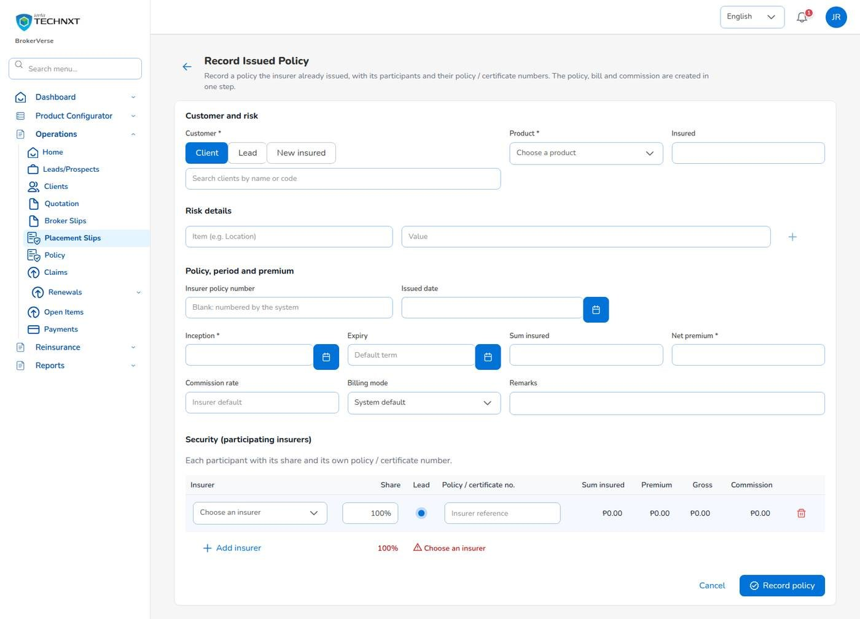
KEY FUNCTION 10 OF 12
Record Issued Policy
Operations > Placement Slips > Record Issued Policy
When: the insurer has already issued the policy, for example a renewal it processed itself.
One step: policy, bill and commission are created together.
Security: each participant with its share and its own policy or certificate number.
Refused: on lines whose journey does not allow a direct policy entry.
Live screen: Placement Slips > Record Issued Policy. Signed in as Processing Team (jose.uw).
BrokerVerse | Processing Team
13

Slide 14
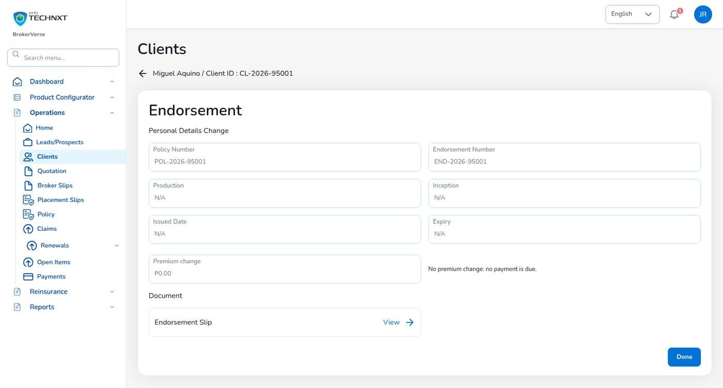
KEY FUNCTION 11 OF 12
Complete an endorsement
Endorsement > Proceed > Complete
Start: Operations raises the request and sends it to the insurer (Waiting for Update).
You: upload the insurer’s endorsement with its number and dates, then Complete.
Money: additional premium is billed; for a co-insured policy the journal splits it by share.
Return premium: credited to the client; already remitted amounts are netted on the next remittance.
Live screen: Endorsement END-2026-95001, completed. Signed in as Processing Team (jose.uw).
BrokerVerse | Processing Team
14

Slide 15
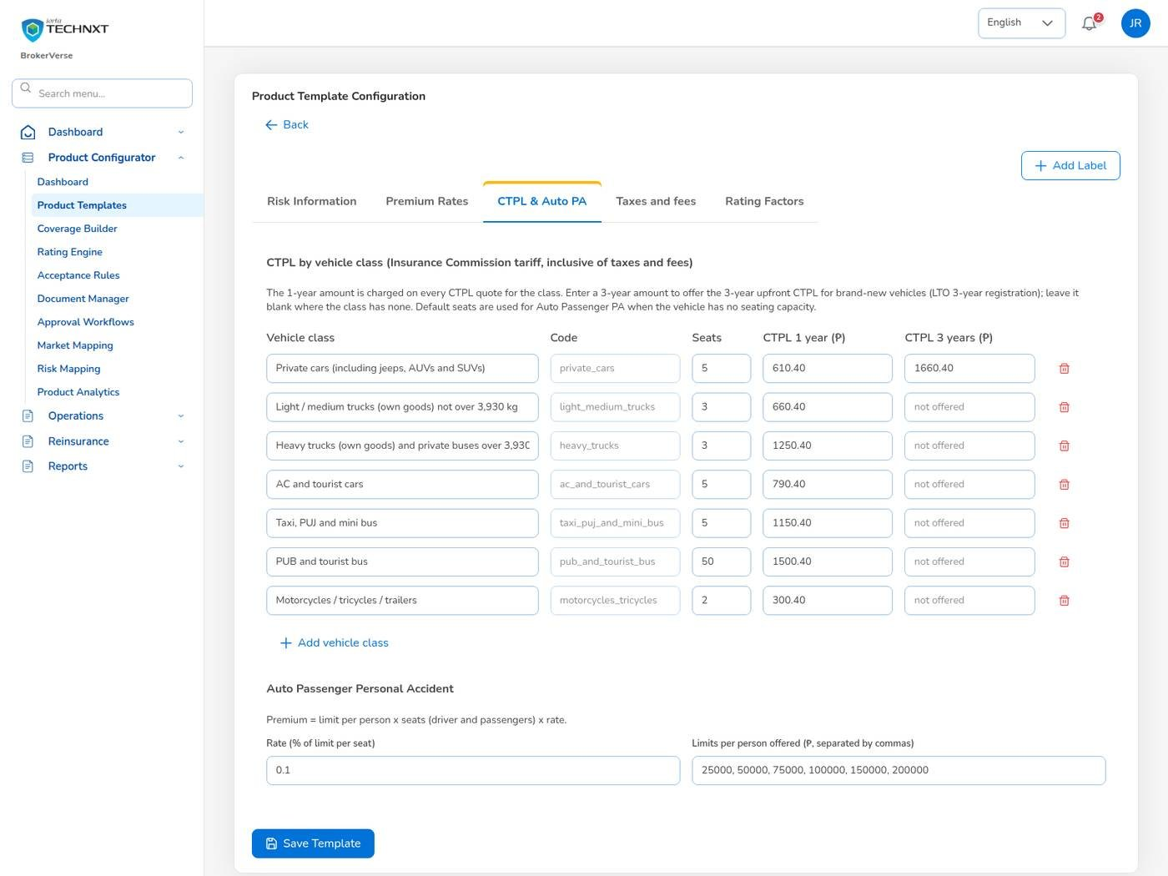
KEY FUNCTION 12 OF 12
Motor tariff
Product Configurator > Product Templates
Vehicle classes: code, default seats, CTPL 1 year and 3 years, e.g. private cars ₱ 610.40 / ₱ 1,660.40.
Auto Passenger PA: rate per seat and the limits per person offered.
Effect: quotation screens use the values at once.
Taxes: come from Master > Configuration, shown read-only on the template.
Live screen: Product Templates > MOT-003-2025, CTPL & Auto PA. Signed in as Processing Team (jose.uw).
BrokerVerse | Processing Team
15

Slide 16
PLACEMENT.JOURNEY
Placement journey by line of business
The journey of each line decides which steps are required. A required step cannot be skipped; the screens show the journey as a progress bar and mark unused steps Not used.
Line of business | Broker Slip | Quotation Slip | Placement Slip | Record Issued Policy
Motor | Optional | Required | Optional | Optional
Fire, IAR, Marine, Casualty, Engineering | Optional | Optional | Required | Optional
Other lines (default) | Optional | Optional | Optional | Optional
Renewals follow the journey only when placement.journey_applies_to_renewals is on (off when delivered). The System Administrator changes the journey on Master > Configuration, tab Placement.
BrokerVerse | Processing Team
16

Slide 17
LEAD TO RENEWAL
End-to-end flow: your part of the cycle
1
2
3
4
5
6
7
Lead
Broker Slip
Quotation Slip
Placement Slip
Policy issue
Payment capture
Official receipt
Sales, Operations
Processing Team
Sales, Processing
Processing Team
Processing Team
Operations, Sales, Processing
Accounting
13
12
11
10
9
8
Month-end
Renewal
Claim
Endorsement
Remittance
Commission
Accounting, Acct. Manager
Operations, Sales, Processing
Claims, two users
Operations, Processing
Accounting, two users
Accounting, two users
Your steps
Done by other personas or by the system
Renewal terms you approve start the next term
2 Broker Slip: market the risk and compare offers.
3 and 4: Quotation Slip for the client, Placement Slip to bind.
5 Policy issue: from the bound slip or the motor quotation.
10 and 12: complete endorsements, approve renewal terms.
BrokerVerse | Processing Team
17

Slide 18
REPORTS > ALL REPORTS
Reports you use (13)
Output formats
CSV
XLSX
PDF
Preview
Scheduled e-mail
Thirteen reports in Reports > All Reports.
Report | What it shows
Production Register | Policies incepted in the period: premium, commission, new or renewal, billing mode
Premium by Product / Month / Insurer | Policy count, sum insured, premium and commission
New Business vs Renewals | New business and renewals by month or agent
Lead Conversion Funnel | Leads by stage with the conversion rate
Placement Pipeline | Broker Slips and Placement Slips of the period with status, lead insurer, premium and age
Market Response | Insurers approached: offers, declines, pending, response days and hit ratio
Co-insurance Register | Co-insured policies with each participant's share, premium and commission
Reinsurance Cession Register | Cessions per treaty and policy
Claims Position | Claims reported: estimate, approved, settled and age
Claims Ageing | Open claims by ageing bucket
Renewal Retention | Renewals due: retained, lost or pending, and the retention rate
Remittance Summary | Remittances to insurers: gross premium, commission, net due, status
Broker Commission Statement | Commission per agent and policy: basis, rate, gross, WHT, net, paid status
BrokerVerse | Processing Team
18

Slide 19
MASTER > CONFIGURATION > SCHEDULES
Schedules and automations
Job | When it runs | What it means for you
Quotation expiry | Daily 00:30 | Quotations expire after 30 days
Renewal pipeline | Daily 05:30 | Policies due within 90 days reach the renewal queue
Renewal notices | Daily 06:00 | Notices at 60, 30 and 15 days
Policy expiry | Daily 00:15 | Expired policies leave the in-force figures
E-mail outbox | Every 5 minutes | Requests for quotation and firm orders leave every 5 minutes
Daily reports | Daily 05:00 | Production Register each morning
Times are Manila time (general.timezone). The System Administrator changes a timetable, switches a job on or off, or runs it now; every run is recorded.
BrokerVerse | Processing Team
19

Slide 20
BELL ICON, TOP RIGHT
Notifications and approvals
Approval
Quotation sent for approval
Info
Policy issued
Client, quotation number and gross premium.
Policy issued from a Placement Slip you own.
Approval
Renewal approval
Approval
Treaty awaiting approval
Renewal terms waiting for your decision.
When treaty approval is on; not your own treaty.
Info
Renewal approved / returned
Info
Endorsement completed
Goes back to the maker with your note.
Sent to the policy owner when you complete it.
BrokerVerse | Processing Team
20

Slide 21
GOOD TO KNOW
Known limitations and tips
Open items that affect you
Tips
The sign-in session is kept in the browser’s local storage: sign out on shared computers and keep the browser up to date.
Two-factor set-up shows a setup key and an app link but no QR code: type the key into the authenticator app.
Filipino is configured as a language but has no screen translation yet.
Only users with policy issuing rights see Issue Policy; others see “All insurers confirmed”.
Treaties are added by the System Administrator on Master > Reinsurance Treaty.
Keep each insurer’s placement e-mail current: slips go there.
Record declines as well as offers.
Check the shares total 100% before you send a Placement Slip.
Use Placement Pipeline to chase slips that are getting old.
BrokerVerse | Processing Team
21

Slide 22
Thank you
BrokerVerse guide for Processing Team
SUPPORT
First line
The key user of your team: how-to questions, checking that a role or setting is not the cause
Second line
Your System Administrator: users, roles, passwords, two-step resets, settings and master data
Third line
iorta TechNXT production support, raised by the System Administrator through the support agreement
Access requests
Your System Administrator (Master > Generals > User Management)
When you report a problem, give the menu path, the record number, the time, your user ID, the message and its request ID. Never send a password or a two-step code.
iorta TechNXT · BrokerVerse insurance broking platform

