Slide 1

THIS GUIDE IS FOR
Sales & Marketing
ROLE
BrokerVerse guide for Sales & Marketing
Sales & Marketing (Account Executive)
SIGN-IN
maria.sales (and the account executives agent.*)
Functions, flows, reports and schedules of your role
ROLE CODE
sales
BrokerVerse OOTB · insurance broking · Philippines · PHP
LANDS ON
Executive Dashboard
Leads and quotations
Renewals
Own production
Prepared by iorta TechNXT · September 2026

Slide 2
WHO YOU ARE IN BROKERVERSE
Role at a glance
What you do
Sign-in and landing page
User name maria.sales. Lands on the Executive Dashboard. Your own figures are on Dashboard > Sales Dashboard.
Finds business: records prospects and leads, alone or in bulk from a spreadsheet.
Quotes: prices motor risks in the quotation wizard and sends them to the client for online acceptance.
Hands over commercial risks: agrees the risk details; the Processing Team markets them on a Broker Slip.
Keeps the book: works the renewal queue, at-risk policies and negotiations.
Watches results: Sales Dashboard, commission and incentive results for your own production.
You hand work to
Processing Team (Broker Slips, placement, policy issue, renewal terms), the client (accepts by e-mail link), Accounting (verifies payments you record).
Maker-checker partners
Your quotation is approved by another user, and renewal terms by the Processing Team. You never post receipts: you record the payment and Accounting confirms it.
BrokerVerse | Sales & Marketing
2

Slide 3
WHAT YOU SEE AFTER SIGN-IN
Menu map
Menus granted to sales in menuPermissions.js; anything else is hidden, refused by the route guard and by the API. The role walk opened 29 screens.
Dashboard
Product Configurator
Operations
Executive Dashboard
Sales Dashboard
Dashboard
Product Templates
Home
Leads/Prospects
Clients
Quotation
Broker Slips
Placement Slips
Policy
Claims
Renewals (8 screens)
Open Items
Payments
Commission
Reports
Commission Dashboard
All Reports (15 reports)
Operational Reports: Production, Claims, Renewal, Remittance, Broker Commission
BrokerVerse | Sales & Marketing
3

Slide 4
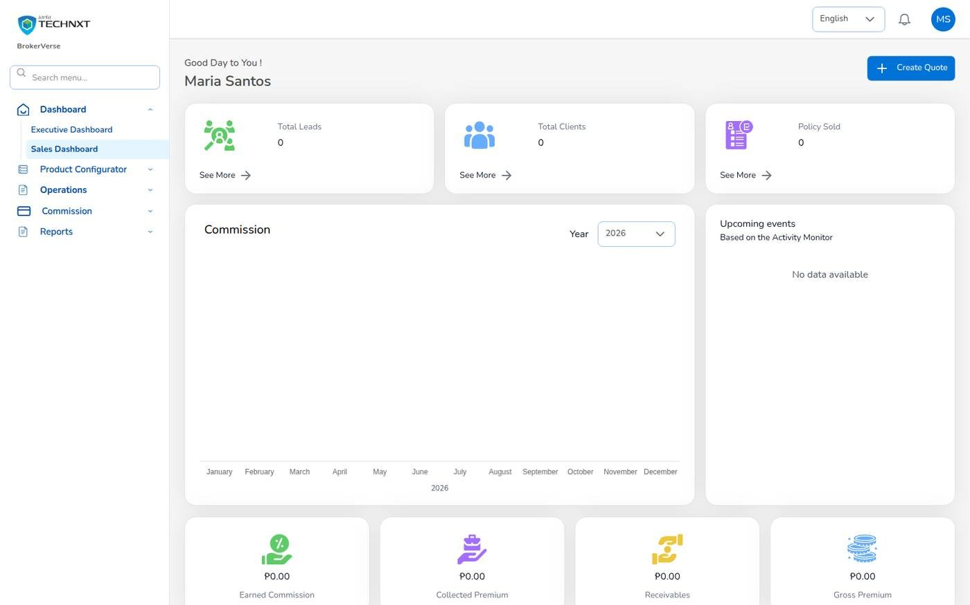
KEY FUNCTION 1 OF 9
Sales Dashboard
Dashboard > Sales Dashboard (also Operations > Home)
Counts: your leads, clients and policies.
Money: earned commission and premium billed on your policies: collected, still due, total.
Direct bill: left out of premium figures, because the client pays the insurer.
Shortcut: Create Quote, and upcoming follow-ups from the activity monitor.
Live screen: Dashboard > Sales Dashboard. Signed in as Sales & Marketing (maria.sales).
BrokerVerse | Sales & Marketing
4

Slide 5
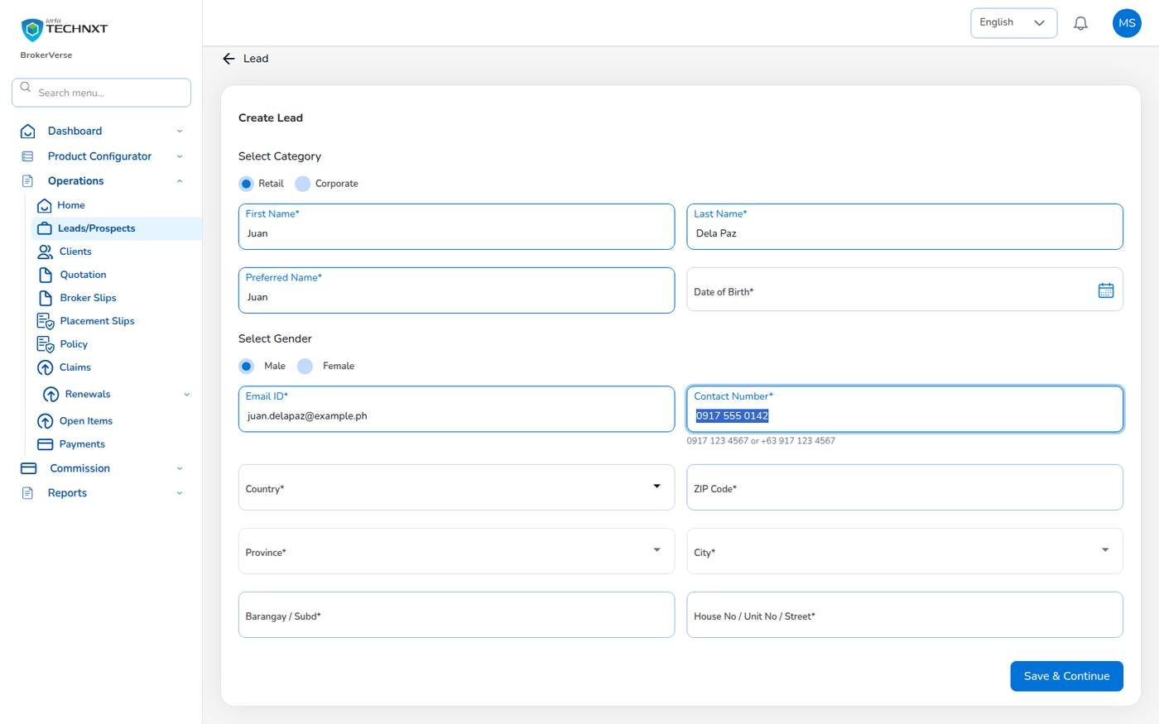
KEY FUNCTION 2 OF 9
Leads and prospects
Operations > Leads/Prospects > Create Lead
Line first: Motor, Fire and Allied Perils, Industrial All Risks or Employee Benefit; then Retail or Corporate.
Checks: age 18 to 100, valid e-mail, mobile 0917 123 4567 or +63 917 123 4567, 4-digit ZIP.
Corporate: company name and TIN are required.
Bulk Upload: up to 1,000 rows from Leads_Upload_Template.xlsx; failed rows listed with the reason.
Live screen: Leads/Prospects > Create Lead, motor prospect. Signed in as Sales & Marketing (maria.sales).
BrokerVerse | Sales & Marketing
5

Slide 6
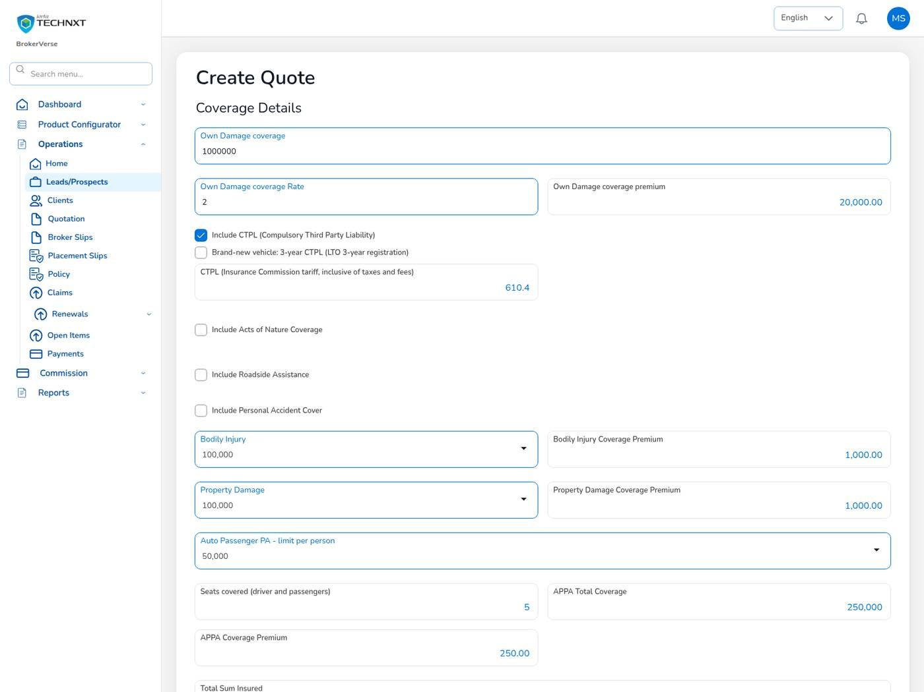
KEY FUNCTION 3 OF 9
Motor quotation: coverage
Lead Details > Create Quote (5 steps)
Own damage: rate from the motor tariff, 2% for private cars.
CTPL and Auto Passenger PA: always priced by the system from template MOT-003-2025.
Co-Insurance: tick it on step 1 when several insurers share the risk; shares total 100% with one lead.
Calculate: after every change. Nothing is saved until Completed Quote.
Live screen: Create Quote, step 3 after Calculate. Signed in as Sales & Marketing (maria.sales).
BrokerVerse | Sales & Marketing
6

Slide 7
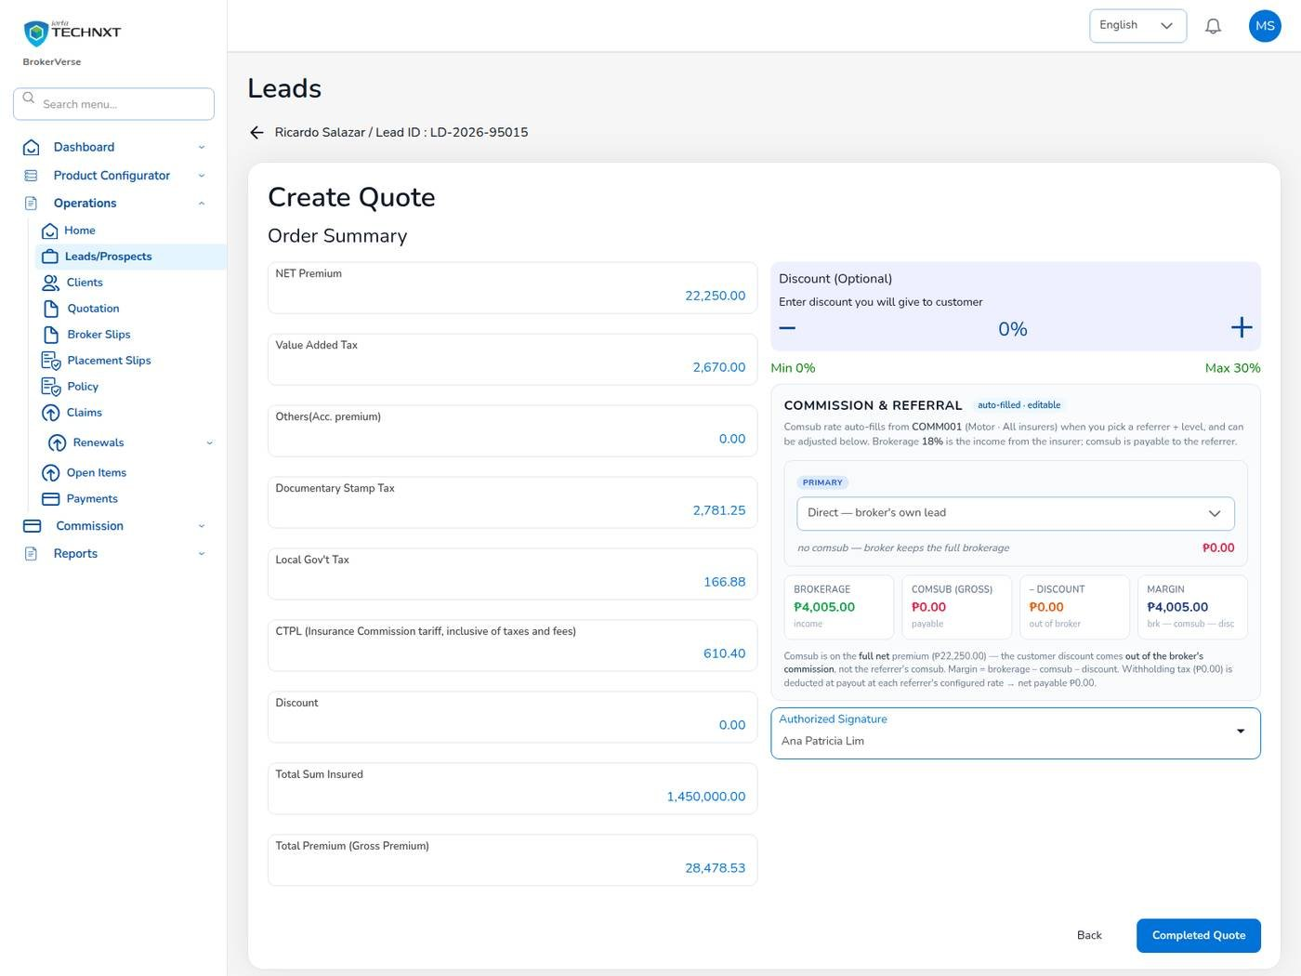
KEY FUNCTION 4 OF 9
Order summary, discount and referrer
Create Quote > Order Summary
Taxes: VAT 12%, DST 12.5%, LGT 0.75% of the net premium; CTPL is not taxed again.
Discount: 0% to 30%, taken from the broker’s commission, not the referrer’s share.
Referrer: choose the referrer or Direct; comsub fills in from the rule (L1 8%, L2 5%).
Server check: the saved premium is recalculated from the configured rates; typed amounts are refused.
Live screen: Create Quote, step 5. Signed in as Sales & Marketing (maria.sales).
BrokerVerse | Sales & Marketing
7

Slide 8
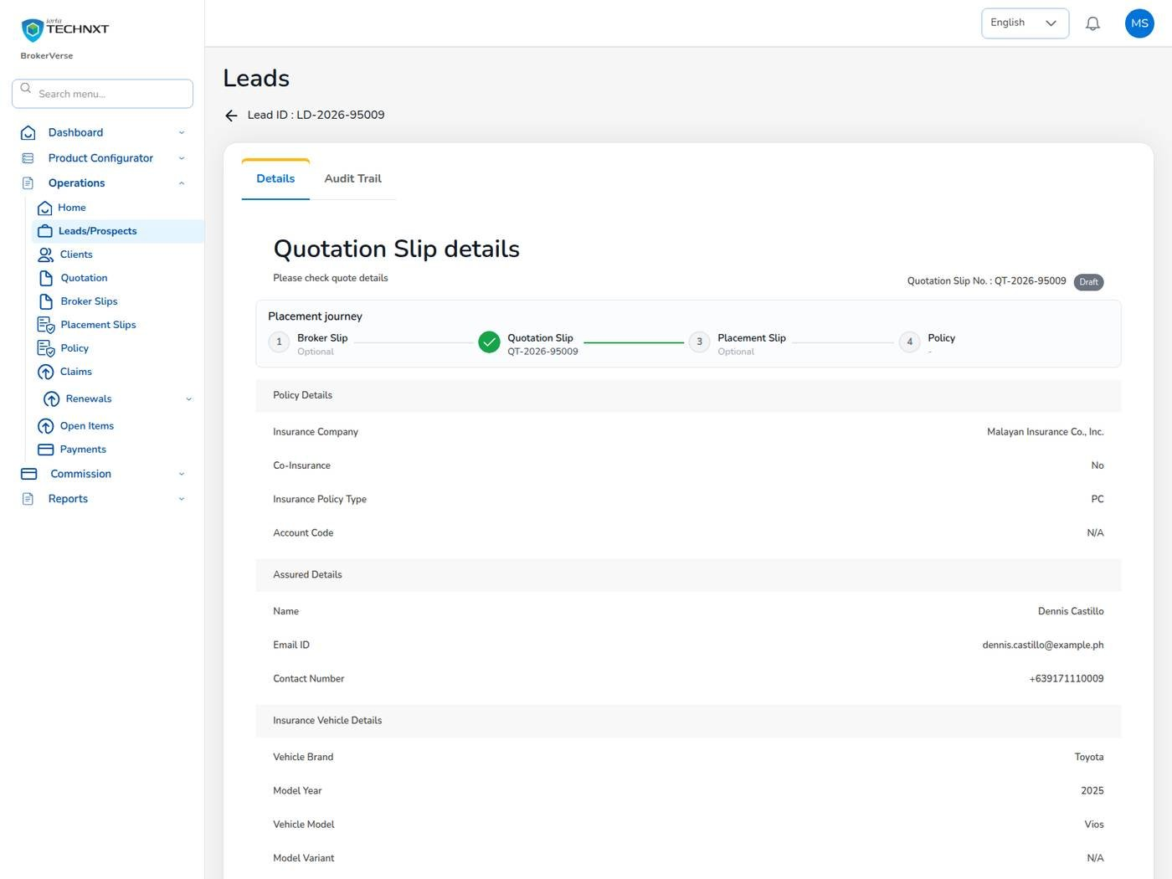
KEY FUNCTION 5 OF 9
Send the quotation to the client
Operations > Quotation > eye icon
Send for Customer Approval: e-mails a signed link valid 7 days; status Pending Customer.
Client: opens the link, no sign-in needed, and selects Approve Quote.
You: are told Customer accepted quotation; the Processing Team is notified.
Share: Download, Email, WhatsApp, Send to Insurer or Copy Link. Quotations expire after 30 days.
Live screen: Quotation detail, Draft. Signed in as Sales & Marketing (maria.sales).
BrokerVerse | Sales & Marketing
8

Slide 9
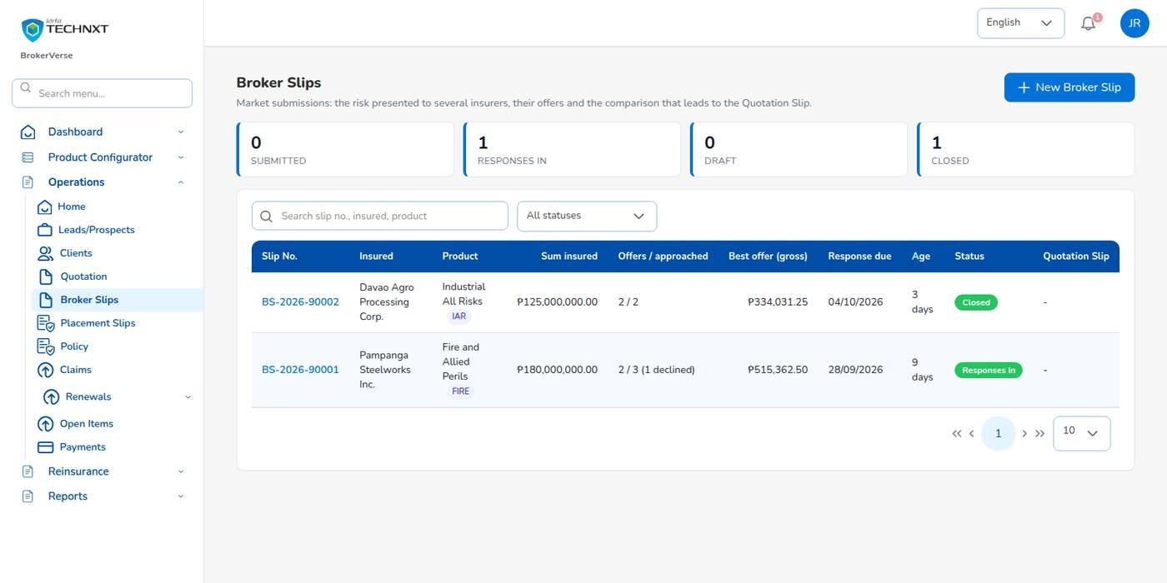
KEY FUNCTION 6 OF 9
Follow a commercial placement
Operations > Broker Slips, Placement Slips
Who does it: the Processing Team markets fire, IAR, marine and other commercial risks.
You see: offers received, declines, best gross offer, response due date and status.
Next: the chosen terms become a Quotation Slip for the client, or a Placement Slip.
Reports: Placement Pipeline and Market Response.
Live screen: Operations > Broker Slips. Signed in as Processing Team (jose.uw).
BrokerVerse | Sales & Marketing
9

Slide 10
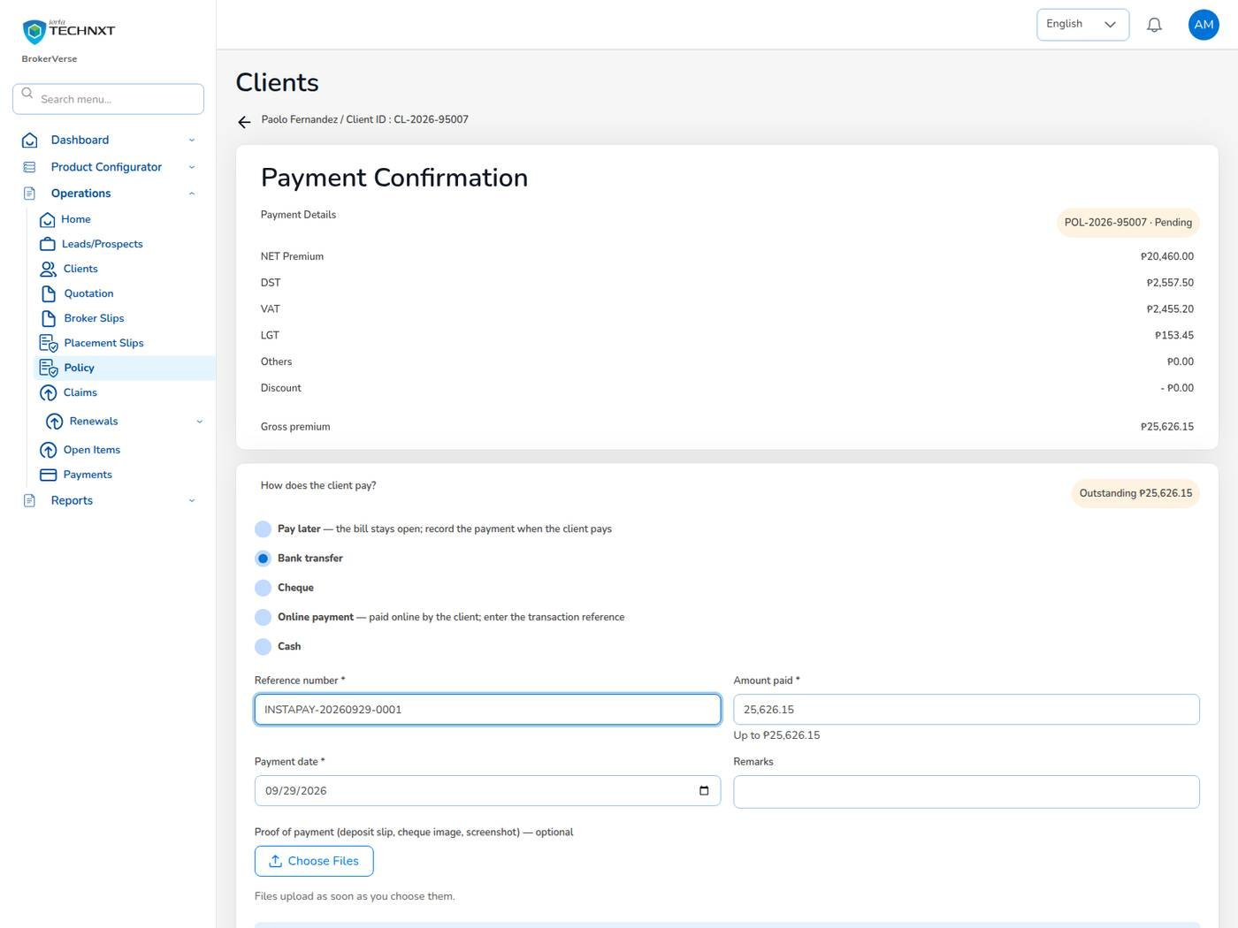
KEY FUNCTION 7 OF 9
Record the client’s payment
Policy > Proceed to Payment
Choose: Pay later, Bank transfer, Cheque, Online payment or Cash.
Enter: reference, amount, payment date and proof of payment if you have it.
Then: payment status Reviewing; Accounting gets Premium payment to verify.
Only Accounting: posts the official receipt (Confirm) or rejects it with a reason.
Live screen: Policy > Proceed to Payment. Signed in as Operations (ana.cs).
BrokerVerse | Sales & Marketing
10

Slide 11
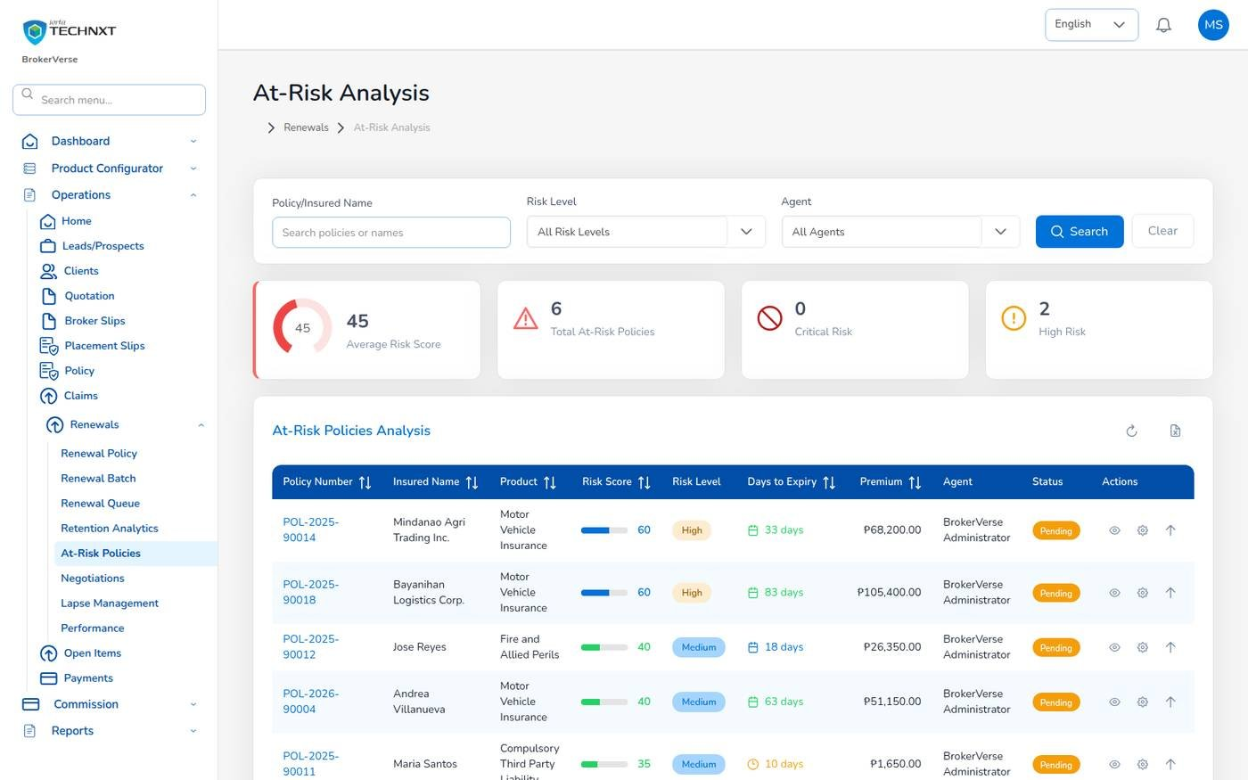
KEY FUNCTION 8 OF 9
Renewals: queue and at-risk policies
Operations > Renewals
Timetable: pipeline 90 days before expiry; notices at 60, 30 and 15 days; lapse 30 days after expiry.
Risk score: claims in the term, unpaid premium, expiry within 30 days, premium increase, no contact, first renewal.
Negotiations: Add Update for each call; Request Approval sends terms to the Processing Team.
Commission: the renewal accrues to the original referrer.
Live screen: Operations > Renewals > At-Risk Policies. Signed in as Sales & Marketing (maria.sales).
BrokerVerse | Sales & Marketing
11

Slide 12
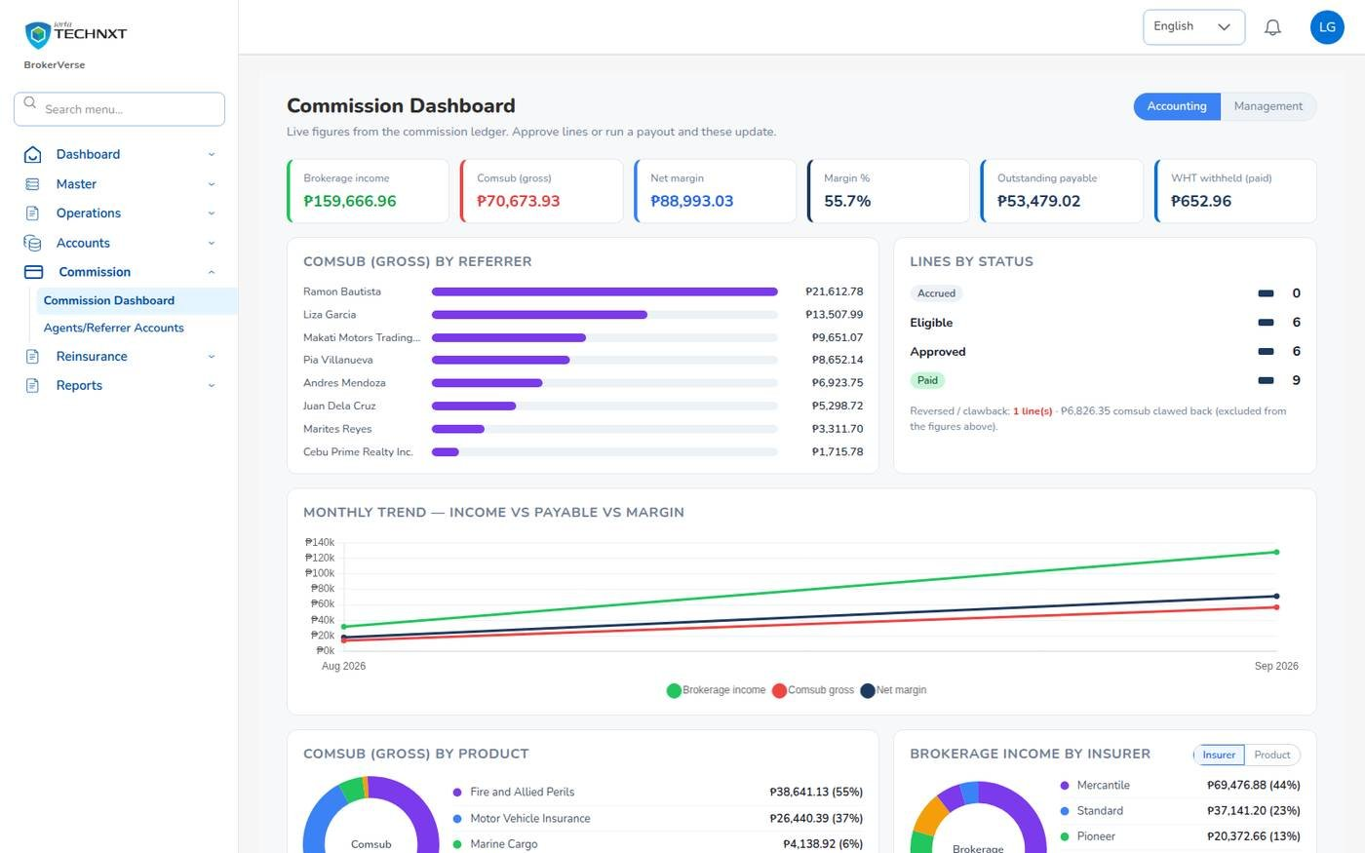
KEY FUNCTION 9 OF 9
Commission dashboard
Commission > Commission Dashboard
Shows: brokerage income, comsub, net margin, outstanding payable and withholding tax.
Breakdowns: by referrer, status, month, product and insurer.
Who earns: only Sales & Marketing users earn commission on their production (commission.eligible_roles).
Payable: when the premium is fully collected and the referrer has a bank account on file.
Live screen: Commission > Commission Dashboard. Signed in as Accounting (liza.finance).
BrokerVerse | Sales & Marketing
12

Slide 13
LEAD TO RENEWAL
End-to-end flow: your part of the cycle
1
2
3
4
5
6
7
Lead
Broker Slip
Quotation Slip
Placement Slip
Policy issue
Payment capture
Official receipt
Sales, Operations
Processing Team
Sales, Processing
Processing Team
Processing Team
Operations, Sales, Processing
Accounting
13
12
11
10
9
8
Month-end
Renewal
Claim
Endorsement
Remittance
Commission
Accounting, Acct. Manager
Operations, Sales, Processing
Claims, two users
Operations, Processing
Accounting, two users
Accounting, two users
Your steps
Done by other personas or by the system
Your renewals start the next cycle
1 Lead: record and qualify the prospect.
3 Quotation Slip: price the motor risk and send the link.
6 Payment capture: record how the client paid.
12 Renewal: work the queue and at-risk list.
BrokerVerse | Sales & Marketing
13

Slide 14
REPORTS > ALL REPORTS
Reports you use (15)
Output formats
CSV
XLSX
PDF
Preview
Scheduled e-mail
Fifteen reports in Reports > All Reports.
Report | What it shows
Production Register | Policies incepted in the period: premium, commission, new or renewal, billing mode
Premium by Product / Month / Insurer | Policy count, sum insured, premium and commission
New Business vs Renewals | New business and renewals by month or agent
Lead Conversion Funnel | Leads by stage with the conversion rate
Placement Pipeline | Broker Slips and Placement Slips of the period with status, lead insurer, premium and age
Market Response | Insurers approached: offers, declines, pending, response days and hit ratio
Co-insurance Register | Co-insured policies with each participant's share, premium and commission
Claims Position | Claims reported: estimate, approved, settled and age
Claims Ageing | Open claims by ageing bucket
Renewal Retention | Renewals due: retained, lost or pending, and the retention rate
Remittance Summary | Remittances to insurers: gross premium, commission, net due, status
Broker Commission Statement | Commission per agent and policy: basis, rate, gross, WHT, net, paid status
Incentive Results | Programme target, achieved and payout per person
SOA / Premium Receivable | Bills issued: amount, paid, balance and age
Receivables Ageing | Outstanding receivables by bucket
BrokerVerse | Sales & Marketing
14

Slide 15
MASTER > CONFIGURATION > SCHEDULES
Schedules and automations
Job | When it runs | What it means for you
Quotation expiry | Daily 00:30 | Your quotations expire after 30 days
Renewal pipeline | Daily 05:30 | Your policies enter the renewal queue 90 days before expiry
Renewal notices | Daily 06:00 | Clients get notices at 60, 30 and 15 days; you get a reminder
Collection reminders | Daily 08:00 | Clients reminded 7 days before premium is due
Daily reports | Daily 05:00 | Production Register ready at 05:00
Times are Manila time (general.timezone). The System Administrator changes a timetable, switches a job on or off, or runs it now; every run is recorded.
BrokerVerse | Sales & Marketing
15

Slide 16
BELL ICON, TOP RIGHT
Notifications and approvals
Task
Customer accepted quotation
Reminder
Renewal notice reminders
The client approved through the link.
For each 60, 30 and 15-day notice on your policies.
Info
Quotation approved
Info
Renewal approved / returned
Another user approved your quotation.
The Processing Team’s decision on your terms.
Info
Policy issued
Alert
Policy lapsed
Policy number, for policies you own.
No renewal within 30 days after expiry.
BrokerVerse | Sales & Marketing
16

Slide 17
GOOD TO KNOW
Known limitations and tips
Open items that affect you
Tips
The sign-in session is kept in the browser’s local storage: sign out on shared computers and keep the browser up to date.
Two-factor set-up shows a setup key and an app link but no QR code: type the key into the authenticator app.
Filipino is configured as a language but has no screen translation yet.
The lead needs an e-mail address before a quotation can be sent for approval.
A quotation converted to a policy cannot be edited: raise an endorsement instead.
Start quotations from Lead Details, not from the quotation list.
Choose the referrer on step 5; the commission follows that choice.
Record declines and offers with the Processing Team: Market Response uses both.
Look at At-Risk Policies every week.
BrokerVerse | Sales & Marketing
17

Slide 18
Thank you
BrokerVerse guide for Sales & Marketing
SUPPORT
First line
The key user of your team: how-to questions, checking that a role or setting is not the cause
Second line
Your System Administrator: users, roles, passwords, two-step resets, settings and master data
Third line
iorta TechNXT production support, raised by the System Administrator through the support agreement
Access requests
Your System Administrator (Master > Generals > User Management)
When you report a problem, give the menu path, the record number, the time, your user ID, the message and its request ID. Never send a password or a two-step code.
iorta TechNXT · BrokerVerse insurance broking platform

