Slide 1

THIS GUIDE IS FOR
System Administrator
ROLE
BrokerVerse guide for System Administrator
System Administrator (Super Admin Access)
SIGN-IN
bea.admin (and the delivered BrokerVerse user)
Functions, flows, reports and schedules of your role
ROLE CODE
system-admin
BrokerVerse OOTB · insurance broking · Philippines · PHP
LANDS ON
Executive Dashboard
Every menu
Users and masters
Settings and schedules
Prepared by iorta TechNXT · September 2026

Slide 2
WHO YOU ARE IN BROKERVERSE
Role at a glance
What you do
Sign-in and landing page
User name bea.admin. Lands on the Executive Dashboard. Idle sessions end after 30 minutes; a role change or password reset ends the user’s other sessions.
Runs the platform: users, roles, system settings, configuration and the scheduled jobs.
Keeps the reference data: company and letterhead, insurers and credit terms, products, locations, commission sharing.
Owns the accounting set-up: document numbering, commission rate matrix, posting rules and account determination, agreed with the Accounting Manager.
Supports every team: sees all 158 screens, so it can reproduce a problem on any of them.
Reviews access: audit trail, sign-in history, password resets and unlocking users.
You hand work to
Processing Team (products and tariff in use), Accounting and the Accounting Manager (GL accounts, posting rules, numbering), every team for user requests.
Maker-checker partners
The role passes every permission check, but maker-checker still applies: you cannot approve a voucher, settlement, close run or reconciliation you prepared yourself.
BrokerVerse | System Administrator
2

Slide 3
WHAT YOU SEE AFTER SIGN-IN
Menu map
system-admin has every menu (all: true) and every permission, including approve:period-end and approve:bank-reconciliation. The role walk opened 158 screens with no errors.
Dashboard
Product Configurator
Master
Operations
Executive Dashboard
Sales Dashboard
Processing Dashboard
Claims Dashboard
Dashboard, Product Templates
Coverage Builder, Rating Engine
Acceptance Rules, Document Manager
Approval Workflows
Market Mapping, Risk Mapping
Product Analytics
System Settings, Configuration
Document Numbering, Schedules, Audit Trail
Generals: company, branch, insurers, lines, products, covers, signatories, vehicles, locations, commission sharing, employees, users and roles
Finance: account determination, posting rules, commission rate matrix, chart of accounts, currency, bank, taxation, close checklist, bank formats and types, petty cash, remittance
Incentive Programs, Reinsurance Treaty
Home
Leads/Prospects
Clients
Quotation
Broker Slips
Placement Slips
Policy
Claims
Renewals (8 screens)
Open Items
Payments
Accounts
Commission
Reinsurance
Reports
Receipts, Collections
Accounting Query, All Clients Accounting
Open Entry Matching / Un-Matching
Disbursement, Petty Cash (5 screens)
Journal Voucher, Correction JV, Reversal JV
Period End (5 screens)
Bank Reconciliation (7 screens)
Tax (6 screens)
Remittance (16 screens)
Incentive (4 screens)
Commission Dashboard
Agents/Referrer Accounts
Treaty Dashboard
Cession Tracking
Claims Recovery
Reconciliation
Analytics
All Reports (39 reports)
Operational Reports: Production, Claims, Renewal, Remittance, Broker Commission
Financial Reports (15 shortcuts)
BrokerVerse | System Administrator
3

Slide 4
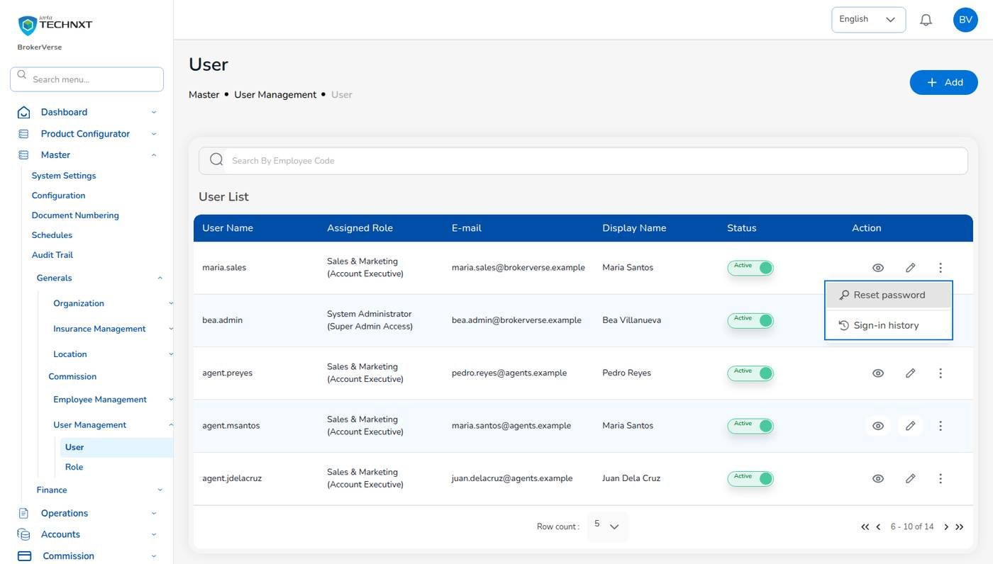
KEY FUNCTION 1 OF 12
Users and account actions
Master > Generals > User Management > User
Add: user name, e-mail, display name and one role. Leave the password empty: a temporary password is shown once.
First sign-in: the user must choose a new password before anything else.
Row actions: Unlock, Reset password, Turn off two-step verification, Sign-in history.
Leavers: switch Status off. History is kept and open sessions end.
Live screen: Master > Generals > User Management > User, account actions. Signed in as System Administrator (bea.admin).
BrokerVerse | System Administrator
4

Slide 5
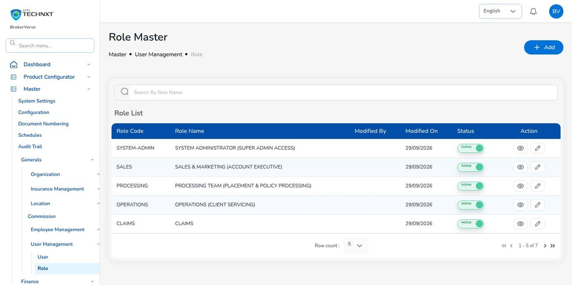
KEY FUNCTION 2 OF 12
The seven roles
Master > Generals > User Management > Role
Fixed roles: system-admin, sales, processing, operations, claims, accounting, accounting-manager.
Inheritance: accounting-manager includes accounting and adds approve:period-end and approve:bank-reconciliation.
Retired: the IT, Business and User Access administrator roles are merged into this one; the Agent login is withdrawn.
Referrers: do not sign in. Sales enters their business and they are paid from the referrer master.
Live screen: Master > Generals > User Management > Role. Signed in as System Administrator (bea.admin).
BrokerVerse | System Administrator
5

Slide 6
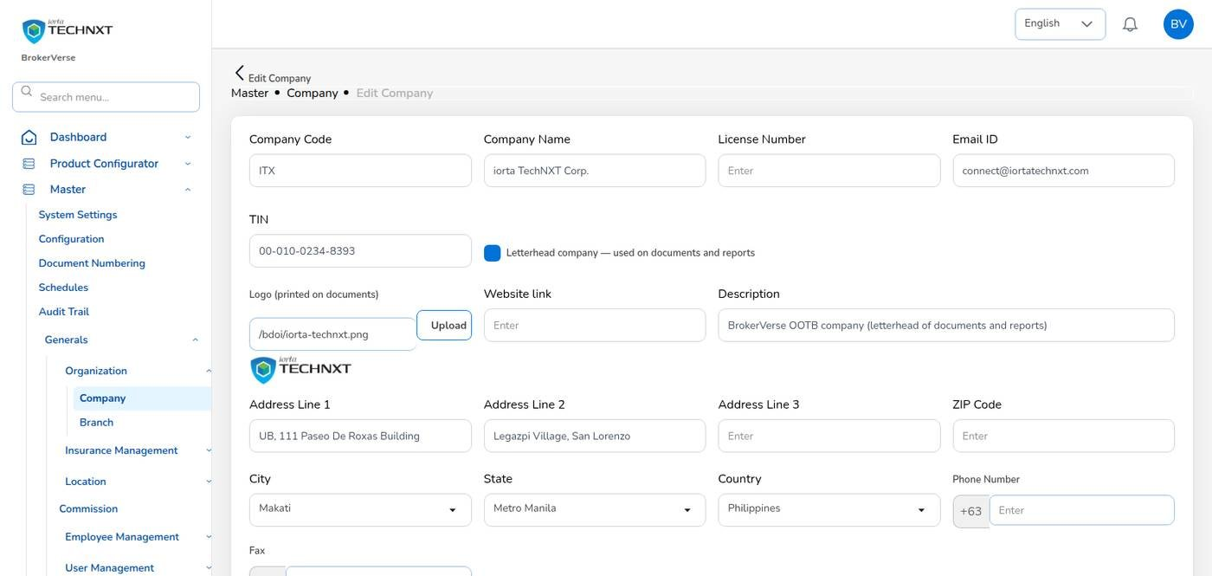
KEY FUNCTION 3 OF 12
Company and letterhead
Master > Generals > Organization > Company
Letterhead: every PDF (slips, policy schedule, OR, PV, debit note, claim letters, BIR forms, reports) uses the letterhead company.
Fill in: company name, Insurance Commission licence, TIN, logo, address, phone and e-mail.
One company: only one company can hold Letterhead company.
Check: print any billing statement as PDF after you save.
Live screen: Master > Generals > Organization > Company, edit. Signed in as System Administrator (bea.admin).
BrokerVerse | System Administrator
6

Slide 7
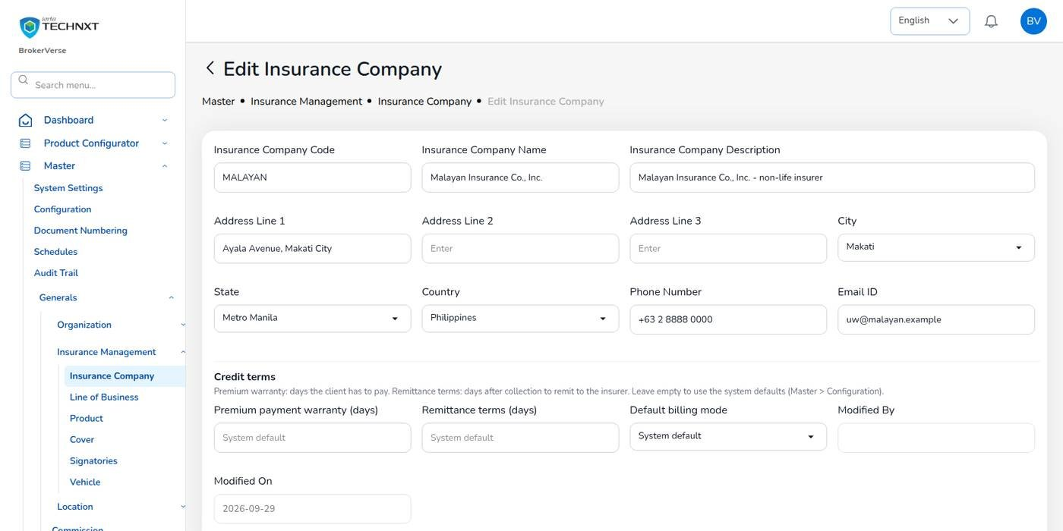
KEY FUNCTION 4 OF 12
Insurers and credit terms
Master > Generals > Insurance Management > Insurance Company
E-mail: requests for quotation, firm orders, loss advices and remittance advices go to the insurer’s e-mail.
Premium payment warranty: days the client has to pay; else collections.default_credit_days (30).
Remittance terms: days after collection to remit; else remittance.default_due_days (30).
Default billing mode: broker billed or direct bill for the insurer’s new policies.
Live screen: Master > Insurance Company, edit. Signed in as System Administrator (bea.admin).
BrokerVerse | System Administrator
7

Slide 8
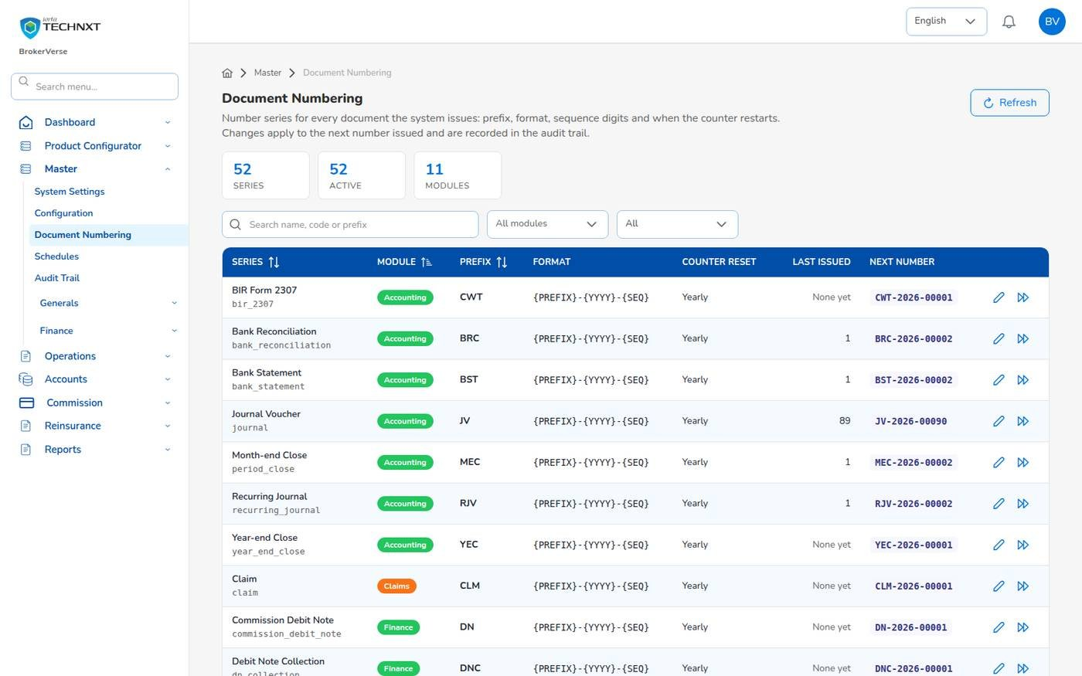
KEY FUNCTION 5 OF 12
Document numbering
Master > Document Numbering
Series: 52 series in 11 modules: POL, QT, BS, PS, OR, INV, PV, JV, CLM, END, DN, MEC, BRC, CWT and more.
Format: tokens {PREFIX}, {YYYY}, {YY}, {MM}, {FY}, {BRANCH}, {LOB}, {SEQ}; delivered as POL-2026-00001.
Reset: every calendar year, fiscal year, month or never.
Go-live: Set next number continues the old system’s series. The OR series must match the Authority to Print.
Live screen: Master > Document Numbering. Signed in as System Administrator (bea.admin).
BrokerVerse | System Administrator
8

Slide 9
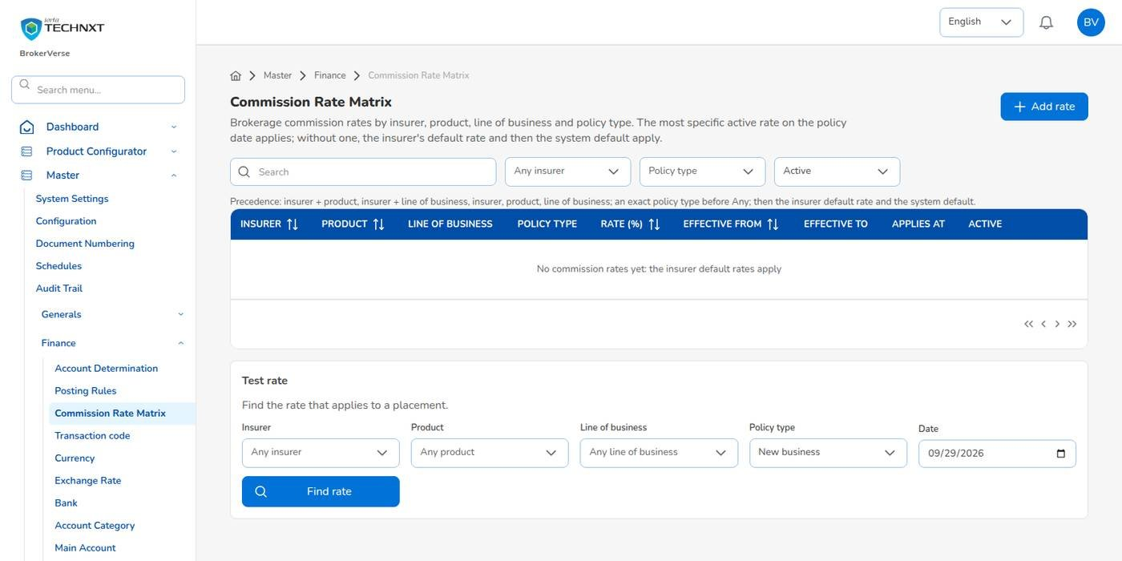
KEY FUNCTION 6 OF 12
Commission Rate Matrix
Master > Finance > Commission Rate Matrix
Holds: the brokerage the broker earns by insurer, product, line and policy type, with effective dates.
Order: most specific rate first, then the insurer’s default rate, then commission.default_rate (15%).
Test rate: shows the rate a placement would get and where it came from.
Not the same as: Master > Generals > Commission, which holds the sharing with referrers.
Live screen: Master > Finance > Commission Rate Matrix. Signed in as System Administrator (bea.admin).
BrokerVerse | System Administrator
9

Slide 10
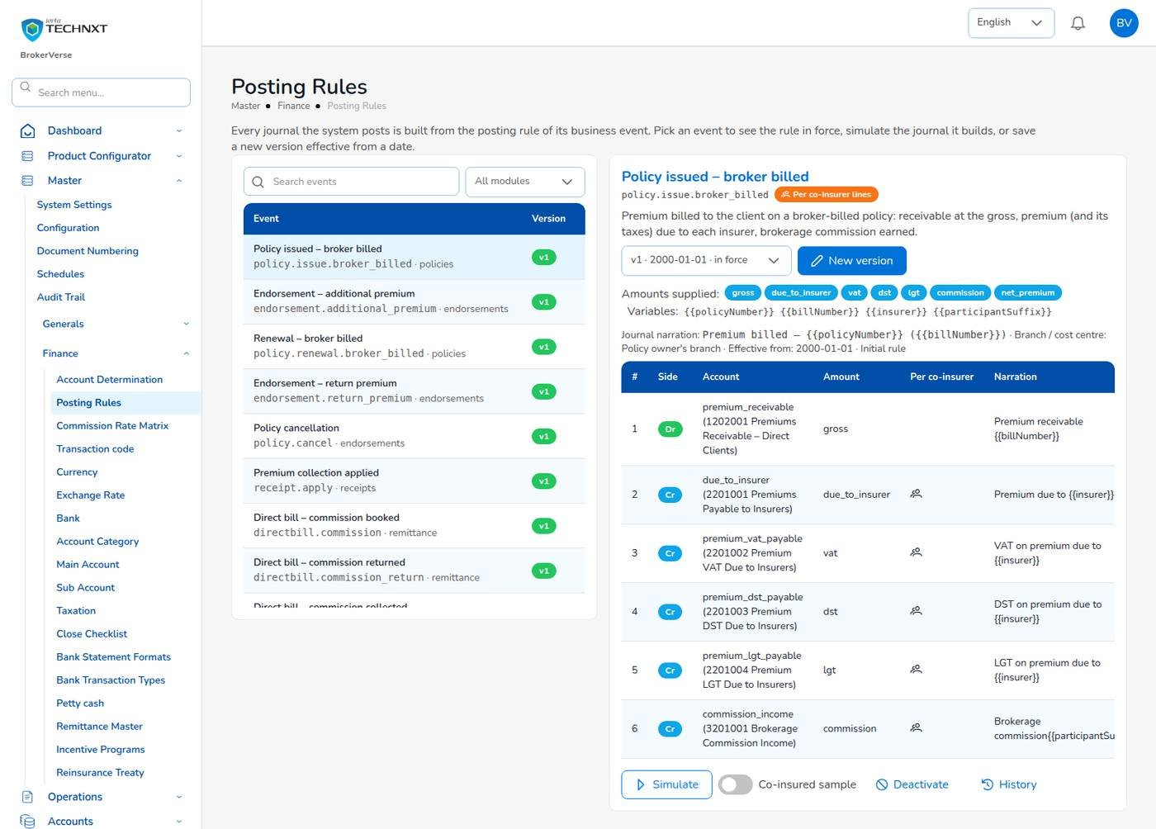
KEY FUNCTION 7 OF 12
Posting rules: from operations to the ledger
Master > Finance > Posting Rules
Events: policy issued, endorsement, renewal, cancellation, receipt, comsub, voucher, remittance, claim funds, cessions and more.
Each line: debit or credit, account role or GL account, amount, narration, split per co-insurer.
Simulate: builds the journal with sample amounts, including a co-insured sample, and checks it balances.
Change: New version from a date, only with the Accounting Manager. Older journals keep the old version.
Live screen: Master > Finance > Posting Rules, Policy issued (broker billed). Signed in as System Administrator (bea.admin).
BrokerVerse | System Administrator
10

Slide 11
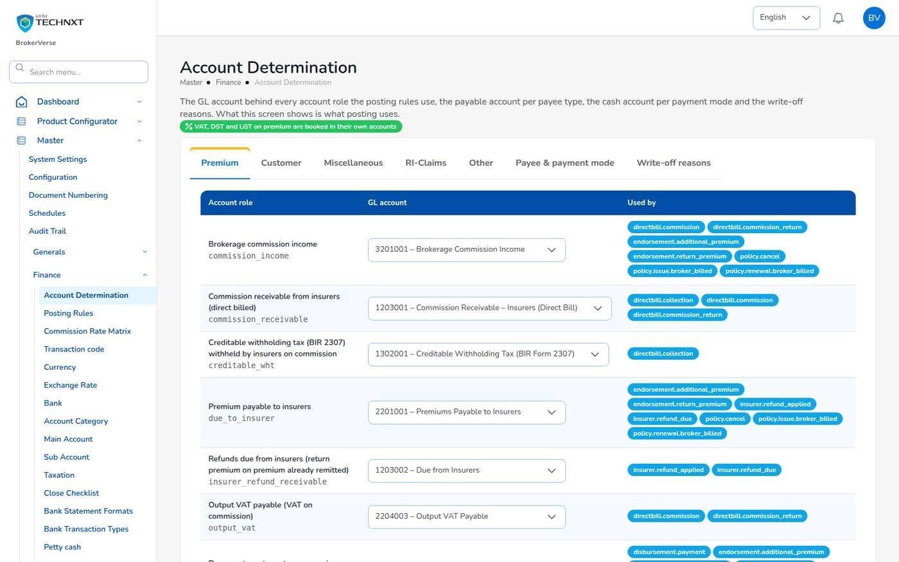
KEY FUNCTION 8 OF 12
Account determination
Master > Finance > Account Determination
Account roles: the GL account behind each role, e.g. brokerage income 3201001, premium payable 2201001.
Payee and payment mode: payable account per payee type and cash account per payment mode.
Write-off reasons: code, GL account and maximum amount for Open Entry Matching.
Effect: applies to postings from the moment you save.
Live screen: Master > Finance > Account Determination. Signed in as System Administrator (bea.admin).
BrokerVerse | System Administrator
11

Slide 12
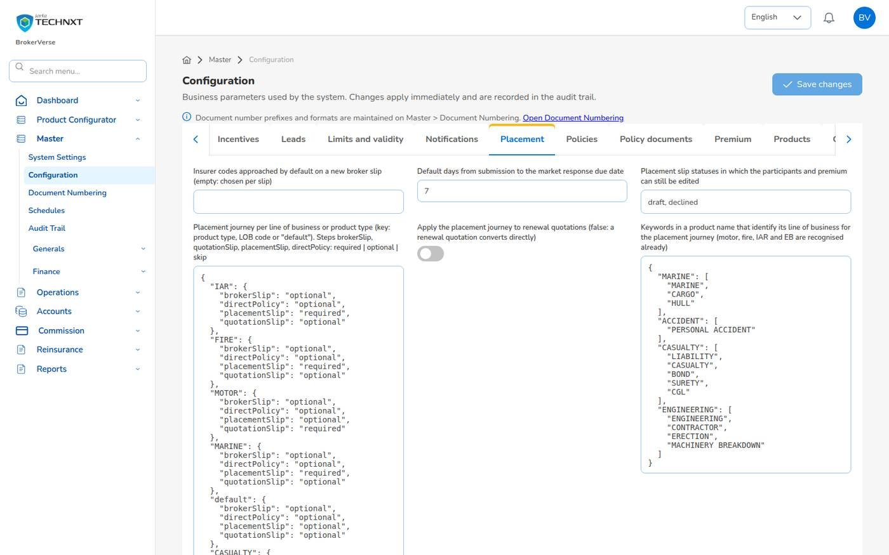
KEY FUNCTION 9 OF 12
Configuration: placement journey and security
Master > Configuration
Tabs: Accounting, BIR, Claims, Collections, Commission, Direct bill, Placement, Quotations, Renewals, Security, Taxes and more.
placement.journey: which steps each line must, may or does not use (fire and IAR require a Placement Slip).
Security: password rules, lockout, 2FA roles (none required when delivered; recommended for admin and accounting).
Audit: every change applies at once and is recorded with old and new value.
Live screen: Master > Configuration, Placement tab. Signed in as System Administrator (bea.admin).
BrokerVerse | System Administrator
12

Slide 13
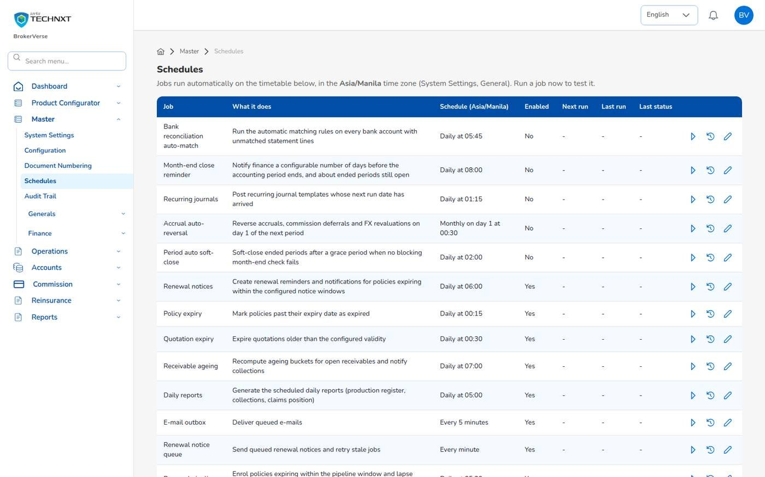
KEY FUNCTION 10 OF 12
Schedules
Master > Configuration > Schedules
Jobs: 15 jobs in Manila time. Six accounting jobs are delivered switched off.
Run now: runs a job at once and shows the result, for example Updated: 5.
Pencil: change the timetable, the job parameters, or switch it on or off.
History: past runs with results. With several servers each run happens once.
Live screen: Master > Schedules. Signed in as System Administrator (bea.admin).
BrokerVerse | System Administrator
13

Slide 14
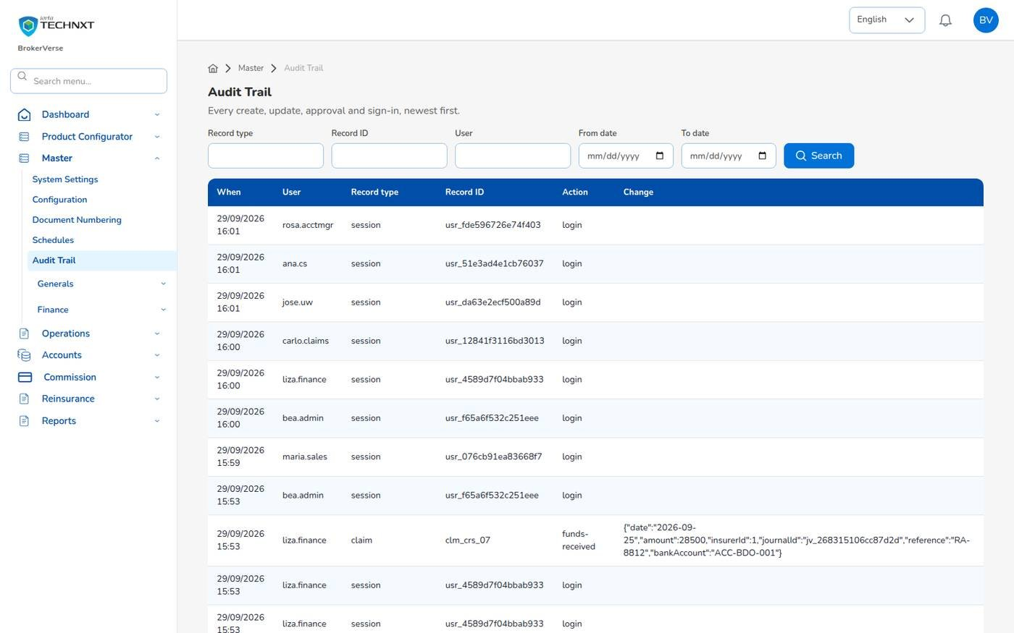
KEY FUNCTION 11 OF 12
Audit trail
Master > Configuration > Audit Trail
Contents: every create, update, approval, report run and sign-in, newest first.
Search: record type (session, policy, receipt, placement, period-close-run), record ID, user, dates.
Use: investigations, access reviews, proof that maker and checker were different people.
Kept: for good (housekeeping.audit_log_days is 0).
Live screen: Master > Audit Trail. Signed in as System Administrator (bea.admin).
BrokerVerse | System Administrator
14

Slide 15
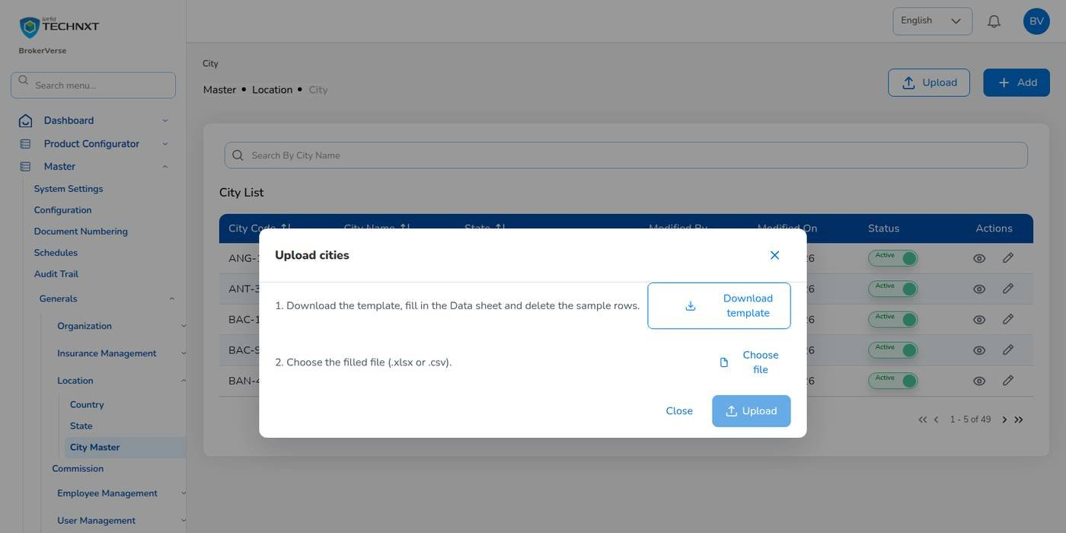
KEY FUNCTION 12 OF 12
Master uploads
Upload button on each master
Template: Download template gives a Data sheet with sample rows, a Columns sheet and Instructions.
Result: rows created or updated, and each failed row with its problem.
Existing code: an upload with an existing code updates the record.
Templates: also delivered in docs/templates.
Live screen: Master > Location > City Master, Upload. Signed in as System Administrator (bea.admin).
BrokerVerse | System Administrator
15

Slide 16
BACKEND/DOCS/API
API and Postman collection
717
46
1
1
endpoints (GET 331, POST 277, PUT 74, DELETE 28, PATCH 7)
folders in the Postman collection
OpenAPI file, generated from the code
touchpoints workbook: endpoint, screen, permission
What you get
How to use it
BrokerVerse.postman_collection.json and its environment (set the base URL and token)
openapi.json with every path and its examples
BrokerVerse_API_Touchpoints.xlsx / .csv: endpoint, the screen that calls it, permission
Generated from the code, so it matches what is deployed
POST /api/auth/login returns an access token; send it as Authorization: Bearer
Every endpoint checks read:, write: or approve: permissions; a wrong role gets 403
Masters without an Upload button are loaded through the route on their template
Share the collection with integration partners, never a password
BrokerVerse | System Administrator
16

Slide 17
BEFORE THE FIRST POLICY
Go-live set-up: your part
1
2
3
4
5
6
Company, letterhead
Users and roles
Insurers, credit terms
Master uploads
Document numbering
Commission rates
You
You
You
You
You
You
12
11
10
9
8
7
Go-live
Open items
Opening balances
Schedules, e-mail
Configuration
Posting rules
Everyone
Accounting
Accounting
You
You
You + Acct. Manager
Your steps
Done by other personas or by the system
After go-live: users, rates and settings as the business changes
Set the SMTP mailbox (Office 365) and switch on e-mail before go-live.
Match the official receipt series to the BIR Authority to Print.
Agree GL accounts, posting rules and maker-checker switches with the Accounting Manager.
Decide which roles must use two-factor authentication (security.require_2fa_roles).
BrokerVerse | System Administrator
17

Slide 18
REPORTS > ALL REPORTS
Reports you use (39)
Output formats
CSV
XLSX
PDF
Preview
Scheduled e-mail
Every report in the catalogue.
Production and placement
Claims and renewals
Insurers and commission
Receivables and cash
Production Register
Premium by Product / Month / Insurer
New Business vs Renewals
Lead Conversion Funnel
Placement Pipeline
Market Response
Co-insurance Register
Reinsurance Cession Register
Claims Position
Claims Ageing
Renewal Retention
Remittance Summary
Broker Commission Statement
Commission Receivable (Direct Bill)
Due to Insurers by Co-insurer
Aged Payables to Insurers
Incentive Results
SOA / Premium Receivable
Receivables Ageing
Collection Report
Receipts Register
Payables / Disbursement Register
Ledger and period end
BIR tax
Bank
Journal Register
Trial Balance
Trial Balance (Opening / Movement / Closing)
General Ledger Detail
Income Statement
Balance Sheet
Month-End Close Status
VAT Summary
SAWT
QAP
SLSP Sales
SLSP Purchases
Bank Reconciliation Statement
Outstanding Cheques
Deposits in Transit
Unmatched Bank Lines
Bank Book
BrokerVerse | System Administrator
18

Slide 19
MASTER > CONFIGURATION > SCHEDULES
Schedules and automations
Job | When it runs | What it means for you
Policy expiry | Daily 00:15 | Policies past expiry become Expired
Quotation expiry | Daily 00:30 | Quotations past validity (30 days) expire
Housekeeping | Daily 02:45 | Old tokens, job runs, read notices and sent e-mails deleted; audit trail kept
Daily reports | Daily 05:00 | Production Register, Collection Report and Claims Position each morning
Renewal pipeline | Daily 05:30 | Policies within 90 days enrolled; lapse after 30 days grace
E-mail outbox | Every 5 minutes | Queued e-mails sent through the configured mailbox
Bank reconciliation auto-match | Daily 05:45 (off when delivered) | Switch on when Accounting asks; same for the other accounting jobs
Times are Manila time (general.timezone). The System Administrator changes a timetable, switches a job on or off, or runs it now; every run is recorded.
BrokerVerse | System Administrator
19

Slide 20
BELL ICON, TOP RIGHT
Notifications and approvals
Approval
Treaty awaiting approval
Task
Settlement cash on Accounting’s instruction
A new reinsurance treaty needs a second user (reinsurance.treaty_requires_approval).
Record funds received and payment to claimant on the claim screen.
Approval
Approvals of every module
E-mail
Outbox
The role holds every permission, so it can receive approval requests addressed to a permission.
Customer e-mails wait in the outbox until the mailbox is set and e-mail is switched on.
Reminder
Premium overdue
Info
Master uploads
Collection reminders for policies you own.
Each upload reports created, updated and failed rows.
BrokerVerse | System Administrator
20

Slide 21
GOOD TO KNOW
Known limitations and tips
Open items that affect you
Tips
Sign-in and request limits are counted per application server; with several servers, add a limit at the load balancer.
Some database queries use the database’s own date: the database time zone must be Asia/Manila.
Several masters have no Upload button yet (Company, Branch, Line of Business, Product, Cover, Signatories, Commission and others): load their templates through the API route on the template.
The Settlement cash panel of a claim paid through the broker sits on the claim screens, which are not in the Accounting menu: the System Administrator records the funds received and the payment to the claimant on Accounting’s instruction.
The Company master list opens with one empty row: type in the search box to list the companies.
Two-factor set-up shows a setup key and an app link but no QR code: type the key into the authenticator app.
Keep this role for administration; do business work with a business role.
Give each person one role, and this role to as few people as possible.
Simulate a posting rule before you save a new version.
Use Run now after changing a job’s settings, then read its history.
Review the audit trail for sign-ins and approvals every week.
BrokerVerse | System Administrator
21

Slide 22
Thank you
BrokerVerse guide for System Administrator
SUPPORT
First line
The key user of your team: how-to questions, checking that a role or setting is not the cause
Second line
Your System Administrator: users, roles, passwords, two-step resets, settings and master data
Third line
iorta TechNXT production support, raised by the System Administrator through the support agreement
Access requests
You: Master > Generals > User Management
When you report a problem, give the menu path, the record number, the time, your user ID, the message and its request ID. Never send a password or a two-step code.
iorta TechNXT · BrokerVerse insurance broking platform

