Slide 1

THIS GUIDE IS FOR
Agent / Referrer
BrokerVerse — Agent / Referrer guide
SIGN-IN
ramon.agent
ROLE CODE
Out-of-the-box functions, flows, reports and schedules
agent
BrokerVerse OOTB · insurance broking · Philippines · PHP
LANDS ON
Agent Dashboard (Operations > Home)
Own book only
Leads to policies
Commission
Prepared by iorta TechNXT · September 2026

Slide 2
WHO YOU ARE IN BROKERVERSE
Role at a glance
What you do
Sign-in and landing page
User name ramon.agent. Lands on the Agent Dashboard: your leads, clients, policies sold, commission and premium collected on your book.
Sells: captures leads, prepares quotations, converts accepted quotes into policies.
Own book only: sees only the leads, clients, quotes and policies you created.
Serves clients: raises endorsements and claim notices, renews own expiring policies.
Earns: commission accrues at issuance; Finance pays it with withholding tax.
You hand work to
Underwriter (quote approval), client (e-mail acceptance), Finance (receipts and commission payout), Claims (settlement), Customer Services.
Maker-checker partners
No approvals of your own: quotes go to the underwriter; payouts need a Finance maker and checker.
BrokerVerse | Agent / Referrer
2

Slide 3
WHAT YOU SEE AFTER SIGN-IN
Menu map
Menus granted to the agent role; the renewals workspace (queue, batch, at-risk, negotiations, lapse, performance) is run by Sales and Underwriting.
Dashboard
Operations
Commission
Agent Dashboard
Home
Leads/Prospects
Clients
Quotation
Policy
Claims
Renewals > Renewal Policy (renew your own expiring policies)
Commission Dashboard
BrokerVerse | Agent / Referrer
3

Slide 4
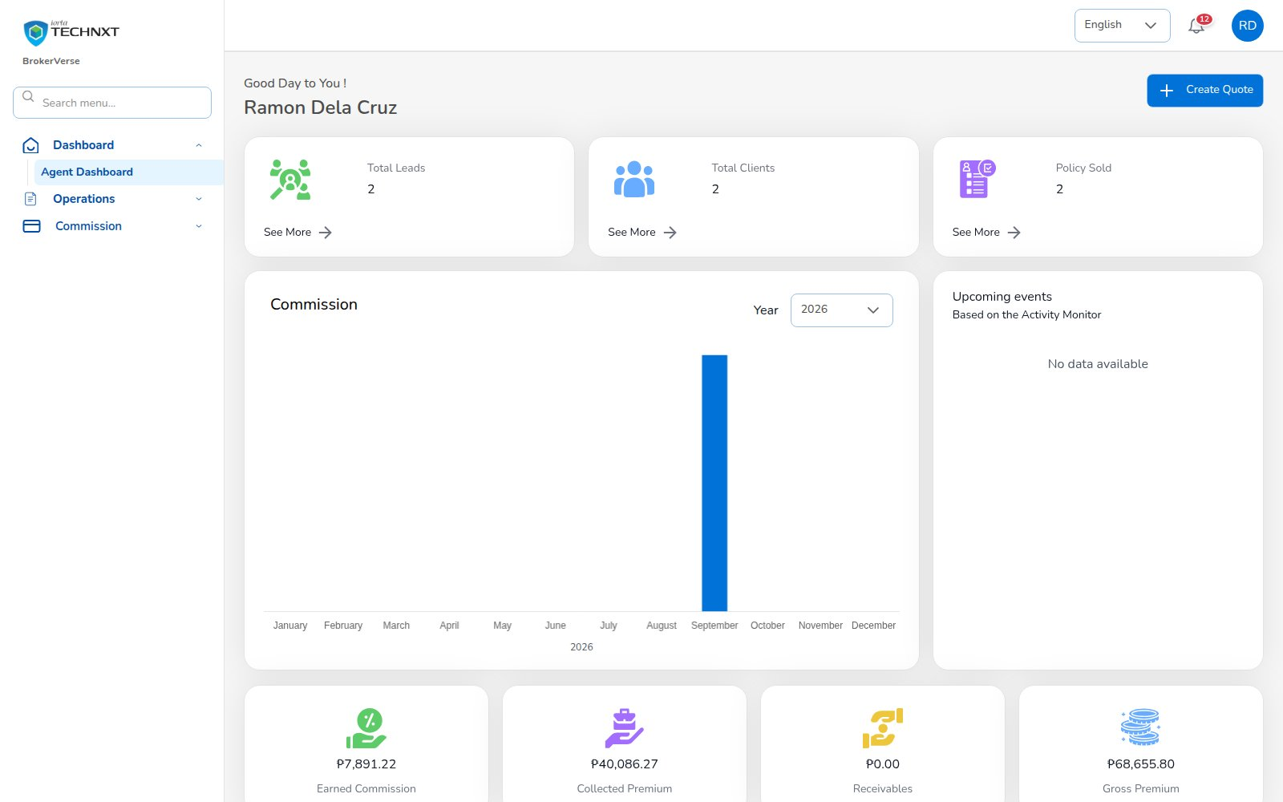
KEY FUNCTION 1 OF 6
Agent dashboard
Dashboard > Agent Dashboard
Purpose: your leads, clients and policies sold, commission by month.
Money tiles: earned commission, collected premium, receivables and gross premium from the bills of your book.
Create Quote: shortcut into the quotation wizard.
Scope: only your own records are counted.
Live screen — Dashboard > Agent Dashboard — signed in as ramon.agent
BrokerVerse | Agent / Referrer
4

Slide 5
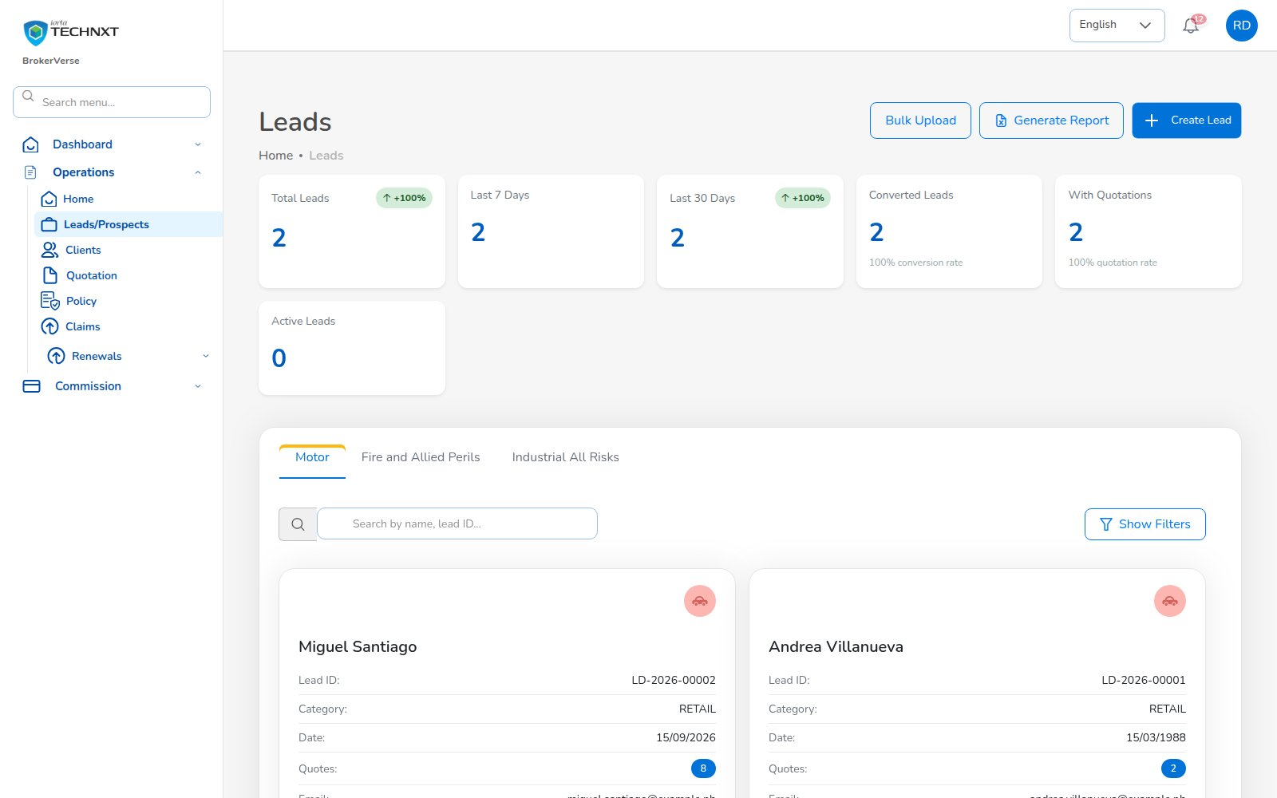
KEY FUNCTION 2 OF 6
Leads / prospects
Operations > Leads/Prospects
Purpose: your prospects by line with KPIs and conversion rate.
Create Lead: required fields, e-mail format, mobile 0917 123 4567 or +63 917 123 4567, date of birth.
Actions: View, Edit, Delete, Bulk Upload.
Next: Create Quote from Lead Details.
Live screen — Operations > Leads/Prospects — signed in as ramon.agent
BrokerVerse | Agent / Referrer
5

Slide 6
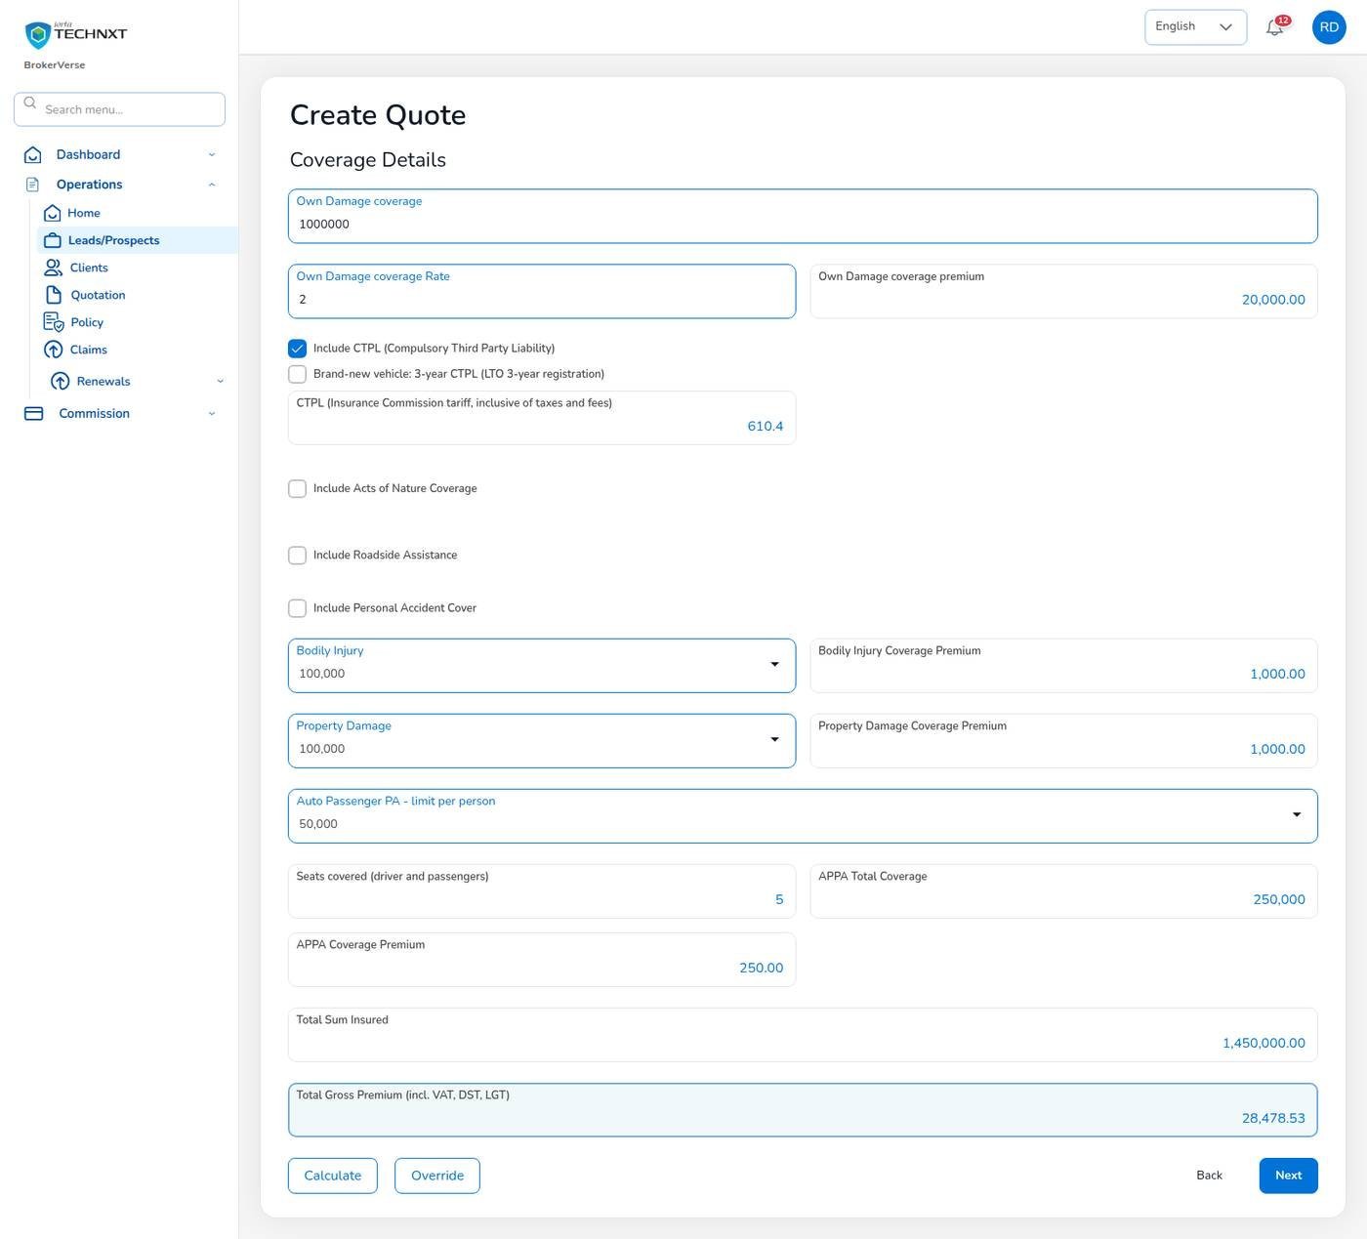
KEY FUNCTION 3 OF 6
Quotation
Lead Details > Create Quote (5 steps)
Pricing: net 28,005.00 + VAT 3,360.60 + DST 3,500.63 + LGT 210.04 = gross 35,076.27.
Server check: the API re-prices with the configured rates; tampered amounts are refused.
Approval: the underwriter is notified; the client gets an e-mail link valid 7 days.
Expiry: unconverted quotes expire after the validity period.
Live screen — Create Quote, step 3: coverage details after Calculate — signed in as ramon.agent
BrokerVerse | Agent / Referrer
6

Slide 7
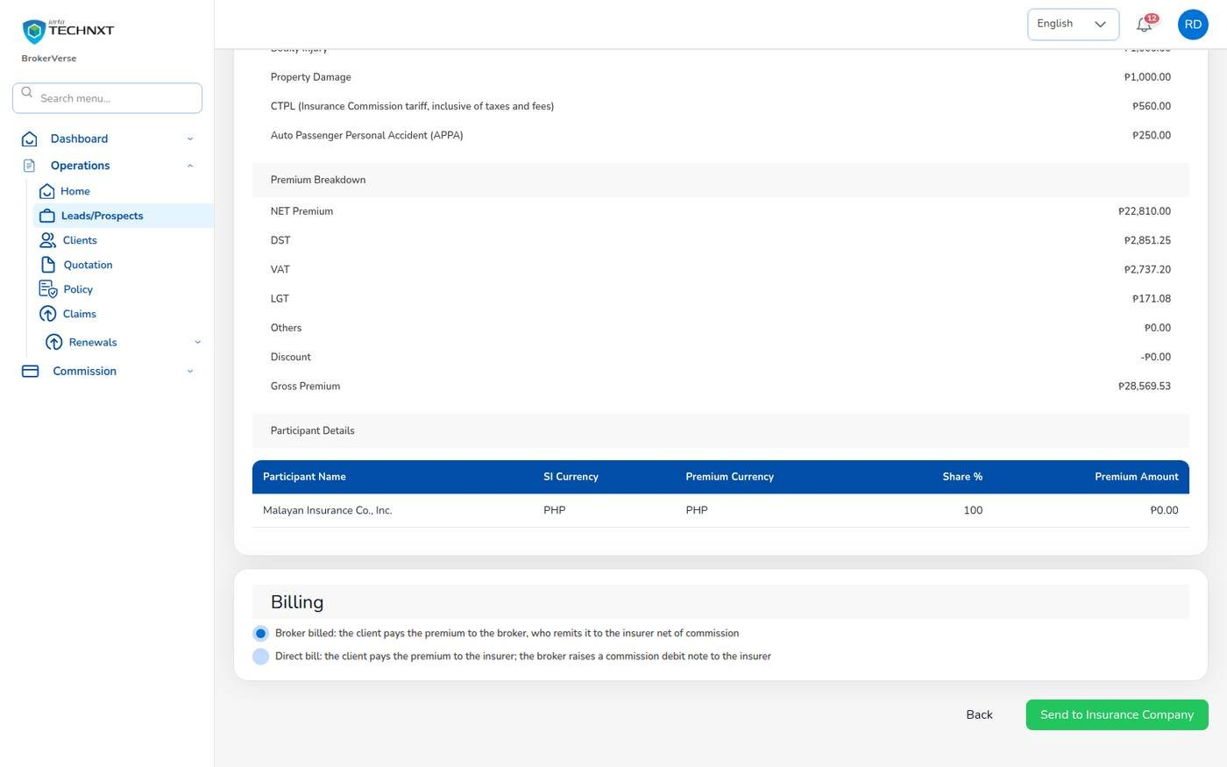
KEY FUNCTION 4 OF 6
Convert to policy
Quotation > Proceed to Policy
KYC: ID type, number and image, chassis, motor and plate or MV file number are required.
Billing: broker billed (default) or direct bill, chosen on Send to Insurance Company.
Downstream: bill INV-, booking journal, collection item and commission accrued (e.g. 4,200.75 on POL-2026-00001).
Payment: record how the client paid; Finance verifies it and posts the receipt.
Live screen — Coverage review with the billing mode before Send to Insurance Company — signed in as ramon.agent
BrokerVerse | Agent / Referrer
7

Slide 8
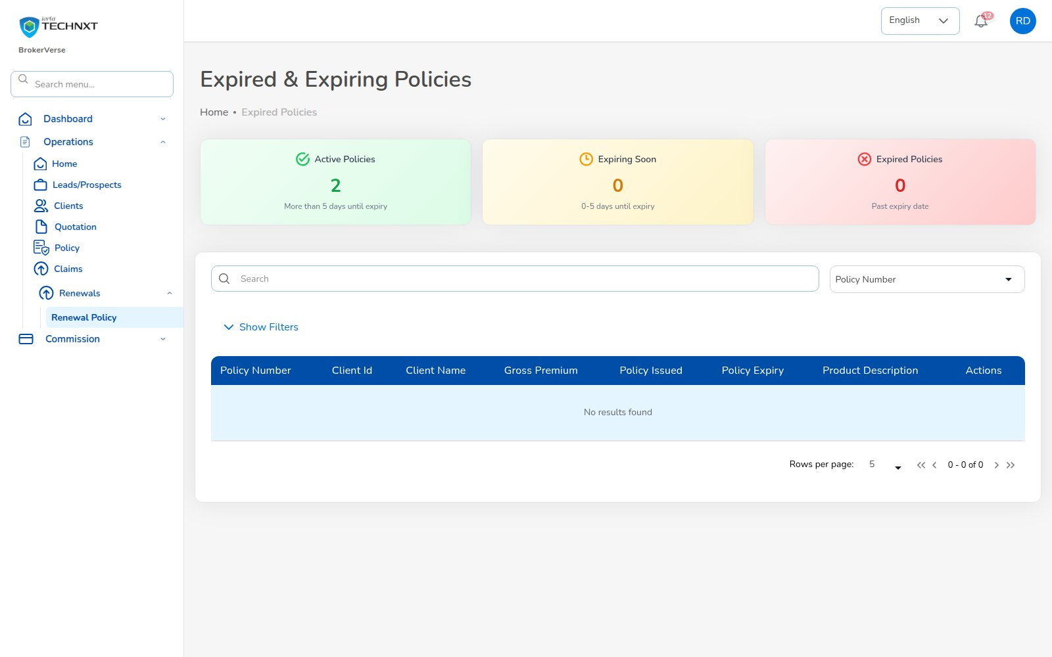
KEY FUNCTION 5 OF 6
Renewals
Operations > Renewals > Renewal Policy
Purpose: your active, expiring (0-5 days) and expired policies.
Timing: notices go to your clients at 60 / 30 / 15 days; you get a reminder each time.
Action: row menu > Renewal starts the renewal quote, linked to the expiring policy.
Scope: only your own policies; the renewals workspace is run by Sales and Underwriting.
Live screen — Operations > Renewals > Renewal Policy — signed in as ramon.agent
BrokerVerse | Agent / Referrer
8

Slide 9
KEY FUNCTION 6 OF 6
Claims notice
Step by step
Operations > Claims
Rule: date of loss must be inside the policy period and not in the future.
Refusal: the reason is shown, e.g. “Date of loss … is outside the policy period”; unpaid premium also blocks it.
Follow-up: you are notified at each status: Processing, Pending Approval, Approved, Settled.
1
Open the client or policy
2
Claim request: date, time, place of loss
3
Cause of loss and estimate
4
Attach documents (2 MB, PNG / JPEG / PDF)
5
Send to the insurer
Claim request steps (the Claims Officer takes it from there)
BrokerVerse | Agent / Referrer
9

Slide 10
LEAD TO RENEWAL
End-to-end flow: your part of the cycle
1
2
3
4
5
6
Lead
Quote
Customer approval
Policy
Billing
Receipt
Agent / Sales / CS
Agent / Sales / UW
Client (e-mail link)
Agent / Sales / UW
System at issuance
Finance
11
10
9
8
7
Renewal
Claim
Endorsement
Remittance
Commission
UW / Sales + schedules
Claims maker + checker
Customer Services
Finance maker + checker
Finance maker + checker
Your steps
Done by other personas or by the system
Renewals come back to you as leads for the next term
1 Lead: capture the prospect.
2 Quote: price and send for approval.
4 Policy: convert once the client accepts.
Later: follow receipts, claims and renewals of your book from notifications.
BrokerVerse | Agent / Referrer
10

Slide 11
FIGURES AND EVIDENCE
Reports and figures you use
The agent role has no Reports menu.
Where | What it gives you
Agent Dashboard | Leads, clients, policies sold, commission by month, collected premium, receivables
Commission Dashboard | Commission earned and payable on your policies
Leads > KPI tiles | Total leads, last 7 / 30 days, converted, conversion rate
Renewal Policy tiles | Active, expiring soon and expired policies in your book
Broker Commission Statement | Ask Finance: commission per policy with WHT and net
BrokerVerse | Agent / Referrer
11

Slide 12
MASTER > CONFIGURATION > SCHEDULES
Schedules and automations
Job | When it runs | What it means for you
Quotation expiry | Every day, 00:30 | Your unconverted quotes expire after the validity
Renewal notices | Every day, 06:00 | Your clients get notices; you get a reminder each time
Renewal pipeline | Every day, 05:30 | Your expiring policies enter the renewal queue
Collection reminders | Every day, 08:00 | Your clients are reminded before premium is due
Policy expiry | Every day, 00:15 | Policies past expiry are marked expired
Times are server time (Philippine time in production). The IT administrator can change a timetable, switch a job off or press Run now; every run is recorded.
BrokerVerse | Agent / Referrer
12

Slide 13
BELL ICON, TOP RIGHT
Notifications and approvals
Task
Customer accepted quotation
Task
New claim registered
Proceed to policy.
A claim was registered on your policy.
Info
Policy issued
Info
Claim status changes
Policy and bill numbers.
Processing, Pending Approval, Approved, Settled.
Info
Endorsement completed
Reminder
Renewal notice sent
With the premium change, if any.
First, second or final notice for your policy.
BrokerVerse | Agent / Referrer
13

Slide 14
GOOD TO KNOW
Known limitations and tips
Open items that affect you
Tips
Your session is kept in the browser’s local storage: sign out on shared computers and keep the browser up to date.
Two-factor set-up shows a setup key and an app link, but no QR code: type the key into the authenticator app.
Screens are in English or Thai; Filipino is configured but has no translation yet.
The commission goes to the referrer chosen on the quote (Account Code, Commission & Referral): choose yourself.
Open the lead and select Create Quote.
Use the Agent Dashboard every morning.
Keep your bank details with Finance so payouts are not held.
BrokerVerse | Agent / Referrer
14

Slide 15
Thank you
BrokerVerse — Agent / Referrer guide
SUPPORT
Service desk
<service desk to be confirmed>
E-mail
<support mailbox to be confirmed>
Hours
<business hours, Manila time, to be confirmed>
Access requests
Your User Access Administrator (Master > User Management)
iorta TechNXT · BrokerVerse insurance-broking platform

