Slide 1

THIS GUIDE IS FOR
Claims Officer
BrokerVerse — Claims Officer guide
SIGN-IN
carlo.claims (maker), lisa.claims2 (checker)
ROLE CODE
Out-of-the-box functions, flows, reports and schedules
claims
BrokerVerse OOTB · insurance broking · Philippines · PHP
LANDS ON
Claims Dashboard
Register claims
Settle with a checker
Claims reports
Prepared by iorta TechNXT · September 2026

Slide 2
WHO YOU ARE IN BROKERVERSE
Role at a glance
What you do
Sign-in and landing page
User names carlo.claims and lisa.claims2. Land on the Claims Dashboard.
Registers claims: from the client or policy with date, time, place and cause of loss and estimate.
Manages: adjuster details, documents, status and insurer claim number.
Settles: submits the settlement for approval by a second claims user.
Reports: claims dashboard, claims position and ageing.
You hand work to
Insurer (claim request e-mail), second claims officer (approval), agent / owner (notified), Finance (claim payments), Reinsurance (recoveries).
Maker-checker partners
carlo.claims makes the settlement, lisa.claims2 approves it; the maker is refused when approving.
BrokerVerse | Claims Officer
2

Slide 3
WHAT YOU SEE AFTER SIGN-IN
Menu map
Menus and screens granted to this role (menuPermissions); anything else is hidden and blocked by the route guard and the API.
Dashboard
Operations
Reinsurance
Reports
Claims Dashboard
Home
Clients
Policy
Claims
Claims Recovery
All Reports (8 reports)
Operational Reports: Production, Claims, Renewal, Remittance, Broker Commission
BrokerVerse | Claims Officer
3

Slide 4
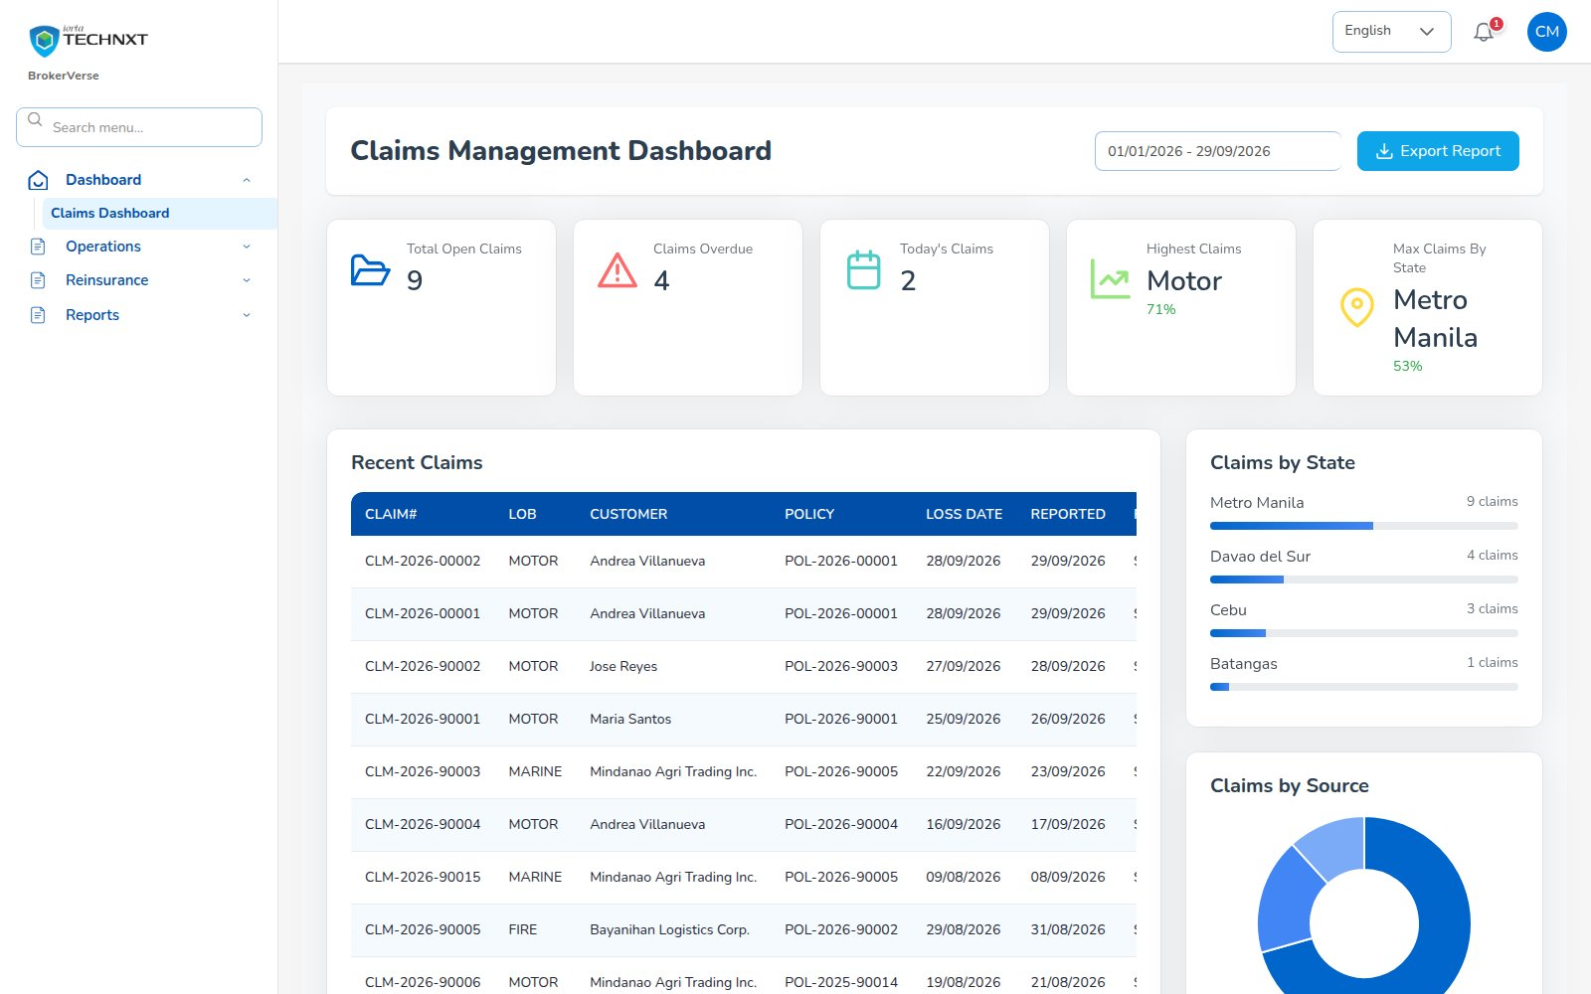
KEY FUNCTION 1 OF 7
Claims dashboard
Dashboard > Claims Dashboard
Purpose: open claims, overdue, today’s, top line and region.
Recent claims: line, customer, policy, loss and report dates, priority, status, amount.
Export Report: Claims Ageing.
Live screen — Dashboard > Claims Dashboard — signed in as carlo.claims
BrokerVerse | Claims Officer
4

Slide 5
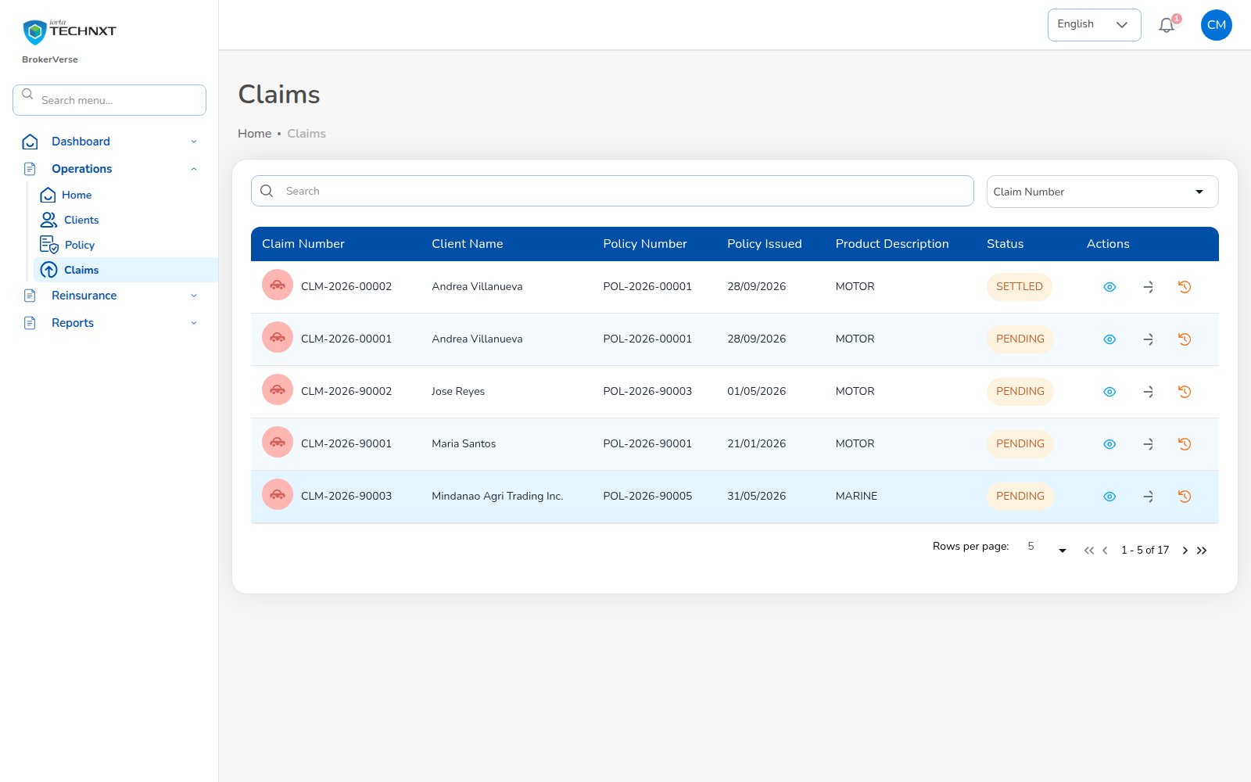
KEY FUNCTION 2 OF 7
Claims list
Operations > Claims
Purpose: all claims with client, policy, product and status.
Status: pending, processing, pending approval, approved, settled, rejected.
Open: the eye icon opens claim details and the settlement.
Live screen — Operations > Claims — signed in as carlo.claims
BrokerVerse | Claims Officer
5

Slide 6
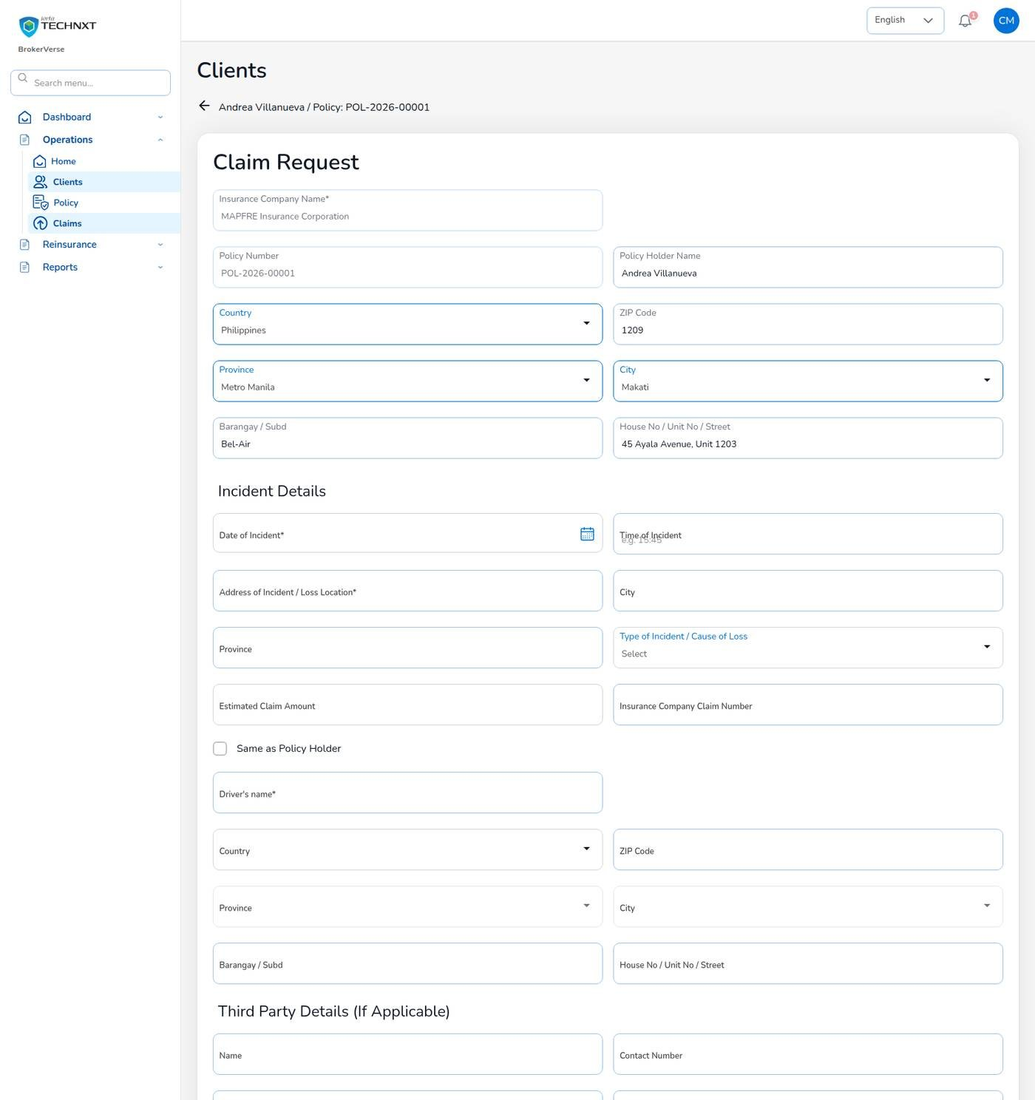
KEY FUNCTION 3 OF 7
Registering a claim
Operations > Policy > … > Claim
Required: date and cause of loss; date not in the future; reported date not before the loss.
Rule: loss date must be inside the policy period and premium paid, or the claim is refused with the reason.
Documents: up to 2 MB each, PNG, JPEG or PDF.
Send: the request is e-mailed to the insurer.
Live screen — Claim Request from the policy row — signed in as carlo.claims
BrokerVerse | Claims Officer
6

Slide 7
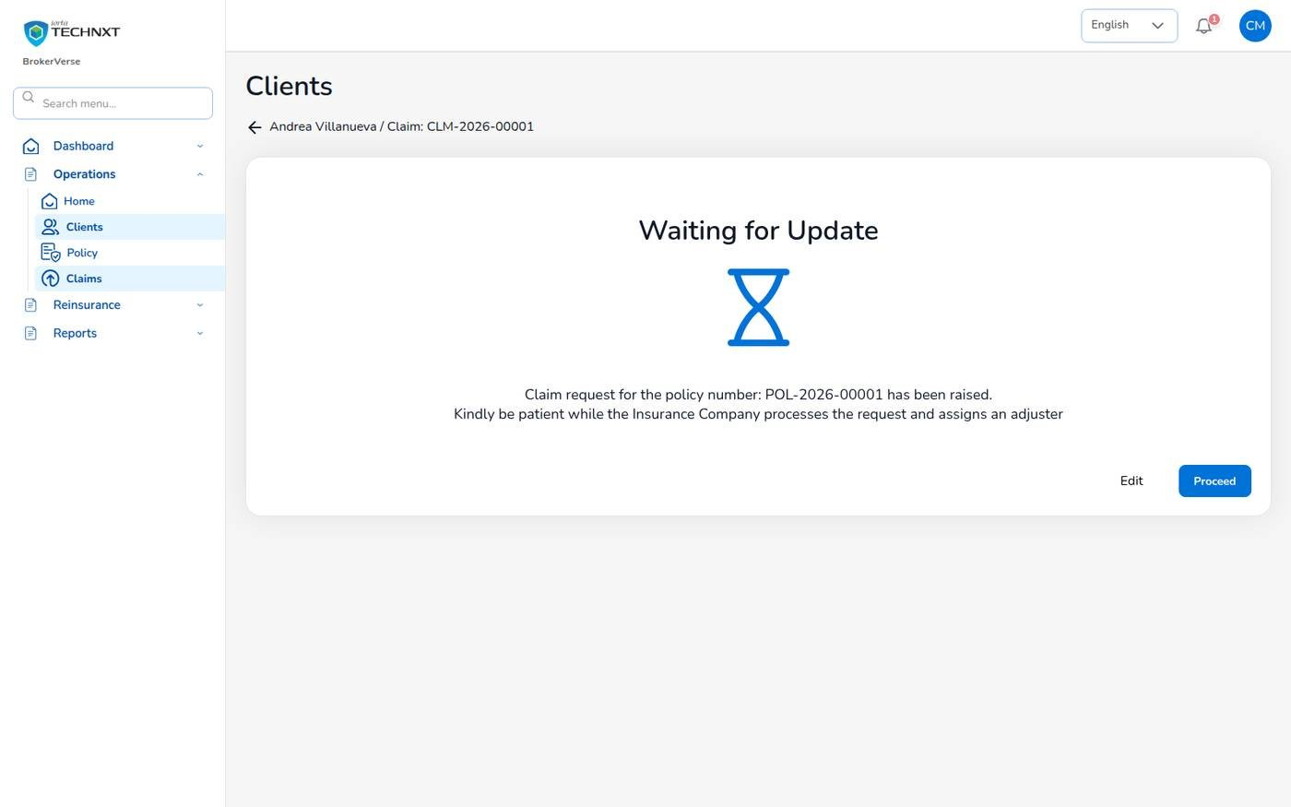
KEY FUNCTION 4 OF 7
Claim raised
Operations > Claims > eye icon
Result: claim number issued; the request is e-mailed to the insurer.
Next: wait for the insurer to assign an adjuster, then Proceed.
Notified: every claims officer and the policy owner get “New claim”.
Edit: correct the request before the insurer acts on it.
Live screen — Waiting for Update: the claim is with the insurer — signed in as carlo.claims
BrokerVerse | Claims Officer
7

Slide 8
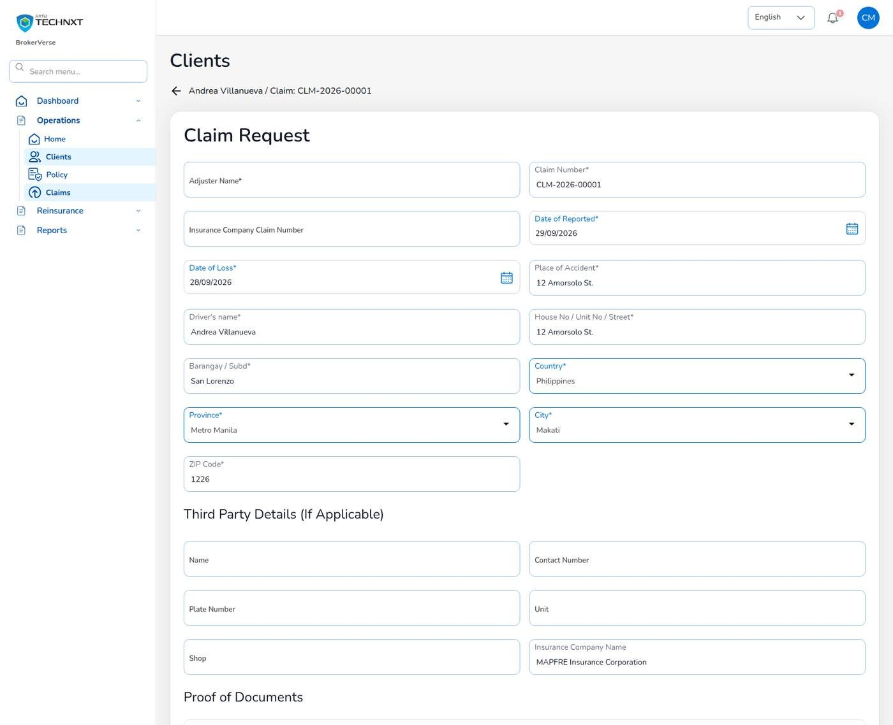
KEY FUNCTION 5 OF 7
Adjuster details
Claim > Proceed > Adjuster details
Address: country, province, city from the address master; 4-digit ZIP.
Same as Policy Holder: copies the holder’s address.
Required: fields with an asterisk must be filled.
Live screen — Adjuster details — signed in as carlo.claims
BrokerVerse | Claims Officer
8

Slide 9
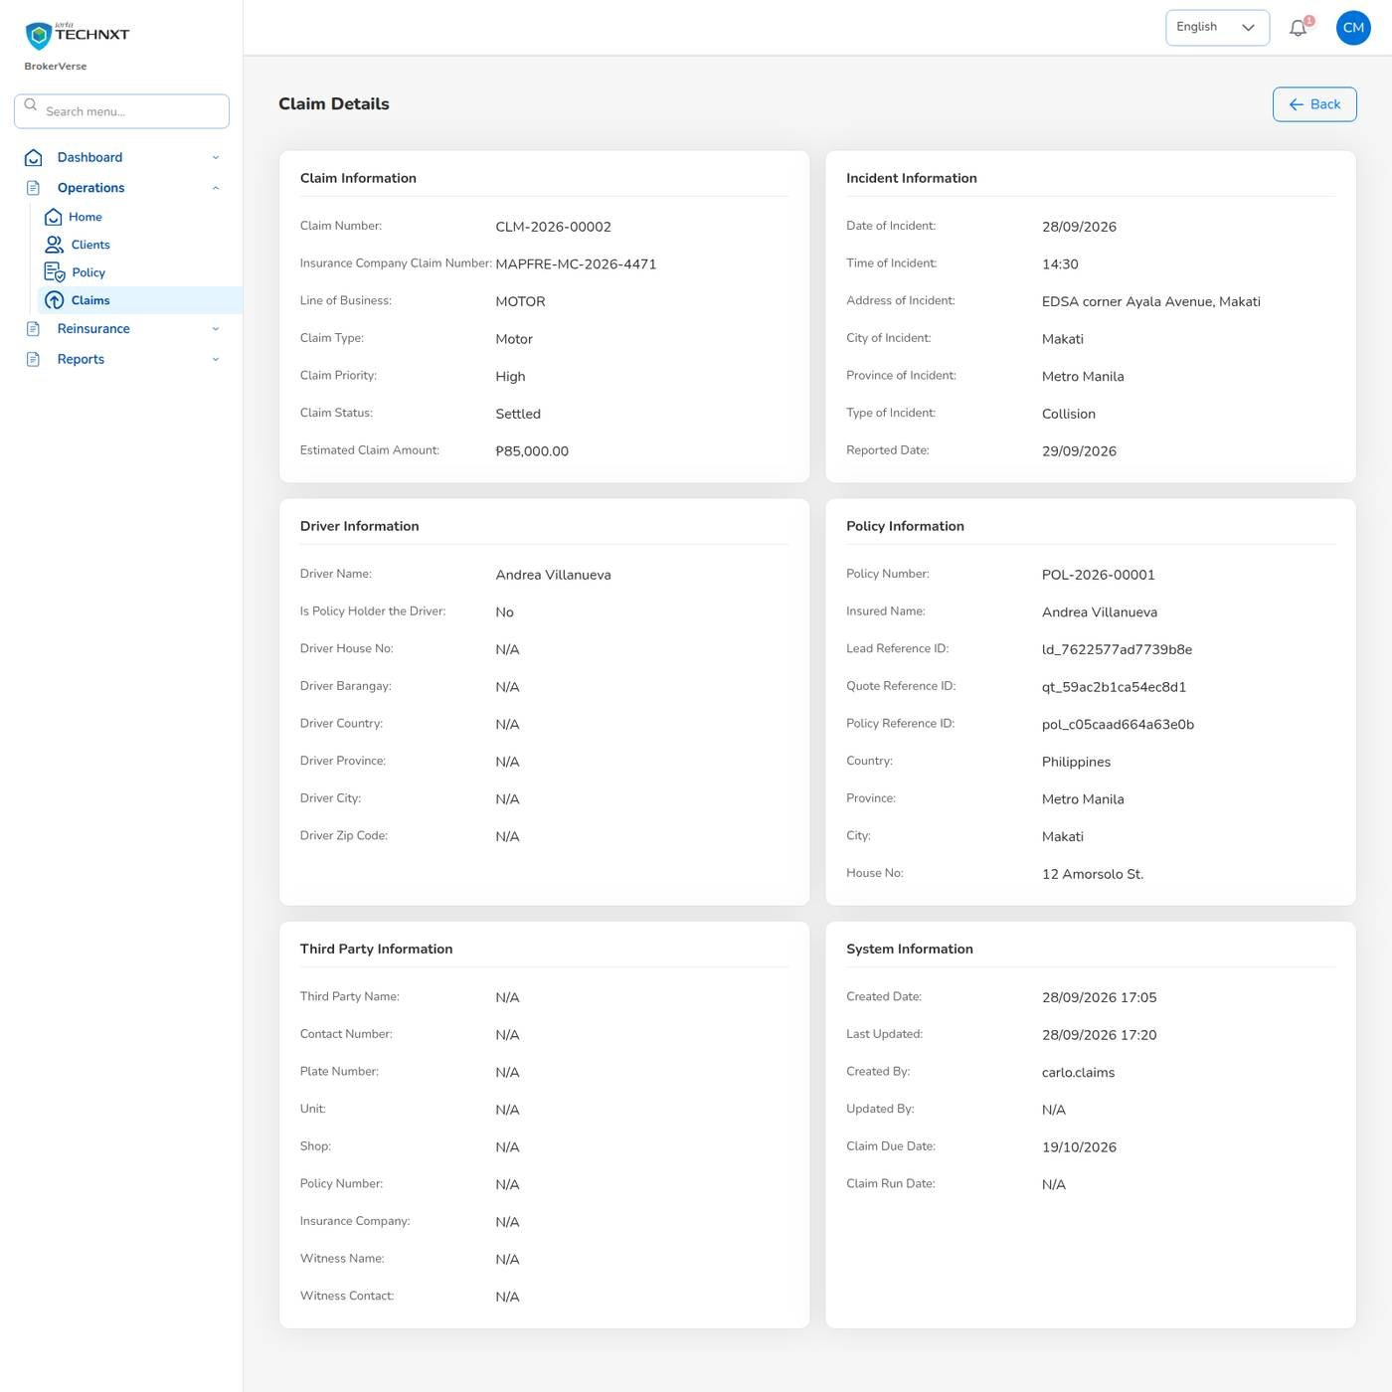
KEY FUNCTION 6 OF 7
Claim details and settlement
Operations > Claims > claim
Sections: claim, incident, driver and policy information; insurer ref MAPFRE-MC-2026-4471.
Maker: settlement type, amount and dates validated, then “submitted for approval”.
Checker: lisa.claims2 uses Review settlement and approves; the maker is refused.
Result: settled 78,500 against an 85,000 estimate; dashboard and report updated.
Live screen — Claim CLM-2026-00002 — signed in as carlo.claims
BrokerVerse | Claims Officer
9

Slide 10
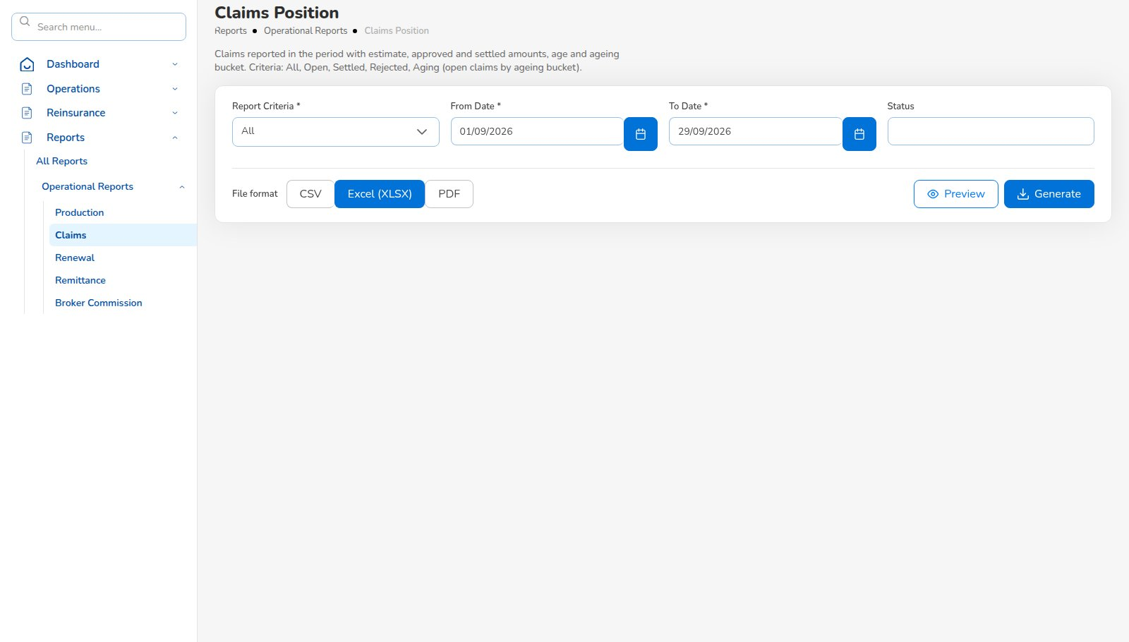
KEY FUNCTION 7 OF 7
Claims report
Reports > Operational Reports > Claims
Criteria: All, Open, Settled, Rejected or Aging (by 30/60/90/180 days).
Content: estimate, approved and settled amounts, age, bucket; Preview on screen.
Formats: CSV, Excel (XLSX) or PDF; Claims Ageing in Reports > All Reports.
Live screen — Reports > Operational Reports > Claims — signed in as carlo.claims
BrokerVerse | Claims Officer
10

Slide 11
LEAD TO RENEWAL
End-to-end flow: your part of the cycle
1
2
3
4
5
6
Lead
Quote
Customer approval
Policy
Billing
Receipt
Agent / Sales / CS
Agent / Sales / UW
Client (e-mail link)
Agent / Sales / UW
System at issuance
Finance
11
10
9
8
7
Renewal
Claim
Endorsement
Remittance
Commission
UW / Sales + schedules
Claims maker + checker
Customer Services
Finance maker + checker
Finance maker + checker
Your steps
Done by other personas or by the system
Claims experience informs the renewal price
10 Claim: register, adjust, settle with a second officer.
Policy period is checked at registration.
Owners and agents are notified at each status.
Recoveries go to Reinsurance > Claims Recovery.
BrokerVerse | Claims Officer
11

Slide 12
REPORTS > ALL REPORTS
Reports you use
Output formats
CSV
XLSX
PDF
On screen
Scheduled e-mail
Eight operational reports in Reports > All Reports.
Report | What it shows | Where
Production Register | Policies incepted in the period: premium, commission, new or renewal; by agent, insurer or branch | All Reports; Operational > Production
Claims Position | Claims reported: estimate, approved, settled, age; criteria All / Open / Settled / Rejected / Aging | All Reports; Operational > Claims
Renewal Retention | Renewals due: retained, lost or pending, old vs new premium, retention rate | All Reports; Operational > Renewal
Remittance Summary | Remittances to insurers: gross premium, commission retained, net due, status | All Reports; Operational > Remittance
Broker Commission Statement | Commission per agent and policy: basis, rate, gross, WHT, net, paid status | All Reports; Operational > Broker Commission
Premium by Product / Month / Insurer | Policy count, sum insured, premium and commission by month, product or insurer | Reports > All Reports
New Business vs Renewals | Policies and premium split into new business and renewals per month | Reports > All Reports
Claims Ageing | Open claims by ageing bucket (30/60/90/180 days) with estimate and approved | Reports > All Reports
BrokerVerse | Claims Officer
12

Slide 13
MASTER > CONFIGURATION > SCHEDULES
Schedules and automations
Job | When it runs | What it means for you
Daily reports | Every day, 05:00 | Claims position generated each morning
Policy expiry | Every day, 00:15 | Expired policies: new losses after expiry are refused
E-mail outbox | Every 5 minutes | Claim request e-mails to insurers leave every 5 minutes
Times are server time (Philippine time in production). The IT administrator can change a timetable, switch a job off or press Run now; every run is recorded.
BrokerVerse | Claims Officer
13

Slide 14
BELL ICON, TOP RIGHT
Notifications and approvals
Task
New claim registered
Info
Claim status changes
Claim number and policy, to every claims officer.
Processing, Pending Approval, Approved, Settled.
Approval
Settlement approval
Info
Settlement approved
Amount and claim, to the other claims officers.
Back to the maker once the checker approves.
BrokerVerse | Claims Officer
14

Slide 15
GOOD TO KNOW
Known limitations and tips
Open items that affect you
Tips
Your session is kept in the browser’s local storage: sign out on shared computers and keep the browser up to date.
Two-factor set-up shows a setup key and an app link, but no QR code: type the key into the authenticator app.
Screens are in English or Thai; Filipino is configured but has no translation yet.
Claims officers do not create leads: Create Lead and Create Policy are hidden for this role.
Check the policy period before registering.
Attach documents when you register, not later.
Record the insurer claim number as soon as you have it.
Ask your checker to use Review settlement.
BrokerVerse | Claims Officer
15

Slide 16
Thank you
BrokerVerse — Claims Officer guide
SUPPORT
Service desk
<service desk to be confirmed>
E-mail
<support mailbox to be confirmed>
Hours
<business hours, Manila time, to be confirmed>
Access requests
Your User Access Administrator (Master > User Management)
iorta TechNXT · BrokerVerse insurance-broking platform

