Slide 1

THIS GUIDE IS FOR
Customer Services
BrokerVerse — Customer Services guide
SIGN-IN
ana.cs
ROLE CODE
Out-of-the-box functions, flows, reports and schedules
customer-services
BrokerVerse OOTB · insurance broking · Philippines · PHP
LANDS ON
Executive Dashboard
Client service
Endorsements
Open items
Prepared by iorta TechNXT · September 2026

Slide 2
WHO YOU ARE IN BROKERVERSE
Role at a glance
What you do
Sign-in and landing page
User name ana.cs. Lands on the Executive Dashboard; start the day on Operations > Open Items.
Serves clients: answers questions from the client 360 view: policies, claims, renewals, endorsements.
Changes policies: personal details and coverage endorsements, re-priced by the server.
Chases open items: expiring policies, pending payments, pending quotes, renewal requests.
Helps sell: can capture leads and quotes like Sales.
You hand work to
Finance (endorsement bills), insurer (endorsement request e-mail), Claims, Sales / agents.
Maker-checker partners
Endorsements are sent to the insurer; extra premium is billed and receipted by Finance.
BrokerVerse | Customer Services
2

Slide 3
WHAT YOU SEE AFTER SIGN-IN
Menu map
Menus and screens granted to this role (menuPermissions); anything else is hidden and blocked by the route guard and the API.
Dashboard
Product Configurator
Operations
Reports
Executive Dashboard
Dashboard
Product Templates
Home
Leads/Prospects
Clients
Quotation
Policy
Claims
Renewals: Renewal Policy, Batch, Queue, Retention Analytics, At-Risk, Negotiations, Lapse Mgmt, Performance
Open Items
Payments
All Reports (9 reports)
Operational Reports: Production, Claims, Renewal, Remittance, Broker Commission
BrokerVerse | Customer Services
3

Slide 4
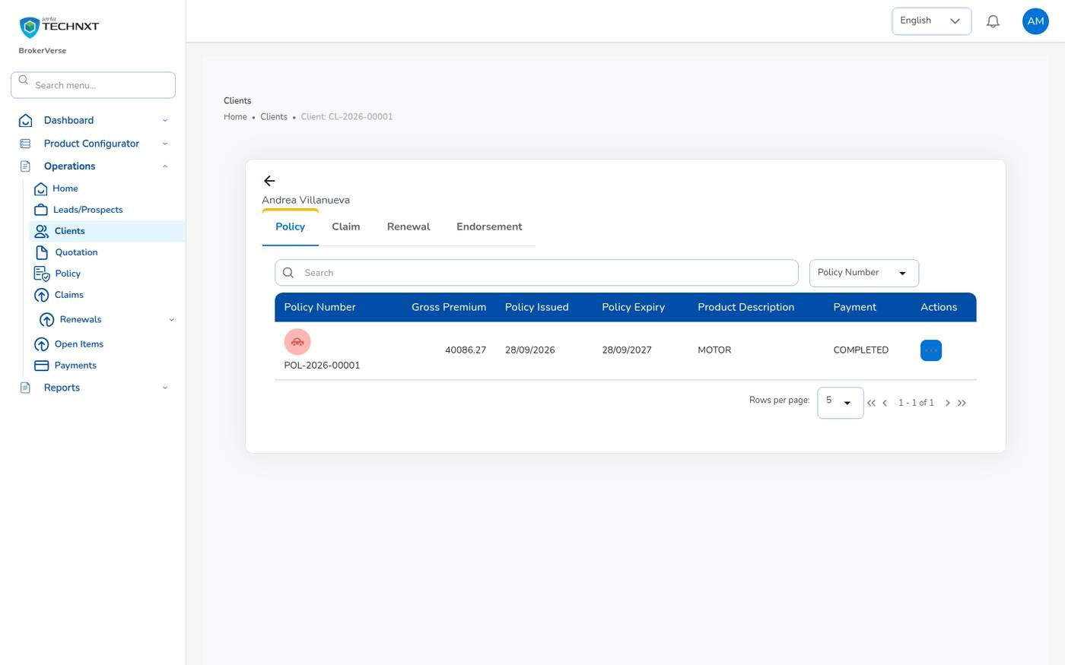
KEY FUNCTION 1 OF 7
Client 360 view
Operations > Clients > client
Purpose: one client (header shows the CL- code) with tabs for Policy, Claim, Renewal and Endorsement.
Row actions: endorsement, claim request, renewal; endorsements listed with END- number and type.
Example: POL-2026-00001, gross 40,086.27 after endorsement, payment completed.
Live screen — Operations > Clients > Andrea Villanueva — signed in as ana.cs
BrokerVerse | Customer Services
4

Slide 5
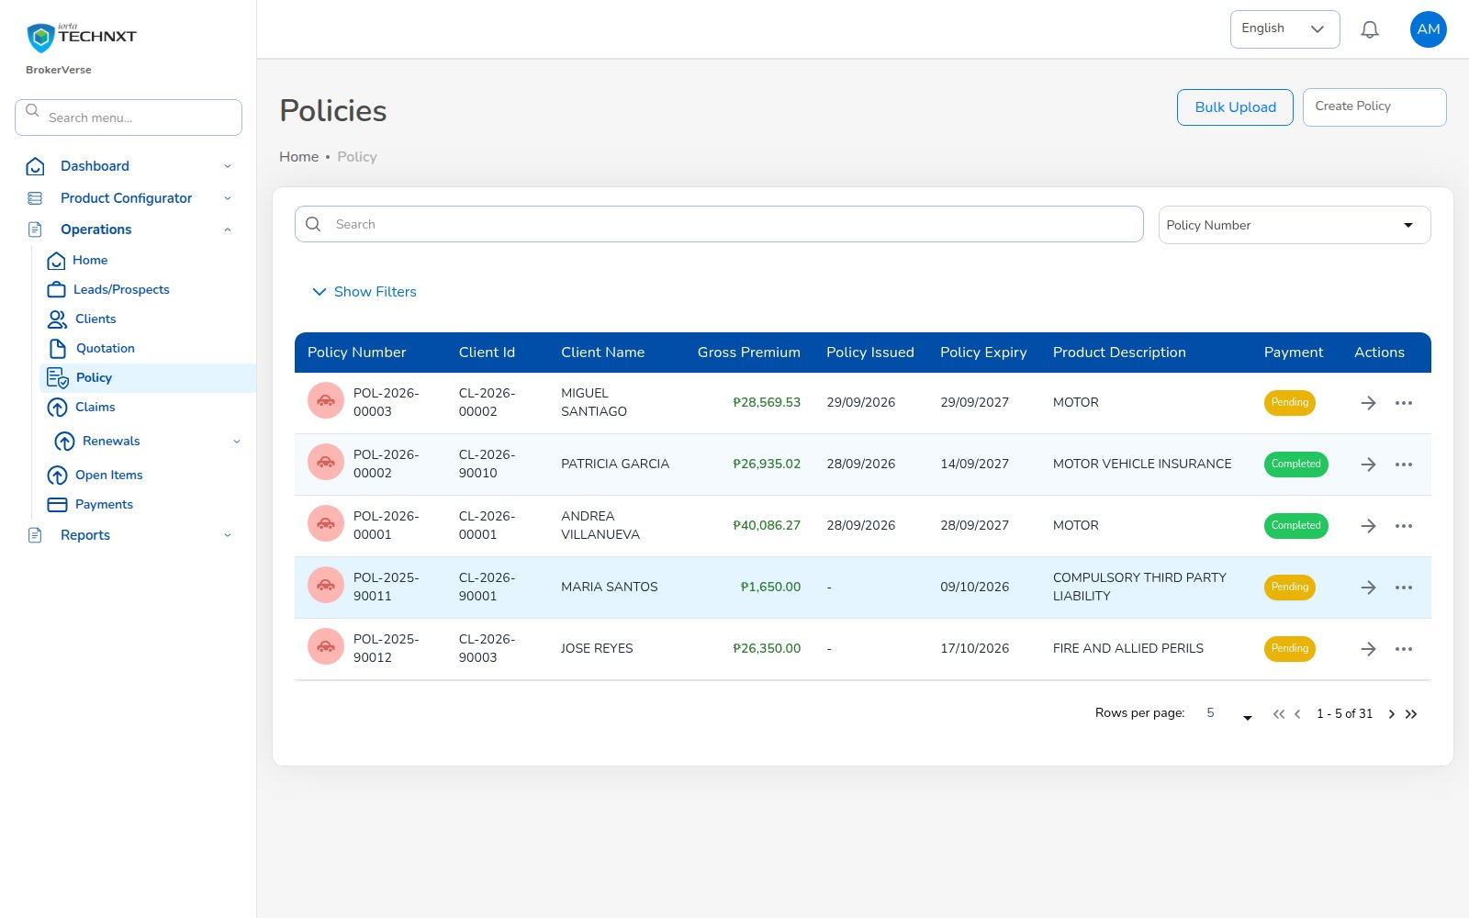
KEY FUNCTION 2 OF 7
Policy list
Operations > Policy
Purpose: all policies with premium, dates and payment status.
Status: completed, pending, expired.
Actions: open; row menu Claim, Endorsement, Reminder (disabled while premium is Pending or Reviewing).
Live screen — Operations > Policy — signed in as ana.cs
BrokerVerse | Customer Services
5

Slide 6
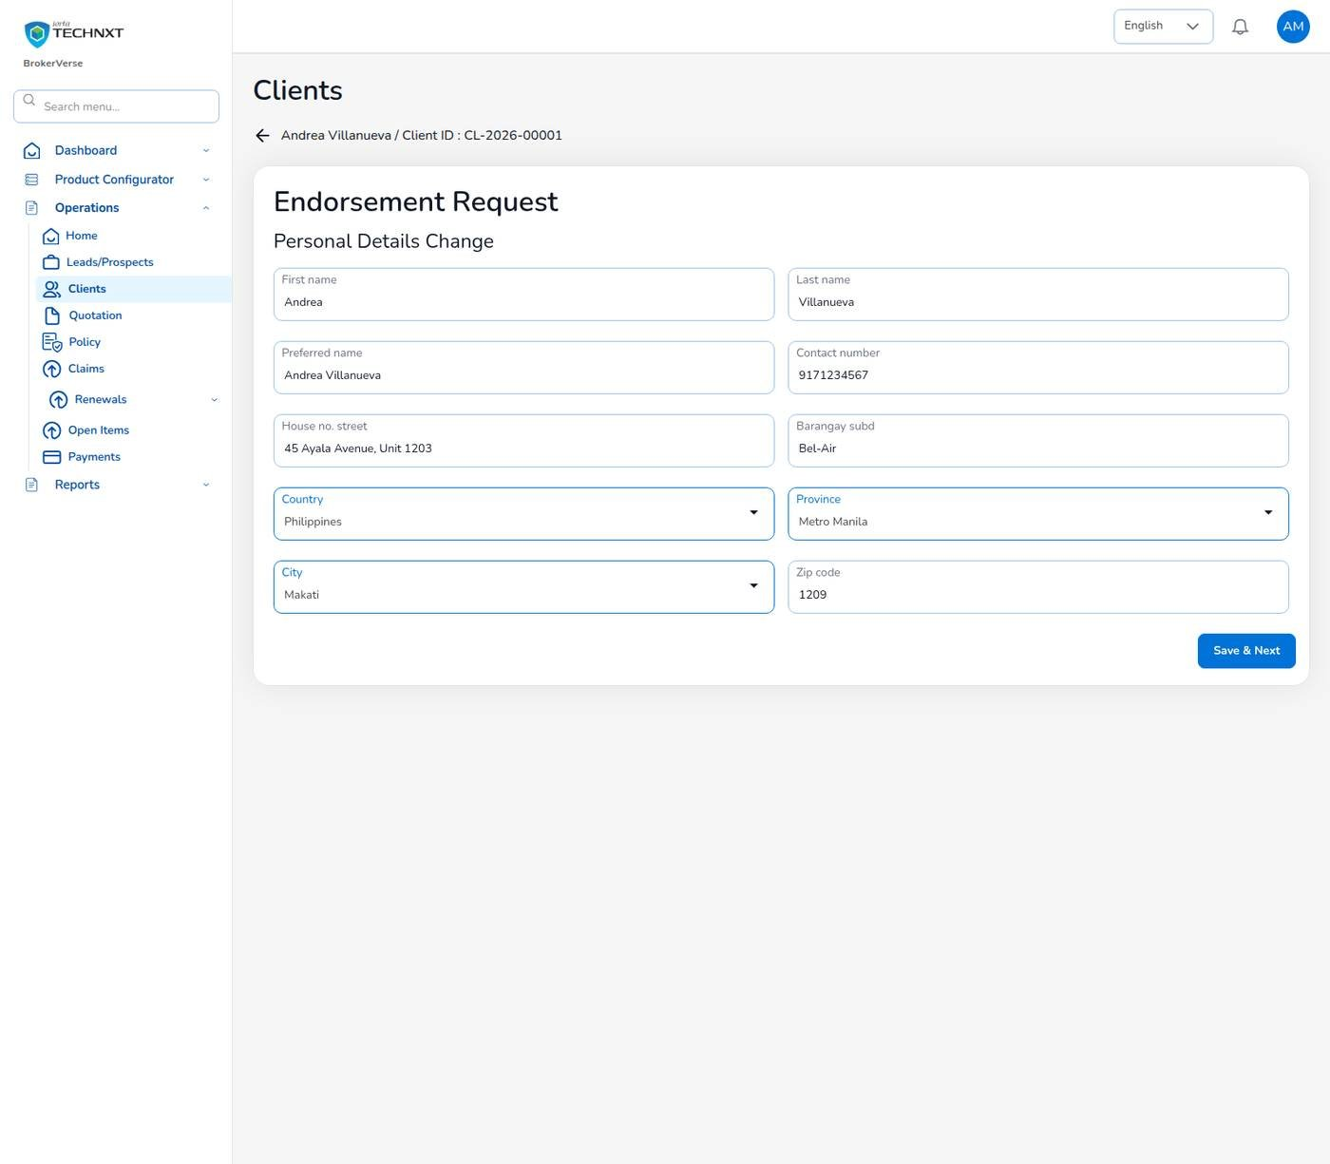
KEY FUNCTION 3 OF 7
Endorsement: personal details
Policy > Endorsement > Personal Details Change
Start: choose the endorsement type first; Proceed stays disabled until you do.
Pre-filled: with the client’s current details, including earlier endorsements.
Validation: required fields, mobile number and 4-digit ZIP.
Downstream: the client record is updated; the owner is notified.
Live screen — Endorsement request, personal details change — signed in as ana.cs
BrokerVerse | Customer Services
6

Slide 7
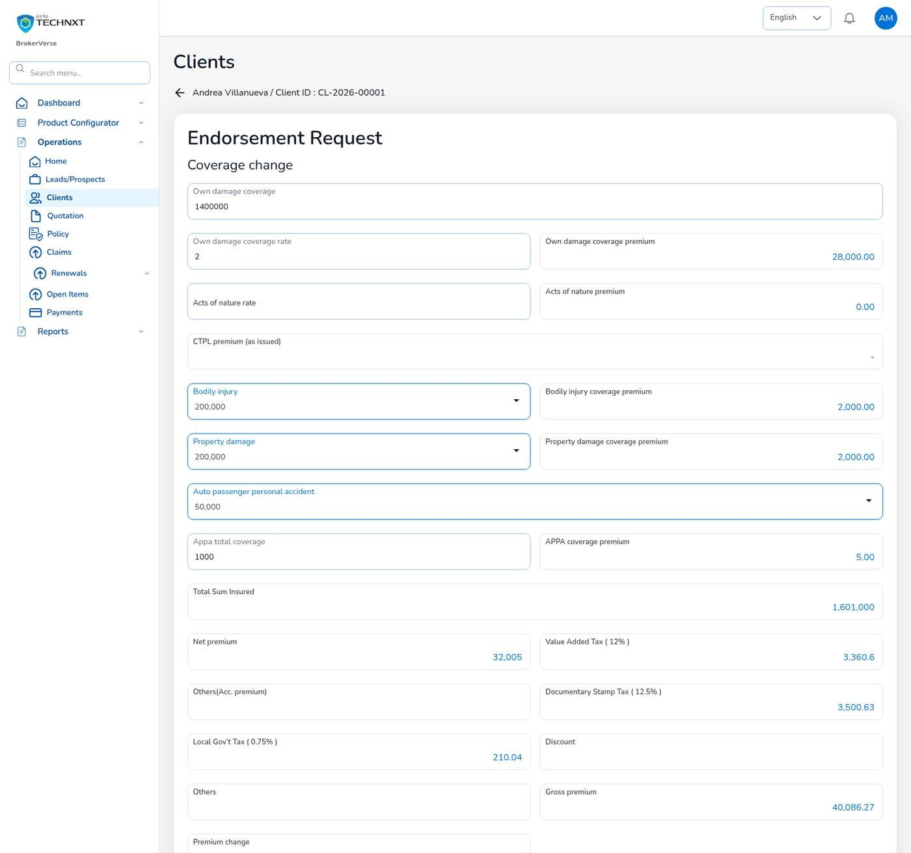
KEY FUNCTION 4 OF 7
Endorsement: coverage change
Policy > Endorsement > Coverage Change
Pricing: re-priced with configured rates; the server checks the premium difference.
Example: own damage 1,400,000: gross 40,086.27, +5,010.00.
Downstream: bill INV-2026-00002, journal 5,010 / 4,410 / 600, collection item.
Send: Send to Insurance Company from the summary.
Live screen — Endorsement request, coverage change re-priced — signed in as ana.cs
BrokerVerse | Customer Services
7

Slide 8
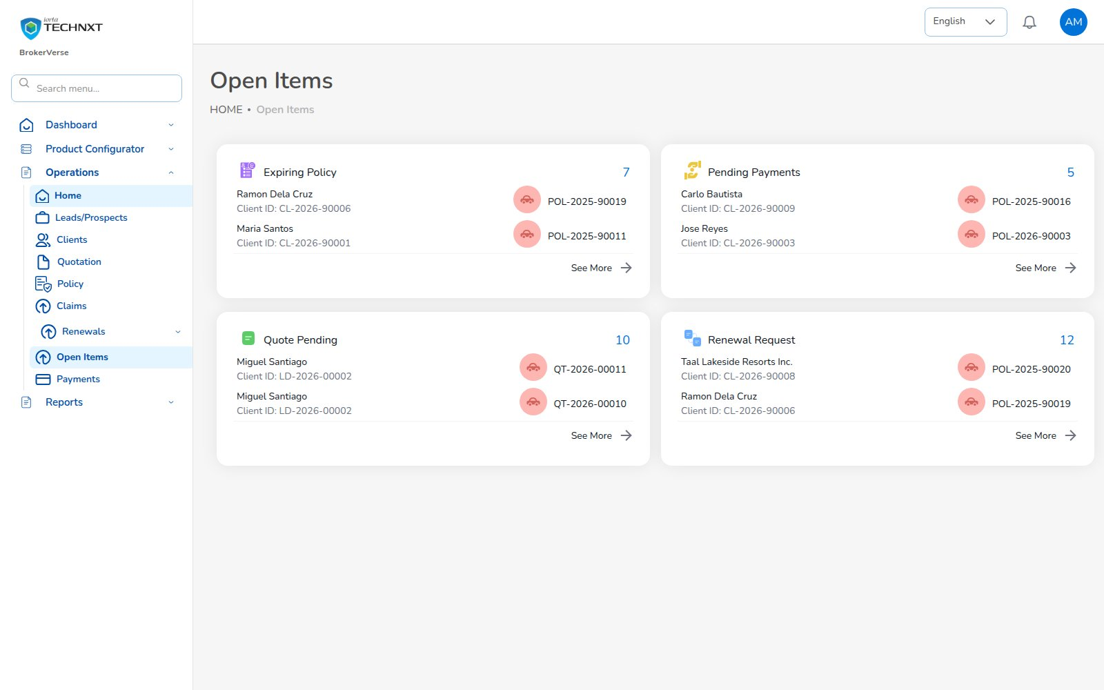
KEY FUNCTION 5 OF 7
Open items
Operations > Open Items
Purpose: expiring policies, pending payments, pending quotes and renewal requests.
Use: your daily worklist; See More opens the full list.
Source: policies, bills and renewals updated by the schedules overnight.
Live screen — Operations > Open Items — signed in as ana.cs
BrokerVerse | Customer Services
8

Slide 9
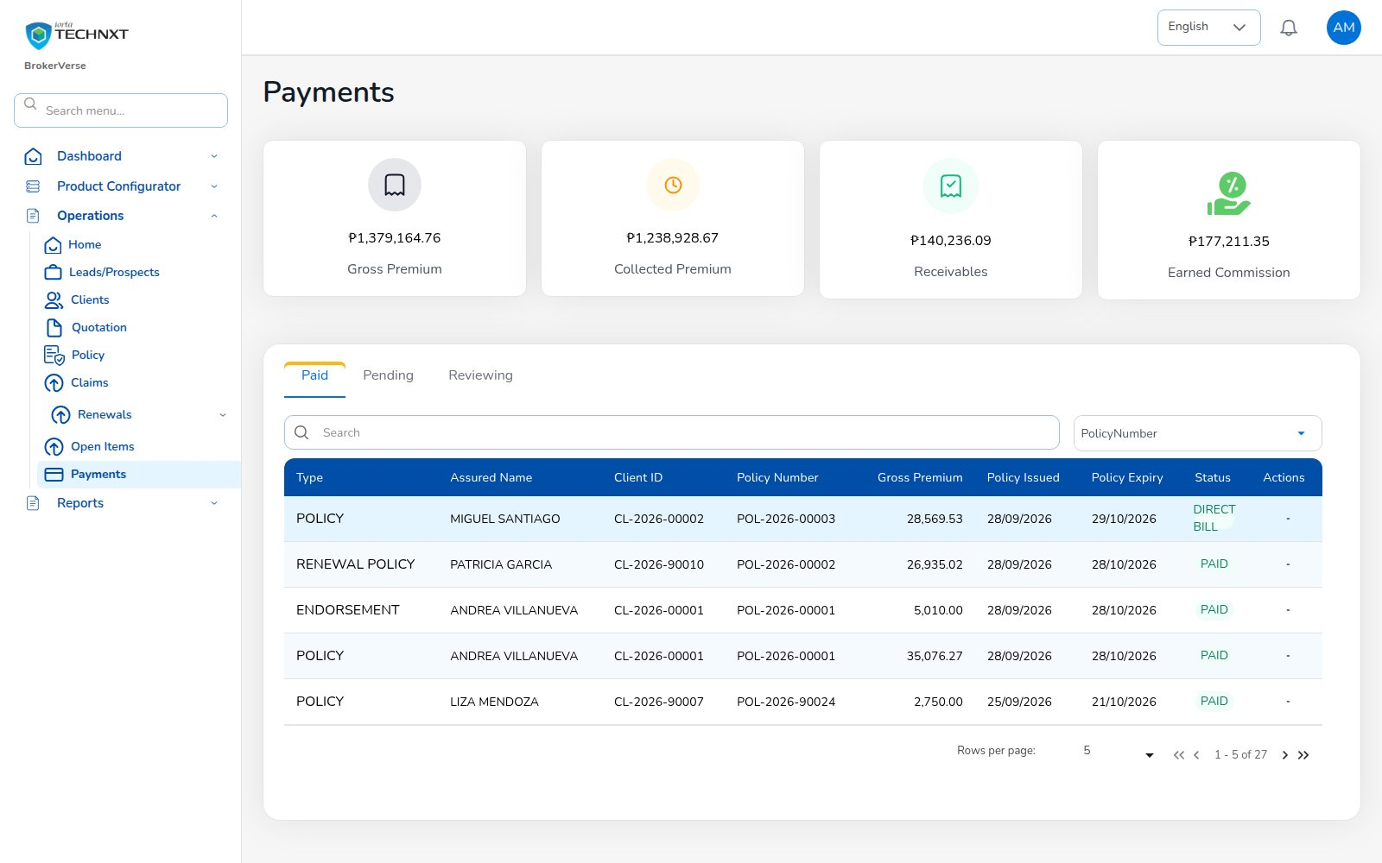
KEY FUNCTION 6 OF 7
Payments
Operations > Payments
Purpose: gross, collected, receivable premium and earned commission.
Tabs: Paid, Pending, Reviewing; type policy, renewal or endorsement; DIRECT BILL for direct-bill policies.
Note: receipts are posted by Finance; you see the result here.
Live screen — Operations > Payments — signed in as ana.cs
BrokerVerse | Customer Services
9

Slide 10
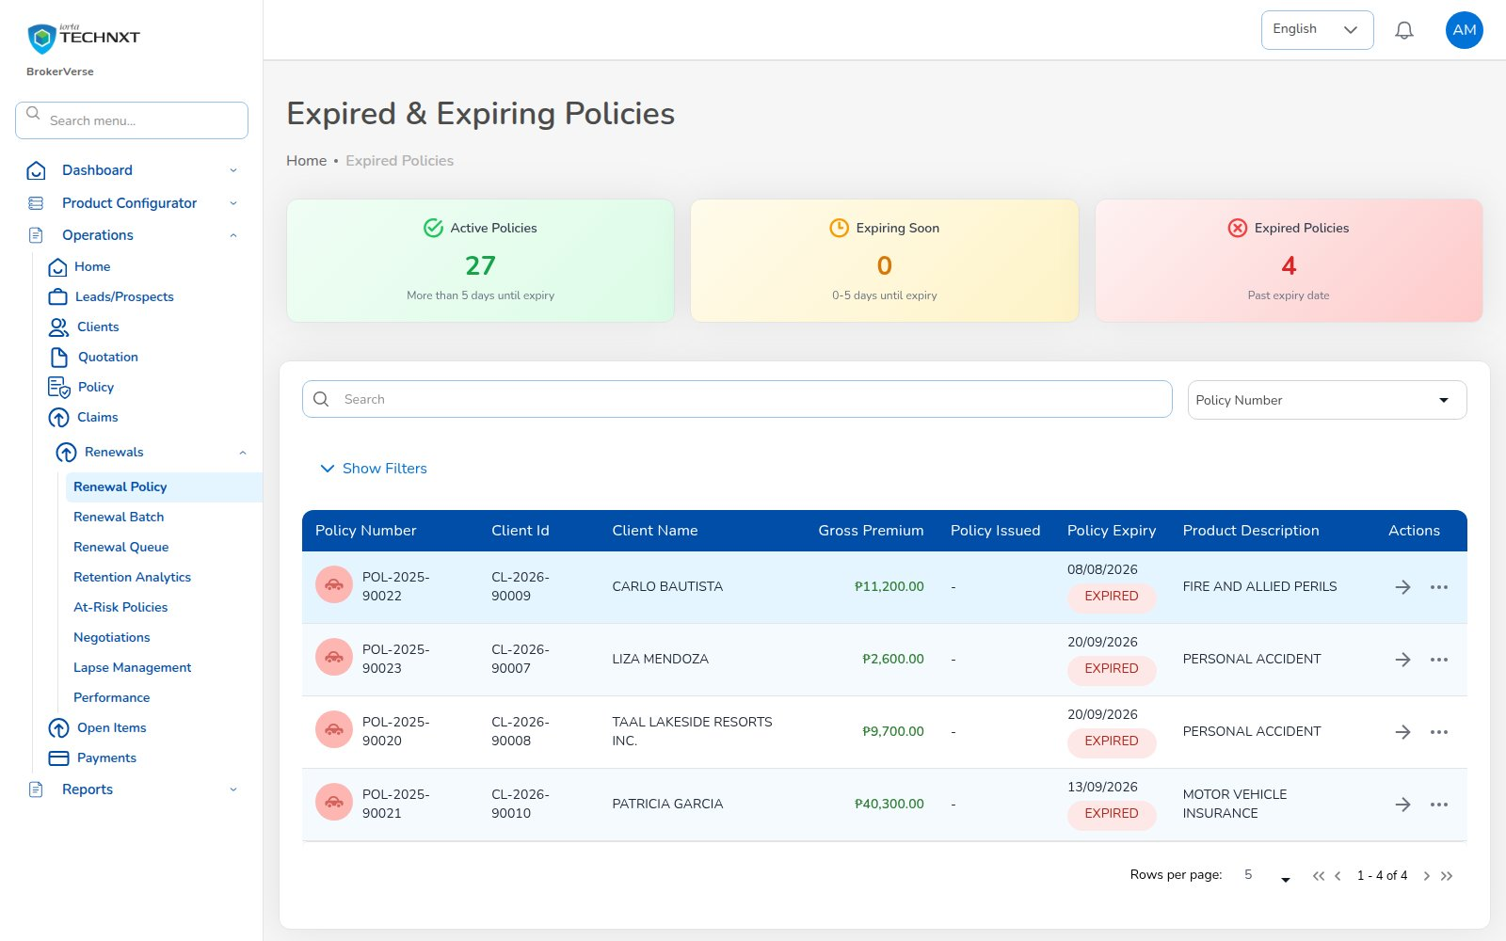
KEY FUNCTION 7 OF 7
Expired and expiring policies
Operations > Renewals > Renewal Policy
Purpose: active, expiring soon (0-5 days) and expired policies.
Action: call the client and start the renewal quote.
Timing: notices already went at 60 / 30 / 15 days.
Live screen — Operations > Renewals > Renewal Policy — signed in as ana.cs
BrokerVerse | Customer Services
10

Slide 11
LEAD TO RENEWAL
End-to-end flow: your part of the cycle
1
2
3
4
5
6
Lead
Quote
Customer approval
Policy
Billing
Receipt
Agent / Sales / CS
Agent / Sales / UW
Client (e-mail link)
Agent / Sales / UW
System at issuance
Finance
11
10
9
8
7
Renewal
Claim
Endorsement
Remittance
Commission
UW / Sales + schedules
Claims maker + checker
Customer Services
Finance maker + checker
Finance maker + checker
Your steps
Done by other personas or by the system
Renewal follow-up starts the next cycle
9 Endorsement: personal and coverage changes.
Extra premium goes to Finance as a bill.
1 Lead: can capture leads for Sales.
11 Renewal: chase expiring policies.
BrokerVerse | Customer Services
11

Slide 12
REPORTS > ALL REPORTS
Reports you use
Output formats
CSV
XLSX
PDF
On screen
Scheduled e-mail
Nine operational reports in Reports > All Reports.
Report | What it shows | Where
Production Register | Policies incepted in the period: premium, commission, new or renewal; by agent, insurer or branch | All Reports; Operational > Production
Claims Position | Claims reported: estimate, approved, settled, age; criteria All / Open / Settled / Rejected / Aging | All Reports; Operational > Claims
Renewal Retention | Renewals due: retained, lost or pending, old vs new premium, retention rate | All Reports; Operational > Renewal
Remittance Summary | Remittances to insurers: gross premium, commission retained, net due, status | All Reports; Operational > Remittance
Broker Commission Statement | Commission per agent and policy: basis, rate, gross, WHT, net, paid status | All Reports; Operational > Broker Commission
Premium by Product / Month / Insurer | Policy count, sum insured, premium and commission by month, product or insurer | Reports > All Reports
New Business vs Renewals | Policies and premium split into new business and renewals per month | Reports > All Reports
Claims Ageing | Open claims by ageing bucket (30/60/90/180 days) with estimate and approved | Reports > All Reports
Lead Conversion Funnel | Leads by stage (new to converted / lost) with share and conversion rate | Reports > All Reports
BrokerVerse | Customer Services
12

Slide 13
MASTER > CONFIGURATION > SCHEDULES
Schedules and automations
Job | When it runs | What it means for you
Renewal notices | Every day, 06:00 | Clients get notices at 60 / 30 / 15 days
Collection reminders | Every day, 08:00 | Clients reminded 7 days before premium is due
Receivable ageing | Every day, 07:00 | Pending payments move to older buckets
Policy expiry | Every day, 00:15 | Expired policies appear in Open Items
E-mail outbox | Every 5 minutes | Client e-mails leave every 5 minutes
Times are server time (Philippine time in production). The IT administrator can change a timetable, switch a job off or press Run now; every run is recorded.
BrokerVerse | Customer Services
13

Slide 14
BELL ICON, TOP RIGHT
Notifications and approvals
Info
Endorsement completed
Reminder
Renewal notice sent
With the premium change.
For policies you own.
Info
Policy cancelled by endorsement
Task
Customer accepted quotation
When a cancellation endorsement completes.
For quotes you created.
BrokerVerse | Customer Services
14

Slide 15
GOOD TO KNOW
Known limitations and tips
Open items that affect you
Tips
Your session is kept in the browser’s local storage: sign out on shared computers and keep the browser up to date.
Two-factor set-up shows a setup key and an app link, but no QR code: type the key into the authenticator app.
Screens are in English or Thai; Filipino is configured but has no translation yet.
Endorsement is offered only on policies in force whose premium is not Pending or Reviewing: renew an expired policy instead.
Pick the endorsement type first, then Proceed.
Check the summary before Send to Insurance Company.
Tell Finance when an endorsement adds premium.
Start the day on Open Items.
BrokerVerse | Customer Services
15

Slide 16
Thank you
BrokerVerse — Customer Services guide
SUPPORT
Service desk
<service desk to be confirmed>
E-mail
<support mailbox to be confirmed>
Hours
<business hours, Manila time, to be confirmed>
Access requests
Your User Access Administrator (Master > User Management)
iorta TechNXT · BrokerVerse insurance-broking platform

