Slide 1

THIS GUIDE IS FOR
IT Administrator
BrokerVerse — IT Administrator guide
SIGN-IN
BrokerVerse
ROLE CODE
Out-of-the-box functions, flows, reports and schedules
it-admin
BrokerVerse OOTB · insurance broking · Philippines · PHP
LANDS ON
Executive Dashboard
All menus
Settings and schedules
Users and roles
Prepared by iorta TechNXT · September 2026

Slide 2
WHO YOU ARE IN BROKERVERSE
Role at a glance
What you do
Sign-in and landing page
User name BrokerVerse. Lands on the Executive Dashboard. Idle sessions end after 30 minutes; a password change or role change ends the other sessions.
Runs the platform: users, roles, system settings, configuration values and scheduled jobs.
Keeps it safe: password policy, sign-in limits, two-factor per role, sign-in history and audit trail.
Supports every persona: full menu access to reproduce and fix issues on any screen.
Owns integrations: API (543 endpoints), Postman collection, OpenAPI and the e-mail outbox.
Operates automation: nine scheduled jobs and report schedules, with Run now and run history.
You hand work to
User Access Administrators for day-to-day user requests; Business Administrator for products, masters and rates; Finance for anything posted to the ledger.
Maker-checker partners
Administrator roles pass every permission check, but maker-checker still applies to vouchers, claims settlements and renewals: you cannot approve what you created.
BrokerVerse | IT Administrator
2

Slide 3
WHAT YOU SEE AFTER SIGN-IN
Menu map
The it-admin role has every menu (all: true) and every read / write permission.
Dashboard
Product Configurator
Master
Operations
Executive Dashboard
Claims Dashboard
Underwriting Dashboard
Agent Dashboard
Dashboard
Product Templates
Coverage Builder
Rating Engine
Underwriting Rules
Document Manager
Approval Workflows
Market / Risk Mapping
Product Analytics
System Settings, Configuration, Schedules, Audit Trail
Generals: Organization, Insurance Mgmt, Location, Commission, Employee Mgmt, User Mgmt
Finance: account setups, transaction codes, currency, FX, bank, accounts, taxation, petty cash, remittance
Incentive Programs
Reinsurance Treaty
Home
Leads/Prospects
Clients
Quotation
Policy
Claims
Renewals: Renewal Policy, Batch, Queue, Retention Analytics, At-Risk, Negotiations, Lapse Mgmt, Performance
Open Items
Payments
Accounts
Commission
Reinsurance
Reports
Receipts, Collections
Accounting Query, All Clients Accounting
Open Entry Matching / Un-Matching
Disbursement
Petty Cash (5 screens)
Journal, Correction and Reversal JV
Remittance (17 screens)
Incentive (4 screens)
Commission Dashboard
Agents/Referrer Accounts
Treaty Dashboard
Cession Tracking
Claims Recovery
Reconciliation
Analytics
All Reports: the 19 catalogue reports
Operational: Production, Claims, Renewal, Remittance, Broker Commission
Financial: SOA / Premium Receivable, Collection, Payables, Journal, Trial Balance
BrokerVerse | IT Administrator
3

Slide 4
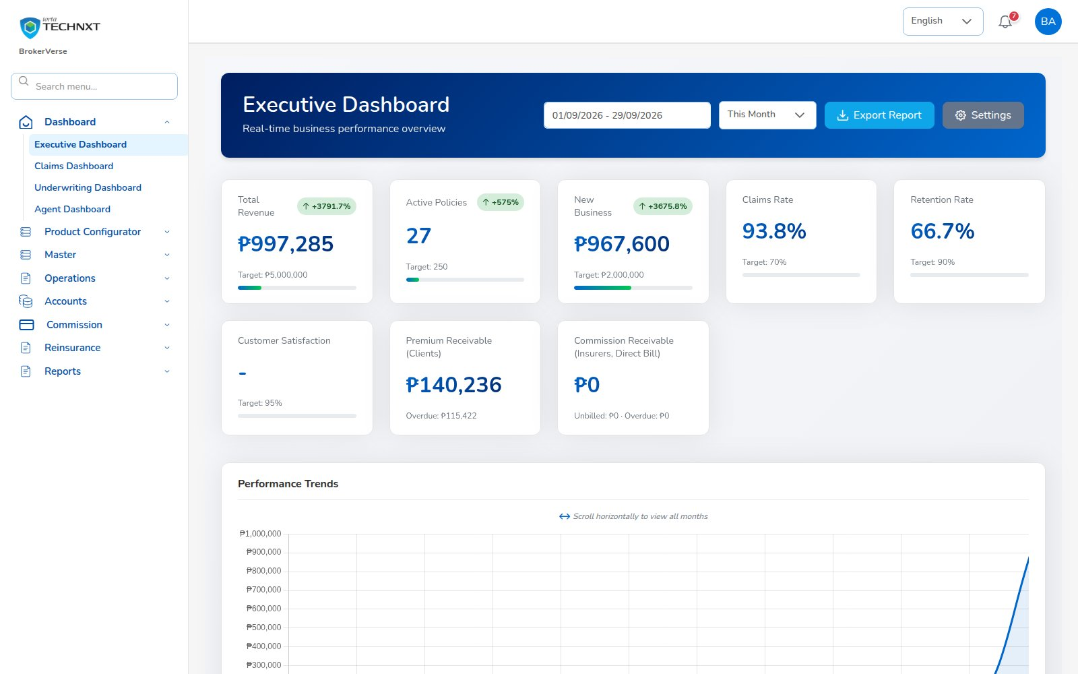
KEY FUNCTION 1 OF 9
Executive dashboard
Dashboard > Executive Dashboard
Purpose: one view of revenue, active policies, new business and claims ratio against target.
Periods: calendar month, quarter or year to date in Manila time, compared with the whole previous period.
Export Report: Production Register for the chosen dates; Settings opens System Settings.
Check: after a release, confirm each dashboard loads for each persona.
Live screen — Dashboard > Executive Dashboard — signed in as BrokerVerse
BrokerVerse | IT Administrator
4

Slide 5
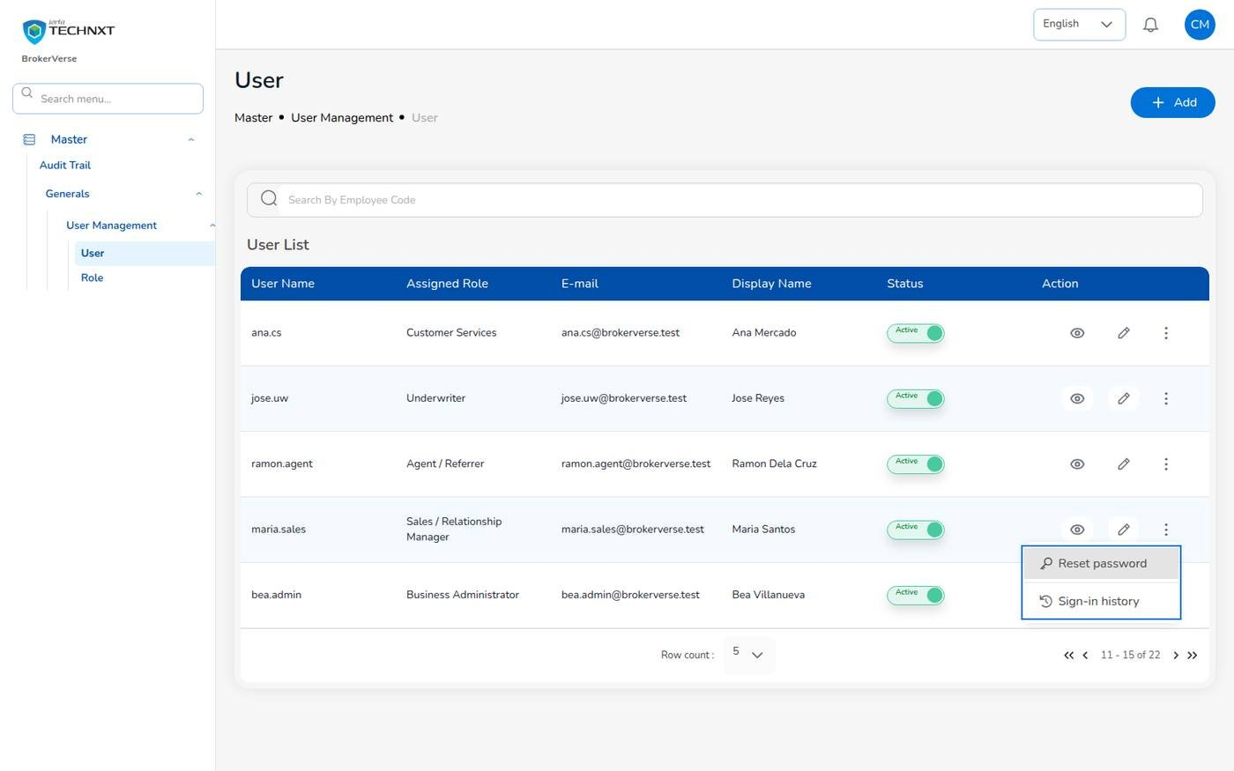
KEY FUNCTION 2 OF 9
User management
Master > Generals > User Management > User
Add: leave the password empty: a temporary password is shown once and must be changed at first sign-in.
Actions: Unlock (Locked tag), Reset password, Turn off two-step verification, Sign-in history.
Rule: only an IT administrator acts on IT / business administrator accounts or on their own.
Audit: every change is written to the audit trail with before and after values.
Live screen — User list with the account actions of a user
BrokerVerse | IT Administrator
5

Slide 6

KEY FUNCTION 3 OF 9
Sign-in security
Sign-in page; profile menu
Password: hidden with show / hide; min 8, upper, lower, digit, symbol; last 5 not reused; 90-day expiry.
Forgot password: e-mailed 6-digit code, valid 15 minutes; 5 wrong entries withdraw it.
Two-factor: authenticator app; users turn it on in the profile menu; compulsory per role with security.require_2fa_roles.
Lockout: 5 failed sign-ins lock the user; 10 attempts per 5 minutes per address and user name.
Live screen — sign-in, two-step verification code (example code)
BrokerVerse | IT Administrator
6

Slide 7
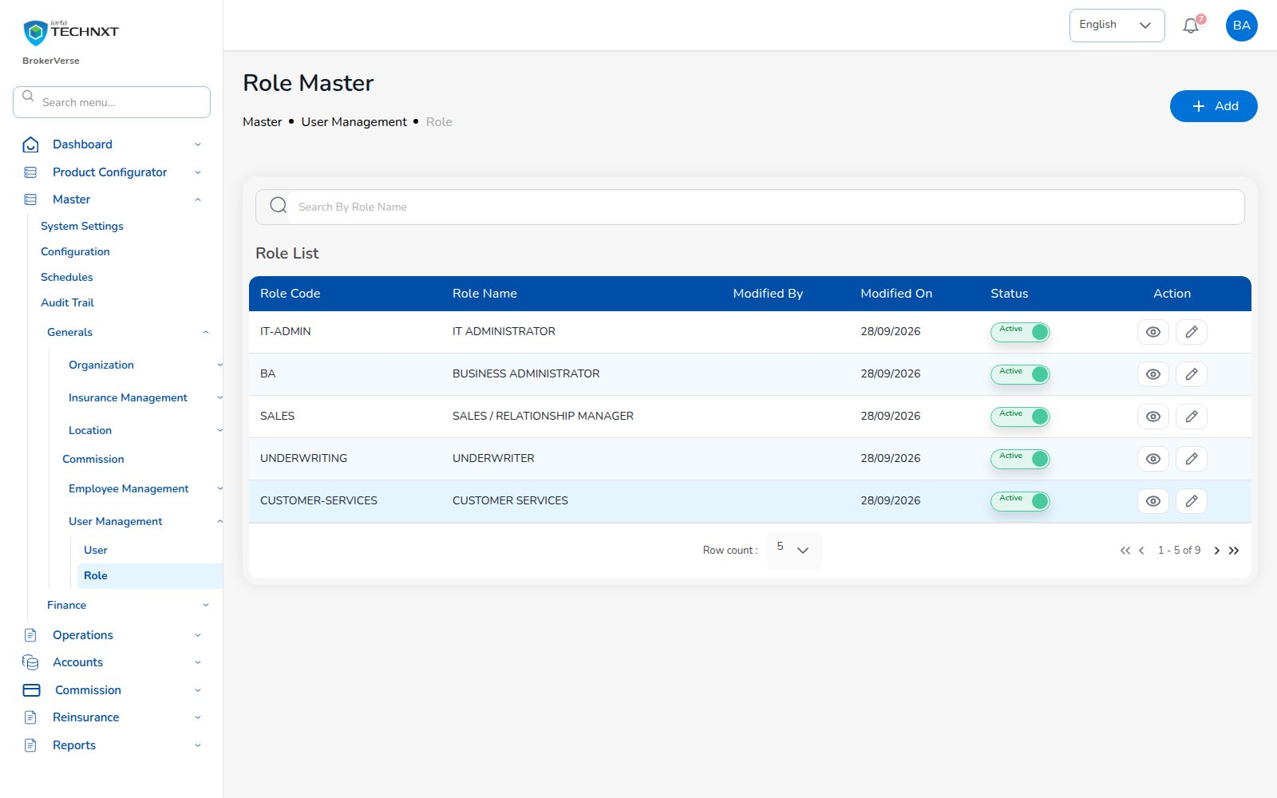
KEY FUNCTION 4 OF 9
Roles and permissions
Master > Generals > User Management > Role
Purpose: the nine personas are roles: it-admin, ba, sales, underwriting, customer-services, claims, finance, agent, user-access-admin.
Permissions: read / write per module (25 modules, e.g. write:receipts, read:audit).
Scope: agents see only their own book (security.scoped_roles).
Rule: only non-system roles with no users can be deleted.
Live screen — Master > User Management > Role — signed in as BrokerVerse
BrokerVerse | IT Administrator
7

Slide 8
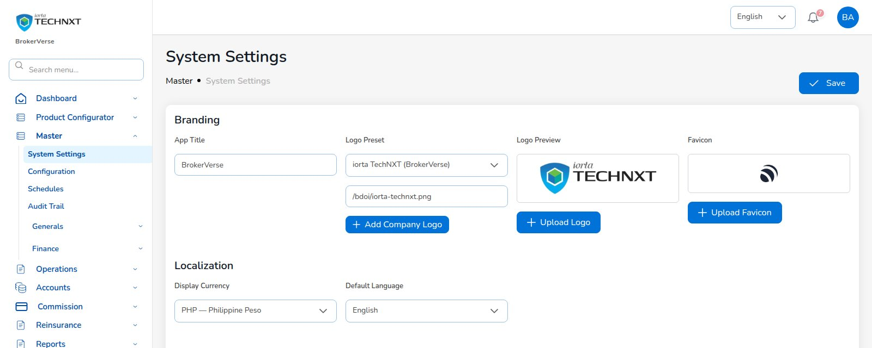
KEY FUNCTION 5 OF 9
System settings: branding and locale
Master > System Settings
Purpose: application name, logo (standard: iorta TechNXT / BrokerVerse), favicon, theme colours.
Locale: display currency PHP, default language (English or Thai).
Effect: applies to every user, including the sign-in page.
Tip: upload your own logo and set your name before go-live.
Live screen — Master > System Settings — signed in as BrokerVerse
BrokerVerse | IT Administrator
8

Slide 9
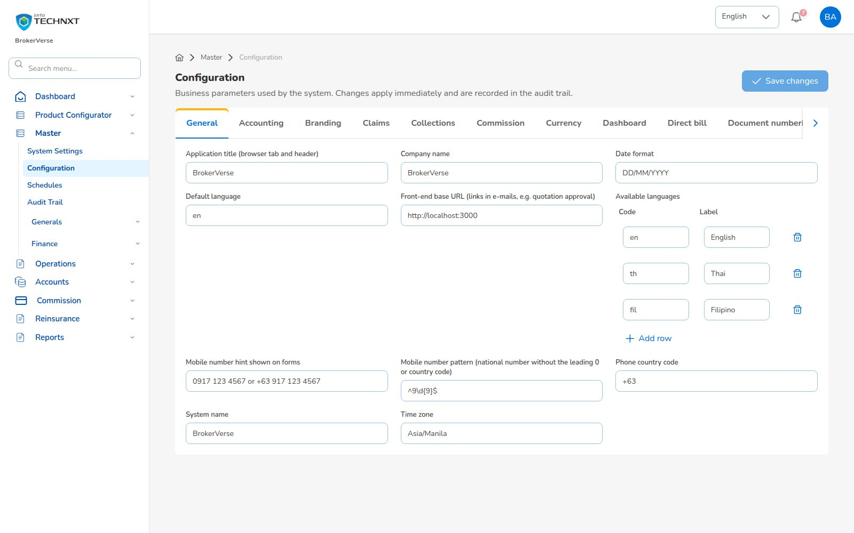
KEY FUNCTION 6 OF 9
Configuration: business parameters
Master > Configuration
Purpose: every business value in one place, in tabs with plain names (Accounting, Claims, Security, Taxes…).
Editor: lists as “a, b, c”, lists of records as a small table, e-mail templates in a text box.
Examples: GL accounts, VAT 12%, DST, LGT 0.75%, notice days 60/30/15, maker-checker switches.
Effect: changes apply immediately and are audited; change GL accounts only with Finance.
Live screen — Master > Configuration — signed in as BrokerVerse
BrokerVerse | IT Administrator
9

Slide 10
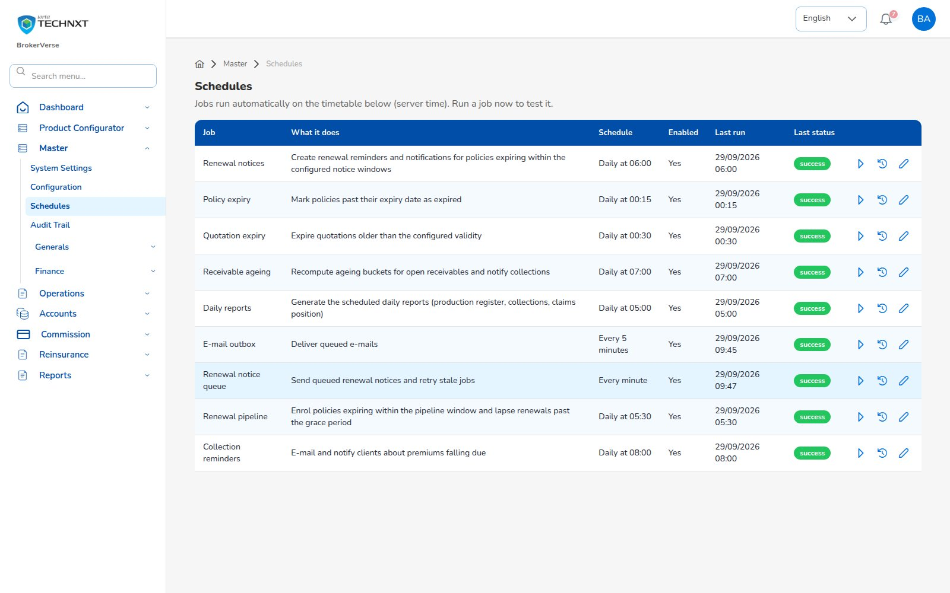
KEY FUNCTION 7 OF 9
Schedules
Master > Configuration > Schedules
Purpose: nine jobs: renewal notices, expiries, ageing, daily reports, e-mail outbox, reminders.
Actions: change timetable, enable / disable, Run now; results shown as “Updated: 5”.
History: last run and status per job; each run is audited.
Time: Manila time; with several API servers each run happens once.
Live screen — Master > Schedules — signed in as BrokerVerse
BrokerVerse | IT Administrator
10

Slide 11
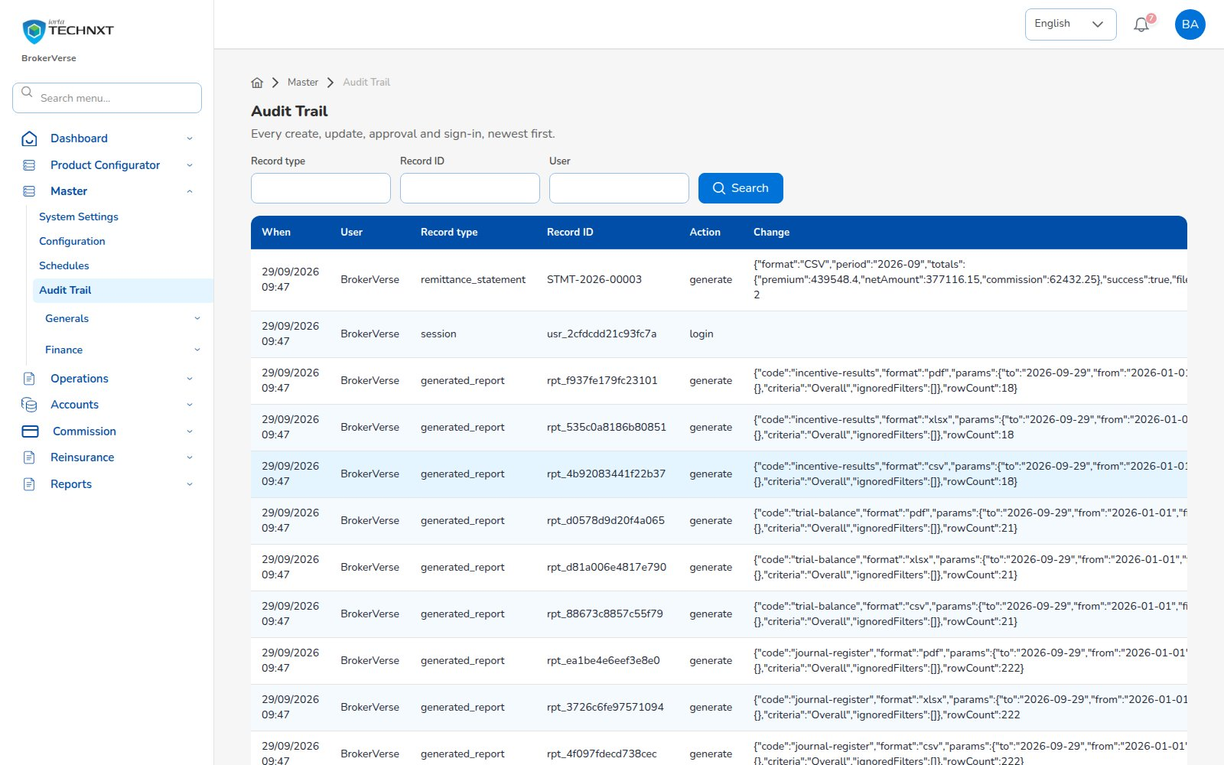
KEY FUNCTION 8 OF 9
Audit trail
Master > Configuration > Audit Trail
Purpose: every create, update, approval, report run and sign-in, newest first.
Filters: record type, record ID, user.
Coverage: logins, reports, jobs, endorsements, receipts, claims, vouchers, cheques, remittances, settlements.
Use: investigations, access reviews and proving maker-checker.
Live screen — Master > Audit Trail — signed in as BrokerVerse
BrokerVerse | IT Administrator
11

Slide 12
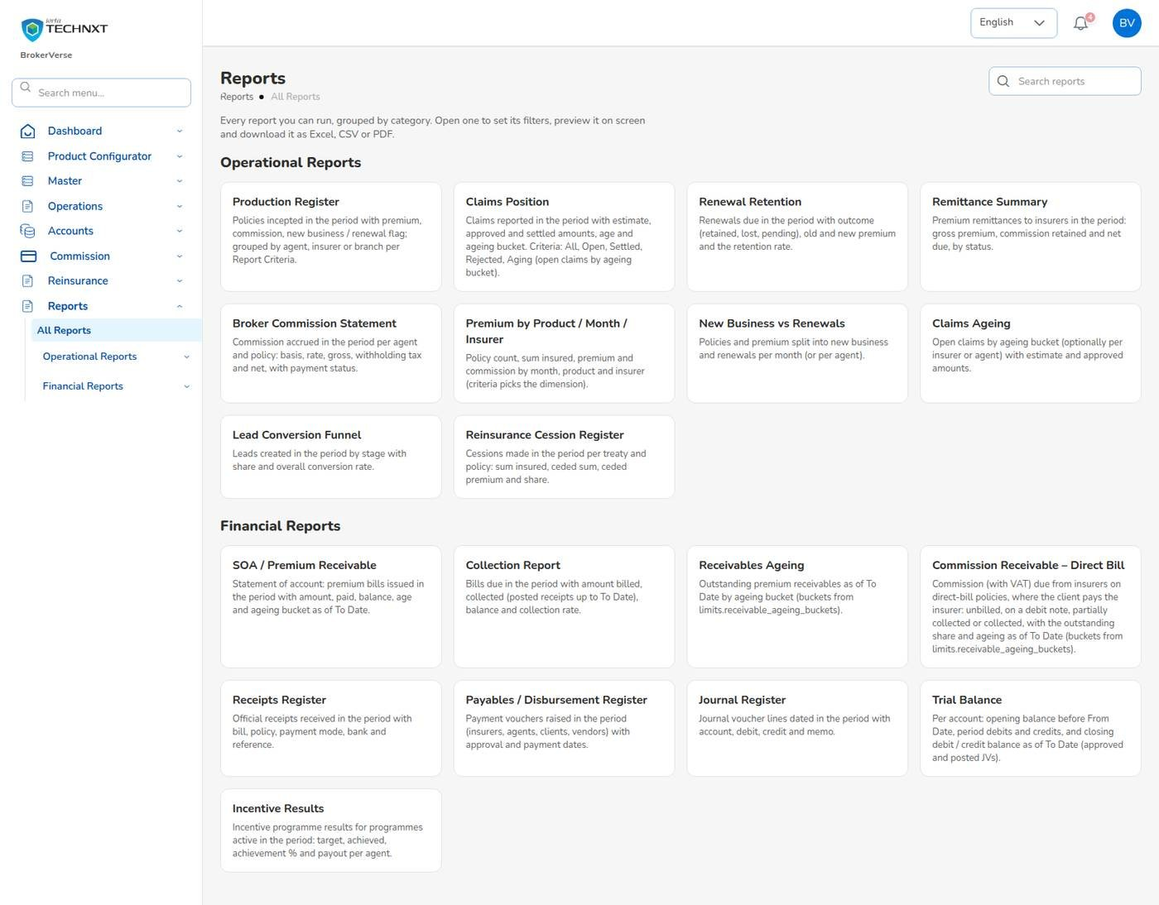
KEY FUNCTION 9 OF 9
Reports
Reports > All Reports
Catalogue: every report the role may run, grouped Operational / Financial, with search.
Report screen: criteria, From / To dates, filters used by the criteria, Preview on screen.
Formats: CSV, Excel (XLSX) or PDF; up to 50,000 rows; links valid 72 hours.
Schedules: report schedules e-mail recipients; each generated file is audited.
Live screen — Reports > All Reports (all 19 reports, administrator)
BrokerVerse | IT Administrator
12

Slide 13
BACKEND/DOCS/API
API and Postman touchpoints
543
37
38
1
endpoints (GET 258, POST 198, PUT 57, DELETE 23, PATCH 7)
modules in the route registry
folders in the Postman collection
OpenAPI file, generated from the code
What you get
How to use it
BrokerVerse.postman_collection.json and environment (set base URL and token)
openapi.json: every path with request and response examples
BrokerVerse_API_Touchpoints.xlsx / .csv: endpoint, screen that calls it, permission
Generated from the code, so it matches what is deployed
POST /api/auth/login returns an access token; send it as Authorization: Bearer
Refresh with /api/auth/refresh; sign-in and requests are rate limited
Every endpoint checks read: / write: permissions: a wrong role gets 403
Useful admin calls: /api/schedules, /api/settings, /api/users, /api/reports
BrokerVerse | IT Administrator
13

Slide 14
LEAD TO RENEWAL
End-to-end flow: you configure every step
1
2
3
4
5
6
Lead
Quote
Customer approval
Policy
Billing
Receipt
Agent / Sales / CS
Agent / Sales / UW
Client (e-mail link)
Agent / Sales / UW
System at issuance
Finance
11
10
9
8
7
Renewal
Claim
Endorsement
Remittance
Commission
UW / Sales + schedules
Claims maker + checker
Customer Services
Finance maker + checker
Finance maker + checker
Your steps
Done by other personas or by the system
Renewal starts the next cycle
Rates and taxes that price quotes come from Configuration and the Product Configurator.
Numbering (LD, QT, POL, INV, OR, PV, JV, CLM, END) comes from settings.
Schedules drive quote and policy expiry, renewal notices, ageing and reminders.
Maker-checker switches (quotes, claims, finance, renewals) are settings you own.
BrokerVerse | IT Administrator
14

Slide 15
REPORTS > ALL REPORTS
Reports you use
Output formats
CSV
XLSX
PDF
On screen
Scheduled e-mail
All 19 reports; e-mail schedules through the report schedules API.
Operational report | What it shows
Production Register | Policies incepted in the period: premium, commission, new or renewal; by agent, insurer or branch
Claims Position | Claims reported: estimate, approved, settled, age; criteria All / Open / Settled / Rejected / Aging
Renewal Retention | Renewals due: retained, lost or pending, old vs new premium, retention rate
Remittance Summary | Remittances to insurers: gross premium, commission retained, net due, status
Broker Commission Statement | Commission per agent and policy: basis, rate, gross, WHT, net, paid status
Premium by Product / Month / Insurer | Policy count, sum insured, premium and commission by month, product or insurer
New Business vs Renewals | Policies and premium split into new business and renewals per month
Claims Ageing | Open claims by ageing bucket (30/60/90/180 days) with estimate and approved
Lead Conversion Funnel | Leads by stage (new to converted / lost) with share and conversion rate
Reinsurance Cession Register | Cessions per treaty and policy: sum insured, ceded sum and premium, share
Financial report | What it shows
SOA / Premium Receivable | Bills issued: amount, paid, balance, age and ageing bucket as of To Date
Collection Report | Bills due: billed, collected, balance and collection rate
Receivables Ageing | Outstanding receivables by bucket (30/60/90/120 days)
Commission Receivable – Direct Bill | Commission and VAT due from insurers on direct-bill policies, with ageing
Receipts Register | Official receipts: bill, policy, payment mode, bank, reference
Payables / Disbursement Register | Payment vouchers to insurers, agents, clients, vendors with approval and paid dates
Journal Register | Journal lines: account, debit, credit, memo
Trial Balance | Opening, period debits and credits, closing balance per account (approved and posted JVs)
Incentive Results | Programme target, achieved, achievement % and payout per agent
BrokerVerse | IT Administrator
15

Slide 16
MASTER > CONFIGURATION > SCHEDULES
Schedules and automations
Job | When it runs | What it means for you
Daily reports | Every day, 05:00 | Files ready for managers each morning
Renewal pipeline | Every day, 05:30 | Policies within 90 days enrolled; lapsed after 30 days grace
Renewal notices | Every day, 06:00 | Notices at 60, 30 and 15 days before expiry
Receivable ageing | Every day, 07:00 | Ageing buckets 30/60/90/120 refreshed
Collection reminders | Every day, 08:00 | Clients reminded 7 days before due, then every 7 days
Policy expiry | Every day, 00:15 | Policies past expiry marked expired
Quotation expiry | Every day, 00:30 | Quotations past validity expired
E-mail outbox | Every 5 minutes | Queued e-mails delivered (needs SMTP configured)
Renewal notice queue | Every minute | Queued renewal notices sent, stale jobs retried
Times are server time (Philippine time in production). The IT administrator can change a timetable, switch a job off or press Run now; every run is recorded.
BrokerVerse | IT Administrator
16

Slide 17
BELL ICON, TOP RIGHT
Notifications and approvals
Reminder
Premium overdue
Approval
Treaty / incentive awaiting approval
Collection reminders for policies you own, e.g. “Premium overdue 55 day(s)”.
Reinsurance treaties and incentive batches need approval.
Approval
Remittances awaiting approval
Alert
Petty cash below minimum
Batches over an approval level land with approvers.
Sent to the custodian when a fund drops below its minimum.
Approval
Journal voucher awaiting approval
E-mail
Outbox
Sent to finance approvers when a JV is submitted.
Customer e-mails wait in the outbox until SMTP is configured.
BrokerVerse | IT Administrator
17

Slide 18
GOOD TO KNOW
Known limitations and tips
Open items that affect you
Tips
Your session is kept in the browser’s local storage: sign out on shared computers and keep the browser up to date.
Two-factor set-up shows a setup key and an app link, but no QR code: type the key into the authenticator app.
Sign-in and request rate limits are counted per API server; with several servers, add a limit at the load balancer.
Screens are in English or Thai; Filipino is configured but has no translation yet.
Some database queries use the database’s own date: set the PostgreSQL time zone to Asia/Manila.
Keep BrokerVerse for administration; use persona users for business work.
Before go-live: SMTP, Manila time zone on API and database, your logo and name, GL accounts, numbering.
Use Run now on a schedule after changing its settings, then read the run history.
Review the audit trail weekly for sign-ins and approvals.
Share the Postman collection, not passwords, with integration partners.
BrokerVerse | IT Administrator
18

Slide 19
Thank you
BrokerVerse — IT Administrator guide
SUPPORT
Service desk
<service desk to be confirmed>
E-mail
<support mailbox to be confirmed>
Hours
<business hours, Manila time, to be confirmed>
Access requests
Your User Access Administrator (Master > User Management)
iorta TechNXT · BrokerVerse insurance-broking platform

