Slide 1

THIS GUIDE IS FOR
User Access Administrator
BrokerVerse — User Access Administrator guide
SIGN-IN
carmela.morfe (and five other access administrators)
ROLE CODE
Out-of-the-box functions, flows, reports and schedules
user-access-admin
BrokerVerse OOTB · insurance broking · Philippines · PHP
LANDS ON
Master > Audit Trail
Users
Roles
Audit and sign-ins
Prepared by iorta TechNXT · September 2026

Slide 2
WHO YOU ARE IN BROKERVERSE
Role at a glance
What you do
Sign-in and landing page
User name carmela.morfe. Lands on Master > Audit Trail, the first screen the role may open.
Manages users: creates users, assigns roles, deactivates leavers, unlocks and resets passwords.
Manages roles: maintains roles and their read / write permissions.
Reviews access: sign-in history per user and the audit trail for access reviews.
No business data: cannot open policies, receipts, claims or reports.
You hand work to
IT administrator (settings, schedules, API), line managers (approve access requests).
Maker-checker partners
Access requests should be approved by the user’s manager before you act.
BrokerVerse | User Access Administrator
2

Slide 3
WHAT YOU SEE AFTER SIGN-IN
Menu map
Grants: master > "Generals > User Management" and "Audit Trail"; permissions read/write users and roles, read audit and settings.
Master
Not in your menu
Generals > User Management > User
Generals > User Management > Role
Audit Trail
Dashboard, Product Configurator
Operations, Accounts
Commission, Reinsurance
Reports
System Settings, Configuration, Schedules
BrokerVerse | User Access Administrator
3

Slide 4
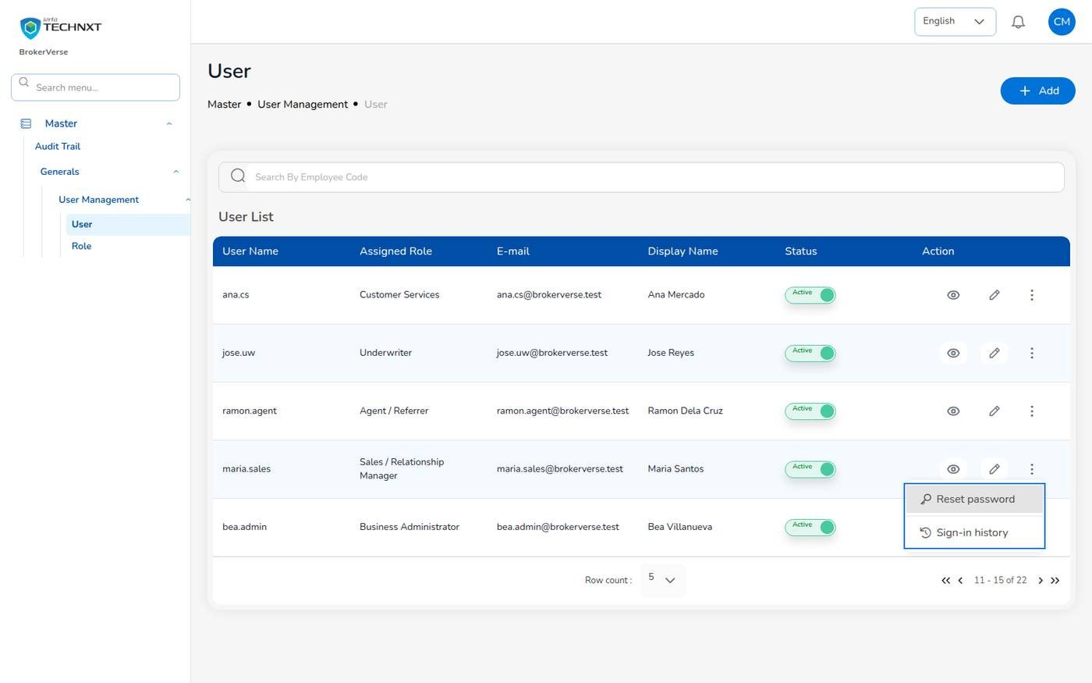
KEY FUNCTION 1 OF 5
Users and account actions
Master > Generals > User Management > User
Purpose: user list with role, e-mail, display name and status (Locked tag).
Actions: Unlock, Reset password (temporary password shown once), Turn off two-step verification, Sign-in history.
Rule: IT and business administrator accounts are handled by the IT administrator.
Leavers: deactivate with the Status switch; history is kept and sessions end.
Live screen — User list with the account actions of a user — signed in as carmela.morfe
BrokerVerse | User Access Administrator
4

Slide 5
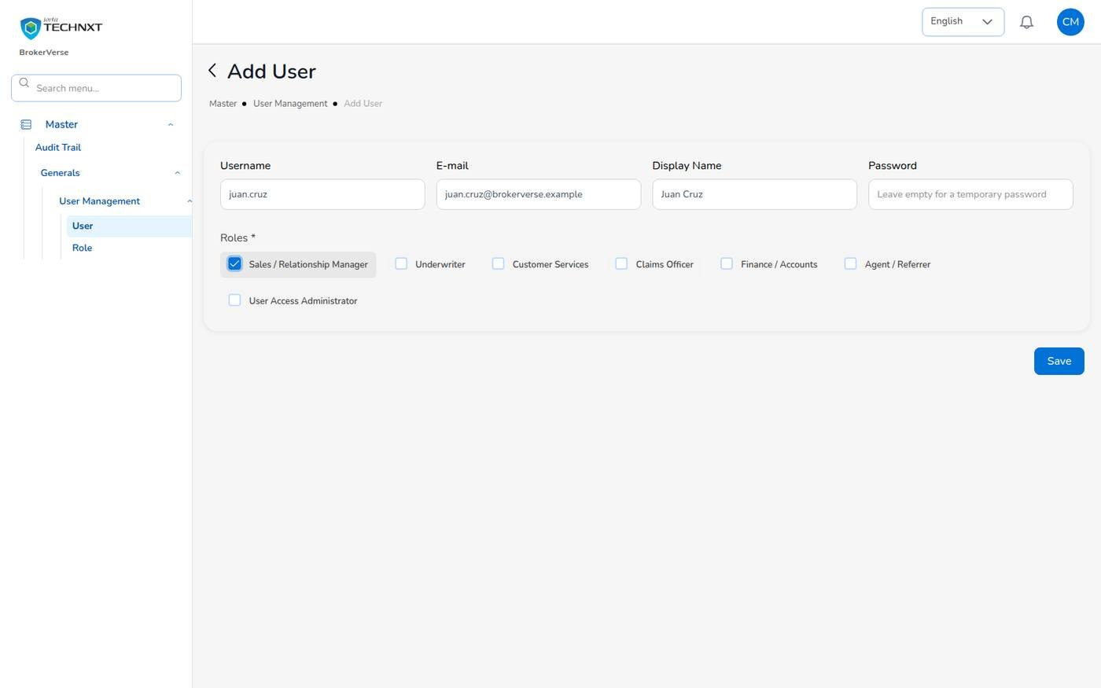
KEY FUNCTION 2 OF 5
Adding a user
Master > User Management > User > + Add
Rules: user name, e-mail, display name and at least one role; only the IT administrator grants admin roles.
Password: leave it empty: a temporary password is shown once; the user must change it at first sign-in.
Policy: min 8, upper, lower, digit, symbol; last 5 not reused; expires after 90 days.
Audit: creation and every change are recorded.
Live screen — Add User (example values) — signed in as carmela.morfe
BrokerVerse | User Access Administrator
5

Slide 6
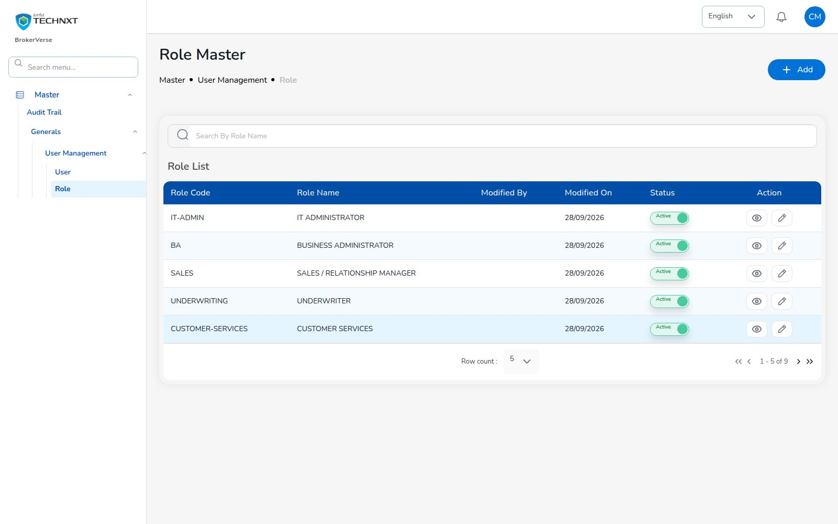
KEY FUNCTION 3 OF 5
Roles
Master > Generals > User Management > Role
Purpose: role code, name, status; view and edit permissions.
Permissions: read / write per module, e.g. write:receipts, read:audit.
Rule: system roles cannot be deleted; a role with users cannot be deleted.
Live screen — Master > User Management > Role — signed in as carmela.morfe
BrokerVerse | User Access Administrator
6

Slide 7
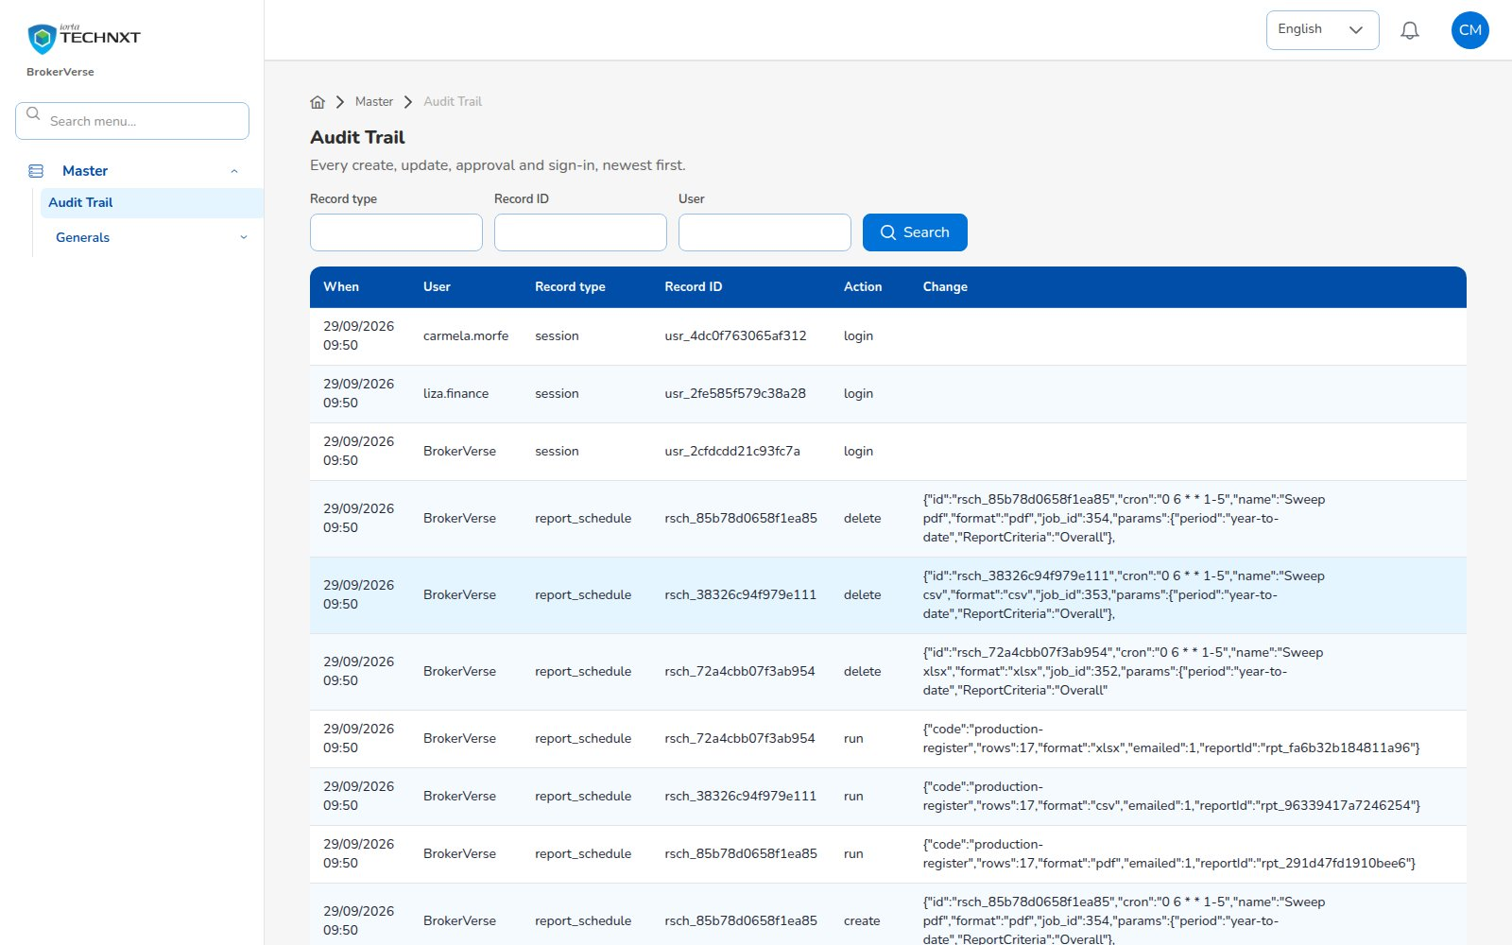
KEY FUNCTION 4 OF 5
Audit trail
Master > Audit Trail
Purpose: every create, update, approval, report and sign-in.
Filters: record type, record ID, user.
Change column: before and after values of each change.
Live screen — Master > Audit Trail — signed in as carmela.morfe
BrokerVerse | User Access Administrator
7

Slide 8
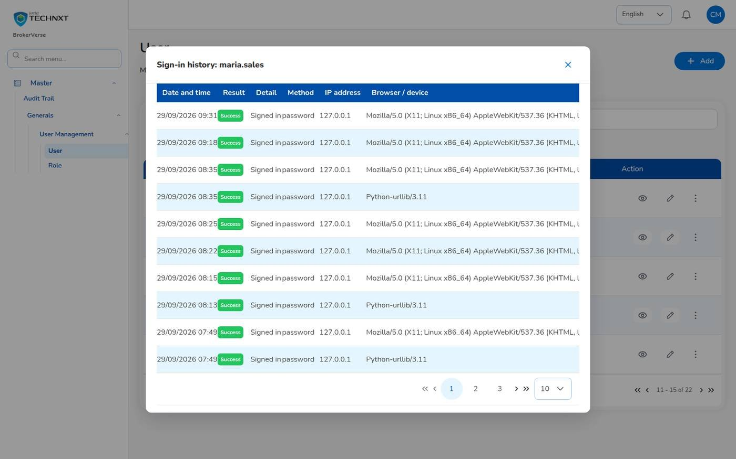
KEY FUNCTION 5 OF 5
Sign-in history
User > … > Sign-in history
Purpose: every sign-in attempt of a user: date and time, result, detail, method, IP address, browser.
Details: wrong password, account locked, code requested, password change required…
Lockout: 5 failed sign-ins lock the account; use Unlock on the user row.
Audit trail: record type “session” lists sign-ins of all users.
Live screen — Sign-in history of a user — signed in as carmela.morfe
BrokerVerse | User Access Administrator
8

Slide 9
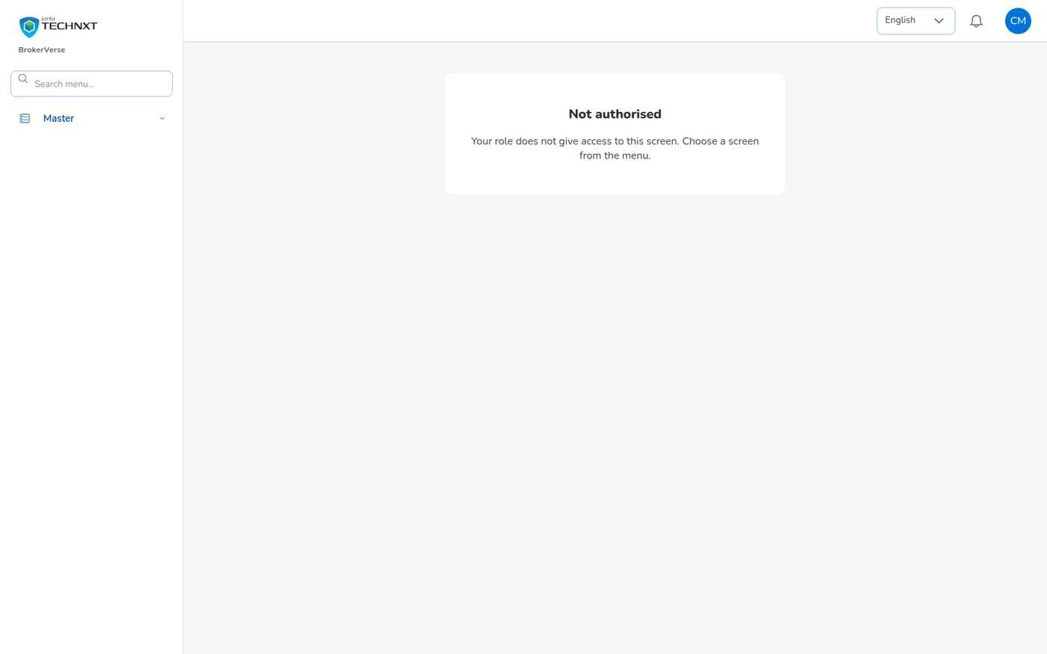
LEAST PRIVILEGE
What you cannot do
Blocked for this role
Open business screens: a typed address such as /accounts/receipts shows “Not authorised”.
Call business APIs: GET /policies answers 403.
Change system settings, configuration or schedules (IT administrator).
Run reports or see dashboards.
Approve any business transaction.
carmela.morfe opening /accounts/receipts: Not authorised
BrokerVerse | User Access Administrator
9

Slide 10
REQUEST TO LEAVER
Access lifecycle: your part
1
2
3
4
5
Access request
Create user
Assign role
First sign-in
Change password
Manager
You
You
User
User
10
9
8
7
6
Audit evidence
Deactivate leaver
Role change
Unlock / reset
Periodic review
You
You
You + manager
You
You
Your steps
Done by other personas or by the system
You are not part of the broking cycle itself
Create and assign only after the manager approves.
Review users and roles periodically.
Unlock or reset on a verified request.
Deactivate leavers on their last day.
BrokerVerse | User Access Administrator
10

Slide 11
FIGURES AND EVIDENCE
Evidence you use instead of reports
This role has no report catalogue.
Where | What it gives you
User list | Active, inactive and locked users with their roles
Role list | Roles, status and permissions
Audit trail | Every change with before / after values, filtered by user or record
Sign-ins | Audit trail record type session, action login
User sign-in history | User row > … > Sign-in history: every attempt with result and detail
BrokerVerse | User Access Administrator
11

Slide 12
MASTER > CONFIGURATION > SCHEDULES
Schedules and automations
Job | When it runs | What it means for you
E-mail outbox | Every 5 minutes | Password reset codes and notices leave every 5 minutes
No business schedules affect this role. Password expiry (90 days) and lockout are rules, not jobs.
BrokerVerse | User Access Administrator
12

Slide 13
BELL ICON, TOP RIGHT
Notifications and approvals
Info
Notifications
E-mail
Password reset code
The bell shows general notices; approvals are addressed to other roles.
Users who use Forgot password get a code by e-mail.
BrokerVerse | User Access Administrator
13

Slide 14
GOOD TO KNOW
Known limitations and tips
Open items that affect you
Tips
A user with no e-mail address (older records) cannot use Forgot password and shows “-” in the E-mail column.
The temporary password is shown only once: copy it before you close the dialog.
Your session is kept in the browser’s local storage: sign out on shared computers and keep the browser up to date.
Two-factor set-up shows a setup key and an app link, but no QR code: type the key into the authenticator app.
Screens are in English or Thai; Filipino is configured but has no translation yet.
Give each person their own user; never share accounts.
Grant the smallest role that does the job.
Keep maker and checker on different people.
Review users with managers every quarter.
BrokerVerse | User Access Administrator
14

Slide 15
Thank you
BrokerVerse — User Access Administrator guide
SUPPORT
Service desk
<service desk to be confirmed>
E-mail
<support mailbox to be confirmed>
Hours
<business hours, Manila time, to be confirmed>
Access requests
IT administrator for settings; line manager to approve access requests
iorta TechNXT · BrokerVerse insurance-broking platform

