Slide 1


BrokerVerse
Process Flow to Screen Walkthrough
Every step of the 16 signed-off BDOI process flows, shown against the BrokerVerse screen that performs it. 111 screens captured from the running platform with the responsible personas.
delivered by
BDO Insurance & Reinsurance Brokers · captured 2026-09-23
Notes:
Title slide. The walkthrough maps each BDOI process flow step to the BrokerVerse screen that implements it. Screens are real captures from journeys executed on the running platform.

Slide 2
About this walkthrough
What it shows
One section per process flow in HL_Process_Overview. Each step of the flow sits beside the menu, tab and action in BrokerVerse that performs it.
How the screens were made
A browser script ran every process for real on the platform, signing in as the persona the flow prescribes at each step: the NB officer quoting and the Underwriting Head approving, the cashier receiving and the Finance Head releasing the disbursement. Nothing is a mock-up.
Controls that surfaced while capturing
A held cheque cannot be matured before its four-day clearing date, and a cancellation endorsement blocks any later claim on that policy. Both are the intended controls.
Data
All names and amounts are sample records from the demo seed.
16
111
process flows
captured screens
12
0
personas signed in
capture errors
BrokerVerse · BDO Insure · delivered by iorta TechNXT
2

Slide 3
The sixteen process flows
01
BDOIR End-to-End
6 screens
09
Claims
11 screens
02
New Business
14 screens
10
Case Management (To-Be)
6 screens
03
Operations
17 screens
11
Customer Servicing Facility
2 screens
04
Marketing Collections
8 screens
12
Renewal (RMEL)
5 screens
05
FRBS Accounting
3 screens
13
Reinsurance
6 screens
06
Disbursement
7 screens
14
Submitted Policies
4 screens
07
Refund Request
4 screens
15
Employee Benefits
5 screens
08
ACSL (Insurer SOA reconciliation)
2 screens
16
Product Maintenance (TSU)
11 screens
BrokerVerse · BDO Insure · delivered by iorta TechNXT
3

Slide 4
BDOIR End-to-End
01
Steps in this flow
01.01 Executive dashboard: KPIs across the whole chain (in force, in placement, unapplied payments, pending approvals, disbursements in flight, past-TAT requests)
01.02 Single maker-checker queue for bookings, endorsements, journals, disbursements, CTE, claim settlements, EB awards and product changes
01.03 Production, collection and claims reports with CSV export
01.04 Client onboarding with sanctions screening, PEP flag and risk tiering feeding every process
01.05 Twelve personas with module entitlements and approver rights (segregation of duties)
01.06 Legacy data migration batches with load, reconciliation and disposition
The umbrella flow that chains new business, cashiering, collections, remittance, disbursement, the general ledger, renewal and claims. Each link is captured in detail in its own process below; these screens show the control points that tie the chain together.
Source flow BDOIR E2E PROCESS FLOW.pdf
Personas admin
Screens 6 steps captured
Notes:
BDOIR End-to-End. Source: BDOIR E2E PROCESS FLOW.pdf. The umbrella flow that chains new business, cashiering, collections, remittance, disbursement, the general ledger, renewal and claims. Each link is captured in detail in its own process below; these screens show the control points that tie the chain together.

Slide 5
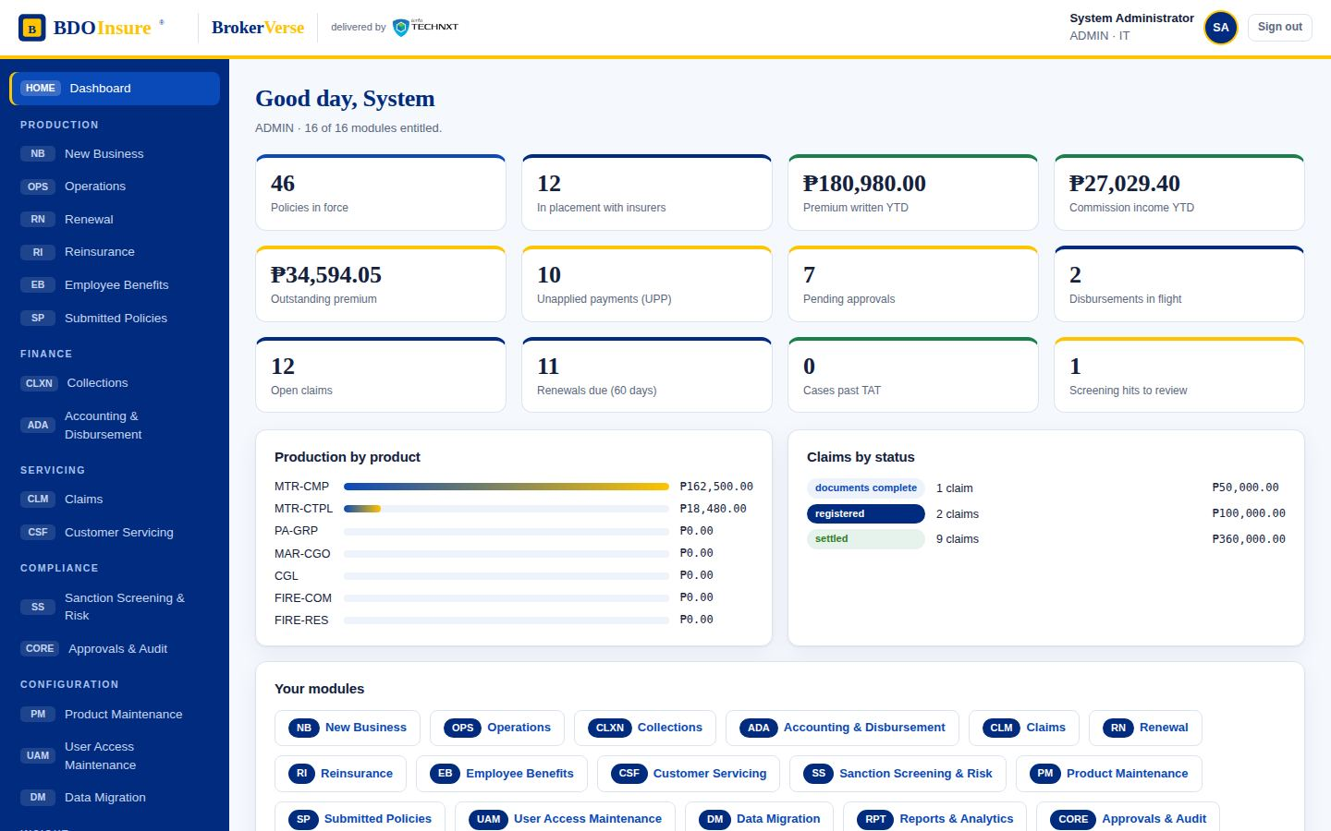
BDOIR End-to-End · step 1 of 6
01.01
Executive dashboard: KPIs across the whole chain (in force, in placement, unapplied payments, pending approvals, disbursements in flight, past-TAT requests)
Screen
Dashboard
Menu path: Dashboard
BrokerVerse · BDO Insure · delivered by iorta TechNXT
5
Notes:
BDOIR End-to-End step 1: Executive dashboard: KPIs across the whole chain (in force, in placement, unapplied payments, pending approvals, disbursements in flight, past-TAT requests). Screen: Dashboard.

Slide 6
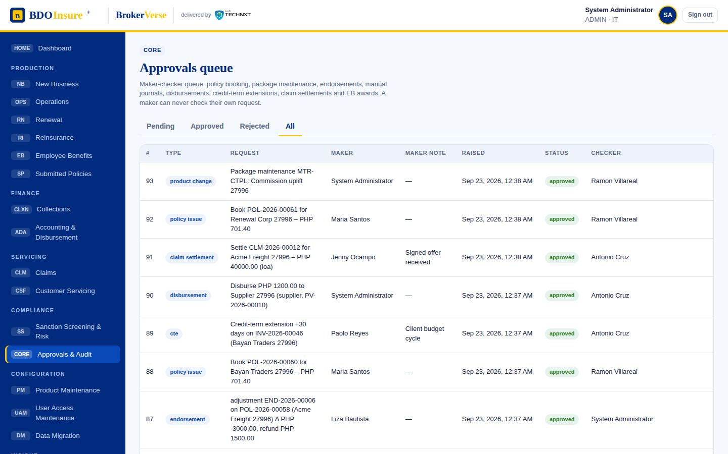
BDOIR End-to-End · step 2 of 6
01.02
Single maker-checker queue for bookings, endorsements, journals, disbursements, CTE, claim settlements, EB awards and product changes
Screen
Approvals & Audit
All
Menu path: Approvals & Audit › All
BrokerVerse · BDO Insure · delivered by iorta TechNXT
6
Notes:
BDOIR End-to-End step 2: Single maker-checker queue for bookings, endorsements, journals, disbursements, CTE, claim settlements, EB awards and product changes. Screen: Approvals & Audit › All.

Slide 7
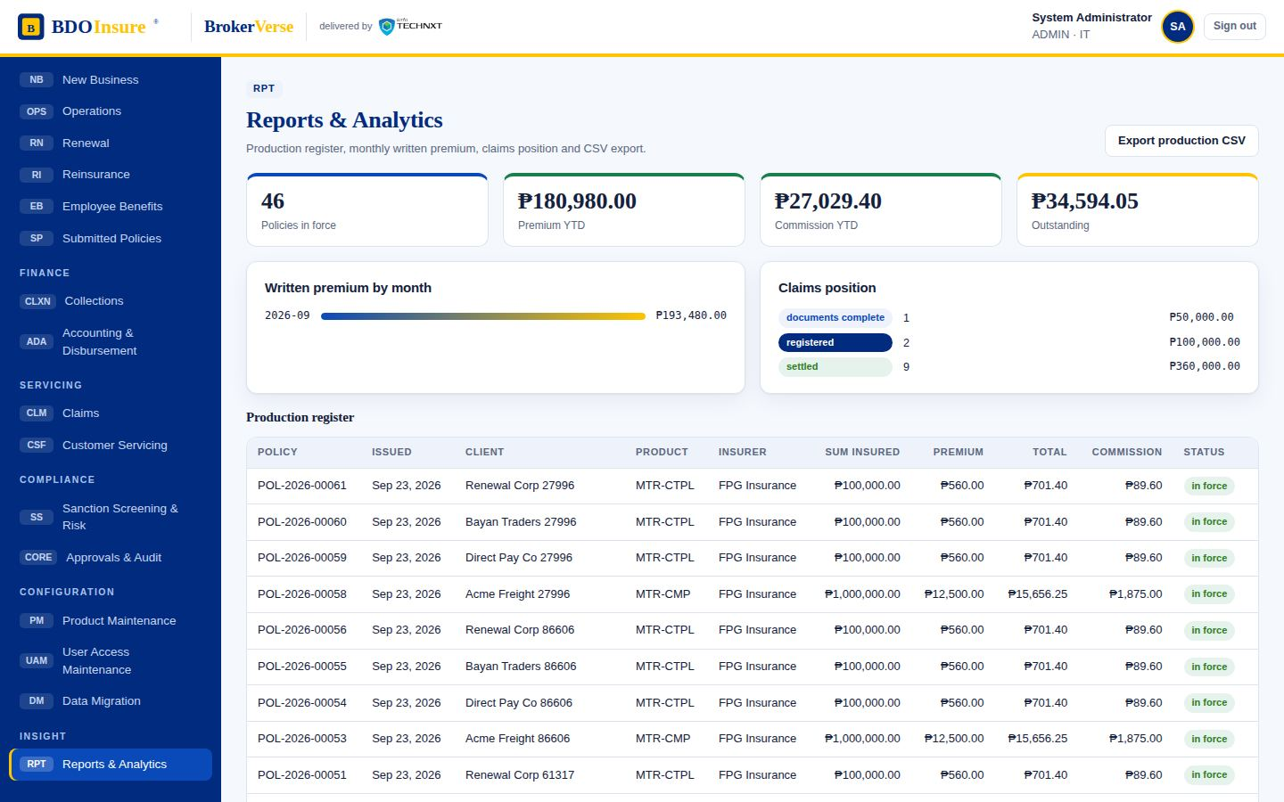
BDOIR End-to-End · step 3 of 6
01.03
Production, collection and claims reports with CSV export
Screen
Reports & Analytics
Menu path: Reports & Analytics
BrokerVerse · BDO Insure · delivered by iorta TechNXT
7
Notes:
BDOIR End-to-End step 3: Production, collection and claims reports with CSV export. Screen: Reports & Analytics.

Slide 8
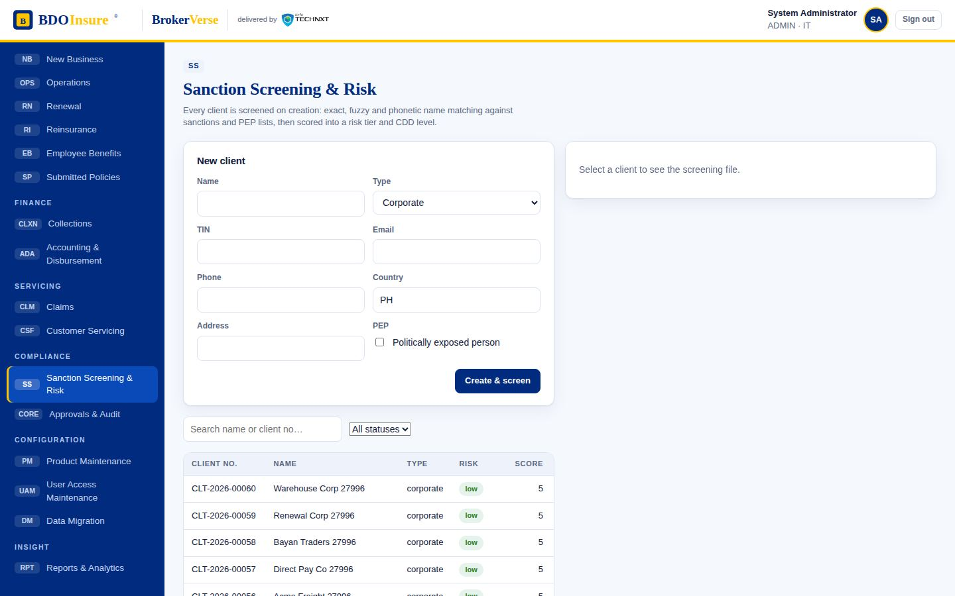
BDOIR End-to-End · step 4 of 6
01.04
Client onboarding with sanctions screening, PEP flag and risk tiering feeding every process
Screen
Sanction Screening & Risk
Menu path: Sanction Screening & Risk
BrokerVerse · BDO Insure · delivered by iorta TechNXT
8
Notes:
BDOIR End-to-End step 4: Client onboarding with sanctions screening, PEP flag and risk tiering feeding every process. Screen: Sanction Screening & Risk.

Slide 9
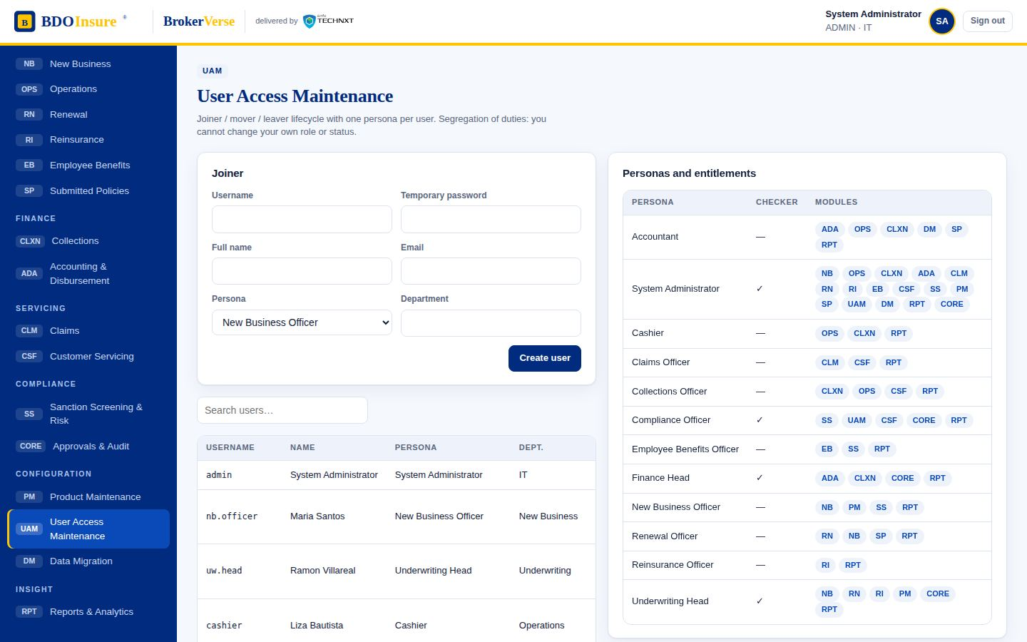
BDOIR End-to-End · step 5 of 6
01.05
Twelve personas with module entitlements and approver rights (segregation of duties)
Screen
User Access Maintenance
Menu path: User Access Maintenance
BrokerVerse · BDO Insure · delivered by iorta TechNXT
9
Notes:
BDOIR End-to-End step 5: Twelve personas with module entitlements and approver rights (segregation of duties). Screen: User Access Maintenance.

Slide 10
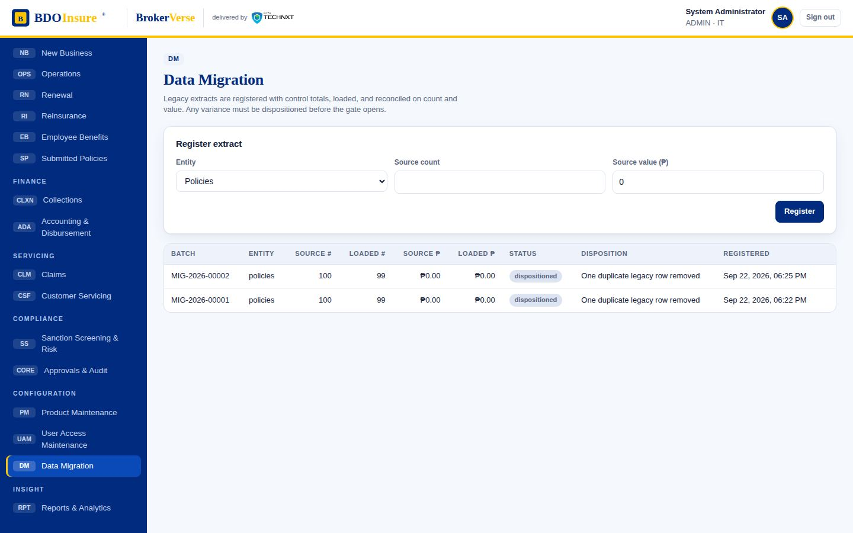
BDOIR End-to-End · step 6 of 6
01.06
Legacy data migration batches with load, reconciliation and disposition
Screen
Data Migration
Menu path: Data Migration
BrokerVerse · BDO Insure · delivered by iorta TechNXT
10
Notes:
BDOIR End-to-End step 6: Legacy data migration batches with load, reconciliation and disposition. Screen: Data Migration.

Slide 11
New Business
02
Steps in this flow
02.01 MAO creates the client in Broker; KYC details captured
02.02 Client is sanction-screened automatically (clear / hit) and risk-tiered
02.03 Quotation prepared with the rating engine (premium, VAT, DST, LGT, commission)
02.04 Quotation created (status: quoted); hold cover can be requested from the insurer
02.05 Proposal sent to the client by email (status: proposal sent)
02.06 Client acceptance recorded (Y); a decline with reason is the N branch
02.07 Placement requested: placement slip goes to the insurer via SFTP or email
02.08 Placement board tracks slips awaiting the insurer, returns and e-policies
02.09 Insurer placed the risk; e-policy received (COG via SFTP or PO email)
02.10 Booking and invoicing raised for checker approval (maker-checker)
02.11 Underwriting Head (checker) reviews the booking request
02.12 Booking approved: invoice, journal and e-policy dispatch are posted automatically
02.13 Policy register: the policy is in force with its invoice and e-policy channel
02.14 Policy detail: placement history, e-policy status and the exception route to the contact centre
Client creation and screening, quotation, proposal, placement to the insurer, e-policy and booking under maker-checker.
Source flow NEW BUSINESS.pdf
Personas nb.officer → uw.head
Screens 14 steps captured
Notes:
New Business. Source: NEW BUSINESS.pdf. Client creation and screening, quotation, proposal, placement to the insurer, e-policy and booking under maker-checker.

Slide 12
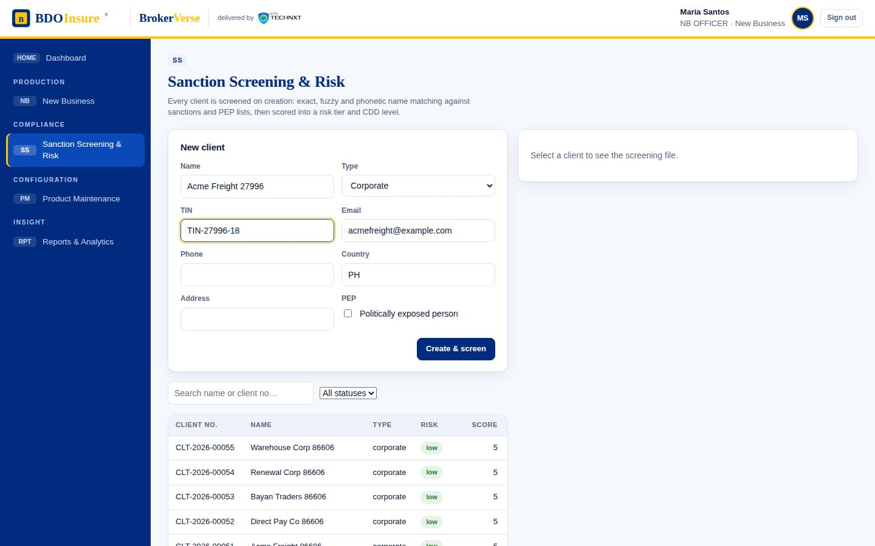
New Business · step 1 of 14
02.01
MAO creates the client in Broker; KYC details captured
Screen
Sanction Screening & Risk
New client form
Menu path: Sanction Screening & Risk › New client form
BrokerVerse · BDO Insure · delivered by iorta TechNXT
12
Notes:
New Business step 1: MAO creates the client in Broker; KYC details captured. Screen: Sanction Screening & Risk › New client form.

Slide 13
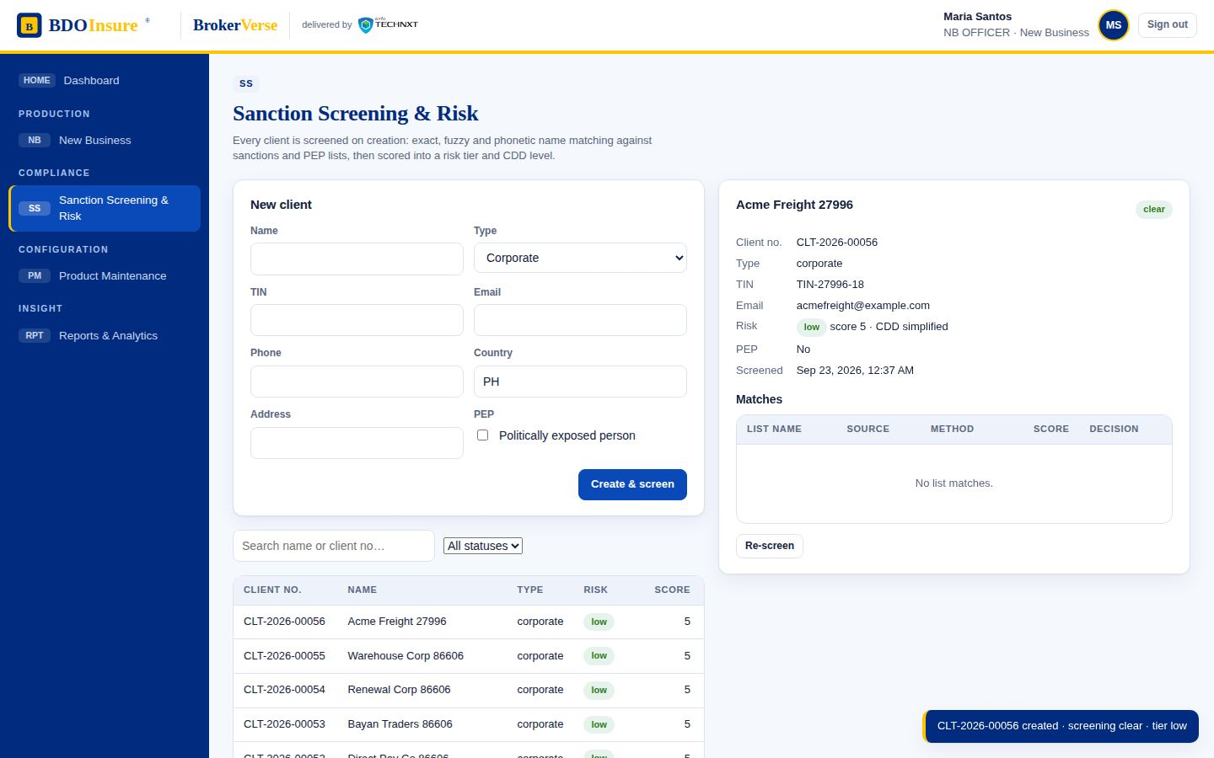
New Business · step 2 of 14
02.02
Client is sanction-screened automatically (clear / hit) and risk-tiered
Screen
Sanction Screening & Risk
Client register
Screening result and CDD level shown on the row
Menu path: Sanction Screening & Risk › Client register
BrokerVerse · BDO Insure · delivered by iorta TechNXT
13
Notes:
New Business step 2: Client is sanction-screened automatically (clear / hit) and risk-tiered. Screen: Sanction Screening & Risk › Client register. Screening result and CDD level shown on the row

Slide 14
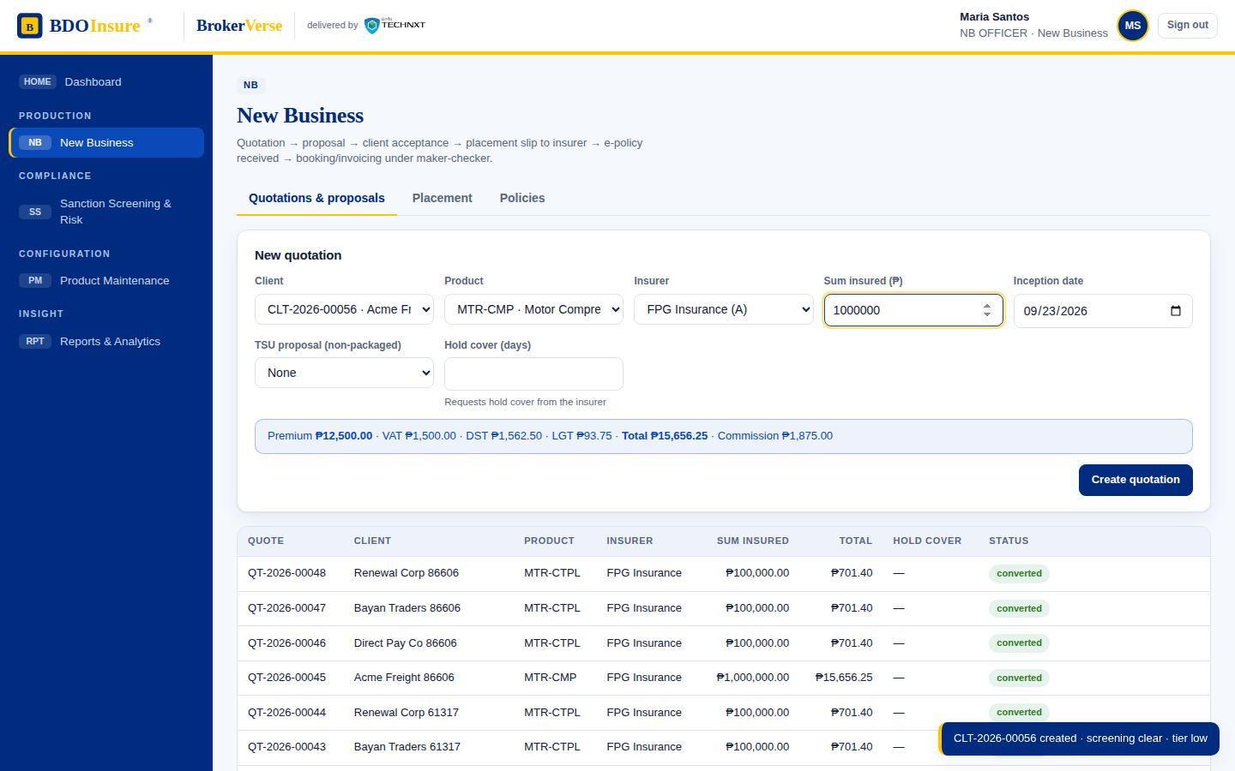
New Business · step 3 of 14
02.03
Quotation prepared with the rating engine (premium, VAT, DST, LGT, commission)
Screen
New Business
Quotations & proposals
New quotation form
Menu path: New Business › Quotations & proposals › New quotation form
BrokerVerse · BDO Insure · delivered by iorta TechNXT
14
Notes:
New Business step 3: Quotation prepared with the rating engine (premium, VAT, DST, LGT, commission). Screen: New Business › Quotations & proposals › New quotation form.

Slide 15
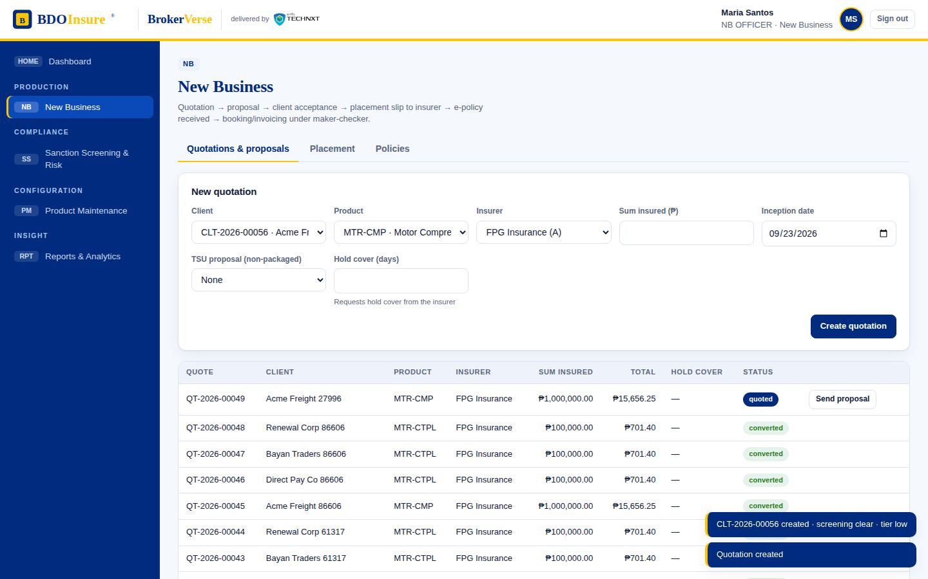
New Business · step 4 of 14
02.04
Quotation created (status: quoted); hold cover can be requested from the insurer
Screen
New Business
Quotations & proposals
Menu path: New Business › Quotations & proposals
BrokerVerse · BDO Insure · delivered by iorta TechNXT
15
Notes:
New Business step 4: Quotation created (status: quoted); hold cover can be requested from the insurer. Screen: New Business › Quotations & proposals.

Slide 16
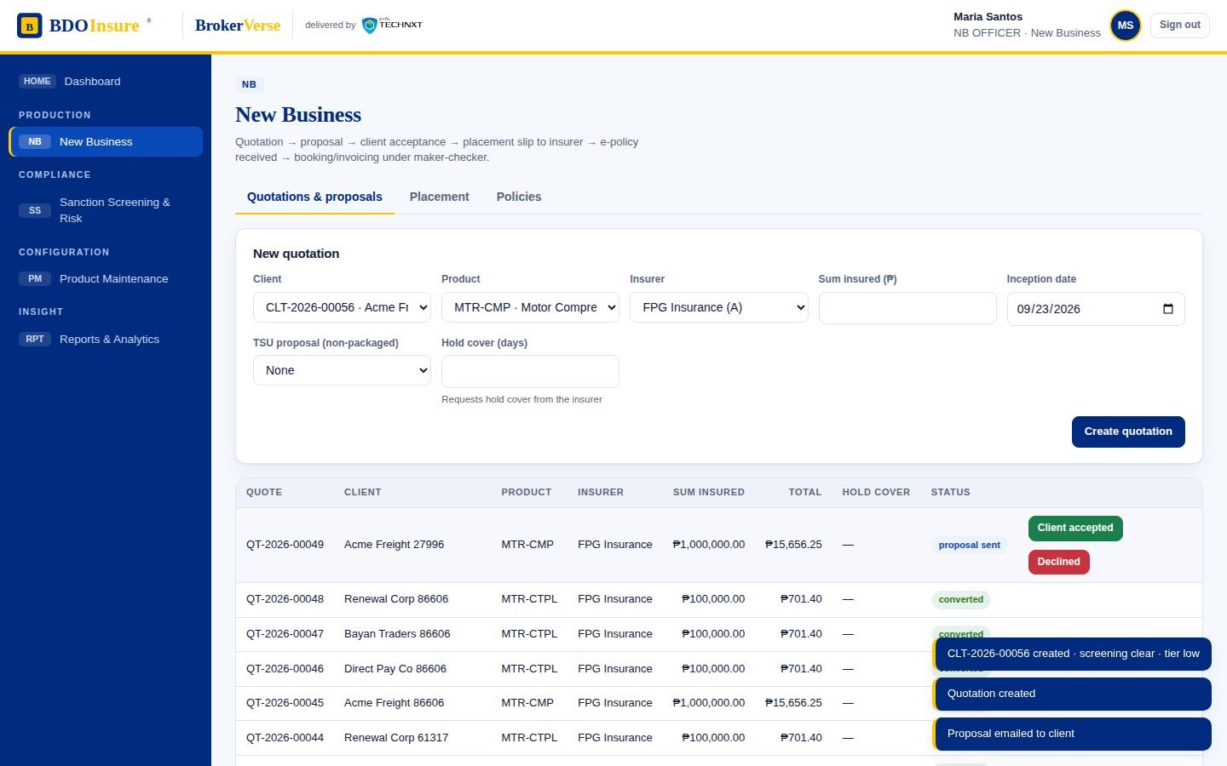
New Business · step 5 of 14
02.05
Proposal sent to the client by email (status: proposal sent)
Screen
New Business
Quotations & proposals
Send proposal
Menu path: New Business › Quotations & proposals › Send proposal
BrokerVerse · BDO Insure · delivered by iorta TechNXT
16
Notes:
New Business step 5: Proposal sent to the client by email (status: proposal sent). Screen: New Business › Quotations & proposals › Send proposal.

Slide 17
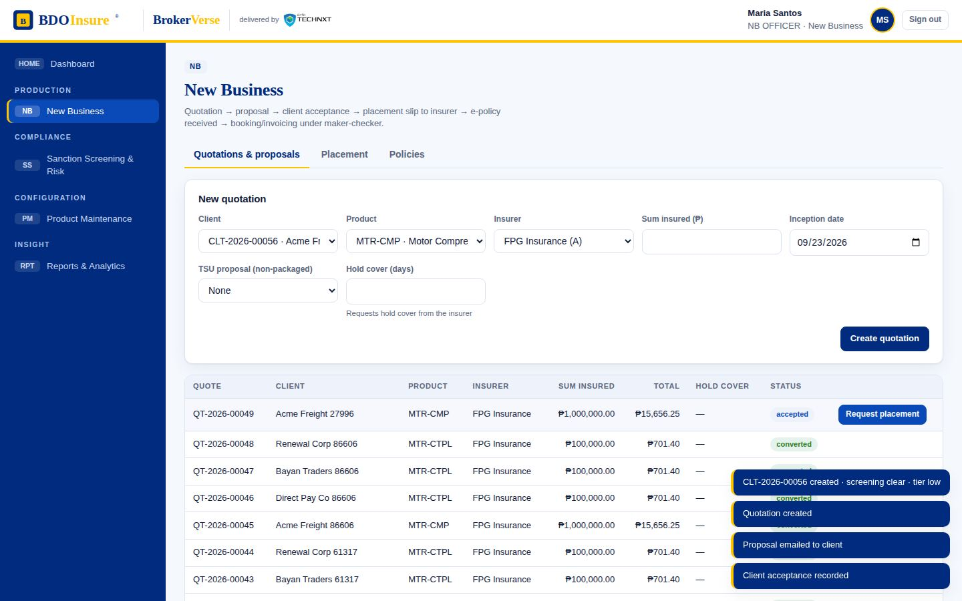
New Business · step 6 of 14
02.06
Client acceptance recorded (Y); a decline with reason is the N branch
Screen
New Business
Quotations & proposals
Client accepted
Menu path: New Business › Quotations & proposals › Client accepted
BrokerVerse · BDO Insure · delivered by iorta TechNXT
17
Notes:
New Business step 6: Client acceptance recorded (Y); a decline with reason is the N branch. Screen: New Business › Quotations & proposals › Client accepted.

Slide 18
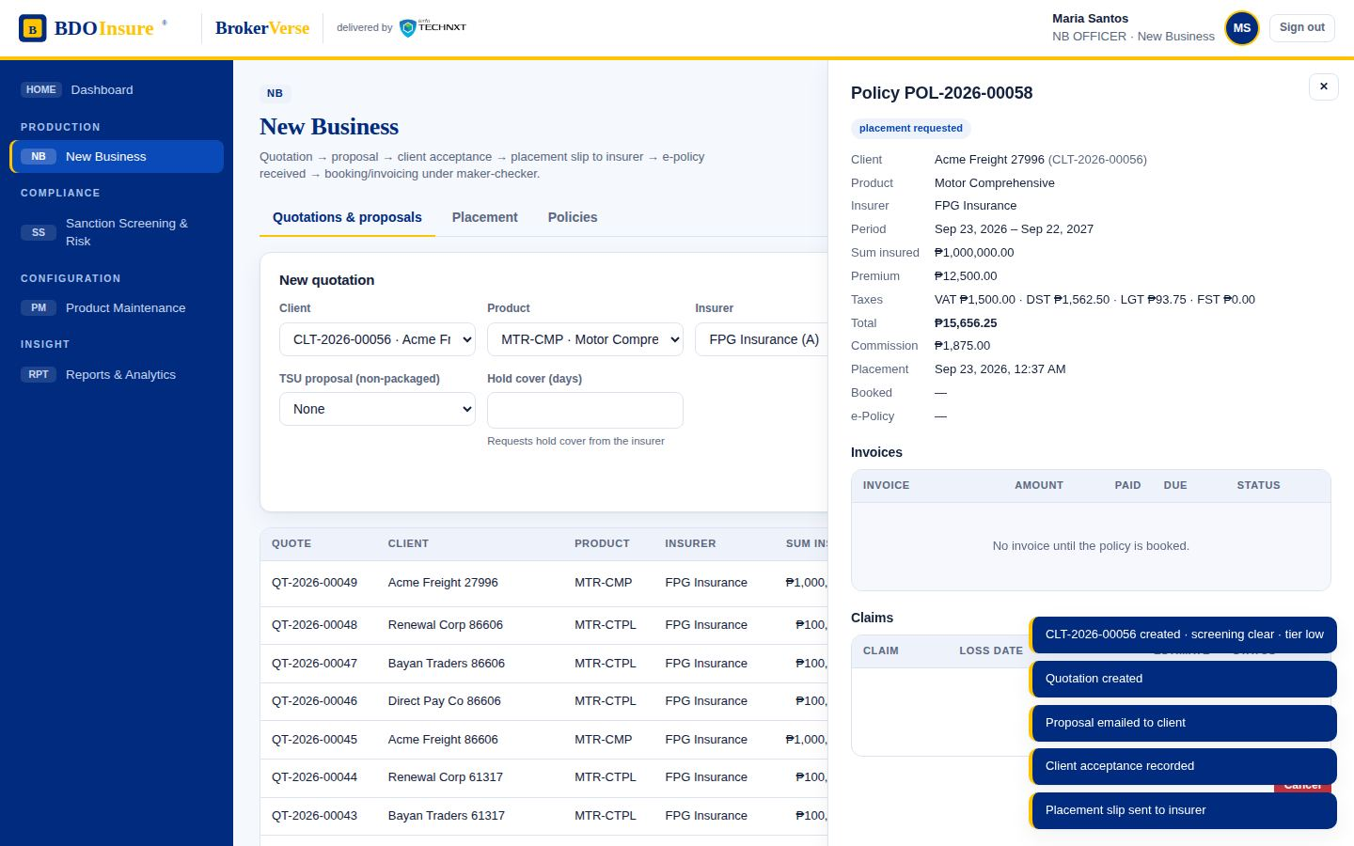
New Business · step 7 of 14
02.07
Placement requested: placement slip goes to the insurer via SFTP or email
Screen
New Business
Policy drawer (placement requested)
Menu path: New Business › Policy drawer (placement requested)
BrokerVerse · BDO Insure · delivered by iorta TechNXT
18
Notes:
New Business step 7: Placement requested: placement slip goes to the insurer via SFTP or email. Screen: New Business › Policy drawer (placement requested).

Slide 19
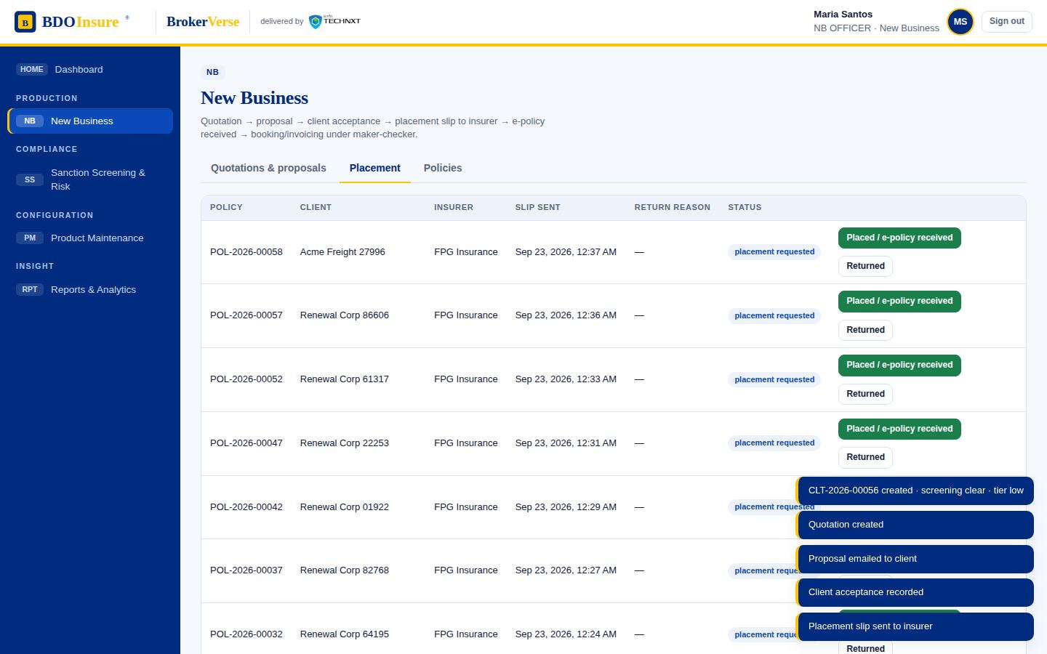
New Business · step 8 of 14
02.08
Placement board tracks slips awaiting the insurer, returns and e-policies
Screen
New Business
Placement
Menu path: New Business › Placement
BrokerVerse · BDO Insure · delivered by iorta TechNXT
19
Notes:
New Business step 8: Placement board tracks slips awaiting the insurer, returns and e-policies. Screen: New Business › Placement.

Slide 20
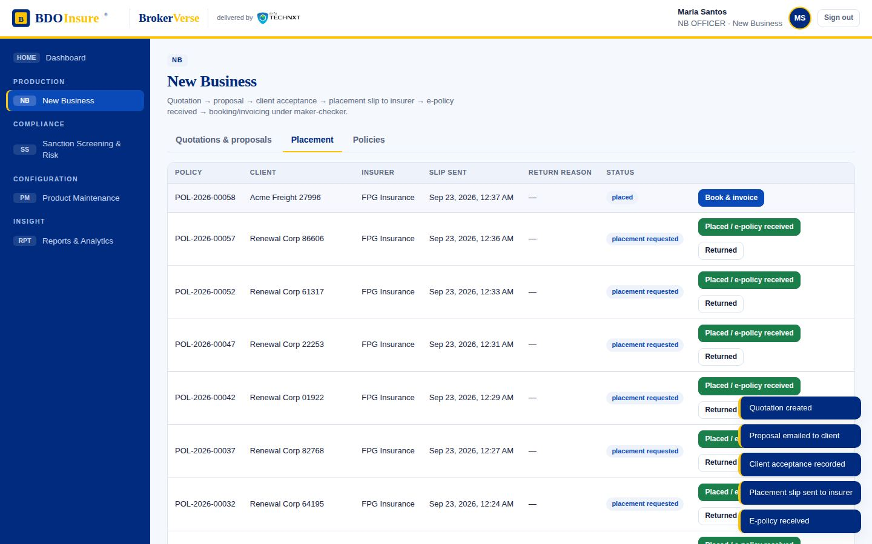
New Business · step 9 of 14
02.09
Insurer placed the risk; e-policy received (COG via SFTP or PO email)
Screen
New Business
Placement
Placed / e-policy received
Menu path: New Business › Placement › Placed / e-policy received
BrokerVerse · BDO Insure · delivered by iorta TechNXT
20
Notes:
New Business step 9: Insurer placed the risk; e-policy received (COG via SFTP or PO email). Screen: New Business › Placement › Placed / e-policy received.

Slide 21
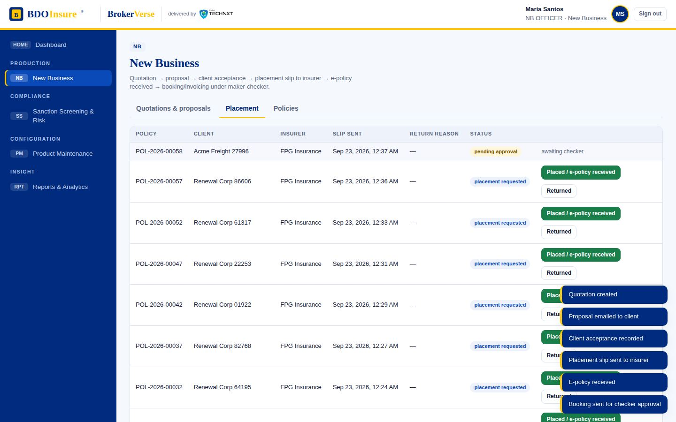
New Business · step 10 of 14
02.10
Booking and invoicing raised for checker approval (maker-checker)
Screen
New Business
Placement
Book & invoice
Menu path: New Business › Placement › Book & invoice
BrokerVerse · BDO Insure · delivered by iorta TechNXT
21
Notes:
New Business step 10: Booking and invoicing raised for checker approval (maker-checker). Screen: New Business › Placement › Book & invoice.

Slide 22
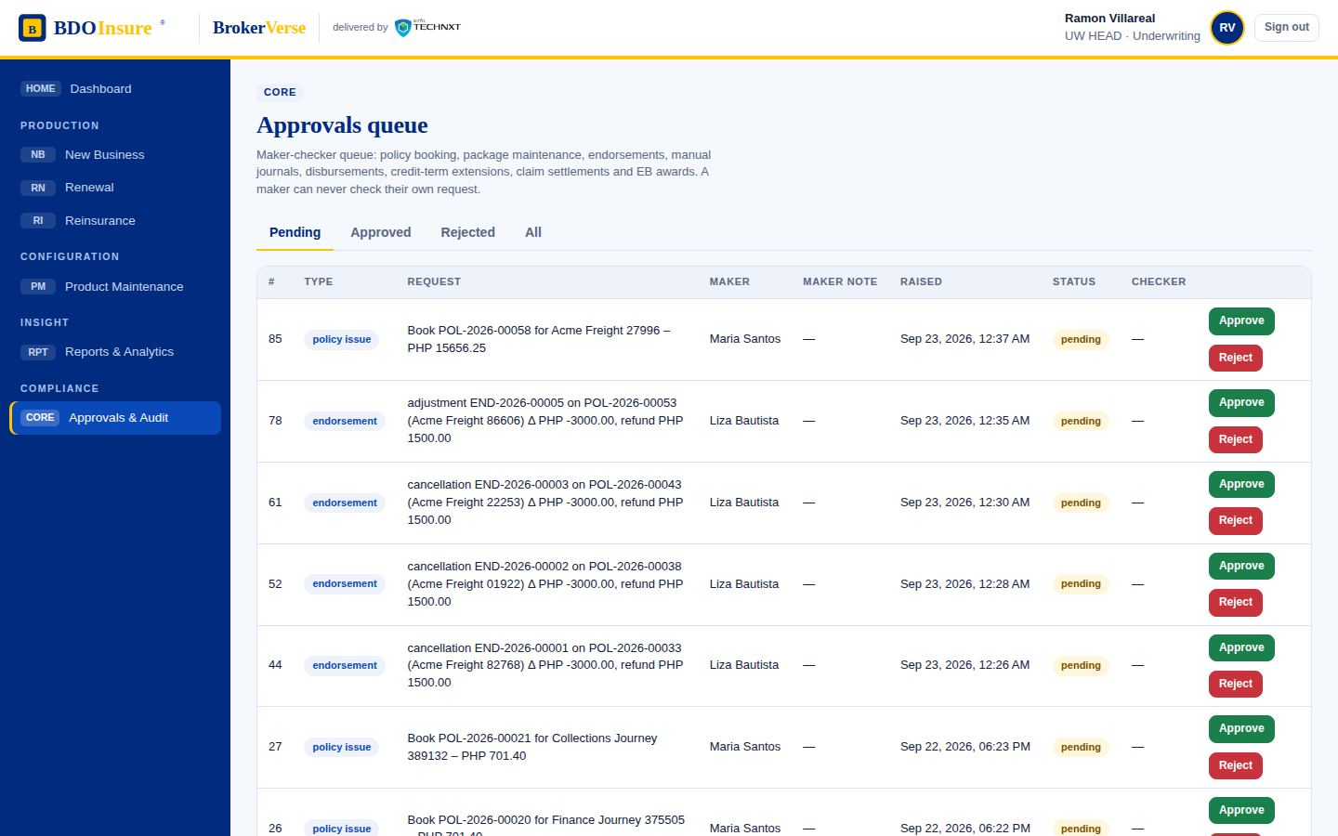
New Business · step 11 of 14
02.11
Underwriting Head (checker) reviews the booking request
Screen
Approvals & Audit
Pending
Menu path: Approvals & Audit › Pending
BrokerVerse · BDO Insure · delivered by iorta TechNXT
22
Notes:
New Business step 11: Underwriting Head (checker) reviews the booking request. Screen: Approvals & Audit › Pending.

Slide 23
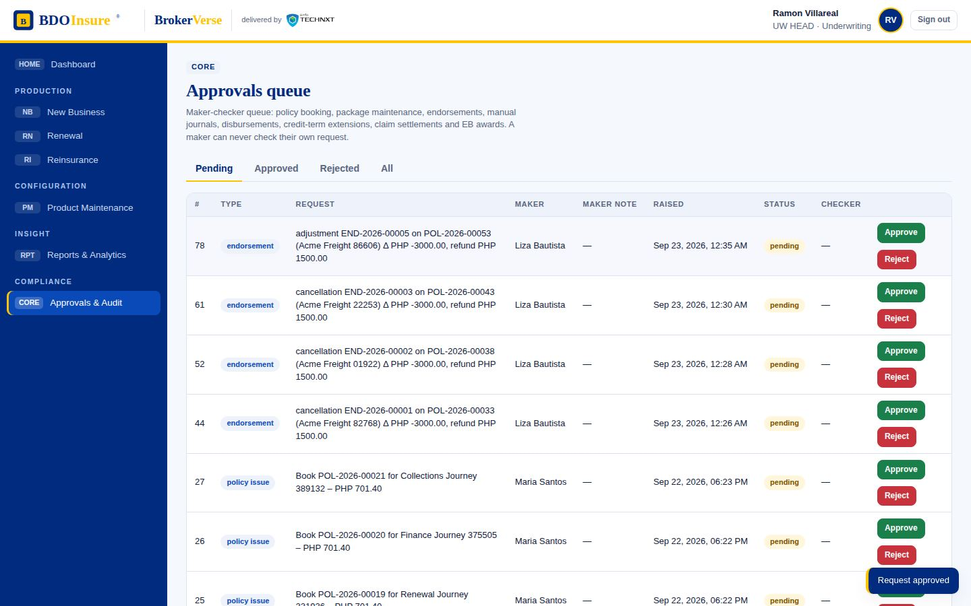
New Business · step 12 of 14
02.12
Booking approved: invoice, journal and e-policy dispatch are posted automatically
Screen
Approvals & Audit
Approve
Menu path: Approvals & Audit › Approve
BrokerVerse · BDO Insure · delivered by iorta TechNXT
23
Notes:
New Business step 12: Booking approved: invoice, journal and e-policy dispatch are posted automatically. Screen: Approvals & Audit › Approve.

Slide 24
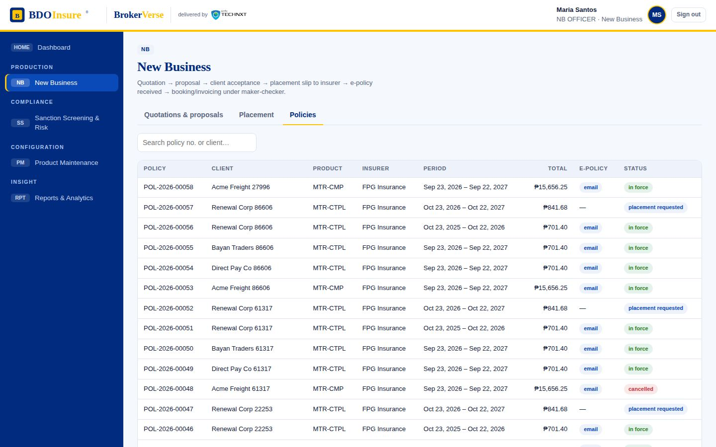
New Business · step 13 of 14
02.13
Policy register: the policy is in force with its invoice and e-policy channel
Screen
New Business
Policies
Menu path: New Business › Policies
BrokerVerse · BDO Insure · delivered by iorta TechNXT
24
Notes:
New Business step 13: Policy register: the policy is in force with its invoice and e-policy channel. Screen: New Business › Policies.

Slide 25
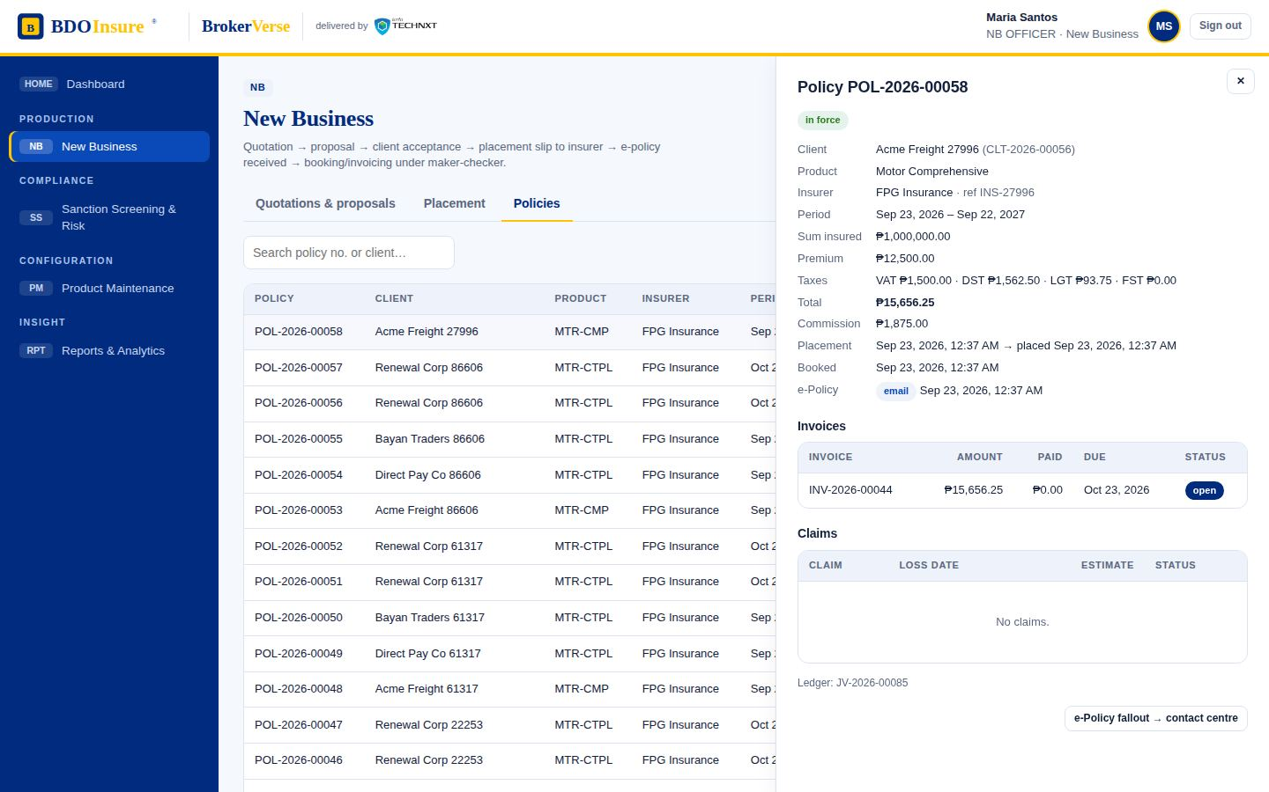
New Business · step 14 of 14
02.14
Policy detail: placement history, e-policy status and the exception route to the contact centre
Screen
New Business
Policies
Policy detail
Menu path: New Business › Policies › Policy detail
BrokerVerse · BDO Insure · delivered by iorta TechNXT
25
Notes:
New Business step 14: Policy detail: placement history, e-policy status and the exception route to the contact centre. Screen: New Business › Policies › Policy detail.

Slide 26
Operations
03
Steps in this flow
03.01 Cashiering: open invoices (premium receivables) awaiting payment
03.02 Receive payment: channel (bills payment, OTC cash/cheque, batch files, autopay) and reference
03.03 Cheque payment recorded and held for the 4-day clearing period
03.04 PDC register: held cheques, matured, bounced (exclusion list) and unapplied premium
03.05 Held cheque shows Matured / Bounced actions once the 4-day hold lapses
03.06 Cash / bills payment applied in full: official receipt issued and receivable cleared
03.07 Payment with zero PR / payment greater than PR is recorded without an invoice
03.08 The amount sits in Unapplied Premium (GL 2400) until applied to an invoice
03.09 Direct payment to insurer identified for a booked policy
03.10 Commission receivable (GL 1250) billed to the insurer; follow-up until collected
03.11 Commission collected: commission official receipt issued
03.12 Adjustment / cancellation validated by the Adjustment Team and routed to the checker-poster
03.13 Endorsement pending checker approval; a refund creates a Refund Request Form (RRF) on approval
03.14 Production reconciliation: insurer production file matched against booked policies
03.15 Rows classified as matched, with discrepancies, or unbooked; each gets a disposition
03.16 Checker-poster reviews the endorsement
03.17 Endorsement posted: premium and commission reversed, RRF raised for the refund
Cashiering channels, post-dated cheque hold, unapplied premium, direct payments with commission receivables, adjustments and production reconciliation.
Source flow OPERATIONS PROCESS FLOW.pdf
Personas cashier → checker
Screens 17 steps captured
Notes:
Operations. Source: OPERATIONS PROCESS FLOW.pdf. Cashiering channels, post-dated cheque hold, unapplied premium, direct payments with commission receivables, adjustments and production reconciliation.

Slide 27
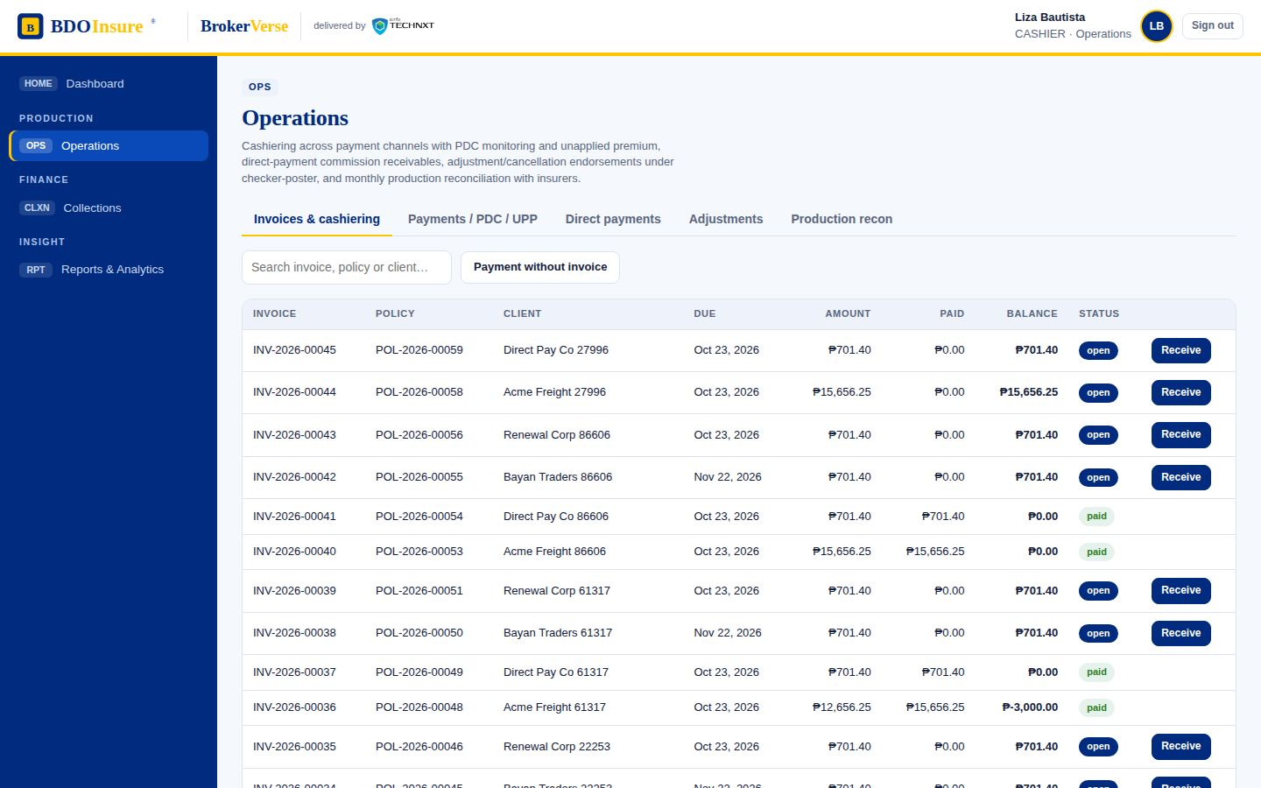
Operations · step 1 of 17
03.01
Cashiering: open invoices (premium receivables) awaiting payment
Screen
Operations
Invoices & cashiering
Menu path: Operations › Invoices & cashiering
BrokerVerse · BDO Insure · delivered by iorta TechNXT
27
Notes:
Operations step 1: Cashiering: open invoices (premium receivables) awaiting payment. Screen: Operations › Invoices & cashiering.

Slide 28
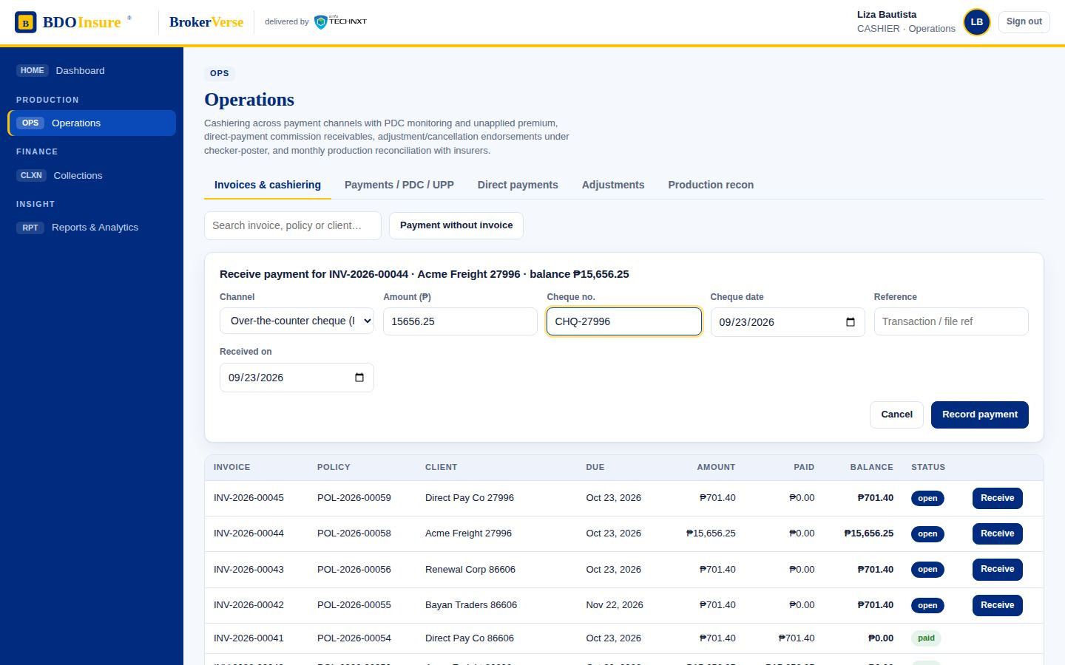
Operations · step 2 of 17
03.02
Receive payment: channel (bills payment, OTC cash/cheque, batch files, autopay) and reference
Screen
Operations
Invoices & cashiering
Receive
Menu path: Operations › Invoices & cashiering › Receive
BrokerVerse · BDO Insure · delivered by iorta TechNXT
28
Notes:
Operations step 2: Receive payment: channel (bills payment, OTC cash/cheque, batch files, autopay) and reference. Screen: Operations › Invoices & cashiering › Receive.

Slide 29
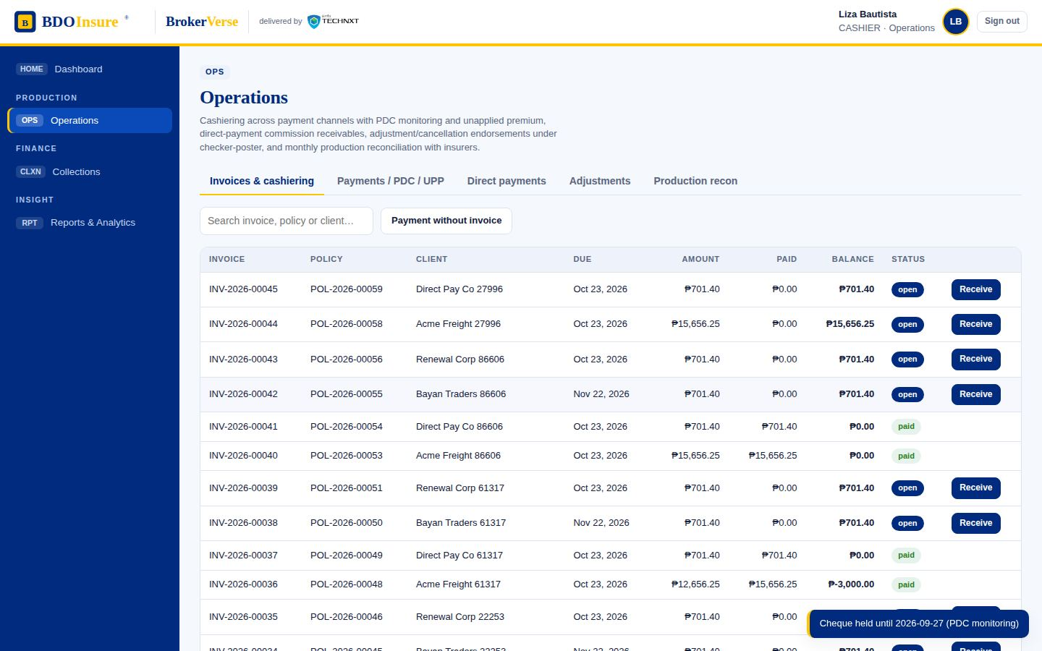
Operations · step 3 of 17
03.03
Cheque payment recorded and held for the 4-day clearing period
Screen
Operations
Receive
Record payment
Menu path: Operations › Receive › Record payment
BrokerVerse · BDO Insure · delivered by iorta TechNXT
29
Notes:
Operations step 3: Cheque payment recorded and held for the 4-day clearing period. Screen: Operations › Receive › Record payment.

Slide 30
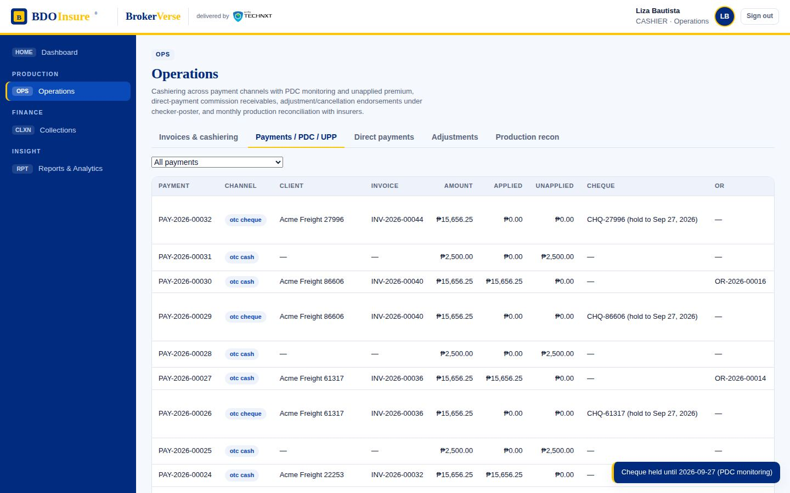
Operations · step 4 of 17
03.04
PDC register: held cheques, matured, bounced (exclusion list) and unapplied premium
Screen
Operations
Payments / PDC / UPP
Menu path: Operations › Payments / PDC / UPP
BrokerVerse · BDO Insure · delivered by iorta TechNXT
30
Notes:
Operations step 4: PDC register: held cheques, matured, bounced (exclusion list) and unapplied premium. Screen: Operations › Payments / PDC / UPP.

Slide 31
Operations · step 5 of 17
03.05
Held cheque shows Matured / Bounced actions once the 4-day hold lapses
Screen
Operations
Payments / PDC / UPP
Held cheque
Menu path: Operations › Payments / PDC / UPP › Held cheque
BrokerVerse · BDO Insure · delivered by iorta TechNXT
31
Notes:
Operations step 5: Held cheque shows Matured / Bounced actions once the 4-day hold lapses. Screen: Operations › Payments / PDC / UPP › Held cheque.

Slide 32
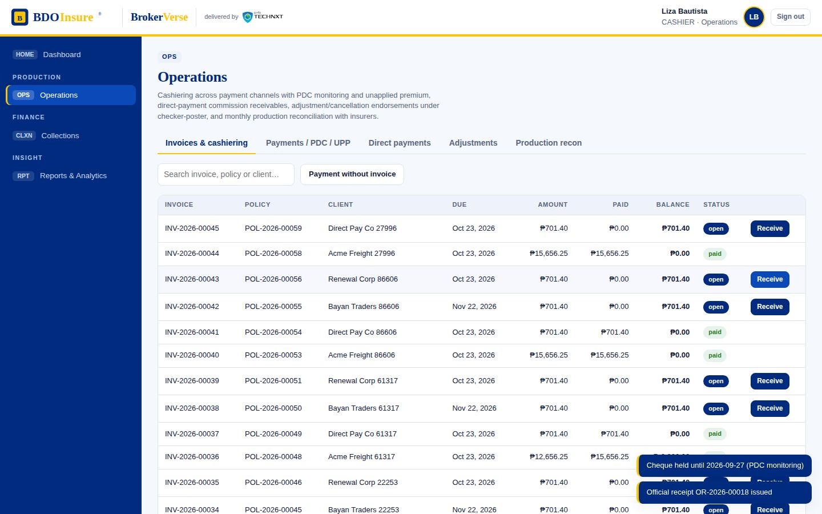
Operations · step 6 of 17
03.06
Cash / bills payment applied in full: official receipt issued and receivable cleared
Screen
Operations
Receive
Official receipt
Menu path: Operations › Receive › Official receipt
BrokerVerse · BDO Insure · delivered by iorta TechNXT
32
Notes:
Operations step 6: Cash / bills payment applied in full: official receipt issued and receivable cleared. Screen: Operations › Receive › Official receipt.

Slide 33
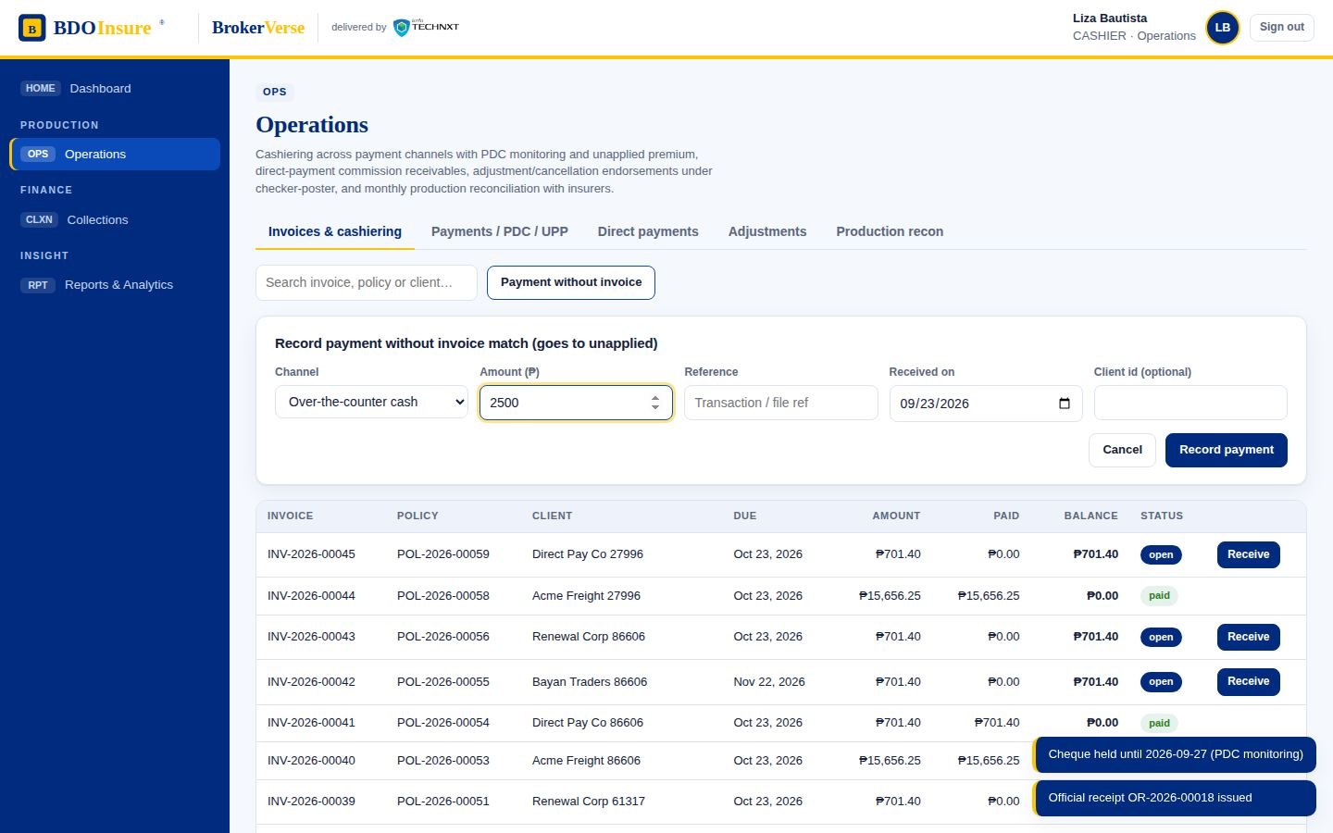
Operations · step 7 of 17
03.07
Payment with zero PR / payment greater than PR is recorded without an invoice
Screen
Operations
Invoices & cashiering
Payment without invoice
Menu path: Operations › Invoices & cashiering › Payment without invoice
BrokerVerse · BDO Insure · delivered by iorta TechNXT
33
Notes:
Operations step 7: Payment with zero PR / payment greater than PR is recorded without an invoice. Screen: Operations › Invoices & cashiering › Payment without invoice.

Slide 34
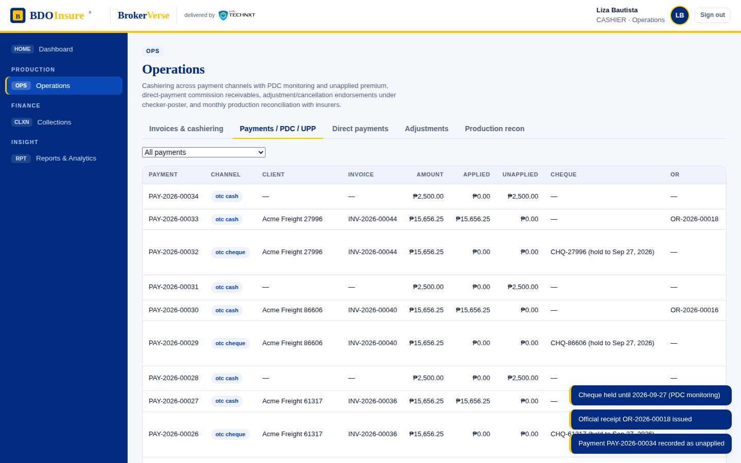
Operations · step 8 of 17
03.08
The amount sits in Unapplied Premium (GL 2400) until applied to an invoice
Screen
Operations
Payments / PDC / UPP
Menu path: Operations › Payments / PDC / UPP
BrokerVerse · BDO Insure · delivered by iorta TechNXT
34
Notes:
Operations step 8: The amount sits in Unapplied Premium (GL 2400) until applied to an invoice. Screen: Operations › Payments / PDC / UPP.

Slide 35
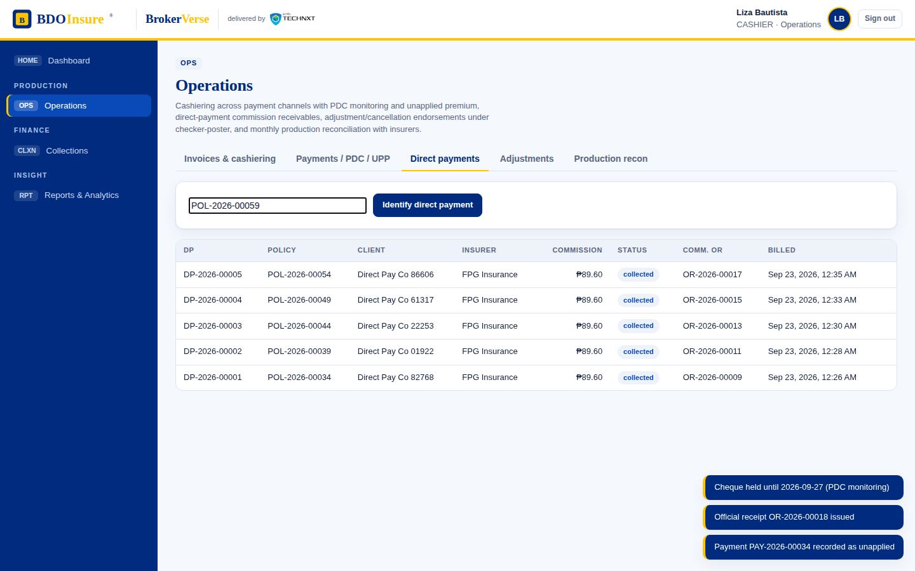
Operations · step 9 of 17
03.09
Direct payment to insurer identified for a booked policy
Screen
Operations
Direct payments
Identify
Menu path: Operations › Direct payments › Identify
BrokerVerse · BDO Insure · delivered by iorta TechNXT
35
Notes:
Operations step 9: Direct payment to insurer identified for a booked policy. Screen: Operations › Direct payments › Identify.

Slide 36
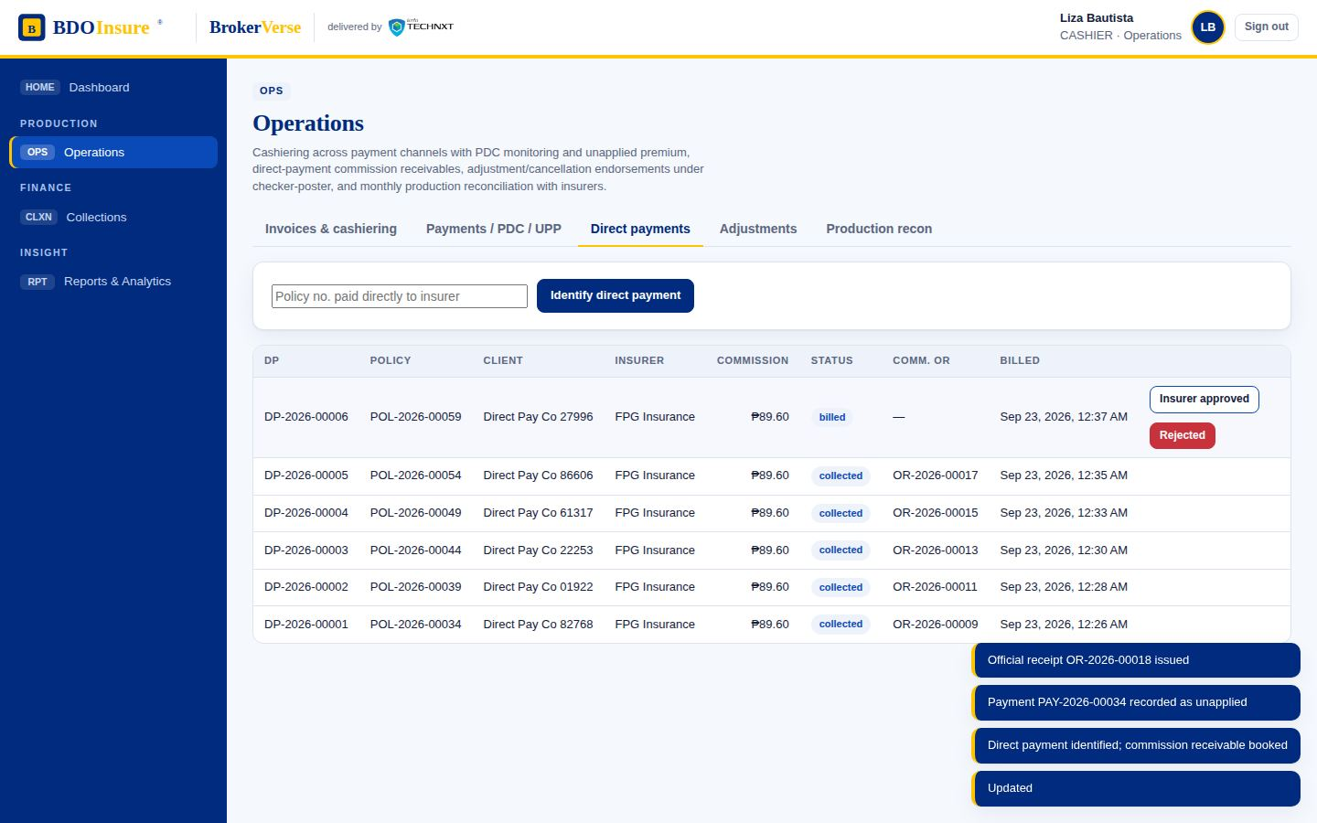
Operations · step 10 of 17
03.10
Commission receivable (GL 1250) billed to the insurer; follow-up until collected
Screen
Operations
Direct payments
Bill insurer
Menu path: Operations › Direct payments › Bill insurer
BrokerVerse · BDO Insure · delivered by iorta TechNXT
36
Notes:
Operations step 10: Commission receivable (GL 1250) billed to the insurer; follow-up until collected. Screen: Operations › Direct payments › Bill insurer.

Slide 37
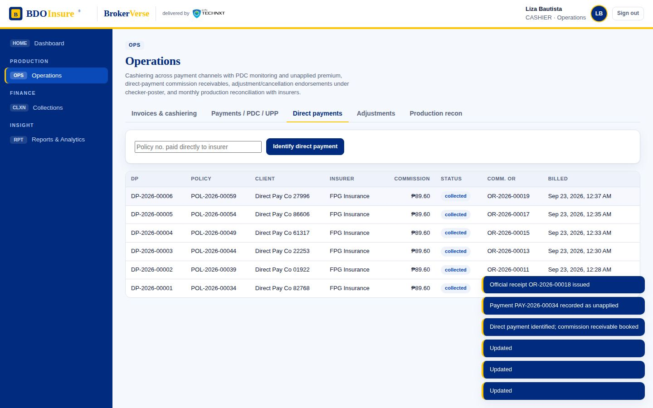
Operations · step 11 of 17
03.11
Commission collected: commission official receipt issued
Screen
Operations
Direct payments
Collect (commission OR)
Menu path: Operations › Direct payments › Collect (commission OR)
BrokerVerse · BDO Insure · delivered by iorta TechNXT
37
Notes:
Operations step 11: Commission collected: commission official receipt issued. Screen: Operations › Direct payments › Collect (commission OR).

Slide 38
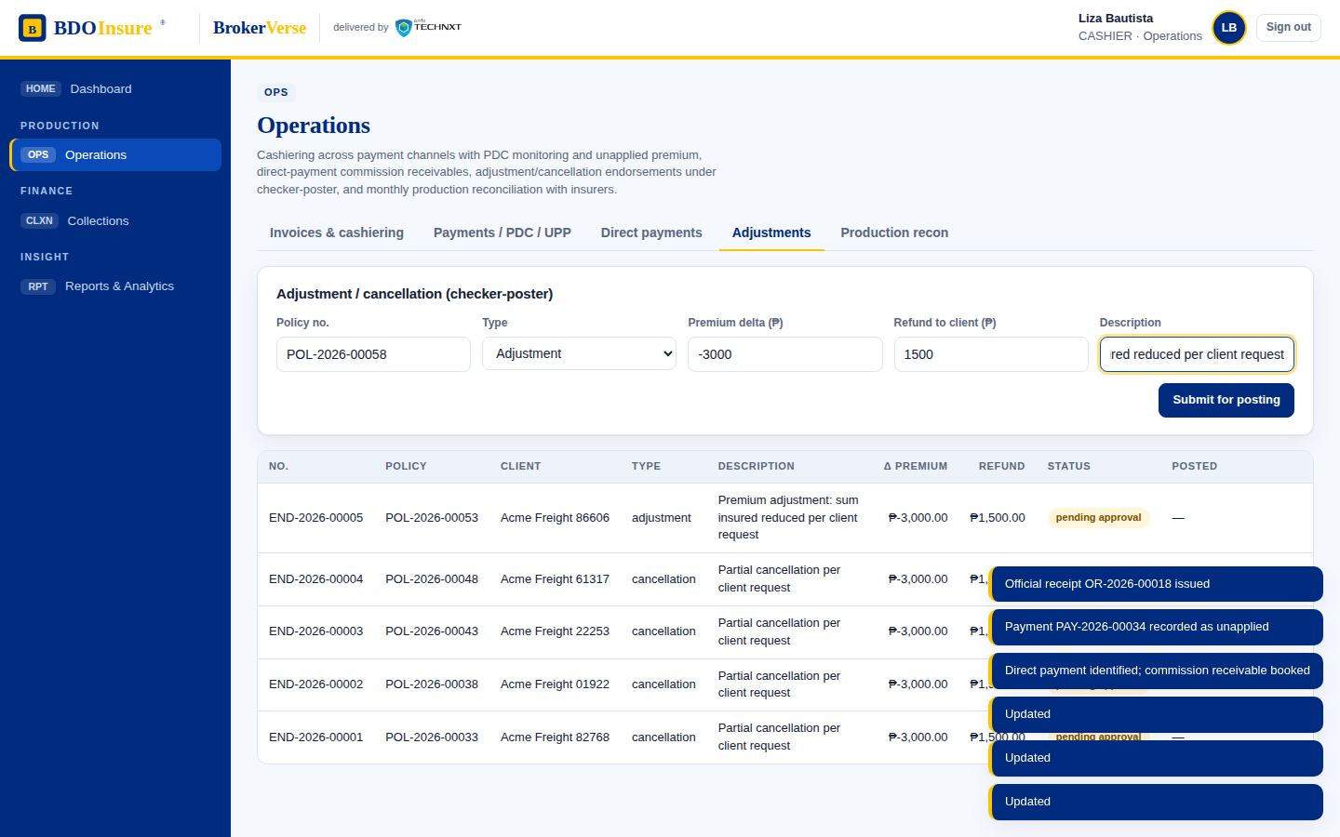
Operations · step 12 of 17
03.12
Adjustment / cancellation validated by the Adjustment Team and routed to the checker-poster
Screen
Operations
Adjustments
Endorsement form
Menu path: Operations › Adjustments › Endorsement form
BrokerVerse · BDO Insure · delivered by iorta TechNXT
38
Notes:
Operations step 12: Adjustment / cancellation validated by the Adjustment Team and routed to the checker-poster. Screen: Operations › Adjustments › Endorsement form.

Slide 39

Operations · step 13 of 17
03.13
Endorsement pending checker approval; a refund creates a Refund Request Form (RRF) on approval
Screen
Operations
Adjustments
Menu path: Operations › Adjustments
BrokerVerse · BDO Insure · delivered by iorta TechNXT
39
Notes:
Operations step 13: Endorsement pending checker approval; a refund creates a Refund Request Form (RRF) on approval. Screen: Operations › Adjustments.

Slide 40
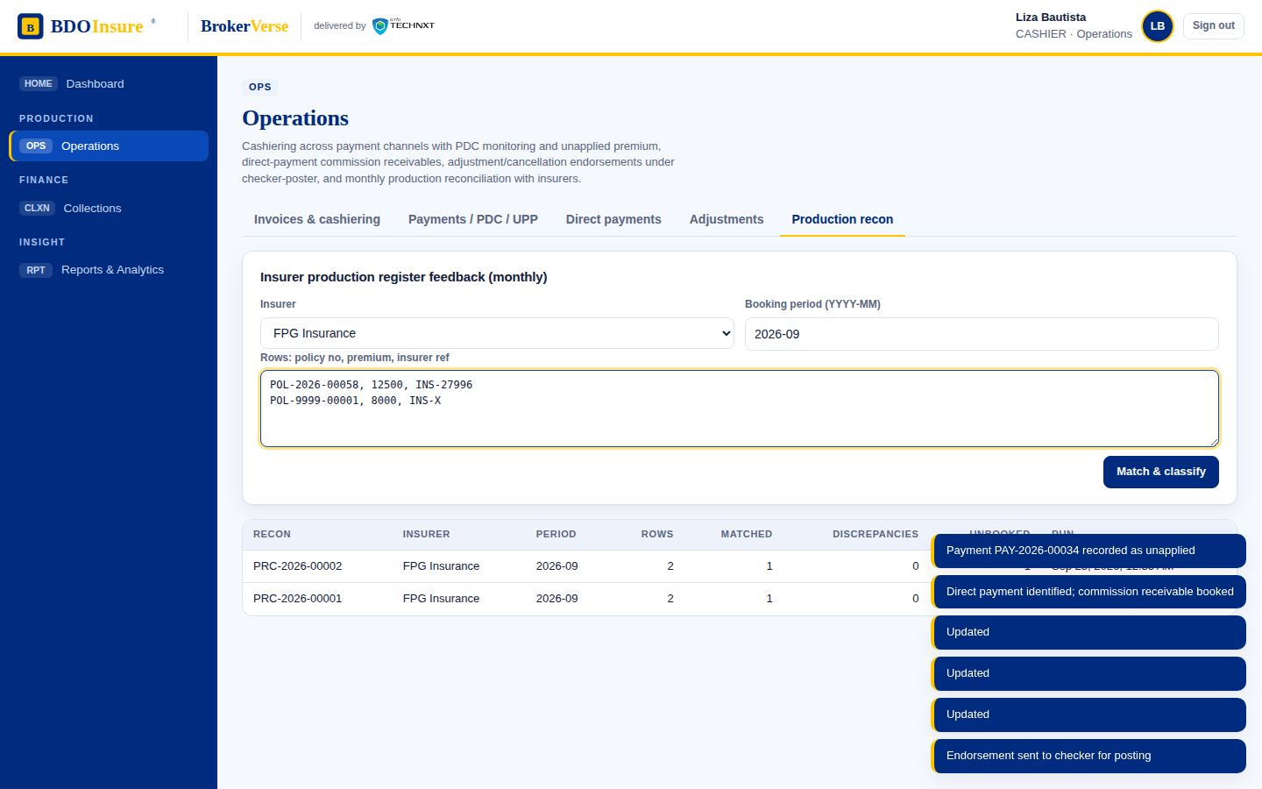
Operations · step 14 of 17
03.14
Production reconciliation: insurer production file matched against booked policies
Screen
Operations
Production recon
Upload
Menu path: Operations › Production recon › Upload
BrokerVerse · BDO Insure · delivered by iorta TechNXT
40
Notes:
Operations step 14: Production reconciliation: insurer production file matched against booked policies. Screen: Operations › Production recon › Upload.

Slide 41
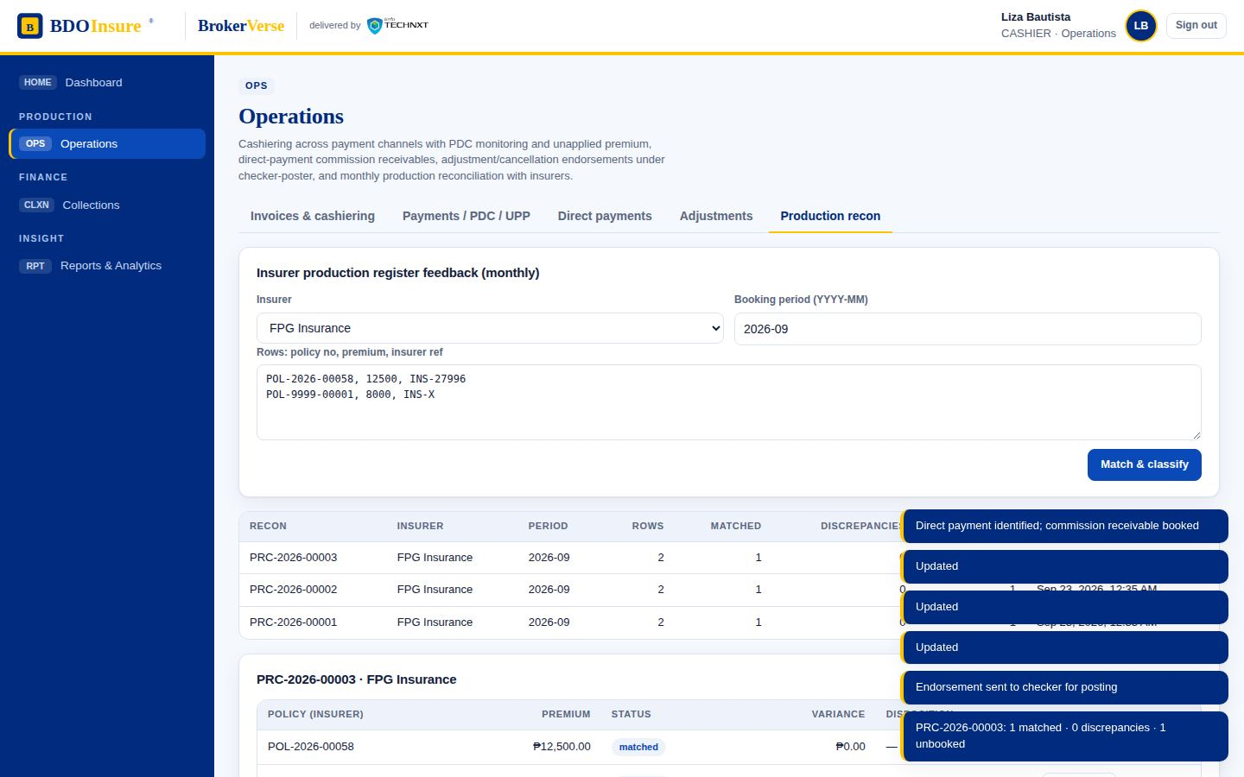
Operations · step 15 of 17
03.15
Rows classified as matched, with discrepancies, or unbooked; each gets a disposition
Screen
Operations
Production recon
Result
Menu path: Operations › Production recon › Result
BrokerVerse · BDO Insure · delivered by iorta TechNXT
41
Notes:
Operations step 15: Rows classified as matched, with discrepancies, or unbooked; each gets a disposition. Screen: Operations › Production recon › Result.

Slide 42
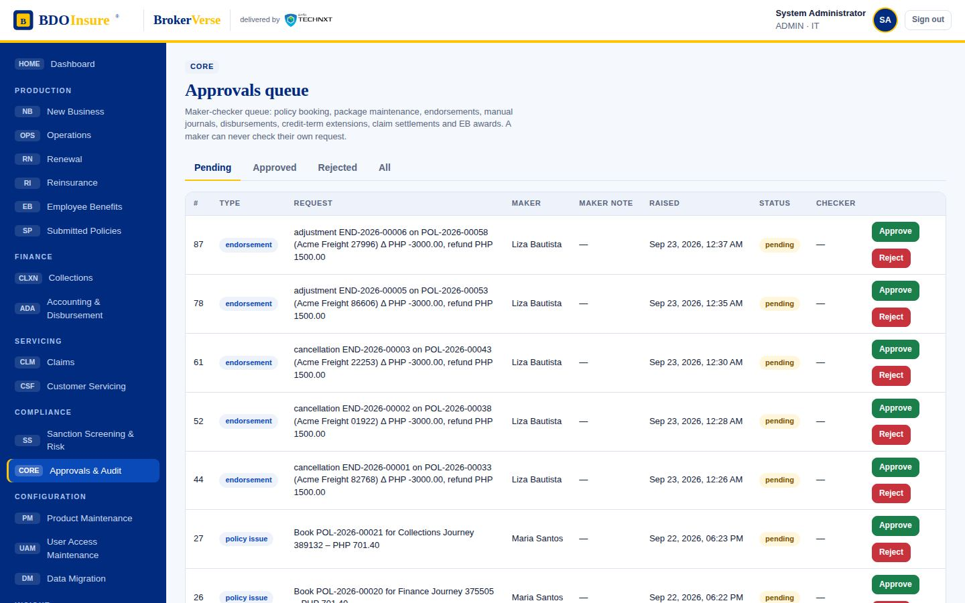
Operations · step 16 of 17
03.16
Checker-poster reviews the endorsement
Screen
Approvals & Audit
Pending
Menu path: Approvals & Audit › Pending
BrokerVerse · BDO Insure · delivered by iorta TechNXT
42
Notes:
Operations step 16: Checker-poster reviews the endorsement. Screen: Approvals & Audit › Pending.

Slide 43
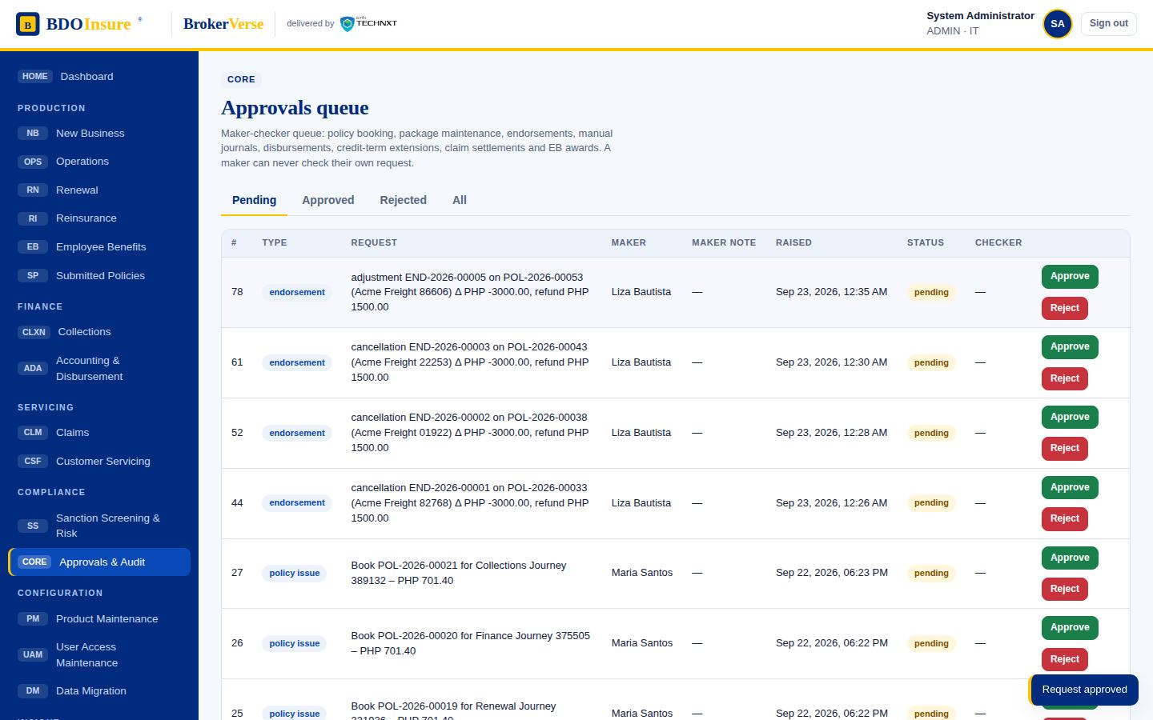
Operations · step 17 of 17
03.17
Endorsement posted: premium and commission reversed, RRF raised for the refund
Screen
Approvals & Audit
Approve
Menu path: Approvals & Audit › Approve
BrokerVerse · BDO Insure · delivered by iorta TechNXT
43
Notes:
Operations step 17: Endorsement posted: premium and commission reversed, RRF raised for the refund. Screen: Approvals & Audit › Approve.

Slide 44
Marketing Collections
04
Steps in this flow
04.01 PR list: newly booked accounts to collect within 10–15 days; ageing and collection stage per invoice
04.02 Statement of account sent to the client
04.03 Marketing diary: when / where / how / what of each collection effort, commitment date and arrangement
04.04 Commitment beyond the 60-day credit term: MAO informed, tagged as committed
04.05 Credit-term extension (CTE) requested for Unit Head approval
04.06 Effort diary per invoice with category tagging
04.07 Unit / Finance Head reviews the CTE request
04.08 CTE approved: due date extended and account stays within term
Premium receivable list by stage, marketing diary, credit-term extension under approval and statement of account.
Source flow MARKETING COLLECTIONS - Process Flow.pdf
Personas collections → fin.head
Screens 8 steps captured
Notes:
Marketing Collections. Source: MARKETING COLLECTIONS - Process Flow.pdf. Premium receivable list by stage, marketing diary, credit-term extension under approval and statement of account.

Slide 45
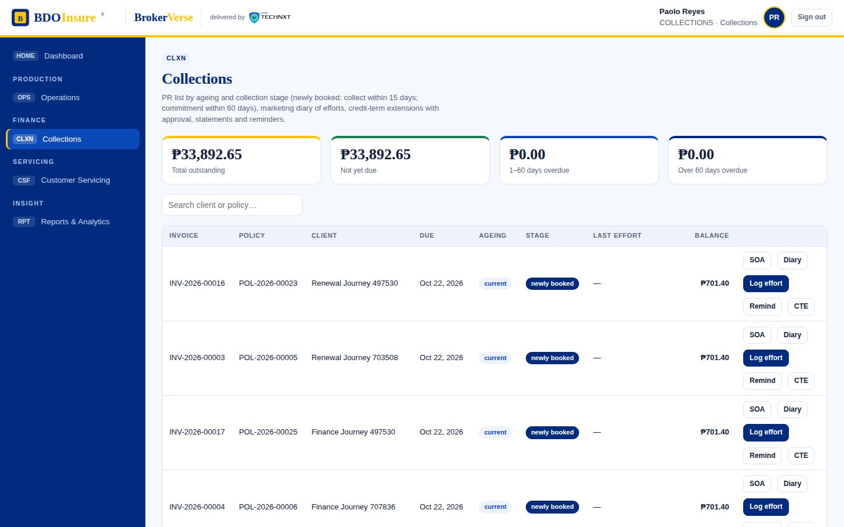
Marketing Collections · step 1 of 8
04.01
PR list: newly booked accounts to collect within 10–15 days; ageing and collection stage per invoice
Screen
Collections
Outstanding premium
Menu path: Collections › Outstanding premium
BrokerVerse · BDO Insure · delivered by iorta TechNXT
45
Notes:
Marketing Collections step 1: PR list: newly booked accounts to collect within 10–15 days; ageing and collection stage per invoice. Screen: Collections › Outstanding premium.

Slide 46
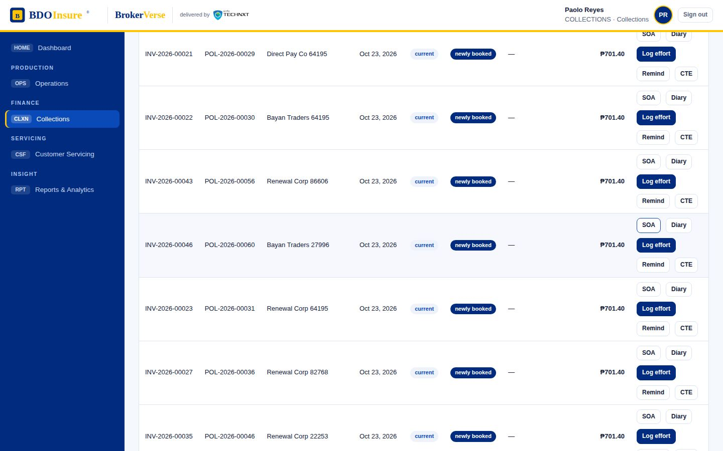
Marketing Collections · step 2 of 8
04.02
Statement of account sent to the client
Screen
Collections
SOA
Menu path: Collections › SOA
BrokerVerse · BDO Insure · delivered by iorta TechNXT
46
Notes:
Marketing Collections step 2: Statement of account sent to the client. Screen: Collections › SOA.

Slide 47
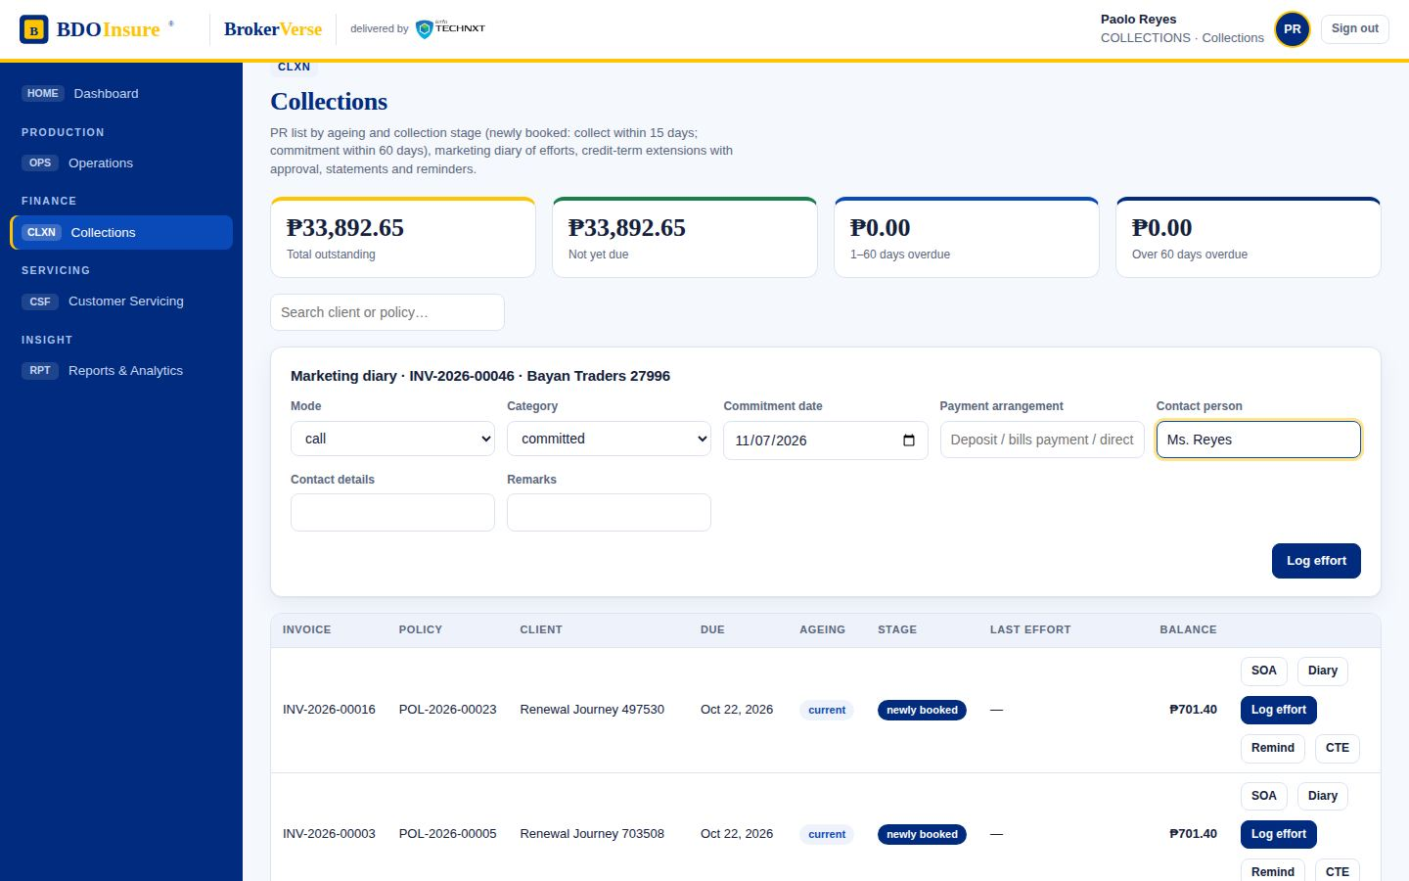
Marketing Collections · step 3 of 8
04.03
Marketing diary: when / where / how / what of each collection effort, commitment date and arrangement
Screen
Collections
Log effort
Menu path: Collections › Log effort
BrokerVerse · BDO Insure · delivered by iorta TechNXT
47
Notes:
Marketing Collections step 3: Marketing diary: when / where / how / what of each collection effort, commitment date and arrangement. Screen: Collections › Log effort.

Slide 48
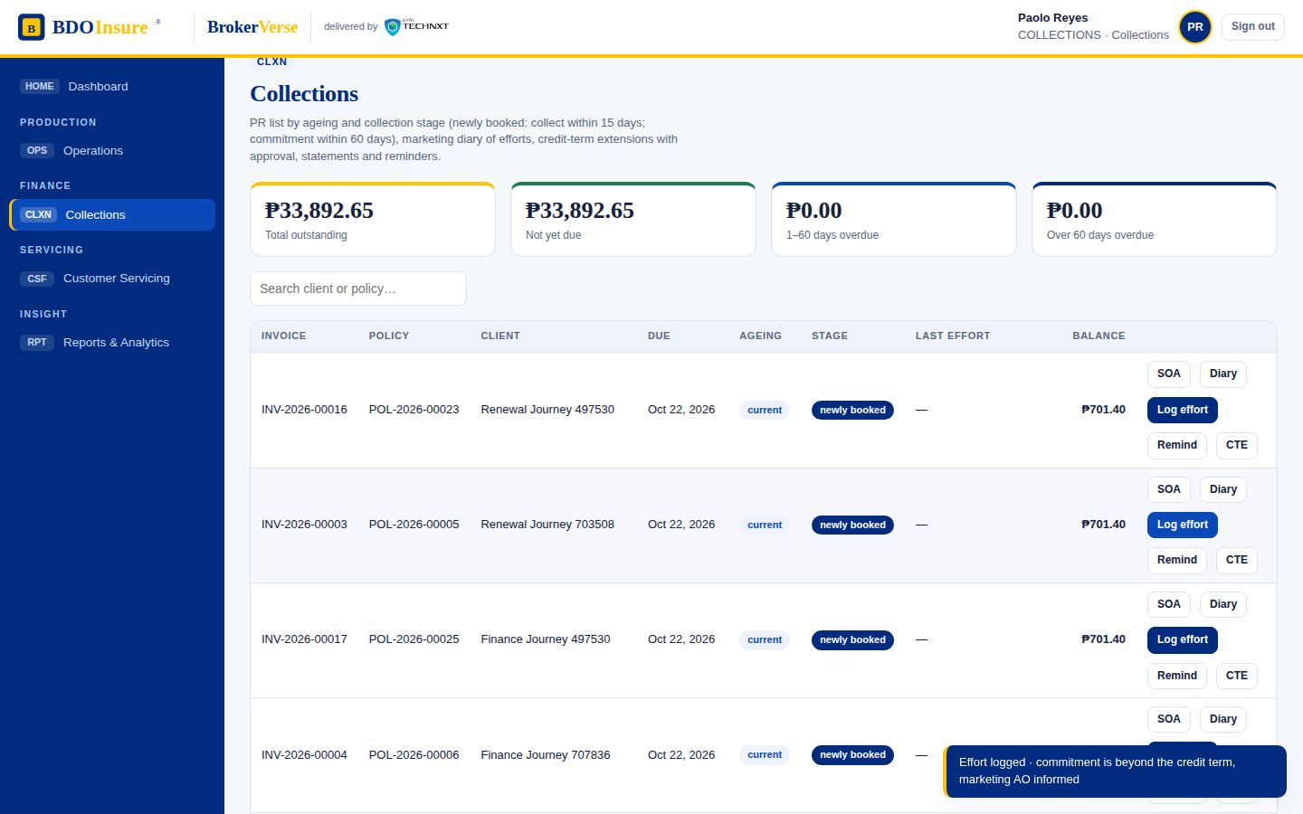
Marketing Collections · step 4 of 8
04.04
Commitment beyond the 60-day credit term: MAO informed, tagged as committed
Screen
Collections
Outstanding premium
Menu path: Collections › Outstanding premium
BrokerVerse · BDO Insure · delivered by iorta TechNXT
48
Notes:
Marketing Collections step 4: Commitment beyond the 60-day credit term: MAO informed, tagged as committed. Screen: Collections › Outstanding premium.

Slide 49
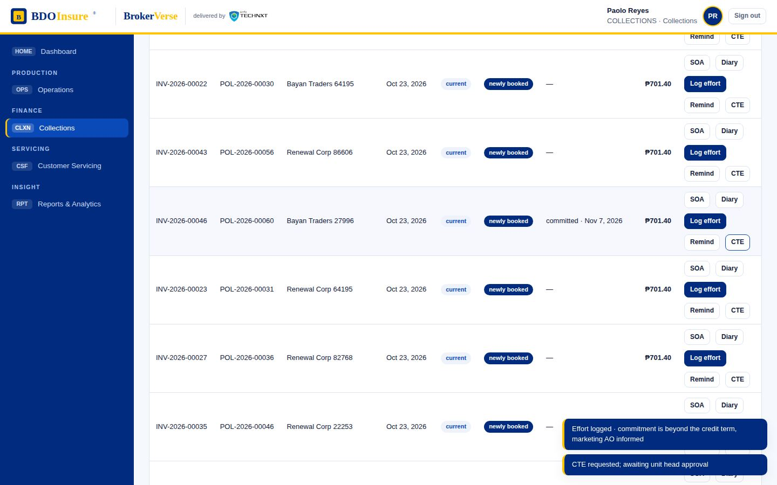
Marketing Collections · step 5 of 8
04.05
Credit-term extension (CTE) requested for Unit Head approval
Screen
Collections
CTE
Menu path: Collections › CTE
BrokerVerse · BDO Insure · delivered by iorta TechNXT
49
Notes:
Marketing Collections step 5: Credit-term extension (CTE) requested for Unit Head approval. Screen: Collections › CTE.

Slide 50
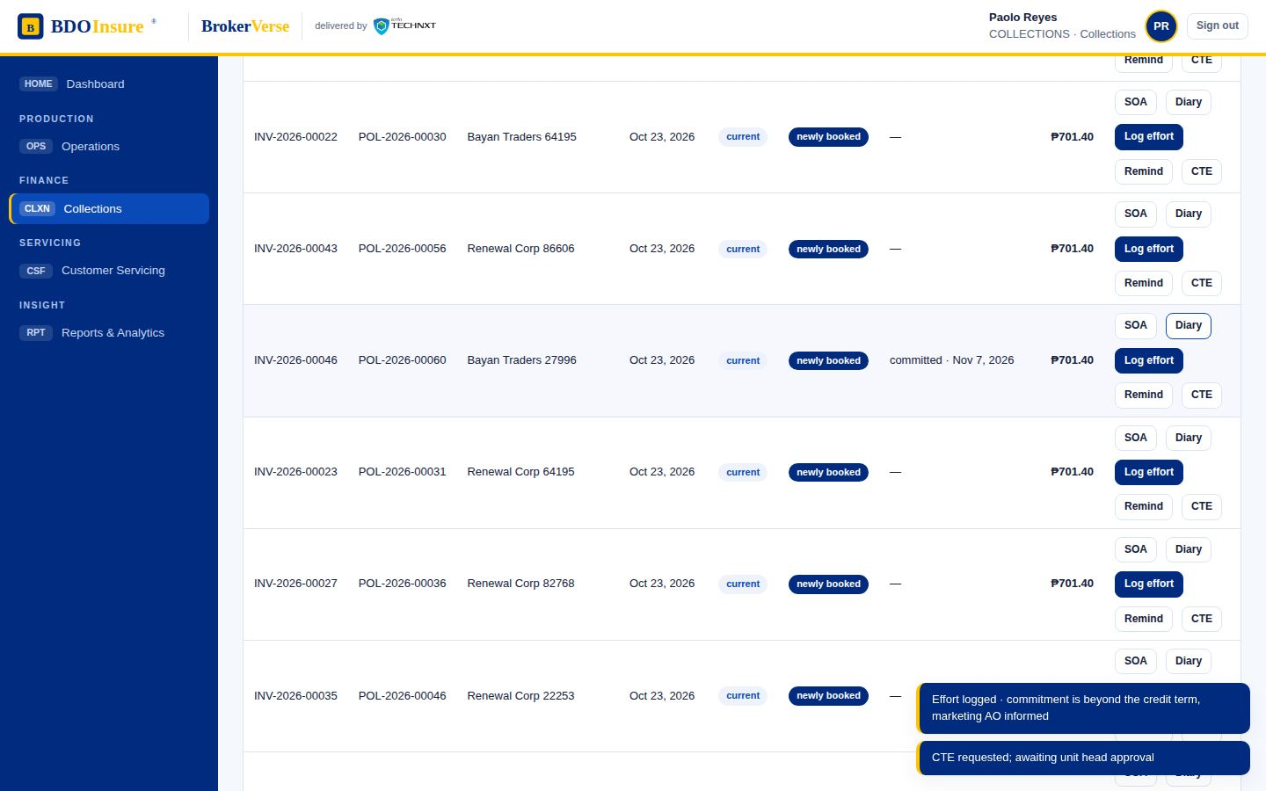
Marketing Collections · step 6 of 8
04.06
Effort diary per invoice with category tagging
Screen
Collections
Diary
Menu path: Collections › Diary
BrokerVerse · BDO Insure · delivered by iorta TechNXT
50
Notes:
Marketing Collections step 6: Effort diary per invoice with category tagging. Screen: Collections › Diary.

Slide 51
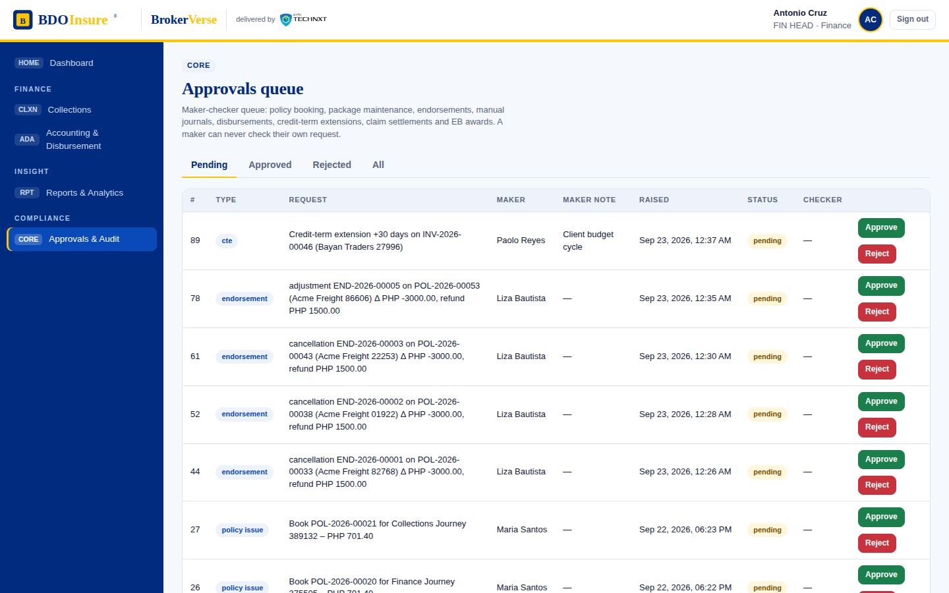
Marketing Collections · step 7 of 8
04.07
Unit / Finance Head reviews the CTE request
Screen
Approvals & Audit
Pending
Menu path: Approvals & Audit › Pending
BrokerVerse · BDO Insure · delivered by iorta TechNXT
51
Notes:
Marketing Collections step 7: Unit / Finance Head reviews the CTE request. Screen: Approvals & Audit › Pending.

Slide 52
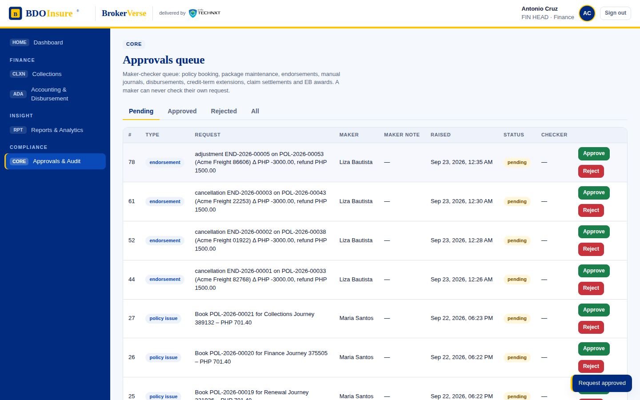
Marketing Collections · step 8 of 8
04.08
CTE approved: due date extended and account stays within term
Screen
Approvals & Audit
Approve
Menu path: Approvals & Audit › Approve
BrokerVerse · BDO Insure · delivered by iorta TechNXT
52
Notes:
Marketing Collections step 8: CTE approved: due date extended and account stays within term. Screen: Approvals & Audit › Approve.

Slide 53
FRBS Accounting
05
Steps in this flow
05.01 System-generated journals (booking, receipts, commissions) and manual entry form routed to the TL for posting
05.02 Trial balance and financial reports generated from the ledger
05.03 EOD / EOM / EOY: period close and reopen, fiscal-year close to retained earnings
Chart of accounts, system-generated journals, manual entries under review, trial balance, period and year-end closing.
Source flow FRBS - ACCOUNTING.pdf
Personas accountant → fin.head
Screens 3 steps captured
Notes:
FRBS Accounting. Source: FRBS - ACCOUNTING.pdf. Chart of accounts, system-generated journals, manual entries under review, trial balance, period and year-end closing.

Slide 54
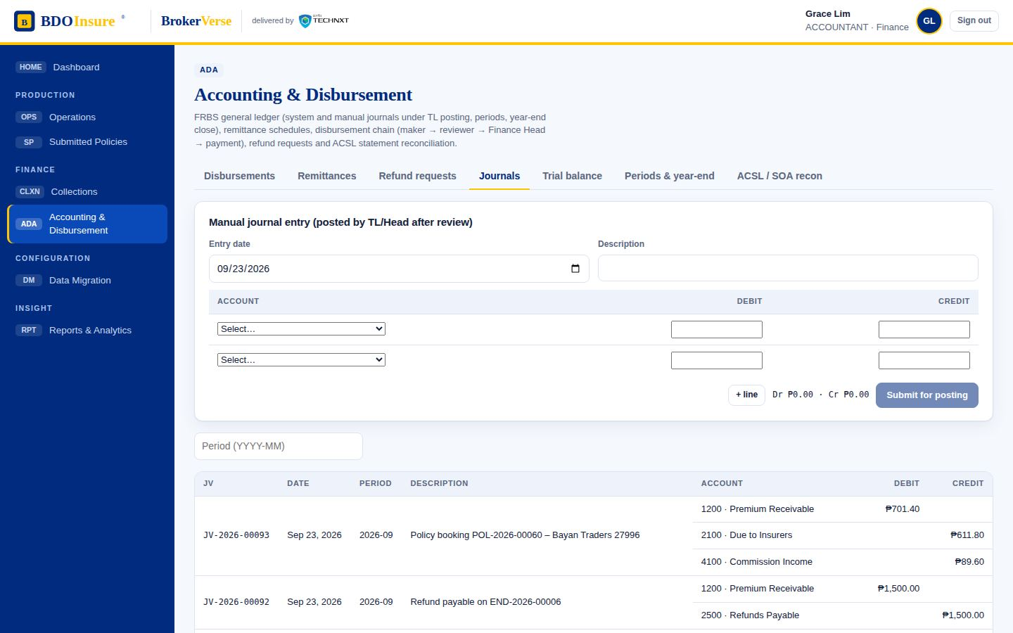
FRBS Accounting · step 1 of 3
05.01
System-generated journals (booking, receipts, commissions) and manual entry form routed to the TL for posting
Screen
Accounting & Disbursement
Journals
Menu path: Accounting & Disbursement › Journals
BrokerVerse · BDO Insure · delivered by iorta TechNXT
54
Notes:
FRBS Accounting step 1: System-generated journals (booking, receipts, commissions) and manual entry form routed to the TL for posting. Screen: Accounting & Disbursement › Journals.

Slide 55
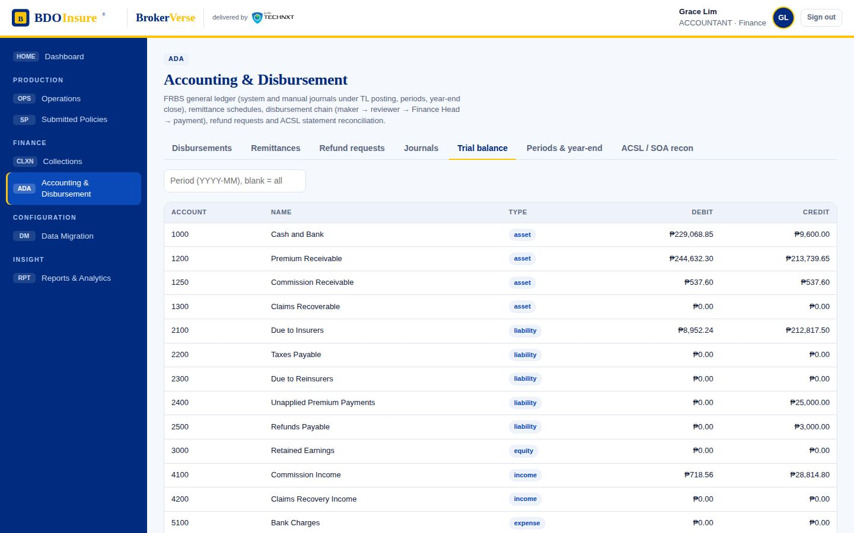
FRBS Accounting · step 2 of 3
05.02
Trial balance and financial reports generated from the ledger
Screen
Accounting & Disbursement
Trial balance
Menu path: Accounting & Disbursement › Trial balance
BrokerVerse · BDO Insure · delivered by iorta TechNXT
55
Notes:
FRBS Accounting step 2: Trial balance and financial reports generated from the ledger. Screen: Accounting & Disbursement › Trial balance.

Slide 56
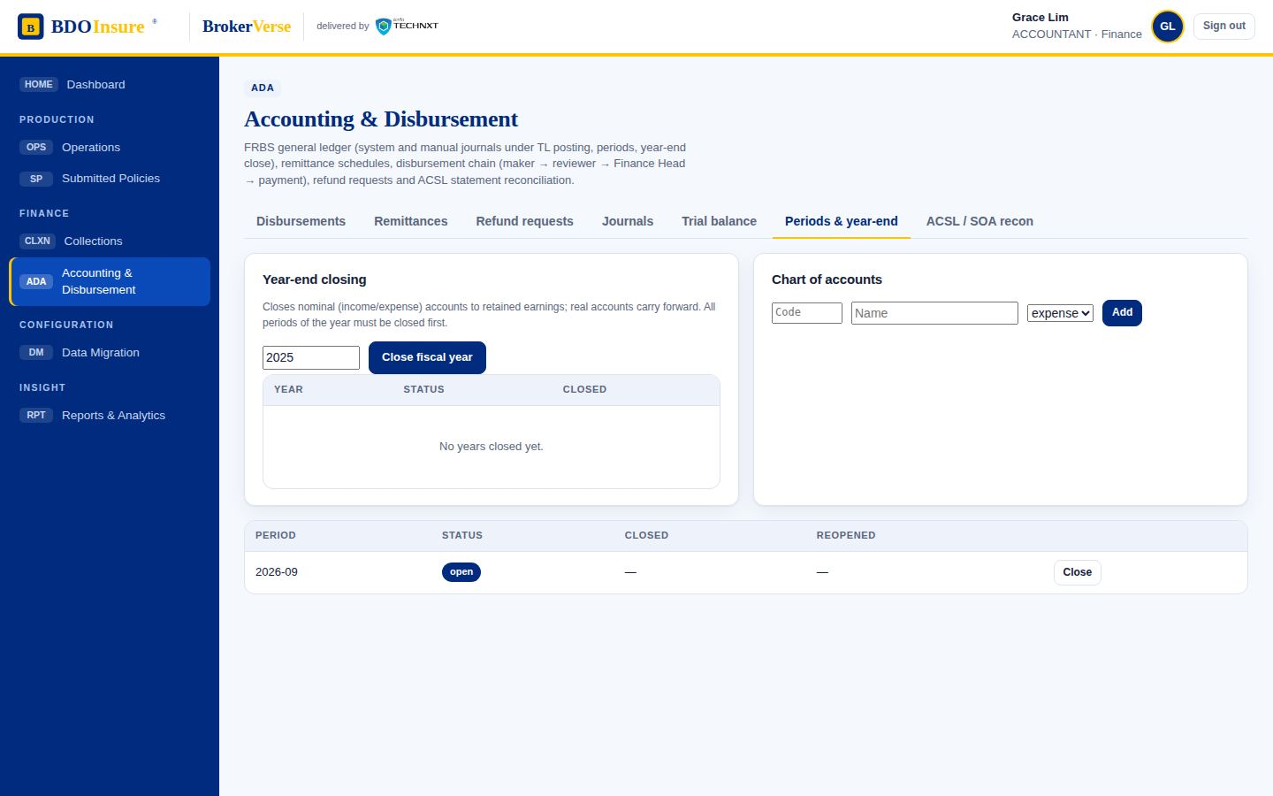
FRBS Accounting · step 3 of 3
05.03
EOD / EOM / EOY: period close and reopen, fiscal-year close to retained earnings
Screen
Accounting & Disbursement
Periods & year-end
Menu path: Accounting & Disbursement › Periods & year-end
BrokerVerse · BDO Insure · delivered by iorta TechNXT
56
Notes:
FRBS Accounting step 3: EOD / EOM / EOY: period close and reopen, fiscal-year close to retained earnings. Screen: Accounting & Disbursement › Periods & year-end.

Slide 57
Disbursement
06
Steps in this flow
06.01 Weekly remittance extract of applied payments per insurer, sanitised and submitted to Disbursement
06.02 Disbursement request (DPO) with payee, amount, mode and bank details
06.03 Request awaits a reviewer other than the maker (segregation of duties)
06.04 Team lead review (DTL) OK; routed to the Finance Head for approval
06.05 Finance Head (DSH / DUH) reviews the voucher
06.06 Approved; ready for payment
06.07 Payment posted with cheque reference; status tagged paid and confirmation email sent
Disbursement chain DPO → DTL → DSH → DUH with segregation of duties, payment posting and confirmation email; weekly remittance to insurers.
Source flow DISBURSEMENT.pdf
Personas accountant → admin (reviewer) → fin.head → accountant
Screens 7 steps captured
Notes:
Disbursement. Source: DISBURSEMENT.pdf. Disbursement chain DPO → DTL → DSH → DUH with segregation of duties, payment posting and confirmation email; weekly remittance to insurers.

Slide 58
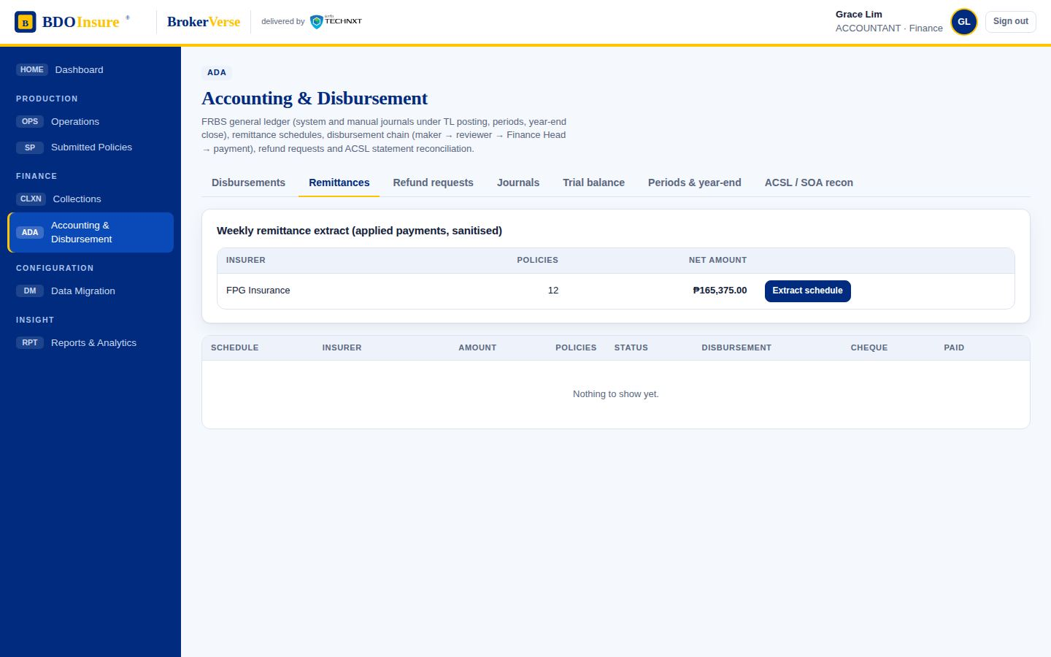
Disbursement · step 1 of 7
06.01
Weekly remittance extract of applied payments per insurer, sanitised and submitted to Disbursement
Screen
Accounting & Disbursement
Remittances
Menu path: Accounting & Disbursement › Remittances
BrokerVerse · BDO Insure · delivered by iorta TechNXT
58
Notes:
Disbursement step 1: Weekly remittance extract of applied payments per insurer, sanitised and submitted to Disbursement. Screen: Accounting & Disbursement › Remittances.

Slide 59
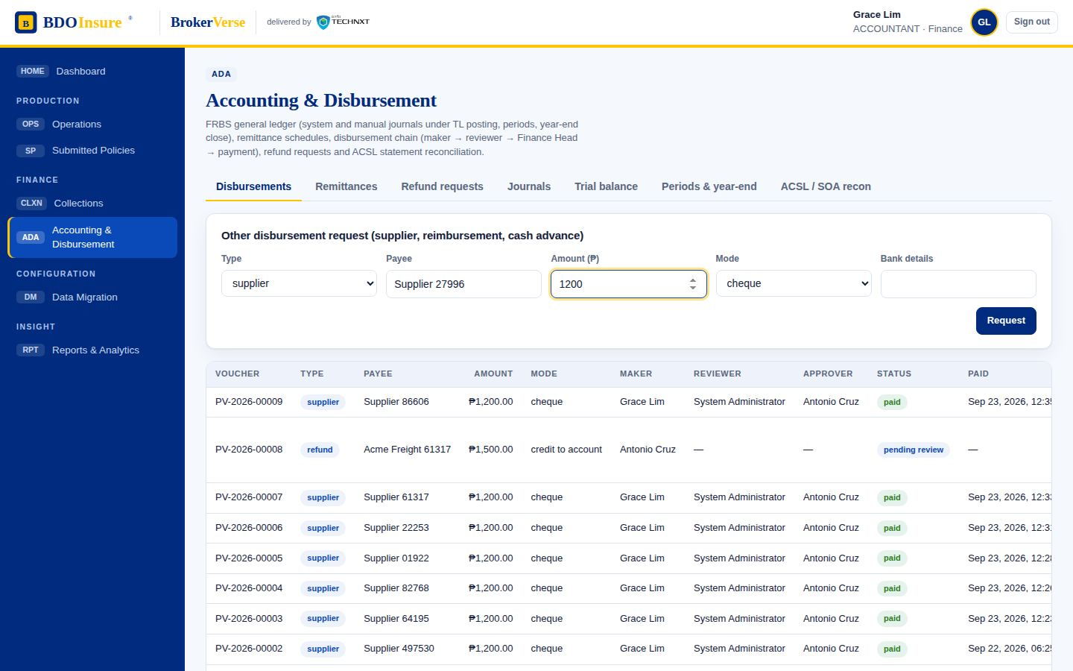
Disbursement · step 2 of 7
06.02
Disbursement request (DPO) with payee, amount, mode and bank details
Screen
Accounting & Disbursement
Disbursements
Request
Menu path: Accounting & Disbursement › Disbursements › Request
BrokerVerse · BDO Insure · delivered by iorta TechNXT
59
Notes:
Disbursement step 2: Disbursement request (DPO) with payee, amount, mode and bank details. Screen: Accounting & Disbursement › Disbursements › Request.

Slide 60
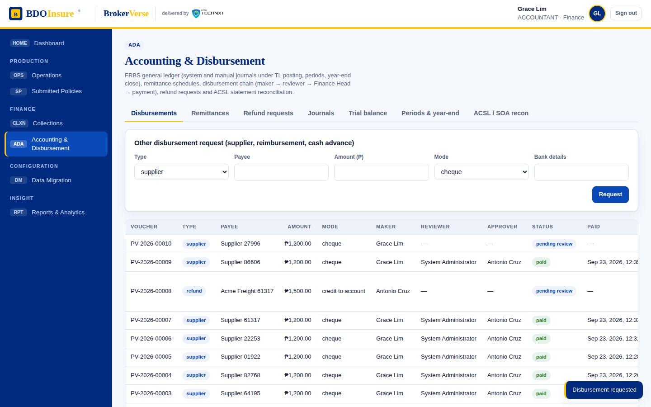
Disbursement · step 3 of 7
06.03
Request awaits a reviewer other than the maker (segregation of duties)
Screen
Accounting & Disbursement
Disbursements
Menu path: Accounting & Disbursement › Disbursements
BrokerVerse · BDO Insure · delivered by iorta TechNXT
60
Notes:
Disbursement step 3: Request awaits a reviewer other than the maker (segregation of duties). Screen: Accounting & Disbursement › Disbursements.

Slide 61
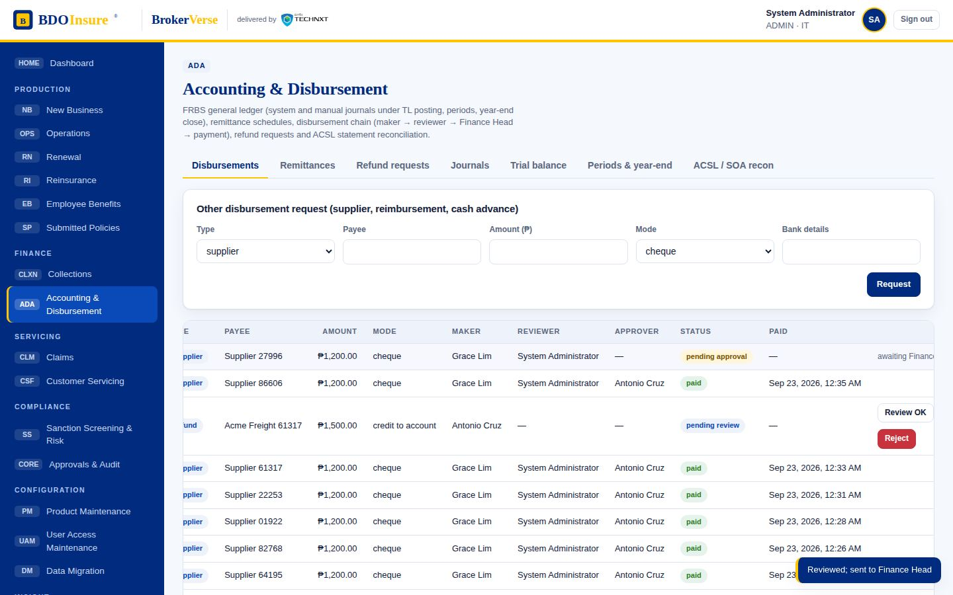
Disbursement · step 4 of 7
06.04
Team lead review (DTL) OK; routed to the Finance Head for approval
Screen
Accounting & Disbursement
Disbursements
Review OK
Menu path: Accounting & Disbursement › Disbursements › Review OK
BrokerVerse · BDO Insure · delivered by iorta TechNXT
61
Notes:
Disbursement step 4: Team lead review (DTL) OK; routed to the Finance Head for approval. Screen: Accounting & Disbursement › Disbursements › Review OK.

Slide 62

Disbursement · step 5 of 7
06.05
Finance Head (DSH / DUH) reviews the voucher
Screen
Approvals & Audit
Pending
Menu path: Approvals & Audit › Pending
BrokerVerse · BDO Insure · delivered by iorta TechNXT
62
Notes:
Disbursement step 5: Finance Head (DSH / DUH) reviews the voucher. Screen: Approvals & Audit › Pending.

Slide 63
Disbursement · step 6 of 7
06.06
Approved; ready for payment
Screen
Approvals & Audit
Approve
Menu path: Approvals & Audit › Approve
BrokerVerse · BDO Insure · delivered by iorta TechNXT
63
Notes:
Disbursement step 6: Approved; ready for payment. Screen: Approvals & Audit › Approve.

Slide 64

Disbursement · step 7 of 7
06.07
Payment posted with cheque reference; status tagged paid and confirmation email sent
Screen
Accounting & Disbursement
Disbursements
Pay
Menu path: Accounting & Disbursement › Disbursements › Pay
BrokerVerse · BDO Insure · delivered by iorta TechNXT
64
Notes:
Disbursement step 7: Payment posted with cheque reference; status tagged paid and confirmation email sent. Screen: Accounting & Disbursement › Disbursements › Pay.

Slide 65
Refund Request
07
Steps in this flow
07.01 RRF register: refund raised by the endorsement with amount, mode and reason
07.02 Marketing TL reviews the RRF
07.03 Unit Head sign-off: a disbursement request is created for the refund
07.04 Refund enters the disbursement chain (review → approve → pay)
Refund Request Form raised from a cancellation, TL review, Unit Head sign-off and hand-off to the disbursement chain.
Source flow REFUND REQUEST.pdf
Personas accountant (TL) → fin.head (UH)
Screens 4 steps captured
Notes:
Refund Request. Source: REFUND REQUEST.pdf. Refund Request Form raised from a cancellation, TL review, Unit Head sign-off and hand-off to the disbursement chain.

Slide 66

Refund Request · step 1 of 4
07.01
RRF register: refund raised by the endorsement with amount, mode and reason
Screen
Accounting & Disbursement
Refund requests
Menu path: Accounting & Disbursement › Refund requests
BrokerVerse · BDO Insure · delivered by iorta TechNXT
66
Notes:
Refund Request step 1: RRF register: refund raised by the endorsement with amount, mode and reason. Screen: Accounting & Disbursement › Refund requests.

Slide 67

Refund Request · step 2 of 4
07.02
Marketing TL reviews the RRF
Screen
Accounting & Disbursement
Refund requests
TL review OK
Menu path: Accounting & Disbursement › Refund requests › TL review OK
BrokerVerse · BDO Insure · delivered by iorta TechNXT
67
Notes:
Refund Request step 2: Marketing TL reviews the RRF. Screen: Accounting & Disbursement › Refund requests › TL review OK.

Slide 68

Refund Request · step 3 of 4
07.03
Unit Head sign-off: a disbursement request is created for the refund
Screen
Accounting & Disbursement
Refund requests
UH approve
Menu path: Accounting & Disbursement › Refund requests › UH approve
BrokerVerse · BDO Insure · delivered by iorta TechNXT
68
Notes:
Refund Request step 3: Unit Head sign-off: a disbursement request is created for the refund. Screen: Accounting & Disbursement › Refund requests › UH approve.

Slide 69

Refund Request · step 4 of 4
07.04
Refund enters the disbursement chain (review → approve → pay)
Screen
Accounting & Disbursement
Disbursements
Menu path: Accounting & Disbursement › Disbursements
BrokerVerse · BDO Insure · delivered by iorta TechNXT
69
Notes:
Refund Request step 4: Refund enters the disbursement chain (review → approve → pay). Screen: Accounting & Disbursement › Disbursements.

Slide 70
ACSL (Insurer SOA reconciliation)
08
Steps in this flow
08.01 Insurer SOA lines captured against the ledger
08.02 Variances flagged (abnormal balances, unknown items) for manual subsidiary-ledger adjustment
Insurer statement of account reconciled against the ledger; abnormal balances raise adjustment entries reviewed by the TL and posted by the FRBS approver.
Source flow ACSL.pdf
Personas accountant → fin.head
Screens 2 steps captured
Notes:
ACSL (Insurer SOA reconciliation). Source: ACSL.pdf. Insurer statement of account reconciled against the ledger; abnormal balances raise adjustment entries reviewed by the TL and posted by the FRBS approver.

Slide 71

ACSL (Insurer SOA reconciliation) · step 1 of 2
08.01
Insurer SOA lines captured against the ledger
Screen
Accounting & Disbursement
ACSL / SOA recon
Menu path: Accounting & Disbursement › ACSL / SOA recon
BrokerVerse · BDO Insure · delivered by iorta TechNXT
71
Notes:
ACSL (Insurer SOA reconciliation) step 1: Insurer SOA lines captured against the ledger. Screen: Accounting & Disbursement › ACSL / SOA recon.

Slide 72

ACSL (Insurer SOA reconciliation) · step 2 of 2
08.02
Variances flagged (abnormal balances, unknown items) for manual subsidiary-ledger adjustment
Screen
Accounting & Disbursement
ACSL / SOA recon
Result
Menu path: Accounting & Disbursement › ACSL / SOA recon › Result
BrokerVerse · BDO Insure · delivered by iorta TechNXT
72
Notes:
ACSL (Insurer SOA reconciliation) step 2: Variances flagged (abnormal balances, unknown items) for manual subsidiary-ledger adjustment. Screen: Accounting & Disbursement › ACSL / SOA recon › Result.

Slide 73
Claims
09
Steps in this flow
09.01 Notice of loss registered against the policy (Claims Acceptance Control checks premium status)
09.02 Preliminary Loss Advice (PLA) sent; claim opened with reserve
09.03 Document checklist by line (motor / non-motor); FLA blocked until complete
09.04 All requirements received: documents complete
09.05 Formal Loss Advice sent to the insurer; adjuster inspection flagged
09.06 Insurer evaluation and offer received
09.07 Insured contests the offer; re-evaluation loop with the insurer
09.08 Settlement by LOA to casa/dealer or cash requested for approval
09.09 Approver reviews the settlement
09.10 Settlement approved
09.11 Claim tagged settled / paid, then closed; declination is the alternative exit
Notice of loss, PLA, document checklist, FLA to the insurer, evaluation and offer, contest loop, settlement approval and closure.
Source flow CLAIMS PROCESS FLOW.pdf
Personas claims → fin.head
Screens 11 steps captured
Notes:
Claims. Source: CLAIMS PROCESS FLOW.pdf. Notice of loss, PLA, document checklist, FLA to the insurer, evaluation and offer, contest loop, settlement approval and closure.

Slide 74

Claims · step 1 of 11
09.01
Notice of loss registered against the policy (Claims Acceptance Control checks premium status)
Screen
Claims
Register
Menu path: Claims › Register
BrokerVerse · BDO Insure · delivered by iorta TechNXT
74
Notes:
Claims step 1: Notice of loss registered against the policy (Claims Acceptance Control checks premium status). Screen: Claims › Register.

Slide 75

Claims · step 2 of 11
09.02
Preliminary Loss Advice (PLA) sent; claim opened with reserve
Screen
Claims
Register
Menu path: Claims › Register
BrokerVerse · BDO Insure · delivered by iorta TechNXT
75
Notes:
Claims step 2: Preliminary Loss Advice (PLA) sent; claim opened with reserve. Screen: Claims › Register.

Slide 76

Claims · step 3 of 11
09.03
Document checklist by line (motor / non-motor); FLA blocked until complete
Screen
Claims
Claim detail
Document checklist
Menu path: Claims › Claim detail › Document checklist
BrokerVerse · BDO Insure · delivered by iorta TechNXT
76
Notes:
Claims step 3: Document checklist by line (motor / non-motor); FLA blocked until complete. Screen: Claims › Claim detail › Document checklist.

Slide 77

Claims · step 4 of 11
09.04
All requirements received: documents complete
Screen
Claims
Claim detail
Menu path: Claims › Claim detail
BrokerVerse · BDO Insure · delivered by iorta TechNXT
77
Notes:
Claims step 4: All requirements received: documents complete. Screen: Claims › Claim detail.

Slide 78

Claims · step 5 of 11
09.05
Formal Loss Advice sent to the insurer; adjuster inspection flagged
Screen
Claims
Claim detail
Send FLA
Menu path: Claims › Claim detail › Send FLA
BrokerVerse · BDO Insure · delivered by iorta TechNXT
78
Notes:
Claims step 5: Formal Loss Advice sent to the insurer; adjuster inspection flagged. Screen: Claims › Claim detail › Send FLA.

Slide 79

Claims · step 6 of 11
09.06
Insurer evaluation and offer received
Screen
Claims
Claim detail
Offer received
Menu path: Claims › Claim detail › Offer received
BrokerVerse · BDO Insure · delivered by iorta TechNXT
79
Notes:
Claims step 6: Insurer evaluation and offer received. Screen: Claims › Claim detail › Offer received.

Slide 80

Claims · step 7 of 11
09.07
Insured contests the offer; re-evaluation loop with the insurer
Screen
Claims
Claim detail
Contest offer
Menu path: Claims › Claim detail › Contest offer
BrokerVerse · BDO Insure · delivered by iorta TechNXT
80
Notes:
Claims step 7: Insured contests the offer; re-evaluation loop with the insurer. Screen: Claims › Claim detail › Contest offer.

Slide 81

Claims · step 8 of 11
09.08
Settlement by LOA to casa/dealer or cash requested for approval
Screen
Claims
Claim detail
Request settlement approval
Menu path: Claims › Claim detail › Request settlement approval
BrokerVerse · BDO Insure · delivered by iorta TechNXT
81
Notes:
Claims step 8: Settlement by LOA to casa/dealer or cash requested for approval. Screen: Claims › Claim detail › Request settlement approval.

Slide 82

Claims · step 9 of 11
09.09
Approver reviews the settlement
Screen
Approvals & Audit
Pending
Menu path: Approvals & Audit › Pending
BrokerVerse · BDO Insure · delivered by iorta TechNXT
82
Notes:
Claims step 9: Approver reviews the settlement. Screen: Approvals & Audit › Pending.

Slide 83
Claims · step 10 of 11
09.10
Settlement approved
Screen
Approvals & Audit
Approve
Menu path: Approvals & Audit › Approve
BrokerVerse · BDO Insure · delivered by iorta TechNXT
83
Notes:
Claims step 10: Settlement approved. Screen: Approvals & Audit › Approve.

Slide 84

Claims · step 11 of 11
09.11
Claim tagged settled / paid, then closed; declination is the alternative exit
Screen
Claims
Claim detail
Mark settled
Menu path: Claims › Claim detail › Mark settled
BrokerVerse · BDO Insure · delivered by iorta TechNXT
84
Notes:
Claims step 11: Claim tagged settled / paid, then closed; declination is the alternative exit. Screen: Claims › Claim detail › Mark settled.

Slide 85
Case Management (To-Be)
10
Steps in this flow
10.01 Contact logged: general inquiry (no client) vs account-related concern
10.02 General inquiry handled and closed at point of contact
10.03 Account-related concern: positive identification (PID) and routing to the owning unit with a TAT
10.04 Case referred to the fulfilment unit; TAT due time computed and past-TAT flagged
10.05 Case returned to the Customer Contact Centre for re-logging with a reason
10.06 Case re-logged and back in the open queue
General vs account-related inquiries, positive identification, point-of-contact handling or referral to the fulfilment unit, TAT monitoring and return to CCC.
Source flow CASE MANAGEMENT TO BE PROCESS FLOW_07152026.pdf
Personas compliance
Screens 6 steps captured
Notes:
Case Management (To-Be). Source: CASE MANAGEMENT TO BE PROCESS FLOW_07152026.pdf. General vs account-related inquiries, positive identification, point-of-contact handling or referral to the fulfilment unit, TAT monitoring and return to CCC.

Slide 86

Case Management (To-Be) · step 1 of 6
10.01
Contact logged: general inquiry (no client) vs account-related concern
Screen
Customer Servicing
Cases
Log case
Menu path: Customer Servicing › Cases › Log case
BrokerVerse · BDO Insure · delivered by iorta TechNXT
86
Notes:
Case Management (To-Be) step 1: Contact logged: general inquiry (no client) vs account-related concern. Screen: Customer Servicing › Cases › Log case.

Slide 87

Case Management (To-Be) · step 2 of 6
10.02
General inquiry handled and closed at point of contact
Screen
Customer Servicing
Cases
Menu path: Customer Servicing › Cases
BrokerVerse · BDO Insure · delivered by iorta TechNXT
87
Notes:
Case Management (To-Be) step 2: General inquiry handled and closed at point of contact. Screen: Customer Servicing › Cases.

Slide 88

Case Management (To-Be) · step 3 of 6
10.03
Account-related concern: positive identification (PID) and routing to the owning unit with a TAT
Screen
Customer Servicing
Cases
Log case
Menu path: Customer Servicing › Cases › Log case
BrokerVerse · BDO Insure · delivered by iorta TechNXT
88
Notes:
Case Management (To-Be) step 3: Account-related concern: positive identification (PID) and routing to the owning unit with a TAT. Screen: Customer Servicing › Cases › Log case.

Slide 89

Case Management (To-Be) · step 4 of 6
10.04
Case referred to the fulfilment unit; TAT due time computed and past-TAT flagged
Screen
Customer Servicing
Cases
Menu path: Customer Servicing › Cases
BrokerVerse · BDO Insure · delivered by iorta TechNXT
89
Notes:
Case Management (To-Be) step 4: Case referred to the fulfilment unit; TAT due time computed and past-TAT flagged. Screen: Customer Servicing › Cases.

Slide 90

Case Management (To-Be) · step 5 of 6
10.05
Case returned to the Customer Contact Centre for re-logging with a reason
Screen
Customer Servicing
Cases
Return to CCC
Menu path: Customer Servicing › Cases › Return to CCC
BrokerVerse · BDO Insure · delivered by iorta TechNXT
90
Notes:
Case Management (To-Be) step 5: Case returned to the Customer Contact Centre for re-logging with a reason. Screen: Customer Servicing › Cases › Return to CCC.

Slide 91

Case Management (To-Be) · step 6 of 6
10.06
Case re-logged and back in the open queue
Screen
Customer Servicing
Cases
Re-log
Menu path: Customer Servicing › Cases › Re-log
BrokerVerse · BDO Insure · delivered by iorta TechNXT
91
Notes:
Case Management (To-Be) step 6: Case re-logged and back in the open queue. Screen: Customer Servicing › Cases › Re-log.

Slide 92
Customer Servicing Facility
11
Steps in this flow
11.01 Servicing facility: search by invoice no., policy no. or client name
11.02 Client contact details updated from the facility
Search by invoice, policy or client name; view policies, invoices and receipts; update contact details.
Source flow CUSTOMER SERVICING FACILITY - Process Flow.pdf
Personas compliance
Screens 2 steps captured
Notes:
Customer Servicing Facility. Source: CUSTOMER SERVICING FACILITY - Process Flow.pdf. Search by invoice, policy or client name; view policies, invoices and receipts; update contact details.

Slide 93

Customer Servicing Facility · step 1 of 2
11.01
Servicing facility: search by invoice no., policy no. or client name
Screen
Customer Servicing
Servicing facility
Menu path: Customer Servicing › Servicing facility
BrokerVerse · BDO Insure · delivered by iorta TechNXT
93
Notes:
Customer Servicing Facility step 1: Servicing facility: search by invoice no., policy no. or client name. Screen: Customer Servicing › Servicing facility.

Slide 94

Customer Servicing Facility · step 2 of 2
11.02
Client contact details updated from the facility
Screen
Customer Servicing
Servicing facility
Update contact
Menu path: Customer Servicing › Servicing facility › Update contact
BrokerVerse · BDO Insure · delivered by iorta TechNXT
94
Notes:
Customer Servicing Facility step 2: Client contact details updated from the facility. Screen: Customer Servicing › Servicing facility › Update contact.

Slide 95
Renewal (RMEL)
12
Steps in this flow
12.01 RMEL: policies expiring within 140 days, pending sanitation
12.02 Sanitation: disposition for renewal / remarket / not for renewal (NRNS letter)
12.03 Initial renewal advice letter sent 70 days before expiry
12.04 Final renewal advice letter sent 45 days before expiry
12.05 Client accepted: renewal policy enters placement and the e-policy cycle
Renewal master expiry list 140 days out, sanitation and disposition, initial and final RA letters, client acceptance and renewal placement.
Source flow RENEWAL (1).pdf
Personas renewals
Screens 5 steps captured
Notes:
Renewal (RMEL). Source: RENEWAL (1).pdf. Renewal master expiry list 140 days out, sanitation and disposition, initial and final RA letters, client acceptance and renewal placement.

Slide 96

Renewal (RMEL) · step 1 of 5
12.01
RMEL: policies expiring within 140 days, pending sanitation
Screen
Renewal
Pipeline
Menu path: Renewal › Pipeline
BrokerVerse · BDO Insure · delivered by iorta TechNXT
96
Notes:
Renewal (RMEL) step 1: RMEL: policies expiring within 140 days, pending sanitation. Screen: Renewal › Pipeline.

Slide 97

Renewal (RMEL) · step 2 of 5
12.02
Sanitation: disposition for renewal / remarket / not for renewal (NRNS letter)
Screen
Renewal
For renewal
Menu path: Renewal › For renewal
BrokerVerse · BDO Insure · delivered by iorta TechNXT
97
Notes:
Renewal (RMEL) step 2: Sanitation: disposition for renewal / remarket / not for renewal (NRNS letter). Screen: Renewal › For renewal.

Slide 98

Renewal (RMEL) · step 3 of 5
12.03
Initial renewal advice letter sent 70 days before expiry
Screen
Renewal
Initial RA
Menu path: Renewal › Initial RA
BrokerVerse · BDO Insure · delivered by iorta TechNXT
98
Notes:
Renewal (RMEL) step 3: Initial renewal advice letter sent 70 days before expiry. Screen: Renewal › Initial RA.

Slide 99

Renewal (RMEL) · step 4 of 5
12.04
Final renewal advice letter sent 45 days before expiry
Screen
Renewal
Final RA
Menu path: Renewal › Final RA
BrokerVerse · BDO Insure · delivered by iorta TechNXT
99
Notes:
Renewal (RMEL) step 4: Final renewal advice letter sent 45 days before expiry. Screen: Renewal › Final RA.

Slide 100

Renewal (RMEL) · step 5 of 5
12.05
Client accepted: renewal policy enters placement and the e-policy cycle
Screen
Renewal
Renew → placement
Menu path: Renewal › Renew → placement
BrokerVerse · BDO Insure · delivered by iorta TechNXT
100
Notes:
Renewal (RMEL) step 5: Client accepted: renewal policy enters placement and the e-policy cycle. Screen: Renewal › Renew → placement.

Slide 101
Reinsurance
13
Steps in this flow
13.01 Facultative placement request from marketing with the risk details
13.02 Request logged; acknowledgement due within 24 hours (TAT flag)
13.03 Acknowledged; slip due within 3 working days
13.04 Slip: reinsurers approached with security rating, share and signed-slip evidence
13.05 Closing: placement closed and debit note issued to the cedant
13.06 Treaty register and cessions with capacity monitoring
Facultative request with 24-hour acknowledgement and 3-day slip TAT, underwriting information loop, reinsurer security rating, signed slips, closing and debit note; treaties and cessions.
Source flow RENISURANCE PROCESS FLOW.pdf
Personas ri.officer
Screens 6 steps captured
Notes:
Reinsurance. Source: RENISURANCE PROCESS FLOW.pdf. Facultative request with 24-hour acknowledgement and 3-day slip TAT, underwriting information loop, reinsurer security rating, signed slips, closing and debit note; treaties and cessions.

Slide 102

Reinsurance · step 1 of 6
13.01
Facultative placement request from marketing with the risk details
Screen
Reinsurance
Facultative placements
Request
Menu path: Reinsurance › Facultative placements › Request
BrokerVerse · BDO Insure · delivered by iorta TechNXT
102
Notes:
Reinsurance step 1: Facultative placement request from marketing with the risk details. Screen: Reinsurance › Facultative placements › Request.

Slide 103

Reinsurance · step 2 of 6
13.02
Request logged; acknowledgement due within 24 hours (TAT flag)
Screen
Reinsurance
Facultative placements
Menu path: Reinsurance › Facultative placements
BrokerVerse · BDO Insure · delivered by iorta TechNXT
103
Notes:
Reinsurance step 2: Request logged; acknowledgement due within 24 hours (TAT flag). Screen: Reinsurance › Facultative placements.

Slide 104

Reinsurance · step 3 of 6
13.03
Acknowledged; slip due within 3 working days
Screen
Reinsurance
Acknowledge
Menu path: Reinsurance › Acknowledge
BrokerVerse · BDO Insure · delivered by iorta TechNXT
104
Notes:
Reinsurance step 3: Acknowledged; slip due within 3 working days. Screen: Reinsurance › Acknowledge.

Slide 105

Reinsurance · step 4 of 6
13.04
Slip: reinsurers approached with security rating, share and signed-slip evidence
Screen
Reinsurance
Prepare slip
Menu path: Reinsurance › Prepare slip
BrokerVerse · BDO Insure · delivered by iorta TechNXT
105
Notes:
Reinsurance step 4: Slip: reinsurers approached with security rating, share and signed-slip evidence. Screen: Reinsurance › Prepare slip.

Slide 106

Reinsurance · step 5 of 6
13.05
Closing: placement closed and debit note issued to the cedant
Screen
Reinsurance
Close & debit note
Menu path: Reinsurance › Close & debit note
BrokerVerse · BDO Insure · delivered by iorta TechNXT
106
Notes:
Reinsurance step 5: Closing: placement closed and debit note issued to the cedant. Screen: Reinsurance › Close & debit note.

Slide 107

Reinsurance · step 6 of 6
13.06
Treaty register and cessions with capacity monitoring
Screen
Reinsurance
Treaties & cessions
Menu path: Reinsurance › Treaties & cessions
BrokerVerse · BDO Insure · delivered by iorta TechNXT
107
Notes:
Reinsurance step 6: Treaty register and cessions with capacity monitoring. Screen: Reinsurance › Treaties & cessions.

Slide 108
Submitted Policies
14
Steps in this flow
14.01 Masterlist upload from the bank / insurer for validation and matching
14.02 Rows validated, matched and consolidated; each reviewed for adequacy
14.03 Findings recorded and an Insurance Adequacy Assessment Form (IAAF) issued
14.04 Policies 150 days from expiry sent to the sanitation handler for renewal / conversion opportunity
Masterlist validation, matching and consolidation, adequacy review with IAAF findings, and hand-off to sanitation 150 days from expiry.
Source flow Submitted Policies_Process Flow.pdf
Personas accountant
Screens 4 steps captured
Notes:
Submitted Policies. Source: Submitted Policies_Process Flow.pdf. Masterlist validation, matching and consolidation, adequacy review with IAAF findings, and hand-off to sanitation 150 days from expiry.

Slide 109

Submitted Policies · step 1 of 4
14.01
Masterlist upload from the bank / insurer for validation and matching
Screen
Submitted Policies
Masterlist batches
Menu path: Submitted Policies › Masterlist batches
BrokerVerse · BDO Insure · delivered by iorta TechNXT
109
Notes:
Submitted Policies step 1: Masterlist upload from the bank / insurer for validation and matching. Screen: Submitted Policies › Masterlist batches.

Slide 110

Submitted Policies · step 2 of 4
14.02
Rows validated, matched and consolidated; each reviewed for adequacy
Screen
Submitted Policies
Masterlist batches
Run pipeline
Menu path: Submitted Policies › Masterlist batches › Run pipeline
BrokerVerse · BDO Insure · delivered by iorta TechNXT
110
Notes:
Submitted Policies step 2: Rows validated, matched and consolidated; each reviewed for adequacy. Screen: Submitted Policies › Masterlist batches › Run pipeline.

Slide 111

Submitted Policies · step 3 of 4
14.03
Findings recorded and an Insurance Adequacy Assessment Form (IAAF) issued
Screen
Submitted Policies
Findings → IAAF
Menu path: Submitted Policies › Findings → IAAF
BrokerVerse · BDO Insure · delivered by iorta TechNXT
111
Notes:
Submitted Policies step 3: Findings recorded and an Insurance Adequacy Assessment Form (IAAF) issued. Screen: Submitted Policies › Findings → IAAF.

Slide 112

Submitted Policies · step 4 of 4
14.04
Policies 150 days from expiry sent to the sanitation handler for renewal / conversion opportunity
Screen
Submitted Policies
Expiring (150 days)
Menu path: Submitted Policies › Expiring (150 days)
BrokerVerse · BDO Insure · delivered by iorta TechNXT
112
Notes:
Submitted Policies step 4: Policies 150 days from expiry sent to the sanitation handler for renewal / conversion opportunity. Screen: Submitted Policies › Expiring (150 days).

Slide 113
Employee Benefits
15
Steps in this flow
15.01 Prospect scheme created from the renewal advice
15.02 Broker of Record received, Terms of Reference prepared, member census uploaded
15.03 TOR, master list and utilisation released to insurers (franchise)
15.04 Comparative analysis of proposals: premium, benefits and capabilities
15.05 Client confirmation and award; ISACOM approval when the provider is not accredited; handoff to processing and collections
Renewal advice, BOR, TOR with master list and utilisation released to insurers, comparative analysis, award with ISACOM for non-accredited providers, handoff.
Source flow EMPLOYEE BENEFITS - Process Flow.pdf
Personas eb.officer
Screens 5 steps captured
Notes:
Employee Benefits. Source: EMPLOYEE BENEFITS - Process Flow.pdf. Renewal advice, BOR, TOR with master list and utilisation released to insurers, comparative analysis, award with ISACOM for non-accredited providers, handoff.

Slide 114

Employee Benefits · step 1 of 5
15.01
Prospect scheme created from the renewal advice
Screen
Employee Benefits
Create scheme
Menu path: Employee Benefits › Create scheme
BrokerVerse · BDO Insure · delivered by iorta TechNXT
114
Notes:
Employee Benefits step 1: Prospect scheme created from the renewal advice. Screen: Employee Benefits › Create scheme.

Slide 115

Employee Benefits · step 2 of 5
15.02
Broker of Record received, Terms of Reference prepared, member census uploaded
Screen
Employee Benefits
Scheme detail
Menu path: Employee Benefits › Scheme detail
BrokerVerse · BDO Insure · delivered by iorta TechNXT
115
Notes:
Employee Benefits step 2: Broker of Record received, Terms of Reference prepared, member census uploaded. Screen: Employee Benefits › Scheme detail.

Slide 116

Employee Benefits · step 3 of 5
15.03
TOR, master list and utilisation released to insurers (franchise)
Screen
Employee Benefits
Release TOR to insurers
Menu path: Employee Benefits › Release TOR to insurers
BrokerVerse · BDO Insure · delivered by iorta TechNXT
116
Notes:
Employee Benefits step 3: TOR, master list and utilisation released to insurers (franchise). Screen: Employee Benefits › Release TOR to insurers.

Slide 117

Employee Benefits · step 4 of 5
15.04
Comparative analysis of proposals: premium, benefits and capabilities
Screen
Employee Benefits
Proposals
Menu path: Employee Benefits › Proposals
BrokerVerse · BDO Insure · delivered by iorta TechNXT
117
Notes:
Employee Benefits step 4: Comparative analysis of proposals: premium, benefits and capabilities. Screen: Employee Benefits › Proposals.

Slide 118

Employee Benefits · step 5 of 5
15.05
Client confirmation and award; ISACOM approval when the provider is not accredited; handoff to processing and collections
Screen
Employee Benefits
Award
Menu path: Employee Benefits › Award
BrokerVerse · BDO Insure · delivered by iorta TechNXT
118
Notes:
Employee Benefits step 5: Client confirmation and award; ISACOM approval when the provider is not accredited; handoff to processing and collections. Screen: Employee Benefits › Award.

Slide 119
Product Maintenance (TSU)
16
Steps in this flow
16.01 PRF / TSU request for a non-packaged risk with completeness and duplicate check
16.02 TSU acknowledges the request (or returns it as incomplete)
16.03 Quotation slip prepared and approved by the TL
16.04 RI referral cleared; quotation slip sent to insurers
16.05 Insurer responses recorded (accepted with evidence / declined / conditional); comparative table ready
16.06 Proposal slip approved with the selected insurer; released to marketing and the client
16.07 Packaged product catalogue with rates, taxes and limits
16.08 Package maintenance request raised for validation and approval
16.09 Approver validates the product change
16.10 Change applied and a release advisory published
16.11 Insurer panel with accreditation and SFTP enrolment for placement channels
Technical Services Unit request for non-packaged risks: completeness and duplicate check, quotation slip, TL approval, RI referral, insurer responses, comparative table and proposal slip; package maintenance with release advisory.
Source flow PRODUCT MAINTENANCE TSU PROCESS_0709.pdf
Personas admin → uw.head
Screens 11 steps captured
Notes:
Product Maintenance (TSU). Source: PRODUCT MAINTENANCE TSU PROCESS_0709.pdf. Technical Services Unit request for non-packaged risks: completeness and duplicate check, quotation slip, TL approval, RI referral, insurer responses, comparative table and proposal slip; package maintenance with release advisory.

Slide 120

Product Maintenance (TSU) · step 1 of 11
16.01
PRF / TSU request for a non-packaged risk with completeness and duplicate check
Screen
Product Maintenance
TSU requests
Submit
Menu path: Product Maintenance › TSU requests › Submit
BrokerVerse · BDO Insure · delivered by iorta TechNXT
120
Notes:
Product Maintenance (TSU) step 1: PRF / TSU request for a non-packaged risk with completeness and duplicate check. Screen: Product Maintenance › TSU requests › Submit.

Slide 121

Product Maintenance (TSU) · step 2 of 11
16.02
TSU acknowledges the request (or returns it as incomplete)
Screen
Product Maintenance
TSU requests
Acknowledge
Menu path: Product Maintenance › TSU requests › Acknowledge
BrokerVerse · BDO Insure · delivered by iorta TechNXT
121
Notes:
Product Maintenance (TSU) step 2: TSU acknowledges the request (or returns it as incomplete). Screen: Product Maintenance › TSU requests › Acknowledge.

Slide 122

Product Maintenance (TSU) · step 3 of 11
16.03
Quotation slip prepared and approved by the TL
Screen
Product Maintenance
TSU detail
TL approve QS
Menu path: Product Maintenance › TSU detail › TL approve QS
BrokerVerse · BDO Insure · delivered by iorta TechNXT
122
Notes:
Product Maintenance (TSU) step 3: Quotation slip prepared and approved by the TL. Screen: Product Maintenance › TSU detail › TL approve QS.

Slide 123

Product Maintenance (TSU) · step 4 of 11
16.04
RI referral cleared; quotation slip sent to insurers
Screen
Product Maintenance
TSU detail
Send QS to insurers
Menu path: Product Maintenance › TSU detail › Send QS to insurers
BrokerVerse · BDO Insure · delivered by iorta TechNXT
123
Notes:
Product Maintenance (TSU) step 4: RI referral cleared; quotation slip sent to insurers. Screen: Product Maintenance › TSU detail › Send QS to insurers.

Slide 124

Product Maintenance (TSU) · step 5 of 11
16.05
Insurer responses recorded (accepted with evidence / declined / conditional); comparative table ready
Screen
Product Maintenance
TSU detail
Comparative table
Menu path: Product Maintenance › TSU detail › Comparative table
BrokerVerse · BDO Insure · delivered by iorta TechNXT
124
Notes:
Product Maintenance (TSU) step 5: Insurer responses recorded (accepted with evidence / declined / conditional); comparative table ready. Screen: Product Maintenance › TSU detail › Comparative table.

Slide 125

Product Maintenance (TSU) · step 6 of 11
16.06
Proposal slip approved with the selected insurer; released to marketing and the client
Screen
Product Maintenance
TSU detail
Approve proposal slip
Menu path: Product Maintenance › TSU detail › Approve proposal slip
BrokerVerse · BDO Insure · delivered by iorta TechNXT
125
Notes:
Product Maintenance (TSU) step 6: Proposal slip approved with the selected insurer; released to marketing and the client. Screen: Product Maintenance › TSU detail › Approve proposal slip.

Slide 126

Product Maintenance (TSU) · step 7 of 11
16.07
Packaged product catalogue with rates, taxes and limits
Screen
Product Maintenance
Packages
Menu path: Product Maintenance › Packages
BrokerVerse · BDO Insure · delivered by iorta TechNXT
126
Notes:
Product Maintenance (TSU) step 7: Packaged product catalogue with rates, taxes and limits. Screen: Product Maintenance › Packages.

Slide 127

Product Maintenance (TSU) · step 8 of 11
16.08
Package maintenance request raised for validation and approval
Screen
Product Maintenance
Packages
Change request
Menu path: Product Maintenance › Packages › Change request
BrokerVerse · BDO Insure · delivered by iorta TechNXT
127
Notes:
Product Maintenance (TSU) step 8: Package maintenance request raised for validation and approval. Screen: Product Maintenance › Packages › Change request.

Slide 128

Product Maintenance (TSU) · step 9 of 11
16.09
Approver validates the product change
Screen
Approvals & Audit
Pending
Menu path: Approvals & Audit › Pending
BrokerVerse · BDO Insure · delivered by iorta TechNXT
128
Notes:
Product Maintenance (TSU) step 9: Approver validates the product change. Screen: Approvals & Audit › Pending.

Slide 129

Product Maintenance (TSU) · step 10 of 11
16.10
Change applied and a release advisory published
Screen
Approvals & Audit
Approve
Menu path: Approvals & Audit › Approve
BrokerVerse · BDO Insure · delivered by iorta TechNXT
129
Notes:
Product Maintenance (TSU) step 10: Change applied and a release advisory published. Screen: Approvals & Audit › Approve.

Slide 130

Product Maintenance (TSU) · step 11 of 11
16.11
Insurer panel with accreditation and SFTP enrolment for placement channels
Screen
Product Maintenance
Insurers
Menu path: Product Maintenance › Insurers
BrokerVerse · BDO Insure · delivered by iorta TechNXT
130
Notes:
Product Maintenance (TSU) step 11: Insurer panel with accreditation and SFTP enrolment for placement channels. Screen: Product Maintenance › Insurers.

Slide 131
Where to open BrokerVerse
1
Demo with sample data
https://claude.ai/artifact/J5CoEBTpXYt77pVyruPQ5v
Sign in as admin / Admin@123, or any persona with Broker@123. Actions are simulated.
2
Illustrated walkthrough
https://claude.ai/artifact/EFoSW1GzSezVPJ8QhgeKvi
The same screens as this deck, with full-size captures.
3
Full platform on your machine
npm install · npm run setup · npm run dev
Then browse to http://localhost:5173. Docker: docker compose up --build serves http://localhost:8080.
4
Regenerate the screens
npm run walkthrough
Re-runs every process in a browser against a running local stack and rebuilds the page.
Notes:
Where to open the application and how to regenerate the walkthrough.

