Slide 1


BDO Insurance & Reinsurance Brokers
How BDOI works, end to end
The sixteen signed-off process flows in HL_Process_Overview integrated into one operating model: the whole chain on one picture, where the money goes, the life of one policy, twelve stages with their BrokerVerse screens, the satellite processes, hand-offs, controls and clocks.
delivered by
Notes:
BDOI stands between BDO clients and the insurance market: it onboards and screens the client, quotes and places the risk, books and invoices, collects, retains commission and remits net premium, accounts for every peso, services the client, handles claims and renews the cover.

Slide 2
What BDOI does
A broker between BDO’s clients and the insurance market. Revenue is commission on premium placed, plus reinsurance commission as cedant.
Clients
Counterparties
Bank-referred consumer accounts (CBG home, motor, fire), corporate, branches, retail, group employee benefits
Accredited insurers (SFTP-enrolled or email), reinsurers and RI brokers
Units
Controls
Marketing, TSU, Reinsurance, Processing, Cashiering, Collections, Disbursement, FRBS, Claims, Contact Centre, Compliance
Maker-checker wherever money or cover changes; segregation of duties; audit trail on every decision
THE CHAIN
Onboard
Quote
Place
Book
Pay
Collect
Remit
Ledger
Adjust
Claim
Service
Renew
One loop. Renewal opens 140 days before expiry and an accepted renewal re-enters placement, so a policy that is cared for never leaves the chain. Claims and servicing run beside it while the policy is in force; the ledger records every step.
BDOI operating model · BrokerVerse · delivered by iorta TechNXT
2

Slide 3
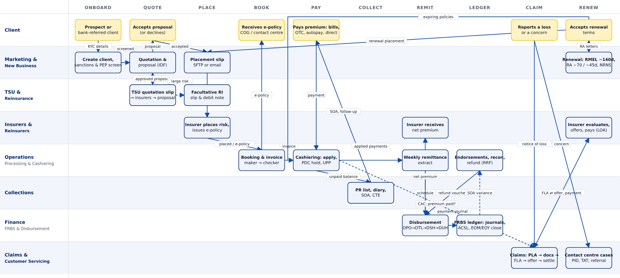
The whole chain on one picture
Read left to right: each lane is a unit or counterparty, each column a stage. Gold boxes are the client’s own steps; dashed arrows are conditional branches (non-packaged risk to TSU, large risk to reinsurance, claim accepted only when premium is paid). The BDOIR end-to-end flow integrated with the New Business, TSU, Reinsurance, Operations, Collections, Disbursement, FRBS, ACSL, Refund, Claims, Case Management and Renewal flows.
BDOI operating model · BrokerVerse · delivered by iorta TechNXT
3
Notes:
Read left to right: each lane is a unit or counterparty, each column a stage. Gold boxes are the client’s own steps; dashed arrows are conditional branches (non-packaged risk to TSU, large risk to reinsurance, claim accepted only when premium is paid). The BDOIR end-to-end flow integrated with the New Business, TSU, Reinsurance, Operations, Collections, Disbursement, FRBS, ACSL, Refund, Claims, Case Management and Renewal flows.

Slide 4
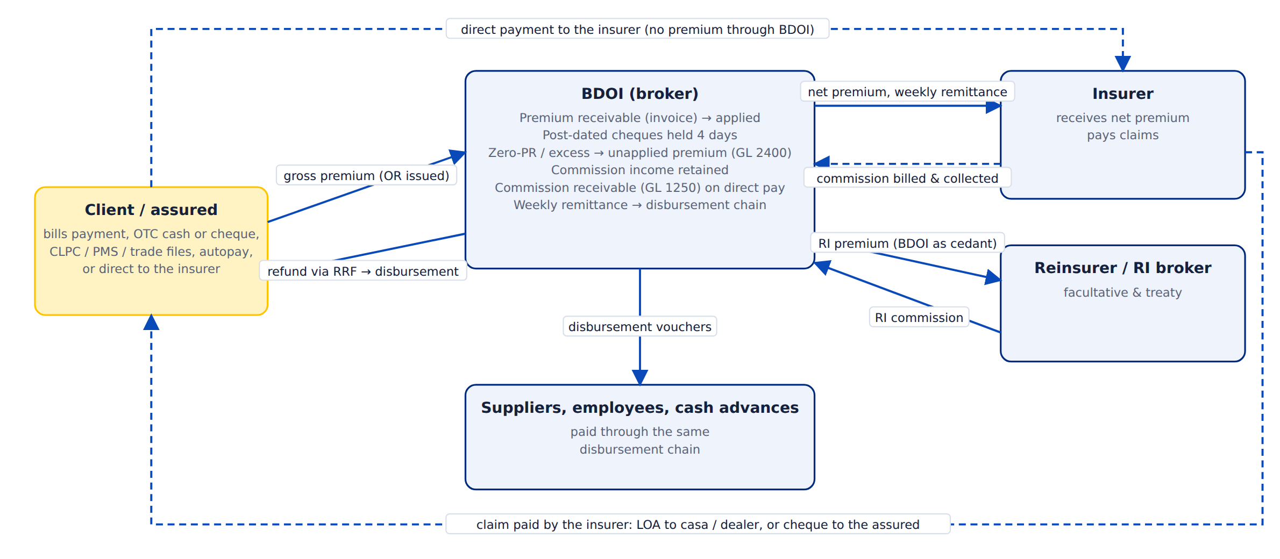
Where the money goes
Gross premium arrives through the cashiering channels and is applied to the invoice; the weekly remittance extract pays insurers the net premium through the disbursement chain. When a client pays the insurer directly, BDOI bills the insurer for its commission. Refunds go back only through a Refund Request Form and the disbursement chain. Claims money never passes through BDOI. As cedant, BDOI remits reinsurance premium and collects reinsurance commission.
BDOI operating model · BrokerVerse · delivered by iorta TechNXT
4
Notes:
Gross premium arrives through the cashiering channels and is applied to the invoice; the weekly remittance extract pays insurers the net premium through the disbursement chain. When a client pays the insurer directly, BDOI bills the insurer for its commission. Refunds go back only through a Refund Request Form and the disbursement chain. Claims money never passes through BDOI. As cedant, BDOI remits reinsurance premium and collects reinsurance commission.

Slide 5
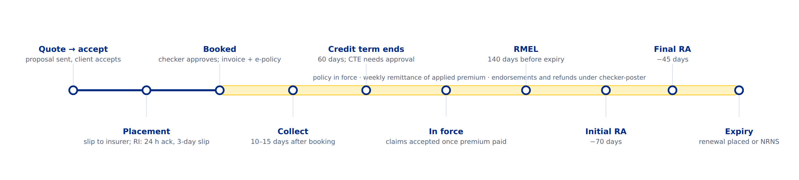
The life of one policy
Collections start 10–15 days after booking and the credit term is 60 days; a commitment beyond it needs a credit-term extension. Claims are accepted only while the policy is in force and the premium is paid. The renewal master expiry list opens 140 days before expiry, with renewal advices at 70 and 45 days; an accepted renewal is placed and booked like new business.
BDOI operating model · BrokerVerse · delivered by iorta TechNXT
5
Notes:
Collections start 10–15 days after booking and the credit term is 60 days; a commitment beyond it needs a credit-term extension. Claims are accepted only while the policy is in force and the premium is paid. The renewal master expiry list opens 140 days before expiry, with renewal advices at 70 and 45 days; an accepted renewal is placed and booked like new business.

Slide 6
Twelve stages
Each stage has its units, a trigger, activities, outputs, a control, a clock and a BrokerVerse screen. The following slides take them one by one.
1
Onboarding & screening
2
Quotation & proposal
3
Placement with the insurer
4
Booking, invoicing & e-policy
Marketing Account Officer (MAO) · Compliance
MAO · Marketing TL · TSU (non-packaged) · Reinsurance
Processing Team / Officer (PT/PO) · Insurer
PO (maker) · Underwriting Head (checker) · COG-OPRM · Contact centre
5
Cashiering & payment application
6
Marketing collections
7
Remittance & disbursement
8
FRBS ledger & reconciliation
Cashiering Team · UPP handler · Marketing (direct payments)
Collection Handler · MAO · Unit / Finance Head
Operations (extract) · Disbursement DPO → DTL → DSH → DUH · Insurer
FRBS Accounting Assistant · TL · Team Head · Accounting Processor (ACSL)
9
Adjustments, cancellations & refunds
10
Claims
11
Customer servicing & case management
12
Renewal (automated RMEL)
Adjustment Team · Operations checker-poster · MAO · Marketing TL · Unit Head
Claim handler · Insurer / adjuster · Assured · Casa / dealer
BDO Contact Centre (CCC) · BDO Insure agent · Fulfilment units
Sanitation Handler · Marketing TL / Team Head · PO · Insurer
BDOI operating model · BrokerVerse · delivered by iorta TechNXT
6

Slide 7
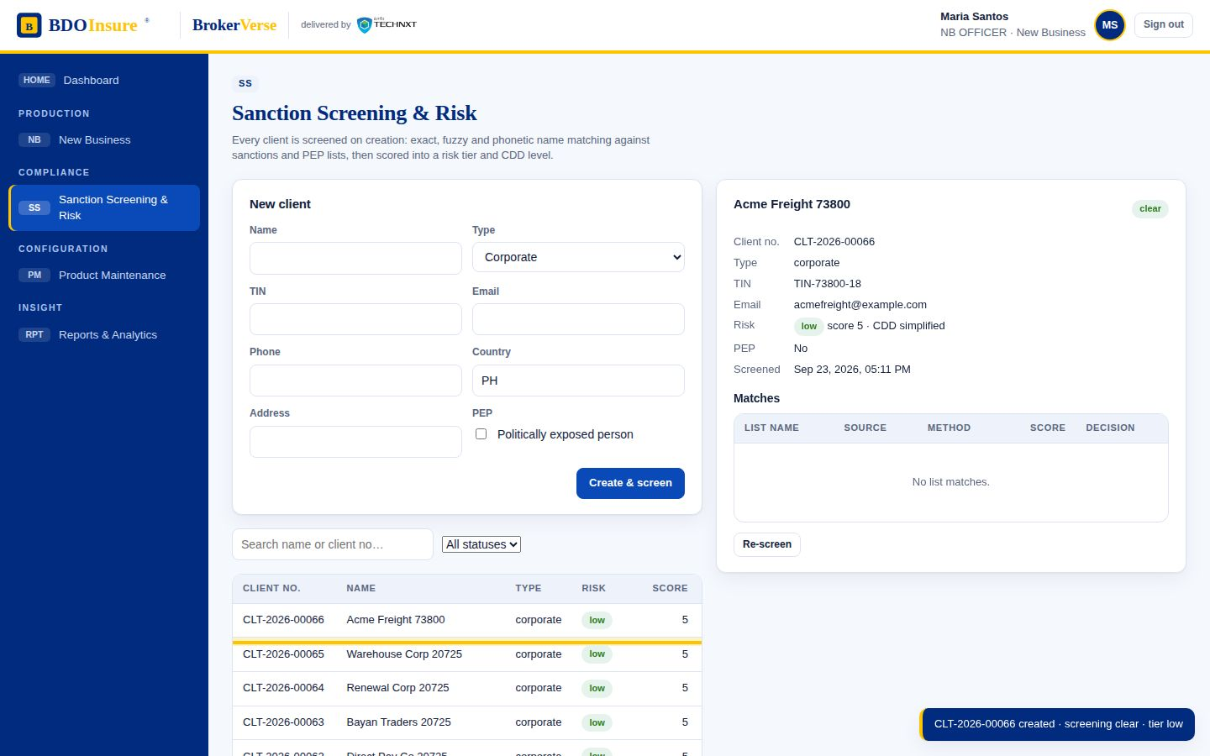
STAGE 1 OF 12
1
Onboarding & screening
Marketing Account Officer (MAO) · Compliance
STARTS WHEN A prospect walks in, a BDO branch or loan unit refers a client (CBG home / motor loans, CLPC), or a corporate account is prospected.
Client created with KYC details and TIN
Automatic sanctions and PEP screening; hit → Compliance clears or declines
Risk score and tier set the customer due-diligence level
PRODUCES
Client record (CLT-no.), screening result, CDD level
CONTROL
No quotation without a screened client; declined clients cannot transact.
In BrokerVerse: Sanction Screening & Risk
CLOCK
Immediate
Onboard
Quote
Place
Book
Pay
Collect
Remit
Ledger
Adjust
Claim
Service
Renew
FLOWS
NEW BUSINESS · BDOIR E2E
SCREEN
Sanction Screening & Risk
BDOI operating model · BrokerVerse · delivered by iorta TechNXT
7
Notes:
Onboarding & screening. Units: Marketing Account Officer (MAO) · Compliance. Starts when A prospect walks in, a BDO branch or loan unit refers a client (CBG home / motor loans, CLPC), or a corporate account is prospected. Client created with KYC details and TIN Automatic sanctions and PEP screening; hit → Compliance clears or declines Risk score and tier set the customer due-diligence level Produces: Client record (CLT-no.), screening result, CDD level. Control: No quotation without a screened client; declined clients cannot transact.. Clock: Immediate. Screen: Sanction Screening & Risk.

Slide 8
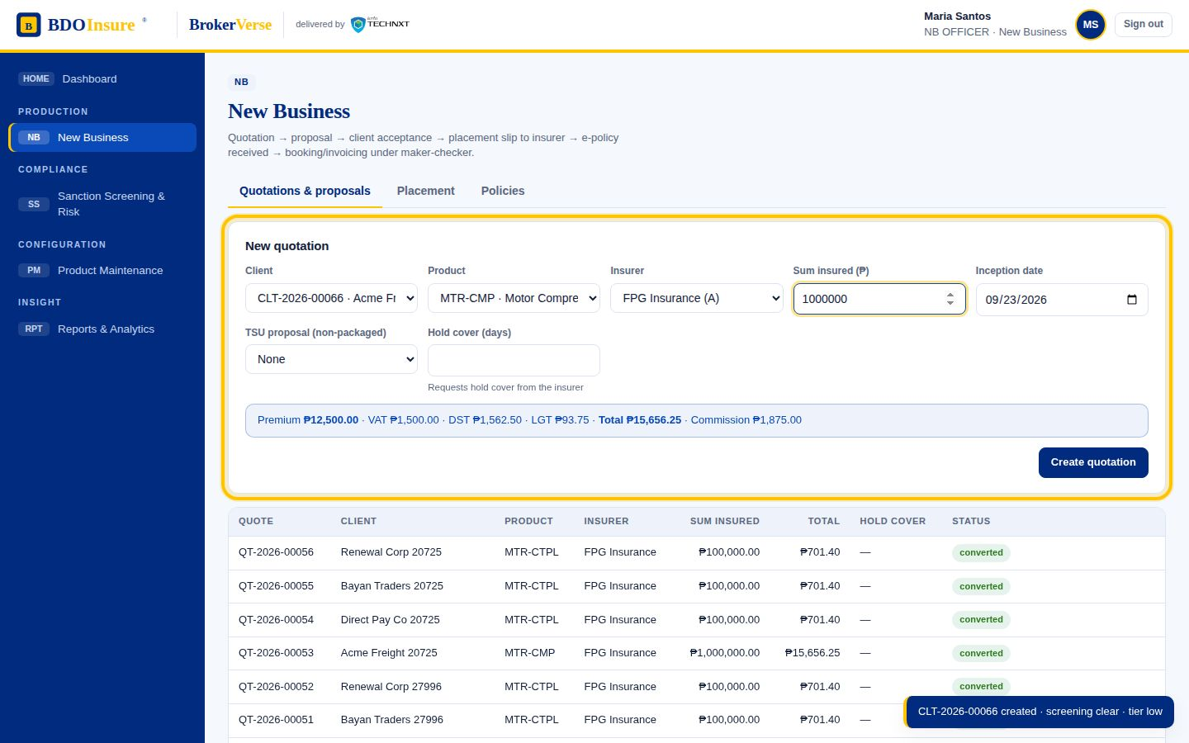
STAGE 2 OF 12
2
Quotation & proposal
MAO · Marketing TL · TSU (non-packaged) · Reinsurance
STARTS WHEN Screened client requests cover, or a renewal/conversion opportunity is opened.
Packaged product: rating engine prices premium, VAT, DST, LGT, FST and commission from the product table
Non-packaged risk: TSU request → completeness and duplicate check → quotation slip → TL approval → RI referral if needed → sent to insurers → responses with evidence → comparative table → proposal slip approved
Proposal emailed; client accepts or declines with reason; hold cover can be requested from the insurer
PRODUCES
Quotation (QT-no.), proposal, TSU proposal slip, hold-cover request
CONTROL
Non-packaged products cannot be quoted without an approved TSU proposal; acceptance limits and survey threshold checked at quotation.
In BrokerVerse: New Business › Quotations & proposals · Product Maintenance › TSU requests
CLOCK
TSU SLA escalation on breach; insurer follow-up until all quotes are in
Onboard
Quote
Place
Book
Pay
Collect
Remit
Ledger
Adjust
Claim
Service
Renew
FLOWS
NEW BUSINESS · PRODUCT MAINTENANCE TSU · RENISURANCE
SCREEN
New Business › Quotations & proposals · Product Maintenance › TSU requests
BDOI operating model · BrokerVerse · delivered by iorta TechNXT
8
Notes:
Quotation & proposal. Units: MAO · Marketing TL · TSU (non-packaged) · Reinsurance. Starts when Screened client requests cover, or a renewal/conversion opportunity is opened. Packaged product: rating engine prices premium, VAT, DST, LGT, FST and commission from the product table Non-packaged risk: TSU request → completeness and duplicate check → quotation slip → TL approval → RI referral if needed → sent to insurers → responses with evidence → comparative table → proposal slip approved Proposal emailed; client accepts or declines with reason; hold cover can be requested from the insurer Produces: Quotation (QT-no.), proposal, TSU proposal slip, hold-cover request. Control: Non-packaged products cannot be quoted without an approved TSU proposal; acceptance limits and survey threshold checked at quotation.. Clock: TSU SLA escalation on breach; insurer follow-up until all quotes are in. Screen: New Business › Quotations & proposals · Product Maintenance › TSU requests.

Slide 9
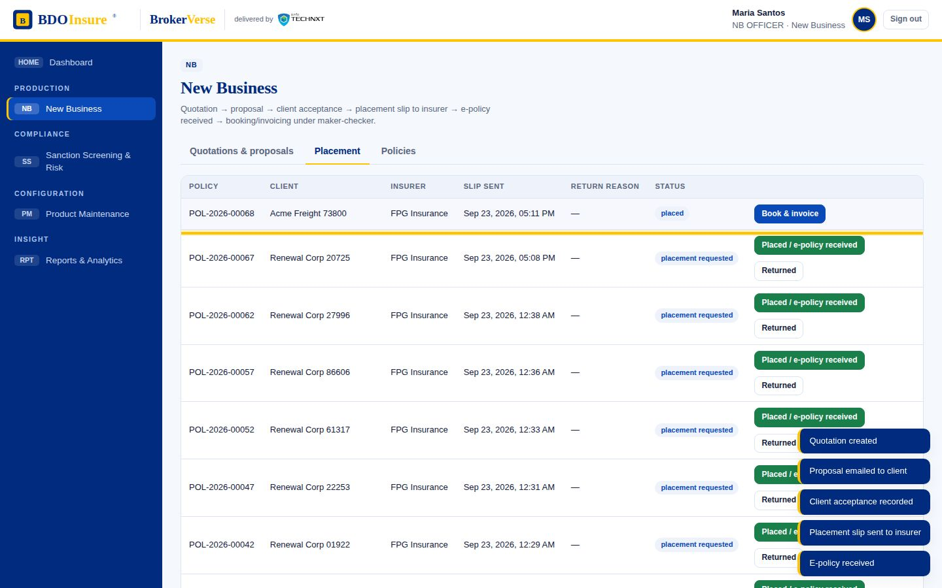
STAGE 3 OF 12
3
Placement with the insurer
Processing Team / Officer (PT/PO) · Insurer
STARTS WHEN Client acceptance recorded.
Policy shell created in status placement requested
Placement slip sent by SFTP when the insurer is enrolled, otherwise by email
Insurer returns (reason routed to marketing, resubmitted) or places the risk and issues the policy
PRODUCES
Policy (POL-no.), placement slip, insurer policy reference
CONTROL
Channel decided by the insurer record; returns carry a reason and can be resubmitted.
In BrokerVerse: New Business › Placement · Reinsurance › Facultative placements
CLOCK
Facultative RI: acknowledge within 24 hours, slip within 3 working days
Onboard
Quote
Place
Book
Pay
Collect
Remit
Ledger
Adjust
Claim
Service
Renew
FLOWS
NEW BUSINESS · RENISURANCE
SCREEN
New Business › Placement · Reinsurance › Facultative placements
BDOI operating model · BrokerVerse · delivered by iorta TechNXT
9
Notes:
Placement with the insurer. Units: Processing Team / Officer (PT/PO) · Insurer. Starts when Client acceptance recorded. Policy shell created in status placement requested Placement slip sent by SFTP when the insurer is enrolled, otherwise by email Insurer returns (reason routed to marketing, resubmitted) or places the risk and issues the policy Produces: Policy (POL-no.), placement slip, insurer policy reference. Control: Channel decided by the insurer record; returns carry a reason and can be resubmitted.. Clock: Facultative RI: acknowledge within 24 hours, slip within 3 working days. Screen: New Business › Placement · Reinsurance › Facultative placements.

Slide 10
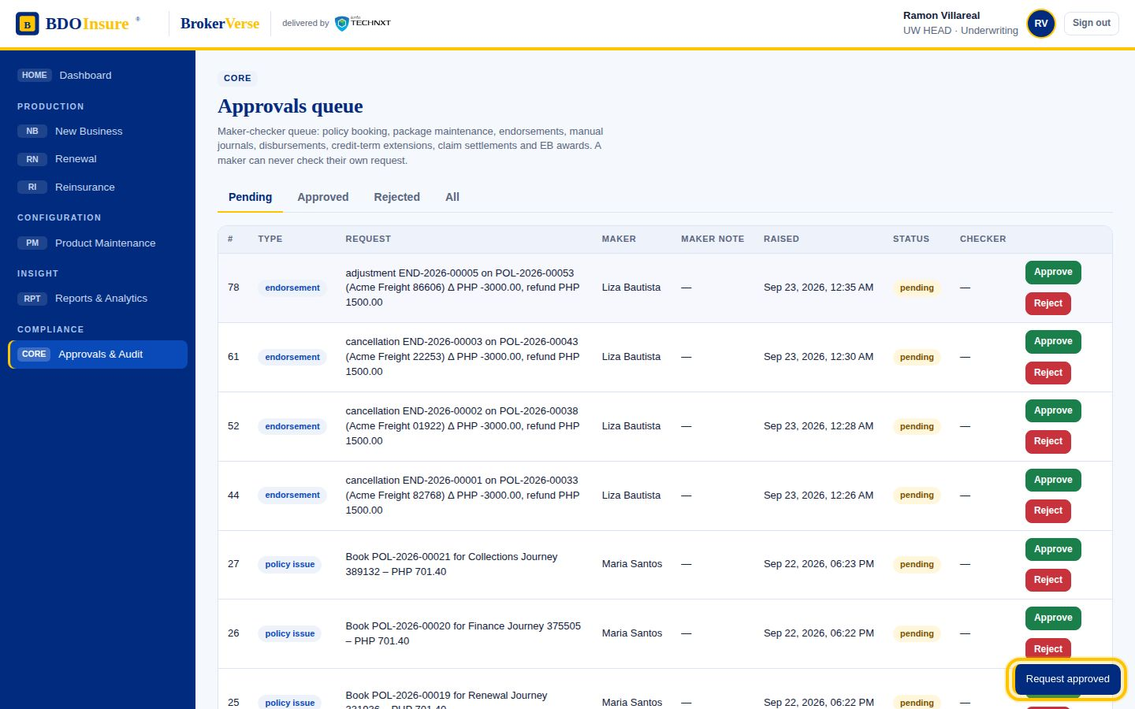
STAGE 4 OF 12
4
Booking, invoicing & e-policy
PO (maker) · Underwriting Head (checker) · COG-OPRM · Contact centre
STARTS WHEN Risk placed and e-policy received.
Book & invoice raises a policy_issue approval; the checker approves
On approval: policy in force, invoice (premium receivable) generated, booking journal posted
E-policy delivered to the client via COG (SFTP) or PO email; fall-outs go to the contact centre with the exception reason
PRODUCES
Invoice (INV-no.), booking journal, e-policy, exception report
CONTROL
Maker-checker with segregation of duties; only in-force, renewed or expired policies can carry claims.
In BrokerVerse: Approvals & Audit · New Business › Policies
CLOCK
Same day once placed
Onboard
Quote
Place
Book
Pay
Collect
Remit
Ledger
Adjust
Claim
Service
Renew
FLOWS
NEW BUSINESS · BDOIR E2E
SCREEN
Approvals & Audit · New Business › Policies
BDOI operating model · BrokerVerse · delivered by iorta TechNXT
10
Notes:
Booking, invoicing & e-policy. Units: PO (maker) · Underwriting Head (checker) · COG-OPRM · Contact centre. Starts when Risk placed and e-policy received. Book & invoice raises a policy_issue approval; the checker approves On approval: policy in force, invoice (premium receivable) generated, booking journal posted E-policy delivered to the client via COG (SFTP) or PO email; fall-outs go to the contact centre with the exception reason Produces: Invoice (INV-no.), booking journal, e-policy, exception report. Control: Maker-checker with segregation of duties; only in-force, renewed or expired policies can carry claims.. Clock: Same day once placed. Screen: Approvals & Audit · New Business › Policies.

Slide 11
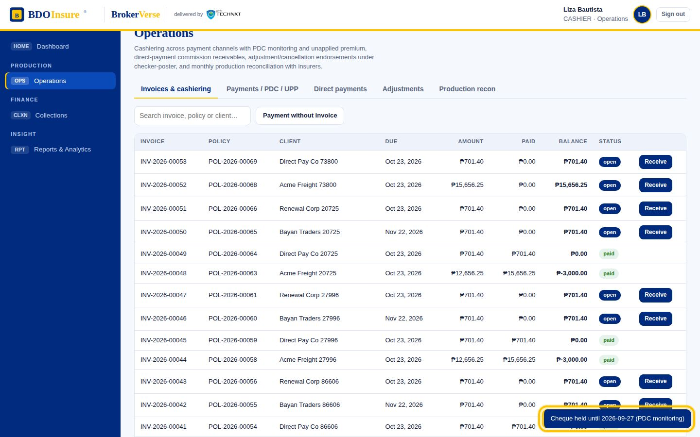
STAGE 5 OF 12
5
Cashiering & payment application
Cashiering Team · UPP handler · Marketing (direct payments)
STARTS WHEN Client pays: bills payment, OTC cash or cheque, CLPC / PMS / trade batch files, direct credit, autopay, or directly to the insurer.
Payment applied to the invoice; official receipt issued; cash and premium journals posted
Post-dated / OTC cheques held 4 days, then matured and applied, or tagged bounced (exclusion list)
Zero-PR or excess payments become unapplied premium (GL 2400) until matched
Direct payment to insurer: commission receivable (GL 1250) identified → billed → approved → collected with a commission OR
PRODUCES
Official receipt (OR-no.), PDC register, unapplied list, commission billing
CONTROL
Cheques cannot mature before the clearing date; unapplied premium never sits against an invoice.
In BrokerVerse: Operations › Invoices & cashiering · Payments / PDC / UPP · Direct payments
CLOCK
4-day cheque hold
Onboard
Quote
Place
Book
Pay
Collect
Remit
Ledger
Adjust
Claim
Service
Renew
FLOWS
OPERATIONS · BDOIR E2E
SCREEN
Operations › Invoices & cashiering · Payments / PDC / UPP · Direct payments
BDOI operating model · BrokerVerse · delivered by iorta TechNXT
11
Notes:
Cashiering & payment application. Units: Cashiering Team · UPP handler · Marketing (direct payments). Starts when Client pays: bills payment, OTC cash or cheque, CLPC / PMS / trade batch files, direct credit, autopay, or directly to the insurer. Payment applied to the invoice; official receipt issued; cash and premium journals posted Post-dated / OTC cheques held 4 days, then matured and applied, or tagged bounced (exclusion list) Zero-PR or excess payments become unapplied premium (GL 2400) until matched Direct payment to insurer: commission receivable (GL 1250) identified → billed → approved → collected with a commission OR Produces: Official receipt (OR-no.), PDC register, unapplied list, commission billing. Control: Cheques cannot mature before the clearing date; unapplied premium never sits against an invoice.. Clock: 4-day cheque hold. Screen: Operations › Invoices & cashiering · Payments / PDC / UPP · Direct payments.

Slide 12
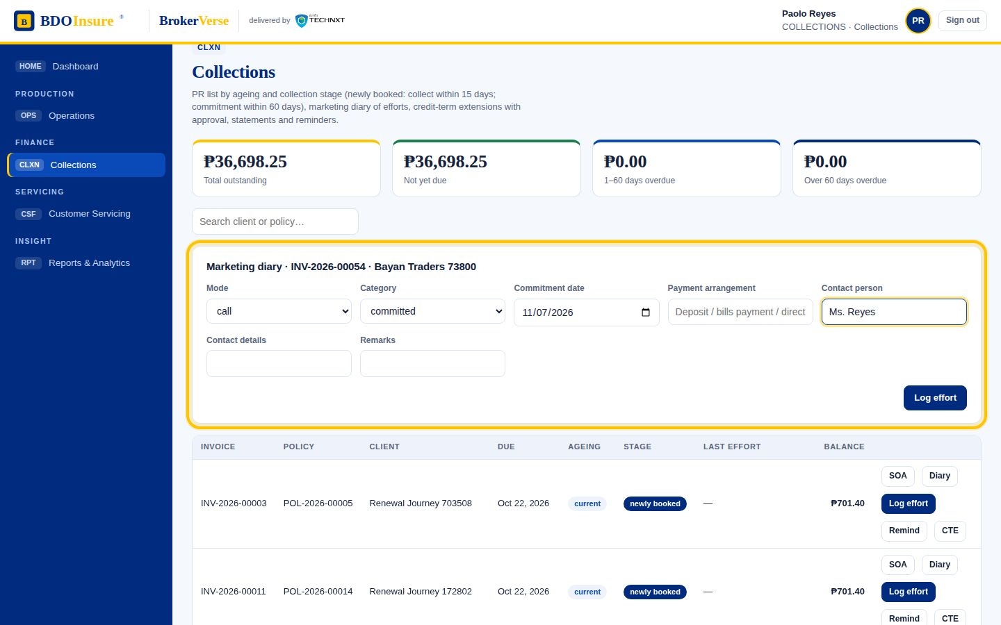
STAGE 6 OF 12
6
Marketing collections
Collection Handler · MAO · Unit / Finance Head
STARTS WHEN Invoice unpaid after booking.
PR list by market segment with ageing and stage: newly booked → within credit term → committed → overdue → escalate
Marketing diary records when, where, how and what of every effort; SOA and reminders sent
Commitment beyond the 60-day credit term emails the MAO; a credit-term extension (CTE) needs Unit Head approval
PRODUCES
Statement of account, effort diary, CTE request
CONTROL
Collect within 10–15 days of booking; CTE extends the due date only after approval.
In BrokerVerse: Collections
CLOCK
60-day credit term
Onboard
Quote
Place
Book
Pay
Collect
Remit
Ledger
Adjust
Claim
Service
Renew
FLOWS
MARKETING COLLECTIONS
SCREEN
Collections
BDOI operating model · BrokerVerse · delivered by iorta TechNXT
12
Notes:
Marketing collections. Units: Collection Handler · MAO · Unit / Finance Head. Starts when Invoice unpaid after booking. PR list by market segment with ageing and stage: newly booked → within credit term → committed → overdue → escalate Marketing diary records when, where, how and what of every effort; SOA and reminders sent Commitment beyond the 60-day credit term emails the MAO; a credit-term extension (CTE) needs Unit Head approval Produces: Statement of account, effort diary, CTE request. Control: Collect within 10–15 days of booking; CTE extends the due date only after approval.. Clock: 60-day credit term. Screen: Collections.

Slide 13
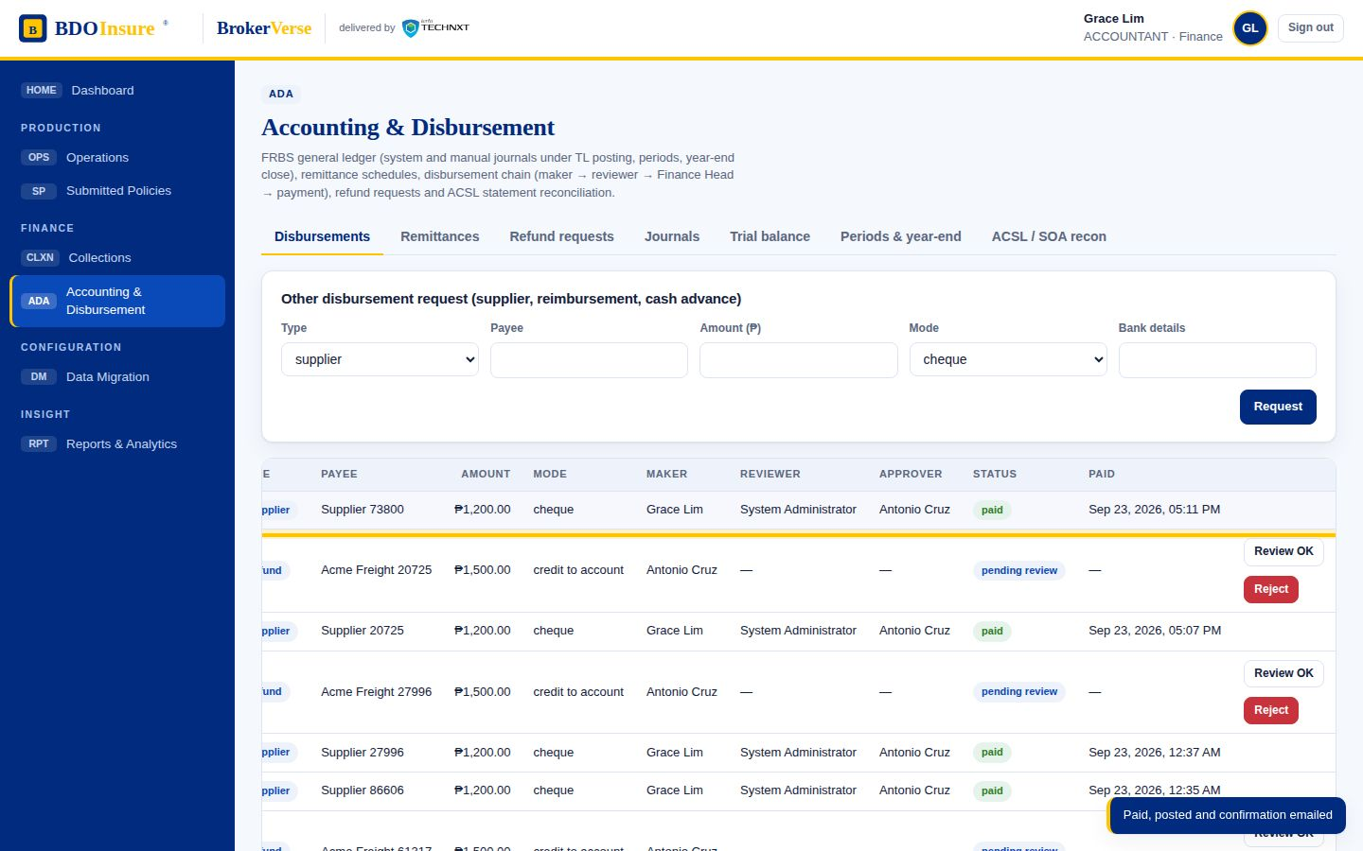
STAGE 7 OF 12
7
Remittance & disbursement
Operations (extract) · Disbursement DPO → DTL → DSH → DUH · Insurer
STARTS WHEN Applied payments accumulate; weekly cycle (Monday to Friday coverage).
Weekly remittance extract per insurer, sanitised (direct-paid and already-remitted policies excluded, endorsements and knock-offs removed)
Submission creates a disbursement voucher; reviewer, section head and unit head sign in sequence
Payment posted with cheque or transaction reference; confirmation email to the requestor; GL batch posted
The same chain pays refunds, suppliers, reimbursements and cash advances
PRODUCES
Remittance schedule, disbursement voucher, payment journal, confirmation email
CONTROL
Requester, reviewer, approver and payer are different people; nothing is paid without the approval chain.
In BrokerVerse: Accounting & Disbursement › Remittances · Disbursements
CLOCK
Weekly extract; end-of-day processing
Onboard
Quote
Place
Book
Pay
Collect
Remit
Ledger
Adjust
Claim
Service
Renew
FLOWS
OPERATIONS · DISBURSEMENT
SCREEN
Accounting & Disbursement › Remittances · Disbursements
BDOI operating model · BrokerVerse · delivered by iorta TechNXT
13
Notes:
Remittance & disbursement. Units: Operations (extract) · Disbursement DPO → DTL → DSH → DUH · Insurer. Starts when Applied payments accumulate; weekly cycle (Monday to Friday coverage). Weekly remittance extract per insurer, sanitised (direct-paid and already-remitted policies excluded, endorsements and knock-offs removed) Submission creates a disbursement voucher; reviewer, section head and unit head sign in sequence Payment posted with cheque or transaction reference; confirmation email to the requestor; GL batch posted The same chain pays refunds, suppliers, reimbursements and cash advances Produces: Remittance schedule, disbursement voucher, payment journal, confirmation email. Control: Requester, reviewer, approver and payer are different people; nothing is paid without the approval chain.. Clock: Weekly extract; end-of-day processing. Screen: Accounting & Disbursement › Remittances · Disbursements.

Slide 14
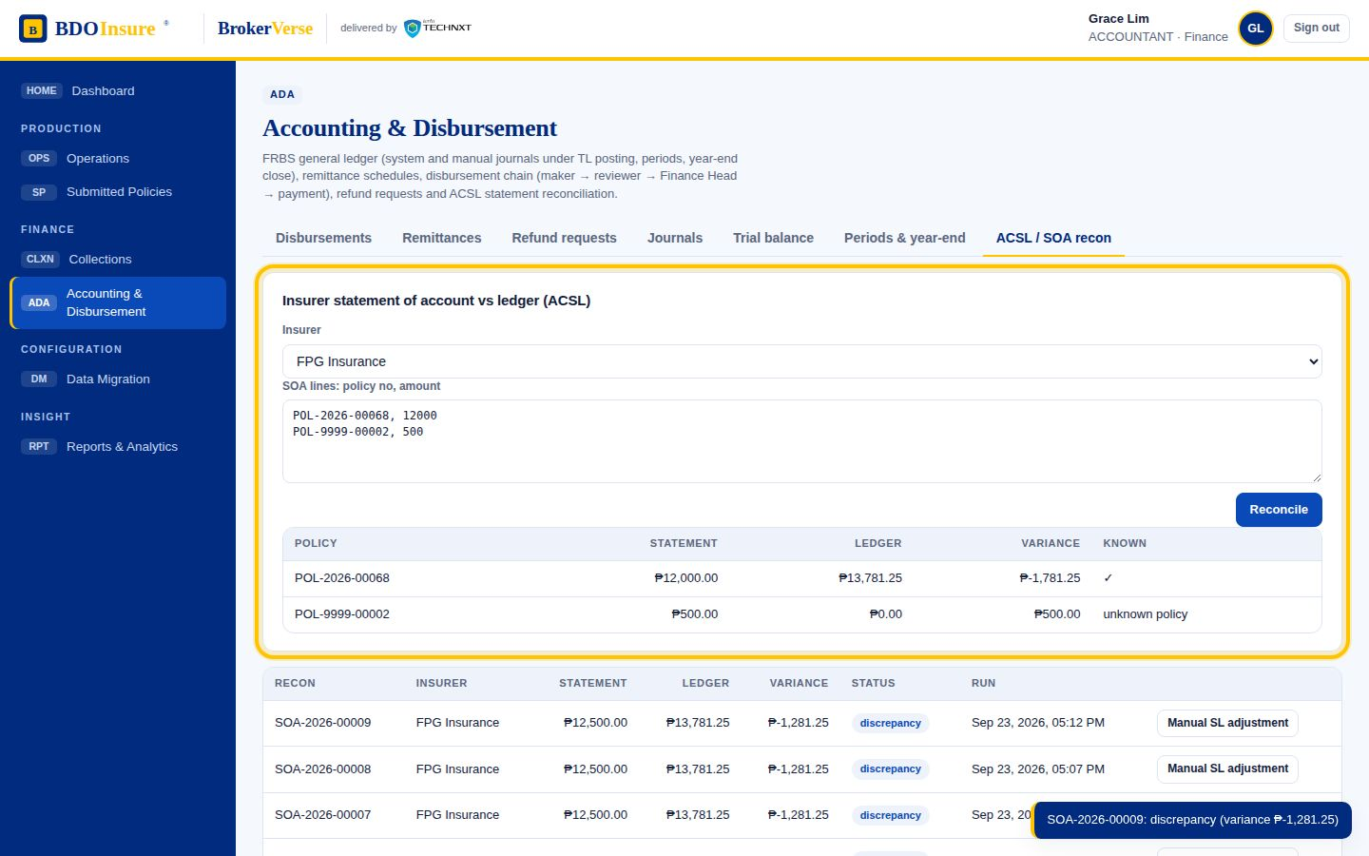
STAGE 8 OF 12
8
FRBS ledger & reconciliation
FRBS Accounting Assistant · TL · Team Head · Accounting Processor (ACSL)
STARTS WHEN Every transaction above posts a journal automatically; month and year ends.
Chart of accounts maintained; system journals for booking, receipts, commissions, remittances and refunds
Manual journals drafted, reviewed by the TL and posted by the FRBS approver
ACSL: insurer statement of account reconciled with the subsidiary ledger; abnormal balances raise adjustment entries
Period close and reopen; fiscal-year close moves nominal balances to retained earnings; trial balance and financial reports
PRODUCES
Journals, trial balance, financial reports, SOA reconciliation runs
CONTROL
Double-entry ledger; closed periods reject postings; only the Finance Head reopens a period.
In BrokerVerse: Accounting & Disbursement › Journals · Trial balance · Periods & year-end · ACSL / SOA recon
CLOCK
Monthly on an agreed date; year-end
Onboard
Quote
Place
Book
Pay
Collect
Remit
Ledger
Adjust
Claim
Service
Renew
FLOWS
FRBS - ACCOUNTING · ACSL
SCREEN
Accounting & Disbursement › Journals · Trial balance · Periods & year-end · ACSL / SOA recon
BDOI operating model · BrokerVerse · delivered by iorta TechNXT
14
Notes:
FRBS ledger & reconciliation. Units: FRBS Accounting Assistant · TL · Team Head · Accounting Processor (ACSL). Starts when Every transaction above posts a journal automatically; month and year ends. Chart of accounts maintained; system journals for booking, receipts, commissions, remittances and refunds Manual journals drafted, reviewed by the TL and posted by the FRBS approver ACSL: insurer statement of account reconciled with the subsidiary ledger; abnormal balances raise adjustment entries Period close and reopen; fiscal-year close moves nominal balances to retained earnings; trial balance and financial reports Produces: Journals, trial balance, financial reports, SOA reconciliation runs. Control: Double-entry ledger; closed periods reject postings; only the Finance Head reopens a period.. Clock: Monthly on an agreed date; year-end. Screen: Accounting & Disbursement › Journals · Trial balance · Periods & year-end · ACSL / SOA recon.

Slide 15
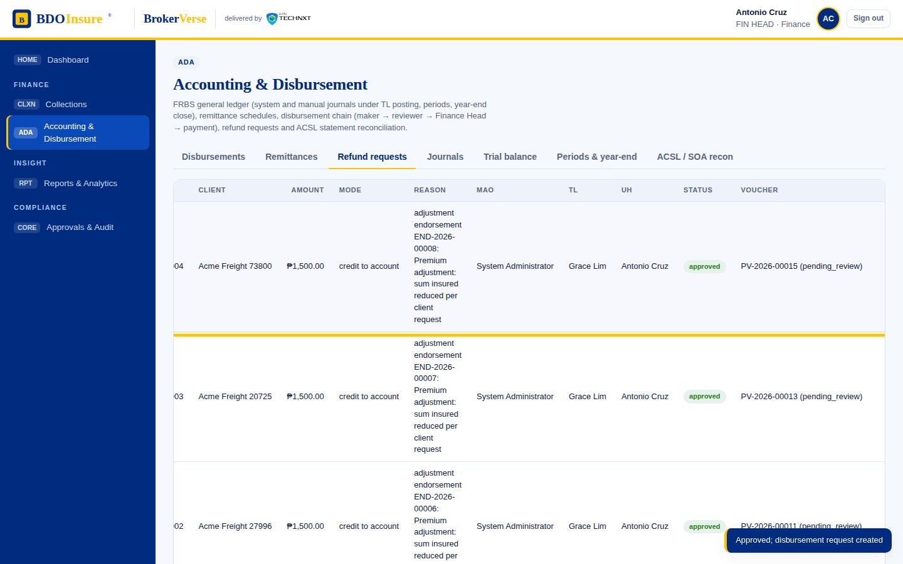
STAGE 9 OF 12
9
Adjustments, cancellations & refunds
Adjustment Team · Operations checker-poster · MAO · Marketing TL · Unit Head
STARTS WHEN Client requests a change or cancellation; production register shows a discrepancy; unapplied premium to be returned.
Endorsement (adjustment or cancellation) validated and posted under checker-poster; premium delta journaled; cancellation sets the policy cancelled
Production reconciliation classifies insurer register rows as matched, with discrepancies or unbooked, each dispositioned
Refund Request Form raised from the endorsement or UPP → Marketing TL review → Unit Head sign-off → refund disbursement voucher
PRODUCES
Endorsement (END-no.), production recon run, RRF and refund voucher
CONTROL
Refunds only originate from endorsements or unapplied premium and are paid only through the disbursement chain.
In BrokerVerse: Operations › Adjustments · Production recon · Accounting & Disbursement › Refund requests
CLOCK
Per disbursement chain
Onboard
Quote
Place
Book
Pay
Collect
Remit
Ledger
Adjust
Claim
Service
Renew
FLOWS
OPERATIONS · REFUND REQUEST · BDOIR E2E
SCREEN
Operations › Adjustments · Production recon · Accounting & Disbursement › Refund requests
BDOI operating model · BrokerVerse · delivered by iorta TechNXT
15
Notes:
Adjustments, cancellations & refunds. Units: Adjustment Team · Operations checker-poster · MAO · Marketing TL · Unit Head. Starts when Client requests a change or cancellation; production register shows a discrepancy; unapplied premium to be returned. Endorsement (adjustment or cancellation) validated and posted under checker-poster; premium delta journaled; cancellation sets the policy cancelled Production reconciliation classifies insurer register rows as matched, with discrepancies or unbooked, each dispositioned Refund Request Form raised from the endorsement or UPP → Marketing TL review → Unit Head sign-off → refund disbursement voucher Produces: Endorsement (END-no.), production recon run, RRF and refund voucher. Control: Refunds only originate from endorsements or unapplied premium and are paid only through the disbursement chain.. Clock: Per disbursement chain. Screen: Operations › Adjustments · Production recon · Accounting & Disbursement › Refund requests.

Slide 16
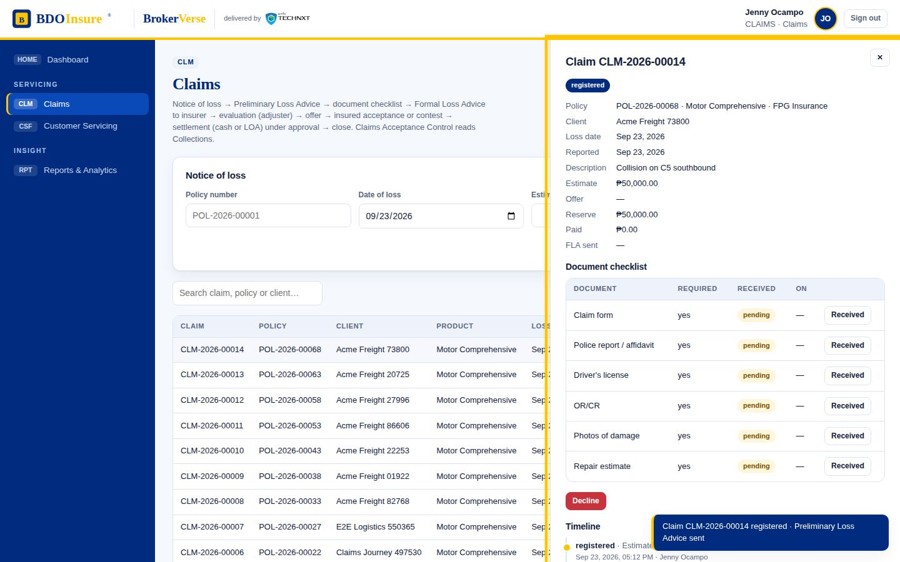
STAGE 10 OF 12
10
Claims
Claim handler · Insurer / adjuster · Assured · Casa / dealer
STARTS WHEN Client, account officer or branch sends notice of loss.
Claims Acceptance Control checks the policy is in force and premium paid; Preliminary Loss Advice sent
Document checklist by line (motor; non-motor via Claims Reporting Form); Formal Loss Advice to the insurer once complete; adjuster flagged
Insurer evaluates and offers; assured accepts or contests (re-evaluation loop, more documents may be requested)
Settlement by Letter of Authority to the preferred casa/dealer or by cash cheque; settlement approved; claim tagged settled and closed, or declined with reason
PRODUCES
PLA, FLA, offer, LOA, settlement
CONTROL
FLA blocked until documents complete; settlement is maker-checker; every stage has a declination exit.
In BrokerVerse: Claims
CLOCK
Age in days tracked per claim
Onboard
Quote
Place
Book
Pay
Collect
Remit
Ledger
Adjust
Claim
Service
Renew
FLOWS
CLAIMS PROCESS FLOW
SCREEN
Claims
BDOI operating model · BrokerVerse · delivered by iorta TechNXT
16
Notes:
Claims. Units: Claim handler · Insurer / adjuster · Assured · Casa / dealer. Starts when Client, account officer or branch sends notice of loss. Claims Acceptance Control checks the policy is in force and premium paid; Preliminary Loss Advice sent Document checklist by line (motor; non-motor via Claims Reporting Form); Formal Loss Advice to the insurer once complete; adjuster flagged Insurer evaluates and offers; assured accepts or contests (re-evaluation loop, more documents may be requested) Settlement by Letter of Authority to the preferred casa/dealer or by cash cheque; settlement approved; claim tagged settled and closed, or declined with reason Produces: PLA, FLA, offer, LOA, settlement. Control: FLA blocked until documents complete; settlement is maker-checker; every stage has a declination exit.. Clock: Age in days tracked per claim. Screen: Claims.

Slide 17
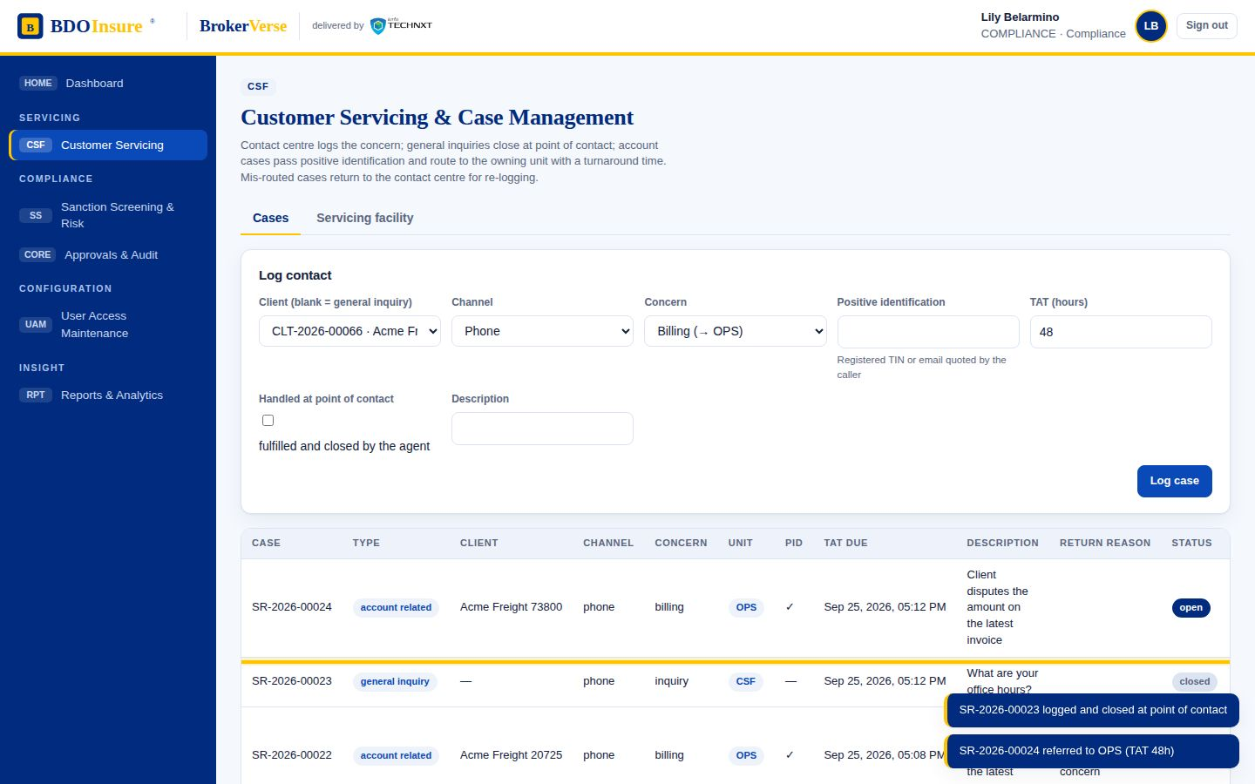
STAGE 11 OF 12
11
Customer servicing & case management
BDO Contact Centre (CCC) · BDO Insure agent · Fulfilment units
STARTS WHEN Customer contacts the contact centre by phone, email or digital channel.
General inquiry handled and closed at point of contact
Account-related concern: positive identification (registered TIN or email) then handled at point of contact or referred to the owning unit with a TAT
Fulfilment unit resolves and closes; mis-routed cases returned to the CCC with a reason and re-logged
Servicing facility: search by invoice, policy or name; view accounts; update contact details
PRODUCES
Case (SR-no.), TAT, contact update
CONTROL
Failed PID blocks the case; past-TAT cases are flagged on the dashboard.
In BrokerVerse: Customer Servicing › Cases · Servicing facility
CLOCK
Per category (hours)
Onboard
Quote
Place
Book
Pay
Collect
Remit
Ledger
Adjust
Claim
Service
Renew
FLOWS
CASE MANAGEMENT TO BE · CUSTOMER SERVICING FACILITY
SCREEN
Customer Servicing › Cases · Servicing facility
BDOI operating model · BrokerVerse · delivered by iorta TechNXT
17
Notes:
Customer servicing & case management. Units: BDO Contact Centre (CCC) · BDO Insure agent · Fulfilment units. Starts when Customer contacts the contact centre by phone, email or digital channel. General inquiry handled and closed at point of contact Account-related concern: positive identification (registered TIN or email) then handled at point of contact or referred to the owning unit with a TAT Fulfilment unit resolves and closes; mis-routed cases returned to the CCC with a reason and re-logged Servicing facility: search by invoice, policy or name; view accounts; update contact details Produces: Case (SR-no.), TAT, contact update. Control: Failed PID blocks the case; past-TAT cases are flagged on the dashboard.. Clock: Per category (hours). Screen: Customer Servicing › Cases · Servicing facility.

Slide 18
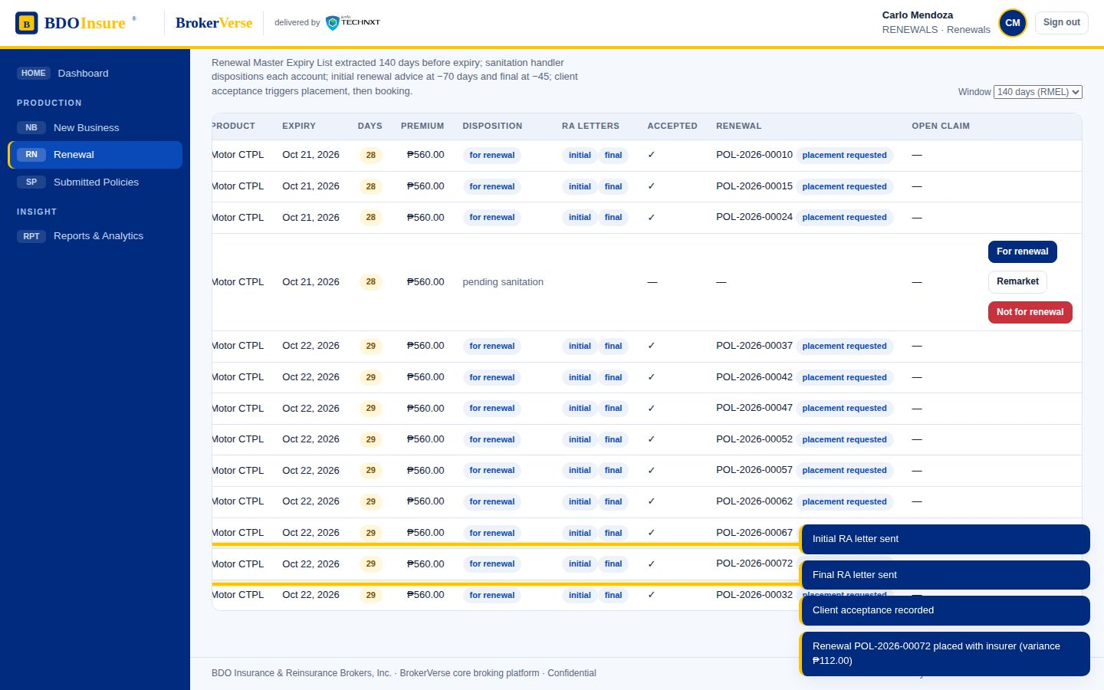
STAGE 12 OF 12
12
Renewal (automated RMEL)
Sanitation Handler · Marketing TL / Team Head · PO · Insurer
STARTS WHEN Policy enters the 140-day window before expiry.
Renewal Master Expiry List generated; sanitation dispositions each account: for renewal, remarket, or not for renewal (NRNS letter)
Renewal advice letters: initial at −70 days, final at −45 days
Client accepts: renewal policy created and enters placement → booking → e-policy like new business
Bank-submitted policies feed the sanitation handler 150 days from expiry (conversion opportunity)
PRODUCES
RMEL, RA letters, NRNS letter, renewal policy
CONTROL
RA timings and order enforced; conversion proceeds through New Business.
In BrokerVerse: Renewal · Submitted Policies › Expiring (150 days)
CLOCK
−140 / −70 / −45 days
Onboard
Quote
Place
Book
Pay
Collect
Remit
Ledger
Adjust
Claim
Service
Renew
FLOWS
RENEWAL · Submitted Policies
SCREEN
Renewal · Submitted Policies › Expiring (150 days)
BDOI operating model · BrokerVerse · delivered by iorta TechNXT
18
Notes:
Renewal (automated RMEL). Units: Sanitation Handler · Marketing TL / Team Head · PO · Insurer. Starts when Policy enters the 140-day window before expiry. Renewal Master Expiry List generated; sanitation dispositions each account: for renewal, remarket, or not for renewal (NRNS letter) Renewal advice letters: initial at −70 days, final at −45 days Client accepts: renewal policy created and enters placement → booking → e-policy like new business Bank-submitted policies feed the sanitation handler 150 days from expiry (conversion opportunity) Produces: RMEL, RA letters, NRNS letter, renewal policy. Control: RA timings and order enforced; conversion proceeds through New Business.. Clock: −140 / −70 / −45 days. Screen: Renewal · Submitted Policies › Expiring (150 days).

Slide 19
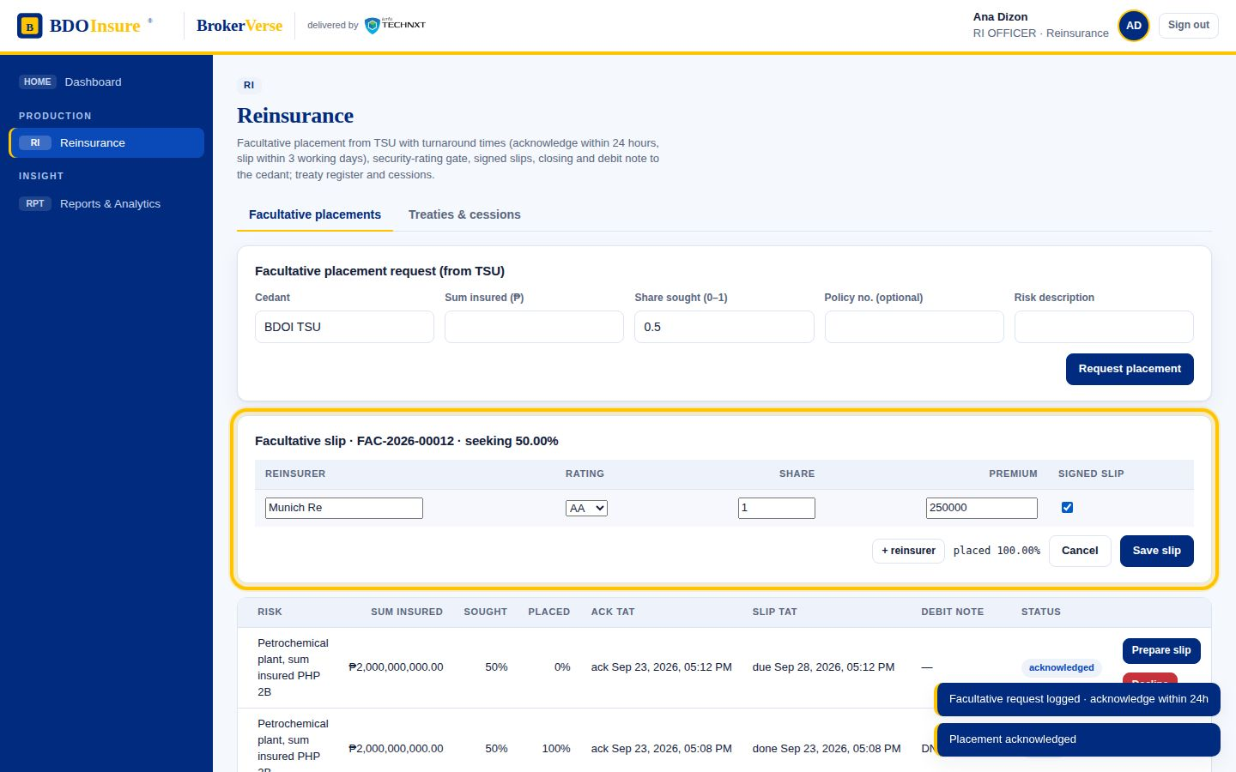
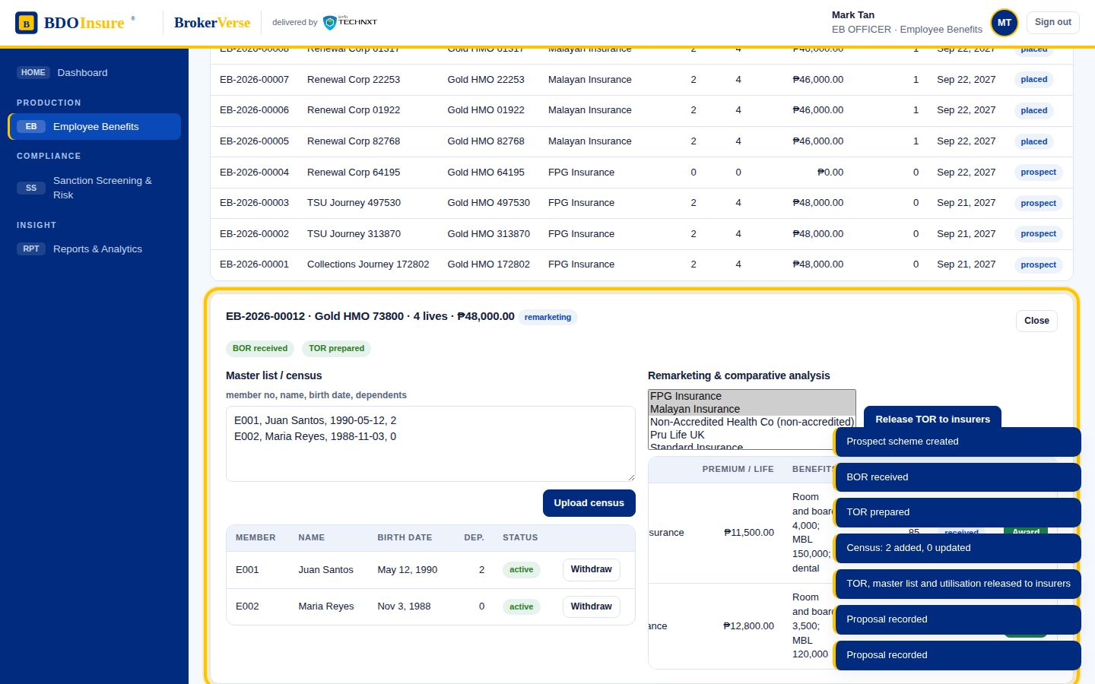
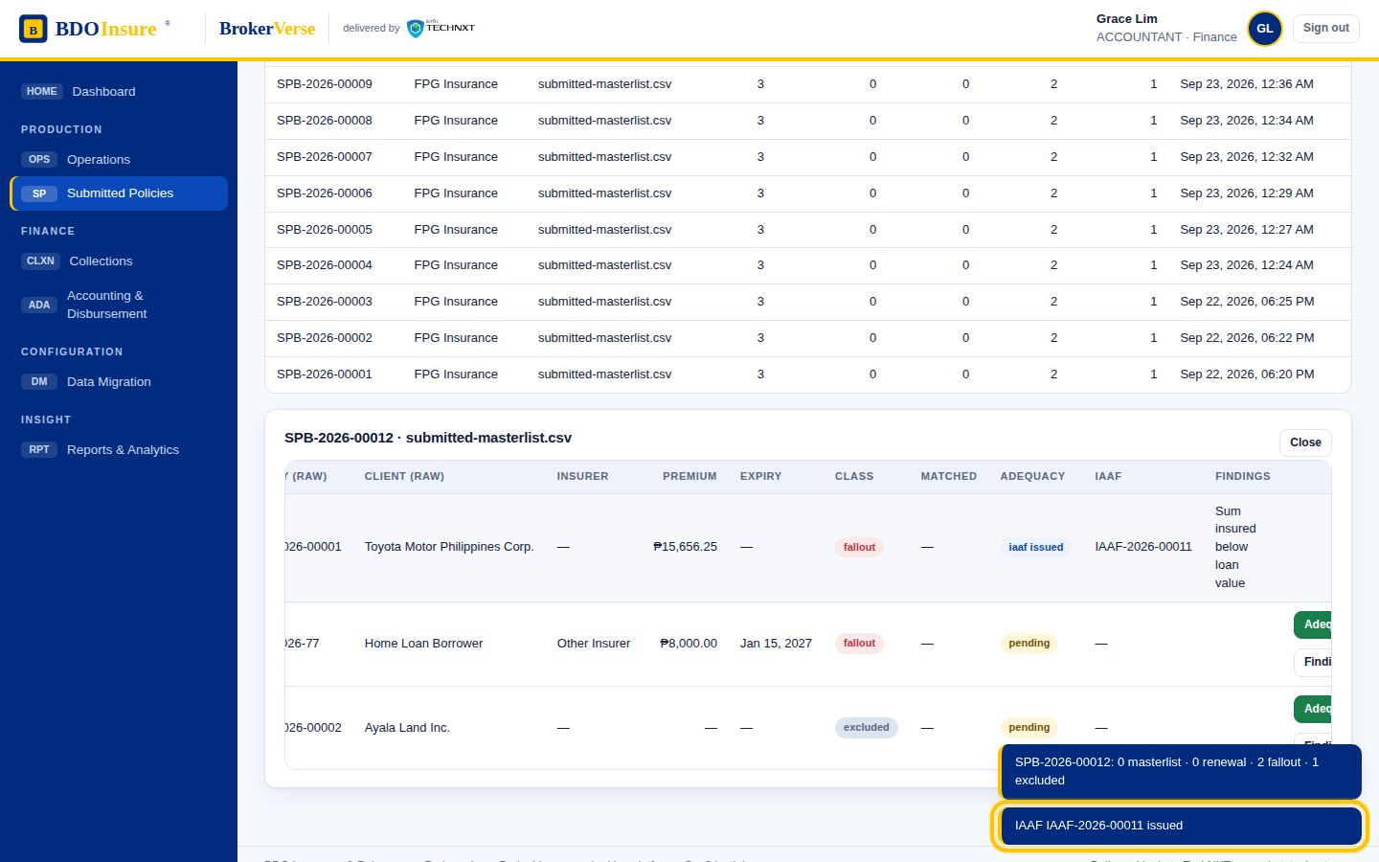
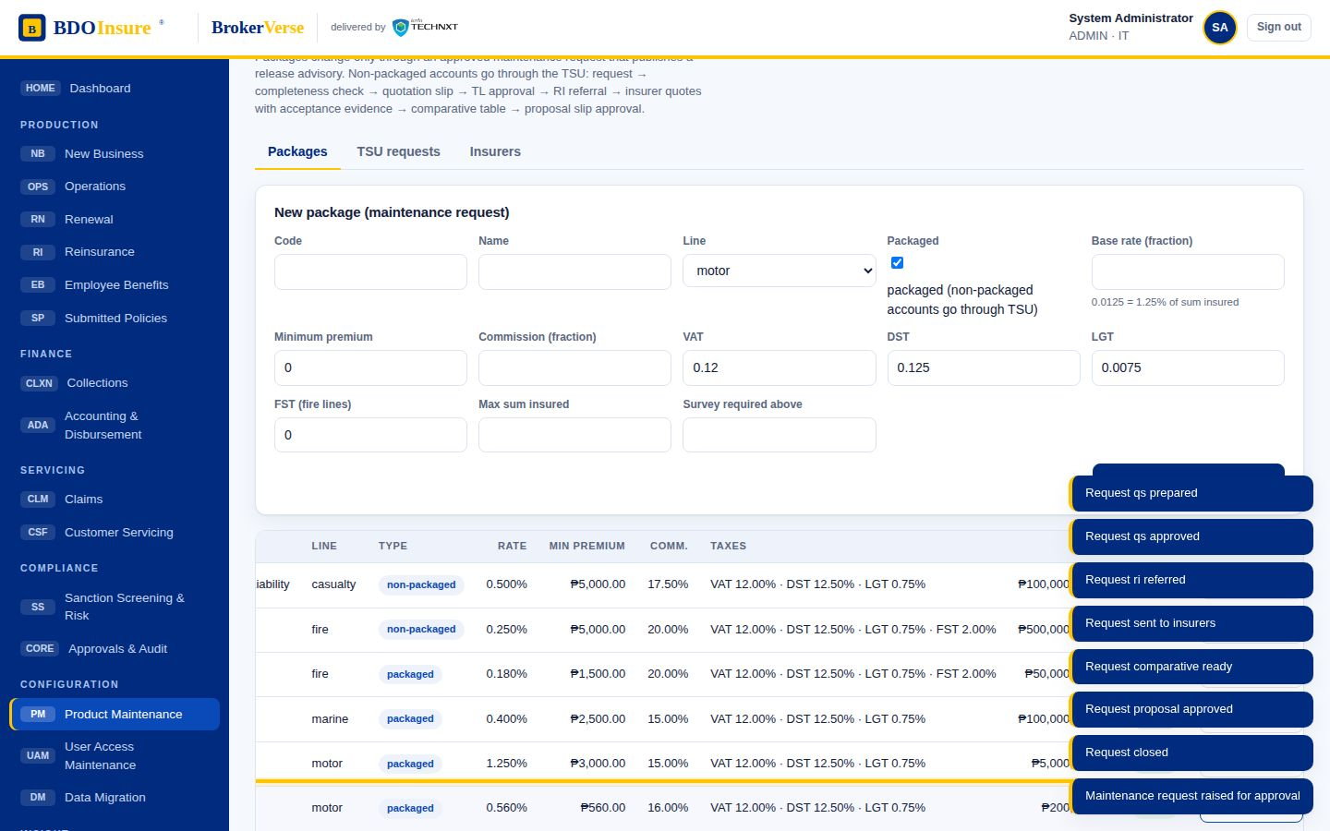
Satellite processes and where they plug in
Four flows run beside the main chain and feed it at specific stages.
Facultative reinsurance
Employee benefits
Feeds stage 2–3 for large or special risks referred by TSU: request → acknowledge (24 h) → underwriting information loop → slip with reinsurers, security rating and signed-slip evidence (3 working days) → closing and debit note to the cedant. RI commission is monitored with the Commission Receivable Unit.
A parallel new-business and renewal track for group schemes: renewal advice → Broker of Record → Terms of Reference with master list and utilisation released to insurers → comparative analysis (premium, benefits, capabilities) → client confirmation and award, with ISACOM approval for a non-accredited provider → handoff to processing and collections (stages 4–6).
RENISURANCE
EMPLOYEE BENEFITS
Submitted policies
Product maintenance
Policies the client bought elsewhere and submitted to the bank for its loan: masterlist validated, matched and consolidated; adequacy reviewed; findings issue an Insurance Adequacy Assessment Form; accounts 150 days from expiry go to the sanitation handler as renewal or conversion opportunities (stage 12).
Keeps stage 2 honest: package creation or change requests are validated, approved under maker-checker and published as a release advisory to Marketing, Operations and TSU; the insurer panel records accreditation (drives ISACOM) and SFTP enrolment (drives the placement channel).
Submitted Policies
PRODUCT MAINTENANCE TSU
BDOI operating model · BrokerVerse · delivered by iorta TechNXT
19

Slide 20
Process hand-offs
Each hand-off is a document or a state that one process writes and the next one reads.
Onboarding → Quotation
Quotation → TSU → Reinsurance
Only a screened client can be quoted; the client number carries into every later document.
Non-packaged risks leave New Business for a TSU quotation slip; large or special risks are referred to RI before quoting; the approved proposal slip returns to New Business.
Placement → Booking → Cashiering
Cashiering → Collections
Placement creates the policy; the checker’s approval creates the invoice; cashiering works only from invoices.
Unpaid invoices become the PR list; applied payments leave it. Beyond-term commitments raise a CTE for the Finance Head.
Cashiering → Remittance → Disbursement → Insurer
Endorsement → Refund → Disbursement
Applied premium is extracted weekly, sanitised and paid to insurers through the four-signature chain; direct-paid policies are excluded.
A cancellation or adjustment with a refund raises an RRF; TL review and Unit Head sign-off create the refund voucher.
BDOI operating model · BrokerVerse · delivered by iorta TechNXT
20

Slide 21
Process hand-offs (continued)
Each hand-off is a document or a state that one process writes and the next one reads.
Everything → FRBS ledger
Collections → Claims
Booking, receipts, commissions, remittances, refunds and settlements post journals automatically; manual entries and ACSL adjustments post only after review and approval.
Claims Acceptance Control reads the invoice balance: an unpaid premium blocks registration.
Booking → Renewal → Placement
Submitted policies → Renewal
In-force policies enter the RMEL 140 days before expiry; an accepted renewal re-enters placement and booking.
Adequacy-reviewed bank-submitted policies feed the sanitation handler 150 days before expiry.
Contact centre → Fulfilment units
Product maintenance → New Business / TSU
Account-related cases are routed to the unit that owns the account; returns go back to the CCC for re-logging.
Release advisories tell Marketing, Operations and TSU what changed in a package and from when.
BDOI operating model · BrokerVerse · delivered by iorta TechNXT
21

Slide 22
Controls: who makes, who checks
Every decision that changes cover or money is maker-checker with segregation of duties.
Decision | Maker | Checker / approver | Approval type
Policy booking | PO / MAO | Underwriting Head | policy_issue
Product change | Product admin | Underwriting Head | product_change
Endorsement | Adjustment Team | Operations checker-poster | endorsement
Manual journal / ACSL adjustment | FRBS Accounting Assistant | FRBS TL then approver | journal
Disbursement | DPO | DTL → DSH → DUH (Finance Head) | disbursement
Credit-term extension | Collection Handler | Unit / Finance Head | cte
Claim settlement | Claim handler | Approver | claim_settlement
EB award to non-accredited insurer | EB Officer | ISACOM | eb_award
Refund request | MAO | Marketing TL review, Unit Head sign-off | RRF
BDOI operating model · BrokerVerse · delivered by iorta TechNXT
22

Slide 23
Clocks: the turnaround times the flows commit to
Clock | Commitment
Facultative RI acknowledgement | 24 hours
Facultative RI slip | 3 working days
Cheque clearing hold | 4 days
Collect newly booked | 10–15 days from booking
Credit term | 60 days
Remittance extract | Weekly, Monday–Friday coverage
RMEL window | 140 days before expiry
Initial / final renewal advice | −70 / −45 days
Submitted policies to sanitation | 150 days before expiry
Submitted policy hold cover | 30 days
Contact-centre case TAT | Hours per category
Ledger close | Monthly on an agreed date; year-end
BDOI operating model · BrokerVerse · delivered by iorta TechNXT
23

Slide 24
BDOI terms
MAO / MTL
Marketing Account Officer / Team Leader
PT / PO
Processing Team / Processing Officer
AT
Adjustment Team
TSU
Technical Services Unit (non-packaged quotations)
PRF
Package Request Form
QS / PS
Quotation Slip / Proposal Slip
IDF
Insurance Data Form (quotation template)
COG-OPRM
e-policy delivery channel via SFTP
CBG / CLPC
Consumer Banking Group / consumer loan payment centre
PR
Premium receivable
PDC
Post-dated cheque
UPP
Unapplied premium payment
OR
Official receipt
CTE
Credit-term extension
SOA
Statement of account
DPO / DTL / DSH / DUH
Disbursement Processor, Team Leader, Section Head, Unit Head
BDOI operating model · BrokerVerse · delivered by iorta TechNXT
24

Slide 25
BDOI terms (continued)
FRBS
Financial Reporting and Bookkeeping Services
ACSL
Accounting subsidiary ledger reconciliation with insurer statements
RRF
Refund Request Form
PLA / FLA
Preliminary / Formal Loss Advice
CRF
Claims Reporting Form (non-motor)
LOA
Letter of Authority to a casa / dealer for repair
CAC
Claims Acceptance Control
PID
Positive identification of the caller
CCC / CLS
Customer Contact Centre / case logging system
RMEL
Renewal Master Expiry List
RA / NRNS
Renewal advice / not-for-renewal notice
IAAF
Insurance Adequacy Assessment Form
BOR / TOR
Broker of Record / Terms of Reference
ISACOM
Approval committee for non-accredited providers
GRF
Group risk form / placement request
Ebix / QPS / ISYS
Legacy systems replaced by BrokerVerse
BDOI operating model · BrokerVerse · delivered by iorta TechNXT
25

Slide 26
Sources and where to go next
1
Source flows
HL_Process_Overview: sixteen flows, each confirmed by its BDOI process owner by email (Dec 2025 – Mar 2026)
2
Operating model page
https://claude.ai/artifact/S1b3QzXUxZdtW4TM8xYyL5
3
Step-by-step screens
https://claude.ai/artifact/EFoSW1GzSezVPJ8QhgeKvi (111 steps, two images each)
4
Demo application
https://claude.ai/artifact/J5CoEBTpXYt77pVyruPQ5v (admin / Admin@123 or any persona with Broker@123)
5
Regenerate this deck
node scripts/build-operating-model.mjs && node scripts/build-operating-model-deck.mjs

