Slide 1


Sign-off Pack Guide: BRD-11 User Access Maintenance
BRD-11 User Access Maintenance business sign-off pack, release set v2.0
BIBS – BDOI Broker System
BDO Insurance and Reinsurance Brokers, Inc. | Version 2.0 | 27 September 2026 | Confidential
Prepared by
Notes:
This deck guides the business units through the BRD-11 User Access Maintenance sign-off pack, release set v2.0. It explains what the pack is, how to read it, the steps up to sign-off and what happens after. It is presented at the kick-off and stays in the pack as file 01.

Slide 2
Purpose of the pack and what sign-off means
• The pack shows the proposed User Access Maintenance of BIBS, screen by screen, so each business unit confirms what it will get
  – Content: 19 screens, 152 fields, 74 business rules, 191 messages
  – Every screen with numbered fields, the navigation per persona, three end-to-end walkthroughs
• Signing freezes the content, the screens and the navigation of the module
  – After sign-off a change goes through the Change Management Register with its mandays
  – Configuration values marked default (SLA hours, thresholds, list entries, templates) stay open
• The screenshots use fictitious seed data only, in the BDO theme
Confidential – BDOI
Sign-off Pack Guide BRD-11 User Access Maintenance | v2.0
2
Notes:
Stress that the pack shows the screens, fields, rules and messages the business is asked to confirm.
Signing means: this is what we get; the look, feel, fields, rules, messages and navigation are frozen.
Data on the screenshots is seed data of the SIT environment; names and numbers are fictitious.

Slide 3
The pack at a glance
File | What it is for | Who reads it | When
00_BIBS_StartHere_BRD-11_User_Access_Maintenance_v2.0.docx | Start Here: the map of the pack, who reads what, the steps and the dates | Everyone | First, on issue
01_BIBS_GuideDeck_BRD-11_User_Access_Maintenance_v2.0.pptx | Sign-off Pack Guide: purpose, approach, the module at a glance, caveats, entry and exit criteria, change control | Business owner, Business Administration, Information Security, BDOI IT; presented at the kick-off | Kick-off session
02_BIBS_FRS_BRD-11_User_Access_Maintenance_v2.0.docx | Functional Requirements Specification v2.0: requirements, the menu of every persona, 18 screen specifications with screenshots, walkthroughs, messages, notifications, reports, the bulk upload, configuration inputs, cross-BRD contract | Business Administration for the requests and reports; Information Security for the role matrix and the separation of duties; BDOI IT for sign-in and identity integration | During the review, with the SIT walkthroughs
03_BIBS_Signoff_BRD-11_User_Access_Maintenance_v2.0.xlsx | Sign-off workbook: one row per screen, field, rule and message with the BU review columns; one menu sheet per persona; comments log, meeting minutes, version history, sign-off certificate | Every reviewer; the signatories sign it | During the review and at sign-off
04_BIBS_TestPlan_BRD-11_User_Access_Maintenance_v2.0.xlsx | Test plan workbook: the test cases traced to the FRs and to the screens, including one screen case and one message case per screen and the access checks by persona | Business users who will run UAT; Information Security; BDOI IT | After the screens; used again in SIT and UAT
05_BIBS_TestPlan_BRD-11_User_Access_Maintenance_Summary_v2.0.docx | Test plan summary: scope, approach, coverage and the cases by area | Business owner, Information Security, BDOI IT | Before sign-off
06_BIBS_Templates_BRD-11_Configuration_Inputs_v2.0.xlsx | Configuration input templates: users and roles load, role-to-permission matrix, approval rules and limits, separation-of-duties rules, password and session parameters, lists of values | Business Administration, Information Security, BDOI IT, the unit heads who name their users | During the review; filled in before the first data migration mock and final before UAT
Confidential – BDOI
Sign-off Pack Guide BRD-11 User Access Maintenance | v2.0
3
Notes:
The files are numbered 00 to 05 so they sort in reading order in the BRD folder. 00 Start Here is the short version of this deck; 02 FRS and 03 workbook carry the same rows; 04 and 05 are the test plan traced to the screens.

Slide 4
Where to start: reading order per role
Role | Read, in this order
Business owner (Product Owner, Marketing Business System) | 00 Start Here; 01 Guide deck; FRS chapters 1-3 (context and personas), 14 (walkthroughs), 19 (configuration inputs), 21 (sign-off) and 22 (proposed rules for confirmation); workbook Sign-off certificate
Business Administration (process owner of user access) | FRS chapter 13 screens SCR-UA-06 to SCR-UA-12, SCR-UA-14 and SCR-UA-17; walkthroughs A and B; chapter 18 (bulk upload); chapter 19 templates CI-01, CI-03 and CI-06; workbook Screen catalogue, Field register, Business rules and Messages of those screens
BDOI Information Security | FRS chapter 3 (personas and permissions), chapter 12 (menu of every persona) and its workbook sheets Menu by persona and Menu <role>; chapter 13 rules of SCR-UA-07, SCR-UA-08, SCR-UA-12, SCR-UA-15, SCR-UA-16 and SCR-UA-18 (separation of duties, second approval, emergency path); walkthroughs C and D; templates CI-02, CI-04 and CI-05
BDOI IT | FRS chapter 7 (interfaces: EIAM on Entra ID, UIDM-ISC), chapter 8 (non-functional requirements), screens SCR-UA-01 to SCR-UA-05, SCR-UA-15 and SCR-UA-18, chapter 20 lines IC-08 to IC-11; template CI-05; the caveats of the Guide deck
Unit heads of the other BRDs (New Business, Operations, Finance, Compliance, Claims, Employee Benefits) | FRS chapter 12, the menu table of their personas, and the workbook sheet Menu <role> of each; walkthrough A (a new user sees exactly the menu of the persona)
iorta TechNXT project team | All documents; keeps the comments log, the meeting minutes and the version history of the workbook, answers every comment and keeps the traceability to SIT and UAT
Confidential – BDOI
Sign-off Pack Guide BRD-11 User Access Maintenance | v2.0
4
Notes:
Nobody needs to read the whole FRS. Each role starts with its chapters and its sheets of the workbook; the walkthroughs in chapter 14 are the fastest way to see the whole process.

Slide 5
Approach: from issue to closure
1
Pack issued
2
Kick-off and screen walkthrough on SIT
3
Review with the workbook; configuration inputs started
4
Comments consolidated and a Q&A session
Release set v2.0 in the BRD-11 folder of Drop 0; invitations to the sessions
Screens shown live; first questions logged in the comments log; minutes
Every row marked Accept, Change requested or Comment; comments log entries; first drafts of the templates (users, role matrix, rules, parameters)
One consolidated comments log, each item typed (clarification, correction, change request) and answered; Q&A minutes
Day 0 (Mon 2-Nov-2026)
2 sessions, Mon 9 and Tue 10-Nov-2026
8 working days after the walkthroughs, until Fri 20-Nov-2026
3 working days, Q&A on Tue 24-Nov-2026
5
One revision cycle (v2.1)
6
Sign-off meeting and signature
7
Content freeze; configuration inputs loaded
8
Traceability into SIT and UAT
Release set v2.1 with the changed rows marked; change requests raised for the rest
Signed sign-off certificate; minutes; open items accepted as assumptions or change requests
Content frozen as signed; approved deltas scheduled in the Change Management Register; role matrix implemented by group-profile requests; users loaded by bulk requests before the first mock
SIT and UAT runs traced to the signed screens, rules, messages and persona menus; results against each row
v2.1 on Thu 26-Nov-2026; check by the reviewers until Fri 27-Nov-2026
Tue 1-Dec-2026
From Wed 2-Dec-2026; templates final before UAT
SIT Apr - Jul 2027; UAT Aug - Oct 2027
Confidential – BDOI
Sign-off Pack Guide BRD-11 User Access Maintenance | v2.0
5
Notes:
1. Pack issued: Day 0 (Mon 2-Nov-2026).
2. Kick-off and screen walkthrough on SIT: 2 sessions, Mon 9 and Tue 10-Nov-2026.
3. Review with the workbook; configuration inputs started: 8 working days after the walkthroughs, until Fri 20-Nov-2026.
4. Comments consolidated and a Q&A session: 3 working days, Q&A on Tue 24-Nov-2026.
5. One revision cycle (v2.1): v2.1 on Thu 26-Nov-2026; check by the reviewers until Fri 27-Nov-2026.
6. Sign-off meeting and signature: Tue 1-Dec-2026.
7. Content freeze; configuration inputs loaded: From Wed 2-Dec-2026; templates final before UAT.
8. Traceability into SIT and UAT: SIT Apr - Jul 2027; UAT Aug - Oct 2027.

Slide 6
Steps in detail (1 of 2): who, inputs, outputs, duration
Step | Who (R, A, C, I) | Inputs | Outputs | Duration
1. Pack issued | R: iorta TechNXT Project Manager; A: iorta TechNXT delivery lead; I: all reviewers | FRS v2.0, workbook, test plan, configuration input templates, guide and deck | Release set v2.0 in the BRD-11 folder of Drop 0; invitations to the sessions | Day 0 (Mon 2-Nov-2026)
2. Kick-off and screen walkthrough on SIT | R: iorta TechNXT Business Analysis; A: BDOI Product Owner; C: Business Administration, Information Security, BDOI IT; I: unit heads of the other BRDs | Guide deck; SIT users with seed data; walkthroughs A to D | Screens shown live; first questions logged in the comments log; minutes | 2 sessions, Mon 9 and Tue 10-Nov-2026
3. Review with the workbook; configuration inputs started | R: Business Administration, Information Security, BDOI IT, unit heads for their menus; A: BDOI Product Owner; C: iorta TechNXT (questions) | FRS chapters of the area; workbook sheets with the BU review columns; the menu sheet of each persona; the configuration input templates | Every row marked Accept, Change requested or Comment; comments log entries; first drafts of the templates (users, role matrix, rules, parameters) | 8 working days after the walkthroughs, until Fri 20-Nov-2026
4. Comments consolidated and a Q&A session | R: iorta TechNXT Project Manager and Business Analysis; A: BDOI Product Owner; C: reviewers | Returned workbooks | One consolidated comments log, each item typed (clarification, correction, change request) and answered; Q&A minutes | 3 working days, Q&A on Tue 24-Nov-2026
Confidential – BDOI
Sign-off Pack Guide BRD-11 User Access Maintenance | v2.0
6
Notes:
R responsible, A accountable, C consulted, I informed. The durations are indicative; the dates are those of the Start Here guide.

Slide 7
Steps in detail (2 of 2): who, inputs, outputs, duration
Step | Who (R, A, C, I) | Inputs | Outputs | Duration
5. One revision cycle (v2.1) | R: iorta TechNXT Business Analysis; A: iorta TechNXT delivery lead; C: reviewers who raised the items | Agreed clarifications and corrections | Release set v2.1 with the changed rows marked; change requests raised for the rest | v2.1 on Thu 26-Nov-2026; check by the reviewers until Fri 27-Nov-2026
6. Sign-off meeting and signature | R: iorta TechNXT Project Manager; A: BDOI Product Owner; C: Business Administration, Information Security, BDOI IT | v2.1 (or v2.0 when no revision is needed); open items with their decision | Signed sign-off certificate; minutes; open items accepted as assumptions or change requests | Tue 1-Dec-2026
7. Content freeze; configuration inputs loaded | R: iorta TechNXT delivery lead; A: BDOI Product Owner; I: BDOI IT, Information Security, other BRD owners, Data Migration working group | Signed set; change requests with mandays; filled configuration input templates | Content frozen as signed; approved deltas scheduled in the Change Management Register; role matrix implemented by group-profile requests; users loaded by bulk requests before the first mock | From Wed 2-Dec-2026; templates final before UAT
8. Traceability into SIT and UAT | R: iorta TechNXT test lead; A: BDOI Product Owner; C: business users, Information Security | Signed FRS rows and test plan | SIT and UAT runs traced to the signed screens, rules, messages and persona menus; results against each row | SIT Apr - Jul 2027; UAT Aug - Oct 2027
Confidential – BDOI
Sign-off Pack Guide BRD-11 User Access Maintenance | v2.0
7
Notes:
R responsible, A accountable, C consulted, I informed. The durations are indicative; the dates are those of the Start Here guide.

Slide 8
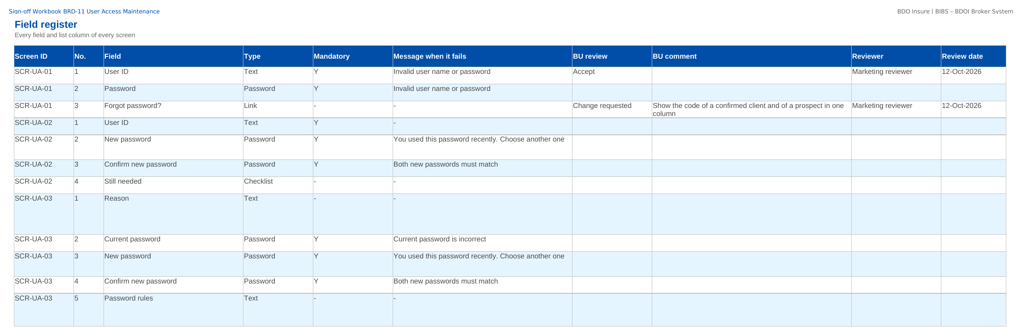
How to fill in the sign-off workbook
• Review the rows of your area on Screen standards, Screen catalogue, Field register, Business rules, Messages
• BU review: Accept, Change requested or Comment
• BU comment: the change asked for
• Reviewer and Review date
• Questions go to the Comments log
• Leave the other columns unchanged; one workbook per unit
Field register sheet of the sign-off workbook
Confidential – BDOI
Sign-off Pack Guide BRD-11 User Access Maintenance | v2.0
8
Notes:
The No. column is the numbered marker on the screenshot of the FRS. The drop-down columns accept only the listed values. The Comments log, Meeting minutes and Version history sheets are kept by the project team; the Sign-off certificate is signed at the end.

Slide 9
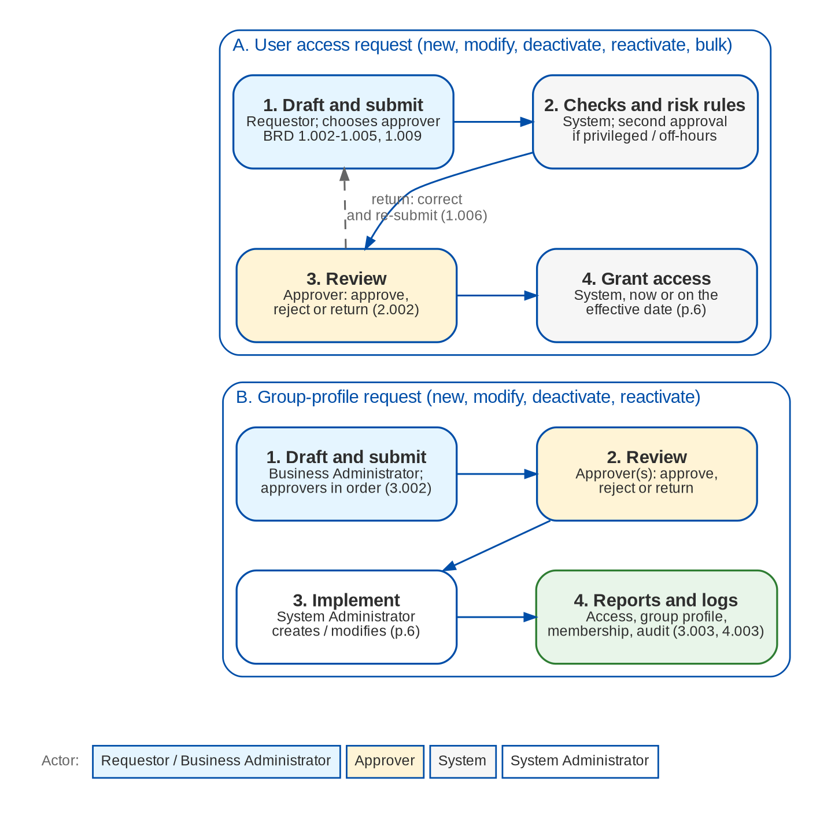
User Access Maintenance at a glance: process flow
BRD-11 process from the client to the booked invoice
Confidential – BDOI
Sign-off Pack Guide BRD-11 User Access Maintenance | v2.0
9
Notes:
The process runs from client onboarding and KYC, through the quotation or the PRF, the account, payment and placement, issuance and booking, to the hand-off to Operations and Accounting.

Slide 10
User Access Maintenance at a glance: personas and menus
Persona | SIT user | Screens | Menu sections
Requestor | requestor | 2 | User Access
Approver | uamapprover | 5 | User Access
Second Approver | secapprover | 2 | User Access
Business Administrator | badmin | 6 | User Access
System Administrator | admin | 5 | User Access
Auditor | auditor | 4 | User Access
Information Security Officer | infosec | 5 | User Access
New Business Approver (keeps the access approval right) | approver | 4 | User Access
Confidential – BDOI
Sign-off Pack Guide BRD-11 User Access Maintenance | v2.0
10
Notes:
Each persona sees only the menu entries of its role; the full menu of each persona is in FRS chapter 12 and on the Menu by persona sheet of the workbook. The menus of 37 more personas of the other BRDs are there too, one table and one sheet each.

Slide 11
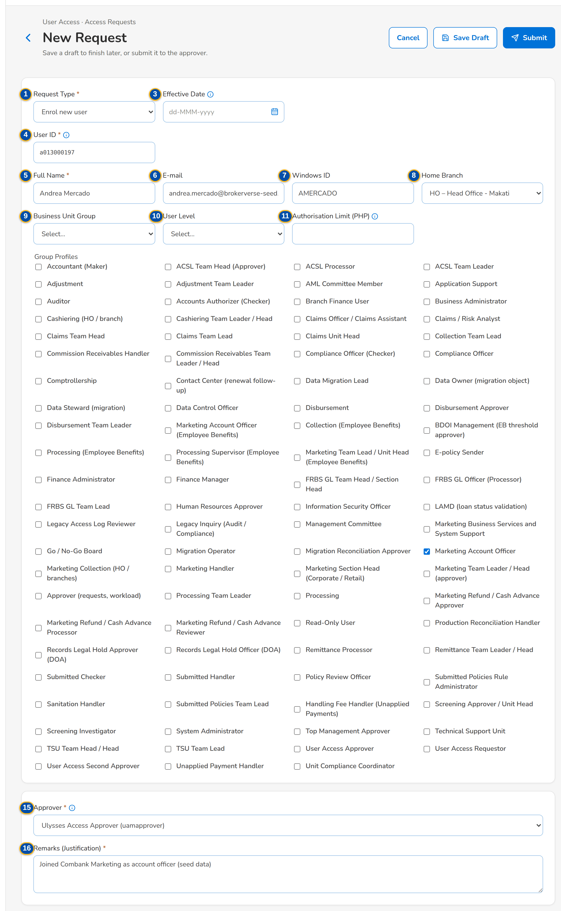
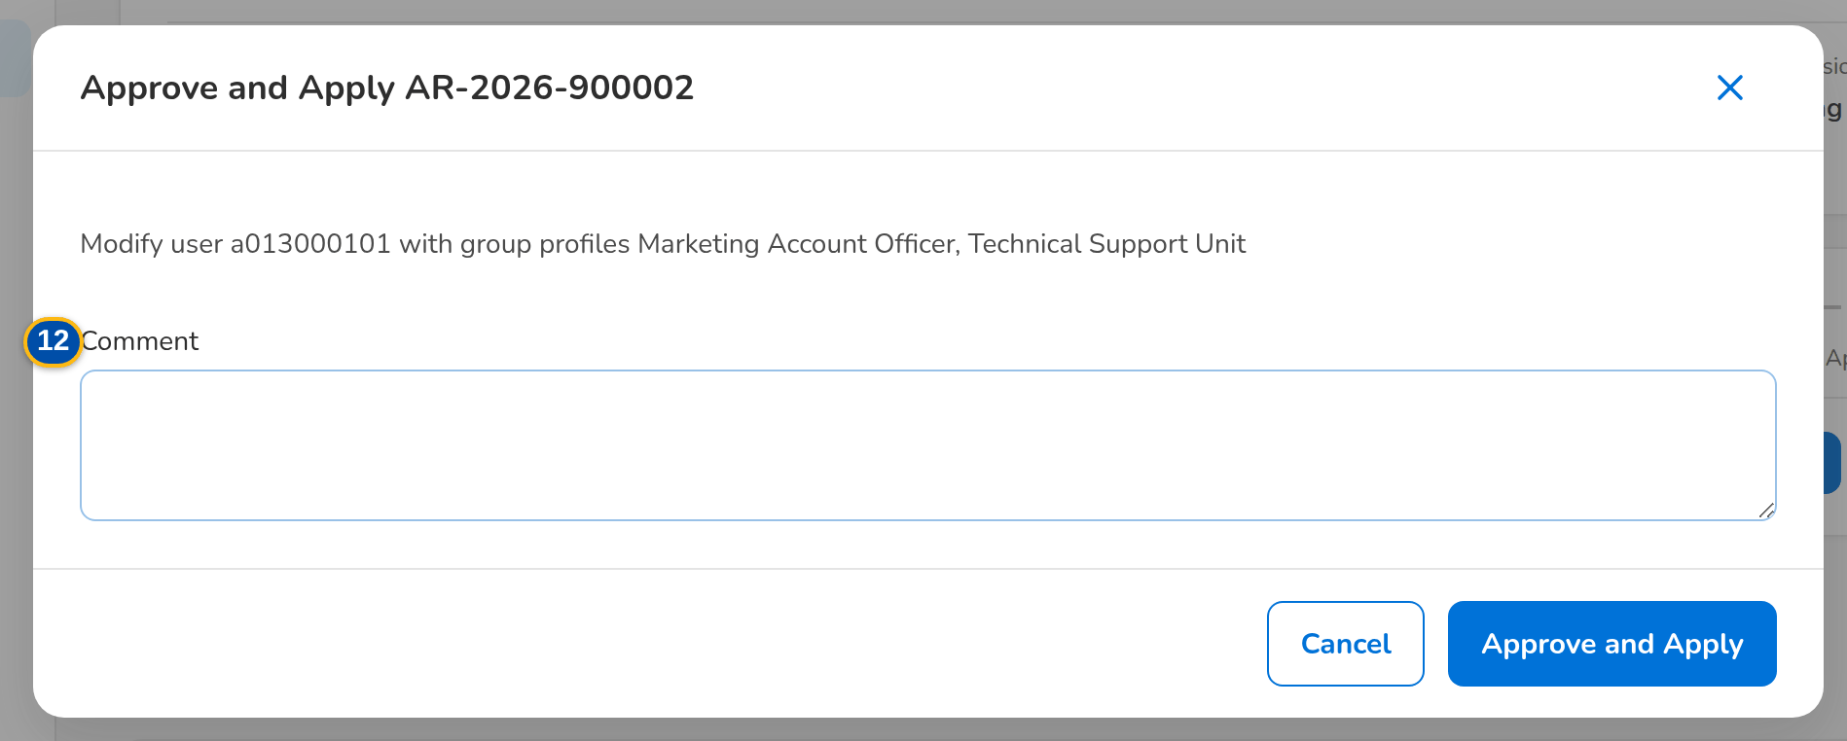
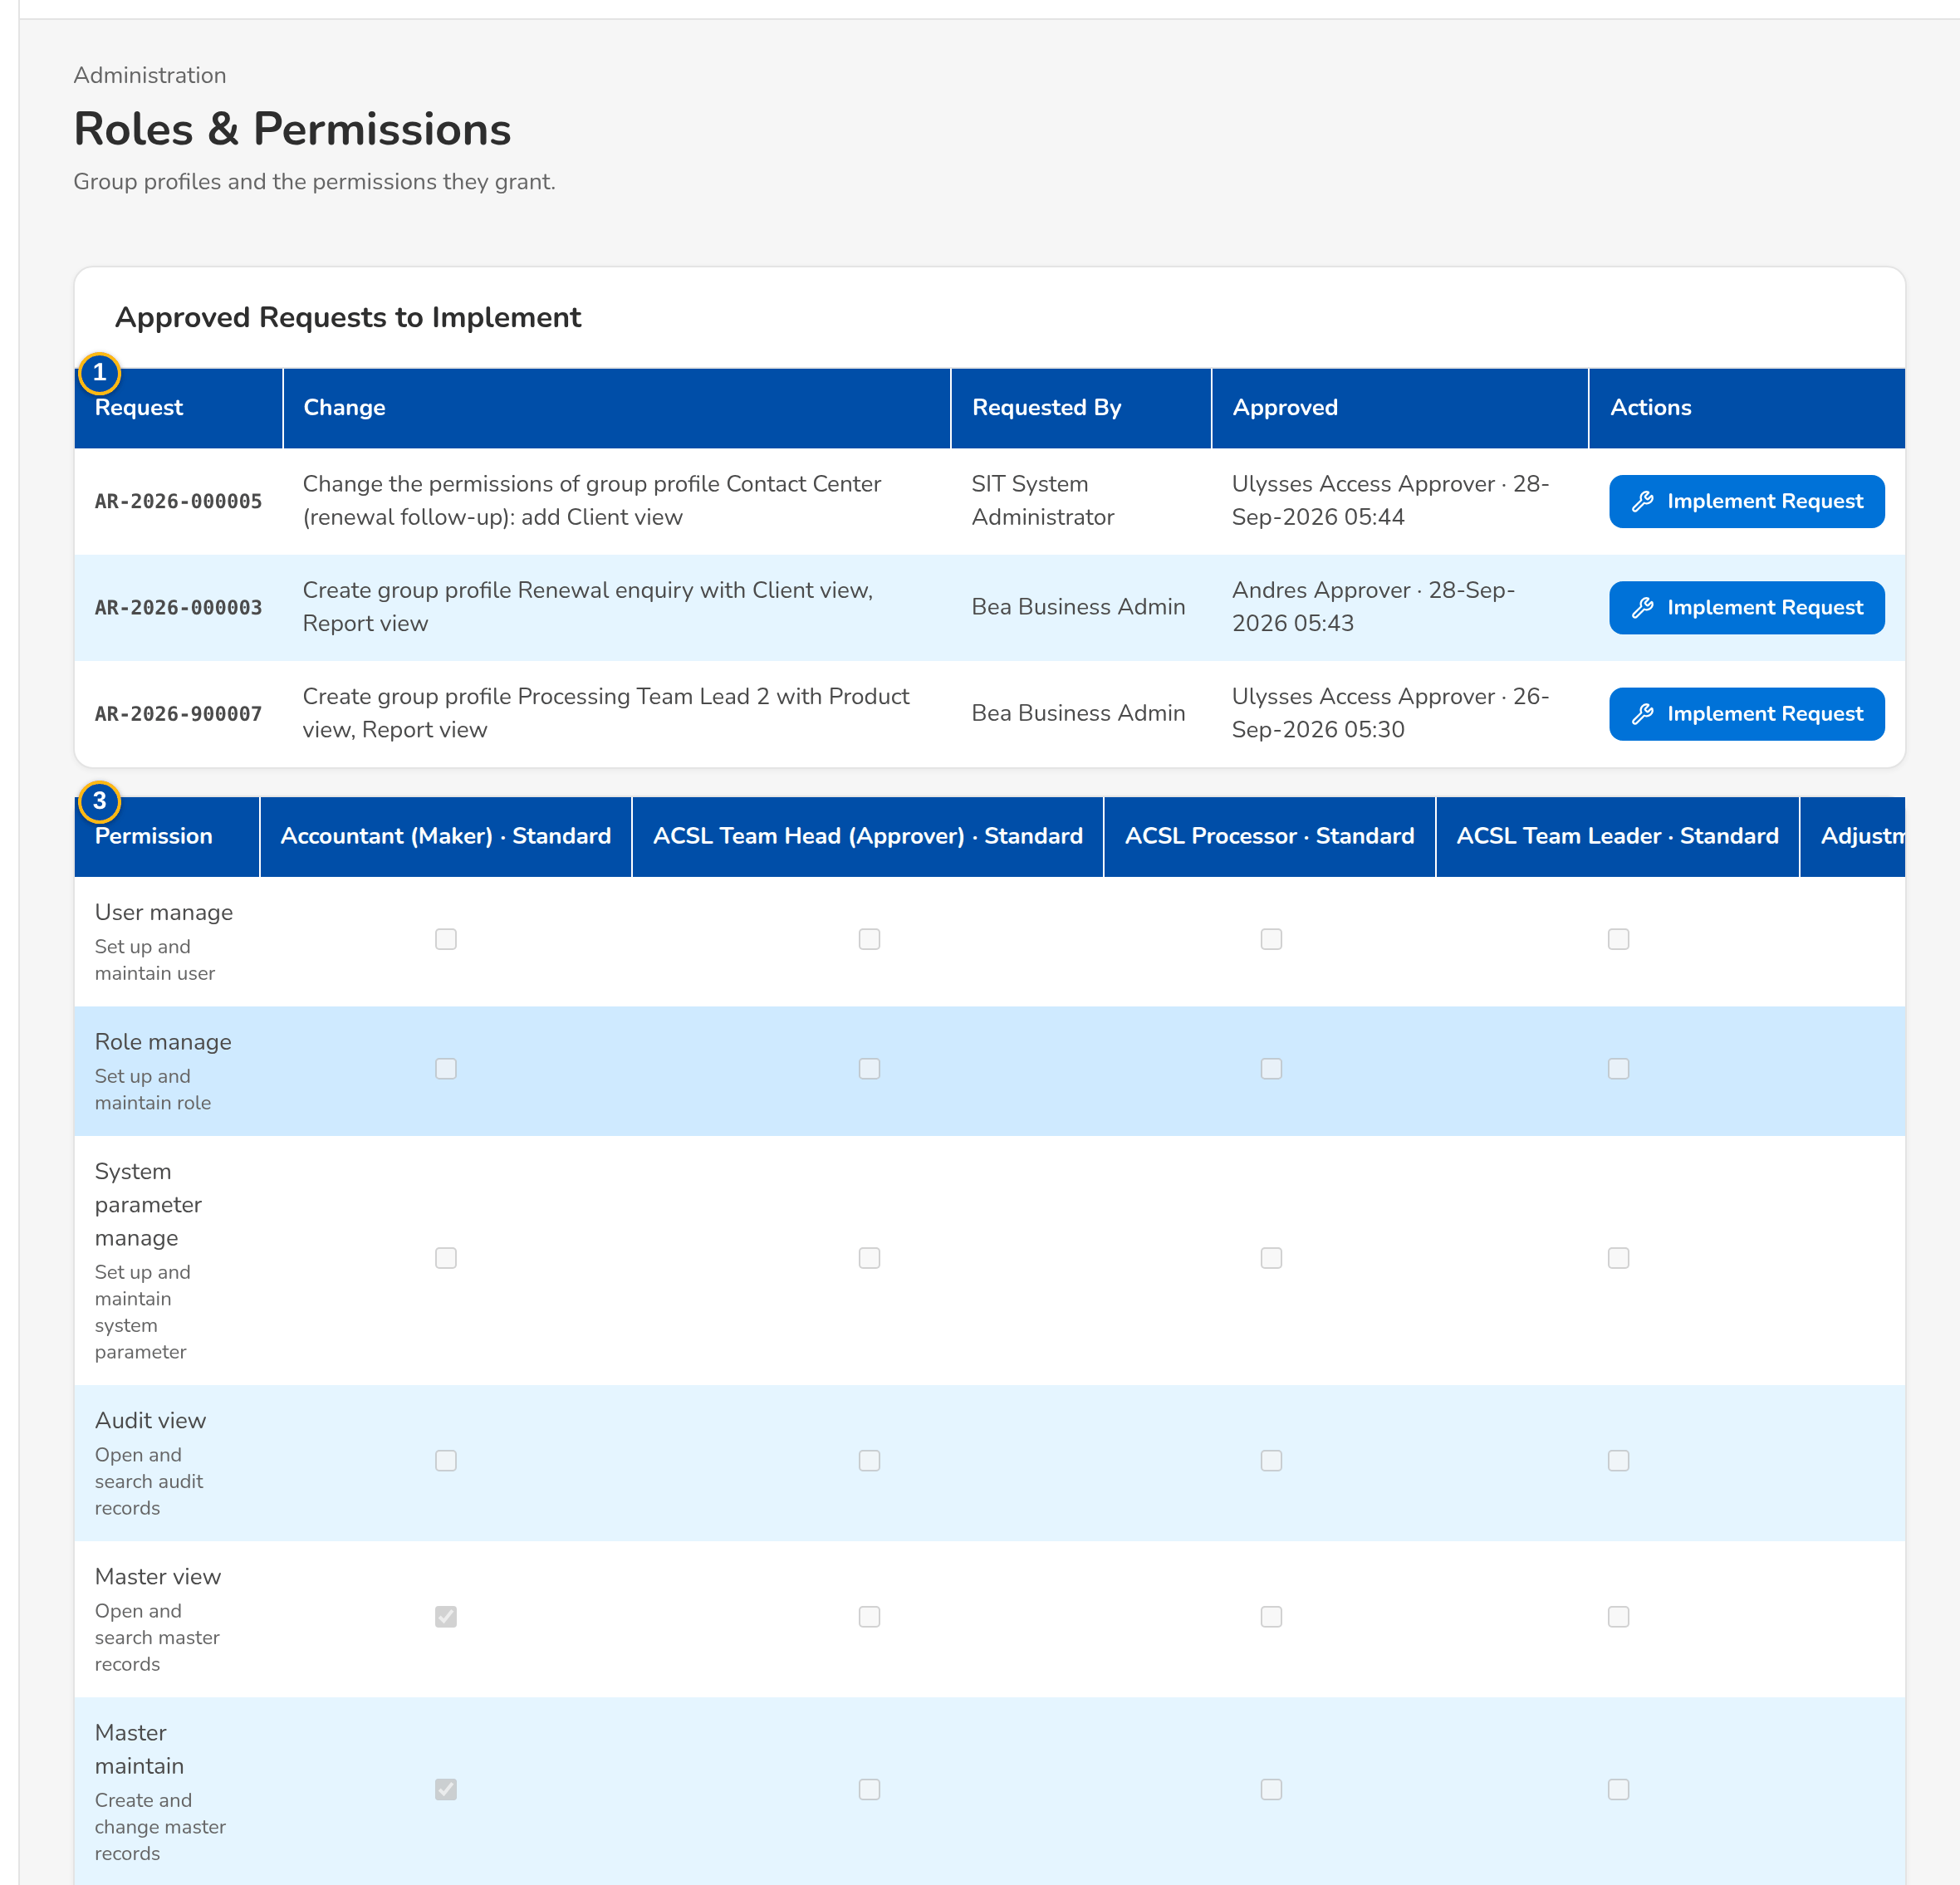
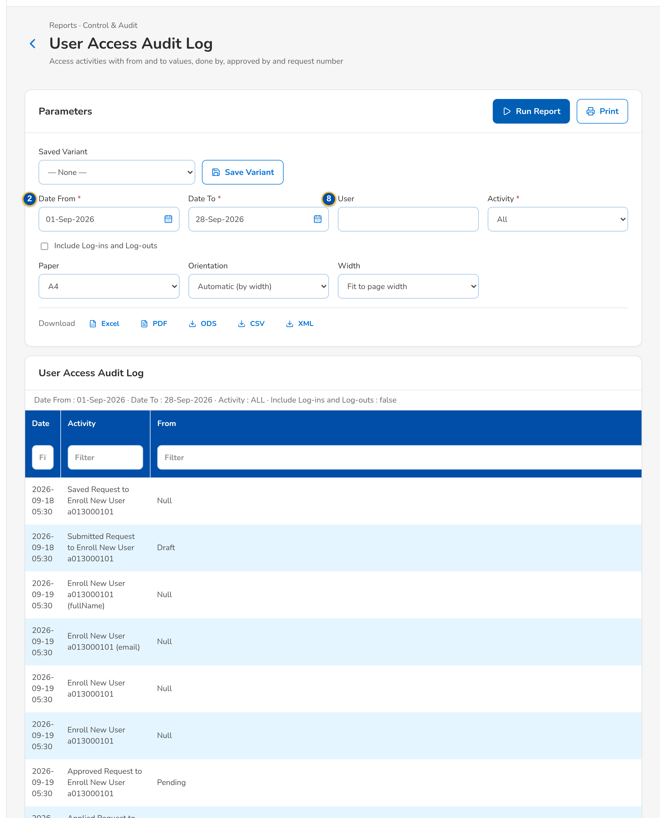
User Access Maintenance at a glance: key screens
An enrolment request with its group profile and approver
The chosen approver decides; nothing changes before
Group-profile changes implemented by the System Administrator
The User Access Audit Log with from and to values
Confidential – BDOI
Sign-off Pack Guide BRD-11 User Access Maintenance | v2.0
11
Notes:
Screenshots of the SIT environment with seed data; every screen of the module is in FRS chapter 13.

Slide 12
Key business rules and validations
• Access changes only through an approved request: the requester and the user concerned never decide it, and only the approver chosen by the requester does.
• A privileged change (a High or Admin profile) or a change outside working hours needs a second approval by another approver, and raises an alert.
• Group-profile changes are approved in order and implemented by a System Administrator who did not raise them; direct edits are an audited, alerted emergency path, closed as delivered.
• The account locks after 3 failed sign-ins; the session warns at 15 minutes of inactivity and ends at 30.
• Passwords: at least 10 characters with upper and lower case, a digit and a symbol; not one of the last 8; expire after 90 days; changed at the first sign-in after an administrator sets them.
• Every change is logged insert-only with its from and to values, approver and request number; four reports give the BRD samples A to D.
• Every persona sees exactly the menu of its group profiles; the insurer functions are hidden from BDOI.
  – Full list: FRS chapter 13 per screen, 74 rules on the Business rules sheet and 191 messages in chapter 15 and on the Messages sheet
Confidential – BDOI
Sign-off Pack Guide BRD-11 User Access Maintenance | v2.0
12
Notes:
These are the rules the business units ask about most. Each rule is stated with its FR on the screen where it applies.

Slide 13
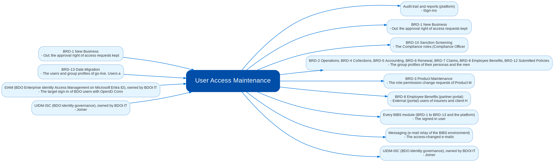
Cross-module dependencies and impacts
What User Access Maintenance takes from and hands to the other BRDs and systems (FRS chapter 19)
Confidential – BDOI
Sign-off Pack Guide BRD-11 User Access Maintenance | v2.0
13
Notes:
The contract is part of the signed set. User Access Maintenance is the source of the users, group profiles and permissions that every BIBS module checks, and of the menus each persona sees. A later change in any BRD that adds a permission, a persona or a screen, or that changes who may approve, is delivered as a group-profile request under this signed set (configuration, no change request) when the permission exists; a new permission, a new separation-of-duties rule, a new request type, or a change to the sign-in and identity integration is raised as a change request against this signed set in the Change Management Register, assessed with its mandays and approved by the owners of both BRDs and by BDOI Information Security; the affected pages of this set are then re-issued and signed as a delta.
IC-01 Every BIBS module (BRD-1 to BRD-13 and the platform) (Out): The signed-in user, the active group profiles and the effective permissions; the sidebar of each persona; the inactivity and session rules
IC-02 BRD-1 New Business (Out / In): Out: the approval right of access requests kept by the New Business Approver; the access requests listed in My Approvals. In: My Approvals (the shared approval list), Lists of Values (business unit groups, user levels, deactivation reasons) and Data Retention (retention rule of cancelled and rejected access requests)
IC-03 BRD-3 Product Maintenance (Out): The role-permission change requests of Product Maintenance (Modify group profile) and the User Access Matrix by area and action class
IC-04 BRD-10 Sanction Screening (Out): The Compliance roles (Compliance Officer, Checker, Unit Compliance Coordinator, Screening Investigator, Screening Approver, AML Committee) and their menus, checked by the persona menu test of the suite BRD-10/11
IC-05 BRD-2 Operations, BRD-4 Collections, BRD-5 Accounting, BRD-6 Renewal, BRD-7 Claims, BRD-8 Employee Benefits, BRD-12 Submitted Policies (Out): The group profiles of their personas and the menus they give; the persona suites of Renewal, Claims and Employee Benefits are checked by the persona menu test
IC-06 BRD-8 Employee Benefits (partner portal) (Out): External (portal) users of insurers and client HR, provisioned through access requests of user type External
IC-07 BRD-13 Data Migration (In): The users and group profiles of go-live. Users are out of the migration scope (DMQ30); they are loaded with the bulk request from the users and roles template of this set, and the migration team's own profiles are given through access requests
IC-08 EIAM (BDO Enterprise Identity Access Management on Microsoft Entra ID), owned by BDOI IT (In): The target sign-in of BDO users with OpenID Connect; BIBS keeps the roles, permissions, the inactivity sign-out and the session log
IC-09 UIDM-ISC (BDO identity governance), owned by BDOI IT (In / Out): Joiner, mover and leaver provisioning and access certification
IC-10 Messaging (e-mail relay of the BIBS environment) (Out): The access-changed e-mails, the password reset links, the password expiry notices and the batch failure e-mails
IC-11 Audit trail and reports (platform) (Out): Sign-ins, failed sign-ins, sign-outs, parameter changes and every access change with its from and to values, request number, done by and approved by

Slide 14
Caveats and possibilities
Topic | What can happen | How it is handled
Additional requirements | New needs can surface during the review, SIT or UAT. | In-scope clarification when the signed text already covers it; configuration when it is a new profile or a changed grant; otherwise a change request with mandays.
Other BRDs change the role matrix | Every BRD adds permissions and personas; the menus of chapter 12 follow the grants. | A new persona of an existing permission is a group-profile request under this signed set; a new permission or rule is a change request against the other BRD, and this set's menu pages are re-issued as a delta.
Identity integrations owned by BDOI IT | Sign-in through EIAM on Microsoft Entra ID and provisioning from UIDM-ISC are named by BDOI for Drop 0; their specifications are open (IQ04, IQ05). | In this set: local sign-in, and every change as a BIBS request. The integrations are change requests once BDOI IT gives the specifications; the screens of this set do not change.
Points for confirmation | A single session per device, an external access-control list and the dormancy values are listed for decision in FRS chapter 22. | Each item is decided with the review; a decision that only sets a value is configuration, a new rule is a change request.
Open questions and assumptions | Open questions of FRS section 10.3 (who the requesters and approvers are, the approval chain, privileged profiles, working hours, password values, business units and user levels) follow the assumptions of section 10.1; chapter 22 lists the proposed rules for confirmation. | Answered as configuration where possible (profiles, parameters, lists, the approvers themselves); otherwise a change request; the assumption stands until then.
Confidential – BDOI
Sign-off Pack Guide BRD-11 User Access Maintenance | v2.0
14
Notes:
Three ways to handle a case: an in-scope clarification (no change to the signed set, answered in the comments log); a change request with mandays in the Change Management Register; a delta sign-off of the affected pages only.

Slide 15
Caveats: worked examples
Topic | Example and how it is handled
Additional requirements | Information Security asks that the Auditor also sees a new report: a group-profile request (configuration). Asking for a third approval level on all requests is a change request.
Other BRDs change the role matrix | Claims adds a Claims Reports viewer: the profile is requested, approved and implemented; the menu sheet of the persona is added in the next version of the set.
Identity integrations owned by BDOI IT | When Entra ID sign-in is enabled, the Login page redirects to BDO's sign-in; the BIBS password rules then apply only to the break-glass administrator.
Points for confirmation | Information Security asks for deactivation after 60 days without sign-in instead of 90: a change of the parameter UAM_DORMANT_DAYS under the second approval.
Open questions and assumptions | Working hours of 07:00-19:00 instead of 08:00-18:00: a change of the parameter UAM_WORKING_HOURS, not a change request.
Confidential – BDOI
Sign-off Pack Guide BRD-11 User Access Maintenance | v2.0
15
Notes:
Use these examples to agree the handling of a case during the review.

Slide 16
Entry and exit criteria, definition of done
Entry
Exit
Done
• Every screenshot of the set is taken on the SIT environment with seed data.
• Reviewers have their SIT users and the walkthrough sessions are held.
• The test plan is traced to the FRS and to the screens; the persona menus are checked by the persona menu test.
• Every row of the workbook reviewed by its unit (Accept, Change requested or Comment), including the menu sheet of every persona.
• Every comments log item closed: answered, corrected in v2.1, or raised as a change request.
• Open questions closed or accepted as assumptions.
• The sign-off certificate signed by the business owner, Business Administration, BDOI Information Security and BDOI IT for their parts.
• Signed certificate filed with the set; version history updated.
• Content frozen as signed; deltas listed in the Change Management Register with mandays.
• Role-to-permission matrix and users of the templates loaded by group-profile and bulk requests, and checked with the reports.
• Test plan agreed for SIT and UAT.
Confidential – BDOI
Sign-off Pack Guide BRD-11 User Access Maintenance | v2.0
16
Notes:
The sign-off meeting starts when the exit criteria are met; the set is done when the certificate is signed and the content of the set is frozen.

Slide 17
After sign-off: readiness checklist
• ☐ Signed FRS, sign-off workbook and screens
• ☐ Open questions closed or accepted as assumptions
• ☐ Configuration inputs from the business: users and roles, role-to-permission matrix, approval rules, separation-of-duties rules, password and session parameters, lists of values
• ☐ Agreed test plan
• ☐ BDOI IT decisions on EIAM and UIDM-ISC recorded as change requests or assumptions
  – After sign-off the content is frozen as signed, the approved deltas are scheduled and the configuration inputs are loaded through requests.
Confidential – BDOI
Sign-off Pack Guide BRD-11 User Access Maintenance | v2.0
17
Notes:
After sign-off the content is frozen as signed, the approved deltas are scheduled and the configuration inputs are loaded through requests.

Slide 18
Change control after sign-off
• A change to anything frozen is raised in the Change Management Register
  – The screen, field, rule or message concerned, the reason and the priority
• The project team assesses the mandays and the effect on the other BRDs through the cross-BRD contract
• The owners of every BRD concerned approve it
• Delivered as a new version of the set (v2.1, v2.2...) with the changed pages signed again (delta sign-off)
• Configuration values marked default change in BIBS without a change request
Confidential – BDOI
Sign-off Pack Guide BRD-11 User Access Maintenance | v2.0
18
Notes:
Nothing in a signed set changes without a request in the register.

Slide 19
Governance, contacts and next steps
Role | Who | Does
Business owner and approver | Product Owner, Marketing Business System | Accountable for the sign-off; chairs the sign-off meeting
Process owner | Business Administration (user access maintenance) | Coordinates the review of the requests and reports and the configuration inputs; signatory
Information Security | BDOI Information Security | Reviews and signs the role matrix, the menus by persona and the separation-of-duties rules
BDOI IT | BDOI IT | Reviews and signs the sign-in and identity integration assumptions (EIAM, UIDM-ISC) and the System Administrator functions
BRD owner | Business Project Services, BDO Unibank ESG | Traceability to the BRD; sign-off coordination
Delivery | iorta TechNXT Project Manager, Business Analysis, test lead | Sessions, answers, comments log, revisions, change requests
Confidential – BDOI
Sign-off Pack Guide BRD-11 User Access Maintenance | v2.0
19
Notes:
Next steps:
Kick-off and first SIT walkthrough on Mon 9-Nov-2026
Workbooks returned by Fri 20-Nov-2026; Q&A on Tue 24-Nov-2026; sign-off on Tue 1-Dec-2026
Configuration input templates filled in: users and role matrix before the first data migration mock; parameters agreed with Information Security before UAT

Slide 20
Next steps and the release order of the other BRD sets
• Kick-off and first SIT walkthrough on Mon 9-Nov-2026
• Workbooks returned by Fri 20-Nov-2026; Q&A on Tue 24-Nov-2026; sign-off on Tue 1-Dec-2026
• Configuration input templates filled in: users and role matrix before the first data migration mock; parameters agreed with Information Security before UAT
Confidential – BDOI
Sign-off Pack Guide BRD-11 User Access Maintenance | v2.0
20
Notes:
The other BRD sets follow the same pack, guide and steps.

