Slide 1


Sign-off Pack Guide: BRD-5 Accounting Disbursement ACSL
BRD-5 Accounting Disbursement ACSL business sign-off pack, release set v2.1
BIBS – BDOI Broker System
BDO Insurance and Reinsurance Brokers, Inc. | Version 2.1 | 8 October 2026 | Confidential
Prepared by
Notes:
This deck guides the business units through the BRD-5 Accounting Disbursement ACSL sign-off pack, release set v2.1. It explains what the pack is, how to read it, the steps up to sign-off and what happens after. It is presented at the kick-off and stays in the pack as file 01.

Slide 2
Purpose of the pack and what sign-off means
• The pack shows the proposed Accounting Disbursement ACSL of BIBS, screen by screen, so each business unit confirms what it will get
  – Content: 51 screens, 293 fields, 98 business rules, 378 messages
  – Every screen with numbered fields, the navigation per persona, three end-to-end walkthroughs
• Signing freezes the content, the screens and the navigation of the module
  – After sign-off a change goes through the Change Management Register with its mandays
  – Configuration values marked default (SLA hours, thresholds, list entries, templates) stay open
• The screenshots use fictitious seed data only, in the BDO theme
Confidential – BDOI
Sign-off Pack Guide BRD-5 Accounting Disbursement ACSL | v2.1
2
Notes:
Stress that the pack shows the screens, fields, rules and messages the business is asked to confirm.
Signing means: this is what we get; the look, feel, fields, rules, messages and navigation are frozen.
Data on the screenshots is seed data of the SIT environment; names and numbers are fictitious.

Slide 3
The pack at a glance (1 of 2)
File | What it is for | Who reads it | When
00_BIBS_StartHere_BRD-05_Accounting_Disbursement_ACSL_v2.1.docx | Start Here: the map of the pack, who reads what, who signs what, the steps and the dates | Everyone | First, on issue
01_BIBS_GuideDeck_BRD-05_Accounting_Disbursement_ACSL_v2.1.pptx | Sign-off Pack Guide: purpose, approach, the module at a glance, caveats and impacts on other modules, entry and exit criteria, change control | Head of Comptrollership, the product owners of FRBS, Disbursement, ACSL and Marketing; presented at the kick-off | Kick-off session
02_BIBS_FRS_BRD-05_Accounting_Disbursement_ACSL_v2.1.docx | Functional Requirements Specification v2.1: requirements of the two former volumes in one document, re-based on the BRD with the minutes of 4-May-2026, with a user-story view and a storyboard index, navigation, 51 screen specifications with screenshots, five walkthroughs, messages, notifications, documents, upload templates, cross-BRD contract | The GL team, Disbursement, ACSL and the Marketing requesters for their sections; Operations and BDOI IT for their chapters | During the review, with the SIT walkthroughs
03_BIBS_Signoff_BRD-05_Accounting_Disbursement_ACSL_v2.1.xlsx | Sign-off workbook: one row per screen, field, rule and message with the BU review columns; comments log, meeting minutes, version history, sign-off certificate | Every reviewer; the approvers sign it | During the review and at sign-off
04_BIBS_TestPlan_BRD-05_Accounting_Disbursement_ACSL_v2.1.xlsx | Test plan workbook: the test cases of both former volumes traced to the FRs and to the screens, including one screen case and one message case per screen | Business users who will run UAT; BDOI IT | After the screens; used again in SIT and UAT
Confidential – BDOI
Sign-off Pack Guide BRD-5 Accounting Disbursement ACSL | v2.1
3
Notes:
The files are numbered in reading order so they sort that way in the BRD folder. 00 Start Here is the short version of this deck; 02 FRS and 03 workbook carry the same rows; 04 and 05 are the test plan traced to the screens; 07 to 09 are the UX screen documents for the BDOI UX Design team, taken from the same screens.

Slide 4
The pack at a glance (2 of 2)
File | What it is for | Who reads it | When
05_BIBS_TestPlan_BRD-05_Accounting_Disbursement_ACSL_Summary_v2.1.docx | Test plan summary: scope, approach, coverage and the cases by area | Product owners, BDOI IT | Before sign-off
07_BIBS_UXDeck_BRD-05_Accounting_Disbursement_ACSL_v2.1.pptx | UX Screen Deck for the BDOI UX Design team: design foundation, navigation and personas, every walkthrough step by step and every screen with all its states | BDOI UX Design team | From the issue, in parallel with the review; re-issued with each version of the set
08_BIBS_UXScreens_BRD-05_Accounting_Disbursement_ACSL_v2.1.xlsx | UX screen register: one row per screen image with the screen, personas, walkthrough and step, state, FRS section and requirements, UXD status and comments, and the Changed in this issue flag | BDOI UX Design team | Kept by the UX Design team; the changed rows are flagged at each issue
09_BIBS_UXScreens_BRD-05_Accounting_Disbursement_ACSL_v2.1.zip | Image package: every screen image at twice the screen resolution (PNG), the component crops and the register as CSV | BDOI UX Design team | Imported into the design tool at each issue
Confidential – BDOI
Sign-off Pack Guide BRD-5 Accounting Disbursement ACSL | v2.1
4
Notes:
The files are numbered in reading order so they sort that way in the BRD folder. 00 Start Here is the short version of this deck; 02 FRS and 03 workbook carry the same rows; 04 and 05 are the test plan traced to the screens; 07 to 09 are the UX screen documents for the BDOI UX Design team, taken from the same screens.

Slide 5
Where to start: reading order per role
Role | Read, in this order
Approvers (Head of Comptrollership; product owners of FRBS and ACSL, Disbursement, Comptrollership and Operations, Marketing) | 00 Start Here; 01 Guide deck; FRS chapters 1-3 (context and personas), 14 (walkthroughs), 20 (sign-off) and 21 (proposed rules for confirmation); workbook Sign-off certificate
GL team (GL Officers, GL Team Lead, GL Section Head) | FRS sections 4.1 to 4.10; the screens SCR-AC-01 to 24 of chapter 13; walkthroughs A and D; messages in chapter 15; configuration in chapter 9
Disbursement (Processors, Team Leaders, Approvers) | FRS section 4.11; the screens SCR-AC-25 to 38; walkthroughs B and E; the documents DO-01 to DO-03 and DO-05 in chapter 17; the upload templates in chapter 18
Marketing (Processors, Reviewers, Approvers) and Human Resources | FRS section 4.12; the screens SCR-AC-39 to 44; walkthrough B (steps 1 to 4 and 8) and E; the Refund Request Form DO-04
ACSL (Processors, Team Leader, Head) | FRS section 4.13; the screens SCR-AC-45 to 51; walkthrough C; the reconciliation report DO-06
Operations (Cashiering and Remittance, BRD-2) | The hand-offs of chapter 19 (remittance payments, refund validations, payment reversals, remittance deductions); walkthrough B; FRS sections 4.11 and 4.13
Business and System Administrators | FRS section 4.10 (administration) and configuration in chapter 9; the lists of values and access screens of the BRD-1 and BRD-11 sets; Menu by persona in chapter 12
BDOI IT | Interfaces and integration (chapter 7), non-functional requirements (chapter 8), configuration and jobs (chapter 9), cross-BRD contract (chapter 19), the bank files of chapter 17; the Technical Specification, reviewed by BDOI IT
BDOI UX Design team | 07 UX Screen Deck: design foundation and navigation first, then the personas, walkthroughs and screens of the design work; 08 UX screen register (filter Changed in this issue at each new issue); 09 image package in the design tool
iorta TechNXT project team | All documents; keeps the comments log, the meeting minutes and the version history of the workbook, answers every comment and keeps the traceability to SIT and UAT
Confidential – BDOI
Sign-off Pack Guide BRD-5 Accounting Disbursement ACSL | v2.1
5
Notes:
Nobody needs to read the whole FRS. Each role starts with its chapters and its sheets of the workbook; the walkthroughs in chapter 14 are the fastest way to see the whole process.

Slide 6
Approach: from issue to closure
1
Pack issued
2
Kick-off and screen walkthrough on SIT
3
Review with the workbook
4
Comments consolidated and a Q&A session
Release set v2.1 in the BRD-05 folder; invitations to the sessions
Screens shown live (general ledger and closing, reports and service fee, Disbursement, the Marketing requests, ACSL); first questions logged in the comments log; minutes
Every row marked Accept, Change requested or Comment; comments log entries
One consolidated comments log, each item typed (clarification, correction, change request) and answered; Q&A minutes
Day 0 (Thu 8-Oct-2026); sessions scheduled after the BRD-4 Collections walkthroughs
5 sessions, 25-Nov to 1-Dec-2026
10 working days after the walkthroughs, until Mon 14-Dec-2026
2 working days, Q&A on Wed 16-Dec-2026
5
One revision cycle (v2.2)
6
Sign-off meeting and signature
7
Content freeze
8
Traceability into SIT and UAT
Release set v2.2 with the changed rows marked; change requests raised for the rest
Signed sign-off certificate; minutes; open items accepted as assumptions or change requests
Content frozen as signed; approved deltas scheduled in the Change Management Register
SIT and UAT runs traced to the signed screens, rules and messages; results against each row
2 working days, v2.2 on Fri 18-Dec-2026; check by the reviewers until Tue 22-Dec-2026
Wed 23-Dec-2026
From Mon 28-Dec-2026
SIT Jan - Jul 2027; UAT Aug - Dec 2027
Confidential – BDOI
Sign-off Pack Guide BRD-5 Accounting Disbursement ACSL | v2.1
6
Notes:
1. Pack issued: Day 0 (Thu 8-Oct-2026); sessions scheduled after the BRD-4 Collections walkthroughs.
2. Kick-off and screen walkthrough on SIT: 5 sessions, 25-Nov to 1-Dec-2026.
3. Review with the workbook: 10 working days after the walkthroughs, until Mon 14-Dec-2026.
4. Comments consolidated and a Q&A session: 2 working days, Q&A on Wed 16-Dec-2026.
5. One revision cycle (v2.2): 2 working days, v2.2 on Fri 18-Dec-2026; check by the reviewers until Tue 22-Dec-2026.
6. Sign-off meeting and signature: Wed 23-Dec-2026.
7. Content freeze: From Mon 28-Dec-2026.
8. Traceability into SIT and UAT: SIT Jan - Jul 2027; UAT Aug - Dec 2027.

Slide 7
Steps in detail (1 of 2): who, inputs, outputs, duration
Step | Who (R, A, C, I) | Inputs | Outputs | Duration
1. Pack issued | R: iorta TechNXT Project Manager; A: iorta TechNXT delivery lead; I: all reviewers | FRS v2.1, workbook, test plan, guide and deck | Release set v2.1 in the BRD-05 folder; invitations to the sessions | Day 0 (Thu 8-Oct-2026); sessions scheduled after the BRD-4 Collections walkthroughs
2. Kick-off and screen walkthrough on SIT | R: iorta TechNXT Business Analysis; A: Head of Comptrollership; C: product owners of FRBS, ACSL, Disbursement and Marketing; I: Operations, BDOI IT | Guide deck; SIT users with seed data; walkthroughs A to E | Screens shown live (general ledger and closing, reports and service fee, Disbursement, the Marketing requests, ACSL); first questions logged in the comments log; minutes | 5 sessions, 25-Nov to 1-Dec-2026
3. Review with the workbook | R: GL team, Disbursement, ACSL and Marketing reviewers; A: the product owners; C: iorta TechNXT (questions) | FRS chapters of the area; workbook sheets with the BU review columns | Every row marked Accept, Change requested or Comment; comments log entries | 10 working days after the walkthroughs, until Mon 14-Dec-2026
4. Comments consolidated and a Q&A session | R: iorta TechNXT Project Manager and Business Analysis; A: Head of Comptrollership; C: reviewers | Returned workbooks | One consolidated comments log, each item typed (clarification, correction, change request) and answered; Q&A minutes | 2 working days, Q&A on Wed 16-Dec-2026
Confidential – BDOI
Sign-off Pack Guide BRD-5 Accounting Disbursement ACSL | v2.1
7
Notes:
R responsible, A accountable, C consulted, I informed. The durations are indicative; the dates are those of the Start Here guide.

Slide 8
Steps in detail (2 of 2): who, inputs, outputs, duration
Step | Who (R, A, C, I) | Inputs | Outputs | Duration
5. One revision cycle (v2.2) | R: iorta TechNXT Business Analysis; A: iorta TechNXT delivery lead; C: reviewers who raised the items | Agreed clarifications and corrections | Release set v2.2 with the changed rows marked; change requests raised for the rest | 2 working days, v2.2 on Fri 18-Dec-2026; check by the reviewers until Tue 22-Dec-2026
6. Sign-off meeting and signature | R: iorta TechNXT Project Manager; A: Head of Comptrollership; C: the product owners, BDOI IT, Business Project Services | v2.2 (or v2.1 when no revision is needed); open items with their decision | Signed sign-off certificate; minutes; open items accepted as assumptions or change requests | Wed 23-Dec-2026
7. Content freeze | R: iorta TechNXT delivery lead; A: Head of Comptrollership; I: BDOI IT, other BRD owners | Signed set; change requests with mandays | Content frozen as signed; approved deltas scheduled in the Change Management Register | From Mon 28-Dec-2026
8. Traceability into SIT and UAT | R: iorta TechNXT test lead; A: Head of Comptrollership; C: business users | Signed FRS rows and test plan | SIT and UAT runs traced to the signed screens, rules and messages; results against each row | SIT Jan - Jul 2027; UAT Aug - Dec 2027
Confidential – BDOI
Sign-off Pack Guide BRD-5 Accounting Disbursement ACSL | v2.1
8
Notes:
R responsible, A accountable, C consulted, I informed. The durations are indicative; the dates are those of the Start Here guide.

Slide 9
Who signs what: parts of the set (1 of 2)
Part of the set | Prepares | Provides input | Reviews | Approves
General ledger, closing, bank reconciliation and report screens (FRS sections 4.1-4.10, screens SCR-AC-01 to 24) | iorta TechNXT | BA (BPS) | Program Manager (BPS), ACSL product owners | FRBS and ACSL PO, Head - Comptrollership
Disbursement screens, fields, documents and bank files (FRS section 4.11, screens SCR-AC-25 to 38) | iorta TechNXT | BA (BPS) | Program Manager (BPS), BDOI IT | Disbursement PO, Head - Comptrollership
Marketing refund and cash-advance requests (FRS section 4.12, screens SCR-AC-39 to 44) | iorta TechNXT | MBS input | Program Manager (BPS), MBS review | Product Owner (Marketing), Marketing head
ACSL screens, reconciliations, cases and corrections (FRS section 4.13, screens SCR-AC-45 to 51) | iorta TechNXT | BA (BPS) | Program Manager (BPS), ACSL product owners | FRBS and ACSL PO, Head - Comptrollership
Business rules, validations and the accounting entries | iorta TechNXT | BA (BPS), MBS input | Program Manager (BPS), ACSL product owners | Head - Comptrollership, FRBS and ACSL PO, Disbursement PO
Messages and notifications | iorta TechNXT | MBS input | Program Manager (BPS) | Head - Comptrollership
Hand-offs with Operations (remittance payments, refund validations, payment reversals, remittance deductions) | iorta TechNXT | BA (BPS) | Program Manager (BPS), ACSL product owners | Comptrollership and Operations PO, Head - Comptrollership
Confidential – BDOI
Sign-off Pack Guide BRD-5 Accounting Disbursement ACSL | v2.1
9
Notes:
The set holds business content only: screens, fields, rules, messages, notifications, documents, walkthroughs and reports. Business users sign the business content; BDOI IT reviews the interfaces, the user access and the Technical Specification, a separate document that holds the technical content; the Program Manager of Business Project Services reviews the traceability and the completeness; the Product Owner approves the whole set; iorta TechNXT prepares it.
The roles are those of the BRD approval sheet (BRD-5 approval sheets: main BRD p.141-142 (Prepared, Input Provided, Reviewed, Approved by), Addendum 1 p.39-40 and the Workshop Addendum p.15-16).

Slide 10
Who signs what: parts of the set (2 of 2)
Part of the set | Prepares | Provides input | Reviews | Approves
Walkthroughs (end-to-end, screen by screen) | iorta TechNXT | MBS input | Program Manager (BPS) | Head - Comptrollership
Proposed business rules and clarifications for confirmation | iorta TechNXT, BA (BPS) | MBS input | Program Manager (BPS), ACSL product owners | Head - Comptrollership, FRBS and ACSL PO, Disbursement PO, Product Owner (Marketing)
Scheduled runs and files, bank files and forms, user access and menus by persona | iorta TechNXT | MBS input | BDOI IT, Program Manager (BPS) | Head - Comptrollership
Test plan (04 workbook, 05 summary) | iorta TechNXT | MBS input | Program Manager (BPS), BDOI IT | Head - Comptrollership
UX screen deck, UX screen register and image package (07 to 09, for the BDOI UX Design team; the screens as specified in this set) | iorta TechNXT | MBS input | Program Manager (BPS) | Head - Comptrollership
Technical Specification (separate document, not part of the business sign-off) | iorta TechNXT | BDOI IT | BDOI IT | BDOI IT
Confidential – BDOI
Sign-off Pack Guide BRD-5 Accounting Disbursement ACSL | v2.1
10
Notes:
The set holds business content only: screens, fields, rules, messages, notifications, documents, walkthroughs and reports. Business users sign the business content; BDOI IT reviews the interfaces, the user access and the Technical Specification, a separate document that holds the technical content; the Program Manager of Business Project Services reviews the traceability and the completeness; the Product Owner approves the whole set; iorta TechNXT prepares it.
The roles are those of the BRD approval sheet (BRD-5 approval sheets: main BRD p.141-142 (Prepared, Input Provided, Reviewed, Approved by), Addendum 1 p.39-40 and the Workshop Addendum p.15-16).

Slide 11
Who signs what: signatories (1 of 2)
Capacity | Role | Confirms by signing
Prepared by | iorta TechNXT project team: Project Manager, Business Analysis, test lead (iorta TechNXT) | The set is complete and consistent as issued, traced to the BRD and to the screens; every comment is answered in the comments log
Prepared by | Business Analysts, Enterprise Services Group - Business Project Services (BPS) (Roda Lyn D. Gallardo; Zean C. Ibay and Jane Tagle for the Workshop Addendum) (BDO Unibank ESG) | The set states the BRD requirements as written; every departure is listed in the proposed rules and clarifications
Input provided by | Marketing Business Services and System Support (MBS Team) (Ma. Fides Rivera; Ruby Evangelista and Darryl Castillo for the Workshop Addendum) (BDOI) | The non-functional requirements and the Marketing refund and cash-advance request screens, fields, rules and messages match the business input
Reviewed by | Program Manager, Enterprise Services Group - Business Project Services (BPS) (Dan Ace R. Cauton) (BDO Unibank ESG) | Traceability of every BRD requirement to the set and completeness of the set
Reviewed by | Product Owners - Comptrollership - ACSL (Freddie A. Atanque, Jennifer T. Lugtu) (BDOI) | The ACSL screens, the reconciliations, cases, corrections and remittance deductions, and the accounting entries they post
Reviewed by | BDOI Information Technology Group (Carmela A. Morfe, Yonille D. Guy, Abegail R. Panghulan, Nelda R. Ranchez) (BDOI) | Scheduled runs and files, the bank files and forms, user access and menus, the hand-offs inside BIBS and the Technical Specification (a separate document); not the business screens
Reviewed by | Marketing Business Services and System Support (Rhommel Mark Galler) (BDOI) | The Workshop Addendum functions for Marketing: the cost centres of the payments and the incentives
Confidential – BDOI
Sign-off Pack Guide BRD-5 Accounting Disbursement ACSL | v2.1
11
Notes:
The certificate sheet of the workbook lists the same signatories in the same order: prepared by, input provided by, reviewed by, approved by, as on the BRD approval sheet. A role the set adds to the approval sheet is marked there.
iorta TechNXT project team: Project Manager, Business Analysis, test lead: Added for this set (author of the FRS set).
Business Analysts, Enterprise Services Group - Business Project Services (BPS) (Roda Lyn D. Gallardo; Zean C. Ibay and Jane Tagle for the Workshop Addendum): Prepared by (p.141, p.39, p.15).
Marketing Business Services and System Support (MBS Team) (Ma. Fides Rivera; Ruby Evangelista and Darryl Castillo for the Workshop Addendum): Input Provided by (p.141, p.39, p.15).
Program Manager, Enterprise Services Group - Business Project Services (BPS) (Dan Ace R. Cauton): Reviewed by (p.141, p.39, p.16).
Product Owners - Comptrollership - ACSL (Freddie A. Atanque, Jennifer T. Lugtu): Reviewed by (p.141, p.40); Input Provided by (p.15).
BDOI Information Technology Group (Carmela A. Morfe, Yonille D. Guy, Abegail R. Panghulan, Nelda R. Ranchez): Reviewed by (p.39).
Marketing Business Services and System Support (Rhommel Mark Galler): Reviewed by (p.16).

Slide 12
Who signs what: signatories (2 of 2)
Capacity | Role | Confirms by signing
Approved by | Product Owner - Comptrollership - Disbursement (Rodrigo R. Dela Cruz) (BDOI) | The Disbursement screens, fields, rules, messages, documents and bank files
Approved by | Product Owner - Comptrollership - FRBS and ACSL (Iris S. Marquez) (BDOI) | The general ledger, closing, bank reconciliation, report pack, service fee and ACSL screens, rules and messages
Approved by | Product Owner - Comptrollership and Operations (Perjelyn Joy R. Gutierrez) (BDOI) | The hand-offs with Operations: remittance payments, refund validations, payment reversals, remittance deductions and the regularisation of cancelled vouchers
Approved by | Product Owner - Marketing, Processing and Collections, AVP (Shellah Marie C. Miranda) (BDOI) | The Marketing refund, cash-advance and check-cancellation requests
Approved by | Head - Comptrollership, VP (Ronald Allan E. De Leon) (BDOI) | Owns the set for Comptrollership and approves all of its contents
Approved by | Head - Institutional Banking, SM and BDO Accounts, FVP (Roderick L. Lim; Head - Retail Marketing on the Workshop Addendum) (BDOI) | The Marketing requests and the service fee of the referrers
Confidential – BDOI
Sign-off Pack Guide BRD-5 Accounting Disbursement ACSL | v2.1
12
Notes:
The certificate sheet of the workbook lists the same signatories in the same order: prepared by, input provided by, reviewed by, approved by, as on the BRD approval sheet. A role the set adds to the approval sheet is marked there.
Product Owner - Comptrollership - Disbursement (Rodrigo R. Dela Cruz): Approved by (p.141, p.40); Input Provided by (p.15).
Product Owner - Comptrollership - FRBS and ACSL (Iris S. Marquez): Approved by (p.141, p.40); Input Provided by (p.15).
Product Owner - Comptrollership and Operations (Perjelyn Joy R. Gutierrez): Approved by (p.142).
Product Owner - Marketing, Processing and Collections, AVP (Shellah Marie C. Miranda): Approved by (p.142, p.40, p.16).
Head - Comptrollership, VP (Ronald Allan E. De Leon): Approved by (p.142, p.40, p.16).
Head - Institutional Banking, SM and BDO Accounts, FVP (Roderick L. Lim; Head - Retail Marketing on the Workshop Addendum): Approved by (p.142, p.40, p.16).

Slide 13
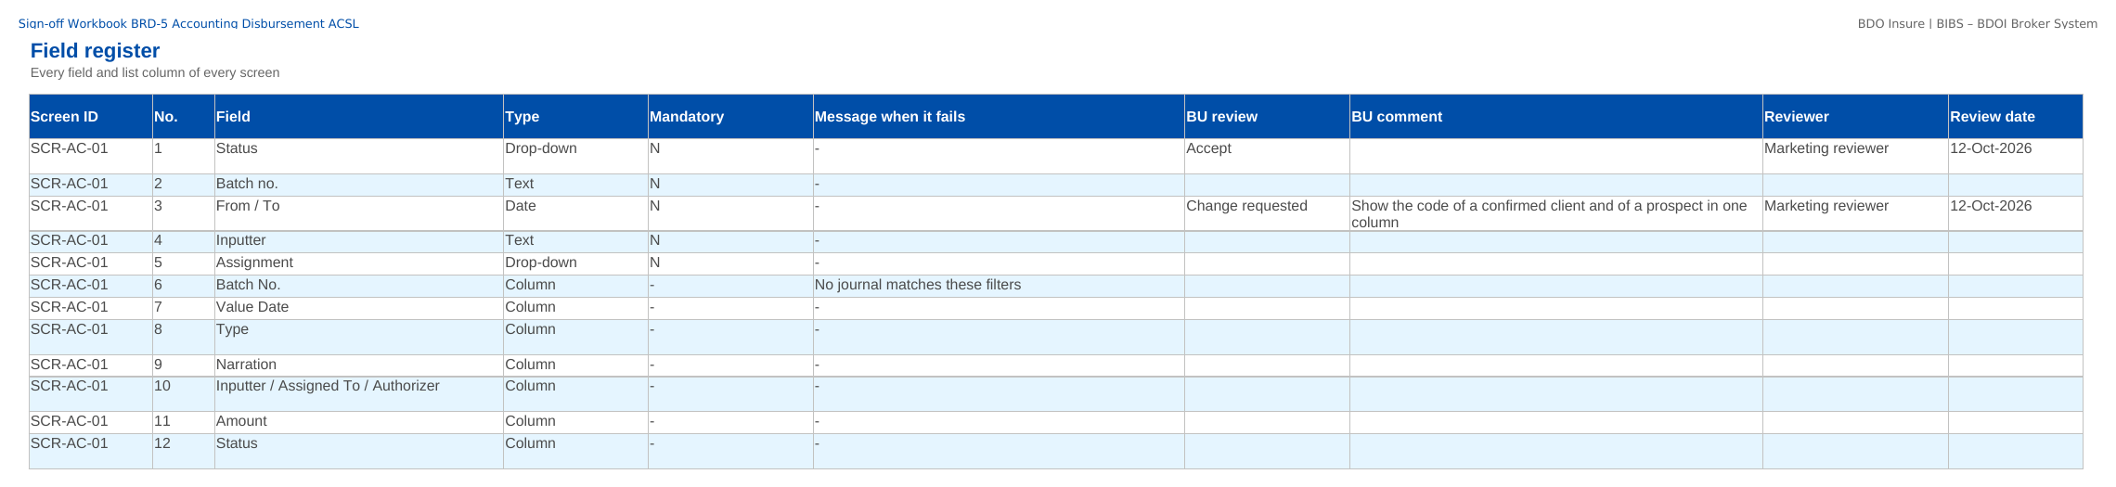
How to fill in the sign-off workbook
• Review the rows of your area on Screen standards, Screen catalogue, Field register, Business rules, Messages
• BU review: Accept, Change requested or Comment
• BU comment: the change asked for
• Reviewer and Review date
• Questions go to the Comments log
• Leave the other columns unchanged; one workbook per unit
Field register sheet of the sign-off workbook
Confidential – BDOI
Sign-off Pack Guide BRD-5 Accounting Disbursement ACSL | v2.1
13
Notes:
The No. column is the numbered marker on the screenshot of the FRS, or the column number of a load template. The drop-down columns accept only the listed values. The Comments log, Meeting minutes and Version history sheets are kept by the project team; the Sign-off certificate is signed at the end.

Slide 14
Accounting Disbursement ACSL at a glance: personas and menus
Persona | SIT user | Screens | Menu sections
GL Officer (FRBS) | glofficer | 46 | Accounting Reports, General Ledger, Receivables & Banking, Payables & Cash, Assets & Investments, Planning & Closing, Tax & Statutory, Accounting Engine
GL Team Lead | gltl | 50 | Accounting Reports, General Ledger, Receivables & Banking, Payables & Cash, Assets & Investments, Planning & Closing, Tax & Statutory, Accounting Engine
GL Section Head | glhead | 47 | Accounting Reports, General Ledger, Receivables & Banking, Payables & Cash, Assets & Investments, Planning & Closing, Tax & Statutory, Accounting Engine
Accountant (bank reconciliation) | accountant | 47 | Accounting Reports, General Ledger, Receivables & Banking, Payables & Cash, Assets & Investments, Planning & Closing, Tax & Statutory, Accounting Engine
Comptrollership administrator (masters and rules) | fmanager | 43 | Refund & Cash Advance Requests, Accounting Reports, General Ledger, Receivables & Banking, Payables & Cash, Assets & Investments, Planning & Closing, Tax & Statutory, Accounting Engine
Disbursement Processor | disb | 20 | Disbursement, Tax & Statutory
Disbursement Team Leader | disbtl | 20 | Disbursement, Tax & Statutory
Disbursement Approver | disbappr | 20 | Disbursement, Accounting Reports, General Ledger, Payables & Cash, Assets & Investments, Accounting Engine
Marketing Processor (AO) | mktao | 4 | Refund & Cash Advance Requests
Marketing Reviewer | mktrev | 5 | Refund & Cash Advance Requests
Marketing Approver | mktappr | 1 | Refund & Cash Advance Requests
Human Resources Approver | hrappr | 1 | Refund & Cash Advance Requests
ACSL Processor | acsl | 16 | ACSL, General Ledger, Receivables & Banking, Payables & Cash, Accounting Engine
ACSL Team Leader | acsltl | 16 | ACSL, General Ledger, Receivables & Banking, Payables & Cash, Accounting Engine
ACSL Head (approver) | acslhead | 16 | ACSL, General Ledger, Receivables & Banking, Payables & Cash, Accounting Engine
Comptrollership (read access) | comptrol | 26 | Disbursement, ACSL, Accounting Reports, General Ledger, Receivables & Banking, Payables & Cash, Accounting Engine
Business Administrator | badmin | 14 | Accounting Reports, General Ledger, Payables & Cash, Assets & Investments, Accounting Engine
System Administrator | admin | 28 | Disbursement, Refund & Cash Advance Requests, ACSL, Accounting Reports, General Ledger, Payables & Cash, Assets & Investments, Accounting Engine
Auditor | auditor | 55 | Disbursement, Refund & Cash Advance Requests, ACSL, Accounting Reports, General Ledger, Receivables & Banking, Payables & Cash, Assets & Investments, Planning & Closing, Tax & Statutory, Accounting Engine
Confidential – BDOI
Sign-off Pack Guide BRD-5 Accounting Disbursement ACSL | v2.1
14
Notes:
Each persona sees only the menu entries of its role; the full menu of each persona is in FRS chapter 12 and on the Menu by persona sheet of the workbook.

Slide 15
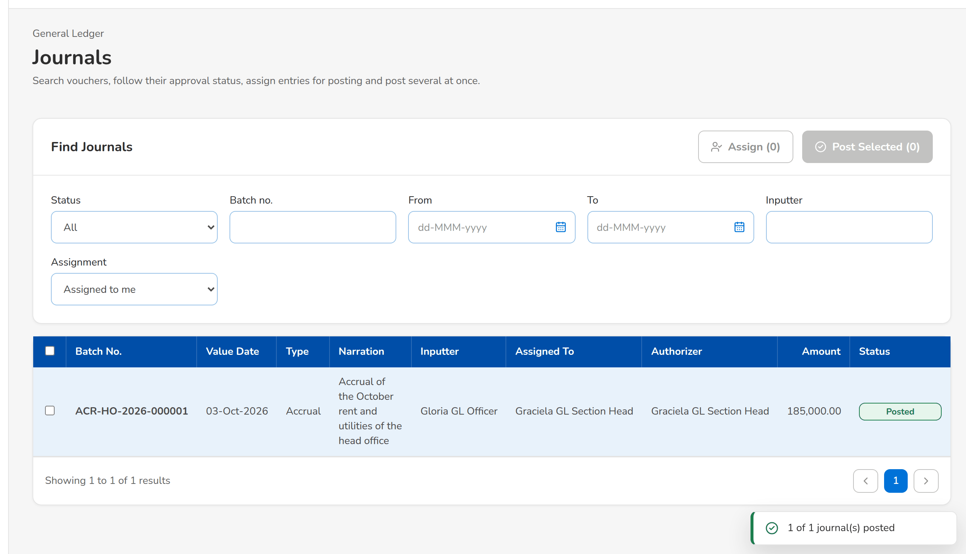
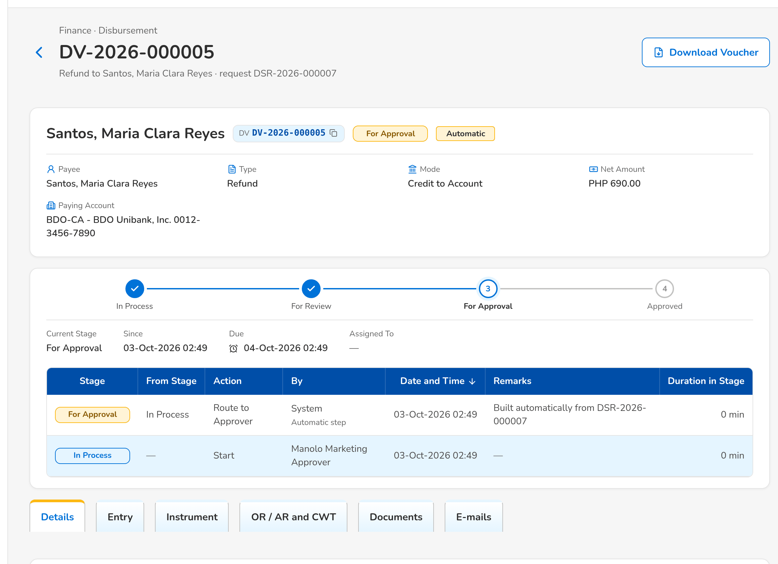
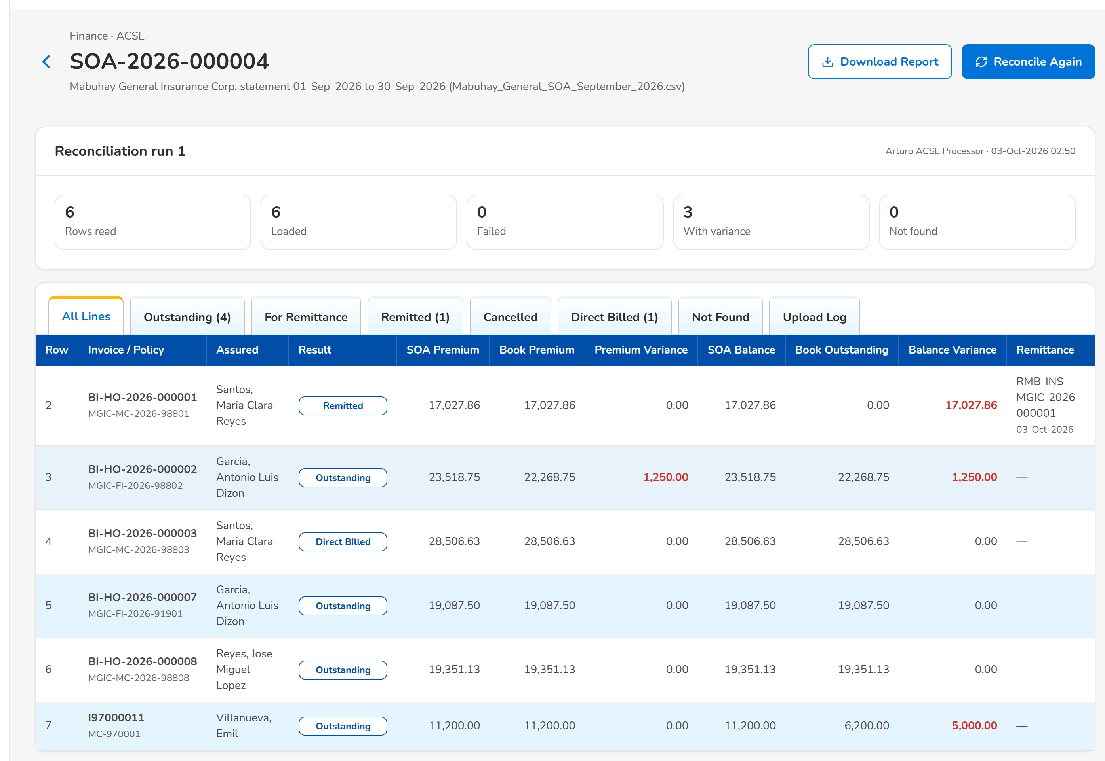
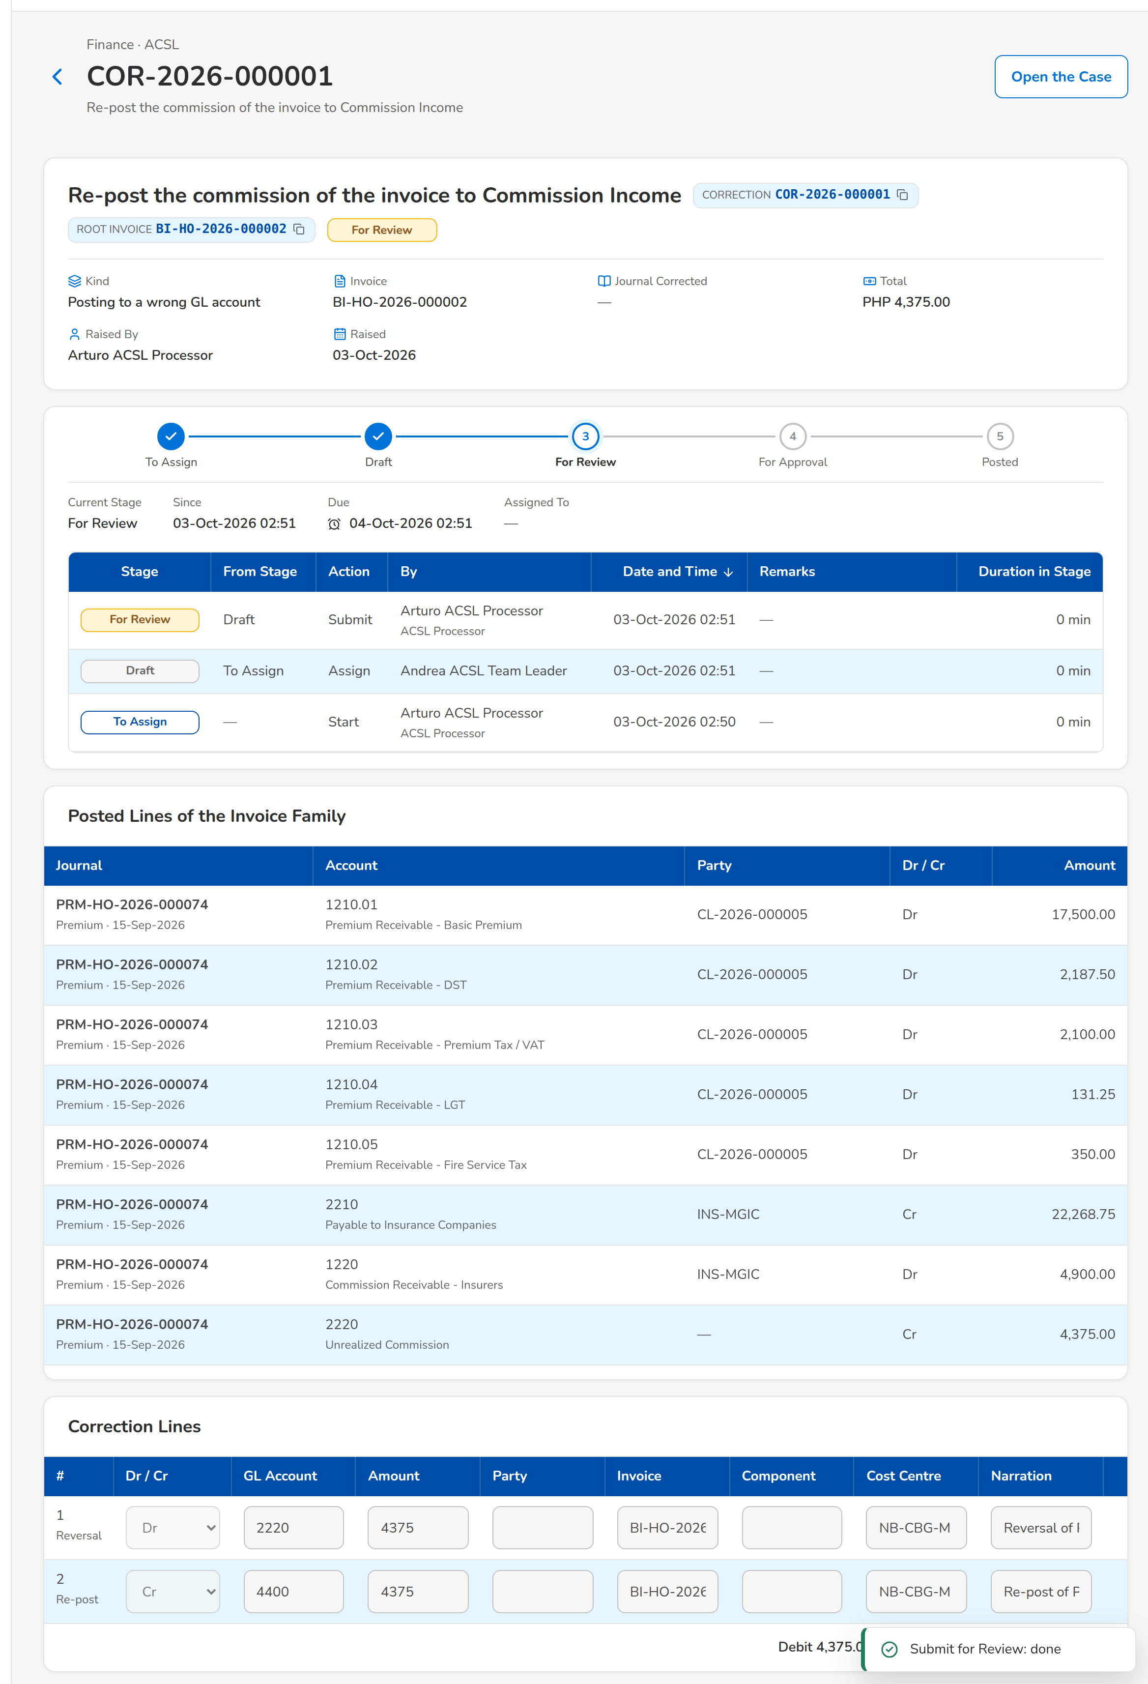
Accounting Disbursement ACSL at a glance: key screens
Journals: the accrual posted from the list of the journals assigned
A refund voucher routed to the approver with its entry
An insurer statement reconciled line by line with the books
A correction entry with the reversal and the re-post of a wrong line
Confidential – BDOI
Sign-off Pack Guide BRD-5 Accounting Disbursement ACSL | v2.1
15
Notes:
Screenshots of the SIT environment with seed data; every screen of the module is in FRS chapter 13.

Slide 16
Key business rules and validations
• Every amount posts through the accounting rules of its business event; a journal posts only when it balances, and posted entries are reversed, never changed.
• Four eyes everywhere: journals, vouchers, payees, bank accounts, fundings, corrections and service-fee runs are approved by another user than their maker; a funding needs a verifier and two approvers.
• Accruals reverse themselves on their reversal date; the broking books close at month end and the GL month closes on the date the GL Team Lead schedules.
• Disbursement pays what the units request: each request becomes a voucher with its proforma entry; refunds and remittances go straight to the approver; approval posts the entry and issues the instrument of the mode.
• A cancelled approved voucher is reversed and its request goes back to its source to be regularised; an approved voucher counts as unregularised until its OR / AR is tagged.
• Marketing refunds and cash advances are reviewed and approved in BIBS (cash advances also by HR) and reach Disbursement on approval; an AR is refunded once.
• ACSL reconciles the insurer statements and the GL with the sub-ledgers, investigates cases and corrects wrong postings with a preparer, a reviewer and an approver.
  – Full list: FRS chapter 13 per screen, 98 rules on the Business rules sheet and 378 messages in FRS chapter 15 and on the Messages sheet
Confidential – BDOI
Sign-off Pack Guide BRD-5 Accounting Disbursement ACSL | v2.1
16
Notes:
These are the rules the business units ask about most. Each rule is stated with its FR on the screen where it applies.

Slide 17
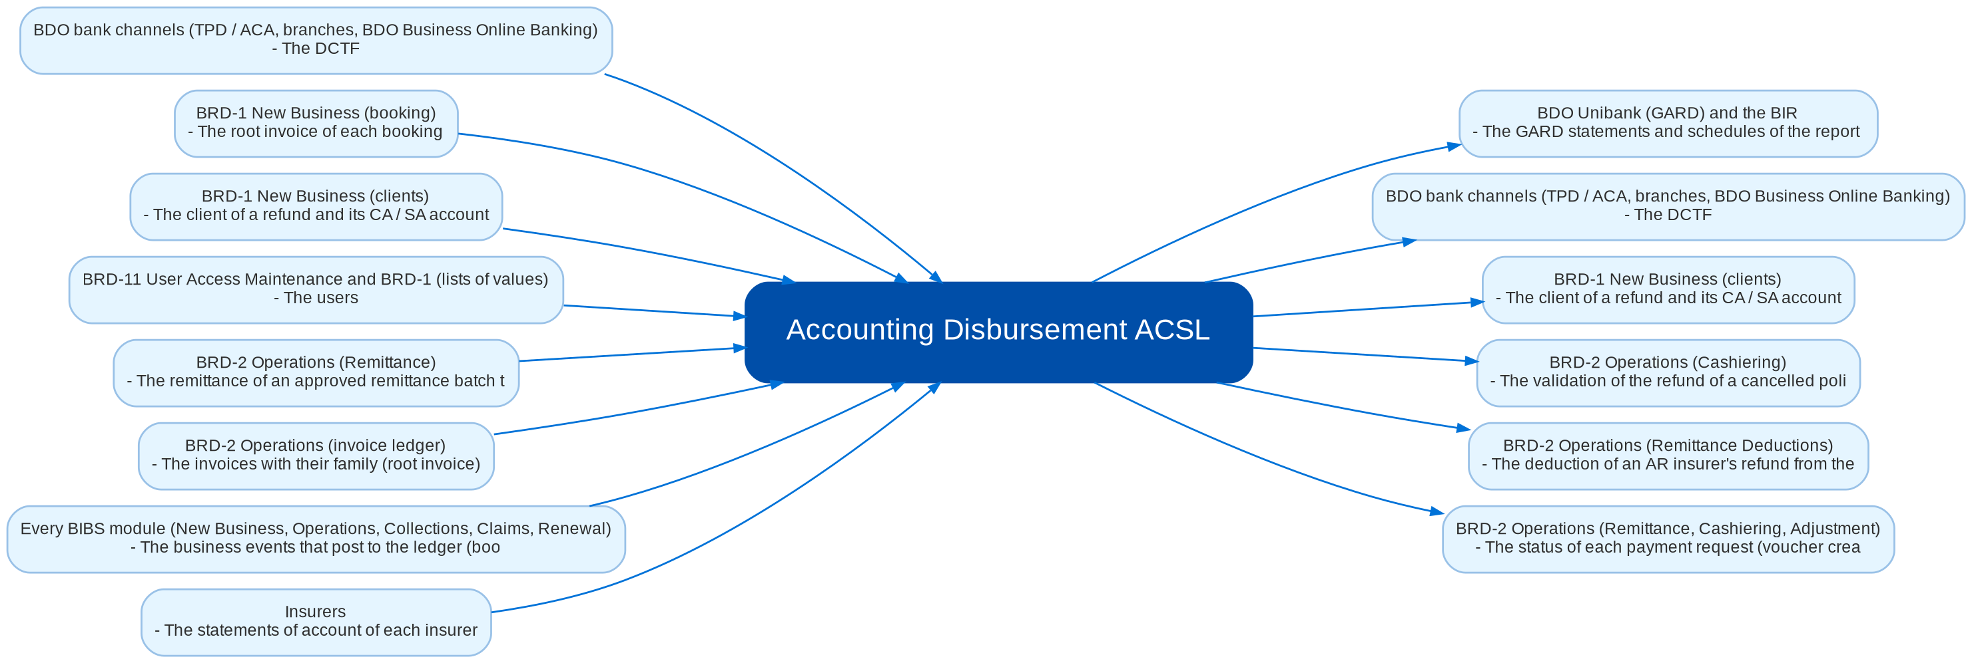
Cross-module dependencies and impacts
What Accounting Disbursement ACSL takes from and hands to the other BRDs and systems (FRS chapter 19)
Confidential – BDOI
Sign-off Pack Guide BRD-5 Accounting Disbursement ACSL | v2.1
17
Notes:
The contract is part of the signed set. A change to anything in this contract is raised in the Change Management Register and assessed with the owners of the other BRD: Disbursement pays what Operations, Marketing and Comptrollership request and reports the payment back, and ACSL corrects the postings of every module, so a change of a disbursement type, a request status or an accounting rule changes what the other BRDs send or receive and is signed by both owners as a delta.
IC-01 Every BIBS module (New Business, Operations, Collections, Claims, Renewal) (In): The business events that post to the ledger (bookings, receipts, remittances, adjustments, commission, vouchers, corrections) with their amounts by component
IC-02 BRD-2 Operations (Remittance) (In): The remittance of an approved remittance batch to the insurer, with the CPC2 and the early-incentive service invoice, the deductions applied and the insurer's DTIP
IC-03 BRD-2 Operations (Remittance, Cashiering, Adjustment) (Out): The status of each payment request (voucher created, approved, paid, returned, cancelled) and the regularisation of a cancelled approved voucher (the remittance restored, the refund put back)
IC-04 BRD-2 Operations (Cashiering) (Out): The validation of the refund of a cancelled policy and the reversal of a payment application asked by ACSL
IC-05 BRD-2 Operations (Remittance Deductions) (Out): The deduction of an AR insurer's refund from the next remittance of the insurer, confirmed by the ACSL Team Leader on the insurer's confirmation
IC-06 BRD-2 Operations (invoice ledger) (In): The invoices with their family (root invoice), components, payments and statuses, read by the SOA reconciliation, the cases and the corrections
IC-07 BRD-1 New Business (clients) (In / Out): The client of a refund and its CA / SA account; the account approved on a refund is written back to the client record
IC-08 BRD-1 New Business (booking) (In): The root invoice of each booking, endorsement and cancellation, and the service invoices of the early incentive
IC-09 BRD-11 User Access Maintenance and BRD-1 (lists of values) (In): The users, roles and permissions of the BRD-5 personas; the lists of values (payee classes, disbursement types, reasons, categories)
IC-10 BDO bank channels (TPD / ACA, branches, BDO Business Online Banking) (Out / In): The DCTF, the ATD, MC / DD, credit ticket and TT forms and the checks; back from the bank the credited accounts, the negotiated checks and the online banking approvals
IC-11 Insurers (In): The statements of account of each insurer, and the BIR 2307 certificates on commission and incentives
IC-12 BDO Unibank (GARD) and the BIR (Out): The GARD statements and schedules of the report pack; the BIR returns, alphalists and books of accounts

Slide 18
Caveats and possibilities
Topic | What can happen | How it is handled
Additional requirements | New needs can surface during the review, SIT or UAT. | In-scope clarification when the signed text already covers it; otherwise a change request with mandays.
Impacts on other modules | Disbursement pays the remittances, refunds and commission refunds of Operations and the Marketing requests; ACSL corrects the postings of every module; every module posts through the accounting rules. | Each change is assessed against the cross-BRD contract (FRS chapter 19); when it touches another set, a delta sign-off of the affected pages of both sets.
Other BRDs change Accounting and Disbursement | Operations (remittance batches, cashiering validations, remittance deductions), New Business (clients, booking, root invoices), User Access (roles) and Data Migration (opening balances, payees) change what this set shows. | The change is raised against the other BRD and assessed against the contract; when it touches this set, a delta sign-off of the affected pages only.
BDOI data still to give | The chart of accounts, the accounting entries of the transactions, the report layouts, the bank file layouts, the check and form layouts and several rates are BDOI data not given yet (AQ01-AQ31). | BIBS holds them as configuration with provisional values; the answer is loaded as configuration, without a change request.
Role matrix to confirm | The grants follow the role matrices read from the scanned pages; the bank reconciliation is held today by the Accountant and Finance Manager roles (AQ28, CLR-AC-15). | BDOI confirms the matrix; a change of a grant is applied through an access request, without a change to the screens.
Integrations pending BDOI IT specifications | The DCTF to TPD, BDO Business Online Banking, the e-filing of the BIR forms and the GARD transmission depend on BDOI IT and the bank (AQ09, AQ07, AQ31). | Files are produced and uploaded by the users until the transfers are specified; an automatic transfer is then a change request. The technical detail is in the Technical Specification, reviewed by BDOI IT.
Open questions and assumptions | Open questions of FRS section 10.3 follow the assumptions of section 10.1; chapter 21 lists the proposed rules and clarifications for confirmation. | Answered as configuration where possible (lists of values, parameters, templates, rules); otherwise a change request; the assumption stands until then.
Confidential – BDOI
Sign-off Pack Guide BRD-5 Accounting Disbursement ACSL | v2.1
18
Notes:
Three ways to handle a case: an in-scope clarification (no change to the signed set, answered in the comments log); a change request with mandays in the Change Management Register; a delta sign-off of the affected pages only.

Slide 19
Caveats: worked examples
Topic | Example and how it is handled
Additional requirements | A reviewer asks for the cost centre on the Disbursement Workbench list: a new column, so a change request; asking which vouchers count as unregularised is a clarification.
Impacts on other modules | A new disbursement type for claims payments needs the request of Claims and its accounting rule: both owners confirm the delta.
Other BRDs change Accounting and Disbursement | Operations changes the remittance schedule columns: the remittance voucher and its documents are re-issued and signed as a delta.
BDOI data still to give | BDOI gives the layout of a GARD schedule: the schedule definition is changed on Account Schedules and the report is issued with it.
Role matrix to confirm | BDOI confirms that the GL Officer reconciles the bank accounts: the permission is added to the role.
Integrations pending BDOI IT specifications | The DCTF is downloaded from the end of day and forwarded to TPD until the transfer is agreed.
Open questions and assumptions | A check goes stale after 180 days until BDOI confirms the period; the answer is a parameter value.
Confidential – BDOI
Sign-off Pack Guide BRD-5 Accounting Disbursement ACSL | v2.1
19
Notes:
Use these examples to agree the handling of a case during the review.

Slide 20
Entry and exit criteria, definition of done
Entry
Exit
Done
• Every screenshot of the set is taken on the SIT environment with seed data.
• Reviewers have their SIT users and the walkthrough sessions are held.
• The test plan is traced to the FRS and to the screens.
• The BRD-2 Operations walkthroughs are held (the remittance batches, refunds and cashiering validations are the input of Disbursement and ACSL).
• Every row of the workbook reviewed by its unit (Accept, Change requested or Comment).
• Every comments log item closed: answered, corrected in v2.2, or raised as a change request.
• Open questions closed or accepted as assumptions.
• The sign-off certificate signed by every signatory of the Who signs what matrix: prepared, input, reviewed and approved as on the BRD-5 approval sheets; the Head of Comptrollership approves the whole set.
• Signed certificate filed with the set; version history updated.
• Content frozen as signed; deltas listed in the Change Management Register with mandays.
• Test plan agreed for SIT and UAT.
Confidential – BDOI
Sign-off Pack Guide BRD-5 Accounting Disbursement ACSL | v2.1
20
Notes:
The sign-off meeting starts when the exit criteria are met; the set is done when the certificate is signed and the content of the set is frozen.

Slide 21
After sign-off: readiness checklist
• ☐ Signed FRS, sign-off workbook and screens
• ☐ Open questions closed or accepted as assumptions
• ☐ Configuration inputs from the business: the chart of accounts and its mapping, the accounting entries of every transaction, the cost-centre rules and the employees, the report and schedule layouts, the payees, the bank accounts and check series, the bank file and form layouts, the service-fee rates and recipients, the SOA layouts of the insurers, the lists of values, users and roles
• ☐ Agreed test plan
• ☐ Migration mapping of the opening balances, the open items and the payees signed (BRD-13)
  – After sign-off the content is frozen as signed and the approved deltas are scheduled.
Confidential – BDOI
Sign-off Pack Guide BRD-5 Accounting Disbursement ACSL | v2.1
21
Notes:
After sign-off the content is frozen as signed and the approved deltas are scheduled.

Slide 22
Change control after sign-off
• A change to anything frozen is raised in the Change Management Register
  – The screen, field, rule or message concerned, the reason and the priority
• The project team assesses the mandays and the effect on the other BRDs through the cross-BRD contract
• The owners of every BRD concerned approve it
• Delivered as a new version of the set (v2.1, v2.2...) with the changed pages signed again (delta sign-off)
• Configuration values marked default change in BIBS without a change request
Confidential – BDOI
Sign-off Pack Guide BRD-5 Accounting Disbursement ACSL | v2.1
22
Notes:
Nothing in a signed set changes without a request in the register.

Slide 23
Governance, contacts and next steps
Role | Who | Does
Business owner and approver | Ronald Allan E. De Leon, VP, Head - Comptrollership | Accountable for the sign-off; chairs the sign-off meeting
Approvers | Iris S. Marquez (FRBS and ACSL), Rodrigo R. Dela Cruz (Disbursement), Perjelyn Joy R. Gutierrez (Comptrollership and Operations), Shellah Marie C. Miranda (Marketing, Processing and Collections), Roderick L. Lim (Institutional Banking, SM and BDO Accounts) | Approve the screens and rules of their units
Reviewers | Freddie A. Atanque and Jennifer T. Lugtu (ACSL); Rhommel Mark Galler (MBS); Ma. Fides Rivera, Ruby Evangelista and Darryl Castillo (MBS input) | Review their screens and rows; raise comments
BDOI IT | Information Technology Group (Carmela A. Morfe, Yonille D. Guy, Abegail R. Panghulan, Nelda R. Ranchez) | Reviews the scheduled runs, files, access and the Technical Specification
BRD owner | Dan Ace R. Cauton, Program Manager, and Roda Lyn D. Gallardo, Zean C. Ibay and Jane Tagle, Business Analysts, ESG-BPS | Traceability to the BRD; sign-off coordination
Delivery | iorta TechNXT Project Manager, Business Analysis, test lead | Sessions, answers, comments log, revisions, change requests
Confidential – BDOI
Sign-off Pack Guide BRD-5 Accounting Disbursement ACSL | v2.1
23
Notes:
Next steps:
Kick-off and first SIT walkthrough on Wed 25-Nov-2026
Workbooks returned by Mon 14-Dec-2026; Q&A on Wed 16-Dec-2026; sign-off on Wed 23-Dec-2026
BRD-13 Data Migration follows (opening balances, open items and payees), then BRD-7 and BRD-8

Slide 24
Next steps and the release order of the other BRD sets
• Kick-off and first SIT walkthrough on Wed 25-Nov-2026
• Workbooks returned by Mon 14-Dec-2026; Q&A on Wed 16-Dec-2026; sign-off on Wed 23-Dec-2026
• BRD-13 Data Migration follows (opening balances, open items and payees), then BRD-7 and BRD-8
Confidential – BDOI
Sign-off Pack Guide BRD-5 Accounting Disbursement ACSL | v2.1
24
Notes:
The other BRD sets follow the same pack, guide and steps.

