Slide 1


Sign-off Pack Guide: BRD-2 Operations
BRD-2 Operations business sign-off pack, release set v2.0
BIBS – BDOI Broker System
BDO Insurance and Reinsurance Brokers, Inc. | Version 2.0 | 28 September 2026 | Confidential
Prepared by
Notes:
This deck guides the business units through the BRD-2 Operations sign-off pack, release set v2.0. It explains what the pack is, how to read it, the steps up to sign-off and what happens after. It is presented at the kick-off and stays in the pack as file 01.

Slide 2
Purpose of the pack and what sign-off means
• The pack shows the proposed Operations of BIBS, screen by screen, so each business unit confirms what it will get
  – Content: 64 screens, 391 fields, 148 business rules, 382 messages
  – Every screen with numbered fields, the navigation per persona, three end-to-end walkthroughs
• Signing freezes the content, the screens and the navigation of the module
  – After sign-off a change goes through the Change Management Register with its mandays
  – Configuration values marked default (SLA hours, thresholds, list entries, templates) stay open
• The screenshots use fictitious seed data only, in the BDO theme
Confidential – BDOI
Sign-off Pack Guide BRD-2 Operations | v2.0
2
Notes:
Stress that the pack shows the screens, fields, rules and messages the business is asked to confirm.
Signing means: this is what we get; the look, feel, fields, rules, messages and navigation are frozen.
Data on the screenshots is seed data of the SIT environment; names and numbers are fictitious.

Slide 3
The pack at a glance (1 of 2)
File | What it is for | Who reads it | When
00_BIBS_StartHere_BRD-02_Operations_v2.0.docx | Start Here: the map of the pack, who reads what, the steps and the dates | Everyone | First, on issue
01_BIBS_GuideDeck_BRD-02_Operations_v2.0.pptx | Sign-off Pack Guide: purpose, approach, the module at a glance, caveats and impacts on other modules, entry and exit criteria, change control | Business owner, unit heads; presented at the kick-off | Kick-off session
02_BIBS_FRS_BRD-02_Operations_v2.0.docx | Functional Requirements Specification v2.0: requirements, navigation, 64 screen specifications with screenshots, walkthroughs, messages, notifications, documents, uploads, cross-BRD contract | Business users of each Operations team; Comptrollership, Disbursement and BDOI IT for their chapters | During the review, with the SIT walkthroughs
03_BIBS_Signoff_BRD-02_Operations_v2.0.xlsx | Sign-off workbook: one row per screen, field, rule and message with the BU review columns; comments log, meeting minutes, version history, sign-off certificate | Every reviewer; the business owner signs it | During the review and at sign-off
04_BIBS_TestPlan_BRD-02_Operations_v2.0.xlsx | Test plan workbook: the test cases traced to the FRs and to the screens, including one screen case and one message case per screen | Business users who will run UAT; BDOI IT | After the screens; used again in SIT and UAT
Confidential – BDOI
Sign-off Pack Guide BRD-2 Operations | v2.0
3
Notes:
The files are numbered in reading order so they sort that way in the BRD folder. 00 Start Here is the short version of this deck; 02 FRS and 03 workbook carry the same rows; 04 and 05 are the test plan traced to the screens; 07 to 09 are the UX screen documents for the BDOI UX Design team, taken from the same screens.

Slide 4
The pack at a glance (2 of 2)
File | What it is for | Who reads it | When
05_BIBS_TestPlan_BRD-02_Operations_Summary_v2.0.docx | Test plan summary: scope, approach, coverage and the cases by area | Business owner, BDOI IT | Before sign-off
07_BIBS_UXDeck_BRD-02_Operations_v2.0.pptx | UX Screen Deck for the BDOI UX Design team: design foundation, navigation and personas, every walkthrough step by step and every screen with all its states | BDOI UX Design team | From the issue, in parallel with the review; re-issued with each version of the set
08_BIBS_UXScreens_BRD-02_Operations_v2.0.xlsx | UX screen register: one row per screen image with the screen, personas, walkthrough and step, state, FRS section and requirements, UXD status and comments, and the Changed in this issue flag | BDOI UX Design team | Kept by the UX Design team; the changed rows are flagged at each issue
09_BIBS_UXScreens_BRD-02_Operations_v2.0.zip | Image package: every screen image at twice the screen resolution (PNG), the component crops and the register as CSV | BDOI UX Design team | Imported into the design tool at each issue
Confidential – BDOI
Sign-off Pack Guide BRD-2 Operations | v2.0
4
Notes:
The files are numbered in reading order so they sort that way in the BRD folder. 00 Start Here is the short version of this deck; 02 FRS and 03 workbook carry the same rows; 04 and 05 are the test plan traced to the screens; 07 to 09 are the UX screen documents for the BDOI UX Design team, taken from the same screens.

Slide 5
Where to start: reading order per role
Role | Read, in this order
Business owner (Product Owner; Operations FT&P) | 00 Start Here; 01 Guide deck; FRS chapters 1-3 (context and personas), 14 (walkthroughs), 20 (sign-off) and 21 (proposed rules for confirmation); workbook Sign-off certificate
Cashiering (cashiers and Team Leader) | FRS chapter 4 Cashiering; the Cashiering screens of chapter 13 (SCR-OP-07 to 22); walkthroughs A (steps 3-4), B (steps 8-9) and D (steps 3-4); messages in chapter 15; documents DO-01 and DO-02 in chapter 17; upload templates in chapter 18
Remittance (processors and Team Leader) | FRS chapter 4 Remittance; screens SCR-OP-23 to 36; walkthroughs A (steps 5-10) and D (step 5); notifications in chapter 16; documents DO-03 and DO-04
Adjustment (processors and Team Leader) | FRS chapter 4 Adjustment / Cancellation; screens SCR-OP-37 to 42; walkthrough B; documents DO-05 and DO-06; Policy Transactions in chapter 12
Production Reconciliation and Commission Receivables | FRS chapter 4 Production Reconciliation and Commission Receivables; screens SCR-OP-43 to 60; walkthrough C; documents DO-07 and DO-08
Marketing Collection and Marketing Team Leader | Holds, special remittance, BIR 2307 tags and endorsement requests (SCR-OP-19, 28 to 31, 38); walkthrough B steps 1-3 and D steps 1-2
Comptrollership, Disbursement and ACSL (BRD-5) | Accounting events (chapter 5); Disbursement Queue and Remittance Deductions (SCR-OP-33, 34, 36); BIR certificates (SCR-OP-58, 59); cross-BRD contract (chapter 19)
BDOI IT | Interfaces and integration (chapter 7), non-functional requirements (chapter 8), configuration and jobs (chapter 9), Interfaces screen (SCR-OP-61), cross-BRD contract (chapter 19); the Technical Specification, reviewed by BDOI IT
BDOI UX Design team | 07 UX Screen Deck: design foundation and navigation first, then the personas, walkthroughs and screens of the design work; 08 UX screen register (filter Changed in this issue at each new issue); 09 image package in the design tool
iorta TechNXT project team | All documents; keeps the comments log, the meeting minutes and the version history of the workbook, answers every comment and keeps the traceability to SIT and UAT
Confidential – BDOI
Sign-off Pack Guide BRD-2 Operations | v2.0
5
Notes:
Nobody needs to read the whole FRS. Each role starts with its chapters and its sheets of the workbook; the walkthroughs in chapter 14 are the fastest way to see the whole process.

Slide 6
Approach: from issue to closure
1
Pack issued
2
Kick-off and screen walkthrough on SIT
3
Review with the workbook
4
Comments consolidated and a Q&A session
Release set v2.0 in the BRD-02 folder; invitations to the sessions
Screens shown live per team (Cashiering, Remittance, Adjustment, Production Reconciliation and Commission Receivables); first questions logged in the comments log; minutes
Every row marked Accept, Change requested or Comment; comments log entries
One consolidated comments log, each item typed (clarification, correction, change request) and answered; Q&A minutes
Day 0 (Mon 28-Sep-2026); sessions scheduled after the BRD-10, 12, 6 and 9 sign-offs
5 sessions, 16 to 20-Nov-2026
10 working days after the walkthroughs, until Fri 4-Dec-2026
3 working days, Q&A on Wed 9-Dec-2026
5
One revision cycle (v2.1)
6
Sign-off meeting and signature
7
Content freeze
8
Traceability into SIT and UAT
Release set v2.1 with the changed rows marked; change requests raised for the rest
Signed sign-off certificate; minutes; open items accepted as assumptions or change requests
Content frozen as signed; approved deltas scheduled in the Change Management Register
SIT and UAT runs traced to the signed screens, rules and messages; results against each row
2 working days, v2.1 on Fri 11-Dec-2026; check by the reviewers until Wed 16-Dec-2026
Fri 18-Dec-2026
From Mon 21-Dec-2026
SIT Jan - Jul 2027; UAT Aug - Dec 2027
Confidential – BDOI
Sign-off Pack Guide BRD-2 Operations | v2.0
6
Notes:
1. Pack issued: Day 0 (Mon 28-Sep-2026); sessions scheduled after the BRD-10, 12, 6 and 9 sign-offs.
2. Kick-off and screen walkthrough on SIT: 5 sessions, 16 to 20-Nov-2026.
3. Review with the workbook: 10 working days after the walkthroughs, until Fri 4-Dec-2026.
4. Comments consolidated and a Q&A session: 3 working days, Q&A on Wed 9-Dec-2026.
5. One revision cycle (v2.1): 2 working days, v2.1 on Fri 11-Dec-2026; check by the reviewers until Wed 16-Dec-2026.
6. Sign-off meeting and signature: Fri 18-Dec-2026.
7. Content freeze: From Mon 21-Dec-2026.
8. Traceability into SIT and UAT: SIT Jan - Jul 2027; UAT Aug - Dec 2027.

Slide 7
Steps in detail (1 of 2): who, inputs, outputs, duration
Step | Who (R, A, C, I) | Inputs | Outputs | Duration
1. Pack issued | R: iorta TechNXT Project Manager; A: iorta TechNXT delivery lead; I: all reviewers | FRS v2.0, workbook, test plan, guide and deck | Release set v2.0 in the BRD-02 folder; invitations to the sessions | Day 0 (Mon 28-Sep-2026); sessions scheduled after the BRD-10, 12, 6 and 9 sign-offs
2. Kick-off and screen walkthrough on SIT | R: iorta TechNXT Business Analysis; A: BDOI Product Owner; C: Operations FT&P unit heads; I: BDOI IT | Guide deck; SIT users with seed data; walkthroughs A, B, C and D | Screens shown live per team (Cashiering, Remittance, Adjustment, Production Reconciliation and Commission Receivables); first questions logged in the comments log; minutes | 5 sessions, 16 to 20-Nov-2026
3. Review with the workbook | R: business users of each Operations team; A: Operations FT&P unit heads; C: iorta TechNXT (questions) | FRS chapters of the area; workbook sheets with the BU review columns | Every row marked Accept, Change requested or Comment; comments log entries | 10 working days after the walkthroughs, until Fri 4-Dec-2026
4. Comments consolidated and a Q&A session | R: iorta TechNXT Project Manager and Business Analysis; A: BDOI Product Owner; C: reviewers | Returned workbooks | One consolidated comments log, each item typed (clarification, correction, change request) and answered; Q&A minutes | 3 working days, Q&A on Wed 9-Dec-2026
Confidential – BDOI
Sign-off Pack Guide BRD-2 Operations | v2.0
7
Notes:
R responsible, A accountable, C consulted, I informed. The durations are indicative; the dates are those of the Start Here guide.

Slide 8
Steps in detail (2 of 2): who, inputs, outputs, duration
Step | Who (R, A, C, I) | Inputs | Outputs | Duration
5. One revision cycle (v2.1) | R: iorta TechNXT Business Analysis; A: iorta TechNXT delivery lead; C: reviewers who raised the items | Agreed clarifications and corrections | Release set v2.1 with the changed rows marked; change requests raised for the rest | 2 working days, v2.1 on Fri 11-Dec-2026; check by the reviewers until Wed 16-Dec-2026
6. Sign-off meeting and signature | R: iorta TechNXT Project Manager; A: BDOI Product Owner; C: Operations FT&P, Comptrollership, BDOI IT | v2.1 (or v2.0 when no revision is needed); open items with their decision | Signed sign-off certificate; minutes; open items accepted as assumptions or change requests | Fri 18-Dec-2026
7. Content freeze | R: iorta TechNXT delivery lead; A: BDOI Product Owner; I: BDOI IT, other BRD owners | Signed set; change requests with mandays | Content frozen as signed; approved deltas scheduled in the Change Management Register | From Mon 21-Dec-2026
8. Traceability into SIT and UAT | R: iorta TechNXT test lead; A: BDOI Product Owner; C: business users | Signed FRS rows and test plan | SIT and UAT runs traced to the signed screens, rules and messages; results against each row | SIT Jan - Jul 2027; UAT Aug - Dec 2027
Confidential – BDOI
Sign-off Pack Guide BRD-2 Operations | v2.0
8
Notes:
R responsible, A accountable, C consulted, I informed. The durations are indicative; the dates are those of the Start Here guide.

Slide 9
Who signs what: parts of the set (1 of 2)
Part of the set | Prepares | Provides input | Reviews | Approves
Screens and fields (FRS screen specifications; workbook Screen catalogue, Field register) | iorta TechNXT | FT&P input | Program Manager (BPS) | Product Owner, Operations FT&P
Business rules and validations | iorta TechNXT | FT&P input, BA (BPS) | Program Manager (BPS) | Product Owner, Operations FT&P
Messages and notifications | iorta TechNXT | FT&P input | Program Manager (BPS) | Product Owner, Operations FT&P
Documents and reports (receipts, remittance schedules, slips, registers, billings, reports) | iorta TechNXT | FT&P input | Program Manager (BPS) | Product Owner, Operations FT&P
Walkthroughs (end-to-end, screen by screen) | iorta TechNXT | FT&P input | Program Manager (BPS) | Product Owner
Confidential – BDOI
Sign-off Pack Guide BRD-2 Operations | v2.0
9
Notes:
The set holds business content only: screens, fields, rules, messages, notifications, documents, walkthroughs and reports. Business users sign the business content; BDOI IT reviews the interfaces, the user access and the Technical Specification, a separate document that holds the technical content; the Program Manager of Business Project Services reviews the traceability and the completeness; the Product Owner approves the whole set; iorta TechNXT prepares it.
The roles are those of the BRD approval sheet (Operations BRD approval sheet p.6-7 (Prepared by, Input Provided by, Reviewed by, Approved by)).

Slide 10
Who signs what: parts of the set (2 of 2)
Part of the set | Prepares | Provides input | Reviews | Approves
Proposed business rules and clarifications for confirmation | iorta TechNXT | BA (BPS), FT&P input | Program Manager (BPS) | Product Owner, Operations FT&P
Interfaces, scheduled runs, user access and menus by persona | iorta TechNXT | FT&P input | BDOI IT | Product Owner
Test plan (04 workbook, 05 summary) | iorta TechNXT | FT&P input | Program Manager (BPS), BDOI IT | Product Owner
UX screen deck, UX screen register and image package (07 to 09, for the BDOI UX Design team; the screens as specified in this set) | iorta TechNXT | FT&P input | Program Manager (BPS) | Product Owner
Technical Specification (separate document, not part of the business sign-off) | iorta TechNXT | BDOI IT | BDOI IT | BDOI IT
Confidential – BDOI
Sign-off Pack Guide BRD-2 Operations | v2.0
10
Notes:
The set holds business content only: screens, fields, rules, messages, notifications, documents, walkthroughs and reports. Business users sign the business content; BDOI IT reviews the interfaces, the user access and the Technical Specification, a separate document that holds the technical content; the Program Manager of Business Project Services reviews the traceability and the completeness; the Product Owner approves the whole set; iorta TechNXT prepares it.
The roles are those of the BRD approval sheet (Operations BRD approval sheet p.6-7 (Prepared by, Input Provided by, Reviewed by, Approved by)).

Slide 11
Who signs what: signatories
Capacity | Role | Confirms by signing
Prepared by | iorta TechNXT project team: Project Manager, Business Analysis, test lead (iorta TechNXT) | The set is complete and consistent as issued, traced to the BRD and to the screens; every comment is answered in the comments log
Prepared by | Business Analyst, Enterprise Services Group - Business Project Services (BPS) (Zean C. Ibay) (BDO Unibank ESG) | The set states the BRD requirements as written; every departure is listed in the proposed rules and clarifications
Input provided by | Operations: Financial Transactions and Processing, BU representatives (Shirley Catapang, Perjelyn Joy Gutierrez) (BDOI) | The Cashiering, Remittance, Adjustment, Production Reconciliation and Commission Receivables screens, fields, rules and messages match the business input
Reviewed by | BDOI Information Technology Group (BDOI IT) (BDOI) | Interfaces and scheduled runs, user access and menus, the Disbursement queue and the uploads that stand in for other systems, and the Technical Specification (a separate document); not the business screens
Approved by | Program Manager, Enterprise Services Group - Business Project Services (BPS) (Dan Ace Cauton) (BDO Unibank ESG) | Traceability of every BRD requirement to the set and completeness of the set
Approved by | Operations: Financial Transactions and Processing (Jose Melvin M. Jarin) (BDOI) | The Operations screens, rules, messages, notifications, documents and accounting events
Approved by | Product Owner, AVP (Shellah Marie C. Miranda) (BDOI) | Owns the set and approves all of its contents
Confidential – BDOI
Sign-off Pack Guide BRD-2 Operations | v2.0
11
Notes:
The certificate sheet of the workbook lists the same signatories in the same order: prepared by, input provided by, reviewed by, approved by, as on the BRD approval sheet. A role the set adds to the approval sheet is marked there.
iorta TechNXT project team: Project Manager, Business Analysis, test lead: Added for this set (author of the FRS set).
Business Analyst, Enterprise Services Group - Business Project Services (BPS) (Zean C. Ibay): Prepared by (p.6).
Operations: Financial Transactions and Processing, BU representatives (Shirley Catapang, Perjelyn Joy Gutierrez): Input Provided by (p.6).
BDOI Information Technology Group (BDOI IT): Reviewed by (p.6-7).
Program Manager, Enterprise Services Group - Business Project Services (BPS) (Dan Ace Cauton): Approved by (p.7).
Operations: Financial Transactions and Processing (Jose Melvin M. Jarin): Approved by (p.7).
Product Owner, AVP (Shellah Marie C. Miranda): Approved by (p.7).

Slide 12
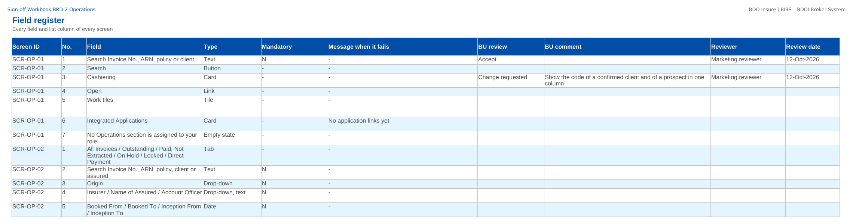
How to fill in the sign-off workbook
• Review the rows of your area on Screen standards, Screen catalogue, Field register, Business rules, Messages
• BU review: Accept, Change requested or Comment
• BU comment: the change asked for
• Reviewer and Review date
• Questions go to the Comments log
• Leave the other columns unchanged; one workbook per unit
Field register sheet of the sign-off workbook
Confidential – BDOI
Sign-off Pack Guide BRD-2 Operations | v2.0
12
Notes:
The No. column is the numbered marker on the screenshot of the FRS, or the column number of a load template. The drop-down columns accept only the listed values. The Comments log, Meeting minutes and Version history sheets are kept by the project team; the Sign-off certificate is signed at the end.

Slide 13
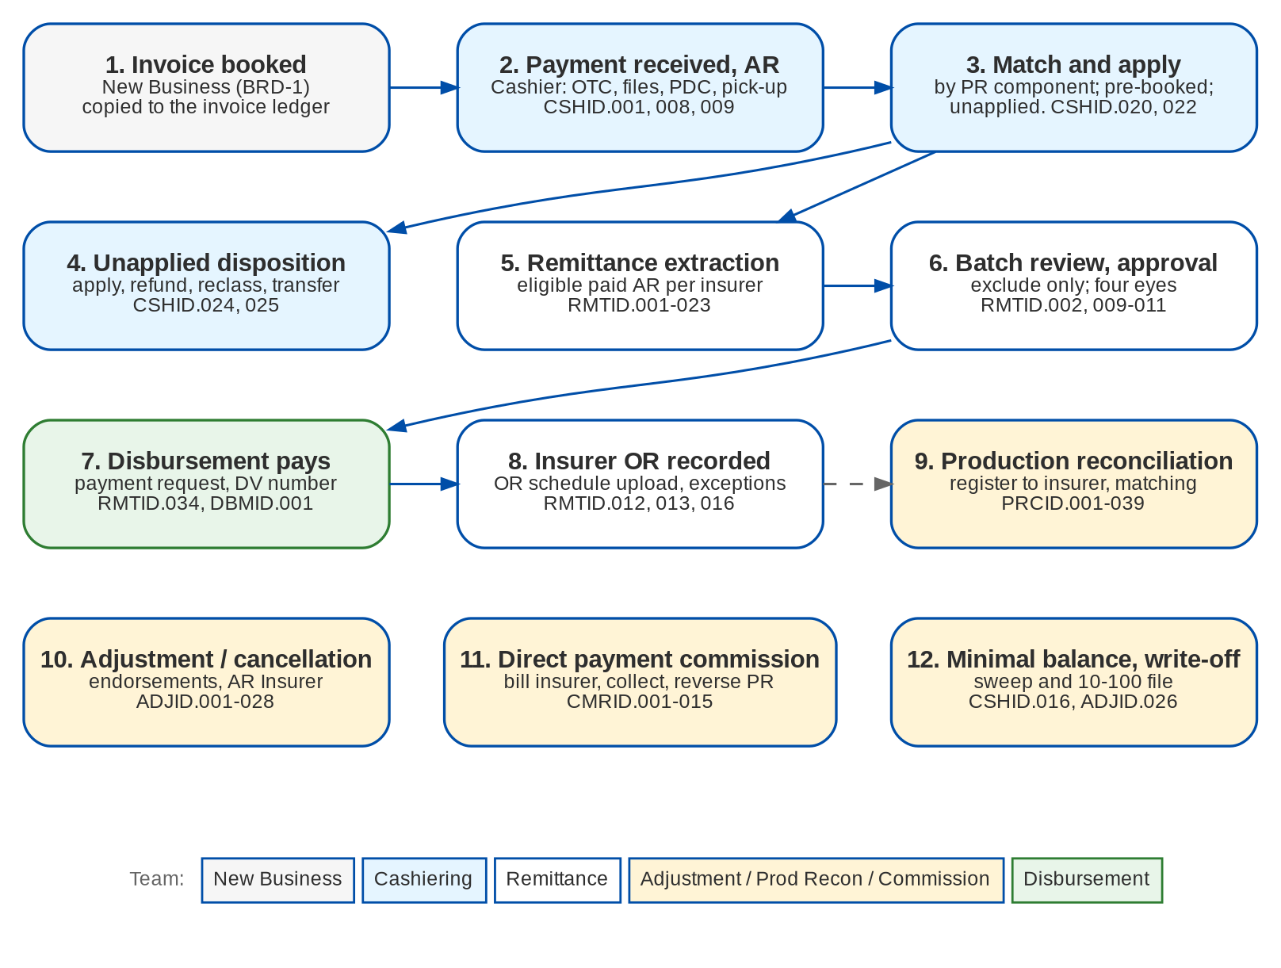
Operations at a glance: process flow
BRD-2 process from the client to the booked invoice
Confidential – BDOI
Sign-off Pack Guide BRD-2 Operations | v2.0
13
Notes:
The process runs from client onboarding and KYC, through the quotation or the PRF, the account, payment and placement, issuance and booking, to the hand-off to Operations and Accounting.

Slide 14
Operations at a glance: personas and menus
Persona | SIT user | Screens | Menu sections
Cashier | cashier | 22 | Operations, Cashiering, Commission Receivables
Cashiering Team Leader / Head | cashtl | 22 | Operations, Cashiering, Commission Receivables
Remittance Processor | remit | 14 | Operations, Remittance
Remittance Team Leader / Head | remittl | 14 | Operations, Remittance
Production Reconciliation Handler | recon | 11 | Production Reconciliation, Operations
Adjustment Processor | adjust | 10 | Adjustment, Operations
Adjustment Team Leader | adjtl | 10 | Adjustment, Operations
Commission Receivables Handler | commrec | 16 | Operations, Cashiering, Commission Receivables
Commission Receivables Team Leader / Head | commtl | 16 | Operations, Cashiering, Commission Receivables
Marketing Collection | mktcoll | 12 | Adjustment, Operations, Cashiering, Remittance
Marketing Team Leader / Unit Head (hold approver) | mkttl | 12 | Adjustment, Operations, Cashiering, Remittance
Comptrollership | comptrol | 8 | Operations, Remittance, Commission Receivables
Disbursement | disb | 7 | Operations, Cashiering
ACSL Processor (remittance deductions) | acsl | 6 | Operations, Remittance
ACSL Team Leader (confirms deductions) | acsltl | 6 | Operations, Remittance
System Administrator | admin | 7 | Operations, Remittance
Auditor | auditor | 6 | Operations, Remittance
Confidential – BDOI
Sign-off Pack Guide BRD-2 Operations | v2.0
14
Notes:
Each persona sees only the menu entries of its role; the full menu of each persona is in FRS chapter 12 and on the Menu by persona sheet of the workbook. The menus of 1 more personas of the other BRDs are there too, one table and one sheet each.

Slide 15
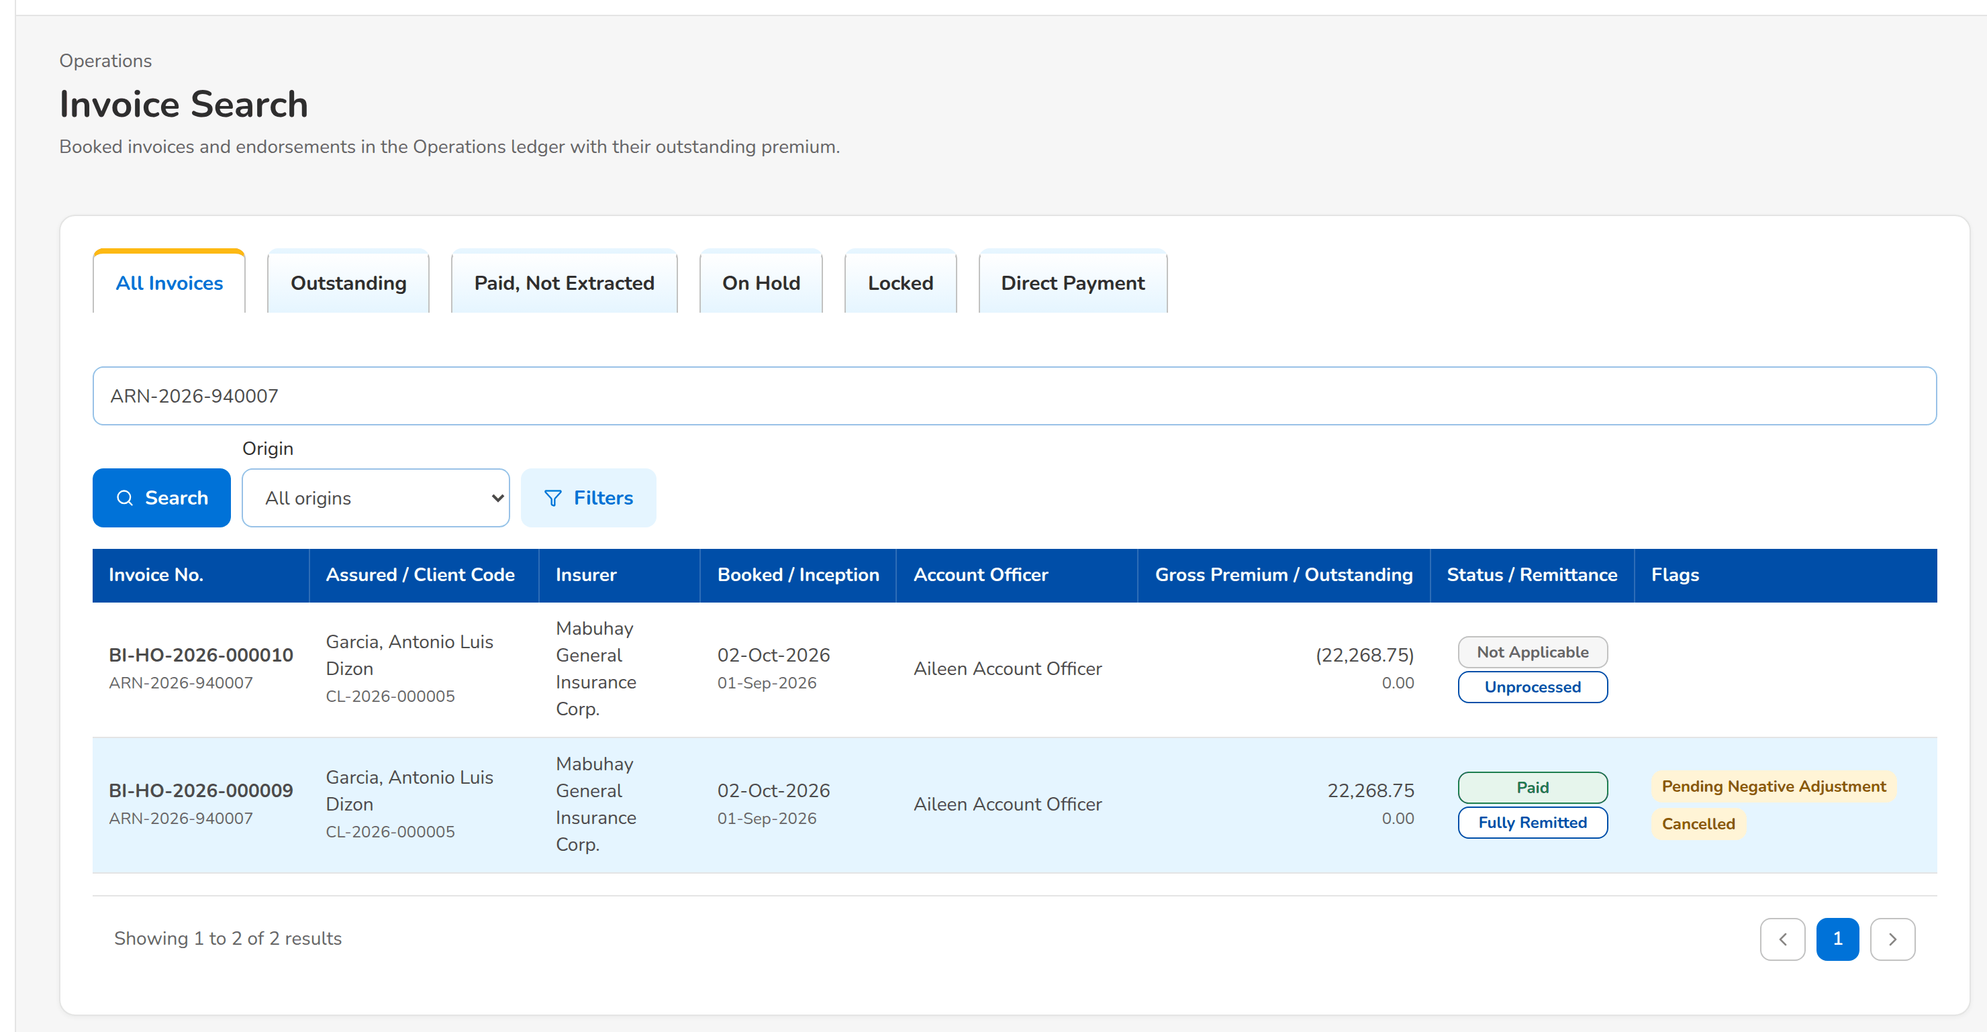
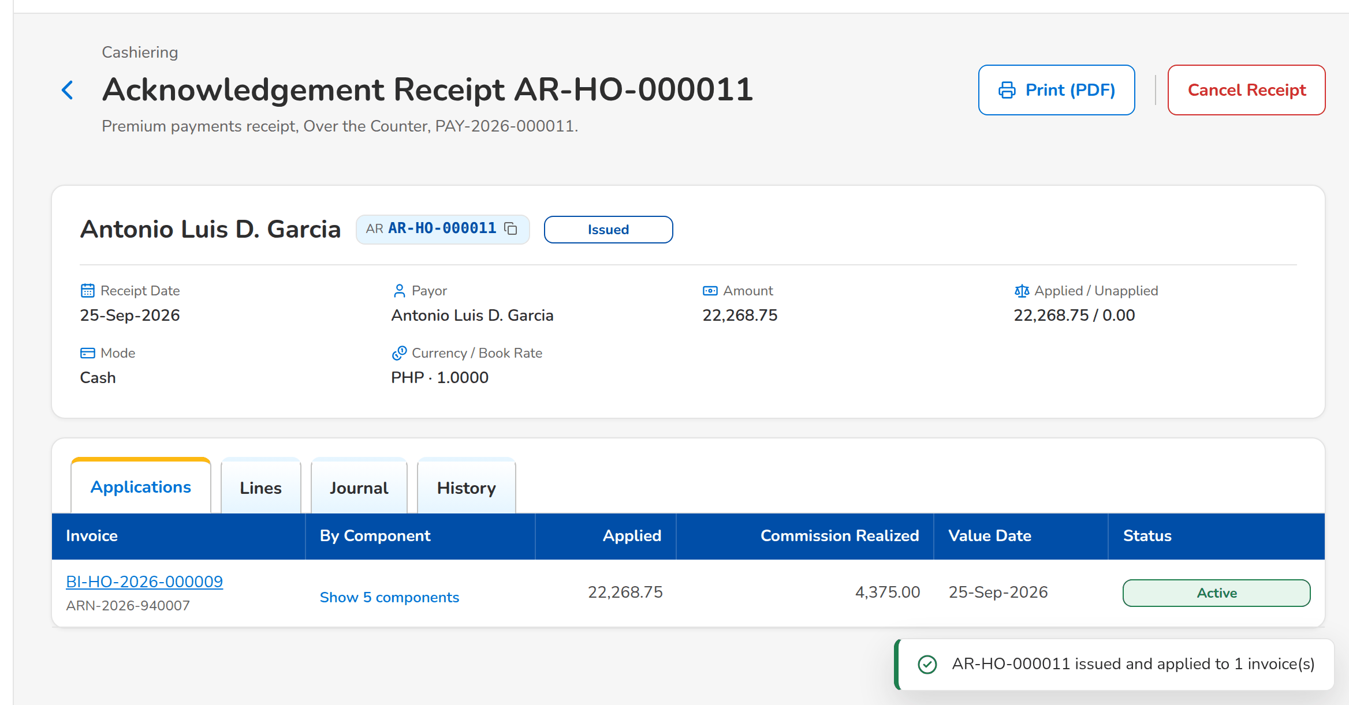
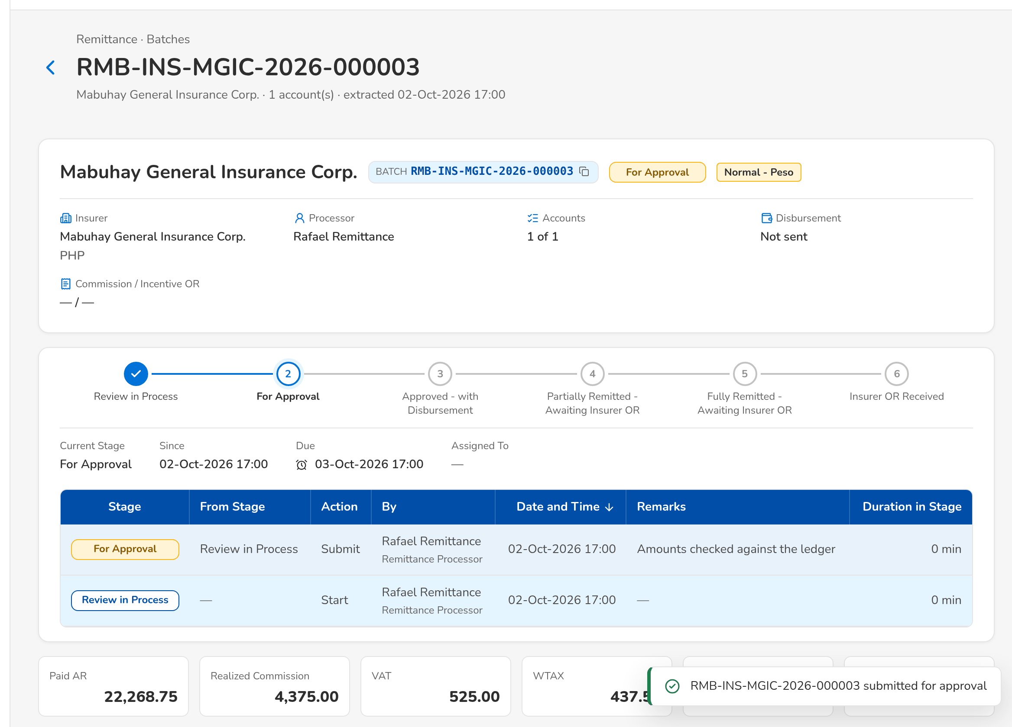
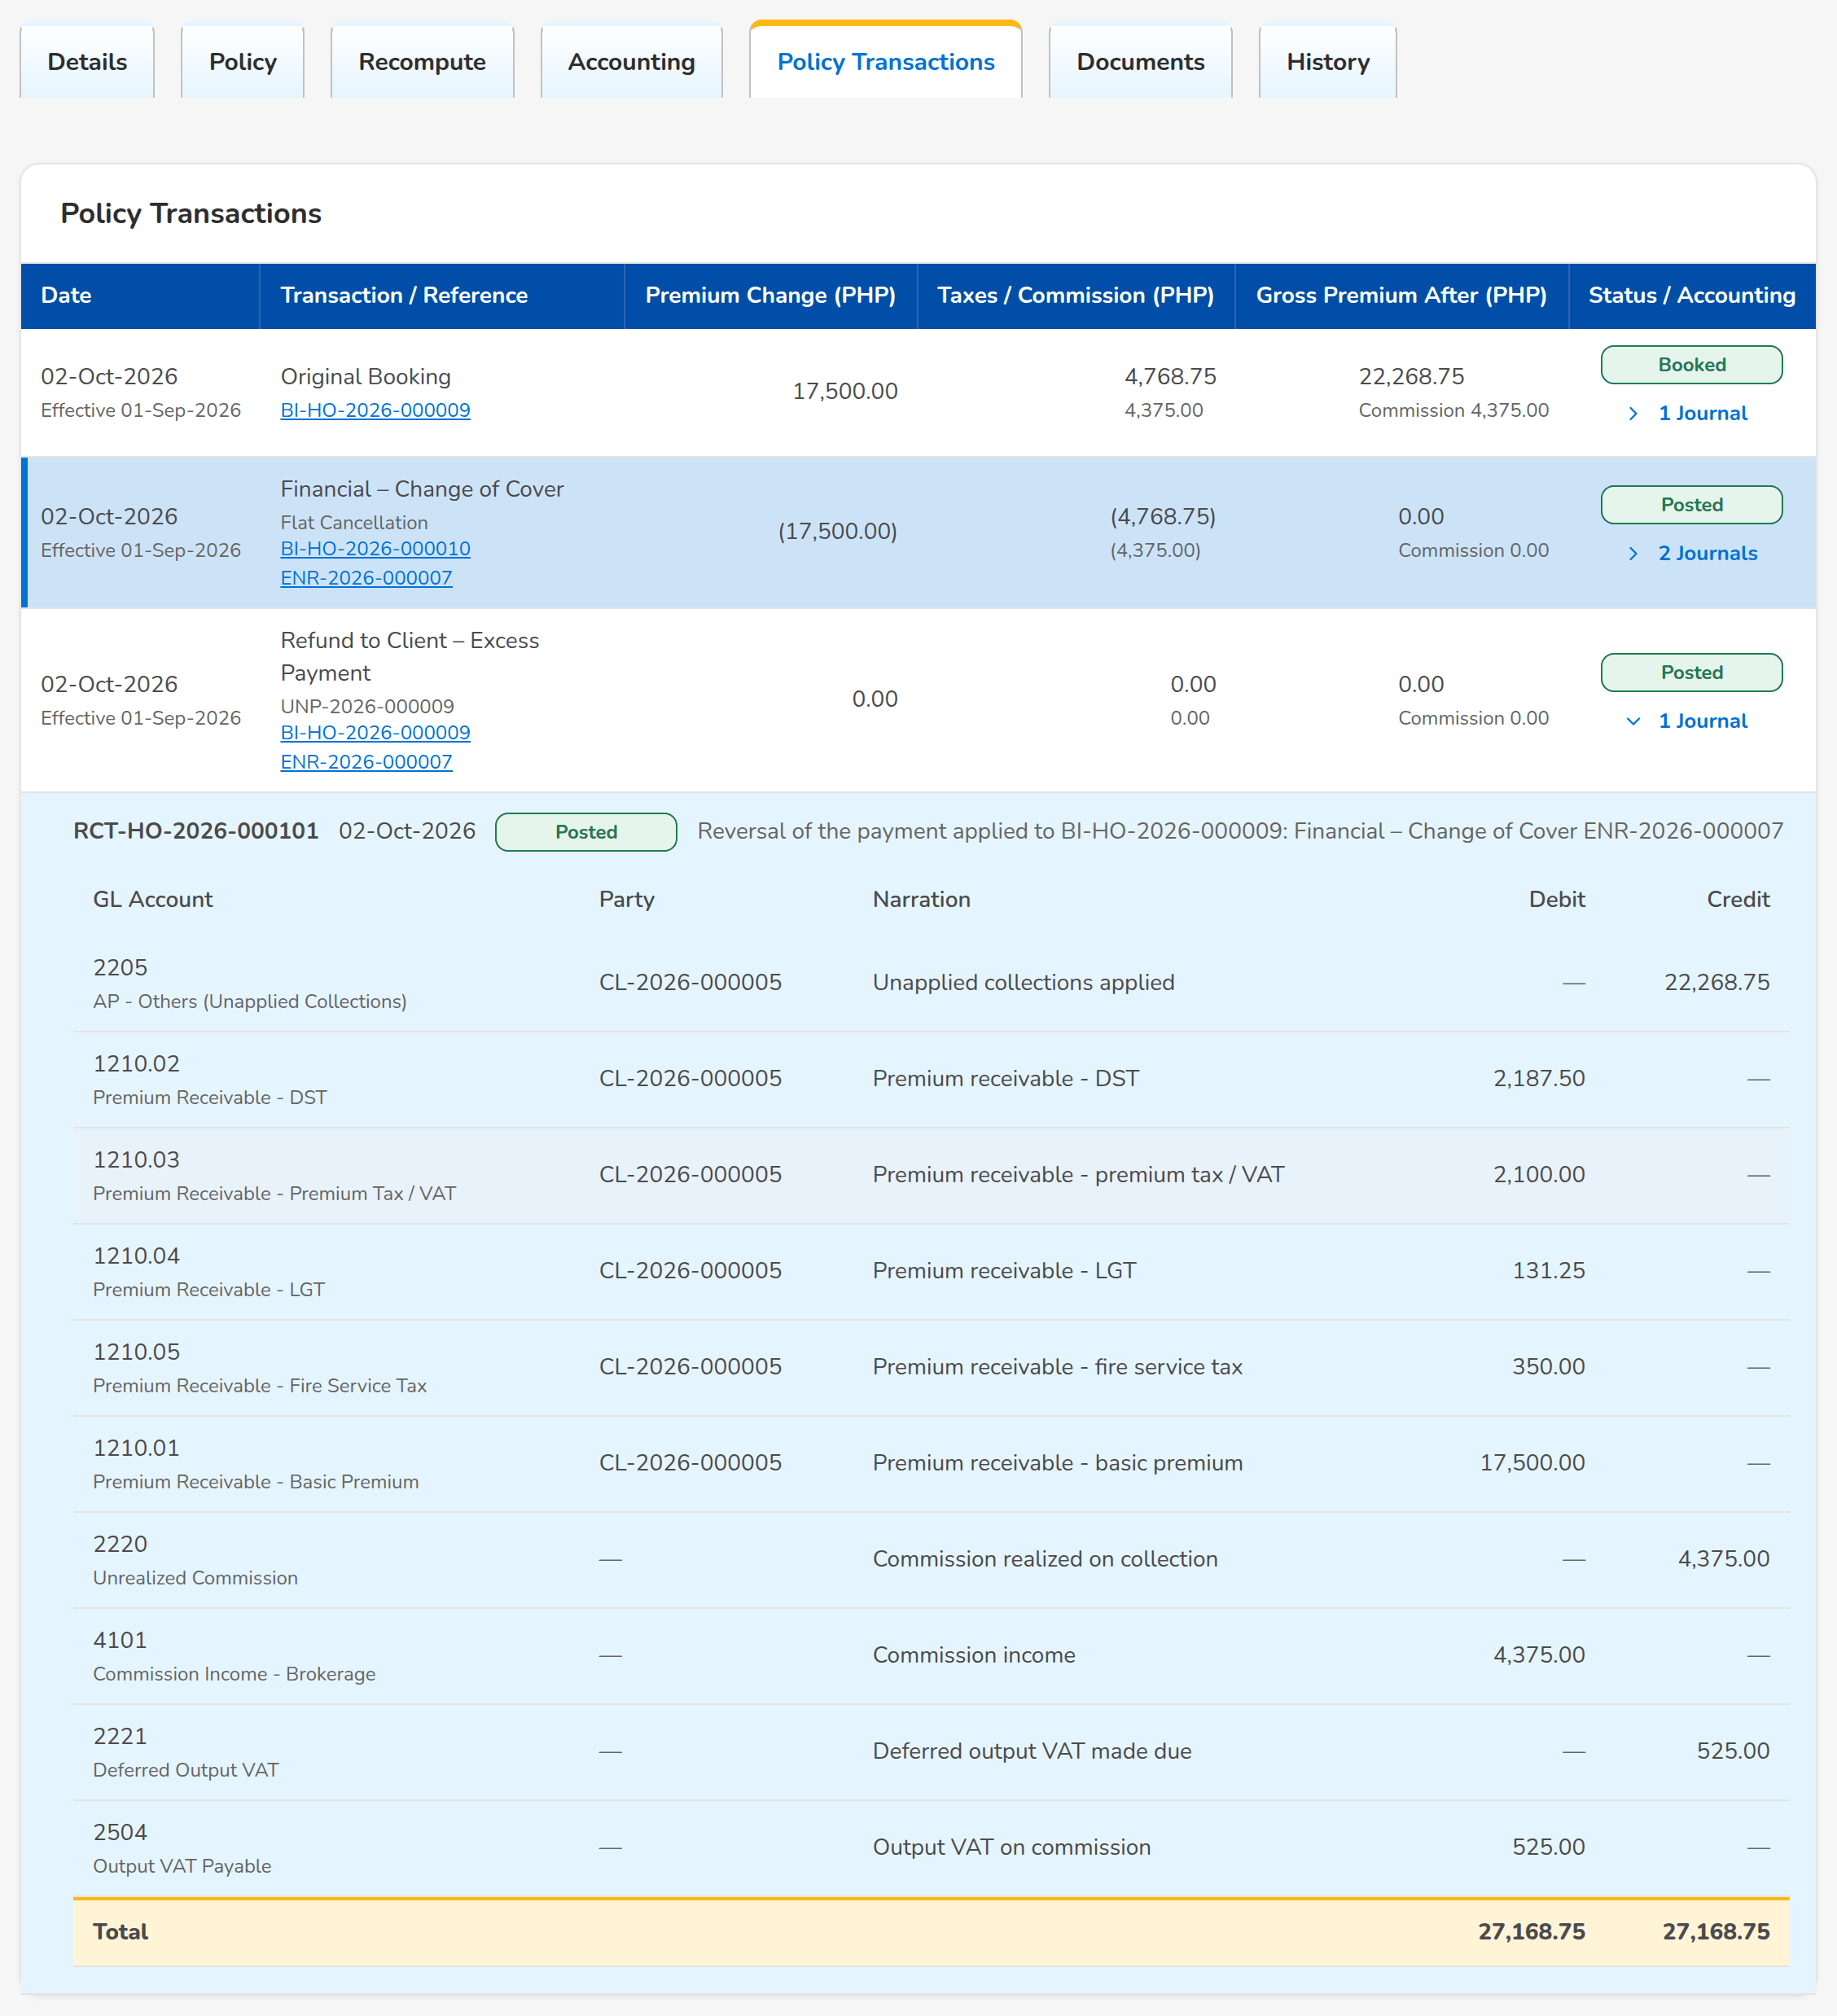
Operations at a glance: key screens
Invoice Search: the Operations ledger
Receipt applied by premium component
Remittance batch submitted for approval
Policy Transactions of a cancelled policy
Confidential – BDOI
Sign-off Pack Guide BRD-2 Operations | v2.0
15
Notes:
Screenshots of the SIT environment with seed data; every screen of the module is in FRS chapter 13.

Slide 16
Key business rules and validations
• Every booked invoice is in the Operations ledger with its payment status, remittance status and flags; Invoice 360 shows its receipts, remittances, adjustments and movements.
• A payment is applied by premium component in the agreed hierarchy; what is left over becomes an unapplied payment whose disposition (apply, reclass, transfer, refund) needs the Team Leader's approval.
• A receipt is cancelled or reinstated only with a reason and a second user's approval; the AR and OR series are controlled per branch.
• Only paid, unlocked invoices without a hold, a pending negative adjustment or a check in holding are extracted for remittance; a batch is approved by someone other than its processor.
• An invoice worked by one team is locked to the others (Remittance, Adjustment, Cashiering) until that team is done.
• An endorsement or cancellation is recomputed per insurer, validated by Adjustment and approved by its Team Leader before posting; posting books the invoice, re-applies payments and sets up the AR Insurer.
• The insurer's production is matched to the booked invoices within tolerance; differences get feedback and a disposition before the cycle is closed.
• Direct payment commission is billed to the insurer, confirmed by its answer and collected; late answers are flagged after ten working days.
  – Full list: FRS chapter 13 per screen, 148 rules on the Business rules sheet and 382 messages in FRS chapter 15 and on the Messages sheet
Confidential – BDOI
Sign-off Pack Guide BRD-2 Operations | v2.0
16
Notes:
These are the rules the business units ask about most. Each rule is stated with its FR on the screen where it applies.

Slide 17
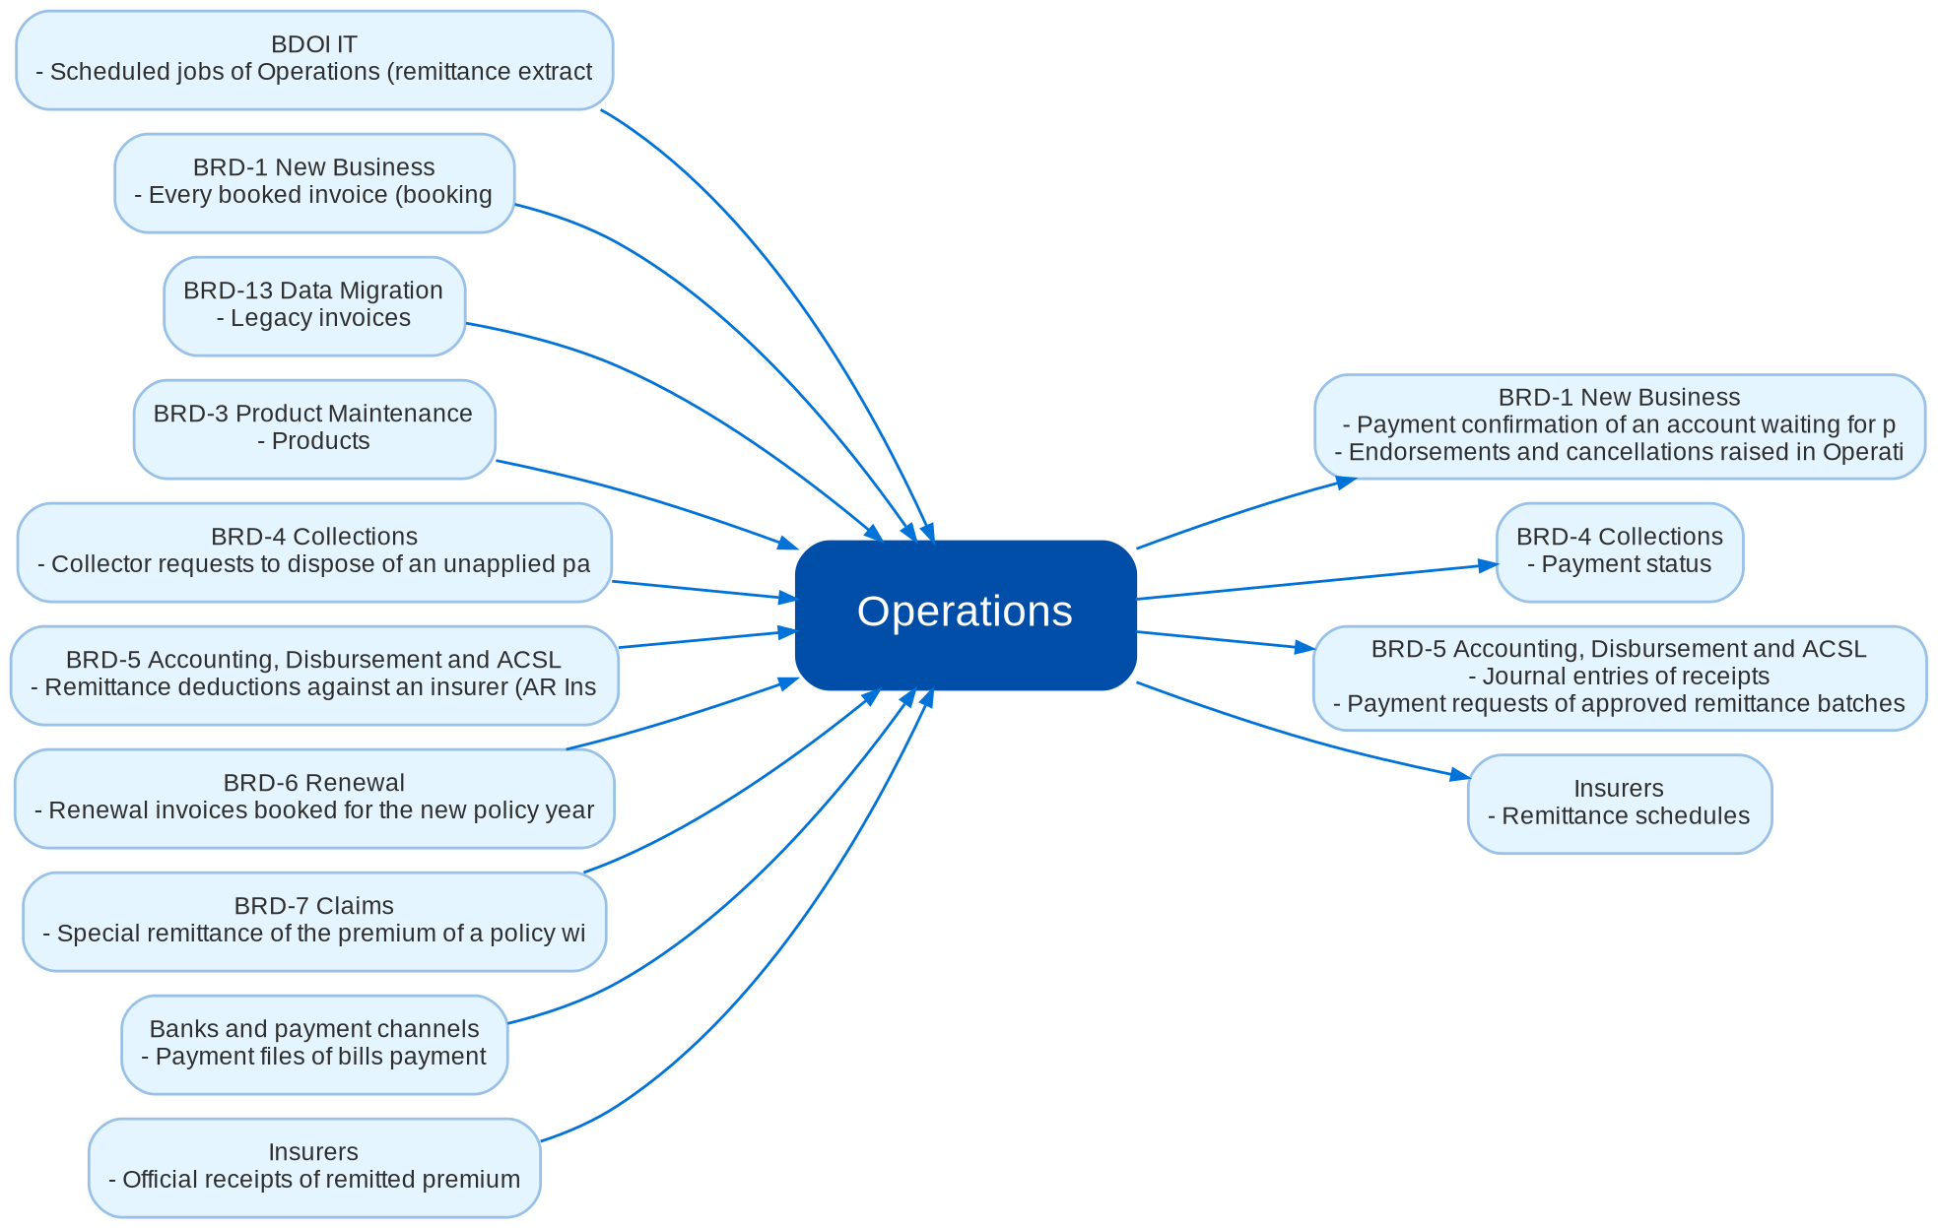
Cross-module dependencies and impacts
What Operations takes from and hands to the other BRDs and systems (FRS chapter 19)
Confidential – BDOI
Sign-off Pack Guide BRD-2 Operations | v2.0
17
Notes:
The contract is part of the signed set.
IC-01 BRD-1 New Business (In): Every booked invoice (booking, endorsement, cancellation) with its policy, assured, insurer, premium components, commission, taxes, direct payment and CWT flags, and the insurer shares of a co-insured policy
IC-02 BRD-1 New Business (Out): Payment confirmation of an account waiting for payment before placement or issuance, and the pre-booked payments of accounts not yet booked
IC-03 BRD-1 New Business (Out): Endorsements and cancellations raised in Operations (Adjustment) and posted as invoices
IC-04 BRD-3 Product Maintenance (In): Products, product lines, premium components and tax rates, insurers with their bank details and contacts, lists of values (reasons, conditions, disposition types)
IC-05 BRD-4 Collections (In): Collector requests to dispose of an unapplied payment, refund validation tasks, CWT 2307 tags, hold and special remittance requests of Marketing Collection
IC-06 BRD-4 Collections (Out): Payment status, receipts and outstanding balances of every invoice; direct payment accounts and their billing status
IC-07 BRD-5 Accounting, Disbursement and ACSL (Out): Journal entries of receipts, applications, cancellations, remittances, endorsements, write-offs, DP collections and incentives
IC-08 BRD-5 Accounting, Disbursement and ACSL (Out): Payment requests of approved remittance batches, refunds, BIR 2307 reversals and incentive pass-ons
IC-09 BRD-5 Accounting, Disbursement and ACSL (In): Remittance deductions against an insurer (AR Insurer, ACSL items) confirmed for recovery from the insurer's next batch
IC-10 BRD-6 Renewal (In): Renewal invoices booked for the new policy year
IC-11 BRD-7 Claims (In): Special remittance of the premium of a policy with a claim filed
IC-12 BRD-13 Data Migration (In): Legacy invoices, receipts and unapplied payments with their open balances
IC-13 Insurers (Out): Remittance schedules, production registers and direct payment commission billings
IC-14 Insurers (In): Official receipts of remitted premium, production feedback, answers to DP billings, BIR 2307 certificates
IC-15 Banks and payment channels (In): Payment files of bills payment, trade, CLPC and direct credit channels
IC-16 BDOI IT (In): Scheduled jobs of Operations (remittance extraction, register extraction, feedback follow-up, daily reports) and the flow-in feeds

Slide 18
Caveats and possibilities
Topic | What can happen | How it is handled
Additional requirements | New needs can surface during the review, SIT or UAT. | In-scope clarification when the signed text already covers it; otherwise a change request with mandays.
Impacts on other modules | Operations takes every booked invoice from New Business (BRD-1) and Renewal (BRD-6), receives the requests of Collections (BRD-4) and Claims (BRD-7), and hands journals, payment requests and deductions to Accounting, Disbursement and ACSL (BRD-5). A change to an Operations rule can change what those modules see. | Each change is assessed against the cross-BRD contract (FRS chapter 19); when it touches another set, a delta sign-off of the affected pages of both sets.
Other BRDs change Operations | Product Maintenance (components, taxes, insurers), User Access (roles), Accounting (GL accounts and journal rules), Collections (request types) and Data Migration (legacy balances) can change what Operations takes or hands over. | The change is raised against the other BRD and assessed against the contract; when it touches this set, a delta sign-off of the affected pages only.
Disbursement queue until the Disbursement module | Payment requests of Operations are worked on the Disbursement Queue of Operations until the Disbursement module of BRD-5 takes them over. | The queue keeps the same statuses and notices; the switch is a configuration change agreed with Disbursement and BDOI IT.
Production Reconciliation in Drop 2 | Production Reconciliation is specified and shown in this set; its release is planned with Drop 2. | Signed with this set; the Drop 2 release notes confirm any change since sign-off.
Integrations pending BDOI IT specifications | Bank payment files, insurer file transfers, the mail relay and the flow-in feeds depend on specifications from BDOI IT. | A file upload or download step until the specification arrives; the automatic transfer is then a change request. The technical detail is in the Technical Specification, reviewed by BDOI IT.
Open questions and assumptions | Open questions of FRS section 10.3 follow the assumptions of section 10.1; chapter 21 lists the proposed rules and clarifications for confirmation. | Answered as configuration where possible (lists of values, parameters, templates); otherwise a change request; the assumption stands until then.
Confidential – BDOI
Sign-off Pack Guide BRD-2 Operations | v2.0
18
Notes:
Three ways to handle a case: an in-scope clarification (no change to the signed set, answered in the comments log); a change request with mandays in the Change Management Register; a delta sign-off of the affected pages only.

Slide 19
Caveats: worked examples
Topic | Example and how it is handled
Additional requirements | A reviewer asks for the AO on the Remittance Batches list: a new column, so a change request; asking which stages the For Approval tab shows is a clarification.
Impacts on other modules | Changing the payment application hierarchy changes the outstanding balances in the Collections worklists and the journals in the General Ledger: both owners confirm the delta.
Other BRDs change Operations | BRD-3 adds a premium component: the application hierarchy and the remittance schedule columns are re-issued and signed as a delta.
Disbursement queue until the Disbursement module | Once BRD-5 Disbursement is live, an approved batch sends its payment request there and the queue shows it read-only.
Production Reconciliation in Drop 2 | A new insurer layout for the production feedback agreed before Drop 2 is added as a delta.
Integrations pending BDOI IT specifications | Insurer ORs are uploaded from the insurer's file today; an automatic pick-up from the insurer's file transfer folder is added when the transport is agreed.
Open questions and assumptions | Hold reasons are one value (Others) until BDOI supplies its list; the list is then loaded as configuration.
Confidential – BDOI
Sign-off Pack Guide BRD-2 Operations | v2.0
19
Notes:
Use these examples to agree the handling of a case during the review.

Slide 20
Entry and exit criteria, definition of done
Entry
Exit
Done
• Every screenshot of the set is taken on the SIT environment with seed data.
• Reviewers have their SIT users and the walkthrough sessions are held.
• The test plan is traced to the FRS and to the screens.
• The BRD-1 New Business set is signed (booked invoices are the input of Operations).
• Every row of the workbook reviewed by its team (Accept, Change requested or Comment).
• Every comments log item closed: answered, corrected in v2.1, or raised as a change request.
• Open questions closed or accepted as assumptions.
• The sign-off certificate signed by every signatory of the Who signs what matrix: prepared, input, reviewed and approved as on the Operations BRD approval sheet; the Product Owner approves the whole set.
• Signed certificate filed with the set; version history updated.
• Content frozen as signed; deltas listed in the Change Management Register with mandays.
• Test plan agreed for SIT and UAT.
Confidential – BDOI
Sign-off Pack Guide BRD-2 Operations | v2.0
20
Notes:
The sign-off meeting starts when the exit criteria are met; the set is done when the certificate is signed and the content of the set is frozen.

Slide 21
After sign-off: readiness checklist
• ☐ Signed FRS, sign-off workbook and screens
• ☐ Open questions closed or accepted as assumptions
• ☐ Configuration inputs from the business: receipt series and BIR authorities to print, lists of values (hold reasons, disposition types, return and exclusion reasons), tolerances, incentive rules and schemes, payment file layouts, users and roles
• ☐ Agreed test plan
• ☐ Migration mapping of the open invoices, receipts and unapplied payments signed (BRD-13)
  – After sign-off the content is frozen as signed and the approved deltas are scheduled.
Confidential – BDOI
Sign-off Pack Guide BRD-2 Operations | v2.0
21
Notes:
After sign-off the content is frozen as signed and the approved deltas are scheduled.

Slide 22
Change control after sign-off
• A change to anything frozen is raised in the Change Management Register
  – The screen, field, rule or message concerned, the reason and the priority
• The project team assesses the mandays and the effect on the other BRDs through the cross-BRD contract
• The owners of every BRD concerned approve it
• Delivered as a new version of the set (v2.1, v2.2...) with the changed pages signed again (delta sign-off)
• Configuration values marked default change in BIBS without a change request
Confidential – BDOI
Sign-off Pack Guide BRD-2 Operations | v2.0
22
Notes:
Nothing in a signed set changes without a request in the register.

Slide 23
Governance, contacts and next steps
Role | Who | Does
Business owner and approver | Shellah Marie C. Miranda, AVP, Product Owner | Accountable for the sign-off; chairs the sign-off meeting
Business owner of Operations | Jose Melvin M. Jarin, Operations: Financial Transactions and Processing | Approves for Operations; coordinates the teams' review
Reviewers | Shirley Catapang and Perjelyn Joy Gutierrez (FT&P, input providers of the BRD); Cashiering, Remittance, Adjustment, Production Reconciliation and Commission Receivables teams | Review their screens and rows; raise comments
BDOI IT | Information Technology Group | Reviews interfaces, jobs, access and the Technical Specification
BRD owner | Dan Ace Cauton, Program Manager, and Zean C. Ibay, Business Analyst, ESG-BPS | Traceability to the BRD; sign-off coordination
Delivery | iorta TechNXT Project Manager, Business Analysis, test lead | Sessions, answers, comments log, revisions, change requests
Confidential – BDOI
Sign-off Pack Guide BRD-2 Operations | v2.0
23
Notes:
Next steps:
Kick-off and first SIT walkthrough on Mon 16-Nov-2026
Workbooks returned by Fri 4-Dec-2026; Q&A on Wed 9-Dec-2026; sign-off on Fri 18-Dec-2026
BRD-4 Collections and BRD-5 Accounting, Disbursement and ACSL follow in the same window; then BRD-13, then BRD-7 and BRD-8

Slide 24
Next steps and the release order of the other BRD sets
• Kick-off and first SIT walkthrough on Mon 16-Nov-2026
• Workbooks returned by Fri 4-Dec-2026; Q&A on Wed 9-Dec-2026; sign-off on Fri 18-Dec-2026
• BRD-4 Collections and BRD-5 Accounting, Disbursement and ACSL follow in the same window; then BRD-13, then BRD-7 and BRD-8
Confidential – BDOI
Sign-off Pack Guide BRD-2 Operations | v2.0
24
Notes:
The other BRD sets follow the same pack, guide and steps.

