Slide 1


Sign-off Pack Guide: BRD-4 Collections
BRD-4 Collections business sign-off pack, release set v2.0
BIBS – BDOI Broker System
BDO Insurance and Reinsurance Brokers, Inc. | Version 2.0 | 1 October 2026 | Confidential
Prepared by
Notes:
This deck guides the business units through the BRD-4 Collections sign-off pack, release set v2.0. It explains what the pack is, how to read it, the steps up to sign-off and what happens after. It is presented at the kick-off and stays in the pack as file 01.

Slide 2
Purpose of the pack and what sign-off means
• The pack shows the proposed Collections of BIBS, screen by screen, so each business unit confirms what it will get
  – Content: 19 screens, 152 fields, 52 business rules, 148 messages
  – Every screen with numbered fields, the navigation per persona, three end-to-end walkthroughs
• Signing freezes the content, the screens and the navigation of the module
  – After sign-off a change goes through the Change Management Register with its mandays
  – Configuration values marked default (SLA hours, thresholds, list entries, templates) stay open
• The screenshots use fictitious seed data only, in the BDO theme
Confidential – BDOI
Sign-off Pack Guide BRD-4 Collections | v2.0
2
Notes:
Stress that the pack shows the screens, fields, rules and messages the business is asked to confirm.
Signing means: this is what we get; the look, feel, fields, rules, messages and navigation are frozen.
Data on the screenshots is seed data of the SIT environment; names and numbers are fictitious.

Slide 3
The pack at a glance (1 of 2)
File | What it is for | Who reads it | When
00_BIBS_StartHere_BRD-04_Collections_v2.0.docx | Start Here: the map of the pack, who reads what, the steps and the dates | Everyone | First, on issue
01_BIBS_GuideDeck_BRD-04_Collections_v2.0.pptx | Sign-off Pack Guide: purpose, approach, the module at a glance, caveats and impacts on other modules, entry and exit criteria, change control | Business owner, unit and section heads; presented at the kick-off | Kick-off session
02_BIBS_FRS_BRD-04_Collections_v2.0.docx | Functional Requirements Specification v2.0: requirements, navigation, 19 screen specifications with screenshots, five walkthroughs, messages, notifications, documents, upload template, cross-BRD contract | Collection handlers and team leads, Marketing AOs and unit heads; Cashiering, Commission Receivables and BDOI IT for their chapters | During the review, with the SIT walkthroughs
03_BIBS_Signoff_BRD-04_Collections_v2.0.xlsx | Sign-off workbook: one row per screen, field, rule and message with the BU review columns; comments log, meeting minutes, version history, sign-off certificate | Every reviewer; the business owner signs it | During the review and at sign-off
04_BIBS_TestPlan_BRD-04_Collections_v2.0.xlsx | Test plan workbook: the test cases traced to the FRs and to the screens, including one screen case and one message case per screen | Business users who will run UAT; BDOI IT | After the screens; used again in SIT and UAT
Confidential – BDOI
Sign-off Pack Guide BRD-4 Collections | v2.0
3
Notes:
The files are numbered in reading order so they sort that way in the BRD folder. 00 Start Here is the short version of this deck; 02 FRS and 03 workbook carry the same rows; 04 and 05 are the test plan traced to the screens; 07 to 09 are the UX screen documents for the BDOI UX Design team, taken from the same screens.

Slide 4
The pack at a glance (2 of 2)
File | What it is for | Who reads it | When
05_BIBS_TestPlan_BRD-04_Collections_Summary_v2.0.docx | Test plan summary: scope, approach, coverage and the cases by area | Business owner, BDOI IT | Before sign-off
07_BIBS_UXDeck_BRD-04_Collections_v2.0.pptx | UX Screen Deck for the BDOI UX Design team: design foundation, navigation and personas, every walkthrough step by step and every screen with all its states | BDOI UX Design team | From the issue, in parallel with the review; re-issued with each version of the set
08_BIBS_UXScreens_BRD-04_Collections_v2.0.xlsx | UX screen register: one row per screen image with the screen, personas, walkthrough and step, state, FRS section and requirements, UXD status and comments, and the Changed in this issue flag | BDOI UX Design team | Kept by the UX Design team; the changed rows are flagged at each issue
09_BIBS_UXScreens_BRD-04_Collections_v2.0.zip | Image package: every screen image at twice the screen resolution (PNG), the component crops and the register as CSV | BDOI UX Design team | Imported into the design tool at each issue
Confidential – BDOI
Sign-off Pack Guide BRD-4 Collections | v2.0
4
Notes:
The files are numbered in reading order so they sort that way in the BRD folder. 00 Start Here is the short version of this deck; 02 FRS and 03 workbook carry the same rows; 04 and 05 are the test plan traced to the screens; 07 to 09 are the UX screen documents for the BDOI UX Design team, taken from the same screens.

Slide 5
Where to start: reading order per role
Role | Read, in this order
Business owner (Product Owners; Marketing unit and section heads) | 00 Start Here; 01 Guide deck; FRS chapters 1-3 (context and personas), 14 (walkthroughs), 20 (sign-off) and 21 (proposed rules for confirmation); workbook Sign-off certificate
Collection Handlers and Collection Team Leads | FRS sections 4.2 to 4.7; the screens of chapter 13 (SCR-CL-01 to 13); walkthroughs A, B and D; messages in chapter 15; the statement of account DO-01 in chapter 17
Marketing Account Officers, Handlers and Team Leads | PR Worklist, Collection Account and Client View (SCR-CL-02 to 04); escalations (SCR-CL-11, 12); walkthroughs A, B and E; the Collections Bulk Update template in chapter 18
Unapplied Payment Handlers | FRS section 4.8; Unapplied Payments, Unapplied Payment and Requests to Cashiering (SCR-CL-14 to 16); walkthrough C; document DO-05
Section Heads and set-up users (Business Administrator) | Assignments, Collections Files and Collections Setup (SCR-CL-17 to 19); Escalation Rules (SCR-CL-13); configuration in chapter 9; the files DO-02 to DO-04
Operations: Cashiering and Commission Receivables (BRD-2) | The hand-offs and requests (FRS sections 4.4 and 4.8, chapter 19); walkthroughs A (step 6) and C (step 3); the DP PR and PR 2307 for Reversal files; FRS section 4.10 for the commission receivable gate
Comptrollership | FRS section 4.10 (commission receivable and incentives, rows FR-CL-090 to 094) and the proposed rules of chapter 21 on them
BDOI IT | Interfaces and integration (chapter 7), non-functional requirements (chapter 8), configuration and jobs (chapter 9), cross-BRD contract (chapter 19); the Technical Specification, reviewed by BDOI IT
BDOI UX Design team | 07 UX Screen Deck: design foundation and navigation first, then the personas, walkthroughs and screens of the design work; 08 UX screen register (filter Changed in this issue at each new issue); 09 image package in the design tool
iorta TechNXT project team | All documents; keeps the comments log, the meeting minutes and the version history of the workbook, answers every comment and keeps the traceability to SIT and UAT
Confidential – BDOI
Sign-off Pack Guide BRD-4 Collections | v2.0
5
Notes:
Nobody needs to read the whole FRS. Each role starts with its chapters and its sheets of the workbook; the walkthroughs in chapter 14 are the fastest way to see the whole process.

Slide 6
Approach: from issue to closure
1
Pack issued
2
Kick-off and screen walkthrough on SIT
3
Review with the workbook
4
Comments consolidated and a Q&A session
Release set v2.0 in the BRD-04 folder; invitations to the sessions
Screens shown live (worklist and account, promises and escalations, unapplied payments, plans and billing, set-up); first questions logged in the comments log; minutes
Every row marked Accept, Change requested or Comment; comments log entries
One consolidated comments log, each item typed (clarification, correction, change request) and answered; Q&A minutes
Day 0 (Thu 1-Oct-2026); sessions scheduled after the BRD-2 Operations walkthroughs
3 sessions, 23 to 25-Nov-2026
10 working days after the walkthroughs, until Wed 9-Dec-2026
3 working days, Q&A on Mon 14-Dec-2026
5
One revision cycle (v2.1)
6
Sign-off meeting and signature
7
Content freeze
8
Traceability into SIT and UAT
Release set v2.1 with the changed rows marked; change requests raised for the rest
Signed sign-off certificate; minutes; open items accepted as assumptions or change requests
Content frozen as signed; approved deltas scheduled in the Change Management Register
SIT and UAT runs traced to the signed screens, rules and messages; results against each row
2 working days, v2.1 on Wed 16-Dec-2026; check by the reviewers until Fri 18-Dec-2026
Tue 22-Dec-2026
From Wed 23-Dec-2026
SIT Jan - Jul 2027; UAT Aug - Dec 2027
Confidential – BDOI
Sign-off Pack Guide BRD-4 Collections | v2.0
6
Notes:
1. Pack issued: Day 0 (Thu 1-Oct-2026); sessions scheduled after the BRD-2 Operations walkthroughs.
2. Kick-off and screen walkthrough on SIT: 3 sessions, 23 to 25-Nov-2026.
3. Review with the workbook: 10 working days after the walkthroughs, until Wed 9-Dec-2026.
4. Comments consolidated and a Q&A session: 3 working days, Q&A on Mon 14-Dec-2026.
5. One revision cycle (v2.1): 2 working days, v2.1 on Wed 16-Dec-2026; check by the reviewers until Fri 18-Dec-2026.
6. Sign-off meeting and signature: Tue 22-Dec-2026.
7. Content freeze: From Wed 23-Dec-2026.
8. Traceability into SIT and UAT: SIT Jan - Jul 2027; UAT Aug - Dec 2027.

Slide 7
Steps in detail (1 of 2): who, inputs, outputs, duration
Step | Who (R, A, C, I) | Inputs | Outputs | Duration
1. Pack issued | R: iorta TechNXT Project Manager; A: iorta TechNXT delivery lead; I: all reviewers | FRS v2.0, workbook, test plan, guide and deck | Release set v2.0 in the BRD-04 folder; invitations to the sessions | Day 0 (Thu 1-Oct-2026); sessions scheduled after the BRD-2 Operations walkthroughs
2. Kick-off and screen walkthrough on SIT | R: iorta TechNXT Business Analysis; A: BDOI Product Owner; C: Collections and Marketing Support, Marketing unit heads; I: Operations, BDOI IT | Guide deck; SIT users with seed data; walkthroughs A to E | Screens shown live (worklist and account, promises and escalations, unapplied payments, plans and billing, set-up); first questions logged in the comments log; minutes | 3 sessions, 23 to 25-Nov-2026
3. Review with the workbook | R: Collection handlers and team leads, Marketing AOs and unit heads; A: Collections and Marketing Support; C: iorta TechNXT (questions) | FRS chapters of the area; workbook sheets with the BU review columns | Every row marked Accept, Change requested or Comment; comments log entries | 10 working days after the walkthroughs, until Wed 9-Dec-2026
4. Comments consolidated and a Q&A session | R: iorta TechNXT Project Manager and Business Analysis; A: BDOI Product Owner; C: reviewers | Returned workbooks | One consolidated comments log, each item typed (clarification, correction, change request) and answered; Q&A minutes | 3 working days, Q&A on Mon 14-Dec-2026
Confidential – BDOI
Sign-off Pack Guide BRD-4 Collections | v2.0
7
Notes:
R responsible, A accountable, C consulted, I informed. The durations are indicative; the dates are those of the Start Here guide.

Slide 8
Steps in detail (2 of 2): who, inputs, outputs, duration
Step | Who (R, A, C, I) | Inputs | Outputs | Duration
5. One revision cycle (v2.1) | R: iorta TechNXT Business Analysis; A: iorta TechNXT delivery lead; C: reviewers who raised the items | Agreed clarifications and corrections | Release set v2.1 with the changed rows marked; change requests raised for the rest | 2 working days, v2.1 on Wed 16-Dec-2026; check by the reviewers until Fri 18-Dec-2026
6. Sign-off meeting and signature | R: iorta TechNXT Project Manager; A: BDOI Product Owner; C: Marketing heads, Operations Head, Comptrollership, BDOI IT | v2.1 (or v2.0 when no revision is needed); open items with their decision | Signed sign-off certificate; minutes; open items accepted as assumptions or change requests | Tue 22-Dec-2026
7. Content freeze | R: iorta TechNXT delivery lead; A: BDOI Product Owner; I: BDOI IT, other BRD owners | Signed set; change requests with mandays | Content frozen as signed; approved deltas scheduled in the Change Management Register | From Wed 23-Dec-2026
8. Traceability into SIT and UAT | R: iorta TechNXT test lead; A: BDOI Product Owner; C: business users | Signed FRS rows and test plan | SIT and UAT runs traced to the signed screens, rules and messages; results against each row | SIT Jan - Jul 2027; UAT Aug - Dec 2027
Confidential – BDOI
Sign-off Pack Guide BRD-4 Collections | v2.0
8
Notes:
R responsible, A accountable, C consulted, I informed. The durations are indicative; the dates are those of the Start Here guide.

Slide 9
Who signs what: parts of the set (1 of 2)
Part of the set | Prepares | Provides input | Reviews | Approves
Screens and fields (FRS screen specifications; workbook Screen catalogue, Field register) | iorta TechNXT | Collections & Marketing input, FT&P input | Program Manager (BPS), Operations Head | Product Owner, Product Owner (Operations), Marketing heads
Business rules and validations | iorta TechNXT | Collections & Marketing input, BA (BPS) | Program Manager (BPS), Operations Head | Product Owner, Product Owner (Operations), Marketing heads
Messages and notifications | iorta TechNXT | Collections & Marketing input | Program Manager (BPS) | Product Owner, Marketing heads
Documents, files and reports (statement of account, worklist and reversal files, application file, reports) | iorta TechNXT | Collections & Marketing input, FT&P input | Program Manager (BPS), Operations Head | Product Owner, Marketing heads
Commission receivable gate and the draft rows on incentives (FR-CL-090 to 094) | iorta TechNXT | BA (BPS), FT&P input | Program Manager (BPS) | Product Owner, Product Owner (Operations), Comptrollership
Walkthroughs (end-to-end, screen by screen) | iorta TechNXT | Collections & Marketing input | Program Manager (BPS) | Product Owner
Confidential – BDOI
Sign-off Pack Guide BRD-4 Collections | v2.0
9
Notes:
The set holds business content only: screens, fields, rules, messages, notifications, documents, walkthroughs and reports. Business users sign the business content; BDOI IT reviews the interfaces, the user access and the Technical Specification, a separate document that holds the technical content; the Program Manager of Business Project Services reviews the traceability and the completeness; the Product Owner approves the whole set; iorta TechNXT prepares it.
The roles are those of the BRD approval sheet (Collections BRD approval sheets: CMS BRD p.93-94 (Prepared, Reviewed, Validated, Approved by), renumbering addendum p.34 and Collections Addendum p.22).

Slide 10
Who signs what: parts of the set (2 of 2)
Part of the set | Prepares | Provides input | Reviews | Approves
Proposed business rules and clarifications for confirmation | iorta TechNXT, BA (BPS) | Collections & Marketing input, FT&P input | Program Manager (BPS), Operations Head | Product Owner, Product Owner (Operations), Marketing heads
Scheduled runs and files, hand-offs inside BIBS, user access and menus by persona | iorta TechNXT | Collections & Marketing input | BDOI IT, Operations Head | Product Owner
Test plan (04 workbook, 05 summary) | iorta TechNXT | Collections & Marketing input | Program Manager (BPS), BDOI IT | Product Owner
UX screen deck, UX screen register and image package (07 to 09, for the BDOI UX Design team; the screens as specified in this set) | iorta TechNXT | Collections & Marketing input | Program Manager (BPS) | Product Owner
Technical Specification (separate document, not part of the business sign-off) | iorta TechNXT | BDOI IT | BDOI IT | BDOI IT
Confidential – BDOI
Sign-off Pack Guide BRD-4 Collections | v2.0
10
Notes:
The set holds business content only: screens, fields, rules, messages, notifications, documents, walkthroughs and reports. Business users sign the business content; BDOI IT reviews the interfaces, the user access and the Technical Specification, a separate document that holds the technical content; the Program Manager of Business Project Services reviews the traceability and the completeness; the Product Owner approves the whole set; iorta TechNXT prepares it.
The roles are those of the BRD approval sheet (Collections BRD approval sheets: CMS BRD p.93-94 (Prepared, Reviewed, Validated, Approved by), renumbering addendum p.34 and Collections Addendum p.22).

Slide 11
Who signs what: signatories (1 of 2)
Capacity | Role | Confirms by signing
Prepared by | iorta TechNXT project team: Project Manager, Business Analysis, test lead (iorta TechNXT) | The set is complete and consistent as issued, traced to the BRD and to the screens; every comment is answered in the comments log
Prepared by | Business Analyst, Enterprise Services Group - Business Project Services (BPS) (Zean C. Ibay) (BDO Unibank ESG) | The set states the BRD requirements as written; every departure is listed in the proposed rules and clarifications
Input provided by | Collections and Marketing Support, HO Marketing Support BBG, Operations, Marketing and Business Services, Marketing - Head Office, Marketing Business Services and System Support (Pia Grace M. Pinili, Maria Victoria Evangelista, Grace Tordesillas, Ma. Fides E. Rivera, Arra R. Rivera, Rhommel Mark Galler) (BDOI) | The worklist, collection account, disposition, promise, installment, escalation, billing statement and unapplied payment screens, fields, rules and messages match the business input
Input provided by | Operations: Financial Transactions and Processing (Perjelyn Joy Gutierrez) (BDOI) | The hand-offs to Cashiering and Commission Receivables, the requests on unapplied payments and the reversal files match what Operations carries out
Reviewed by | VP and Head, BDOI Operations (John Benedict S. Santos) (BDOI) | The Collections process with Operations and the caveat of p.93: exports and downloads run in the background and do not slow the system
Reviewed by | BDOI Information Technology Group: IT Core Business Delivery (Reynaldo Valera Jr.) and IT AIO Core Business Delivery - Insurance (Wynonah Allyssa D. Agojo) (BDOI) | Scheduled runs and files, user access and menus, the hand-offs inside BIBS and the Technical Specification (a separate document); not the business screens
Confidential – BDOI
Sign-off Pack Guide BRD-4 Collections | v2.0
11
Notes:
The certificate sheet of the workbook lists the same signatories in the same order: prepared by, input provided by, reviewed by, approved by, as on the BRD approval sheet. A role the set adds to the approval sheet is marked there.
iorta TechNXT project team: Project Manager, Business Analysis, test lead: Added for this set (author of the FRS set).
Business Analyst, Enterprise Services Group - Business Project Services (BPS) (Zean C. Ibay): Prepared by (p.93 and p.34).
Collections and Marketing Support, HO Marketing Support BBG, Operations, Marketing and Business Services, Marketing - Head Office, Marketing Business Services and System Support (Pia Grace M. Pinili, Maria Victoria Evangelista, Grace Tordesillas, Ma. Fides E. Rivera, Arra R. Rivera, Rhommel Mark Galler): Reviewed by (p.93, p.34, p.22); Input Provider in the intended audience (p.37).
Operations: Financial Transactions and Processing (Perjelyn Joy Gutierrez): Reviewed by (p.93); Input Provider (p.37).
VP and Head, BDOI Operations (John Benedict S. Santos): Reviewed by, with the caveat on exports (p.93).
BDOI Information Technology Group: IT Core Business Delivery (Reynaldo Valera Jr.) and IT AIO Core Business Delivery - Insurance (Wynonah Allyssa D. Agojo): Validated by and Prepared by (p.93-94); Reviewed by (p.34).

Slide 12
Who signs what: signatories (2 of 2)
Capacity | Role | Confirms by signing
Approved by | Program Manager, Enterprise Services Group - Business Project Services (BPS) (Dan Ace Cauton) (BDO Unibank ESG) | Traceability of every BRD requirement to the set and completeness of the set
Approved by | Product Owner, AVP (Shellah Marie C. Miranda) (BDOI) | Owns the set and approves all of its contents
Approved by | Product Owner, AVP (Jose Melvin Jarin) (BDOI) | The addendum functions: escalation, bulk update, reassignment, installments, promises, billing statements
Approved by | Unit Head - Combank and Corbank (Mark Joseph C. Makalintal) and Heads of Retail Marketing (Edmundante F. Ramirez, Roderick Lim) (BDOI) | The collector screens, rules and messages for the Corporate, Commercial and Retail Marketing units
Approved by | Head - Comptrollership, VP (Ronald Allan E. De Leon) (BDOI) | The commission receivable gate and the draft rows on incentives, commission refunds and mixed payments
Confidential – BDOI
Sign-off Pack Guide BRD-4 Collections | v2.0
12
Notes:
The certificate sheet of the workbook lists the same signatories in the same order: prepared by, input provided by, reviewed by, approved by, as on the BRD approval sheet. A role the set adds to the approval sheet is marked there.
Program Manager, Enterprise Services Group - Business Project Services (BPS) (Dan Ace Cauton): Validated by (p.94); Approved by (p.34); Reviewed by (p.22).
Product Owner, AVP (Shellah Marie C. Miranda): Approved by (p.94, p.34, p.22).
Product Owner, AVP (Jose Melvin Jarin): Approved by (p.22).
Unit Head - Combank and Corbank (Mark Joseph C. Makalintal) and Heads of Retail Marketing (Edmundante F. Ramirez, Roderick Lim): Approved by (p.22).
Head - Comptrollership, VP (Ronald Allan E. De Leon): Approved by (p.22).

Slide 13
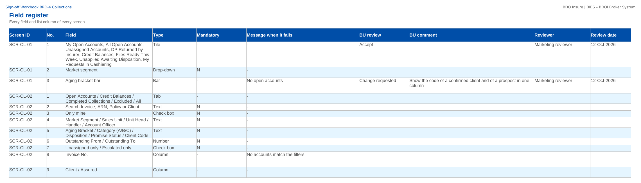
How to fill in the sign-off workbook
• Review the rows of your area on Screen standards, Screen catalogue, Field register, Business rules, Messages
• BU review: Accept, Change requested or Comment
• BU comment: the change asked for
• Reviewer and Review date
• Questions go to the Comments log
• Leave the other columns unchanged; one workbook per unit
Field register sheet of the sign-off workbook
Confidential – BDOI
Sign-off Pack Guide BRD-4 Collections | v2.0
13
Notes:
The No. column is the numbered marker on the screenshot of the FRS, or the column number of a load template. The drop-down columns accept only the listed values. The Comments log, Meeting minutes and Version history sheets are kept by the project team; the Sign-off certificate is signed at the end.

Slide 14
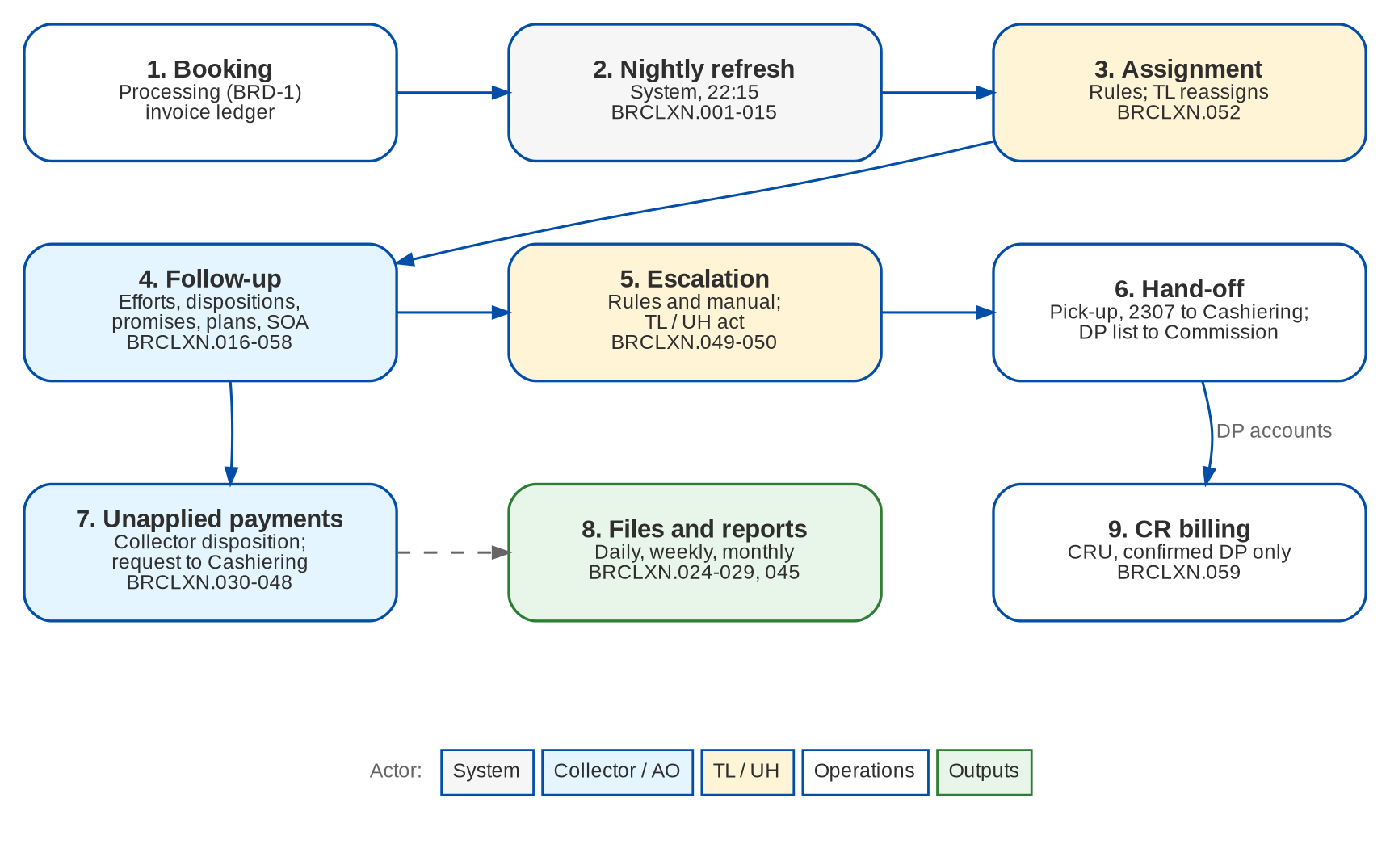
Collections at a glance: process flow
BRD-4 process from the client to the booked invoice
Confidential – BDOI
Sign-off Pack Guide BRD-4 Collections | v2.0
14
Notes:
The process runs from client onboarding and KYC, through the quotation or the PRF, the account, payment and placement, issuance and booking, to the hand-off to Operations and Accounting.

Slide 15
Collections at a glance: personas and menus
Persona | SIT user | Screens | Menu sections
Marketing Account Officer | ao | 10 | Collections
Marketing Team Lead | mkttl | 12 | Collections
Marketing Handler | mkthandler | 10 | Collections
Collection Handler | clxhandler | 10 | Collections
Collection Team Lead | clxtl | 12 | Collections
Section Head (Corporate / Retail) | clxuh | 13 | Collections
Unapplied Payment Handler | upphandler | 10 | Collections
Processing Unit | proc | 9 | Collections
Cashier (read access and exports) | cashier | 10 | Collections
Disbursement (read access and exports) | disb | 10 | Collections
Comptrollership (read access) | comptrol | 10 | Collections
Business Administrator | badmin | 11 | Collections
System Administrator | admin | 12 | Collections
Auditor | auditor | 10 | Collections
Confidential – BDOI
Sign-off Pack Guide BRD-4 Collections | v2.0
15
Notes:
Each persona sees only the menu entries of its role; the full menu of each persona is in FRS chapter 12 and on the Menu by persona sheet of the workbook. The menus of 1 more personas of the other BRDs are there too, one table and one sheet each.

Slide 16
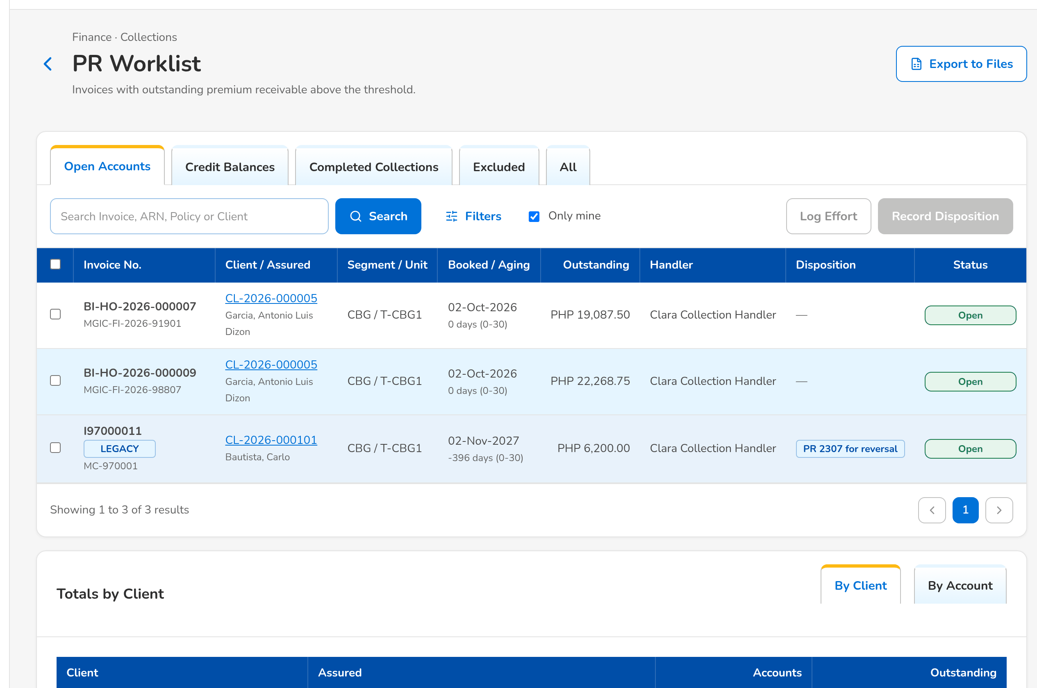
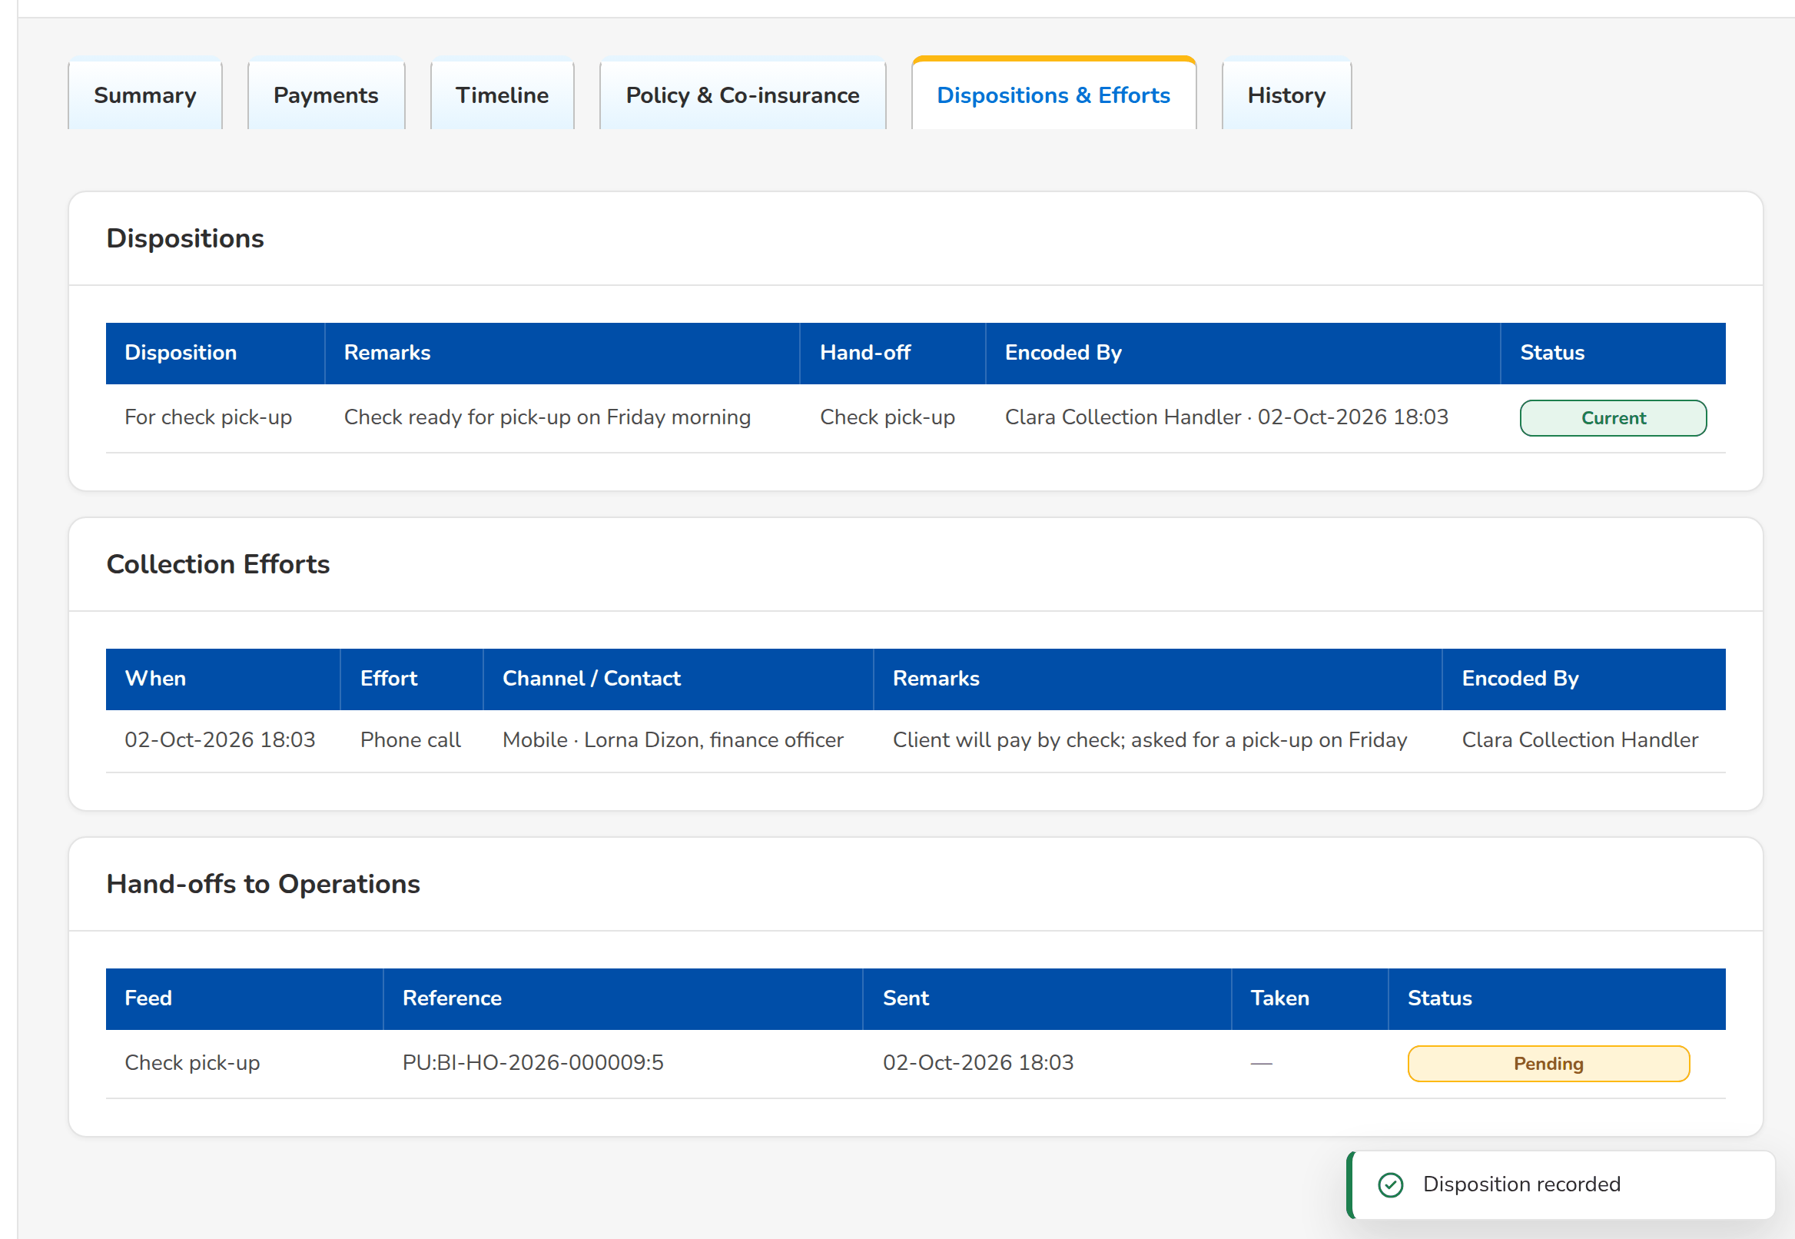
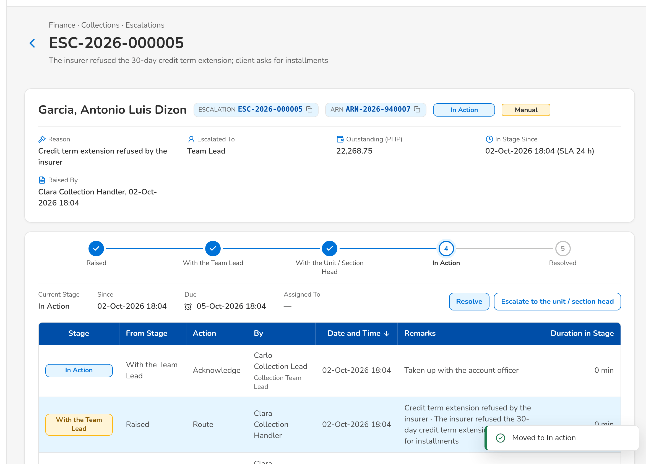
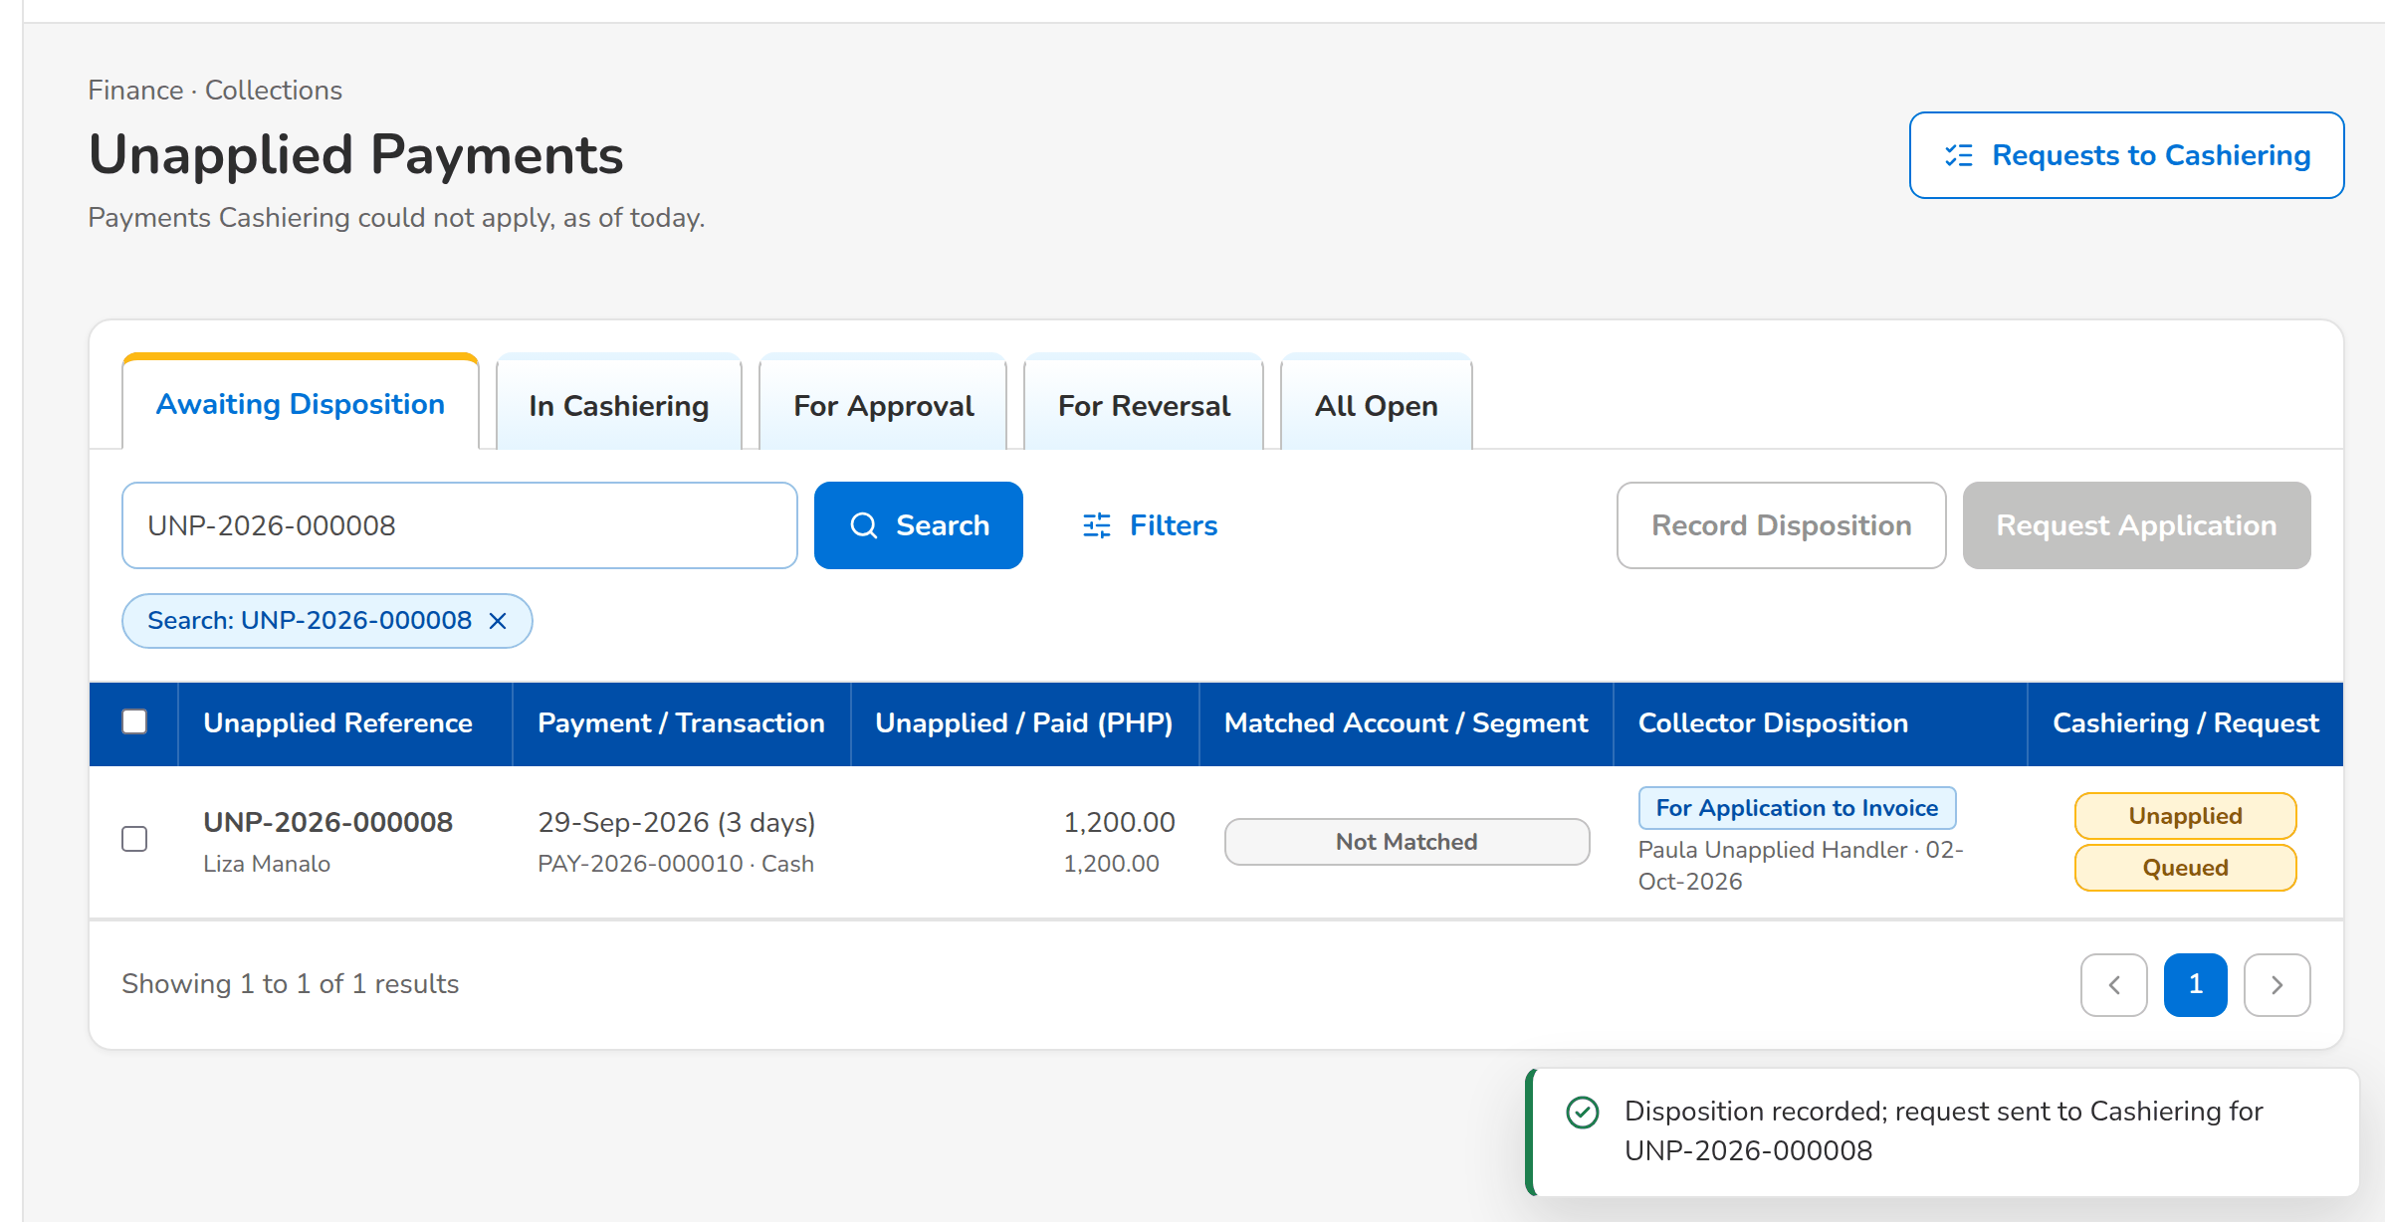
Collections at a glance: key screens
PR Worklist: the outstanding accounts of the handler
Collection account with the disposition handed to Cashiering
An escalation in action with the team lead
An unapplied payment sent to Cashiering for application
Confidential – BDOI
Sign-off Pack Guide BRD-4 Collections | v2.0
16
Notes:
Screenshots of the SIT environment with seed data; every screen of the module is in FRS chapter 13.

Slide 17
Key business rules and validations
• Every booked invoice with premium receivable above the threshold (10.00 by default) is a collection account, refreshed every night from the Operations invoice ledger; Collections keeps no second copy of the money and posts no accounting entry.
• New accounts go to a handler by the assignment rules, else to their account officer; team leads reassign accounts permanently or until an end date.
• A disposition with an Operations action is handed over inside BIBS: check pick-up and BIR 2307 tags to Cashiering, direct payment accounts to Commission Receivables; some dispositions are reserved to some roles.
• Promises to pay are checked every night against the payments applied; a broken promise notifies the collector and escalates the account.
• Escalation rules (aging, no commitment, broken promises, overdue installments, amount) escalate accounts every night; a new or changed rule applies only once another user authorizes it.
• A request on an unapplied payment is carried out by Cashiering with its own approvals; For Application to Invoice needs a valid invoice number of the ledger.
• Updating several accounts at once needs the bulk update permission; an account opened by one user is locked to the others for the edit-lock time.
• Files and exports run in the background and are published with the time from which they may be downloaded.
  – Full list: FRS chapter 13 per screen, 52 rules on the Business rules sheet and 148 messages in FRS chapter 15 and on the Messages sheet
Confidential – BDOI
Sign-off Pack Guide BRD-4 Collections | v2.0
17
Notes:
These are the rules the business units ask about most. Each rule is stated with its FR on the screen where it applies.

Slide 18
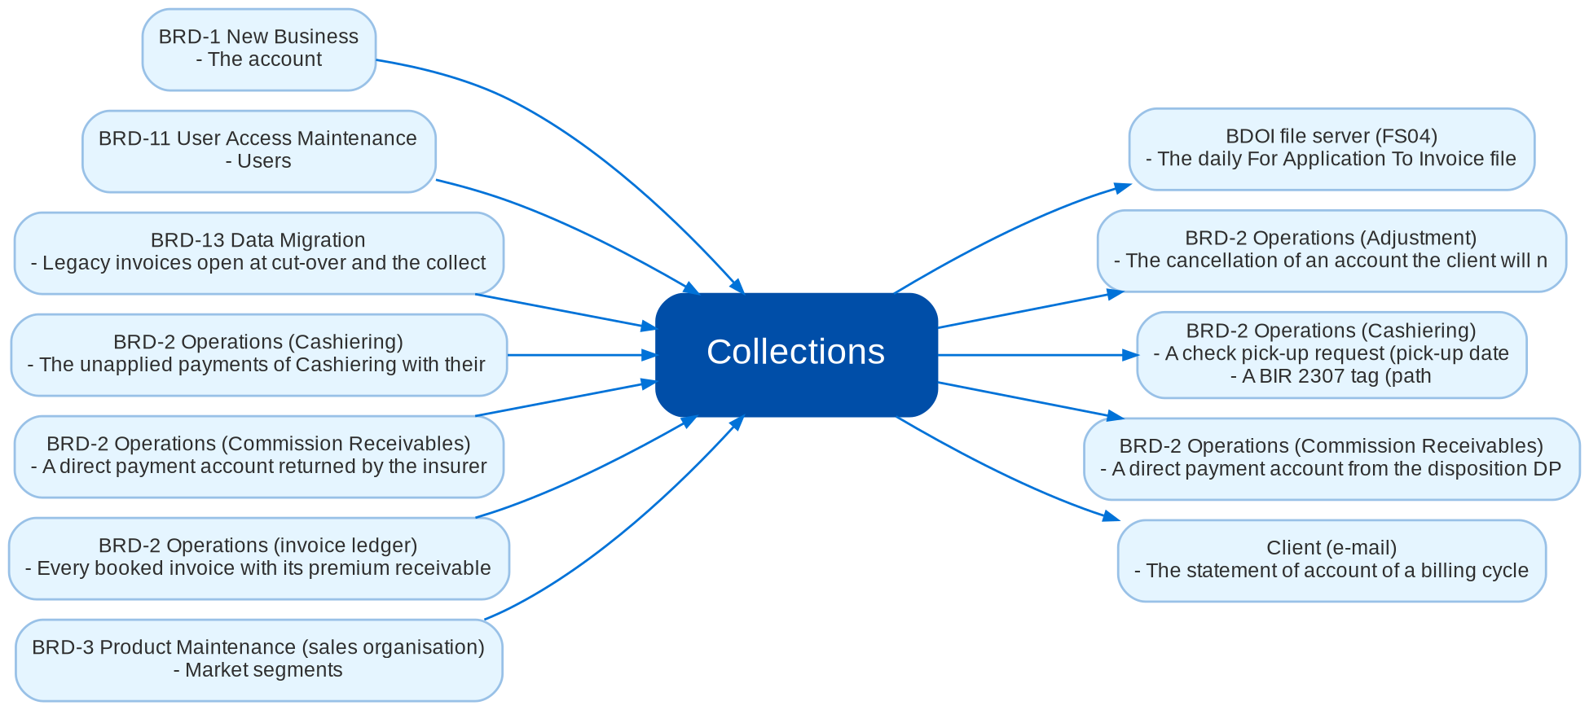
Cross-module dependencies and impacts
What Collections takes from and hands to the other BRDs and systems (FRS chapter 19)
Confidential – BDOI
Sign-off Pack Guide BRD-4 Collections | v2.0
18
Notes:
The contract is part of the signed set. A change to anything in this contract is raised in the Change Management Register and assessed with the owners of the other BRD: Collections reads the Operations invoice ledger and hands its work to Cashiering, Commission Receivables and Adjustment, so a change of a disposition with an Operations action, of a request type or of a balance component changes what Operations receives and is signed by both owners as a delta.
IC-01 BRD-2 Operations (invoice ledger) (In): Every booked invoice with its premium receivable by component, PR2307, payment and remittance status, direct payment and CWT flags, holds, pending negative adjustments and the team that locks it
IC-02 BRD-1 New Business (In): The account, client, policy, insurer shares, account officer, market segment and sales unit of each booked invoice
IC-03 BRD-2 Operations (Cashiering) (Out): A check pick-up request (pick-up date, address, contact, check amount, number and bank) from the disposition For check pick-up
IC-04 BRD-2 Operations (Cashiering) (Out): A BIR 2307 tag (path, certificate number and period, 2% amount) from the disposition PR 2307 for reversal
IC-05 BRD-2 Operations (Commission Receivables) (Out): A direct payment account from the disposition DP PR for reversal, for the direct payment list of Commission Receivables
IC-06 BRD-2 Operations (Commission Receivables) (In): A direct payment account returned by the insurer
IC-07 BRD-2 Operations (Cashiering) (In): The unapplied payments of Cashiering with their payment, matched account, Cashiering tab and status
IC-08 BRD-2 Operations (Cashiering) (Out): A request on an unapplied payment (apply to an invoice, refund, reclass, transfer to another unit) from a collector disposition, and the answer of Cashiering (accepted, rejected, applied)
IC-09 BRD-2 Operations (Adjustment) (Out): The cancellation of an account the client will not pay (disposition Cancel account)
IC-10 BRD-3 Product Maintenance (sales organisation) (In): Market segments, sales units and their Unit Heads
IC-11 BRD-11 User Access Maintenance (In): Users, roles and the Collections permissions; the handlers that may receive accounts and escalations
IC-12 BRD-13 Data Migration (In): Legacy invoices open at cut-over and the collection follow-up carried from legacy (disposition, promises, installments, collector)
IC-13 Client (e-mail) (Out): The statement of account of a billing cycle, password protected, and its password in a separate e-mail
IC-14 BDOI file server (FS04) (Out): The daily For Application To Invoice file

Slide 19
Caveats and possibilities
Topic | What can happen | How it is handled
Additional requirements | New needs can surface during the review, SIT or UAT. | In-scope clarification when the signed text already covers it; otherwise a change request with mandays.
Impacts on other modules | Collections reads the Operations invoice ledger (BRD-2) and hands its work to Cashiering, Commission Receivables and Adjustment. A change of a Collections disposition or request can change what Operations receives. | Each change is assessed against the cross-BRD contract (FRS chapter 19); when it touches another set, a delta sign-off of the affected pages of both sets.
Other BRDs change Collections | New Business (booking), Operations (balances, payment application, requests), Product Maintenance (sales organisation), User Access (roles) and Data Migration (legacy follow-up) can change what Collections shows. | The change is raised against the other BRD and assessed against the contract; when it touches this set, a delta sign-off of the affected pages only.
Lists of values still to confirm | The PR and unapplied payment dispositions, the effort codes and the escalation defaults carry provisional values marked to confirm (CQ08, CQ14). | BDOI gives its lists; they are loaded as configuration on the Lists of Values and Collections Setup screens, without a change request.
Commission receivable rows in draft | The rows on incentives, commission refunds and mixed payments (FR-CL-091 to 094) come from the draft addendum only (CQ01). | Signed as proposed rules; confirmed or changed when BDOI signs the addendum.
Integrations pending BDOI IT specifications | The transfer of the daily application file to the file server FS04 and the Marketing Diary kept in ISYS depend on BDOI IT (OQ17, CQ20). | A download from Collections Files until the transfer is specified; the automatic transfer is then a change request. The technical detail is in the Technical Specification, reviewed by BDOI IT.
Open questions and assumptions | Open questions of FRS section 10.3 follow the assumptions of section 10.1; chapter 21 lists the proposed rules and clarifications for confirmation. | Answered as configuration where possible (lists of values, parameters, templates); otherwise a change request; the assumption stands until then.
Confidential – BDOI
Sign-off Pack Guide BRD-4 Collections | v2.0
19
Notes:
Three ways to handle a case: an in-scope clarification (no change to the signed set, answered in the comments log); a change request with mandays in the Change Management Register; a delta sign-off of the affected pages only.

Slide 20
Caveats: worked examples
Topic | Example and how it is handled
Additional requirements | A reviewer asks for the bank AO on the PR Worklist: a new column, so a change request; asking which accounts the Credit Balances tab shows is a clarification.
Impacts on other modules | A new disposition that hands accounts to Adjustment needs a new hand-off in Operations: both owners confirm the delta.
Other BRDs change Collections | Operations changes the payment application hierarchy: the outstanding by component on the collection account changes and is signed as a delta.
Lists of values still to confirm | BDOI adds the disposition For legal follow-up with category C and Marketing as owner: a list value and its attributes.
Commission receivable rows in draft | If BDOI drops automatic incentive billing, FR-CL-092 is removed in v2.1 without affecting the rest of the set.
Integrations pending BDOI IT specifications | The application file is downloaded each morning and copied to FS04 by Cashiering until the transfer is agreed.
Open questions and assumptions | The minimal balance threshold is 10.00 until BDOI confirms it (CQ03); the answer is a parameter value.
Confidential – BDOI
Sign-off Pack Guide BRD-4 Collections | v2.0
20
Notes:
Use these examples to agree the handling of a case during the review.

Slide 21
Entry and exit criteria, definition of done
Entry
Exit
Done
• Every screenshot of the set is taken on the SIT environment with seed data.
• Reviewers have their SIT users and the walkthrough sessions are held.
• The test plan is traced to the FRS and to the screens.
• The BRD-2 Operations walkthroughs are held (the invoice ledger and the Cashiering screens are the input and the output of Collections).
• Every row of the workbook reviewed by its team (Accept, Change requested or Comment).
• Every comments log item closed: answered, corrected in v2.1, or raised as a change request.
• Open questions closed or accepted as assumptions.
• The sign-off certificate signed by every signatory of the Who signs what matrix: prepared, input, reviewed and approved as on the Collections BRD approval sheets; the Product Owner approves the whole set.
• Signed certificate filed with the set; version history updated.
• Content frozen as signed; deltas listed in the Change Management Register with mandays.
• Test plan agreed for SIT and UAT.
Confidential – BDOI
Sign-off Pack Guide BRD-4 Collections | v2.0
21
Notes:
The sign-off meeting starts when the exit criteria are met; the set is done when the certificate is signed and the content of the set is frozen.

Slide 22
After sign-off: readiness checklist
• ☐ Signed FRS, sign-off workbook and screens
• ☐ Open questions closed or accepted as assumptions
• ☐ Configuration inputs from the business: the PR and unapplied payment dispositions with their category, owner, Operations action and reserved roles, effort codes, escalation reasons and rules, billing frequencies, the threshold, aging brackets and edit-lock time, the assignment rules and the Unit Heads, the statement of account wording, users and roles
• ☐ Agreed test plan
• ☐ Migration mapping of the open collection follow-up (dispositions, promises, installments, collectors) signed (BRD-13)
  – After sign-off the content is frozen as signed and the approved deltas are scheduled.
Confidential – BDOI
Sign-off Pack Guide BRD-4 Collections | v2.0
22
Notes:
After sign-off the content is frozen as signed and the approved deltas are scheduled.

Slide 23
Change control after sign-off
• A change to anything frozen is raised in the Change Management Register
  – The screen, field, rule or message concerned, the reason and the priority
• The project team assesses the mandays and the effect on the other BRDs through the cross-BRD contract
• The owners of every BRD concerned approve it
• Delivered as a new version of the set (v2.1, v2.2...) with the changed pages signed again (delta sign-off)
• Configuration values marked default change in BIBS without a change request
Confidential – BDOI
Sign-off Pack Guide BRD-4 Collections | v2.0
23
Notes:
Nothing in a signed set changes without a request in the register.

Slide 24
Governance, contacts and next steps
Role | Who | Does
Business owner and approver | Shellah Marie C. Miranda, AVP, Product Owner | Accountable for the sign-off; chairs the sign-off meeting
Approvers of the addendum | Jose Melvin Jarin, AVP, Product Owner; Mark Joseph C. Makalintal, Unit Head - Combank and Corbank; Edmundante F. Ramirez and Roderick Lim, Retail Marketing; Ronald Allan E. De Leon, Head - Comptrollership | Approve the addendum functions and the commission receivable rows for their units
Reviewers | John Benedict S. Santos, VP and Head, BDOI Operations; Collections and Marketing Support (Pia Grace M. Pinili, Maria Victoria Evangelista), HO Marketing Support BBG (Grace Tordesillas), Marketing (Ma. Fides E. Rivera, Arra R. Rivera, Rhommel Mark Galler), Operations FT&P (Perjelyn Joy Gutierrez) | Review their screens and rows; raise comments
BDOI IT | IT Core Business Delivery (Reynaldo Valera Jr.) and IT AIO Core Business Delivery - Insurance (Wynonah Allyssa D. Agojo) | Reviews the scheduled runs, files, access and the Technical Specification
BRD owner | Dan Ace Cauton, Program Manager, and Zean C. Ibay, Business Analyst, ESG-BPS | Traceability to the BRD; sign-off coordination
Delivery | iorta TechNXT Project Manager, Business Analysis, test lead | Sessions, answers, comments log, revisions, change requests
Confidential – BDOI
Sign-off Pack Guide BRD-4 Collections | v2.0
24
Notes:
Next steps:
Kick-off and first SIT walkthrough on Mon 23-Nov-2026
Workbooks returned by Wed 9-Dec-2026; Q&A on Mon 14-Dec-2026; sign-off on Tue 22-Dec-2026
BRD-5 Accounting, Disbursement and ACSL follows in the same window; then BRD-13, then BRD-7 and BRD-8

Slide 25
Next steps and the release order of the other BRD sets
• Kick-off and first SIT walkthrough on Mon 23-Nov-2026
• Workbooks returned by Wed 9-Dec-2026; Q&A on Mon 14-Dec-2026; sign-off on Tue 22-Dec-2026
• BRD-5 Accounting, Disbursement and ACSL follows in the same window; then BRD-13, then BRD-7 and BRD-8
Confidential – BDOI
Sign-off Pack Guide BRD-4 Collections | v2.0
25
Notes:
The other BRD sets follow the same pack, guide and steps.

