Slide 1


BDOI Business Process Reverse KT
Our understanding: As-Is, pain points, To-Be in the BRDs, gaps and best practice
BIBS – BDOI Broker System
BDO Insurance and Reinsurance Brokers, Inc. | Version 2.0 | 27 September 2026 | Confidential
Prepared by
Notes:
Reverse knowledge transfer from the iorta TechNXT team to BDOI after the Day 1 business overview (21-Sep-2026) and the floor walks and discovery sessions of 22 to 25-Sep-2026. The deck plays back how we understand BDOI's business, department by department and end to end: how the work runs today, where the business users feel the pain, what the BRDs ask for and how that answers the pain, what the BRDs do not cover yet, and which insurance-broker practices go beyond the BRDs. It closes with a roadmap for streamlining and automation, the data migration and integration challenges, and the open points we need BDOI to confirm. It is not a build status report.

Slide 2
Why this reverse KT
We walked the floor with 40+ process owners. This deck gives back what we understood, so BDOI can correct it before the FRS sign-offs.
What this deck is
What we ask of each department
What this deck is not
• Our understanding of how BDOI works today, per department and end to end
• The pain points the business users raised on the floor, in their words
• What the BRDs ask for (To-Be) and how it answers those pain points
• What the BRDs miss, and industry practice beyond the BRDs
• Confirm or correct the As-Is swimlanes and the pain points
• Confirm the rules and values we heard (days, rates, tolerances, volumes)
• Decide the open points and the items marked "BDOI to confirm"
• Say which best practices BDOI wants on the roadmap
• Not a build status or test report
• Not a change to the signed BRDs: gaps become register items or change requests through the normal governance
• Not a design: the FRS per BRD remains the reference for screens and rules
Confidential – BDOI
BDOI Business Process Reverse KT | v2.0
2
Notes:
The purpose is validation, not presentation: each department confirms or corrects the As-Is, the pain points and the gaps of its chapter. Corrections go to the floor-walk notes workbook and the discrepancy register.

Slide 3
What we learned, in six messages
1. One deal, five tools, three references
2. E-mail and Excel carry the work
3. Controls rely on people
• Excel templates, Broker, ISYS, QPS and EBIX for one policy (NB flow)
• ISYS, QPS and EBIX numbers on the same transaction (OV-03)
• The BRDs answer it: one client, one ARN, one invoice ledger
• 16 department hand-offs by e-mail, file, Teams or paper
• Dispositions, recon, DP lists, trackers in Excel
• Most move into workflows in the BRDs
• Wet signatures at 3-6 levels; checker-poster one by one
• Intake checks and reversals by hand
• The BRDs add maker-checker; a DOA matrix is still to agree
4. IT is in the business path
5. What the BRDs miss
6. Beyond the BRDs
• Extracts (RMEL, recon), migrations, batches, reports and the close
• WinSCP and text files between systems
• The BRDs give users self-service and scheduled jobs
• Direct-pay payments without entries; credit policy
• Case management; government remittances
• Quote validity, risk survey, e-policy fall-outs, Marine open covers
• One insurer interface standard for ~55 insurers
• Automated cash application and payment references
• Host-to-host banking, portals, analytics: the H2-H3 roadmap
Confidential – BDOI
BDOI Business Process Reverse KT | v2.0
3
Notes:
The six messages of the reverse KT. Each is developed in the holistic chapter and the department chapters; the evidence refs point to the floor-walk notes and the process flows.

Slide 4
How we built our understanding
21-25 Sep
12
66
17
Day 1 business overview, floor walks and discovery sessions
floor-walk sessions with designated process owners (22-23 Sep)
floor-walk notes: As-Is, To-Be, pain points
open points raised on the floor
BDOI Day 1 deck; floor-walk schedule
Iorta floor-walk POC schedule
Floor-walk notes workbook
Floor-walk notes, Open Points
16
13 + 1
239
59
high-level process flows confirmed by BDOI process owners
BRDs in scope plus the Reinsurance BRD (phase 2)
register items on the BRDs; 64 High
change champions (21) and additional POCs / SMEs (38)
HL Process Overview pack
BRD pack; answer A3
Discrepancy register
Day 1 p.5
Floor-walk notes: 66 rows, 17 open points. Process flows: New Business, Renewal, Submitted Policies, EB, TSU, Reinsurance, Operations, Collections, Disbursement, Refund, FRBS, ACSL, Claims, CSF, Case Management, end to end.
Confidential – BDOI
BDOI Business Process Reverse KT | v2.0
4
Notes:
Five sources, cross-checked: the Day 1 business overview BDOI presented on 21-Sep; the floor walks of 22 and 23-Sep with the designated process owners; the discovery sessions of 21, 23, 24 and 25-Sep and their notes; the high-level process flows the process owners confirmed by e-mail between Dec 2025 and Jul 2026; and the BRDs with the discrepancy register maintained by the project.

Slide 5
Floor-walk coverage (1/2)
Date | Time | Process | Floor | Process owners
21 Sep | Full day | Business overview; discovery | - | BDOI programme, BU and IT leads (Day 1 deck)
22 Sep | 9-10 am | New Business | 43F | Rose Lique, Marla Apostol (Corporate); Grace Tordesillas, Kin Ysaac Flores (Non-CBG Retail); Justine Malonzo, Jhosven Awa (CBG Motor); Lyka Palomeno, Regina Matutina
22 Sep | 10-11 am | Renewal Marketing | 43F | Amara Cruz, Rose Lique, Joy Ilagan, Tina Fajardo; Grace Tordesillas, Kin Ysaac Flores; Criffson Rendon, Joyce Aritao; Ma. Christena Cezar; Cezssane Canarias, Jeramie Ramos
22 Sep | 11-11:30 am | Marketing Admin | 43F | Rose Lique, Reymark Marcelo; Nina Odvina, Kim Nayve, Mae Varron, Grace Tordesillas, Jordan Lambino
22 Sep | 1-1:30 pm | Product Maintenance (TSU) | 44F | Cherry Ann Manalo, Joy Intia
22 Sep | 1:30-3 pm | Renewal Processing | 44F | Angelo Alibuyog (CBG Fire), Ces Remodo (CBG Motor), Berna Corpuz (Non-CBG Corporate), Norberto Fulo (Non-CBG Retail)
22 Sep | 2-3:30 pm | Placement and Booking | 43F | Ramoncito Manalo, Cherry Ann Catayas; Jean Deam Dela Cruz, Cristina Labrador, Mae Anne B. Roque; John Ray Bellen, Rey Mark Magsael
Confidential – BDOI
BDOI Business Process Reverse KT | v2.0
5

Slide 6
Floor-walk coverage (2/2)
Date | Time | Process | Floor | Process owners
22 Sep | 3:30-5 pm | Collections | 43F, 44F | Sheryne Hernaez, Pia Pinili
22 Sep | 5-6 pm | Claims | 44F | Elmar O. Alvarez Jr., Richard Castanares
23 Sep | 9-10 am | Employee Benefits | 43F | Marianne Alpapara, Jyneffer Liansing, Edwin Garcia
23 Sep | 10 am-12 nn | Disbursement, FRBS, ACSL | 44F | Rodrigo Dela Cruz, Cherry Francisco, Lineth Santos, Guada Jane Pelo; Iris Marquez, Fatima Joy Aguas, Cherie Jocson; Jeniffer Lugtu, Mario Sabangan, Jennifer Carinan, Freddie Atanque
23 Sep | 1-5 pm | Operations: Cashiering, Remittance, Adjustment, Prod Recon | 44F | Perjelyn Joy Gutierrez, Shirley Catapang, Ronna Marie Go, Aimee Medina, Renque Galos, Carolyn Pasia Baloto, Joy Ebuenga, Mark Andrew Francisco
23-25 Sep | Sessions | Cashiering, Other Income, Tax (23); Collections, Commission (24); NB, Trade, Product (25) | - | Operations, Comptrollership, Marketing and TSU process owners
Confidential – BDOI
BDOI Business Process Reverse KT | v2.0
6
Notes:
The designated process owners of the floor-walk schedule (Iorta floor-walk POC workbook) and the discovery sessions. Reinsurance, Sanction Screening, User Access and the contact centre were not in the September slots; their chapters rely on the confirmed process flows and the BRDs.

Slide 7
Agenda
0
Our understanding of BDOI, end to end
1
New Business
2
Renewal
3
Submitted Policies
Holistic view
Part A | BRD-1
Part A | BRD-6
Part A | BRD-12
4
Employee Benefits
5
Product Maintenance and TSU
6
Reinsurance
7
Operations
Part A | BRD-8
Part B | BRD-3
Part B | RI BRD (phase 2)
Part C | BRD-2
8
Collections
9
Accounting, Disbursement and ACSL
10
Claims
11
Customer Servicing and Case Management
Part C | BRD-4
Part D | BRD-5
Part E | BRD-7
Part E | BRD-9
12
Sanction Screening
13
User Access Maintenance
14-16
Data migration, integrations, shared capabilities
17
Roadmap, consolidated gaps and open points
Part F | BRD-10
Part F | BRD-11
Part G | cross-cutting
Part H
Confidential – BDOI
BDOI Business Process Reverse KT | v2.0
7
Notes:
Chapter 0 is the enterprise view. Parts A to F follow the BDOI departments, one chapter per business area; each chapter has the same slides: at a glance, what we heard on the floor, the As-Is swimlane(s), the pain points, the To-Be in the BRD, how the BRD answers the pain points, what the BRD does not cover, and best practice. Part G covers data migration, integrations and shared capabilities; Part H the roadmap, the consolidated gaps and the open points.

Slide 8
How to read this deck
• Each department chapter plays back: what we heard, the As-Is flow, the pain points, the To-Be in the BRD, what the BRD does not cover, and best practice
• Swimlanes: one lane per BDOI role, external party (grey) or system (light blue); dashed boxes are steps in today's systems or files
• Yellow numbered circles are pain points; the slide after the swimlanes explains each one with its source
• On the To-Be swimlane (the BRD), light blue boxes are steps a user takes on a screen and solid blue boxes are steps the system runs by itself
• Coverage chips: In the BRD, Partly in BRD, Not in BRD, Beyond the BRD (industry practice), BDOI to confirm
• Refs: floor-walk notes (NB-03, CA-02...), Day 1 overview page, process flow, BRD page, register item (DCR-nnn), open question (Qnn)
• Not in this deck: build progress, test status or plans; those are in the programme status reports
Confidential – BDOI
BDOI Business Process Reverse KT | v2.0
8
Notes:
Refs: floor-walk notes carry the row number of the floor-walk notes workbook (OV-, NB-, PM-, CA-, CO-...); "Day 1 p.n" is a page of the BDOI Day 1 overview; "NB flow", "Renewal flow" and so on are the high-level process flows that the BDOI process owners confirmed; BRD-n p.n is the PDF page of the BRD; DCR-nnn is the discrepancy register; Qnn, AQnn, OQnn are open questions of the BRD specifications.

Slide 9
0. Our understanding of BDOI
The enterprise today, the To-Be in the BRDs, and where the pain sits
Confidential – BDOI | BDOI Business Process Reverse KT
Notes:
Before the department chapters, the enterprise view: BDOI at a glance, who does what, the broking lifecycle, the end-to-end flow today, the systems landscape, the reference problem, the hand-offs between departments, the business challenges BDOI named, the To-Be in the BRDs and the maturity view.

Slide 10
BDOI at a glance
~55
8
3
3
insurer partners, each connected and handled differently
branches, plus head office units
core systems: ISYS / Broker, QPS, EBIX Evolution, plus Excel
references for one transaction (ISYS, QPS, EBIX), plus the payment reference
OV-01
FN-01
Day 1 p.10
OV-03
21,200
25,800
50,000+
1,344
New Business transactions a month
renewal transactions a month
Employee Benefits members
named users across the BRDs; up to 429 at once
BRD-1 p.210
BRD-6 p.186-188
EB-01
Umbrella BRD p.42
Sources: floor-walk notes OV-01, OV-03, FN-01, EB-01; Day 1 p.10 and p.24; BRD-1 p.210; BRD-6 p.186; umbrella BRD p.42.
Confidential – BDOI
BDOI Business Process Reverse KT | v2.0
10
Notes:
BDOI is the insurance brokerage arm of BDO, serving retail and corporate customers across the full broking lifecycle with about 55 insurer partners (Day 1 p.6; OV-01). The figures come from the floor walk and the BRD usage tables.

Slide 11
Who does what today
Marketing: Corporate and IBG
Marketing: Retail and Branches
Marketing Admin and Support
Employee Benefits
• Corporate and institutional clients; IBG referrals
• Quotations, proposals, renewals, collections follow-up
• Chapters 1, 2, 8
• CBG Motor, Fire, Home; Non-CBG Retail; 8 branches
• Bank-referred and bulk business (HLS, LAD)
• Chapters 1, 2, 3
• RMEL split and dispositions; refunds (RRF)
• Account Support for Combank; UPP handling
• Chapters 2, 9
• Group life, HMO and accident programmes
• BOR, TOR, proposals, comparative, placement
• Chapter 4
TSU and MBS
Reinsurance
Processing
Operations
• Non-package terms; quotation slips; comparative
• Package design, set-up and release
• Chapter 5
• Facultative placement for cedants and TSU
• RI premium, commission, claims, cash calls
• Chapter 6
• Client and account set-up; placement; booking
• Renewal sanitation (CBG Fire and Motor)
• Chapters 1, 2
• Cashiering, Remittance, Adjustment and Collateral Release
• Production recon, CRU, invoicing
• Chapter 7
Collections
Comptrollership
Claims
Contact centre, COG, Compliance, IT
• Premium receivable follow-up with Marketing AOs
• ICS, commitments, CTE, dispositions
• Chapter 8
• FRBS: GL, reconciliation, close, BIR
• Disbursement; ACSL sub-ledger
• Chapter 9
• Motor and Non-Motor claims, client advocacy
• Insurers, adjusters, CASA / dealers
• Chapter 10
• Contact centre and COG-OPRM (letters, e-policies)
• Compliance: screening, AMLA; IT: extracts, batches
• Chapters 11-13
Confidential – BDOI
BDOI Business Process Reverse KT | v2.0
11
Notes:
The BDOI functions as we met them on the floor (Day 1 p.4-8 and the floor-walk schedule), with the chapter of this deck that covers each. Compliance and IT support every function.

Slide 12
The broking lifecycle and its three flows
Market, find the opportunity
Understand the need
Source quotes and terms
Present, confirm
Place and book
Collect, reconcile
Service, adjust, renew, claims
Systems and tools used today
ISYS / Broker; bank lists (HLS, LAD)
E-mail; Broker; declaration form
IDF Excel, QPS, ISYS; TSU Excel
E-mail, PDF, shared drive
ISYS, QPS, EBIX; SFTP, e-mail
EBIX, ICS, Autopay, Excel, Teams
EBIX, Excel, CLS, e-mail
Owner
Marketing AO
Marketing AO
Marketing, TSU, RI
Marketing
Processing, IT
Operations, Collections, Comptrollership
Operations, Renewal, Claims, contact centre
Information flow
Decision flow
Financial flow
• Client and policy data keyed in Broker, ISYS, QPS and EBIX
• Quotations, instructions and documents travel by e-mail and shared drive
• Three references per transaction (OV-03)
• Business reviews and approvals by e-mail, Teams and wet signature
• Insurer and customer confirmations by e-mail
• SLA and validity kept by memory (NB-03, NB-07)
• Premium receipts, application and reconciliation across payment routes
• Commission after full premium; remittance weekly
• Accounting entries, reversals and adjustments partly by hand
Confidential – BDOI
BDOI Business Process Reverse KT | v2.0
12
Notes:
BDOI's own view of the lifecycle (Day 1 p.6), with the systems and owners we saw at each stage. Information, decisions and money move together; today each crosses several tools and e-mail.

Slide 13
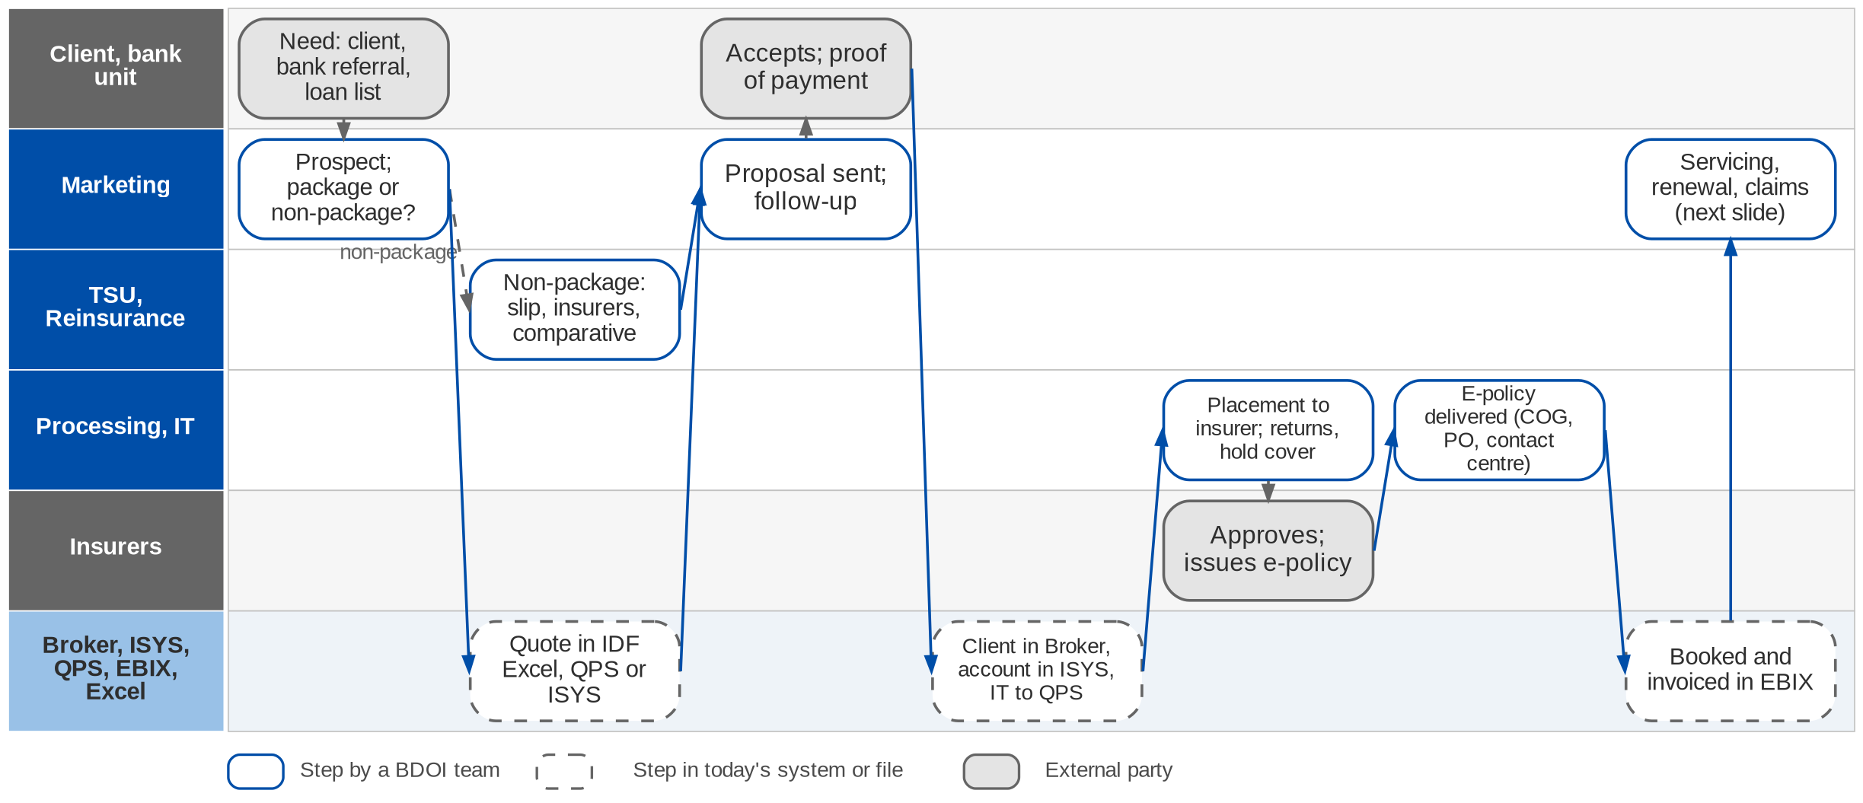
End to end today (1/2): prospect to booked policy
From the client's need to a booked policy (BDOIR end-to-end process flow; Day 1 p.11, p.18)
Confidential – BDOI
BDOI Business Process Reverse KT | v2.0
13
Notes:
The first half of BDOI's end-to-end flow. Marketing works the prospect and decides package or non-package; TSU (and Reinsurance for large risks) sources non-package terms. The quotation is prepared in Excel templates, QPS or ISYS; after acceptance and payment the client is created in Broker, the account in ISYS and both are migrated to QPS by IT. Processing places with the insurer, handles returns and hold covers, receives the e-policy, delivers it through COG, the officer or the contact centre, and books and invoices in EBIX.

Slide 14
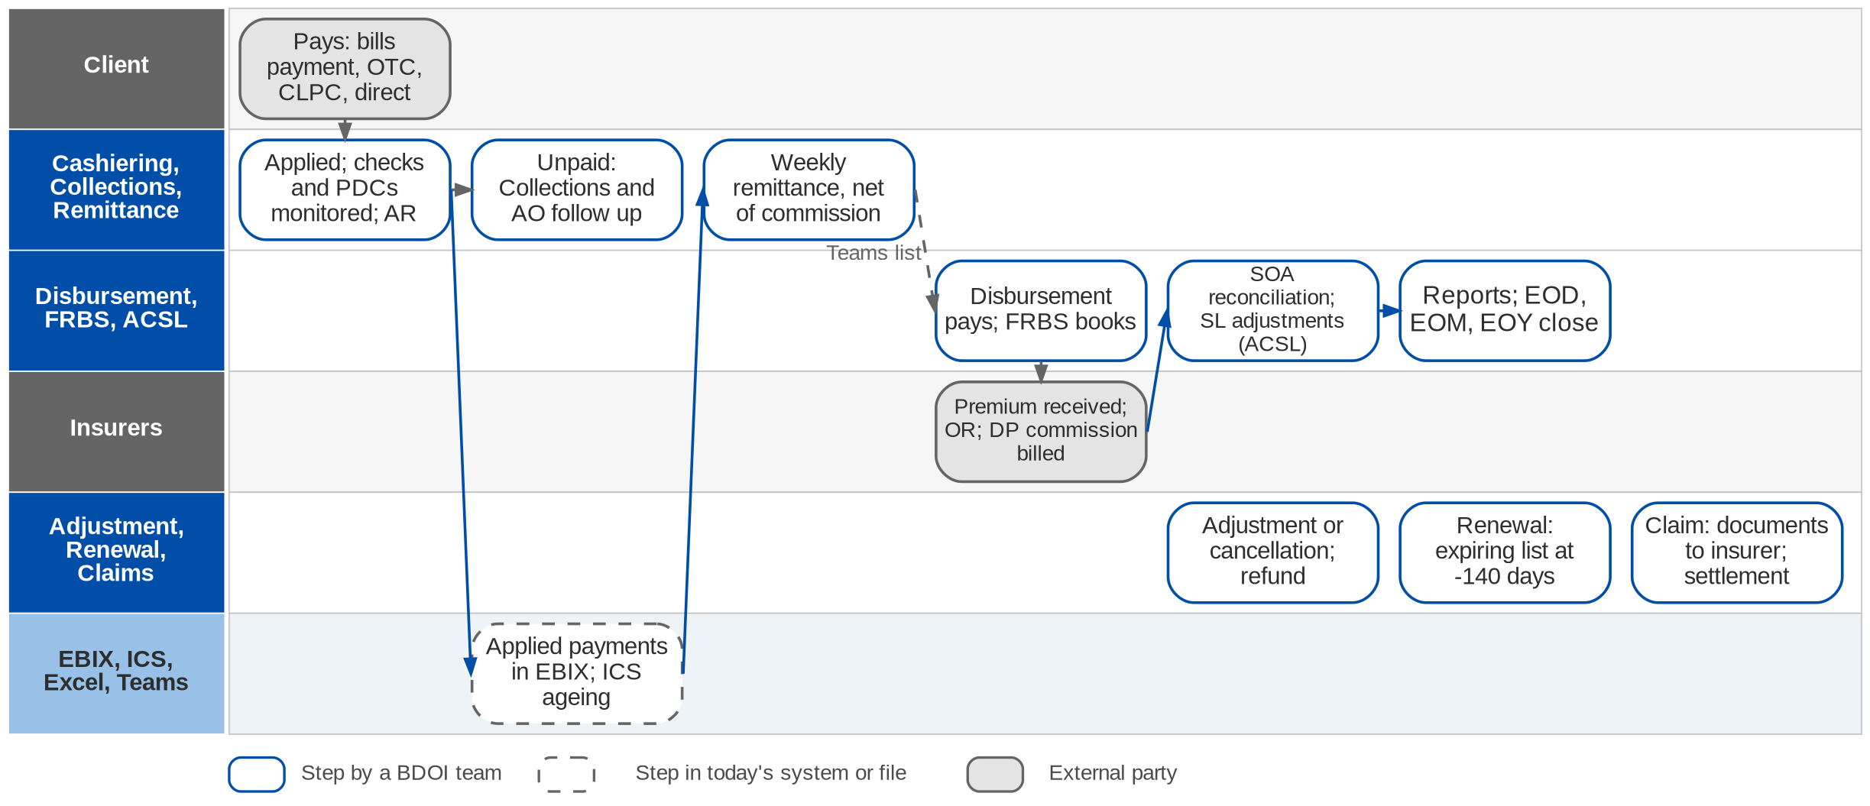
End to end today (2/2): premium to books, and servicing
Money and servicing after booking (BDOIR end-to-end process flow; Day 1 p.12-14)
Confidential – BDOI
BDOI Business Process Reverse KT | v2.0
14
Notes:
The second half. The client pays through bills payment, over the counter, CLPC, autopay or directly to the insurer; Cashiering applies the payment and monitors checks and PDCs; Collections follows unpaid premium with the AO. Every week Remittance prepares the settlement net of commission, Disbursement pays the insurer and FRBS books it; commission on direct payments is billed to the insurer; ACSL reconciles the insurer statements and adjusts the sub-ledger; FRBS closes the books. After booking three servicing paths start: adjustment or cancellation (with a refund), renewal from the expiring list 140 days ahead, and claims.

Slide 15
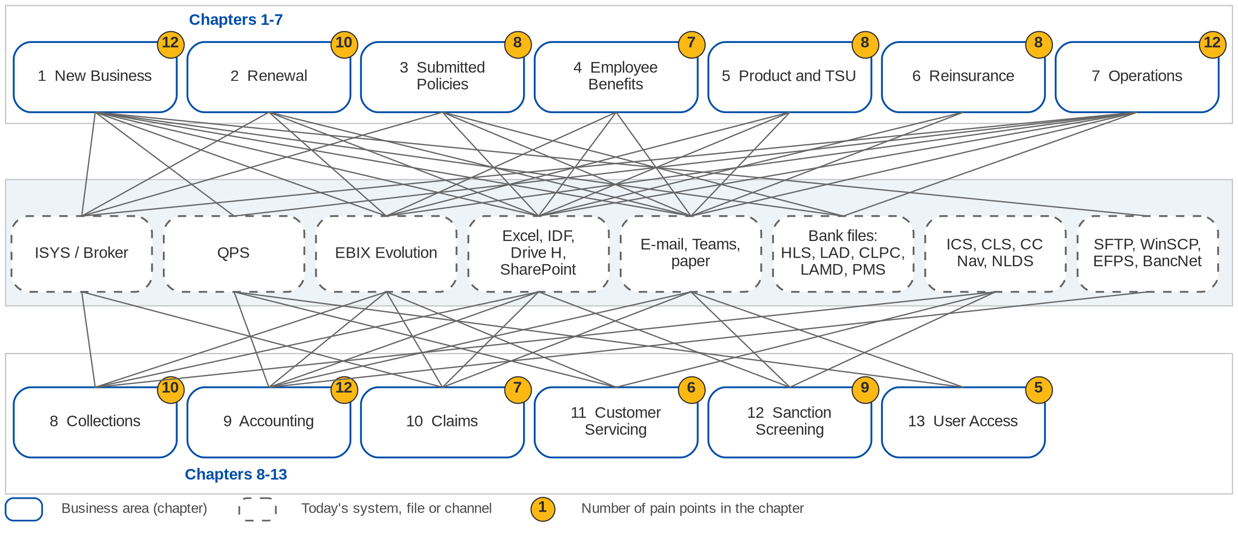
Today: thirteen areas and the tools they depend on
Each line is a system, file or channel an area depends on today (floor walk, process flows, BRD current process)
Confidential – BDOI
BDOI Business Process Reverse KT | v2.0
15
Notes:
Every area works in its own mix of systems and files. New Business alone touches Excel templates, Broker, ISYS, QPS, EBIX, bank files and SFTP. Operations and Comptrollership run on EBIX with Excel, Teams and SharePoint around it. Collections uses ICS; the contact centre CLS and CC Nav; Compliance SharePoint and NLDS. Almost every hand-off between areas is an e-mail or a spreadsheet, so the same client, policy and payment are keyed several times. The yellow number on each area is the count of pain points in its chapter.

Slide 16
One transaction, several references
To-Be in the BRD
ISYS / Broker
Invoice number
Marketing; the client pays against it
QPS
QPS reference
Processing; holds all three numbers
EBIX
EBIX reference
Booking, accounting, remittance
Bank, Cashiering
Payment reference
Bills payment, CLPC, Autopay
• One client master and one account number (ARN) per account (BRNB.102)
• One invoice ledger; related transactions carry the root invoice number (ACSL 2.16, DIS 3.27.2)
• Legacy references kept for search after migration
Seen in Cashiering (CA-01), the overview (OV-03), the e-policy text files (NB flow) and the reversal lists (DPPR).
What it causes today
• Tracing one transaction across systems is slow (OV-03)
• Receipts are created by hand against three numbers (CA-01)
• Each payment is checked: "in QPS with an EBIX reference?" (Cashiering flow)
• Reversal lists are matched to IT extracts by VLOOKUP on the invoice number (DPPR / PR2307)
• E-policy updates need text files with the policy, ISYS, EBIX and QPS numbers (NB flow)
• Migration must map several legacy references per invoice (CQ22, DMQ11)
Our recommendation
• One lifecycle reference printed on quotation, invoice, AR / OR, SOA and e-policy letter
• A payment reference with a check digit derived from it, carried in bank files
• BDOI to confirm (open point OV-03)
Confidential – BDOI
BDOI Business Process Reverse KT | v2.0
16
Notes:
The same deal carries an ISYS invoice number (the client pays against it), a QPS reference, an EBIX reference and a payment reference; QPS holds all three. It is the single most repeated friction on the floor: it slows every trace, forces manual receipts and VLOOKUPs, and it will need careful mapping in the data migration.

Slide 17
Hand-offs between departments (1/3)
From | To | What passes | Channel today | To-Be in the BRDs
Marketing | TSU | Non-package request (PRF / TSU form) | E-mail | Request in the TSU workflow (BRD-3)
TSU | Reinsurance | Large or special risks for facultative placement | E-mail | RI module in phase 2; referral not specified
Marketing | Processing | Accepted quote, GRF / ARF, proof of payment | E-mail, ISYS ARF | Account submitted in the workflow (BRD-1)
Processing | IT | ISYS to QPS migration; policy-number text files | Request, text file | Not needed: one system, one account
Processing | Insurers | Placement slips, hold covers, returns | E-mail, SFTP | Slip with send log; channel per insurer
Processing, IT | COG, contact centre | E-policy delivery and fall-outs | SFTP, e-mail | One e-policy sender; fall-out queue not specified
Confidential – BDOI
BDOI Business Process Reverse KT | v2.0
17

Slide 18
Hand-offs between departments (2/3)
From | To | What passes | Channel today | To-Be in the BRDs
Marketing | Operations | Endorsement and cancellation requests | E-mail with documents | Request in the system; premium recomputed
Marketing, units | CRU | Direct-payment lists | Shared folder | Uploaded, validated, billed per insurer
Collections | Marketing AO | CTE, escalation, day-60 outcome | E-mail | Escalation rules; CTE record not specified
Remittance | Disbursement | Weekly settlement list | Teams list, signed copy | Batch approval creates the voucher
Marketing | Disbursement | Refund requests (RRF) | Paper, scanned copies | RRF in the workflow
Disbursement | FRBS | Signed documents for the GL entry | Paper | Entry posted at approval
Confidential – BDOI
BDOI Business Process Reverse KT | v2.0
18

Slide 19
Hand-offs between departments (3/3)
From | To | What passes | Channel today | To-Be in the BRDs
IT | FRBS, ACSL, units | Reports and extracts | Shared folder | Reports run by users
CRU | IT, Cashiering | DPPR / PR2307 reversal lists | SharePoint, Teams | Tagging and reversal in the system
IT | Marketing Admin, AO | Expiring list (RMEL) and dispositions | Excel, e-mail | Work assigned by rule
Contact centre | Fulfilment unit | Referred client concerns | E-mail, CLS prompt | Not in BRD-9 (case management)
Confidential – BDOI
BDOI Business Process Reverse KT | v2.0
19
Notes:
Every row is a place where work waits, is re-keyed or is lost today. The To-Be column says how the BRDs close it; rows marked "not specified" are in the gaps of the chapters.

Slide 20
Business challenges BDOI named, and what we saw
Operational bottlenecks
Data quality
• Multiple hand-offs: 16 department hand-offs by e-mail, file or paper (previous slide)
• Waiting for approval: 3-6 signatures on refunds and disbursements
• Peak workload: 20-30K recon lines per insurer a month; 25,800 renewals a month
BRDs: workflow with queues, rules and batch jobs; approvals in the system
• Three references per transaction; leads and clients in one category (OV-03, OV-04)
• Outstanding per client not reliable; ageing keeps running after payment (CO-01, CO-02)
• Duplicate clients across Broker, QPS and EBIX
BRDs: one client master and one account; dedupe at migration; lead category open
Manual workarounds
Reporting limitations
• Excel for quotes, dispositions, recon, DP lists, trackers and the RI sheet
• E-mail for requests, returns, CTE; Teams for approvals
• Receipts, reversals, invoices and journals by hand
BRDs: most steps move into the system; gaps listed per chapter
• Reports need IT and a consolidation from several systems (RP-01)
• No real-time pipeline or status; ManCom lists in Excel
• Hard to trace figures to source transactions
BRDs: users run reports; ad-hoc builder and data-platform feed still open
Confidential – BDOI
BDOI Business Process Reverse KT | v2.0
20
Notes:
The four challenge areas of the Day 1 overview (p.15), each with the evidence we saw on the floor and how far the BRDs answer it.

Slide 21
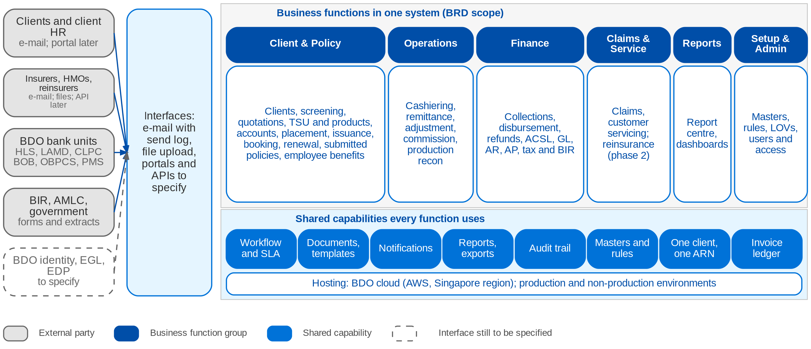
To-Be in the BRDs: one platform
Business functions and shared capabilities of the BRDs; external parties and interfaces
Confidential – BDOI
BDOI Business Process Reverse KT | v2.0
21
Notes:
The BRDs together describe one application for the thirteen areas, grouped the way BDOI navigates: client and policy, operations, finance, claims and service, reports, and setup and administration. Every function uses the same shared capabilities: workflow with SLA, documents and templates, notifications, reports, the audit trail and the configuration masters the business maintains. External parties reach it by e-mail with a send log, by file, or later by portal and API; the bank, insurer, directory and data-platform interfaces are still to be specified with BDO IT (Part G).

Slide 22
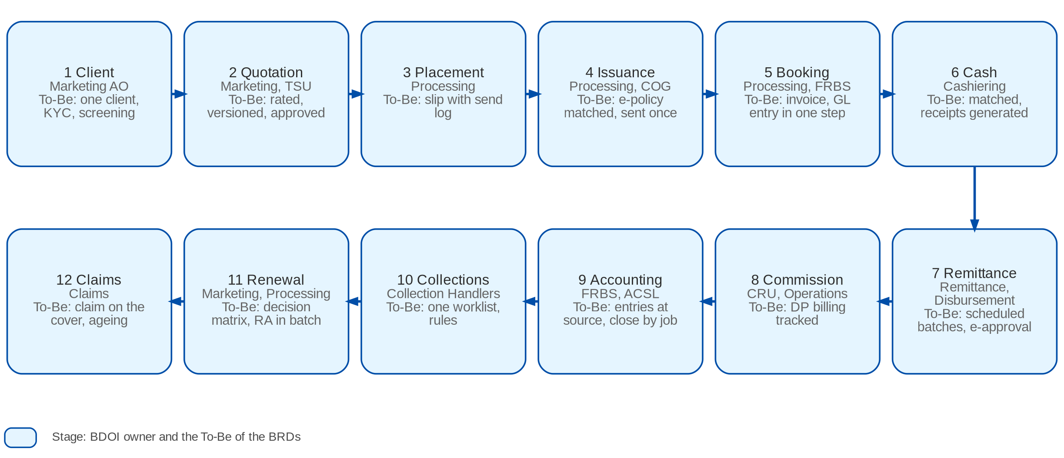
To-Be value chain: one record from client to claims
From client to claims: the stage, the BDOI owner and the To-Be of the BRDs
Confidential – BDOI
BDOI Business Process Reverse KT | v2.0
22
Notes:
The chain follows one policy and its money. In the To-Be every stage reads the same client, account (ARN) and invoice ledger, so no stage re-keys the output of the previous one: the change that removes most of the pain points of the department chapters.

Slide 23
Maturity: today, To-Be, best practice
1 Manual: paper, e-mail
2 Tool-assisted: spreadsheets, separate systems
3 One workflow in one system
4 Automated, with exception queues
5 Integrated and measured
Automation
Controls
Data
Integration
Customer service
Compliance
Reporting
Today
To-Be in the BRDs
Best practice
Scale: project team assessment from the floor walk, the process flows and the BRDs
Confidential – BDOI
BDOI Business Process Reverse KT | v2.0
23
Notes:
The scale is the project team's reading of what we saw on the floor, the BRDs and the practices in each chapter. It is a discussion aid, not an audit rating. Integration stays lowest in the To-Be because the bank, insurer and enterprise interfaces are still to be specified.
Automation: today 1, To-Be 4, best practice 5. Today: split files, receipts, reversals and journals by hand (Operations and FRBS flows). To-Be: jobs, matching and straight-through steps with exception queues.
Controls: today 2, To-Be 4, best practice 5. Today: wet signatures, Teams approvals, checker-poster one by one. To-Be: maker-checker and approval matrices in the workflow.
Data: today 1, To-Be 4, best practice 5. Today: three references, Excel masterlists, re-keying across five tools. To-Be: one client, one ARN, one invoice ledger.
Integration: today 2, To-Be 3, best practice 5. Today: e-mail, SFTP and WinSCP files, IT batches. To-Be: uploads and seams; APIs to specify.
Customer service: today 2, To-Be 3, best practice 5. Today: CBG-only view, cases logged by hand. To-Be: every account; case management not in BRD-9.
Compliance: today 1, To-Be 4, best practice 5. Today: KYC and AMLA outside the system, names matched by hand. To-Be: screening on every trigger with cases.
Reporting: today 1, To-Be 4, best practice 5. Today: reports need IT (RP-01). To-Be: users run reports; ad-hoc builder open.

Slide 24
Part A
Marketing and Sales
New business, renewal, submitted policies and employee benefits: the front office and its hand-off to Processing
1. New Business BRD-1
2. Renewal BRD-6
3. Submitted Policies BRD-12
4. Employee Benefits BRD-8
Confidential – BDOI | BDOI Business Process Reverse KT
Notes:
New business, renewal, submitted policies and employee benefits: the front office and its hand-off to Processing

Slide 25
1. New Business: at a glance
Department and roles
Volumes and business rules
How we learned it
Marketing (CBG, Non-CBG Retail, Corporate, Branches) and Processing (Placement and Booking)
• Marketing AO, TL, TH, UH per segment; Marketing Account Support (Combank)
• TSU (non-package proposals; see chapter 5)
• Processing Team (client and account set-up), Processing Officer and TL (placement, booking)
• IT (ISYS to QPS migration, e-policy batch, exception report); COG-OPRM (e-policy sending)
• BDOI contact centre (e-policy after a fall-out); Adjustment Team (cancellations)
485
named users, 145 concurrent (BRD-1 p.210)
Floor walk: 22-Sep-2026 (New Business 9-10 am; Placement and Booking 2-3:30 pm, 43F) and 25-Sep-2026
Process owners: Rose Lique, Marla Apostol, Grace Tordesillas, Kin Ysaac Flores, Justine Malonzo, Jhosven Awa and 9 more (floor-walk coverage slide)
• High-level New Business process flow (CBG Motor, CBG Fire, Non-CBG Corporate, Non-CBG Retail, Branches)
• BDOI Day 1 overview p.11 and p.18
• BRD-1 p.132-134; Other Lines addendum p.47-48; BRNB.001-115
21,200
transactions a month; 1,300 endorsements (p.210-211)
30 days
quote validity for every product, retail and corporate (NB-03)
7 / 3 days
SLA for complex / normal corporate risks (NB-07)
The process in one line
Request
Quotation
Acceptance
Client and account
Migration
Placement
E-policy
Booking
Confidential – BDOI
BDOI Business Process Reverse KT | v2.0
25
Notes:
New Business turns a customer need into an issued, booked and delivered policy. It is the spine of the business: every other area reads the client, the account and the booked invoice it creates. The journey differs by segment (CBG Motor, CBG Fire and Home, Non-CBG Retail, Corporate, Branches, bank trade business) and by product type: package products go from quotation to policy on fixed terms, non-package risks go through TSU for insurer terms (chapter 5). Today one deal crosses five tools: Excel templates, Broker, ISYS, QPS and EBIX.
Floor walk: 22-Sep-2026 (New Business 9-10 am; Placement and Booking 2-3:30 pm, 43F) and 25-Sep-2026; Rose Lique, Marla Apostol, Grace Tordesillas, Kin Ysaac Flores, Justine Malonzo, Jhosven Awa, Lyka Palomeno, Regina Matutina; Ramoncito Manalo, Cherry Ann Catayas, Jean Deam Dela Cruz, Cristina Labrador, Mae Anne B. Roque, John Ray Bellen, Rey Mark Magsael.
Sources: High-level New Business process flow (CBG Motor, CBG Fire, Non-CBG Corporate, Non-CBG Retail, Branches); BDOI Day 1 overview p.11 and p.18; BRD-1 p.132-134; Other Lines addendum p.47-48; BRNB.001-115

Slide 26
1. New Business: what we heard on the floor (1/3)
Ref | Topic | Type | What we heard (As-Is) | What the business wants (To-Be)
NB-01 | Routing | Open point | Package goes quote to policy; non-package goes direct to policy issuance; some package products go straight to placement. On 25-Sep: the TSU step is for non-package only. | Confirm routing per product type.
NB-02 | Premium confirmation | As-Is | Marketing shares the premium computation with the client; placement follows once the client confirms. | -
NB-03 | Quote validity | Business rule | A quote is valid 30 days for all products, retail and corporate. | The system applies 30-day validity on every quote.
NB-04 | KYC, AMLA | Open point | Insurance declaration form and KYC done outside the system, for every new customer; then the AMLA check. | Confirm whether KYC and AMLA come into the system.
NB-05 | Risk survey | Business rule | A risk survey is required above 500M. | Confirm the basis (sum insured? PHP?).
NB-06 | Quote to insurer | As-Is | Non-life lines (Motor, Property, Marine): the quote request goes to the insurer with recommended terms. | -
Confidential – BDOI
BDOI Business Process Reverse KT | v2.0
26

Slide 27
1. New Business: what we heard on the floor (2/3)
Ref | Topic | Type | What we heard (As-Is) | What the business wants (To-Be)
NB-07 | SLA | User aspiration | Complex risk 7 days, normal risk 3 days. | SLA tracking available.
NB-08 | TSU step | Business rule | Non-package: TSU before the quotation; after acceptance to the Placement team. | -
NB-09 | Package flow | Pain point | Client created in Broker, proposal in EBIX, then QPS for the package policy: one deal keyed in three systems. | -
NB-10 | TOR | As-Is | Terms of reference kept per product. | -
NB-11 | Pipeline | User aspiration | TSU outstanding items and risk profile in a pipeline report; sources are the bank and direct clients. | Pipeline for Retail and Corporate accounts.
NB-12 | CBG quick quote | As-Is | CBG gives quick-quote details; allocation by branch or area and by region to the handler; placement once agreed. | -
Confidential – BDOI
BDOI Business Process Reverse KT | v2.0
27

Slide 28
1. New Business: what we heard on the floor (3/3)
Ref | Topic | Type | What we heard (As-Is) | What the business wants (To-Be)
NB-13 | CBG Motor | Business rule | CBG is Motor and package only, so TSU is not involved. | -
NB-14 | Non-CBG from the bank | Open point | The bank gives details and premium; the first year premium is free; the process stops when the COC is received from PGA. | Commission on the free first year (Cashiering).
NB-15 | Kept for renewal | As-Is | Client code created and kept in Broker so it can be retrieved at renewal. | -
DC-01 | Documents | Business rule | Policy schedules follow insurer templates; no BDOI template for NB or endorsement; the renewal advice uses the BDOI template. | -
TR-01, 02 | Trade and Marine | As-Is | Clients import with bank trade loans; business from the bank is mostly Marine Open Policy declarations; accumulation to track by location. | -
Confidential – BDOI
BDOI Business Process Reverse KT | v2.0
28
Notes:
Notes of the business overview (21-Sep) and of the New Business sessions of 22 and 25-Sep. NB-01 has two versions from two sessions and is an open point.
NB-01 Routing (Open point): Package goes quote to policy; non-package goes direct to policy issuance; some package products go straight to placement. On 25-Sep: the TSU step is for non-package only. Wants: Confirm routing per product type.
NB-02 Premium confirmation (As-Is): Marketing shares the premium computation with the client; placement follows once the client confirms.
NB-03 Quote validity (Business rule): A quote is valid 30 days for all products, retail and corporate. Wants: The system applies 30-day validity on every quote.
NB-04 KYC, AMLA (Open point): Insurance declaration form and KYC done outside the system, for every new customer; then the AMLA check. Wants: Confirm whether KYC and AMLA come into the system.
NB-05 Risk survey (Business rule): A risk survey is required above 500M. Wants: Confirm the basis (sum insured? PHP?).
NB-06 Quote to insurer (As-Is): Non-life lines (Motor, Property, Marine): the quote request goes to the insurer with recommended terms.
NB-07 SLA (User aspiration): Complex risk 7 days, normal risk 3 days. Wants: SLA tracking available.
NB-08 TSU step (Business rule): Non-package: TSU before the quotation; after acceptance to the Placement team.
NB-09 Package flow (Pain point): Client created in Broker, proposal in EBIX, then QPS for the package policy: one deal keyed in three systems.
NB-10 TOR (As-Is): Terms of reference kept per product.
NB-11 Pipeline (User aspiration): TSU outstanding items and risk profile in a pipeline report; sources are the bank and direct clients. Wants: Pipeline for Retail and Corporate accounts.
NB-12 CBG quick quote (As-Is): CBG gives quick-quote details; allocation by branch or area and by region to the handler; placement once agreed.
NB-13 CBG Motor (Business rule): CBG is Motor and package only, so TSU is not involved.
NB-14 Non-CBG from the bank (Open point): The bank gives details and premium; the first year premium is free; the process stops when the COC is received from PGA. Wants: Commission on the free first year (Cashiering).
NB-15 Kept for renewal (As-Is): Client code created and kept in Broker so it can be retrieved at renewal.
DC-01 Documents (Business rule): Policy schedules follow insurer templates; no BDOI template for NB or endorsement; the renewal advice uses the BDOI template.
TR-01, 02 Trade and Marine (As-Is): Clients import with bank trade loans; business from the bank is mostly Marine Open Policy declarations; accumulation to track by location.

Slide 29
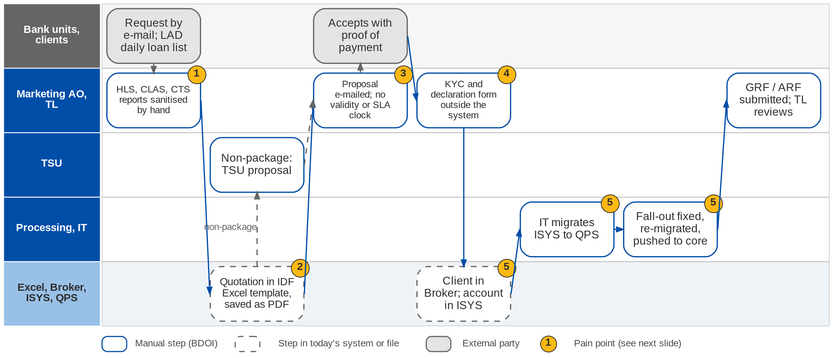
1. New Business: As-Is process (1/2)
Request to account today (New Business process flow; Day 1 p.18; NB-01 to NB-15)
Confidential – BDOI
BDOI Business Process Reverse KT | v2.0
29
Notes:
Requests reach the Marketing AO by e-mail: individual requests from bank AOs, branches, IBG or clients, and for CBG Fire a daily list of approved loans from CBG LAD. The AO builds the insurance report from HLS, CLAS and CTS and sanitises it by hand. Quotations are prepared in the IDF Excel templates (or ISYS for package accounts), saved as PDF and e-mailed; non-package risks go to TSU. There is no control on quote validity or SLA. Once the client accepts with proof of payment, KYC and the insurance declaration are done outside the system, the client is created in Broker and the account in ISYS. The Processing Officer then asks IT to migrate client and account from ISYS to QPS; when the migration fails the account is fixed and re-migrated, then pushed to the core system. Marketing submits the GRF / ARF and the TL reviews it.

Slide 30
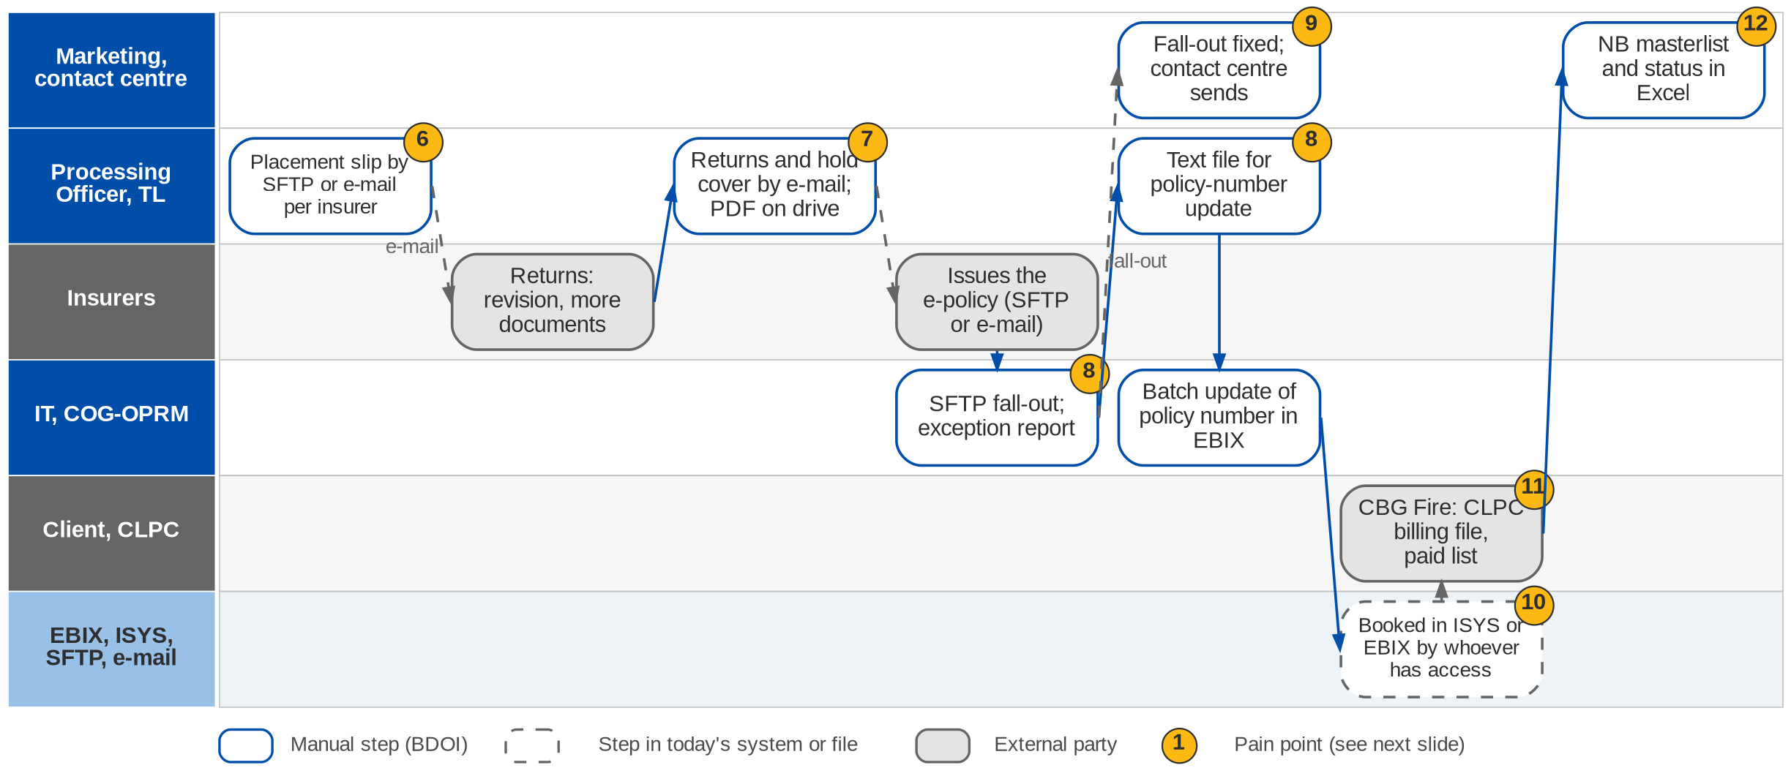
1. New Business: As-Is process (2/2)
Placement to booking and e-policy delivery today (New Business process flow; Day 1 p.18)
Confidential – BDOI
BDOI Business Process Reverse KT | v2.0
30
Notes:
The Processing Officer sends the placement slip to each insurer by SFTP or, for insurers without SFTP, as a PDF by e-mail, and handles returns (revision, more documents, cancellation) with Marketing. Hold covers go by e-mail and the PDF is saved on the shared drive with the link in the e-mail. The insurer issues the e-policy. When SFTP works, IT updates the policy number in EBIX by batch and COG-OPRM sends the e-policy to the client; when the insurer is not on SFTP or the transfer falls out, the officer creates a text file for the policy-number update, IT runs an e-policy exception report, and Marketing fixes the fall-out and passes the e-policy to the BDOI contact centre to send. Placement and booking are done in ISYS or EBIX depending on who has access. For CBG Fire the AO prepares the billing file for CLPC and checks the CLPC masterlist to see whether billed accounts are paid. Status is kept in the NB masterlist in Excel.

Slide 31
1. New Business: one process, seven segment variants
Segment | Request from | Quotation | Client and account | Placement, e-policy
CBG Motor (package) | BDO branch or CBG Auto Loans AO, by e-mail | Excel template with ISYS reference; quick quote | Client in Broker; account in ISYS; IT migration to QPS | Slip by SFTP or e-mail; IT batch policy number; COG or PO sends
CBG Fire and Home | CBG AO; CBG LAD daily approved-loan list from HLS | IDF Excel template converted to PDF | Processing bulk upload into Broker from the insurance report | GRF to Placement; hold cover by e-mail; CLPC billing and paid list
Non-CBG Corporate, all lines | IBG or client, by e-mail | ISYS full quote (package); Excel or TSU proposal (non-package) | Broker and ISYS; IT migration to QPS | Placement PDF by e-mail per insurer; SFTP or PO sends
Non-CBG Retail | BDO branch, by e-mail | Excel quick quote; ISYS for package and motor | Broker; ISYS ARF module | Slip PDF by e-mail; e-policy as above
Branches | Bank AO or client; single or bulk | Excel quick quote; ISYS for package | Broker; ISYS | Slip PDF by e-mail; e-policy as above
Bank-referred, free first year | Bank gives details and premium | None; premium from the bank | Client code in Broker for renewal | Stops at the COC from PGA; handled at renewal
TSU accounts, EB, SM Construction, Combank | Via TSU, EB or Marketing Account Support | TSU proposal or insurer terms | Encoded in EBIX directly | PO places; insurer SOA before booking and invoicing
Confidential – BDOI
BDOI Business Process Reverse KT | v2.0
31
Notes:
The segment variants of the New Business process flow (confirmed by the CBG Motor, CBG Fire, Non-CBG Corporate, Non-CBG Retail and Branches process owners, Dec 2025 - Mar 2026) and of the 25-Sep session (NB-12 to NB-15).

Slide 32
1. New Business: pain points today
1
Requests and bank lists by hand
Requests arrive by e-mail; HLS, CLAS and CTS reports are sanitised by hand.
NB flow; BRD-1 p.133
7
Returns and hold covers by e-mail
Revisions, hold covers and PDFs travel by e-mail and shared drive.
NB flow; BRD-1 p.133
2
Quotations in Excel templates
IDF templates filled, converted to PDF, shared by drive link.
NB flow; BRD-1 p.133
8
E-policy fall-outs
Text files, an IT exception report and a batch update of policy numbers.
NB flow
3
No validity or SLA control
30-day validity and 7 / 3-day SLA are tracked by memory.
NB-03, NB-07
9
Three senders of the e-policy
COG-OPRM, the Processing Officer or the contact centre after a fall-out.
NB flow
4
KYC outside the system
Insurance declaration form and KYC done on paper before the AMLA check.
NB-04; Workshop addendum p.3-5
10
Booking depends on access
Placement and booking done in ISYS or EBIX by whoever has access.
NB flow; BRD-1 p.133-134
5
One deal keyed in three systems
Broker, then ISYS, then an IT migration to QPS with a fall-out loop.
NB-09; NB flow; OV-02
11
CBG Fire billing by hand
CLPC billing file prepared and paid list checked manually.
NB flow; BRD-1 p.133
6
Placement per insurer by e-mail
Slips by SFTP only for enrolled insurers; the rest by e-mail.
NB flow; OV-01
12
Pipeline and status in Excel
NB masterlist and status reports compiled by hand.
NB-11; BRD-1 p.133
Confidential – BDOI
BDOI Business Process Reverse KT | v2.0
32
Notes:
Points 1 to 5 are on the request-to-account swimlane, 6 to 12 on the placement-to-booking swimlane. The BRD-1 current-process section (p.133-134) names most of them; the process flow adds the ISYS to QPS migration loop and the e-policy fall-out chain.
1. Requests and bank lists by hand: Requests arrive by e-mail; HLS, CLAS and CTS reports are sanitised by hand. (NB flow; BRD-1 p.133)
2. Quotations in Excel templates: IDF templates filled, converted to PDF, shared by drive link. (NB flow; BRD-1 p.133)
3. No validity or SLA control: 30-day validity and 7 / 3-day SLA are tracked by memory. (NB-03, NB-07)
4. KYC outside the system: Insurance declaration form and KYC done on paper before the AMLA check. (NB-04; Workshop addendum p.3-5)
5. One deal keyed in three systems: Broker, then ISYS, then an IT migration to QPS with a fall-out loop. (NB-09; NB flow; OV-02)
6. Placement per insurer by e-mail: Slips by SFTP only for enrolled insurers; the rest by e-mail. (NB flow; OV-01)
7. Returns and hold covers by e-mail: Revisions, hold covers and PDFs travel by e-mail and shared drive. (NB flow; BRD-1 p.133)
8. E-policy fall-outs: Text files, an IT exception report and a batch update of policy numbers. (NB flow)
9. Three senders of the e-policy: COG-OPRM, the Processing Officer or the contact centre after a fall-out. (NB flow)
10. Booking depends on access: Placement and booking done in ISYS or EBIX by whoever has access. (NB flow; BRD-1 p.133-134)
11. CBG Fire billing by hand: CLPC billing file prepared and paid list checked manually. (NB flow; BRD-1 p.133)
12. Pipeline and status in Excel: NB masterlist and status reports compiled by hand. (NB-11; BRD-1 p.133)

Slide 33
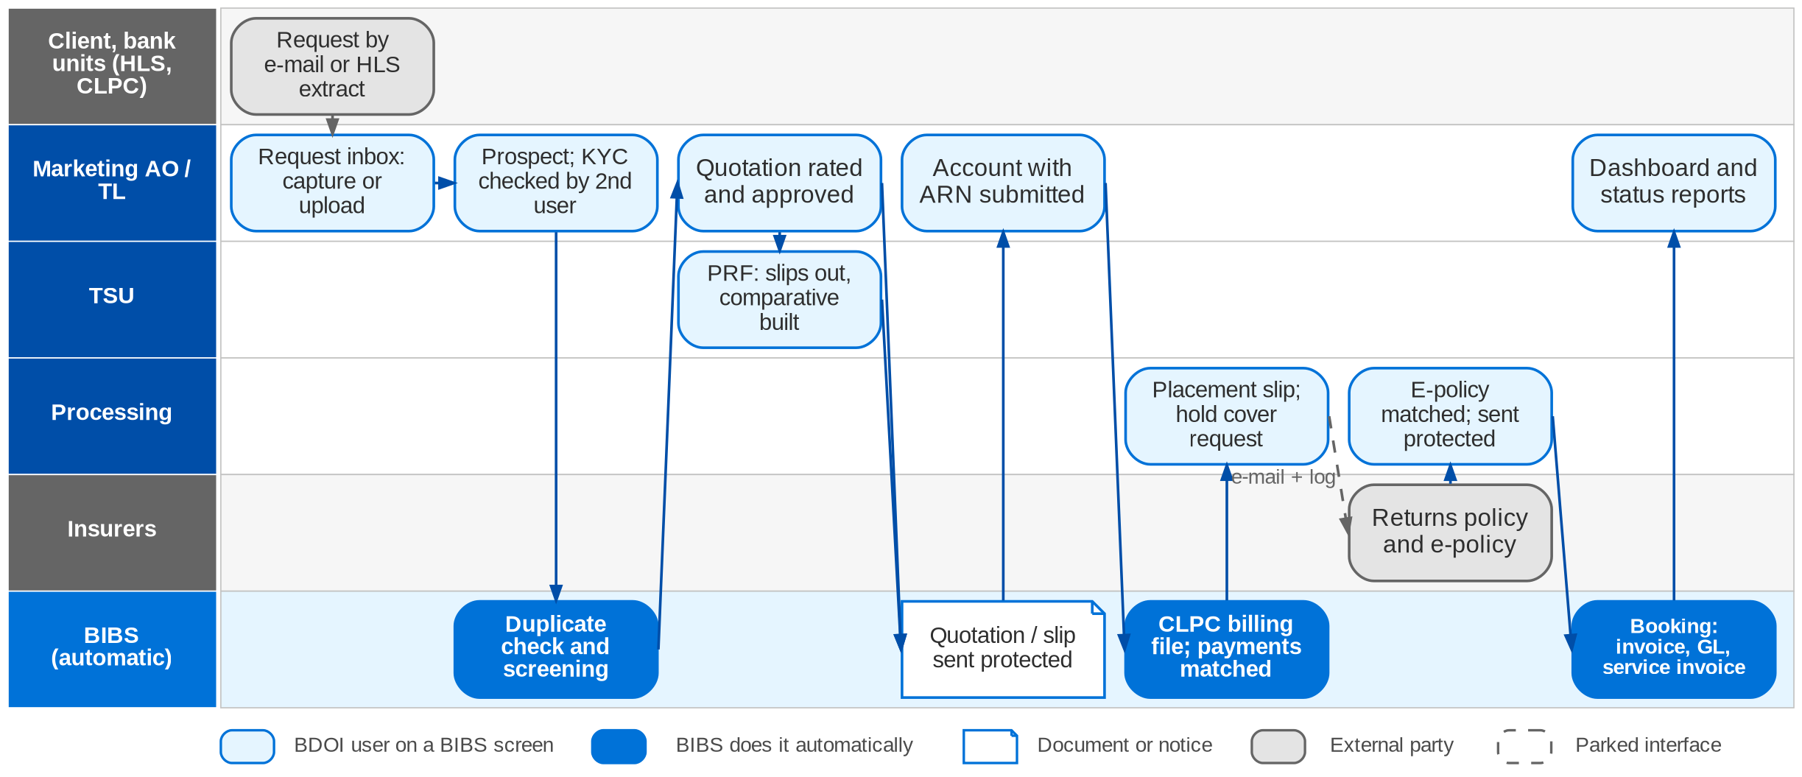
1. New Business: To-Be in the BRD
Request to booking in BIBS: workflows NB_CLIENT, NB_QUOTATION, NB_PROPOSAL, NB_ACCOUNT (FRS BRD-1 section 5)
Confidential – BDOI
BDOI Business Process Reverse KT | v2.0
33
Notes:
In BIBS, requests are captured in a request inbox or loaded from a source-system file. Every client starts as a prospect and is confirmed after a second user verifies the KYC documents. Package quotations are rated with the Appendix A formulas, approved and sent protected; non-package risks go through the PRF, with quotation slips to insurers and a comparative compiled by BIBS. One account per accepted risk group carries the ARN. BIBS produces the CLPC billing file and matches payment reports. Processing sends placement slips and hold cover requests with a send log, matches the e-policy and sends it protected. Booking posts the invoice, the GL entry and the service invoice in one transaction; batch booking runs at 20:00. Dashboards read the workflow history. The HLS interface, the mailbox reader and insurer SFTP / API are parked seams (Q11, Q12, Q06).

Slide 34
1. New Business: how the BRD answers (1/2)
Pain point today
To-Be in the BRD
Benefit
1
Requests and bank lists by hand
Request inbox; HLS extract and bulk files uploaded with a template and row checks
Up to 5,000 rows a file
2
Quotations in Excel templates
Quotation rated with the Appendix A formulas, versioned, approved and sent protected
No Excel quotes
3
No validity or SLA control
SLA timers and breach alerts (BRNB.012, 022); quote validity not specified
Partly: see gaps
4
KYC outside the system
Prospect, KYC documents, verification by a second user, screening, then confirmed client
Four-eyes KYC
5
One deal keyed in three systems
One client master and one account (ARN) used by every module; no migration between systems
Keyed once
6
Placement per insurer by e-mail
Placement slip generated and sent per insurer with a send log; channel per insurer configurable
Send log per slip
Confidential – BDOI
BDOI Business Process Reverse KT | v2.0
34

Slide 35
1. New Business: how the BRD answers (2/2)
Pain point today
To-Be in the BRD
Benefit
7
Returns and hold covers by e-mail
Returns and hold cover requests handled in the placement workflow; documents stored
No drive links
8
E-policy fall-outs
E-policy received, matched and policy number set automatically (BRNB.073-074)
Fall-out queue open
9
Three senders of the e-policy
One E-policy Sender role sends protected e-policies with a log
One sender
10
Booking depends on access
Booking posts invoice, GL entry and service invoice in one transaction; roles by persona
One step
11
CBG Fire billing by hand
CLPC billing file produced and payment report matched in the system
Matching automated
12
Pipeline and status in Excel
Dashboards and status reports read the workflow history
Live pipeline
Confidential – BDOI
BDOI Business Process Reverse KT | v2.0
35
Notes:
The BRD states objectives without turnaround targets; the benefit column names what the To-Be removes.
1. Requests and bank lists by hand -> Request inbox; HLS extract and bulk files uploaded with a template and row checks Benefit: Up to 5,000 rows a file.
2. Quotations in Excel templates -> Quotation rated with the Appendix A formulas, versioned, approved and sent protected Benefit: No Excel quotes.
3. No validity or SLA control -> SLA timers and breach alerts (BRNB.012, 022); quote validity not specified Benefit: Partly: see gaps.
4. KYC outside the system -> Prospect, KYC documents, verification by a second user, screening, then confirmed client Benefit: Four-eyes KYC.
5. One deal keyed in three systems -> One client master and one account (ARN) used by every module; no migration between systems Benefit: Keyed once.
6. Placement per insurer by e-mail -> Placement slip generated and sent per insurer with a send log; channel per insurer configurable Benefit: Send log per slip.
7. Returns and hold covers by e-mail -> Returns and hold cover requests handled in the placement workflow; documents stored Benefit: No drive links.
8. E-policy fall-outs -> E-policy received, matched and policy number set automatically (BRNB.073-074) Benefit: Fall-out queue open.
9. Three senders of the e-policy -> One E-policy Sender role sends protected e-policies with a log Benefit: One sender.
10. Booking depends on access -> Booking posts invoice, GL entry and service invoice in one transaction; roles by persona Benefit: One step.
11. CBG Fire billing by hand -> CLPC billing file produced and payment report matched in the system Benefit: Matching automated.
12. Pipeline and status in Excel -> Dashboards and status reports read the workflow history Benefit: Live pipeline.

Slide 36
1. New Business: gaps in the BRD (1/2)
Coverage | Item | What we saw on the floor | What the BRD says | Our recommendation | Ref
Not in BRD | Quote validity | 30 days for every product (NB-03). | No validity or expiry on the quotation (BRNB.043). | Validity parameter per product, auto-expiry and re-quote. | NB-03
Not in BRD | Risk survey | Required above 500M (NB-05). | No survey step; the TSI threshold only routes to TSU. | Survey trigger by sum insured, survey document type, status on the account. | NB-05
Partly in BRD | SLA values | Complex 7 days, normal 3 days (NB-07). | SLA timers without values or complexity class. | Configure the values and a complex / normal flag. | NB-07; PQ08
BDOI to confirm | Routing per product | Two versions of the routing (21 and 25-Sep). | Rule-based TSU routing; thresholds open. | One routing matrix per product and segment. | NB-01; Q04
Not in BRD | E-policy fall-out queue | Text files, IT exception report, contact centre sends. | Receive and match only; no exception queue. | Exception queue with owner and SLA; one sender. | NB flow; Q31
Not in BRD | Marine open-cover declarations | Bank trade business; declarations under open policies (TR-01). | Product codes only; no open-cover master or declarations. | Open-cover master, declaration intake, certificate, premium per declaration. | TR-01; DCR-132
Not in BRD | Accumulation by location | Marine accumulation to track by location (TR-02). | Trade accumulation report listed, no BRD. | Location-based accumulation with capacity alerts. | TR-02; DCR-132
Confidential – BDOI
BDOI Business Process Reverse KT | v2.0
36

Slide 37
1. New Business: gaps in the BRD (2/2)
Coverage | Item | What we saw on the floor | What the BRD says | Our recommendation | Ref
Partly in BRD | Pipeline and lead source | Pipeline from bank and direct sources, TSU items (NB-11). | Status and stalled-account reports; lead source not defined. | Lead source on every prospect; pipeline for Retail and Corporate. | NB-11; Q19
Partly in BRD | Allocation to handlers | By branch or area and region (NB-12). | Assign and re-assign by hand. | Automatic allocation rules by branch and region. | NB-12
Partly in BRD | Free first year and COC | Premium free in year one; COC from PGA ends the case (NB-14). | FFY register; COC and payer not specified. | Define the COC receipt and the commission on FFY. | NB-14; Q36
Partly in BRD | Terms of reference per product | TOR kept per product (NB-10). | TOR only in Submitted Policies and EB. | TOR held on the product and shown at quotation. | NB-10; SQ19
BDOI to confirm | KYC, declaration form, CIF | Outside the system (NB-04). | KYC gate at onboarding; declaration form in no BRD; CIF reuse open. | Bring the declaration form into onboarding; reuse the BDO CIF if allowed. | NB-04; Q16
Partly in BRD | Source feeds and personas | CLAS and CTS reports; Combank Account Support books. | HLS only; Combank roles not in the matrix. | Add CLAS / CTS to the inventory and the roles to the access matrix. | Q11; DCR-121
Confidential – BDOI
BDOI Business Process Reverse KT | v2.0
37
Notes:
Quote validity, the risk survey, the e-policy fall-out queue and Marine open-cover declarations are not in any BRD. The other items are rules the BRD leaves open.
[Not in BRD] Quote validity. Seen: 30 days for every product (NB-03). BRD: No validity or expiry on the quotation (BRNB.043). Recommendation: Validity parameter per product, auto-expiry and re-quote. (NB-03)
[Not in BRD] Risk survey. Seen: Required above 500M (NB-05). BRD: No survey step; the TSI threshold only routes to TSU. Recommendation: Survey trigger by sum insured, survey document type, status on the account. (NB-05)
[Partly in BRD] SLA values. Seen: Complex 7 days, normal 3 days (NB-07). BRD: SLA timers without values or complexity class. Recommendation: Configure the values and a complex / normal flag. (NB-07; PQ08)
[BDOI to confirm] Routing per product. Seen: Two versions of the routing (21 and 25-Sep). BRD: Rule-based TSU routing; thresholds open. Recommendation: One routing matrix per product and segment. (NB-01; Q04)
[Not in BRD] E-policy fall-out queue. Seen: Text files, IT exception report, contact centre sends. BRD: Receive and match only; no exception queue. Recommendation: Exception queue with owner and SLA; one sender. (NB flow; Q31)
[Not in BRD] Marine open-cover declarations. Seen: Bank trade business; declarations under open policies (TR-01). BRD: Product codes only; no open-cover master or declarations. Recommendation: Open-cover master, declaration intake, certificate, premium per declaration. (TR-01; DCR-132)
[Not in BRD] Accumulation by location. Seen: Marine accumulation to track by location (TR-02). BRD: Trade accumulation report listed, no BRD. Recommendation: Location-based accumulation with capacity alerts. (TR-02; DCR-132)
[Partly in BRD] Pipeline and lead source. Seen: Pipeline from bank and direct sources, TSU items (NB-11). BRD: Status and stalled-account reports; lead source not defined. Recommendation: Lead source on every prospect; pipeline for Retail and Corporate. (NB-11; Q19)
[Partly in BRD] Allocation to handlers. Seen: By branch or area and region (NB-12). BRD: Assign and re-assign by hand. Recommendation: Automatic allocation rules by branch and region. (NB-12)
[Partly in BRD] Free first year and COC. Seen: Premium free in year one; COC from PGA ends the case (NB-14). BRD: FFY register; COC and payer not specified. Recommendation: Define the COC receipt and the commission on FFY. (NB-14; Q36)
[Partly in BRD] Terms of reference per product. Seen: TOR kept per product (NB-10). BRD: TOR only in Submitted Policies and EB. Recommendation: TOR held on the product and shown at quotation. (NB-10; SQ19)
[BDOI to confirm] KYC, declaration form, CIF. Seen: Outside the system (NB-04). BRD: KYC gate at onboarding; declaration form in no BRD; CIF reuse open. Recommendation: Bring the declaration form into onboarding; reuse the BDO CIF if allowed. (NB-04; Q16)
[Partly in BRD] Source feeds and personas. Seen: CLAS and CTS reports; Combank Account Support books. BRD: HLS only; Combank roles not in the matrix. Recommendation: Add CLAS / CTS to the inventory and the roles to the access matrix. (Q11; DCR-121)

Slide 38
1. New Business: best practice (1/2)
Digital placement exchange
Broker CRM and pipeline
E-policy ingestion with OCR
Partly in BRD
One pattern for ~55 insurers
Partly in BRD
Sales productivity
Partly in BRD
No fall-out text files
Industry practice: Placement, returns and e-policies exchanged through one standard channel (API or SFTP with a common layout).
For BDOI: Agree a BDOI insurer data standard and on-board insurers in waves.
Industry practice: Leads from bank referrals, funnel stages, hit ratio and cross-sell per client.
For BDOI: Add lead source and funnel KPIs to the dashboard.
Industry practice: E-policies read, matched to the account and filed automatically; exceptions in a queue.
For BDOI: Start with the top insurers by volume.
Reuse of bank KYC
BDOI to confirm
Faster onboarding
Industry practice: Client data and KYC reused from the bank CIF for bank-referred clients.
For BDOI: Confirm with Compliance and BDO IT (Q16).
Confidential – BDOI
BDOI Business Process Reverse KT | v2.0
38

Slide 39
1. New Business: best practice (2/2)
Quote lifecycle control
Digital acceptance and payment link
Straight-through bank business
Not in BRD
Fewer stale quotes
Beyond the BRD
Shorter cycle
Partly in BRD
Volume at low cost
Industry practice: Validity, auto-expiry, SLA clocks and reminders on every quote.
For BDOI: Add validity and SLA values (NB-03, NB-07).
Industry practice: Client accepts the proposal online with e-signature and pays by link.
For BDOI: After go-live, with the e-signature decision (CP-01).
Industry practice: Bank loan files (HLS, LAD) become quotations and accounts in bulk without re-keying.
For BDOI: Specify the HLS, CLAS and CTS feeds.
Marine declarations portal
Beyond the BRD
Trade growth
Industry practice: Declarations by portal or API with e-certificates and QR verification.
For BDOI: Specify open covers first (TR-01).
Confidential – BDOI
BDOI Business Process Reverse KT | v2.0
39
Notes:
Practices of insurance brokers that fit BDOI, beyond what the BRD asks; the chip shows how far the BRD already covers each one.
Digital placement exchange [Partly in BRD]. Placement, returns and e-policies exchanged through one standard channel (API or SFTP with a common layout). For BDOI: Agree a BDOI insurer data standard and on-board insurers in waves.
Broker CRM and pipeline [Partly in BRD]. Leads from bank referrals, funnel stages, hit ratio and cross-sell per client. For BDOI: Add lead source and funnel KPIs to the dashboard.
E-policy ingestion with OCR [Partly in BRD]. E-policies read, matched to the account and filed automatically; exceptions in a queue. For BDOI: Start with the top insurers by volume.
Reuse of bank KYC [BDOI to confirm]. Client data and KYC reused from the bank CIF for bank-referred clients. For BDOI: Confirm with Compliance and BDO IT (Q16).
Quote lifecycle control [Not in BRD]. Validity, auto-expiry, SLA clocks and reminders on every quote. For BDOI: Add validity and SLA values (NB-03, NB-07).
Digital acceptance and payment link [Beyond the BRD]. Client accepts the proposal online with e-signature and pays by link. For BDOI: After go-live, with the e-signature decision (CP-01).
Straight-through bank business [Partly in BRD]. Bank loan files (HLS, LAD) become quotations and accounts in bulk without re-keying. For BDOI: Specify the HLS, CLAS and CTS feeds.
Marine declarations portal [Beyond the BRD]. Declarations by portal or API with e-certificates and QR verification. For BDOI: Specify open covers first (TR-01).

Slide 40
2. Renewal: at a glance
Department and roles
Volumes and business rules
How we learned it
Marketing (renewal AOs, Marketing Admin) and Processing (renewal sanitation and placement)
• Marketing Admin (MA) and Marketing Admin TL; Marketing TL, TH and AO
• Sanitation Handler (SH) and head-office SH (CBG Fire, CBG Motor)
• Processing Officer and TL (Non-CBG corporate and retail)
• IT (RMEL extract, RA text file); ES-COG-OPRM (RA letters); contact centre
• Clients and insurers (external)
25,800
renewal transactions a month; growth 20% a year (BRD-6 p.186-188)
Floor walk: 22-Sep-2026 (Renewal Marketing 10-11 am, 43F; Renewal Processing 1:30-3 pm, 44F)
Process owners: Amara Cruz, Rose Lique, Joy Ilagan, Tina Fajardo, Grace Tordesillas, Kin Ysaac Flores and 9 more (floor-walk coverage slide)
• High-level Renewal process flow (CBG automated RMEL; Non-CBG; non-package and exceptions)
• BDOI Day 1 overview p.14
• BRD-6 p.80-84 (current process); BRRN.001-040
-140 days
expiring list (RMEL) extracted from EBIX (Renewal flow)
-70 / -40
days: first and final notice (CBG); final at -45 for Non-CBG
2 channels
RA by e-mail and by snail mail (CBG)
The process in one line
Expiring list
Sanitation
Disposition
Review
Renewal advice
Client decision
Placement
Booking
Confidential – BDOI
BDOI Business Process Reverse KT | v2.0
40
Notes:
Renewal starts 140 days before expiry, when IT extracts the renewal master expiry list (RMEL) from EBIX. Sanitation handlers and Marketing decide for each account whether and how it renews, BDOI sends the renewal advice (RA) to the client on its own template, the accepted accounts go to the insurers for placement and the renewal is booked like new business. CBG Fire and Motor renewals are sanitised centrally and in bulk; Non-CBG renewals pass through Marketing Admin, the TL and the AO; non-package and exception accounts are handled by Processing. At renewal a policy can move between package and non-package (PM-04).
Floor walk: 22-Sep-2026 (Renewal Marketing 10-11 am, 43F; Renewal Processing 1:30-3 pm, 44F); Amara Cruz, Rose Lique, Joy Ilagan, Tina Fajardo, Grace Tordesillas, Kin Ysaac Flores, Criffson Rendon, Joyce Aritao, Ma. Christena Cezar, Cezssane Canarias, Jeramie Ramos; Angelo Alibuyog, Ces Remodo, Berna Corpuz, Norberto Fulo.
Sources: High-level Renewal process flow (CBG automated RMEL; Non-CBG; non-package and exceptions); BDOI Day 1 overview p.14; BRD-6 p.80-84 (current process); BRRN.001-040

Slide 41
2. Renewal: what we heard on the floor
Ref | Topic | Type | What we heard (As-Is) | What the business wants (To-Be)
RN-01 | Review and disposition | Pain point | Renewal review and dispositions are done in Excel; the renewal master expiry list is sent and the renewal advice goes to the client. | Major pain point: move it into the system.
RN-02 | Pro-forma entries | User aspiration | Renewal accounting is not real time, so adjustments are made later for additional remittance or recovery. | Pro-forma accounting entries for renewals.
PM-04 | Package switch | User aspiration | At renewal a policy can move from package to non-package or back. | The system allows the switch at renewal.
DC-01 | Renewal advice template | Business rule | Policy schedules follow insurer templates; the renewal advice uses the BDOI template. | RA generated from the BDOI template.
Day 1 p.14 | Servicing path | As-Is | Send the sanitised renewal master expiry list; generate the renewal advice letter and send it to the client. | -
Renewal flow | Notice days | Business rule | RMEL at -140 days; first notice at -70 days; final notice at -40 days (CBG) or -45 days (Non-CBG); CBG letters also by snail mail. | -
Renewal flow | Non-package and exceptions | As-Is | Accounts with no QPS set-up are booked directly in EBIX; Processing computes, prepares the dispositioned files and coordinates with the AO when the insurer does not approve. | -
Confidential – BDOI
BDOI Business Process Reverse KT | v2.0
41
Notes:
Notes of the business overview (21-Sep) and of the Renewal Marketing and Processing floor walks (22-Sep).
RN-01 Review and disposition (Pain point): Renewal review and dispositions are done in Excel; the renewal master expiry list is sent and the renewal advice goes to the client. Wants: Major pain point: move it into the system.
RN-02 Pro-forma entries (User aspiration): Renewal accounting is not real time, so adjustments are made later for additional remittance or recovery. Wants: Pro-forma accounting entries for renewals.
PM-04 Package switch (User aspiration): At renewal a policy can move from package to non-package or back. Wants: The system allows the switch at renewal.
DC-01 Renewal advice template (Business rule): Policy schedules follow insurer templates; the renewal advice uses the BDOI template. Wants: RA generated from the BDOI template.
Day 1 p.14 Servicing path (As-Is): Send the sanitised renewal master expiry list; generate the renewal advice letter and send it to the client.
Renewal flow Notice days (Business rule): RMEL at -140 days; first notice at -70 days; final notice at -40 days (CBG) or -45 days (Non-CBG); CBG letters also by snail mail.
Renewal flow Non-package and exceptions (As-Is): Accounts with no QPS set-up are booked directly in EBIX; Processing computes, prepares the dispositioned files and coordinates with the AO when the insurer does not approve.

Slide 42
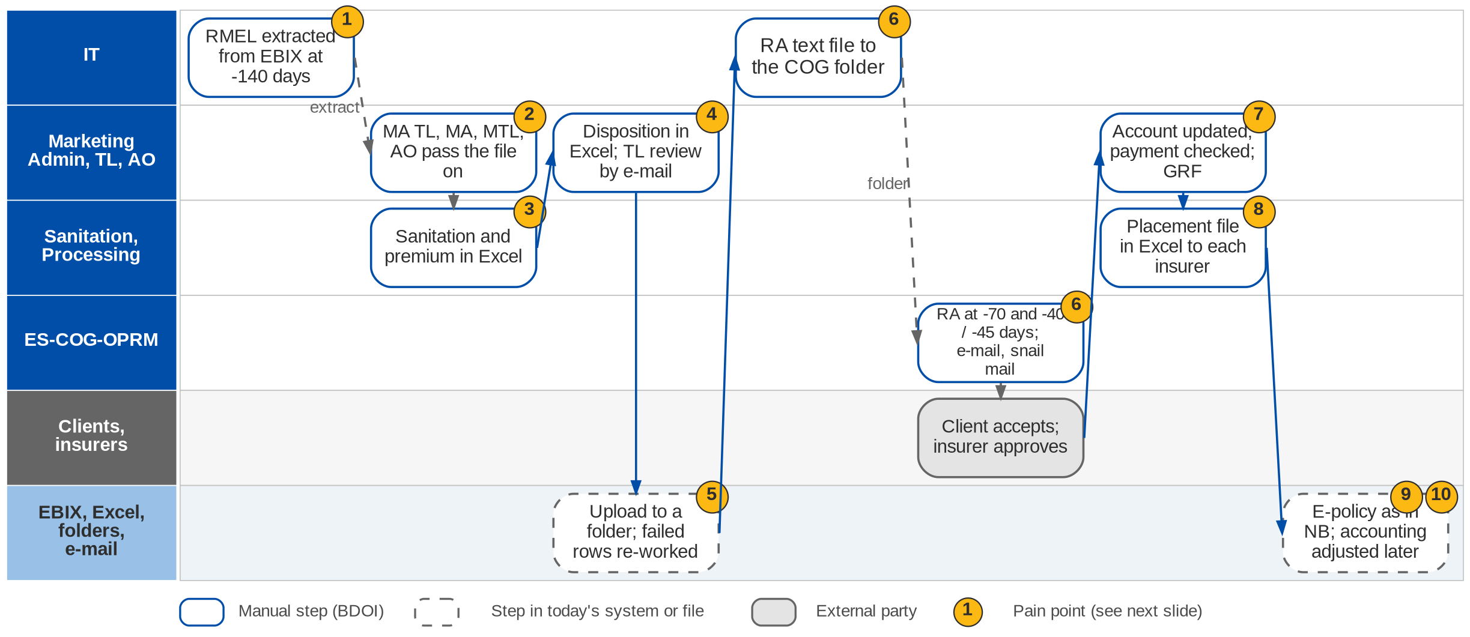
2. Renewal: As-Is process
Renewal today (Renewal process flow: CBG automated RMEL, Non-CBG, exceptions; Day 1 p.14; RN-01, RN-02)
Confidential – BDOI
BDOI Business Process Reverse KT | v2.0
42
Notes:
IT extracts the RMEL from EBIX 140 days before the expiry month. For CBG the head-office sanitation handler tells the branch handlers; for Non-CBG the Marketing Admin TL tells Marketing Admin, who splits the file per segment for the Marketing TL, who passes it to the AO. The handlers identify the accounts for renewal, update the details and compute the premium in Excel; the AO gives a disposition and the TL reviews it by e-mail. The files are dropped in a folder for upload, and failed rows are corrected and re-uploaded. IT generates the RA text file into the ES-COG-OPRM folder; COG generates the RA letters at -70 and -40 or -45 days and sends them by e-mail and, for CBG, by snail mail. When the client accepts, the AO updates the account, Marketing Admin validates the payment and applies the changes, and Processing prepares the placement file in Excel and e-mails it to each insurer. The e-policy then follows the New Business path, and renewal accounting is adjusted after the fact.

Slide 43
2. Renewal: three renewal paths
Path | Who starts | Sanitation and disposition | Renewal advice | Placement
CBG Fire and Motor (automated RMEL) | Head-office SH advises branch SHs | SH identifies, updates, computes; MTL / MTH review by e-mail | IT RA text file; COG e-mail and snail mail; -70 / -40 days | MA validates payment; GRF; slip by SFTP or e-mail
Non-CBG (package) | MA TL advises MA; MA splits per segment | AO dispositions, TL reviews; PO sanitises per insurer | IT RA text file; COG e-mail; -70 / -45 days | MTL submits; PO places by Excel file per insurer
Non-CBG non-package and exceptions | MA TL advises MA | PO computes and prepares the dispositioned files | PO drops RA text files for COG; -70 / -45 days | PO coordinates with the AO when the insurer declines
CBG Home only | Head-office SH | As CBG; PO coordinates insurer and Marketing by e-mail | As CBG | MA TL reviews and sends to PO
Branches without an MA TL | MTL does the MA TL steps | As Non-CBG | As Non-CBG | As Non-CBG
Confidential – BDOI
BDOI Business Process Reverse KT | v2.0
43
Notes:
The paths of the Renewal process flow confirmed by the CBG Motor, CBG Fire, Non-CBG Corporate, Non-CBG Marketing and Branches owners.

Slide 44
2. Renewal: pain points today
1
IT extracts the expiring list
The RMEL is an IT extract from EBIX; business cannot run it.
Renewal flow; BRD-6 p.80
6
RA through text files and COG
IT text file, COG print; snail mail for CBG; notice days differ by segment.
Renewal flow; DC-01
2
Many hand-offs before work starts
MA TL, MA, MTL and AO (or head-office and branch SHs) pass the file on.
Renewal flow
7
Accepted renewals re-keyed
AO updates the account; payment and changes validated by hand.
Renewal flow; BRD-6 p.82
3
Sanitation in Excel
Handlers identify accounts, update details and compute premium in Excel.
Renewal flow; BRD-6 p.81
8
Insurer lists from Excel
Placement files prepared in Excel and e-mailed to each insurer.
Renewal flow; BRD-6 p.82
4
Disposition in Excel
AO dispositions in a spreadsheet, reviewed by e-mail.
RN-01; BRD-6 p.81
9
Accounting after the fact
No real-time renewal accounting; additional remittance or recovery adjusted later.
RN-02
5
Upload and correction loop
Files dropped in a folder; failed rows found and re-worked.
Renewal flow
10
E-policy fall-outs again
The e-policy leg repeats the New Business fall-out chain.
Renewal flow
Confidential – BDOI
BDOI Business Process Reverse KT | v2.0
44
Notes:
Points 1 to 10 are on the swimlane; the BRD-6 current process (p.80-84) and the Renewal flow agree on them.
1. IT extracts the expiring list: The RMEL is an IT extract from EBIX; business cannot run it. (Renewal flow; BRD-6 p.80)
2. Many hand-offs before work starts: MA TL, MA, MTL and AO (or head-office and branch SHs) pass the file on. (Renewal flow)
3. Sanitation in Excel: Handlers identify accounts, update details and compute premium in Excel. (Renewal flow; BRD-6 p.81)
4. Disposition in Excel: AO dispositions in a spreadsheet, reviewed by e-mail. (RN-01; BRD-6 p.81)
5. Upload and correction loop: Files dropped in a folder; failed rows found and re-worked. (Renewal flow)
6. RA through text files and COG: IT text file, COG print; snail mail for CBG; notice days differ by segment. (Renewal flow; DC-01)
7. Accepted renewals re-keyed: AO updates the account; payment and changes validated by hand. (Renewal flow; BRD-6 p.82)
8. Insurer lists from Excel: Placement files prepared in Excel and e-mailed to each insurer. (Renewal flow; BRD-6 p.82)
9. Accounting after the fact: No real-time renewal accounting; additional remittance or recovery adjusted later. (RN-02)
10. E-policy fall-outs again: The e-policy leg repeats the New Business fall-out chain. (Renewal flow)

Slide 45
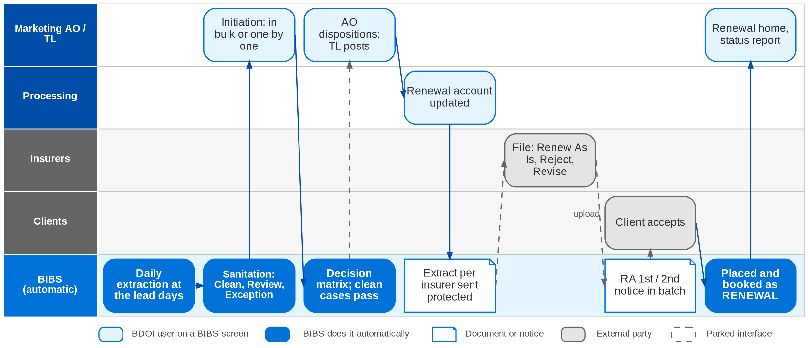
2. Renewal: To-Be in the BRD
Renewal in BIBS: workflow RNW_CASE with the decision matrix (FRS BRD-6 sections 2.2 and 5)
Confidential – BDOI
BDOI Business Process Reverse KT | v2.0
45
Notes:
In BIBS a daily job extracts the accounts that expire within the lead days; users can also generate the list for any date range. BIBS runs the sanitation, matching and eligibility checks and classifies each record Clean, Review or Exception. An authorised user initiates the renewal, in bulk (for example CLG) or one by one. The decision matrix proposes a disposition; a Clean case with an automatic rule proceeds straight through. Otherwise the AO dispositions online and the TL reviews and posts. Processing updates the renewal account; BIBS builds the extract per insurer and sends it protected, and the insurer's decision file is applied: Renew As Is advances, Reject or Revise stops or reroutes. The Renewal Advice (first or second notice) goes out in batch, protected. Acceptance moves the account to placement and booking without re-keying, and it books as business type RENEWAL.

Slide 46
2. Renewal: how the BRD answers (1/2)
Pain point today
To-Be in the BRD
Benefit
1
IT extracts the expiring list
Daily job extracts expiring accounts at the lead days; users generate the list for any range
25,800 a month without IT
2
Many hand-offs before work starts
Work assigned by rule to the AO or handler; staged workflow with notices
No file passing
3
Sanitation in Excel
Sanitation, matching and eligibility checks classify each record Clean, Review or Exception
Checks by the system
4
Disposition in Excel
AO dispositions online; clean cases pass by the decision matrix
Straight-through for clean cases
5
Upload and correction loop
Records never leave the system; no upload step
No correction loop
Confidential – BDOI
BDOI Business Process Reverse KT | v2.0
46

Slide 47
2. Renewal: how the BRD answers (2/2)
Pain point today
To-Be in the BRD
Benefit
6
RA through text files and COG
RA first and second notice from the latest template, in batch, by e-mail
RA in 20 s; print open
7
Accepted renewals re-keyed
Acceptance moves the account to placement and booking; it books as RENEWAL
No re-keying
8
Insurer lists from Excel
Extract per insurer sent protected; insurer decision file uploaded and applied
Protected, logged
9
Accounting after the fact
Renewal books through New Business booking in real time; pro-forma not specified
Partly: see gaps
10
E-policy fall-outs again
Same e-policy receipt and sender as New Business
Fall-out queue open
Confidential – BDOI
BDOI Business Process Reverse KT | v2.0
47
Notes:
The benefit column names what the To-Be removes.
1. IT extracts the expiring list -> Daily job extracts expiring accounts at the lead days; users generate the list for any range Benefit: 25,800 a month without IT.
2. Many hand-offs before work starts -> Work assigned by rule to the AO or handler; staged workflow with notices Benefit: No file passing.
3. Sanitation in Excel -> Sanitation, matching and eligibility checks classify each record Clean, Review or Exception Benefit: Checks by the system.
4. Disposition in Excel -> AO dispositions online; clean cases pass by the decision matrix Benefit: Straight-through for clean cases.
5. Upload and correction loop -> Records never leave the system; no upload step Benefit: No correction loop.
6. RA through text files and COG -> RA first and second notice from the latest template, in batch, by e-mail Benefit: RA in 20 s; print open.
7. Accepted renewals re-keyed -> Acceptance moves the account to placement and booking; it books as RENEWAL Benefit: No re-keying.
8. Insurer lists from Excel -> Extract per insurer sent protected; insurer decision file uploaded and applied Benefit: Protected, logged.
9. Accounting after the fact -> Renewal books through New Business booking in real time; pro-forma not specified Benefit: Partly: see gaps.
10. E-policy fall-outs again -> Same e-policy receipt and sender as New Business Benefit: Fall-out queue open.

Slide 48
2. Renewal: gaps in the BRD
Coverage | Item | What we saw on the floor | What the BRD says | Our recommendation | Ref
Not in BRD | Pro-forma renewal entries | Adjustments after the fact for additional remittance or recovery (RN-02). | Renewal books through NB booking; no pro-forma. | Pro-forma entry at acceptance, finalised at booking; differences posted automatically. | RN-02
Not in BRD | Snail-mail and print channel | CBG RAs and reminders printed by COG and mailed. | RA by e-mail only (BRRN.010). | Print batch for a mail house with delivery tracking, per client preference. | Renewal flow; SQ09
Partly in BRD | Notice days per segment | -70 first; -40 (CBG) or -45 (Non-CBG) final. | First and second notice; days not per segment. | Lead days configurable per segment and product. | Renewal flow
Partly in BRD | Package switch at renewal | Package to non-package or back (PM-04). | Restructure goes the NB path; no explicit switch rule. | Switch rule with product-version handling at sanitation. | PM-04; PQ11
Partly in BRD | Online or upload per segment | CBG in bulk files; Non-CBG by AO. | Both paths described; choice per segment open. | Online disposition for all, bulk actions for CBG. | DCR-062
BDOI to confirm | Renewal of submitted policies | SP renewals prepared by the Submitted handlers (chapter 3). | Two renewal paths; boundary open. | Confirm the hand-off from Submitted Policies to Renewal. | DCR-129, 146
Confidential – BDOI
BDOI Business Process Reverse KT | v2.0
48
Notes:
Renewal pro-forma accounting and the snail-mail channel are not in the BRD.
[Not in BRD] Pro-forma renewal entries. Seen: Adjustments after the fact for additional remittance or recovery (RN-02). BRD: Renewal books through NB booking; no pro-forma. Recommendation: Pro-forma entry at acceptance, finalised at booking; differences posted automatically. (RN-02)
[Not in BRD] Snail-mail and print channel. Seen: CBG RAs and reminders printed by COG and mailed. BRD: RA by e-mail only (BRRN.010). Recommendation: Print batch for a mail house with delivery tracking, per client preference. (Renewal flow; SQ09)
[Partly in BRD] Notice days per segment. Seen: -70 first; -40 (CBG) or -45 (Non-CBG) final. BRD: First and second notice; days not per segment. Recommendation: Lead days configurable per segment and product. (Renewal flow)
[Partly in BRD] Package switch at renewal. Seen: Package to non-package or back (PM-04). BRD: Restructure goes the NB path; no explicit switch rule. Recommendation: Switch rule with product-version handling at sanitation. (PM-04; PQ11)
[Partly in BRD] Online or upload per segment. Seen: CBG in bulk files; Non-CBG by AO. BRD: Both paths described; choice per segment open. Recommendation: Online disposition for all, bulk actions for CBG. (DCR-062)
[BDOI to confirm] Renewal of submitted policies. Seen: SP renewals prepared by the Submitted handlers (chapter 3). BRD: Two renewal paths; boundary open. Recommendation: Confirm the hand-off from Submitted Policies to Renewal. (DCR-129, 146)

Slide 49
2. Renewal: best practice
Straight-through renewals
Omnichannel renewal notices
Pay-to-renew link
In the BRD
Volume without headcount
Partly in BRD
Retention
Partly in BRD
Faster acceptance
Industry practice: A decision matrix renews clean accounts automatically; people handle exceptions only.
For BDOI: Agree the rules with Marketing so most CBG renewals pass untouched.
Industry practice: E-mail, SMS, print and portal notices with delivery tracking.
For BDOI: Add SMS and a print batch to the RA.
Industry practice: The RA carries a payment link; payment is the acceptance.
For BDOI: Add a payment reference and link to the RA template.
Experience-based renewal pricing
Retention analytics
Early renewal window
Partly in BRD
Better terms
Partly in BRD
Persistency
Beyond the BRD
Fewer last-minute cases
Industry practice: Claims and payment history feed the renewal terms and insurer choice.
For BDOI: Show loss experience at sanitation (DCR-150).
Industry practice: Lapse-risk scores, persistency and lost-business reasons per segment.
For BDOI: Track reasons for non-renewal in the disposition list.
Industry practice: Terms agreed with insurers before the RMEL so RAs go out on day one.
For BDOI: Negotiate renewal terms per package yearly with TSU.
Confidential – BDOI
BDOI Business Process Reverse KT | v2.0
49
Notes:
Practices of insurance brokers that fit BDOI, beyond what the BRD asks; the chip shows how far the BRD already covers each one.
Straight-through renewals [In the BRD]. A decision matrix renews clean accounts automatically; people handle exceptions only. For BDOI: Agree the rules with Marketing so most CBG renewals pass untouched.
Omnichannel renewal notices [Partly in BRD]. E-mail, SMS, print and portal notices with delivery tracking. For BDOI: Add SMS and a print batch to the RA.
Pay-to-renew link [Partly in BRD]. The RA carries a payment link; payment is the acceptance. For BDOI: Add a payment reference and link to the RA template.
Experience-based renewal pricing [Partly in BRD]. Claims and payment history feed the renewal terms and insurer choice. For BDOI: Show loss experience at sanitation (DCR-150).
Retention analytics [Partly in BRD]. Lapse-risk scores, persistency and lost-business reasons per segment. For BDOI: Track reasons for non-renewal in the disposition list.
Early renewal window [Beyond the BRD]. Terms agreed with insurers before the RMEL so RAs go out on day one. For BDOI: Negotiate renewal terms per package yearly with TSU.

Slide 50
3. Submitted Policies: at a glance
Department and roles
Volumes and business rules
How we learned it
CBG and Non-CBG Marketing - Submitted Policies
• Submitted Handler and Submitted Checker (CBG)
• Sanitation Handler; Team Lead
• Policy Reviewer (Non-CBG Corporate); Marketing AO; NB AO and TL
• Admin Team UPP handler (handling fee)
• Bank units: Home Loan AO, IBG / Leasing, LFS, CIU, LAMD; COG
63,000
sanitations a year, growing 25% a year (BRD-12 p.13-14)
Floor walk: Discovery 24-Sep-2026; process flow walked with Marketing (Submitted Policies)
Process owners: CBG and Non-CBG Marketing process owners (Submitted Policies)
• High-level Submitted Policies process flow (5 pages: intake, handling fee, three renewal paths)
• BRD-12 p.4-7 (current and envisioned); BRIDSP-01 to 33
• Floor-walk note SP-01
30 days
to consolidate the submitted masterlist after extraction
150 days
before expiry: masterlist to the Sanitation Handler (SP flow)
3-5 days
for the insurer to accept the 30-day hold cover, else re-assign
The process in one line
Bank extract
Documents
Masterlist
Review
IAAF
Loan match
Expiry
Conversion
Confidential – BDOI
BDOI Business Process Reverse KT | v2.0
50
Notes:
When a bank client (home loan, auto loan, leasing) buys insurance outside BDOI and submits the policy to the bank, BDOI checks that the cover is adequate, issues an IAAF to the bank unit, monitors the policy on a masterlist and tries to win the business at renewal. Today it is tracked outside any system, on masterlists kept on a shared drive (Drive H) and SharePoint (SP-01).
Floor walk: Discovery 24-Sep-2026; process flow walked with Marketing (Submitted Policies); CBG and Non-CBG Marketing process owners (Submitted Policies).
Sources: High-level Submitted Policies process flow (5 pages: intake, handling fee, three renewal paths); BRD-12 p.4-7 (current and envisioned); BRIDSP-01 to 33; Floor-walk note SP-01

Slide 51
3. Submitted Policies: what we heard on the floor
Ref | Topic | Type | What we heard (As-Is) | What the business wants (To-Be)
SP-01 | Leasing and mortgage | Pain point | Leasing and mortgage accounts are "submitted policies"; they are tracked manually, not in a system. | -
SP flow p.1 | Intake | As-Is | Policy details extracted from LFS and CIU and the daily HLS insurance report; documents from the Home Loan AO and IBG / Leasing; validated and consolidated in the Submitted Masterlist on Drive H within 30 days; IAAF (PDF) issued when there are findings. | -
SP flow p.2 | Handling fee (CBG Motor) | As-Is | UPP list on SharePoint filtered for handling-fee billing; NB TL assigns to the AO; disposition fed back by e-mail; client IDs saved in a shared folder. | -
SP flow p.3 | Renewal CBG Motor | As-Is | SPI list from Drive H mapped to NB and Renewal databases; matched with LAMD; FFY, BDO / SM employees and No Touch excluded; loan status updated; RA by snail mail at 90 days; NRNS list to COG and to AOs for call-outs. | -
SP flow p.4 | Renewal CBG Fire | Business rule | Assign an insurer different from the expiring one; proposal with a 30-day hold cover by e-mail; accepted within 3-5 days or re-assigned. | -
SP flow p.5 | Renewal Non-CBG Retail | As-Is | AO asks the insurer to quote on expiring terms, quotes the employee, prepares the ARF in ISYS; NRNS letter by e-mail if declined. | -
Confidential – BDOI
BDOI Business Process Reverse KT | v2.0
51
Notes:
Note of the 24-Sep session and the steps of the Submitted Policies process flow.
SP-01 Leasing and mortgage (Pain point): Leasing and mortgage accounts are "submitted policies"; they are tracked manually, not in a system.
SP flow p.1 Intake (As-Is): Policy details extracted from LFS and CIU and the daily HLS insurance report; documents from the Home Loan AO and IBG / Leasing; validated and consolidated in the Submitted Masterlist on Drive H within 30 days; IAAF (PDF) issued when there are findings.
SP flow p.2 Handling fee (CBG Motor) (As-Is): UPP list on SharePoint filtered for handling-fee billing; NB TL assigns to the AO; disposition fed back by e-mail; client IDs saved in a shared folder.
SP flow p.3 Renewal CBG Motor (As-Is): SPI list from Drive H mapped to NB and Renewal databases; matched with LAMD; FFY, BDO / SM employees and No Touch excluded; loan status updated; RA by snail mail at 90 days; NRNS list to COG and to AOs for call-outs.
SP flow p.4 Renewal CBG Fire (Business rule): Assign an insurer different from the expiring one; proposal with a 30-day hold cover by e-mail; accepted within 3-5 days or re-assigned.
SP flow p.5 Renewal Non-CBG Retail (As-Is): AO asks the insurer to quote on expiring terms, quotes the employee, prepares the ARF in ISYS; NRNS letter by e-mail if declined.

Slide 52
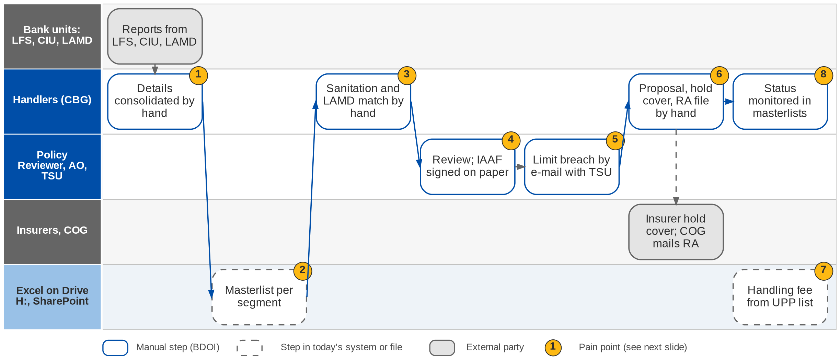
3. Submitted Policies: As-Is process
Submitted policies today (BRD-12 p.4-7)
Confidential – BDOI
BDOI Business Process Reverse KT | v2.0
52
Notes:
Today CBG Motor Team Leads extract policy details from LFS and CIU and the Submitted Handler consolidates them within 30 days; CBG Fire policies come from Home Loan AOs; Non-CBG Corporate and Branch policies are reviewed by a Policy Reviewer who issues an IAAF on paper; Non-CBG Retail policies come from the LAMD report. Each segment keeps an Excel masterlist on a shared drive. At renewal a Sanitation Handler matches the list against LAMD by hand, excludes accounts that must not be renewed, assigns an insurer and sends a proposal with a 30-day hold cover request, and an RA text file goes to COG for mailing. Limit breaches are handled by e-mail with TSU, handling-fee payments are filtered from the UPP list on SharePoint, and status is monitored in the masterlists.

Slide 53
3. Submitted Policies: intake and three renewal paths
Path | Source | What the handler does | Output | Channel
Intake (all segments) | LFS, CIU, HLS daily; documents from Home Loan AO and IBG / Leasing | Validate, match, consolidate; review adequacy; checker validates | Masterlist on Drive H; IAAF if findings | E-mail (PDF)
Handling fee (CBG Motor) | UPP list on SharePoint | Filter for handling-fee billing; NB TL assigns; AO dispositions | UPP list updated | E-mail, SharePoint
Renewal CBG Motor | SPI list on Drive H; LAMD | Map to NB and Renewal data; exclude FFY, employees, No Touch; loan status; vehicle type and insurer | RA text file to COG; NRNS list | Snail mail at 90 days; call-outs
Renewal CBG Fire | Expiring list; LAMD | Different insurer from the expiring one; premium; 30-day hold cover request | RA, status to TL | E-mail to insurer; snail mail
Renewal Non-CBG Retail | LAMD report | Insurer approval to quote on expiring terms; quotation; ARF in ISYS | Placement file and booking | E-mail; NRNS letter
Confidential – BDOI
BDOI Business Process Reverse KT | v2.0
53
Notes:
The five pages of the Submitted Policies process flow.

Slide 54
3. Submitted Policies: pain points today
1
Policy details consolidated by hand
Excel reports and documents per segment; 30 days to consolidate CBG Motor.
BRD-12 p.4-5; BRIDSP-01, 02
5
Limit breaches by e-mail
Breaches handled with TSU by e-mail.
BRD-12 p.4-7; BRIDSP-16-19
2
Separate masterlists
One Excel masterlist per segment on Drive H:, with e-mail and SharePoint.
BRD-12 p.4-5; BRIDSP-04
6
Renewal prepared by hand
Proposal, 30-day hold cover request and RA text file for COG prepared manually.
BRD-12 p.5-7; BRIDSP-22-26
3
Sanitation and LAMD matching by hand
Exclusions (FFY, employees, No Touch) applied manually.
BRD-12 p.4-7; BRIDSP-08, 09
7
Handling fee from the UPP list
Handling-fee payments filtered from the Unapplied Payment List on SharePoint.
BRD-12 p.4-7; BRIDSP-31
4
Reviews and IAAF on paper
Adequacy reviews by e-mail; IAAF signed on paper.
BRD-12 p.4-5; BRIDSP-05-07
8
Status in the masterlists
No reports or alerts from live data.
BRD-12 p.4-7; BRIDSP-20, 21, 24
Confidential – BDOI
BDOI Business Process Reverse KT | v2.0
54
Notes:
The eight points of the BRD-12 current process (p.4-7); the process flow confirms each one.
1. Policy details consolidated by hand: Excel reports and documents per segment; 30 days to consolidate CBG Motor. (BRD-12 p.4-5; BRIDSP-01, 02)
2. Separate masterlists: One Excel masterlist per segment on Drive H:, with e-mail and SharePoint. (BRD-12 p.4-5; BRIDSP-04)
3. Sanitation and LAMD matching by hand: Exclusions (FFY, employees, No Touch) applied manually. (BRD-12 p.4-7; BRIDSP-08, 09)
4. Reviews and IAAF on paper: Adequacy reviews by e-mail; IAAF signed on paper. (BRD-12 p.4-5; BRIDSP-05-07)
5. Limit breaches by e-mail: Breaches handled with TSU by e-mail. (BRD-12 p.4-7; BRIDSP-16-19)
6. Renewal prepared by hand: Proposal, 30-day hold cover request and RA text file for COG prepared manually. (BRD-12 p.5-7; BRIDSP-22-26)
7. Handling fee from the UPP list: Handling-fee payments filtered from the Unapplied Payment List on SharePoint. (BRD-12 p.4-7; BRIDSP-31)
8. Status in the masterlists: No reports or alerts from live data. (BRD-12 p.4-7; BRIDSP-20, 21, 24)

Slide 55
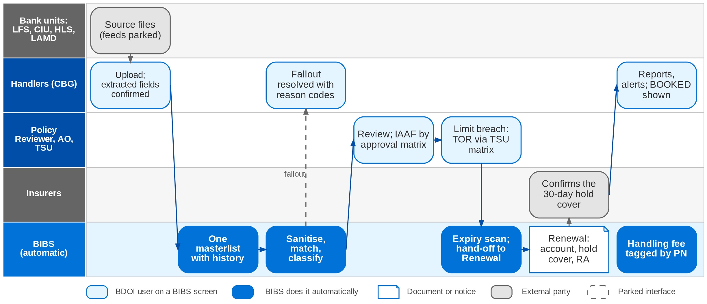
3. Submitted Policies: To-Be in the BRD
Submitted Policies in BIBS: workflow SBM_POLICY and the Renewal hand-off (FRS BRD-12 section 2.2; decision D2)
Confidential – BDOI
BDOI Business Process Reverse KT | v2.0
55
Notes:
In BIBS each source file is uploaded and validated, one masterlist record per policy; fields are proposed from the policy document and saved only after a user confirms them. One Submitted Masterlist keeps history and role-based access. A processing run sanitises, matches against LAMD by PN, classifies (Inforced or Submitted), buckets and tags each policy; fallout is listed with reason codes. Reviews and the IAAF follow the approval matrix, with stamped signatures. A limit breach produces a TOR approved by the TSU matrix and handed to the AO. The expiry scan hands renewable policies to the Renewal module, which creates the account, requests the 30-day hold cover and sends the letters. Handling-fee payments are tagged in the Unapplied Payment List by PN or location reference. The source feeds, OCR, qualified e-signature and COG transport are parked ports (upload, manual entry, stamped signature, print batch).

Slide 56
3. Submitted Policies: how the BRD answers (1/2)
Pain point today
To-Be in the BRD
Benefit
1
Policy details consolidated by hand
Each source uploaded; fields extracted from the document and confirmed by a user
Keyed once
2
Separate masterlists
One Submitted Masterlist with history and role-based access
2 s response (p.13-14)
3
Sanitation and LAMD matching by hand
Configurable rules sanitise, match, classify and bucket every policy; fallout reported
63,000 a year by rule
4
Reviews and IAAF on paper
Reviews, IAAF and approval matrix in BIBS, with stamped signatures
Approval trail
Confidential – BDOI
BDOI Business Process Reverse KT | v2.0
56

Slide 57
3. Submitted Policies: how the BRD answers (2/2)
Pain point today
To-Be in the BRD
Benefit
5
Limit breaches by e-mail
TOR generated, approved by the TSU matrix and handed over to the AO
Limit check by rule
6
Renewal prepared by hand
Expiry scan hands renewable policies to Renewal: account, hold cover, letters
No manual RA file
7
Handling fee from the UPP list
Handling-fee payments tagged automatically by PN or location reference
Tagged daily
8
Status in the masterlists
Reports, alerts and notifications from live data
Live status
Confidential – BDOI
BDOI Business Process Reverse KT | v2.0
57
Notes:
The benefit column names what the To-Be removes.
1. Policy details consolidated by hand -> Each source uploaded; fields extracted from the document and confirmed by a user Benefit: Keyed once.
2. Separate masterlists -> One Submitted Masterlist with history and role-based access Benefit: 2 s response (p.13-14).
3. Sanitation and LAMD matching by hand -> Configurable rules sanitise, match, classify and bucket every policy; fallout reported Benefit: 63,000 a year by rule.
4. Reviews and IAAF on paper -> Reviews, IAAF and approval matrix in BIBS, with stamped signatures Benefit: Approval trail.
5. Limit breaches by e-mail -> TOR generated, approved by the TSU matrix and handed over to the AO Benefit: Limit check by rule.
6. Renewal prepared by hand -> Expiry scan hands renewable policies to Renewal: account, hold cover, letters Benefit: No manual RA file.
7. Handling fee from the UPP list -> Handling-fee payments tagged automatically by PN or location reference Benefit: Tagged daily.
8. Status in the masterlists -> Reports, alerts and notifications from live data Benefit: Live status.

Slide 58
3. Submitted Policies: gaps in the BRD
Coverage | Item | What we saw on the floor | What the BRD says | Our recommendation | Ref
Partly in BRD | Lead days | Masterlist to sanitation at 150 days; RMEL at 140 days; RA at 90 days. | Hand-off to Renewal; days not stated. | One timeline shared with Renewal (chapter 2). | BRIDSP-23; DCR-129
Not in BRD | Snail-mail RA and reminders | COG prints and mails RA and reminder letters. | Channel open. | Same print channel as Renewal, with tracking. | SQ09
Partly in BRD | Handling fee | UPP list on SharePoint; AO disposition by e-mail. | Tagging only; fee undefined. | Define the fee and bill it from the masterlist. | BRIDSP-31; DCR-126
Partly in BRD | Two LAMD intakes | LAMD used by Submitted Policies and Renewal. | Two loan-status feeds. | One LAMD intake shared by both. | DCR-146
BDOI to confirm | One or many policies per IAAF | An IAAF may cover several policies. | Open. | Allow several policies per IAAF. | DCR-125
Partly in BRD | Hold-cover expiry | 30-day hold cover; 3-5 days to accept. | Hold cover requested; expiry rule open. | Expiry alert and re-assignment rule. | DCR-155
Confidential – BDOI
BDOI Business Process Reverse KT | v2.0
58
Notes:
Mostly timing and channel details; the lead days of Submitted Policies and Renewal do not line up.
[Partly in BRD] Lead days. Seen: Masterlist to sanitation at 150 days; RMEL at 140 days; RA at 90 days. BRD: Hand-off to Renewal; days not stated. Recommendation: One timeline shared with Renewal (chapter 2). (BRIDSP-23; DCR-129)
[Not in BRD] Snail-mail RA and reminders. Seen: COG prints and mails RA and reminder letters. BRD: Channel open. Recommendation: Same print channel as Renewal, with tracking. (SQ09)
[Partly in BRD] Handling fee. Seen: UPP list on SharePoint; AO disposition by e-mail. BRD: Tagging only; fee undefined. Recommendation: Define the fee and bill it from the masterlist. (BRIDSP-31; DCR-126)
[Partly in BRD] Two LAMD intakes. Seen: LAMD used by Submitted Policies and Renewal. BRD: Two loan-status feeds. Recommendation: One LAMD intake shared by both. (DCR-146)
[BDOI to confirm] One or many policies per IAAF. Seen: An IAAF may cover several policies. BRD: Open. Recommendation: Allow several policies per IAAF. (DCR-125)
[Partly in BRD] Hold-cover expiry. Seen: 30-day hold cover; 3-5 days to accept. BRD: Hold cover requested; expiry rule open. Recommendation: Expiry alert and re-assignment rule. (DCR-155)

Slide 59
3. Submitted Policies: best practice
Live bank loan feeds
Rule-based adequacy check
Deficiency notices to the bank
Partly in BRD
No masterlists
Partly in BRD
Faster review
Partly in BRD
Protects the bank
Industry practice: Loan, collateral and paid-off status received from the bank systems daily.
For BDOI: Specify LFS, CIU, HLS and LAMD feeds (SQ01).
Industry practice: Sum insured against loan, mortgagee clause and expiry checked by rule on extracted data.
For BDOI: Start with CBG Motor and Fire.
Industry practice: Automatic notices and escalation to the bank unit when cover is short or lapsed.
For BDOI: Use the IAAF as the notice, sent from the system.
Conversion programme
E-signature on IAAF and TOR
Partly in BRD
New premium
BDOI to confirm
No paper
Industry practice: Submitted policies targeted for conversion with offers at renewal, tracked per segment.
For BDOI: Report conversion rate per segment.
Industry practice: IAAF and TOR signed electronically.
For BDOI: Decide with Legal and Compliance (CP-01).
Confidential – BDOI
BDOI Business Process Reverse KT | v2.0
59
Notes:
Practices of insurance brokers that fit BDOI, beyond what the BRD asks; the chip shows how far the BRD already covers each one.
Live bank loan feeds [Partly in BRD]. Loan, collateral and paid-off status received from the bank systems daily. For BDOI: Specify LFS, CIU, HLS and LAMD feeds (SQ01).
Rule-based adequacy check [Partly in BRD]. Sum insured against loan, mortgagee clause and expiry checked by rule on extracted data. For BDOI: Start with CBG Motor and Fire.
Deficiency notices to the bank [Partly in BRD]. Automatic notices and escalation to the bank unit when cover is short or lapsed. For BDOI: Use the IAAF as the notice, sent from the system.
Conversion programme [Partly in BRD]. Submitted policies targeted for conversion with offers at renewal, tracked per segment. For BDOI: Report conversion rate per segment.
E-signature on IAAF and TOR [BDOI to confirm]. IAAF and TOR signed electronically. For BDOI: Decide with Legal and Compliance (CP-01).

Slide 60
4. Employee Benefits: at a glance
Department and roles
Volumes and business rules
How we learned it
Employee Benefits: Marketing, Processing and Collection
• EB Marketing AO and TL / UH (five EB teams)
• BDOI Management (approval above the threshold); ISACOM (non-accredited provider)
• EB Processing and Processing Supervisor; EB Collection
• Client HR (master list, utilization)
• Insurers and HMOs (proposals, claims validation)
50,000+
members handled today (EB-01)
Floor walk: 23-Sep-2026, 9-10 am, 43F; discovery 21-Sep-2026
Process owners: Marianne Alpapara, Jyneffer Liansing, Edwin Garcia
• High-level Employee Benefits process flow (new business and renewal)
• BRD-8 workshop addendum p.3-5 (current and envisioned); BRID-001-030
• Floor-walk notes EB-01 to EB-03
4,200
transactions in 2025, of which 4,150 renewals (Add. p.14)
135 days
before expiry: default renewal advice (TAT annex)
20
BDOI users: Marketing 13, Processing 4, Collection 3
The process in one line
Renewal advice
BOR
Franchise
TOR
Proposals
Comparative
Client decision
Placement
Confidential – BDOI
BDOI Business Process Reverse KT | v2.0
60
Notes:
Employee Benefits places group programmes for corporate clients. It works like non-life business with more parties: the client's HR sends the master list (headcount only at quote stage), BDOI obtains the broker of record (BOR) and the insurers' franchise, releases the terms of reference (TOR), compares the proposals on premium, benefits and provider capabilities and presents a recommendation. After the client confirms, Processing receives the employee details and places the programme. BDOI handles more than 50,000 members today.
Floor walk: 23-Sep-2026, 9-10 am, 43F; discovery 21-Sep-2026; Marianne Alpapara, Jyneffer Liansing, Edwin Garcia.
Sources: High-level Employee Benefits process flow (new business and renewal); BRD-8 workshop addendum p.3-5 (current and envisioned); BRID-001-030; Floor-walk notes EB-01 to EB-03

Slide 61
4. Employee Benefits: what we heard on the floor
Ref | Topic | Type | What we heard (As-Is) | What the business wants (To-Be)
EB-01 | Quote and placement | User aspiration | Like non-life: Marketing gets the master list from the customer (headcount only at quote stage), sends it to insurers and negotiates; Processing then gets the employee details and places. More than 50,000 members today. | The system handles large member volumes (50K+).
EB-02 | EB claims | As-Is | Claims are validated by the provider; BDOI only captures the details from the provider. | -
EB-03 | Broker of record | Business rule | The broker of record is kept for corporate EB renewal. | -
EB flow | Renewal | As-Is | Renewal advice before expiry; BOR, master list, utilization and indicative proposal secured; indicative renewal from the incumbent; client feedback; comparative; approval above the internal threshold; placement after confirmation. | -
EB flow | New business | Business rule | New client tagged as prospect; BOR to insurers for franchise approval; TOR from existing benefits; TOR, master list and utilization released to the insurers with franchise; ISACOM approval if awarded to a non-accredited provider. | -
EB flow | Portals | User aspiration | Insurer portal for uploads and management; client portal for uploads and policy management. | Portals for insurers and client HR (the drop plan says no portal at go-live).
Confidential – BDOI
BDOI Business Process Reverse KT | v2.0
61
Notes:
Notes of the business overview (21-Sep) and of the EB floor walk (23-Sep).
EB-01 Quote and placement (User aspiration): Like non-life: Marketing gets the master list from the customer (headcount only at quote stage), sends it to insurers and negotiates; Processing then gets the employee details and places. More than 50,000 members today. Wants: The system handles large member volumes (50K+).
EB-02 EB claims (As-Is): Claims are validated by the provider; BDOI only captures the details from the provider.
EB-03 Broker of record (Business rule): The broker of record is kept for corporate EB renewal.
EB flow Renewal (As-Is): Renewal advice before expiry; BOR, master list, utilization and indicative proposal secured; indicative renewal from the incumbent; client feedback; comparative; approval above the internal threshold; placement after confirmation.
EB flow New business (Business rule): New client tagged as prospect; BOR to insurers for franchise approval; TOR from existing benefits; TOR, master list and utilization released to the insurers with franchise; ISACOM approval if awarded to a non-accredited provider.
EB flow Portals (User aspiration): Insurer portal for uploads and management; client portal for uploads and policy management. Wants: Portals for insurers and client HR (the drop plan says no portal at go-live).

Slide 62
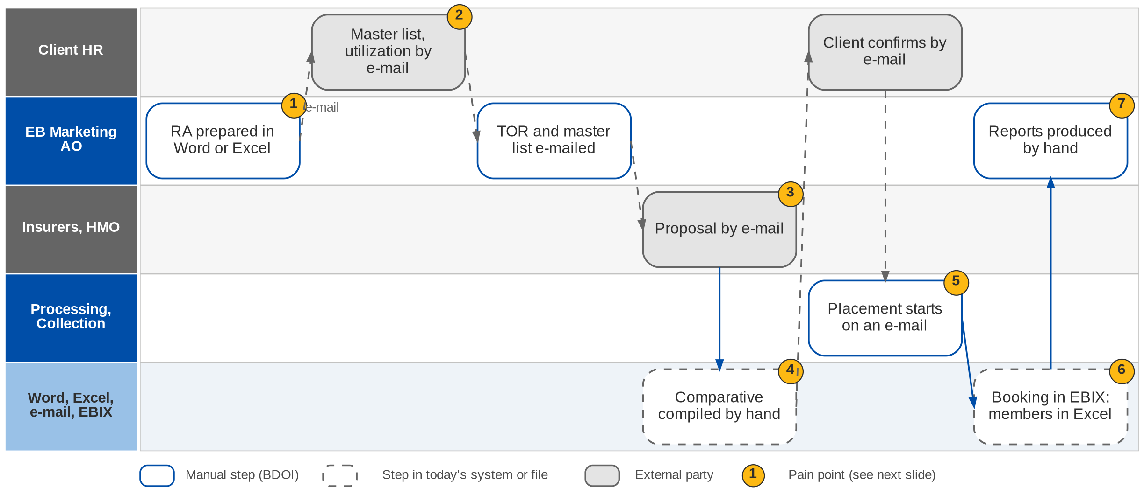
4. Employee Benefits: As-Is process
Employee Benefits today (BRD-8 Add. p.3)
Confidential – BDOI
BDOI Business Process Reverse KT | v2.0
62
Notes:
Today renewal advices are prepared in Word or Excel. The TOR, master lists, utilization reports and proposals travel by e-mail with no repository, and insurers and clients reply by e-mail. The comparative is compiled by hand. Placement starts on an e-mail to Processing, member movements and billing are tracked in spreadsheets, booking is in EBIX, and reports are produced manually.

Slide 63
4. Employee Benefits: pain points today
1
Renewal advices by hand
Prepared in Word or Excel for each programme.
BRD-8 Add. p.3; BRID-001
5
Placement starts on an e-mail
Hand-offs between Marketing, Processing and Collection run on e-mail.
BRD-8 Add. p.3; BRID-017
2
No document repository
TOR, master lists, utilization and proposals travel by e-mail.
BRD-8 Add. p.3; BRID-002, 007
6
Members and billing in spreadsheets
Member movements, direct billing, cards and SOAs tracked in Excel.
BRD-8 Add. p.3; BRID-013, 021, 030
3
Insurers and clients reply by e-mail
No secure channel and no validation before use.
BRD-8 Add. p.3-4; BRID-005
7
Reports by hand
Production, renewal and TAT reports compiled manually.
BRD-8 Add. p.3; BRID-022
4
Comparative compiled by hand
Proposals are re-keyed into a comparative.
BRD-8 Add. p.3; BRID-010
Confidential – BDOI
BDOI Business Process Reverse KT | v2.0
63
Notes:
The seven points of the BRD-8 current process (Add. p.3-5); the EB process flow confirms them.
1. Renewal advices by hand: Prepared in Word or Excel for each programme. (BRD-8 Add. p.3; BRID-001)
2. No document repository: TOR, master lists, utilization and proposals travel by e-mail. (BRD-8 Add. p.3; BRID-002, 007)
3. Insurers and clients reply by e-mail: No secure channel and no validation before use. (BRD-8 Add. p.3-4; BRID-005)
4. Comparative compiled by hand: Proposals are re-keyed into a comparative. (BRD-8 Add. p.3; BRID-010)
5. Placement starts on an e-mail: Hand-offs between Marketing, Processing and Collection run on e-mail. (BRD-8 Add. p.3; BRID-017)
6. Members and billing in spreadsheets: Member movements, direct billing, cards and SOAs tracked in Excel. (BRD-8 Add. p.3; BRID-013, 021, 030)
7. Reports by hand: Production, renewal and TAT reports compiled manually. (BRD-8 Add. p.3; BRID-022)

Slide 64
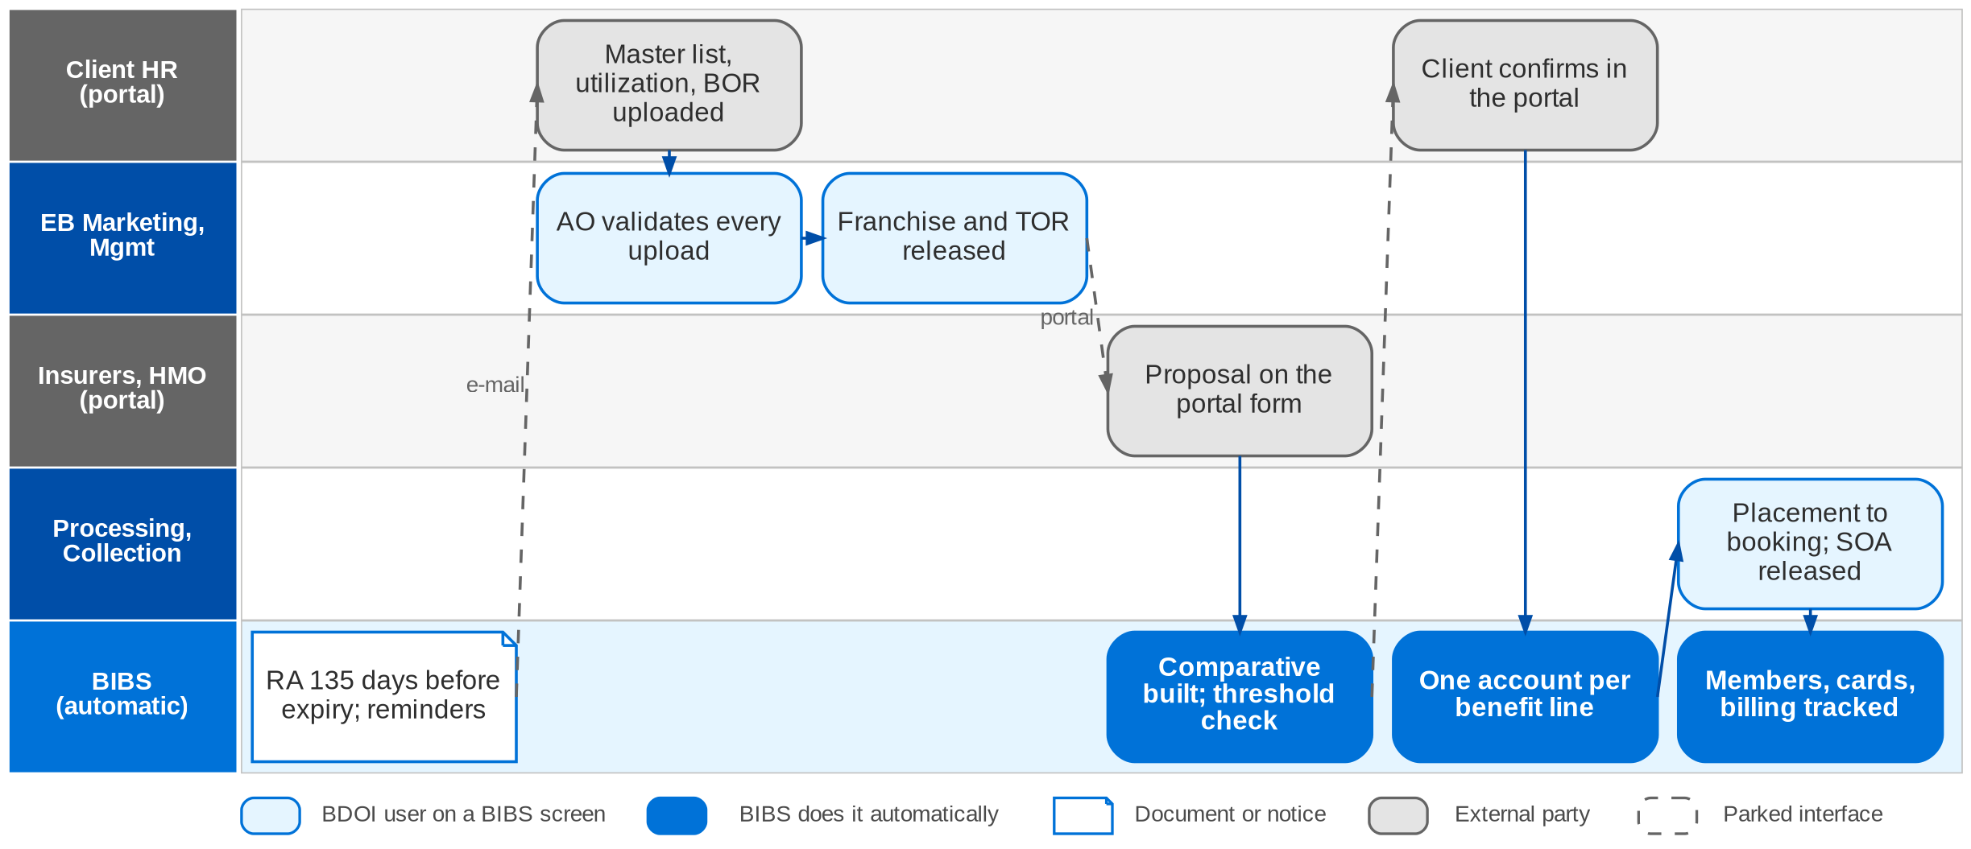
4. Employee Benefits: To-Be in the BRD
EB cycle in BIBS: workflow EB_CYCLE and the partner portal (FRS BRD-8 sections 2.2 and 5)
Confidential – BDOI
BDOI Business Process Reverse KT | v2.0
64
Notes:
In BIBS a daily job sends the renewal advice 135 days before expiry (default), with reminders and a feedback request. Client HR users upload the master list, utilization and the signed BOR in the partner portal; the AO validates every upload before it takes effect. Target insurers approve the franchise in the portal; the TOR and the unnamed master list are released to them, and they submit proposals on a structured form. BIBS builds the comparative from the validated proposals; sign-off and the value-threshold approval are workflow steps. The client's confirmation creates one account per benefit line and notifies Processing, who place, issue and book on the BRD-1 spine and release the SOA. Member changes, direct billing, contracts, HMO cards and SOAs are tracked items with automatic follow-ups.

Slide 65
4. Employee Benefits: how the BRD answers
Pain point today
To-Be in the BRD
Benefit
1
Renewal advices by hand
Daily job sends the RA 135 days before expiry, with reminders and a feedback request
About 4,150 renewals a year
2
No document repository
Every document registered with cycle, type, process and version; outbound files protected
One repository
3
Insurers and clients reply by e-mail
Insurers and client HR work in the partner portal; uploads take effect after BDOI validation
Validation before use
4
Comparative compiled by hand
Comparative built from the validated proposals; sign-off and threshold approval in the workflow
No re-keying
5
Placement starts on an e-mail
Client confirmation creates one account per benefit line and notifies Processing
Hand-off in the system
6
Members and billing in spreadsheets
Member changes, direct billing, contracts, HMO cards and SOAs are tracked items with follow-ups
Automatic follow-ups
7
Reports by hand
Production, Renewal, Placement, New Business and TAT reports with a business type filter
Live reports
Confidential – BDOI
BDOI Business Process Reverse KT | v2.0
65
Notes:
The benefit column names what the To-Be removes.
1. Renewal advices by hand -> Daily job sends the RA 135 days before expiry, with reminders and a feedback request Benefit: About 4,150 renewals a year.
2. No document repository -> Every document registered with cycle, type, process and version; outbound files protected Benefit: One repository.
3. Insurers and clients reply by e-mail -> Insurers and client HR work in the partner portal; uploads take effect after BDOI validation Benefit: Validation before use.
4. Comparative compiled by hand -> Comparative built from the validated proposals; sign-off and threshold approval in the workflow Benefit: No re-keying.
5. Placement starts on an e-mail -> Client confirmation creates one account per benefit line and notifies Processing Benefit: Hand-off in the system.
6. Members and billing in spreadsheets -> Member changes, direct billing, contracts, HMO cards and SOAs are tracked items with follow-ups Benefit: Automatic follow-ups.
7. Reports by hand -> Production, Renewal, Placement, New Business and TAT reports with a business type filter Benefit: Live reports.

Slide 66
4. Employee Benefits: gaps in the BRD
Coverage | Item | What we saw on the floor | What the BRD says | Our recommendation | Ref
Not in BRD | EB claims capture | Provider validates; BDOI captures claim details (EB-02). | No claims row in BRD-8; BRD-7 covers Motor and Non-Motor only. | Capture provider claims and utilization per programme. | EB-02
Not in BRD | ISACOM approval | Needed when a non-accredited provider wins. | Only in the process flow. | Approval step and document in the EB cycle. | EB flow; DCR-090
Partly in BRD | Member volumes | 50,000+ members (EB-01). | NFR counts transactions (4,200 a year), not members. | Size and test member uploads and roster at 50K+. | EB-01; EBQ15
Partly in BRD | Census validation | Master lists by e-mail and Excel. | Upload with AO validation; no data checks. | Checks for duplicates, eligibility and changes since the last list. | BRID-007, 013
BDOI to confirm | Portals at go-live | Insurer and client portals in the EB flow. | Portal in BRD-8; drop plan says no portal. | Confirm the portal timing and external-user security. | DCR-211, 096
Partly in BRD | Member data privacy | Employee data travels by e-mail. | Masking and need-to-know rules open. | Data Privacy Act controls on member data. | DCR-094
BDOI to confirm | Renewal advice lead days | Advice sent before expiry. | 180 or 135 days. | Confirm the default per programme. | DCR-087
Confidential – BDOI
BDOI Business Process Reverse KT | v2.0
66
Notes:
EB claims capture and the ISACOM approval are not in the BRD; member volumes are not sized.
[Not in BRD] EB claims capture. Seen: Provider validates; BDOI captures claim details (EB-02). BRD: No claims row in BRD-8; BRD-7 covers Motor and Non-Motor only. Recommendation: Capture provider claims and utilization per programme. (EB-02)
[Not in BRD] ISACOM approval. Seen: Needed when a non-accredited provider wins. BRD: Only in the process flow. Recommendation: Approval step and document in the EB cycle. (EB flow; DCR-090)
[Partly in BRD] Member volumes. Seen: 50,000+ members (EB-01). BRD: NFR counts transactions (4,200 a year), not members. Recommendation: Size and test member uploads and roster at 50K+. (EB-01; EBQ15)
[Partly in BRD] Census validation. Seen: Master lists by e-mail and Excel. BRD: Upload with AO validation; no data checks. Recommendation: Checks for duplicates, eligibility and changes since the last list. (BRID-007, 013)
[BDOI to confirm] Portals at go-live. Seen: Insurer and client portals in the EB flow. BRD: Portal in BRD-8; drop plan says no portal. Recommendation: Confirm the portal timing and external-user security. (DCR-211, 096)
[Partly in BRD] Member data privacy. Seen: Employee data travels by e-mail. BRD: Masking and need-to-know rules open. Recommendation: Data Privacy Act controls on member data. (DCR-094)
[BDOI to confirm] Renewal advice lead days. Seen: Advice sent before expiry. BRD: 180 or 135 days. Recommendation: Confirm the default per programme. (DCR-087)

Slide 67
4. Employee Benefits: best practice
HR self-service census
Automatic member endorsements
Utilization analytics
Partly in BRD
Clean member data
Partly in BRD
Accurate billing
Partly in BRD
Better renewals
Industry practice: Client HR uploads the census; the system checks duplicates, eligibility and changes.
For BDOI: Start with an upload template and checks, portal later.
Industry practice: Additions and deletions billed pro rata and reconciled to the insurer invoice.
For BDOI: Use BRID-013 / 025 / 030 as the base.
Industry practice: Claims and utilization per programme drive the renewal negotiation.
For BDOI: Capture provider claims (EB-02).
Digital member cards
Privacy by design
Provider scorecard
Beyond the BRD
Member experience
Not in BRD
Compliance
Beyond the BRD
Better advice
Industry practice: HMO and life cards issued digitally to members.
For BDOI: With the HMOs after go-live.
Industry practice: Masking, need-to-know access and retention for member data.
For BDOI: Agree the rules with the DPO (DCR-094).
Industry practice: Insurer and HMO service levels, network and claims turnaround scored in the comparative.
For BDOI: Add capability scores to the comparative.
Confidential – BDOI
BDOI Business Process Reverse KT | v2.0
67
Notes:
Practices of insurance brokers that fit BDOI, beyond what the BRD asks; the chip shows how far the BRD already covers each one.
HR self-service census [Partly in BRD]. Client HR uploads the census; the system checks duplicates, eligibility and changes. For BDOI: Start with an upload template and checks, portal later.
Automatic member endorsements [Partly in BRD]. Additions and deletions billed pro rata and reconciled to the insurer invoice. For BDOI: Use BRID-013 / 025 / 030 as the base.
Utilization analytics [Partly in BRD]. Claims and utilization per programme drive the renewal negotiation. For BDOI: Capture provider claims (EB-02).
Digital member cards [Beyond the BRD]. HMO and life cards issued digitally to members. For BDOI: With the HMOs after go-live.
Privacy by design [Not in BRD]. Masking, need-to-know access and retention for member data. For BDOI: Agree the rules with the DPO (DCR-094).
Provider scorecard [Beyond the BRD]. Insurer and HMO service levels, network and claims turnaround scored in the comparative. For BDOI: Add capability scores to the comparative.

Slide 68
Part B
Technical: TSU, Product and Reinsurance
Package and non-package products, insurer terms, and facultative reinsurance
5. Product Maintenance and TSU BRD-3
6. Reinsurance RI BRD (phase 2)
Confidential – BDOI | BDOI Business Process Reverse KT
Notes:
Package and non-package products, insurer terms, and facultative reinsurance

Slide 69
5. Product and TSU: at a glance
Department and roles
Volumes and business rules
How we learned it
Technical Support Unit (TSU) and Marketing Business Services (MBS)
• Marketing AO and TL / TH / UH (requesters)
• TSU Officer (maker), TSU TL, TSU Head
• Reinsurance team (large or special risks)
• ManCom (package sign-off); MBS and IT (package set-up)
• Insurers (terms)
13
TSU users, all concurrent; MBS 5 (BRD-3 p.33)
Floor walk: 22-Sep-2026, 1-1:30 pm, 44F; discovery 21 and 25-Sep-2026
Process owners: Cherry Ann Manalo, Joy Intia
• High-level Product Maintenance TSU process flow (package and non-package)
• BDOI Day 1 overview p.9 (data and reference maintenance)
• BRD-3 p.12-13; BRPM.001-022; PMADD01-08
2 types
package (fixed rates and conditions) and non-package (per deal) (PM-02)
~55
insurers to negotiate with (OV-01)
5 masters
insurers, products, packages, LOVs, MIS fields (Day 1 p.9)
The process in one line
Request
Completeness
Risk review
Quotation slip
Insurers
Comparative
Sign-off
Set-up and release
Confidential – BDOI
BDOI Business Process Reverse KT | v2.0
69
Notes:
TSU is the technical desk between Marketing and the insurers. Marketing decides whether a customer need is served by a package (fixed rates and conditions that BDOI designs and the insurer follows) or a non-package placement (terms negotiated per deal). TSU checks the request, assesses the risk, prepares the quotation slip, refers large or special risks to Reinsurance, negotiates with insurers, builds the comparative and prepares the proposal and sign-off. Packages are then set up by MBS and IT and released with an advisory. Product maintenance was named a key pain point (PM-01).
Floor walk: 22-Sep-2026, 1-1:30 pm, 44F; discovery 21 and 25-Sep-2026; Cherry Ann Manalo, Joy Intia.
Sources: High-level Product Maintenance TSU process flow (package and non-package); BDOI Day 1 overview p.9 (data and reference maintenance); BRD-3 p.12-13; BRPM.001-022; PMADD01-08

Slide 70
5. Product and TSU: what we heard on the floor (1/2)
Ref | Topic | Type | What we heard (As-Is) | What the business wants (To-Be)
PM-01 | Package and non-package | User aspiration | Marketing decides package or non-package from the customer need; BDOI defines the product and the insurer follows. | Product maintenance in the system for both package and non-package.
PM-02 | Design and rates | Business rule | Marketing gives the requirement; the product team designs and negotiates with the insurer, incl. incentives for packages; commission rate as agreed by Marketing. | Package = fixed rates and conditions; non-package rates differ per deal.
PM-03 | Package set-up | Pain point | Packages are defined and maintained manually, starting from a customer-specific requirement of Marketing. | Packages defined and maintained in the system.
PM-04 | Change at renewal | User aspiration | At renewal a policy can move from package to non-package or back. | Allow the switch at renewal.
Confidential – BDOI
BDOI Business Process Reverse KT | v2.0
70

Slide 71
5. Product and TSU: what we heard on the floor (2/2)
Ref | Topic | Type | What we heard (As-Is) | What the business wants (To-Be)
NB-08 | TSU step | Business rule | Non-package: the request goes to TSU before the quotation; once the customer accepts, to Placement. | -
TSU flow | Tracking and evidence | Pain point | Request encoded in an Excel monitoring file; acceptance evidence (signed slip, stamped slip or explicit e-mail) checked by hand; placement status tracker kept by hand; comparative table built manually in Excel. | -
TSU flow | Reinsurance loop | As-Is | Large sum insured, special risks or non-standard cover go to the Reinsurance team; RI comments come back to Marketing, who revises terms or closes the request. | -
TSU flow | Set-up dependency | Pain point | Package creation needs a maintenance request to MBS / IT; screenshots kept as evidence; TSU validates rates and conditions; release advisory to Marketing, Operations and TSU. | -
Confidential – BDOI
BDOI Business Process Reverse KT | v2.0
71
Notes:
Notes of the business overview (21-Sep), the Product Maintenance floor walk (22-Sep) and the 25-Sep session.
PM-01 Package and non-package (User aspiration): Marketing decides package or non-package from the customer need; BDOI defines the product and the insurer follows. Wants: Product maintenance in the system for both package and non-package.
PM-02 Design and rates (Business rule): Marketing gives the requirement; the product team designs and negotiates with the insurer, incl. incentives for packages; commission rate as agreed by Marketing. Wants: Package = fixed rates and conditions; non-package rates differ per deal.
PM-03 Package set-up (Pain point): Packages are defined and maintained manually, starting from a customer-specific requirement of Marketing. Wants: Packages defined and maintained in the system.
PM-04 Change at renewal (User aspiration): At renewal a policy can move from package to non-package or back. Wants: Allow the switch at renewal.
NB-08 TSU step (Business rule): Non-package: the request goes to TSU before the quotation; once the customer accepts, to Placement.
TSU flow Tracking and evidence (Pain point): Request encoded in an Excel monitoring file; acceptance evidence (signed slip, stamped slip or explicit e-mail) checked by hand; placement status tracker kept by hand; comparative table built manually in Excel.
TSU flow Reinsurance loop (As-Is): Large sum insured, special risks or non-standard cover go to the Reinsurance team; RI comments come back to Marketing, who revises terms or closes the request.
TSU flow Set-up dependency (Pain point): Package creation needs a maintenance request to MBS / IT; screenshots kept as evidence; TSU validates rates and conditions; release advisory to Marketing, Operations and TSU.

Slide 72
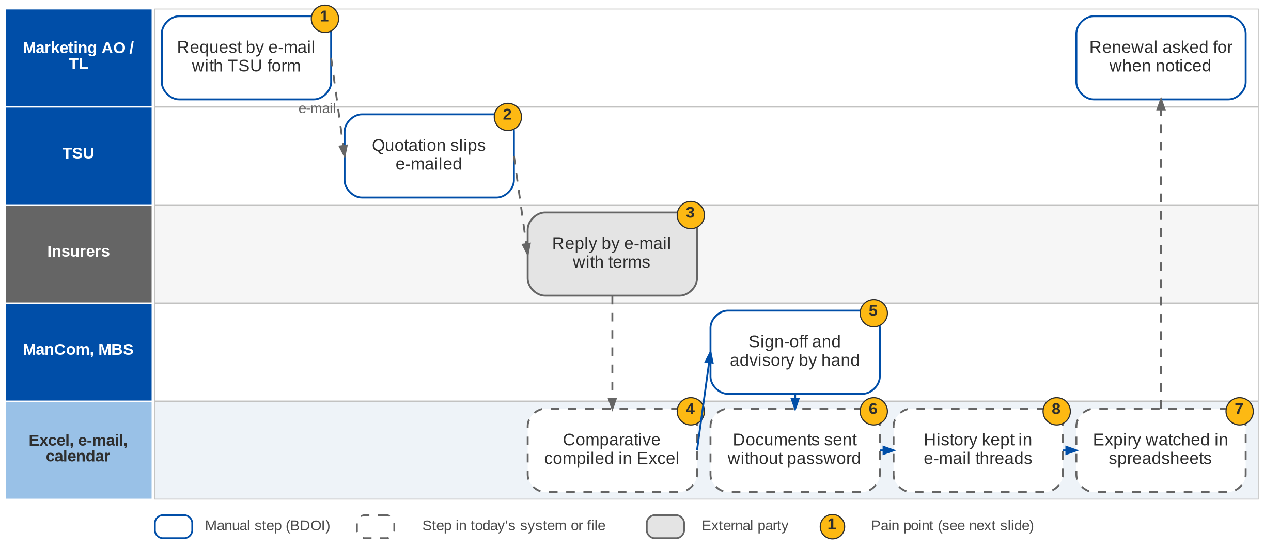
5. Product and TSU: As-Is process
Package set-up today (BRD-3 p.12-13)
Confidential – BDOI
BDOI Business Process Reverse KT | v2.0
72
Notes:
Marketing asks TSU for a package placement by e-mail with a TSU request form. TSU prepares quotation slips and e-mails them to insurers, who reply by e-mail with signed slips or approved terms. The comparative table is compiled in Excel and shared by e-mail. Sign-off and advisories are manual, documents go out without password protection, package expiry is watched in spreadsheets or calendars, and changes and approvals are tracked in e-mail threads.

Slide 73
5. Product and TSU: the TSU request today, step by step
Step | What TSU does | Check or decision | Tool today
1 Request | Receives the PRF (package) or TSU request form (non-package) with client, risk, cover, basis of quotation | Complete, documents attached, no duplicate; else returned "Incomplete submission" | E-mail
2 Log | Acknowledges and encodes the request | Request tracker | Excel monitoring file
3 Risk review | Validates cover structure, sum insured and limits, policy terms | Needs reinsurance? (large SI, special risk, non-standard cover) | E-mail to RI team
4 Quotation slip | Prepares the slip with risk details, terms and pricing; TSU TL approves | TL approval; revise on return | Word / Excel
5 Insurers | Sends the slip, follows up, escalates after the SLA; records accepted, declined, conditional | Acceptance evidence: signed or stamped slip, explicit e-mail | E-mail; status tracker
6 Comparative | Compiles premium, cover, conditions, exclusions; asks for more quotes if needed | Enough for a recommendation? | Excel
7 Proposal | Sign-off sheet; ManCom (package) or TL / Head (non-package); proposal slip to Marketing | Approved; Marketing sends to the client | Paper signatures
8 Set-up and release | Maintenance request to MBS / IT; validates rates, conditions, set-up; release advisory | Set-up correct? | MBS / IT; screenshots
Confidential – BDOI
BDOI Business Process Reverse KT | v2.0
73
Notes:
The steps of the Product Maintenance TSU process flow (09-Jul).

Slide 74
5. Product and TSU: pain points today
1
Requests by e-mail
Marketing requests placements by e-mail using a TSU request form.
BRD-3 p.12; BRPM.008
5
Manual sign-off and advisory
ManCom sign-off and the advisory are prepared outside a system.
BRD-3 p.12-13; BRPM.015, 016
2
Quotation slips by e-mail
TSU prepares and e-mails the slips; no log of what was sent.
BRD-3 p.12; BRPM.010
6
Documents without a password
Shared documents have no password protection.
BRD-3 p.13
3
Insurer replies in mailboxes
Signed slips and approved terms arrive by e-mail.
BRD-3 p.12; BRPM.012
7
Expiry in spreadsheets
Package expiry is monitored in spreadsheets or calendars.
BRD-3 p.13; BRPM.017
4
Comparative in Excel
Compiled by hand and shared by e-mail.
BRD-3 p.12; BRPM.014; PMADD03
8
History in e-mail threads
Changes, approvals and documents are tracked in e-mail and files.
BRD-3 p.13
Confidential – BDOI
BDOI Business Process Reverse KT | v2.0
74
Notes:
The eight points of the BRD-3 current process (p.12-13); the TSU process flow confirms them and adds the reinsurance loop.
1. Requests by e-mail: Marketing requests placements by e-mail using a TSU request form. (BRD-3 p.12; BRPM.008)
2. Quotation slips by e-mail: TSU prepares and e-mails the slips; no log of what was sent. (BRD-3 p.12; BRPM.010)
3. Insurer replies in mailboxes: Signed slips and approved terms arrive by e-mail. (BRD-3 p.12; BRPM.012)
4. Comparative in Excel: Compiled by hand and shared by e-mail. (BRD-3 p.12; BRPM.014; PMADD03)
5. Manual sign-off and advisory: ManCom sign-off and the advisory are prepared outside a system. (BRD-3 p.12-13; BRPM.015, 016)
6. Documents without a password: Shared documents have no password protection. (BRD-3 p.13)
7. Expiry in spreadsheets: Package expiry is monitored in spreadsheets or calendars. (BRD-3 p.13; BRPM.017)
8. History in e-mail threads: Changes, approvals and documents are tracked in e-mail and files. (BRD-3 p.13)

Slide 75
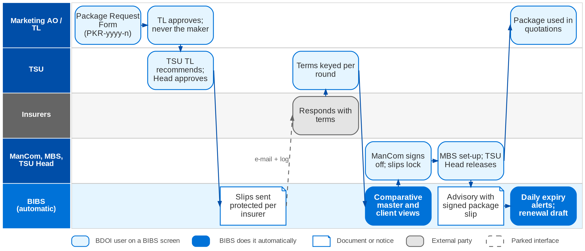
5. Product and TSU: To-Be in the BRD
Package lifecycle in BIBS: workflow PM_PACKAGE_REQUEST (FRS BRD-3 sections 2.2 and 5)
Confidential – BDOI
BDOI Business Process Reverse KT | v2.0
75
Notes:
In BIBS Marketing logs the Package Request Form, which BIBS numbers PKR-yyyy-n. A Marketing TL, TH or UH approves it (never the maker); the TSU TL recommends and the TSU Head approves. TSU prepares the quotation slips, which are approved and e-mailed per insurer, protected and logged. Insurer responses are keyed in with their outcome, over as many rounds as needed. BIBS keeps one comparative master per request and derives client views from it. ManCom signs off, which locks the slips; MBS creates the package version and the TSU Head or Business Administrator releases it. The advisory is drafted on release and sent with the signed package slip. A daily job raises expiry alerts and can draft the renewal request.

Slide 76
5. Product and TSU: how the BRD answers (1/2)
Pain point today
To-Be in the BRD
Benefit
1
Requests by e-mail
Package Request Form logged in BIBS, numbered PKR-yyyy-n and tracked by stage
Stage and SLA per request
2
Quotation slips by e-mail
Quotation slips prepared, approved and e-mailed per insurer, protected and logged
Send log per slip
3
Insurer replies in mailboxes
TSU keys in each response with its outcome; every change is kept
Rounds recorded
4
Comparative in Excel
One comparative master per package; client views derived from it
No Excel re-compile
Confidential – BDOI
BDOI Business Process Reverse KT | v2.0
76

Slide 77
5. Product and TSU: how the BRD answers (2/2)
Pain point today
To-Be in the BRD
Benefit
5
Manual sign-off and advisory
ManCom signs off in BIBS; the advisory is drafted on release
Sign-off before release
6
Documents without a password
Documents leave password protected; password in a separate e-mail
Every document protected
7
Expiry in spreadsheets
Daily job raises expiry alerts and can draft the renewal request
No expiry missed
8
History in e-mail threads
Every action in the request history and the audit trail
Full history per package
Confidential – BDOI
BDOI Business Process Reverse KT | v2.0
77
Notes:
The benefit column names what the To-Be removes.
1. Requests by e-mail -> Package Request Form logged in BIBS, numbered PKR-yyyy-n and tracked by stage Benefit: Stage and SLA per request.
2. Quotation slips by e-mail -> Quotation slips prepared, approved and e-mailed per insurer, protected and logged Benefit: Send log per slip.
3. Insurer replies in mailboxes -> TSU keys in each response with its outcome; every change is kept Benefit: Rounds recorded.
4. Comparative in Excel -> One comparative master per package; client views derived from it Benefit: No Excel re-compile.
5. Manual sign-off and advisory -> ManCom signs off in BIBS; the advisory is drafted on release Benefit: Sign-off before release.
6. Documents without a password -> Documents leave password protected; password in a separate e-mail Benefit: Every document protected.
7. Expiry in spreadsheets -> Daily job raises expiry alerts and can draft the renewal request Benefit: No expiry missed.
8. History in e-mail threads -> Every action in the request history and the audit trail Benefit: Full history per package.

Slide 78
5. Product and TSU: gaps in the BRD (1/2)
Coverage | Item | What we saw on the floor | What the BRD says | Our recommendation | Ref
Partly in BRD | Non-package product maintenance | Both types to be maintained in the system (PM-01). | BRD-3 covers packages; non-package "if and when added". | Bring non-package product and TOR templates into scope. | PM-01; DCR-036
Not in BRD | Reinsurance referral | Large or special risks go to the RI team and back. | No RI referral in BRD-1 or BRD-3; RI is phase 2. | Referral trigger and RI status on the TSU request (see chapter 6). | TSU flow; A3
Partly in BRD | Acceptance evidence | Signed slip, stamped slip or explicit e-mail. | Insurer response recorded; evidence type not gated. | Require the evidence document before placement. | BRPM.013
Partly in BRD | SLA values | Follow-up and escalation after SLA breach. | SLA tracking; values open. | Set SLA per request type and complexity. | PQ08; NB-07
Confidential – BDOI
BDOI Business Process Reverse KT | v2.0
78

Slide 79
5. Product and TSU: gaps in the BRD (2/2)
Coverage | Item | What we saw on the floor | What the BRD says | Our recommendation | Ref
Partly in BRD | Rate formulas without IT | Package set-up needs MBS / IT. | Scheme versions; new formulas still need IT. | Rating rules maintained by the business with approval. | PQ12
Partly in BRD | Package switch at renewal | Package to non-package or back (PM-04). | No explicit rule. | Switch rule with product versions. | PM-04; PQ11
BDOI to confirm | Excess commission and incentives | Incentives negotiated per package. | CPC2 undefined. | Define incentive types, rates and bases. | PM-02; DCR-037
BDOI to confirm | ManCom signature | Paper sign-off sheet. | Physical signatures. | E-sign-off in the workflow (CP-01). | PQ07
Confidential – BDOI
BDOI Business Process Reverse KT | v2.0
79
Notes:
Non-package product maintenance is out of BRD-3; the reinsurance referral has no requirement in phase 1.
[Partly in BRD] Non-package product maintenance. Seen: Both types to be maintained in the system (PM-01). BRD: BRD-3 covers packages; non-package "if and when added". Recommendation: Bring non-package product and TOR templates into scope. (PM-01; DCR-036)
[Not in BRD] Reinsurance referral. Seen: Large or special risks go to the RI team and back. BRD: No RI referral in BRD-1 or BRD-3; RI is phase 2. Recommendation: Referral trigger and RI status on the TSU request (see chapter 6). (TSU flow; A3)
[Partly in BRD] Acceptance evidence. Seen: Signed slip, stamped slip or explicit e-mail. BRD: Insurer response recorded; evidence type not gated. Recommendation: Require the evidence document before placement. (BRPM.013)
[Partly in BRD] SLA values. Seen: Follow-up and escalation after SLA breach. BRD: SLA tracking; values open. Recommendation: Set SLA per request type and complexity. (PQ08; NB-07)
[Partly in BRD] Rate formulas without IT. Seen: Package set-up needs MBS / IT. BRD: Scheme versions; new formulas still need IT. Recommendation: Rating rules maintained by the business with approval. (PQ12)
[Partly in BRD] Package switch at renewal. Seen: Package to non-package or back (PM-04). BRD: No explicit rule. Recommendation: Switch rule with product versions. (PM-04; PQ11)
[BDOI to confirm] Excess commission and incentives. Seen: Incentives negotiated per package. BRD: CPC2 undefined. Recommendation: Define incentive types, rates and bases. (PM-02; DCR-037)
[BDOI to confirm] ManCom signature. Seen: Paper sign-off sheet. BRD: Physical signatures. Recommendation: E-sign-off in the workflow (CP-01). (PQ07)

Slide 80
5. Product and TSU: best practice
Business-maintained rating rules
Insurer appetite and capacity register
Test premiums before release
Partly in BRD
Speed to market
Not in BRD
Better placement
Partly in BRD
No wrong rates
Industry practice: Rates, factors and formulas maintained by TSU with approval and versions, without IT.
For BDOI: A rules screen with test premiums before release.
Industry practice: Per insurer: lines, limits, appetite, accreditation, commission, remittance terms.
For BDOI: Build on the insurer records of Day 1 p.9.
Industry practice: Automatic test cases run on every package before it goes live.
For BDOI: Turn the validation checkpoint into test cases.
Package performance analytics
E-sign-off
One product catalogue
Beyond the BRD
Better products
BDOI to confirm
No paper
Partly in BRD
One source of truth
Industry practice: Take-up, loss ratio and retention per package reviewed yearly.
For BDOI: Report per package from booking and claims data.
Industry practice: ManCom sign-off and slips signed electronically.
For BDOI: With the e-signature decision (CP-01).
Industry practice: Package and non-package products, TOR and documents in one catalogue used by every module.
For BDOI: Extend BRD-3 to non-package (PM-01).
Confidential – BDOI
BDOI Business Process Reverse KT | v2.0
80
Notes:
Practices of insurance brokers that fit BDOI, beyond what the BRD asks; the chip shows how far the BRD already covers each one.
Business-maintained rating rules [Partly in BRD]. Rates, factors and formulas maintained by TSU with approval and versions, without IT. For BDOI: A rules screen with test premiums before release.
Insurer appetite and capacity register [Not in BRD]. Per insurer: lines, limits, appetite, accreditation, commission, remittance terms. For BDOI: Build on the insurer records of Day 1 p.9.
Test premiums before release [Partly in BRD]. Automatic test cases run on every package before it goes live. For BDOI: Turn the validation checkpoint into test cases.
Package performance analytics [Beyond the BRD]. Take-up, loss ratio and retention per package reviewed yearly. For BDOI: Report per package from booking and claims data.
E-sign-off [BDOI to confirm]. ManCom sign-off and slips signed electronically. For BDOI: With the e-signature decision (CP-01).
One product catalogue [Partly in BRD]. Package and non-package products, TOR and documents in one catalogue used by every module. For BDOI: Extend BRD-3 to non-package (PM-01).

Slide 81
6. Reinsurance: at a glance
Department and roles
Volumes and business rules
How we learned it
BDOI Reinsurance (RI Team Head, RI Officers), with TSU, Claims and Comptrollership
• RI Unit Head, RI Team Head, RI Officer
• BDOI TSU (requests facultative placement); Claims Handler (RI claims)
• Commission Receivable Unit; Cashiering and Remittance
• Comptrollership (RI entries)
• Cedants, reinsurers and partner RI brokers (external)
24 h
to acknowledge a facultative placement request (RI flow)
Floor walk: Process flow confirmed by the RI and Claims heads (Feb 2026); not walked in Sep-2026
Process owners: Alvin B. Pila (RI Team Head), Allan I. Villas (Claims)
• High-level Reinsurance process flow (4 pages: placement, RI commission collections, RI claims, RI settlement)
• ReInsurance BRD v1, 11-Mar-2025 (phase 2); BDOI answer A3
• Umbrella BRD capability 15; Report List #112-115
3 days
working days to prepare the facultative slip (RI flow)
48 / 72 h
to share loss reports / invoice reinsurers for their share of a claim
106
requirements in the RI BRD, phase 2 (FRID-001 to 106)
The process in one line
Request
Acknowledge
Slip
Market
Closing
Debit note
Collections
Claims
Confidential – BDOI
BDOI Business Process Reverse KT | v2.0
81
Notes:
BDOI Reinsurance places facultative reinsurance for cedants and for risks TSU cannot place fully in the direct market. The RI officer reviews the request, prepares the facultative slip, approaches reinsurers or partner RI brokers, negotiates, confirms the closings and sends the debit note to the cedant; then monitors premium payment warranties, RI premium remittance and RI commission, and handles RI claims, cash calls and settlement. BDOI placed the reinsurance module in phase 2 (answer A3), so it is outside the January 2028 go-live, but the TSU referral and the RI transactions that Remittance handles in Drop 1 (DCR-210) touch phase 1.
Floor walk: Process flow confirmed by the RI and Claims heads (Feb 2026); not walked in Sep-2026; Alvin B. Pila (RI Team Head), Allan I. Villas (Claims).
Sources: High-level Reinsurance process flow (4 pages: placement, RI commission collections, RI claims, RI settlement); ReInsurance BRD v1, 11-Mar-2025 (phase 2); BDOI answer A3; Umbrella BRD capability 15; Report List #112-115

Slide 82
6. Reinsurance: what we heard on the floor
Ref | Topic | Type | What we heard (As-Is) | What the business wants (To-Be)
RI flow p.4 | Facultative placement | Business rule | TSU sends the request; RI acknowledges within 24 hours, reviews and prepares the facultative slip within 3 working days, approaches reinsurers or RI brokers, negotiates and informs TSU in writing. | -
RI flow p.4 | Closing | As-Is | RI checks special conditions, warranties and subjectivities, the share placed, sends the closings and the debit note to the cedant and secures the signed placement slip from the reinsurers. | -
RI flow p.1 | RI commission | Pain point | A monitoring sheet of premium payment schedules and expected RI premium and commission dates is shared with the Commission Receivable Unit; reminders and extensions handled by hand. | -
RI flow p.4 | RI claims | Business rule | Preliminary loss advice within 5 days; RCRF not later than the next working day; loss adjuster reports to all reinsurers within 48 hours; lead reinsurer agrees the adjuster. | -
RI flow p.4 | Settlement | Business rule | Acknowledge the statement of claim or cash call within 48 hours; invoice the reinsurer panel within 72 hours; collect within 10 days; remit to the reinsured within 5 days. | -
A3; DCR-210 | Scope | Open point | Reinsurance module in phase 2; Remittance handles "reinsurance transactions" in Drop 1. | Which RI transactions and entries are in Drop 1.
Confidential – BDOI
BDOI Business Process Reverse KT | v2.0
82
Notes:
Steps of the Reinsurance process flow; the RI team was not part of the September floor walks.
RI flow p.4 Facultative placement (Business rule): TSU sends the request; RI acknowledges within 24 hours, reviews and prepares the facultative slip within 3 working days, approaches reinsurers or RI brokers, negotiates and informs TSU in writing.
RI flow p.4 Closing (As-Is): RI checks special conditions, warranties and subjectivities, the share placed, sends the closings and the debit note to the cedant and secures the signed placement slip from the reinsurers.
RI flow p.1 RI commission (Pain point): A monitoring sheet of premium payment schedules and expected RI premium and commission dates is shared with the Commission Receivable Unit; reminders and extensions handled by hand.
RI flow p.4 RI claims (Business rule): Preliminary loss advice within 5 days; RCRF not later than the next working day; loss adjuster reports to all reinsurers within 48 hours; lead reinsurer agrees the adjuster.
RI flow p.4 Settlement (Business rule): Acknowledge the statement of claim or cash call within 48 hours; invoice the reinsurer panel within 72 hours; collect within 10 days; remit to the reinsured within 5 days.
A3; DCR-210 Scope (Open point): Reinsurance module in phase 2; Remittance handles "reinsurance transactions" in Drop 1. Wants: Which RI transactions and entries are in Drop 1.

Slide 83
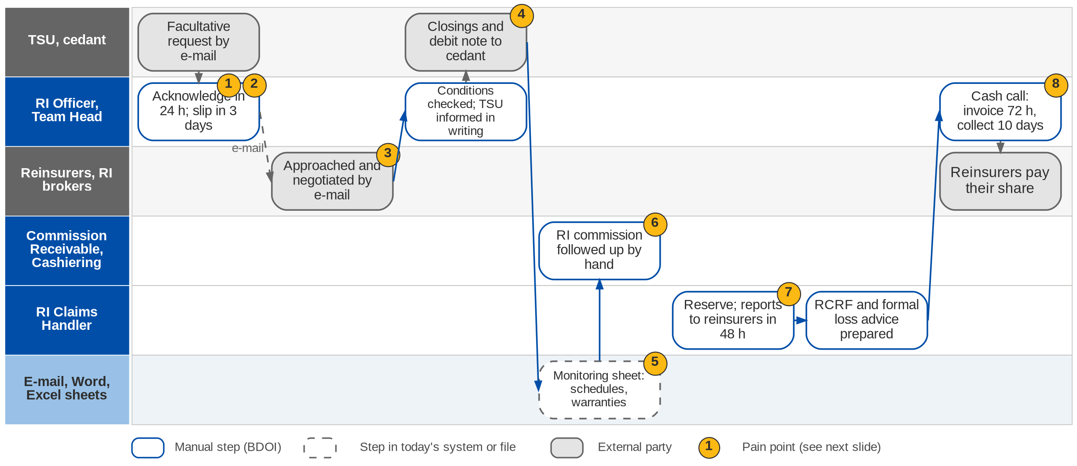
6. Reinsurance: As-Is process
Reinsurance today (Reinsurance process flow: placement, commission collections, claims, settlement)
Confidential – BDOI
BDOI Business Process Reverse KT | v2.0
83
Notes:
TSU e-mails the facultative request. The RI officer acknowledges it within 24 hours, reviews the underwriting information and prepares the facultative slip within 3 working days, approaches reinsurers and partner RI brokers by e-mail and negotiates. Once enough capacity is secured the officer checks conditions and warranties, informs TSU in writing, sends the closings and the debit note to the cedant and chases the signed slips. Premium payment schedules, warranties and expected RI commission are tracked on a monitoring sheet shared with the Commission Receivable Unit, with reminders by e-mail. For claims the claims handler records the reserve, shares the adjuster's reports with every reinsurer within 48 hours, prepares the RCRF and the formal loss advice, and for cash calls invoices the panel within 72 hours, collects within 10 days and remits within 5 days. None of the deadlines is tracked by a system.

Slide 84
6. Reinsurance: pain points today
1
Requests by e-mail
TSU requests and underwriting information arrive by e-mail.
RI flow p.4
5
Monitoring sheet in Excel
Payment schedules and warranties on a shared spreadsheet.
RI flow p.1
2
TATs tracked by memory
24-hour acknowledgement and 3-day slip are not measured.
RI flow p.4
6
RI commission chased by hand
Commission Receivable and RI follow up reinsurers and brokers.
RI flow p.1
3
Market approached by e-mail
Slips, shares and terms negotiated in e-mail threads.
RI flow p.4
7
Claim deadlines not tracked
5-day PLA, next-day RCRF, 48-hour report sharing kept by hand.
RI flow p.4
4
Closings and debit notes by hand
Word documents; signed slips chased by e-mail.
RI flow p.4
8
Cash calls and settlement by hand
72-hour invoice, 10-day collection, 5-day remittance.
RI flow p.4
Confidential – BDOI
BDOI Business Process Reverse KT | v2.0
84
Notes:
Points 1 to 8 are on the As-Is swimlane.
1. Requests by e-mail: TSU requests and underwriting information arrive by e-mail. (RI flow p.4)
2. TATs tracked by memory: 24-hour acknowledgement and 3-day slip are not measured. (RI flow p.4)
3. Market approached by e-mail: Slips, shares and terms negotiated in e-mail threads. (RI flow p.4)
4. Closings and debit notes by hand: Word documents; signed slips chased by e-mail. (RI flow p.4)
5. Monitoring sheet in Excel: Payment schedules and warranties on a shared spreadsheet. (RI flow p.1)
6. RI commission chased by hand: Commission Receivable and RI follow up reinsurers and brokers. (RI flow p.1)
7. Claim deadlines not tracked: 5-day PLA, next-day RCRF, 48-hour report sharing kept by hand. (RI flow p.4)
8. Cash calls and settlement by hand: 72-hour invoice, 10-day collection, 5-day remittance. (RI flow p.4)

Slide 85
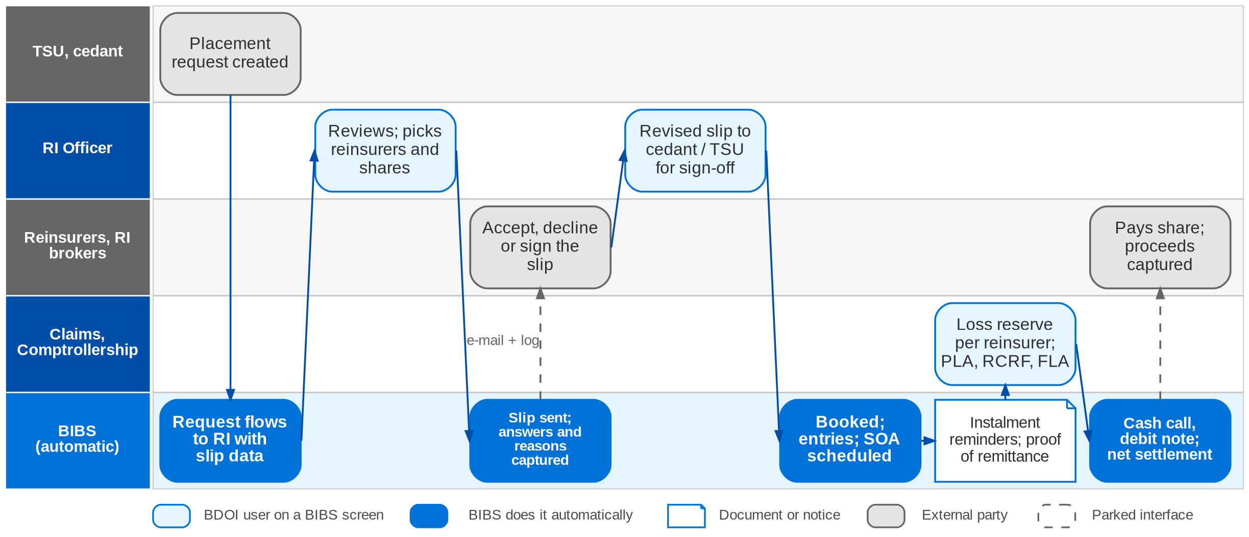
6. Reinsurance: To-Be in the BRD
Reinsurance To-Be in the RI BRD (phase 2): FRID-001 to 106
Confidential – BDOI
BDOI Business Process Reverse KT | v2.0
85
Notes:
In the RI BRD, TSU creates the placement request in the system and it flows to BDOI RI with the slip information. Reinsurers and RI brokers are kept as contacts with their shares; the request and the slips are sent to them from the system, and non-acceptance reasons are captured and notified to TSU. Revised slips go back to the cedant or TSU for sign-off and then to the reinsurers; the signed slip is handed to Operations, booked with generated accounting entries and an SOA is scheduled and sent. Premium payments are applied and matched, instalment reminders go to the AO, and a proof of remittance and remittance schedule are generated. For claims the system records the net loss reserve per reinsurer, generates the PLA, RCRF and formal loss advice, sends cash calls and debit notes, captures paid proceeds with the cash entry and supports net settlement. Every action is logged with its turnaround time.

Slide 86
6. Reinsurance: how the BRD answers (1/2)
Pain point today
To-Be in the BRD
Benefit
1
Requests by e-mail
TSU creates the placement request; it flows to RI with the slip data (FRID-001-007)
No e-mail intake
2
TATs tracked by memory
Status changes and turnaround times logged (FRID-098); no SLA clock
Partly: see gaps
3
Market approached by e-mail
Reinsurers and brokers as contacts with shares; slips sent and answers captured (FRID-008-016)
Communication log
4
Closings and debit notes by hand
Revisions logged; signed slip to Operations; booking and entries generated (FRID-020-032)
Entries generated
Confidential – BDOI
BDOI Business Process Reverse KT | v2.0
86

Slide 87
6. Reinsurance: how the BRD answers (2/2)
Pain point today
To-Be in the BRD
Benefit
5
Monitoring sheet in Excel
Instalment and due-date reminders scheduled (FRID-049-054)
No sheet
6
RI commission chased by hand
Premium applied and matched; proof of remittance; commission scenarios (FRID-039-048)
Tracked per account
7
Claim deadlines not tracked
Loss reserve per reinsurer; PLA, RCRF and FLA generated and sent (FRID-101-105)
Templates, log
8
Cash calls and settlement by hand
Cash calls, debit notes, proceeds capture and net settlement (FRID-058-094, 106)
Entry on receipt
Confidential – BDOI
BDOI Business Process Reverse KT | v2.0
87
Notes:
The To-Be is the phase-2 RI BRD (FRID numbers).
1. Requests by e-mail -> TSU creates the placement request; it flows to RI with the slip data (FRID-001-007) Benefit: No e-mail intake.
2. TATs tracked by memory -> Status changes and turnaround times logged (FRID-098); no SLA clock Benefit: Partly: see gaps.
3. Market approached by e-mail -> Reinsurers and brokers as contacts with shares; slips sent and answers captured (FRID-008-016) Benefit: Communication log.
4. Closings and debit notes by hand -> Revisions logged; signed slip to Operations; booking and entries generated (FRID-020-032) Benefit: Entries generated.
5. Monitoring sheet in Excel -> Instalment and due-date reminders scheduled (FRID-049-054) Benefit: No sheet.
6. RI commission chased by hand -> Premium applied and matched; proof of remittance; commission scenarios (FRID-039-048) Benefit: Tracked per account.
7. Claim deadlines not tracked -> Loss reserve per reinsurer; PLA, RCRF and FLA generated and sent (FRID-101-105) Benefit: Templates, log.
8. Cash calls and settlement by hand -> Cash calls, debit notes, proceeds capture and net settlement (FRID-058-094, 106) Benefit: Entry on receipt.

Slide 88
6. Reinsurance: gaps in the BRD
Coverage | Item | What we saw on the floor | What the BRD says | Our recommendation | Ref
BDOI to confirm | RI transactions in Drop 1 | Remittance handles RI transactions today. | Which transactions and entries is undefined. | List the RI transactions Remittance must support at go-live. | DCR-210; A3
Not in BRD | TSU referral in phase 1 | Large or special risks go from TSU to RI. | No referral in BRD-1 or BRD-3. | A referral status on the TSU request until the module arrives. | TSU flow
Partly in BRD | Turnaround clocks | 24 h, 3 days, 48 h, 72 h, 10 days, 5 days. | Turnaround logged, no SLA clocks or alerts. | SLA clocks with alerts on each deadline. | RI flow; FRID-098
Partly in BRD | RI commission follow-up | Monitoring sheet with the Commission Receivable Unit. | Commission scenarios; follow-up owner not stated. | RI commission receivable on the same worklist as direct commission. | RI flow p.1; FRID-042
Partly in BRD | Warranty breaches and extensions | Extensions escalated to the RI Unit Head. | Reminders only. | Warranty breach alert and an extension approval. | RI flow p.1
Not in BRD | Reinsurer security | Reinsurers chosen per slip. | Contacts and shares only. | Reinsurer register with rating and accreditation. | CORE-15
Partly in BRD | RI reports | Four RI reports in the Report List. | Generic reporting (FRID-095). | Specify the four reports (#112-115). | Report List #112-115
Confidential – BDOI
BDOI Business Process Reverse KT | v2.0
88
Notes:
The TATs of the flow are not requirements in the RI BRD, and the RI transactions of Drop 1 are undefined.
[BDOI to confirm] RI transactions in Drop 1. Seen: Remittance handles RI transactions today. BRD: Which transactions and entries is undefined. Recommendation: List the RI transactions Remittance must support at go-live. (DCR-210; A3)
[Not in BRD] TSU referral in phase 1. Seen: Large or special risks go from TSU to RI. BRD: No referral in BRD-1 or BRD-3. Recommendation: A referral status on the TSU request until the module arrives. (TSU flow)
[Partly in BRD] Turnaround clocks. Seen: 24 h, 3 days, 48 h, 72 h, 10 days, 5 days. BRD: Turnaround logged, no SLA clocks or alerts. Recommendation: SLA clocks with alerts on each deadline. (RI flow; FRID-098)
[Partly in BRD] RI commission follow-up. Seen: Monitoring sheet with the Commission Receivable Unit. BRD: Commission scenarios; follow-up owner not stated. Recommendation: RI commission receivable on the same worklist as direct commission. (RI flow p.1; FRID-042)
[Partly in BRD] Warranty breaches and extensions. Seen: Extensions escalated to the RI Unit Head. BRD: Reminders only. Recommendation: Warranty breach alert and an extension approval. (RI flow p.1)
[Not in BRD] Reinsurer security. Seen: Reinsurers chosen per slip. BRD: Contacts and shares only. Recommendation: Reinsurer register with rating and accreditation. (CORE-15)
[Partly in BRD] RI reports. Seen: Four RI reports in the Report List. BRD: Generic reporting (FRID-095). Recommendation: Specify the four reports (#112-115). (Report List #112-115)

Slide 89
6. Reinsurance: best practice
Structured RI placement
Reinsurer security register
Bordereaux automation
Partly in BRD
Control of shares
Not in BRD
Counterparty risk
Partly in BRD
Less re-keying
Industry practice: Lines, shares, signing-down and the order placed held per slip; the total always adds to 100%.
For BDOI: Specify share and signing rules in the phase-2 design.
Industry practice: Rating, Insurance Commission accreditation and limits per reinsurer, checked at placement.
For BDOI: Add to the insurer register.
Industry practice: Premium and claims bordereaux generated and reconciled per reinsurer.
For BDOI: Extend the SOA to bordereaux.
SLA tracker for claims and cash calls
Payment warranty monitor
Net settlement with reinsurers
Partly in BRD
Faster recoveries
Partly in BRD
Avoids cover disputes
In the BRD
Fewer payments
Industry practice: Clocks on PLA, reports, invoices, collection and remittance, with escalation.
For BDOI: Use the TATs of the flow as the SLA values.
Industry practice: Premium payment warranties tracked with alerts before breach.
For BDOI: Build on FRID-049-054.
Industry practice: Premium, commission and claims netted per reinsurer and period.
For BDOI: Agree netting rules with Comptrollership (FRID-106).
Confidential – BDOI
BDOI Business Process Reverse KT | v2.0
89
Notes:
Practices of insurance brokers that fit BDOI, beyond what the BRD asks; the chip shows how far the BRD already covers each one.
Structured RI placement [Partly in BRD]. Lines, shares, signing-down and the order placed held per slip; the total always adds to 100%. For BDOI: Specify share and signing rules in the phase-2 design.
Reinsurer security register [Not in BRD]. Rating, Insurance Commission accreditation and limits per reinsurer, checked at placement. For BDOI: Add to the insurer register.
Bordereaux automation [Partly in BRD]. Premium and claims bordereaux generated and reconciled per reinsurer. For BDOI: Extend the SOA to bordereaux.
SLA tracker for claims and cash calls [Partly in BRD]. Clocks on PLA, reports, invoices, collection and remittance, with escalation. For BDOI: Use the TATs of the flow as the SLA values.
Payment warranty monitor [Partly in BRD]. Premium payment warranties tracked with alerts before breach. For BDOI: Build on FRID-049-054.
Net settlement with reinsurers [In the BRD]. Premium, commission and claims netted per reinsurer and period. For BDOI: Agree netting rules with Comptrollership (FRID-106).

Slide 90
Part C
Operations
The money after booking: cashiering, remittance, adjustments, commission, reconciliation, collections
7. Operations BRD-2
8. Collections BRD-4
Confidential – BDOI | BDOI Business Process Reverse KT
Notes:
The money after booking: cashiering, remittance, adjustments, commission, reconciliation, collections

Slide 91
7. Operations: at a glance
Department and roles
Volumes and business rules
How we learned it
Operations (Financial Transactions and Processing)
• Cashiers at head office (11) and branches (5); Cashiering TL / TH
• Remittance Processor (4) and TL / TH
• Adjustment / Collateral Release Processor (6) and TL / TH (checker-poster)
• Production Reconciliation Handler (4); CRU (Commission Receivable Unit)
• IT (monthly extracts, reversal files, Autopay)
• Marketing, Comptrollership, Disbursement (hand-offs)
~55
insurer partners, each settled and reconciled separately (OV-01)
Floor walk: 23-Sep-2026, 1:00-5:00 pm, 44F; discovery 21 and 23-Sep-2026
Process owners: Perjelyn Joy Gutierrez, Shirley Catapang, Ronna Marie Go, Aimee Medina, Renque Galos, Carolyn Pasia Baloto, Joy Ebuenga, Mark Andrew Francisco
• High-level Operations process flow (Cashiering, Remittance, Adjustment, Commission receivables, Production recon, DPPR / PR2307 reversal, Invoicing)
• BDOI Day 1 overview p.20-25
• BRD-2 p.10-13; CSHID, RMTID, PRCID, ADJID, CMRID, MKTID, DBMID
20-30K
production lines per insurer a month to reconcile (Day 1 p.24)
~2,000
records in one bulk payment file (CA-05)
4 days
check hold before a payment is applied (Cashiering flow)
The process in one line
Payment files
Checks
Split and apply
Receipts
Remittance
Disbursement
Insurer OR
Reconciliation
Confidential – BDOI
BDOI Business Process Reverse KT | v2.0
91
Notes:
Operations takes over every invoice booked by Processing and follows its money until the insurer is paid, the insurer's official receipt is recorded and every difference is closed. BDOI collects premium on behalf of about 55 insurers and remits it net of its commission. Seven sub-processes run side by side: Cashiering, Remittance, Adjustment and Cancellation, Commission receivables for direct-payment policies, Production Reconciliation, DPPR / PR2307 reversal and policy-fee invoicing. The floor walk added the volumes the BRD does not give (OQ44, DCR-025): 20-30 thousand production lines per insurer a month and bulk payment files of about 2,000 records.
Floor walk: 23-Sep-2026, 1:00-5:00 pm, 44F; discovery 21 and 23-Sep-2026; Perjelyn Joy Gutierrez, Shirley Catapang, Ronna Marie Go, Aimee Medina, Renque Galos, Carolyn Pasia Baloto, Joy Ebuenga, Mark Andrew Francisco.
Sources: High-level Operations process flow (Cashiering, Remittance, Adjustment, Commission receivables, Production recon, DPPR / PR2307 reversal, Invoicing); BDOI Day 1 overview p.20-25; BRD-2 p.10-13; CSHID, RMTID, PRCID, ADJID, CMRID, MKTID, DBMID

Slide 92
7. Operations: what we heard on the floor (1/3)
Ref | Topic | Type | What we heard (As-Is) | What the business wants (To-Be)
OV-03 | Three references | Pain point | One transaction carries three numbers: ISYS invoice no., QPS reference and EBIX reference, plus the payment reference. QPS holds all three. | One reference across the lifecycle (to confirm).
CA-01 | Receipts | Pain point | The client pays against the ISYS invoice number; QPS has the insurer reference and EBIX its own. Receipts are created by hand. | Receipts generated by the system.
CA-02 | Threshold account | Business rule | Amounts below PHP 0.99 go to a separate adjustment (threshold) account, e.g. the .99 of 8,787.99. | Threshold and variance handling configurable.
CA-03 | Direct pay | Pain point | A direct-pay policy is tagged, so only commission entries exist. If the insured still pays BDOI, no accounting entry is created. | A solution, e.g. allow the direct-pay tag to be changed.
CA-04 | Receipt types | Business rule | Two receipts: AR to the client for premium, OR to the insurer for commission. | Both AR and OR generated from the system.
Confidential – BDOI
BDOI Business Process Reverse KT | v2.0
92

Slide 93
7. Operations: what we heard on the floor (2/3)
Ref | Topic | Type | What we heard (As-Is) | What the business wants (To-Be)
CA-05 | Bulk payment | As-Is | Bulk payment files of about 2,000 records. | Walk through bulk payment on the floor (open point).
Day 1 p.20 | Payment files | As-Is | Bills Payment, CLPC, PMS, Trade, Direct Credit and FS04 files; 4-day check hold, bounced-check list, QPS / EBIX reference and zero-PR checks; exact, excess or actual-payment files; Autopay; unapplied report. | -
Day 1 p.21 | Remittance | As-Is | Weekly EBIX extract of applied payments (Monday to Friday); DPPR reversal, endorsement / knock-off and invalid accounts removed; settlement approved on an MS Teams list; signed copy kept for audit; Disbursement posts. | -
EN-01 | Endorsement | User aspiration | Marketing e-mails the request with documents; Operations validates, keys it in the EBIX endorsement module; TL / TH checker-poster; posting one by one; entries flow to Comptrollership. | Endorsement computes the premium from the adjustment, like New Business, not just captures it.
EN-02 | Cancellation | Open point | Cancellation with refund of premium including applicable tax. | Tax treatment on refund to confirm (FRS).
Confidential – BDOI
BDOI Business Process Reverse KT | v2.0
93

Slide 94
7. Operations: what we heard on the floor (3/3)
Ref | Topic | Type | What we heard (As-Is) | What the business wants (To-Be)
CM-01 | Commission trigger | Business rule | Commission is confirmed from premium collected (Collections) and only after the full premium is collected, also for instalment and multi-year policies. | -
CM-02 | Co-insurance | Business rule | Co-insurance: commission can be processed when one insurer has paid. Direct policy: partial commission payment is not accepted. | -
CM-03 | Excess commission | Business rule | Excess commission is computed differently for Motor and Fire and kept in the incentive module. | -
IC-01 | Early-remittance incentive | Business rule | Insurers pay an incentive for early remittance, only on premium sold within credit terms. Rates agreed with each insurer; posted to Other Income (IC-02). | Incentive by insurer to walk through (open point).
Day 1 p.23-24 | DP commission, reversal | Pain point | DP lists per unit in a shared folder, consolidated in Excel, billed by e-mail; production recon of 20-30K lines per insurer; DPPR / PR2307 reversal through SharePoint, Teams, IT extract and VLOOKUP, with a 0.01-0.99 variance. | -
Confidential – BDOI
BDOI Business Process Reverse KT | v2.0
94
Notes:
The notes of the discovery sessions (21 and 23-Sep) and of the Operations floor walk (23-Sep). Joy was the single point of contact for the Cashiering items.
OV-03 Three references (Pain point): One transaction carries three numbers: ISYS invoice no., QPS reference and EBIX reference, plus the payment reference. QPS holds all three. Wants: One reference across the lifecycle (to confirm).
CA-01 Receipts (Pain point): The client pays against the ISYS invoice number; QPS has the insurer reference and EBIX its own. Receipts are created by hand. Wants: Receipts generated by the system.
CA-02 Threshold account (Business rule): Amounts below PHP 0.99 go to a separate adjustment (threshold) account, e.g. the .99 of 8,787.99. Wants: Threshold and variance handling configurable.
CA-03 Direct pay (Pain point): A direct-pay policy is tagged, so only commission entries exist. If the insured still pays BDOI, no accounting entry is created. Wants: A solution, e.g. allow the direct-pay tag to be changed.
CA-04 Receipt types (Business rule): Two receipts: AR to the client for premium, OR to the insurer for commission. Wants: Both AR and OR generated from the system.
CA-05 Bulk payment (As-Is): Bulk payment files of about 2,000 records. Wants: Walk through bulk payment on the floor (open point).
Day 1 p.20 Payment files (As-Is): Bills Payment, CLPC, PMS, Trade, Direct Credit and FS04 files; 4-day check hold, bounced-check list, QPS / EBIX reference and zero-PR checks; exact, excess or actual-payment files; Autopay; unapplied report.
Day 1 p.21 Remittance (As-Is): Weekly EBIX extract of applied payments (Monday to Friday); DPPR reversal, endorsement / knock-off and invalid accounts removed; settlement approved on an MS Teams list; signed copy kept for audit; Disbursement posts.
EN-01 Endorsement (User aspiration): Marketing e-mails the request with documents; Operations validates, keys it in the EBIX endorsement module; TL / TH checker-poster; posting one by one; entries flow to Comptrollership. Wants: Endorsement computes the premium from the adjustment, like New Business, not just captures it.
EN-02 Cancellation (Open point): Cancellation with refund of premium including applicable tax. Wants: Tax treatment on refund to confirm (FRS).
CM-01 Commission trigger (Business rule): Commission is confirmed from premium collected (Collections) and only after the full premium is collected, also for instalment and multi-year policies.
CM-02 Co-insurance (Business rule): Co-insurance: commission can be processed when one insurer has paid. Direct policy: partial commission payment is not accepted.
CM-03 Excess commission (Business rule): Excess commission is computed differently for Motor and Fire and kept in the incentive module.
IC-01 Early-remittance incentive (Business rule): Insurers pay an incentive for early remittance, only on premium sold within credit terms. Rates agreed with each insurer; posted to Other Income (IC-02). Wants: Incentive by insurer to walk through (open point).
Day 1 p.23-24 DP commission, reversal (Pain point): DP lists per unit in a shared folder, consolidated in Excel, billed by e-mail; production recon of 20-30K lines per insurer; DPPR / PR2307 reversal through SharePoint, Teams, IT extract and VLOOKUP, with a 0.01-0.99 variance.

Slide 95
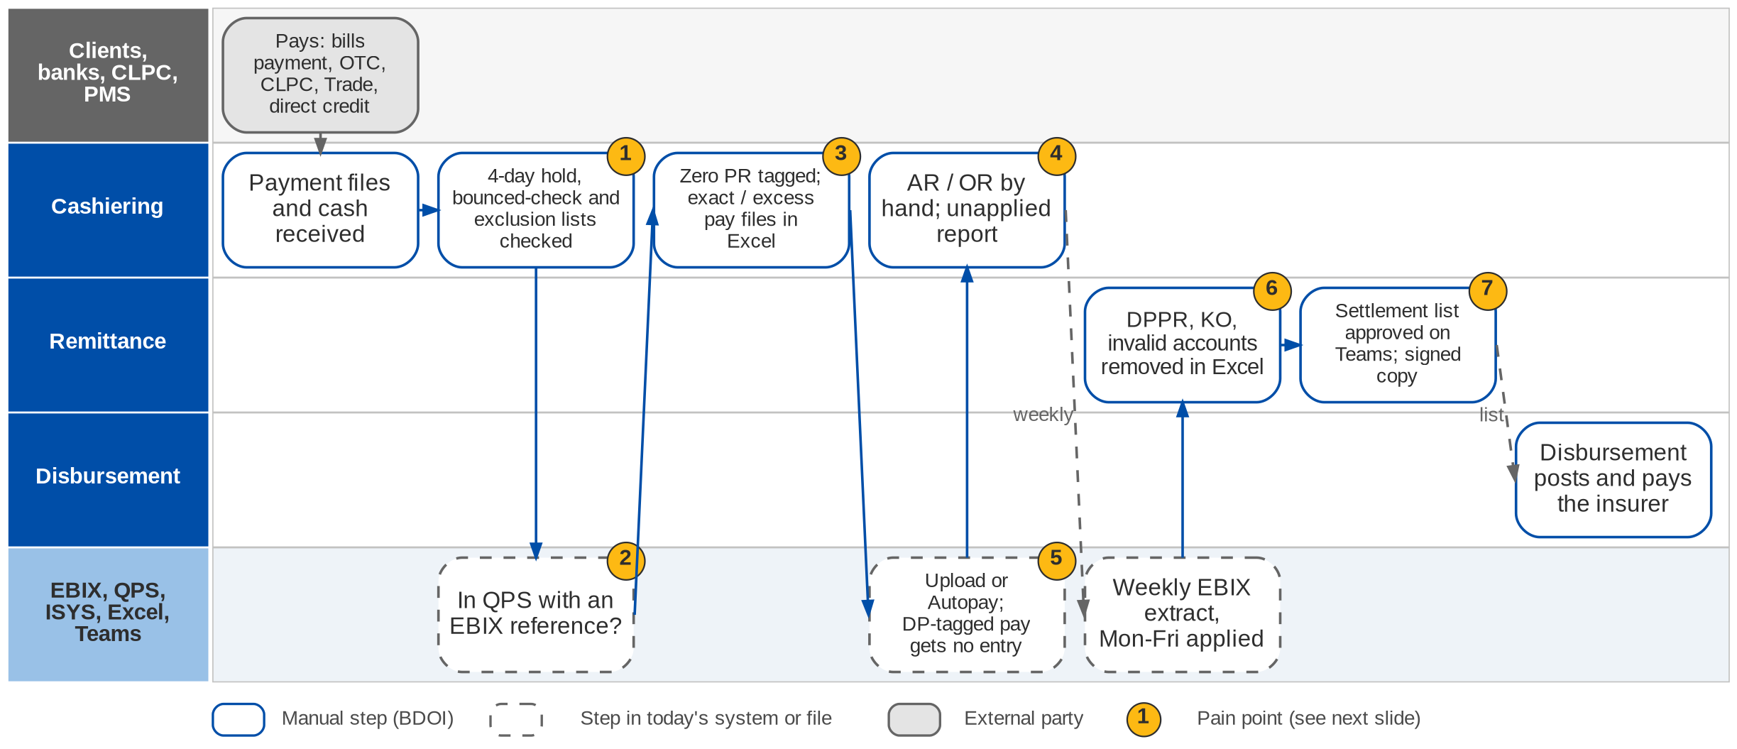
7. Operations: As-Is process (1/3)
Cashiering and Remittance today (Operations process flow; Day 1 p.20-21; CA-01 to CA-05)
Confidential – BDOI
BDOI Business Process Reverse KT | v2.0
95
Notes:
Payment files arrive from bills payment, CLPC, PMS (post-dated checks), Trade, direct credit and the FS04 batch; cash is received at the counter. Before a payment is applied the cashier checks the 4-day hold on checks, the bounced-check list and the exclusion list, and whether the account is in QPS with an EBIX reference. Zero-PR accounts are tagged, and exact-payment, excess-payment and actual-payment files are built before upload or Autopay; items that do not apply end in the unapplied report. Receipts (AR to the client, OR to the insurer) are prepared by hand. When a direct-pay policy is paid to BDOI no premium entry is created (CA-03). Every week Remittance extracts the applied payments of Monday to Friday from EBIX, removes DPPR reversals, knock-offs and invalid accounts in Excel, and has the settlement list approved on an MS Teams list with a signed copy kept for audit; Disbursement then posts and pays the insurer.

Slide 96
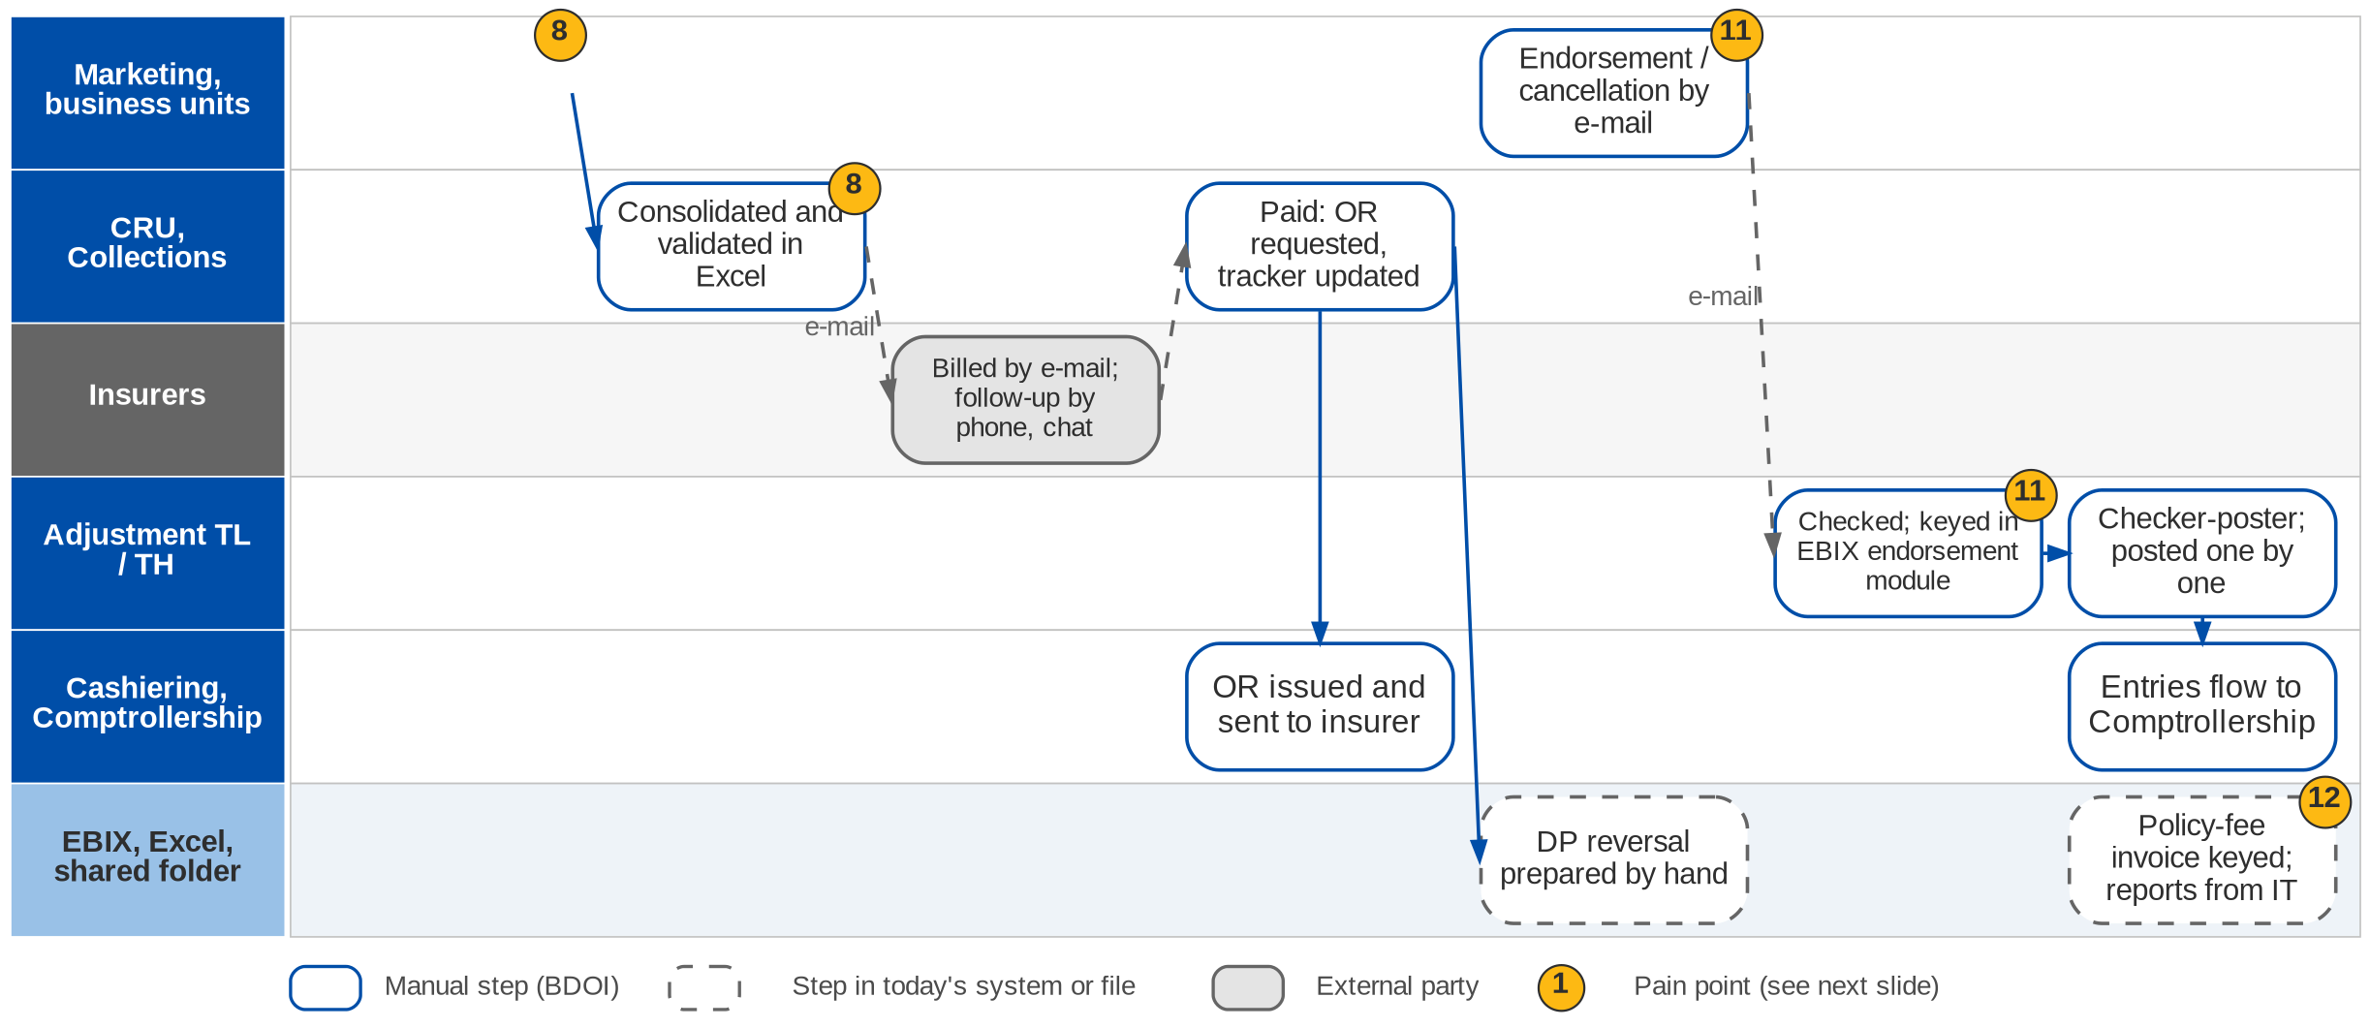
7. Operations: As-Is process (2/3)
Commission receivables (direct payment), Adjustment and policy-fee invoicing today (Operations process flow; Day 1 p.22-23, 25; EN-01)
Confidential – BDOI
BDOI Business Process Reverse KT | v2.0
96
Notes:
When a client pays the insurer directly, BDOI's commission is still due. Each unit lists these direct-payment (DP) transactions in a shared folder; the CRU consolidates the lists in Excel, removes duplicates and validates them against production reports and commission trackers, bills each insurer by e-mail and follows up by e-mail, phone and messaging. When the insurer pays, the CRU asks Cashiering for the OR, sends it to the insurer and prepares the DP reversal by hand. Endorsements and cancellations start with an e-mail from Marketing; Operations checks the documents, keys the request in the EBIX endorsement module and the TL or TH checks and posts each one individually; the entries flow to Comptrollership. Policy-fee (service) invoices are keyed in the EBIX report menu from the schedule of the requestor. Reports are requested from IT.

Slide 97
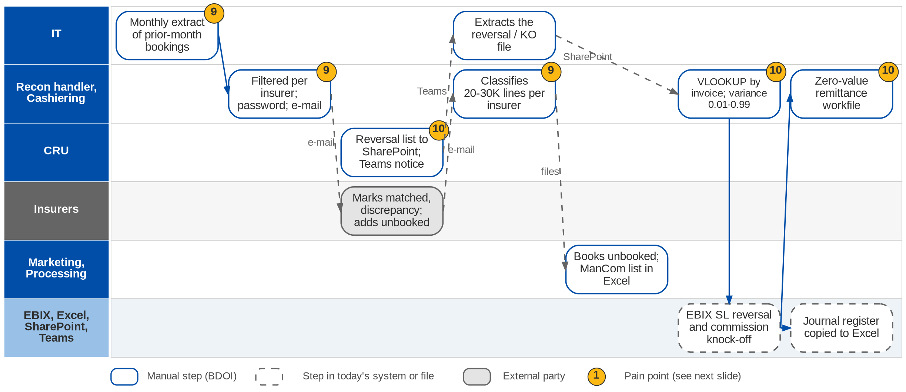
7. Operations: As-Is process (3/3)
Production reconciliation and DPPR / PR2307 reversal today (Operations process flow; Day 1 p.24)
Confidential – BDOI
BDOI Business Process Reverse KT | v2.0
97
Notes:
In the first week of each month IT extracts the accounts booked in the previous month. Operations filters the file per insurer, protects it with a password and e-mails it. The insurer marks matched accounts and discrepancies and adds a file of accounts it has but BDOI has not booked; the handler classifies 20-30 thousand lines per insurer as matched, matched with discrepancies or unbooked, sends the unbooked and discrepancy files to Marketing and Processing and keeps a ManCom masterlist in Excel. For the DPPR / PR2307 reversal the CRU uploads a reversal list to SharePoint and notifies IT on Teams; IT extracts the reversal and knock-off file; Cashiering matches it by invoice number with a VLOOKUP and a variance of 0.01 to 0.99, posts the EBIX sub-ledger reversal and the commission knock-off, copies the journal register to Excel and creates a zero-value remittance workfile for Disbursement.

Slide 98
7. Operations: seven sub-processes at a glance
Sub-process | Trigger and frequency | What happens today | Tools | Volume, rule | Owner
Cashiering | Daily payment files; counter | Checks, split files, upload or Autopay, receipts, unapplied report | EBIX, QPS, ISYS, Excel | ~2,000 rows a file; 4-day hold; 0.99 threshold | Cashiering TL / TH
Remittance | Weekly (Monday to Friday) | Extract applied payments, sanitise, settlement list, approval, hand-off | EBIX, Excel, Teams | Per insurer; signed copy for audit | Remittance TL / TH
Adjustment, cancellation | Marketing e-mail | Validate documents, key in EBIX endorsement module, checker-poster | EBIX, e-mail | Posted one by one; refund with tax | Adjustment TL / TH
Commission receivables (DP) | Monthly DP lists | Consolidate, validate, bill per insurer, follow up, OR, DP reversal | Excel, e-mail, phone | Full premium first; no partial for direct | CRU
Production reconciliation | Monthly, first week | IT extract, per-insurer files, insurer feedback, classification, unbooked follow-up | Excel, e-mail | 20-30K lines per insurer | Recon handler
DPPR / PR2307 reversal | On CRU list | SharePoint list, IT extract, VLOOKUP, SL reversal, knock-off, zero workfile | EBIX, SharePoint, Teams | Variance 0.01-0.99 | CRU, Cashiering
Policy-fee invoicing | Requestor schedule | Key client, risk code, date, amount, branch, allocation; preview; send | EBIX report menu | Status must read Invoiced | Operations
Confidential – BDOI
BDOI Business Process Reverse KT | v2.0
98
Notes:
The seven sub-processes BDOI showed on 23-Sep (Day 1 overview p.20-25 and the Operations process flow). BRD-2 covers all seven; the volumes, frequencies and tolerances in the fifth column come from the floor walk, not the BRD.

Slide 99
7. Operations: pain points today
1
Intake checks by hand
4-day check hold, bounced-check list and exclusion list are checked before each payment is applied.
Operations flow (Cashiering); Day 1 p.20
7
Approval on Teams, signed paper copy
The settlement list is approved on an MS Teams list; a signed copy is kept for audit.
Day 1 p.21
2
Three references per transaction
ISYS invoice no., QPS reference, EBIX reference and payment reference; tracing is slow.
OV-03, CA-01
8
DP commission billed from Excel
Unit lists consolidated by hand, billed by e-mail, chased by phone and chat.
Day 1 p.23; BRD-2 p.11
3
Payment files split in Excel
Zero-PR tagging and exact, excess and actual-payment files are built by hand.
Operations flow (Cashiering)
9
Insurer reconciliation in Excel
20-30K lines per insurer a month, password e-mails, manual classification.
Day 1 p.24; BRD-2 p.11
4
Manual receipts and unapplied
AR and OR are prepared by hand; unapplied items are followed offline.
CA-01, CA-04; BRD-2 p.11
10
Reversals through IT and VLOOKUP
SharePoint and Teams hand-offs, IT extract, manual SL journals, zero-value workfile.
Day 1 p.24; TX-02
5
Direct-pay money without entries
A client payment on a DP-tagged policy creates no premium entry.
CA-03
11
Endorsements by e-mail and keyed
Requests arrive by e-mail; premium is computed outside; posting one by one.
EN-01; BRD-2 p.11
6
Remittance sanitised by hand
Weekly EBIX extract cleaned of reversals, knock-offs and invalid accounts in Excel.
Day 1 p.21; BRD-2 p.11
12
Invoices keyed, reports from IT
Policy-fee invoices keyed in a report menu; reports need IT.
Day 1 p.25; RP-01; BRD-2 p.11
Confidential – BDOI
BDOI Business Process Reverse KT | v2.0
99
Notes:
The twelve points combine the six current-process items of BRD-2 (p.11) with what the process owners showed on the floor. Points 1 to 7 are on the Cashiering and Remittance swimlane, 8, 11 and 12 on the Commission and Adjustment swimlane, 9 and 10 on the Reconciliation and Reversal swimlane.
1. Intake checks by hand: 4-day check hold, bounced-check list and exclusion list are checked before each payment is applied. (Operations flow (Cashiering); Day 1 p.20)
2. Three references per transaction: ISYS invoice no., QPS reference, EBIX reference and payment reference; tracing is slow. (OV-03, CA-01)
3. Payment files split in Excel: Zero-PR tagging and exact, excess and actual-payment files are built by hand. (Operations flow (Cashiering))
4. Manual receipts and unapplied: AR and OR are prepared by hand; unapplied items are followed offline. (CA-01, CA-04; BRD-2 p.11)
5. Direct-pay money without entries: A client payment on a DP-tagged policy creates no premium entry. (CA-03)
6. Remittance sanitised by hand: Weekly EBIX extract cleaned of reversals, knock-offs and invalid accounts in Excel. (Day 1 p.21; BRD-2 p.11)
7. Approval on Teams, signed paper copy: The settlement list is approved on an MS Teams list; a signed copy is kept for audit. (Day 1 p.21)
8. DP commission billed from Excel: Unit lists consolidated by hand, billed by e-mail, chased by phone and chat. (Day 1 p.23; BRD-2 p.11)
9. Insurer reconciliation in Excel: 20-30K lines per insurer a month, password e-mails, manual classification. (Day 1 p.24; BRD-2 p.11)
10. Reversals through IT and VLOOKUP: SharePoint and Teams hand-offs, IT extract, manual SL journals, zero-value workfile. (Day 1 p.24; TX-02)
11. Endorsements by e-mail and keyed: Requests arrive by e-mail; premium is computed outside; posting one by one. (EN-01; BRD-2 p.11)
12. Invoices keyed, reports from IT: Policy-fee invoices keyed in a report menu; reports need IT. (Day 1 p.25; RP-01; BRD-2 p.11)

Slide 100
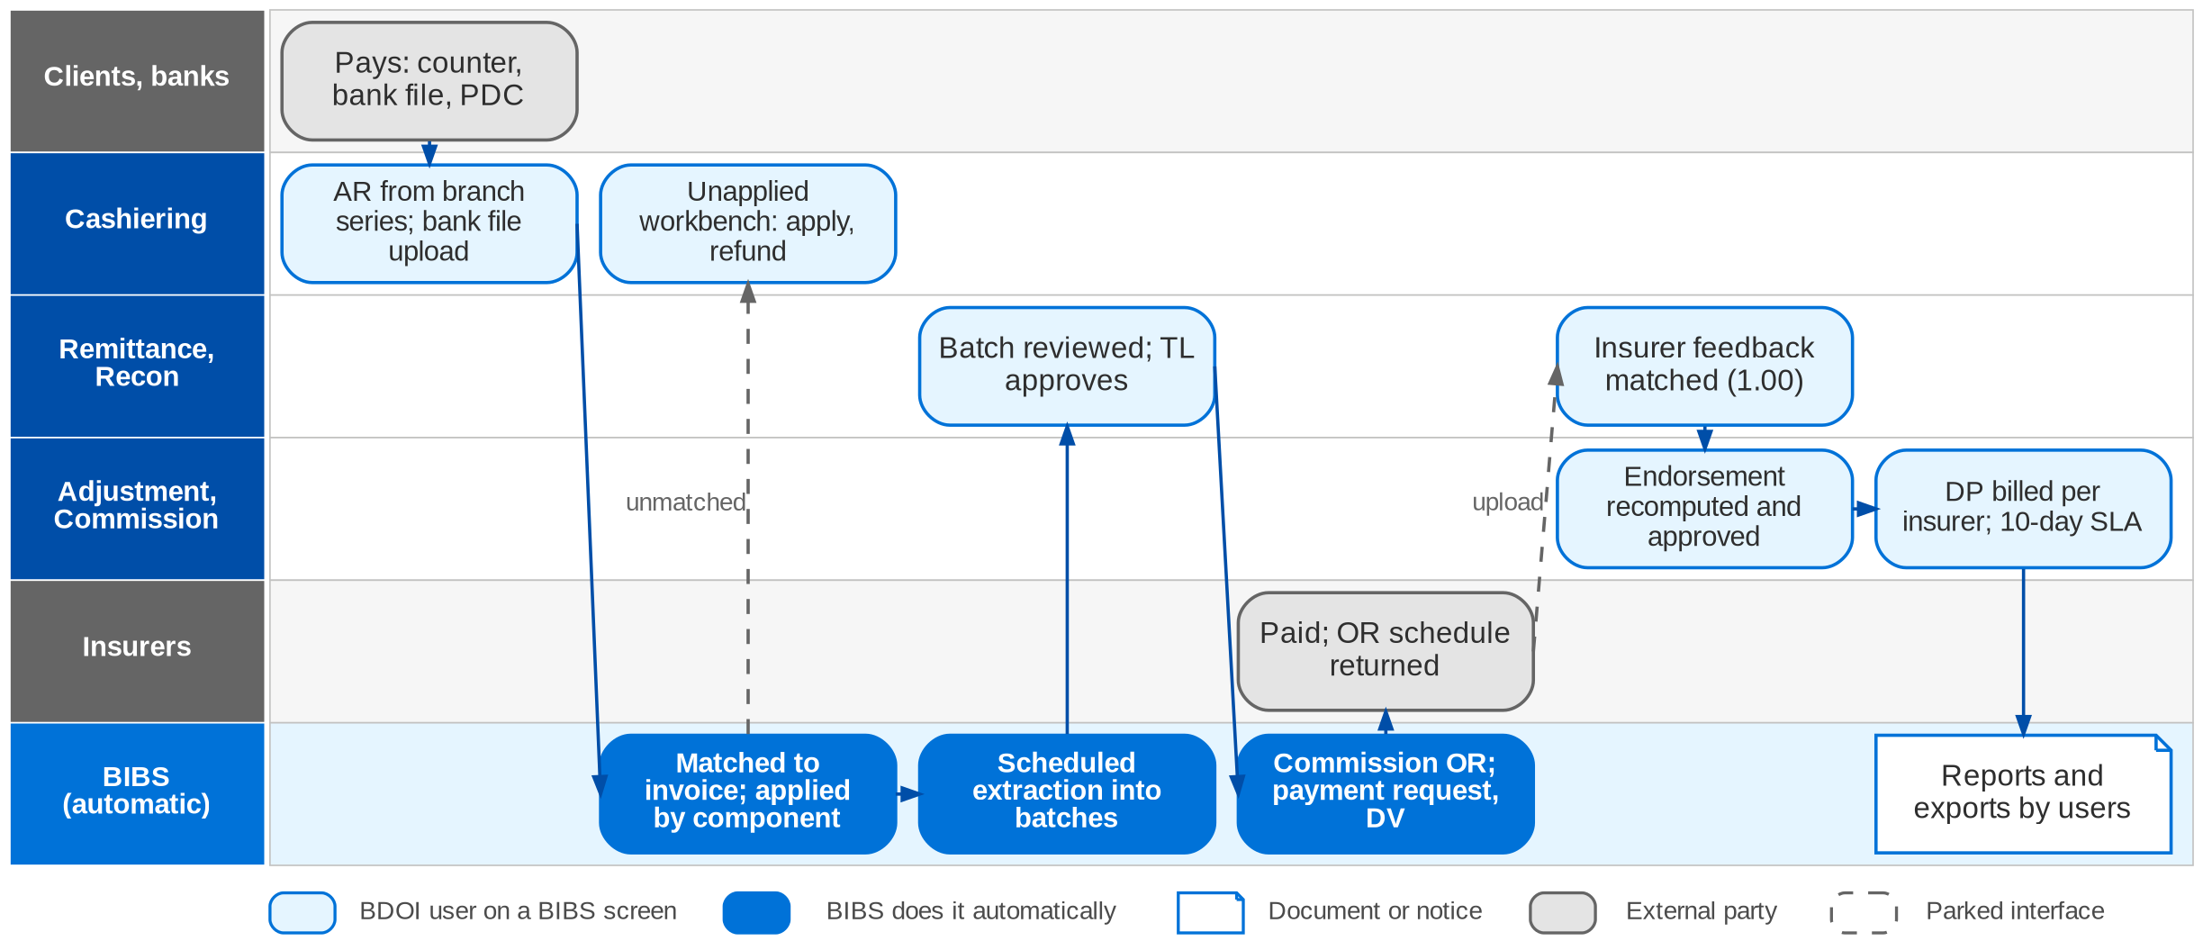
7. Operations: To-Be in the BRD
Life of a booked invoice in BIBS: Cashiering, Remittance, Reconciliation, Adjustment, Commission (FRS BRD-2 section 2.2)
Confidential – BDOI
BDOI Business Process Reverse KT | v2.0
100
Notes:
In BIBS the booked invoice is copied into the invoice ledger with its components. The cashier issues an AR from the branch series; BIBS matches the payment to the invoice and applies it by component, and money it cannot apply goes to the unapplied workbench. A scheduled job extracts paid, cleared and eligible premium into batches per insurer and type; the TL approves the batch (four eyes), which posts the remittance, issues the commission OR and raises the payment request to Disbursement. The insurer's OR schedule is uploaded. The production register goes to the insurer and its feedback is matched within a 1.00 tolerance. Endorsements are requests recomputed per insurer and approved; direct-payment accounts are billed per insurer against a 10-working-day SLA.

Slide 101
7. Operations: how the BRD answers (1/2)
Pain point today
To-Be in the BRD
Benefit
1
Intake checks by hand
Clearing period and bounced-check status checked by the system at acceptance; holds carry a reason
Checks at entry
2
Three references per transaction
The booked invoice carries one ARN and invoice number; legacy references kept for search
One number to trace
3
Payment files split in Excel
Payment matched to the invoice and applied by component; excess goes to unapplied automatically
No split files
4
Manual receipts and unapplied
AR and OR from controlled series per branch; unapplied workbench with disposition and approval
Receipts generated
5
Direct-pay money without entries
DP tag set at quotation and reversed on confirmed collection (MKTID.011-012); a payment on a DP invoice needs a rule (see gaps)
Partly answered
6
Remittance sanitised by hand
Scheduled extraction of paid, cleared and eligible premium into batches per insurer
No manual extract
Confidential – BDOI
BDOI Business Process Reverse KT | v2.0
101

Slide 102
7. Operations: how the BRD answers (2/2)
Pain point today
To-Be in the BRD
Benefit
7
Approval on Teams, signed paper copy
Batch approval in the workflow by a TL / TH who is not the maker; audit trail kept
Four eyes, no paper
8
DP commission billed from Excel
DP lists uploaded, validated, billed per insurer with a 10-working-day SLA; OR on collection
Tracked to closure
9
Insurer reconciliation in Excel
Register sent to the insurer; feedback uploaded and matched within tolerance; unbooked followed
Matching automated
10
Reversals through IT and VLOOKUP
PR2307 tagging and reversal entries generated from the invoice (CSHID.026-027)
No IT extract
11
Endorsements by e-mail and keyed
Endorsement request in the system, premium recomputed per insurer, approved, posted in batches
Computed, not keyed
12
Invoices keyed, reports from IT
Service invoice from the Other Income screen; users run reports and exports themselves
Self-service
Confidential – BDOI
BDOI Business Process Reverse KT | v2.0
102
Notes:
The BRD states the target (unified operations, scheduled extraction, automatic matching, validated entries, tracking) without turnaround targets; the benefit column names the control or the effort the To-Be removes.
1. Intake checks by hand -> Clearing period and bounced-check status checked by the system at acceptance; holds carry a reason Benefit: Checks at entry.
2. Three references per transaction -> The booked invoice carries one ARN and invoice number; legacy references kept for search Benefit: One number to trace.
3. Payment files split in Excel -> Payment matched to the invoice and applied by component; excess goes to unapplied automatically Benefit: No split files.
4. Manual receipts and unapplied -> AR and OR from controlled series per branch; unapplied workbench with disposition and approval Benefit: Receipts generated.
5. Direct-pay money without entries -> DP tag set at quotation and reversed on confirmed collection (MKTID.011-012); a payment on a DP invoice needs a rule (see gaps) Benefit: Partly answered.
6. Remittance sanitised by hand -> Scheduled extraction of paid, cleared and eligible premium into batches per insurer Benefit: No manual extract.
7. Approval on Teams, signed paper copy -> Batch approval in the workflow by a TL / TH who is not the maker; audit trail kept Benefit: Four eyes, no paper.
8. DP commission billed from Excel -> DP lists uploaded, validated, billed per insurer with a 10-working-day SLA; OR on collection Benefit: Tracked to closure.
9. Insurer reconciliation in Excel -> Register sent to the insurer; feedback uploaded and matched within tolerance; unbooked followed Benefit: Matching automated.
10. Reversals through IT and VLOOKUP -> PR2307 tagging and reversal entries generated from the invoice (CSHID.026-027) Benefit: No IT extract.
11. Endorsements by e-mail and keyed -> Endorsement request in the system, premium recomputed per insurer, approved, posted in batches Benefit: Computed, not keyed.
12. Invoices keyed, reports from IT -> Service invoice from the Other Income screen; users run reports and exports themselves Benefit: Self-service.

Slide 103
7. Operations: gaps in the BRD (1/2)
Coverage | Item | What we saw on the floor | What the BRD says | Our recommendation | Ref
Not in BRD | Payment on a direct-pay invoice | The client still pays BDOI; no entry is created (CA-03). | DP tag at quotation (MKTID.011); no rule for cash received on a DP invoice. | Alert at acceptance, park in unapplied with a DP flag, re-tag with approval, define the entries. Raise a High DCR. | CA-03
Not in BRD | Exclusion and bounced-check lists | Checked by hand at intake; tagged "Processed: Exclusion - reason". | Bounced check is a cancel reason only (CSHID.003); exclusion applies to remittance. | Maintained lists with reason codes, checked at acceptance; payor flag "cash only". | Day 1 p.20
Partly in BRD | Check hold | 4 days at Cashiering before application. | 3 banking days at remittance (RMTID.017). | One clearing rule per instrument, configurable; confirm where it applies. | OQ20; RMTID.017
Partly in BRD | Tolerances and threshold account | 0.99 threshold account; 0.01-0.99 reversal variance. | Three other values: 10.00, 1.00, 10-100 (DCR-014). | One tolerance matrix by component, band and approver, with its GL account. | CA-02; DCR-014; OQ11
Not in BRD | Volumes | 20-30K lines per insurer a month; ~2,000-row payment files. | Operations NFR volumes are blank. | Add volume NFRs and test them in the performance test. | CA-05; DCR-025
Partly in BRD | Commission recognition | Only after full premium; co-insurance per insurer; no partial for direct. | Realised on application (CSHID.014); rule for regular commission open. | State the rule per case; align with PFRS 15 (see best practice). | CM-01, CM-02; OQ07
Confidential – BDOI
BDOI Business Process Reverse KT | v2.0
103

Slide 104
7. Operations: gaps in the BRD (2/2)
Coverage | Item | What we saw on the floor | What the BRD says | Our recommendation | Ref
Partly in BRD | Early-remittance incentive | Only on premium sold within credit terms; rates per insurer. | Two definitions (RMTID.023, PRCID.028); no credit-term condition. | One incentive programme per insurer with its condition and rate table. | IC-01, IC-02; DCR-013
Partly in BRD | Remittance approval | Teams list and signed copy. | Workflow approval; approver not named. | Name the approver per insurer or amount; the e-approval replaces the paper copy. | OQ21; CP-01
Partly in BRD | Knock-off entries | Dr Commission Receivable / Cr Insurer; zero-value workfile to Disbursement. | Reversal entries partly given; knock-off not stated. | Define the entries; netting removes the zero cheque. | OQ07; DCR-028
Partly in BRD | Policy-fee invoice | Allocation by branch and department (100%); amounts from a requestor schedule. | Manual service invoice (CORE-08.22); split allocation not stated. | Allow split allocation and a schedule upload. | Day 1 p.25
BDOI to confirm | Excess commission | Motor and Fire computed differently, in the incentive module. | CPC2 package incentive (Add.2 p.8-9). | Confirm that excess commission is CPC2 and give rate and base. | CM-03; DCR-037
BDOI to confirm | One lifecycle reference | Three system references per transaction. | ARN and invoice ledger; legacy references kept. | Confirm one reference from quotation to remittance, printed on every document. | OV-03; AQ29
Confidential – BDOI
BDOI Business Process Reverse KT | v2.0
104
Notes:
Items the floor walk showed that BRD-2 does not state, or states differently. The first two are true gaps; the others are rules or values the BRD must carry. Each becomes a register item (DCR) or an answer to an open question.
[Not in BRD] Payment on a direct-pay invoice. Seen: The client still pays BDOI; no entry is created (CA-03). BRD: DP tag at quotation (MKTID.011); no rule for cash received on a DP invoice. Recommendation: Alert at acceptance, park in unapplied with a DP flag, re-tag with approval, define the entries. Raise a High DCR. (CA-03)
[Not in BRD] Exclusion and bounced-check lists. Seen: Checked by hand at intake; tagged "Processed: Exclusion - reason". BRD: Bounced check is a cancel reason only (CSHID.003); exclusion applies to remittance. Recommendation: Maintained lists with reason codes, checked at acceptance; payor flag "cash only". (Day 1 p.20)
[Partly in BRD] Check hold. Seen: 4 days at Cashiering before application. BRD: 3 banking days at remittance (RMTID.017). Recommendation: One clearing rule per instrument, configurable; confirm where it applies. (OQ20; RMTID.017)
[Partly in BRD] Tolerances and threshold account. Seen: 0.99 threshold account; 0.01-0.99 reversal variance. BRD: Three other values: 10.00, 1.00, 10-100 (DCR-014). Recommendation: One tolerance matrix by component, band and approver, with its GL account. (CA-02; DCR-014; OQ11)
[Not in BRD] Volumes. Seen: 20-30K lines per insurer a month; ~2,000-row payment files. BRD: Operations NFR volumes are blank. Recommendation: Add volume NFRs and test them in the performance test. (CA-05; DCR-025)
[Partly in BRD] Commission recognition. Seen: Only after full premium; co-insurance per insurer; no partial for direct. BRD: Realised on application (CSHID.014); rule for regular commission open. Recommendation: State the rule per case; align with PFRS 15 (see best practice). (CM-01, CM-02; OQ07)
[Partly in BRD] Early-remittance incentive. Seen: Only on premium sold within credit terms; rates per insurer. BRD: Two definitions (RMTID.023, PRCID.028); no credit-term condition. Recommendation: One incentive programme per insurer with its condition and rate table. (IC-01, IC-02; DCR-013)
[Partly in BRD] Remittance approval. Seen: Teams list and signed copy. BRD: Workflow approval; approver not named. Recommendation: Name the approver per insurer or amount; the e-approval replaces the paper copy. (OQ21; CP-01)
[Partly in BRD] Knock-off entries. Seen: Dr Commission Receivable / Cr Insurer; zero-value workfile to Disbursement. BRD: Reversal entries partly given; knock-off not stated. Recommendation: Define the entries; netting removes the zero cheque. (OQ07; DCR-028)
[Partly in BRD] Policy-fee invoice. Seen: Allocation by branch and department (100%); amounts from a requestor schedule. BRD: Manual service invoice (CORE-08.22); split allocation not stated. Recommendation: Allow split allocation and a schedule upload. (Day 1 p.25)
[BDOI to confirm] Excess commission. Seen: Motor and Fire computed differently, in the incentive module. BRD: CPC2 package incentive (Add.2 p.8-9). Recommendation: Confirm that excess commission is CPC2 and give rate and base. (CM-03; DCR-037)
[BDOI to confirm] One lifecycle reference. Seen: Three system references per transaction. BRD: ARN and invoice ledger; legacy references kept. Recommendation: Confirm one reference from quotation to remittance, printed on every document. (OV-03; AQ29)

Slide 105
7. Operations: best practice (1/2)
Unique payment reference
Automated cash application
Bank host-to-host collections
Partly in BRD
Auto cash application
Partly in BRD
Fewer manual matches
Beyond the BRD
Same-day cash visibility
Industry practice: A check-digit reference or virtual account per client or invoice, printed on invoices and SOAs and carried in bank files.
For BDOI: Generate it at booking and ask the bank channels to carry it (OBPCS, direct credit).
Industry practice: Rule and fuzzy matching (payor name, amount tolerance, many-to-one) with confidence scores; the system learns from manual matches.
For BDOI: Extend exact matching with scored suggestions on the unapplied workbench.
Industry practice: Collections through bank APIs, InstaPay / PESONet and QR Ph with intraday notices instead of text files run by IT.
For BDOI: Plan with BDO IT after go-live (CMS / BOB, OBPCS).
Premium trust account discipline
One tolerance and write-off matrix
Partly in BRD
Control
Partly in BRD
Consistency
Industry practice: Premium held in trust for insurers is reconciled daily: bank, unapplied plus amounts due to insurers, and the sub-ledger.
For BDOI: Add a daily three-way reconciliation report; confirm the Insurance Commission rules with Compliance.
Industry practice: Tolerances by component, amount band and approver in one table, each with its GL account.
For BDOI: Replace the four values seen today (DCR-014).
Confidential – BDOI
BDOI Business Process Reverse KT | v2.0
105

Slide 106
7. Operations: best practice (2/2)
Remittance calendar per insurer
Insurer statement reconciliation
Commission recognition under PFRS 15
Partly in BRD
Incentive capture
Partly in BRD
Fewer disputes
BDOI to confirm
Accurate income
Industry practice: Remittance dates per insurer, an automatic remittance advice and the insurer OR returned electronically.
For BDOI: Use the calendar to meet the early-remittance window and earn the incentive.
Industry practice: Insurer statements of account and commission statements matched automatically, differences routed to owners.
For BDOI: Extend production matching to commission statements.
Industry practice: Commission recognised when the placement is done, with a provision for cancellations; collection tracked separately.
For BDOI: Agree the policy with Comptrollership and the auditors.
Incentive accruals
Partly in BRD
Income visibility
Industry practice: Contingent and incentive commission estimated and accrued monthly, trued up when the insurer pays.
For BDOI: Add a monthly accrual to the incentive schemes.
Confidential – BDOI
BDOI Business Process Reverse KT | v2.0
106
Notes:
Practices of insurance brokers that fit BDOI, beyond what the BRD asks; the chip shows how far the BRD already covers each one.
Unique payment reference [Partly in BRD]. A check-digit reference or virtual account per client or invoice, printed on invoices and SOAs and carried in bank files. For BDOI: Generate it at booking and ask the bank channels to carry it (OBPCS, direct credit).
Automated cash application [Partly in BRD]. Rule and fuzzy matching (payor name, amount tolerance, many-to-one) with confidence scores; the system learns from manual matches. For BDOI: Extend exact matching with scored suggestions on the unapplied workbench.
Bank host-to-host collections [Beyond the BRD]. Collections through bank APIs, InstaPay / PESONet and QR Ph with intraday notices instead of text files run by IT. For BDOI: Plan with BDO IT after go-live (CMS / BOB, OBPCS).
Premium trust account discipline [Partly in BRD]. Premium held in trust for insurers is reconciled daily: bank, unapplied plus amounts due to insurers, and the sub-ledger. For BDOI: Add a daily three-way reconciliation report; confirm the Insurance Commission rules with Compliance.
One tolerance and write-off matrix [Partly in BRD]. Tolerances by component, amount band and approver in one table, each with its GL account. For BDOI: Replace the four values seen today (DCR-014).
Remittance calendar per insurer [Partly in BRD]. Remittance dates per insurer, an automatic remittance advice and the insurer OR returned electronically. For BDOI: Use the calendar to meet the early-remittance window and earn the incentive.
Insurer statement reconciliation [Partly in BRD]. Insurer statements of account and commission statements matched automatically, differences routed to owners. For BDOI: Extend production matching to commission statements.
Commission recognition under PFRS 15 [BDOI to confirm]. Commission recognised when the placement is done, with a provision for cancellations; collection tracked separately. For BDOI: Agree the policy with Comptrollership and the auditors.
Incentive accruals [Partly in BRD]. Contingent and incentive commission estimated and accrued monthly, trued up when the insurer pays. For BDOI: Add a monthly accrual to the incentive schemes.

Slide 107
8. Collections: at a glance
Department and roles
Volumes and business rules
How we learned it
Operations - Collections, with Marketing collection staff
• Collection Handler; Marketing AO and Marketing Handler
• Team Lead, Unit Head, Section Heads (Corporate, Retail)
• Unapplied Payment Handler
• Cashiering and Commission (act on dispositions)
• Insurers (credit term extension)
10-15 days
first collection follow-up after booking (Day 1 p.19)
Floor walk: 22-Sep-2026, 3:30-5:00 pm, 43F and 44F; discovery 21 and 24-Sep-2026
Process owners: Sheryne Hernaez, Pia Pinili
• High-level Marketing Collections process flow (current end-to-end manual flow)
• BDOI Day 1 overview p.19
• BRD-4 (CMS BRD) p.40-41; BRCLXN.001-064
60 days
to secure the client's payment commitment (Day 1 p.19)
1,200
dispositions and 1,200 autopay records a day (BRD-4 NFR)
3 routes
deposit, bills payment, direct payment to the insurer
The process in one line
Booking
PR list
Diary
Follow-up
Commitment
CTE
Disposition
Payment check
Confidential – BDOI
BDOI Business Process Reverse KT | v2.0
107
Notes:
Collections follows every unpaid premium from booking until the payment is confirmed and handed to Cashiering. It is relationship-driven: the Marketing AO owns the client and records the client's payment instruction in the Marketing Diary; the Collection Handler follows up, secures a payment commitment and checks the credit term, and the AO asks the insurer for a credit term extension (CTE) when the client needs more time. Premium and commission collection are tracked today in ICS, the Internal Collection System, a call-centre style tool fed from EBIX.
Floor walk: 22-Sep-2026, 3:30-5:00 pm, 43F and 44F; discovery 21 and 24-Sep-2026; Sheryne Hernaez, Pia Pinili.
Sources: High-level Marketing Collections process flow (current end-to-end manual flow); BDOI Day 1 overview p.19; BRD-4 (CMS BRD) p.40-41; BRCLXN.001-064

Slide 108
8. Collections: what we heard on the floor
Ref | Topic | Type | What we heard (As-Is) | What the business wants (To-Be)
CO-01 | Outstanding per client | Pain point | Collection information is captured in a separate system; the outstanding amount per customer is not shown properly. | The correct outstanding amount per customer.
CO-02 | ICS status and ageing | Pain point | ICS (Internal Collection System) tracks premium and commission collection; data flows from EBIX; the handler updates the contact status. After collection the status stays on the last action and ageing keeps running. | Status closes on payment; ageing stops.
CO-03 | Credit policy | Open point | Credit policy to be defined. | BDOI to confirm the credit policy.
Day 1 p.19 | Follow-up rules | Business rule | Newly booked and unpaid: collect within 10-15 days from booking; secure a payment commitment within 60 days; payment by deposit, bills payment or direct payment. | -
Day 1 p.19 | Friction named by BDOI | Pain point | Manual diary and status updates; e-mail-based CTE coordination; several payment-validation sources; follow-up that depends on the handler. | -
Collections flow | Payment check | As-Is | Deposit: check with Cashiering. Bills payment: look in the Unapplied screen. Direct payment: check with the insurer. Then proceed to Cashiering. | -
Confidential – BDOI
BDOI Business Process Reverse KT | v2.0
108
Notes:
Notes of the Collections floor walk (22-Sep) and of the Collections and Commission session (24-Sep).
CO-01 Outstanding per client (Pain point): Collection information is captured in a separate system; the outstanding amount per customer is not shown properly. Wants: The correct outstanding amount per customer.
CO-02 ICS status and ageing (Pain point): ICS (Internal Collection System) tracks premium and commission collection; data flows from EBIX; the handler updates the contact status. After collection the status stays on the last action and ageing keeps running. Wants: Status closes on payment; ageing stops.
CO-03 Credit policy (Open point): Credit policy to be defined. Wants: BDOI to confirm the credit policy.
Day 1 p.19 Follow-up rules (Business rule): Newly booked and unpaid: collect within 10-15 days from booking; secure a payment commitment within 60 days; payment by deposit, bills payment or direct payment.
Day 1 p.19 Friction named by BDOI (Pain point): Manual diary and status updates; e-mail-based CTE coordination; several payment-validation sources; follow-up that depends on the handler.
Collections flow Payment check (As-Is): Deposit: check with Cashiering. Bills payment: look in the Unapplied screen. Direct payment: check with the insurer. Then proceed to Cashiering.

Slide 109
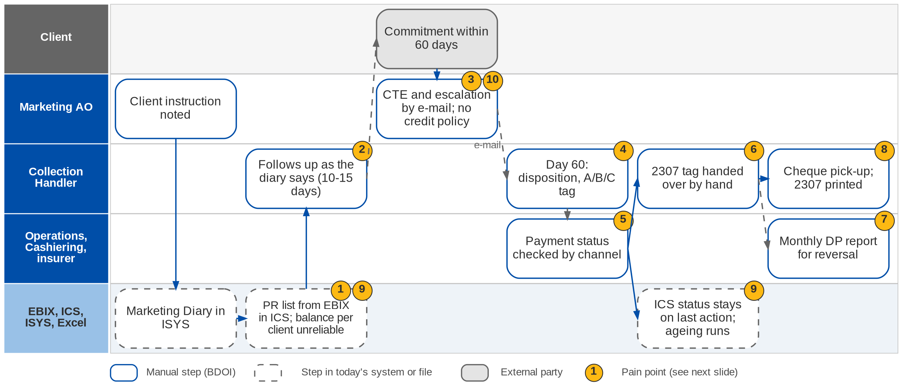
8. Collections: As-Is process
Premium receivable follow-up today (Marketing Collections process flow; BRD-4 p.40-41; CO-01 to CO-03)
Confidential – BDOI
BDOI Business Process Reverse KT | v2.0
109
Notes:
The AO records the client's payment instruction in the Marketing Diary in ISYS. The Collection Handler takes the outstanding-PR list of the market segment and follows up each account as the diary says: new bookings within 10 to 15 days, a payment commitment within 60 days. A commitment outside the credit term goes to the AO by e-mail; the AO asks the insurer for a credit term extension and escalates to the Unit Head. The handler updates the category and remarks and checks the payment by channel with Cashiering, the Unapplied screen or the insurer. In ICS the status stays on the last action and the ageing keeps running after the premium is paid, and the outstanding amount per client is not reliable. CWT 2307 tagging moves from Marketing to Operations by hand, and Operations extracts the Direct Payment report every month for PR reversal.

Slide 110
8. Collections: pain points today
1
PR list and diary in two systems
The handler takes the EBIX list and checks the ISYS Marketing Diary per account.
BRD-4 p.40-41, steps 1-2
6
2307 tagging handed over
A net-of-CWT payment stays a Marketing action until the BIR 2307 is collected.
BRD-4 p.40-41, step 9
2
Follow-up by hand
New bookings within 10-15 days, commitment within 60 days, tracked by the handler.
BRD-4 p.40-41; Day 1 p.19
7
DP report extracted monthly
Operations extracts the Direct Payment report as the basis for PR reversal.
BRD-4 p.40-41, step 10
3
CTE and escalation by e-mail
The AO asks the insurer for a credit term extension and escalates to the Unit Head.
BRD-4 p.40-41; Day 1 p.19
8
Side tasks by e-mail
Cheque pick-up requests and 2307 certificates received by e-mail.
BRD-4 p.40
4
Dispositions kept by hand
Day-60 disposition, category A / B / C and remarks are updated manually.
BRD-4 p.40-41, steps 6-7
9
ICS status and ageing wrong
Status stays on the last action and ageing runs after payment; balance per client unreliable.
CO-01, CO-02
5
Payment status by channel
Deposit with Cashiering, bills payment on the Unapplied screen, direct payment with the insurer.
BRD-4 p.40-41; Collections flow
10
No written credit policy
Credit terms, CTE and cancellation for non-payment are decided case by case.
CO-03
Confidential – BDOI
BDOI Business Process Reverse KT | v2.0
110
Notes:
Points 1 to 8 are the steps of the current process in BRD-4 (p.40-41), which the Marketing Collections flow confirms; points 9 and 10 were raised on the floor.
1. PR list and diary in two systems: The handler takes the EBIX list and checks the ISYS Marketing Diary per account. (BRD-4 p.40-41, steps 1-2)
2. Follow-up by hand: New bookings within 10-15 days, commitment within 60 days, tracked by the handler. (BRD-4 p.40-41; Day 1 p.19)
3. CTE and escalation by e-mail: The AO asks the insurer for a credit term extension and escalates to the Unit Head. (BRD-4 p.40-41; Day 1 p.19)
4. Dispositions kept by hand: Day-60 disposition, category A / B / C and remarks are updated manually. (BRD-4 p.40-41, steps 6-7)
5. Payment status by channel: Deposit with Cashiering, bills payment on the Unapplied screen, direct payment with the insurer. (BRD-4 p.40-41; Collections flow)
6. 2307 tagging handed over: A net-of-CWT payment stays a Marketing action until the BIR 2307 is collected. (BRD-4 p.40-41, step 9)
7. DP report extracted monthly: Operations extracts the Direct Payment report as the basis for PR reversal. (BRD-4 p.40-41, step 10)
8. Side tasks by e-mail: Cheque pick-up requests and 2307 certificates received by e-mail. (BRD-4 p.40)
9. ICS status and ageing wrong: Status stays on the last action and ageing runs after payment; balance per client unreliable. (CO-01, CO-02)
10. No written credit policy: Credit terms, CTE and cancellation for non-payment are decided case by case. (CO-03)

Slide 111
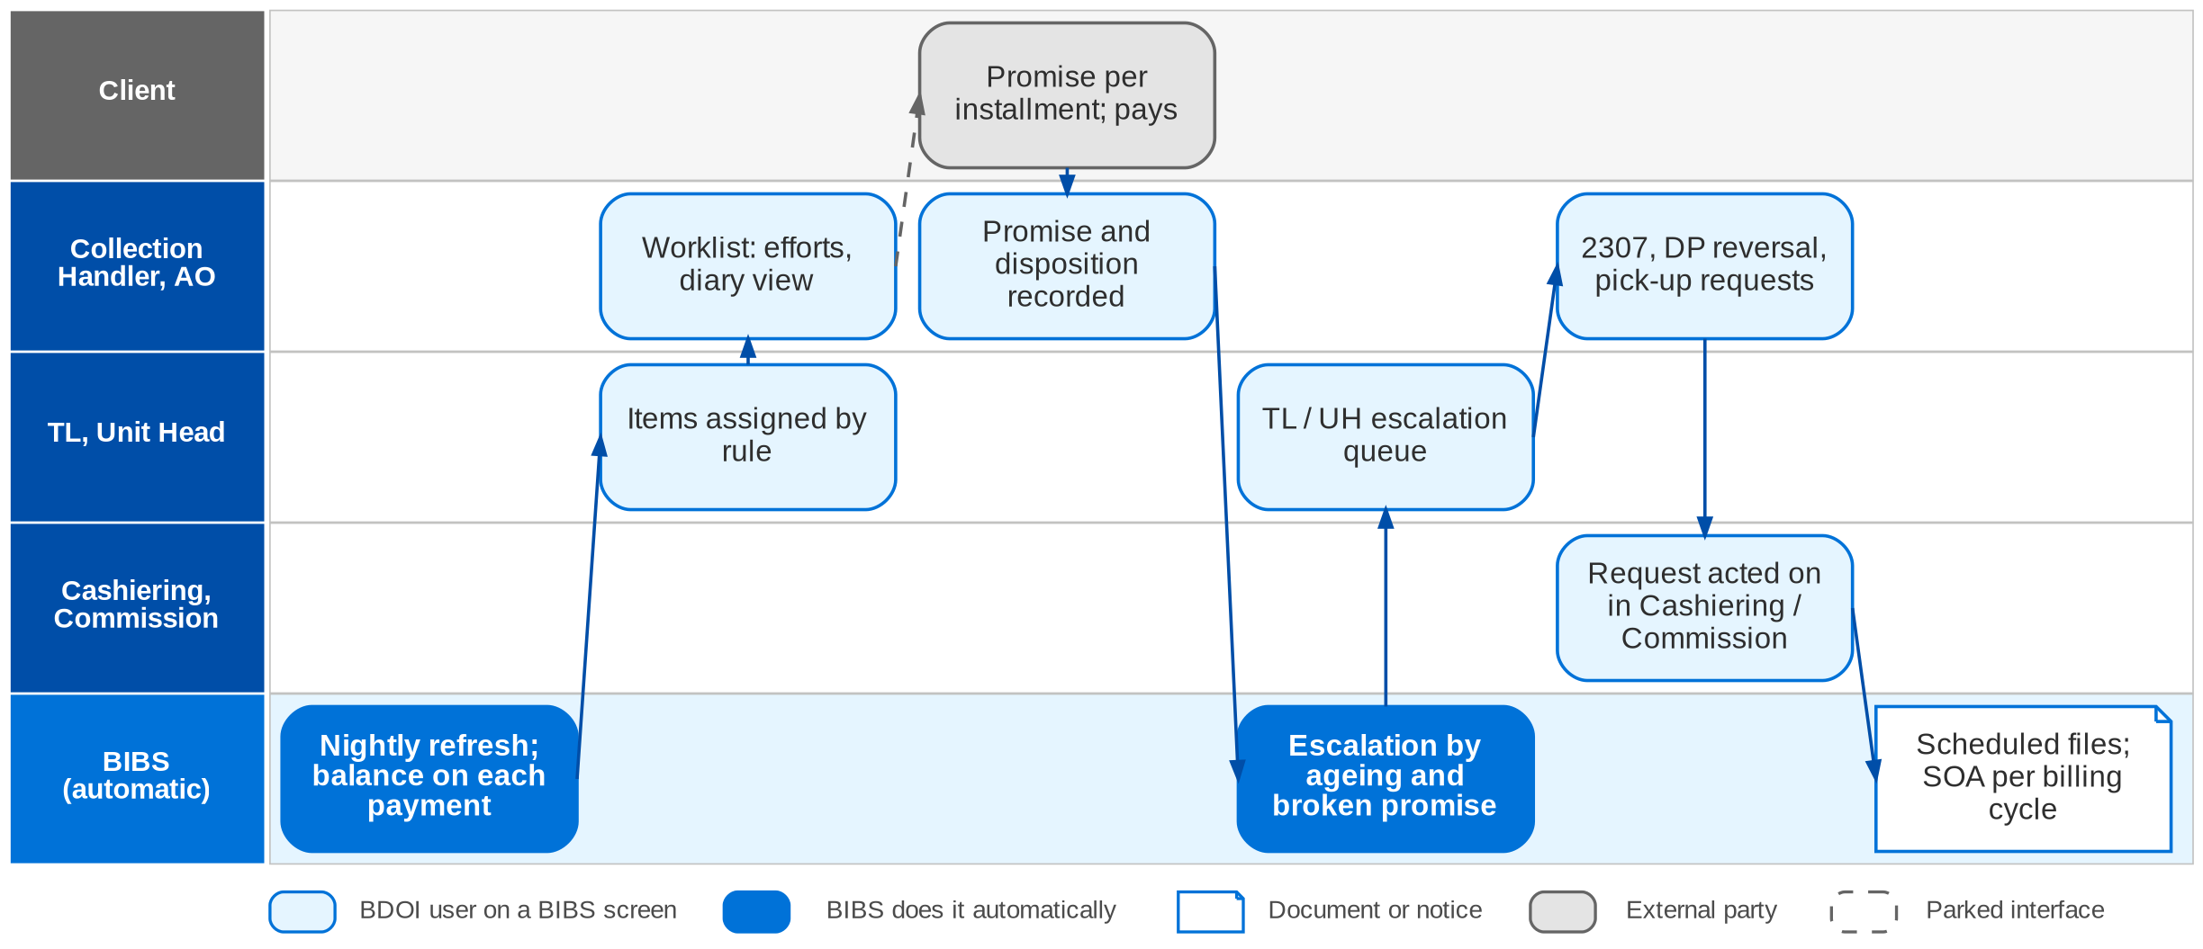
8. Collections: To-Be in the BRD
Collections in BIBS: worklist, promises, escalation (workflow CLX_ESCALATION) and hand-offs (design COLLECTIONS_DESIGN)
Confidential – BDOI
BDOI Business Process Reverse KT | v2.0
111
Notes:
In BIBS a nightly job after the 22:00 end of day turns every invoice with PR above the threshold into a collection item, refreshes existing items and closes items at zero, keeping their history. The TL assigns items by rule (segment, unit, client). The handler records efforts, promises per installment, the collector disposition and the A / B / C category on the item, with the Marketing Diary in view. Rules escalate by ageing, commitments and broken promises to the TL / UH queue. Dispositions for Operations become in-app requests: "PR 2307 for reversal" to Cashiering, "DP PR for reversal" to Commission, "for check pick-up" to the Cashiering queue. The monthly and weekly files are produced on schedule, and billing statements are issued per billing cycle of multi-year policies.

Slide 112
8. Collections: how the BRD answers (1/2)
Pain point today
To-Be in the BRD
Benefit
1
PR list and diary in two systems
One worklist read from the invoice ledger, with the Marketing Diary in view on the item
Refreshed nightly
2
Follow-up by hand
Efforts, promises per instalment and reminders recorded on the collection item
History kept per item
3
CTE and escalation by e-mail
Escalation rules by ageing, commitments and broken promises; manual escalation, also in bulk
TL / UH queue by rule
4
Dispositions kept by hand
Disposition from a list of values with category A / B / C; append-only history
Audit per field
5
Payment status by channel
Payment status, balances and co-insurance shares read from the invoice ledger
Same-day balance
Confidential – BDOI
BDOI Business Process Reverse KT | v2.0
112

Slide 113
8. Collections: how the BRD answers (2/2)
Pain point today
To-Be in the BRD
Benefit
6
2307 tagging handed over
"PR 2307 for reversal" goes to the Cashiering 2307 intake as an in-app request
No e-mail hand-off
7
DP report extracted monthly
DP-for-reversal file on the first working day; the same list goes to Commission
Ready on day 1
8
Side tasks by e-mail
Cheque pick-up request placed on the Cashiering queue from the item
Request tracked
9
ICS status and ageing wrong
Item closes as completed when the balance reaches zero or the threshold; ageing stops; balance summed per client (BRCLXN.003, 008, 022)
Accurate ageing
10
No written credit policy
Configurable escalation days only (BRCLXN.049); the credit policy itself is not in the BRD
Gap: see next slide
Confidential – BDOI
BDOI Business Process Reverse KT | v2.0
113
Notes:
The benefit column names the control or the effort the To-Be removes.
1. PR list and diary in two systems -> One worklist read from the invoice ledger, with the Marketing Diary in view on the item Benefit: Refreshed nightly.
2. Follow-up by hand -> Efforts, promises per instalment and reminders recorded on the collection item Benefit: History kept per item.
3. CTE and escalation by e-mail -> Escalation rules by ageing, commitments and broken promises; manual escalation, also in bulk Benefit: TL / UH queue by rule.
4. Dispositions kept by hand -> Disposition from a list of values with category A / B / C; append-only history Benefit: Audit per field.
5. Payment status by channel -> Payment status, balances and co-insurance shares read from the invoice ledger Benefit: Same-day balance.
6. 2307 tagging handed over -> "PR 2307 for reversal" goes to the Cashiering 2307 intake as an in-app request Benefit: No e-mail hand-off.
7. DP report extracted monthly -> DP-for-reversal file on the first working day; the same list goes to Commission Benefit: Ready on day 1.
8. Side tasks by e-mail -> Cheque pick-up request placed on the Cashiering queue from the item Benefit: Request tracked.
9. ICS status and ageing wrong -> Item closes as completed when the balance reaches zero or the threshold; ageing stops; balance summed per client (BRCLXN.003, 008, 022) Benefit: Accurate ageing.
10. No written credit policy -> Configurable escalation days only (BRCLXN.049); the credit policy itself is not in the BRD Benefit: Gap: see next slide.

Slide 114
8. Collections: gaps in the BRD
Coverage | Item | What we saw on the floor | What the BRD says | Our recommendation | Ref
Not in BRD | Credit policy | Credit terms, CTE and non-payment decided case by case (CO-03). | Credit term is only a diary field; escalation days configurable. | Write the policy: terms per segment and product, CTE approval with the insurer, cancellation request at day N (Insurance Code s.77). | CO-03; CQ20
Partly in BRD | 10-15 and 60-day rules | Stated on the floor as the working rules. | Described as today's process; defaults of the escalation rule open. | Set them as the default rule values, per segment. | Day 1 p.19; CQ14
Partly in BRD | CTE with the insurer | Requested and approved by e-mail. | CTE is an effort code; no request or approval record. | A CTE request with the insurer's answer and new due date on the item. | Collections flow; CQ20
Partly in BRD | Day-60 outcome | Cancel, coordinate or refer to the bank AO. | Disposition list; no hand-off to Adjustment. | Raise the cancellation request from the collection item. | BRCLXN.016
Partly in BRD | Marketing Diary | Kept in ISYS by the AO. | Diary shown on the item; in BIBS or interfaced is undecided. | Keep the diary in BIBS so AO and handler share one record. | CQ20
BDOI to confirm | Commission tracked in ICS | ICS also tracks commission collection. | Commission follow-up sits with CRU (CMRID); BRCLXN.061-064 only in the draft. | Confirm the owner of commission follow-up. | CO-02; DCR-039
Confidential – BDOI
BDOI Business Process Reverse KT | v2.0
114
Notes:
The credit policy is the one true gap: it drives the follow-up days, the CTE and the cancellation for non-payment.
[Not in BRD] Credit policy. Seen: Credit terms, CTE and non-payment decided case by case (CO-03). BRD: Credit term is only a diary field; escalation days configurable. Recommendation: Write the policy: terms per segment and product, CTE approval with the insurer, cancellation request at day N (Insurance Code s.77). (CO-03; CQ20)
[Partly in BRD] 10-15 and 60-day rules. Seen: Stated on the floor as the working rules. BRD: Described as today's process; defaults of the escalation rule open. Recommendation: Set them as the default rule values, per segment. (Day 1 p.19; CQ14)
[Partly in BRD] CTE with the insurer. Seen: Requested and approved by e-mail. BRD: CTE is an effort code; no request or approval record. Recommendation: A CTE request with the insurer's answer and new due date on the item. (Collections flow; CQ20)
[Partly in BRD] Day-60 outcome. Seen: Cancel, coordinate or refer to the bank AO. BRD: Disposition list; no hand-off to Adjustment. Recommendation: Raise the cancellation request from the collection item. (BRCLXN.016)
[Partly in BRD] Marketing Diary. Seen: Kept in ISYS by the AO. BRD: Diary shown on the item; in BIBS or interfaced is undecided. Recommendation: Keep the diary in BIBS so AO and handler share one record. (CQ20)
[BDOI to confirm] Commission tracked in ICS. Seen: ICS also tracks commission collection. BRD: Commission follow-up sits with CRU (CMRID); BRCLXN.061-064 only in the draft. Recommendation: Confirm the owner of commission follow-up. (CO-02; DCR-039)

Slide 115
8. Collections: best practice
Segmented dunning strategies
Written credit policy in the system
Pay-by-link, QR Ph, e-wallets
Partly in BRD
Faster cash
Not in BRD
Compliance
Beyond the BRD
Convenience
Industry practice: Pre-due and overdue reminders by SMS and e-mail, with a strategy per segment and risk.
For BDOI: Add client-facing reminders to the escalation rules.
Industry practice: Credit terms per segment and product, CTE workflow with the insurer, automatic cancellation request at day N.
For BDOI: Approve the policy, then configure it (CO-03).
Industry practice: Payment links in reminders and SOAs, applied straight through.
For BDOI: Add after go-live with the bank channels.
Collection KPIs
Client self-service statement
Promise-to-pay discipline
Partly in BRD
Visibility
Partly in BRD
Fewer calls
In the BRD
Accountability
Industry practice: Days sales outstanding, collection effectiveness, promises kept, roll rates; prioritise by likelihood to pay.
For BDOI: Build a Collections dashboard on the worklist.
Industry practice: Clients see their statement and payment history online or through the contact centre.
For BDOI: Start with the SOA through the contact centre (BRCLXN.058).
Industry practice: Promises per instalment with reminders and broken-promise escalation.
For BDOI: Agree the escalation days per segment.
Confidential – BDOI
BDOI Business Process Reverse KT | v2.0
115
Notes:
Practices of insurance brokers that fit BDOI, beyond what the BRD asks; the chip shows how far the BRD already covers each one.
Segmented dunning strategies [Partly in BRD]. Pre-due and overdue reminders by SMS and e-mail, with a strategy per segment and risk. For BDOI: Add client-facing reminders to the escalation rules.
Written credit policy in the system [Not in BRD]. Credit terms per segment and product, CTE workflow with the insurer, automatic cancellation request at day N. For BDOI: Approve the policy, then configure it (CO-03).
Pay-by-link, QR Ph, e-wallets [Beyond the BRD]. Payment links in reminders and SOAs, applied straight through. For BDOI: Add after go-live with the bank channels.
Collection KPIs [Partly in BRD]. Days sales outstanding, collection effectiveness, promises kept, roll rates; prioritise by likelihood to pay. For BDOI: Build a Collections dashboard on the worklist.
Client self-service statement [Partly in BRD]. Clients see their statement and payment history online or through the contact centre. For BDOI: Start with the SOA through the contact centre (BRCLXN.058).
Promise-to-pay discipline [In the BRD]. Promises per instalment with reminders and broken-promise escalation. For BDOI: Agree the escalation days per segment.

Slide 116
Part D
Comptrollership
Accounting (FRBS), Disbursement, ACSL, refunds, tax and BIR
9. Accounting, Disbursement and ACSL BRD-5
Confidential – BDOI | BDOI Business Process Reverse KT
Notes:
Accounting (FRBS), Disbursement, ACSL, refunds, tax and BIR

Slide 117
9. Accounting: at a glance
Department and roles
Volumes and business rules
How we learned it
Comptrollership: FRBS (GL team), Disbursement, ACSL
• FRBS Accounting Assistant, TL, TH (GL set-up, journals, reconciliation, close)
• Disbursement Processor (DPO), TL (DTL), Section Head (DSH), Unit Head (DUH)
• ACSL Accounting Processor and AP TL; FRBS approver
• Marketing AO, Marketing Admin, UPP and Marketing Support (refund requests)
• MBS, UPP handler (payee upkeep); IT Operations; BDO TPD and branches
3 levels
of signed approval: DTL, DSH, DUH (DS-01)
Floor walk: 23-Sep-2026, 10:00 am-12:00 nn, 44F; discovery 21 and 23-Sep-2026
Process owners: Rodrigo Dela Cruz, Cherry Francisco, Lineth Santos, Guada Jane Pelo (Disbursement), Iris Marquez, Fatima Joy Aguas and 5 more (floor-walk coverage slide)
• High-level flows: Disbursement (in-system, online banking, outside the system, government), Refund Request (five segments), FRBS GL, ACSL
• BDOI Day 1 overview p.26-27
• BRD-5 p.44-48; DIS, MKT, FRBS, ACSL requirement families
5
refund approval chains, one per segment (Refund Request flow)
8
branches to tag with profit and cost centres (FN-01)
15% / 2%
withholding tax on commission / on suppliers (TX-01, TX-03)
The process in one line
Request
Payee
Voucher
Approvals
Payment
GL entry
Reconciliation
Close and report
Confidential – BDOI
BDOI Business Process Reverse KT | v2.0
117
Notes:
Comptrollership turns every business event into accounting and pays everyone BDOI owes: insurers (remittance), clients (refunds), suppliers, employees and the government. Disbursement runs four routes (in the system, online banking, bank instruments outside the system and government payments) with three levels of signed approval. FRBS keeps the chart of accounts, reviews the reports IT prepares, reconciles, posts manual journals and closes the books at day, month and year end. ACSL keeps the accounts sub-ledger clean by finding abnormal balances and posting adjustments. Refund requests start in Marketing with five different approval chains.
Floor walk: 23-Sep-2026, 10:00 am-12:00 nn, 44F; discovery 21 and 23-Sep-2026; Rodrigo Dela Cruz, Cherry Francisco, Lineth Santos, Guada Jane Pelo (Disbursement); Iris Marquez, Fatima Joy Aguas, Cherie Jocson (FRBS); Jeniffer Lugtu, Mario Sabangan, Jennifer Carinan, Freddie Atanque (ACSL).
Sources: High-level flows: Disbursement (in-system, online banking, outside the system, government), Refund Request (five segments), FRBS GL, ACSL; BDOI Day 1 overview p.26-27; BRD-5 p.44-48; DIS, MKT, FRBS, ACSL requirement families

Slide 118
9. Accounting: what we heard on the floor (1/3)
Ref | Topic | Type | What we heard (As-Is) | What the business wants (To-Be)
DS-01 | Approval | Business rule | Multi-level approval with maker and checker. | -
DS-02 | Settlement types | As-Is | Remittance and settlement cover insurer payments, customer payments and sundry creditors; client premium refunds are also settled here. | -
DS-03 | Working file | Pain point | For individual companies a working file is prepared and sent to the Disbursement team. | -
DS-04 | Payment mode | Pain point | Remittance is always processed in batch. The mode of payment is captured outside the system, as most modes are not in the system. | -
DS-05 | Entries | User aspiration | Remittance entries pass through intermediate accounts. | Debit Cash in Bank and credit the insurance company directly.
TX-01 | WHT on commission | Business rule | WHT on commission is 15% during remittance processing. | -
Confidential – BDOI
BDOI Business Process Reverse KT | v2.0
118

Slide 119
9. Accounting: what we heard on the floor (2/3)
Ref | Topic | Type | What we heard (As-Is) | What the business wants (To-Be)
TX-03 | WHT certificate | User aspiration | Certificates prepared outside the system. | 2% WHT certificate (BIR 2307) generated for suppliers.
TX-04 | BIR reports | Business rule | Monthly, from the trial balance and sub-ledger; WHT based on disbursements; the tax code changes by supplier. | -
TX-05 | VAT | Business rule | Input VAT quarterly from the sub-ledger; output VAT the same. | -
RC-01 | Reconciliation | Open point | Bank reconciliation and insurer reconciliation (premium and commission). | Detail during the floor walk.
RC-02 | Insurer reconciliation | User aspiration | Done on statements of account. | Insurer reconciliation account-wise.
FN-01 | Branches | User aspiration | BDOI has 8 branches. | Profit centre and cost centre tagged and mapped.
Confidential – BDOI
BDOI Business Process Reverse KT | v2.0
119

Slide 120
9. Accounting: what we heard on the floor (3/3)
Ref | Topic | Type | What we heard (As-Is) | What the business wants (To-Be)
RP-01 | Reports | Pain point | Reports are made by hand: data pulled from several systems and consolidated, with IT help. | Business units run reports themselves.
OI-01 | Other income | User aspiration | Other income recorded outside a standard invoice. | Other income registered through invoicing.
OI-02 | Service fee | Business rule | A service invoice records other income; WHT rate differs by income type; VAT applies; OR issued after. | -
OI-03 | Referral fee | Pain point | Referral is treated as a service fee, credited from an Excel list. | -
Confidential – BDOI
BDOI Business Process Reverse KT | v2.0
120
Notes:
Notes of the Cashiering, Other Income, Disbursement and Tax session (23-Sep) and of the Comptrollership floor walk.
DS-01 Approval (Business rule): Multi-level approval with maker and checker.
DS-02 Settlement types (As-Is): Remittance and settlement cover insurer payments, customer payments and sundry creditors; client premium refunds are also settled here.
DS-03 Working file (Pain point): For individual companies a working file is prepared and sent to the Disbursement team.
DS-04 Payment mode (Pain point): Remittance is always processed in batch. The mode of payment is captured outside the system, as most modes are not in the system.
DS-05 Entries (User aspiration): Remittance entries pass through intermediate accounts. Wants: Debit Cash in Bank and credit the insurance company directly.
TX-01 WHT on commission (Business rule): WHT on commission is 15% during remittance processing.
TX-03 WHT certificate (User aspiration): Certificates prepared outside the system. Wants: 2% WHT certificate (BIR 2307) generated for suppliers.
TX-04 BIR reports (Business rule): Monthly, from the trial balance and sub-ledger; WHT based on disbursements; the tax code changes by supplier.
TX-05 VAT (Business rule): Input VAT quarterly from the sub-ledger; output VAT the same.
RC-01 Reconciliation (Open point): Bank reconciliation and insurer reconciliation (premium and commission). Wants: Detail during the floor walk.
RC-02 Insurer reconciliation (User aspiration): Done on statements of account. Wants: Insurer reconciliation account-wise.
FN-01 Branches (User aspiration): BDOI has 8 branches. Wants: Profit centre and cost centre tagged and mapped.
RP-01 Reports (Pain point): Reports are made by hand: data pulled from several systems and consolidated, with IT help. Wants: Business units run reports themselves.
OI-01 Other income (User aspiration): Other income recorded outside a standard invoice. Wants: Other income registered through invoicing.
OI-02 Service fee (Business rule): A service invoice records other income; WHT rate differs by income type; VAT applies; OR issued after.
OI-03 Referral fee (Pain point): Referral is treated as a service fee, credited from an Excel list.

Slide 121
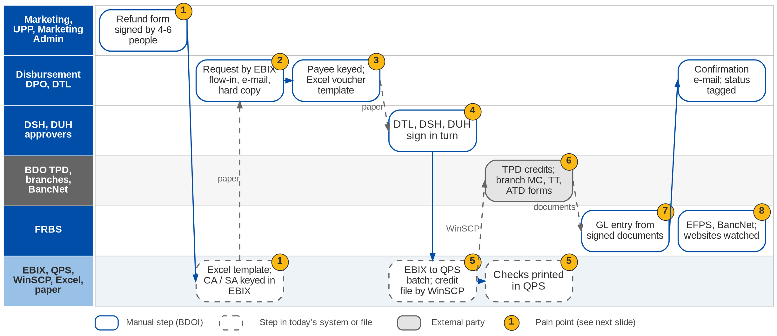
9. Accounting: As-Is process (1/2)
Refunds and Disbursement today (Refund Request and Disbursement process flows; Day 1 p.27; DS-01 to DS-05)
Confidential – BDOI
BDOI Business Process Reverse KT | v2.0
121
Notes:
A refund starts with a Refund Request Form (client ID, CA / SA or check details, amount, reason) that the AO fills in; depending on the segment it goes through four to six signatures, and Marketing Admin, Collections or UPP fills an Excel template and keys the CA / SA in EBIX. Disbursement receives requests through the EBIX flow-in, by e-mail or on paper. Payee details are kept by MBS (insurers), the UPP handler (clients) and the DTL (sundry creditors). The DPO prepares the Excel disbursement template and bank forms; the DTL, DSH and DUH sign in turn. In-system payments run from EBIX to QPS by an IT batch, and the credit file is sent through WinSCP to the Transaction Processing Department (TPD); checks are printed in QPS. Credit tickets, ATDs, manager's checks, demand drafts and telegraphic transfers are bank forms done at a BDO branch. The signed documents go to FRBS for the GL entry. FRBS files taxes in EFPS and pays SSS, Pag-IBIG and PhilHealth through BancNet, then watches the government websites.

Slide 122
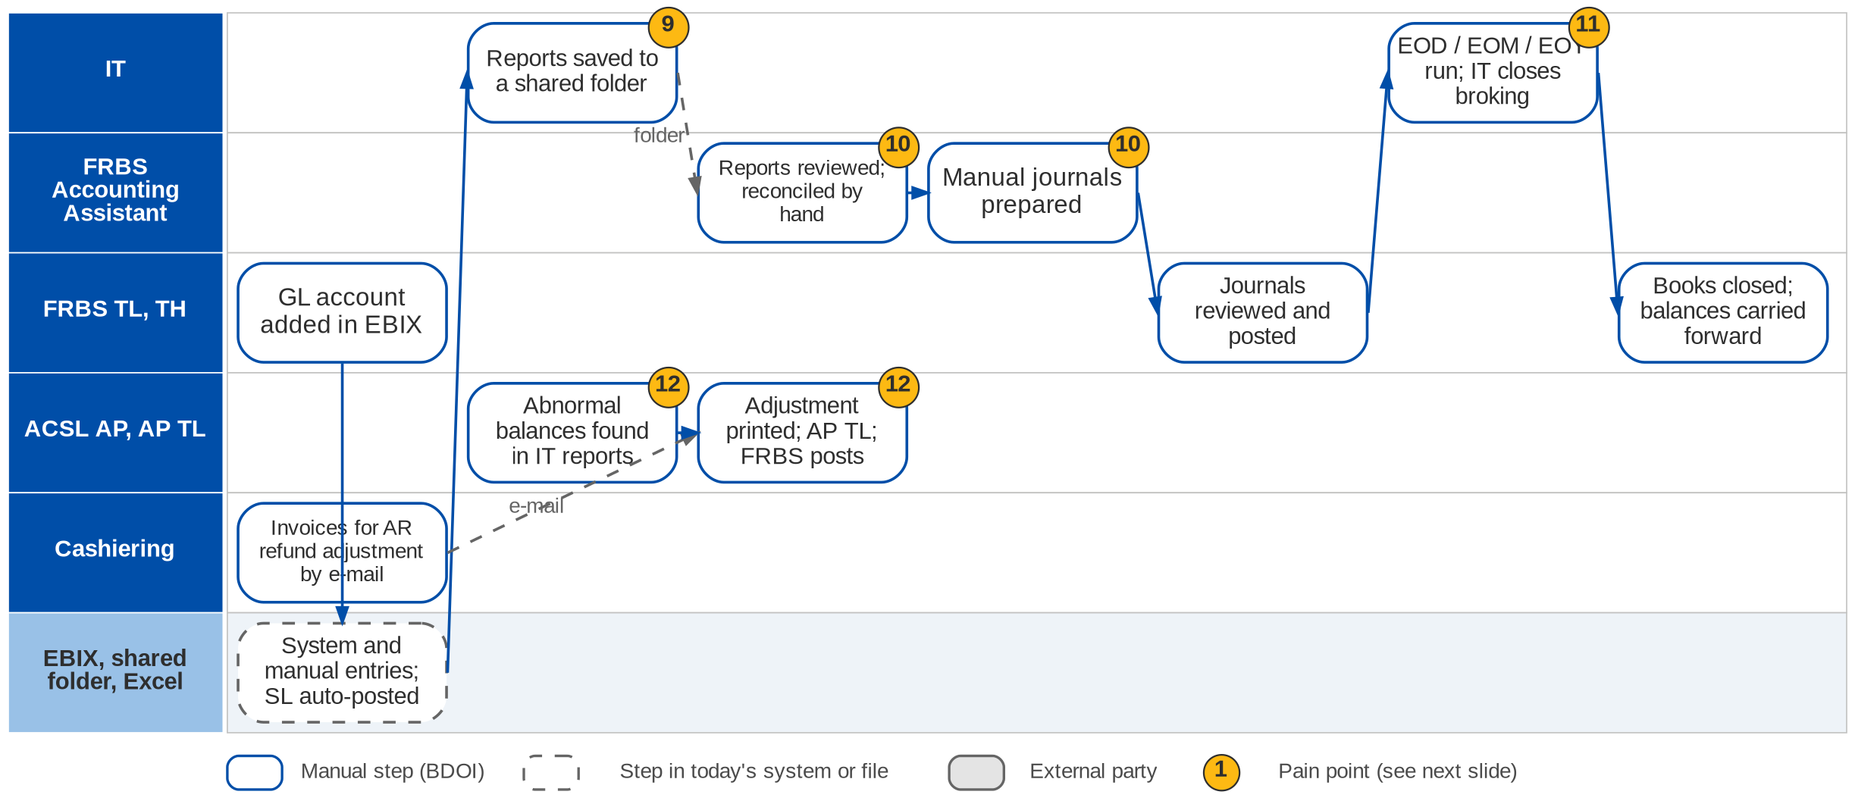
9. Accounting: As-Is process (2/2)
General ledger, close and ACSL today (FRBS Accounting and ACSL process flows; Day 1 p.26)
Confidential – BDOI
BDOI Business Process Reverse KT | v2.0
122
Notes:
FRBS team leads add GL accounts in the EBIX account maintenance; EBIX creates entries from the source transactions and FRBS adds manual entries; sub-ledgers post automatically. IT generates the required reports and saves them in a shared folder; the accounting assistant reviews them, reconciles and prepares manual journals that the TL or TH reviews and posts. At day, month and year end IT extracts the output reports and closes the broking transactions before FRBS triggers the closing of the books and the balances are carried forward. ACSL receives reports from IT (PR, DTIP, CRU), looks for abnormal balances, analyses the invoices, prints the adjustment for the AP TL and routes it to an FRBS approver for posting; Cashiering e-mails invoices due for AR refund adjustment.

Slide 123
9. Accounting: refund chains and payment routes (1/2)
Route or segment | Starts with | Approvals today | Keyed or executed by | Hand-off
Refund: Non-CBG Retail | AO fills the RRF | MTL, TH, then MAD TL and Marketing UH | Marketing Admin (Excel, EBIX) | MAD TL to Disbursement
Refund: Non-CBG Corporate | AO fills the RRF | MAD review, MAD TL, Marketing UH | Marketing Admin | MAD TL to Disbursement
Refund: CBG Motor | AO instructs the UPP AO; bank confirms account name | Approver 1, Approver 2, UH | Approver 2 keys in EBIX | UPP AO to Disbursement
Refund: CBG Fire | AO instructs Marketing Support | MS TL, UH | MS TL keys CA / SA | Paper and scanned copy
Refund: Non-CBG Branches | AO fills the RRF | MTL, UH, then Collections TL and UH | Collections Processor | CP to Disbursement
Confidential – BDOI
BDOI Business Process Reverse KT | v2.0
123

Slide 124
9. Accounting: refund chains and payment routes (2/2)
Route or segment | Starts with | Approvals today | Keyed or executed by | Hand-off
Pay: in the system | EBIX flow-in (remittance, refunds) | DSH approves and posts; DTL runs end of day | IT batch EBIX to QPS; WinSCP to TPD | TPD returns processed list
Pay: online banking | Hard-copy request | DTL, second DTL verifier, DSH, DUH; two online authorisations | DTL in online banking | Signed documents to FRBS
Pay: outside the system | Hard-copy request | DTL, DSH, DUH | DPO: CT, ATD, MC, DD, TT forms at a BDO branch | Bank confirmation e-mail
Pay: government | Tax and contribution due dates | DTL maker, DSH, DUH | FRBS SH in EFPS; BancNet for SSS, Pag-IBIG, PhilHealth | 24-hour posting; website check
Confidential – BDOI
BDOI Business Process Reverse KT | v2.0
124
Notes:
From the Refund Request and Disbursement flows confirmed by the process owners (Dec 2025). The five refund chains answer open question AQ18; the government route is not in BRD-5.

Slide 125
9. Accounting: pain points today
1
Refunds on paper, five chains
RRF signed by 4-6 people; Excel template; CA / SA re-keyed in EBIX.
Refund Request flow; BRD-5 p.45
7
GL entries by another unit
Signed documents go to FRBS, who enters the GL entry.
Disbursement flow; BRD-5 p.45
2
Requests by e-mail and paper
Disbursement receives EBIX flow-in, e-mails and hard copies.
Disbursement flow; Day 1 p.27
8
Government payments by hand
EFPS filing and BancNet payments with a 24-hour posting; websites watched.
Disbursement flow (government)
3
Payees kept in three places
MBS (insurers), UPP handler (clients), DTL (sundry) keep payee details.
Disbursement flow
9
Reports prepared by IT
IT saves reports in a shared folder; business cannot run them.
FRBS flow; RP-01
4
Three levels of wet signature
DTL, DSH and DUH sign; online banking adds a second DTL.
DS-01; Disbursement flow
10
Reconciliation and journals by hand
Bank and insurer reconciliation and manual journals in Excel.
FRBS flow; RC-01
5
File chain through IT and QPS
EBIX to QPS batch, credit file by WinSCP to TPD, checks printed in QPS.
Disbursement flow; DS-04
11
IT needed to close
IT runs end-of-day, month and year and closes broking transactions.
FRBS flow; BRD-5 p.45
6
Payment modes outside the system
Credit tickets, ATD, MC, DD and TT are bank forms at a branch.
DS-04; BRD-5 p.45
12
Abnormal balances found by reading
ACSL scans IT reports; adjustments printed for review.
ACSL flow
Confidential – BDOI
BDOI Business Process Reverse KT | v2.0
125
Notes:
Points 1 to 8 are on the Disbursement and Refund swimlane, 9 to 12 on the GL and ACSL swimlane.
1. Refunds on paper, five chains: RRF signed by 4-6 people; Excel template; CA / SA re-keyed in EBIX. (Refund Request flow; BRD-5 p.45)
2. Requests by e-mail and paper: Disbursement receives EBIX flow-in, e-mails and hard copies. (Disbursement flow; Day 1 p.27)
3. Payees kept in three places: MBS (insurers), UPP handler (clients), DTL (sundry) keep payee details. (Disbursement flow)
4. Three levels of wet signature: DTL, DSH and DUH sign; online banking adds a second DTL. (DS-01; Disbursement flow)
5. File chain through IT and QPS: EBIX to QPS batch, credit file by WinSCP to TPD, checks printed in QPS. (Disbursement flow; DS-04)
6. Payment modes outside the system: Credit tickets, ATD, MC, DD and TT are bank forms at a branch. (DS-04; BRD-5 p.45)
7. GL entries by another unit: Signed documents go to FRBS, who enters the GL entry. (Disbursement flow; BRD-5 p.45)
8. Government payments by hand: EFPS filing and BancNet payments with a 24-hour posting; websites watched. (Disbursement flow (government))
9. Reports prepared by IT: IT saves reports in a shared folder; business cannot run them. (FRBS flow; RP-01)
10. Reconciliation and journals by hand: Bank and insurer reconciliation and manual journals in Excel. (FRBS flow; RC-01)
11. IT needed to close: IT runs end-of-day, month and year and closes broking transactions. (FRBS flow; BRD-5 p.45)
12. Abnormal balances found by reading: ACSL scans IT reports; adjustments printed for review. (ACSL flow)

Slide 126
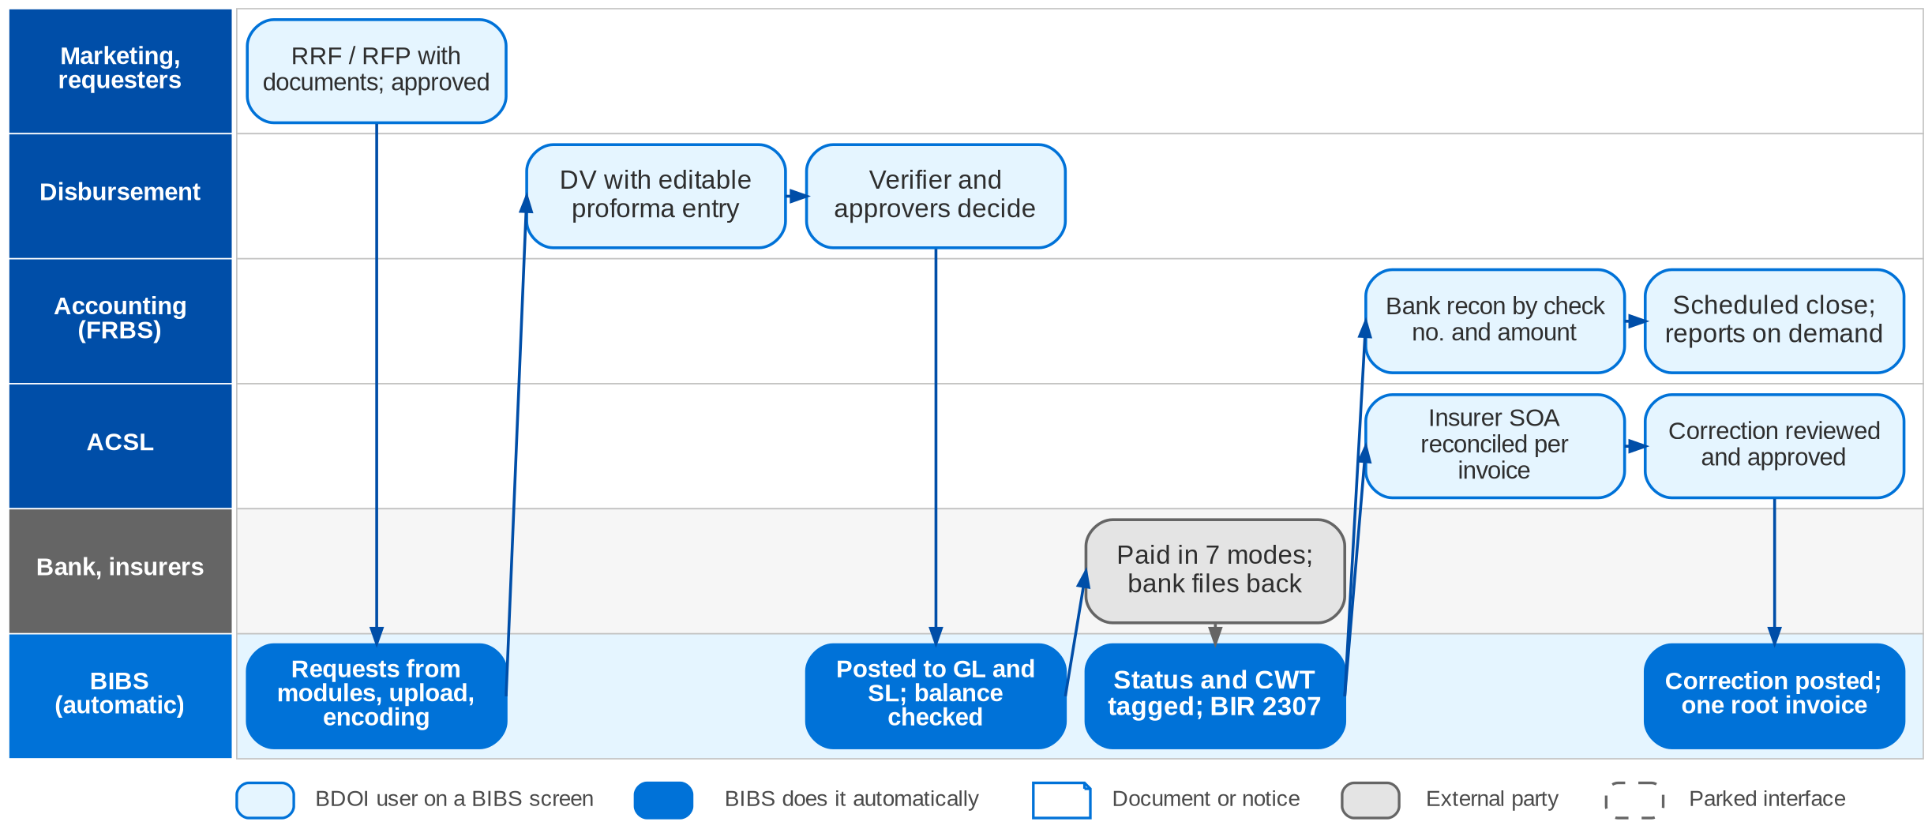
9. Accounting: To-Be in the BRD
Disbursement, accounting and ACSL in BIBS (design ACCOUNTING_DISBURSEMENT_DESIGN; BRD-5 p.46-48)
Confidential – BDOI
BDOI Business Process Reverse KT | v2.0
126
Notes:
In BIBS refund and cash-advance requests are raised on the RRF / RFP with documents and approved in the workflow, then routed to Disbursement. Disbursement receives requests from the other modules, by upload or by encoding; BIBS creates the disbursement voucher with an editable proforma entry. The verifier and approvers decide in BIBS, and approval posts the entry to the GL and the sub-ledger, which refuses unbalanced entries. The payment runs in one of seven modes; statuses and CWT are tagged automatically and by bank files, and BIR 2307 is generated. ACSL uploads the insurer statements and reconciles them per invoice, and posts corrections through create, review, approve and post. Accounting reconciles the bank by check number and amount, closes the books on schedule and runs the reports on demand. The BDO Business Online Banking interface is parked (AQ09): approvals are confirmed manually or by file.

Slide 127
9. Accounting: how the BRD answers (1/2)
Pain point today
To-Be in the BRD
Benefit
1
Refunds on paper, five chains
RRF and RFP in the system with documents; approval routes them to Disbursement
No paper hand-over
2
Requests by e-mail and paper
Requests from other modules, uploads and encoding in one intake
One request queue
3
Payees kept in three places
One consolidated payee master for every mode (DIS 2.2.0-2.2.8)
Payee kept once
4
Three levels of wet signature
Voucher and proforma entry by the system; verifier and approvers decide in the workflow
E-approval
5
File chain through IT and QPS
Credit file and check printing from the same system; credited file uploaded back
No QPS step
6
Payment modes outside the system
Seven payment modes with instrument life cycles and bank forms generated
Mode recorded
Confidential – BDOI
BDOI Business Process Reverse KT | v2.0
127

Slide 128
9. Accounting: how the BRD answers (2/2)
Pain point today
To-Be in the BRD
Benefit
7
GL entries by another unit
Approval posts the entry to the GL and sub-ledger; unbalanced entries refused
Entry at approval
8
Government payments by hand
Payment to government is a disbursement class only; filing and confirmation not specified
Gap: see next slides
9
Reports prepared by IT
Users run input and output reports on demand
No IT request
10
Reconciliation and journals by hand
Bank file matched on check number and amount; insurer statements reconciled per invoice
Matching automated
11
IT needed to close
Broking books close by a scheduled job; FRBS closes the period
No IT in the close
12
Abnormal balances found by reading
Ageing with SL-GL difference; corrections through create, review, approve, post
Posting on approval
Confidential – BDOI
BDOI Business Process Reverse KT | v2.0
128
Notes:
The benefit column names the control or the effort the To-Be removes.
1. Refunds on paper, five chains -> RRF and RFP in the system with documents; approval routes them to Disbursement Benefit: No paper hand-over.
2. Requests by e-mail and paper -> Requests from other modules, uploads and encoding in one intake Benefit: One request queue.
3. Payees kept in three places -> One consolidated payee master for every mode (DIS 2.2.0-2.2.8) Benefit: Payee kept once.
4. Three levels of wet signature -> Voucher and proforma entry by the system; verifier and approvers decide in the workflow Benefit: E-approval.
5. File chain through IT and QPS -> Credit file and check printing from the same system; credited file uploaded back Benefit: No QPS step.
6. Payment modes outside the system -> Seven payment modes with instrument life cycles and bank forms generated Benefit: Mode recorded.
7. GL entries by another unit -> Approval posts the entry to the GL and sub-ledger; unbalanced entries refused Benefit: Entry at approval.
8. Government payments by hand -> Payment to government is a disbursement class only; filing and confirmation not specified Benefit: Gap: see next slides.
9. Reports prepared by IT -> Users run input and output reports on demand Benefit: No IT request.
10. Reconciliation and journals by hand -> Bank file matched on check number and amount; insurer statements reconciled per invoice Benefit: Matching automated.
11. IT needed to close -> Broking books close by a scheduled job; FRBS closes the period Benefit: No IT in the close.
12. Abnormal balances found by reading -> Ageing with SL-GL difference; corrections through create, review, approve, post Benefit: Posting on approval.

Slide 129
9. Accounting: gaps in the BRD (1/2)
Coverage | Item | What we saw on the floor | What the BRD says | Our recommendation | Ref
Not in BRD | Government remittances | EFPS for BIR; BancNet for SSS, Pag-IBIG, PhilHealth; 24-hour posting; websites watched. | A disbursement class only (DIS 3.25.1). | Tax and contribution calendar, filing reference and payment confirmation captured on the voucher. | Disbursement flow
Partly in BRD | Delegation of authority | DTL, DSH, DUH; second DTL for online banking. | Single approver (DIS 2.19) or verifier plus two for funding. | Approval matrix by amount and payment type, all in the workflow. | DS-01; AQ28
Partly in BRD | Refund routing per segment | Five chains of 3-6 approvers. | Refund approval generic (MKT 1.14-1.16). | Configure routing by segment; aim for two levels. | Refund flow; AQ18
Partly in BRD | Payee bank details | Bank confirms the account name; same name as depositor? | Duplicate check only; validation open. | Name match, dual control on bank-detail changes. | AQ11, AQ19
Partly in BRD | WHT rate on commission | 15% at remittance. | WTAX column; rate not stated. | Tax table by payee class (ATC) and rate. | TX-01
Partly in BRD | Tax by income type | WHT differs by income type; VAT applies. | OR types with VAT and WTAX; no matrix. | Income-type matrix (ATC, WHT, VAT) driving the service invoice. | OI-02
Confidential – BDOI
BDOI Business Process Reverse KT | v2.0
129

Slide 130
9. Accounting: gaps in the BRD (2/2)
Coverage | Item | What we saw on the floor | What the BRD says | Our recommendation | Ref
Partly in BRD | Referral fees | Credited from an Excel list. | Service-fee monitoring (FRBS 2.10); no referrer master. | Referrer master, computation, payout and 2307. | OI-03; AQ20
Partly in BRD | Profit and cost centres | 8 branches to map. | Cost-centre rules (FRBS 3.1.1); profit centre has no BRD. | Profit and cost centre on every entry, mapped per branch. | FN-01; AQ26
Partly in BRD | Remittance entries | Want Dr Cash in Bank / Cr Insurer directly. | Entries per voucher type not given. | Give the entries per voucher type. | DS-05; AQ02
Partly in BRD | Abnormal balances | Found by reading IT reports. | Ageing with SL-GL difference only. | Rule-based exception queue for ACSL. | ACSL flow; AQ30
Partly in BRD | Self-service reports | Reports need IT (RP-01). | Standard reports on demand; ad-hoc builder parked. | Governed report builder after go-live. | RP-01; CRQ11
BDOI to confirm | BIR books and VAT return | Monthly BIR reports; VAT quarterly. | Books format open; monthly VAT return still listed. | Confirm CAS format and drop the monthly VAT return. | TX-04, TX-05; AQ07; DCR-055
Confidential – BDOI
BDOI Business Process Reverse KT | v2.0
130
Notes:
Government remittances are the one true gap. The others are rules and values the floor showed (approval levels, tax rates, refund routing) that BRD-5 leaves open.
[Not in BRD] Government remittances. Seen: EFPS for BIR; BancNet for SSS, Pag-IBIG, PhilHealth; 24-hour posting; websites watched. BRD: A disbursement class only (DIS 3.25.1). Recommendation: Tax and contribution calendar, filing reference and payment confirmation captured on the voucher. (Disbursement flow)
[Partly in BRD] Delegation of authority. Seen: DTL, DSH, DUH; second DTL for online banking. BRD: Single approver (DIS 2.19) or verifier plus two for funding. Recommendation: Approval matrix by amount and payment type, all in the workflow. (DS-01; AQ28)
[Partly in BRD] Refund routing per segment. Seen: Five chains of 3-6 approvers. BRD: Refund approval generic (MKT 1.14-1.16). Recommendation: Configure routing by segment; aim for two levels. (Refund flow; AQ18)
[Partly in BRD] Payee bank details. Seen: Bank confirms the account name; same name as depositor? BRD: Duplicate check only; validation open. Recommendation: Name match, dual control on bank-detail changes. (AQ11, AQ19)
[Partly in BRD] WHT rate on commission. Seen: 15% at remittance. BRD: WTAX column; rate not stated. Recommendation: Tax table by payee class (ATC) and rate. (TX-01)
[Partly in BRD] Tax by income type. Seen: WHT differs by income type; VAT applies. BRD: OR types with VAT and WTAX; no matrix. Recommendation: Income-type matrix (ATC, WHT, VAT) driving the service invoice. (OI-02)
[Partly in BRD] Referral fees. Seen: Credited from an Excel list. BRD: Service-fee monitoring (FRBS 2.10); no referrer master. Recommendation: Referrer master, computation, payout and 2307. (OI-03; AQ20)
[Partly in BRD] Profit and cost centres. Seen: 8 branches to map. BRD: Cost-centre rules (FRBS 3.1.1); profit centre has no BRD. Recommendation: Profit and cost centre on every entry, mapped per branch. (FN-01; AQ26)
[Partly in BRD] Remittance entries. Seen: Want Dr Cash in Bank / Cr Insurer directly. BRD: Entries per voucher type not given. Recommendation: Give the entries per voucher type. (DS-05; AQ02)
[Partly in BRD] Abnormal balances. Seen: Found by reading IT reports. BRD: Ageing with SL-GL difference only. Recommendation: Rule-based exception queue for ACSL. (ACSL flow; AQ30)
[Partly in BRD] Self-service reports. Seen: Reports need IT (RP-01). BRD: Standard reports on demand; ad-hoc builder parked. Recommendation: Governed report builder after go-live. (RP-01; CRQ11)
[BDOI to confirm] BIR books and VAT return. Seen: Monthly BIR reports; VAT quarterly. BRD: Books format open; monthly VAT return still listed. Recommendation: Confirm CAS format and drop the monthly VAT return. (TX-04, TX-05; AQ07; DCR-055)

Slide 131
9. Accounting: best practice (1/2)
Payment hub with the bank
Delegation of authority in the workflow
Payee account validation
Partly in BRD
No file hand-offs
Partly in BRD
Faster approval
Partly in BRD
Fraud control
Industry practice: Host-to-host payments for credit to account, MC, TT and online banking, with digital signing and status back.
For BDOI: Replace WinSCP and branch forms with BDO host-to-host (CMS / New BOB).
Industry practice: Approval limits by amount and type, e-approval, no wet signatures.
For BDOI: Approve a DOA matrix; the audit trail replaces the signed copy.
Industry practice: Name match, test credit and dual control on bank-detail changes.
For BDOI: Apply to refunds and new payees.
Government payments calendar
Straight-through refunds
Not in BRD
No penalties
Partly in BRD
Client experience
Industry practice: Due dates, filing and payment through eFPS / eGov, confirmation captured.
For BDOI: Add a calendar and confirmation to Disbursement.
Industry practice: Refund computed from the cancellation or excess and paid to a validated account.
For BDOI: Link cancellation, refund request and payment.
Confidential – BDOI
BDOI Business Process Reverse KT | v2.0
131

Slide 132
9. Accounting: best practice (2/2)
Continuous close
Automated tax certificates
BIR e-invoicing readiness
Partly in BRD
Shorter close
Partly in BRD
Compliance
BDOI to confirm
Compliance
Industry practice: Daily SL-GL reconciliation, close calendar and checklist, variance analysis.
For BDOI: Add a close checklist and daily reconciliation report.
Industry practice: 2307 for every payee and a register of certificates received, reconciled to SAWT.
For BDOI: Extend 2307 generation to all payees.
Industry practice: CAS-registered books and electronic invoicing (EIS) when it applies.
For BDOI: Confirm applicability with Tax and plan the format.
Multi-dimensional chart of accounts
Partly in BRD
Profitability view
Industry practice: Branch, profit centre, cost centre, product, insurer and segment on every entry.
For BDOI: Map the 8 branches and centres before go-live.
Confidential – BDOI
BDOI Business Process Reverse KT | v2.0
132
Notes:
Practices of insurance brokers that fit BDOI, beyond what the BRD asks; the chip shows how far the BRD already covers each one.
Payment hub with the bank [Partly in BRD]. Host-to-host payments for credit to account, MC, TT and online banking, with digital signing and status back. For BDOI: Replace WinSCP and branch forms with BDO host-to-host (CMS / New BOB).
Delegation of authority in the workflow [Partly in BRD]. Approval limits by amount and type, e-approval, no wet signatures. For BDOI: Approve a DOA matrix; the audit trail replaces the signed copy.
Payee account validation [Partly in BRD]. Name match, test credit and dual control on bank-detail changes. For BDOI: Apply to refunds and new payees.
Government payments calendar [Not in BRD]. Due dates, filing and payment through eFPS / eGov, confirmation captured. For BDOI: Add a calendar and confirmation to Disbursement.
Straight-through refunds [Partly in BRD]. Refund computed from the cancellation or excess and paid to a validated account. For BDOI: Link cancellation, refund request and payment.
Continuous close [Partly in BRD]. Daily SL-GL reconciliation, close calendar and checklist, variance analysis. For BDOI: Add a close checklist and daily reconciliation report.
Automated tax certificates [Partly in BRD]. 2307 for every payee and a register of certificates received, reconciled to SAWT. For BDOI: Extend 2307 generation to all payees.
BIR e-invoicing readiness [BDOI to confirm]. CAS-registered books and electronic invoicing (EIS) when it applies. For BDOI: Confirm applicability with Tax and plan the format.
Multi-dimensional chart of accounts [Partly in BRD]. Branch, profit centre, cost centre, product, insurer and segment on every entry. For BDOI: Map the 8 branches and centres before go-live.

Slide 133
Part E
Claims and Customer Service
Serving the client after the sale: claims, the contact centre and case management
10. Claims BRD-7
11. Customer Servicing and Case Management BRD-9
Confidential – BDOI | BDOI Business Process Reverse KT
Notes:
Serving the client after the sale: claims, the contact centre and case management

Slide 134
10. Claims: at a glance
Department and roles
Volumes and business rules
How we learned it
Claims and Risk Management
• Claims Officer / Claim Handler (Motor and Non-Motor teams)
• Team Lead, Team Head, Unit Head
• Marketing AO and branch (notice of loss)
• Assured, CASA / dealer, adjuster
• Insurers (evaluation, offer, LOA or cheque)
55
claims booked a day; growth 10% a year (BRD-7 p.32-41)
Floor walk: 22-Sep-2026, 5-6 pm, 44F; discovery 21-Sep-2026
Process owners: Elmar O. Alvarez Jr., Richard Castanares
• High-level Claims process flow (Motor and Non-Motor swimlanes)
• BDOI Day 1 overview p.8 and p.14
• BRD-7 p.23-27; BRCLM.001-043
1,096
status and settlement updates a day
37
Claims users: 28 head office, 9 branches
2 paths
Motor (LOA to a repair shop, or cash) and Non-Motor (adjuster, offer)
The process in one line
Notice
Documents
Loss advice
Evaluation
Offer
Acceptance
Settlement
Closure
Confidential – BDOI
BDOI Business Process Reverse KT | v2.0
134
Notes:
BDOI supports the client from the notice of loss to settlement, as the client's advocate with the insurer. Motor claims end with a letter of authority (LOA) to a repair shop or dealer, or with a cash offer; Non-Motor claims go through the claims reporting form, the formal loss advice, an adjuster's inspection and an offer that the client accepts or contests. Claims are handled outside any system today and were called a major pain point (CL-01).
Floor walk: 22-Sep-2026, 5-6 pm, 44F; discovery 21-Sep-2026; Elmar O. Alvarez Jr., Richard Castanares.
Sources: High-level Claims process flow (Motor and Non-Motor swimlanes); BDOI Day 1 overview p.8 and p.14; BRD-7 p.23-27; BRCLM.001-043

Slide 135
10. Claims: what we heard on the floor
Ref | Topic | Type | What we heard (As-Is) | What the business wants (To-Be)
CL-01 | Claims handling | Pain point | Claims are handled outside the system and manually. | Major pain point: claims in the system.
Day 1 p.8 | What BDOI needs to see | User aspiration | How a claim links to the policy; required documents and status values; who can update, review or approve; how customer communication is recorded. | -
Claims flow | Motor | As-Is | Client, AO or branch sends the notice and PLA; handler completes the documents and sends them to the insurer; insurer issues an LOA to the preferred CASA / dealer or evaluates a cash offer; assured signs; repair monitored offline; claim tagged settled. | -
Claims flow | Non-Motor | As-Is | Claims reporting form (CRF); formal loss advice to the insurer; initial assessment; adjuster inspection when needed; evaluation; offer reviewed and sent to the insured; accept, or contest and re-evaluate; payment; claim closed. | -
Day 1 p.14 | Servicing path | As-Is | Receive the claim from the client; submit documents to the insurer; inform the client of settlement or declination. | -
EB-02 | EB claims | As-Is | Employee Benefits claims are validated by the provider; BDOI captures the details (see chapter 4). | -
Confidential – BDOI
BDOI Business Process Reverse KT | v2.0
135
Notes:
Notes of the business overview (21-Sep) and of the Claims floor walk (22-Sep).
CL-01 Claims handling (Pain point): Claims are handled outside the system and manually. Wants: Major pain point: claims in the system.
Day 1 p.8 What BDOI needs to see (User aspiration): How a claim links to the policy; required documents and status values; who can update, review or approve; how customer communication is recorded.
Claims flow Motor (As-Is): Client, AO or branch sends the notice and PLA; handler completes the documents and sends them to the insurer; insurer issues an LOA to the preferred CASA / dealer or evaluates a cash offer; assured signs; repair monitored offline; claim tagged settled.
Claims flow Non-Motor (As-Is): Claims reporting form (CRF); formal loss advice to the insurer; initial assessment; adjuster inspection when needed; evaluation; offer reviewed and sent to the insured; accept, or contest and re-evaluate; payment; claim closed.
Day 1 p.14 Servicing path (As-Is): Receive the claim from the client; submit documents to the insurer; inform the client of settlement or declination.
EB-02 EB claims (As-Is): Employee Benefits claims are validated by the provider; BDOI captures the details (see chapter 4).

Slide 136
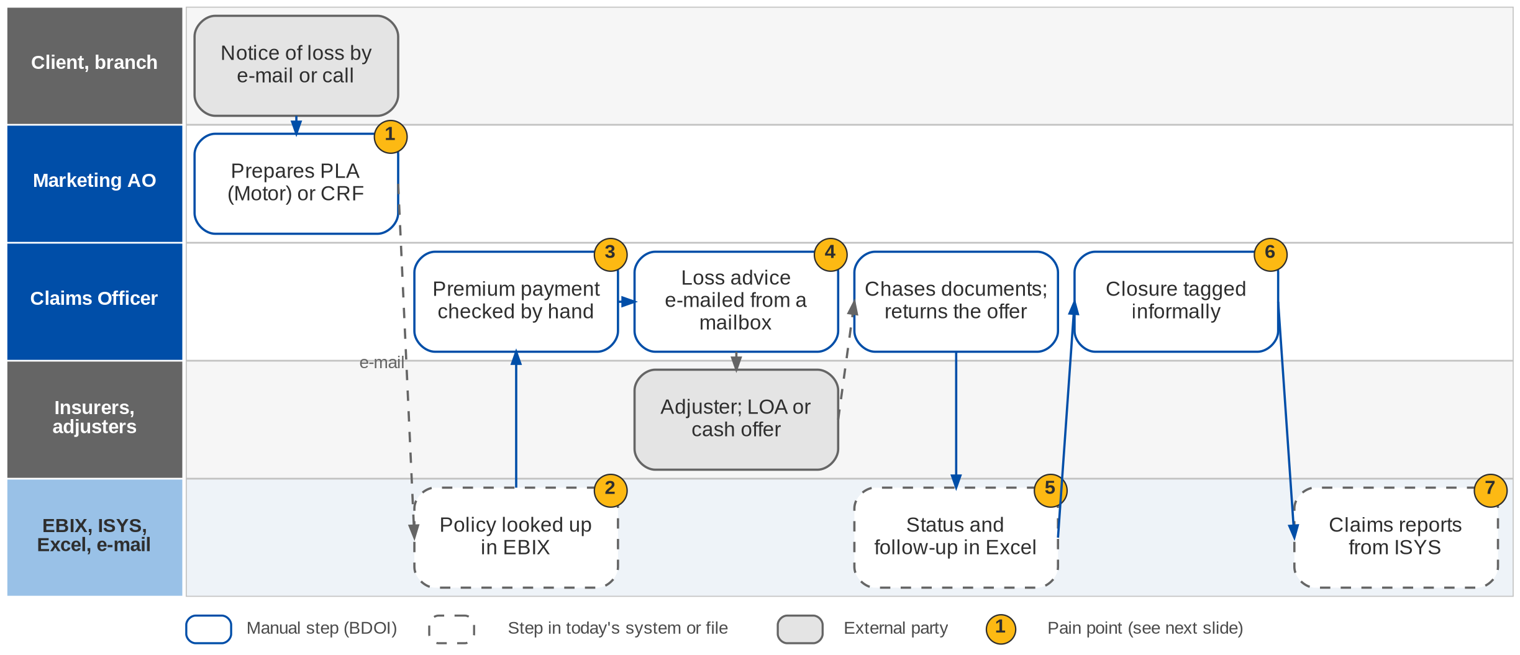
10. Claims: As-Is process
Claims today (BRD-7 p.24-26)
Confidential – BDOI
BDOI Business Process Reverse KT | v2.0
136
Notes:
Today the notice of loss arrives by e-mail or call; Marketing prepares the Preliminary Loss Advice for Motor or the Claims Reporting Form for Non-Motor. Policy details are looked up in EBIX and re-keyed. Premium payment is checked by hand. The loss advice goes to the insurer by e-mail from a mailbox and the handler chases the client for documents. Status and follow-up are tracked in spreadsheets, closure is tagged informally, and claims reports are extracted from ISYS.

Slide 137
10. Claims: Motor and Non-Motor paths today
Step | Motor | Non-Motor
Notice | Client, AO or branch sends the notice and a preliminary loss advice (PLA) | Client sends the notice; Claims completes the claims reporting form (CRF) with the client
Documents | Handler coordinates the documents with the client until complete | Handler checks completeness; asks the client for missing documents
To the insurer | Documents and PLA sent to the insurer | Formal loss advice (FLA) sent; insurer makes an initial assessment
Evaluation | Insurer reviews; issues or concerns go back to the handler | Adjuster appointed when needed; inspection arranged with BDOI
Offer | LOA to the preferred CASA / dealer, or a cash offer after evaluation | Offer reviewed by Claims and sent to the insured
Decision | Assured signs the offer; CASA / dealer repairs | Accepts, or contests; insurer re-evaluates or keeps its position
Close | Repair monitored offline; claim tagged settled / closed | Signed offer; payment; property damage claim closed
Confidential – BDOI
BDOI Business Process Reverse KT | v2.0
137
Notes:
From the Claims process flow (swimlane version), confirmed by the Claims team on 13-Feb-2026.

Slide 138
10. Claims: pain points today
1
Notice prepared by hand
PLA or CRF prepared by Marketing from an e-mail or a call.
BRD-7 p.24-25
5
Status in spreadsheets
Status, adjuster, reserve and follow-up dates tracked in Excel.
BRD-7 p.23, 27; BRCLM.010-024
2
Policy details re-keyed
Policy details are looked up in EBIX and keyed again.
BRD-7 p.24-25; BRCLM.003, 004
6
Informal closure
No distinction between temporary and permanent closure.
BRD-7 p.27-28; BRCLM.005, 035
3
Premium checked by hand
Nothing stops a claim on an unpaid invoice.
BRD-7 p.23; BRCLM.001
7
Reports from ISYS
Claims reports are extracted from ISYS.
BRD-7 p.39-42; Report List
4
Loss advice from a mailbox
No send log; insurer claim numbers kept outside a system.
BRD-7 p.24-25; BRCLM.041, 043
Confidential – BDOI
BDOI Business Process Reverse KT | v2.0
138
Notes:
The seven points of the BRD-7 current process (p.23-27); the Claims flow confirms them.
1. Notice prepared by hand: PLA or CRF prepared by Marketing from an e-mail or a call. (BRD-7 p.24-25)
2. Policy details re-keyed: Policy details are looked up in EBIX and keyed again. (BRD-7 p.24-25; BRCLM.003, 004)
3. Premium checked by hand: Nothing stops a claim on an unpaid invoice. (BRD-7 p.23; BRCLM.001)
4. Loss advice from a mailbox: No send log; insurer claim numbers kept outside a system. (BRD-7 p.24-25; BRCLM.041, 043)
5. Status in spreadsheets: Status, adjuster, reserve and follow-up dates tracked in Excel. (BRD-7 p.23, 27; BRCLM.010-024)
6. Informal closure: No distinction between temporary and permanent closure. (BRD-7 p.27-28; BRCLM.005, 035)
7. Reports from ISYS: Claims reports are extracted from ISYS. (BRD-7 p.39-42; Report List)

Slide 139
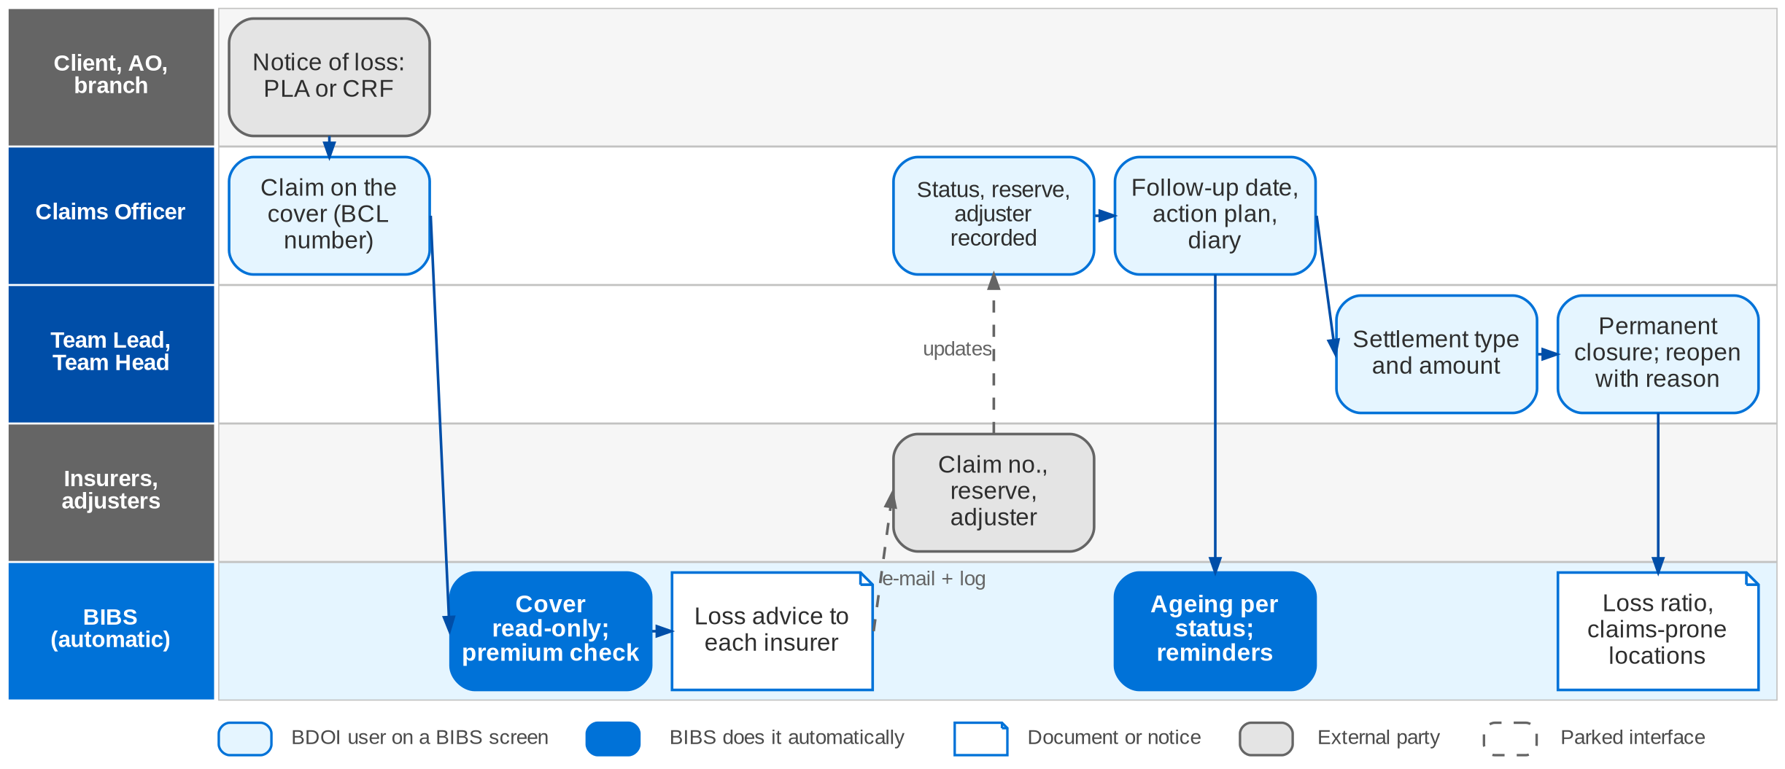
10. Claims: To-Be in the BRD
Claim lifecycle in BIBS: workflow BCL_CLAIM (FRS BRD-7 sections 2.2 and 5)
Confidential – BDOI
BDOI Business Process Reverse KT | v2.0
139
Notes:
In BIBS the Claims Officer records the claim on the client's cover; the claim number is BCL-yyyy-nnnnnn. The cover, policy number, version, locations, Marketing unit and branch come from the BIBS account, read-only. BIBS reads the invoice ledger and disables the authorization code while premium is unpaid. The loss advice is generated and e-mailed to each insurer with a send log; insurer claim numbers are recorded per insurer. Status (restricted by role and unit), adjuster, reserve, next follow-up date, action plan and diary are on the claim, with history. Settlement type and amount are recorded; permanent closure needs a closing settlement type and a TL or TH. Ageing, outstanding, settled, loss experience and loss ratio reports run in BIBS and export to Excel.

Slide 140
10. Claims: how the BRD answers
Pain point today
To-Be in the BRD
Benefit
1
Notice prepared by hand
Claim recorded on the cover in BIBS with the PLA / CRF data; number BCL-yyyy-nnnnnn
55 claims a day
2
Policy details re-keyed
Cover, policy, version, locations, unit and branch read from the account, read-only
No re-keying
3
Premium checked by hand
Invoice ledger read; authorization code disabled while premium is unpaid
Check in 5 s
4
Loss advice from a mailbox
Loss advice generated and e-mailed per insurer; insurer claim numbers recorded
Send log
5
Status in spreadsheets
Status within the role / unit matrix, adjuster, reserve, follow-up and diary on the claim
1,096 updates a day
6
Informal closure
Temporary and permanent closure; permanent needs a settlement type and a TL / TH
Four-eyes closure
7
Reports from ISYS
Ageing, outstanding, settled, loss experience and loss ratio reports in BIBS, to Excel
No ISYS extract
Confidential – BDOI
BDOI Business Process Reverse KT | v2.0
140
Notes:
The benefit column names what the To-Be removes.
1. Notice prepared by hand -> Claim recorded on the cover in BIBS with the PLA / CRF data; number BCL-yyyy-nnnnnn Benefit: 55 claims a day.
2. Policy details re-keyed -> Cover, policy, version, locations, unit and branch read from the account, read-only Benefit: No re-keying.
3. Premium checked by hand -> Invoice ledger read; authorization code disabled while premium is unpaid Benefit: Check in 5 s.
4. Loss advice from a mailbox -> Loss advice generated and e-mailed per insurer; insurer claim numbers recorded Benefit: Send log.
5. Status in spreadsheets -> Status within the role / unit matrix, adjuster, reserve, follow-up and diary on the claim Benefit: 1,096 updates a day.
6. Informal closure -> Temporary and permanent closure; permanent needs a settlement type and a TL / TH Benefit: Four-eyes closure.
7. Reports from ISYS -> Ageing, outstanding, settled, loss experience and loss ratio reports in BIBS, to Excel Benefit: No ISYS extract.

Slide 141
10. Claims: gaps in the BRD
Coverage | Item | What we saw on the floor | What the BRD says | Our recommendation | Ref
Partly in BRD | Offer and contest loop | Offer reviewed, sent, accepted or contested, re-evaluated. | Status values only; no offer record. | Offer record with versions, acceptance and contest reason. | Claims flow
Partly in BRD | Repair monitoring after the LOA | Repair tracked offline until completion. | LOA statuses; no repair milestones. | Repair milestones and dealer updates until the car is released. | CLQ05
Partly in BRD | Document checklist | Documents chased until complete. | Diary and statuses; no checklist per claim type. | Checklist per line and cause of loss with reminders. | CLQ26
Not in BRD | Digital notice of loss | Notice by e-mail or call; PLA or CRF prepared by hand. | Claim record from PLA / CRF data; no client channel. | Notice through the contact centre or a web form with photos. | CLQ23
BDOI to confirm | Money through BDOI | Cheque payable to the assured; cash settlement. | Open whether proceeds pass through BDOI. | Confirm per line; if yes, route through Disbursement. | DCR-086
BDOI to confirm | Authorization code | Premium checked before filing. | Code disabled while premium unpaid; code undefined. | Define the code and who can override. | DCR-085
Confidential – BDOI
BDOI Business Process Reverse KT | v2.0
141
Notes:
The offer and contest loop, repair monitoring and a digital notice of loss are not in the BRD.
[Partly in BRD] Offer and contest loop. Seen: Offer reviewed, sent, accepted or contested, re-evaluated. BRD: Status values only; no offer record. Recommendation: Offer record with versions, acceptance and contest reason. (Claims flow)
[Partly in BRD] Repair monitoring after the LOA. Seen: Repair tracked offline until completion. BRD: LOA statuses; no repair milestones. Recommendation: Repair milestones and dealer updates until the car is released. (CLQ05)
[Partly in BRD] Document checklist. Seen: Documents chased until complete. BRD: Diary and statuses; no checklist per claim type. Recommendation: Checklist per line and cause of loss with reminders. (CLQ26)
[Not in BRD] Digital notice of loss. Seen: Notice by e-mail or call; PLA or CRF prepared by hand. BRD: Claim record from PLA / CRF data; no client channel. Recommendation: Notice through the contact centre or a web form with photos. (CLQ23)
[BDOI to confirm] Money through BDOI. Seen: Cheque payable to the assured; cash settlement. BRD: Open whether proceeds pass through BDOI. Recommendation: Confirm per line; if yes, route through Disbursement. (DCR-086)
[BDOI to confirm] Authorization code. Seen: Premium checked before filing. BRD: Code disabled while premium unpaid; code undefined. Recommendation: Define the code and who can override. (DCR-085)

Slide 142
10. Claims: best practice
Digital first notice of loss
Client status updates
Insurer SLA scorecards
Not in BRD
Faster start
Partly in BRD
Fewer follow-up calls
Partly in BRD
Better insurer choice
Industry practice: Notice by web, app or contact centre with photos and automatic policy lookup.
For BDOI: Start with a contact-centre form that creates the claim.
Industry practice: Automatic SMS or e-mail at each status change.
For BDOI: Send notices on the key statuses.
Industry practice: Days from notice to offer and offer to payment, per insurer and line.
For BDOI: Build from the ageing reports.
Repair network integration
Document checklist with chasing
Claims analytics for renewals
Beyond the BRD
Shorter repair time
Not in BRD
Complete files first time
Partly in BRD
Better terms
Industry practice: LOA and repair status exchanged with accredited shops and dealers.
For BDOI: After go-live with the main dealers.
Industry practice: Checklist per claim type and automatic reminders to the client.
For BDOI: Define the checklists with the Claims team.
Industry practice: Loss ratio and claims-prone locations feed renewals and risk advice.
For BDOI: Share loss experience with Renewal and TSU.
Confidential – BDOI
BDOI Business Process Reverse KT | v2.0
142
Notes:
Practices of insurance brokers that fit BDOI, beyond what the BRD asks; the chip shows how far the BRD already covers each one.
Digital first notice of loss [Not in BRD]. Notice by web, app or contact centre with photos and automatic policy lookup. For BDOI: Start with a contact-centre form that creates the claim.
Client status updates [Partly in BRD]. Automatic SMS or e-mail at each status change. For BDOI: Send notices on the key statuses.
Insurer SLA scorecards [Partly in BRD]. Days from notice to offer and offer to payment, per insurer and line. For BDOI: Build from the ageing reports.
Repair network integration [Beyond the BRD]. LOA and repair status exchanged with accredited shops and dealers. For BDOI: After go-live with the main dealers.
Document checklist with chasing [Not in BRD]. Checklist per claim type and automatic reminders to the client. For BDOI: Define the checklists with the Claims team.
Claims analytics for renewals [Partly in BRD]. Loss ratio and claims-prone locations feed renewals and risk advice. For BDOI: Share loss experience with Renewal and TSU.

Slide 143
11. Customer Servicing: at a glance
Department and roles
Volumes and business rules
How we learned it
Contact Center Management / Alternative Distribution
• BDO Insure contact centre agent (CSR)
• Contact centre supervisor; BDO contact centre (BDO CCC) personnel
• Fulfilment units: the Marketing unit that manages the account
• Contact centre management, leads and heads; System Administrator
• Callers (clients)
144,400
access, retrieval and search transactions a year (BRD-9 p.13-14)
Floor walk: Process flows walked with the contact centre owners; not a September floor-walk slot
Process owners: Contact Center Management (BDO Insure)
• High-level Customer Servicing Facility process flow
• BDOI Case Management To-Be process flow, 15-Jul-2026
• BRD-9 p.3-5; e-mail clarification p.17; BRCSF-001-011
24
concurrent agents, supervisors and personnel
2
contact centres involved: BDO Insure and BDO CCC (XQ02)
< 3 s
retrieval, update and search; 5 s documents
The process in one line
Contact
Identify
Search
View
Verify
Update
Resend or refer
Close
Confidential – BDOI
BDOI Business Process Reverse KT | v2.0
143
Notes:
The BDO Insure contact centre answers clients by phone, e-mail and digital channels. Agents search the client's accounts, answer inquiries, update contact details and resend documents; concerns they cannot close go to the fulfilment unit that manages the account. Today the facility shows full details for CBG accounts only, and every contact is logged by hand in a separate case tool. BDOI has already drawn its own case-management To-Be (15-Jul-2026), which goes further than BRD-9.
Floor walk: Process flows walked with the contact centre owners; not a September floor-walk slot; Contact Center Management (BDO Insure).
Sources: High-level Customer Servicing Facility process flow; BDOI Case Management To-Be process flow, 15-Jul-2026; BRD-9 p.3-5; e-mail clarification p.17; BRCSF-001-011

Slide 144
11. Customer Servicing: what we heard on the floor
Ref | Topic | Type | What we heard (As-Is) | What the business wants (To-Be)
CSF flow | Search | As-Is | Account inquiry by invoice number, PN number, last, first or full name (CBG); client inquiry by name for Non-CBG; open the account from the invoice or client code; view contact and insurance details. | -
CSF flow | Contact update | Pain point | When contact details change, the agent updates them and the system migration updates the source databases (QPS, EBIX). | -
Case To-Be | Case logging | User aspiration | Agent identifies the client and the concern; logs every concern in CLS by typing it in; general inquiries answered from CC Nav and closed. | Client details filled in automatically in the case form.
Case To-Be | Positive identification | User aspiration | Positive identification (PID) of the client before any account transaction; failed PID closes the case. | PID as a step of the case.
Case To-Be | Referral and TAT | User aspiration | Concerns not solved at the first contact are referred to the fulfilment unit by e-mail and a CLS prompt. | Cases routed automatically to the Marketing unit of the account; open cases within or past TAT visible; invalid returns re-logged by BDO CCC.
NB and RN flows | E-policy after fall-out | Pain point | After an SFTP fall-out Marketing fixes the e-policy and the BDOI contact centre sends it to the client. | -
Confidential – BDOI
BDOI Business Process Reverse KT | v2.0
144
Notes:
Steps of the Customer Servicing flow and of BDOI's case-management To-Be flow.
CSF flow Search (As-Is): Account inquiry by invoice number, PN number, last, first or full name (CBG); client inquiry by name for Non-CBG; open the account from the invoice or client code; view contact and insurance details.
CSF flow Contact update (Pain point): When contact details change, the agent updates them and the system migration updates the source databases (QPS, EBIX).
Case To-Be Case logging (User aspiration): Agent identifies the client and the concern; logs every concern in CLS by typing it in; general inquiries answered from CC Nav and closed. Wants: Client details filled in automatically in the case form.
Case To-Be Positive identification (User aspiration): Positive identification (PID) of the client before any account transaction; failed PID closes the case. Wants: PID as a step of the case.
Case To-Be Referral and TAT (User aspiration): Concerns not solved at the first contact are referred to the fulfilment unit by e-mail and a CLS prompt. Wants: Cases routed automatically to the Marketing unit of the account; open cases within or past TAT visible; invalid returns re-logged by BDO CCC.
NB and RN flows E-policy after fall-out (Pain point): After an SFTP fall-out Marketing fixes the e-policy and the BDOI contact centre sends it to the client.

Slide 145
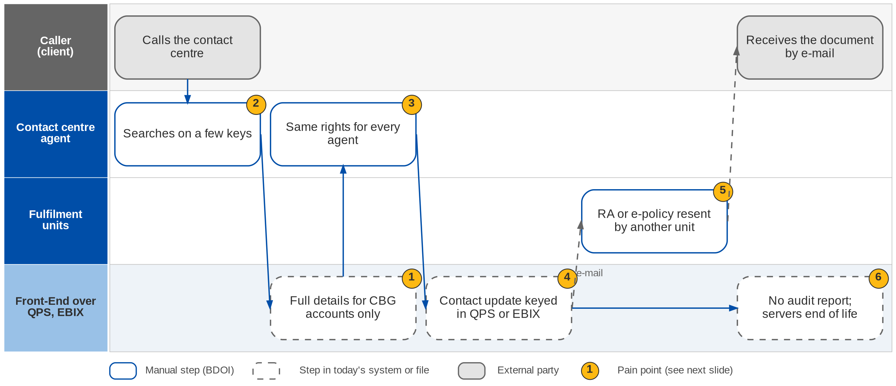
11. Customer Servicing: As-Is process
Contact centre servicing today (BRD-9 p.4)
Confidential – BDOI
BDOI Business Process Reverse KT | v2.0
145
Notes:
Today the agent searches the Front-End on a limited set of keys. Full account details show for CBG accounts only; for non-CBG accounts the agent sees only contact details, account number and expiry date. Every agent has the same rights. Contact updates are written into QPS or EBIX. Renewal advice and e-policy resends are handled outside the tool by the fulfilment units, and management has no audit report. The servers have reached end of life.

Slide 146
11. Customer Servicing: BDOI's case-management To-Be
Step | What happens | Who
1 Contact | Customer contacts the BDO Insure contact centre by phone, e-mail, web or digital channel | Customer
2 Identify | Agent identifies the client and whether the concern is account-related or a general inquiry | BDO Insure agent
3 General inquiry | Answered from CC Nav; concern logged and closed | BDO Insure agent
4 PID | Existing client: positive identification; failed PID ends the transaction and the case is logged and closed | BDO Insure agent
5 First-contact fix | Solved at the point of contact: request fulfilled; case logged with client details filled in automatically; closed | BDO Insure agent
6 Referral | Not solvable at first contact: case routed automatically to the Marketing unit of the account; unit notified | Agent, system
7 Resolve or return | Fulfilment unit filters open cases within or past TAT, resolves and closes, or returns an erroneous case; BDO CCC re-logs valid returns | Fulfilment unit, BDO CCC
Confidential – BDOI
BDOI Business Process Reverse KT | v2.0
146
Notes:
BDOI's case-management To-Be flow of 15-Jul-2026. It is BDOI's own design, beyond BRD-9, and should be taken into the BRD.

Slide 147
11. Customer Servicing: pain points today
1
Full details for CBG accounts only
Non-CBG accounts show contact details, account number and expiry date only.
BRD-9 p.4; BRCSF-002, 005
4
Updates written in QPS or EBIX
Contact details are changed in the legacy systems.
BRD-9 p.3-5; BRCSF-004
2
Limited search keys
Agents cannot search by every key the caller gives.
BRD-9 p.17 (e-mail); BRCSF-003
5
Resends outside the tool
RA and e-policy resends are handled by other units.
BRD-9 p.17 (e-mail item 9); BRCSF-006
3
No role-based access
Agents, supervisors and management have the same rights.
BRD-9 p.4
6
No audit report; ageing servers
Management has no audit trail of agent actions; servers at end of life.
BRD-9 p.4; BRCSF-010, 011
Confidential – BDOI
BDOI Business Process Reverse KT | v2.0
147
Notes:
The six points of the BRD-9 current process (p.3-5).
1. Full details for CBG accounts only: Non-CBG accounts show contact details, account number and expiry date only. (BRD-9 p.4; BRCSF-002, 005)
2. Limited search keys: Agents cannot search by every key the caller gives. (BRD-9 p.17 (e-mail); BRCSF-003)
3. No role-based access: Agents, supervisors and management have the same rights. (BRD-9 p.4)
4. Updates written in QPS or EBIX: Contact details are changed in the legacy systems. (BRD-9 p.3-5; BRCSF-004)
5. Resends outside the tool: RA and e-policy resends are handled by other units. (BRD-9 p.17 (e-mail item 9); BRCSF-006)
6. No audit report; ageing servers: Management has no audit trail of agent actions; servers at end of life. (BRD-9 p.4; BRCSF-010, 011)

Slide 148
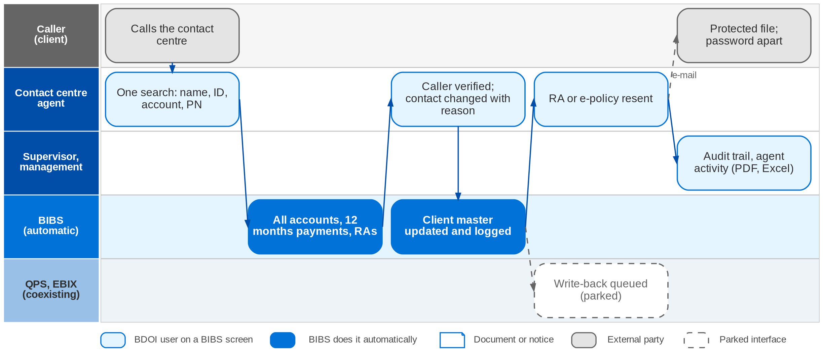
11. Customer Servicing: To-Be in the BRD
Servicing contact in BIBS: no approval workflow, every action immediate and logged (FRS BRD-9 section 2.2)
Confidential – BDOI
BDOI Business Process Reverse KT | v2.0
148
Notes:
In BIBS the agent signs in to the Customer Search. One search box takes the name, client ID, account number, PN number or application number, and results group by client. The servicing view shows the client summary, every account (CBG and non-CBG) with its CSF status, payments of the last 12 months, RAs, e-policies and documents. Before an update the agent completes the verification checklist; only contact fields change, with a reason, in the BIBS client master. The agent resends the RA or the e-policy to the registered e-mail, password protected, with the password sent separately. The contact change is queued for QPS and EBIX while they coexist (parked seam, CSQ01). Management prints or saves the audit trail and agent activity in PDF or Excel.

Slide 149
11. Customer Servicing: how the BRD answers
Pain point today
To-Be in the BRD
Benefit
1
Full details for CBG accounts only
Every account of the client, CBG and non-CBG, with status and payments
All segments
2
Limited search keys
One search box for name, client ID, account number, PN number and application number
< 3 s search
3
No role-based access
Agent, supervisor and management roles with separate rights to update, resend and upload
Role-based access
4
Updates written in QPS or EBIX
Update made once in the BIBS client master after verifying the caller; write-back seam for QPS / EBIX
Verification before change
5
Resends outside the tool
Agent views, downloads and resends the RA and e-policy to the registered e-mail, protected
Resend in one call
6
No audit report; ageing servers
Every change and agent action logged; audit trail in PDF or Excel
Full audit trail
Confidential – BDOI
BDOI Business Process Reverse KT | v2.0
149
Notes:
The benefit column names what the To-Be removes.
1. Full details for CBG accounts only -> Every account of the client, CBG and non-CBG, with status and payments Benefit: All segments.
2. Limited search keys -> One search box for name, client ID, account number, PN number and application number Benefit: < 3 s search.
3. No role-based access -> Agent, supervisor and management roles with separate rights to update, resend and upload Benefit: Role-based access.
4. Updates written in QPS or EBIX -> Update made once in the BIBS client master after verifying the caller; write-back seam for QPS / EBIX Benefit: Verification before change.
5. Resends outside the tool -> Agent views, downloads and resends the RA and e-policy to the registered e-mail, protected Benefit: Resend in one call.
6. No audit report; ageing servers -> Every change and agent action logged; audit trail in PDF or Excel Benefit: Full audit trail.

Slide 150
11. Customer Servicing: gaps in the BRD
Coverage | Item | What we saw on the floor | What the BRD says | Our recommendation | Ref
Not in BRD | Case management | Every contact logged by hand in CLS; BDOI's To-Be wants cases in the system. | Case logging out of BRD-9 (CSF-EM10); umbrella BRD wants it. | Bring BDOI's 15-Jul To-Be into scope as a change request. | DCR-163; CRQ04
Partly in BRD | Positive identification | PID before any account transaction. | Caller verification topic only. | PID questions and result recorded on the case. | CSQ03
Not in BRD | Referral routing and TAT | Referral by e-mail; no TAT view. | Not specified. | Auto-route to the account's unit; TAT per case type; return loop. | Case To-Be
Partly in BRD | Write-back to legacy | Contact updates written to QPS and EBIX. | Write-back seam; open. | No write-back after go-live; one client master. | DCR-104, 202
Partly in BRD | E-policy after a fall-out | Contact centre sends e-policies Marketing fixed. | Resend on request only. | One e-policy sender with an exception queue (chapter 1). | NB flow
BDOI to confirm | Two contact centres | BDO Insure and BDO CCC both handle cases. | Roles open. | Confirm who logs, who resolves, who re-logs. | XQ02
Confidential – BDOI
BDOI Business Process Reverse KT | v2.0
150
Notes:
Case management is the main gap: BRD-9 puts it out of scope while the umbrella BRD and BDOI's own To-Be want it.
[Not in BRD] Case management. Seen: Every contact logged by hand in CLS; BDOI's To-Be wants cases in the system. BRD: Case logging out of BRD-9 (CSF-EM10); umbrella BRD wants it. Recommendation: Bring BDOI's 15-Jul To-Be into scope as a change request. (DCR-163; CRQ04)
[Partly in BRD] Positive identification. Seen: PID before any account transaction. BRD: Caller verification topic only. Recommendation: PID questions and result recorded on the case. (CSQ03)
[Not in BRD] Referral routing and TAT. Seen: Referral by e-mail; no TAT view. BRD: Not specified. Recommendation: Auto-route to the account's unit; TAT per case type; return loop. (Case To-Be)
[Partly in BRD] Write-back to legacy. Seen: Contact updates written to QPS and EBIX. BRD: Write-back seam; open. Recommendation: No write-back after go-live; one client master. (DCR-104, 202)
[Partly in BRD] E-policy after a fall-out. Seen: Contact centre sends e-policies Marketing fixed. BRD: Resend on request only. Recommendation: One e-policy sender with an exception queue (chapter 1). (NB flow)
[BDOI to confirm] Two contact centres. Seen: BDO Insure and BDO CCC both handle cases. BRD: Roles open. Recommendation: Confirm who logs, who resolves, who re-logs. (XQ02)

Slide 151
11. Customer Servicing: best practice
Omnichannel case management
Screen-pop and assisted PID
Self-service
Not in BRD
One view of every concern
Partly in BRD
Shorter calls
Beyond the BRD
Fewer calls
Industry practice: Every call, e-mail and chat is a case with SLA, routing and history on the client record.
For BDOI: Adopt BDOI's 15-Jul To-Be.
Industry practice: Caller recognised from the number; PID by OTP or questions from the client record.
For BDOI: Add PID to the servicing view.
Industry practice: Clients get RA, e-policy, SOA and payment status online or by chatbot.
For BDOI: Phase after go-live; start with document download.
Knowledge base and scripts
First-contact resolution metrics
Beyond the BRD
Consistent answers
Beyond the BRD
Service quality
Industry practice: Answers and call scripts per concern type, kept by the contact centre.
For BDOI: Move CC Nav content into the case tool.
Industry practice: First-contact resolution, TAT met and satisfaction per unit.
For BDOI: Report from case data.
Confidential – BDOI
BDOI Business Process Reverse KT | v2.0
151
Notes:
Practices of insurance brokers that fit BDOI, beyond what the BRD asks; the chip shows how far the BRD already covers each one.
Omnichannel case management [Not in BRD]. Every call, e-mail and chat is a case with SLA, routing and history on the client record. For BDOI: Adopt BDOI's 15-Jul To-Be.
Screen-pop and assisted PID [Partly in BRD]. Caller recognised from the number; PID by OTP or questions from the client record. For BDOI: Add PID to the servicing view.
Self-service [Beyond the BRD]. Clients get RA, e-policy, SOA and payment status online or by chatbot. For BDOI: Phase after go-live; start with document download.
Knowledge base and scripts [Beyond the BRD]. Answers and call scripts per concern type, kept by the contact centre. For BDOI: Move CC Nav content into the case tool.
First-contact resolution metrics [Beyond the BRD]. First-contact resolution, TAT met and satisfaction per unit. For BDOI: Report from case data.

Slide 152
Part F
Control and Enablement
Compliance screening and user access, which every other area depends on
12. Sanction Screening BRD-10
13. User Access Maintenance BRD-11
Confidential – BDOI | BDOI Business Process Reverse KT
Notes:
Compliance screening and user access, which every other area depends on

Slide 153
12. Sanction Screening: at a glance
Department and roles
Volumes and business rules
How we learned it
Compliance (Chief Compliance Officer)
• Compliance Officer and Compliance Checker
• Unit Compliance Coordinator; Investigators (287)
• Approver (Unit Head, 8)
• AML Committee (5 members)
• Operations Lead; Auditor
64 h
a month freed for Compliance (BRD-10 p.4-5)
Floor walk: Not walked in Sep-2026; KYC / AMLA raised in the New Business session of 25-Sep
Process owners: Compliance (Chief Compliance Officer)
• BRD-10 p.6-7 (current process), p.8 (to-be)
• SNSRP-101 to 706
• Floor-walk note NB-04
4 h > 1 h
case cycle time, current to target (p.4-5)
10 min
saved per case on name screening (p.4-5)
300
list records a day at most (p.22-25)
The process in one line
Configure
List intake
Matching
Risk tagging
Case
Investigation
Approval
STR
Confidential – BDOI
BDOI Business Process Reverse KT | v2.0
153
Notes:
Compliance screens clients against sanction and PEP lists, profiles their risk, reviews possible matches and files suspicious transaction reports with the AMLC. Today names are matched by hand against lists that arrive by e-mail and are kept on SharePoint, and the PEP list is refreshed quarterly through one NLDS user. On the floor, Marketing confirmed that KYC and the AMLA check for every new client happen outside the system (NB-04). BRD-10 is the only BRD with quantified benefits (p.4-5).
Floor walk: Not walked in Sep-2026; KYC / AMLA raised in the New Business session of 25-Sep; Compliance (Chief Compliance Officer).
Sources: BRD-10 p.6-7 (current process), p.8 (to-be); SNSRP-101 to 706; Floor-walk note NB-04

Slide 154
12. Sanction Screening: what we heard on the floor
Ref | Topic | Type | What we heard (As-Is) | What the business wants (To-Be)
NB-04 | KYC and AMLA | Open point | KYC for every new customer (corporate and retail), then the AMLA check; both done outside the system with the insurance declaration form. | Confirm whether KYC and AMLA come into the system.
BRD-10 p.6 | Lists | Pain point | Sanctioned names arrive by e-mail advisory and are consolidated on SharePoint; the PEP list is refreshed quarterly through NLDS, which one person can access. | -
BRD-10 p.7 | Matching and cases | Pain point | Names matched by hand; risk tag and review template filled by hand; review and approval routed by e-mail; STR prepared by hand and filed on the AMLC portal. | -
CP-01 | E-signature | Open point | E-signature requirement to be checked with Legal and Compliance. | Decision on e-signature for approvals and documents.
Confidential – BDOI
BDOI Business Process Reverse KT | v2.0
154
Notes:
The floor-walk note that touches Compliance, and the current process of BRD-10.
NB-04 KYC and AMLA (Open point): KYC for every new customer (corporate and retail), then the AMLA check; both done outside the system with the insurance declaration form. Wants: Confirm whether KYC and AMLA come into the system.
BRD-10 p.6 Lists (Pain point): Sanctioned names arrive by e-mail advisory and are consolidated on SharePoint; the PEP list is refreshed quarterly through NLDS, which one person can access.
BRD-10 p.7 Matching and cases (Pain point): Names matched by hand; risk tag and review template filled by hand; review and approval routed by e-mail; STR prepared by hand and filed on the AMLC portal.
CP-01 E-signature (Open point): E-signature requirement to be checked with Legal and Compliance. Wants: Decision on e-signature for approvals and documents.

Slide 155
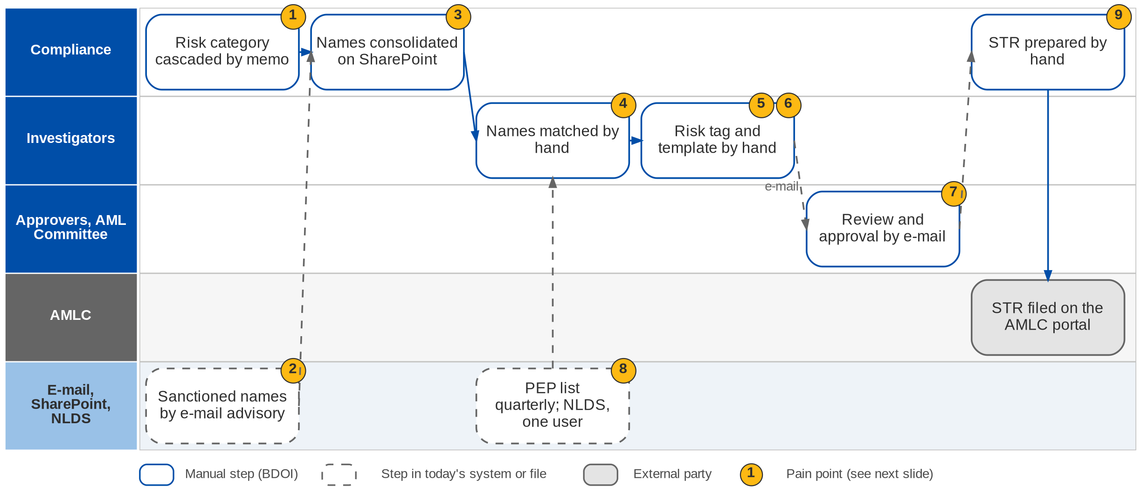
12. Sanction Screening: As-Is process
Name screening and risk profiling today (BRD-10 p.6-7)
Confidential – BDOI
BDOI Business Process Reverse KT | v2.0
155
Notes:
Today the risk-profile category is cascaded by memo. The AML unit sends sanctioned names by e-mail advisory; Compliance consolidates them and publishes them on SharePoint. Investigators match the names against new and existing clients by hand, tag the client risk profile by hand, fill review templates outside the system and route them by e-mail for review and approval. PEP lists are prepared every quarter by Marketing and validated in NLDS, to which one person has access. There is no Enhanced Due Diligence for PEPs. The STR is prepared by hand and filed on the AMLC portal.

Slide 156
12. Sanction Screening: pain points today
1
Risk category by memo
The risk-profile category is cascaded by memo.
BRD-10 p.6
6
Templates outside the system
Review templates are filled outside the system and e-mailed.
BRD-10 p.6
2
Sanctioned names by e-mail
The AML unit sends names by e-mail advisory.
BRD-10 p.6
7
Routing by e-mail
Review and approval items are routed by e-mail.
BRD-10 p.6
3
List kept on SharePoint
Compliance consolidates and publishes the names on SharePoint.
BRD-10 p.6
8
PEP list quarterly; one NLDS user
PEP lists prepared by Marketing AOs; no EDD for PEPs.
BRD-10 p.7
4
Matching by hand
Names are matched against new and existing clients manually.
BRD-10 p.6
9
STR by hand
The STR is prepared manually and filed on the AMLC portal.
BRD-10 p.6
5
Risk profile tagged by hand
The client risk profile is tagged manually.
BRD-10 p.6
Confidential – BDOI
BDOI Business Process Reverse KT | v2.0
156
Notes:
The nine points of the BRD-10 current process (p.6-7).
1. Risk category by memo: The risk-profile category is cascaded by memo. (BRD-10 p.6)
2. Sanctioned names by e-mail: The AML unit sends names by e-mail advisory. (BRD-10 p.6)
3. List kept on SharePoint: Compliance consolidates and publishes the names on SharePoint. (BRD-10 p.6)
4. Matching by hand: Names are matched against new and existing clients manually. (BRD-10 p.6)
5. Risk profile tagged by hand: The client risk profile is tagged manually. (BRD-10 p.6)
6. Templates outside the system: Review templates are filled outside the system and e-mailed. (BRD-10 p.6)
7. Routing by e-mail: Review and approval items are routed by e-mail. (BRD-10 p.6)
8. PEP list quarterly; one NLDS user: PEP lists prepared by Marketing AOs; no EDD for PEPs. (BRD-10 p.7)
9. STR by hand: The STR is prepared manually and filed on the AMLC portal. (BRD-10 p.6)

Slide 157
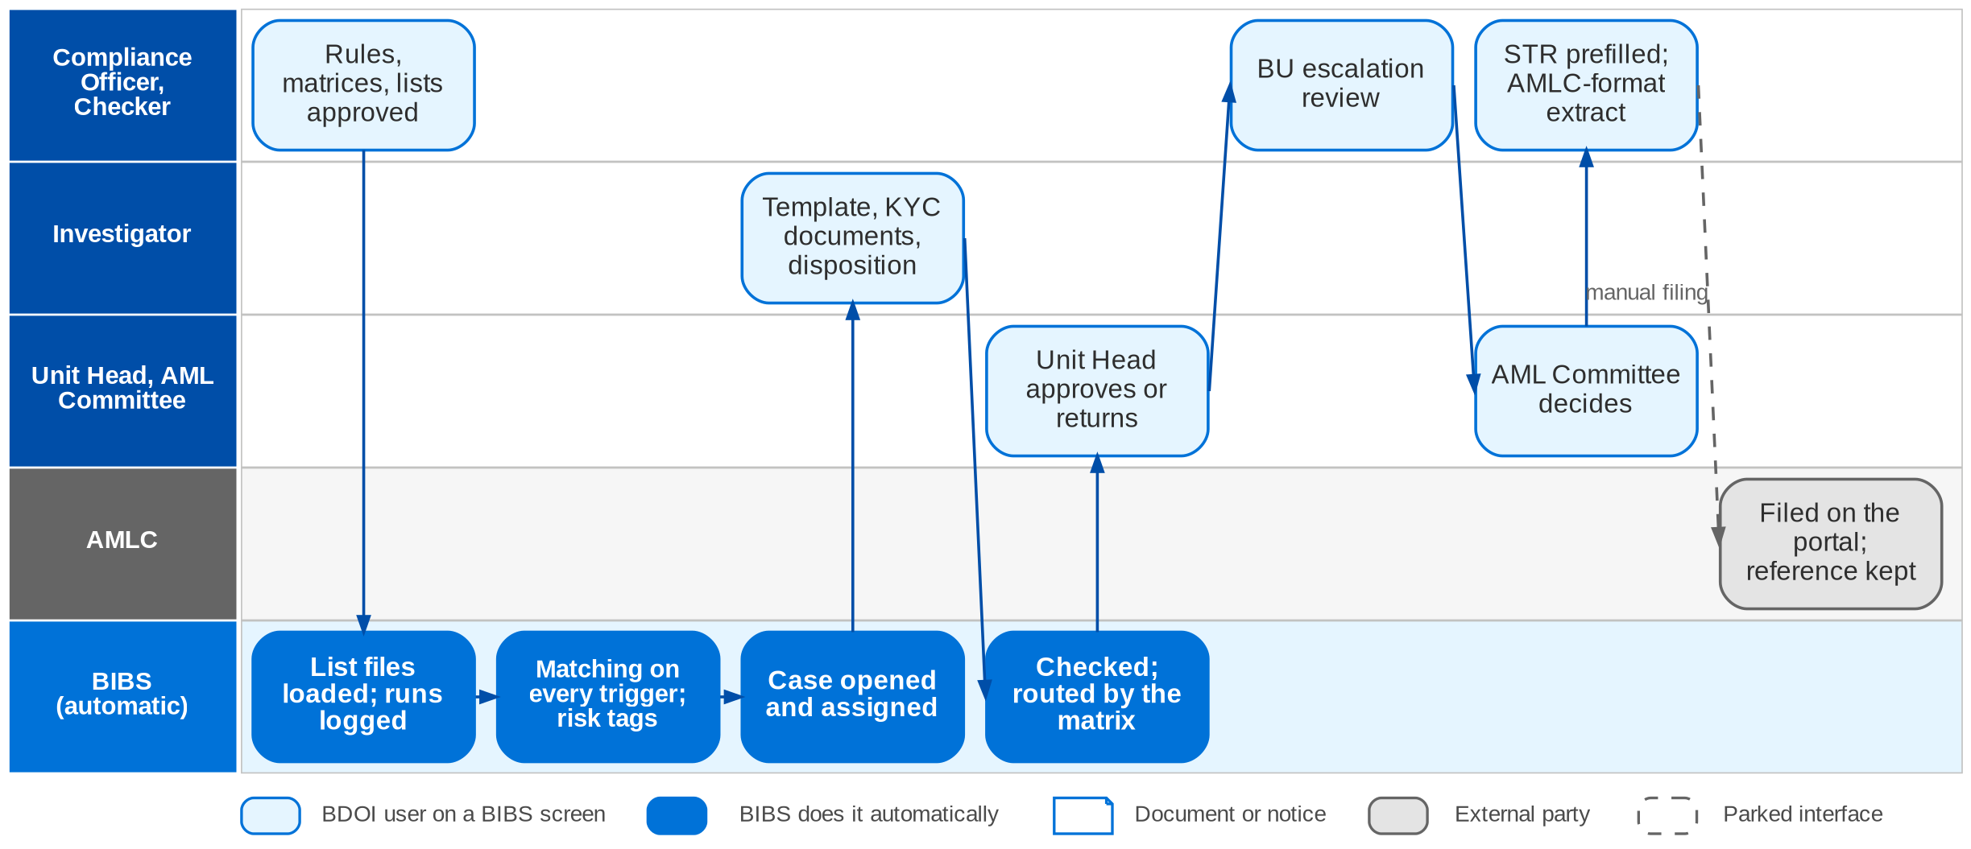
12. Sanction Screening: To-Be in the BRD
To-be screening in BIBS: case workflow SCR_CASE (FRS BRD-10 sections 2.2 and 5)
Confidential – BDOI
BDOI Business Process Reverse KT | v2.0
157
Notes:
In BIBS Compliance maintains the risk categories, rules, matrices, templates and dispositions; a checker approves each version. List files load on a schedule or by upload, and every run is logged. BIBS matches every new client, every identity change, every account application, every list change and the whole client base in a batch window, with exact, phonetic and fuzzy rules, and sets the risk rating and the PEP / watchlist tags. A case opens and is assigned by the assignment matrix. The Investigator completes the review template, uploads the KYC documents and submits. BIBS validates the case and routes it by the approval matrix to the Unit Head, Compliance and the AML Committee. The STR is prefilled from the case and the committee-approved STRs are extracted in the AMLC format; the AMLC reference is recorded after portal filing.

Slide 158
12. Sanction Screening: how the BRD answers (1/2)
Pain point today
To-Be in the BRD
Benefit
1
Risk category by memo
Risk categories and rules maintained in BIBS; a checker approves each version
Maker-checker on rules
2
Sanctioned names by e-mail
List files loaded on a schedule or uploaded; every run logged, failed records reported
10-300 records a day
3
List kept on SharePoint
Watchlist held in BIBS by source; manual additions through maker-checker
One list
4
Matching by hand
Every new client, application, list change and the client base in a batch window
10 min saved per case
5
Risk profile tagged by hand
Risk rules set the rating and PEP / watchlist tags; override with evidence
Tags by rule
Confidential – BDOI
BDOI Business Process Reverse KT | v2.0
158

Slide 159
12. Sanction Screening: how the BRD answers (2/2)
Pain point today
To-Be in the BRD
Benefit
6
Templates outside the system
Review template completed on the case with the KYC documents
Case cycle 4 h > 1 h
7
Routing by e-mail
Case validated and routed by the approval matrix to UH, Compliance and AML Committee
64 h a month freed
8
PEP list quarterly; one NLDS user
PEP entries in the watchlist; PEP clients get a case and, where required, an EDD review
EDD for PEPs
9
STR by hand
STR prefilled from the case; approved STRs extracted in the AMLC format
Reference recorded
Confidential – BDOI
BDOI Business Process Reverse KT | v2.0
159
Notes:
The benefit column names what the To-Be removes.
1. Risk category by memo -> Risk categories and rules maintained in BIBS; a checker approves each version Benefit: Maker-checker on rules.
2. Sanctioned names by e-mail -> List files loaded on a schedule or uploaded; every run logged, failed records reported Benefit: 10-300 records a day.
3. List kept on SharePoint -> Watchlist held in BIBS by source; manual additions through maker-checker Benefit: One list.
4. Matching by hand -> Every new client, application, list change and the client base in a batch window Benefit: 10 min saved per case.
5. Risk profile tagged by hand -> Risk rules set the rating and PEP / watchlist tags; override with evidence Benefit: Tags by rule.
6. Templates outside the system -> Review template completed on the case with the KYC documents Benefit: Case cycle 4 h > 1 h.
7. Routing by e-mail -> Case validated and routed by the approval matrix to UH, Compliance and AML Committee Benefit: 64 h a month freed.
8. PEP list quarterly; one NLDS user -> PEP entries in the watchlist; PEP clients get a case and, where required, an EDD review Benefit: EDD for PEPs.
9. STR by hand -> STR prefilled from the case; approved STRs extracted in the AMLC format Benefit: Reference recorded.

Slide 160
12. Sanction Screening: gaps in the BRD
Coverage | Item | What we saw on the floor | What the BRD says | Our recommendation | Ref
BDOI to confirm | Block or warn on a match | Screening today happens after KYC, outside the system. | Screening on client creation and account submission; effect of an open match not decided. | Decide block or warn at quotation, placement, booking and renewal. | DCR-112
Partly in BRD | Insurance declaration form | Collected with KYC outside the system (NB-04). | Not in any BRD. | Capture the declaration in client onboarding. | NB-04
Partly in BRD | PEP source for individuals | Quarterly PEP list through NLDS. | Source for individuals open. | Name the PEP source and refresh frequency. | DCR-109
Not in BRD | Adverse media | Not screened today. | Not required. | Consider adverse-media screening for high-risk clients. | DCR-111
Not in BRD | Beneficial owners | Corporate clients screened by name. | Related parties not screened. | Screen beneficial owners and authorised signatories. | SQ11
BDOI to confirm | Screening of migrated clients | Legacy clients screened at different times. | Full re-screen after load proposed. | Confirm a full re-screen at cut-over. | DCR-208; DMQ06
Confidential – BDOI
BDOI Business Process Reverse KT | v2.0
160
Notes:
Block or warn on a match is the decision that shapes New Business and Renewal.
[BDOI to confirm] Block or warn on a match. Seen: Screening today happens after KYC, outside the system. BRD: Screening on client creation and account submission; effect of an open match not decided. Recommendation: Decide block or warn at quotation, placement, booking and renewal. (DCR-112)
[Partly in BRD] Insurance declaration form. Seen: Collected with KYC outside the system (NB-04). BRD: Not in any BRD. Recommendation: Capture the declaration in client onboarding. (NB-04)
[Partly in BRD] PEP source for individuals. Seen: Quarterly PEP list through NLDS. BRD: Source for individuals open. Recommendation: Name the PEP source and refresh frequency. (DCR-109)
[Not in BRD] Adverse media. Seen: Not screened today. BRD: Not required. Recommendation: Consider adverse-media screening for high-risk clients. (DCR-111)
[Not in BRD] Beneficial owners. Seen: Corporate clients screened by name. BRD: Related parties not screened. Recommendation: Screen beneficial owners and authorised signatories. (SQ11)
[BDOI to confirm] Screening of migrated clients. Seen: Legacy clients screened at different times. BRD: Full re-screen after load proposed. Recommendation: Confirm a full re-screen at cut-over. (DCR-208; DMQ06)

Slide 161
12. Sanction Screening: best practice
Reuse bank screening
Tuned fuzzy matching
Adverse-media screening
BDOI to confirm
One view of risk
Partly in BRD
Fewer false alerts
Not in BRD
Risk coverage
Industry practice: BDO group CIF and screening results reused for bank-referred clients.
For BDOI: Confirm with BDO Compliance (SQ11, Q16).
Industry practice: Commercial watchlists with fuzzy matching tuned on BDOI data.
For BDOI: Tune thresholds during SIT.
Industry practice: News and adverse-media checks for high-risk clients.
For BDOI: Add for high-risk segments.
Perpetual KYC
Beneficial-owner screening
Partly in BRD
Always current
Not in BRD
Compliance
Industry practice: Re-screening on every list update and on client events.
For BDOI: Schedule re-screening after each list load.
Industry practice: Owners, directors and signatories screened with the client.
For BDOI: Capture related parties at onboarding.
Confidential – BDOI
BDOI Business Process Reverse KT | v2.0
161
Notes:
Practices of insurance brokers that fit BDOI, beyond what the BRD asks; the chip shows how far the BRD already covers each one.
Reuse bank screening [BDOI to confirm]. BDO group CIF and screening results reused for bank-referred clients. For BDOI: Confirm with BDO Compliance (SQ11, Q16).
Tuned fuzzy matching [Partly in BRD]. Commercial watchlists with fuzzy matching tuned on BDOI data. For BDOI: Tune thresholds during SIT.
Adverse-media screening [Not in BRD]. News and adverse-media checks for high-risk clients. For BDOI: Add for high-risk segments.
Perpetual KYC [Partly in BRD]. Re-screening on every list update and on client events. For BDOI: Schedule re-screening after each list load.
Beneficial-owner screening [Not in BRD]. Owners, directors and signatories screened with the client. For BDOI: Capture related parties at onboarding.

Slide 162
13. User Access: at a glance
Department and roles
Volumes and business rules
How we learned it
UAM process owner (Product Owner) with BDO ITIO
• Requestor (14 users)
• Approver (8) and second approver
• Business Administrator (group-profile requests)
• System Administrator (implements group profiles)
• Auditor; the affected user
1,344
named users across the BRDs; 429 concurrent at most (umbrella BRD)
Floor walk: Not walked in Sep-2026; access issues seen in the New Business and Customer Servicing flows
Process owners: UAM process owner; BDO ITIO
• BRD-11 p.5-6 (current, envisioned); NFR p.11-18
• New Business process flow (who books); Case Management To-Be (two contact centres)
• Integration inventory INT-01 (EIAM), INT-02 (UIDM-ISC)
10
access transactions a month on average (BRD-11 p.11)
14 / 8
requestors / approvers
3
failed sign-ins lock the account (BRD-11)
The process in one line
Draft
Submit
Risk check
Decide
Correct
Apply
Group profile
Reports
Confidential – BDOI
BDOI Business Process Reverse KT | v2.0
162
Notes:
Today BDOI coordinates every access request with IT, which causes delays (BRD-11 p.5). The BRD asks for a module in which the business manages permissions, roles and access levels itself, with self-service requests, approvals and access reports. The floor walk showed why this matters beyond BRD-11: in New Business, who books depends on who has EBIX access; Combank account support books on behalf of Marketing; two contact centres handle cases; and EB portal users would be BDOI's first external users.
Floor walk: Not walked in Sep-2026; access issues seen in the New Business and Customer Servicing flows; UAM process owner; BDO ITIO.
Sources: BRD-11 p.5-6 (current, envisioned); NFR p.11-18; New Business process flow (who books); Case Management To-Be (two contact centres); Integration inventory INT-01 (EIAM), INT-02 (UIDM-ISC)

Slide 163
13. User Access: what we heard on the floor
Ref | Topic | Type | What we heard (As-Is) | What the business wants (To-Be)
NB flow | Who books | Pain point | The Processing Officer or the MAO books in EBIX "depending on who has access"; Marketing Account Support books for Combank. | -
Case To-Be | Two contact centres | As-Is | BDO Insure agents and BDO CCC both log and handle cases. | -
EB flow | External users | User aspiration | Insurer and client HR portals planned for Employee Benefits. | Portal users with their own access rules.
BRD-11 p.5 | Requests through IT | Pain point | Every QPS access request is coordinated with IT; approvers are reached by e-mail; access lists compiled by hand. | -
Confidential – BDOI
BDOI Business Process Reverse KT | v2.0
163
Notes:
Access observations from the process flows and the floor walk.
NB flow Who books (Pain point): The Processing Officer or the MAO books in EBIX "depending on who has access"; Marketing Account Support books for Combank.
Case To-Be Two contact centres (As-Is): BDO Insure agents and BDO CCC both log and handle cases.
EB flow External users (User aspiration): Insurer and client HR portals planned for Employee Benefits. Wants: Portal users with their own access rules.
BRD-11 p.5 Requests through IT (Pain point): Every QPS access request is coordinated with IT; approvers are reached by e-mail; access lists compiled by hand.

Slide 164
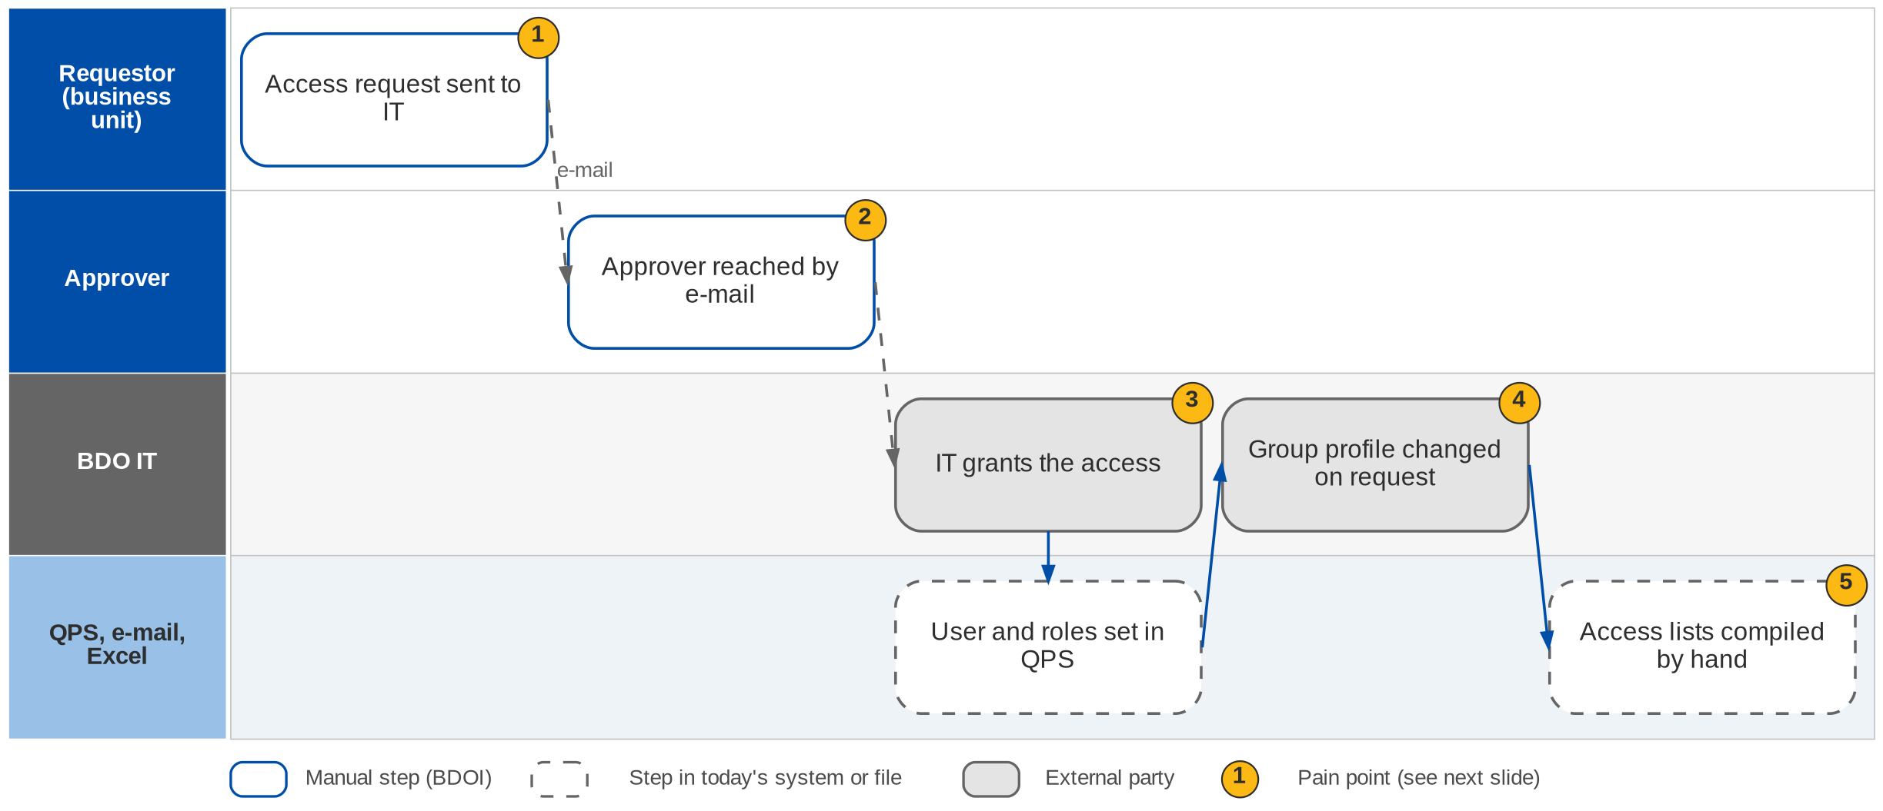
13. User Access: As-Is process
Access requests today (BRD-11 p.5-6)
Confidential – BDOI
BDOI Business Process Reverse KT | v2.0
164
Notes:
Today the business unit sends access requests to IT and coordinates them. The approver is reached by e-mail. IT grants the access in QPS, and group profiles are created or changed by IT on request. Access lists are compiled by hand (BRD-11 p.5).

Slide 165
13. User Access: pain points today
1
Requests go through IT
The business unit coordinates every request with IT; this causes delays.
BRD-11 p.5
4
Group profiles changed by IT
Profile changes are made on request with no approval trail.
BRD-11 p.5-6; BRD 3.002
2
Approver reached by e-mail
No queue of requests waiting for a decision.
BRD-11 p.5; BRD 2.002
5
Access lists by hand
Who has which access, and since when, is compiled manually.
BRD-11 p.5; BRD 3.003, 4.003
3
IT grants the access
The grant waits for IT; no effective date.
BRD-11 p.5-6
Confidential – BDOI
BDOI Business Process Reverse KT | v2.0
165
Notes:
The five points of the BRD-11 current process (p.5-6).
1. Requests go through IT: The business unit coordinates every request with IT; this causes delays. (BRD-11 p.5)
2. Approver reached by e-mail: No queue of requests waiting for a decision. (BRD-11 p.5; BRD 2.002)
3. IT grants the access: The grant waits for IT; no effective date. (BRD-11 p.5-6)
4. Group profiles changed by IT: Profile changes are made on request with no approval trail. (BRD-11 p.5-6; BRD 3.002)
5. Access lists by hand: Who has which access, and since when, is compiled manually. (BRD-11 p.5; BRD 3.003, 4.003)

Slide 166
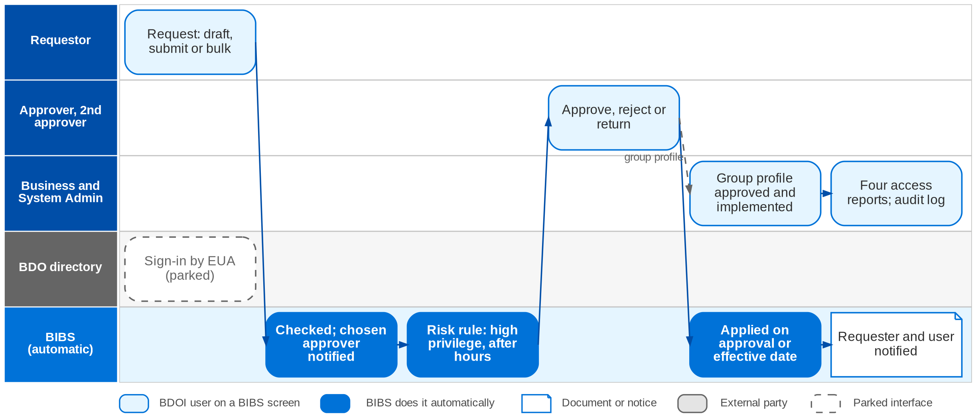
13. User Access: To-Be in the BRD
User access and group-profile requests in BIBS (FRS BRD-11 section 2.2)
Confidential – BDOI
BDOI Business Process Reverse KT | v2.0
166
Notes:
In BIBS the Requestor raises the request (enrol, modify, deactivate or reactivate, alone or in bulk), as a draft or submitted, and chooses the approver. BIBS checks it, sets it PENDING and notifies the chosen approver, who sees it under "Assigned to me". A change to a high-privilege profile, or a submission outside working hours, needs a second approval and raises an alert. The approver approves, rejects with a reason or returns it with remarks. BIBS applies the change on approval or on the effective date, logs the from / to values and notifies the requester and the affected user. Group profiles are requested by the Business Administrator, approved in order and implemented by the System Administrator. Four reports and a structured audit log show who has which access, since when and who changed it. Sign-in by the BDO directory (EUA) is a parked port.

Slide 167
13. User Access: how the BRD answers
Pain point today
To-Be in the BRD
Benefit
1
Requests go through IT
Requestor raises the request in BIBS, as a draft or submitted, alone or in bulk
No IT hand-off
2
Approver reached by e-mail
Chosen approver notified; request listed under "Assigned to me"
Queue per approver
3
IT grants the access
BIBS applies the access on approval or on the effective date; high-risk changes need a 2nd approval
Four eyes on every change
4
Group profiles changed by IT
Business Administrator requests; approvers approve in order; System Administrator implements
Approval trail
5
Access lists by hand
Four reports and a structured audit log with from / to values
Reports in 20 s
Confidential – BDOI
BDOI Business Process Reverse KT | v2.0
167
Notes:
The benefit column names what the To-Be removes.
1. Requests go through IT -> Requestor raises the request in BIBS, as a draft or submitted, alone or in bulk Benefit: No IT hand-off.
2. Approver reached by e-mail -> Chosen approver notified; request listed under "Assigned to me" Benefit: Queue per approver.
3. IT grants the access -> BIBS applies the access on approval or on the effective date; high-risk changes need a 2nd approval Benefit: Four eyes on every change.
4. Group profiles changed by IT -> Business Administrator requests; approvers approve in order; System Administrator implements Benefit: Approval trail.
5. Access lists by hand -> Four reports and a structured audit log with from / to values Benefit: Reports in 20 s.

Slide 168
13. User Access: gaps in the BRD
Coverage | Item | What we saw on the floor | What the BRD says | Our recommendation | Ref
Partly in BRD | BIBS-wide access matrix | Access decides who books, sends and approves. | BRD-11 covers the process; the matrix of all modules is open. | One role and access matrix for all modules, approved by every BRD owner. | DCR-121
BDOI to confirm | Enterprise sign-in | Windows ID through BDO EUA today. | EUA in BRD-11; the IER names EIAM (Entra ID). | Confirm EIAM single sign-on and MFA for all users. | DCR-143, 230; INT-01
BDOI to confirm | Identity governance | Access requests in the business module. | UIDM-ISC may take over requests and approvals. | Decide which tool owns requests and recertification. | DCR-229; INT-02
Partly in BRD | Personas seen on the floor | Combank account support; two contact centres; sanitation handlers. | Not all in the role list. | Add them to the matrix. | XQ02; DCR-121
Partly in BRD | External users | EB portal users planned. | Provisioning, MFA and hosting open. | Rules for external users before any portal goes live. | DCR-096
Confidential – BDOI
BDOI Business Process Reverse KT | v2.0
168
Notes:
The BIBS-wide access matrix and the enterprise identity decisions shape every module.
[Partly in BRD] BIBS-wide access matrix. Seen: Access decides who books, sends and approves. BRD: BRD-11 covers the process; the matrix of all modules is open. Recommendation: One role and access matrix for all modules, approved by every BRD owner. (DCR-121)
[BDOI to confirm] Enterprise sign-in. Seen: Windows ID through BDO EUA today. BRD: EUA in BRD-11; the IER names EIAM (Entra ID). Recommendation: Confirm EIAM single sign-on and MFA for all users. (DCR-143, 230; INT-01)
[BDOI to confirm] Identity governance. Seen: Access requests in the business module. BRD: UIDM-ISC may take over requests and approvals. Recommendation: Decide which tool owns requests and recertification. (DCR-229; INT-02)
[Partly in BRD] Personas seen on the floor. Seen: Combank account support; two contact centres; sanitation handlers. BRD: Not all in the role list. Recommendation: Add them to the matrix. (XQ02; DCR-121)
[Partly in BRD] External users. Seen: EB portal users planned. BRD: Provisioning, MFA and hosting open. Recommendation: Rules for external users before any portal goes live. (DCR-096)

Slide 169
13. User Access: best practice
Single sign-on with MFA
Access recertification
Segregation-of-duties matrix
Partly in BRD
Security and convenience
Partly in BRD
Audit
Partly in BRD
Fraud control
Industry practice: Sign-in through the enterprise identity provider with MFA.
For BDOI: Confirm EIAM (DCR-230).
Industry practice: Managers confirm their team's access every quarter.
For BDOI: Use the access reports as the review input.
Industry practice: Conflicting roles (maker and approver, payee set-up and payment) blocked by rule.
For BDOI: Define the conflicts with Audit.
Privileged access control
Joiner-mover-leaver automation
Not in BRD
Security
Beyond the BRD
No stale access
Industry practice: Administrator access time-bound, approved and recorded.
For BDOI: Agree with BDO IT Security.
Industry practice: Access granted and removed from HR events.
For BDOI: Through the identity governance tool.
Confidential – BDOI
BDOI Business Process Reverse KT | v2.0
169
Notes:
Practices of insurance brokers that fit BDOI, beyond what the BRD asks; the chip shows how far the BRD already covers each one.
Single sign-on with MFA [Partly in BRD]. Sign-in through the enterprise identity provider with MFA. For BDOI: Confirm EIAM (DCR-230).
Access recertification [Partly in BRD]. Managers confirm their team's access every quarter. For BDOI: Use the access reports as the review input.
Segregation-of-duties matrix [Partly in BRD]. Conflicting roles (maker and approver, payee set-up and payment) blocked by rule. For BDOI: Define the conflicts with Audit.
Privileged access control [Not in BRD]. Administrator access time-bound, approved and recorded. For BDOI: Agree with BDO IT Security.
Joiner-mover-leaver automation [Beyond the BRD]. Access granted and removed from HR events. For BDOI: Through the identity governance tool.

Slide 170
Part G
Cross-cutting topics
Data migration, integrations and shared capabilities: what every department depends on, and where the programme risk sits
14. Data migration BRD-13 (draft) and the migration strategy
15. Integrations Integration inventory of the programme alignment pack
16. Shared capabilities Across all BRDs
Confidential – BDOI | BDOI Business Process Reverse KT
Notes:
Three topics cut across every chapter: moving the data out of EBIX, QPS, ISYS and the spreadsheets; connecting BDOI to about 55 insurers, the BDO bank channels and the government; and the shared capabilities (documents, e-signature, notifications, SLA, audit, reports) that every department asked for on the floor.

Slide 171
14. Data migration: the BRD and the floor
A selective, continuity-first migration: clean masters and open items move; history stays readable in legacy or an archive.
What BRD-13 asks
What the floor walk adds
Key dates
• Migrate clean masters: clients, LOVs, insurers, products, packages, rates, chart of accounts map
• Carry forward open items: open invoices, unapplied payments, receivables, remittance in flight
• Archive history read-only; in-force policies recreated at renewal
• 23 requirements, all "must have"; draft, unsigned
• Data also lives in ICS, CLS, SharePoint, Drive H and Excel trackers (DP lists, commission trackers, RI sheet, NB and ManCom masterlists)
• Three references per transaction to map (OV-03)
• Direct-pay tags, threshold accounts and 0.99 variances in the balances (CA-02, CA-03)
• Leads and clients in one category (OV-04)
• Mock 1 Apr 2027; Mock 2 Jul 2027; Mock 3 Aug 2027; Mock 4 Oct 2027
• Dress rehearsal Nov 2027
• Freeze Fri 31-Dec-2027; load Sat 1-Jan-2028
• Go-live Mon 3-Jan-2028; true-ups to May 2028
Confidential – BDOI
BDOI Business Process Reverse KT | v2.0
171
Notes:
BRD-13 is a draft v0.01 of 14-Apr-2026, unsigned (DCR-189, 190). It asks for a selective migration, not a full history conversion: master and reference data migrate, open financial items are carried forward on legacy sub-ledgers, history is archived with logged access, and in-force policies are recreated cleanly when they renew. The floor walk showed where the data actually lives today and why it is hard to move.

Slide 172
14. Data migration: where the data lives today
Source | What it holds | After the freeze | What the floor walk adds
EBIX Evolution | Booking, invoices, AR / OR, remittance, unapplied, GL, payees, branches, EB programmes, claims | Read-only until the archive is loaded | Policy-fee invoices keyed in the report menu; DP tags without premium entries
QPS | Quotations, clients, covers, packages, rates, sales organisation, renewals, users | Read-only; retired after the last QPS policy renews | Holds the three references; receives accounts migrated from ISYS
ISYS / Broker | Leads, clients, accounts, Marketing Diary, claims and GL reports | Read-only; archived | Client codes kept for renewal (NB-15); leads not separated (OV-04)
ICS (Collections) | Dispositions, promises, collector assignments, ageing | Read-only; archived | Status and ageing wrong after payment (CO-02); named CMS in the BRD: confirm
Excel, Drive H, SharePoint | Submitted masterlists, RMEL dispositions, RA trackers, KYC documents | Migrated or archived with checksums | Also DP lists, commission trackers, RI sheet, NB masterlist, ManCom list
CLS, CC Nav | Contact-centre cases and knowledge | Not in the object list | Every contact logged by hand; confirm scope
Confidential – BDOI
BDOI Business Process Reverse KT | v2.0
172
Notes:
Sources: DM strategy "Legacy systems in scope"; DATA_MIGRATION_DESIGN section 2; floor-walk notes and process flows.

Slide 173
14. Data migration: objects and treatment
Group | Objects | Treatment | Planning volume
Reference | LOVs and MIS values, branches, sales organisation, insurers, products and risk codes, packages, commission rates, chart of accounts map | Migrate | Under 100 insurers; ~600 AOs; a few hundred products
Users | Users and roles | Excluded: recreated by access requests | ~1,344 users
Clients | Clients, contacts, payout accounts; KYC documents; screening results | Migrate; KYC archived; full re-screen | Loaders sized for 1,000,000
Policies | In-force policy headers (every expiry to 31-May-2028); expired policies; RA-sent file; submitted masterlists; EB programmes | Conditional; archive | 250-310K renewable accounts a year
Open items | Open invoices with components and insurer shares; unapplied payments; open collection state; remittance in flight; PDCs; open claims | Carry forward on legacy sub-ledgers | Sized for 500,000 invoices; 55 new claims a day
Ledger | Opening trial balance; GL history; FY2027 true-ups | Migrate; archive; true-up | A few thousand lines
History | Closed transactions, legacy documents | Archive with legacy inquiry | To supply
Confidential – BDOI
BDOI Business Process Reverse KT | v2.0
173
Notes:
DM layouts, objects R01-H02. Real counts are due from BDOI by 29-Jan-2027 (DMQ28).

Slide 174
14. Data migration: approach and gates
G1 Decide
G2 Map
G3 Validate
G4 Load
G5 Reconcile
G6 Accept
G7 Go-live
What happens
Class per object: migrate, carry, archive, exclude
Code maps and rules
Quality checks: 0.5% masters, 0 money
Load through business services; rerunnable
Counts, amounts, hashes, fields, GL
Business acceptance per object
Go / no-go: 12 criteria
Who signs
Data owner
Data owner, steward
Migration lead
Migration lead
Comptrollership
Department head
Go / no-go board
Reconciliation levels
Rehearsals
Cut-over weekend
• L1 counts; L2 amounts, tolerance 0.00
• L3 hash totals; L4 field by field
• L5 GL: clearing 0.00 per branch and currency
• Mock 1-4 in SIT and UAT, Apr to Oct 2027
• Dress rehearsal Nov 2027 with 20% time margin
• Reference data and clients load first
• Freeze Fri 31-Dec-2027 22:00; load Sat
• Go / no-go Sun 18:00; go-live Mon 3-Jan-2028
• Hypercare 30 days; daily sub-ledger to GL check
Confidential – BDOI
BDOI Business Process Reverse KT | v2.0
174
Notes:
Every object passes seven gates with segregation of duties. Reconciliation runs at five levels, from counts to the general ledger, with Migration Clearing at 0.00 per branch and currency. Four mock loads and a dress rehearsal precede the cut-over weekend.

Slide 175
14. Data migration: challenges we see
Duplicate clients
Several references per invoice
Balances by component
Partly in BRD
BDOI to confirm
Partly in BRD
• Same client in Broker, QPS, EBIX, ICS with different numbers
• Scored matching; steward queue for 60-89
• Bank CIF as a key: BDOI to confirm (DMQ04)
• ISYS, QPS, EBIX and payment references (OV-03)
• Uniqueness of EBIX vs QPS numbers unknown (DMQ11)
• Mapping per reference needed (CQ22)
• Legacy may not give open balances per component and insurer share (DMQ12)
• Threshold accounts and DP tags distort balances (CA-02, CA-03)
• Paid vs remitted split
Data outside systems
January 2028 renewals
People and time
Not in BRD
Partly in BRD
BDOI to confirm
• DP lists, commission trackers, RI sheet, NB and ManCom masterlists in Excel
• CLS cases; SharePoint lists
• Not in the object list (DMQ30)
• RMEL normally at -140 days; January expiries get days to 4 weeks
• Every header to 31-May-2028 must load
• Package remapping at sanitation (DMQ36)
• Data owners and stewards not named
• M1 decisions due 16-Oct-2026
• Cut-over over the year-end holidays
Confidential – BDOI
BDOI Business Process Reverse KT | v2.0
175
Notes:
From the DM strategy risks, the design and the floor walk.

Slide 176
14. Data migration: gaps
Coverage | Item | What we saw on the floor | What the BRD says | Our recommendation | Ref
BDOI to confirm | BRD-13 status | Draft v0.01, unsigned, template text. | Draft only. | Sign BRD-13 with the migration object list. | DCR-189, 190
Partly in BRD | Go-live scope per BRD | Each department keeps open items differently. | Scope, cut-off and format uneven across BRDs. | One object register approved by every data owner. | DCR-157
Not in BRD | Objects outside BRD-13 | Claims, EB, SP masterlists, payees, PDCs, DP and RI trackers. | Not listed. | Add them with class and owner. | DMQ30; DCR-196
BDOI to confirm | Collections source | ICS on the floor. | CMS (Collection Management System). | Confirm ICS = CMS and its extract. | CO-02; DCR-221
BDOI to confirm | Volumes | Volumes heard on the floor only. | Counts to be supplied. | Supply counts per object by M3. | DMQ28
BDOI to confirm | Year-end option | Cut-over at year end. | Provisional opening, true-ups to May 2028 proposed. | Comptrollership to confirm option A. | DMQ39
Partly in BRD | Data owners and stewards | Owners implied by department. | Roles described, people not named. | Name an owner and a steward per object. | DMQ01
Confidential – BDOI
BDOI Business Process Reverse KT | v2.0
176
Notes:
BRD-13 gaps from the register (DCR-157, 189-209) and from the floor walk.
[BDOI to confirm] BRD-13 status. Seen: Draft v0.01, unsigned, template text. BRD: Draft only. Recommendation: Sign BRD-13 with the migration object list. (DCR-189, 190)
[Partly in BRD] Go-live scope per BRD. Seen: Each department keeps open items differently. BRD: Scope, cut-off and format uneven across BRDs. Recommendation: One object register approved by every data owner. (DCR-157)
[Not in BRD] Objects outside BRD-13. Seen: Claims, EB, SP masterlists, payees, PDCs, DP and RI trackers. BRD: Not listed. Recommendation: Add them with class and owner. (DMQ30; DCR-196)
[BDOI to confirm] Collections source. Seen: ICS on the floor. BRD: CMS (Collection Management System). Recommendation: Confirm ICS = CMS and its extract. (CO-02; DCR-221)
[BDOI to confirm] Volumes. Seen: Volumes heard on the floor only. BRD: Counts to be supplied. Recommendation: Supply counts per object by M3. (DMQ28)
[BDOI to confirm] Year-end option. Seen: Cut-over at year end. BRD: Provisional opening, true-ups to May 2028 proposed. Recommendation: Comptrollership to confirm option A. (DMQ39)
[Partly in BRD] Data owners and stewards. Seen: Owners implied by department. BRD: Roles described, people not named. Recommendation: Name an owner and a steward per object. (DMQ01)

Slide 177
14. Data migration: best practice
Named data owners and stewards
Clean at source now
Reconciled by construction
Partly in BRD
Accountability
Partly in BRD
Fewer fall-outs
In the BRD
Audit comfort
Industry practice: Each object has a business owner who signs the class, the maps and the acceptance, and stewards who clean it.
For BDOI: Name them in October 2026.
Industry practice: Duplicates, missing TINs and old unapplied items fixed in legacy long before the mocks.
For BDOI: Start a cleansing sprint per department in Q4 2026.
Industry practice: Every load reconciles counts, amounts and GL; clearing account at zero.
For BDOI: Comptrollership signs each financial object.
Rehearse the cut-over
Retire spreadsheets
Legacy inquiry and archive
In the BRD
Predictable go-live
Beyond the BRD
One source of truth
In the BRD
Decommissioning
Industry practice: Timed mocks and a dress rehearsal with the real run book.
For BDOI: Keep the four mocks and the dress rehearsal.
Industry practice: Every tracker either migrates into the system or is archived; none survives go-live.
For BDOI: Inventory the trackers per department.
Industry practice: History readable after legacy is switched off, with logged access.
For BDOI: Agree retention per record type (DCR-136).
Confidential – BDOI
BDOI Business Process Reverse KT | v2.0
177
Notes:
Practices of insurance brokers that fit BDOI, beyond what the BRD asks; the chip shows how far the BRD already covers each one.
Named data owners and stewards [Partly in BRD]. Each object has a business owner who signs the class, the maps and the acceptance, and stewards who clean it. For BDOI: Name them in October 2026.
Clean at source now [Partly in BRD]. Duplicates, missing TINs and old unapplied items fixed in legacy long before the mocks. For BDOI: Start a cleansing sprint per department in Q4 2026.
Reconciled by construction [In the BRD]. Every load reconciles counts, amounts and GL; clearing account at zero. For BDOI: Comptrollership signs each financial object.
Rehearse the cut-over [In the BRD]. Timed mocks and a dress rehearsal with the real run book. For BDOI: Keep the four mocks and the dress rehearsal.
Retire spreadsheets [Beyond the BRD]. Every tracker either migrates into the system or is archived; none survives go-live. For BDOI: Inventory the trackers per department.
Legacy inquiry and archive [In the BRD]. History readable after legacy is switched off, with logged access. For BDOI: Agree retention per record type (DCR-136).

Slide 178
15. Integrations: today, BRDs and the floor
All external touch-points are owned by BDO IT; specifications for the enterprise and insurer interfaces are requested by 31-Jan-2027.
Today
In the BRDs and the IER
What the floor walk adds
• About 55 insurers, each handled differently (OV-01)
• Slips, returns, e-policies, SOAs, recon files by e-mail; SFTP for some insurers
• Bank files (HLS, LAD, CLPC, LAMD, PMS, FS04) moved and run by IT
• Credit files by WinSCP to TPD; EFPS and BancNet by hand
• 20 interfaces (INT-01 to 20): identity, bank channels, loan systems, mail, insurers, EGL, EDP
• Most are seams: upload or manual until specified
• Insurer channel per insurer: e-mail, SFTP or API (Q06)
• Owner of every touch-point: BDO IT
• CLAS and CTS reports (New Business)
• WinSCP to TPD; EFPS; BancNet (Disbursement)
• ICS, CLS and CC Nav (Collections, contact centre)
• SharePoint and Teams hand-offs (Operations)
Confidential – BDOI
BDOI Business Process Reverse KT | v2.0
178
Notes:
Today almost every exchange with insurers, the bank and the government is an e-mail, a file moved by IT, or a form. The BRDs and the IER list twenty interfaces; most are seams until their specifications arrive. The floor walk added several channels the inventory does not yet name.

Slide 179
15. Integrations: the inventory (1/2)
Counterparty | Data | Today | To-Be target | Status | Open
Insurers (~55) | Slips, e-policies, returns, SOAs, recon, DP billing, ORs, claims | E-mail; SFTP for some | Channel per insurer | Change | IQ18; Q06
Identity: EIAM, UIDM-ISC | Sign-in, accounts, entitlements | EUA / Windows ID | SSO; provisioning | Change | IQ04-05; DCR-143
HLS, LOAS, LAMD, LFS, CIU | Loan and home-insurance requests, loan status, submitted policies | Excel reports | File or API | Change | IQ06-08; DCR-146
CLAS, CTS | Bank insurance reports for bulk quotes | Sanitised by hand | Not in the inventory | New | Floor walk
CLPC | CBG Fire billing and payment report | Excel file | SFTP file | Change | Q28
OBPCS, Old BOB, PMS | Bills payment, direct credits, PDCs | Files via IT (FS01, FS04) | Upload layouts | Configure | IQ09-10
Confidential – BDOI
BDOI Business Process Reverse KT | v2.0
179

Slide 180
15. Integrations: the inventory (2/2)
Counterparty | Data | Today | To-Be target | Status | Open
CMS / New BOB, TPD | Outward payments; credited file back | QPS text via WinSCP | Outward file or host-to-host | Change | IQ10; AQ09
EFPS, BancNet (SSS, Pag-IBIG, PhilHealth) | Tax filing and contributions | Manual; websites watched | Not in the inventory | New | Floor walk
CCM, M365 mailbox | Outbound mail; inbound requests | Manual capture | SMTP relay; mailbox reader | Configure, New | IQ11-12
EGL, EDP, CARMS | Group ledger, analytics data | Report exports | Extracts | New | IQ15-17; DCR-233
NLDS, AMLC, Bridger | PEP lists, STR, screening evidence | One NLDS user; manual | List intake; STR extract | Change | SQ01
Mail house, COG | Printed RA and reminder letters | RA text files | Print batch | New | SQ09
Confidential – BDOI
BDOI Business Process Reverse KT | v2.0
180
Notes:
From the programme alignment integration inventory (INT-01 to INT-20) and the BRD interfaces; completed with the channels of the floor walk.

Slide 181
15. Integrations: challenges we see
55 insurers, 55 ways
Bank channels without layouts
Enterprise feeds undefined
Partly in BRD
BDOI to confirm
Not in BRD
• Every insurer exchanges differently today (OV-01)
• Only some are on SFTP; the rest e-mail
• No BDOI insurer data standard
• CMS / New BOB, OBPCS, Old BOB, PMS named without layouts
• AFTS unexplained
• IT runs the files today (DCR-234)
• EGL and EDP have no specification in any BRD (DCR-233)
• CARMS unknown
• Specs requested by 31-Jan-2027
Identity decisions
Duplicate intakes
Channels not yet listed
BDOI to confirm
Partly in BRD
Not in BRD
• EUA in BRD-11 vs EIAM (Entra ID) in the IER (DCR-230)
• Identity governance may own access requests (DCR-229)
• External users for portals (DCR-096)
• LAMD used by Renewal and Submitted Policies (DCR-146)
• HLS / LOAS in two drops
• CLPC payments specified twice (DCR-027)
• CLAS, CTS; EFPS, BancNet
• Print and mail house for letters
• E-policy fall-out handling
Confidential – BDOI
BDOI Business Process Reverse KT | v2.0
181
Notes:
From the integration inventory, the register and the floor walk.

Slide 182
15. Integrations: gaps
Coverage | Item | What we saw on the floor | What the BRD says | Our recommendation | Ref
Not in BRD | Insurer data standard | ~55 insurers, each different (OV-01). | Channel per insurer configurable; no common standard. | A BDOI insurer interface standard (layouts, SFTP / API) and on-boarding waves. | OV-01; Q06
Not in BRD | Government channels | EFPS, BancNet by hand. | Not specified. | Add to the inventory; calendar and confirmation in Disbursement. | Disbursement flow
Not in BRD | CLAS, CTS feeds | Bank reports sanitised by hand. | HLS only. | Add to the inventory with layouts. | NB flow; Q11
Partly in BRD | EGL and EDP | GARD report exports. | No specification. | BDO IT to specify by 31-Jan-2027. | DCR-233
Partly in BRD | Bank payment channels | WinSCP to TPD; branch forms. | Named; layouts and transport open. | Host-to-host with status back. | DCR-234; AQ09
BDOI to confirm | Print channel | COG prints RA and reminders. | Channel open. | Mail-house batch with tracking. | SQ09
Confidential – BDOI
BDOI Business Process Reverse KT | v2.0
182
Notes:
Integration gaps across the BRDs.
[Not in BRD] Insurer data standard. Seen: ~55 insurers, each different (OV-01). BRD: Channel per insurer configurable; no common standard. Recommendation: A BDOI insurer interface standard (layouts, SFTP / API) and on-boarding waves. (OV-01; Q06)
[Not in BRD] Government channels. Seen: EFPS, BancNet by hand. BRD: Not specified. Recommendation: Add to the inventory; calendar and confirmation in Disbursement. (Disbursement flow)
[Not in BRD] CLAS, CTS feeds. Seen: Bank reports sanitised by hand. BRD: HLS only. Recommendation: Add to the inventory with layouts. (NB flow; Q11)
[Partly in BRD] EGL and EDP. Seen: GARD report exports. BRD: No specification. Recommendation: BDO IT to specify by 31-Jan-2027. (DCR-233)
[Partly in BRD] Bank payment channels. Seen: WinSCP to TPD; branch forms. BRD: Named; layouts and transport open. Recommendation: Host-to-host with status back. (DCR-234; AQ09)
[BDOI to confirm] Print channel. Seen: COG prints RA and reminders. BRD: Channel open. Recommendation: Mail-house batch with tracking. (SQ09)

Slide 183
15. Integrations: best practice
One insurer interface standard
Integration layer with monitoring
Bank host-to-host
Beyond the BRD
Scale to 55 insurers
Partly in BRD
Fewer IT batches
Partly in BRD
Same-day status
Industry practice: One BDOI layout and channel (API or SFTP) for slips, e-policies, SOAs and recon files; insurers on-boarded in waves.
For BDOI: Start with the top 10 insurers by premium.
Industry practice: All files and APIs through one layer with retries, alerts and a message log.
For BDOI: Agree with BDO IT architecture.
Industry practice: Collections and payments by host-to-host with status callbacks.
For BDOI: Plan with BDO transaction banking.
Event-driven notices
Partner portals
Beyond the BRD
Real-time status
BDOI to confirm
Self-service
Industry practice: Business events published once for reports, analytics and partners.
For BDOI: Use for the EDP feed.
Industry practice: Insurers, HMOs and client HR upload and download through a portal.
For BDOI: Confirm timing (DCR-211).
Confidential – BDOI
BDOI Business Process Reverse KT | v2.0
183
Notes:
Practices of insurance brokers that fit BDOI, beyond what the BRD asks; the chip shows how far the BRD already covers each one.
One insurer interface standard [Beyond the BRD]. One BDOI layout and channel (API or SFTP) for slips, e-policies, SOAs and recon files; insurers on-boarded in waves. For BDOI: Start with the top 10 insurers by premium.
Integration layer with monitoring [Partly in BRD]. All files and APIs through one layer with retries, alerts and a message log. For BDOI: Agree with BDO IT architecture.
Bank host-to-host [Partly in BRD]. Collections and payments by host-to-host with status callbacks. For BDOI: Plan with BDO transaction banking.
Event-driven notices [Beyond the BRD]. Business events published once for reports, analytics and partners. For BDOI: Use for the EDP feed.
Partner portals [BDOI to confirm]. Insurers, HMOs and client HR upload and download through a portal. For BDOI: Confirm timing (DCR-211).

Slide 184
16. Shared capabilities (1/2)
Capability | What the floor walk showed | In the BRDs | Our recommendation
One lifecycle reference | Three system references per deal (OV-03) | ARN and invoice ledger | Confirm one reference on every document
Documents and templates | Insurer templates for schedules; BDOI template for RA only (DC-01) | Templates per module, versioned | One template library owned by the business
E-signature | Wet signatures on refunds, disbursements, ManCom; signed copy for audit | Not a platform requirement | Decision with Legal and Compliance (CP-01)
SLA and TAT | 7 / 3 days NB, 24 h / 3 days RI, TAT in cases | SLA timers in some BRDs; values open | One SLA catalogue with values per step
Notifications | Follow-ups by e-mail, phone, chat | Notifications per workflow step | Add client-facing SMS and e-mail
Confidential – BDOI
BDOI Business Process Reverse KT | v2.0
184

Slide 185
16. Shared capabilities (2/2)
Capability | What the floor walk showed | In the BRDs | Our recommendation
Self-service reports | Reports need IT (RP-01) | Report centre; ad-hoc builder parked | Governed report builder after go-live
Configuration masters | Insurers, products, LOVs, MIS fields, audit (Day 1 p.9) | Masters with approval | Business owners per master
Tolerances and thresholds | Four different values (CA-02, reversal variance) | Hard-coded per BRD | One tolerance matrix
Data privacy and retention | Member and client data by e-mail | Retention differs by BRD (DCR-136) | One retention schedule; masking rules
Confidential – BDOI
BDOI Business Process Reverse KT | v2.0
185
Notes:
Capabilities that are not one department's: the floor walk raised each of them in several sessions.

Slide 186
Part H
Roadmap and best practice
Streamline first, then automate: what BDOI can do now, at go-live and after
17. Roadmap, gaps and open points Principles, automation map, horizons, KPIs, consolidated gaps, open points
Confidential – BDOI | BDOI Business Process Reverse KT
Notes:
The roadmap does not wait for the system. Some improvements are decisions BDOI can take now (rules, owners, templates, data clean-up); the BRD scope arrives at go-live in January 2028; automation and integration beyond the BRDs follow once the platform is stable.

Slide 187
17. Five levers to streamline before we automate
1
2
3
4
5
Eliminate
Simplify
Standardise
Automate
Integrate and measure
Remove steps that exist only because systems are separate
Fewer hand-offs and approval levels
One rule, one value, one template
Let the system do the routine; people handle exceptions
Connect partners; run on KPIs
At BDOI
• ISYS to QPS migration
• Split payment files
• Text files for e-policy updates
• Zero-value remittance workfile
At BDOI
• Five refund chains to one rule
• 3-4 signatures to a DOA matrix
• RMEL passed through 4 hands
At BDOI
• One tolerance matrix
• One credit policy
• One insurer layout
• Notice days per segment
At BDOI
• Cash application
• Insurer recon
• Renewal decision matrix
• Reversals and entries
At BDOI
• Insurer and bank channels
• SLA and TAT dashboards
• Self-service reports
Confidential – BDOI
BDOI Business Process Reverse KT | v2.0
187
Notes:
Automating a broken process only makes it fail faster. These five levers, applied in order, are how insurance brokers usually take cost and delay out of operations; each has BDOI examples from the floor walk.

Slide 188
17. Automation opportunities by department (1/2)
Department | Manual work today (floor walk) | Lever | When | Benefit
New Business | Excel quotes; three systems; e-policy fall-outs | One client and account; e-policy exception queue; insurer standard | Go-live, After | High
Renewal | Excel sanitation and dispositions; RA text files; snail mail | Decision matrix; RA in batch; print batch | Go-live | High
Submitted Policies | Masterlists on Drive H; LAMD matching by hand | Rules on one masterlist; bank feeds | Go-live, After | Medium
Employee Benefits | 50K+ member lists by e-mail | Census upload with checks; portal | Go-live, After | Medium
TSU, Product | Excel tracker and comparative; IT for set-up | Workflow; rules maintained by TSU | Go-live | Medium
Reinsurance | E-mail placement; monitoring sheet | RI module; SLA clocks | Phase 2 | Medium
Cashiering | Intake checks; split files; receipts | Auto application; unique payment reference | Go-live, After | High
Confidential – BDOI
BDOI Business Process Reverse KT | v2.0
188

Slide 189
17. Automation opportunities by department (2/2)
Department | Manual work today (floor walk) | Lever | When | Benefit
Remittance, Recon | Excel sanitising; 20-30K lines per insurer | Scheduled batches; automatic matching | Go-live | High
Commission | DP lists in Excel; reversals via IT | DP billing tracked; reversal entries generated | Go-live | High
Collections | ICS status; CTE by e-mail | Worklist with rules; dunning; credit policy | Go-live, After | Medium
Comptrollership | Wet signatures; WinSCP; journals; IT close | E-approval; host-to-host; entries at source | Go-live, After | High
Claims | Offline claims and repairs | Claim on the cover; client notices | Go-live, After | Medium
Contact centre | Cases logged by hand in CLS | Case management (BDOI To-Be) | Change request | Medium
Confidential – BDOI
BDOI Business Process Reverse KT | v2.0
189
Notes:
The benefit is the project team's estimate of effort removed and control gained, from what we saw on the floor. "Go-live" means the lever is in the BRD scope; "After" means beyond the BRDs.

Slide 190
17. Roadmap in four horizons
H0: Prepare
Now to Dec 2027
H1: Go-live
Jan 2028
H2: Automate
Feb 2028 - Dec 2028
H3: Optimise
2029 onward
Streamline and decide
• Credit policy, DOA matrix, tolerance matrix
• One reference; notice days; SLA values
• Data owners; clean-up at source
• Insurer interface standard agreed
• Retire trackers per department
BRD scope in one system
• One client, one ARN, one invoice ledger
• Workflows with maker-checker
• Matching, batches, decision matrix
• Reports run by users
• Migrated masters and open items
Exceptions only
• Cash application with scoring; payment references
• E-policy ingestion; fall-out queue
• Case management; client notices
• Bank host-to-host; EFPS calendar
• Reinsurance module (phase 2)
Integrated and measured
• Insurer APIs and portals
• Self-service for clients and HR
• Analytics: retention, profitability
• Continuous close
• Assisted work: document reading, next best action
Enablers across the horizons
• Business owners for every master, rule and report
• Change champions (21) and SMEs (38) per department
• BDO IT specifications for bank, insurer and enterprise interfaces
• Decisions on the open points of this deck
• Training and quick-reference cards per role
• KPIs measured from go-live
Confidential – BDOI
BDOI Business Process Reverse KT | v2.0
190
Notes:
H0 is what BDOI can decide and prepare now; H1 is the BRD scope at go-live; H2 and H3 go beyond the BRDs. The enablers make every horizon possible.

Slide 191
17. KPIs to measure operational efficiency (1/2)
KPI | How it is today | Target idea | Owner
Quote turnaround | 7 / 3 days, not tracked (NB-07) | Measured per quote; 90% within SLA | Marketing
Request to booked policy | Not measured; three systems | Days from acceptance to booking | Processing
E-policy fall-outs | Exception report from IT | Share of e-policies without fall-out | Processing, IT
Renewal retention | Excel dispositions | Retention and reasons per segment | Marketing
Straight-through renewals | None | Share renewed by the decision matrix | Marketing, Processing
Unapplied cash | Unapplied report worked offline | Amount and age of unapplied | Cashiering
Confidential – BDOI
BDOI Business Process Reverse KT | v2.0
191

Slide 192
17. KPIs to measure operational efficiency (2/2)
KPI | How it is today | Target idea | Owner
Days sales outstanding | ICS ageing unreliable (CO-02) | DSO per segment; promises kept | Collections
Remittance on time | Weekly, by hand | Share remitted in the incentive window | Remittance
Recon match rate | 20-30K lines by hand | Share matched automatically | Production recon
Close duration | IT runs the close | Working days to close the month | FRBS
Claims cycle time | Offline | Notice to settlement, per insurer | Claims
First-contact resolution | Cases by hand in CLS | Share closed at first contact | Contact centre
Confidential – BDOI
BDOI Business Process Reverse KT | v2.0
192
Notes:
Targets are suggestions for BDOI to set; the baseline is what we heard on the floor.

Slide 193
Summary: from today to best practice
1 Manual: paper, e-mail
2 Tool-assisted: spreadsheets, separate systems
3 One workflow in one system
4 Automated, with exception queues
5 Integrated and measured
Automation
Controls
Data
Integration
Customer service
Compliance
Reporting
Today
To-Be in the BRDs
Best practice
Scale: project team assessment from the floor walk, the process flows and the BRDs
Confidential – BDOI
BDOI Business Process Reverse KT | v2.0
193
Notes:
The To-Be moves every theme to one workflow in one system or better; the roadmap takes the themes to automated and integrated. Integration and customer service need the most work beyond the BRDs.
Automation: today 1, To-Be 4, best practice 5. Today: split files, receipts, reversals and journals by hand (Operations and FRBS flows). To-Be: jobs, matching and straight-through steps with exception queues.
Controls: today 2, To-Be 4, best practice 5. Today: wet signatures, Teams approvals, checker-poster one by one. To-Be: maker-checker and approval matrices in the workflow.
Data: today 1, To-Be 4, best practice 5. Today: three references, Excel masterlists, re-keying across five tools. To-Be: one client, one ARN, one invoice ledger.
Integration: today 2, To-Be 3, best practice 5. Today: e-mail, SFTP and WinSCP files, IT batches. To-Be: uploads and seams; APIs to specify.
Customer service: today 2, To-Be 3, best practice 5. Today: CBG-only view, cases logged by hand. To-Be: every account; case management not in BRD-9.
Compliance: today 1, To-Be 4, best practice 5. Today: KYC and AMLA outside the system, names matched by hand. To-Be: screening on every trigger with cases.
Reporting: today 1, To-Be 4, best practice 5. Today: reports need IT (RP-01). To-Be: users run reports; ad-hoc builder open.

Slide 194
17. What the BRDs miss: the top items (1/2)
Level | Item | Areas | Why it matters | Recommendation
High | Payment on a direct-pay invoice | Operations | Money received without an accounting entry (CA-03) | Rule at acceptance and entries; new DCR
High | Credit policy | Collections, Operations | Drives follow-up, CTE and cancellation; Insurance Code s.77 | Write and configure the policy (CO-03)
High | Case management | Contact centre | Every contact logged by hand; BDOI already has a To-Be | Take the 15-Jul To-Be in as a change request
High | Government remittances | Comptrollership | EFPS and BancNet by hand; penalty risk | Calendar and confirmation in Disbursement
High | Insurer interface standard | All front and back office | ~55 insurers, each handled differently | One layout and channel; on-board in waves
High | Migration objects outside BRD-13 | All | Trackers, claims, EB, payees, PDCs not listed | Object register with owners
Medium | Quote validity; risk survey | New Business | 30-day validity and 500M survey not in BRD-1 | Parameters and survey step
Confidential – BDOI
BDOI Business Process Reverse KT | v2.0
194

Slide 195
17. What the BRDs miss: the top items (2/2)
Level | Item | Areas | Why it matters | Recommendation
Medium | E-policy fall-out queue | New Business, Renewal | Text files and IT reports today | Exception queue; one sender
Medium | Renewal pro-forma entries | Renewal, Comptrollership | Adjustments after the fact (RN-02) | Pro-forma at acceptance
Medium | Marine open covers; accumulation | New Business (Trade) | Bank trade business not modelled (TR-01, TR-02) | Open-cover master and accumulation
Medium | EB claims; ISACOM approval | Employee Benefits | Provider claims and approvals outside | Capture claims; approval step
Medium | Exclusion and bounced-check lists | Cashiering | Checked by hand at intake | Maintained lists checked at acceptance
Medium | Snail mail and print channel | Renewal, Submitted Policies | CBG letters printed and mailed | Print batch with tracking
Medium | Reinsurance referral in phase 1 | TSU, Reinsurance | Large risks referred by e-mail | Referral status on the TSU request
Confidential – BDOI
BDOI Business Process Reverse KT | v2.0
195
Notes:
The items of the chapters that are not in any BRD or that block several areas, ranked by impact. Each becomes a register item or a change request with BDOI's decision.

Slide 196
Open items per area (discrepancy register)
Area | BRD | High | Medium | Low | Open | Answered
New Business | BRD-1 | 11 | 17 | 7 | 33 | 2
Renewal | BRD-6 | 15 | 23 | 10 | 41 | 7
Submitted Policies | BRD-12 | 10 | 14 | 5 | 27 | 2
Employee Benefits | BRD-8 | 8 | 13 | 5 | 23 | 3
Product and TSU | BRD-3 | 7 | 9 | 6 | 19 | 3
Operations | BRD-2 | 12 | 20 | 5 | 34 | 3
Collections | BRD-4 | 12 | 20 | 4 | 32 | 4
Accounting | BRD-5 | 10 | 18 | 4 | 30 | 2
Claims | BRD-7 | 11 | 17 | 2 | 27 | 3
Customer Servicing | BRD-9 | 10 | 12 | 3 | 24 | 1
Sanction Screening | BRD-10 | 5 | 12 | 3 | 19 | 1
User Access | BRD-11 | 10 | 12 | 3 | 22 | 3
239 items are raised against the BRDs and the Report List; 64 are High.
High items change what is built, the money, compliance or access; they are resolved before the FRS of the area is signed off.
Items that touch several BRDs, such as the service window, RPO and retention, count under each BRD.
The floor-walk gaps of this deck are added to the register after BDOI confirms them.
Confidential – BDOI
BDOI Business Process Reverse KT | v2.0
196
Notes:
239 items are raised against the BRDs and the Report List; 64 are High.
High items change what is built, the money, compliance or access; they are resolved before the FRS of the area is signed off.
Items that touch several BRDs, such as the service window, RPO and retention, count under each BRD.
The floor-walk gaps of this deck are added to the register after BDOI confirms them.
Source: docs/deliverables/src/registers/discrepancy_register.yaml. An item that touches several BRDs is counted under each of them.

Slide 197
17. Open points for BDOI to confirm (1/3)
# | Ref | Area | Open point | Where it closes
1 | OV-03 | Business overview | One common reference across the lifecycle? | BDOI to confirm
2 | OV-04 | Business overview | Client categories going forward: lead, prospect, existing; retail, corporate | BDOI to confirm
3 | NB-01 | New Business | Routing per product type: TSU for non-package only? Package direct to placement? | Floor walk
4 | NB-04 | New Business | KYC and AMLA in the system, or outside? | BDOI to confirm
5 | NB-05 | New Business | Basis of the 500M risk-survey threshold (sum insured? PHP?) | BDOI to confirm
6 | NB-09 | New Business | Confirm "ibis" and "qbs" in the notes are EBIX and QPS | Internal
7 | NB-14 | New Business | Commission on the free first-year premium | Floor walk (Cashiering)
8 | NB-15 | New Business, Renewal | Non-CBG bank-referred clients at renewal | Floor walk (Renewal)
Confidential – BDOI
BDOI Business Process Reverse KT | v2.0
197

Slide 198
17. Open points for BDOI to confirm (2/3)
# | Ref | Area | Open point | Where it closes
9 | EN-02 | Operations | Tax treatment on cancellation refunds | FRS
10 | TR-02 | Trade, Marine | Marine accumulation by location | FRS
11 | CA-03 | Cashiering | Payment received on a direct-pay invoice: allow a change of the DP tag? | Floor walk
12 | CA-05 | Cashiering | Walk through the bulk payment (~2,000 records) | Floor walk
13 | CO-03 | Collections | Credit policy | BDOI to confirm
14 | IC-01 | Incentives | Early-remittance incentive by insurer | Floor walk
15 | TX-02 | Tax | DPPR / PR2307 reversal and knock-off process | Floor walk
16 | RC-01 | Reconciliation | Bank and insurer reconciliation detail | Floor walk
Confidential – BDOI
BDOI Business Process Reverse KT | v2.0
198

Slide 199
17. Open points for BDOI to confirm (3/3)
# | Ref | Area | Open point | Where it closes
17 | CP-01 | Compliance | E-signature requirement | Legal and Compliance
18 | DCR-112 | Compliance | Sanctions match: block or warn at quotation, placement, booking, renewal | Chief Compliance Officer
19 | DCR-121 | All | One access matrix for all modules | Product Owner and BRD owners
20 | DCR-157 | All | Go-live data migration scope per legacy source | All BRD owners
21 | DCR-037 | Operations, TSU | Incentive programmes (CPC2, excess commission) with rate, base and payer | Comptrollership, MBS
22 | DCR-136 | All | One retention schedule per record type | Compliance, Comptrollership
23 | DCR-210 | Reinsurance | Reinsurance transactions Remittance handles in Drop 1 | RI, Operations
Confidential – BDOI
BDOI Business Process Reverse KT | v2.0
199
Notes:
The 17 open points of the floor-walk notes, plus the cross-BRD decisions that unblock the most chapters.

Slide 200
What we ask of BDOI
• Each department confirms or corrects its chapter: As-Is swimlanes, pain points, rules and values (by 9-Oct-2026)
• Decide the 23 open points, starting with the credit policy, the direct-pay rule, e-signature and the one reference
• Choose the best practices BDOI wants on the roadmap (H0 to H3)
• Name the data owners and stewards per migration object; start the clean-up at source
• BDO IT: specifications for the insurer, bank, government and enterprise interfaces by 31-Jan-2027
• Confirmed gaps enter the discrepancy register or become change requests; the FRS of each BRD follows
Confidential – BDOI
BDOI Business Process Reverse KT | v2.0
200
Notes:
The reverse KT is complete when each department has confirmed or corrected its chapter. We propose one 60-minute session per part (A to F) in the first two weeks of October, and a steering committee review of Parts G and H.

