Slide 1


BDOI Reverse KT - Floor Walk
What we saw and heard on the floor: As-Is, pain points and the way forward
BIBS – BDOI Broker System
BDO Insurance and Reinsurance Brokers, Inc. | Version 3.0 | 27 September 2026 | Confidential
Prepared by
Notes:
Reverse knowledge transfer from the iorta TechNXT team to BDOI, based only on what we saw and heard: the Day 1 business overview of 21-Sep-2026, the floor walks of 22 and 23-Sep with the designated process owners, the discovery sessions of 23 to 25-Sep and our notes of them, and the business process flows BDOI shared. The deck plays back our understanding of how each department works today, where the users feel the pain, what they asked for, and the practices and roadmap we suggest. It deliberately leaves out the BRD review and build status; those are in the end-to-end deck (v2.0). Reinsurance, Sanction Screening and User Access are not in this edition because they were not part of the floor walk.

Slide 2
Why this reverse KT
We walked the floor with 40+ process owners. This deck gives back what we saw and heard, so BDOI can correct it.
What this deck is
What we ask of each department
What this deck is not
• How each department works today, as we saw it on the floor
• The pain points the business users raised, in their words
• What the users asked for, and the practices we suggest
• The end-to-end view across departments
• Confirm or correct the As-Is swimlanes and pain points
• Confirm the rules and values we heard (days, rates, volumes)
• Answer the 17 open points of the floor walk
• Say which suggestions BDOI wants on the roadmap
• Not a review of the BRDs
• Not a build status or test report
• Not a design: it describes today and the business's wishes
Confidential – BDOI
BDOI Reverse KT - Floor Walk | v3.0
2
Notes:
The purpose is validation: each department confirms or corrects the As-Is, the pain points and what we understood the business wants. Corrections go into our floor-walk notes.

Slide 3
What we learned, in six messages
1. One deal, five tools, three references
2. E-mail and Excel carry the work
3. Controls rely on people
• Excel templates, Broker, ISYS, QPS and EBIX for one policy (NB flow)
• ISYS, QPS and EBIX numbers on the same transaction (OV-03)
• IT migrates accounts from ISYS to QPS
• 15 hand-offs between teams by e-mail, file, Teams or paper
• Dispositions, recon, DP lists and trackers in Excel
• Masterlists on Drive H and SharePoint
• Wet signatures at 3-6 levels; checker-poster one by one
• Intake checks, reversals and journals by hand
• Approvals on Teams lists with signed copies
4. IT is in the business path
5. Volumes are real
6. The business knows what it wants
• Extracts (RMEL, production recon), migrations, batches
• Reports and the close need IT (RP-01)
• WinSCP and text files between systems
• 50,000+ EB members (EB-01)
• 20-30K production lines per insurer a month
• About 2,000 records in a bulk payment file (CA-05)
• Product maintenance, claims and renewals in a system
• Receipts, endorsements and reports without manual work
• One way to connect to about 55 insurers (OV-01)
Confidential – BDOI
BDOI Reverse KT - Floor Walk | v3.0
3
Notes:
The six messages of the floor walk; each is developed in the chapters.

Slide 4
How we built our understanding
21-25 Sep
12
66
17
Day 1 business overview, floor walks and discovery sessions
floor-walk sessions with designated process owners (22-23 Sep)
floor-walk notes: As-Is, wants, pain points
open points raised on the floor
BDOI Day 1 deck; floor-walk schedule
Floor-walk POC schedule
Our floor-walk notes
Floor-walk notes, open points
15
10
59
40+
business process flows shared by BDOI
business areas in this deck, in 5 department parts
change champions (21) and additional POCs / SMEs (38)
process owners met on the floor
HL Process Overview pack
This deck
Day 1 p.5
Floor-walk POC schedule
Process flows shared by BDOI: end to end, New Business, Renewal, Submitted Policies, Employee Benefits, TSU, Operations, Collections, Disbursement, Refund, FRBS, ACSL, Claims, Customer Servicing, Case Management.
Confidential – BDOI
BDOI Reverse KT - Floor Walk | v3.0
4
Notes:
Four sources: the Day 1 business overview BDOI presented on 21-Sep; the floor walks of 22 and 23-Sep with the designated process owners; the discovery sessions of 21, 23, 24 and 25-Sep and our notes of them; and the process flows BDOI shared (HL Process Overview pack).

Slide 5
Floor-walk coverage (1/2)
Date | Time | Process | Floor | Process owners
21 Sep | Full day | Business overview; discovery | - | BDOI programme, BU and IT leads (Day 1 deck)
22 Sep | 9-10 am | New Business | 43F | Rose Lique, Marla Apostol (Corporate); Grace Tordesillas, Kin Ysaac Flores (Non-CBG Retail); Justine Malonzo, Jhosven Awa (CBG Motor); Lyka Palomeno, Regina Matutina
22 Sep | 10-11 am | Renewal Marketing | 43F | Amara Cruz, Rose Lique, Joy Ilagan, Tina Fajardo; Grace Tordesillas, Kin Ysaac Flores; Criffson Rendon, Joyce Aritao; Ma. Christena Cezar; Cezssane Canarias, Jeramie Ramos
22 Sep | 11-11:30 am | Marketing Admin | 43F | Rose Lique, Reymark Marcelo; Nina Odvina, Kim Nayve, Mae Varron, Grace Tordesillas, Jordan Lambino
22 Sep | 1-1:30 pm | Product Maintenance (TSU) | 44F | Cherry Ann Manalo, Joy Intia
22 Sep | 1:30-3 pm | Renewal Processing | 44F | Angelo Alibuyog (CBG Fire), Ces Remodo (CBG Motor), Berna Corpuz (Non-CBG Corporate), Norberto Fulo (Non-CBG Retail)
22 Sep | 2-3:30 pm | Placement and Booking | 43F | Ramoncito Manalo, Cherry Ann Catayas; Jean Deam Dela Cruz, Cristina Labrador, Mae Anne B. Roque; John Ray Bellen, Rey Mark Magsael
Confidential – BDOI
BDOI Reverse KT - Floor Walk | v3.0
5

Slide 6
Floor-walk coverage (2/2)
Date | Time | Process | Floor | Process owners
22 Sep | 3:30-5 pm | Collections | 43F, 44F | Sheryne Hernaez, Pia Pinili
22 Sep | 5-6 pm | Claims | 44F | Elmar O. Alvarez Jr., Richard Castanares
23 Sep | 9-10 am | Employee Benefits | 43F | Marianne Alpapara, Jyneffer Liansing, Edwin Garcia
23 Sep | 10 am-12 nn | Disbursement, FRBS, ACSL | 44F | Rodrigo Dela Cruz, Cherry Francisco, Lineth Santos, Guada Jane Pelo; Iris Marquez, Fatima Joy Aguas, Cherie Jocson; Jeniffer Lugtu, Mario Sabangan, Jennifer Carinan, Freddie Atanque
23 Sep | 1-5 pm | Operations: Cashiering, Remittance, Adjustment, Prod Recon | 44F | Perjelyn Joy Gutierrez, Shirley Catapang, Ronna Marie Go, Aimee Medina, Renque Galos, Carolyn Pasia Baloto, Joy Ebuenga, Mark Andrew Francisco
23-25 Sep | Sessions | Cashiering, Other Income, Tax (23); Collections, Commission (24); NB, Trade, Product (25) | - | Operations, Comptrollership, Marketing and TSU process owners
Confidential – BDOI
BDOI Reverse KT - Floor Walk | v3.0
6
Notes:
The designated process owners of the floor-walk POC schedule and the discovery sessions.

Slide 7
Agenda
0
Our understanding of BDOI, end to end
1
New Business
2
Renewal
3
Submitted Policies
Holistic view
Part A
Part A
Part A
4
Employee Benefits
5
Product Maintenance and TSU
6
Operations
7
Collections
Part A
Part B
Part C
Part C
8
Comptrollership
9
Claims
10
Customer Servicing and Case Management
11-13
Data, integrations, shared needs
Part D
Part E
Part E
Part F | cross-cutting
14
Roadmap and open points
Part G
Confidential – BDOI
BDOI Reverse KT - Floor Walk | v3.0
7
Notes:
Chapter 0 is the enterprise view. Parts A to E follow the departments we walked; each chapter has the same slides: at a glance, what we heard, the As-Is swimlane(s), the pain points, what the business wants, and best practice. Part F covers data, integrations and shared needs; Part G the roadmap and the open points.

Slide 8
How to read this deck
• Every statement comes from the floor walk, our notes or a process flow BDOI shared; the ref says which
• Each department chapter: at a glance, what we heard, the As-Is flow, the pain points, what the business wants, best practice
• Swimlanes: one lane per BDOI role, external party (grey) or system (light blue); dashed boxes are steps in today's systems or files
• Yellow numbered circles are pain points; the slide after the swimlanes explains each one
• "What the business wants" pairs each pain point with what users asked for, and the lever we suggest
• Not in this deck: the BRD review, build status, Reinsurance, Sanction Screening, User Access (not walked)
Confidential – BDOI
BDOI Reverse KT - Floor Walk | v3.0
8
Notes:
Refs: floor-walk notes carry the row number of our floor-walk notes workbook (OV-, NB-, PM-, CA-...); "Day 1 p.n" is a page of the BDOI Day 1 overview; "NB flow", "Renewal flow" and so on are the process flows BDOI shared.

Slide 9
0. Our understanding of BDOI
The enterprise as we saw it on the floor
Confidential – BDOI | BDOI Reverse KT - Floor Walk
Notes:
Before the department chapters, the enterprise view: BDOI at a glance, who does what, the broking lifecycle, the end-to-end flow today, the tools each area depends on, the reference problem, the hand-offs between departments, the business challenges BDOI named, and what the business asked for across departments.

Slide 10
BDOI at a glance
~55
8
3
3
insurer partners, each connected and handled differently
branches, plus head office units
core systems: ISYS / Broker, QPS, EBIX Evolution, plus Excel
references for one transaction (ISYS, QPS, EBIX), plus the payment reference
OV-01
FN-01
Day 1 p.10
OV-03
50,000+
20-30K
~2,000
59
Employee Benefits members
production lines per insurer a month to reconcile
records in one bulk payment file
change champions and SMEs across the units
EB-01
Day 1 p.24
CA-05
Day 1 p.5
Sources: floor-walk notes OV-01, OV-03, FN-01, EB-01, CA-05; Day 1 p.5, p.10 and p.24.
Confidential – BDOI
BDOI Reverse KT - Floor Walk | v3.0
10
Notes:
BDOI is the insurance brokerage arm of BDO, serving retail and corporate customers across the full broking lifecycle (Day 1 p.6).

Slide 11
Who does what today
Marketing: Corporate and IBG
Marketing: Retail and Branches
Marketing Admin and Support
Employee Benefits
• Corporate and institutional clients; IBG referrals
• Quotations, proposals, renewals, collections follow-up
• Chapters 1, 2, 7
• CBG Motor, Fire, Home; Non-CBG Retail; 8 branches
• Bank-referred and bulk business (HLS, LAD)
• Chapters 1, 2, 3
• RMEL split and dispositions; refunds (RRF)
• Account Support for Combank; UPP handling
• Chapters 2, 8
• Group life, HMO and accident programmes
• BOR, TOR, proposals, comparative, placement
• Chapter 4
TSU and MBS
Processing
Operations
Collections
• Non-package terms; quotation slips; comparative
• Package design, set-up and release
• Chapter 5
• Client and account set-up; placement; booking
• Renewal sanitation (CBG Fire and Motor)
• Chapters 1, 2
• Cashiering, Remittance, Adjustment and Collateral Release
• Production recon, CRU, invoicing
• Chapter 6
• Premium receivable follow-up with Marketing AOs
• ICS, commitments, CTE, dispositions
• Chapter 7
Comptrollership
Claims
Contact centre and COG
IT
• FRBS: GL, reconciliation, close, BIR
• Disbursement; ACSL sub-ledger
• Chapter 8
• Motor and Non-Motor claims, client advocacy
• Insurers, adjusters, repair shops
• Chapter 9
• Contact centre: inquiries, updates, resends, cases
• COG-OPRM: RA letters, e-policies
• Chapters 2, 10
• Extracts, migrations, batches and reports
• In the business path of most departments
• All chapters
Confidential – BDOI
BDOI Reverse KT - Floor Walk | v3.0
11
Notes:
The BDOI functions as we met them on the floor (Day 1 p.4-8 and the floor-walk schedule), with the chapter of this deck that covers each.

Slide 12
The broking lifecycle and its three flows
Market, find the opportunity
Understand the need
Source quotes and terms
Present, confirm
Place and book
Collect, reconcile
Service, adjust, renew, claims
Systems and tools used today
ISYS / Broker; bank lists (HLS, LAD)
E-mail; Broker; declaration form
IDF Excel, QPS, ISYS; TSU Excel
E-mail, PDF, shared drive
ISYS, QPS, EBIX; SFTP, e-mail
EBIX, ICS, Autopay, Excel, Teams
EBIX, Excel, CLS, e-mail
Owner
Marketing AO
Marketing AO
Marketing, TSU
Marketing
Processing, IT
Operations, Collections, Comptrollership
Operations, Renewal, Claims, contact centre
Information flow
Decision flow
Financial flow
• Client and policy data keyed in Broker, ISYS, QPS and EBIX
• Quotations, instructions and documents by e-mail and shared drive
• Three references per transaction (OV-03)
• Reviews and approvals by e-mail, Teams and wet signature
• Insurer and customer confirmations by e-mail
• SLA and validity kept by memory (NB-03, NB-07)
• Premium receipts, application and reconciliation across payment routes
• Commission after full premium; remittance weekly
• Entries, reversals and adjustments partly by hand
Confidential – BDOI
BDOI Reverse KT - Floor Walk | v3.0
12
Notes:
BDOI's own view of the lifecycle (Day 1 p.6), with the systems and owners we saw at each stage. Information, decisions and money move together; today each crosses several tools and e-mail.

Slide 13
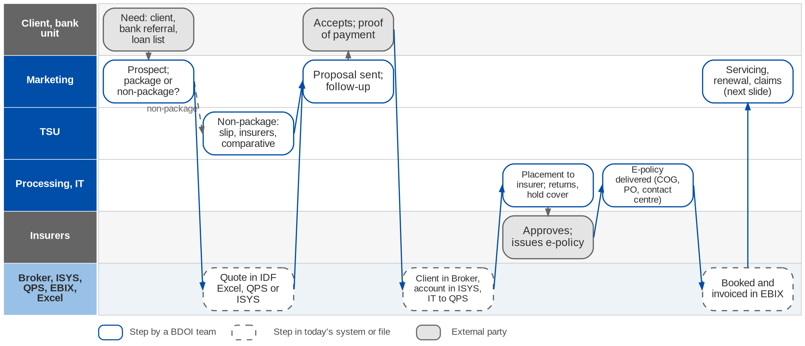
End to end today (1/2): prospect to booked policy
From the client's need to a booked policy (BDOIR end-to-end process flow; Day 1 p.11, p.18)
Confidential – BDOI
BDOI Reverse KT - Floor Walk | v3.0
13
Notes:
The first half of BDOI's end-to-end flow. Marketing works the prospect and decides package or non-package; TSU sources non-package terms. The quotation is prepared in Excel templates, QPS or ISYS; after acceptance and payment the client is created in Broker, the account in ISYS and both are migrated to QPS by IT. Processing places with the insurer, handles returns and hold covers, receives the e-policy, delivers it through COG, the officer or the contact centre, and books and invoices in EBIX.

Slide 14
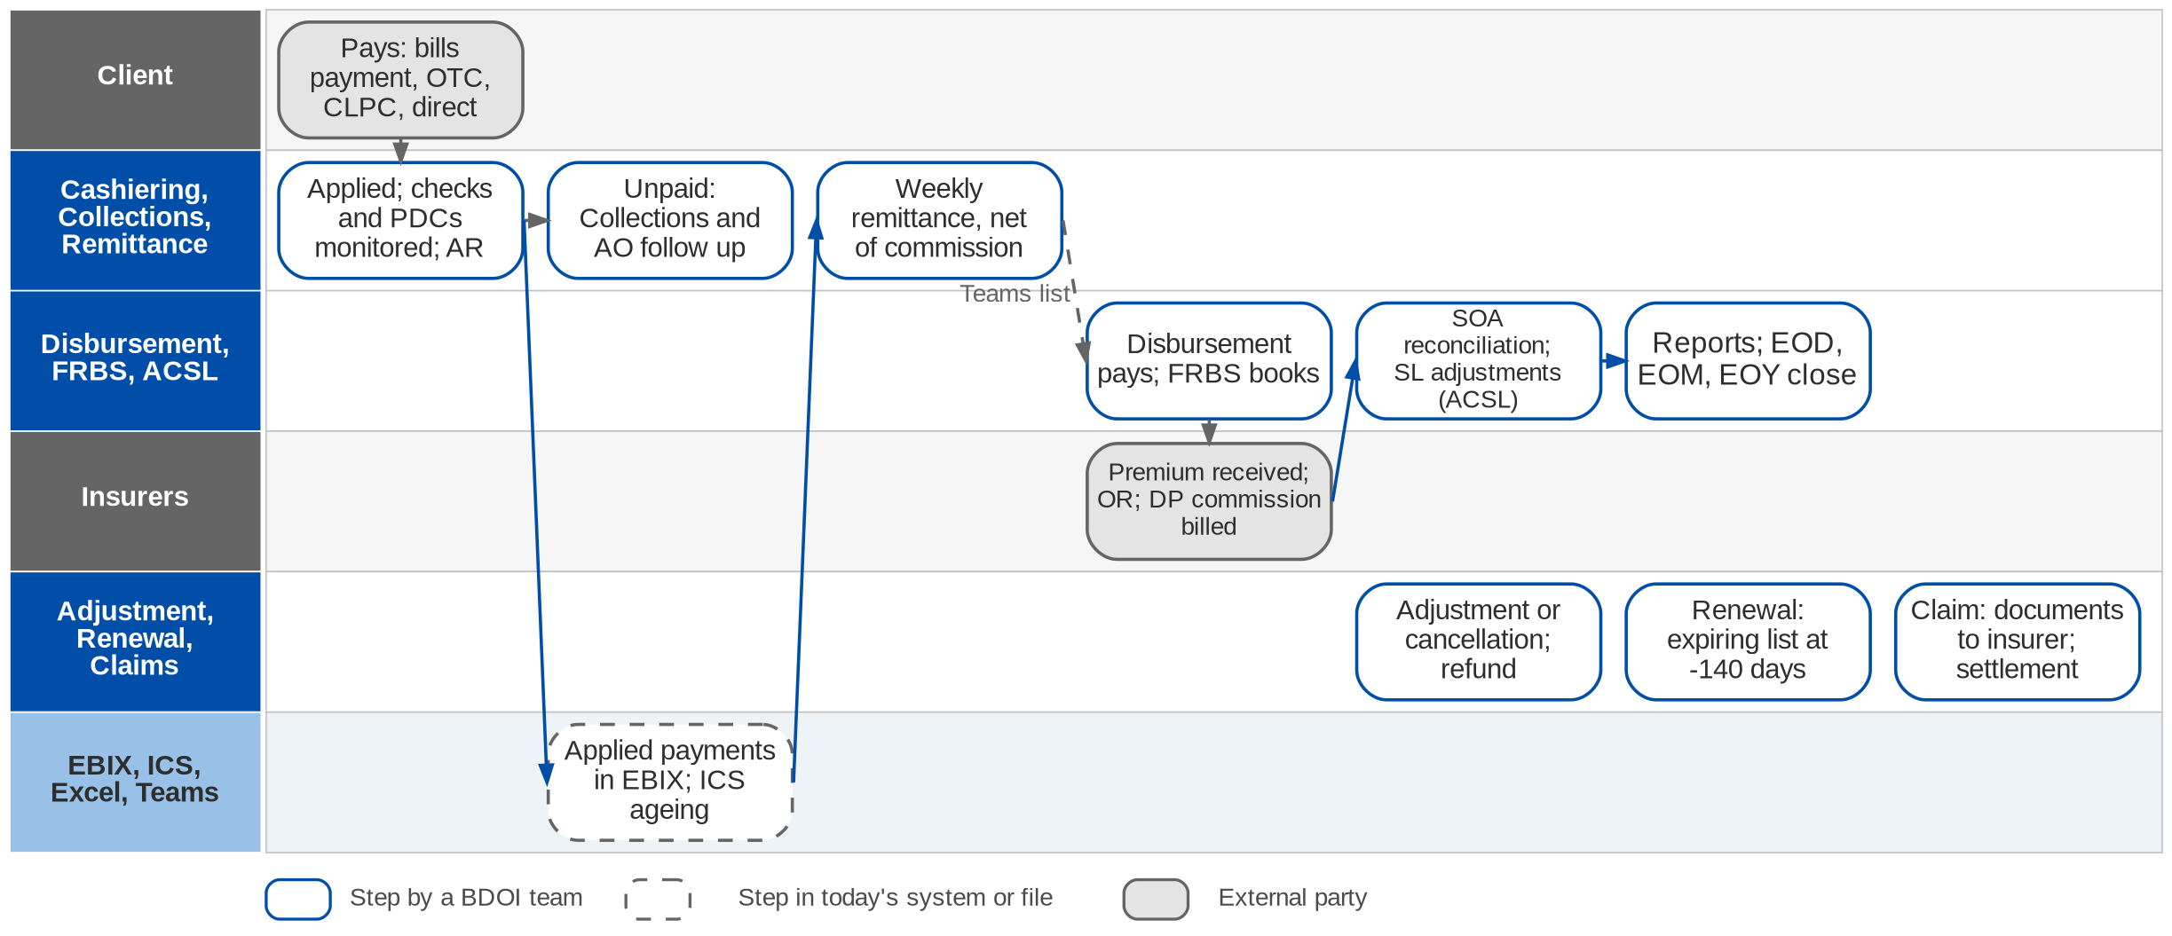
End to end today (2/2): premium to books, and servicing
Money and servicing after booking (BDOIR end-to-end process flow; Day 1 p.12-14)
Confidential – BDOI
BDOI Reverse KT - Floor Walk | v3.0
14
Notes:
The second half. The client pays through bills payment, over the counter, CLPC, autopay or directly to the insurer; Cashiering applies the payment and monitors checks and PDCs; Collections follows unpaid premium with the AO. Every week Remittance prepares the settlement net of commission, Disbursement pays the insurer and FRBS books it; commission on direct payments is billed to the insurer; ACSL reconciles the insurer statements and adjusts the sub-ledger; FRBS closes the books. After booking three servicing paths start: adjustment or cancellation (with a refund), renewal from the expiring list 140 days ahead, and claims.

Slide 15
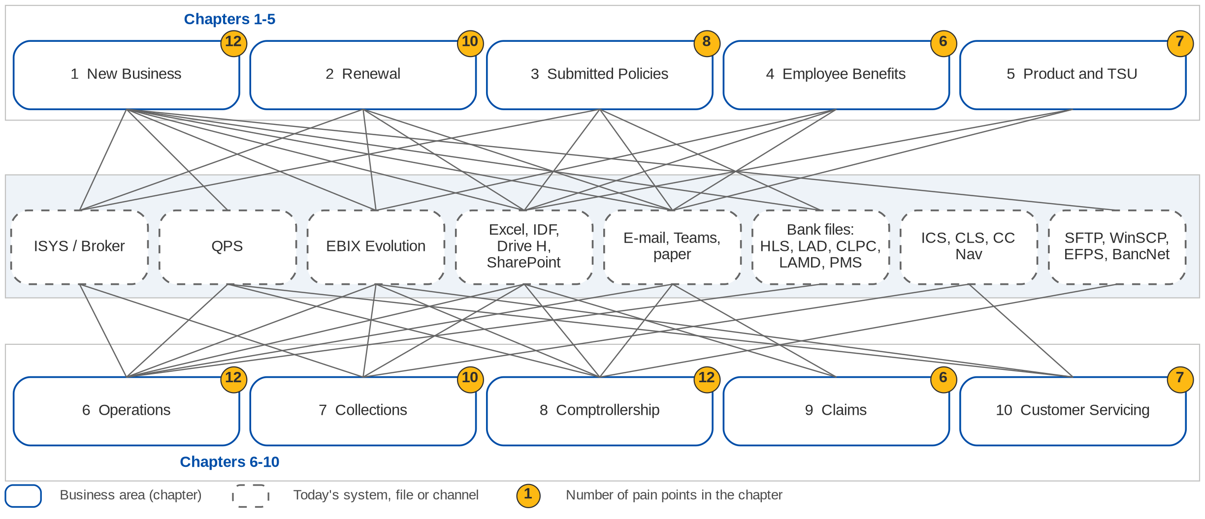
Today: ten areas and the tools they depend on
Each line is a system, file or channel an area depends on today (floor walk and BDOI process flows)
Confidential – BDOI
BDOI Reverse KT - Floor Walk | v3.0
15
Notes:
Every area works in its own mix of systems and files. New Business alone touches Excel templates, Broker, ISYS, QPS, EBIX, bank files and SFTP. Operations and Comptrollership run on EBIX with Excel, Teams and SharePoint around it; Collections uses ICS; the contact centre CLS and CC Nav. The yellow number on each area is the count of pain points in its chapter.

Slide 16
One transaction, several references
What the business asked
ISYS / Broker
Invoice number
Marketing; the client pays against it
QPS
QPS reference
Processing; holds all three numbers
EBIX
EBIX reference
Booking, accounting, remittance
Bank, Cashiering
Payment reference
Bills payment, CLPC, Autopay
• Does BDOI expect one common reference across the lifecycle? (open point OV-03)
• Receipts generated from the system (CA-01, CA-04)
Seen in Cashiering (CA-01), the overview (OV-03), the e-policy text files (NB flow) and the reversal lists (Day 1 p.24).
What it causes today
• Tracing one transaction across systems is slow (OV-03)
• Receipts are created by hand against three numbers (CA-01)
• Each payment is checked: "in QPS with an EBIX reference?" (Cashiering flow)
• Reversal lists are matched to IT extracts by VLOOKUP on the invoice number (Day 1 p.24)
• E-policy updates need text files with the policy, ISYS, EBIX and QPS numbers (NB flow)
Our suggestion
• One lifecycle reference printed on quotation, invoice, AR / OR, SOA and e-policy letter
• A payment reference with a check digit derived from it, carried in bank files
Confidential – BDOI
BDOI Reverse KT - Floor Walk | v3.0
16
Notes:
The same deal carries an ISYS invoice number (the client pays against it), a QPS reference, an EBIX reference and a payment reference; QPS holds all three. It was the most repeated friction on the floor: it slows every trace, forces manual receipts and VLOOKUPs, and it matters for the data migration.

Slide 17
Hand-offs between departments (1/2)
From | To | What passes | Channel today | What it causes
Marketing | TSU | Non-package request (PRF / TSU form) | E-mail | Incomplete requests returned; tracked in Excel
Marketing | Processing | Accepted quote, GRF / ARF, proof of payment | E-mail, ISYS ARF | Re-keying; waiting for documents
Processing | IT | ISYS to QPS migration; policy-number text files | Request, text file | Fall-out loops; delay to placement
Processing | Insurers | Placement slips, hold covers, returns | E-mail, SFTP | Each insurer different; no send record
Processing, IT | COG, contact centre | E-policy delivery and fall-outs | SFTP, e-mail | Three senders; exception report
Marketing | Operations | Endorsement and cancellation requests | E-mail with documents | Validation and keying by hand
Marketing, units | CRU | Direct-payment lists | Shared folder | Consolidation and duplicates in Excel
Collections | Marketing AO | CTE, escalation, day-60 outcome | E-mail | Follow-up depends on the handler
Confidential – BDOI
BDOI Reverse KT - Floor Walk | v3.0
17

Slide 18
Hand-offs between departments (2/2)
From | To | What passes | Channel today | What it causes
Remittance | Disbursement | Weekly settlement list | Teams list, signed copy | Paper kept for audit
Marketing | Disbursement | Refund requests (RRF) | Paper, scanned copies | 4-6 signatures; re-keying in EBIX
Disbursement | FRBS | Signed documents for the GL entry | Paper | Entries made by another unit
IT | FRBS, ACSL, units | Reports and extracts | Shared folder | Business waits for IT
CRU | IT, Cashiering | DPPR / PR2307 reversal lists | SharePoint, Teams | VLOOKUP and manual journals
IT | Marketing Admin, AO | Expiring list (RMEL) and dispositions | Excel, e-mail | Four hands before work starts
Contact centre | Fulfilment unit | Referred client concerns | E-mail, CLS prompt | No TAT view; re-logging
Confidential – BDOI
BDOI Reverse KT - Floor Walk | v3.0
18
Notes:
Every row is a hand-off we saw on the floor or in a BDOI process flow, where work waits, is re-keyed or is lost.

Slide 19
Business challenges BDOI named, and what we saw
Operational bottlenecks
Data quality
• Multiple hand-offs: 15 department hand-offs by e-mail, file or paper
• Waiting for approval: 3-6 signatures on refunds and disbursements
• Peak workload: 20-30K recon lines per insurer a month; renewals from 140 days out
• Three references per transaction (OV-03)
• Leads and existing customers in one category (OV-04)
• Outstanding per client not reliable; ageing runs after payment (CO-01, CO-02)
Manual workarounds
Reporting limitations
• Excel for quotes, dispositions, recon, DP lists and trackers
• E-mail for requests, returns and CTE; Teams for approvals
• Receipts, reversals, invoices and journals by hand
• Reports need IT and a consolidation from several systems (RP-01)
• No real-time pipeline or status; ManCom lists in Excel
• Hard to trace figures back to source transactions
Confidential – BDOI
BDOI Reverse KT - Floor Walk | v3.0
19
Notes:
The four challenge areas of the Day 1 overview (p.15), each with the evidence we saw on the floor.

Slide 20
What the business asked for (1/2)
Theme | What the users asked for | Ref | Chapter
Connecting insurers | One common way to connect with every insurer partner | OV-01 | All
One reference | One common reference across the lifecycle (to confirm) | OV-03 | All
Client categories | Leads, prospects and existing clients; retail and corporate (to confirm) | OV-04 | 1
Product maintenance | Package and non-package products maintained in the system; switch at renewal | PM-01, 03, 04 | 5
Quotes | 30-day validity applied; SLA tracking; pipeline for Retail and Corporate | NB-03, 07, 11 | 1
Renewals | Renewal advice from the BDOI template; pro-forma accounting entries | DC-01, RN-02 | 2
Endorsements | Endorsement computes the premium like New Business | EN-01 | 6
Cashiering | AR and OR from the system; configurable threshold; a direct-pay solution | CA-02, 03, 04 | 6
Collections | Correct outstanding per customer | CO-01 | 7
Confidential – BDOI
BDOI Reverse KT - Floor Walk | v3.0
20

Slide 21
What the business asked for (2/2)
Theme | What the users asked for | Ref | Chapter
Employee Benefits | The system handles 50K+ members | EB-01 | 4
Accounting | Debit Cash in Bank, credit the insurer directly; profit and cost centres; 2% WHT certificates | DS-05, FN-01, TX-03 | 8
Reconciliation | Insurer reconciliation account-wise | RC-02 | 8
Other income | Other income registered through invoicing | OI-01 | 8
Reports | Business units run reports themselves | RP-01 | All
Claims | Claims in a system, linked to the policy | CL-01; Day 1 p.8 | 9
Case management | Cases routed to the account's unit, TAT visible (BDOI's To-Be) | Case Management flow | 10
E-signature | E-signature, to check with Legal and Compliance | CP-01 | All
Confidential – BDOI
BDOI Reverse KT - Floor Walk | v3.0
21
Notes:
The To-Be as the business users voiced it on the floor, gathered from the "What the business wants" column of our notes.

Slide 22
Part A
Marketing and Sales
New business, renewal, submitted policies and employee benefits: the front office and its hand-off to Processing
1. New Business Marketing (CBG, Non-CBG Retail, Corporate, Branches) and Processing (Placement and Booking)
2. Renewal Marketing (renewal AOs, Marketing Admin) and Processing (renewal sanitation and placement)
3. Submitted Policies CBG and Non-CBG Marketing - Submitted Policies
4. Employee Benefits Employee Benefits: Marketing, Processing and Collection
Confidential – BDOI | BDOI Reverse KT - Floor Walk
Notes:
New business, renewal, submitted policies and employee benefits: the front office and its hand-off to Processing

Slide 23
1. New Business: at a glance
Department and roles
Volumes and business rules
How we learned it
Marketing (CBG, Non-CBG Retail, Corporate, Branches) and Processing (Placement and Booking)
• Marketing AO, TL, TH, UH per segment; Marketing Account Support (Combank)
• TSU (non-package proposals; see chapter 5)
• Processing Team (client and account set-up), Processing Officer and TL (placement, booking)
• IT (ISYS to QPS migration, e-policy batch, exception report); COG-OPRM (e-policy sending)
• BDOI contact centre (e-policy after a fall-out); Adjustment Team (cancellations)
30 days
quote validity for every product, retail and corporate (NB-03)
Floor walk: 22-Sep-2026 (New Business 9-10 am; Placement and Booking 2-3:30 pm, 43F) and 25-Sep-2026
Process owners: Rose Lique, Marla Apostol, Grace Tordesillas, Kin Ysaac Flores, Justine Malonzo, Jhosven Awa and 9 more (floor-walk coverage slide)
• New Business process flow (CBG Motor, CBG Fire, Non-CBG Corporate, Non-CBG Retail, Branches)
• BDOI Day 1 overview p.11 and p.18
• Floor-walk notes NB-01 to NB-15, DC-01, TR-01, TR-02
7 / 3 days
SLA for complex / normal corporate risks (NB-07)
500M
value above which a risk survey is required (NB-05)
5 tools
for one deal: Excel templates, Broker, ISYS, QPS, EBIX (NB flow)
The process in one line
Request
Quotation
Acceptance
Client and account
Migration
Placement
E-policy
Booking
Confidential – BDOI
BDOI Reverse KT - Floor Walk | v3.0
23
Notes:
New Business turns a customer need into an issued, booked and delivered policy, and every other area reads the client, the account and the invoice it creates. The journey differs by segment and by product type: package products follow fixed terms, non-package risks go through TSU. On the floor one deal crossed five tools: Excel templates, Broker, ISYS, QPS and EBIX, with an IT migration between ISYS and QPS.
Floor walk: 22-Sep-2026 (New Business 9-10 am; Placement and Booking 2-3:30 pm, 43F) and 25-Sep-2026; Rose Lique, Marla Apostol, Grace Tordesillas, Kin Ysaac Flores, Justine Malonzo, Jhosven Awa, Lyka Palomeno, Regina Matutina; Ramoncito Manalo, Cherry Ann Catayas, Jean Deam Dela Cruz, Cristina Labrador, Mae Anne B. Roque, John Ray Bellen, Rey Mark Magsael.
Sources: New Business process flow (CBG Motor, CBG Fire, Non-CBG Corporate, Non-CBG Retail, Branches); BDOI Day 1 overview p.11 and p.18; Floor-walk notes NB-01 to NB-15, DC-01, TR-01, TR-02

Slide 24
1. New Business: what we heard on the floor (1/3)
Ref | Topic | Type | What we heard (As-Is) | What the business wants (To-Be)
NB-01 | Routing | Open point | Package goes quote to policy; non-package goes direct to policy issuance; some package products go straight to placement. On 25-Sep: the TSU step is for non-package only. | Confirm routing per product type.
NB-02 | Premium confirmation | As-Is | Marketing shares the premium computation with the client; placement follows once the client confirms. | -
NB-03 | Quote validity | Business rule | A quote is valid 30 days for all products, retail and corporate. | The system applies 30-day validity on every quote.
NB-04 | KYC, AMLA | Open point | Insurance declaration form and KYC done outside the system, for every new customer; then the AMLA check. | Confirm whether KYC and AMLA come into the system.
NB-05 | Risk survey | Business rule | A risk survey is required above 500M. | Confirm the basis (sum insured? PHP?).
NB-06 | Quote to insurer | As-Is | Non-life lines (Motor, Property, Marine): the quote request goes to the insurer with recommended terms. | -
Confidential – BDOI
BDOI Reverse KT - Floor Walk | v3.0
24

Slide 25
1. New Business: what we heard on the floor (2/3)
Ref | Topic | Type | What we heard (As-Is) | What the business wants (To-Be)
NB-07 | SLA | User aspiration | Complex risk 7 days, normal risk 3 days. | SLA tracking available.
NB-08 | TSU step | Business rule | Non-package: TSU before the quotation; after acceptance to the Placement team. | -
NB-09 | Package flow | Pain point | Client created in Broker, proposal in EBIX, then QPS for the package policy: one deal keyed in three systems. | -
NB-10 | TOR | As-Is | Terms of reference kept per product. | -
NB-11 | Pipeline | User aspiration | TSU outstanding items and risk profile in a pipeline report; sources are the bank and direct clients. | Pipeline for Retail and Corporate accounts.
NB-12 | CBG quick quote | As-Is | CBG gives quick-quote details; allocation by branch or area and by region to the handler; placement once agreed. | -
Confidential – BDOI
BDOI Reverse KT - Floor Walk | v3.0
25

Slide 26
1. New Business: what we heard on the floor (3/3)
Ref | Topic | Type | What we heard (As-Is) | What the business wants (To-Be)
NB-13 | CBG Motor | Business rule | CBG is Motor and package only, so TSU is not involved. | -
NB-14 | Non-CBG from the bank | Open point | The bank gives details and premium; the first year premium is free; the process stops when the COC is received from PGA. | Commission on the free first year (Cashiering).
NB-15 | Kept for renewal | As-Is | Client code created and kept in Broker so it can be retrieved at renewal. | -
DC-01 | Documents | Business rule | Policy schedules follow insurer templates; no BDOI template for NB or endorsement; the renewal advice uses the BDOI template. | -
TR-01, 02 | Trade and Marine | As-Is | Clients import with bank trade loans; business from the bank is mostly Marine Open Policy declarations; accumulation to track by location. | -
Confidential – BDOI
BDOI Reverse KT - Floor Walk | v3.0
26
Notes:
Notes of the business overview (21-Sep) and of the New Business sessions of 22 and 25-Sep. NB-01 has two versions from two sessions and is an open point.
NB-01 Routing (Open point): Package goes quote to policy; non-package goes direct to policy issuance; some package products go straight to placement. On 25-Sep: the TSU step is for non-package only. Wants: Confirm routing per product type.
NB-02 Premium confirmation (As-Is): Marketing shares the premium computation with the client; placement follows once the client confirms.
NB-03 Quote validity (Business rule): A quote is valid 30 days for all products, retail and corporate. Wants: The system applies 30-day validity on every quote.
NB-04 KYC, AMLA (Open point): Insurance declaration form and KYC done outside the system, for every new customer; then the AMLA check. Wants: Confirm whether KYC and AMLA come into the system.
NB-05 Risk survey (Business rule): A risk survey is required above 500M. Wants: Confirm the basis (sum insured? PHP?).
NB-06 Quote to insurer (As-Is): Non-life lines (Motor, Property, Marine): the quote request goes to the insurer with recommended terms.
NB-07 SLA (User aspiration): Complex risk 7 days, normal risk 3 days. Wants: SLA tracking available.
NB-08 TSU step (Business rule): Non-package: TSU before the quotation; after acceptance to the Placement team.
NB-09 Package flow (Pain point): Client created in Broker, proposal in EBIX, then QPS for the package policy: one deal keyed in three systems.
NB-10 TOR (As-Is): Terms of reference kept per product.
NB-11 Pipeline (User aspiration): TSU outstanding items and risk profile in a pipeline report; sources are the bank and direct clients. Wants: Pipeline for Retail and Corporate accounts.
NB-12 CBG quick quote (As-Is): CBG gives quick-quote details; allocation by branch or area and by region to the handler; placement once agreed.
NB-13 CBG Motor (Business rule): CBG is Motor and package only, so TSU is not involved.
NB-14 Non-CBG from the bank (Open point): The bank gives details and premium; the first year premium is free; the process stops when the COC is received from PGA. Wants: Commission on the free first year (Cashiering).
NB-15 Kept for renewal (As-Is): Client code created and kept in Broker so it can be retrieved at renewal.
DC-01 Documents (Business rule): Policy schedules follow insurer templates; no BDOI template for NB or endorsement; the renewal advice uses the BDOI template.
TR-01, 02 Trade and Marine (As-Is): Clients import with bank trade loans; business from the bank is mostly Marine Open Policy declarations; accumulation to track by location.

Slide 27
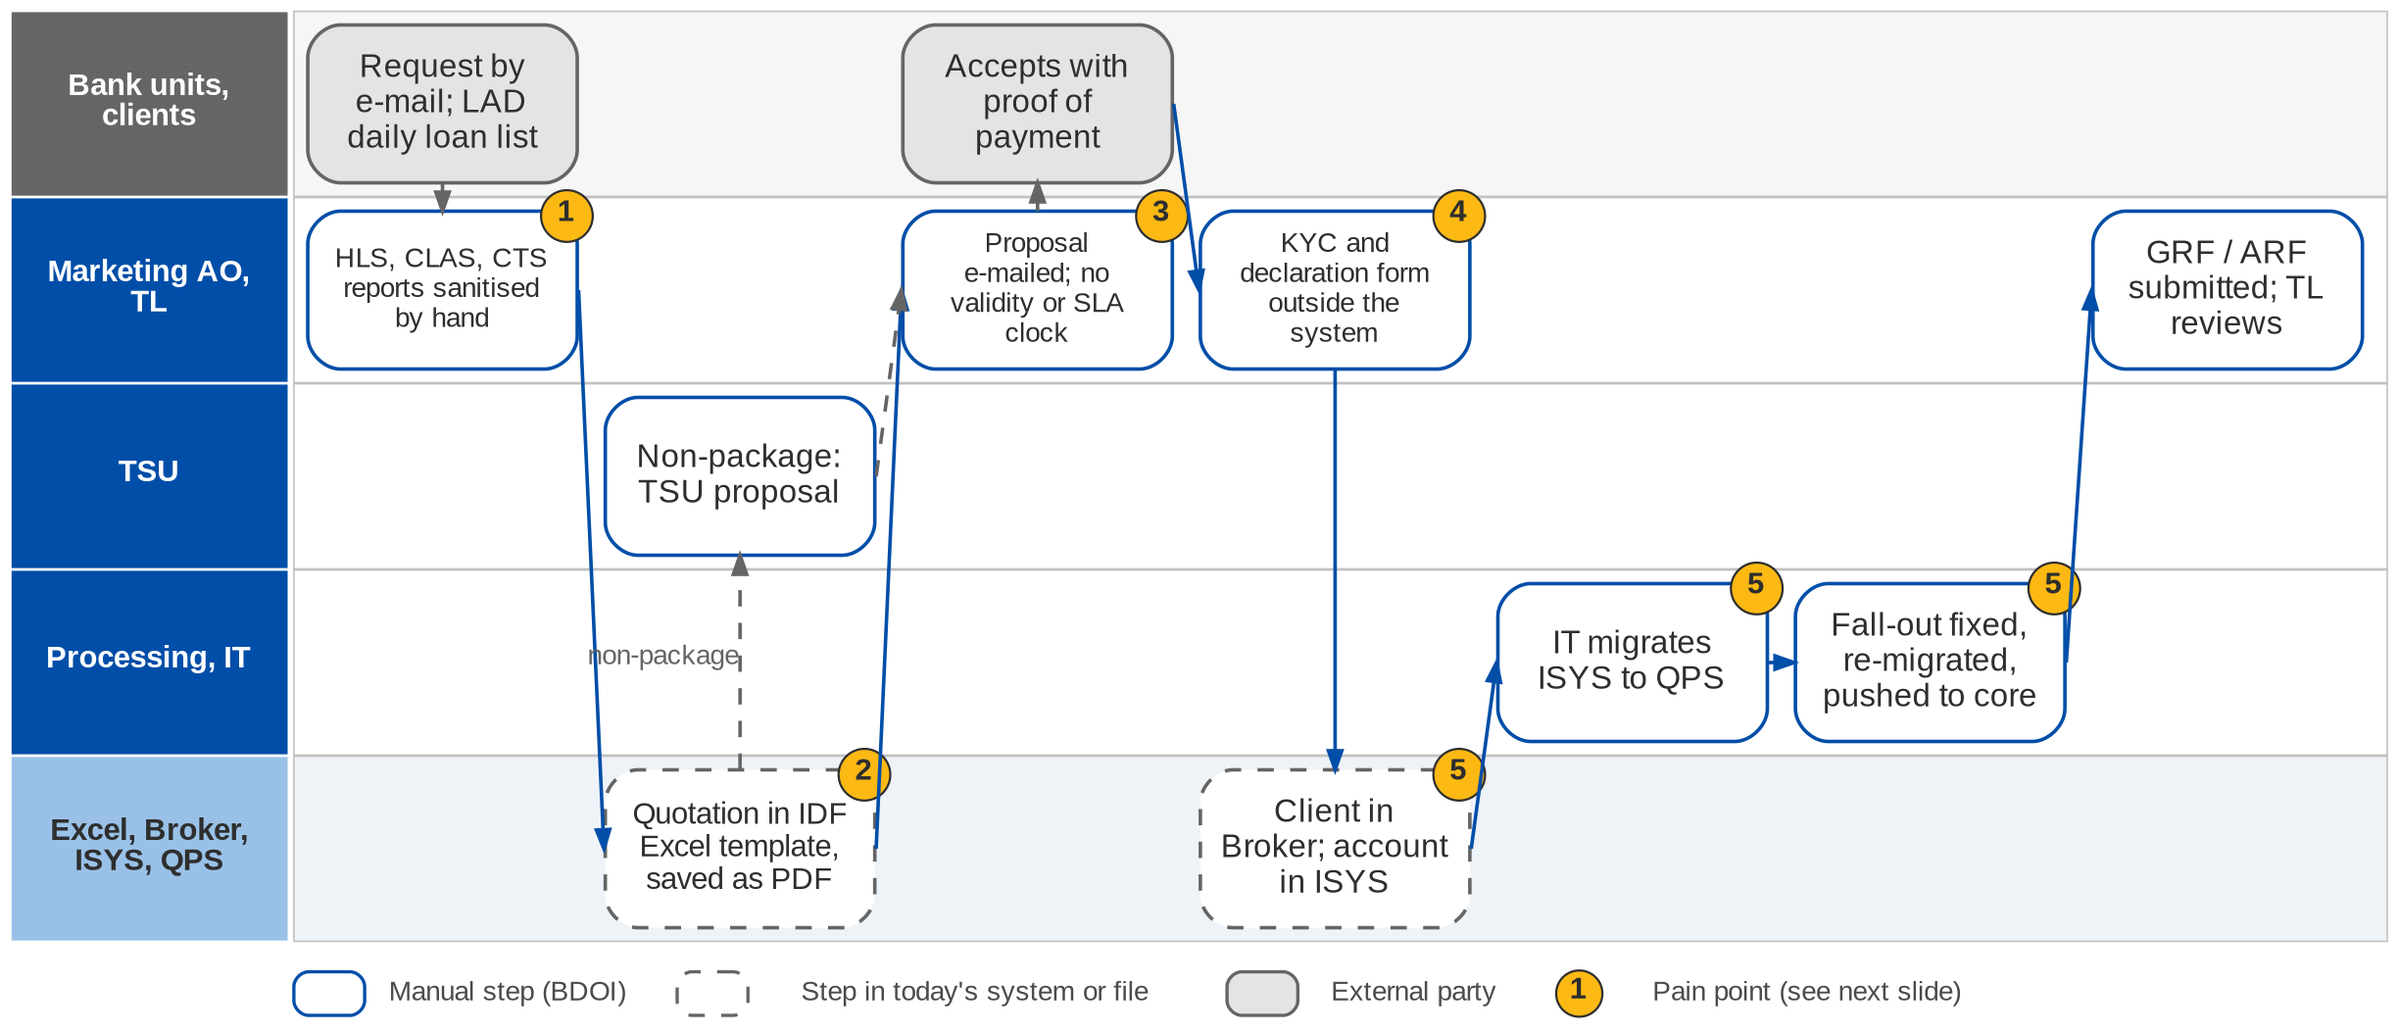
1. New Business: As-Is process (1/2)
Request to account today (New Business process flow; Day 1 p.18; NB-01 to NB-15)
Confidential – BDOI
BDOI Reverse KT - Floor Walk | v3.0
27
Notes:
Requests reach the Marketing AO by e-mail: individual requests from bank AOs, branches, IBG or clients, and for CBG Fire a daily list of approved loans from CBG LAD. The AO builds the insurance report from HLS, CLAS and CTS and sanitises it by hand. Quotations are prepared in the IDF Excel templates (or ISYS for package accounts), saved as PDF and e-mailed; non-package risks go to TSU. There is no control on quote validity or SLA. Once the client accepts with proof of payment, KYC and the insurance declaration are done outside the system, the client is created in Broker and the account in ISYS. The Processing Officer then asks IT to migrate client and account from ISYS to QPS; when the migration fails the account is fixed and re-migrated, then pushed to the core system. Marketing submits the GRF / ARF and the TL reviews it.

Slide 28
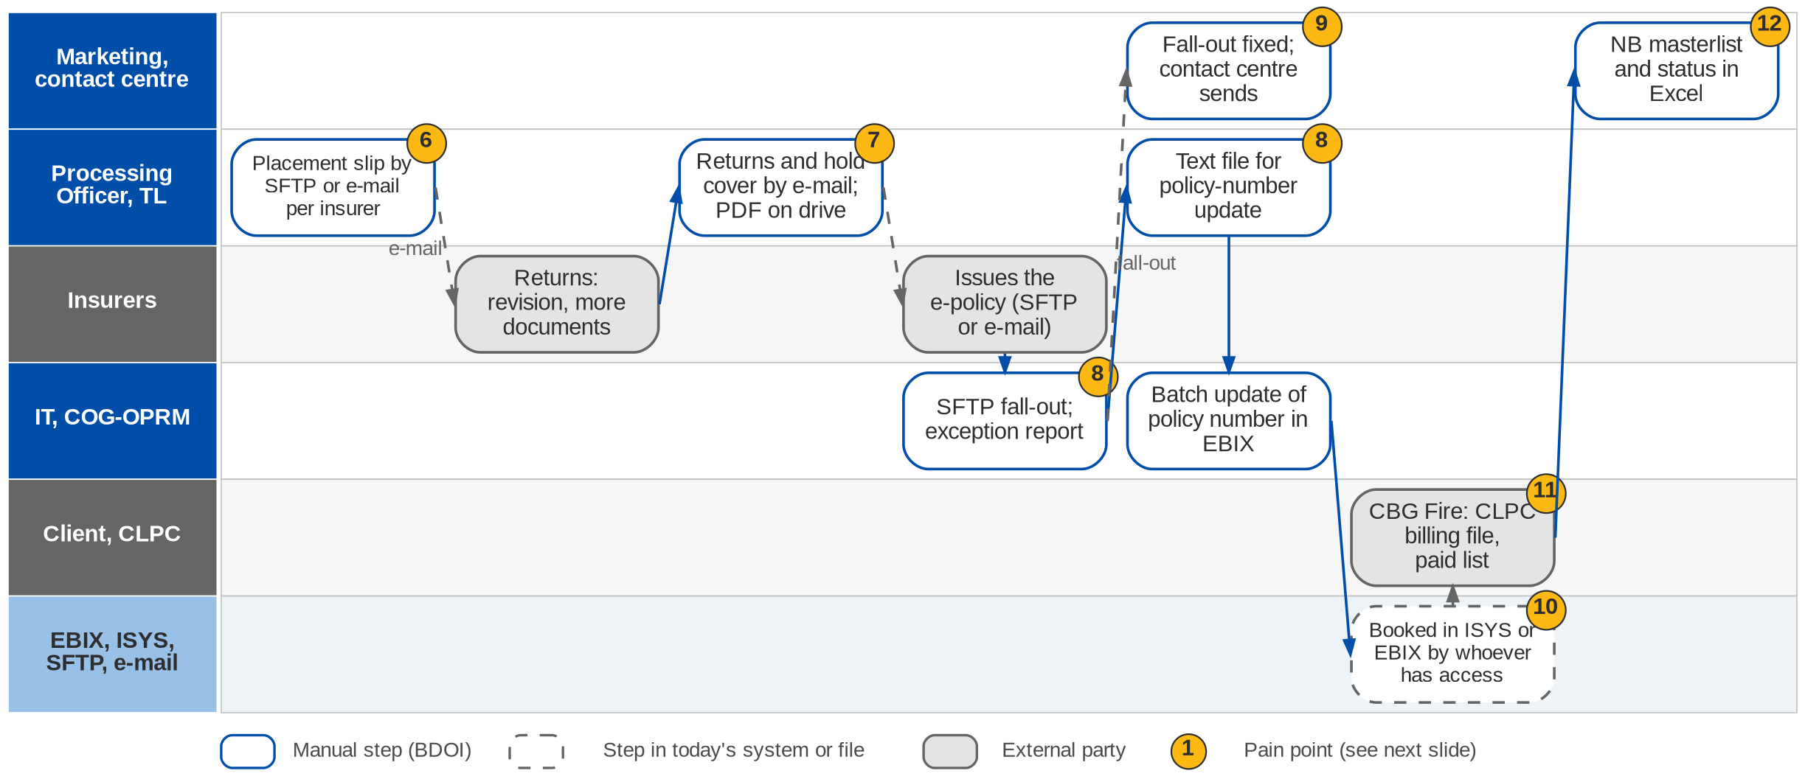
1. New Business: As-Is process (2/2)
Placement to booking and e-policy delivery today (New Business process flow; Day 1 p.18)
Confidential – BDOI
BDOI Reverse KT - Floor Walk | v3.0
28
Notes:
The Processing Officer sends the placement slip to each insurer by SFTP or, for insurers without SFTP, as a PDF by e-mail, and handles returns (revision, more documents, cancellation) with Marketing. Hold covers go by e-mail and the PDF is saved on the shared drive with the link in the e-mail. The insurer issues the e-policy. When SFTP works, IT updates the policy number in EBIX by batch and COG-OPRM sends the e-policy to the client; when the insurer is not on SFTP or the transfer falls out, the officer creates a text file for the policy-number update, IT runs an e-policy exception report, and Marketing fixes the fall-out and passes the e-policy to the BDOI contact centre to send. Placement and booking are done in ISYS or EBIX depending on who has access. For CBG Fire the AO prepares the billing file for CLPC and checks the CLPC masterlist to see whether billed accounts are paid. Status is kept in the NB masterlist in Excel.

Slide 29
1. New Business: one process, seven segment variants
Segment | Request from | Quotation | Client and account | Placement, e-policy
CBG Motor (package) | BDO branch or CBG Auto Loans AO, by e-mail | Excel template with ISYS reference; quick quote | Client in Broker; account in ISYS; IT migration to QPS | Slip by SFTP or e-mail; IT batch policy number; COG or PO sends
CBG Fire and Home | CBG AO; CBG LAD daily approved-loan list from HLS | IDF Excel template converted to PDF | Processing bulk upload into Broker from the insurance report | GRF to Placement; hold cover by e-mail; CLPC billing and paid list
Non-CBG Corporate, all lines | IBG or client, by e-mail | ISYS full quote (package); Excel or TSU proposal (non-package) | Broker and ISYS; IT migration to QPS | Placement PDF by e-mail per insurer; SFTP or PO sends
Non-CBG Retail | BDO branch, by e-mail | Excel quick quote; ISYS for package and motor | Broker; ISYS ARF module | Slip PDF by e-mail; e-policy as above
Branches | Bank AO or client; single or bulk | Excel quick quote; ISYS for package | Broker; ISYS | Slip PDF by e-mail; e-policy as above
Bank-referred, free first year | Bank gives details and premium | None; premium from the bank | Client code in Broker for renewal | Stops at the COC from PGA; handled at renewal
TSU accounts, EB, SM Construction, Combank | Via TSU, EB or Marketing Account Support | TSU proposal or insurer terms | Encoded in EBIX directly | PO places; insurer SOA before booking and invoicing
Confidential – BDOI
BDOI Reverse KT - Floor Walk | v3.0
29
Notes:
The segment variants of the New Business process flow (confirmed by the CBG Motor, CBG Fire, Non-CBG Corporate, Non-CBG Retail and Branches process owners, Dec 2025 - Mar 2026) and of the 25-Sep session (NB-12 to NB-15).

Slide 30
1. New Business: pain points today
1
Requests and bank lists by hand
Requests arrive by e-mail; HLS, CLAS and CTS reports are sanitised by hand.
NB flow
7
Returns and hold covers by e-mail
Revisions, hold covers and PDFs travel by e-mail and shared drive.
NB flow
2
Quotations in Excel templates
IDF templates filled, converted to PDF, shared by drive link.
NB flow
8
E-policy fall-outs
Text files, an IT exception report and a batch update of policy numbers.
NB flow
3
No validity or SLA control
30-day validity and 7 / 3-day SLA are tracked by memory.
NB-03, NB-07
9
Three senders of the e-policy
COG-OPRM, the Processing Officer or the contact centre after a fall-out.
NB flow
4
KYC outside the system
Insurance declaration form and KYC done on paper before the AMLA check.
NB-04
10
Booking depends on access
Placement and booking done in ISYS or EBIX by whoever has access.
NB flow
5
One deal keyed in three systems
Broker, then ISYS, then an IT migration to QPS with a fall-out loop.
NB-09; NB flow; OV-02
11
CBG Fire billing by hand
CLPC billing file prepared and paid list checked manually.
NB flow
6
Placement per insurer by e-mail
Slips by SFTP only for enrolled insurers; the rest by e-mail.
NB flow; OV-01
12
Pipeline and status in Excel
NB masterlist and status reports compiled by hand.
NB-11
Confidential – BDOI
BDOI Reverse KT - Floor Walk | v3.0
30
Notes:
Points 1 to 5 are on the request-to-account swimlane, 6 to 12 on the placement-to-booking swimlane.
1. Requests and bank lists by hand: Requests arrive by e-mail; HLS, CLAS and CTS reports are sanitised by hand. (NB flow)
2. Quotations in Excel templates: IDF templates filled, converted to PDF, shared by drive link. (NB flow)
3. No validity or SLA control: 30-day validity and 7 / 3-day SLA are tracked by memory. (NB-03, NB-07)
4. KYC outside the system: Insurance declaration form and KYC done on paper before the AMLA check. (NB-04)
5. One deal keyed in three systems: Broker, then ISYS, then an IT migration to QPS with a fall-out loop. (NB-09; NB flow; OV-02)
6. Placement per insurer by e-mail: Slips by SFTP only for enrolled insurers; the rest by e-mail. (NB flow; OV-01)
7. Returns and hold covers by e-mail: Revisions, hold covers and PDFs travel by e-mail and shared drive. (NB flow)
8. E-policy fall-outs: Text files, an IT exception report and a batch update of policy numbers. (NB flow)
9. Three senders of the e-policy: COG-OPRM, the Processing Officer or the contact centre after a fall-out. (NB flow)
10. Booking depends on access: Placement and booking done in ISYS or EBIX by whoever has access. (NB flow)
11. CBG Fire billing by hand: CLPC billing file prepared and paid list checked manually. (NB flow)
12. Pipeline and status in Excel: NB masterlist and status reports compiled by hand. (NB-11)

Slide 31
1. New Business: what the business wants (1/2)
Pain point today
What the business wants
Lever
1
Requests and bank lists by hand
Bank lists and e-mailed requests captured once, in bulk where the bank sends a list
Bulk intake
2
Quotations in Excel templates
Quotations produced from one rated template, versioned and approved before sending
Rating rules
3
No validity or SLA control
30-day validity and the 7 / 3-day SLA tracked on every quote (NB-03, NB-07)
SLA clocks
4
KYC outside the system
Decide whether KYC and AMLA move into the system (NB-04)
To confirm
5
One deal keyed in three systems
One client and one account created once, used by placement, booking and renewal
Key once
6
Placement per insurer by e-mail
One way of sending placement slips to every insurer, with a record of what was sent
Insurer standard
Confidential – BDOI
BDOI Reverse KT - Floor Walk | v3.0
31

Slide 32
1. New Business: what the business wants (2/2)
Pain point today
What the business wants
Lever
7
Returns and hold covers by e-mail
Returns and hold covers tracked with the placement, documents stored with the account
Document store
8
E-policy fall-outs
E-policy fall-outs visible in one queue with an owner, no text files
Exception queue
9
Three senders of the e-policy
One team sends every e-policy
One sender
10
Booking depends on access
Booking by role, not by who has access to which system
Access by role
11
CBG Fire billing by hand
CLPC billing file produced and the paid list matched automatically
Auto matching
12
Pipeline and status in Excel
Pipeline for Retail and Corporate, by source, without Excel (NB-11)
Live dashboard
Confidential – BDOI
BDOI Reverse KT - Floor Walk | v3.0
32
Notes:
For each pain point: what the business users asked for, and the lever we suggest.
1. Requests and bank lists by hand -> Bank lists and e-mailed requests captured once, in bulk where the bank sends a list Lever: Bulk intake.
2. Quotations in Excel templates -> Quotations produced from one rated template, versioned and approved before sending Lever: Rating rules.
3. No validity or SLA control -> 30-day validity and the 7 / 3-day SLA tracked on every quote (NB-03, NB-07) Lever: SLA clocks.
4. KYC outside the system -> Decide whether KYC and AMLA move into the system (NB-04) Lever: To confirm.
5. One deal keyed in three systems -> One client and one account created once, used by placement, booking and renewal Lever: Key once.
6. Placement per insurer by e-mail -> One way of sending placement slips to every insurer, with a record of what was sent Lever: Insurer standard.
7. Returns and hold covers by e-mail -> Returns and hold covers tracked with the placement, documents stored with the account Lever: Document store.
8. E-policy fall-outs -> E-policy fall-outs visible in one queue with an owner, no text files Lever: Exception queue.
9. Three senders of the e-policy -> One team sends every e-policy Lever: One sender.
10. Booking depends on access -> Booking by role, not by who has access to which system Lever: Access by role.
11. CBG Fire billing by hand -> CLPC billing file produced and the paid list matched automatically Lever: Auto matching.
12. Pipeline and status in Excel -> Pipeline for Retail and Corporate, by source, without Excel (NB-11) Lever: Live dashboard.

Slide 33
1. New Business: best practice (1/2)
Digital placement exchange
Broker CRM and pipeline
E-policy ingestion with OCR
One pattern for ~55 insurers
Sales productivity
No fall-out text files
Industry practice: Placement, returns and e-policies exchanged through one standard channel (API or SFTP with a common layout).
For BDOI: Agree a BDOI insurer data standard and on-board insurers in waves.
Industry practice: Leads from bank referrals, funnel stages, hit ratio and cross-sell per client.
For BDOI: Add lead source and funnel KPIs to the dashboard.
Industry practice: E-policies read, matched to the account and filed automatically; exceptions in a queue.
For BDOI: Start with the top insurers by volume.
Reuse of bank KYC
Faster onboarding
Industry practice: Client data and KYC reused from the bank CIF for bank-referred clients.
For BDOI: Confirm with Compliance and BDO IT.
Confidential – BDOI
BDOI Reverse KT - Floor Walk | v3.0
33

Slide 34
1. New Business: best practice (2/2)
Quote lifecycle control
Digital acceptance and payment link
Straight-through bank business
Fewer stale quotes
Shorter cycle
Volume at low cost
Industry practice: Validity, auto-expiry, SLA clocks and reminders on every quote.
For BDOI: Add validity and SLA values (NB-03, NB-07).
Industry practice: Client accepts the proposal online with e-signature and pays by link.
For BDOI: After go-live, with the e-signature decision (CP-01).
Industry practice: Bank loan files (HLS, LAD) become quotations and accounts in bulk without re-keying.
For BDOI: Specify the HLS, CLAS and CTS feeds.
Marine declarations portal
Trade growth
Industry practice: Declarations by portal or API with e-certificates and QR verification.
For BDOI: Specify open covers first (TR-01).
Confidential – BDOI
BDOI Reverse KT - Floor Walk | v3.0
34
Notes:
Practices of insurance brokers that fit what we saw at BDOI; each card says what the practice is and where BDOI could start.
Digital placement exchange. Placement, returns and e-policies exchanged through one standard channel (API or SFTP with a common layout). For BDOI: Agree a BDOI insurer data standard and on-board insurers in waves.
Broker CRM and pipeline. Leads from bank referrals, funnel stages, hit ratio and cross-sell per client. For BDOI: Add lead source and funnel KPIs to the dashboard.
E-policy ingestion with OCR. E-policies read, matched to the account and filed automatically; exceptions in a queue. For BDOI: Start with the top insurers by volume.
Reuse of bank KYC. Client data and KYC reused from the bank CIF for bank-referred clients. For BDOI: Confirm with Compliance and BDO IT.
Quote lifecycle control. Validity, auto-expiry, SLA clocks and reminders on every quote. For BDOI: Add validity and SLA values (NB-03, NB-07).
Digital acceptance and payment link. Client accepts the proposal online with e-signature and pays by link. For BDOI: After go-live, with the e-signature decision (CP-01).
Straight-through bank business. Bank loan files (HLS, LAD) become quotations and accounts in bulk without re-keying. For BDOI: Specify the HLS, CLAS and CTS feeds.
Marine declarations portal. Declarations by portal or API with e-certificates and QR verification. For BDOI: Specify open covers first (TR-01).

Slide 35
2. Renewal: at a glance
Department and roles
Volumes and business rules
How we learned it
Marketing (renewal AOs, Marketing Admin) and Processing (renewal sanitation and placement)
• Marketing Admin (MA) and Marketing Admin TL; Marketing TL, TH and AO
• Sanitation Handler (SH) and head-office SH (CBG Fire, CBG Motor)
• Processing Officer and TL (Non-CBG corporate and retail)
• IT (RMEL extract, RA text file); ES-COG-OPRM (RA letters); contact centre
• Clients and insurers (external)
-140 days
the expiring list (RMEL) is extracted from EBIX (Renewal flow)
Floor walk: 22-Sep-2026 (Renewal Marketing 10-11 am, 43F; Renewal Processing 1:30-3 pm, 44F)
Process owners: Amara Cruz, Rose Lique, Joy Ilagan, Tina Fajardo, Grace Tordesillas, Kin Ysaac Flores and 9 more (floor-walk coverage slide)
• Renewal process flow (CBG automated RMEL; Non-CBG; non-package and exceptions)
• BDOI Day 1 overview p.14
• Floor-walk notes RN-01, RN-02, PM-04, DC-01
-70 days
first renewal notice to the client
-40 / -45
days: final notice for CBG / Non-CBG
3 paths
CBG automated RMEL, Non-CBG, non-package and exceptions
The process in one line
Expiring list
Sanitation
Disposition
Review
Renewal advice
Client decision
Placement
Booking
Confidential – BDOI
BDOI Reverse KT - Floor Walk | v3.0
35
Notes:
Renewal starts 140 days before expiry with the RMEL extract from EBIX. Handlers and Marketing decide whether and how each account renews in Excel, BDOI sends the renewal advice on its own template, accepted accounts go to the insurers and the renewal is booked like new business. Review and disposition in Excel was called a major pain point (RN-01).
Floor walk: 22-Sep-2026 (Renewal Marketing 10-11 am, 43F; Renewal Processing 1:30-3 pm, 44F); Amara Cruz, Rose Lique, Joy Ilagan, Tina Fajardo, Grace Tordesillas, Kin Ysaac Flores, Criffson Rendon, Joyce Aritao, Ma. Christena Cezar, Cezssane Canarias, Jeramie Ramos; Angelo Alibuyog, Ces Remodo, Berna Corpuz, Norberto Fulo.
Sources: Renewal process flow (CBG automated RMEL; Non-CBG; non-package and exceptions); BDOI Day 1 overview p.14; Floor-walk notes RN-01, RN-02, PM-04, DC-01

Slide 36
2. Renewal: what we heard on the floor
Ref | Topic | Type | What we heard (As-Is) | What the business wants (To-Be)
RN-01 | Review and disposition | Pain point | Renewal review and dispositions are done in Excel; the renewal master expiry list is sent and the renewal advice goes to the client. | Major pain point: move it into the system.
RN-02 | Pro-forma entries | User aspiration | Renewal accounting is not real time, so adjustments are made later for additional remittance or recovery. | Pro-forma accounting entries for renewals.
PM-04 | Package switch | User aspiration | At renewal a policy can move from package to non-package or back. | The system allows the switch at renewal.
DC-01 | Renewal advice template | Business rule | Policy schedules follow insurer templates; the renewal advice uses the BDOI template. | RA generated from the BDOI template.
Day 1 p.14 | Servicing path | As-Is | Send the sanitised renewal master expiry list; generate the renewal advice letter and send it to the client. | -
Renewal flow | Notice days | Business rule | RMEL at -140 days; first notice at -70 days; final notice at -40 days (CBG) or -45 days (Non-CBG); CBG letters also by snail mail. | -
Renewal flow | Non-package and exceptions | As-Is | Accounts with no QPS set-up are booked directly in EBIX; Processing computes, prepares the dispositioned files and coordinates with the AO when the insurer does not approve. | -
Confidential – BDOI
BDOI Reverse KT - Floor Walk | v3.0
36
Notes:
Notes of the business overview (21-Sep) and of the Renewal Marketing and Processing floor walks (22-Sep).
RN-01 Review and disposition (Pain point): Renewal review and dispositions are done in Excel; the renewal master expiry list is sent and the renewal advice goes to the client. Wants: Major pain point: move it into the system.
RN-02 Pro-forma entries (User aspiration): Renewal accounting is not real time, so adjustments are made later for additional remittance or recovery. Wants: Pro-forma accounting entries for renewals.
PM-04 Package switch (User aspiration): At renewal a policy can move from package to non-package or back. Wants: The system allows the switch at renewal.
DC-01 Renewal advice template (Business rule): Policy schedules follow insurer templates; the renewal advice uses the BDOI template. Wants: RA generated from the BDOI template.
Day 1 p.14 Servicing path (As-Is): Send the sanitised renewal master expiry list; generate the renewal advice letter and send it to the client.
Renewal flow Notice days (Business rule): RMEL at -140 days; first notice at -70 days; final notice at -40 days (CBG) or -45 days (Non-CBG); CBG letters also by snail mail.
Renewal flow Non-package and exceptions (As-Is): Accounts with no QPS set-up are booked directly in EBIX; Processing computes, prepares the dispositioned files and coordinates with the AO when the insurer does not approve.

Slide 37
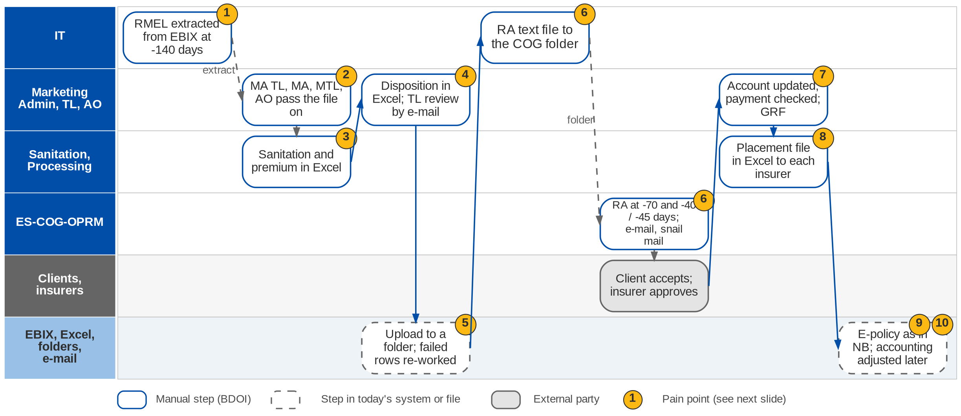
2. Renewal: As-Is process
Renewal today (Renewal process flow: CBG automated RMEL, Non-CBG, exceptions; Day 1 p.14; RN-01, RN-02)
Confidential – BDOI
BDOI Reverse KT - Floor Walk | v3.0
37
Notes:
IT extracts the RMEL from EBIX 140 days before the expiry month. For CBG the head-office sanitation handler tells the branch handlers; for Non-CBG the Marketing Admin TL tells Marketing Admin, who splits the file per segment for the Marketing TL, who passes it to the AO. The handlers identify the accounts for renewal, update the details and compute the premium in Excel; the AO gives a disposition and the TL reviews it by e-mail. The files are dropped in a folder for upload, and failed rows are corrected and re-uploaded. IT generates the RA text file into the ES-COG-OPRM folder; COG generates the RA letters at -70 and -40 or -45 days and sends them by e-mail and, for CBG, by snail mail. When the client accepts, the AO updates the account, Marketing Admin validates the payment and applies the changes, and Processing prepares the placement file in Excel and e-mails it to each insurer. The e-policy then follows the New Business path, and renewal accounting is adjusted after the fact.

Slide 38
2. Renewal: three renewal paths
Path | Who starts | Sanitation and disposition | Renewal advice | Placement
CBG Fire and Motor (automated RMEL) | Head-office SH advises branch SHs | SH identifies, updates, computes; MTL / MTH review by e-mail | IT RA text file; COG e-mail and snail mail; -70 / -40 days | MA validates payment; GRF; slip by SFTP or e-mail
Non-CBG (package) | MA TL advises MA; MA splits per segment | AO dispositions, TL reviews; PO sanitises per insurer | IT RA text file; COG e-mail; -70 / -45 days | MTL submits; PO places by Excel file per insurer
Non-CBG non-package and exceptions | MA TL advises MA | PO computes and prepares the dispositioned files | PO drops RA text files for COG; -70 / -45 days | PO coordinates with the AO when the insurer declines
CBG Home only | Head-office SH | As CBG; PO coordinates insurer and Marketing by e-mail | As CBG | MA TL reviews and sends to PO
Branches without an MA TL | MTL does the MA TL steps | As Non-CBG | As Non-CBG | As Non-CBG
Confidential – BDOI
BDOI Reverse KT - Floor Walk | v3.0
38
Notes:
The paths of the Renewal process flow confirmed by the CBG Motor, CBG Fire, Non-CBG Corporate, Non-CBG Marketing and Branches owners.

Slide 39
2. Renewal: pain points today
1
IT extracts the expiring list
The RMEL is an IT extract from EBIX; business cannot run it.
Renewal flow
6
RA through text files and COG
IT text file, COG print; snail mail for CBG; notice days differ by segment.
Renewal flow; DC-01
2
Many hand-offs before work starts
MA TL, MA, MTL and AO (or head-office and branch SHs) pass the file on.
Renewal flow
7
Accepted renewals re-keyed
AO updates the account; payment and changes validated by hand.
Renewal flow
3
Sanitation in Excel
Handlers identify accounts, update details and compute premium in Excel.
Renewal flow
8
Insurer lists from Excel
Placement files prepared in Excel and e-mailed to each insurer.
Renewal flow
4
Disposition in Excel
AO dispositions in a spreadsheet, reviewed by e-mail.
RN-01
9
Accounting after the fact
No real-time renewal accounting; additional remittance or recovery adjusted later.
RN-02
5
Upload and correction loop
Files dropped in a folder; failed rows found and re-worked.
Renewal flow
10
E-policy fall-outs again
The e-policy leg repeats the New Business fall-out chain.
Renewal flow
Confidential – BDOI
BDOI Reverse KT - Floor Walk | v3.0
39
Notes:
The ten points are on the Renewal swimlane.
1. IT extracts the expiring list: The RMEL is an IT extract from EBIX; business cannot run it. (Renewal flow)
2. Many hand-offs before work starts: MA TL, MA, MTL and AO (or head-office and branch SHs) pass the file on. (Renewal flow)
3. Sanitation in Excel: Handlers identify accounts, update details and compute premium in Excel. (Renewal flow)
4. Disposition in Excel: AO dispositions in a spreadsheet, reviewed by e-mail. (RN-01)
5. Upload and correction loop: Files dropped in a folder; failed rows found and re-worked. (Renewal flow)
6. RA through text files and COG: IT text file, COG print; snail mail for CBG; notice days differ by segment. (Renewal flow; DC-01)
7. Accepted renewals re-keyed: AO updates the account; payment and changes validated by hand. (Renewal flow)
8. Insurer lists from Excel: Placement files prepared in Excel and e-mailed to each insurer. (Renewal flow)
9. Accounting after the fact: No real-time renewal accounting; additional remittance or recovery adjusted later. (RN-02)
10. E-policy fall-outs again: The e-policy leg repeats the New Business fall-out chain. (Renewal flow)

Slide 40
2. Renewal: what the business wants (1/2)
Pain point today
What the business wants
Lever
1
IT extracts the expiring list
Expiring list available to the business without an IT extract
Scheduled list
2
Many hand-offs before work starts
Work assigned straight to the handler or AO, not passed through four hands
Assignment rules
3
Sanitation in Excel
Sanitation checks and premium computed by rule
Rules
4
Disposition in Excel
Review and disposition out of Excel (RN-01)
Online disposition
5
Upload and correction loop
No upload step, so no failed rows to re-work
No file upload
Confidential – BDOI
BDOI Reverse KT - Floor Walk | v3.0
40

Slide 41
2. Renewal: what the business wants (2/2)
Pain point today
What the business wants
Lever
6
RA through text files and COG
Renewal advice from the BDOI template (DC-01), by e-mail and print, per client preference
Batch RA
7
Accepted renewals re-keyed
Acceptance carries the account straight to placement
Key once
8
Insurer lists from Excel
Insurer lists produced per insurer, not built in Excel
Insurer standard
9
Accounting after the fact
Pro-forma accounting entries for renewals (RN-02)
Pro-forma
10
E-policy fall-outs again
Same e-policy exception queue as New Business
Exception queue
Confidential – BDOI
BDOI Reverse KT - Floor Walk | v3.0
41
Notes:
For each pain point: what the business users asked for, and the lever we suggest.
1. IT extracts the expiring list -> Expiring list available to the business without an IT extract Lever: Scheduled list.
2. Many hand-offs before work starts -> Work assigned straight to the handler or AO, not passed through four hands Lever: Assignment rules.
3. Sanitation in Excel -> Sanitation checks and premium computed by rule Lever: Rules.
4. Disposition in Excel -> Review and disposition out of Excel (RN-01) Lever: Online disposition.
5. Upload and correction loop -> No upload step, so no failed rows to re-work Lever: No file upload.
6. RA through text files and COG -> Renewal advice from the BDOI template (DC-01), by e-mail and print, per client preference Lever: Batch RA.
7. Accepted renewals re-keyed -> Acceptance carries the account straight to placement Lever: Key once.
8. Insurer lists from Excel -> Insurer lists produced per insurer, not built in Excel Lever: Insurer standard.
9. Accounting after the fact -> Pro-forma accounting entries for renewals (RN-02) Lever: Pro-forma.
10. E-policy fall-outs again -> Same e-policy exception queue as New Business Lever: Exception queue.

Slide 42
2. Renewal: best practice
Straight-through renewals
Omnichannel renewal notices
Pay-to-renew link
Volume without headcount
Retention
Faster acceptance
Industry practice: A decision matrix renews clean accounts automatically; people handle exceptions only.
For BDOI: Agree the rules with Marketing so most CBG renewals pass untouched.
Industry practice: E-mail, SMS, print and portal notices with delivery tracking.
For BDOI: Add SMS and a print batch to the RA.
Industry practice: The RA carries a payment link; payment is the acceptance.
For BDOI: Add a payment reference and link to the RA template.
Experience-based renewal pricing
Retention analytics
Early renewal window
Better terms
Persistency
Fewer last-minute cases
Industry practice: Claims and payment history feed the renewal terms and insurer choice.
For BDOI: Show loss experience at sanitation.
Industry practice: Lapse-risk scores, persistency and lost-business reasons per segment.
For BDOI: Track reasons for non-renewal in the disposition list.
Industry practice: Terms agreed with insurers before the RMEL so RAs go out on day one.
For BDOI: Negotiate renewal terms per package yearly with TSU.
Confidential – BDOI
BDOI Reverse KT - Floor Walk | v3.0
42
Notes:
Practices of insurance brokers that fit what we saw at BDOI; each card says what the practice is and where BDOI could start.
Straight-through renewals. A decision matrix renews clean accounts automatically; people handle exceptions only. For BDOI: Agree the rules with Marketing so most CBG renewals pass untouched.
Omnichannel renewal notices. E-mail, SMS, print and portal notices with delivery tracking. For BDOI: Add SMS and a print batch to the RA.
Pay-to-renew link. The RA carries a payment link; payment is the acceptance. For BDOI: Add a payment reference and link to the RA template.
Experience-based renewal pricing. Claims and payment history feed the renewal terms and insurer choice. For BDOI: Show loss experience at sanitation.
Retention analytics. Lapse-risk scores, persistency and lost-business reasons per segment. For BDOI: Track reasons for non-renewal in the disposition list.
Early renewal window. Terms agreed with insurers before the RMEL so RAs go out on day one. For BDOI: Negotiate renewal terms per package yearly with TSU.

Slide 43
3. Submitted Policies: at a glance
Department and roles
Volumes and business rules
How we learned it
CBG and Non-CBG Marketing - Submitted Policies
• Submitted Handler and Submitted Checker (CBG)
• Sanitation Handler; Team Lead
• Policy Reviewer (Non-CBG Corporate); Marketing AO; NB AO and TL
• Admin Team UPP handler (handling fee)
• Bank units: Home Loan AO, IBG / Leasing, LFS, CIU, LAMD; COG
30 days
to consolidate the submitted masterlist after extraction (SP flow)
Floor walk: Discovery 24-Sep-2026; process flow walked with Marketing (Submitted Policies)
Process owners: CBG and Non-CBG Marketing process owners (Submitted Policies)
• Submitted Policies process flow (5 pages: intake, handling fee, three renewal paths)
• Floor-walk note SP-01
150 days
before expiry: masterlist to the Sanitation Handler (SP flow)
90 days
before expiry: RA by snail mail for CBG Motor (SP flow)
3-5 days
for the insurer to accept the 30-day hold cover, else re-assign
The process in one line
Bank extract
Documents
Masterlist
Review
IAAF
Loan match
Expiry
Conversion
Confidential – BDOI
BDOI Reverse KT - Floor Walk | v3.0
43
Notes:
When a bank client (home loan, auto loan, leasing) buys insurance elsewhere and submits the policy to the bank, BDOI checks the cover, issues an IAAF to the bank unit, monitors the policy on a masterlist and tries to win the business at renewal. It is tracked outside any system today (SP-01), on masterlists on Drive H and SharePoint.
Floor walk: Discovery 24-Sep-2026; process flow walked with Marketing (Submitted Policies); CBG and Non-CBG Marketing process owners (Submitted Policies).
Sources: Submitted Policies process flow (5 pages: intake, handling fee, three renewal paths); Floor-walk note SP-01

Slide 44
3. Submitted Policies: what we heard on the floor
Ref | Topic | Type | What we heard (As-Is) | What the business wants (To-Be)
SP-01 | Leasing and mortgage | Pain point | Leasing and mortgage accounts are "submitted policies"; they are tracked manually, not in a system. | -
SP flow p.1 | Intake | As-Is | Policy details extracted from LFS and CIU and the daily HLS insurance report; documents from the Home Loan AO and IBG / Leasing; validated and consolidated in the Submitted Masterlist on Drive H within 30 days; IAAF (PDF) issued when there are findings. | -
SP flow p.2 | Handling fee (CBG Motor) | As-Is | UPP list on SharePoint filtered for handling-fee billing; NB TL assigns to the AO; disposition fed back by e-mail; client IDs saved in a shared folder. | -
SP flow p.3 | Renewal CBG Motor | As-Is | SPI list from Drive H mapped to NB and Renewal databases; matched with LAMD; FFY, BDO / SM employees and No Touch excluded; loan status updated; RA by snail mail at 90 days; NRNS list to COG and to AOs for call-outs. | -
SP flow p.4 | Renewal CBG Fire | Business rule | Assign an insurer different from the expiring one; proposal with a 30-day hold cover by e-mail; accepted within 3-5 days or re-assigned. | -
SP flow p.5 | Renewal Non-CBG Retail | As-Is | AO asks the insurer to quote on expiring terms, quotes the employee, prepares the ARF in ISYS; NRNS letter by e-mail if declined. | -
Confidential – BDOI
BDOI Reverse KT - Floor Walk | v3.0
44
Notes:
Note of the 24-Sep session and the steps of the Submitted Policies process flow.
SP-01 Leasing and mortgage (Pain point): Leasing and mortgage accounts are "submitted policies"; they are tracked manually, not in a system.
SP flow p.1 Intake (As-Is): Policy details extracted from LFS and CIU and the daily HLS insurance report; documents from the Home Loan AO and IBG / Leasing; validated and consolidated in the Submitted Masterlist on Drive H within 30 days; IAAF (PDF) issued when there are findings.
SP flow p.2 Handling fee (CBG Motor) (As-Is): UPP list on SharePoint filtered for handling-fee billing; NB TL assigns to the AO; disposition fed back by e-mail; client IDs saved in a shared folder.
SP flow p.3 Renewal CBG Motor (As-Is): SPI list from Drive H mapped to NB and Renewal databases; matched with LAMD; FFY, BDO / SM employees and No Touch excluded; loan status updated; RA by snail mail at 90 days; NRNS list to COG and to AOs for call-outs.
SP flow p.4 Renewal CBG Fire (Business rule): Assign an insurer different from the expiring one; proposal with a 30-day hold cover by e-mail; accepted within 3-5 days or re-assigned.
SP flow p.5 Renewal Non-CBG Retail (As-Is): AO asks the insurer to quote on expiring terms, quotes the employee, prepares the ARF in ISYS; NRNS letter by e-mail if declined.

Slide 45
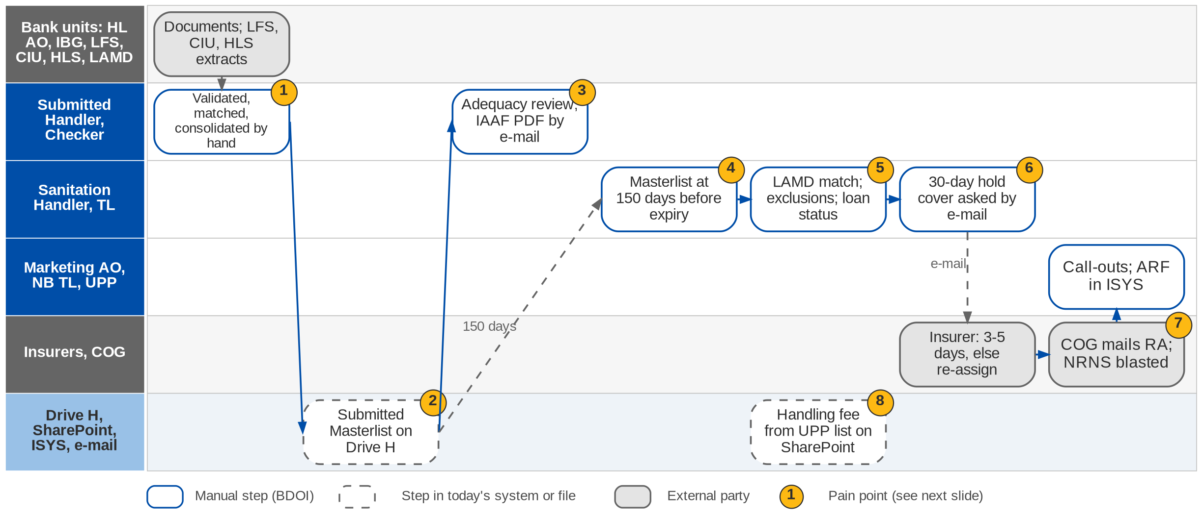
3. Submitted Policies: As-Is process
Submitted policies today (Submitted Policies process flow pages 1-5; SP-01)
Confidential – BDOI
BDOI Reverse KT - Floor Walk | v3.0
45
Notes:
Policy details are extracted from LFS and CIU and from the daily HLS insurance report, and policy documents come from the Home Loan AO and IBG / Leasing. The Submitted Handler validates, matches and consolidates them into the Submitted Masterlist on Drive H within 30 days, reviews the adequacy of the cover, has a checker validate it and issues an IAAF (PDF) by e-mail when there are findings. 150 days before expiry the masterlist goes to the Sanitation Handler, who matches it with LAMD, excludes free-first-year, BDO / SM employee and No Touch accounts, updates the loan status, computes the premium and asks an insurer for a 30-day hold cover by e-mail; if the insurer does not accept in 3-5 days the account is re-assigned. COG sends the RA and reminder letters by snail mail (CBG Motor at 90 days) and blasts the NRNS list; AOs call the clients. The handling fee for CBG Motor is worked from the UPP list on SharePoint.

Slide 46
3. Submitted Policies: intake and three renewal paths
Path | Source | What the handler does | Output | Channel
Intake (all segments) | LFS, CIU, HLS daily; documents from Home Loan AO and IBG / Leasing | Validate, match, consolidate; review adequacy; checker validates | Masterlist on Drive H; IAAF if findings | E-mail (PDF)
Handling fee (CBG Motor) | UPP list on SharePoint | Filter for handling-fee billing; NB TL assigns; AO dispositions | UPP list updated | E-mail, SharePoint
Renewal CBG Motor | SPI list on Drive H; LAMD | Map to NB and Renewal data; exclude FFY, employees, No Touch; loan status; vehicle type and insurer | RA text file to COG; NRNS list | Snail mail at 90 days; call-outs
Renewal CBG Fire | Expiring list; LAMD | Different insurer from the expiring one; premium; 30-day hold cover request | RA, status to TL | E-mail to insurer; snail mail
Renewal Non-CBG Retail | LAMD report | Insurer approval to quote on expiring terms; quotation; ARF in ISYS | Placement file and booking | E-mail; NRNS letter
Confidential – BDOI
BDOI Reverse KT - Floor Walk | v3.0
46
Notes:
The five pages of the Submitted Policies process flow.

Slide 47
3. Submitted Policies: pain points today
1
Policy details consolidated by hand
Extracts and documents from several bank units validated and merged manually.
SP flow p.1; SP-01
5
LAMD matching by hand
Exclusions and loan status updated manually.
SP flow p.3
2
Masterlists on a shared drive
Masterlists per segment on Drive H; status monitored in them.
SP flow p.1, p.3
6
Insurers chased by e-mail
Hold-cover requests; accept in 3-5 days or re-assign by hand.
SP flow p.4
3
Review and IAAF by e-mail
Adequacy reviewed by hand; IAAF issued as a PDF by e-mail.
SP flow p.1
7
Letters by snail mail
RA and reminders printed and mailed by COG; NRNS lists blasted.
SP flow p.3
4
Timelines do not line up
Masterlist at 150 days, RMEL at 140, RA at 90 days.
SP flow p.3; Renewal flow
8
Handling fee from a SharePoint list
UPP list filtered; AO disposition by e-mail.
SP flow p.2
Confidential – BDOI
BDOI Reverse KT - Floor Walk | v3.0
47
Notes:
The eight points are on the Submitted Policies swimlane.
1. Policy details consolidated by hand: Extracts and documents from several bank units validated and merged manually. (SP flow p.1; SP-01)
2. Masterlists on a shared drive: Masterlists per segment on Drive H; status monitored in them. (SP flow p.1, p.3)
3. Review and IAAF by e-mail: Adequacy reviewed by hand; IAAF issued as a PDF by e-mail. (SP flow p.1)
4. Timelines do not line up: Masterlist at 150 days, RMEL at 140, RA at 90 days. (SP flow p.3; Renewal flow)
5. LAMD matching by hand: Exclusions and loan status updated manually. (SP flow p.3)
6. Insurers chased by e-mail: Hold-cover requests; accept in 3-5 days or re-assign by hand. (SP flow p.4)
7. Letters by snail mail: RA and reminders printed and mailed by COG; NRNS lists blasted. (SP flow p.3)
8. Handling fee from a SharePoint list: UPP list filtered; AO disposition by e-mail. (SP flow p.2)

Slide 48
3. Submitted Policies: what the business wants (1/2)
Pain point today
What the business wants
Lever
1
Policy details consolidated by hand
Bank extracts and documents captured once, matched by rule
Rules
2
Masterlists on a shared drive
One masterlist with history, no shared-drive copies
One record
3
Review and IAAF by e-mail
Review, checker and IAAF in one flow, sent and logged
Workflow
4
Timelines do not line up
One renewal timeline shared with Renewal
One calendar
Confidential – BDOI
BDOI Reverse KT - Floor Walk | v3.0
48

Slide 49
3. Submitted Policies: what the business wants (2/2)
Pain point today
What the business wants
Lever
5
LAMD matching by hand
Loan status and exclusions applied by rule
Rules
6
Insurers chased by e-mail
Hold-cover requests tracked with the 3-5 day clock
SLA clock
7
Letters by snail mail
Letters by e-mail or a tracked print batch
Print batch
8
Handling fee from a SharePoint list
Handling fee billed from the masterlist
Billing rule
Confidential – BDOI
BDOI Reverse KT - Floor Walk | v3.0
49
Notes:
For each pain point: what the business needs, and the lever we suggest.
1. Policy details consolidated by hand -> Bank extracts and documents captured once, matched by rule Lever: Rules.
2. Masterlists on a shared drive -> One masterlist with history, no shared-drive copies Lever: One record.
3. Review and IAAF by e-mail -> Review, checker and IAAF in one flow, sent and logged Lever: Workflow.
4. Timelines do not line up -> One renewal timeline shared with Renewal Lever: One calendar.
5. LAMD matching by hand -> Loan status and exclusions applied by rule Lever: Rules.
6. Insurers chased by e-mail -> Hold-cover requests tracked with the 3-5 day clock Lever: SLA clock.
7. Letters by snail mail -> Letters by e-mail or a tracked print batch Lever: Print batch.
8. Handling fee from a SharePoint list -> Handling fee billed from the masterlist Lever: Billing rule.

Slide 50
3. Submitted Policies: best practice
Live bank loan feeds
Rule-based adequacy check
Deficiency notices to the bank
No masterlists
Faster review
Protects the bank
Industry practice: Loan, collateral and paid-off status received from the bank systems daily.
For BDOI: Agree feeds for LFS, CIU, HLS and LAMD with BDO IT.
Industry practice: Sum insured against loan, mortgagee clause and expiry checked by rule on extracted data.
For BDOI: Start with CBG Motor and Fire.
Industry practice: Automatic notices and escalation to the bank unit when cover is short or lapsed.
For BDOI: Use the IAAF as the notice, sent from the system.
Conversion programme
E-signature on IAAF
New premium
No paper
Industry practice: Submitted policies targeted for conversion with offers at renewal, tracked per segment.
For BDOI: Report conversion rate per segment.
Industry practice: IAAF and terms of reference signed electronically.
For BDOI: Decide with Legal and Compliance (CP-01).
Confidential – BDOI
BDOI Reverse KT - Floor Walk | v3.0
50
Notes:
Practices of insurance brokers that fit what we saw at BDOI; each card says what the practice is and where BDOI could start.
Live bank loan feeds. Loan, collateral and paid-off status received from the bank systems daily. For BDOI: Agree feeds for LFS, CIU, HLS and LAMD with BDO IT.
Rule-based adequacy check. Sum insured against loan, mortgagee clause and expiry checked by rule on extracted data. For BDOI: Start with CBG Motor and Fire.
Deficiency notices to the bank. Automatic notices and escalation to the bank unit when cover is short or lapsed. For BDOI: Use the IAAF as the notice, sent from the system.
Conversion programme. Submitted policies targeted for conversion with offers at renewal, tracked per segment. For BDOI: Report conversion rate per segment.
E-signature on IAAF. IAAF and terms of reference signed electronically. For BDOI: Decide with Legal and Compliance (CP-01).

Slide 51
4. Employee Benefits: at a glance
Department and roles
Volumes and business rules
How we learned it
Employee Benefits: Marketing, Processing and Collection
• EB Marketing AO, TL and UH
• BDOI Management (approval above the internal threshold); ISACOM (non-accredited provider)
• EB Processing and Collection
• Client HR (master list, utilization, broker of record)
• Insurers and HMOs (proposals, claims validation)
50,000+
members handled today (EB-01)
Floor walk: 23-Sep-2026, 9-10 am, 43F; discovery 21-Sep-2026
Process owners: Marianne Alpapara, Jyneffer Liansing, Edwin Garcia
• Employee Benefits process flow shared by BDOI (new business and renewal)
• Floor-walk notes EB-01 to EB-03
BOR
broker of record kept for corporate renewal (EB-03)
2 portals
for insurers and client HR in BDOI's EB flow
Provider
validates EB claims; BDOI captures them (EB-02)
The process in one line
Renewal advice
BOR
Franchise
TOR
Proposals
Comparative
Client decision
Placement
Confidential – BDOI
BDOI Reverse KT - Floor Walk | v3.0
51
Notes:
Employee Benefits places group life, HMO and accident programmes for corporate clients. It works like non-life business with more parties: client HR sends the master list, BDOI obtains the broker of record and the insurers' franchise, sends the terms of reference, compares the proposals and presents a recommendation; after the client confirms, Processing receives the employee details and places the programme. More than 50,000 members today.
Floor walk: 23-Sep-2026, 9-10 am, 43F; discovery 21-Sep-2026; Marianne Alpapara, Jyneffer Liansing, Edwin Garcia.
Sources: Employee Benefits process flow shared by BDOI (new business and renewal); Floor-walk notes EB-01 to EB-03

Slide 52
4. Employee Benefits: what we heard on the floor
Ref | Topic | Type | What we heard (As-Is) | What the business wants (To-Be)
EB-01 | Quote and placement | User aspiration | Like non-life: Marketing gets the master list from the customer (headcount only at quote stage), sends it to insurers and negotiates; Processing then gets the employee details and places. More than 50,000 members today. | The system handles large member volumes (50K+).
EB-02 | EB claims | As-Is | Claims are validated by the provider; BDOI only captures the details from the provider. | -
EB-03 | Broker of record | Business rule | The broker of record is kept for corporate EB renewal. | -
EB flow | Renewal | As-Is | Renewal advice before expiry; BOR, master list, utilization and indicative proposal secured; indicative renewal from the incumbent; client feedback; comparative; approval above the internal threshold; placement after confirmation. | -
EB flow | New business | Business rule | New client tagged as prospect; BOR to insurers for franchise approval; TOR from existing benefits; TOR, master list and utilization released to the insurers with franchise; ISACOM approval if awarded to a non-accredited provider. | -
EB flow | Portals | User aspiration | Insurer portal for uploads and management; client portal for uploads and policy management. | Portals for insurers and client HR.
Confidential – BDOI
BDOI Reverse KT - Floor Walk | v3.0
52
Notes:
Notes of the business overview (21-Sep) and of the EB floor walk (23-Sep).
EB-01 Quote and placement (User aspiration): Like non-life: Marketing gets the master list from the customer (headcount only at quote stage), sends it to insurers and negotiates; Processing then gets the employee details and places. More than 50,000 members today. Wants: The system handles large member volumes (50K+).
EB-02 EB claims (As-Is): Claims are validated by the provider; BDOI only captures the details from the provider.
EB-03 Broker of record (Business rule): The broker of record is kept for corporate EB renewal.
EB flow Renewal (As-Is): Renewal advice before expiry; BOR, master list, utilization and indicative proposal secured; indicative renewal from the incumbent; client feedback; comparative; approval above the internal threshold; placement after confirmation.
EB flow New business (Business rule): New client tagged as prospect; BOR to insurers for franchise approval; TOR from existing benefits; TOR, master list and utilization released to the insurers with franchise; ISACOM approval if awarded to a non-accredited provider.
EB flow Portals (User aspiration): Insurer portal for uploads and management; client portal for uploads and policy management. Wants: Portals for insurers and client HR.

Slide 53
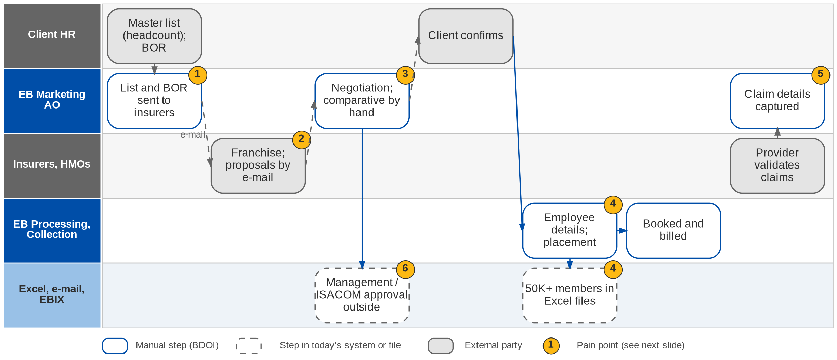
4. Employee Benefits: As-Is process
Employee Benefits today (EB floor walk 23-Sep; EB-01 to EB-03; EB process flow)
Confidential – BDOI
BDOI Reverse KT - Floor Walk | v3.0
53
Notes:
Marketing receives the master list from the client (headcount only at quote stage) and the broker of record, sends them to the insurers and negotiates; proposals come back by e-mail and the comparative is prepared by hand. After the client confirms, Processing gets the employee details and places the programme; member lists of more than 50,000 members travel as files. Above-threshold awards and awards to a non-accredited provider need management or ISACOM approval. EB claims are validated by the provider and BDOI captures the details.

Slide 54
4. Employee Benefits: pain points today
1
Master lists and BOR by e-mail
Headcount lists and the broker of record travel by e-mail.
EB-01, EB-03
4
50K+ members in files
Employee details for placement handled as spreadsheets.
EB-01
2
Proposals by e-mail
Insurers and HMOs send proposals and revisions by e-mail.
EB-01; EB flow
5
Claims captured from providers
Provider validates; BDOI re-captures the details.
EB-02
3
Comparative by hand
Premiums, benefits and provider capabilities compared manually.
EB flow
6
Approvals outside the system
Above-threshold and ISACOM approvals handled offline.
EB flow
Confidential – BDOI
BDOI Reverse KT - Floor Walk | v3.0
54
Notes:
The six points are on the EB swimlane.
1. Master lists and BOR by e-mail: Headcount lists and the broker of record travel by e-mail. (EB-01, EB-03)
2. Proposals by e-mail: Insurers and HMOs send proposals and revisions by e-mail. (EB-01; EB flow)
3. Comparative by hand: Premiums, benefits and provider capabilities compared manually. (EB flow)
4. 50K+ members in files: Employee details for placement handled as spreadsheets. (EB-01)
5. Claims captured from providers: Provider validates; BDOI re-captures the details. (EB-02)
6. Approvals outside the system: Above-threshold and ISACOM approvals handled offline. (EB flow)

Slide 55
4. Employee Benefits: what the business wants
Pain point today
What the business wants
Lever
1
Master lists and BOR by e-mail
Master list, utilization and BOR uploaded once and kept per programme
Upload
2
Proposals by e-mail
Insurers upload proposals themselves (insurer portal in BDOI's flow)
Insurer portal
3
Comparative by hand
Comparative generated on premiums, benefits and capabilities
Generated comparative
4
50K+ members in files
The system handles 50K+ members (EB-01)
Volume
5
Claims captured from providers
Provider claims captured per programme
Claims capture
6
Approvals outside the system
Approval triggered by the internal threshold; ISACOM when needed
Workflow
Confidential – BDOI
BDOI Reverse KT - Floor Walk | v3.0
55
Notes:
For each pain point: what the business needs; the next slide is BDOI's own EB flow.
1. Master lists and BOR by e-mail -> Master list, utilization and BOR uploaded once and kept per programme Lever: Upload.
2. Proposals by e-mail -> Insurers upload proposals themselves (insurer portal in BDOI's flow) Lever: Insurer portal.
3. Comparative by hand -> Comparative generated on premiums, benefits and capabilities Lever: Generated comparative.
4. 50K+ members in files -> The system handles 50K+ members (EB-01) Lever: Volume.
5. Claims captured from providers -> Provider claims captured per programme Lever: Claims capture.
6. Approvals outside the system -> Approval triggered by the internal threshold; ISACOM when needed Lever: Workflow.

Slide 56
4. Employee Benefits: BDOI's EB flow, step by step
Step | What happens | Who
1 Renewal advice | System sends the renewal advice before expiry | System
2 Requirements | Request the BOR; secure the master list, utilization and indicative proposal; uploaded | EB Marketing, client HR
3 Franchise | BOR sent to the insurers for franchise approval | EB Marketing, insurers
4 TOR | TOR from the existing benefits and options; released with the master list and utilization to insurers with franchise | EB Marketing
5 Proposals | Indicative renewal from the incumbent; client feedback; insurers update proposals on client changes | Insurers, client
6 Comparative | Comparative on premiums, benefits and capabilities (stability, clinics, hospitals, technology); approval above the threshold; ISACOM for a non-accredited provider | EB Marketing, management
7 Placement | Placement after client confirmation; hand-off to Processing and Collections | EB Processing
8 Reports and portals | New business, renewal and placement reports; insurer and client portals | All
Confidential – BDOI
BDOI Reverse KT - Floor Walk | v3.0
56
Notes:
The EB process flow BDOI shared. It describes how BDOI wants EB to run, so it is the business aspiration for this chapter.

Slide 57
4. Employee Benefits: best practice
HR self-service census
Automatic member endorsements
Utilization analytics
Clean member data
Accurate billing
Better renewals
Industry practice: Client HR uploads the census; the system checks duplicates, eligibility and changes.
For BDOI: Start with an upload template and checks; portal later.
Industry practice: Additions and deletions billed pro rata and reconciled to the insurer invoice.
For BDOI: Start with the largest programmes.
Industry practice: Claims and utilization per programme drive the renewal negotiation.
For BDOI: Capture provider claims (EB-02).
Digital member cards
Privacy by design
Provider scorecard
Member experience
Compliance
Better advice
Industry practice: HMO and life cards issued digitally to members.
For BDOI: With the HMOs after go-live.
Industry practice: Masking, need-to-know access and retention for member data.
For BDOI: Agree the rules with the Data Protection Officer.
Industry practice: Insurer and HMO service levels, network and claims turnaround scored in the comparative.
For BDOI: Add capability scores to the comparative.
Confidential – BDOI
BDOI Reverse KT - Floor Walk | v3.0
57
Notes:
Practices of insurance brokers that fit what we saw at BDOI; each card says what the practice is and where BDOI could start.
HR self-service census. Client HR uploads the census; the system checks duplicates, eligibility and changes. For BDOI: Start with an upload template and checks; portal later.
Automatic member endorsements. Additions and deletions billed pro rata and reconciled to the insurer invoice. For BDOI: Start with the largest programmes.
Utilization analytics. Claims and utilization per programme drive the renewal negotiation. For BDOI: Capture provider claims (EB-02).
Digital member cards. HMO and life cards issued digitally to members. For BDOI: With the HMOs after go-live.
Privacy by design. Masking, need-to-know access and retention for member data. For BDOI: Agree the rules with the Data Protection Officer.
Provider scorecard. Insurer and HMO service levels, network and claims turnaround scored in the comparative. For BDOI: Add capability scores to the comparative.

Slide 58
Part B
TSU and Product
Package and non-package products and insurer terms
5. Product Maintenance and TSU Technical Support Unit (TSU) and Marketing Business Services (MBS)
Confidential – BDOI | BDOI Reverse KT - Floor Walk
Notes:
Package and non-package products and insurer terms

Slide 59
5. Product and TSU: at a glance
Department and roles
Volumes and business rules
How we learned it
Technical Support Unit (TSU) and Marketing Business Services (MBS)
• Marketing AO and TL / TH / UH (requesters)
• TSU Officer (maker), TSU TL, TSU Head
• ManCom (package sign-off); MBS and IT (package set-up)
• Reinsurance team (large or special risks, on referral)
• Insurers (terms)
2 types
package (fixed rates and conditions) and non-package (per deal) (PM-02)
Floor walk: 22-Sep-2026, 1-1:30 pm, 44F; discovery 21 and 25-Sep-2026
Process owners: Cherry Ann Manalo, Joy Intia
• Product Maintenance TSU process flow (package and non-package)
• BDOI Day 1 overview p.9 (data and reference maintenance)
• Floor-walk notes PM-01 to PM-04, NB-06, NB-08
~55
insurers to negotiate with (OV-01)
8 steps
from request to set-up and release (TSU flow)
5 masters
insurers, products, packages, LOVs, MIS fields (Day 1 p.9)
The process in one line
Request
Completeness
Risk review
Quotation slip
Insurers
Comparative
Sign-off
Set-up and release
Confidential – BDOI
BDOI Reverse KT - Floor Walk | v3.0
59
Notes:
TSU is the technical desk between Marketing and the insurers. Marketing decides whether a need is served by a package (fixed rates and conditions that BDOI designs and the insurer follows) or a non-package placement (terms per deal). TSU checks the request, assesses the risk, prepares the quotation slip, negotiates with insurers, builds the comparative and prepares the proposal and sign-off; MBS and IT set packages up. Product maintenance was named a key pain point (PM-01).
Floor walk: 22-Sep-2026, 1-1:30 pm, 44F; discovery 21 and 25-Sep-2026; Cherry Ann Manalo, Joy Intia.
Sources: Product Maintenance TSU process flow (package and non-package); BDOI Day 1 overview p.9 (data and reference maintenance); Floor-walk notes PM-01 to PM-04, NB-06, NB-08

Slide 60
5. Product and TSU: what we heard on the floor (1/2)
Ref | Topic | Type | What we heard (As-Is) | What the business wants (To-Be)
PM-01 | Package and non-package | User aspiration | Marketing decides package or non-package from the customer need; BDOI defines the product and the insurer follows. | Product maintenance in the system for both package and non-package.
PM-02 | Design and rates | Business rule | Marketing gives the requirement; the product team designs and negotiates with the insurer, incl. incentives for packages; commission rate as agreed by Marketing. | Package = fixed rates and conditions; non-package rates differ per deal.
PM-03 | Package set-up | Pain point | Packages are defined and maintained manually, starting from a customer-specific requirement of Marketing. | Packages defined and maintained in the system.
PM-04 | Change at renewal | User aspiration | At renewal a policy can move from package to non-package or back. | Allow the switch at renewal.
Confidential – BDOI
BDOI Reverse KT - Floor Walk | v3.0
60

Slide 61
5. Product and TSU: what we heard on the floor (2/2)
Ref | Topic | Type | What we heard (As-Is) | What the business wants (To-Be)
NB-08 | TSU step | Business rule | Non-package: the request goes to TSU before the quotation; once the customer accepts, to Placement. | -
TSU flow | Tracking and evidence | Pain point | Request encoded in an Excel monitoring file; acceptance evidence (signed slip, stamped slip or explicit e-mail) checked by hand; placement status tracker kept by hand; comparative table built manually in Excel. | -
TSU flow | Reinsurance loop | As-Is | Large sum insured, special risks or non-standard cover go to the Reinsurance team; RI comments come back to Marketing, who revises terms or closes the request. | -
TSU flow | Set-up dependency | Pain point | Package creation needs a maintenance request to MBS / IT; screenshots kept as evidence; TSU validates rates and conditions; release advisory to Marketing, Operations and TSU. | -
Confidential – BDOI
BDOI Reverse KT - Floor Walk | v3.0
61
Notes:
Notes of the business overview (21-Sep), the Product Maintenance floor walk (22-Sep) and the 25-Sep session.
PM-01 Package and non-package (User aspiration): Marketing decides package or non-package from the customer need; BDOI defines the product and the insurer follows. Wants: Product maintenance in the system for both package and non-package.
PM-02 Design and rates (Business rule): Marketing gives the requirement; the product team designs and negotiates with the insurer, incl. incentives for packages; commission rate as agreed by Marketing. Wants: Package = fixed rates and conditions; non-package rates differ per deal.
PM-03 Package set-up (Pain point): Packages are defined and maintained manually, starting from a customer-specific requirement of Marketing. Wants: Packages defined and maintained in the system.
PM-04 Change at renewal (User aspiration): At renewal a policy can move from package to non-package or back. Wants: Allow the switch at renewal.
NB-08 TSU step (Business rule): Non-package: the request goes to TSU before the quotation; once the customer accepts, to Placement.
TSU flow Tracking and evidence (Pain point): Request encoded in an Excel monitoring file; acceptance evidence (signed slip, stamped slip or explicit e-mail) checked by hand; placement status tracker kept by hand; comparative table built manually in Excel.
TSU flow Reinsurance loop (As-Is): Large sum insured, special risks or non-standard cover go to the Reinsurance team; RI comments come back to Marketing, who revises terms or closes the request.
TSU flow Set-up dependency (Pain point): Package creation needs a maintenance request to MBS / IT; screenshots kept as evidence; TSU validates rates and conditions; release advisory to Marketing, Operations and TSU.

Slide 62
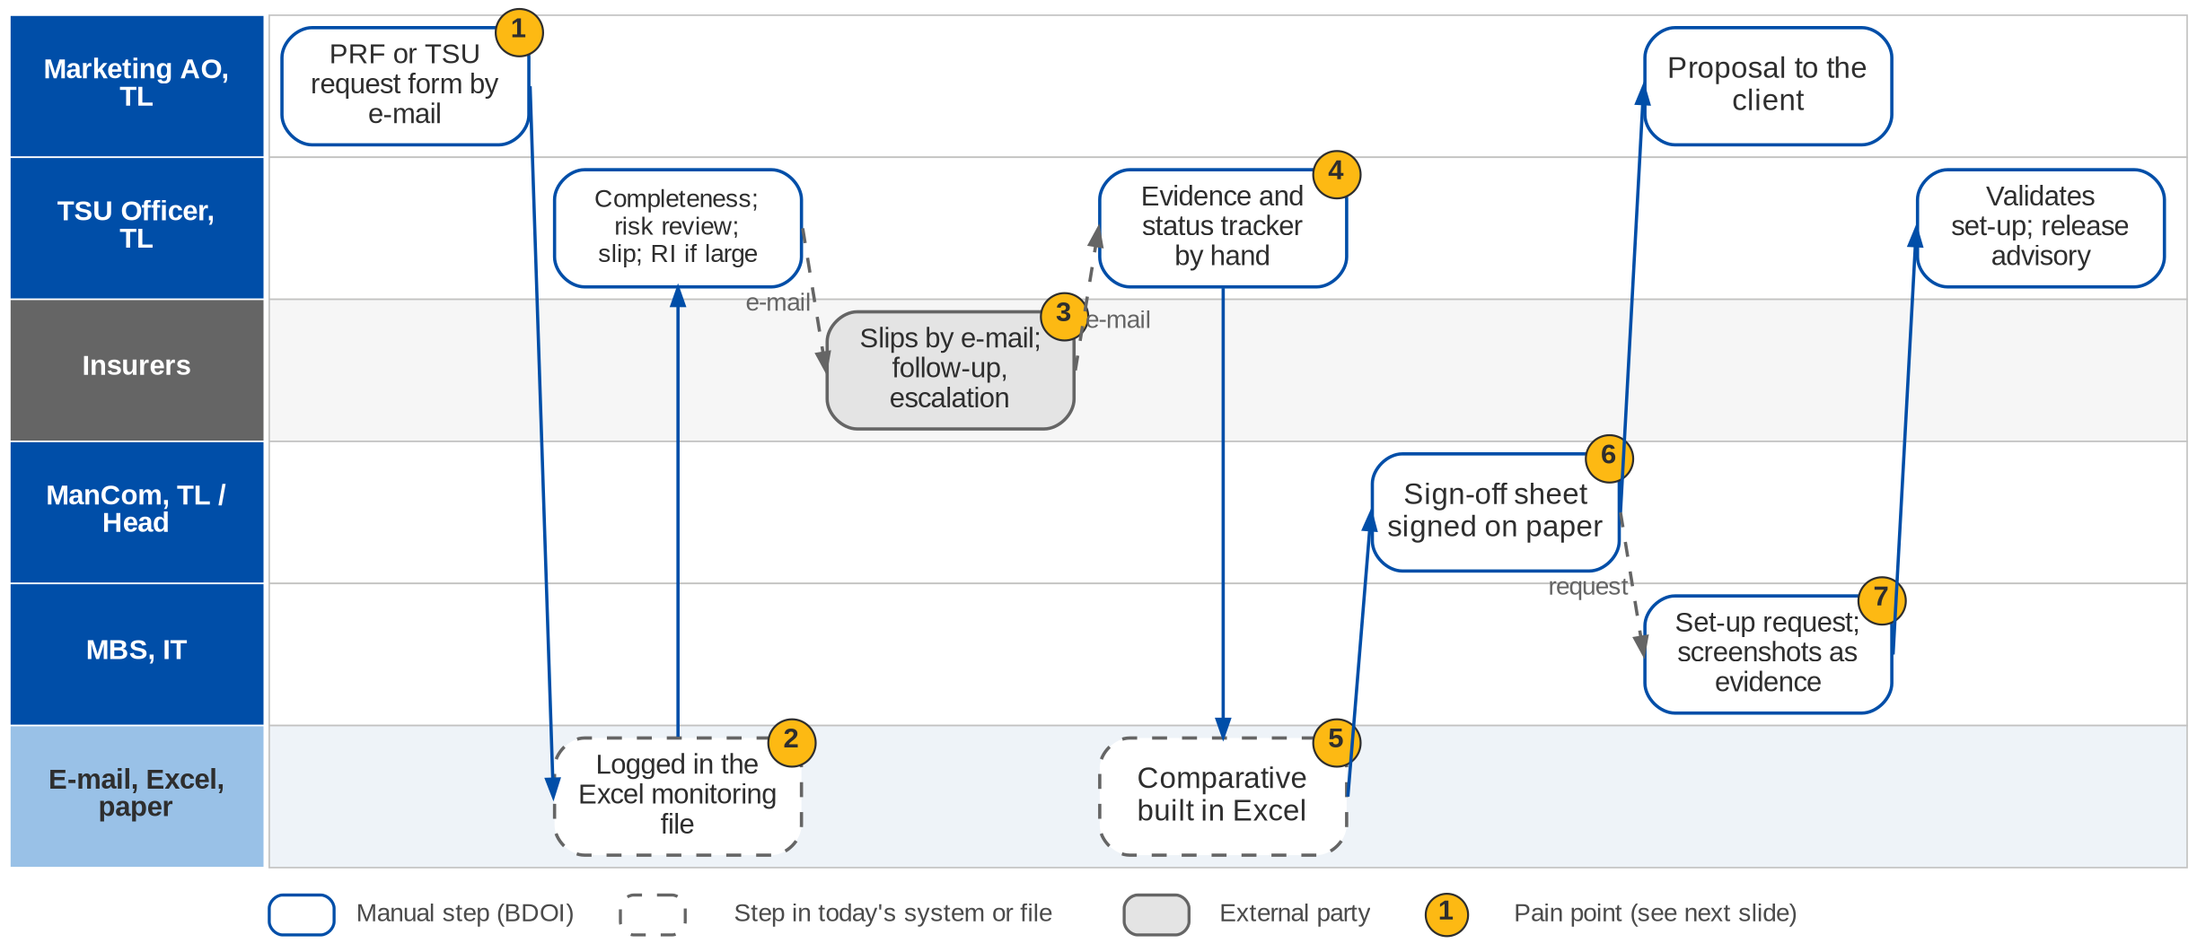
5. Product and TSU: As-Is process
TSU request to package release today (Product Maintenance TSU process flow; PM-01 to PM-04)
Confidential – BDOI
BDOI Reverse KT - Floor Walk | v3.0
62
Notes:
Marketing sends the PRF (package) or TSU request form (non-package) by e-mail; TSU checks completeness, returns incomplete requests and logs the request in an Excel monitoring file. TSU reviews the risk, prepares the quotation slip for the TL's approval (large or special risks go to Reinsurance), sends it to insurers, follows up and escalates after the SLA, and records accepted, declined or conditional answers, checking the acceptance evidence by hand. The comparative is built in Excel; the sign-off sheet goes to ManCom (package) or the TL / Head (non-package) on paper; the proposal goes to Marketing and the client. Packages are then set up through a maintenance request to MBS / IT, with screenshots as evidence, and released with an advisory.

Slide 63
5. Product and TSU: the TSU request today, step by step
Step | What TSU does | Check or decision | Tool today
1 Request | Receives the PRF (package) or TSU request form (non-package) with client, risk, cover, basis of quotation | Complete, documents attached, no duplicate; else returned "Incomplete submission" | E-mail
2 Log | Acknowledges and encodes the request | Request tracker | Excel monitoring file
3 Risk review | Validates cover structure, sum insured and limits, policy terms | Needs reinsurance? (large SI, special risk, non-standard cover) | E-mail to RI team
4 Quotation slip | Prepares the slip with risk details, terms and pricing; TSU TL approves | TL approval; revise on return | Word / Excel
5 Insurers | Sends the slip, follows up, escalates after the SLA; records accepted, declined, conditional | Acceptance evidence: signed or stamped slip, explicit e-mail | E-mail; status tracker
6 Comparative | Compiles premium, cover, conditions, exclusions; asks for more quotes if needed | Enough for a recommendation? | Excel
7 Proposal | Sign-off sheet; ManCom (package) or TL / Head (non-package); proposal slip to Marketing | Approved; Marketing sends to the client | Paper signatures
8 Set-up and release | Maintenance request to MBS / IT; validates rates, conditions, set-up; release advisory | Set-up correct? | MBS / IT; screenshots
Confidential – BDOI
BDOI Reverse KT - Floor Walk | v3.0
63
Notes:
The steps of the Product Maintenance TSU process flow (09-Jul).

Slide 64
5. Product and TSU: pain points today
1
Requests by e-mail
PRF and TSU request forms arrive by e-mail; incomplete ones go back.
TSU flow
5
Comparative in Excel
Premium, cover, conditions and exclusions compiled manually.
TSU flow
2
Tracker in Excel
Every request is encoded in an Excel monitoring file.
TSU flow
6
Paper sign-off
ManCom and TL / Head sign the sign-off sheet on paper.
TSU flow
3
Insurers chased by e-mail
Slips, follow-ups and escalations by e-mail per insurer.
TSU flow
7
Set-up depends on MBS and IT
Packages defined and maintained manually through IT requests.
PM-03; TSU flow
4
Evidence and status by hand
Signed or stamped slips checked by hand; status tracker kept manually.
TSU flow
Confidential – BDOI
BDOI Reverse KT - Floor Walk | v3.0
64
Notes:
The seven points are on the TSU swimlane.
1. Requests by e-mail: PRF and TSU request forms arrive by e-mail; incomplete ones go back. (TSU flow)
2. Tracker in Excel: Every request is encoded in an Excel monitoring file. (TSU flow)
3. Insurers chased by e-mail: Slips, follow-ups and escalations by e-mail per insurer. (TSU flow)
4. Evidence and status by hand: Signed or stamped slips checked by hand; status tracker kept manually. (TSU flow)
5. Comparative in Excel: Premium, cover, conditions and exclusions compiled manually. (TSU flow)
6. Paper sign-off: ManCom and TL / Head sign the sign-off sheet on paper. (TSU flow)
7. Set-up depends on MBS and IT: Packages defined and maintained manually through IT requests. (PM-03; TSU flow)

Slide 65
5. Product and TSU: what the business wants
Pain point today
What the business wants
Lever
1
Requests by e-mail
Requests raised in the system with the required fields checked
Workflow
2
Tracker in Excel
Request tracker kept by the system
No Excel
3
Insurers chased by e-mail
Slips sent and answers recorded per insurer, with SLA escalation
SLA clock
4
Evidence and status by hand
Acceptance evidence attached before placement
Evidence gate
5
Comparative in Excel
Comparative built from the recorded answers
Generated comparative
6
Paper sign-off
Sign-off in the workflow
E-sign-off
7
Set-up depends on MBS and IT
Package and non-package products maintained in the system (PM-01, PM-03); switch at renewal (PM-04)
Product catalogue
Confidential – BDOI
BDOI Reverse KT - Floor Walk | v3.0
65
Notes:
For each pain point: what the business users asked for, and the lever we suggest.
1. Requests by e-mail -> Requests raised in the system with the required fields checked Lever: Workflow.
2. Tracker in Excel -> Request tracker kept by the system Lever: No Excel.
3. Insurers chased by e-mail -> Slips sent and answers recorded per insurer, with SLA escalation Lever: SLA clock.
4. Evidence and status by hand -> Acceptance evidence attached before placement Lever: Evidence gate.
5. Comparative in Excel -> Comparative built from the recorded answers Lever: Generated comparative.
6. Paper sign-off -> Sign-off in the workflow Lever: E-sign-off.
7. Set-up depends on MBS and IT -> Package and non-package products maintained in the system (PM-01, PM-03); switch at renewal (PM-04) Lever: Product catalogue.

Slide 66
5. Product and TSU: best practice
Business-maintained rating rules
Insurer appetite and capacity register
Test premiums before release
Speed to market
Better placement
No wrong rates
Industry practice: Rates, factors and formulas maintained by TSU with approval and versions, without IT.
For BDOI: A rules screen with test premiums before release.
Industry practice: Per insurer: lines, limits, appetite, accreditation, commission, remittance terms.
For BDOI: Build on the insurer records of Day 1 p.9.
Industry practice: Automatic test cases run on every package before it goes live.
For BDOI: Turn the set-up validation into test cases.
Package performance analytics
E-sign-off
One product catalogue
Better products
No paper
One source of truth
Industry practice: Take-up, loss ratio and retention per package reviewed yearly.
For BDOI: Report per package from booking and claims data.
Industry practice: ManCom sign-off and slips signed electronically.
For BDOI: With the e-signature decision (CP-01).
Industry practice: Package and non-package products, terms of reference and documents in one catalogue.
For BDOI: Cover both product types (PM-01).
Confidential – BDOI
BDOI Reverse KT - Floor Walk | v3.0
66
Notes:
Practices of insurance brokers that fit what we saw at BDOI; each card says what the practice is and where BDOI could start.
Business-maintained rating rules. Rates, factors and formulas maintained by TSU with approval and versions, without IT. For BDOI: A rules screen with test premiums before release.
Insurer appetite and capacity register. Per insurer: lines, limits, appetite, accreditation, commission, remittance terms. For BDOI: Build on the insurer records of Day 1 p.9.
Test premiums before release. Automatic test cases run on every package before it goes live. For BDOI: Turn the set-up validation into test cases.
Package performance analytics. Take-up, loss ratio and retention per package reviewed yearly. For BDOI: Report per package from booking and claims data.
E-sign-off. ManCom sign-off and slips signed electronically. For BDOI: With the e-signature decision (CP-01).
One product catalogue. Package and non-package products, terms of reference and documents in one catalogue. For BDOI: Cover both product types (PM-01).

Slide 67
Part C
Operations
The money after booking: cashiering, remittance, adjustments, commission, reconciliation, collections
6. Operations Operations (Financial Transactions and Processing)
7. Collections Operations - Collections, with Marketing collection staff
Confidential – BDOI | BDOI Reverse KT - Floor Walk
Notes:
The money after booking: cashiering, remittance, adjustments, commission, reconciliation, collections

Slide 68
6. Operations: at a glance
Department and roles
Volumes and business rules
How we learned it
Operations (Financial Transactions and Processing)
• Cashiers at head office and branches; Cashiering TL / TH
• Remittance Processor and TL / TH
• Adjustment / Collateral Release Processor and TL / TH (checker-poster)
• Production Reconciliation Handler; CRU (Commission Receivable Unit)
• IT (monthly extracts, reversal files, Autopay)
• Marketing, Comptrollership, Disbursement (hand-offs)
~55
insurer partners, each settled and reconciled separately (OV-01)
Floor walk: 23-Sep-2026, 1:00-5:00 pm, 44F; discovery 21 and 23-Sep-2026
Process owners: Perjelyn Joy Gutierrez, Shirley Catapang, Ronna Marie Go, Aimee Medina, Renque Galos, Carolyn Pasia Baloto, Joy Ebuenga, Mark Andrew Francisco
• Operations process flow (Cashiering, Remittance, Adjustment, Commission receivables, Production recon, DPPR / PR2307 reversal, Invoicing)
• BDOI Day 1 overview p.20-25
• Floor-walk notes CA-01 to CA-05, CM-01 to CM-03, IC-01, IC-02, EN-01, EN-02, OV-03
20-30K
production lines per insurer a month to reconcile (Day 1 p.24)
~2,000
records in one bulk payment file (CA-05)
4 days
check hold before a payment is applied (Cashiering flow)
The process in one line
Payment files
Checks
Split and apply
Receipts
Remittance
Disbursement
Insurer OR
Reconciliation
Confidential – BDOI
BDOI Reverse KT - Floor Walk | v3.0
68
Notes:
Operations takes over every booked invoice and follows its money until the insurer is paid and every difference is closed. BDOI collects premium for about 55 insurers and remits it net of commission. Seven sub-processes run side by side. The floor walk gave the volumes: 20-30 thousand production lines per insurer a month and bulk payment files of about 2,000 records.
Floor walk: 23-Sep-2026, 1:00-5:00 pm, 44F; discovery 21 and 23-Sep-2026; Perjelyn Joy Gutierrez, Shirley Catapang, Ronna Marie Go, Aimee Medina, Renque Galos, Carolyn Pasia Baloto, Joy Ebuenga, Mark Andrew Francisco.
Sources: Operations process flow (Cashiering, Remittance, Adjustment, Commission receivables, Production recon, DPPR / PR2307 reversal, Invoicing); BDOI Day 1 overview p.20-25; Floor-walk notes CA-01 to CA-05, CM-01 to CM-03, IC-01, IC-02, EN-01, EN-02, OV-03

Slide 69
6. Operations: what we heard on the floor (1/3)
Ref | Topic | Type | What we heard (As-Is) | What the business wants (To-Be)
OV-03 | Three references | Pain point | One transaction carries three numbers: ISYS invoice no., QPS reference and EBIX reference, plus the payment reference. QPS holds all three. | One reference across the lifecycle (to confirm).
CA-01 | Receipts | Pain point | The client pays against the ISYS invoice number; QPS has the insurer reference and EBIX its own. Receipts are created by hand. | Receipts generated by the system.
CA-02 | Threshold account | Business rule | Amounts below PHP 0.99 go to a separate adjustment (threshold) account, e.g. the .99 of 8,787.99. | Threshold and variance handling configurable.
CA-03 | Direct pay | Pain point | A direct-pay policy is tagged, so only commission entries exist. If the insured still pays BDOI, no accounting entry is created. | A solution, e.g. allow the direct-pay tag to be changed.
CA-04 | Receipt types | Business rule | Two receipts: AR to the client for premium, OR to the insurer for commission. | Both AR and OR generated from the system.
Confidential – BDOI
BDOI Reverse KT - Floor Walk | v3.0
69

Slide 70
6. Operations: what we heard on the floor (2/3)
Ref | Topic | Type | What we heard (As-Is) | What the business wants (To-Be)
CA-05 | Bulk payment | As-Is | Bulk payment files of about 2,000 records. | Walk through bulk payment on the floor (open point).
Day 1 p.20 | Payment files | As-Is | Bills Payment, CLPC, PMS, Trade, Direct Credit and FS04 files; 4-day check hold, bounced-check list, QPS / EBIX reference and zero-PR checks; exact, excess or actual-payment files; Autopay; unapplied report. | -
Day 1 p.21 | Remittance | As-Is | Weekly EBIX extract of applied payments (Monday to Friday); DPPR reversal, endorsement / knock-off and invalid accounts removed; settlement approved on an MS Teams list; signed copy kept for audit; Disbursement posts. | -
EN-01 | Endorsement | User aspiration | Marketing e-mails the request with documents; Operations validates, keys it in the EBIX endorsement module; TL / TH checker-poster; posting one by one; entries flow to Comptrollership. | Endorsement computes the premium from the adjustment, like New Business, not just captures it.
EN-02 | Cancellation | Open point | Cancellation with refund of premium including applicable tax. | Tax treatment on refund to confirm.
Confidential – BDOI
BDOI Reverse KT - Floor Walk | v3.0
70

Slide 71
6. Operations: what we heard on the floor (3/3)
Ref | Topic | Type | What we heard (As-Is) | What the business wants (To-Be)
CM-01 | Commission trigger | Business rule | Commission is confirmed from premium collected (Collections) and only after the full premium is collected, also for instalment and multi-year policies. | -
CM-02 | Co-insurance | Business rule | Co-insurance: commission can be processed when one insurer has paid. Direct policy: partial commission payment is not accepted. | -
CM-03 | Excess commission | Business rule | Excess commission is computed differently for Motor and Fire and kept in the incentive module. | -
IC-01 | Early-remittance incentive | Business rule | Insurers pay an incentive for early remittance, only on premium sold within credit terms. Rates agreed with each insurer; posted to Other Income (IC-02). | Incentive by insurer to walk through (open point).
Day 1 p.23-24 | DP commission, reversal | Pain point | DP lists per unit in a shared folder, consolidated in Excel, billed by e-mail; production recon of 20-30K lines per insurer; DPPR / PR2307 reversal through SharePoint, Teams, IT extract and VLOOKUP, with a 0.01-0.99 variance. | -
Confidential – BDOI
BDOI Reverse KT - Floor Walk | v3.0
71
Notes:
The notes of the discovery sessions (21 and 23-Sep) and of the Operations floor walk (23-Sep). Joy was the single point of contact for the Cashiering items.
OV-03 Three references (Pain point): One transaction carries three numbers: ISYS invoice no., QPS reference and EBIX reference, plus the payment reference. QPS holds all three. Wants: One reference across the lifecycle (to confirm).
CA-01 Receipts (Pain point): The client pays against the ISYS invoice number; QPS has the insurer reference and EBIX its own. Receipts are created by hand. Wants: Receipts generated by the system.
CA-02 Threshold account (Business rule): Amounts below PHP 0.99 go to a separate adjustment (threshold) account, e.g. the .99 of 8,787.99. Wants: Threshold and variance handling configurable.
CA-03 Direct pay (Pain point): A direct-pay policy is tagged, so only commission entries exist. If the insured still pays BDOI, no accounting entry is created. Wants: A solution, e.g. allow the direct-pay tag to be changed.
CA-04 Receipt types (Business rule): Two receipts: AR to the client for premium, OR to the insurer for commission. Wants: Both AR and OR generated from the system.
CA-05 Bulk payment (As-Is): Bulk payment files of about 2,000 records. Wants: Walk through bulk payment on the floor (open point).
Day 1 p.20 Payment files (As-Is): Bills Payment, CLPC, PMS, Trade, Direct Credit and FS04 files; 4-day check hold, bounced-check list, QPS / EBIX reference and zero-PR checks; exact, excess or actual-payment files; Autopay; unapplied report.
Day 1 p.21 Remittance (As-Is): Weekly EBIX extract of applied payments (Monday to Friday); DPPR reversal, endorsement / knock-off and invalid accounts removed; settlement approved on an MS Teams list; signed copy kept for audit; Disbursement posts.
EN-01 Endorsement (User aspiration): Marketing e-mails the request with documents; Operations validates, keys it in the EBIX endorsement module; TL / TH checker-poster; posting one by one; entries flow to Comptrollership. Wants: Endorsement computes the premium from the adjustment, like New Business, not just captures it.
EN-02 Cancellation (Open point): Cancellation with refund of premium including applicable tax. Wants: Tax treatment on refund to confirm.
CM-01 Commission trigger (Business rule): Commission is confirmed from premium collected (Collections) and only after the full premium is collected, also for instalment and multi-year policies.
CM-02 Co-insurance (Business rule): Co-insurance: commission can be processed when one insurer has paid. Direct policy: partial commission payment is not accepted.
CM-03 Excess commission (Business rule): Excess commission is computed differently for Motor and Fire and kept in the incentive module.
IC-01 Early-remittance incentive (Business rule): Insurers pay an incentive for early remittance, only on premium sold within credit terms. Rates agreed with each insurer; posted to Other Income (IC-02). Wants: Incentive by insurer to walk through (open point).
Day 1 p.23-24 DP commission, reversal (Pain point): DP lists per unit in a shared folder, consolidated in Excel, billed by e-mail; production recon of 20-30K lines per insurer; DPPR / PR2307 reversal through SharePoint, Teams, IT extract and VLOOKUP, with a 0.01-0.99 variance.

Slide 72
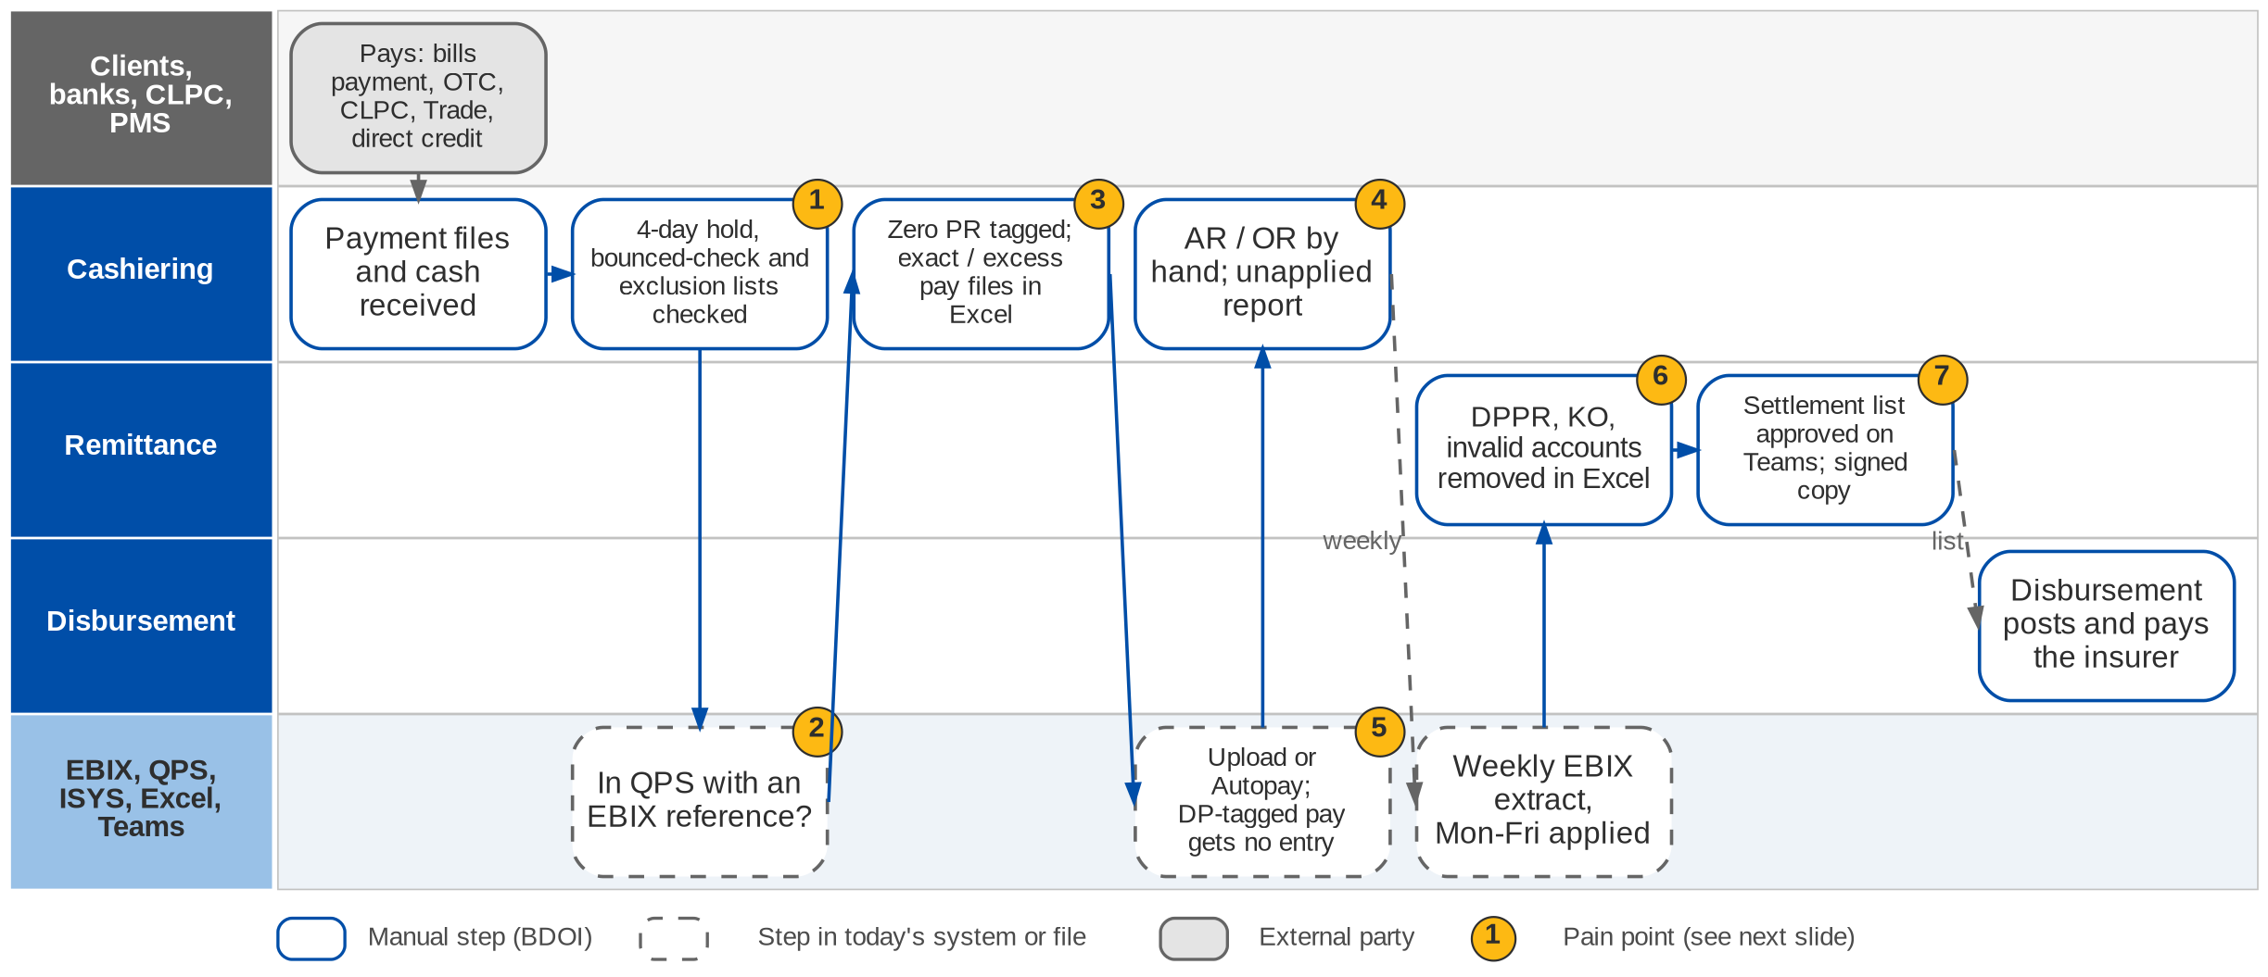
6. Operations: As-Is process (1/3)
Cashiering and Remittance today (Operations process flow; Day 1 p.20-21; CA-01 to CA-05)
Confidential – BDOI
BDOI Reverse KT - Floor Walk | v3.0
72
Notes:
Payment files arrive from bills payment, CLPC, PMS (post-dated checks), Trade, direct credit and the FS04 batch; cash is received at the counter. Before a payment is applied the cashier checks the 4-day hold on checks, the bounced-check list and the exclusion list, and whether the account is in QPS with an EBIX reference. Zero-PR accounts are tagged, and exact-payment, excess-payment and actual-payment files are built before upload or Autopay; items that do not apply end in the unapplied report. Receipts (AR to the client, OR to the insurer) are prepared by hand. When a direct-pay policy is paid to BDOI no premium entry is created (CA-03). Every week Remittance extracts the applied payments of Monday to Friday from EBIX, removes DPPR reversals, knock-offs and invalid accounts in Excel, and has the settlement list approved on an MS Teams list with a signed copy kept for audit; Disbursement then posts and pays the insurer.

Slide 73
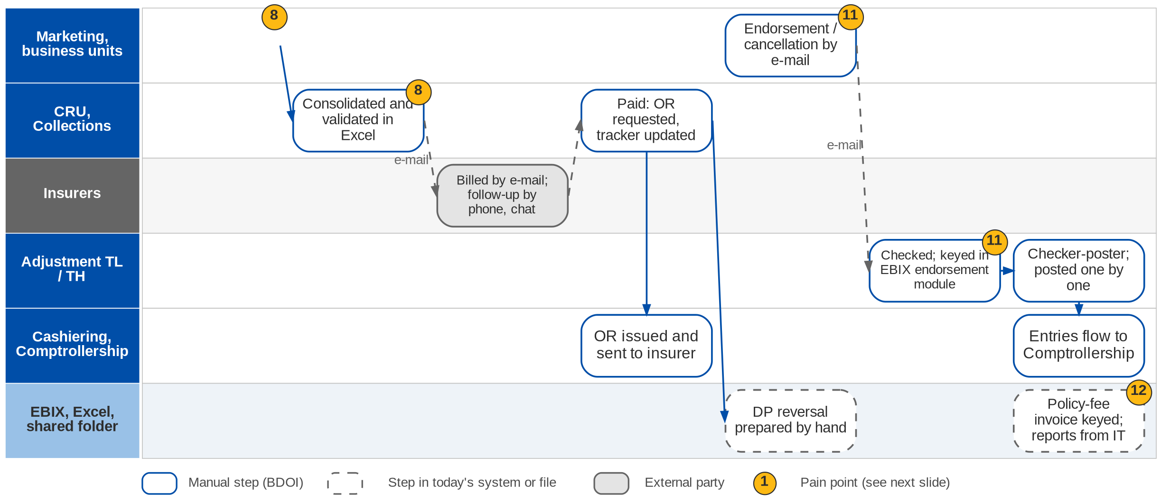
6. Operations: As-Is process (2/3)
Commission receivables (direct payment), Adjustment and policy-fee invoicing today (Operations process flow; Day 1 p.22-23, 25; EN-01)
Confidential – BDOI
BDOI Reverse KT - Floor Walk | v3.0
73
Notes:
When a client pays the insurer directly, BDOI's commission is still due. Each unit lists these direct-payment (DP) transactions in a shared folder; the CRU consolidates the lists in Excel, removes duplicates and validates them against production reports and commission trackers, bills each insurer by e-mail and follows up by e-mail, phone and messaging. When the insurer pays, the CRU asks Cashiering for the OR, sends it to the insurer and prepares the DP reversal by hand. Endorsements and cancellations start with an e-mail from Marketing; Operations checks the documents, keys the request in the EBIX endorsement module and the TL or TH checks and posts each one individually; the entries flow to Comptrollership. Policy-fee (service) invoices are keyed in the EBIX report menu from the schedule of the requestor. Reports are requested from IT.

Slide 74
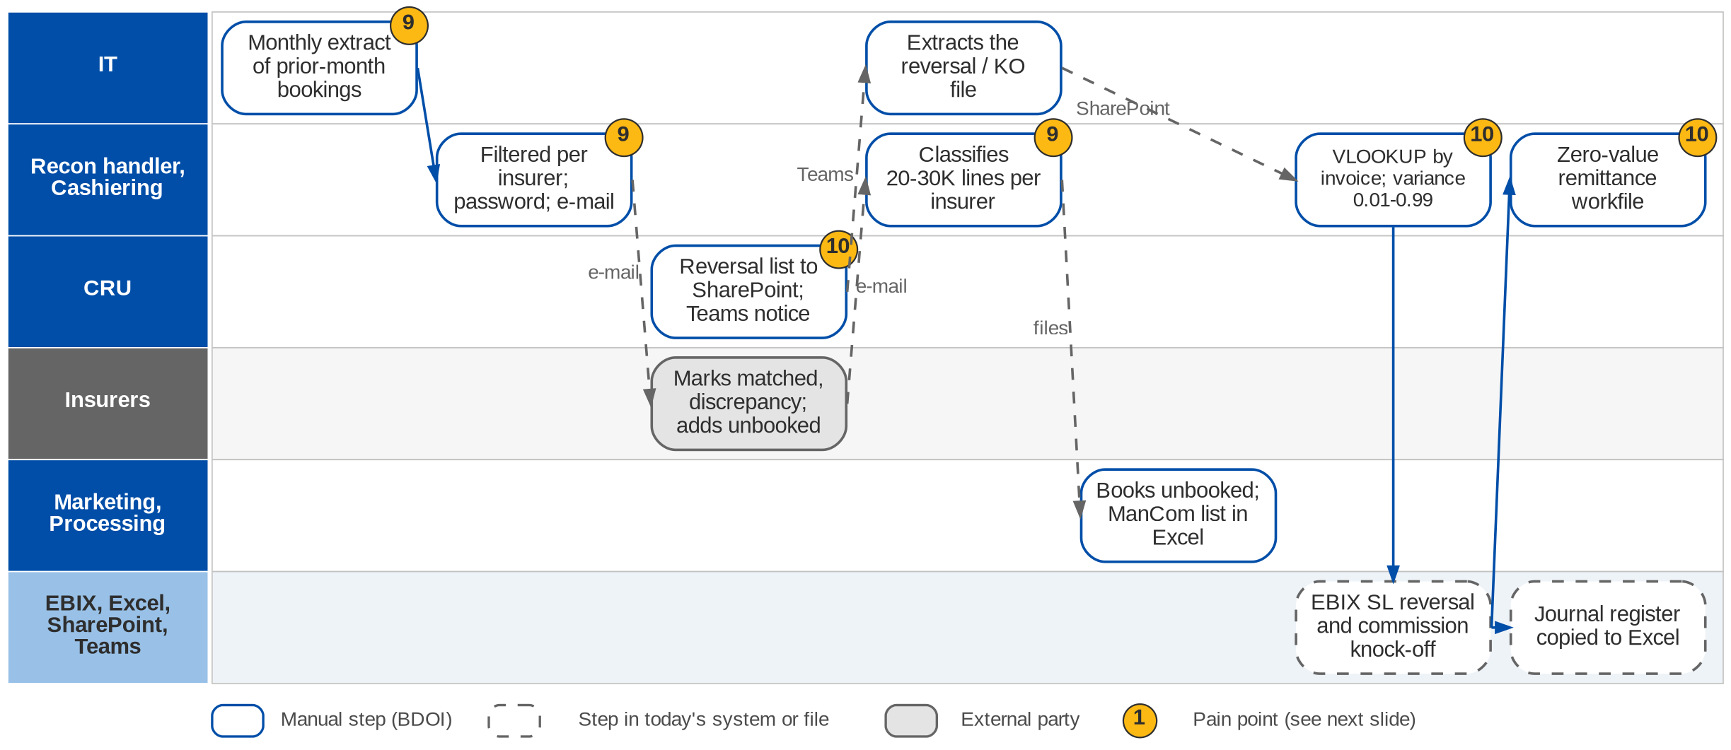
6. Operations: As-Is process (3/3)
Production reconciliation and DPPR / PR2307 reversal today (Operations process flow; Day 1 p.24)
Confidential – BDOI
BDOI Reverse KT - Floor Walk | v3.0
74
Notes:
In the first week of each month IT extracts the accounts booked in the previous month. Operations filters the file per insurer, protects it with a password and e-mails it. The insurer marks matched accounts and discrepancies and adds a file of accounts it has but BDOI has not booked; the handler classifies 20-30 thousand lines per insurer as matched, matched with discrepancies or unbooked, sends the unbooked and discrepancy files to Marketing and Processing and keeps a ManCom masterlist in Excel. For the DPPR / PR2307 reversal the CRU uploads a reversal list to SharePoint and notifies IT on Teams; IT extracts the reversal and knock-off file; Cashiering matches it by invoice number with a VLOOKUP and a variance of 0.01 to 0.99, posts the EBIX sub-ledger reversal and the commission knock-off, copies the journal register to Excel and creates a zero-value remittance workfile for Disbursement.

Slide 75
6. Operations: seven sub-processes at a glance
Sub-process | Trigger and frequency | What happens today | Tools | Volume, rule | Owner
Cashiering | Daily payment files; counter | Checks, split files, upload or Autopay, receipts, unapplied report | EBIX, QPS, ISYS, Excel | ~2,000 rows a file; 4-day hold; 0.99 threshold | Cashiering TL / TH
Remittance | Weekly (Monday to Friday) | Extract applied payments, sanitise, settlement list, approval, hand-off | EBIX, Excel, Teams | Per insurer; signed copy for audit | Remittance TL / TH
Adjustment, cancellation | Marketing e-mail | Validate documents, key in EBIX endorsement module, checker-poster | EBIX, e-mail | Posted one by one; refund with tax | Adjustment TL / TH
Commission receivables (DP) | Monthly DP lists | Consolidate, validate, bill per insurer, follow up, OR, DP reversal | Excel, e-mail, phone | Full premium first; no partial for direct | CRU
Production reconciliation | Monthly, first week | IT extract, per-insurer files, insurer feedback, classification, unbooked follow-up | Excel, e-mail | 20-30K lines per insurer | Recon handler
DPPR / PR2307 reversal | On CRU list | SharePoint list, IT extract, VLOOKUP, SL reversal, knock-off, zero workfile | EBIX, SharePoint, Teams | Variance 0.01-0.99 | CRU, Cashiering
Policy-fee invoicing | Requestor schedule | Key client, risk code, date, amount, branch, allocation; preview; send | EBIX report menu | Status must read Invoiced | Operations
Confidential – BDOI
BDOI Reverse KT - Floor Walk | v3.0
75
Notes:
The seven sub-processes BDOI showed on 23-Sep (Day 1 overview p.20-25 and the Operations process flow); volumes, frequencies and tolerances as heard on the floor.

Slide 76
6. Operations: pain points today
1
Intake checks by hand
4-day check hold, bounced-check list and exclusion list are checked before each payment is applied.
Operations flow (Cashiering); Day 1 p.20
7
Approval on Teams, signed paper copy
The settlement list is approved on an MS Teams list; a signed copy is kept for audit.
Day 1 p.21
2
Three references per transaction
ISYS invoice no., QPS reference, EBIX reference and payment reference; tracing is slow.
OV-03, CA-01
8
DP commission billed from Excel
Unit lists consolidated by hand, billed by e-mail, chased by phone and chat.
Day 1 p.23
3
Payment files split in Excel
Zero-PR tagging and exact, excess and actual-payment files are built by hand.
Operations flow (Cashiering)
9
Insurer reconciliation in Excel
20-30K lines per insurer a month, password e-mails, manual classification.
Day 1 p.24
4
Manual receipts and unapplied
AR and OR are prepared by hand; unapplied items are followed offline.
CA-01, CA-04
10
Reversals through IT and VLOOKUP
SharePoint and Teams hand-offs, IT extract, manual SL journals, zero-value workfile.
Day 1 p.24; TX-02
5
Direct-pay money without entries
A client payment on a DP-tagged policy creates no premium entry.
CA-03
11
Endorsements by e-mail and keyed
Requests arrive by e-mail; premium is computed outside; posting one by one.
EN-01
6
Remittance sanitised by hand
Weekly EBIX extract cleaned of reversals, knock-offs and invalid accounts in Excel.
Day 1 p.21
12
Invoices keyed, reports from IT
Policy-fee invoices keyed in a report menu; reports need IT.
Day 1 p.25; RP-01
Confidential – BDOI
BDOI Reverse KT - Floor Walk | v3.0
76
Notes:
Points 1 to 7 are on the Cashiering and Remittance swimlane, 8, 11 and 12 on the Commission and Adjustment swimlane, 9 and 10 on the Reconciliation and Reversal swimlane.
1. Intake checks by hand: 4-day check hold, bounced-check list and exclusion list are checked before each payment is applied. (Operations flow (Cashiering); Day 1 p.20)
2. Three references per transaction: ISYS invoice no., QPS reference, EBIX reference and payment reference; tracing is slow. (OV-03, CA-01)
3. Payment files split in Excel: Zero-PR tagging and exact, excess and actual-payment files are built by hand. (Operations flow (Cashiering))
4. Manual receipts and unapplied: AR and OR are prepared by hand; unapplied items are followed offline. (CA-01, CA-04)
5. Direct-pay money without entries: A client payment on a DP-tagged policy creates no premium entry. (CA-03)
6. Remittance sanitised by hand: Weekly EBIX extract cleaned of reversals, knock-offs and invalid accounts in Excel. (Day 1 p.21)
7. Approval on Teams, signed paper copy: The settlement list is approved on an MS Teams list; a signed copy is kept for audit. (Day 1 p.21)
8. DP commission billed from Excel: Unit lists consolidated by hand, billed by e-mail, chased by phone and chat. (Day 1 p.23)
9. Insurer reconciliation in Excel: 20-30K lines per insurer a month, password e-mails, manual classification. (Day 1 p.24)
10. Reversals through IT and VLOOKUP: SharePoint and Teams hand-offs, IT extract, manual SL journals, zero-value workfile. (Day 1 p.24; TX-02)
11. Endorsements by e-mail and keyed: Requests arrive by e-mail; premium is computed outside; posting one by one. (EN-01)
12. Invoices keyed, reports from IT: Policy-fee invoices keyed in a report menu; reports need IT. (Day 1 p.25; RP-01)

Slide 77
6. Operations: what the business wants (1/2)
Pain point today
What the business wants
Lever
1
Intake checks by hand
Clearing period, bounced checks and exclusions checked automatically at acceptance
Checks at entry
2
Three references per transaction
One reference across the lifecycle (OV-03, to confirm)
One reference
3
Payment files split in Excel
Payments matched and applied without split files
Auto application
4
Manual receipts and unapplied
AR and OR generated by the system (CA-01, CA-04)
System receipts
5
Direct-pay money without entries
A rule for payments on direct-pay policies, e.g. allow the tag to change (CA-03)
To decide
6
Remittance sanitised by hand
Weekly remittance extract ready, already cleaned of reversals and invalid accounts
Scheduled batches
Confidential – BDOI
BDOI Reverse KT - Floor Walk | v3.0
77

Slide 78
6. Operations: what the business wants (2/2)
Pain point today
What the business wants
Lever
7
Approval on Teams, signed paper copy
Approval in the workflow with an audit trail instead of a Teams list and paper
E-approval
8
DP commission billed from Excel
DP billing per insurer tracked to collection
Worklist
9
Insurer reconciliation in Excel
Insurer feedback matched automatically; unbooked items followed
Auto matching
10
Reversals through IT and VLOOKUP
Reversals and knock-offs without IT extracts or VLOOKUP
Entries at source
11
Endorsements by e-mail and keyed
Endorsement computes the premium like New Business (EN-01)
Rated endorsement
12
Invoices keyed, reports from IT
Other income registered through invoicing; users run their own reports (OI-01, RP-01)
Self-service
Confidential – BDOI
BDOI Reverse KT - Floor Walk | v3.0
78
Notes:
For each pain point: what the business users asked for, and the lever we suggest.
1. Intake checks by hand -> Clearing period, bounced checks and exclusions checked automatically at acceptance Lever: Checks at entry.
2. Three references per transaction -> One reference across the lifecycle (OV-03, to confirm) Lever: One reference.
3. Payment files split in Excel -> Payments matched and applied without split files Lever: Auto application.
4. Manual receipts and unapplied -> AR and OR generated by the system (CA-01, CA-04) Lever: System receipts.
5. Direct-pay money without entries -> A rule for payments on direct-pay policies, e.g. allow the tag to change (CA-03) Lever: To decide.
6. Remittance sanitised by hand -> Weekly remittance extract ready, already cleaned of reversals and invalid accounts Lever: Scheduled batches.
7. Approval on Teams, signed paper copy -> Approval in the workflow with an audit trail instead of a Teams list and paper Lever: E-approval.
8. DP commission billed from Excel -> DP billing per insurer tracked to collection Lever: Worklist.
9. Insurer reconciliation in Excel -> Insurer feedback matched automatically; unbooked items followed Lever: Auto matching.
10. Reversals through IT and VLOOKUP -> Reversals and knock-offs without IT extracts or VLOOKUP Lever: Entries at source.
11. Endorsements by e-mail and keyed -> Endorsement computes the premium like New Business (EN-01) Lever: Rated endorsement.
12. Invoices keyed, reports from IT -> Other income registered through invoicing; users run their own reports (OI-01, RP-01) Lever: Self-service.

Slide 79
6. Operations: best practice (1/2)
Unique payment reference
Automated cash application
Bank host-to-host collections
Auto cash application
Fewer manual matches
Same-day cash visibility
Industry practice: A check-digit reference or virtual account per client or invoice, printed on invoices and SOAs and carried in bank files.
For BDOI: Generate it at booking and ask the bank channels to carry it (OBPCS, direct credit).
Industry practice: Rule and fuzzy matching (payor name, amount tolerance, many-to-one) with confidence scores; the system learns from manual matches.
For BDOI: Extend exact matching with scored suggestions on the unapplied workbench.
Industry practice: Collections through bank APIs, InstaPay / PESONet and QR Ph with intraday notices instead of text files run by IT.
For BDOI: Plan with BDO IT after go-live (CMS / BOB, OBPCS).
Premium trust account discipline
One tolerance and write-off matrix
Control
Consistency
Industry practice: Premium held in trust for insurers is reconciled daily: bank, unapplied plus amounts due to insurers, and the sub-ledger.
For BDOI: Add a daily three-way reconciliation report; confirm the Insurance Commission rules with Compliance.
Industry practice: Tolerances by component, amount band and approver in one table, each with its GL account.
For BDOI: Replace the four values seen today.
Confidential – BDOI
BDOI Reverse KT - Floor Walk | v3.0
79

Slide 80
6. Operations: best practice (2/2)
Remittance calendar per insurer
Insurer statement reconciliation
Commission recognition under PFRS 15
Incentive capture
Fewer disputes
Accurate income
Industry practice: Remittance dates per insurer, an automatic remittance advice and the insurer OR returned electronically.
For BDOI: Use the calendar to meet the early-remittance window and earn the incentive.
Industry practice: Insurer statements of account and commission statements matched automatically, differences routed to owners.
For BDOI: Extend production matching to commission statements.
Industry practice: Commission recognised when the placement is done, with a provision for cancellations; collection tracked separately.
For BDOI: Agree the policy with Comptrollership and the auditors.
Incentive accruals
Income visibility
Industry practice: Contingent and incentive commission estimated and accrued monthly, trued up when the insurer pays.
For BDOI: Add a monthly accrual to the incentive schemes.
Confidential – BDOI
BDOI Reverse KT - Floor Walk | v3.0
80
Notes:
Practices of insurance brokers that fit what we saw at BDOI; each card says what the practice is and where BDOI could start.
Unique payment reference. A check-digit reference or virtual account per client or invoice, printed on invoices and SOAs and carried in bank files. For BDOI: Generate it at booking and ask the bank channels to carry it (OBPCS, direct credit).
Automated cash application. Rule and fuzzy matching (payor name, amount tolerance, many-to-one) with confidence scores; the system learns from manual matches. For BDOI: Extend exact matching with scored suggestions on the unapplied workbench.
Bank host-to-host collections. Collections through bank APIs, InstaPay / PESONet and QR Ph with intraday notices instead of text files run by IT. For BDOI: Plan with BDO IT after go-live (CMS / BOB, OBPCS).
Premium trust account discipline. Premium held in trust for insurers is reconciled daily: bank, unapplied plus amounts due to insurers, and the sub-ledger. For BDOI: Add a daily three-way reconciliation report; confirm the Insurance Commission rules with Compliance.
One tolerance and write-off matrix. Tolerances by component, amount band and approver in one table, each with its GL account. For BDOI: Replace the four values seen today.
Remittance calendar per insurer. Remittance dates per insurer, an automatic remittance advice and the insurer OR returned electronically. For BDOI: Use the calendar to meet the early-remittance window and earn the incentive.
Insurer statement reconciliation. Insurer statements of account and commission statements matched automatically, differences routed to owners. For BDOI: Extend production matching to commission statements.
Commission recognition under PFRS 15. Commission recognised when the placement is done, with a provision for cancellations; collection tracked separately. For BDOI: Agree the policy with Comptrollership and the auditors.
Incentive accruals. Contingent and incentive commission estimated and accrued monthly, trued up when the insurer pays. For BDOI: Add a monthly accrual to the incentive schemes.

Slide 81
7. Collections: at a glance
Department and roles
Volumes and business rules
How we learned it
Operations - Collections, with Marketing collection staff
• Collection Handler; Marketing AO and Marketing Handler
• Team Lead, Unit Head, Section Heads (Corporate, Retail)
• Unapplied Payment Handler
• Cashiering and Commission (act on dispositions)
• Insurers (credit term extension)
10-15 days
first collection follow-up after booking (Day 1 p.19)
Floor walk: 22-Sep-2026, 3:30-5:00 pm, 43F and 44F; discovery 21 and 24-Sep-2026
Process owners: Sheryne Hernaez, Pia Pinili
• Marketing Collections process flow (current end-to-end manual flow)
• BDOI Day 1 overview p.19
• Floor-walk notes CO-01 to CO-03
60 days
to secure the client's payment commitment (Day 1 p.19)
ICS
tracks premium and commission collection today (CO-02)
3 routes
deposit, bills payment, direct payment to the insurer
The process in one line
Booking
PR list
Diary
Follow-up
Commitment
CTE
Disposition
Payment check
Confidential – BDOI
BDOI Reverse KT - Floor Walk | v3.0
81
Notes:
Collections follows every unpaid premium from booking until the payment is confirmed and handed to Cashiering. The Marketing AO owns the client and records the payment instruction in the Marketing Diary; the Collection Handler follows up, secures a commitment and checks the credit term; the AO asks the insurer for a credit term extension when needed. ICS tracks premium and commission collection today.
Floor walk: 22-Sep-2026, 3:30-5:00 pm, 43F and 44F; discovery 21 and 24-Sep-2026; Sheryne Hernaez, Pia Pinili.
Sources: Marketing Collections process flow (current end-to-end manual flow); BDOI Day 1 overview p.19; Floor-walk notes CO-01 to CO-03

Slide 82
7. Collections: what we heard on the floor
Ref | Topic | Type | What we heard (As-Is) | What the business wants (To-Be)
CO-01 | Outstanding per client | Pain point | Collection information is captured in a separate system; the outstanding amount per customer is not shown properly. | The correct outstanding amount per customer.
CO-02 | ICS status and ageing | Pain point | ICS (Internal Collection System) tracks premium and commission collection; data flows from EBIX; the handler updates the contact status. After collection the status stays on the last action and ageing keeps running. | Status closes on payment; ageing stops.
CO-03 | Credit policy | Open point | Credit policy to be defined. | BDOI to confirm the credit policy.
Day 1 p.19 | Follow-up rules | Business rule | Newly booked and unpaid: collect within 10-15 days from booking; secure a payment commitment within 60 days; payment by deposit, bills payment or direct payment. | -
Day 1 p.19 | Friction named by BDOI | Pain point | Manual diary and status updates; e-mail-based CTE coordination; several payment-validation sources; follow-up that depends on the handler. | -
Collections flow | Payment check | As-Is | Deposit: check with Cashiering. Bills payment: look in the Unapplied screen. Direct payment: check with the insurer. Then proceed to Cashiering. | -
Confidential – BDOI
BDOI Reverse KT - Floor Walk | v3.0
82
Notes:
Notes of the Collections floor walk (22-Sep) and of the Collections and Commission session (24-Sep).
CO-01 Outstanding per client (Pain point): Collection information is captured in a separate system; the outstanding amount per customer is not shown properly. Wants: The correct outstanding amount per customer.
CO-02 ICS status and ageing (Pain point): ICS (Internal Collection System) tracks premium and commission collection; data flows from EBIX; the handler updates the contact status. After collection the status stays on the last action and ageing keeps running. Wants: Status closes on payment; ageing stops.
CO-03 Credit policy (Open point): Credit policy to be defined. Wants: BDOI to confirm the credit policy.
Day 1 p.19 Follow-up rules (Business rule): Newly booked and unpaid: collect within 10-15 days from booking; secure a payment commitment within 60 days; payment by deposit, bills payment or direct payment.
Day 1 p.19 Friction named by BDOI (Pain point): Manual diary and status updates; e-mail-based CTE coordination; several payment-validation sources; follow-up that depends on the handler.
Collections flow Payment check (As-Is): Deposit: check with Cashiering. Bills payment: look in the Unapplied screen. Direct payment: check with the insurer. Then proceed to Cashiering.

Slide 83
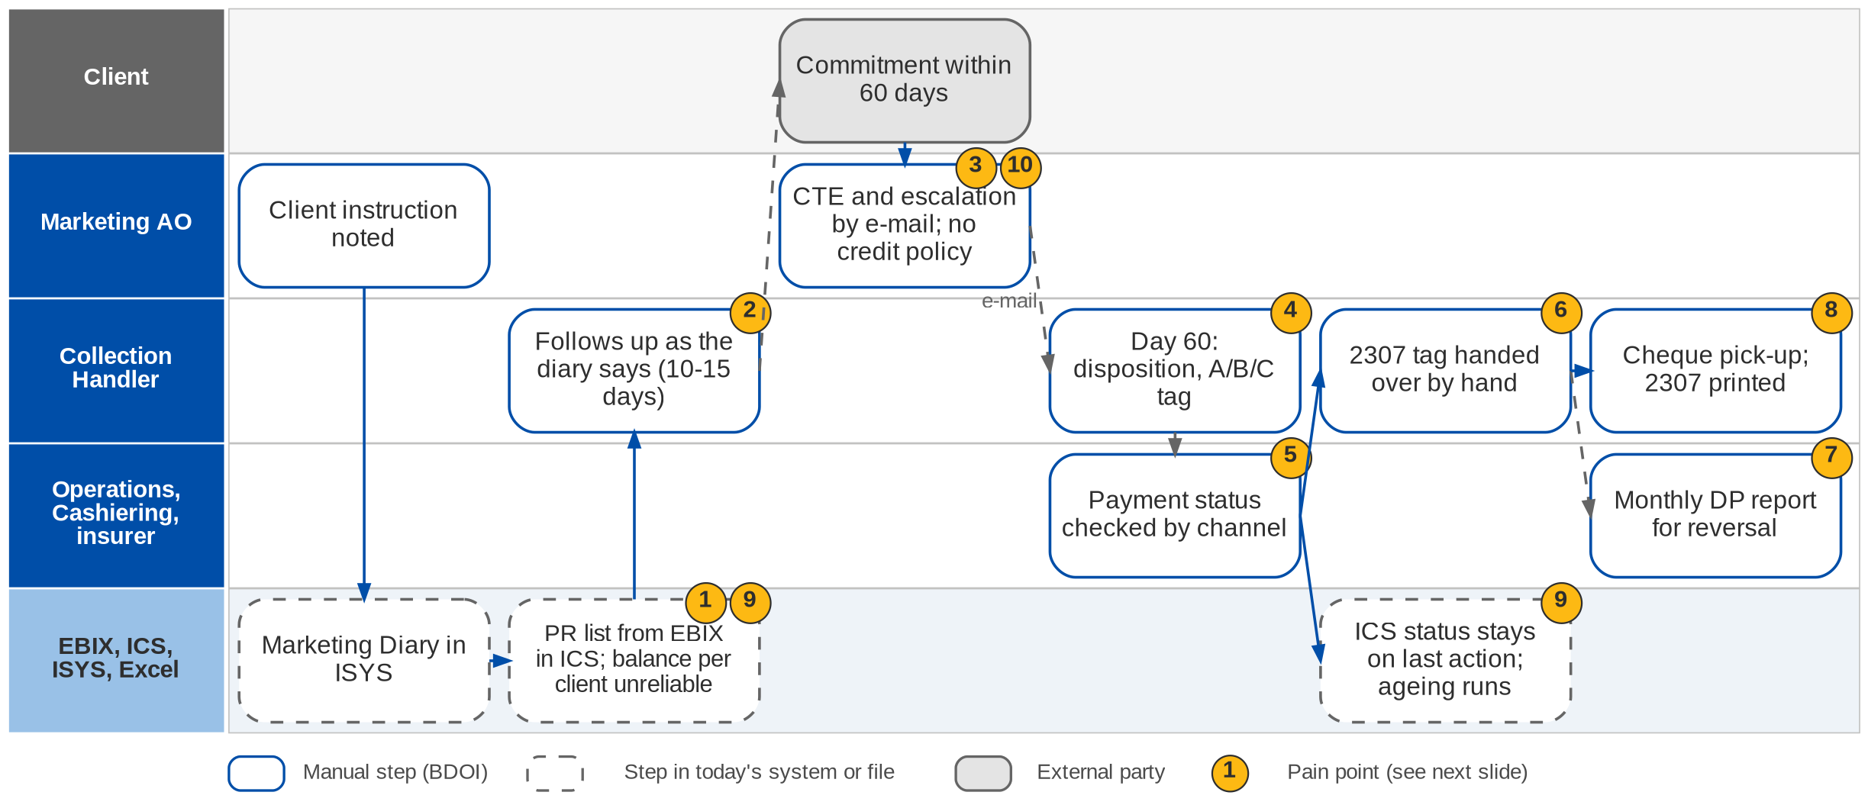
7. Collections: As-Is process
Premium receivable follow-up today (Marketing Collections process flow; Day 1 p.19; CO-01 to CO-03)
Confidential – BDOI
BDOI Reverse KT - Floor Walk | v3.0
83
Notes:
The AO records the client's payment instruction in the Marketing Diary in ISYS. The Collection Handler takes the outstanding-PR list of the market segment and follows up each account as the diary says: new bookings within 10 to 15 days, a payment commitment within 60 days. A commitment outside the credit term goes to the AO by e-mail; the AO asks the insurer for a credit term extension and escalates to the Unit Head. The handler updates the category and remarks and checks the payment by channel with Cashiering, the Unapplied screen or the insurer. In ICS the status stays on the last action and the ageing keeps running after the premium is paid, and the outstanding amount per client is not reliable. CWT 2307 tagging moves from Marketing to Operations by hand, and Operations extracts the Direct Payment report every month for PR reversal.

Slide 84
7. Collections: pain points today
1
PR list and diary in two systems
The handler takes the EBIX list and checks the ISYS Marketing Diary per account.
Collections flow
6
2307 tagging handed over
A net-of-CWT payment stays a Marketing action until the BIR 2307 is collected.
Collections flow
2
Follow-up by hand
New bookings within 10-15 days, commitment within 60 days, tracked by the handler.
Collections flow; Day 1 p.19
7
DP report extracted monthly
Operations extracts the Direct Payment report as the basis for PR reversal.
Collections flow
3
CTE and escalation by e-mail
The AO asks the insurer for a credit term extension and escalates to the Unit Head.
Collections flow; Day 1 p.19
8
Side tasks by e-mail
Cheque pick-up requests and 2307 certificates received by e-mail.
Collections flow
4
Dispositions kept by hand
Day-60 disposition, category A / B / C and remarks are updated manually.
Collections flow
9
ICS status and ageing wrong
Status stays on the last action and ageing runs after payment; balance per client unreliable.
CO-01, CO-02
5
Payment status by channel
Deposit with Cashiering, bills payment on the Unapplied screen, direct payment with the insurer.
Collections flow
10
No written credit policy
Credit terms, CTE and cancellation for non-payment are decided case by case.
CO-03
Confidential – BDOI
BDOI Reverse KT - Floor Walk | v3.0
84
Notes:
Points 1 to 10 are on the Collections swimlane.
1. PR list and diary in two systems: The handler takes the EBIX list and checks the ISYS Marketing Diary per account. (Collections flow)
2. Follow-up by hand: New bookings within 10-15 days, commitment within 60 days, tracked by the handler. (Collections flow; Day 1 p.19)
3. CTE and escalation by e-mail: The AO asks the insurer for a credit term extension and escalates to the Unit Head. (Collections flow; Day 1 p.19)
4. Dispositions kept by hand: Day-60 disposition, category A / B / C and remarks are updated manually. (Collections flow)
5. Payment status by channel: Deposit with Cashiering, bills payment on the Unapplied screen, direct payment with the insurer. (Collections flow)
6. 2307 tagging handed over: A net-of-CWT payment stays a Marketing action until the BIR 2307 is collected. (Collections flow)
7. DP report extracted monthly: Operations extracts the Direct Payment report as the basis for PR reversal. (Collections flow)
8. Side tasks by e-mail: Cheque pick-up requests and 2307 certificates received by e-mail. (Collections flow)
9. ICS status and ageing wrong: Status stays on the last action and ageing runs after payment; balance per client unreliable. (CO-01, CO-02)
10. No written credit policy: Credit terms, CTE and cancellation for non-payment are decided case by case. (CO-03)

Slide 85
7. Collections: what the business wants (1/2)
Pain point today
What the business wants
Lever
1
PR list and diary in two systems
One worklist with the Marketing Diary in view
One record
2
Follow-up by hand
The 10-15 and 60-day rules applied by the system, with reminders
Rules
3
CTE and escalation by e-mail
CTE requested and answered on the account, not by e-mail
CTE record
4
Dispositions kept by hand
Dispositions and categories kept with their history
History
5
Payment status by channel
Payment status visible whatever the payment route
One view
Confidential – BDOI
BDOI Reverse KT - Floor Walk | v3.0
85

Slide 86
7. Collections: what the business wants (2/2)
Pain point today
What the business wants
Lever
6
2307 tagging handed over
2307 tagging handed over in the system
No e-mail
7
DP report extracted monthly
Direct-payment report ready on the first working day
Scheduled
8
Side tasks by e-mail
Cheque pick-ups requested from the account
Tracked requests
9
ICS status and ageing wrong
Correct outstanding per customer; status closes and ageing stops on payment (CO-01, CO-02)
Accurate ageing
10
No written credit policy
A written credit policy (CO-03, BDOI to confirm)
To decide
Confidential – BDOI
BDOI Reverse KT - Floor Walk | v3.0
86
Notes:
For each pain point: what the business users asked for, and the lever we suggest.
1. PR list and diary in two systems -> One worklist with the Marketing Diary in view Lever: One record.
2. Follow-up by hand -> The 10-15 and 60-day rules applied by the system, with reminders Lever: Rules.
3. CTE and escalation by e-mail -> CTE requested and answered on the account, not by e-mail Lever: CTE record.
4. Dispositions kept by hand -> Dispositions and categories kept with their history Lever: History.
5. Payment status by channel -> Payment status visible whatever the payment route Lever: One view.
6. 2307 tagging handed over -> 2307 tagging handed over in the system Lever: No e-mail.
7. DP report extracted monthly -> Direct-payment report ready on the first working day Lever: Scheduled.
8. Side tasks by e-mail -> Cheque pick-ups requested from the account Lever: Tracked requests.
9. ICS status and ageing wrong -> Correct outstanding per customer; status closes and ageing stops on payment (CO-01, CO-02) Lever: Accurate ageing.
10. No written credit policy -> A written credit policy (CO-03, BDOI to confirm) Lever: To decide.

Slide 87
7. Collections: best practice
Segmented dunning strategies
Written credit policy in the system
Pay-by-link, QR Ph, e-wallets
Faster cash
Compliance
Convenience
Industry practice: Pre-due and overdue reminders by SMS and e-mail, with a strategy per segment and risk.
For BDOI: Add client-facing reminders to the escalation rules.
Industry practice: Credit terms per segment and product, CTE workflow with the insurer, automatic cancellation request at day N.
For BDOI: Approve the policy, then configure it (CO-03).
Industry practice: Payment links in reminders and SOAs, applied straight through.
For BDOI: Add after go-live with the bank channels.
Collection KPIs
Client self-service statement
Promise-to-pay discipline
Visibility
Fewer calls
Accountability
Industry practice: Days sales outstanding, collection effectiveness, promises kept, roll rates; prioritise by likelihood to pay.
For BDOI: Build a Collections dashboard on the worklist.
Industry practice: Clients see their statement and payment history online or through the contact centre.
For BDOI: Start with the SOA through the contact centre.
Industry practice: Promises per instalment with reminders and broken-promise escalation.
For BDOI: Agree the escalation days per segment.
Confidential – BDOI
BDOI Reverse KT - Floor Walk | v3.0
87
Notes:
Practices of insurance brokers that fit what we saw at BDOI; each card says what the practice is and where BDOI could start.
Segmented dunning strategies. Pre-due and overdue reminders by SMS and e-mail, with a strategy per segment and risk. For BDOI: Add client-facing reminders to the escalation rules.
Written credit policy in the system. Credit terms per segment and product, CTE workflow with the insurer, automatic cancellation request at day N. For BDOI: Approve the policy, then configure it (CO-03).
Pay-by-link, QR Ph, e-wallets. Payment links in reminders and SOAs, applied straight through. For BDOI: Add after go-live with the bank channels.
Collection KPIs. Days sales outstanding, collection effectiveness, promises kept, roll rates; prioritise by likelihood to pay. For BDOI: Build a Collections dashboard on the worklist.
Client self-service statement. Clients see their statement and payment history online or through the contact centre. For BDOI: Start with the SOA through the contact centre.
Promise-to-pay discipline. Promises per instalment with reminders and broken-promise escalation. For BDOI: Agree the escalation days per segment.

Slide 88
Part D
Comptrollership
Disbursement, FRBS accounting, ACSL, refunds, tax and BIR
8. Comptrollership Comptrollership: FRBS (GL team), Disbursement, ACSL
Confidential – BDOI | BDOI Reverse KT - Floor Walk
Notes:
Disbursement, FRBS accounting, ACSL, refunds, tax and BIR

Slide 89
8. Comptrollership: at a glance
Department and roles
Volumes and business rules
How we learned it
Comptrollership: FRBS (GL team), Disbursement, ACSL
• FRBS Accounting Assistant, TL, TH (GL set-up, journals, reconciliation, close)
• Disbursement Processor (DPO), TL (DTL), Section Head (DSH), Unit Head (DUH)
• ACSL Accounting Processor and AP TL; FRBS approver
• Marketing AO, Marketing Admin, UPP and Marketing Support (refund requests)
• MBS, UPP handler (payee upkeep); IT Operations; BDO TPD and branches
3 levels
of signed approval: DTL, DSH, DUH (DS-01)
Floor walk: 23-Sep-2026, 10:00 am-12:00 nn, 44F; discovery 21 and 23-Sep-2026
Process owners: Rodrigo Dela Cruz, Cherry Francisco, Lineth Santos, Guada Jane Pelo (Disbursement), Iris Marquez, Fatima Joy Aguas and 5 more (floor-walk coverage slide)
• Process flows: Disbursement (in the system, online banking, outside the system, government), Refund Request (five segments), FRBS GL, ACSL
• BDOI Day 1 overview p.26-27
• Floor-walk notes DS-01 to DS-05, TX-01 to TX-05, RC-01, RC-02, FN-01, RP-01, OI-01 to OI-03
5
refund approval chains, one per segment (Refund Request flow)
8
branches to tag with profit and cost centres (FN-01)
15% / 2%
withholding tax on commission / on suppliers (TX-01, TX-03)
The process in one line
Request
Payee
Voucher
Approvals
Payment
GL entry
Reconciliation
Close and report
Confidential – BDOI
BDOI Reverse KT - Floor Walk | v3.0
89
Notes:
Comptrollership turns every business event into accounting and pays everyone BDOI owes: insurers, clients, suppliers, employees and the government. Disbursement runs four routes with three levels of signed approval; FRBS keeps the chart of accounts, reviews the reports IT prepares, reconciles, posts manual journals and closes the books; ACSL keeps the sub-ledger clean. Refund requests start in Marketing with five approval chains.
Floor walk: 23-Sep-2026, 10:00 am-12:00 nn, 44F; discovery 21 and 23-Sep-2026; Rodrigo Dela Cruz, Cherry Francisco, Lineth Santos, Guada Jane Pelo (Disbursement); Iris Marquez, Fatima Joy Aguas, Cherie Jocson (FRBS); Jeniffer Lugtu, Mario Sabangan, Jennifer Carinan, Freddie Atanque (ACSL).
Sources: Process flows: Disbursement (in the system, online banking, outside the system, government), Refund Request (five segments), FRBS GL, ACSL; BDOI Day 1 overview p.26-27; Floor-walk notes DS-01 to DS-05, TX-01 to TX-05, RC-01, RC-02, FN-01, RP-01, OI-01 to OI-03

Slide 90
8. Comptrollership: what we heard on the floor (1/3)
Ref | Topic | Type | What we heard (As-Is) | What the business wants (To-Be)
DS-01 | Approval | Business rule | Multi-level approval with maker and checker. | -
DS-02 | Settlement types | As-Is | Remittance and settlement cover insurer payments, customer payments and sundry creditors; client premium refunds are also settled here. | -
DS-03 | Working file | Pain point | For individual companies a working file is prepared and sent to the Disbursement team. | -
DS-04 | Payment mode | Pain point | Remittance is always processed in batch. The mode of payment is captured outside the system, as most modes are not in the system. | -
DS-05 | Entries | User aspiration | Remittance entries pass through intermediate accounts. | Debit Cash in Bank and credit the insurance company directly.
TX-01 | WHT on commission | Business rule | WHT on commission is 15% during remittance processing. | -
Confidential – BDOI
BDOI Reverse KT - Floor Walk | v3.0
90

Slide 91
8. Comptrollership: what we heard on the floor (2/3)
Ref | Topic | Type | What we heard (As-Is) | What the business wants (To-Be)
TX-03 | WHT certificate | User aspiration | Certificates prepared outside the system. | 2% WHT certificate (BIR 2307) generated for suppliers.
TX-04 | BIR reports | Business rule | Monthly, from the trial balance and sub-ledger; WHT based on disbursements; the tax code changes by supplier. | -
TX-05 | VAT | Business rule | Input VAT quarterly from the sub-ledger; output VAT the same. | -
RC-01 | Reconciliation | Open point | Bank reconciliation and insurer reconciliation (premium and commission). | Detail during the floor walk.
RC-02 | Insurer reconciliation | User aspiration | Done on statements of account. | Insurer reconciliation account-wise.
FN-01 | Branches | User aspiration | BDOI has 8 branches. | Profit centre and cost centre tagged and mapped.
Confidential – BDOI
BDOI Reverse KT - Floor Walk | v3.0
91

Slide 92
8. Comptrollership: what we heard on the floor (3/3)
Ref | Topic | Type | What we heard (As-Is) | What the business wants (To-Be)
RP-01 | Reports | Pain point | Reports are made by hand: data pulled from several systems and consolidated, with IT help. | Business units run reports themselves.
OI-01 | Other income | User aspiration | Other income recorded outside a standard invoice. | Other income registered through invoicing.
OI-02 | Service fee | Business rule | A service invoice records other income; WHT rate differs by income type; VAT applies; OR issued after. | -
OI-03 | Referral fee | Pain point | Referral is treated as a service fee, credited from an Excel list. | -
Confidential – BDOI
BDOI Reverse KT - Floor Walk | v3.0
92
Notes:
Notes of the Cashiering, Other Income, Disbursement and Tax session (23-Sep) and of the Comptrollership floor walk.
DS-01 Approval (Business rule): Multi-level approval with maker and checker.
DS-02 Settlement types (As-Is): Remittance and settlement cover insurer payments, customer payments and sundry creditors; client premium refunds are also settled here.
DS-03 Working file (Pain point): For individual companies a working file is prepared and sent to the Disbursement team.
DS-04 Payment mode (Pain point): Remittance is always processed in batch. The mode of payment is captured outside the system, as most modes are not in the system.
DS-05 Entries (User aspiration): Remittance entries pass through intermediate accounts. Wants: Debit Cash in Bank and credit the insurance company directly.
TX-01 WHT on commission (Business rule): WHT on commission is 15% during remittance processing.
TX-03 WHT certificate (User aspiration): Certificates prepared outside the system. Wants: 2% WHT certificate (BIR 2307) generated for suppliers.
TX-04 BIR reports (Business rule): Monthly, from the trial balance and sub-ledger; WHT based on disbursements; the tax code changes by supplier.
TX-05 VAT (Business rule): Input VAT quarterly from the sub-ledger; output VAT the same.
RC-01 Reconciliation (Open point): Bank reconciliation and insurer reconciliation (premium and commission). Wants: Detail during the floor walk.
RC-02 Insurer reconciliation (User aspiration): Done on statements of account. Wants: Insurer reconciliation account-wise.
FN-01 Branches (User aspiration): BDOI has 8 branches. Wants: Profit centre and cost centre tagged and mapped.
RP-01 Reports (Pain point): Reports are made by hand: data pulled from several systems and consolidated, with IT help. Wants: Business units run reports themselves.
OI-01 Other income (User aspiration): Other income recorded outside a standard invoice. Wants: Other income registered through invoicing.
OI-02 Service fee (Business rule): A service invoice records other income; WHT rate differs by income type; VAT applies; OR issued after.
OI-03 Referral fee (Pain point): Referral is treated as a service fee, credited from an Excel list.

Slide 93
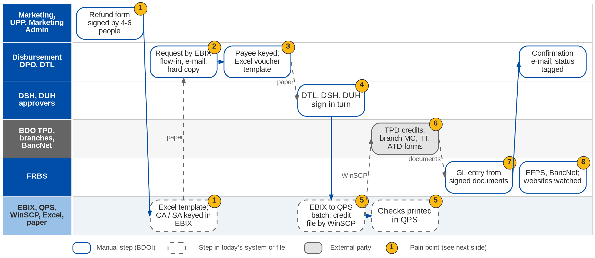
8. Comptrollership: As-Is process (1/2)
Refunds and Disbursement today (Refund Request and Disbursement process flows; Day 1 p.27; DS-01 to DS-05)
Confidential – BDOI
BDOI Reverse KT - Floor Walk | v3.0
93
Notes:
A refund starts with a Refund Request Form (client ID, CA / SA or check details, amount, reason) that the AO fills in; depending on the segment it goes through four to six signatures, and Marketing Admin, Collections or UPP fills an Excel template and keys the CA / SA in EBIX. Disbursement receives requests through the EBIX flow-in, by e-mail or on paper. Payee details are kept by MBS (insurers), the UPP handler (clients) and the DTL (sundry creditors). The DPO prepares the Excel disbursement template and bank forms; the DTL, DSH and DUH sign in turn. In-system payments run from EBIX to QPS by an IT batch, and the credit file is sent through WinSCP to the Transaction Processing Department (TPD); checks are printed in QPS. Credit tickets, ATDs, manager's checks, demand drafts and telegraphic transfers are bank forms done at a BDO branch. The signed documents go to FRBS for the GL entry. FRBS files taxes in EFPS and pays SSS, Pag-IBIG and PhilHealth through BancNet, then watches the government websites.

Slide 94
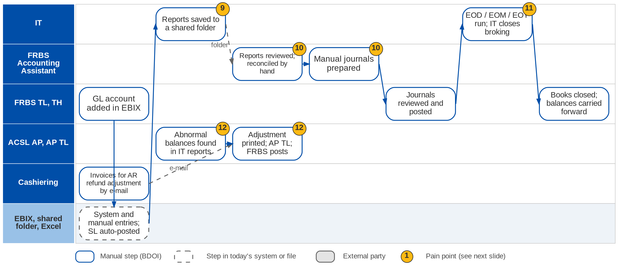
8. Comptrollership: As-Is process (2/2)
General ledger, close and ACSL today (FRBS Accounting and ACSL process flows; Day 1 p.26)
Confidential – BDOI
BDOI Reverse KT - Floor Walk | v3.0
94
Notes:
FRBS team leads add GL accounts in the EBIX account maintenance; EBIX creates entries from the source transactions and FRBS adds manual entries; sub-ledgers post automatically. IT generates the required reports and saves them in a shared folder; the accounting assistant reviews them, reconciles and prepares manual journals that the TL or TH reviews and posts. At day, month and year end IT extracts the output reports and closes the broking transactions before FRBS triggers the closing of the books and the balances are carried forward. ACSL receives reports from IT (PR, DTIP, CRU), looks for abnormal balances, analyses the invoices, prints the adjustment for the AP TL and routes it to an FRBS approver for posting; Cashiering e-mails invoices due for AR refund adjustment.

Slide 95
8. Comptrollership: refund chains and payment routes (1/2)
Route or segment | Starts with | Approvals today | Keyed or executed by | Hand-off
Refund: Non-CBG Retail | AO fills the RRF | MTL, TH, then MAD TL and Marketing UH | Marketing Admin (Excel, EBIX) | MAD TL to Disbursement
Refund: Non-CBG Corporate | AO fills the RRF | MAD review, MAD TL, Marketing UH | Marketing Admin | MAD TL to Disbursement
Refund: CBG Motor | AO instructs the UPP AO; bank confirms account name | Approver 1, Approver 2, UH | Approver 2 keys in EBIX | UPP AO to Disbursement
Refund: CBG Fire | AO instructs Marketing Support | MS TL, UH | MS TL keys CA / SA | Paper and scanned copy
Refund: Non-CBG Branches | AO fills the RRF | MTL, UH, then Collections TL and UH | Collections Processor | CP to Disbursement
Confidential – BDOI
BDOI Reverse KT - Floor Walk | v3.0
95

Slide 96
8. Comptrollership: refund chains and payment routes (2/2)
Route or segment | Starts with | Approvals today | Keyed or executed by | Hand-off
Pay: in the system | EBIX flow-in (remittance, refunds) | DSH approves and posts; DTL runs end of day | IT batch EBIX to QPS; WinSCP to TPD | TPD returns processed list
Pay: online banking | Hard-copy request | DTL, second DTL verifier, DSH, DUH; two online authorisations | DTL in online banking | Signed documents to FRBS
Pay: outside the system | Hard-copy request | DTL, DSH, DUH | DPO: CT, ATD, MC, DD, TT forms at a BDO branch | Bank confirmation e-mail
Pay: government | Tax and contribution due dates | DTL maker, DSH, DUH | FRBS SH in EFPS; BancNet for SSS, Pag-IBIG, PhilHealth | 24-hour posting; website check
Confidential – BDOI
BDOI Reverse KT - Floor Walk | v3.0
96
Notes:
From the Refund Request and Disbursement process flows confirmed by the process owners.

Slide 97
8. Comptrollership: pain points today
1
Refunds on paper, five chains
RRF signed by 4-6 people; Excel template; CA / SA re-keyed in EBIX.
Refund Request flow
7
GL entries by another unit
Signed documents go to FRBS, who enters the GL entry.
Disbursement flow
2
Requests by e-mail and paper
Disbursement receives EBIX flow-in, e-mails and hard copies.
Disbursement flow; Day 1 p.27
8
Government payments by hand
EFPS filing and BancNet payments with a 24-hour posting; websites watched.
Disbursement flow (government)
3
Payees kept in three places
MBS (insurers), UPP handler (clients), DTL (sundry) keep payee details.
Disbursement flow
9
Reports prepared by IT
IT saves reports in a shared folder; business cannot run them.
FRBS flow; RP-01
4
Three levels of wet signature
DTL, DSH and DUH sign; online banking adds a second DTL.
DS-01; Disbursement flow
10
Reconciliation and journals by hand
Bank and insurer reconciliation and manual journals in Excel.
FRBS flow; RC-01
5
File chain through IT and QPS
EBIX to QPS batch, credit file by WinSCP to TPD, checks printed in QPS.
Disbursement flow; DS-04
11
IT needed to close
IT runs end-of-day, month and year and closes broking transactions.
FRBS flow
6
Payment modes outside the system
Credit tickets, ATD, MC, DD and TT are bank forms at a branch.
DS-04; Disbursement flow
12
Abnormal balances found by reading
ACSL scans IT reports; adjustments printed for review.
ACSL flow
Confidential – BDOI
BDOI Reverse KT - Floor Walk | v3.0
97
Notes:
Points 1 to 8 are on the Disbursement and Refund swimlane, 9 to 12 on the GL and ACSL swimlane.
1. Refunds on paper, five chains: RRF signed by 4-6 people; Excel template; CA / SA re-keyed in EBIX. (Refund Request flow)
2. Requests by e-mail and paper: Disbursement receives EBIX flow-in, e-mails and hard copies. (Disbursement flow; Day 1 p.27)
3. Payees kept in three places: MBS (insurers), UPP handler (clients), DTL (sundry) keep payee details. (Disbursement flow)
4. Three levels of wet signature: DTL, DSH and DUH sign; online banking adds a second DTL. (DS-01; Disbursement flow)
5. File chain through IT and QPS: EBIX to QPS batch, credit file by WinSCP to TPD, checks printed in QPS. (Disbursement flow; DS-04)
6. Payment modes outside the system: Credit tickets, ATD, MC, DD and TT are bank forms at a branch. (DS-04; Disbursement flow)
7. GL entries by another unit: Signed documents go to FRBS, who enters the GL entry. (Disbursement flow)
8. Government payments by hand: EFPS filing and BancNet payments with a 24-hour posting; websites watched. (Disbursement flow (government))
9. Reports prepared by IT: IT saves reports in a shared folder; business cannot run them. (FRBS flow; RP-01)
10. Reconciliation and journals by hand: Bank and insurer reconciliation and manual journals in Excel. (FRBS flow; RC-01)
11. IT needed to close: IT runs end-of-day, month and year and closes broking transactions. (FRBS flow)
12. Abnormal balances found by reading: ACSL scans IT reports; adjustments printed for review. (ACSL flow)

Slide 98
8. Comptrollership: what the business wants (1/2)
Pain point today
What the business wants
Lever
1
Refunds on paper, five chains
One refund request with routing by segment and fewer signatures
Workflow
2
Requests by e-mail and paper
Every disbursement request in one intake, none on paper
One queue
3
Payees kept in three places
Payee details kept once for every payment type
One payee master
4
Three levels of wet signature
Maker-checker kept, with approval limits instead of wet signatures (DS-01)
DOA matrix
5
File chain through IT and QPS
Credit files and checks produced without QPS and WinSCP
Host-to-host
6
Payment modes outside the system
Mode of payment captured in the system (DS-04)
Mode recorded
Confidential – BDOI
BDOI Reverse KT - Floor Walk | v3.0
98

Slide 99
8. Comptrollership: what the business wants (2/2)
Pain point today
What the business wants
Lever
7
GL entries by another unit
Entry Debit Cash in Bank / Credit Insurance Company, posted at approval (DS-05)
Entries at source
8
Government payments by hand
Tax and contribution due dates tracked; filing and payment confirmed
Calendar
9
Reports prepared by IT
Business units run reports themselves (RP-01)
Self-service
10
Reconciliation and journals by hand
Bank and insurer reconciliation account-wise, automated (RC-01, RC-02)
Auto matching
11
IT needed to close
Close run by Comptrollership, not IT
Scheduled close
12
Abnormal balances found by reading
Abnormal balances flagged by rule
Exception queue
Confidential – BDOI
BDOI Reverse KT - Floor Walk | v3.0
99
Notes:
For each pain point: what the business users asked for, and the lever we suggest.
1. Refunds on paper, five chains -> One refund request with routing by segment and fewer signatures Lever: Workflow.
2. Requests by e-mail and paper -> Every disbursement request in one intake, none on paper Lever: One queue.
3. Payees kept in three places -> Payee details kept once for every payment type Lever: One payee master.
4. Three levels of wet signature -> Maker-checker kept, with approval limits instead of wet signatures (DS-01) Lever: DOA matrix.
5. File chain through IT and QPS -> Credit files and checks produced without QPS and WinSCP Lever: Host-to-host.
6. Payment modes outside the system -> Mode of payment captured in the system (DS-04) Lever: Mode recorded.
7. GL entries by another unit -> Entry Debit Cash in Bank / Credit Insurance Company, posted at approval (DS-05) Lever: Entries at source.
8. Government payments by hand -> Tax and contribution due dates tracked; filing and payment confirmed Lever: Calendar.
9. Reports prepared by IT -> Business units run reports themselves (RP-01) Lever: Self-service.
10. Reconciliation and journals by hand -> Bank and insurer reconciliation account-wise, automated (RC-01, RC-02) Lever: Auto matching.
11. IT needed to close -> Close run by Comptrollership, not IT Lever: Scheduled close.
12. Abnormal balances found by reading -> Abnormal balances flagged by rule Lever: Exception queue.

Slide 100
8. Comptrollership: best practice (1/2)
Payment hub with the bank
Delegation of authority in the workflow
Payee account validation
No file hand-offs
Faster approval
Fraud control
Industry practice: Host-to-host payments for credit to account, MC, TT and online banking, with digital signing and status back.
For BDOI: Replace WinSCP and branch forms with BDO host-to-host (CMS / New BOB).
Industry practice: Approval limits by amount and type, e-approval, no wet signatures.
For BDOI: Approve a DOA matrix; the audit trail replaces the signed copy.
Industry practice: Name match, test credit and dual control on bank-detail changes.
For BDOI: Apply to refunds and new payees.
Government payments calendar
Straight-through refunds
No penalties
Client experience
Industry practice: Due dates, filing and payment through eFPS / eGov, confirmation captured.
For BDOI: Add a calendar and confirmation to Disbursement.
Industry practice: Refund computed from the cancellation or excess and paid to a validated account.
For BDOI: Link cancellation, refund request and payment.
Confidential – BDOI
BDOI Reverse KT - Floor Walk | v3.0
100

Slide 101
8. Comptrollership: best practice (2/2)
Continuous close
Automated tax certificates
BIR e-invoicing readiness
Shorter close
Compliance
Compliance
Industry practice: Daily SL-GL reconciliation, close calendar and checklist, variance analysis.
For BDOI: Add a close checklist and daily reconciliation report.
Industry practice: 2307 for every payee and a register of certificates received, reconciled to SAWT.
For BDOI: Extend 2307 generation to all payees.
Industry practice: CAS-registered books and electronic invoicing (EIS) when it applies.
For BDOI: Confirm applicability with Tax and plan the format.
Multi-dimensional chart of accounts
Profitability view
Industry practice: Branch, profit centre, cost centre, product, insurer and segment on every entry.
For BDOI: Map the 8 branches and centres before go-live.
Confidential – BDOI
BDOI Reverse KT - Floor Walk | v3.0
101
Notes:
Practices of insurance brokers that fit what we saw at BDOI; each card says what the practice is and where BDOI could start.
Payment hub with the bank. Host-to-host payments for credit to account, MC, TT and online banking, with digital signing and status back. For BDOI: Replace WinSCP and branch forms with BDO host-to-host (CMS / New BOB).
Delegation of authority in the workflow. Approval limits by amount and type, e-approval, no wet signatures. For BDOI: Approve a DOA matrix; the audit trail replaces the signed copy.
Payee account validation. Name match, test credit and dual control on bank-detail changes. For BDOI: Apply to refunds and new payees.
Government payments calendar. Due dates, filing and payment through eFPS / eGov, confirmation captured. For BDOI: Add a calendar and confirmation to Disbursement.
Straight-through refunds. Refund computed from the cancellation or excess and paid to a validated account. For BDOI: Link cancellation, refund request and payment.
Continuous close. Daily SL-GL reconciliation, close calendar and checklist, variance analysis. For BDOI: Add a close checklist and daily reconciliation report.
Automated tax certificates. 2307 for every payee and a register of certificates received, reconciled to SAWT. For BDOI: Extend 2307 generation to all payees.
BIR e-invoicing readiness. CAS-registered books and electronic invoicing (EIS) when it applies. For BDOI: Confirm applicability with Tax and plan the format.
Multi-dimensional chart of accounts. Branch, profit centre, cost centre, product, insurer and segment on every entry. For BDOI: Map the 8 branches and centres before go-live.

Slide 102
Part E
Claims and Customer Service
Serving the client after the sale: claims, the contact centre and case management
9. Claims Claims and Risk Management
10. Customer Servicing and Case Management Contact Center Management / Alternative Distribution
Confidential – BDOI | BDOI Reverse KT - Floor Walk
Notes:
Serving the client after the sale: claims, the contact centre and case management

Slide 103
9. Claims: at a glance
Department and roles
Volumes and business rules
How we learned it
Claims and Risk Management
• Claims Officer / Claim Handler (Motor and Non-Motor teams)
• Team Lead, Team Head, Unit Head
• Marketing AO and branch (notice of loss)
• Assured, CASA / dealer, adjuster
• Insurers (evaluation, offer, LOA or cheque)
2 paths
Motor and Non-Motor claims (Claims flow)
Floor walk: 22-Sep-2026, 5-6 pm, 44F; discovery 21-Sep-2026
Process owners: Elmar O. Alvarez Jr., Richard Castanares
• Claims process flow (Motor and Non-Motor swimlanes)
• BDOI Day 1 overview p.8 and p.14
• Floor-walk note CL-01
LOA / cash
Motor settlement: letter of authority to a repair shop, or cash
Adjuster
appointed for Non-Motor losses when needed
Outside
the system: claims handled manually today (CL-01)
The process in one line
Notice
Documents
Loss advice
Evaluation
Offer
Acceptance
Settlement
Closure
Confidential – BDOI
BDOI Reverse KT - Floor Walk | v3.0
103
Notes:
BDOI supports the client from the notice of loss to settlement, as the client's advocate with the insurer. Motor claims end with a letter of authority to a repair shop or dealer, or a cash offer; Non-Motor claims go through the claims reporting form, the formal loss advice, an adjuster's inspection and an offer that the client accepts or contests. Claims are handled outside any system today (CL-01).
Floor walk: 22-Sep-2026, 5-6 pm, 44F; discovery 21-Sep-2026; Elmar O. Alvarez Jr., Richard Castanares.
Sources: Claims process flow (Motor and Non-Motor swimlanes); BDOI Day 1 overview p.8 and p.14; Floor-walk note CL-01

Slide 104
9. Claims: what we heard on the floor
Ref | Topic | Type | What we heard (As-Is) | What the business wants (To-Be)
CL-01 | Claims handling | Pain point | Claims are handled outside the system and manually. | Major pain point: claims in the system.
Day 1 p.8 | What BDOI needs to see | User aspiration | How a claim links to the policy; required documents and status values; who can update, review or approve; how customer communication is recorded. | -
Claims flow | Motor | As-Is | Client, AO or branch sends the notice and PLA; handler completes the documents and sends them to the insurer; insurer issues an LOA to the preferred CASA / dealer or evaluates a cash offer; assured signs; repair monitored offline; claim tagged settled. | -
Claims flow | Non-Motor | As-Is | Claims reporting form (CRF); formal loss advice to the insurer; initial assessment; adjuster inspection when needed; evaluation; offer reviewed and sent to the insured; accept, or contest and re-evaluate; payment; claim closed. | -
Day 1 p.14 | Servicing path | As-Is | Receive the claim from the client; submit documents to the insurer; inform the client of settlement or declination. | -
EB-02 | EB claims | As-Is | Employee Benefits claims are validated by the provider; BDOI captures the details (see chapter 4). | -
Confidential – BDOI
BDOI Reverse KT - Floor Walk | v3.0
104
Notes:
Notes of the business overview (21-Sep) and of the Claims floor walk (22-Sep).
CL-01 Claims handling (Pain point): Claims are handled outside the system and manually. Wants: Major pain point: claims in the system.
Day 1 p.8 What BDOI needs to see (User aspiration): How a claim links to the policy; required documents and status values; who can update, review or approve; how customer communication is recorded.
Claims flow Motor (As-Is): Client, AO or branch sends the notice and PLA; handler completes the documents and sends them to the insurer; insurer issues an LOA to the preferred CASA / dealer or evaluates a cash offer; assured signs; repair monitored offline; claim tagged settled.
Claims flow Non-Motor (As-Is): Claims reporting form (CRF); formal loss advice to the insurer; initial assessment; adjuster inspection when needed; evaluation; offer reviewed and sent to the insured; accept, or contest and re-evaluate; payment; claim closed.
Day 1 p.14 Servicing path (As-Is): Receive the claim from the client; submit documents to the insurer; inform the client of settlement or declination.
EB-02 EB claims (As-Is): Employee Benefits claims are validated by the provider; BDOI captures the details (see chapter 4).

Slide 105
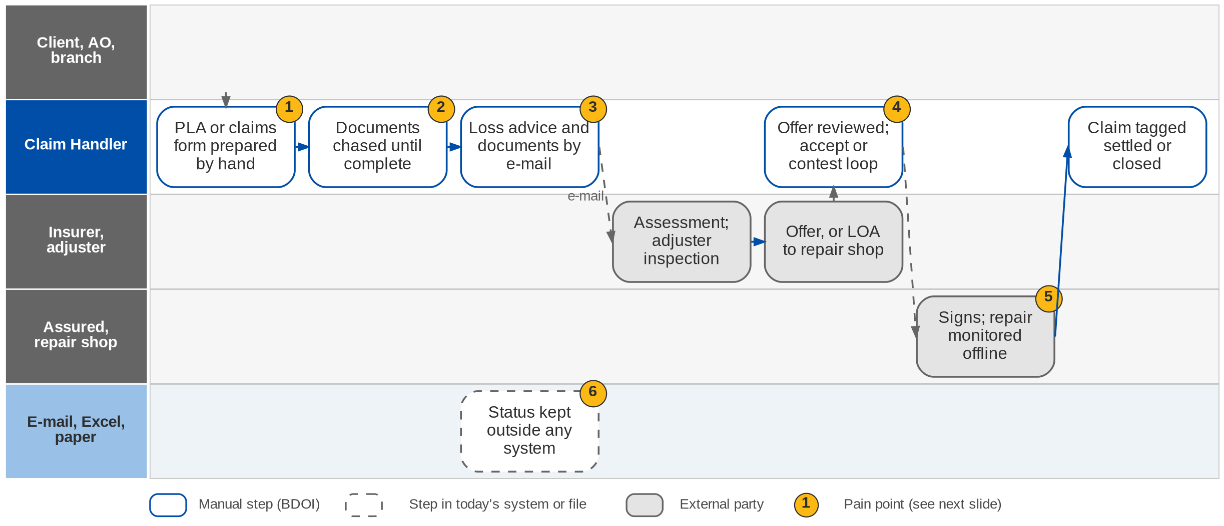
9. Claims: As-Is process
Claims today (Claims process flow, Motor and Non-Motor; Day 1 p.14; CL-01)
Confidential – BDOI
BDOI Reverse KT - Floor Walk | v3.0
105
Notes:
The client, the AO or the branch sends the notice of loss; Claims prepares the preliminary loss advice (Motor) or the claims reporting form (Non-Motor) and chases the documents until complete, then sends them with the loss advice to the insurer by e-mail. The insurer assesses the loss, with an adjuster's inspection when needed, and makes an offer, or for Motor issues a letter of authority to the preferred repair shop or dealer. Claims reviews the offer and sends it to the insured, who signs or contests; a contested offer goes back for re-evaluation. Repairs are monitored offline, and the claim is tagged settled or closed. None of it is in a system.

Slide 106
9. Claims: Motor and Non-Motor paths today
Step | Motor | Non-Motor
Notice | Client, AO or branch sends the notice and a preliminary loss advice (PLA) | Client sends the notice; Claims completes the claims reporting form (CRF) with the client
Documents | Handler coordinates the documents with the client until complete | Handler checks completeness; asks the client for missing documents
To the insurer | Documents and PLA sent to the insurer | Formal loss advice (FLA) sent; insurer makes an initial assessment
Evaluation | Insurer reviews; issues or concerns go back to the handler | Adjuster appointed when needed; inspection arranged with BDOI
Offer | LOA to the preferred CASA / dealer, or a cash offer after evaluation | Offer reviewed by Claims and sent to the insured
Decision | Assured signs the offer; CASA / dealer repairs | Accepts, or contests; insurer re-evaluates or keeps its position
Close | Repair monitored offline; claim tagged settled / closed | Signed offer; payment; property damage claim closed
Confidential – BDOI
BDOI Reverse KT - Floor Walk | v3.0
106
Notes:
From the Claims process flow (swimlane version), confirmed by the Claims team on 13-Feb-2026.

Slide 107
9. Claims: pain points today
1
Notice and forms by hand
Notice by e-mail or call; PLA or claims form prepared manually.
Claims flow
4
Offer and contest by e-mail
Offers reviewed, sent, accepted or contested outside a system.
Claims flow
2
Documents chased by hand
No checklist; the handler follows up until the file is complete.
Claims flow
5
Repairs monitored offline
After the LOA, repair progress is followed by phone and e-mail.
Claims flow
3
Loss advice by e-mail
Loss advice and documents e-mailed to each insurer.
Claims flow
6
Claims outside the system
Claims are handled manually; status and history kept offline.
CL-01
Confidential – BDOI
BDOI Reverse KT - Floor Walk | v3.0
107
Notes:
The six points are on the Claims swimlane.
1. Notice and forms by hand: Notice by e-mail or call; PLA or claims form prepared manually. (Claims flow)
2. Documents chased by hand: No checklist; the handler follows up until the file is complete. (Claims flow)
3. Loss advice by e-mail: Loss advice and documents e-mailed to each insurer. (Claims flow)
4. Offer and contest by e-mail: Offers reviewed, sent, accepted or contested outside a system. (Claims flow)
5. Repairs monitored offline: After the LOA, repair progress is followed by phone and e-mail. (Claims flow)
6. Claims outside the system: Claims are handled manually; status and history kept offline. (CL-01)

Slide 108
9. Claims: what the business wants
Pain point today
What the business wants
Lever
1
Notice and forms by hand
The claim linked to its policy from the first notice (Day 1 p.8)
Claim on the policy
2
Documents chased by hand
Required documents and status values per claim type (Day 1 p.8)
Checklist
3
Loss advice by e-mail
Loss advice generated and sent from the claim, with a record
Send log
4
Offer and contest by e-mail
Who can update, review or approve, recorded on the claim (Day 1 p.8)
Roles
5
Repairs monitored offline
Repair milestones followed to completion
Milestones
6
Claims outside the system
Claims handled in the system, with customer communication recorded (CL-01; Day 1 p.8)
One record
Confidential – BDOI
BDOI Reverse KT - Floor Walk | v3.0
108
Notes:
For each pain point: what the business needs, and the lever we suggest.
1. Notice and forms by hand -> The claim linked to its policy from the first notice (Day 1 p.8) Lever: Claim on the policy.
2. Documents chased by hand -> Required documents and status values per claim type (Day 1 p.8) Lever: Checklist.
3. Loss advice by e-mail -> Loss advice generated and sent from the claim, with a record Lever: Send log.
4. Offer and contest by e-mail -> Who can update, review or approve, recorded on the claim (Day 1 p.8) Lever: Roles.
5. Repairs monitored offline -> Repair milestones followed to completion Lever: Milestones.
6. Claims outside the system -> Claims handled in the system, with customer communication recorded (CL-01; Day 1 p.8) Lever: One record.

Slide 109
9. Claims: best practice
Digital first notice of loss
Client status updates
Insurer SLA scorecards
Faster start
Fewer follow-up calls
Better insurer choice
Industry practice: Notice by web, app or contact centre with photos and automatic policy lookup.
For BDOI: Start with a contact-centre form that creates the claim.
Industry practice: Automatic SMS or e-mail at each status change.
For BDOI: Send notices on the key statuses.
Industry practice: Days from notice to offer and offer to payment, per insurer and line.
For BDOI: Build from the ageing reports.
Repair network integration
Document checklist with chasing
Claims analytics for renewals
Shorter repair time
Complete files first time
Better terms
Industry practice: LOA and repair status exchanged with accredited shops and dealers.
For BDOI: After go-live with the main dealers.
Industry practice: Checklist per claim type and automatic reminders to the client.
For BDOI: Define the checklists with the Claims team.
Industry practice: Loss ratio and claims-prone locations feed renewals and risk advice.
For BDOI: Share loss experience with Renewal and TSU.
Confidential – BDOI
BDOI Reverse KT - Floor Walk | v3.0
109
Notes:
Practices of insurance brokers that fit what we saw at BDOI; each card says what the practice is and where BDOI could start.
Digital first notice of loss. Notice by web, app or contact centre with photos and automatic policy lookup. For BDOI: Start with a contact-centre form that creates the claim.
Client status updates. Automatic SMS or e-mail at each status change. For BDOI: Send notices on the key statuses.
Insurer SLA scorecards. Days from notice to offer and offer to payment, per insurer and line. For BDOI: Build from the ageing reports.
Repair network integration. LOA and repair status exchanged with accredited shops and dealers. For BDOI: After go-live with the main dealers.
Document checklist with chasing. Checklist per claim type and automatic reminders to the client. For BDOI: Define the checklists with the Claims team.
Claims analytics for renewals. Loss ratio and claims-prone locations feed renewals and risk advice. For BDOI: Share loss experience with Renewal and TSU.

Slide 110
10. Customer Servicing: at a glance
Department and roles
Volumes and business rules
How we learned it
Contact Center Management / Alternative Distribution
• BDO Insure contact centre agent (CSR)
• Contact centre supervisor; BDO contact centre (BDO CCC) personnel
• Fulfilment units: the Marketing unit that manages the account
• Contact centre management, leads and heads; System Administrator
• Callers (clients)
2 centres
BDO Insure contact centre and BDO CCC handle cases (Case To-Be)
Floor walk: Process flows shared by BDOI; the contact centre was not in the September floor-walk slots
Process owners: Contact Center Management (BDO Insure)
• Customer Servicing Facility process flow
• BDOI Case Management To-Be process flow, 15-Jul-2026
• New Business and Renewal flows (e-policy after a fall-out)
2 paths
search: CBG accounts by invoice or PN, non-CBG by name (CSF flow)
7 steps
in BDOI's case-management To-Be of 15-Jul-2026
TAT
per referred case, which BDOI wants visible (Case To-Be)
The process in one line
Contact
Identify
Search
View
Verify
Update
Resend or refer
Close
Confidential – BDOI
BDOI Reverse KT - Floor Walk | v3.0
110
Notes:
The BDO Insure contact centre answers clients by phone, e-mail and digital channels: searching accounts, answering inquiries, updating contact details, resending documents and referring what it cannot close to the Marketing unit that manages the account. Every contact is logged by hand in CLS. BDOI has drawn its own case-management To-Be (15-Jul-2026), shown after the pain points.
Floor walk: Process flows shared by BDOI; the contact centre was not in the September floor-walk slots; Contact Center Management (BDO Insure).
Sources: Customer Servicing Facility process flow; BDOI Case Management To-Be process flow, 15-Jul-2026; New Business and Renewal flows (e-policy after a fall-out)

Slide 111
10. Customer Servicing: what we heard on the floor
Ref | Topic | Type | What we heard (As-Is) | What the business wants (To-Be)
CSF flow | Search | As-Is | Account inquiry by invoice number, PN number, last, first or full name (CBG); client inquiry by name for Non-CBG; open the account from the invoice or client code; view contact and insurance details. | -
CSF flow | Contact update | Pain point | When contact details change, the agent updates them and the system migration updates the source databases (QPS, EBIX). | -
Case To-Be | Case logging | User aspiration | Agent identifies the client and the concern; logs every concern in CLS by typing it in; general inquiries answered from CC Nav and closed. | Client details filled in automatically in the case form.
Case To-Be | Positive identification | User aspiration | Positive identification (PID) of the client before any account transaction; failed PID closes the case. | PID as a step of the case.
Case To-Be | Referral and TAT | User aspiration | Concerns not solved at the first contact are referred to the fulfilment unit by e-mail and a CLS prompt. | Cases routed automatically to the Marketing unit of the account; open cases within or past TAT visible; invalid returns re-logged by BDO CCC.
NB and RN flows | E-policy after fall-out | Pain point | After an SFTP fall-out Marketing fixes the e-policy and the BDOI contact centre sends it to the client. | -
Confidential – BDOI
BDOI Reverse KT - Floor Walk | v3.0
111
Notes:
Steps of the Customer Servicing flow and of BDOI's case-management To-Be flow.
CSF flow Search (As-Is): Account inquiry by invoice number, PN number, last, first or full name (CBG); client inquiry by name for Non-CBG; open the account from the invoice or client code; view contact and insurance details.
CSF flow Contact update (Pain point): When contact details change, the agent updates them and the system migration updates the source databases (QPS, EBIX).
Case To-Be Case logging (User aspiration): Agent identifies the client and the concern; logs every concern in CLS by typing it in; general inquiries answered from CC Nav and closed. Wants: Client details filled in automatically in the case form.
Case To-Be Positive identification (User aspiration): Positive identification (PID) of the client before any account transaction; failed PID closes the case. Wants: PID as a step of the case.
Case To-Be Referral and TAT (User aspiration): Concerns not solved at the first contact are referred to the fulfilment unit by e-mail and a CLS prompt. Wants: Cases routed automatically to the Marketing unit of the account; open cases within or past TAT visible; invalid returns re-logged by BDO CCC.
NB and RN flows E-policy after fall-out (Pain point): After an SFTP fall-out Marketing fixes the e-policy and the BDOI contact centre sends it to the client.

Slide 112
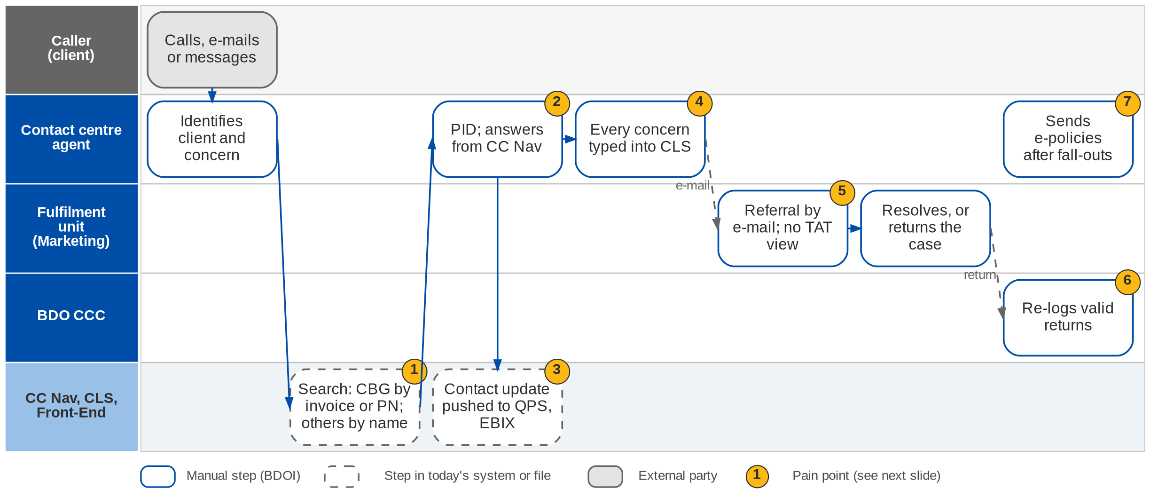
10. Customer Servicing: As-Is process
Contact-centre servicing today (CSF process flow; Case Management flow; NB flow)
Confidential – BDOI
BDOI Reverse KT - Floor Walk | v3.0
112
Notes:
The client contacts the BDO Insure contact centre. The agent identifies the client and the concern, searches CBG accounts by invoice number, PN or name and non-CBG accounts by name only, and answers general inquiries from CC Nav. For an account concern the agent checks the client's identity (PID). Contact changes are updated and pushed to the QPS and EBIX databases. Every concern is typed into CLS; concerns that cannot be closed are referred to the fulfilment unit by e-mail and a CLS prompt, without a TAT view, and cases returned as erroneous are re-logged by BDO CCC. After an e-policy fall-out the contact centre also sends the e-policy to the client.

Slide 113
10. Customer Servicing: pain points today
1
Two search paths
CBG accounts by invoice or PN; non-CBG accounts by name only.
CSF flow
5
Referrals by e-mail
Fulfilment units are told by e-mail; no view of TAT.
Case Management flow
2
PID and answers by hand
Identity checked by questions; answers looked up in CC Nav.
Case Management flow
6
Returned cases re-logged
Erroneous cases go back and BDO CCC logs them again.
Case Management flow
3
Updates pushed to legacy
Contact changes written to the QPS and EBIX databases.
CSF flow
7
Contact centre sends fall-outs
E-policies fixed by Marketing are sent by the contact centre.
NB flow
4
Every concern keyed into CLS
Agents type every contact into CLS, even resolved ones.
Case Management flow
Confidential – BDOI
BDOI Reverse KT - Floor Walk | v3.0
113
Notes:
The seven points are on the Customer Servicing swimlane.
1. Two search paths: CBG accounts by invoice or PN; non-CBG accounts by name only. (CSF flow)
2. PID and answers by hand: Identity checked by questions; answers looked up in CC Nav. (Case Management flow)
3. Updates pushed to legacy: Contact changes written to the QPS and EBIX databases. (CSF flow)
4. Every concern keyed into CLS: Agents type every contact into CLS, even resolved ones. (Case Management flow)
5. Referrals by e-mail: Fulfilment units are told by e-mail; no view of TAT. (Case Management flow)
6. Returned cases re-logged: Erroneous cases go back and BDO CCC logs them again. (Case Management flow)
7. Contact centre sends fall-outs: E-policies fixed by Marketing are sent by the contact centre. (NB flow)

Slide 114
10. Customer Servicing: what the business wants
Pain point today
What the business wants
Lever
1
Two search paths
One search across every account, CBG and non-CBG
One view
2
PID and answers by hand
PID as a step of the case; answers at hand
PID step
3
Updates pushed to legacy
Contact changes made once in one client record
One client
4
Every concern keyed into CLS
Case form filled with the client's details automatically
Case management
5
Referrals by e-mail
Cases routed automatically to the Marketing unit of the account; TAT visible
Routing and TAT
6
Returned cases re-logged
Return loop in the case, without re-logging
Case history
7
Contact centre sends fall-outs
One e-policy sender (see chapter 1)
One sender
Confidential – BDOI
BDOI Reverse KT - Floor Walk | v3.0
114
Notes:
For each pain point: what BDOI's case-management To-Be asks for.
1. Two search paths -> One search across every account, CBG and non-CBG Lever: One view.
2. PID and answers by hand -> PID as a step of the case; answers at hand Lever: PID step.
3. Updates pushed to legacy -> Contact changes made once in one client record Lever: One client.
4. Every concern keyed into CLS -> Case form filled with the client's details automatically Lever: Case management.
5. Referrals by e-mail -> Cases routed automatically to the Marketing unit of the account; TAT visible Lever: Routing and TAT.
6. Returned cases re-logged -> Return loop in the case, without re-logging Lever: Case history.
7. Contact centre sends fall-outs -> One e-policy sender (see chapter 1) Lever: One sender.

Slide 115
10. Customer Servicing: BDOI's case-management To-Be
Step | What happens | Who
1 Contact | Customer contacts the BDO Insure contact centre by phone, e-mail, web or digital channel | Customer
2 Identify | Agent identifies the client and whether the concern is account-related or a general inquiry | BDO Insure agent
3 General inquiry | Answered from CC Nav; concern logged and closed | BDO Insure agent
4 PID | Existing client: positive identification; failed PID ends the transaction and the case is logged and closed | BDO Insure agent
5 First-contact fix | Solved at the point of contact: request fulfilled; case logged with client details filled in automatically; closed | BDO Insure agent
6 Referral | Not solvable at first contact: case routed automatically to the Marketing unit of the account; unit notified | Agent, system
7 Resolve or return | Fulfilment unit filters open cases within or past TAT, resolves and closes, or returns an erroneous case; BDO CCC re-logs valid returns | Fulfilment unit, BDO CCC
Confidential – BDOI
BDOI Reverse KT - Floor Walk | v3.0
115
Notes:
BDOI's case-management To-Be flow of 15-Jul-2026: how the business wants the contact centre to work.

Slide 116
10. Customer Servicing: best practice
Omnichannel case management
Screen-pop and assisted PID
Self-service
One view of every concern
Shorter calls
Fewer calls
Industry practice: Every call, e-mail and chat is a case with SLA, routing and history on the client record.
For BDOI: Adopt BDOI's 15-Jul To-Be.
Industry practice: Caller recognised from the number; PID by OTP or questions from the client record.
For BDOI: Add PID to the servicing view.
Industry practice: Clients get RA, e-policy, SOA and payment status online or by chatbot.
For BDOI: Phase after go-live; start with document download.
Knowledge base and scripts
First-contact resolution metrics
Consistent answers
Service quality
Industry practice: Answers and call scripts per concern type, kept by the contact centre.
For BDOI: Move CC Nav content into the case tool.
Industry practice: First-contact resolution, TAT met and satisfaction per unit.
For BDOI: Report from case data.
Confidential – BDOI
BDOI Reverse KT - Floor Walk | v3.0
116
Notes:
Practices of insurance brokers that fit what we saw at BDOI; each card says what the practice is and where BDOI could start.
Omnichannel case management. Every call, e-mail and chat is a case with SLA, routing and history on the client record. For BDOI: Adopt BDOI's 15-Jul To-Be.
Screen-pop and assisted PID. Caller recognised from the number; PID by OTP or questions from the client record. For BDOI: Add PID to the servicing view.
Self-service. Clients get RA, e-policy, SOA and payment status online or by chatbot. For BDOI: Phase after go-live; start with document download.
Knowledge base and scripts. Answers and call scripts per concern type, kept by the contact centre. For BDOI: Move CC Nav content into the case tool.
First-contact resolution metrics. First-contact resolution, TAT met and satisfaction per unit. For BDOI: Report from case data.

Slide 117
Part F
Cross-cutting topics
Data, integrations and shared needs we saw in every department
11. Data we will have to move What the floor walk tells us
12. Integrations Channels we saw on the floor
13. Shared needs Across departments
Confidential – BDOI | BDOI Reverse KT - Floor Walk
Notes:
Three topics cut across the chapters: where the data lives today, how BDOI exchanges with insurers, banks and the government, and the needs every department raised.

Slide 118
11. Data: where it lives today
Where | What we saw it hold | Seen in
EBIX Evolution | Booking, invoices, AR / OR, remittance, unapplied, GL, payees, policy-fee invoices; DP tags without premium entries | Operations, Comptrollership flows; CA-03
QPS | Quotations, package policies, renewals; holds the three references | NB flow; OV-03
ISYS / Broker | Leads, clients, accounts, Marketing Diary; client codes kept for renewal | NB flow; NB-15; Collections flow
ICS | Premium and commission collection status and ageing | CO-02
Excel, Drive H, SharePoint | NB masterlist, RMEL dispositions, submitted masterlists, DP lists, commission trackers, ManCom unbooked list, UPP list | NB, Renewal, SP, Operations flows
CLS, CC Nav | Contact-centre cases and knowledge | Case Management flow
Confidential – BDOI
BDOI Reverse KT - Floor Walk | v3.0
118
Notes:
Every place the floor walk and the process flows showed business data being kept. All of it matters for the move to one system.

Slide 119
11. Data: challenges we see for the move
Several references per transaction
Client categories and duplicates
Balances with workarounds
• ISYS, QPS, EBIX and payment references (OV-03)
• Each must map to one record
• Decide the one reference first
• Leads and existing customers in one category (OV-04)
• Same client in Broker, QPS and EBIX
• Clean-up before the move
• Direct-pay tags without premium entries (CA-03)
• Threshold account for amounts below 0.99 (CA-02)
• Reversal variances 0.01-0.99
Status not reliable
Data in spreadsheets
Volumes
• ICS status stays on the last action; ageing runs (CO-02)
• Outstanding per client not shown properly (CO-01)
• Needs a reconciliation before the move
• Trackers and masterlists in Excel and SharePoint
• Some are the only record of the work
• Decide per tracker: move or archive
• 50,000+ EB members (EB-01)
• 20-30K recon lines per insurer a month
• Bulk files of about 2,000 records
Confidential – BDOI
BDOI Reverse KT - Floor Walk | v3.0
119
Notes:
What the floor walk tells us about the data quality and the effort to move it.

Slide 120
12. Integrations: channels we saw on the floor
Counterparty | What passes | How it works today | Seen in
Insurers (~55) | Placement slips, returns, e-policies, SOAs, production recon, DP billing, ORs | E-mail; SFTP for enrolled insurers; each handled differently | OV-01; NB, Operations flows
BDO bank units (HLS, LAD, CLAS, CTS, LAMD, LFS, CIU) | Loan lists, insurance reports, submitted policies | Excel reports sanitised by hand | NB, SP flows
CLPC | CBG Fire billing and payment confirmation | Excel billing file; masterlist check | NB flow
Bank payment files | Bills payment, CLPC, PMS (PDC), Trade, direct credit, FS04 | Files uploaded or run by IT; Autopay | Day 1 p.20
BDO TPD, branches | Credit files; MC, TT, DD, ATD, credit tickets | QPS text file via WinSCP; bank forms at a branch | Disbursement flow
Government | BIR (EFPS); SSS, Pag-IBIG, PhilHealth (BancNet) | Filed and paid by hand; websites watched | Disbursement flow
Clients | Quotations, RA letters, e-policies, SOAs | E-mail; snail mail through COG | NB, Renewal, SP flows
Confidential – BDOI
BDOI Reverse KT - Floor Walk | v3.0
120
Notes:
Every external exchange the floor walk and the process flows showed. Today most are e-mail, files moved by IT, or forms.

Slide 121
12. Integrations: challenges we see
55 insurers, 55 ways
IT runs the files
Bank lists by hand
• Each partner handled differently (OV-01)
• SFTP for some, e-mail for the rest
• The business asked for one common solution
• Extracts, batches and migrations by IT
• Text files for policy-number updates
• WinSCP for credit files
• HLS, LAD, CLAS, CTS and LAMD reports sanitised in Excel
• CLPC billing and paid lists matched by hand
• Loan status updated manually
Government by hand
Letters by print and mail
E-policy fall-outs
• EFPS filing and BancNet payments
• 24-hour posting; websites watched
• No calendar or confirmation record
• RA and reminders printed by COG
• Snail mail for CBG clients
• NRNS lists blasted as text files
• SFTP fall-outs need text files and an IT exception report
• Three different senders
• Contact centre sends after Marketing fixes
Confidential – BDOI
BDOI Reverse KT - Floor Walk | v3.0
121
Notes:
From the floor walk and the process flows.

Slide 122
13. Shared needs every department raised
Need | What the floor walk showed | Our suggestion
One lifecycle reference | Three system references per deal (OV-03) | One reference on every document
Documents and templates | Insurer templates for schedules; BDOI template for RA only (DC-01) | One template library owned by the business
E-signature | Wet signatures on refunds, disbursements, ManCom; signed copy for audit (CP-01) | Decision with Legal and Compliance
SLA and TAT | 7 / 3 days for quotes, TAT for referred cases | One SLA catalogue with values per step
Notifications | Follow-ups by e-mail, phone, chat | Automatic reminders to clients and staff
Self-service reports | Reports need IT (RP-01) | Business-run reports and dashboards
Reference data | Insurers, products, LOVs, MIS fields, audit (Day 1 p.9) | Business owners per master
Tolerances | Threshold account and reversal variances (CA-02) | One configurable tolerance table
Confidential – BDOI
BDOI Reverse KT - Floor Walk | v3.0
122
Notes:
Needs that are not one department's; the floor walk raised each of them in several sessions.

Slide 123
Part G
Roadmap and open points
Streamline first, then automate: what BDOI can do now, at go-live and after
14. Roadmap and open points Levers, automation map, horizons, KPIs, open points
Confidential – BDOI | BDOI Reverse KT - Floor Walk
Notes:
The roadmap does not wait for the system. Some improvements are decisions BDOI can take now; automation follows once the platform is live.

Slide 124
14. Five levers to streamline before we automate
1
2
3
4
5
Eliminate
Simplify
Standardise
Automate
Integrate and measure
Remove steps that exist only because systems are separate
Fewer hand-offs and approval levels
One rule, one value, one template
Let the system do the routine; people handle exceptions
Connect partners; run on KPIs
At BDOI
• ISYS to QPS migration
• Split payment files
• Text files for e-policy updates
• Zero-value remittance workfile
At BDOI
• Five refund chains to one rule
• 3-4 signatures to an approval matrix
• RMEL passed through 4 hands
At BDOI
• One tolerance table
• One credit policy
• One insurer layout
• Notice days per segment
At BDOI
• Cash application
• Insurer recon
• Renewal rules
• Reversals and entries
At BDOI
• Insurer and bank channels
• SLA and TAT dashboards
• Self-service reports
Confidential – BDOI
BDOI Reverse KT - Floor Walk | v3.0
124
Notes:
Automating a broken process only makes it fail faster. These five levers, applied in order, are how insurance brokers usually take cost and delay out of operations; each has BDOI examples from the floor walk.

Slide 125
14. Automation opportunities by department (1/2)
Department | Manual work today (floor walk) | Lever | Benefit
New Business | Excel quotes; three systems; e-policy fall-outs | One client and account; exception queue; insurer standard | High
Renewal | Excel sanitation and dispositions; RA text files; snail mail | Renewal rules; RA in batch; print batch | High
Submitted Policies | Masterlists on Drive H; LAMD matching by hand | Rules on one masterlist; bank feeds | Medium
Employee Benefits | 50K+ member lists by e-mail | Census upload with checks; portals | Medium
TSU, Product | Excel tracker and comparative; IT for set-up | Workflow; rules maintained by TSU | Medium
Cashiering | Intake checks; split files; receipts | Auto application; unique payment reference | High
Confidential – BDOI
BDOI Reverse KT - Floor Walk | v3.0
125

Slide 126
14. Automation opportunities by department (2/2)
Department | Manual work today (floor walk) | Lever | Benefit
Remittance, Recon | Excel sanitising; 20-30K lines per insurer | Scheduled batches; automatic matching | High
Commission | DP lists in Excel; reversals via IT | DP billing tracked; reversal entries generated | High
Collections | ICS status; CTE by e-mail | Worklist with rules; reminders; credit policy | Medium
Comptrollership | Wet signatures; WinSCP; journals; IT close | E-approval; host-to-host; entries at source | High
Claims | Offline claims and repairs | Claim on the policy; client notices | Medium
Contact centre | Cases logged by hand in CLS | Case management (BDOI's To-Be) | Medium
Confidential – BDOI
BDOI Reverse KT - Floor Walk | v3.0
126
Notes:
The benefit is our estimate of effort removed and control gained, from what we saw on the floor.

Slide 127
14. Roadmap in four horizons
H0: Prepare
Now to Dec 2027
H1: Go-live
Jan 2028
H2: Automate
Feb 2028 - Dec 2028
H3: Optimise
2029 onward
Streamline and decide
• Credit policy, approval matrix, tolerance table
• One reference; notice days; SLA values
• Data owners; clean-up at source
• Insurer interface standard agreed
• Retire trackers per department
One system for the daily work
• One client, one account, one invoice
• Workflows with maker-checker
• Matching, batches, renewal rules
• Reports run by users
• Masters and open items moved
Exceptions only
• Cash application with scoring; payment references
• E-policy reading; fall-out queue
• Case management; client notices
• Bank host-to-host; government calendar
Integrated and measured
• Insurer APIs and portals
• Self-service for clients and HR
• Analytics: retention, profitability
• Continuous close
• Assisted work: document reading, next best action
Enablers across the horizons
• Business owners for every master, rule and report
• Change champions (21) and SMEs (38) per department
• BDO IT for bank, insurer and government channels
• Answers to the open points of the floor walk
• Training and quick-reference cards per role
• KPIs measured from go-live
Confidential – BDOI
BDOI Reverse KT - Floor Walk | v3.0
127
Notes:
H0 is what BDOI can decide and prepare now; H1 is one system at go-live; H2 and H3 build on it. The enablers make every horizon possible.

Slide 128
14. KPIs to measure operational efficiency (1/2)
KPI | How it is today | Target idea | Owner
Quote turnaround | 7 / 3 days, not tracked (NB-07) | Measured per quote; share within SLA | Marketing
Request to booked policy | Not measured; three systems | Days from acceptance to booking | Processing
E-policy fall-outs | Exception report from IT | Share of e-policies without fall-out | Processing, IT
Renewal retention | Excel dispositions | Retention and reasons per segment | Marketing
Unapplied cash | Unapplied report worked offline | Amount and age of unapplied | Cashiering
Days sales outstanding | ICS ageing unreliable (CO-02) | DSO per segment; promises kept | Collections
Confidential – BDOI
BDOI Reverse KT - Floor Walk | v3.0
128

Slide 129
14. KPIs to measure operational efficiency (2/2)
KPI | How it is today | Target idea | Owner
Remittance on time | Weekly, by hand | Share remitted in the incentive window | Remittance
Recon match rate | 20-30K lines by hand | Share matched automatically | Production recon
Close duration | IT runs the close | Working days to close the month | FRBS
Claims cycle time | Offline | Notice to settlement, per insurer | Claims
First-contact resolution | Cases by hand in CLS | Share closed at first contact | Contact centre
Confidential – BDOI
BDOI Reverse KT - Floor Walk | v3.0
129
Notes:
Targets are suggestions for BDOI to set; the baseline is what we heard on the floor.

Slide 130
14. Open points for BDOI to confirm (1/2)
# | Ref | Area | Open point | Where it closes
1 | OV-03 | Business overview | One common reference across the lifecycle? | BDOI to confirm
2 | OV-04 | Business overview | Client categories going forward: lead, prospect, existing; retail, corporate | BDOI to confirm
3 | NB-01 | New Business | Routing per product type: TSU for non-package only? Package direct to placement? | Floor walk
4 | NB-04 | New Business | KYC and AMLA in the system, or outside? | BDOI to confirm
5 | NB-05 | New Business | Basis of the 500M risk-survey threshold (sum insured? PHP?) | BDOI to confirm
6 | NB-09 | New Business | Confirm "ibis" and "qbs" in our notes are EBIX and QPS | Internal
7 | NB-14 | New Business | Commission on the free first-year premium | Floor walk (Cashiering)
8 | NB-15 | New Business, Renewal | Non-CBG bank-referred clients at renewal | Floor walk (Renewal)
9 | EN-02 | Operations | Tax treatment on cancellation refunds | Follow-up session
Confidential – BDOI
BDOI Reverse KT - Floor Walk | v3.0
130

Slide 131
14. Open points for BDOI to confirm (2/2)
# | Ref | Area | Open point | Where it closes
10 | TR-02 | Trade, Marine | Marine accumulation by location | Follow-up session
11 | CA-03 | Cashiering | Payment received on a direct-pay policy: allow a change of the DP tag? | Floor walk
12 | CA-05 | Cashiering | Walk through the bulk payment (~2,000 records) | Floor walk
13 | CO-03 | Collections | Credit policy | BDOI to confirm
14 | IC-01 | Incentives | Early-remittance incentive by insurer | Floor walk
15 | TX-02 | Tax | DPPR / PR2307 reversal and knock-off process | Floor walk
16 | RC-01 | Reconciliation | Bank and insurer reconciliation detail | Floor walk
17 | CP-01 | Compliance | E-signature requirement | Legal and Compliance
Confidential – BDOI
BDOI Reverse KT - Floor Walk | v3.0
131
Notes:
The 17 open points of our floor-walk notes.

Slide 132
What we ask of BDOI
• Each department confirms or corrects its chapter: As-Is swimlanes, pain points, rules and values (by 9-Oct-2026)
• Answer the 17 open points, starting with the one reference, the direct-pay rule, the credit policy and e-signature
• Choose the suggestions BDOI wants on the roadmap (H0 to H3)
• Name data owners per department; start the clean-up of references, categories and trackers
• Plan the remaining walks: Reinsurance, Compliance (sanction screening) and user access
Confidential – BDOI
BDOI Reverse KT - Floor Walk | v3.0
132
Notes:
The reverse KT is complete when each department has confirmed or corrected its chapter. We propose one 60-minute session per part (A to E) in the first two weeks of October, and a review of Parts F and G with the programme leads.

