Slide 1


BIBS Business Process Deck
Business processes: As-Is, Envisioned in BIBS, Gaps and Best Practice
BIBS – BDOI Broker System
BDO Insurance and Reinsurance Brokers, Inc. | Version 1.0 | 25 September 2026 | Confidential
Prepared by
Notes:
Deck for the BDOI steering committee and the department heads. It shows each business area in pictures: how the work runs today, how it runs in BIBS, what is still open, and which practices BDOI should adopt. Every statement cites the BRD (PDF page of the source pack), the FRS or the discrepancy register (DCR numbers). The deck is rebuilt from docs/deliverables/src/decks/.

Slide 2
Agenda
0
Holistic view: the enterprise today, in BIBS and at best practice
1
New Business
2
Operations
3
Product Maintenance
BRD-1
Built
BRD-2
Built
BRD-3
Built
4
Collections
5
Accounting and Disbursement
6
Renewal
7
Claims
BRD-4
In build
BRD-5
In build
BRD-6
Designed
BRD-7
Designed
8
Employee Benefits
9
Customer Servicing Facility
10
Sanction Screening
11
User Access Maintenance
BRD-8
Designed
BRD-9
Designed
BRD-10
Designed
BRD-11
Partly built
12
Submitted Policies
13
Summary: maturity, decisions and roadmap
BRD-12
Designed
Confidential – BDOI
BIBS Business Process Deck | v1.0
2
Notes:
Chapter 0 gives the enterprise view across all twelve BRDs. Chapters 1 to 12 follow the business order, from New Business to Submitted Policies; each chapter has the same seven slides. The status chip shows whether the area is built, in build or designed in BIBS. The summary repeats the maturity view, the decisions and the roadmap.

Slide 3
How to read the process slides
• Each business area has seven slides: at a glance, As-Is swimlane, pain points, envisioned swimlane, before and after, gaps, best practice
• Lanes are BDOI roles (Header Blue), external parties (grey) and today's systems (light blue)
• Yellow numbered circles mark pain points: manual steps, re-keying, hand-offs, weak controls
• On the envisioned diagram, solid blue boxes are what BIBS does automatically
• Dashed lines are e-mail or file hand-offs, or interfaces that are parked until BDO or the insurers provide them
• References: BRD PDF page, BRD requirement ID, FRS section, register item (DCR-nnn), open question (Qnn)
Confidential – BDOI
BIBS Business Process Deck | v1.0
3
Notes:
Swimlanes: one lane per BDOI role, external party or system. Yellow circles are pain points; the slide after the As-Is diagram explains each one with its BRD page. On the envisioned diagram, light blue boxes are steps a BDOI user takes on a BIBS screen and solid CTA Blue boxes are steps BIBS runs by itself (jobs, checks, matching, postings). Dashed lines are hand-offs by e-mail or file, or parked interfaces.

Slide 4
0. Holistic view
The enterprise today, in BIBS and at best practice
Confidential – BDOI | BIBS Business Process Deck
Notes:
The holistic chapter looks across the twelve BRDs before going area by area: where the work sits today, what BIBS puts in one platform, how money and data flow from the client to claims, how far each theme moves, and which cross-BRD decisions BDOI must take.

Slide 5
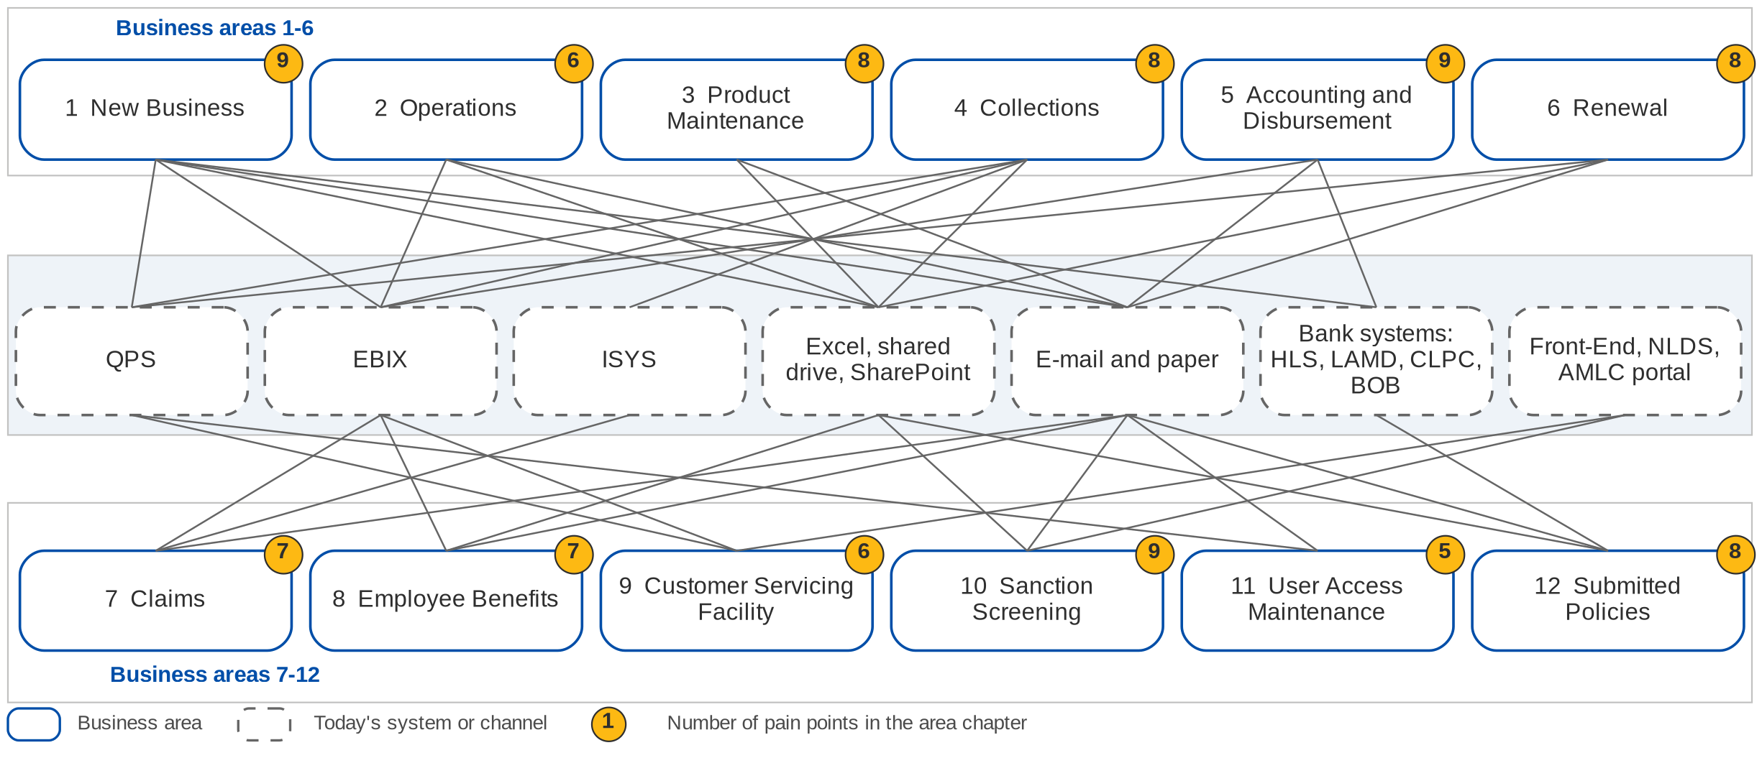
Today: twelve areas, seven systems and channels
Each line is a system or channel an area depends on today (current-process sections of the 12 BRDs)
Confidential – BDOI
BIBS Business Process Deck | v1.0
5
Notes:
Each business area works in its own mix of systems and files. New Business quotes in QPS and books in EBIX (BRD-1 p.133); Collections uses EBIX, QPS and the ISYS Marketing Diary (BRD-4 p.40-41); Claims reports come from ISYS (BRD-7, Report List); Sanction Screening runs on e-mail advisories, SharePoint and NLDS (BRD-10 p.6-7); Submitted Policies keeps Excel masterlists on a shared drive (BRD-12 p.4-5); the contact centre uses the BDO-Insure Front-End over QPS and EBIX (BRD-9 p.4). Almost every hand-off between areas runs by e-mail and spreadsheet, so the same client, policy and payment are keyed several times. The yellow number on each area is the count of pain points in its chapter.

Slide 6
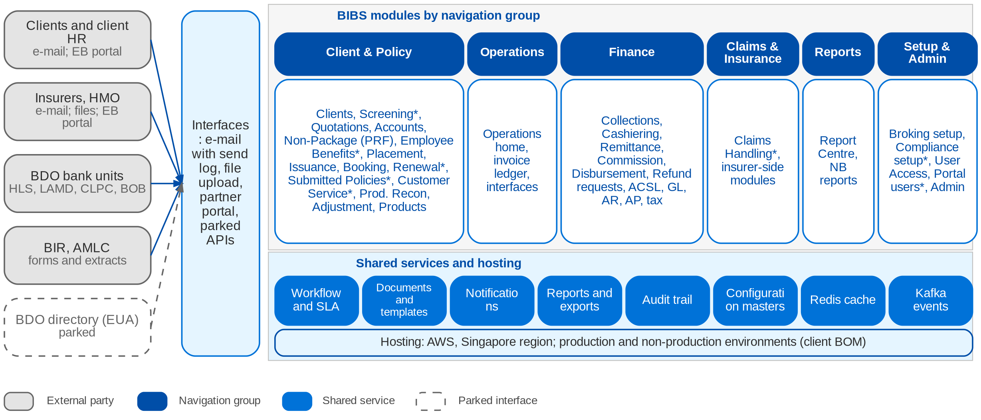
Envisioned: BIBS as one platform
Module map by navigation group (* designed, not yet built); shared services; external parties; hosting
Confidential – BDOI
BIBS Business Process Deck | v1.0
6
Notes:
BIBS puts the twelve areas in one application with six navigation groups, following the BDOI navigation of the BDO Insure UX design (frontend/src/navigation/modules.ts; BDO UX guidelines section 3). Every module uses the same shared services: workflow with SLA, documents and templates, notifications, the report centre, the insert-only audit trail and the configuration masters that the business maintains. External parties reach BIBS by e-mail with a send log, by file upload, or through the partner portal for Employee Benefits. The HLS, insurer API, CLPC transfer and BDO directory (EUA) interfaces are parked seams until BDO and the insurers give the specifications. Redis caching, Kafka events and the AWS Singapore hosting are the client technology bill of materials; their conformance is tracked in the bill of materials deliverable (item 4) and the technical architecture (item 12).

Slide 7
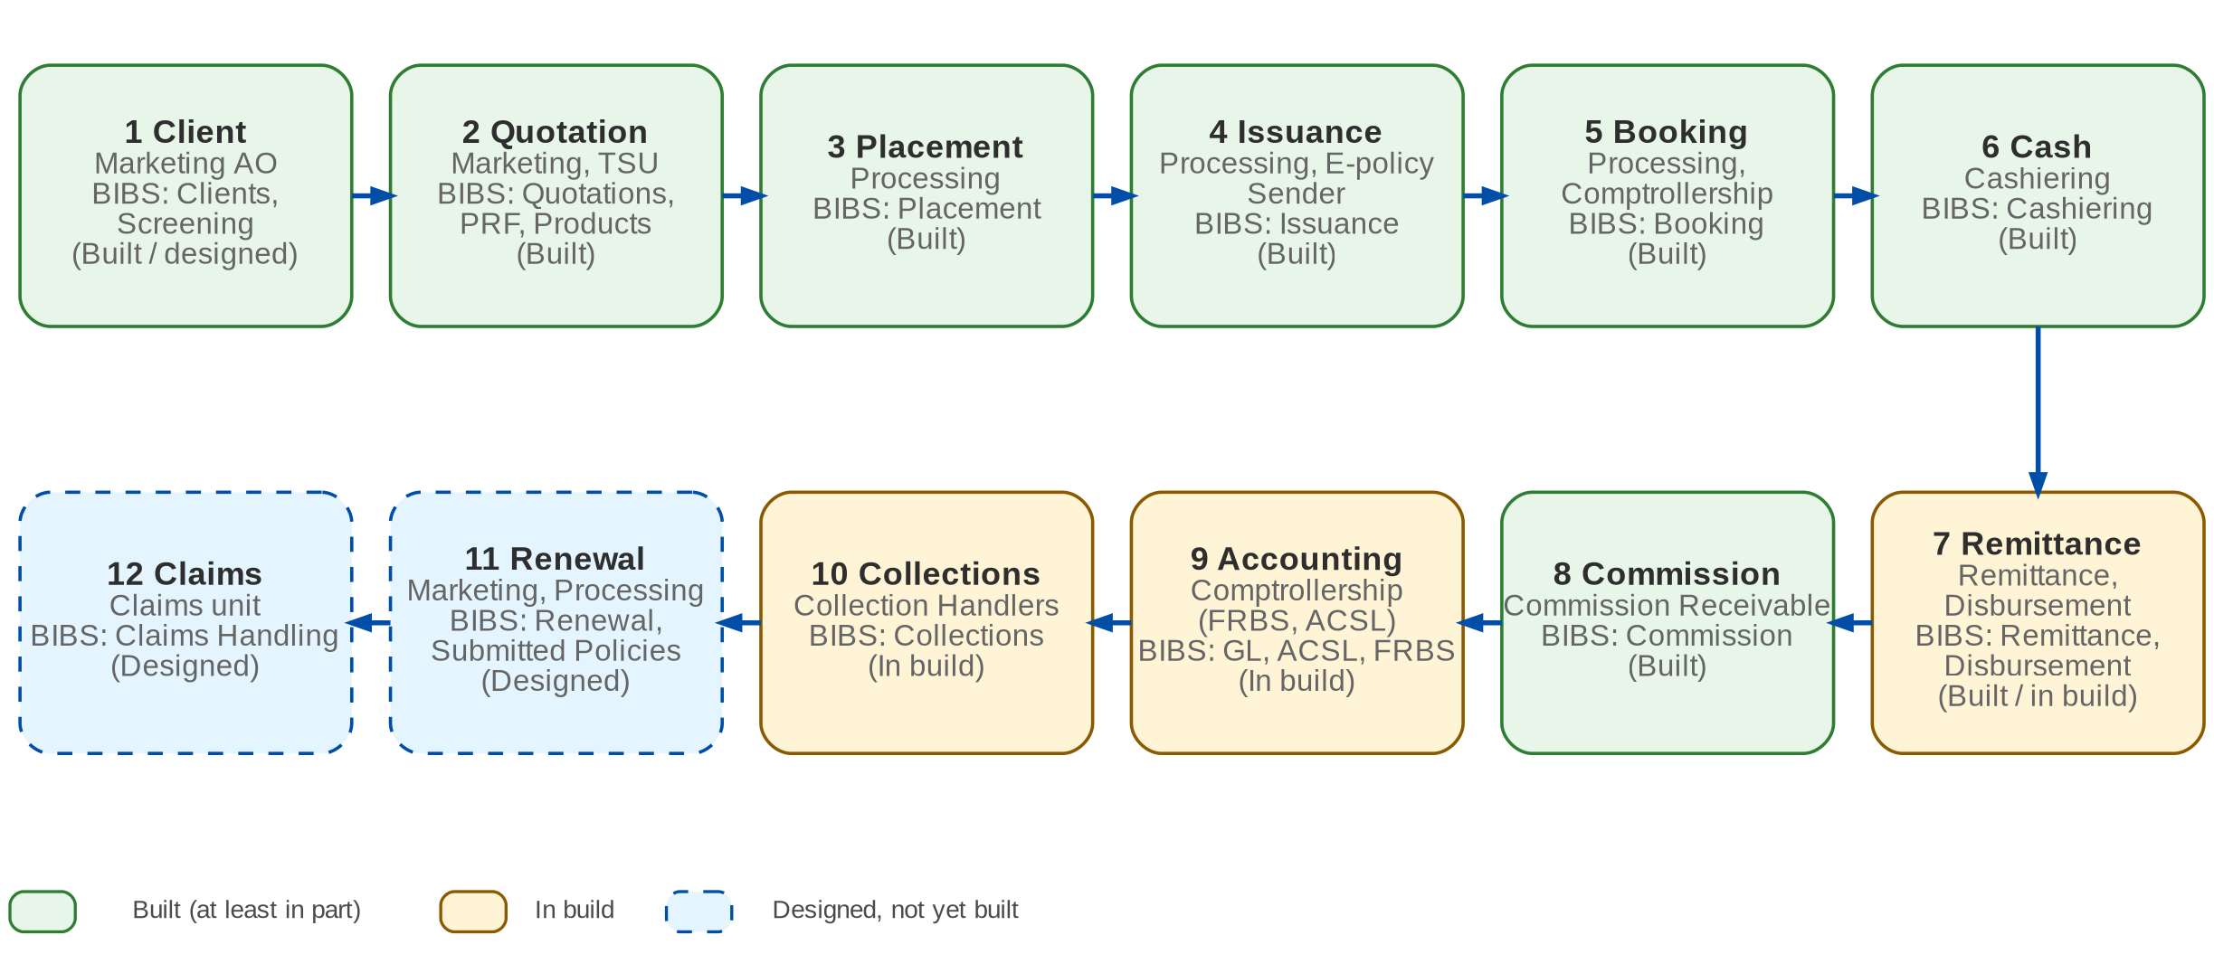
End-to-end value chain
From client to claims: the stage, the BDOI owner and the BIBS module (status in brackets)
Confidential – BDOI
BIBS Business Process Deck | v1.0
7
Notes:
The chain follows one policy and its money. Marketing owns the client and the quotation; Processing places, issues and books; Operations receives the cash, remits the premium net of commission to the insurer and collects the commission; Comptrollership accounts for it; Collections follows unpaid premium; Renewal restarts the cycle; Claims serves the client during the cover. In BIBS every stage reads the same client, account (ARN) and invoice ledger, so no stage re-keys the output of the previous one.

Slide 8
Best-practice target view
1 Manual: paper, e-mail
2 Tool-assisted: spreadsheets, separate systems
3 One workflow in one system
4 Automated, with exception queues
5 Integrated and measured
Automation
Controls
Data
Integration
Customer service
Compliance
Reporting
Today
BIBS envisioned
Best practice
Scale: project team assessment from the BRD current-process sections and the BIBS designs
Confidential – BDOI
BIBS Business Process Deck | v1.0
8
Notes:
The scale is the project team's reading of the current-process sections of the twelve BRDs, the BIBS designs and the practices named in each chapter. It is a discussion aid for the steering committee, not an audit rating. Integration stays at level 3 in BIBS until the parked interfaces (HLS, insurer APIs, CLPC transfer, BDO directory, mailbox reading, OCR) are specified by BDO and the insurers.
Automation: today 1, BIBS 4, best practice 5. Today most steps are manual (BRD-1 p.133, BRD-2 p.11, BRD-5 p.44). BIBS runs jobs, matching and straight-through steps with exception queues.
Controls: today 2, BIBS 4, best practice 5. Approvals run by e-mail and paper (BRD-5 p.45, BRD-10 p.6). BIBS enforces maker-checker, four-eyes and approval matrices.
Data: today 1, BIBS 4, best practice 5. Separate masterlists and re-keying (BRD-12 p.4, BRD-1 p.133). BIBS has one client, one ARN and one invoice ledger.
Integration: today 2, BIBS 3, best practice 5. Files and e-mail with banks and insurers. BIBS adds uploads and seams; APIs are parked.
Customer service: today 2, BIBS 4, best practice 5. The Front-End shows full details for CBG accounts only (BRD-9 p.4). BIBS shows every account, with resends.
Compliance: today 1, BIBS 4, best practice 5. Name matching by hand, no EDD for PEPs (BRD-10 p.6-7). BIBS screens on every trigger and routes cases.
Reporting: today 1, BIBS 4, best practice 5. Reports depend on IT (BRD-2 p.11, BRD-5 p.44). BIBS users run reports and exports themselves.

Slide 9
Open items per area (discrepancy register)
Area | BRD | High | Medium | Low | Open | Answered
New Business | BRD-1 | 11 | 14 | 3 | 26 | 2
Operations | BRD-2 | 10 | 15 | 4 | 27 | 2
Product Maintenance | BRD-3 | 6 | 7 | 4 | 17 | 0
Collections | BRD-4 | 12 | 12 | 3 | 24 | 3
Accounting and Disbursement | BRD-5 | 7 | 14 | 4 | 24 | 1
Renewal | BRD-6 | 11 | 19 | 9 | 38 | 1
Claims | BRD-7 | 9 | 15 | 1 | 23 | 2
Employee Benefits | BRD-8 | 7 | 12 | 4 | 21 | 2
Customer Servicing Facility | BRD-9 | 9 | 8 | 2 | 19 | 0
Sanction Screening | BRD-10 | 5 | 9 | 3 | 17 | 0
User Access Maintenance | BRD-11 | 8 | 10 | 3 | 18 | 3
Submitted Policies | BRD-12 | 9 | 12 | 4 | 24 | 1
162 items are raised against the 12 BRDs and the Report List; 8 are answered by a later signed BDOI document.
High items change what is built, the money, compliance or access; they are resolved before the FRS of the area is signed off.
Items that touch several BRDs, such as the service window, RPO and retention, count under each BRD.
The next slide lists the decisions that unblock the most areas.
Confidential – BDOI
BIBS Business Process Deck | v1.0
9
Notes:
162 items are raised against the 12 BRDs and the Report List; 8 are answered by a later signed BDOI document.
High items change what is built, the money, compliance or access; they are resolved before the FRS of the area is signed off.
Items that touch several BRDs, such as the service window, RPO and retention, count under each BRD.
The next slide lists the decisions that unblock the most areas.
Source: docs/deliverables/src/registers/discrepancy_register.yaml. An item that touches several BRDs is counted under each of them.

Slide 10
Cross-BRD gaps: decisions for BDOI
Level | Gap | Impact | Owner | Decision needed | Ref
High | Directory sign-in (EUA) for every user | Identity source for all BIBS users | UAM owner with BDO ITIO | Provide the EUA interface; are contact centre agents in the directory? | DCR-143
High | BIBS-wide user access matrix | Roles and persona tests of every module | Product Owner, all BRD owners | Approve one matrix for all modules | DCR-121
High | Renewal of submitted policies; one LAMD intake | Two renewal paths; two loan-status feeds | Renewal and Submitted Policies owners | Confirm the hand-off boundary and one LAMD report | DCR-129, 146
High | Incentive programmes in four BRDs | Incentive income computed twice or not at all | Comptrollership, MBS, Operations | List the programmes with rate, base, payer | DCR-037
High | Sanctions match: block or warn | Business with a possible sanctioned party | Chief Compliance Officer | Block or warn on quotation, placement, booking, renewal | DCR-112
High | One service window, RPO / RTO, maintenance slot | Backup, DR and batch design of the platform | BDO IT with the BRD owners | Agree one BIBS-wide NFR set | DCR-133, 135, 138
High | Retention per record type | Legal record keeping; archive design | Compliance, Comptrollership | One schedule; archive or purge at the end | DCR-136
High | Go-live data migration scope | Open items and history at cut-over | All BRD owners | What is migrated from EBIX, ISYS, QPS, Excel | DCR-157
Confidential – BDOI
BIBS Business Process Deck | v1.0
10
Notes:
The priority items of the discrepancy register and the open cross-BRD questions of BDOI_CROSS_BRD_DECISIONS.md. Each blocks more than one area. The proposals in the register are the project's default until BDOI decides.
DCR-143 (High): Directory sign-in (EUA) for every user. Impact: Identity source for all BIBS users. Owner: UAM owner with BDO ITIO. Decision: Provide the EUA interface; are contact centre agents in the directory?
DCR-121 (High): BIBS-wide user access matrix. Impact: Roles and persona tests of every module. Owner: Product Owner, all BRD owners. Decision: Approve one matrix for all modules
DCR-129, 146 (High): Renewal of submitted policies; one LAMD intake. Impact: Two renewal paths; two loan-status feeds. Owner: Renewal and Submitted Policies owners. Decision: Confirm the hand-off boundary and one LAMD report
DCR-037 (High): Incentive programmes in four BRDs. Impact: Incentive income computed twice or not at all. Owner: Comptrollership, MBS, Operations. Decision: List the programmes with rate, base, payer
DCR-112 (High): Sanctions match: block or warn. Impact: Business with a possible sanctioned party. Owner: Chief Compliance Officer. Decision: Block or warn on quotation, placement, booking, renewal
DCR-133, 135, 138 (High): One service window, RPO / RTO, maintenance slot. Impact: Backup, DR and batch design of the platform. Owner: BDO IT with the BRD owners. Decision: Agree one BIBS-wide NFR set
DCR-136 (High): Retention per record type. Impact: Legal record keeping; archive design. Owner: Compliance, Comptrollership. Decision: One schedule; archive or purge at the end
DCR-157 (High): Go-live data migration scope. Impact: Open items and history at cut-over. Owner: All BRD owners. Decision: What is migrated from EBIX, ISYS, QPS, Excel

Slide 11
Roadmap: built, in build, designed
Built
In build
Designed, next
• BRD-1 New Business
• BRD-2 Operations
• BRD-3 Product Maintenance
• BRD-11 baseline: users, roles, access requests, lock-out, session
• Finance platform for BRD-5: chart, journals, engine, periods, FX, bank reconciliation
• BRD-4 Collections (foundation and worklist)
• BRD-5 Disbursement, ACSL, FRBS reports
• BRD-5 Refund and cash-advance requests
• Shared work item BT0: business type New Business / Renewal
• BRD-11 changes and BRD-10 Sanction Screening
• BRD-7 Claims
• BRD-8 Employee Benefits and partner portal
• BRD-9 Customer Servicing Facility
• BRD-6 Renewal and BRD-12 Submitted Policies
What BDOI must decide to move forward
• EUA interface and the BIBS-wide access matrix (DCR-143, 121)
• Renewal boundary with Submitted Policies; one LAMD intake (DCR-129, 146)
• Incentive programmes and the Fire premium tax (DCR-037, 005)
• Sanctions: block or warn (DCR-112)
• One NFR set: service window, RPO / RTO, retention (DCR-133, 135, 136)
• Migration scope per legacy source (DCR-157)
• Partner portal users: provisioning, MFA, hosting (DCR-096)
• Sign-off of the FRS per BRD (sign-off tracker, item 32)
Confidential – BDOI
BIBS Business Process Deck | v1.0
11
Notes:
Status on 25 September 2026. The build order of the designed areas follows the cross-BRD decisions (section 6.2): User Access with Sanction Screening first, then Claims, Employee Benefits, Customer Servicing, Renewal and Submitted Policies, with the Renewal hand-off and the CSF integration last. The decisions below move the gaps of several areas at once.

Slide 12
1. New Business
BRD-1 | Client onboarding to booking (Fire, Motor, Other Lines, Non-Package)
Confidential – BDOI | BIBS Business Process Deck
Notes:
BRD-1 New Business: Client onboarding to booking (Fire, Motor, Other Lines, Non-Package).

Slide 13
1. New Business: at a glance
Department and roles
Volumes and NFRs (BRD)
BRD and build status
Marketing, TSU and Processing
• Marketing AO, TL / TH / UH (Retail, Commercial, Corporate, Institutional)
• TSU (non-package slips, insurer terms)
• Processing and Processing TL (placement, issuance, booking)
• Approver, E-policy Sender, Adjustment
• Comptrollership (service invoice)
485
named users; 145 concurrent (p.210)
Built
Built; FRS v1.0 issued for review
• BRD-1 p.132-134 (current and envisioned process)
• Other Lines addendum p.47-48; Workshop addendum Apr-2026 p.3-19
• BRNB.001-115
• FRS BRD-1 v1.0, sections 2 and 5
21,200
transactions a month (p.210); 1,300 endorsements (p.211)
10 s
response for every listed function (p.210-211)
5 + 15
years online + archive; backup every 4 h (p.82)
The process in one line
Request
Onboarding
Quotation / PRF
Account
Payment
Placement
Issuance
Booking
Confidential – BDOI
BIBS Business Process Deck | v1.0
13
Notes:
New Business is the spine of BIBS: every other area reads the client, the account (ARN) and the booked invoice that it creates. It is built, and FRS BRD-1 v1.0 describes the delivered screens. The volumes come from the usage tables of the BRD (p.210-212) and the retention values from the workshop addendum (p.82), which prevail over "follow QPS" (assumption A-NB-08).
Sources: BRD-1 p.132-134 (current and envisioned process); Other Lines addendum p.47-48; Workshop addendum Apr-2026 p.3-19; BRNB.001-115; FRS BRD-1 v1.0, sections 2 and 5

Slide 14
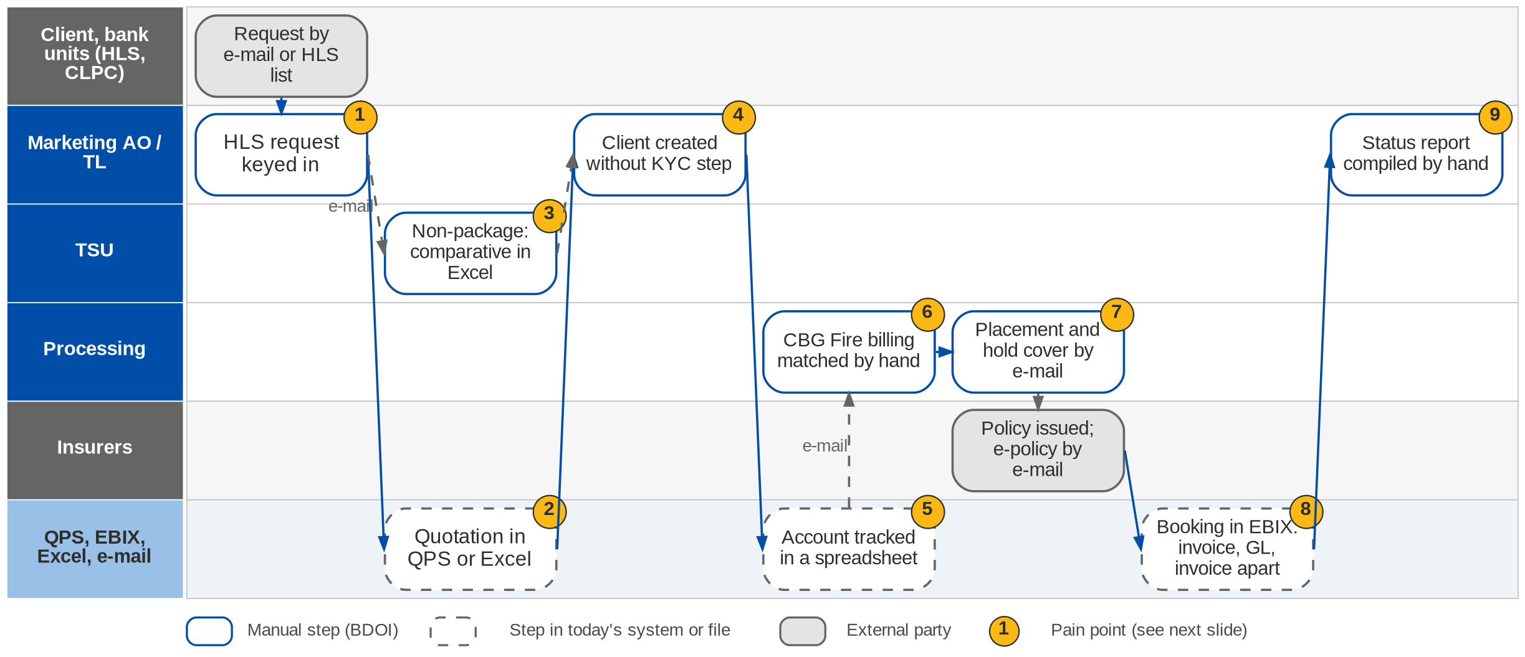
1. New Business: As-Is process
Request to booking today (BRD-1 p.133-134, p.47)
Confidential – BDOI
BIBS Business Process Deck | v1.0
14
Notes:
Today most New Business work is manual. Requests arrive by e-mail; HLS requests are keyed in. Quotations are prepared in QPS or Excel; non-package risks go to TSU by e-mail and the comparative is built in Excel. Clients are created without a standard onboarding step. Accounts are tracked in spreadsheets, so duplicates are found late. CBG Fire billing and payment matching are manual. Placement files, hold covers and e-policies go by e-mail without a log. Booking, GL entries and invoices are separate steps, and status reports are compiled by hand (BRD p.133-134; Other Lines addendum p.47). Bulk processing exists for CBG Home only.

Slide 15
1. New Business: pain points today
1
Requests arrive by e-mail and are keyed in
HLS requests are re-keyed; bulk processing exists for CBG Home only.
BRD-1 p.133; BRNB.023, 041
6
CBG Fire billing and payment matching by hand
The CLPC billing file and payment reports are handled manually.
BRD-1 p.133; BRNB.067, 068
2
Quotations prepared in QPS or Excel
Rating and versions live outside one workflow; approvals by e-mail.
BRD-1 p.133; FRS 2.1 row 2
7
Placement, hold cover, e-policy by e-mail
Files leave by e-mail with no send log and no protection rule.
BRD-1 p.133; BRNB.071, 072, 073
3
Non-package placement by e-mail
TSU receives risks by e-mail and builds the comparative table in Excel.
Other Lines addendum p.47
8
Booking in separate steps
Invoice, GL entry and service invoice are separate tasks.
BRD-1 p.133-134; BRNB.027, 100
4
No standard client onboarding
Clients are created without a KYC verification step.
Workshop addendum p.3-5; BRNB.090
9
Status monitoring by hand
Status and reconciliation reports are compiled manually.
BRD-1 p.133
5
Accounts in spreadsheets
No single account number; duplicates are found late.
BRD-1 p.133; BRNB.032, 051
Confidential – BDOI
BIBS Business Process Deck | v1.0
15
Notes:
The numbered markers on the As-Is swimlane refer to these points. The page numbers are PDF pages of the BRD-1 pack.
1. Requests arrive by e-mail and are keyed in: HLS requests are re-keyed; bulk processing exists for CBG Home only. (BRD-1 p.133; BRNB.023, 041)
2. Quotations prepared in QPS or Excel: Rating and versions live outside one workflow; approvals by e-mail. (BRD-1 p.133; FRS 2.1 row 2)
3. Non-package placement by e-mail: TSU receives risks by e-mail and builds the comparative table in Excel. (Other Lines addendum p.47)
4. No standard client onboarding: Clients are created without a KYC verification step. (Workshop addendum p.3-5; BRNB.090)
5. Accounts in spreadsheets: No single account number; duplicates are found late. (BRD-1 p.133; BRNB.032, 051)
6. CBG Fire billing and payment matching by hand: The CLPC billing file and payment reports are handled manually. (BRD-1 p.133; BRNB.067, 068)
7. Placement, hold cover, e-policy by e-mail: Files leave by e-mail with no send log and no protection rule. (BRD-1 p.133; BRNB.071, 072, 073)
8. Booking in separate steps: Invoice, GL entry and service invoice are separate tasks. (BRD-1 p.133-134; BRNB.027, 100)
9. Status monitoring by hand: Status and reconciliation reports are compiled manually. (BRD-1 p.133)

Slide 16
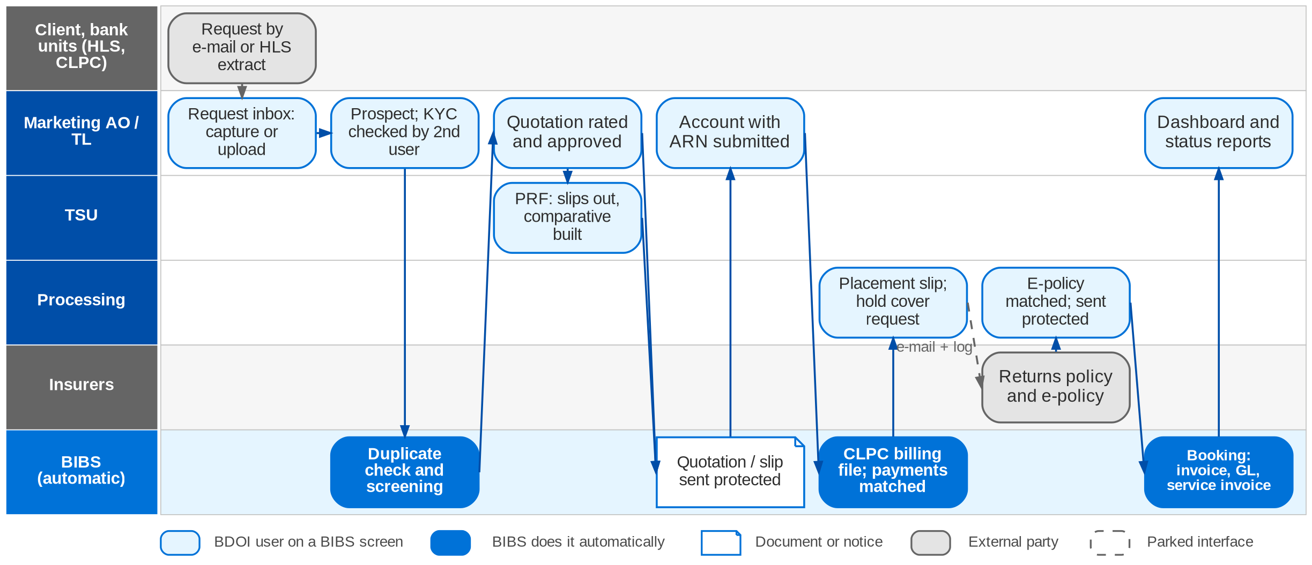
1. New Business: envisioned in BIBS
Request to booking in BIBS: workflows NB_CLIENT, NB_QUOTATION, NB_PROPOSAL, NB_ACCOUNT (FRS BRD-1 section 5)
Confidential – BDOI
BIBS Business Process Deck | v1.0
16
Notes:
In BIBS, requests are captured in a request inbox or loaded from a source-system file. Every client starts as a prospect and is confirmed after a second user verifies the KYC documents. Package quotations are rated with the Appendix A formulas, approved and sent protected; non-package risks go through the PRF, with quotation slips to insurers and a comparative compiled by BIBS. One account per accepted risk group carries the ARN. BIBS produces the CLPC billing file and matches payment reports. Processing sends placement slips and hold cover requests with a send log, matches the e-policy and sends it protected. Booking posts the invoice, the GL entry and the service invoice in one transaction; batch booking runs at 20:00. Dashboards read the workflow history. The HLS interface, the mailbox reader and insurer SFTP / API are parked seams (Q11, Q12, Q06).

Slide 17
1. New Business: before and after
Today (pain point)
In BIBS
Measure
1
Requests arrive by e-mail and are keyed in
Request inbox; HLS extract and bulk files uploaded with a template and row checks
Up to 5,000 rows a file
2
Quotations prepared in QPS or Excel
Quotation rated with the Appendix A formulas, versioned, approved before it is sent
Approval before send
3
Non-package placement by e-mail
PRF workflow: TSU slips per insurer, insurer terms keyed once, comparative compiled by BIBS
Comparative not re-keyed
4
No standard client onboarding
Prospect, KYC documents, verification by a second user, then confirmed client
Four-eyes KYC
5
Accounts in spreadsheets
One ARN per account; workflow stage; duplicate check at creation
Duplicates stopped at entry
6
CBG Fire billing and payment matching by hand
CLPC billing file produced and payment report matched in BIBS
Matching automated
7
Placement, hold cover, e-policy by e-mail
Slips, hold cover requests and e-policies generated, password protected and logged
Send log per document
8
Booking in separate steps
Booking posts invoice, GL entry and service invoice in one transaction; batch at 20:00
One step instead of three
9
Status monitoring by hand
Dashboards and status reports read the workflow history
10 s response (p.211)
Confidential – BDOI
BIBS Business Process Deck | v1.0
17
Notes:
Each row pairs a pain point with the BIBS behaviour that removes it. The BRD states objectives (batch processing across all segments, one workflow, reports) but no turnaround targets, so the measures are the NFR values and the controls added.
1. Requests arrive by e-mail and are keyed in -> Request inbox; HLS extract and bulk files uploaded with a template and row checks Measure: Up to 5,000 rows a file.
2. Quotations prepared in QPS or Excel -> Quotation rated with the Appendix A formulas, versioned, approved before it is sent Measure: Approval before send.
3. Non-package placement by e-mail -> PRF workflow: TSU slips per insurer, insurer terms keyed once, comparative compiled by BIBS Measure: Comparative not re-keyed.
4. No standard client onboarding -> Prospect, KYC documents, verification by a second user, then confirmed client Measure: Four-eyes KYC.
5. Accounts in spreadsheets -> One ARN per account; workflow stage; duplicate check at creation Measure: Duplicates stopped at entry.
6. CBG Fire billing and payment matching by hand -> CLPC billing file produced and payment report matched in BIBS Measure: Matching automated.
7. Placement, hold cover, e-policy by e-mail -> Slips, hold cover requests and e-policies generated, password protected and logged Measure: Send log per document.
8. Booking in separate steps -> Booking posts invoice, GL entry and service invoice in one transaction; batch at 20:00 Measure: One step instead of three.
9. Status monitoring by hand -> Dashboards and status reports read the workflow history Measure: 10 s response (p.211).

Slide 18
1. New Business: gaps in the envisioned process
Level | Gap | Impact | Owner | Decision needed | Ref
High | Quotation before the client exists | Walk-in and bank-referred prospects may not be quotable | Marketing / Product Owner | May BIBS create a prospect code at quotation (BRNB.029 vs 063)? | DCR-001
High | Fire premium tax rate and base | Gross premium on every Fire quotation and invoice | Comptrollership | Which taxes, rates and bases apply to Fire? | DCR-005
High | Motor OD / Theft base 81% or 90% of TSI | Motor premium differs by 9 points of TSI | Marketing / TSU | When each base applies | DCR-006
High | CLPC payments and endorsements specified twice | Two payment intakes and two endorsement paths | NB and Operations | Confirm Cashiering as the single payment intake and Adjustment for endorsements | DCR-027
High | Sanctions match blocks or warns | Business placed with a possible sanctioned party | Compliance | Block or warn on quotation to booking | DCR-112
Parked | HLS, mailbox, insurer SFTP / API, OCR | Uploads and manual capture remain | BDO IT and insurers | Interface specifications | Q11, Q12, Q06, Q24
Confidential – BDOI
BIBS Business Process Deck | v1.0
18
Notes:
High items first. The parked interfaces are built as seams: a port, a staging table or a manual upload, so adding the transport later needs no workflow change (FRS section 7).
DCR-001 (High): Quotation before the client exists. Impact: Walk-in and bank-referred prospects may not be quotable. Owner: Marketing / Product Owner. Decision: May BIBS create a prospect code at quotation (BRNB.029 vs 063)?
DCR-005 (High): Fire premium tax rate and base. Impact: Gross premium on every Fire quotation and invoice. Owner: Comptrollership. Decision: Which taxes, rates and bases apply to Fire?
DCR-006 (High): Motor OD / Theft base 81% or 90% of TSI. Impact: Motor premium differs by 9 points of TSI. Owner: Marketing / TSU. Decision: When each base applies
DCR-027 (High): CLPC payments and endorsements specified twice. Impact: Two payment intakes and two endorsement paths. Owner: NB and Operations. Decision: Confirm Cashiering as the single payment intake and Adjustment for endorsements
DCR-112 (High): Sanctions match blocks or warns. Impact: Business placed with a possible sanctioned party. Owner: Compliance. Decision: Block or warn on quotation to booking
Q11, Q12, Q06, Q24 (Parked): HLS, mailbox, insurer SFTP / API, OCR. Impact: Uploads and manual capture remain. Owner: BDO IT and insurers. Decision: Interface specifications

Slide 19
1. New Business: best practice
Straight-through processing with exception queues
KYC at onboarding and a single client view
Maker-checker on client documents
Partly in BIBS
Supported by BIBS
Supported by BIBS
BIBS: Bulk uploads with row checks, batch booking, work queues per stage.
BDOI: Give the product matrix and minimum fields per line (Q01, Q02) so clean cases pass untouched.
BIBS: Prospect to confirmed client with four-eyes KYC; one client record for every module.
BDOI: Confirm the BDO KYC standard fields, CIF and duplicate keys (Q16, Q17).
BIBS: Approval before a quotation, PRF or slip is sent; maker cannot approve.
BDOI: Set the approval chain and limits (Q05).
Protected digital documents
Screening before binding
Production KPIs against target
Partly in BIBS
Partly in BIBS
BDOI to adopt
BIBS: Password-protected PDF and Excel, password sent separately, send log.
BDOI: Agree the password convention (DCR-153).
BIBS: Screening on client creation and account submission (BRD-10 design).
BDOI: Decide block or warn while a match is open (DCR-112).
BIBS: Dashboard by region, department, team and officer.
BDOI: Provide the sales hierarchy and targets (Q41).
Confidential – BDOI
BIBS Business Process Deck | v1.0
19
Notes:
Practices that fit a Philippine insurance broker, and what BIBS supports today or by design.
Straight-through processing with exception queues [Partly in BIBS]. BIBS: Bulk uploads with row checks, batch booking, work queues per stage. BDOI: Give the product matrix and minimum fields per line (Q01, Q02) so clean cases pass untouched.
KYC at onboarding and a single client view [Supported by BIBS]. BIBS: Prospect to confirmed client with four-eyes KYC; one client record for every module. BDOI: Confirm the BDO KYC standard fields, CIF and duplicate keys (Q16, Q17).
Maker-checker on client documents [Supported by BIBS]. BIBS: Approval before a quotation, PRF or slip is sent; maker cannot approve. BDOI: Set the approval chain and limits (Q05).
Protected digital documents [Partly in BIBS]. BIBS: Password-protected PDF and Excel, password sent separately, send log. BDOI: Agree the password convention (DCR-153).
Screening before binding [Partly in BIBS]. BIBS: Screening on client creation and account submission (BRD-10 design). BDOI: Decide block or warn while a match is open (DCR-112).
Production KPIs against target [BDOI to adopt]. BIBS: Dashboard by region, department, team and officer. BDOI: Provide the sales hierarchy and targets (Q41).

Slide 20
2. Operations
BRD-2 | Cashiering, Remittance, Production Reconciliation, Adjustment, Commission / Direct Payment
Confidential – BDOI | BIBS Business Process Deck
Notes:
BRD-2 Operations: Cashiering, Remittance, Production Reconciliation, Adjustment, Commission / Direct Payment.

Slide 21
2. Operations: at a glance
Department and roles
Volumes and NFRs (BRD)
BRD and build status
Operations, Financial Transactions and Processing
• Cashier, HO (11) and branches (5); Cashiering TL / TH
• Remittance Processor (4) and TL / TH
• Production Reconciliation Handler (4)
• Adjustment Processor (6) and TL
• Commission Handler and TL / TH
• Marketing Collection; Comptrollership; Disbursement
16
cashiers: 11 head office, 5 branches (annex p.115-120)
Built
Built; FRS v1.0 issued for review
• BRD-2 p.10-13 (current and envisioned process)
• CSHID, RMTID, PRCID, ADJID, CMRID, MKTID, DBMID
• FRS BRD-2 v1.0, sections 1.6 and 2
< 5 s
response for every function; batch print of 50 documents < 10 s
99.9%
availability; use 07:00-18:30
1.00
matching tolerance for insurer feedback (FRS BRD-2)
The process in one line
Booked invoice
Payment
Apply
Unapplied
Remittance
Disbursement
Insurer OR
Reconciliation
Confidential – BDOI
BIBS Business Process Deck | v1.0
21
Notes:
Operations takes over every invoice booked in New Business and follows its money until the insurer is paid, the insurer's official receipt is recorded and every difference is closed. BDOI collects premium on behalf of insurers and remits it net of its commission (BRD-2 p.11). The modules are built; FRS BRD-2 describes the delivered screens. The BRD gives users and response times but no transaction volumes (OQ44). The annex names 11 head-office and 5 branch cashiers, 4 remittance processors, 4 reconciliation handlers and 6 adjustment processors, plus team leads.
Sources: BRD-2 p.10-13 (current and envisioned process); CSHID, RMTID, PRCID, ADJID, CMRID, MKTID, DBMID; FRS BRD-2 v1.0, sections 1.6 and 2

Slide 22
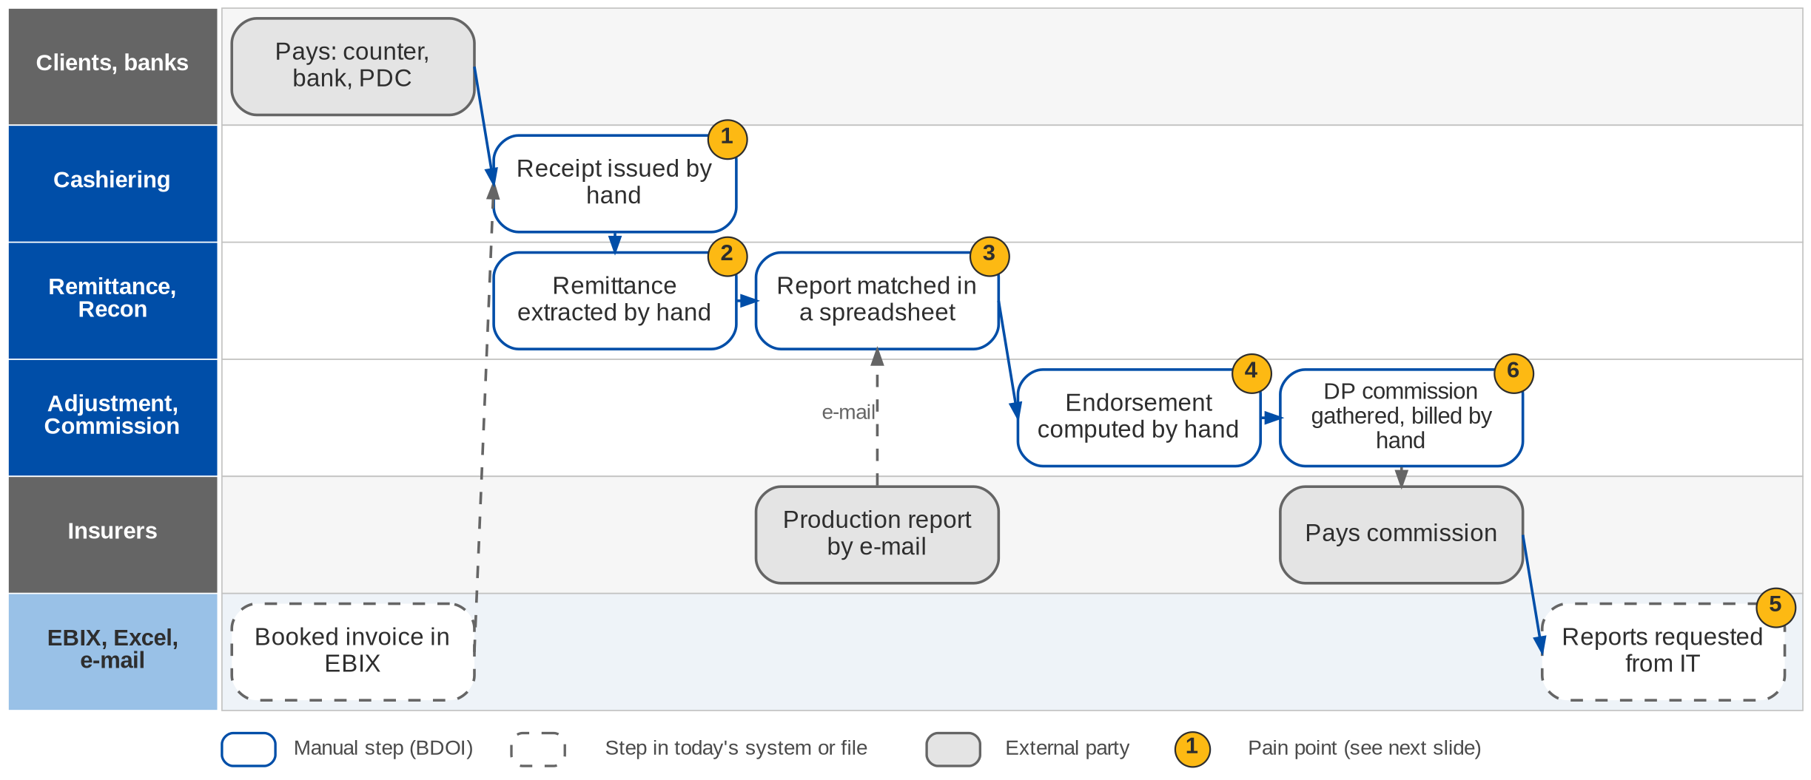
2. Operations: As-Is process
Payment to insurer today (BRD-2 p.11)
Confidential – BDOI
BIBS Business Process Deck | v1.0
22
Notes:
Today receipts are issued by hand and payment details are not visible; payment application is fragmented. Remittances are extracted manually with no tracking of batches and no check of what is not for remittance. Booked accounts are matched with insurer reports by hand. Endorsements go through redundant steps with manual computation. Reports depend on IT, and direct-payment commission receivables are gathered, cleaned and billed by hand (BRD-2 p.11, current process items 1-6).

Slide 23
2. Operations: pain points today
1
Manual receipts
Payment details are not visible and payment application is fragmented.
BRD-2 p.11, item 1; CSHID.001-027
4
Endorsements computed by hand
Redundant steps, manual computation and limited traceability.
BRD-2 p.11, item 4; ADJID.001-028
2
Remittance extracted by hand
No batch tracking and no check of what is not for remittance.
BRD-2 p.11, item 2; RMTID.001-023
5
Reports depend on IT
Timely, correct and complete reports need the IT Group.
BRD-2 p.11, item 5
3
Insurer reports matched by hand
Booked accounts are matched manually; unmatched items are checked one by one.
BRD-2 p.11, item 3; PRCID.001-039
6
Commission receivables billed by hand
Direct-payment data are gathered, sanitised and billed to insurers manually.
BRD-2 p.11, item 6; CMRID.001-015
Confidential – BDOI
BIBS Business Process Deck | v1.0
23
Notes:
The six points are the six "current process" items of the BRD (p.11), in the same order.
1. Manual receipts: Payment details are not visible and payment application is fragmented. (BRD-2 p.11, item 1; CSHID.001-027)
2. Remittance extracted by hand: No batch tracking and no check of what is not for remittance. (BRD-2 p.11, item 2; RMTID.001-023)
3. Insurer reports matched by hand: Booked accounts are matched manually; unmatched items are checked one by one. (BRD-2 p.11, item 3; PRCID.001-039)
4. Endorsements computed by hand: Redundant steps, manual computation and limited traceability. (BRD-2 p.11, item 4; ADJID.001-028)
5. Reports depend on IT: Timely, correct and complete reports need the IT Group. (BRD-2 p.11, item 5)
6. Commission receivables billed by hand: Direct-payment data are gathered, sanitised and billed to insurers manually. (BRD-2 p.11, item 6; CMRID.001-015)

Slide 24
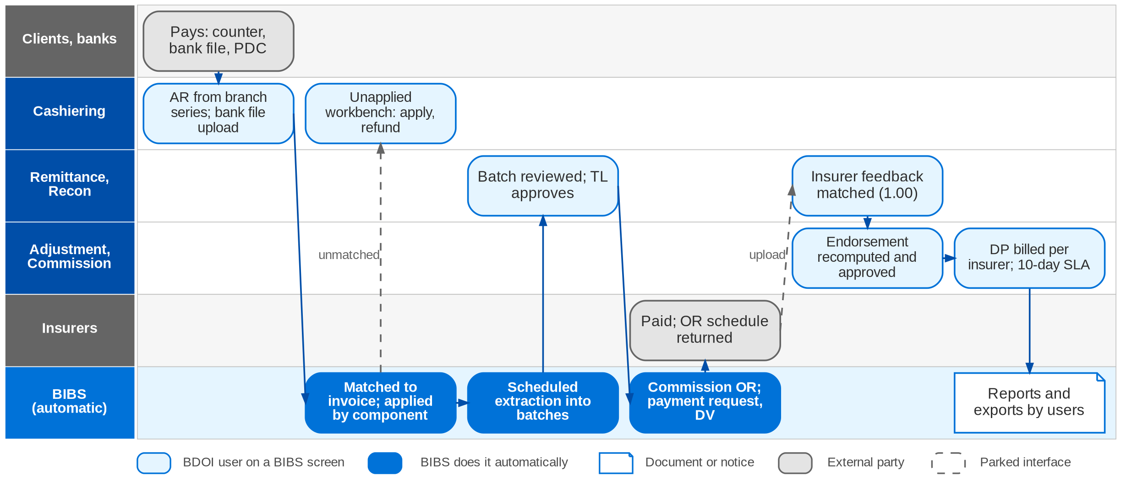
2. Operations: envisioned in BIBS
Life of a booked invoice in BIBS: Cashiering, Remittance, Reconciliation, Adjustment, Commission (FRS BRD-2 section 2.2)
Confidential – BDOI
BIBS Business Process Deck | v1.0
24
Notes:
In BIBS the booked invoice is copied into the invoice ledger with its components. The cashier issues an AR from the branch series; BIBS matches the payment to the invoice and applies it by component, and money it cannot apply goes to the unapplied workbench. A scheduled job extracts paid, cleared and eligible premium into batches per insurer and type; the TL approves the batch (four eyes), which posts the remittance, issues the commission OR and raises the payment request to Disbursement. The insurer's OR schedule is uploaded. The production register goes to the insurer and its feedback is matched within a 1.00 tolerance. Endorsements are requests recomputed per insurer and approved; direct-payment accounts are billed per insurer against a 10-working-day SLA.

Slide 25
2. Operations: before and after
Today (pain point)
In BIBS
Measure
1
Manual receipts
AR and OR from controlled series; payment matched at acceptance and applied by component
Unapplied money kept in a workbench
2
Remittance extracted by hand
Scheduled and manual extraction with eligibility checks; batches with approval, DV and insurer OR
Batch reference per remittance
3
Insurer reports matched by hand
Register sent to the insurer; feedback uploaded and matched; differences followed to closure
Tolerance 1.00
4
Endorsements computed by hand
Endorsement requests recomputed per insurer, approved, posted in batches, linked to the original
Four-eyes approval
5
Reports depend on IT
Users run the reports themselves, with view and export rights
Response < 5 s (annex)
6
Commission receivables billed by hand
DP lists validated and billed per insurer; answers tracked; commission collected with an OR
10 working days SLA
Confidential – BDOI
BIBS Business Process Deck | v1.0
25
Notes:
The BRD states the target (unified operations, scheduled extraction, auto-matching, validated entries, tracking) without turnaround targets; the measures are the controls BIBS adds.
1. Manual receipts -> AR and OR from controlled series; payment matched at acceptance and applied by component Measure: Unapplied money kept in a workbench.
2. Remittance extracted by hand -> Scheduled and manual extraction with eligibility checks; batches with approval, DV and insurer OR Measure: Batch reference per remittance.
3. Insurer reports matched by hand -> Register sent to the insurer; feedback uploaded and matched; differences followed to closure Measure: Tolerance 1.00.
4. Endorsements computed by hand -> Endorsement requests recomputed per insurer, approved, posted in batches, linked to the original Measure: Four-eyes approval.
5. Reports depend on IT -> Users run the reports themselves, with view and export rights Measure: Response < 5 s (annex).
6. Commission receivables billed by hand -> DP lists validated and billed per insurer; answers tracked; commission collected with an OR Measure: 10 working days SLA.

Slide 26
2. Operations: gaps in the envisioned process
Level | Gap | Impact | Owner | Decision needed | Ref
High | Early-remittance incentive in two places | Incentive income computed twice or on the wrong lines | Operations | One programme? Lines, rates and start of the window | DCR-013
High | Three minimal-balance rules | Small balances post to different GL accounts | Operations, Comptrollership | One rule at 10.00; GL accounts; who approves write-off | DCR-014
High | Paid AR above the DTIP balance | Remittance capped or withheld | Operations | Remit the DTIP balance or exclude the account | DCR-015
High | CWT 2307 cash payments without entries | GL entries for CWT unclear | Comptrollership | Give the entries and when Dr DTIP / Cr PR2307 posts | DCR-028
High | CLPC payments and endorsements also in BRD-1 | Two payment intakes and two endorsement paths | Operations and NB | Confirm Cashiering and Adjustment as owners | DCR-027
Parked | Insurer report pick-up; Collection and Disbursement links | Uploads and in-app queue until BRD-4 / BRD-5 are built | Insurers, BDO IT | Mailbox or SFTP channel per insurer | OQ29, OQ01, OQ02
Confidential – BDOI
BIBS Business Process Deck | v1.0
26
Notes:
Most Operations gaps are rules that the BRD states twice or leaves open. BIBS builds a documented default behind a parameter, so the answer is a configuration change (FRS BRD-2 section 1.6).
DCR-013 (High): Early-remittance incentive in two places. Impact: Incentive income computed twice or on the wrong lines. Owner: Operations. Decision: One programme? Lines, rates and start of the window
DCR-014 (High): Three minimal-balance rules. Impact: Small balances post to different GL accounts. Owner: Operations, Comptrollership. Decision: One rule at 10.00; GL accounts; who approves write-off
DCR-015 (High): Paid AR above the DTIP balance. Impact: Remittance capped or withheld. Owner: Operations. Decision: Remit the DTIP balance or exclude the account
DCR-028 (High): CWT 2307 cash payments without entries. Impact: GL entries for CWT unclear. Owner: Comptrollership. Decision: Give the entries and when Dr DTIP / Cr PR2307 posts
DCR-027 (High): CLPC payments and endorsements also in BRD-1. Impact: Two payment intakes and two endorsement paths. Owner: Operations and NB. Decision: Confirm Cashiering and Adjustment as owners
OQ29, OQ01, OQ02 (Parked): Insurer report pick-up; Collection and Disbursement links. Impact: Uploads and in-app queue until BRD-4 / BRD-5 are built. Owner: Insurers, BDO IT. Decision: Mailbox or SFTP channel per insurer

Slide 27
2. Operations: best practice
Automated bank and insurer reconciliation
Premium remittance discipline
Maker-checker and segregation of duties
Supported by BIBS
Supported by BIBS
Supported by BIBS
BIBS: Bank files uploaded and matched; insurer feedback matched within 1.00; duplicate files refused.
BDOI: Give the bank file layouts and an OR tolerance (OQ03, OQ22).
BIBS: Only paid, cleared (3 banking days) and eligible premium is batched; holds need a reason.
BDOI: Agree a remittance calendar per insurer and the DTIP rule (DCR-015).
BIBS: Batch approval, receipt cancellation and endorsements need a TL / TH who is not the maker.
BDOI: Set approver limits per team.
Unapplied cash under ageing control
Commission receivable follow-up
Controlled receipt series
Partly in BIBS
Partly in BIBS
Supported by BIBS
BIBS: Unapplied workbench with disposition, approval and reversal.
BDOI: One small-balance rule and write-off authority (DCR-014).
BIBS: DP billing per insurer with a 10-working-day SLA; incentive scheme engine built.
BDOI: Give incentive targets and amounts so the schemes can go live (OQ39).
BIBS: AR and OR numbered from controlled series per branch; cancellations approved.
BDOI: Confirm OR per batch or per payment for BIR purposes (OQ49).
Confidential – BDOI
BIBS Business Process Deck | v1.0
27
Notes:
Practices that fit a Philippine insurance broker, and what BIBS supports today or by design.
Automated bank and insurer reconciliation [Supported by BIBS]. BIBS: Bank files uploaded and matched; insurer feedback matched within 1.00; duplicate files refused. BDOI: Give the bank file layouts and an OR tolerance (OQ03, OQ22).
Premium remittance discipline [Supported by BIBS]. BIBS: Only paid, cleared (3 banking days) and eligible premium is batched; holds need a reason. BDOI: Agree a remittance calendar per insurer and the DTIP rule (DCR-015).
Maker-checker and segregation of duties [Supported by BIBS]. BIBS: Batch approval, receipt cancellation and endorsements need a TL / TH who is not the maker. BDOI: Set approver limits per team.
Unapplied cash under ageing control [Partly in BIBS]. BIBS: Unapplied workbench with disposition, approval and reversal. BDOI: One small-balance rule and write-off authority (DCR-014).
Commission receivable follow-up [Partly in BIBS]. BIBS: DP billing per insurer with a 10-working-day SLA; incentive scheme engine built. BDOI: Give incentive targets and amounts so the schemes can go live (OQ39).
Controlled receipt series [Supported by BIBS]. BIBS: AR and OR numbered from controlled series per branch; cancellations approved. BDOI: Confirm OR per batch or per payment for BIR purposes (OQ49).

Slide 28
3. Product Maintenance
BRD-3 | Package products, from the Package Request Form to release and expiry
Confidential – BDOI | BIBS Business Process Deck
Notes:
BRD-3 Product Maintenance: Package products, from the Package Request Form to release and expiry.

Slide 29
3. Product Maintenance: at a glance
Department and roles
Volumes and NFRs (BRD)
BRD and build status
Marketing Business Services (MBS) and TSU
• Marketing AO and Marketing TL / TH / UH
• TSU Officer, TSU Team Lead, TSU Head
• MBS (package set-up)
• ManCom (sign-off)
• Business Administrator (release)
13
TSU users, all concurrent; MBS 5 (p.33)
Built
Built; FRS v1.0 issued for review (reference FRS)
• BRD-3 p.12-13 (current and envisioned process)
• BRPM.001-022; workshop addendum PMADD01-06
• FRS BRD-3 v1.0, sections 2 and 5
485
Marketing users, 145 concurrent (p.33)
< 5 s
response for every role (p.33)
99.9%
availability; use 07:00-18:30 (p.33)
The process in one line
Request
Approval
TSU review
Negotiation
Comparative
ManCom
Set-up
Release
Confidential – BDOI
BIBS Business Process Deck | v1.0
29
Notes:
A package is a pre-arranged programme whose terms, rates and conditions BDOI negotiates with one or more insurers and then offers through Marketing. Product Maintenance feeds the products and package versions that quotations, accounts and booking read. It is built; FRS BRD-3 is the reference FRS for the pack. The BRD states no volumes (the project assumes tens of package requests a month).
Sources: BRD-3 p.12-13 (current and envisioned process); BRPM.001-022; workshop addendum PMADD01-06; FRS BRD-3 v1.0, sections 2 and 5

Slide 30
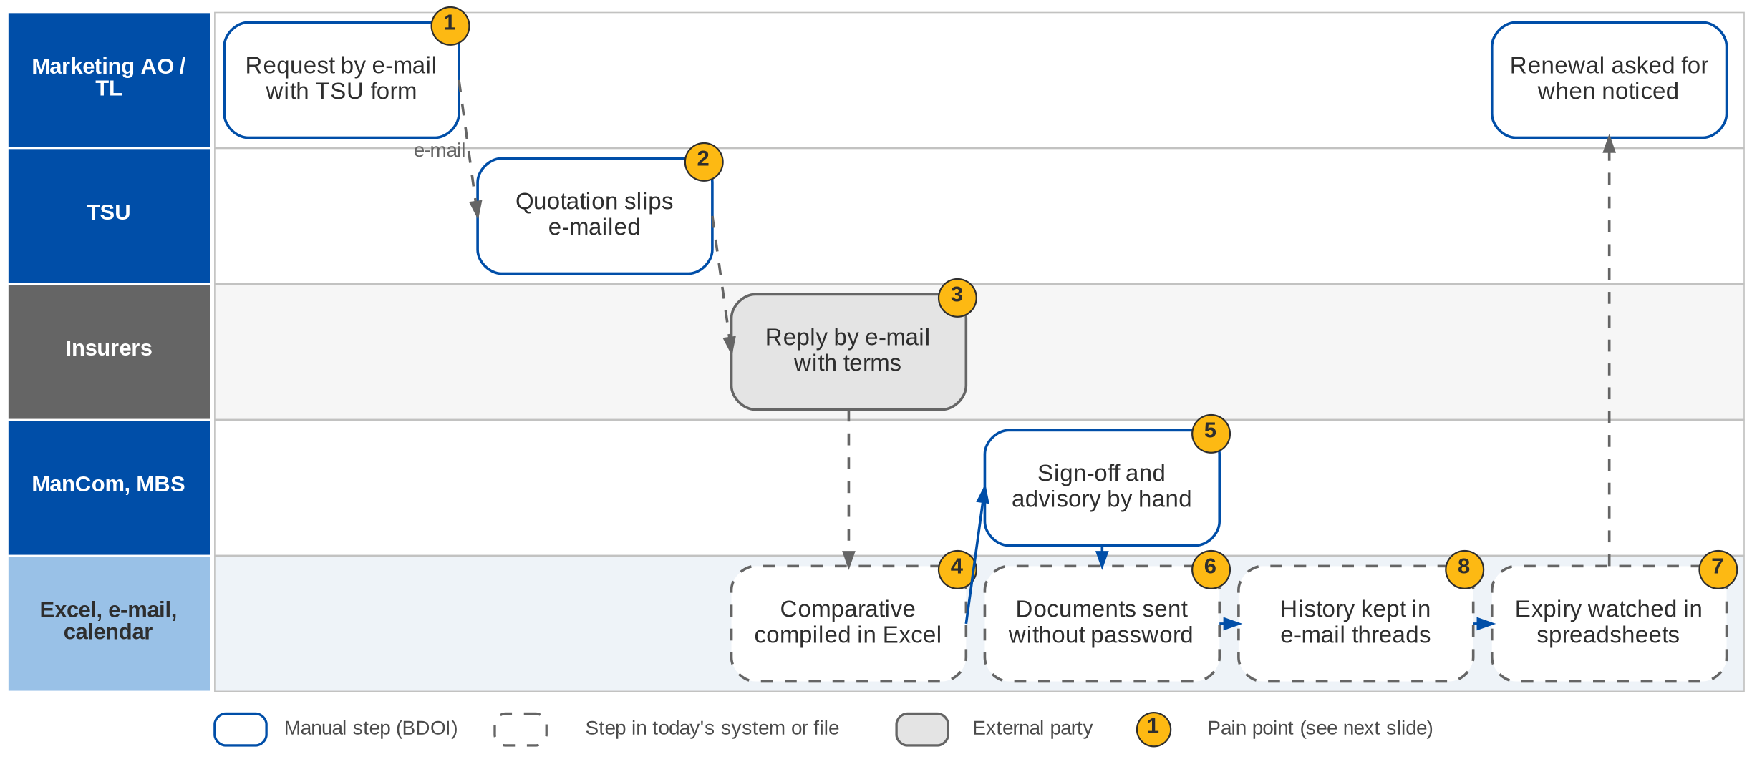
3. Product Maintenance: As-Is process
Package set-up today (BRD-3 p.12-13)
Confidential – BDOI
BIBS Business Process Deck | v1.0
30
Notes:
Marketing asks TSU for a package placement by e-mail with a TSU request form. TSU prepares quotation slips and e-mails them to insurers, who reply by e-mail with signed slips or approved terms. The comparative table is compiled in Excel and shared by e-mail. Sign-off and advisories are manual, documents go out without password protection, package expiry is watched in spreadsheets or calendars, and changes and approvals are tracked in e-mail threads.

Slide 31
3. Product Maintenance: pain points today
1
Requests by e-mail
Marketing requests placements by e-mail using a TSU request form.
BRD-3 p.12; BRPM.008
5
Manual sign-off and advisory
ManCom sign-off and the advisory are prepared outside a system.
BRD-3 p.12-13; BRPM.015, 016
2
Quotation slips by e-mail
TSU prepares and e-mails the slips; no log of what was sent.
BRD-3 p.12; BRPM.010
6
Documents without a password
Shared documents have no password protection.
BRD-3 p.13
3
Insurer replies in mailboxes
Signed slips and approved terms arrive by e-mail.
BRD-3 p.12; BRPM.012
7
Expiry in spreadsheets
Package expiry is monitored in spreadsheets or calendars.
BRD-3 p.13; BRPM.017
4
Comparative in Excel
Compiled by hand and shared by e-mail.
BRD-3 p.12; BRPM.014; PMADD03
8
History in e-mail threads
Changes, approvals and documents are tracked in e-mail and files.
BRD-3 p.13
Confidential – BDOI
BIBS Business Process Deck | v1.0
31
Notes:
The eight points are the current-process rows of the BRD (p.12-13).
1. Requests by e-mail: Marketing requests placements by e-mail using a TSU request form. (BRD-3 p.12; BRPM.008)
2. Quotation slips by e-mail: TSU prepares and e-mails the slips; no log of what was sent. (BRD-3 p.12; BRPM.010)
3. Insurer replies in mailboxes: Signed slips and approved terms arrive by e-mail. (BRD-3 p.12; BRPM.012)
4. Comparative in Excel: Compiled by hand and shared by e-mail. (BRD-3 p.12; BRPM.014; PMADD03)
5. Manual sign-off and advisory: ManCom sign-off and the advisory are prepared outside a system. (BRD-3 p.12-13; BRPM.015, 016)
6. Documents without a password: Shared documents have no password protection. (BRD-3 p.13)
7. Expiry in spreadsheets: Package expiry is monitored in spreadsheets or calendars. (BRD-3 p.13; BRPM.017)
8. History in e-mail threads: Changes, approvals and documents are tracked in e-mail and files. (BRD-3 p.13)

Slide 32
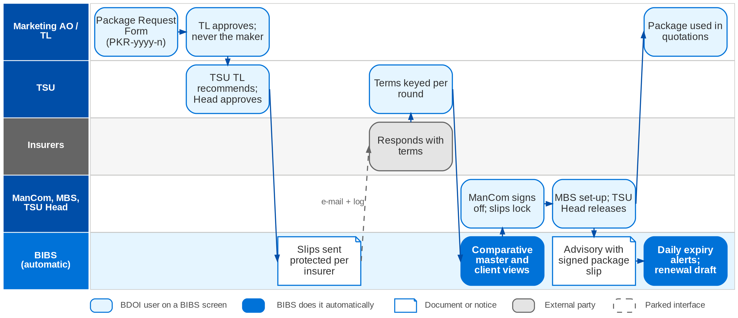
3. Product Maintenance: envisioned in BIBS
Package lifecycle in BIBS: workflow PM_PACKAGE_REQUEST (FRS BRD-3 sections 2.2 and 5)
Confidential – BDOI
BIBS Business Process Deck | v1.0
32
Notes:
In BIBS Marketing logs the Package Request Form, which BIBS numbers PKR-yyyy-n. A Marketing TL, TH or UH approves it (never the maker); the TSU TL recommends and the TSU Head approves. TSU prepares the quotation slips, which are approved and e-mailed per insurer, protected and logged. Insurer responses are keyed in with their outcome, over as many rounds as needed. BIBS keeps one comparative master per request and derives client views from it. ManCom signs off, which locks the slips; MBS creates the package version and the TSU Head or Business Administrator releases it. The advisory is drafted on release and sent with the signed package slip. A daily job raises expiry alerts and can draft the renewal request.

Slide 33
3. Product Maintenance: before and after
Today (pain point)
In BIBS
Measure
1
Requests by e-mail
Package Request Form logged in BIBS, numbered PKR-yyyy-n and tracked by stage
Stage and SLA per request
2
Quotation slips by e-mail
Quotation slips prepared, approved and e-mailed per insurer, protected and logged
Send log per slip
3
Insurer replies in mailboxes
TSU keys in each response with its outcome; every change is kept
Rounds recorded
4
Comparative in Excel
One comparative master per package; client views derived from it
No Excel re-compile
5
Manual sign-off and advisory
ManCom signs off in BIBS; the advisory is drafted on release
Sign-off before release
6
Documents without a password
Documents leave password protected; password in a separate e-mail
Every document protected
7
Expiry in spreadsheets
Daily job raises expiry alerts and can draft the renewal request
No expiry missed
8
History in e-mail threads
Every action in the request history and the audit trail
Full history per package
Confidential – BDOI
BIBS Business Process Deck | v1.0
33
Notes:
No turnaround targets are given in the BRD; the measures are the controls BIBS adds.
1. Requests by e-mail -> Package Request Form logged in BIBS, numbered PKR-yyyy-n and tracked by stage Measure: Stage and SLA per request.
2. Quotation slips by e-mail -> Quotation slips prepared, approved and e-mailed per insurer, protected and logged Measure: Send log per slip.
3. Insurer replies in mailboxes -> TSU keys in each response with its outcome; every change is kept Measure: Rounds recorded.
4. Comparative in Excel -> One comparative master per package; client views derived from it Measure: No Excel re-compile.
5. Manual sign-off and advisory -> ManCom signs off in BIBS; the advisory is drafted on release Measure: Sign-off before release.
6. Documents without a password -> Documents leave password protected; password in a separate e-mail Measure: Every document protected.
7. Expiry in spreadsheets -> Daily job raises expiry alerts and can draft the renewal request Measure: No expiry missed.
8. History in e-mail threads -> Every action in the request history and the audit trail Measure: Full history per package.

Slide 34
3. Product Maintenance: gaps in the envisioned process
Level | Gap | Impact | Owner | Decision needed | Ref
High | Incentive criteria without a definition | Incentive income across four BRDs | MBS, Comptrollership | List the programmes (CPC2 and others) with rate, base, payer | DCR-037
High | Password convention for documents | Clients and insurers cannot open files without a known rule | MBS, Information Security | Password rule per document type | DCR-153
Medium | Role-to-action matrix; ManCom decision rule | Approval routing and persona tests | MBS and TSU | Approve the matrix; ManCom membership and quorum | DCR-035
Medium | Non-package product maintenance | Scope of the module | MBS | Confirm out of scope for this phase | DCR-036
Medium | BRQID.008 dropped without a revision entry | Renewals repriced without client evidence | MBS | Confirm BRRN.038 now governs | DCR-030
Parked | Product master feed to other BDOI systems | Other systems not updated automatically | BDO IT | Which systems receive product changes | PQ16
Confidential – BDOI
BIBS Business Process Deck | v1.0
34
Notes:
The High incentive item is shared with BRD-2, BRD-4 and BRD-5; the criteria are kept once in Product Maintenance.
DCR-037 (High): Incentive criteria without a definition. Impact: Incentive income across four BRDs. Owner: MBS, Comptrollership. Decision: List the programmes (CPC2 and others) with rate, base, payer
DCR-153 (High): Password convention for documents. Impact: Clients and insurers cannot open files without a known rule. Owner: MBS, Information Security. Decision: Password rule per document type
DCR-035 (Medium): Role-to-action matrix; ManCom decision rule. Impact: Approval routing and persona tests. Owner: MBS and TSU. Decision: Approve the matrix; ManCom membership and quorum
DCR-036 (Medium): Non-package product maintenance. Impact: Scope of the module. Owner: MBS. Decision: Confirm out of scope for this phase
DCR-030 (Medium): BRQID.008 dropped without a revision entry. Impact: Renewals repriced without client evidence. Owner: MBS. Decision: Confirm BRRN.038 now governs
PQ16 (Parked): Product master feed to other BDOI systems. Impact: Other systems not updated automatically. Owner: BDO IT. Decision: Which systems receive product changes

Slide 35
3. Product Maintenance: best practice
Configurable rules owned by the business
Maker-checker on product changes
One version of the terms
Supported by BIBS
Supported by BIBS
Supported by BIBS
BIBS: Products, package versions, rates and incentive criteria kept as masters, maintained without IT.
BDOI: Name the business owner of each master and its approver.
BIBS: Marketing approval, TSU Head approval, ManCom sign-off and release validation; never the maker.
BDOI: Approve the role-to-action matrix (DCR-035).
BIBS: One comparative master per request and versioned packages; old versions locked.
BDOI: Retire Excel comparatives once BIBS is live.
Protected digital documents
Expiry and renewal pipeline
KPI on package turnaround
Partly in BIBS
Supported by BIBS
BDOI to adopt
BIBS: Slips and advisories password protected, password sent separately, send log.
BDOI: Agree the password convention (DCR-153).
BIBS: Daily expiry alerts and a renewal request pre-filled from the current version.
BDOI: Set the lead days per package type.
BIBS: Stage history and SLA per stage (for example 120 hours for negotiation).
BDOI: Adopt turnaround targets per stage and review them monthly.
Confidential – BDOI
BIBS Business Process Deck | v1.0
35
Notes:
Practices that fit a Philippine insurance broker, and what BIBS supports today or by design.
Configurable rules owned by the business [Supported by BIBS]. BIBS: Products, package versions, rates and incentive criteria kept as masters, maintained without IT. BDOI: Name the business owner of each master and its approver.
Maker-checker on product changes [Supported by BIBS]. BIBS: Marketing approval, TSU Head approval, ManCom sign-off and release validation; never the maker. BDOI: Approve the role-to-action matrix (DCR-035).
One version of the terms [Supported by BIBS]. BIBS: One comparative master per request and versioned packages; old versions locked. BDOI: Retire Excel comparatives once BIBS is live.
Protected digital documents [Partly in BIBS]. BIBS: Slips and advisories password protected, password sent separately, send log. BDOI: Agree the password convention (DCR-153).
Expiry and renewal pipeline [Supported by BIBS]. BIBS: Daily expiry alerts and a renewal request pre-filled from the current version. BDOI: Set the lead days per package type.
KPI on package turnaround [BDOI to adopt]. BIBS: Stage history and SLA per stage (for example 120 hours for negotiation). BDOI: Adopt turnaround targets per stage and review them monthly.

Slide 36
4. Collections
BRD-4 | Premium receivable follow-up, unapplied payments, escalation and billing statements
Confidential – BDOI | BIBS Business Process Deck
Notes:
BRD-4 Collections: Premium receivable follow-up, unapplied payments, escalation and billing statements.

Slide 37
4. Collections: at a glance
Department and roles
Volumes and NFRs (BRD)
BRD and build status
Operations - Collections, with Marketing collection staff
• Collection Handler; Marketing AO and Marketing Handler
• Team Lead, Unit Head, Section Heads (Corporate, Retail)
• Unapplied Payment Handler (CQ10)
• Cashiering and Commission (act on dispositions)
• App Support and DCO (refresh monitoring)
130
users, 56 concurrent (NFR, p.51-58)
In build
In build (foundation and worklist); FRS to follow
• CMS BRD p.40-42 (current and target process)
• BRCLXN.001-060 (signed); 061-064 draft only
• Requirements baseline BDOI_CLXN_BRD_SPEC.md; design COLLECTIONS_DESIGN.md
1,200
dispositions a day; 1,200 payment file lines a day
< 5 s
per screen; daily report < 3 min
RPO 4 h
and RTO 4 h; use 06:00-22:00 Mon-Fri
The process in one line
Booking
Nightly refresh
Assignment
Follow-up
Promise
Escalation
Disposition
Hand-off
Confidential – BDOI
BIBS Business Process Deck | v1.0
37
Notes:
Collections follows unpaid premium receivables (PR) until they are paid, reversed or cancelled. The CMS BRD describes a separate application fed nightly from EBIX and QPS; in BIBS it is a module that reads the Operations invoice ledger and hands work to Cashiering and Commission inside the application. It posts no money itself. The module is in build; there is no FRS yet, so this chapter uses the requirements baseline and the design.
Sources: CMS BRD p.40-42 (current and target process); BRCLXN.001-060 (signed); 061-064 draft only; Requirements baseline BDOI_CLXN_BRD_SPEC.md; design COLLECTIONS_DESIGN.md

Slide 38
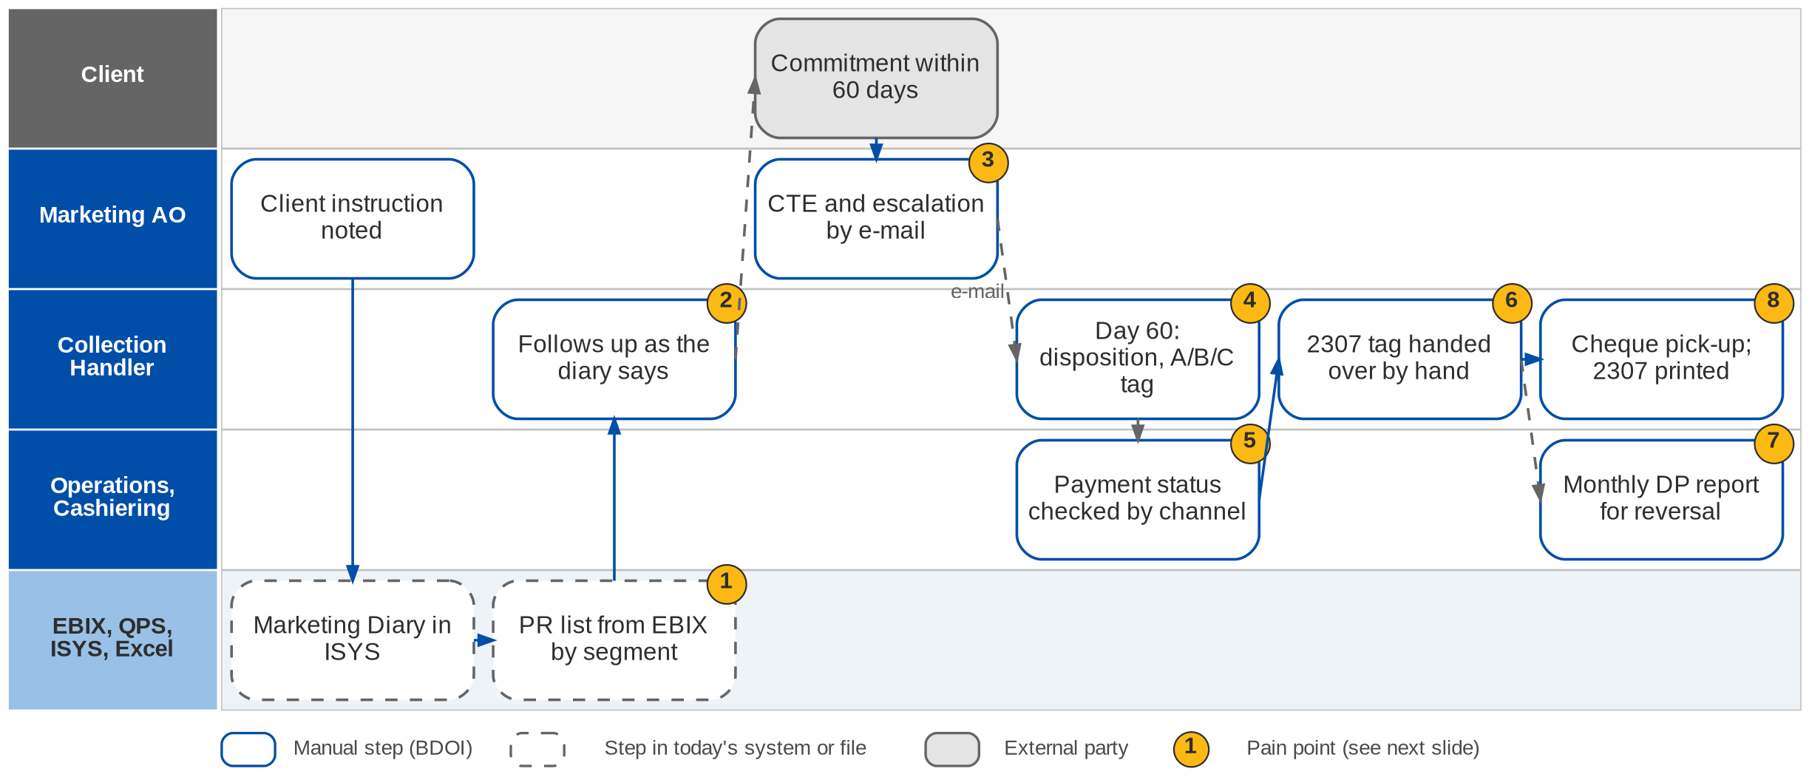
4. Collections: As-Is process
Premium receivable follow-up today (CMS BRD p.40-41)
Confidential – BDOI
BIBS Business Process Deck | v1.0
38
Notes:
Today the AO records the client's payment instruction in the Marketing Diary in ISYS. The Collection Handler takes the outstanding-PR list of the market segment from EBIX and follows up each account as the diary says: new bookings within 10 to 15 days, a payment commitment within 60 days. A commitment outside the credit term goes to the AO, who asks the insurer for a credit term extension and escalates to the Unit Head by e-mail. On day 60 without a commitment the handler sets a disposition and the A / B / C tag. Payment status is checked by channel with Cashiering, the Unapplied screen or the insurer. CWT 2307 tagging moves from Marketing to Operations by hand, and Operations extracts the Direct Payment report every month for PR reversal.

Slide 39
4. Collections: pain points today
1
PR list and diary in two systems
The handler takes the EBIX list and checks the ISYS Marketing Diary per account.
CMS BRD p.40-41, steps 1-2
5
Payment status by channel
Deposit with Cashiering, bills payment on the Unapplied screen, direct payment with the insurer.
CMS BRD p.40-41, step 8
2
Follow-up by hand
New bookings within 10-15 days, commitment within 60 days, tracked by the handler.
CMS BRD p.40-41, steps 3-4
6
2307 tagging handed over
A net-of-CWT payment stays a Marketing action until the BIR 2307 is collected.
CMS BRD p.40-41, step 9
3
CTE and escalation by e-mail
The AO asks the insurer for a credit term extension and escalates to the Unit Head.
CMS BRD p.40-41, step 5
7
DP report extracted monthly
Operations extracts the Direct Payment report as the basis for PR reversal.
CMS BRD p.40-41, step 10
4
Dispositions kept by hand
Day-60 disposition, category A / B / C and remarks are updated manually.
CMS BRD p.40-41, steps 6-7
8
Side tasks by e-mail
Cheque pick-up requests and 2307 certificates received by e-mail.
CMS BRD p.40, other tasks
Confidential – BDOI
BIBS Business Process Deck | v1.0
39
Notes:
Steps 1-10 of the current process (CMS BRD p.40-41) and the handler's other tasks (p.40).
1. PR list and diary in two systems: The handler takes the EBIX list and checks the ISYS Marketing Diary per account. (CMS BRD p.40-41, steps 1-2)
2. Follow-up by hand: New bookings within 10-15 days, commitment within 60 days, tracked by the handler. (CMS BRD p.40-41, steps 3-4)
3. CTE and escalation by e-mail: The AO asks the insurer for a credit term extension and escalates to the Unit Head. (CMS BRD p.40-41, step 5)
4. Dispositions kept by hand: Day-60 disposition, category A / B / C and remarks are updated manually. (CMS BRD p.40-41, steps 6-7)
5. Payment status by channel: Deposit with Cashiering, bills payment on the Unapplied screen, direct payment with the insurer. (CMS BRD p.40-41, step 8)
6. 2307 tagging handed over: A net-of-CWT payment stays a Marketing action until the BIR 2307 is collected. (CMS BRD p.40-41, step 9)
7. DP report extracted monthly: Operations extracts the Direct Payment report as the basis for PR reversal. (CMS BRD p.40-41, step 10)
8. Side tasks by e-mail: Cheque pick-up requests and 2307 certificates received by e-mail. (CMS BRD p.40, other tasks)

Slide 40
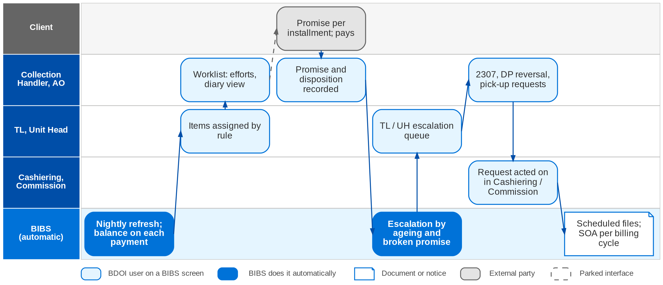
4. Collections: envisioned in BIBS
Collections in BIBS: worklist, promises, escalation (workflow CLX_ESCALATION) and hand-offs (design COLLECTIONS_DESIGN)
Confidential – BDOI
BIBS Business Process Deck | v1.0
40
Notes:
In BIBS a nightly job after the 22:00 end of day turns every invoice with PR above the threshold into a collection item, refreshes existing items and closes items at zero, keeping their history. The TL assigns items by rule (segment, unit, client). The handler records efforts, promises per installment, the collector disposition and the A / B / C category on the item, with the Marketing Diary in view. Rules escalate by ageing, commitments and broken promises to the TL / UH queue. Dispositions for Operations become in-app requests: "PR 2307 for reversal" to Cashiering, "DP PR for reversal" to Commission, "for check pick-up" to the Cashiering queue. The monthly and weekly files are produced on schedule, and billing statements are issued per billing cycle of multi-year policies.

Slide 41
4. Collections: before and after
Today (pain point)
In BIBS
Measure
1
PR list and diary in two systems
One worklist read from the invoice ledger, with the Marketing Diary in view on the item
Refreshed nightly after 22:00
2
Follow-up by hand
Efforts, promises per installment and reminders recorded on the collection item
History kept per item
3
CTE and escalation by e-mail
Escalation rules by ageing, commitments and broken promises; manual escalation, also in bulk
TL / UH queue by rule
4
Dispositions kept by hand
Disposition from a list of values with category A / B / C; append-only history
From / to audit per field
5
Payment status by channel
Payment status, balances and co-insurance shares read from the invoice ledger
Same-day balance refresh
6
2307 tagging handed over
"PR 2307 for reversal" goes to the Cashiering 2307 intake as an in-app request
No e-mail hand-off
7
DP report extracted monthly
DP-for-reversal file on the first working day; the same list goes to Commission
Ready on working day 1
8
Side tasks by e-mail
Cheque pick-up request placed on the Cashiering queue from the item
Request tracked
Confidential – BDOI
BIBS Business Process Deck | v1.0
41
Notes:
The CMS BRD gives volume and response targets (NFR 15.01-15.14) but no collection-rate targets.
1. PR list and diary in two systems -> One worklist read from the invoice ledger, with the Marketing Diary in view on the item Measure: Refreshed nightly after 22:00.
2. Follow-up by hand -> Efforts, promises per installment and reminders recorded on the collection item Measure: History kept per item.
3. CTE and escalation by e-mail -> Escalation rules by ageing, commitments and broken promises; manual escalation, also in bulk Measure: TL / UH queue by rule.
4. Dispositions kept by hand -> Disposition from a list of values with category A / B / C; append-only history Measure: From / to audit per field.
5. Payment status by channel -> Payment status, balances and co-insurance shares read from the invoice ledger Measure: Same-day balance refresh.
6. 2307 tagging handed over -> "PR 2307 for reversal" goes to the Cashiering 2307 intake as an in-app request Measure: No e-mail hand-off.
7. DP report extracted monthly -> DP-for-reversal file on the first working day; the same list goes to Commission Measure: Ready on working day 1.
8. Side tasks by e-mail -> Cheque pick-up request placed on the Cashiering queue from the item Measure: Request tracked.

Slide 42
4. Collections: gaps in the envisioned process
Level | Gap | Impact | Owner | Decision needed | Ref
High | BRCLXN.061-064 only in the unsigned draft | Commission, incentive and refund items not approved | Head of BDOI Operations | In scope? Owner: Collections or Commission | DCR-039, CQ01
High | List at invoice or cover level | Grain of the list and of the threshold rule | Head of BDOI Operations | Confirm invoice level; threshold per invoice, ARN or client | DCR-041, CQ02
High | One session per device | Session control for every user | Operations with BDO ITIO | For all users, Collections only, or no one | DCR-044, 141
High | Open EBIX PRs and history at go-live | Worklist incomplete at cut-over | Operations, BDO IT | Migration scope, cut-off and format | DCR-157, CQ07
Medium | Minimal balance threshold value | Which invoices enter the list | Operations - Collections | Value, currency, net of PR2307? | CQ03
Medium | Escalation defaults and promise rules | Escalation and broken-promise tests | Operations - Collections | Days (45 / 60), levels, grace days | CQ14, CQ16
Confidential – BDOI
BIBS Business Process Deck | v1.0
42
Notes:
BRCLXN.061-064 appear only in the unsigned draft of the workshop addendum; they are designed as Draft and built only after BDOI confirms them (CQ01). The Operations Head's caveat on exports (p.93) is met by asynchronous, permission-gated exports.
DCR-039, CQ01 (High): BRCLXN.061-064 only in the unsigned draft. Impact: Commission, incentive and refund items not approved. Owner: Head of BDOI Operations. Decision: In scope? Owner: Collections or Commission
DCR-041, CQ02 (High): List at invoice or cover level. Impact: Grain of the list and of the threshold rule. Owner: Head of BDOI Operations. Decision: Confirm invoice level; threshold per invoice, ARN or client
DCR-044, 141 (High): One session per device. Impact: Session control for every user. Owner: Operations with BDO ITIO. Decision: For all users, Collections only, or no one
DCR-157, CQ07 (High): Open EBIX PRs and history at go-live. Impact: Worklist incomplete at cut-over. Owner: Operations, BDO IT. Decision: Migration scope, cut-off and format
CQ03 (Medium): Minimal balance threshold value. Impact: Which invoices enter the list. Owner: Operations - Collections. Decision: Value, currency, net of PR2307?
CQ14, CQ16 (Medium): Escalation defaults and promise rules. Impact: Escalation and broken-promise tests. Owner: Operations - Collections. Decision: Days (45 / 60), levels, grace days

Slide 43
4. Collections: best practice
Ageing control with escalation by rule
Promise-to-pay per installment
Single view of the receivable
Supported by BIBS
Supported by BIBS
Supported by BIBS
BIBS: Rules by ageing, commitments and broken promises; TL / UH queue; manual escalation in bulk.
BDOI: Set the default days and levels (CQ14).
BIBS: Promises recorded per installment, marked kept or broken from the ledger.
BDOI: Define when a promise is kept and the grace days (CQ16).
BIBS: Invoice 360: policy, invoice, co-insurance shares, payments and history on one screen.
BDOI: Retire the separate EBIX and Excel lists after migration.
Collections monitors; finance posts
Credit term discipline
Collection KPIs
Supported by BIBS
BDOI to adopt
Partly in BIBS
BIBS: Collections posts no money; Cashiering and Commission act on its requests.
BDOI: Keep this split in the role matrix (DCR-121).
BIBS: Commitment dates and CTE requests can be recorded on the item.
BDOI: Publish credit terms per segment and track CTEs in BIBS (CQ20).
BIBS: Outstanding PR, escalation and broken-promise reports; Collections home.
BDOI: Define the dashboard per role and the collection targets (CQ21).
Confidential – BDOI
BIBS Business Process Deck | v1.0
43
Notes:
Practices that fit a Philippine insurance broker, and what BIBS supports today or by design.
Ageing control with escalation by rule [Supported by BIBS]. BIBS: Rules by ageing, commitments and broken promises; TL / UH queue; manual escalation in bulk. BDOI: Set the default days and levels (CQ14).
Promise-to-pay per installment [Supported by BIBS]. BIBS: Promises recorded per installment, marked kept or broken from the ledger. BDOI: Define when a promise is kept and the grace days (CQ16).
Single view of the receivable [Supported by BIBS]. BIBS: Invoice 360: policy, invoice, co-insurance shares, payments and history on one screen. BDOI: Retire the separate EBIX and Excel lists after migration.
Collections monitors; finance posts [Supported by BIBS]. BIBS: Collections posts no money; Cashiering and Commission act on its requests. BDOI: Keep this split in the role matrix (DCR-121).
Credit term discipline [BDOI to adopt]. BIBS: Commitment dates and CTE requests can be recorded on the item. BDOI: Publish credit terms per segment and track CTEs in BIBS (CQ20).
Collection KPIs [Partly in BIBS]. BIBS: Outstanding PR, escalation and broken-promise reports; Collections home. BDOI: Define the dashboard per role and the collection targets (CQ21).

Slide 44
5. Accounting and Disbursement
BRD-5 | Accounting (FRBS), Disbursement, ACSL, Marketing refund and cash-advance requests, financial reports
Confidential – BDOI | BIBS Business Process Deck
Notes:
BRD-5 Accounting and Disbursement: Accounting (FRBS), Disbursement, ACSL, Marketing refund and cash-advance requests, financial reports.

Slide 45
5. Accounting and Disbursement: at a glance
Department and roles
Volumes and NFRs (BRD)
BRD and build status
Comptrollership: FRBS (GL team), Disbursement, ACSL
• FRBS officer, TL, TH (Accounting, 5 users)
• Disbursement processor, verifier and approvers (8 users)
• ACSL officer and approver (6 users)
• Marketing AO and employees (refund and cash-advance requests); HR approver
• Business and System Administrator
19
Comptrollership users: FRBS 5, Disbursement 8, ACSL 6 (p.133-137)
In build
GL platform built; Disbursement, ACSL, FRBS reports in build
• BRD-5 p.44-45 (current process), p.46-48 (envisioned)
• FRBS, DIS, MKT, ACSL, BASAU requirements; Addenda 1 and 2
• Requirements baseline BDOI_ACCT_BRD_SPEC.md; design ACCOUNTING_DISBURSEMENT_DESIGN.md
198
remittance DVs a year (+20%); 246 refunds; 293 supplier payments
5-10 s
screen load; reports 10-20 s first load
15 Apr
year-end close deadline (FRBS 2.7.0, p.59)
The process in one line
Request
Voucher
Approval
Payment
Status and CWT
Posting
Reconciliation
Close and report
Confidential – BDOI
BIBS Business Process Deck | v1.0
45
Notes:
BDOI handles two kinds of money: trust money (premium collected for insurers and remitted net of commission) and its own income (commission, service fee, profit share, incentives). BRD-2 covers the front of the cycle; BRD-5 covers the back office of Comptrollership. Most of the accounting core already exists in BIBS (chart, journals, accounting engine, sub-ledger, periods, FX revaluation, year-end, bank reconciliation, BIR returns and 2307). The large new build is Disbursement, then ACSL reconciliation and correction, the Marketing request flow and the BDOI report pack. There is no FRS yet; this chapter uses the requirements baseline and the design.
Sources: BRD-5 p.44-45 (current process), p.46-48 (envisioned); FRBS, DIS, MKT, ACSL, BASAU requirements; Addenda 1 and 2; Requirements baseline BDOI_ACCT_BRD_SPEC.md; design ACCOUNTING_DISBURSEMENT_DESIGN.md

Slide 46
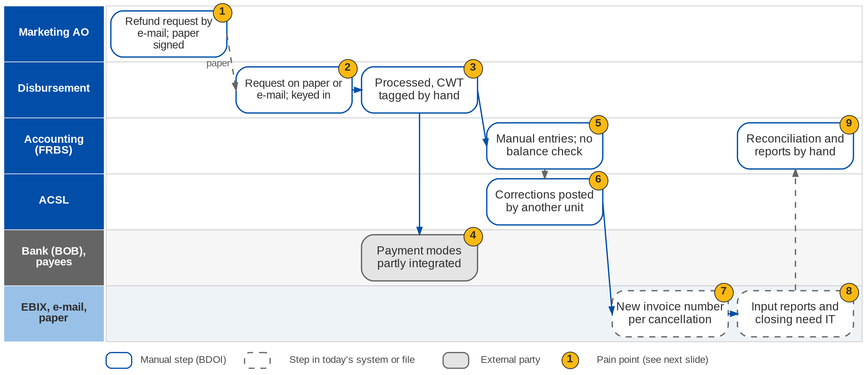
5. Accounting and Disbursement: As-Is process
Disbursement, accounting and ACSL today (BRD-5 p.44-45)
Confidential – BDOI
BIBS Business Process Deck | v1.0
46
Notes:
Today Marketing refund and cash-advance requests arrive from AOs by e-mail; review and approval happen outside the system and signed paper is handed to Disbursement. Some disbursement requests still come on paper or by e-mail; not every payment method is integrated; processing and CWT tagging are manual; communication and approval run outside the system. In Accounting the input reports and the closing of the broking books depend on IT, output reports and reconciliations are manual, unbalanced transactions are not prevented and some entries are keyed by hand. In ACSL, input reports depend on IT, corrections and reversals are manual and posted by a separate unit, a cancellation gets a different invoice number, and reports lack the source-system references (BRD-5 p.44-45).

Slide 47
5. Accounting and Disbursement: pain points today
1
Marketing requests by e-mail and paper
Review and approval outside the system; signed paper handed to Disbursement.
BRD-5 p.45, B.2 a-c
6
Corrections by another unit
Correction and reversal entries are processed manually and posted by a separate unit.
BRD-5 p.45, C b-c
2
Requests received by hand
Some disbursement requests still arrive as paper or e-mail.
BRD-5 p.45, B a
7
Cancellations get a new invoice number
Related transactions cannot be followed under one number; reports lack source references.
BRD-5 p.45, C d-e
3
Manual processing and CWT tagging
Communication and approval run outside the system; payees only for CTA and check.
BRD-5 p.45, B c-e
8
IT needed for input and closing
Input reports and the closing of the broking books depend on IT support.
BRD-5 p.44, A a; p.45, C a
4
Payment methods not all integrated
Not every mode of payment is in the system; most output reports are manual.
BRD-5 p.45, B b, f
9
Reconciliation and reports by hand
Output reports are generated and reconciliations performed manually.
BRD-5 p.44, A b-c
5
Unbalanced entries not prevented
Some accounting entries are keyed by hand.
BRD-5 p.44, A d-e
Confidential – BDOI
BIBS Business Process Deck | v1.0
47
Notes:
The points are the lettered current-process items of the BRD (A = Accounting, B = Disbursement, B.2 = Marketing requests, C = ACSL), p.44-45.
1. Marketing requests by e-mail and paper: Review and approval outside the system; signed paper handed to Disbursement. (BRD-5 p.45, B.2 a-c)
2. Requests received by hand: Some disbursement requests still arrive as paper or e-mail. (BRD-5 p.45, B a)
3. Manual processing and CWT tagging: Communication and approval run outside the system; payees only for CTA and check. (BRD-5 p.45, B c-e)
4. Payment methods not all integrated: Not every mode of payment is in the system; most output reports are manual. (BRD-5 p.45, B b, f)
5. Unbalanced entries not prevented: Some accounting entries are keyed by hand. (BRD-5 p.44, A d-e)
6. Corrections by another unit: Correction and reversal entries are processed manually and posted by a separate unit. (BRD-5 p.45, C b-c)
7. Cancellations get a new invoice number: Related transactions cannot be followed under one number; reports lack source references. (BRD-5 p.45, C d-e)
8. IT needed for input and closing: Input reports and the closing of the broking books depend on IT support. (BRD-5 p.44, A a; p.45, C a)
9. Reconciliation and reports by hand: Output reports are generated and reconciliations performed manually. (BRD-5 p.44, A b-c)

Slide 48
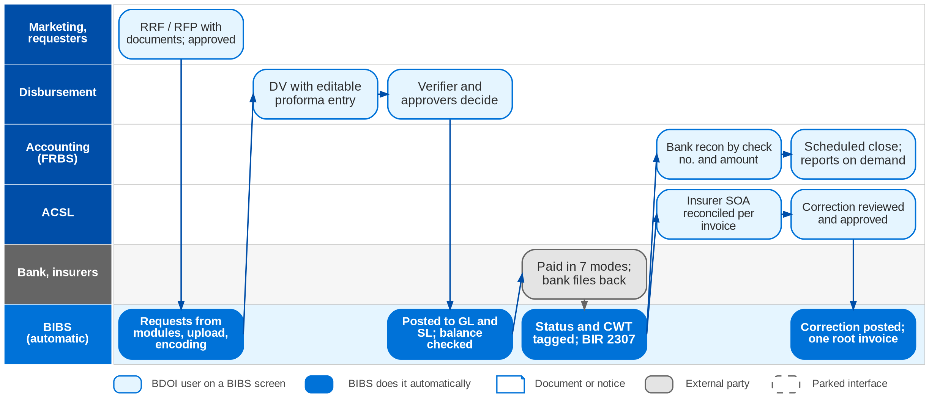
5. Accounting and Disbursement: envisioned in BIBS
Disbursement, accounting and ACSL in BIBS (design ACCOUNTING_DISBURSEMENT_DESIGN; BRD-5 p.46-48)
Confidential – BDOI
BIBS Business Process Deck | v1.0
48
Notes:
In BIBS refund and cash-advance requests are raised on the RRF / RFP with documents and approved in the workflow, then routed to Disbursement. Disbursement receives requests from the other modules, by upload or by encoding; BIBS creates the disbursement voucher with an editable proforma entry. The verifier and approvers decide in BIBS, and approval posts the entry to the GL and the sub-ledger, which refuses unbalanced entries. The payment runs in one of seven modes; statuses and CWT are tagged automatically and by bank files, and BIR 2307 is generated. ACSL uploads the insurer statements and reconciles them per invoice, and posts corrections through create, review, approve and post. Accounting reconciles the bank by check number and amount, closes the books on schedule and runs the reports on demand. The BDO Business Online Banking interface is parked (AQ09): approvals are confirmed manually or by file.

Slide 49
5. Accounting and Disbursement: before and after
Today (pain point)
In BIBS
Measure
1
Marketing requests by e-mail and paper
RRF and RFP in BIBS with documents; Marketing (and HR) approval routes them to Disbursement
No paper hand-over
2
Requests received by hand
Requests from other modules, uploads and encoding in one intake
One request queue
3
Manual processing and CWT tagging
DV and proforma entry created by BIBS; approval in the workflow; payees for every mode
Verifier plus two approvers
4
Payment methods not all integrated
Seven payment modes with instrument life cycles; end-of-day files and forms
Statuses tagged by bank file
5
Unbalanced entries not prevented
Validator refuses unbalanced entries and flags negative balances; accruals reverse automatically
Debit = credit enforced
6
Corrections by another unit
ACSL corrections post on approval to the sub-ledger and the invoice ledger
Posting on approval
7
Cancellations get a new invoice number
Every related transaction carries one root invoice number; source references in reports
One invoice family
8
IT needed for input and closing
Users run input reports; broking books close by a scheduled job
No IT request
9
Reconciliation and reports by hand
Bank file matched on check number and amount; reports on demand
Reports 10-20 s (p.133-137)
Confidential – BDOI
BIBS Business Process Deck | v1.0
49
Notes:
The BRD gives response times and yearly volumes; it states no turnaround targets. The measures are the controls BIBS adds.
1. Marketing requests by e-mail and paper -> RRF and RFP in BIBS with documents; Marketing (and HR) approval routes them to Disbursement Measure: No paper hand-over.
2. Requests received by hand -> Requests from other modules, uploads and encoding in one intake Measure: One request queue.
3. Manual processing and CWT tagging -> DV and proforma entry created by BIBS; approval in the workflow; payees for every mode Measure: Verifier plus two approvers.
4. Payment methods not all integrated -> Seven payment modes with instrument life cycles; end-of-day files and forms Measure: Statuses tagged by bank file.
5. Unbalanced entries not prevented -> Validator refuses unbalanced entries and flags negative balances; accruals reverse automatically Measure: Debit = credit enforced.
6. Corrections by another unit -> ACSL corrections post on approval to the sub-ledger and the invoice ledger Measure: Posting on approval.
7. Cancellations get a new invoice number -> Every related transaction carries one root invoice number; source references in reports Measure: One invoice family.
8. IT needed for input and closing -> Users run input reports; broking books close by a scheduled job Measure: No IT request.
9. Reconciliation and reports by hand -> Bank file matched on check number and amount; reports on demand Measure: Reports 10-20 s (p.133-137).

Slide 50
5. Accounting and Disbursement: gaps in the envisioned process
Level | Gap | Impact | Owner | Decision needed | Ref
High | One invoice number or a root number | BIR invoice uniqueness against one reference per policy | Comptrollership (ACSL) | Accept a root invoice number linking related documents | DCR-058, AQ29
High | Incentive programmes (CPC2 and early incentive) | Incentive income and service invoices | Comptrollership, MBS, Operations | Rates, base, payer, service invoice per programme | DCR-037, AQ24
High | Payee master and open items at go-live | Disbursement cannot start without payees | Comptrollership | Migration file, cut-off and reconciliation | DCR-157, AQ11
Medium | GL month-end closing rule | Close date, reopening, period controls | FRBS | 2nd banking day or a preferred date; can a month reopen? | DCR-054, AQ04
Medium | RRF and RFP mandatory fields | Marketing request screens and tests | Comptrollership, Marketing | Mandatory fields and approval chain per segment | DCR-052, AQ18
Parked | BDO Business Online Banking and DCTF channel | Funding approvals confirmed by hand or file | BDO IT | Channel per payment mode; DCTF specification | AQ09, AQ10
Confidential – BDOI
BIBS Business Process Deck | v1.0
50
Notes:
The invoice-number question (DCR-058, AQ29) decides how ACSL links booking, adjustment and cancellation.
DCR-058, AQ29 (High): One invoice number or a root number. Impact: BIR invoice uniqueness against one reference per policy. Owner: Comptrollership (ACSL). Decision: Accept a root invoice number linking related documents
DCR-037, AQ24 (High): Incentive programmes (CPC2 and early incentive). Impact: Incentive income and service invoices. Owner: Comptrollership, MBS, Operations. Decision: Rates, base, payer, service invoice per programme
DCR-157, AQ11 (High): Payee master and open items at go-live. Impact: Disbursement cannot start without payees. Owner: Comptrollership. Decision: Migration file, cut-off and reconciliation
DCR-054, AQ04 (Medium): GL month-end closing rule. Impact: Close date, reopening, period controls. Owner: FRBS. Decision: 2nd banking day or a preferred date; can a month reopen?
DCR-052, AQ18 (Medium): RRF and RFP mandatory fields. Impact: Marketing request screens and tests. Owner: Comptrollership, Marketing. Decision: Mandatory fields and approval chain per segment
AQ09, AQ10 (Parked): BDO Business Online Banking and DCTF channel. Impact: Funding approvals confirmed by hand or file. Owner: BDO IT. Decision: Channel per payment mode; DCTF specification

Slide 51
5. Accounting and Disbursement: best practice
Maker-checker and dual approval on payments
Balanced posting and a closed period
Automated bank reconciliation
Supported by BIBS
Supported by BIBS
Partly in BIBS
BIBS: DV verifier and approvers; account funding with a verifier and two approvers; maker cannot approve.
BDOI: Confirm the approvers, their order and limits (AQ10, AQ28).
BIBS: Unbalanced entries refused; posting only to open periods; scheduled close with a checklist.
BDOI: Agree the close calendar and reopen rule (AQ04).
BIBS: Bank file import and matching on check number and amount.
BDOI: Give the bank file layouts per bank (AQ08).
Sub-ledger reconciled to the GL
BIR withholding and certificates from the system
One invoice family for audit
Supported by BIBS
Partly in BIBS
BDOI to adopt
BIBS: GL-SL reconciliation per GL code; insurer SOA reconciled per invoice.
BDOI: Ask insurers to show the BDOI invoice number on their SOA (AQ21).
BIBS: CWT tagging and BIR 2307 generated; BIR returns from the tax module.
BDOI: Confirm the BIR forms and books still required (AQ07).
BIBS: Root invoice number carried by booking, ledger and every downstream document.
BDOI: Accept the root-number model (DCR-058).
Confidential – BDOI
BIBS Business Process Deck | v1.0
51
Notes:
Practices that fit a Philippine insurance broker, and what BIBS supports today or by design.
Maker-checker and dual approval on payments [Supported by BIBS]. BIBS: DV verifier and approvers; account funding with a verifier and two approvers; maker cannot approve. BDOI: Confirm the approvers, their order and limits (AQ10, AQ28).
Balanced posting and a closed period [Supported by BIBS]. BIBS: Unbalanced entries refused; posting only to open periods; scheduled close with a checklist. BDOI: Agree the close calendar and reopen rule (AQ04).
Automated bank reconciliation [Partly in BIBS]. BIBS: Bank file import and matching on check number and amount. BDOI: Give the bank file layouts per bank (AQ08).
Sub-ledger reconciled to the GL [Supported by BIBS]. BIBS: GL-SL reconciliation per GL code; insurer SOA reconciled per invoice. BDOI: Ask insurers to show the BDOI invoice number on their SOA (AQ21).
BIR withholding and certificates from the system [Partly in BIBS]. BIBS: CWT tagging and BIR 2307 generated; BIR returns from the tax module. BDOI: Confirm the BIR forms and books still required (AQ07).
One invoice family for audit [BDOI to adopt]. BIBS: Root invoice number carried by booking, ledger and every downstream document. BDOI: Accept the root-number model (DCR-058).

Slide 52
6. Renewal
BRD-6 | Expiring list, disposition, insurer round-trip, Renewal Advice, acceptance to booking
Confidential – BDOI | BIBS Business Process Deck
Notes:
BRD-6 Renewal: Expiring list, disposition, insurer round-trip, Renewal Advice, acceptance to booking.

Slide 53
6. Renewal: at a glance
Department and roles
Volumes and NFRs (BRD)
BRD and build status
Marketing and Processing (RMEL renewal)
• Marketing Team Leader (75) and AO / Account Broker (319)
• Processing Team Leader (50) and Processing Officer / Broker (73)
• Contact Center user (follow-ups, remarks)
• LAMD user (paid-off and RMU reports)
• Clients and insurers (external)
25,800
transactions a month per process; growth 20% a year (p.186-188)
Designed
Designed, not yet built; FRS v1.0 issued for review
• BRD-6 p.41-43 (current and envisioned process)
• Workshop addendum p.3-15 (BRRN.001-040)
• FRS BRD-6 v1.0, sections 2 and 5; cross-BRD decisions D1, D2
485
users for reports and RA; 145 concurrent
10 s
online; 20 s for reports and RA generation
07-22
use 07:00-22:00 Monday to Saturday
The process in one line
Extraction
Sanitation
Initiation
Disposition
Processing
Insurer
Renewal Advice
Booking
Confidential – BDOI
BIBS Business Process Deck | v1.0
53
Notes:
BDOI renews the policies it has placed. RMEL Phase 2 moves the renewal online: the Business Units extract the list themselves, disposition online in a staged workflow, export the accounts per insurer and monitor each renewal. The workshop addendum adds rule-based governance: sanitation, a mandatory reference, buckets, a decision matrix and automatic progression to booking. Renewal is designed; the build needs the shared business-type change BT0 first (decision D1).
Sources: BRD-6 p.41-43 (current and envisioned process); Workshop addendum p.3-15 (BRRN.001-040); FRS BRD-6 v1.0, sections 2 and 5; cross-BRD decisions D1, D2

Slide 54
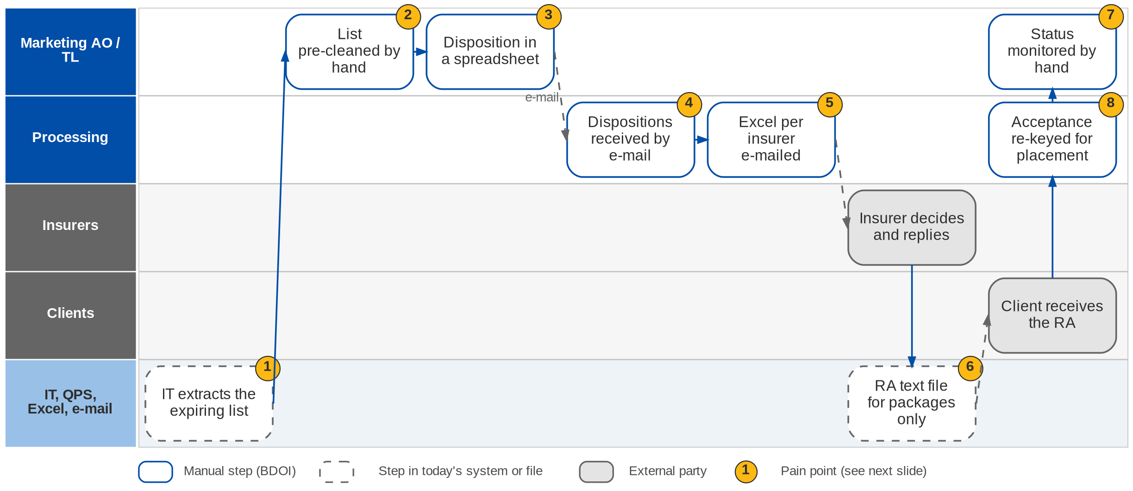
6. Renewal: As-Is process
Renewal today (BRD-6 p.42-43; workshop addendum p.3)
Confidential – BDOI
BIBS Business Process Deck | v1.0
54
Notes:
Today IT extracts the list of expiring accounts. Eligibility depends on manual pre-cleaning of the list. Marketing records dispositions in spreadsheets and communicates with Processing by e-mail. Accounts go to insurers by e-mail from Excel. Renewal Advices come from an IT text file and work for packaged accounts only, with the upload to QPS; non-packaged accounts and exceptions are handled by hand. Renewal status is monitored by hand, and accepted renewals are re-keyed for placement and booking.

Slide 55
6. Renewal: pain points today
1
IT extracts the expiring list
The RMEL list depends on an IT extraction.
BRD-6 p.42; BRRN.002, 005
5
Accounts to insurers from Excel
Accounts are sent to insurers by e-mail from Excel files.
BRD-6 p.42; BRD 3.009
2
Manual pre-cleaning
Eligibility depends on cleaning the list by hand before disposition.
Workshop addendum p.3; BRRN.009, 020
6
RA text file for packages only
The IT text file and the QPS upload cover packaged accounts only.
BRD-6 p.42; BRRN.010
3
Disposition in a spreadsheet
Marketing records the disposition of each account in Excel.
BRD-6 p.42; BRD 2.004
7
Status monitored by hand
No status report or summary counters.
BRD-6 p.42-43; BRRN.019, 036
4
Hand-offs by e-mail
Marketing and Processing communicate by e-mail; no stage or assignment.
BRD-6 p.42
8
Accepted renewals re-keyed
Accepted renewals are keyed again for placement and booking.
Workshop addendum p.3; BRRN.038, 040
Confidential – BDOI
BIBS Business Process Deck | v1.0
55
Notes:
The eight points are the current-process rows of the BRD (p.42-43) and the workshop addendum (p.3).
1. IT extracts the expiring list: The RMEL list depends on an IT extraction. (BRD-6 p.42; BRRN.002, 005)
2. Manual pre-cleaning: Eligibility depends on cleaning the list by hand before disposition. (Workshop addendum p.3; BRRN.009, 020)
3. Disposition in a spreadsheet: Marketing records the disposition of each account in Excel. (BRD-6 p.42; BRD 2.004)
4. Hand-offs by e-mail: Marketing and Processing communicate by e-mail; no stage or assignment. (BRD-6 p.42)
5. Accounts to insurers from Excel: Accounts are sent to insurers by e-mail from Excel files. (BRD-6 p.42; BRD 3.009)
6. RA text file for packages only: The IT text file and the QPS upload cover packaged accounts only. (BRD-6 p.42; BRRN.010)
7. Status monitored by hand: No status report or summary counters. (BRD-6 p.42-43; BRRN.019, 036)
8. Accepted renewals re-keyed: Accepted renewals are keyed again for placement and booking. (Workshop addendum p.3; BRRN.038, 040)

Slide 56
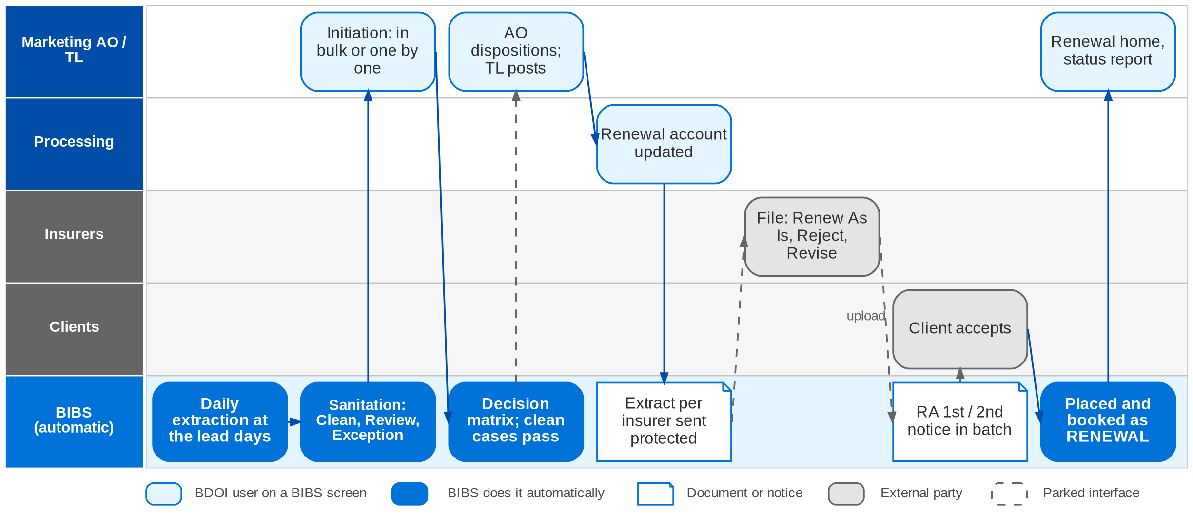
6. Renewal: envisioned in BIBS
Renewal in BIBS: workflow RNW_CASE with the decision matrix (FRS BRD-6 sections 2.2 and 5)
Confidential – BDOI
BIBS Business Process Deck | v1.0
56
Notes:
In BIBS a daily job extracts the accounts that expire within the lead days; users can also generate the list for any date range. BIBS runs the sanitation, matching and eligibility checks and classifies each record Clean, Review or Exception. An authorised user initiates the renewal, in bulk (for example CLG) or one by one. The decision matrix proposes a disposition; a Clean case with an automatic rule proceeds straight through. Otherwise the AO dispositions online and the TL reviews and posts. Processing updates the renewal account; BIBS builds the extract per insurer and sends it protected, and the insurer's decision file is applied: Renew As Is advances, Reject or Revise stops or reroutes. The Renewal Advice (first or second notice) goes out in batch, protected. Acceptance moves the account to placement and booking without re-keying, and it books as business type RENEWAL.

Slide 57
6. Renewal: before and after
Today (pain point)
In BIBS
Measure
1
IT extracts the expiring list
Daily job extracts expiring accounts at the lead days; users generate the list for any range
25,800 a month without IT
2
Manual pre-cleaning
Sanitation, matching and eligibility checks classify each record Clean, Review or Exception
Checks run by BIBS
3
Disposition in a spreadsheet
AO dispositions online; clean cases with an automatic rule get a system disposition
Straight-through for clean cases
4
Hand-offs by e-mail
Staged workflow with assignment, review, return and post; notice at each step
Stage per renewal
5
Accounts to insurers from Excel
Extract per insurer sent protected; insurer decision file uploaded and applied
Protected, logged
6
RA text file for packages only
RA first and second notice for any account, from the latest template, in batch
RA in 20 s (p.186-188)
7
Status monitored by hand
Renewal home, status report with summary counters, listings with escalation
Live status
8
Accepted renewals re-keyed
Acceptance moves the account to placement and booking; it books as RENEWAL
No re-keying
Confidential – BDOI
BIBS Business Process Deck | v1.0
57
Notes:
The volumes and response times come from the usage table (p.186-188).
1. IT extracts the expiring list -> Daily job extracts expiring accounts at the lead days; users generate the list for any range Measure: 25,800 a month without IT.
2. Manual pre-cleaning -> Sanitation, matching and eligibility checks classify each record Clean, Review or Exception Measure: Checks run by BIBS.
3. Disposition in a spreadsheet -> AO dispositions online; clean cases with an automatic rule get a system disposition Measure: Straight-through for clean cases.
4. Hand-offs by e-mail -> Staged workflow with assignment, review, return and post; notice at each step Measure: Stage per renewal.
5. Accounts to insurers from Excel -> Extract per insurer sent protected; insurer decision file uploaded and applied Measure: Protected, logged.
6. RA text file for packages only -> RA first and second notice for any account, from the latest template, in batch Measure: RA in 20 s (p.186-188).
7. Status monitored by hand -> Renewal home, status report with summary counters, listings with escalation Measure: Live status.
8. Accepted renewals re-keyed -> Acceptance moves the account to placement and booking; it books as RENEWAL Measure: No re-keying.

Slide 58
6. Renewal: gaps in the envisioned process
Level | Gap | Impact | Owner | Decision needed | Ref
High | Disposition online or by batch upload | Disposition screens and the upload path | Marketing and Processing (RMEL) | Which segments disposition online; who prepares the file | DCR-062
High | Manual initiation against straight-through | Workflow triggers of the renewal | Marketing and Processing (RMEL) | Initiation always manual? Is CBG STP started automatically? | DCR-063
High | Legacy policies expiring after go-live | First-year renewals could be missed | RMEL, BDO IT | Load expiring EBIX / QPS policies; how many months | DCR-075
High | Boundary with Submitted Policies; LAMD intake | Two renewal paths; two loan-status feeds | RMEL and Submitted Policies owners | Confirm decision D2; one LAMD report or two | DCR-129, 146
High | Sanctions match during renewal | Renewal of a possibly sanctioned client | Compliance | Block or warn while a match is open | DCR-112
Medium | NRNS checkpoint | Reminder timing and letters | RMEL | 90 days before expiry? What is "not yet submitted"? | DCR-064
Confidential – BDOI
BIBS Business Process Deck | v1.0
58
Notes:
Two contradictions inside the BRD decide the workflow triggers: disposition online or by upload (DCR-062), and manual initiation against straight-through processing (DCR-063). Renewal owns the renewal of submitted policies from the hand-off on (decision D2); the one-LAMD-intake question is still open (XQ01).
DCR-062 (High): Disposition online or by batch upload. Impact: Disposition screens and the upload path. Owner: Marketing and Processing (RMEL). Decision: Which segments disposition online; who prepares the file
DCR-063 (High): Manual initiation against straight-through. Impact: Workflow triggers of the renewal. Owner: Marketing and Processing (RMEL). Decision: Initiation always manual? Is CBG STP started automatically?
DCR-075 (High): Legacy policies expiring after go-live. Impact: First-year renewals could be missed. Owner: RMEL, BDO IT. Decision: Load expiring EBIX / QPS policies; how many months
DCR-129, 146 (High): Boundary with Submitted Policies; LAMD intake. Impact: Two renewal paths; two loan-status feeds. Owner: RMEL and Submitted Policies owners. Decision: Confirm decision D2; one LAMD report or two
DCR-112 (High): Sanctions match during renewal. Impact: Renewal of a possibly sanctioned client. Owner: Compliance. Decision: Block or warn while a match is open
DCR-064 (Medium): NRNS checkpoint. Impact: Reminder timing and letters. Owner: RMEL. Decision: 90 days before expiry? What is "not yet submitted"?

Slide 59
6. Renewal: best practice
Straight-through processing with exception queues
Rules owned by the business
Evidence of client acceptance
Supported by BIBS
Supported by BIBS
Supported by BIBS
BIBS: Decision matrix; clean cases proceed; Review and Exception buckets go to people.
BDOI: Approve the matrix rows and which segments run STP (DCR-063).
BIBS: Lead days, buckets, eligibility checks and the matrix are maintained as configuration.
BDOI: Name the rule owner and approver in RMEL.
BIBS: Acceptance recorded; changed terms need evidence (BRRN.038).
BDOI: Agree which evidence is enough (e-mail, signed RA).
Protected digital documents
Loss experience in the renewal decision
Persistency KPI
Partly in BIBS
Partly in BIBS
BDOI to adopt
BIBS: Extracts and RAs sent protected in batch with a send log.
BDOI: Agree the password convention (DCR-153).
BIBS: Account history reads claims through the Claims query service (decision D4).
BDOI: Build Claims first; decide the total-loss indicator (XQ10).
BIBS: Status report and summary counters by unit and segment.
BDOI: Define the persistency report (XQ06) and a retention target per segment.
Confidential – BDOI
BIBS Business Process Deck | v1.0
59
Notes:
Practices that fit a Philippine insurance broker, and what BIBS supports today or by design.
Straight-through processing with exception queues [Supported by BIBS]. BIBS: Decision matrix; clean cases proceed; Review and Exception buckets go to people. BDOI: Approve the matrix rows and which segments run STP (DCR-063).
Rules owned by the business [Supported by BIBS]. BIBS: Lead days, buckets, eligibility checks and the matrix are maintained as configuration. BDOI: Name the rule owner and approver in RMEL.
Evidence of client acceptance [Supported by BIBS]. BIBS: Acceptance recorded; changed terms need evidence (BRRN.038). BDOI: Agree which evidence is enough (e-mail, signed RA).
Protected digital documents [Partly in BIBS]. BIBS: Extracts and RAs sent protected in batch with a send log. BDOI: Agree the password convention (DCR-153).
Loss experience in the renewal decision [Partly in BIBS]. BIBS: Account history reads claims through the Claims query service (decision D4). BDOI: Build Claims first; decide the total-loss indicator (XQ10).
Persistency KPI [BDOI to adopt]. BIBS: Status report and summary counters by unit and segment. BDOI: Define the persistency report (XQ06) and a retention target per segment.

Slide 60
7. Claims
BRD-7 | Claims logging and monitoring, from notice of loss to closure and loss analytics
Confidential – BDOI | BIBS Business Process Deck
Notes:
BRD-7 Claims: Claims logging and monitoring, from notice of loss to closure and loss analytics.

Slide 61
7. Claims: at a glance
Department and roles
Volumes and NFRs (BRD)
BRD and build status
Claims and Risk Management
• Claims Officer / Claims Assistant (Motor and Non-Motor teams)
• Team Lead, Team Head, Unit Head
• Claims / Risk user (loss analytics)
• Marketing AO and TL (notice, loss information)
• Clients, insurers and adjusters (external)
55
claims booked a day; 10% growth (p.32-41)
Designed
Designed, not yet built; FRS v1.0 issued for review
• BRD-7 p.23-27 (current process and target facility)
• Workshop addendum p.5-7 (BRCLM.036-043)
• FRS BRD-7 v1.0, sections 2 and 5
1,096
status and settlement updates a day
37
Claims users: 28 head office, 9 branches
5 s
screens, booking, premium validation
The process in one line
Notice
Record
Premium check
Loss advice
Handling
Follow-up
Settlement
Closure
Confidential – BDOI
BIBS Business Process Deck | v1.0
61
Notes:
BDOI is a broker: the insurer accepts, evaluates and pays a claim; BDOI files and follows the claim for the client. The scope is claims logging and monitoring. Motor and Non-Motor claims use the same record and statuses; they differ in the notice document (PLA or CRF) and the settlement path (LOA or cash offer, adjuster, signed release). Claims is designed; Renewal reads its loss experience through the Claims query service (decision D4).
Sources: BRD-7 p.23-27 (current process and target facility); Workshop addendum p.5-7 (BRCLM.036-043); FRS BRD-7 v1.0, sections 2 and 5

Slide 62
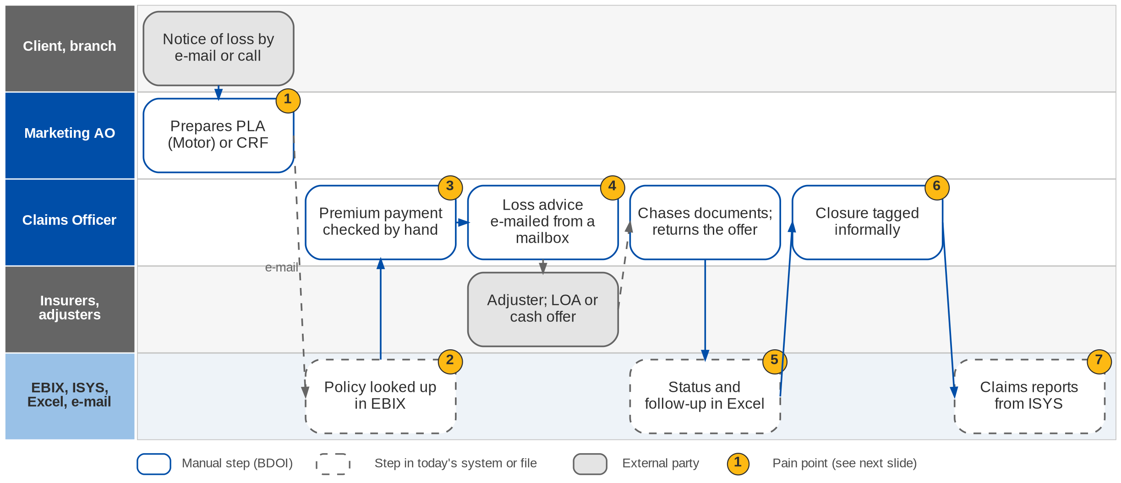
7. Claims: As-Is process
Claims today (BRD-7 p.24-26)
Confidential – BDOI
BIBS Business Process Deck | v1.0
62
Notes:
Today the notice of loss arrives by e-mail or call; Marketing prepares the Preliminary Loss Advice for Motor or the Claims Reporting Form for Non-Motor. Policy details are looked up in EBIX and re-keyed. Premium payment is checked by hand. The loss advice goes to the insurer by e-mail from a mailbox and the handler chases the client for documents. Status and follow-up are tracked in spreadsheets, closure is tagged informally, and claims reports are extracted from ISYS.

Slide 63
7. Claims: pain points today
1
Notice prepared by hand
PLA or CRF prepared by Marketing from an e-mail or a call.
BRD-7 p.24-25
5
Status in spreadsheets
Status, adjuster, reserve and follow-up dates tracked in Excel.
BRD-7 p.23, 27; BRCLM.010-024
2
Policy details re-keyed
Policy details are looked up in EBIX and keyed again.
BRD-7 p.24-25; BRCLM.003, 004
6
Informal closure
No distinction between temporary and permanent closure.
BRD-7 p.27-28; BRCLM.005, 035
3
Premium checked by hand
Nothing stops a claim on an unpaid invoice.
BRD-7 p.23; BRCLM.001
7
Reports from ISYS
Claims reports are extracted from ISYS.
BRD-7 p.39-42; Report List
4
Loss advice from a mailbox
No send log; insurer claim numbers kept outside a system.
BRD-7 p.24-25; BRCLM.041, 043
Confidential – BDOI
BIBS Business Process Deck | v1.0
63
Notes:
The seven points are the current-process rows of FRS BRD-7 section 2.1, from the BRD (p.23-27).
1. Notice prepared by hand: PLA or CRF prepared by Marketing from an e-mail or a call. (BRD-7 p.24-25)
2. Policy details re-keyed: Policy details are looked up in EBIX and keyed again. (BRD-7 p.24-25; BRCLM.003, 004)
3. Premium checked by hand: Nothing stops a claim on an unpaid invoice. (BRD-7 p.23; BRCLM.001)
4. Loss advice from a mailbox: No send log; insurer claim numbers kept outside a system. (BRD-7 p.24-25; BRCLM.041, 043)
5. Status in spreadsheets: Status, adjuster, reserve and follow-up dates tracked in Excel. (BRD-7 p.23, 27; BRCLM.010-024)
6. Informal closure: No distinction between temporary and permanent closure. (BRD-7 p.27-28; BRCLM.005, 035)
7. Reports from ISYS: Claims reports are extracted from ISYS. (BRD-7 p.39-42; Report List)

Slide 64
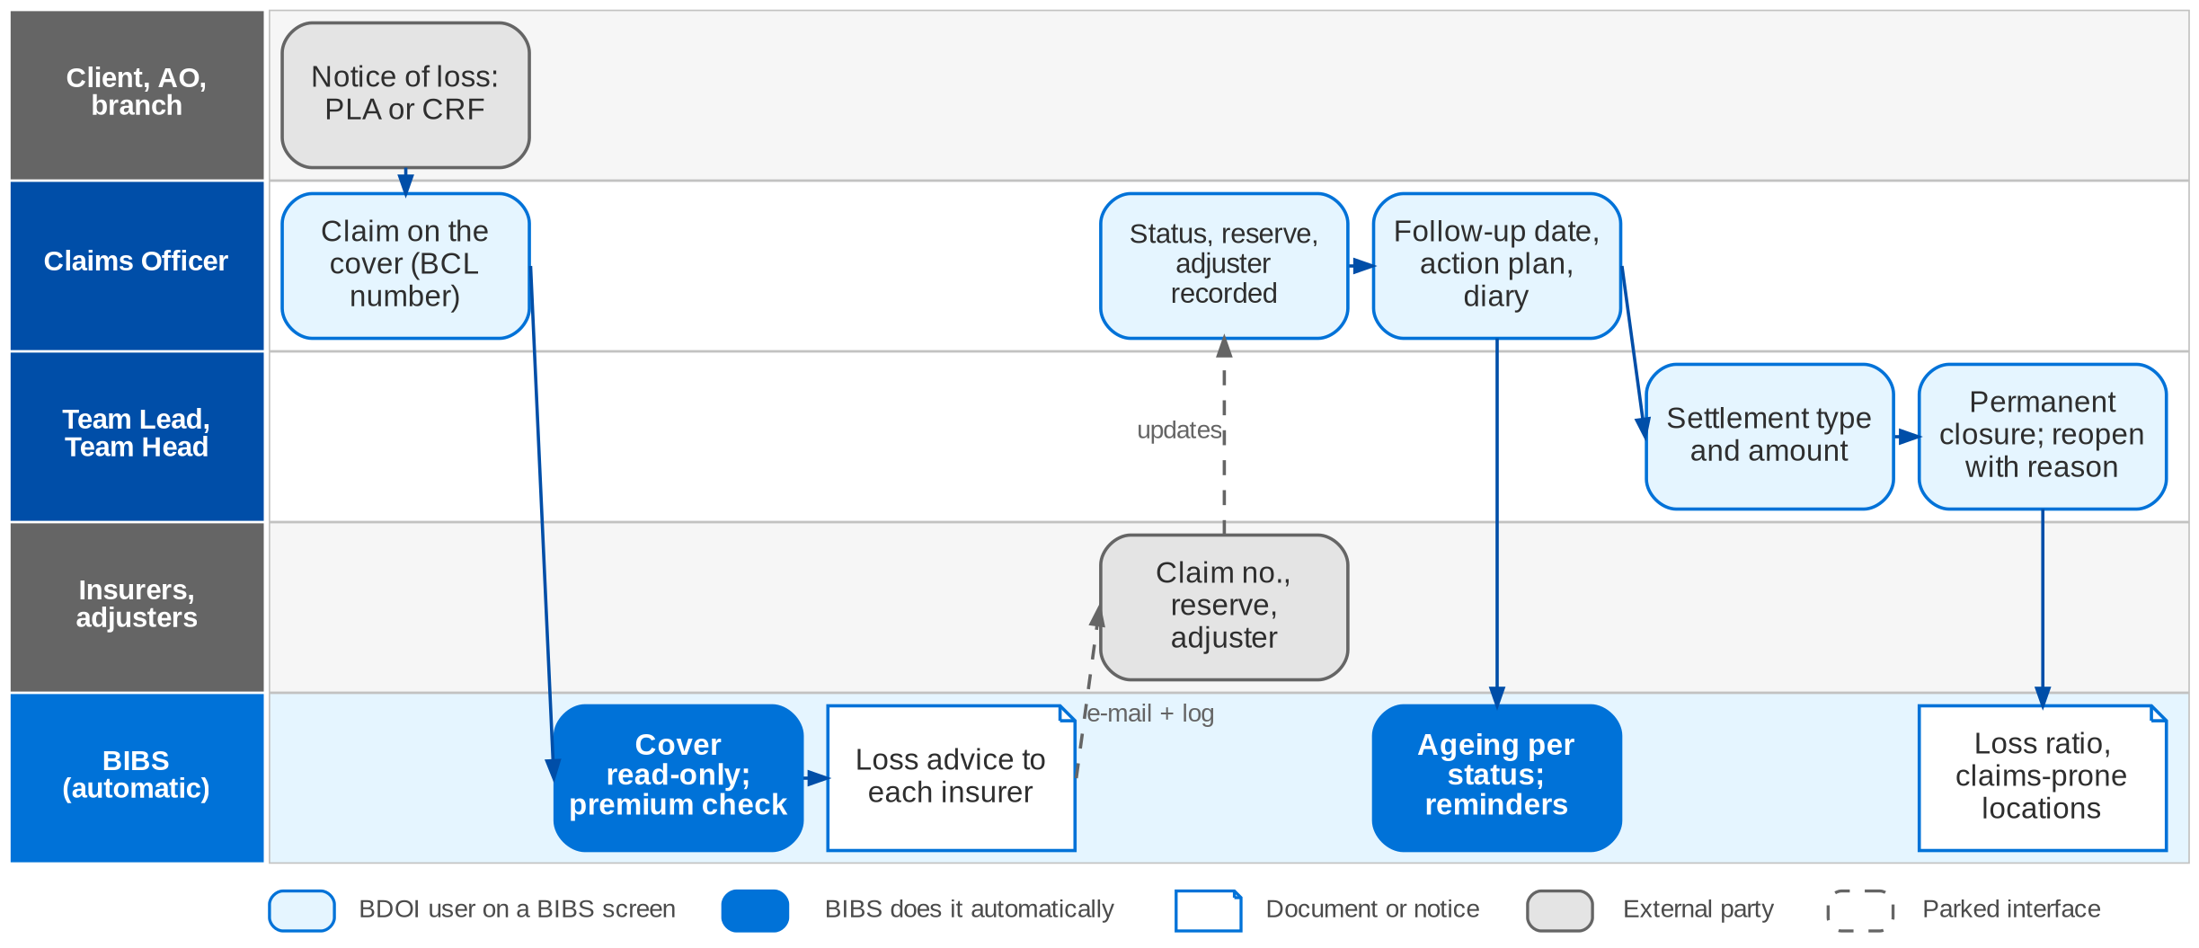
7. Claims: envisioned in BIBS
Claim lifecycle in BIBS: workflow BCL_CLAIM (FRS BRD-7 sections 2.2 and 5)
Confidential – BDOI
BIBS Business Process Deck | v1.0
64
Notes:
In BIBS the Claims Officer records the claim on the client's cover; the claim number is BCL-yyyy-nnnnnn. The cover, policy number, version, locations, Marketing unit and branch come from the BIBS account, read-only. BIBS reads the invoice ledger and disables the authorization code while premium is unpaid. The loss advice is generated and e-mailed to each insurer with a send log; insurer claim numbers are recorded per insurer. Status (restricted by role and unit), adjuster, reserve, next follow-up date, action plan and diary are on the claim, with history. Settlement type and amount are recorded; permanent closure needs a closing settlement type and a TL or TH. Ageing, outstanding, settled, loss experience and loss ratio reports run in BIBS and export to Excel.

Slide 65
7. Claims: before and after
Today (pain point)
In BIBS
Measure
1
Notice prepared by hand
Claim recorded on the cover in BIBS with the PLA / CRF data; number BCL-yyyy-nnnnnn
55 claims a day
2
Policy details re-keyed
Cover, policy, version, locations, unit and branch read from the account, read-only
No re-keying
3
Premium checked by hand
Invoice ledger read; authorization code disabled while premium is unpaid
Check in 5 s
4
Loss advice from a mailbox
Loss advice generated and e-mailed per insurer; insurer claim numbers recorded
Send log
5
Status in spreadsheets
Status within the role / unit matrix, adjuster, reserve, follow-up and diary on the claim
1,096 updates a day
6
Informal closure
Temporary and permanent closure; permanent needs a settlement type and a TL / TH
Four-eyes closure
7
Reports from ISYS
Ageing, outstanding, settled, loss experience and loss ratio reports in BIBS, to Excel
No ISYS extract
Confidential – BDOI
BIBS Business Process Deck | v1.0
65
Notes:
The usage table gives volumes and response times (p.32-41); no claim turnaround target is given.
1. Notice prepared by hand -> Claim recorded on the cover in BIBS with the PLA / CRF data; number BCL-yyyy-nnnnnn Measure: 55 claims a day.
2. Policy details re-keyed -> Cover, policy, version, locations, unit and branch read from the account, read-only Measure: No re-keying.
3. Premium checked by hand -> Invoice ledger read; authorization code disabled while premium is unpaid Measure: Check in 5 s.
4. Loss advice from a mailbox -> Loss advice generated and e-mailed per insurer; insurer claim numbers recorded Measure: Send log.
5. Status in spreadsheets -> Status within the role / unit matrix, adjuster, reserve, follow-up and diary on the claim Measure: 1,096 updates a day.
6. Informal closure -> Temporary and permanent closure; permanent needs a settlement type and a TL / TH Measure: Four-eyes closure.
7. Reports from ISYS -> Ageing, outstanding, settled, loss experience and loss ratio reports in BIBS, to Excel Measure: No ISYS extract.

Slide 66
7. Claims: gaps in the envisioned process
Level | Gap | Impact | Owner | Decision needed | Ref
High | Claims Authorization Code undefined | Valid claims could be blocked | Claims and Risk Management | What the code is; which unpaid invoice blocks; TL / TH override | DCR-085
High | Settlement type and settlement status | Claim closure and reporting | Claims and Risk Management | One list or two; which values close the claim | DCR-078
High | Does claim money pass through BDOI? | Cashiering and Disbursement flows for settlements | Claims, Operations | Record the cheque only, or handle the money | DCR-086
High | Open and historical claims at go-live | Loss ratio and claims-prone analysis need history | Claims, BDO IT | Scope and years from EBIX / ISYS | DCR-157, CLQ14
Medium | Who closes and reopens | Closure permissions | Claims and Risk Management | Officer or TL / TH for permanent closure | DCR-079
Medium | Total-loss indicator | Renewal eligibility after a total loss | Claims, Renewal | Settlement type, loss nature or a flag | XQ10
Confidential – BDOI
BIBS Business Process Deck | v1.0
66
Notes:
The Claims Authorization Code (DCR-085) decides how unpaid premium stops a claim.
DCR-085 (High): Claims Authorization Code undefined. Impact: Valid claims could be blocked. Owner: Claims and Risk Management. Decision: What the code is; which unpaid invoice blocks; TL / TH override
DCR-078 (High): Settlement type and settlement status. Impact: Claim closure and reporting. Owner: Claims and Risk Management. Decision: One list or two; which values close the claim
DCR-086 (High): Does claim money pass through BDOI?. Impact: Cashiering and Disbursement flows for settlements. Owner: Claims, Operations. Decision: Record the cheque only, or handle the money
DCR-157, CLQ14 (High): Open and historical claims at go-live. Impact: Loss ratio and claims-prone analysis need history. Owner: Claims, BDO IT. Decision: Scope and years from EBIX / ISYS
DCR-079 (Medium): Who closes and reopens. Impact: Closure permissions. Owner: Claims and Risk Management. Decision: Officer or TL / TH for permanent closure
XQ10 (Medium): Total-loss indicator. Impact: Renewal eligibility after a total loss. Owner: Claims, Renewal. Decision: Settlement type, loss nature or a flag

Slide 67
7. Claims: best practice
Premium-paid check before filing
Claims diary with ageing control
Four-eyes closure
Supported by BIBS
Supported by BIBS
Supported by BIBS
BIBS: Invoice ledger read at intake; authorization disabled while unpaid, with reason and history.
BDOI: Define the rule and the override (DCR-085).
BIBS: Next follow-up date, action plan, diary; age overall and per status; Claims home.
BDOI: Set follow-up targets per status.
BIBS: Permanent closure needs a closing settlement type and a TL or TH; reopen with a reason.
BDOI: Confirm who closes (DCR-079).
Loss data for pricing and renewal
Confidential claim documents
Claims service KPIs
Partly in BIBS
Partly in BIBS
BDOI to adopt
BIBS: Loss experience and claims-prone locations; Renewal reads claims (decision D4).
BDOI: Migrate claims history (CLQ14).
BIBS: Document access classes per type; claims reports as CLAIM_REPORT (decision D3).
BDOI: Approve the confidentiality matrix under the Data Privacy Act (XQ04).
BIBS: Ageing, outstanding and settled reports, 90-days-past-due list.
BDOI: Adopt turnaround targets for notice-to-advice and advice-to-settlement.
Confidential – BDOI
BIBS Business Process Deck | v1.0
67
Notes:
Practices that fit a Philippine insurance broker, and what BIBS supports today or by design.
Premium-paid check before filing [Supported by BIBS]. BIBS: Invoice ledger read at intake; authorization disabled while unpaid, with reason and history. BDOI: Define the rule and the override (DCR-085).
Claims diary with ageing control [Supported by BIBS]. BIBS: Next follow-up date, action plan, diary; age overall and per status; Claims home. BDOI: Set follow-up targets per status.
Four-eyes closure [Supported by BIBS]. BIBS: Permanent closure needs a closing settlement type and a TL or TH; reopen with a reason. BDOI: Confirm who closes (DCR-079).
Loss data for pricing and renewal [Partly in BIBS]. BIBS: Loss experience and claims-prone locations; Renewal reads claims (decision D4). BDOI: Migrate claims history (CLQ14).
Confidential claim documents [Partly in BIBS]. BIBS: Document access classes per type; claims reports as CLAIM_REPORT (decision D3). BDOI: Approve the confidentiality matrix under the Data Privacy Act (XQ04).
Claims service KPIs [BDOI to adopt]. BIBS: Ageing, outstanding and settled reports, 90-days-past-due list. BDOI: Adopt turnaround targets for notice-to-advice and advice-to-settlement.

Slide 68
8. Employee Benefits
BRD-8 | Group benefit programmes: renewal advice to placement, member servicing, partner portal
Confidential – BDOI | BIBS Business Process Deck
Notes:
BRD-8 Employee Benefits: Group benefit programmes: renewal advice to placement, member servicing, partner portal.

Slide 69
8. Employee Benefits: at a glance
Department and roles
Volumes and NFRs (BRD)
BRD and build status
Employee Benefits: Marketing, Processing and Collection
• EB Marketing AO and TL / UH (five EB teams)
• BDOI Management (threshold approval)
• EB Processing and Processing Supervisor
• EB Collection
• Portal: insurer and HMO users, client HR users
4,200
transactions in 2025; 4,150 are renewals (Add. p.14)
Designed
Designed with the partner portal; FRS v1.0 issued for review
• BRD-8 workshop addendum Add. p.3-5 (current and envisioned)
• BRID-001-030; main BRD p.5
• FRS BRD-8 v1.0; decision D7 (portal users)
20
BDOI users: Marketing 13, Processing 4, Collection 3
135
days before expiry: default renewal advice (TAT annex)
99.99%
availability asked; use 08:30-19:00 (p.36-37)
The process in one line
Renewal advice
Requirements
BOR and franchise
TOR
Proposals
Comparative
Client decision
Placement
Confidential – BDOI
BIBS Business Process Deck | v1.0
69
Notes:
Business comes from five EB teams: BDO (captive bank group accounts), SM, Voluntary, Solicited and New Business. Renewals dominate. Insurers and client HR users are the first external users of BIBS: they work in the partner portal, and nothing they upload takes effect before BDOI validates it. Portal users are provisioned through User Access Maintenance as external users (decision D7). Employee Benefits is designed.
Sources: BRD-8 workshop addendum Add. p.3-5 (current and envisioned); BRID-001-030; main BRD p.5; FRS BRD-8 v1.0; decision D7 (portal users)

Slide 70
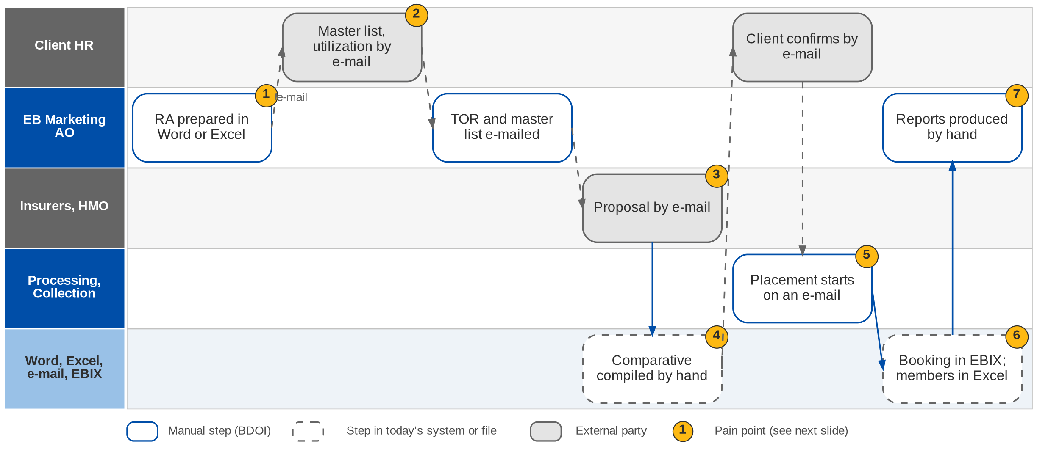
8. Employee Benefits: As-Is process
Employee Benefits today (BRD-8 Add. p.3)
Confidential – BDOI
BIBS Business Process Deck | v1.0
70
Notes:
Today renewal advices are prepared in Word or Excel. The TOR, master lists, utilization reports and proposals travel by e-mail with no repository, and insurers and clients reply by e-mail. The comparative is compiled by hand. Placement starts on an e-mail to Processing, member movements and billing are tracked in spreadsheets, booking is in EBIX, and reports are produced manually.

Slide 71
8. Employee Benefits: pain points today
1
Renewal advices by hand
Prepared in Word or Excel for each programme.
BRD-8 Add. p.3; BRID-001
5
Placement starts on an e-mail
Hand-offs between Marketing, Processing and Collection run on e-mail.
BRD-8 Add. p.3; BRID-017
2
No document repository
TOR, master lists, utilization and proposals travel by e-mail.
BRD-8 Add. p.3; BRID-002, 007
6
Members and billing in spreadsheets
Member movements, direct billing, cards and SOAs tracked in Excel.
BRD-8 Add. p.3; BRID-013, 021, 030
3
Insurers and clients reply by e-mail
No secure channel and no validation before use.
BRD-8 Add. p.3-4; BRID-005
7
Reports by hand
Production, renewal and TAT reports compiled manually.
BRD-8 Add. p.3; BRID-022
4
Comparative compiled by hand
Proposals are re-keyed into a comparative.
BRD-8 Add. p.3; BRID-010
Confidential – BDOI
BIBS Business Process Deck | v1.0
71
Notes:
The seven points are the current-process rows of FRS BRD-8 section 2.1, from the addendum (Add. p.3).
1. Renewal advices by hand: Prepared in Word or Excel for each programme. (BRD-8 Add. p.3; BRID-001)
2. No document repository: TOR, master lists, utilization and proposals travel by e-mail. (BRD-8 Add. p.3; BRID-002, 007)
3. Insurers and clients reply by e-mail: No secure channel and no validation before use. (BRD-8 Add. p.3-4; BRID-005)
4. Comparative compiled by hand: Proposals are re-keyed into a comparative. (BRD-8 Add. p.3; BRID-010)
5. Placement starts on an e-mail: Hand-offs between Marketing, Processing and Collection run on e-mail. (BRD-8 Add. p.3; BRID-017)
6. Members and billing in spreadsheets: Member movements, direct billing, cards and SOAs tracked in Excel. (BRD-8 Add. p.3; BRID-013, 021, 030)
7. Reports by hand: Production, renewal and TAT reports compiled manually. (BRD-8 Add. p.3; BRID-022)

Slide 72
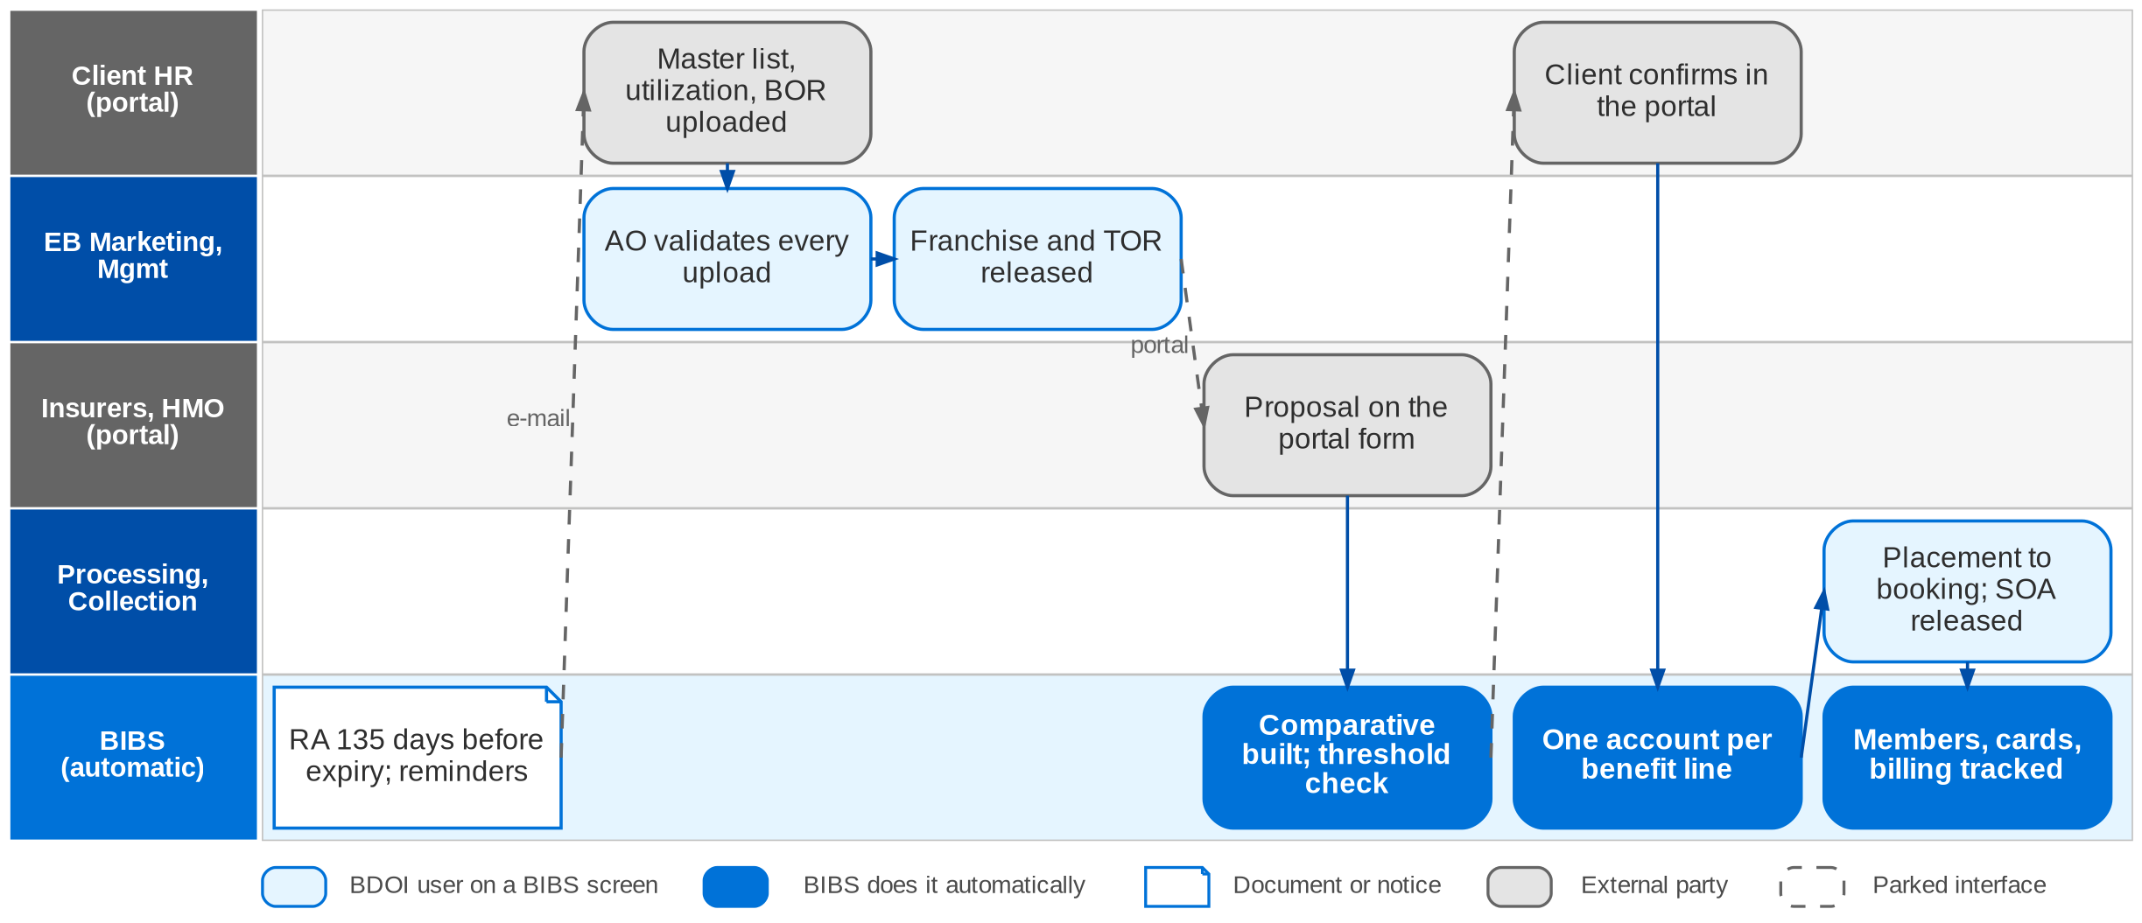
8. Employee Benefits: envisioned in BIBS
EB cycle in BIBS: workflow EB_CYCLE and the partner portal (FRS BRD-8 sections 2.2 and 5)
Confidential – BDOI
BIBS Business Process Deck | v1.0
72
Notes:
In BIBS a daily job sends the renewal advice 135 days before expiry (default), with reminders and a feedback request. Client HR users upload the master list, utilization and the signed BOR in the partner portal; the AO validates every upload before it takes effect. Target insurers approve the franchise in the portal; the TOR and the unnamed master list are released to them, and they submit proposals on a structured form. BIBS builds the comparative from the validated proposals; sign-off and the value-threshold approval are workflow steps. The client's confirmation creates one account per benefit line and notifies Processing, who place, issue and book on the BRD-1 spine and release the SOA. Member changes, direct billing, contracts, HMO cards and SOAs are tracked items with automatic follow-ups.

Slide 73
8. Employee Benefits: before and after
Today (pain point)
In BIBS
Measure
1
Renewal advices by hand
Daily job sends the RA 135 days before expiry, with reminders and a feedback request
About 4,150 renewals a year
2
No document repository
Every document registered with cycle, type, process and version; outbound files protected
One repository
3
Insurers and clients reply by e-mail
Insurers and client HR work in the partner portal; uploads take effect after BDOI validation
Validation before use
4
Comparative compiled by hand
Comparative built from the validated proposals; sign-off and threshold approval in the workflow
No re-keying
5
Placement starts on an e-mail
Client confirmation creates one account per benefit line and notifies Processing
Hand-off in the system
6
Members and billing in spreadsheets
Member changes, direct billing, contracts, HMO cards and SOAs are tracked items with follow-ups
Automatic follow-ups
7
Reports by hand
Production, Renewal, Placement, New Business and TAT reports with a business type filter
Live reports
Confidential – BDOI
BIBS Business Process Deck | v1.0
73
Notes:
The BRD asks for automatic renewal advices, one repository, secure access and standard comparatives (Add. p.4-5); it gives no turnaround target.
1. Renewal advices by hand -> Daily job sends the RA 135 days before expiry, with reminders and a feedback request Measure: About 4,150 renewals a year.
2. No document repository -> Every document registered with cycle, type, process and version; outbound files protected Measure: One repository.
3. Insurers and clients reply by e-mail -> Insurers and client HR work in the partner portal; uploads take effect after BDOI validation Measure: Validation before use.
4. Comparative compiled by hand -> Comparative built from the validated proposals; sign-off and threshold approval in the workflow Measure: No re-keying.
5. Placement starts on an e-mail -> Client confirmation creates one account per benefit line and notifies Processing Measure: Hand-off in the system.
6. Members and billing in spreadsheets -> Member changes, direct billing, contracts, HMO cards and SOAs are tracked items with follow-ups Measure: Automatic follow-ups.
7. Reports by hand -> Production, Renewal, Placement, New Business and TAT reports with a business type filter Measure: Live reports.

Slide 74
8. Employee Benefits: gaps in the envisioned process
Level | Gap | Impact | Owner | Decision needed | Ref
High | No data-privacy rule for member data | Health-related personal data under the Data Privacy Act | EB, Compliance (DPO) | Access, masking and retention for master lists and utilization | DCR-094
High | External portal users | Internet-facing access: hosting, MFA, provisioning | EB, BDO Information Security | Who creates and approves portal users; MFA; DMZ | DCR-096
Medium | RA 180 or 135 days before expiry | Timing of the renewal cycle | EB Marketing | Days before expiry and number of reminders | DCR-087
Medium | BOR for renewals | Insurer requests blocked or not | EB Marketing | Never, when remarketing, or always | DCR-088
Medium | Franchise and ISACOM steps | Steps without requirement rows | EB Marketing | What ISACOM approves, and when | DCR-090
Medium | HMO providers as insurers | Catalog of placement counterparties | EB, MBS | List the benefit lines; HMOs held with insurers? | DCR-097
Confidential – BDOI
BIBS Business Process Deck | v1.0
74
Notes:
Member lists and utilization reports are health-related personal data: DCR-094 is the main compliance gap.
DCR-094 (High): No data-privacy rule for member data. Impact: Health-related personal data under the Data Privacy Act. Owner: EB, Compliance (DPO). Decision: Access, masking and retention for master lists and utilization
DCR-096 (High): External portal users. Impact: Internet-facing access: hosting, MFA, provisioning. Owner: EB, BDO Information Security. Decision: Who creates and approves portal users; MFA; DMZ
DCR-087 (Medium): RA 180 or 135 days before expiry. Impact: Timing of the renewal cycle. Owner: EB Marketing. Decision: Days before expiry and number of reminders
DCR-088 (Medium): BOR for renewals. Impact: Insurer requests blocked or not. Owner: EB Marketing. Decision: Never, when remarketing, or always
DCR-090 (Medium): Franchise and ISACOM steps. Impact: Steps without requirement rows. Owner: EB Marketing. Decision: What ISACOM approves, and when
DCR-097 (Medium): HMO providers as insurers. Impact: Catalog of placement counterparties. Owner: EB, MBS. Decision: List the benefit lines; HMOs held with insurers?

Slide 75
8. Employee Benefits: best practice
Data-privacy controls on member data
Secure partner portal
One version-controlled repository
Partly in BIBS
Partly in BIBS
Supported by BIBS
BIBS: Document access classes, protected files, download logging, audit trail.
BDOI: Set masking and retention for member data with the DPO (DCR-094).
BIBS: Portal roles for insurers and client HR; uploads validated before use; lock-out after 3 attempts.
BDOI: Decide MFA, hosting and provisioning (DCR-096).
BIBS: Documents registered by cycle, type, process and version.
BDOI: Stop e-mailing census files once the portal is live.
Approval thresholds owned by the business
Service KPIs per programme
Straight-through renewal where terms are unchanged
Supported by BIBS
Supported by BIBS
BDOI to adopt
BIBS: Threshold rules on TSI or premium route the comparative to BDOI Management.
BDOI: Set the threshold values.
BIBS: TAT report and EB home with pending items and overdue follow-ups.
BDOI: Agree TAT targets per step with the five EB teams.
BIBS: Incumbent indicative terms can go to the client without remarketing.
BDOI: Define when a renewal may skip remarketing.
Confidential – BDOI
BIBS Business Process Deck | v1.0
75
Notes:
Practices that fit a Philippine insurance broker, and what BIBS supports today or by design.
Data-privacy controls on member data [Partly in BIBS]. BIBS: Document access classes, protected files, download logging, audit trail. BDOI: Set masking and retention for member data with the DPO (DCR-094).
Secure partner portal [Partly in BIBS]. BIBS: Portal roles for insurers and client HR; uploads validated before use; lock-out after 3 attempts. BDOI: Decide MFA, hosting and provisioning (DCR-096).
One version-controlled repository [Supported by BIBS]. BIBS: Documents registered by cycle, type, process and version. BDOI: Stop e-mailing census files once the portal is live.
Approval thresholds owned by the business [Supported by BIBS]. BIBS: Threshold rules on TSI or premium route the comparative to BDOI Management. BDOI: Set the threshold values.
Service KPIs per programme [Supported by BIBS]. BIBS: TAT report and EB home with pending items and overdue follow-ups. BDOI: Agree TAT targets per step with the five EB teams.
Straight-through renewal where terms are unchanged [BDOI to adopt]. BIBS: Incumbent indicative terms can go to the client without remarketing. BDOI: Define when a renewal may skip remarketing.

Slide 76
9. Customer Servicing Facility
BRD-9 | Contact centre search, servicing view, contact updates, document resends
Confidential – BDOI | BIBS Business Process Deck
Notes:
BRD-9 Customer Servicing Facility: Contact centre search, servicing view, contact updates, document resends.

Slide 77
9. Customer Servicing Facility: at a glance
Department and roles
Volumes and NFRs (BRD)
BRD and build status
Contact Center Management / Alternative Distribution
• BDO Insure Contact Center Agent
• Contact Center Supervisor; BDO Contact Center personnel
• Contact Center Management, leads and heads
• System Administrator
• Callers (clients) and the fulfilment units
144,400
access, retrieval and search transactions a year (p.13-14)
Designed
Designed, not yet built; FRS v1.0 issued for review
• BRD-9 p.3-5 (current and envisioned); e-mail clarification p.17
• BRCSF-001-011
• FRS BRD-9 v1.0, sections 2 and 5
24
concurrent agents, supervisors and personnel
< 3 s
retrieval, update and search; 5 s documents
06-22
use 06:00-22:00; availability 99.9%
The process in one line
Sign in
Search
Servicing view
Verify caller
Update contact
Resend
Documents
Audit
Confidential – BDOI
BIBS Business Process Deck | v1.0
77
Notes:
The BDO-Insure Front-End System was built by BDO IT for the contact centre agents. It shows full account details only for CBG accounts, lets agents update contact details only, has servers at end of life and no role-based access control (BRD-9 p.4). In BIBS the CSF reads the BIBS modules through their query services and stores only its own records. It has no approval workflow: every action is immediate and logged. It is designed. Note: the printed e-mail in the pack carries meeting credentials; circulate a redacted copy (DCR-098).
Sources: BRD-9 p.3-5 (current and envisioned); e-mail clarification p.17; BRCSF-001-011; FRS BRD-9 v1.0, sections 2 and 5

Slide 78
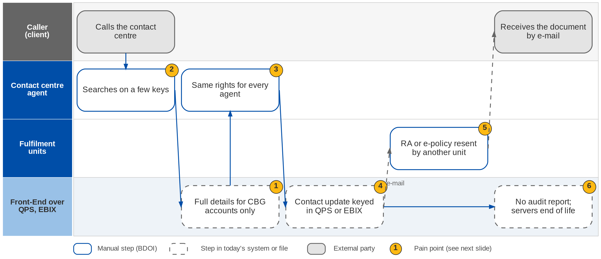
9. Customer Servicing Facility: As-Is process
Contact centre servicing today (BRD-9 p.4)
Confidential – BDOI
BIBS Business Process Deck | v1.0
78
Notes:
Today the agent searches the Front-End on a limited set of keys. Full account details show for CBG accounts only; for non-CBG accounts the agent sees only contact details, account number and expiry date. Every agent has the same rights. Contact updates are written into QPS or EBIX. Renewal advice and e-policy resends are handled outside the tool by the fulfilment units, and management has no audit report. The servers have reached end of life.

Slide 79
9. Customer Servicing Facility: pain points today
1
Full details for CBG accounts only
Non-CBG accounts show contact details, account number and expiry date only.
BRD-9 p.4; BRCSF-002, 005
4
Updates written in QPS or EBIX
Contact details are changed in the legacy systems.
BRD-9 p.3-5; BRCSF-004
2
Limited search keys
Agents cannot search by every key the caller gives.
BRD-9 p.17 (e-mail); BRCSF-003
5
Resends outside the tool
RA and e-policy resends are handled by other units.
BRD-9 p.17 (e-mail item 9); BRCSF-006
3
No role-based access
Agents, supervisors and management have the same rights.
BRD-9 p.4
6
No audit report; ageing servers
Management has no audit trail of agent actions; servers at end of life.
BRD-9 p.4; BRCSF-010, 011
Confidential – BDOI
BIBS Business Process Deck | v1.0
79
Notes:
The six points are the current-process rows of FRS BRD-9 section 2.1, from the BRD (p.3-5, p.17).
1. Full details for CBG accounts only: Non-CBG accounts show contact details, account number and expiry date only. (BRD-9 p.4; BRCSF-002, 005)
2. Limited search keys: Agents cannot search by every key the caller gives. (BRD-9 p.17 (e-mail); BRCSF-003)
3. No role-based access: Agents, supervisors and management have the same rights. (BRD-9 p.4)
4. Updates written in QPS or EBIX: Contact details are changed in the legacy systems. (BRD-9 p.3-5; BRCSF-004)
5. Resends outside the tool: RA and e-policy resends are handled by other units. (BRD-9 p.17 (e-mail item 9); BRCSF-006)
6. No audit report; ageing servers: Management has no audit trail of agent actions; servers at end of life. (BRD-9 p.4; BRCSF-010, 011)

Slide 80
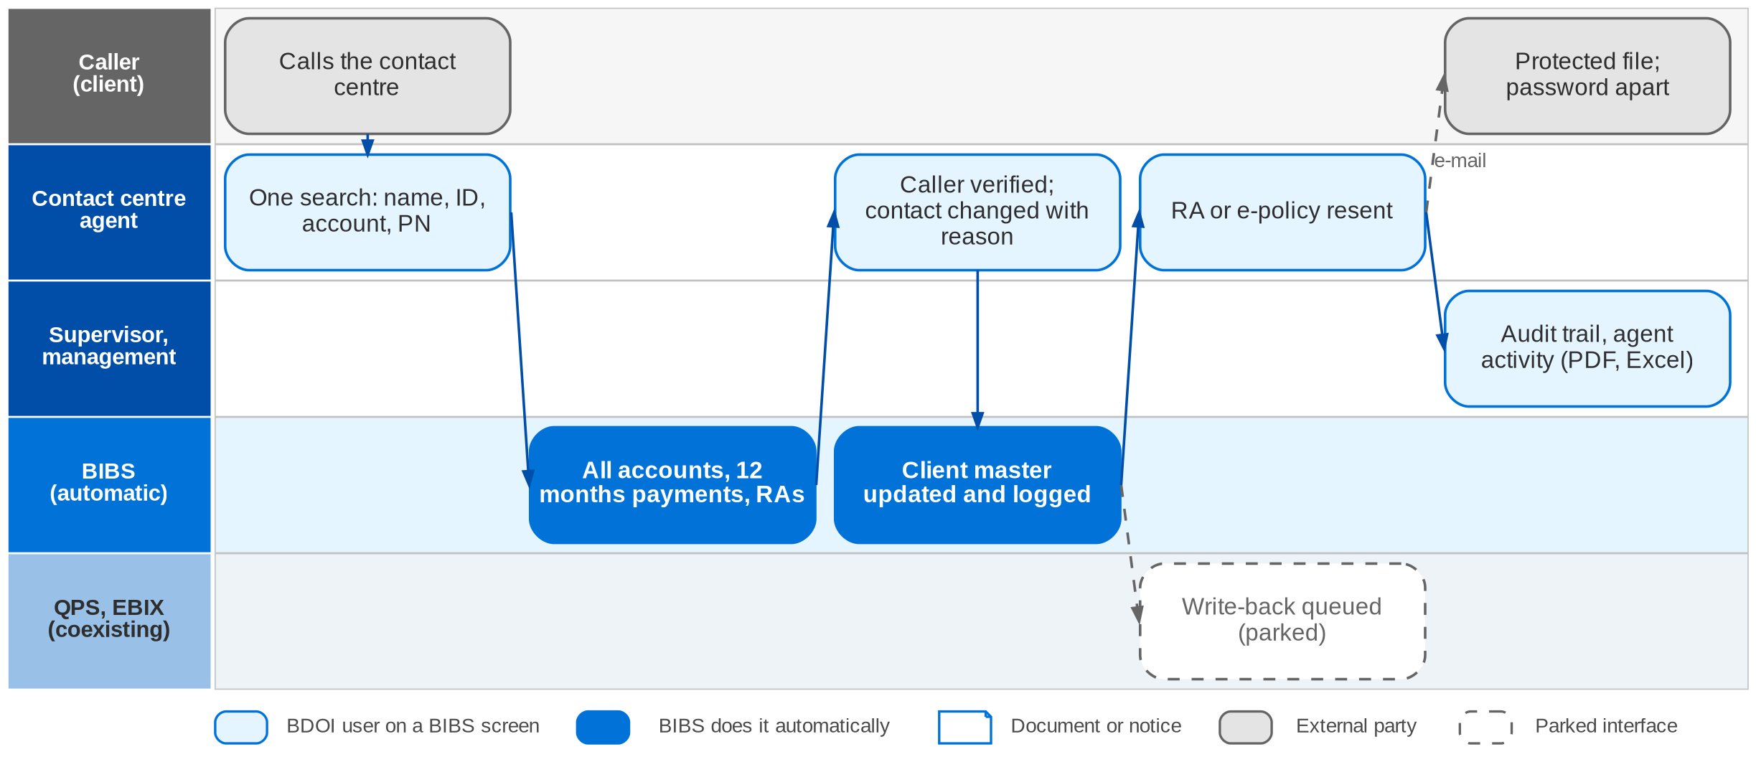
9. Customer Servicing Facility: envisioned in BIBS
Servicing contact in BIBS: no approval workflow, every action immediate and logged (FRS BRD-9 section 2.2)
Confidential – BDOI
BIBS Business Process Deck | v1.0
80
Notes:
In BIBS the agent signs in to the Customer Search. One search box takes the name, client ID, account number, PN number or application number, and results group by client. The servicing view shows the client summary, every account (CBG and non-CBG) with its CSF status, payments of the last 12 months, RAs, e-policies and documents. Before an update the agent completes the verification checklist; only contact fields change, with a reason, in the BIBS client master. The agent resends the RA or the e-policy to the registered e-mail, password protected, with the password sent separately. The contact change is queued for QPS and EBIX while they coexist (parked seam, CSQ01). Management prints or saves the audit trail and agent activity in PDF or Excel.

Slide 81
9. Customer Servicing Facility: before and after
Today (pain point)
In BIBS
Measure
1
Full details for CBG accounts only
Every account of the client, CBG and non-CBG, with status and payments
All segments
2
Limited search keys
One search box for name, client ID, account number, PN number and application number
< 3 s search
3
No role-based access
Agent, supervisor and management roles with separate rights to update, resend and upload
Role-based access
4
Updates written in QPS or EBIX
Update made once in the BIBS client master after verifying the caller; write-back seam for QPS / EBIX
Verification before change
5
Resends outside the tool
Agent views, downloads and resends the RA and e-policy to the registered e-mail, protected
Resend in one call
6
No audit report; ageing servers
Every change and agent action logged; audit trail in PDF or Excel
Full audit trail
Confidential – BDOI
BIBS Business Process Deck | v1.0
81
Notes:
The usage table gives the volumes and response times (p.13-14).
1. Full details for CBG accounts only -> Every account of the client, CBG and non-CBG, with status and payments Measure: All segments.
2. Limited search keys -> One search box for name, client ID, account number, PN number and application number Measure: < 3 s search.
3. No role-based access -> Agent, supervisor and management roles with separate rights to update, resend and upload Measure: Role-based access.
4. Updates written in QPS or EBIX -> Update made once in the BIBS client master after verifying the caller; write-back seam for QPS / EBIX Measure: Verification before change.
5. Resends outside the tool -> Agent views, downloads and resends the RA and e-policy to the registered e-mail, protected Measure: Resend in one call.
6. No audit report; ageing servers -> Every change and agent action logged; audit trail in PDF or Excel Measure: Full audit trail.

Slide 82
9. Customer Servicing Facility: gaps in the envisioned process
Level | Gap | Impact | Owner | Decision needed | Ref
High | Write-back to QPS and EBIX | Two systems of record while they coexist | Contact Center Management, BDO IT | Until when are QPS / EBIX kept? Write back or not? | DCR-104, CSQ01
High | Agents in the BDO directory | Sign-in of contact centre agents | BDO ITIO | Are agents in EUA? Local sign-in meanwhile? | DCR-143
High | Backup every 15 minutes or 4 hours | Backup and recovery design of the platform | BDO IT | Is RPO 15 minutes BIBS-wide? | DCR-102
Medium | Statuses Pending, Awaiting, Booked, Open / Closed | What the agent tells the caller | Contact Center Management | Define each status and its source | DCR-101
Medium | Two contact centre roles | Renewal follow-up role and CSF roles | Contact Center, RMEL | Same people? One role or two? | XQ02
Medium | Documents agents may see | Confidential claim and renewal documents | Contact Center, Compliance | Confidentiality matrix per document type | XQ04, XQ05
Confidential – BDOI
BIBS Business Process Deck | v1.0
82
Notes:
The write-back to QPS and EBIX (DCR-104) decides how long two systems of record coexist.
DCR-104, CSQ01 (High): Write-back to QPS and EBIX. Impact: Two systems of record while they coexist. Owner: Contact Center Management, BDO IT. Decision: Until when are QPS / EBIX kept? Write back or not?
DCR-143 (High): Agents in the BDO directory. Impact: Sign-in of contact centre agents. Owner: BDO ITIO. Decision: Are agents in EUA? Local sign-in meanwhile?
DCR-102 (High): Backup every 15 minutes or 4 hours. Impact: Backup and recovery design of the platform. Owner: BDO IT. Decision: Is RPO 15 minutes BIBS-wide?
DCR-101 (Medium): Statuses Pending, Awaiting, Booked, Open / Closed. Impact: What the agent tells the caller. Owner: Contact Center Management. Decision: Define each status and its source
XQ02 (Medium): Two contact centre roles. Impact: Renewal follow-up role and CSF roles. Owner: Contact Center, RMEL. Decision: Same people? One role or two?
XQ04, XQ05 (Medium): Documents agents may see. Impact: Confidential claim and renewal documents. Owner: Contact Center, Compliance. Decision: Confidentiality matrix per document type

Slide 83
9. Customer Servicing Facility: best practice
Single client view
Verify the caller before any change
Protected delivery of documents
Supported by BIBS
Supported by BIBS
Supported by BIBS
BIBS: All accounts, payments, RAs, e-policies and documents of the client on one screen.
BDOI: Retire the Front-End once the data are in BIBS.
BIBS: Verification checklist before a contact update; only contact fields change.
BDOI: Approve the verification questions.
BIBS: Resend to the registered e-mail only, password protected, password sent separately.
BDOI: Agree the password convention (DCR-153).
Least-privilege roles
Quality review of agent actions
First-contact resolution KPI
Supported by BIBS
Supported by BIBS
BDOI to adopt
BIBS: Separate rights to update, resend and upload for agents, supervisors and management.
BDOI: Approve the role matrix (DCR-121).
BIBS: Agent activity and contact-change reports for supervisors.
BDOI: Set a sampling routine for supervisors.
BIBS: Actions logged per contact.
BDOI: Track first-contact resolution and repeat calls per reason.
Confidential – BDOI
BIBS Business Process Deck | v1.0
83
Notes:
Practices that fit a Philippine insurance broker, and what BIBS supports today or by design.
Single client view [Supported by BIBS]. BIBS: All accounts, payments, RAs, e-policies and documents of the client on one screen. BDOI: Retire the Front-End once the data are in BIBS.
Verify the caller before any change [Supported by BIBS]. BIBS: Verification checklist before a contact update; only contact fields change. BDOI: Approve the verification questions.
Protected delivery of documents [Supported by BIBS]. BIBS: Resend to the registered e-mail only, password protected, password sent separately. BDOI: Agree the password convention (DCR-153).
Least-privilege roles [Supported by BIBS]. BIBS: Separate rights to update, resend and upload for agents, supervisors and management. BDOI: Approve the role matrix (DCR-121).
Quality review of agent actions [Supported by BIBS]. BIBS: Agent activity and contact-change reports for supervisors. BDOI: Set a sampling routine for supervisors.
First-contact resolution KPI [BDOI to adopt]. BIBS: Actions logged per contact. BDOI: Track first-contact resolution and repeat calls per reason.

Slide 84
10. Sanction Screening
BRD-10 | Sanction and PEP screening, risk profiling, case review, escalation, STR
Confidential – BDOI | BIBS Business Process Deck
Notes:
BRD-10 Sanction Screening: Sanction and PEP screening, risk profiling, case review, escalation, STR.

Slide 85
10. Sanction Screening: at a glance
Department and roles
Volumes and NFRs (BRD)
BRD and build status
Compliance (Chief Compliance Officer)
• Compliance Officer and Compliance Checker
• Unit Compliance Coordinator; Investigators (287)
• Approver (Unit Head, 8)
• AML Committee (5 members)
• Operations Lead; Auditor
64 h
a month freed for Compliance (p.4-5)
Designed
Designed, not yet built; FRS v1.0 issued for review
• BRD-10 p.6-7 (current process, rendered from images), p.8 (to-be)
• SNSRP-101 to 706
• FRS BRD-10 v1.0, sections 2 and 5
4 h > 1 h
case cycle time, current to target (p.4-5)
10 min
saved per case on name screening (p.4-5)
300
list records a day at most (10 to 300; p.22-25)
The process in one line
Configure
List intake
Matching
Risk tagging
Case
Investigation
Approval
STR
Confidential – BDOI
BIBS Business Process Deck | v1.0
85
Notes:
BDOI screens clients by hand today. The BRD asks for one in-system workflow with configurable criteria and matrices, a list updated on a schedule, automated matching, risk tagging and case creation, review templates, routing to approvers, escalation to Compliance and the AML Committee, STR preparation and extraction, and immutable audit logs. The benefits on p.4-5 are the only quantified targets in the twelve BRDs. The module is designed.
Sources: BRD-10 p.6-7 (current process, rendered from images), p.8 (to-be); SNSRP-101 to 706; FRS BRD-10 v1.0, sections 2 and 5

Slide 86
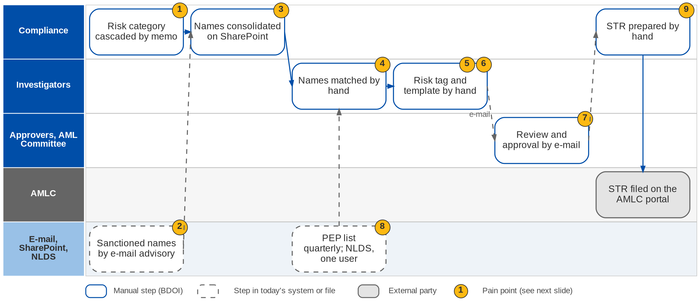
10. Sanction Screening: As-Is process
Name screening and risk profiling today (BRD-10 p.6-7)
Confidential – BDOI
BIBS Business Process Deck | v1.0
86
Notes:
Today the risk-profile category is cascaded by memo. The AML unit sends sanctioned names by e-mail advisory; Compliance consolidates them and publishes them on SharePoint. Investigators match the names against new and existing clients by hand, tag the client risk profile by hand, fill review templates outside the system and route them by e-mail for review and approval. PEP lists are prepared every quarter by Marketing and validated in NLDS, to which one person has access. There is no Enhanced Due Diligence for PEPs. The STR is prepared by hand and filed on the AMLC portal.

Slide 87
10. Sanction Screening: pain points today
1
Risk category by memo
The risk-profile category is cascaded by memo.
BRD-10 p.6
6
Templates outside the system
Review templates are filled outside the system and e-mailed.
BRD-10 p.6
2
Sanctioned names by e-mail
The AML unit sends names by e-mail advisory.
BRD-10 p.6
7
Routing by e-mail
Review and approval items are routed by e-mail.
BRD-10 p.6
3
List kept on SharePoint
Compliance consolidates and publishes the names on SharePoint.
BRD-10 p.6
8
PEP list quarterly; one NLDS user
PEP lists prepared by Marketing AOs; no EDD for PEPs.
BRD-10 p.7
4
Matching by hand
Names are matched against new and existing clients manually.
BRD-10 p.6
9
STR by hand
The STR is prepared manually and filed on the AMLC portal.
BRD-10 p.6
5
Risk profile tagged by hand
The client risk profile is tagged manually.
BRD-10 p.6
Confidential – BDOI
BIBS Business Process Deck | v1.0
87
Notes:
The nine points are the current-process rows of FRS BRD-10 section 2.1, read from the image pages of the BRD (p.6-7).
1. Risk category by memo: The risk-profile category is cascaded by memo. (BRD-10 p.6)
2. Sanctioned names by e-mail: The AML unit sends names by e-mail advisory. (BRD-10 p.6)
3. List kept on SharePoint: Compliance consolidates and publishes the names on SharePoint. (BRD-10 p.6)
4. Matching by hand: Names are matched against new and existing clients manually. (BRD-10 p.6)
5. Risk profile tagged by hand: The client risk profile is tagged manually. (BRD-10 p.6)
6. Templates outside the system: Review templates are filled outside the system and e-mailed. (BRD-10 p.6)
7. Routing by e-mail: Review and approval items are routed by e-mail. (BRD-10 p.6)
8. PEP list quarterly; one NLDS user: PEP lists prepared by Marketing AOs; no EDD for PEPs. (BRD-10 p.7)
9. STR by hand: The STR is prepared manually and filed on the AMLC portal. (BRD-10 p.6)

Slide 88
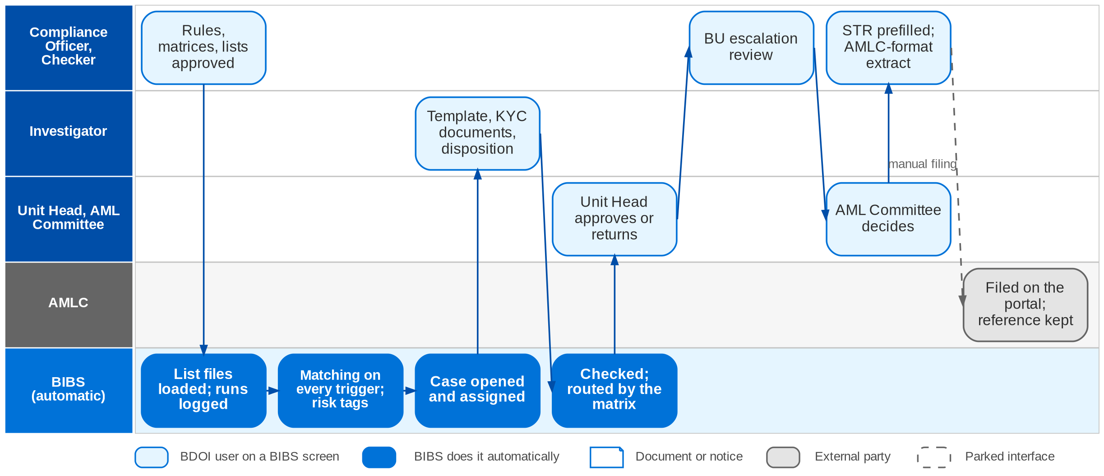
10. Sanction Screening: envisioned in BIBS
To-be screening in BIBS: case workflow SCR_CASE (FRS BRD-10 sections 2.2 and 5)
Confidential – BDOI
BIBS Business Process Deck | v1.0
88
Notes:
In BIBS Compliance maintains the risk categories, rules, matrices, templates and dispositions; a checker approves each version. List files load on a schedule or by upload, and every run is logged. BIBS matches every new client, every identity change, every account application, every list change and the whole client base in a batch window, with exact, phonetic and fuzzy rules, and sets the risk rating and the PEP / watchlist tags. A case opens and is assigned by the assignment matrix. The Investigator completes the review template, uploads the KYC documents and submits. BIBS validates the case and routes it by the approval matrix to the Unit Head, Compliance and the AML Committee. The STR is prefilled from the case and the committee-approved STRs are extracted in the AMLC format; the AMLC reference is recorded after portal filing.

Slide 89
10. Sanction Screening: before and after
Today (pain point)
In BIBS
Measure
1
Risk category by memo
Risk categories and rules maintained in BIBS; a checker approves each version
Maker-checker on rules
2
Sanctioned names by e-mail
List files loaded on a schedule or uploaded; every run logged, failed records reported
10-300 records a day
3
List kept on SharePoint
Watchlist held in BIBS by source; manual additions through maker-checker
One list
4
Matching by hand
Every new client, application, list change and the client base in a batch window
10 min saved per case
5
Risk profile tagged by hand
Risk rules set the rating and PEP / watchlist tags; override with evidence
Tags by rule
6
Templates outside the system
Review template completed on the case with the KYC documents
Case cycle 4 h > 1 h
7
Routing by e-mail
Case validated and routed by the approval matrix to UH, Compliance and AML Committee
64 h a month freed
8
PEP list quarterly; one NLDS user
PEP entries in the watchlist; PEP clients get a case and, where required, an EDD review
EDD for PEPs
9
STR by hand
STR prefilled from the case; approved STRs extracted in the AMLC format
Reference recorded
Confidential – BDOI
BIBS Business Process Deck | v1.0
89
Notes:
The measures are BDOI's own benefit targets (p.4-5).
1. Risk category by memo -> Risk categories and rules maintained in BIBS; a checker approves each version Measure: Maker-checker on rules.
2. Sanctioned names by e-mail -> List files loaded on a schedule or uploaded; every run logged, failed records reported Measure: 10-300 records a day.
3. List kept on SharePoint -> Watchlist held in BIBS by source; manual additions through maker-checker Measure: One list.
4. Matching by hand -> Every new client, application, list change and the client base in a batch window Measure: 10 min saved per case.
5. Risk profile tagged by hand -> Risk rules set the rating and PEP / watchlist tags; override with evidence Measure: Tags by rule.
6. Templates outside the system -> Review template completed on the case with the KYC documents Measure: Case cycle 4 h > 1 h.
7. Routing by e-mail -> Case validated and routed by the approval matrix to UH, Compliance and AML Committee Measure: 64 h a month freed.
8. PEP list quarterly; one NLDS user -> PEP entries in the watchlist; PEP clients get a case and, where required, an EDD review Measure: EDD for PEPs.
9. STR by hand -> STR prefilled from the case; approved STRs extracted in the AMLC format Measure: Reference recorded.

Slide 90
10. Sanction Screening: gaps in the envisioned process
Level | Gap | Impact | Owner | Decision needed | Ref
High | Open match blocks or warns | Business with a possible sanctioned party | Chief Compliance Officer | Block or warn on quotation, placement, booking, renewal | DCR-112
Medium | PEP source for individual clients | PEP coverage | Compliance | Which list screens individuals | DCR-109
Medium | AML Committee decision rule | When a case is final | Compliance | Any member, majority, all, or a quorum | DCR-108
Medium | Adverse media and EDD template | Scope of the review | Compliance | Adverse media in scope? EDD fields | DCR-111
Medium | 287 concurrent investigators | Load target and role design | Compliance | Who the investigators are; real concurrency | DCR-110
Parked | AMLC portal filing | Filing stays manual | Compliance | Keep manual filing with the extract | SNSRP-706
Confidential – BDOI
BIBS Business Process Deck | v1.0
90
Notes:
Whether an open match blocks business (DCR-112) is the key compliance decision; BIBS warns by banner and has the block behind a parameter, off by default. Filing on the AMLC portal stays manual; BIBS extracts the committee-approved STRs in the AMLC format and records the reference.
DCR-112 (High): Open match blocks or warns. Impact: Business with a possible sanctioned party. Owner: Chief Compliance Officer. Decision: Block or warn on quotation, placement, booking, renewal
DCR-109 (Medium): PEP source for individual clients. Impact: PEP coverage. Owner: Compliance. Decision: Which list screens individuals
DCR-108 (Medium): AML Committee decision rule. Impact: When a case is final. Owner: Compliance. Decision: Any member, majority, all, or a quorum
DCR-111 (Medium): Adverse media and EDD template. Impact: Scope of the review. Owner: Compliance. Decision: Adverse media in scope? EDD fields
DCR-110 (Medium): 287 concurrent investigators. Impact: Load target and role design. Owner: Compliance. Decision: Who the investigators are; real concurrency
SNSRP-706 (Parked): AMLC portal filing. Impact: Filing stays manual. Owner: Compliance. Decision: Keep manual filing with the extract

Slide 91
10. Sanction Screening: best practice
Screening on every trigger
Maker-checker on rules and lists
Risk-based due diligence for PEPs
Supported by BIBS
Supported by BIBS
Partly in BIBS
BIBS: New client, identity change, account application, list change and a monthly full re-screen.
BDOI: Confirm the screening scope and batch window.
BIBS: Criteria, matrices and manual list entries are approved by the Compliance Checker.
BDOI: Name the checker and a back-up.
BIBS: PEP and high-risk cases; EDD case type when the category requires it.
BDOI: Give the EDD template and the PEP source (DCR-109, 111).
Clear escalation to the AML Committee
Timely STR filing with AMLC
Immutable audit trail
Supported by BIBS
Partly in BIBS
Supported by BIBS
BIBS: Approval and escalation matrices route cases to UH, Compliance and the committee.
BDOI: Set the committee decision rule (DCR-108).
BIBS: STR prefilled, completeness check, AMLC-format extract, reference recorded.
BDOI: Keep a filing calendar and monitor it on the STR report.
BIBS: Every run, match, decision and override logged, insert-only.
BDOI: Agree the retention of screening records (DCR-136).
Confidential – BDOI
BIBS Business Process Deck | v1.0
91
Notes:
Practices that fit a Philippine insurance broker, and what BIBS supports today or by design.
Screening on every trigger [Supported by BIBS]. BIBS: New client, identity change, account application, list change and a monthly full re-screen. BDOI: Confirm the screening scope and batch window.
Maker-checker on rules and lists [Supported by BIBS]. BIBS: Criteria, matrices and manual list entries are approved by the Compliance Checker. BDOI: Name the checker and a back-up.
Risk-based due diligence for PEPs [Partly in BIBS]. BIBS: PEP and high-risk cases; EDD case type when the category requires it. BDOI: Give the EDD template and the PEP source (DCR-109, 111).
Clear escalation to the AML Committee [Supported by BIBS]. BIBS: Approval and escalation matrices route cases to UH, Compliance and the committee. BDOI: Set the committee decision rule (DCR-108).
Timely STR filing with AMLC [Partly in BIBS]. BIBS: STR prefilled, completeness check, AMLC-format extract, reference recorded. BDOI: Keep a filing calendar and monitor it on the STR report.
Immutable audit trail [Supported by BIBS]. BIBS: Every run, match, decision and override logged, insert-only. BDOI: Agree the retention of screening records (DCR-136).

Slide 92
11. User Access Maintenance
BRD-11 | User access requests, approvals, group profiles, access reports
Confidential – BDOI | BIBS Business Process Deck
Notes:
BRD-11 User Access Maintenance: User access requests, approvals, group profiles, access reports.

Slide 93
11. User Access Maintenance: at a glance
Department and roles
Volumes and NFRs (BRD)
BRD and build status
UAM process owner (Product Owner) with BDO ITIO
• Requestor (14 users)
• Approver (8) and second approver
• Business Administrator (group-profile requests)
• System Administrator (implements group profiles)
• Auditor; the affected user
10
access transactions a month on average (p.11)
Partly built
Baseline built (users, roles, access requests); BRD-11 changes designed
• BRD-11 p.5-6 (current, envisioned, two process diagrams)
• BRD 1.002-4.003; NFR p.11-18
• FRS BRD-11 v1.0, sections 2.3 (baseline) and 5
14
requestors, 5 concurrent; 8 approvers
10 s
response; reports 20 s (p.11)
3
failed sign-ins lock the account (built, D5)
The process in one line
Draft
Submit
Risk check
Decide
Correct
Apply
Group profile
Reports
Confidential – BDOI
BIBS Business Process Deck | v1.0
93
Notes:
Today BDOI coordinates every QPS access request with IT, which causes delays (BRD-11 p.5). The BRD asks for a module in which the business unit manages permissions, roles and access levels itself, with self-service requests. Part of it is built: users, roles, permissions, sign-in with lock-out after 3 attempts, the session policy (warning at 15 minutes, sign-out at 30), access requests under four eyes and the User Access Matrix. BRD-11 adds drafts, returns, chosen approvers, effective dates, bulk, second approval, group-profile requests and four reports. Directory sign-in (EUA) is a parked port until BDO supplies the interface (decision D6).
Sources: BRD-11 p.5-6 (current, envisioned, two process diagrams); BRD 1.002-4.003; NFR p.11-18; FRS BRD-11 v1.0, sections 2.3 (baseline) and 5

Slide 94
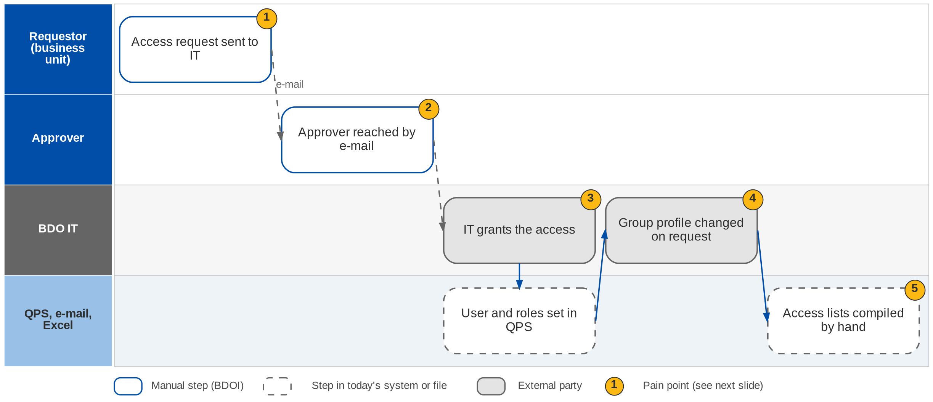
11. User Access Maintenance: As-Is process
Access requests today (BRD-11 p.5-6)
Confidential – BDOI
BIBS Business Process Deck | v1.0
94
Notes:
Today the business unit sends access requests to IT and coordinates them. The approver is reached by e-mail. IT grants the access in QPS, and group profiles are created or changed by IT on request. Access lists are compiled by hand (BRD-11 p.5).

Slide 95
11. User Access Maintenance: pain points today
1
Requests go through IT
The business unit coordinates every request with IT; this causes delays.
BRD-11 p.5
4
Group profiles changed by IT
Profile changes are made on request with no approval trail.
BRD-11 p.5-6; BRD 3.002
2
Approver reached by e-mail
No queue of requests waiting for a decision.
BRD-11 p.5; BRD 2.002
5
Access lists by hand
Who has which access, and since when, is compiled manually.
BRD-11 p.5; BRD 3.003, 4.003
3
IT grants the access
The grant waits for IT; no effective date.
BRD-11 p.5-6
Confidential – BDOI
BIBS Business Process Deck | v1.0
95
Notes:
The five points are the current-process rows of the BRD (p.5).
1. Requests go through IT: The business unit coordinates every request with IT; this causes delays. (BRD-11 p.5)
2. Approver reached by e-mail: No queue of requests waiting for a decision. (BRD-11 p.5; BRD 2.002)
3. IT grants the access: The grant waits for IT; no effective date. (BRD-11 p.5-6)
4. Group profiles changed by IT: Profile changes are made on request with no approval trail. (BRD-11 p.5-6; BRD 3.002)
5. Access lists by hand: Who has which access, and since when, is compiled manually. (BRD-11 p.5; BRD 3.003, 4.003)

Slide 96
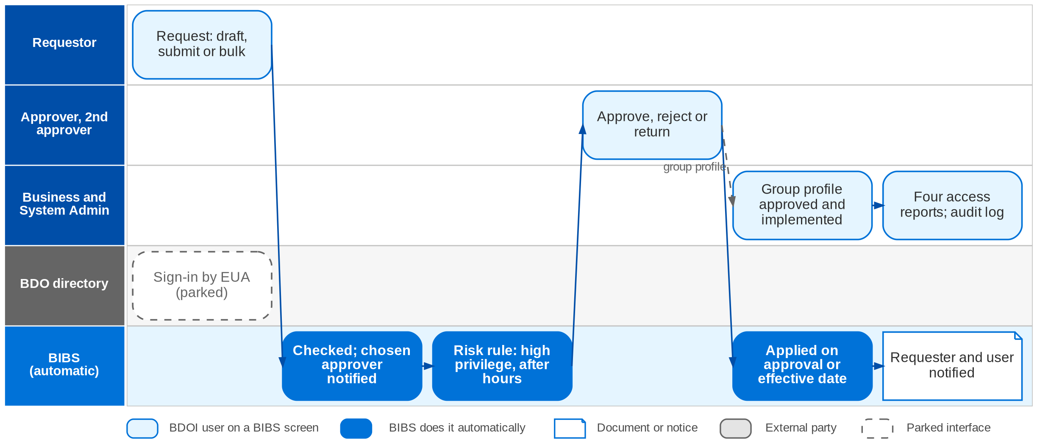
11. User Access Maintenance: envisioned in BIBS
User access and group-profile requests in BIBS (FRS BRD-11 section 2.2)
Confidential – BDOI
BIBS Business Process Deck | v1.0
96
Notes:
In BIBS the Requestor raises the request (enrol, modify, deactivate or reactivate, alone or in bulk), as a draft or submitted, and chooses the approver. BIBS checks it, sets it PENDING and notifies the chosen approver, who sees it under "Assigned to me". A change to a high-privilege profile, or a submission outside working hours, needs a second approval and raises an alert. The approver approves, rejects with a reason or returns it with remarks. BIBS applies the change on approval or on the effective date, logs the from / to values and notifies the requester and the affected user. Group profiles are requested by the Business Administrator, approved in order and implemented by the System Administrator. Four reports and a structured audit log show who has which access, since when and who changed it. Sign-in by the BDO directory (EUA) is a parked port.

Slide 97
11. User Access Maintenance: before and after
Today (pain point)
In BIBS
Measure
1
Requests go through IT
Requestor raises the request in BIBS, as a draft or submitted, alone or in bulk
No IT hand-off
2
Approver reached by e-mail
Chosen approver notified; request listed under "Assigned to me"
Queue per approver
3
IT grants the access
BIBS applies the access on approval or on the effective date; high-risk changes need a 2nd approval
Four eyes on every change
4
Group profiles changed by IT
Business Administrator requests; approvers approve in order; System Administrator implements
Approval trail
5
Access lists by hand
Four reports and a structured audit log with from / to values
Reports in 20 s
Confidential – BDOI
BIBS Business Process Deck | v1.0
97
Notes:
The volumes are small (p.11); the value is control and speed, not throughput.
1. Requests go through IT -> Requestor raises the request in BIBS, as a draft or submitted, alone or in bulk Measure: No IT hand-off.
2. Approver reached by e-mail -> Chosen approver notified; request listed under "Assigned to me" Measure: Queue per approver.
3. IT grants the access -> BIBS applies the access on approval or on the effective date; high-risk changes need a 2nd approval Measure: Four eyes on every change.
4. Group profiles changed by IT -> Business Administrator requests; approvers approve in order; System Administrator implements Measure: Approval trail.
5. Access lists by hand -> Four reports and a structured audit log with from / to values Measure: Reports in 20 s.

Slide 98
11. User Access Maintenance: gaps in the envisioned process
Level | Gap | Impact | Owner | Decision needed | Ref
High | No BIBS-wide user access matrix | Roles and persona tests of every module | UAM process owner, all BRD owners | Provide or approve one matrix | DCR-121
High | Directory sign-in (EUA) | Identity source for every user | BDO ITIO | EUA interface; local sign-in meanwhile | DCR-143, D6
High | BRD written for QPS only | Scope of access maintenance | UAM process owner | Confirm BRD-11 applies to all of BIBS | DCR-114
High | No acceptance criteria; NFRs "follow QPS" | Test and sign-off | UAM process owner | Concur with the FRS criteria; give QPS retention | DCR-115
High | Single session per device | Session control for all users | UAM owner, ITIO | All users, Collections only, or no one | DCR-141, XQ11
High | External portal users | First internet-facing users | UAM owner, Information Security | Provisioning, MFA, hosting (decision D7) | DCR-096
Confidential – BDOI
BIBS Business Process Deck | v1.0
98
Notes:
The BRD is written for the "QPS User Access Maintenance Module" (DCR-114); the project reads it as BIBS-wide. It has no acceptance criteria (DCR-115); the FRS proposes them for BDOI's concurrence.
DCR-121 (High): No BIBS-wide user access matrix. Impact: Roles and persona tests of every module. Owner: UAM process owner, all BRD owners. Decision: Provide or approve one matrix
DCR-143, D6 (High): Directory sign-in (EUA). Impact: Identity source for every user. Owner: BDO ITIO. Decision: EUA interface; local sign-in meanwhile
DCR-114 (High): BRD written for QPS only. Impact: Scope of access maintenance. Owner: UAM process owner. Decision: Confirm BRD-11 applies to all of BIBS
DCR-115 (High): No acceptance criteria; NFRs "follow QPS". Impact: Test and sign-off. Owner: UAM process owner. Decision: Concur with the FRS criteria; give QPS retention
DCR-141, XQ11 (High): Single session per device. Impact: Session control for all users. Owner: UAM owner, ITIO. Decision: All users, Collections only, or no one
DCR-096 (High): External portal users. Impact: First internet-facing users. Owner: UAM owner, Information Security. Decision: Provisioning, MFA, hosting (decision D7)

Slide 99
11. User Access Maintenance: best practice
Least privilege from one role matrix
Segregation of duties
Joiner, mover, leaver discipline
Partly in BIBS
Supported by BIBS
Supported by BIBS
BIBS: Roles by permission and area; User Access Matrix with Excel export.
BDOI: Approve one BIBS-wide matrix (DCR-121).
BIBS: Approver cannot be the requester; maker-checker in every module; incompatible pairs can be blocked.
BDOI: Name the role pairs one user must not hold.
BIBS: Enrol, modify, deactivate and reactivate requests with effective dates.
BDOI: Link HR movements to access requests.
Periodic access review
Single sign-on with the BDO directory
Audit of every access change
BDOI to adopt
Partly in BIBS
Supported by BIBS
BIBS: User access, group profile and membership reports.
BDOI: Run a quarterly recertification by each unit head.
BIBS: Directory authentication port; local sign-in with lock-out until then.
BDOI: Provide the EUA interface (DCR-143).
BIBS: Insert-only change log with from / to values and the approver.
BDOI: Agree the retention of access logs.
Confidential – BDOI
BIBS Business Process Deck | v1.0
99
Notes:
Practices that fit a Philippine insurance broker, and what BIBS supports today or by design.
Least privilege from one role matrix [Partly in BIBS]. BIBS: Roles by permission and area; User Access Matrix with Excel export. BDOI: Approve one BIBS-wide matrix (DCR-121).
Segregation of duties [Supported by BIBS]. BIBS: Approver cannot be the requester; maker-checker in every module; incompatible pairs can be blocked. BDOI: Name the role pairs one user must not hold.
Joiner, mover, leaver discipline [Supported by BIBS]. BIBS: Enrol, modify, deactivate and reactivate requests with effective dates. BDOI: Link HR movements to access requests.
Periodic access review [BDOI to adopt]. BIBS: User access, group profile and membership reports. BDOI: Run a quarterly recertification by each unit head.
Single sign-on with the BDO directory [Partly in BIBS]. BIBS: Directory authentication port; local sign-in with lock-out until then. BDOI: Provide the EUA interface (DCR-143).
Audit of every access change [Supported by BIBS]. BIBS: Insert-only change log with from / to values and the approver. BDOI: Agree the retention of access logs.

Slide 100
12. Submitted Policies
BRD-12 | Policies submitted by bank clients: masterlist, sanitation, review, IAAF, renewal hand-off
Confidential – BDOI | BIBS Business Process Deck
Notes:
BRD-12 Submitted Policies: Policies submitted by bank clients: masterlist, sanitation, review, IAAF, renewal hand-off.

Slide 101
12. Submitted Policies: at a glance
Department and roles
Volumes and NFRs (BRD)
BRD and build status
CBG and Non-CBG Marketing - Submitted Policies
• Submitted Handler and Submitted Checker (CBG)
• Sanitation Handler; Team Lead; rule administrator
• Policy Review Officer (Non-CBG Corporate)
• Marketing AO, NB Team Lead, TSU
• Admin Team UPP handler; Placement and Booking users
63,000
sanitations a year, +25% a year (p.13-14)
Designed
Designed, not yet built; FRS v1.0 issued for review
• BRD-12 p.4-7 (current and envisioned, image pages)
• BRIDSP-01 to 33
• FRS BRD-12 v1.0, sections 2 and 5; decision D2
30
CBG Admin / Marketing users, 15 concurrent
2 s
response for every listed transaction
30
days to consolidate CBG Motor policies (p.4-5)
The process in one line
Intake
Extraction
Masterlist
Processing run
Review and IAAF
Limits and TOR
Expiry scan
Renewal
Confidential – BDOI
BIBS Business Process Deck | v1.0
101
Notes:
Submitted policies are policies that bank clients (CBG Motor, CBG Fire, Non-CBG Corporate and Branches, Non-CBG Retail) placed outside BDOI and submitted to the bank. BDOI keeps them on a masterlist, reviews their adequacy, and at expiry converts them to BDOI-placed renewals. In BIBS the renewal from the hand-off on belongs to the Renewal module (decision D2). The module is designed; the build needs BT0, Collections and Cashiering for its ports.
Sources: BRD-12 p.4-7 (current and envisioned, image pages); BRIDSP-01 to 33; FRS BRD-12 v1.0, sections 2 and 5; decision D2

Slide 102
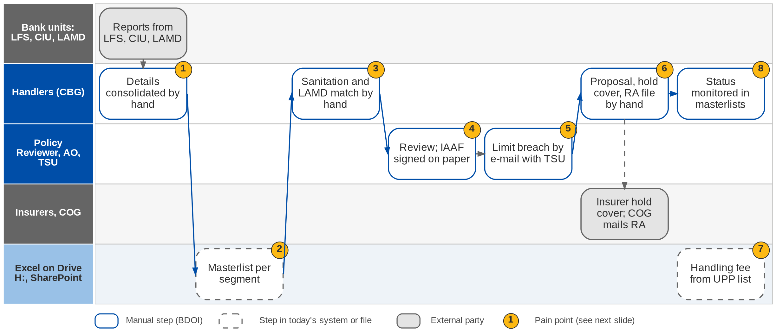
12. Submitted Policies: As-Is process
Submitted policies today (BRD-12 p.4-7)
Confidential – BDOI
BIBS Business Process Deck | v1.0
102
Notes:
Today CBG Motor Team Leads extract policy details from LFS and CIU and the Submitted Handler consolidates them within 30 days; CBG Fire policies come from Home Loan AOs; Non-CBG Corporate and Branch policies are reviewed by a Policy Reviewer who issues an IAAF on paper; Non-CBG Retail policies come from the LAMD report. Each segment keeps an Excel masterlist on a shared drive. At renewal a Sanitation Handler matches the list against LAMD by hand, excludes accounts that must not be renewed, assigns an insurer and sends a proposal with a 30-day hold cover request, and an RA text file goes to COG for mailing. Limit breaches are handled by e-mail with TSU, handling-fee payments are filtered from the UPP list on SharePoint, and status is monitored in the masterlists.

Slide 103
12. Submitted Policies: pain points today
1
Policy details consolidated by hand
Excel reports and documents per segment; 30 days to consolidate CBG Motor.
BRD-12 p.4-5; BRIDSP-01, 02
5
Limit breaches by e-mail
Breaches handled with TSU by e-mail.
BRD-12 p.4-7; BRIDSP-16-19
2
Separate masterlists
One Excel masterlist per segment on Drive H:, with e-mail and SharePoint.
BRD-12 p.4-5; BRIDSP-04
6
Renewal prepared by hand
Proposal, 30-day hold cover request and RA text file for COG prepared manually.
BRD-12 p.5-7; BRIDSP-22-26
3
Sanitation and LAMD matching by hand
Exclusions (FFY, employees, No Touch) applied manually.
BRD-12 p.4-7; BRIDSP-08, 09
7
Handling fee from the UPP list
Handling-fee payments filtered from the Unapplied Payment List on SharePoint.
BRD-12 p.4-7; BRIDSP-31
4
Reviews and IAAF on paper
Adequacy reviews by e-mail; IAAF signed on paper.
BRD-12 p.4-5; BRIDSP-05-07
8
Status in the masterlists
No reports or alerts from live data.
BRD-12 p.4-7; BRIDSP-20, 21, 24
Confidential – BDOI
BIBS Business Process Deck | v1.0
103
Notes:
The eight points are the current-process rows of FRS BRD-12 section 2.1, read from the image pages of the BRD (p.4-7).
1. Policy details consolidated by hand: Excel reports and documents per segment; 30 days to consolidate CBG Motor. (BRD-12 p.4-5; BRIDSP-01, 02)
2. Separate masterlists: One Excel masterlist per segment on Drive H:, with e-mail and SharePoint. (BRD-12 p.4-5; BRIDSP-04)
3. Sanitation and LAMD matching by hand: Exclusions (FFY, employees, No Touch) applied manually. (BRD-12 p.4-7; BRIDSP-08, 09)
4. Reviews and IAAF on paper: Adequacy reviews by e-mail; IAAF signed on paper. (BRD-12 p.4-5; BRIDSP-05-07)
5. Limit breaches by e-mail: Breaches handled with TSU by e-mail. (BRD-12 p.4-7; BRIDSP-16-19)
6. Renewal prepared by hand: Proposal, 30-day hold cover request and RA text file for COG prepared manually. (BRD-12 p.5-7; BRIDSP-22-26)
7. Handling fee from the UPP list: Handling-fee payments filtered from the Unapplied Payment List on SharePoint. (BRD-12 p.4-7; BRIDSP-31)
8. Status in the masterlists: No reports or alerts from live data. (BRD-12 p.4-7; BRIDSP-20, 21, 24)

Slide 104
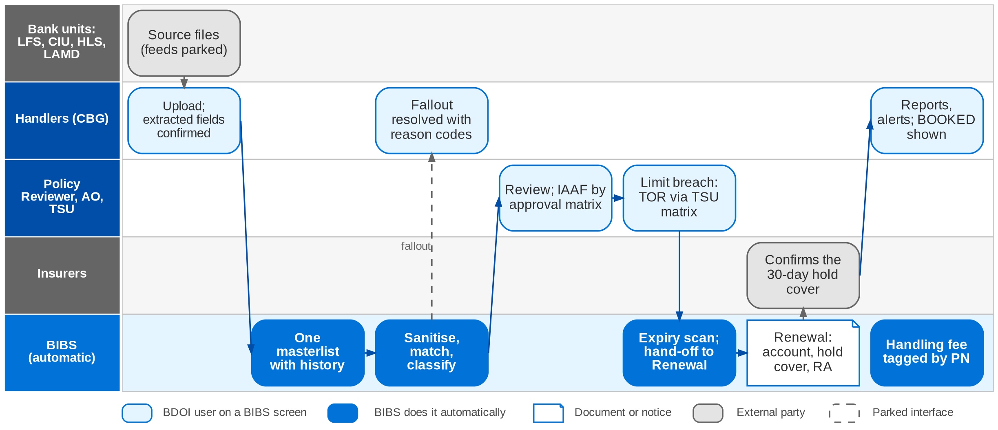
12. Submitted Policies: envisioned in BIBS
Submitted Policies in BIBS: workflow SBM_POLICY and the Renewal hand-off (FRS BRD-12 section 2.2; decision D2)
Confidential – BDOI
BIBS Business Process Deck | v1.0
104
Notes:
In BIBS each source file is uploaded and validated, one masterlist record per policy; fields are proposed from the policy document and saved only after a user confirms them. One Submitted Masterlist keeps history and role-based access. A processing run sanitises, matches against LAMD by PN, classifies (Inforced or Submitted), buckets and tags each policy; fallout is listed with reason codes. Reviews and the IAAF follow the approval matrix, with stamped signatures. A limit breach produces a TOR approved by the TSU matrix and handed to the AO. The expiry scan hands renewable policies to the Renewal module, which creates the account, requests the 30-day hold cover and sends the letters. Handling-fee payments are tagged in the Unapplied Payment List by PN or location reference. The source feeds, OCR, qualified e-signature and COG transport are parked ports (upload, manual entry, stamped signature, print batch).

Slide 105
12. Submitted Policies: before and after
Today (pain point)
In BIBS
Measure
1
Policy details consolidated by hand
Each source uploaded; fields extracted from the document and confirmed by a user
Keyed once
2
Separate masterlists
One Submitted Masterlist with history and role-based access
2 s response (p.13-14)
3
Sanitation and LAMD matching by hand
Configurable rules sanitise, match, classify and bucket every policy; fallout reported
63,000 a year by rule
4
Reviews and IAAF on paper
Reviews, IAAF and approval matrix in BIBS, with stamped signatures
Approval trail
5
Limit breaches by e-mail
TOR generated, approved by the TSU matrix and handed over to the AO
Limit check by rule
6
Renewal prepared by hand
Expiry scan hands renewable policies to Renewal: account, hold cover, letters
No manual RA file
7
Handling fee from the UPP list
Handling-fee payments tagged automatically by PN or location reference
Tagged daily
8
Status in the masterlists
Reports, alerts and notifications from live data
Live status
Confidential – BDOI
BIBS Business Process Deck | v1.0
105
Notes:
The usage table gives the volumes and the 2-second response target (p.13-14), the tightest in the twelve BRDs.
1. Policy details consolidated by hand -> Each source uploaded; fields extracted from the document and confirmed by a user Measure: Keyed once.
2. Separate masterlists -> One Submitted Masterlist with history and role-based access Measure: 2 s response (p.13-14).
3. Sanitation and LAMD matching by hand -> Configurable rules sanitise, match, classify and bucket every policy; fallout reported Measure: 63,000 a year by rule.
4. Reviews and IAAF on paper -> Reviews, IAAF and approval matrix in BIBS, with stamped signatures Measure: Approval trail.
5. Limit breaches by e-mail -> TOR generated, approved by the TSU matrix and handed over to the AO Measure: Limit check by rule.
6. Renewal prepared by hand -> Expiry scan hands renewable policies to Renewal: account, hold cover, letters Measure: No manual RA file.
7. Handling fee from the UPP list -> Handling-fee payments tagged automatically by PN or location reference Measure: Tagged daily.
8. Status in the masterlists -> Reports, alerts and notifications from live data Measure: Live status.

Slide 106
12. Submitted Policies: gaps in the envisioned process
Level | Gap | Impact | Owner | Decision needed | Ref
High | Bucket list and precedence | Which submitted policies are renewed | CBG and Non-CBG Marketing | Complete bucket list; FFY, RMU, Fully Paid renewed? | DCR-124
High | Renewal boundary with BRD-6 | Two renewal paths for one policy | Submitted Policies and RMEL owners | Confirm decision D2; notices and proposals (XQ03) | DCR-129
High | One LAMD intake or two | Loan status for buckets and renewal eligibility | Marketing, LAMD | One report, one owner, frequency | DCR-146, XQ01
Medium | One IAAF per policy | IAAF generation and approvals | Non-CBG Corporate Marketing | One IAAF per policy; approval matrix | DCR-125
Medium | Handling fee undefined | Amount, payer, VAT, OR, GL account | Marketing, Comptrollership | Define the fee and who dispositions it | DCR-126
Parked | Source feeds, OCR, e-signature, COG | Uploads, manual entry, stamped signature, print batch | BDO IT, COG | Interface specifications per source | FRS BRD-12 section 7
Confidential – BDOI
BIBS Business Process Deck | v1.0
106
Notes:
The bucket list (DCR-124) and the LAMD intake (DCR-146) decide which submitted policies are renewed.
DCR-124 (High): Bucket list and precedence. Impact: Which submitted policies are renewed. Owner: CBG and Non-CBG Marketing. Decision: Complete bucket list; FFY, RMU, Fully Paid renewed?
DCR-129 (High): Renewal boundary with BRD-6. Impact: Two renewal paths for one policy. Owner: Submitted Policies and RMEL owners. Decision: Confirm decision D2; notices and proposals (XQ03)
DCR-146, XQ01 (High): One LAMD intake or two. Impact: Loan status for buckets and renewal eligibility. Owner: Marketing, LAMD. Decision: One report, one owner, frequency
DCR-125 (Medium): One IAAF per policy. Impact: IAAF generation and approvals. Owner: Non-CBG Corporate Marketing. Decision: One IAAF per policy; approval matrix
DCR-126 (Medium): Handling fee undefined. Impact: Amount, payer, VAT, OR, GL account. Owner: Marketing, Comptrollership. Decision: Define the fee and who dispositions it
FRS BRD-12 section 7 (Parked): Source feeds, OCR, e-signature, COG. Impact: Uploads, manual entry, stamped signature, print batch. Owner: BDO IT, COG. Decision: Interface specifications per source

Slide 107
12. Submitted Policies: best practice
Automated matching with bank loan data
Rules owned by the business
Adequacy review with an approval matrix
Supported by BIBS
Supported by BIBS
Supported by BIBS
BIBS: LAMD matching by PN in the processing run; fallout with reason codes.
BDOI: One LAMD report and owner (DCR-146).
BIBS: Sanitation, bucket and insurer-assignment rules maintained by a rule administrator.
BDOI: Give the bucket precedence (DCR-124).
BIBS: Policy reviews and IAAF routed by the matrix.
BDOI: Approve the IAAF matrix (DCR-125).
Digital signature
One masterlist
Conversion KPI
Partly in BIBS
Supported by BIBS
BDOI to adopt
BIBS: Stamped signature image today; e-signature port parked.
BDOI: Choose a qualified e-signature service.
BIBS: One record per policy with history, handler and conversion status.
BDOI: Migrate the Excel masterlists with reconciliation (BRIDSP-33).
BIBS: Masterlist shows BOOKED when the renewal books; persistency report for submitted accounts.
BDOI: Set conversion targets per segment.
Confidential – BDOI
BIBS Business Process Deck | v1.0
107
Notes:
Practices that fit a Philippine insurance broker, and what BIBS supports today or by design.
Automated matching with bank loan data [Supported by BIBS]. BIBS: LAMD matching by PN in the processing run; fallout with reason codes. BDOI: One LAMD report and owner (DCR-146).
Rules owned by the business [Supported by BIBS]. BIBS: Sanitation, bucket and insurer-assignment rules maintained by a rule administrator. BDOI: Give the bucket precedence (DCR-124).
Adequacy review with an approval matrix [Supported by BIBS]. BIBS: Policy reviews and IAAF routed by the matrix. BDOI: Approve the IAAF matrix (DCR-125).
Digital signature [Partly in BIBS]. BIBS: Stamped signature image today; e-signature port parked. BDOI: Choose a qualified e-signature service.
One masterlist [Supported by BIBS]. BIBS: One record per policy with history, handler and conversion status. BDOI: Migrate the Excel masterlists with reconciliation (BRIDSP-33).
Conversion KPI [BDOI to adopt]. BIBS: Masterlist shows BOOKED when the renewal books; persistency report for submitted accounts. BDOI: Set conversion targets per segment.

Slide 108
13. Summary
Maturity, decisions and roadmap
Confidential – BDOI | BIBS Business Process Deck
Notes:
The summary repeats the three views the steering committee acts on.

Slide 109
Summary: from today to best practice
1 Manual: paper, e-mail
2 Tool-assisted: spreadsheets, separate systems
3 One workflow in one system
4 Automated, with exception queues
5 Integrated and measured
Automation
Controls
Data
Integration
Customer service
Compliance
Reporting
Today
BIBS envisioned
Best practice
Scale: project team assessment from the BRD current-process sections and the BIBS designs
Confidential – BDOI
BIBS Business Process Deck | v1.0
109
Notes:
BIBS moves every theme to one workflow in one system or better. Integration is the theme that stays furthest from best practice, because the bank, insurer and directory interfaces are parked until their owners specify them.
Automation: today 1, BIBS 4, best practice 5. Today most steps are manual (BRD-1 p.133, BRD-2 p.11, BRD-5 p.44). BIBS runs jobs, matching and straight-through steps with exception queues.
Controls: today 2, BIBS 4, best practice 5. Approvals run by e-mail and paper (BRD-5 p.45, BRD-10 p.6). BIBS enforces maker-checker, four-eyes and approval matrices.
Data: today 1, BIBS 4, best practice 5. Separate masterlists and re-keying (BRD-12 p.4, BRD-1 p.133). BIBS has one client, one ARN and one invoice ledger.
Integration: today 2, BIBS 3, best practice 5. Files and e-mail with banks and insurers. BIBS adds uploads and seams; APIs are parked.
Customer service: today 2, BIBS 4, best practice 5. The Front-End shows full details for CBG accounts only (BRD-9 p.4). BIBS shows every account, with resends.
Compliance: today 1, BIBS 4, best practice 5. Name matching by hand, no EDD for PEPs (BRD-10 p.6-7). BIBS screens on every trigger and routes cases.
Reporting: today 1, BIBS 4, best practice 5. Reports depend on IT (BRD-2 p.11, BRD-5 p.44). BIBS users run reports and exports themselves.

Slide 110
Summary: decisions for BDOI
Level | Gap | Impact | Owner | Decision needed | Ref
High | Directory sign-in (EUA) for every user | Identity source for all BIBS users | UAM owner with BDO ITIO | Provide the EUA interface; are contact centre agents in the directory? | DCR-143
High | BIBS-wide user access matrix | Roles and persona tests of every module | Product Owner, all BRD owners | Approve one matrix for all modules | DCR-121
High | Renewal of submitted policies; one LAMD intake | Two renewal paths; two loan-status feeds | Renewal and Submitted Policies owners | Confirm the hand-off boundary and one LAMD report | DCR-129, 146
High | Incentive programmes in four BRDs | Incentive income computed twice or not at all | Comptrollership, MBS, Operations | List the programmes with rate, base, payer | DCR-037
High | Sanctions match: block or warn | Business with a possible sanctioned party | Chief Compliance Officer | Block or warn on quotation, placement, booking, renewal | DCR-112
High | One service window, RPO / RTO, maintenance slot | Backup, DR and batch design of the platform | BDO IT with the BRD owners | Agree one BIBS-wide NFR set | DCR-133, 135, 138
High | Retention per record type | Legal record keeping; archive design | Compliance, Comptrollership | One schedule; archive or purge at the end | DCR-136
High | Go-live data migration scope | Open items and history at cut-over | All BRD owners | What is migrated from EBIX, ISYS, QPS, Excel | DCR-157
Confidential – BDOI
BIBS Business Process Deck | v1.0
110
Notes:
The same eight decisions as in the holistic chapter; each unblocks more than one area.
DCR-143 (High): Directory sign-in (EUA) for every user. Impact: Identity source for all BIBS users. Owner: UAM owner with BDO ITIO. Decision: Provide the EUA interface; are contact centre agents in the directory?
DCR-121 (High): BIBS-wide user access matrix. Impact: Roles and persona tests of every module. Owner: Product Owner, all BRD owners. Decision: Approve one matrix for all modules
DCR-129, 146 (High): Renewal of submitted policies; one LAMD intake. Impact: Two renewal paths; two loan-status feeds. Owner: Renewal and Submitted Policies owners. Decision: Confirm the hand-off boundary and one LAMD report
DCR-037 (High): Incentive programmes in four BRDs. Impact: Incentive income computed twice or not at all. Owner: Comptrollership, MBS, Operations. Decision: List the programmes with rate, base, payer
DCR-112 (High): Sanctions match: block or warn. Impact: Business with a possible sanctioned party. Owner: Chief Compliance Officer. Decision: Block or warn on quotation, placement, booking, renewal
DCR-133, 135, 138 (High): One service window, RPO / RTO, maintenance slot. Impact: Backup, DR and batch design of the platform. Owner: BDO IT with the BRD owners. Decision: Agree one BIBS-wide NFR set
DCR-136 (High): Retention per record type. Impact: Legal record keeping; archive design. Owner: Compliance, Comptrollership. Decision: One schedule; archive or purge at the end
DCR-157 (High): Go-live data migration scope. Impact: Open items and history at cut-over. Owner: All BRD owners. Decision: What is migrated from EBIX, ISYS, QPS, Excel

Slide 111
Summary: roadmap
Built
In build
Designed, next
• BRD-1 New Business
• BRD-2 Operations
• BRD-3 Product Maintenance
• BRD-11 baseline: users, roles, access requests, lock-out, session
• Finance platform for BRD-5: chart, journals, engine, periods, FX, bank reconciliation
• BRD-4 Collections (foundation and worklist)
• BRD-5 Disbursement, ACSL, FRBS reports
• BRD-5 Refund and cash-advance requests
• Shared work item BT0: business type New Business / Renewal
• BRD-11 changes and BRD-10 Sanction Screening
• BRD-7 Claims
• BRD-8 Employee Benefits and partner portal
• BRD-9 Customer Servicing Facility
• BRD-6 Renewal and BRD-12 Submitted Policies
What BDOI must decide to move forward
• EUA interface and the BIBS-wide access matrix (DCR-143, 121)
• Renewal boundary with Submitted Policies; one LAMD intake (DCR-129, 146)
• Incentive programmes and the Fire premium tax (DCR-037, 005)
• Sanctions: block or warn (DCR-112)
• One NFR set: service window, RPO / RTO, retention (DCR-133, 135, 136)
• Migration scope per legacy source (DCR-157)
• Partner portal users: provisioning, MFA, hosting (DCR-096)
• Sign-off of the FRS per BRD (sign-off tracker, item 32)
Confidential – BDOI
BIBS Business Process Deck | v1.0
111
Notes:
Status on 25 September 2026. The build order of the designed areas follows the cross-BRD decisions (section 6.2): User Access with Sanction Screening first, then Claims, Employee Benefits, Customer Servicing, Renewal and Submitted Policies, with the Renewal hand-off and the CSF integration last. The decisions below move the gaps of several areas at once.

Slide 112
Next steps
• Department heads review their chapter with the FRS of their BRD and return comments through the sign-off tracker
• BDOI answers the High items of the discrepancy register, starting with the eight decisions of this deck
• The project team refreshes this deck after the end-to-end build, with screenshots of the BIBS screens
• The steering committee confirms the build order of the designed areas
Confidential – BDOI
BIBS Business Process Deck | v1.0
112
Notes:
The deck is refreshed in phase B (after the end-to-end build) from the running platform. Comments go to the document review and sign-off tracker (deliverable 32).

