Slide 1


Sign-off Pack Guide: BRD-6 Renewal
BRD-6 Renewal business sign-off pack, release set v2.0
BIBS – BDOI Broker System
BDO Insurance and Reinsurance Brokers, Inc. | Version 2.0 | 8 October 2026 | Confidential
Prepared by
Notes:
This deck guides the business units through the BRD-6 Renewal sign-off pack, release set v2.0. It explains what the pack is, how to read it, the steps up to sign-off and what happens after. It is presented at the kick-off and stays in the pack as file 01.

Slide 2
Purpose of the pack and what sign-off means
• The pack shows the proposed Renewal of BIBS, screen by screen, so each business unit confirms what it will get
  – Content: 20 screens, 130 fields, 59 business rules, 151 messages
  – Every screen with numbered fields, the navigation per persona, three end-to-end walkthroughs
• Signing freezes the content, the screens and the navigation of the module
  – After sign-off a change goes through the Change Management Register with its mandays
  – Configuration values marked default (SLA hours, thresholds, list entries, templates) stay open
• The screenshots use fictitious seed data only, in the BDO theme
Confidential – BDOI
Sign-off Pack Guide BRD-6 Renewal | v2.0
2
Notes:
Stress that the pack shows the screens, fields, rules and messages the business is asked to confirm.
Signing means: this is what we get; the look, feel, fields, rules, messages and navigation are frozen.
Data on the screenshots is seed data of the SIT environment; names and numbers are fictitious.

Slide 3
The pack at a glance (1 of 2)
File | What it is for | Who reads it | When
00_BIBS_StartHere_BRD-06_Renewal_v2.0.docx | Start Here: the map of the pack, who reads what, the steps and the dates | Everyone | First, on issue
01_BIBS_GuideDeck_BRD-06_Renewal_v2.0.pptx | Sign-off Pack Guide: purpose, approach, the module at a glance, caveats and impacts on other modules, entry and exit criteria, change control | Product Owners, Marketing heads and the Combank / Corbank Unit Head; presented at the kick-off | Kick-off session
02_BIBS_FRS_BRD-06_Renewal_v2.0.docx | Functional Requirements Specification v2.0: requirements, navigation, 20 screen specifications with screenshots, five walkthroughs, messages, notifications, documents, uploads, cross-BRD contract | Marketing Team Leaders and Account Officers, Processing Team Leaders and Officers, MBS; Contact Center, LAMD and BDOI IT for their chapters | During the review, with the SIT walkthroughs
03_BIBS_Signoff_BRD-06_Renewal_v2.0.xlsx | Sign-off workbook: one row per screen, field, rule and message with the BU review columns; comments log, meeting minutes, version history, sign-off certificate | Every reviewer; the business owner signs it | During the review and at sign-off
04_BIBS_TestPlan_BRD-06_Renewal_v2.0.xlsx | Test plan workbook: the test cases traced to the FRs and to the screens, including one screen case and one message case per screen | Business users who will run UAT; BDOI IT | After the screens; used again in SIT and UAT
Confidential – BDOI
Sign-off Pack Guide BRD-6 Renewal | v2.0
3
Notes:
The files are numbered in reading order so they sort that way in the BRD folder. 00 Start Here is the short version of this deck; 02 FRS and 03 workbook carry the same rows; 04 and 05 are the test plan traced to the screens; 07 to 09 are the UX screen documents for the BDOI UX Design team, taken from the same screens.

Slide 4
The pack at a glance (2 of 2)
File | What it is for | Who reads it | When
05_BIBS_TestPlan_BRD-06_Renewal_Summary_v2.0.docx | Test plan summary: scope, approach, coverage and the cases by area | Business owner, BDOI IT | Before sign-off
07_BIBS_UXDeck_BRD-06_Renewal_v2.0.pptx | UX Screen Deck for the BDOI UX Design team: design foundation, navigation and personas, every walkthrough step by step and every screen with all its states | BDOI UX Design team | From the issue, in parallel with the review; re-issued with each version of the set
08_BIBS_UXScreens_BRD-06_Renewal_v2.0.xlsx | UX screen register: one row per screen image with the screen, personas, walkthrough and step, state, FRS section and requirements, UXD status and comments, and the Changed in this issue flag | BDOI UX Design team | Kept by the UX Design team; the changed rows are flagged at each issue
09_BIBS_UXScreens_BRD-06_Renewal_v2.0.zip | Image package: every screen image at twice the screen resolution (PNG), the component crops and the register as CSV | BDOI UX Design team | Imported into the design tool at each issue
Confidential – BDOI
Sign-off Pack Guide BRD-6 Renewal | v2.0
4
Notes:
The files are numbered in reading order so they sort that way in the BRD folder. 00 Start Here is the short version of this deck; 02 FRS and 03 workbook carry the same rows; 04 and 05 are the test plan traced to the screens; 07 to 09 are the UX screen documents for the BDOI UX Design team, taken from the same screens.

Slide 5
Where to start: reading order per role
Role | Read, in this order
Business owner (Product Owners; Marketing heads; Combank / Corbank Unit Head) | 00 Start Here; 01 Guide deck; FRS chapters 1-3 (context and personas), 14 (walkthroughs), 20 (sign-off) and 21 (proposed rules for confirmation); workbook Sign-off certificate
Marketing Team Leaders | FRS sections 4.2 to 4.6; Expiry List, TL Review and Transfers (SCR-RN-02, 08, 09); walkthroughs A, D and E; messages in chapter 15
Marketing Account Officers (Account Brokers) | My Dispositions, the renewal and its tabs, Set Disposition (SCR-RN-03 to 07); Letters and Record Acceptance (SCR-RN-13, 14); walkthroughs A, B and D
Processing Team Leaders and Processing Officers | FRS sections 4.7 and 4.8; Processing Worklist, Insurer Batches and Record Insurer Response (SCR-RN-10 to 12); Package Map and Go-live (SCR-RN-19, 20); walkthrough B; the insurer extract DO-03 in chapter 17
Contact Center and LAMD | Follow-ups (SCR-RN-15) and walkthrough C for the Contact Center; LAMD Reports (SCR-RN-16) and FRS FR-RN-025 for LAMD; the uploads in chapter 18
Marketing Business Services and System Support (Business Administrator) | Renewal Setup (SCR-RN-17 to 20); configuration in chapter 9; the letters DO-01 and DO-02; the menus by persona in chapter 12
BDOI IT | Interfaces and integration (chapter 7), non-functional requirements (chapter 8), configuration (chapter 9), cross-BRD contract (chapter 19); the Technical Specification, reviewed by BDOI IT
BDOI UX Design team | 07 UX Screen Deck: design foundation and navigation first, then the personas, walkthroughs and screens of the design work; 08 UX screen register (filter Changed in this issue at each new issue); 09 image package in the design tool
iorta TechNXT project team | All documents; keeps the comments log, the meeting minutes and the version history of the workbook, answers every comment and keeps the traceability to SIT and UAT
Confidential – BDOI
Sign-off Pack Guide BRD-6 Renewal | v2.0
5
Notes:
Nobody needs to read the whole FRS. Each role starts with its chapters and its sheets of the workbook; the walkthroughs in chapter 14 are the fastest way to see the whole process.

Slide 6
Approach: from issue to closure
1
Pack issued
2
Kick-off and screen walkthrough on SIT
3
Review with the workbook
4
Comments consolidated and a Q&A session
Release set v2.0 in the BRD-06 folder; invitations to the sessions
Screens shown live (expiry list and disposition, review and transfers, processing and the insurer, letters and acceptance, set-up); first questions logged in the comments log; minutes
Every row marked Accept, Change requested or Comment; comments log entries
One consolidated comments log, each item typed (clarification, correction, change request) and answered; Q&A minutes
Day 0 (Thu 8-Oct-2026); sessions in the Drop 1 window of November 2026
3 sessions, 4 to 6-Nov-2026
10 working days after the walkthroughs, until Fri 20-Nov-2026
2 working days, Q&A on Tue 24-Nov-2026
5
One revision cycle (v2.1)
6
Sign-off meeting and signature
7
Content freeze
8
Traceability into SIT and UAT
Release set v2.1 with the changed rows marked; change requests raised for the rest
Signed sign-off certificate; minutes; open items accepted as assumptions or change requests
Content frozen as signed; approved deltas scheduled in the Change Management Register
SIT and UAT runs traced to the signed screens, rules and messages; results against each row
1 working day, v2.1 on Wed 25-Nov-2026; check by the reviewers until Thu 26-Nov-2026
Fri 27-Nov-2026
From Mon 30-Nov-2026
SIT Jan - Jul 2027; UAT Aug - Dec 2027
Confidential – BDOI
Sign-off Pack Guide BRD-6 Renewal | v2.0
6
Notes:
1. Pack issued: Day 0 (Thu 8-Oct-2026); sessions in the Drop 1 window of November 2026.
2. Kick-off and screen walkthrough on SIT: 3 sessions, 4 to 6-Nov-2026.
3. Review with the workbook: 10 working days after the walkthroughs, until Fri 20-Nov-2026.
4. Comments consolidated and a Q&A session: 2 working days, Q&A on Tue 24-Nov-2026.
5. One revision cycle (v2.1): 1 working day, v2.1 on Wed 25-Nov-2026; check by the reviewers until Thu 26-Nov-2026.
6. Sign-off meeting and signature: Fri 27-Nov-2026.
7. Content freeze: From Mon 30-Nov-2026.
8. Traceability into SIT and UAT: SIT Jan - Jul 2027; UAT Aug - Dec 2027.

Slide 7
Steps in detail (1 of 2): who, inputs, outputs, duration
Step | Who (R, A, C, I) | Inputs | Outputs | Duration
1. Pack issued | R: iorta TechNXT Project Manager; A: iorta TechNXT delivery lead; I: all reviewers | FRS v2.0, workbook, test plan, guide and deck | Release set v2.0 in the BRD-06 folder; invitations to the sessions | Day 0 (Thu 8-Oct-2026); sessions in the Drop 1 window of November 2026
2. Kick-off and screen walkthrough on SIT | R: iorta TechNXT Business Analysis; A: BDOI Product Owner; C: Marketing and Processing input providers, MBS; I: Contact Center, LAMD, BDOI IT | Guide deck; SIT users with seed data; walkthroughs A to E | Screens shown live (expiry list and disposition, review and transfers, processing and the insurer, letters and acceptance, set-up); first questions logged in the comments log; minutes | 3 sessions, 4 to 6-Nov-2026
3. Review with the workbook | R: Marketing Team Leaders and Account Officers, Processing Team Leaders and Officers, MBS; A: Marketing Business Services and System Support; C: iorta TechNXT (questions) | FRS chapters of the area; workbook sheets with the BU review columns | Every row marked Accept, Change requested or Comment; comments log entries | 10 working days after the walkthroughs, until Fri 20-Nov-2026
4. Comments consolidated and a Q&A session | R: iorta TechNXT Project Manager and Business Analysis; A: BDOI Product Owner; C: reviewers | Returned workbooks | One consolidated comments log, each item typed (clarification, correction, change request) and answered; Q&A minutes | 2 working days, Q&A on Tue 24-Nov-2026
Confidential – BDOI
Sign-off Pack Guide BRD-6 Renewal | v2.0
7
Notes:
R responsible, A accountable, C consulted, I informed. The durations are indicative; the dates are those of the Start Here guide.

Slide 8
Steps in detail (2 of 2): who, inputs, outputs, duration
Step | Who (R, A, C, I) | Inputs | Outputs | Duration
5. One revision cycle (v2.1) | R: iorta TechNXT Business Analysis; A: iorta TechNXT delivery lead; C: reviewers who raised the items | Agreed clarifications and corrections | Release set v2.1 with the changed rows marked; change requests raised for the rest | 1 working day, v2.1 on Wed 25-Nov-2026; check by the reviewers until Thu 26-Nov-2026
6. Sign-off meeting and signature | R: iorta TechNXT Project Manager; A: BDOI Product Owner; C: Product Owners, Marketing heads, Combank / Corbank Unit Head, BDOI IT | v2.1 (or v2.0 when no revision is needed); open items with their decision | Signed sign-off certificate; minutes; open items accepted as assumptions or change requests | Fri 27-Nov-2026
7. Content freeze | R: iorta TechNXT delivery lead; A: BDOI Product Owner; I: BDOI IT, other BRD owners | Signed set; change requests with mandays | Content frozen as signed; approved deltas scheduled in the Change Management Register | From Mon 30-Nov-2026
8. Traceability into SIT and UAT | R: iorta TechNXT test lead; A: BDOI Product Owner; C: business users | Signed FRS rows and test plan | SIT and UAT runs traced to the signed screens, rules and messages; results against each row | SIT Jan - Jul 2027; UAT Aug - Dec 2027
Confidential – BDOI
Sign-off Pack Guide BRD-6 Renewal | v2.0
8
Notes:
R responsible, A accountable, C consulted, I informed. The durations are indicative; the dates are those of the Start Here guide.

Slide 9
Who signs what: parts of the set (1 of 2)
Part of the set | Prepares | Provides input | Reviews | Approves
Screens and fields (FRS screen specifications; workbook Screen catalogue, Field register) | iorta TechNXT | Marketing & MBS input | Program Manager (BPS), MBS review | Product Owner, Product Owner (2), Combank / Corbank UH, Retail Marketing heads
Business rules, checks, classification and the decision matrix | iorta TechNXT | Marketing & MBS input, BA (BPS) | Program Manager (BPS), MBS review | Product Owner, Product Owner (2), Combank / Corbank UH, Retail Marketing heads
Messages and notifications | iorta TechNXT | Marketing & MBS input | Program Manager (BPS) | Product Owner, Retail Marketing heads
Documents and files (Renewal Advice, No Advice and Not for Renewal letters, insurer extract, expiry list and account details) | iorta TechNXT | Marketing & MBS input | Program Manager (BPS), MBS review | Product Owner, Combank / Corbank UH, Retail Marketing heads
Walkthroughs (end-to-end, screen by screen) | iorta TechNXT | Marketing & MBS input | Program Manager (BPS) | Product Owner
Proposed business rules and clarifications for confirmation | iorta TechNXT, BA (BPS) | Marketing & MBS input | Program Manager (BPS), MBS review | Product Owner, Product Owner (2), Combank / Corbank UH, Retail Marketing heads
Confidential – BDOI
Sign-off Pack Guide BRD-6 Renewal | v2.0
9
Notes:
The set holds business content only: screens, fields, rules, messages, notifications, documents, walkthroughs and reports. Business users sign the business content; BDOI IT reviews the interfaces, the user access and the Technical Specification, a separate document that holds the technical content; the Program Manager of Business Project Services reviews the traceability and the completeness; the Product Owner approves the whole set; iorta TechNXT prepares it.
The roles are those of the BRD approval sheet (Renewal BRD approval sheets: Renewal Addendum (Walkthrough) p.17-19, Renewal Addendum (Workshop) p.42-44, Renewal Addendum 1 p.61-64 and the RMEL Phase 2 Online Dispositioning BRD p.214-215 (Prepared, Input provided, Reviewed, Approved by)).

Slide 10
Who signs what: parts of the set (2 of 2)
Part of the set | Prepares | Provides input | Reviews | Approves
Scheduled runs, uploads, protected e-mails, user access and menus by persona | iorta TechNXT | Marketing & MBS input | BDOI IT, MBS review | Product Owner
Accounting impact: none of its own (a renewal books through the New Business booking) | iorta TechNXT | BA (BPS) | Program Manager (BPS) | Comptrollership
Test plan (04 workbook, 05 summary) | iorta TechNXT | Marketing & MBS input | Program Manager (BPS), BDOI IT | Product Owner
UX screen deck, UX screen register and image package (07 to 09, for the BDOI UX Design team; the screens as specified in this set) | iorta TechNXT | Marketing & MBS input | Program Manager (BPS) | Product Owner
Technical Specification (separate document, not part of the business sign-off) | iorta TechNXT | BDOI IT | BDOI IT | BDOI IT
Confidential – BDOI
Sign-off Pack Guide BRD-6 Renewal | v2.0
10
Notes:
The set holds business content only: screens, fields, rules, messages, notifications, documents, walkthroughs and reports. Business users sign the business content; BDOI IT reviews the interfaces, the user access and the Technical Specification, a separate document that holds the technical content; the Program Manager of Business Project Services reviews the traceability and the completeness; the Product Owner approves the whole set; iorta TechNXT prepares it.
The roles are those of the BRD approval sheet (Renewal BRD approval sheets: Renewal Addendum (Walkthrough) p.17-19, Renewal Addendum (Workshop) p.42-44, Renewal Addendum 1 p.61-64 and the RMEL Phase 2 Online Dispositioning BRD p.214-215 (Prepared, Input provided, Reviewed, Approved by)).

Slide 11
Who signs what: signatories (1 of 2)
Capacity | Role | Confirms by signing
Prepared by | iorta TechNXT project team: Project Manager, Business Analysis, test lead (iorta TechNXT) | The set is complete and consistent as issued, traced to the BRD and to the screens; every comment is answered in the comments log
Prepared by | Business Analysts, Enterprise Services Group - Business Project Services (BPS) (Zean C. Ibay, Roda Lyn D. Gallardo, Jane Tagle) (BDO Unibank ESG) | The set states the BRD requirements as written; every departure is listed in the proposed rules and clarifications
Input provided by | Marketing Business Services and System Support and the Marketing and Processing input providers (Ma. Fides R. Rivera, Rose Marie Lique, Jackie Lyn Serrano, Marie Grace Mendiola, Berna Corpuz, Maria Cecilia Remodo, Alma Aramburo Olegario, Grace Tordesillas, Jocimarie Biaoco Palcat, Angelo Tiu Alibuyog, Amara Camille Linis Cruz, Racquel Jimenez, Clarissa Pagalanan, Herbert De Guzman) (BDOI) | The expiry list, disposition, Team Leader review, transfer, processing, insurer, letter, acceptance and follow-up screens, fields, rules and messages match the business input
Reviewed by | Marketing Business Services and System Support (Rhommel Mark Galler) (BDOI) | The lists of values, templates, set-up and the menus of the Renewal users as the business administers them
Reviewed by | BDOI Information Technology Group (Angela Villamarzo Ramirez, Ma. Carmela Austria Morfe) (BDOI) | Scheduled runs, uploads, protected e-mails, user access and menus and the Technical Specification (a separate document); not the business screens
Reviewed by | Program Manager and BA Unit Head, Enterprise Services Group - Business Project Services (BPS) (Dan Ace R. Cauton, Edward Kenneth Cadena) (BDO Unibank ESG) | Traceability of every BRD requirement to the set and completeness of the set
Confidential – BDOI
Sign-off Pack Guide BRD-6 Renewal | v2.0
11
Notes:
The certificate sheet of the workbook lists the same signatories in the same order: prepared by, input provided by, reviewed by, approved by, as on the BRD approval sheet. A role the set adds to the approval sheet is marked there.
iorta TechNXT project team: Project Manager, Business Analysis, test lead: Added for this set (author of the FRS set).
Business Analysts, Enterprise Services Group - Business Project Services (BPS) (Zean C. Ibay, Roda Lyn D. Gallardo, Jane Tagle): Prepared by (p.17, p.42, p.61, p.214).
Marketing Business Services and System Support and the Marketing and Processing input providers (Ma. Fides R. Rivera, Rose Marie Lique, Jackie Lyn Serrano, Marie Grace Mendiola, Berna Corpuz, Maria Cecilia Remodo, Alma Aramburo Olegario, Grace Tordesillas, Jocimarie Biaoco Palcat, Angelo Tiu Alibuyog, Amara Camille Linis Cruz, Racquel Jimenez, Clarissa Pagalanan, Herbert De Guzman): Input provided by (p.17-18, p.42-43, p.61-62, p.214).
Marketing Business Services and System Support (Rhommel Mark Galler): Reviewed by (p.19, p.44).
BDOI Information Technology Group (Angela Villamarzo Ramirez, Ma. Carmela Austria Morfe): Reviewed by (p.63).
Program Manager and BA Unit Head, Enterprise Services Group - Business Project Services (BPS) (Dan Ace R. Cauton, Edward Kenneth Cadena): Reviewed by (p.19, p.44, p.63, p.214).

Slide 12
Who signs what: signatories (2 of 2)
Capacity | Role | Confirms by signing
Approved by | Product Owner, AVP (Shellah Marie C. Miranda) (BDOI) | Owns the set and approves all of its contents
Approved by | Product Owner, AVP (Jose Melvin Jarin) (BDOI) | The addendum functions: sanitation, classification, decision matrix, LAMD and Contact Center, insurer responses and the progression to placement and booking
Approved by | Unit Head - Combank and Corbank Marketing / Corporate Processing, SAVP (Mark Joseph C. Makalintal) (BDOI) | The screens, rules and messages of the Corporate and Commercial Marketing units and of Corporate Processing
Approved by | Head - Retail Marketing, VP (Edmundante F. Ramirez) and Head - Corporate and Retail Marketing, FVP (Roderick Lim) (BDOI) | The screens, rules and messages of the Retail and Corporate Marketing units
Approved by | Head - Comptrollership, VP (Ronald Allan E. De Leon) (BDOI) | Informed of the set: the Renewal BRD marks the Comptrollership approval as not required; a renewal books through the New Business booking and posts nothing itself
Confidential – BDOI
Sign-off Pack Guide BRD-6 Renewal | v2.0
12
Notes:
The certificate sheet of the workbook lists the same signatories in the same order: prepared by, input provided by, reviewed by, approved by, as on the BRD approval sheet. A role the set adds to the approval sheet is marked there.
Product Owner, AVP (Shellah Marie C. Miranda): Approved by (p.19, p.44, p.64, p.214).
Product Owner, AVP (Jose Melvin Jarin): Approved by (p.19 on leave, p.44 for regularization).
Unit Head - Combank and Corbank Marketing / Corporate Processing, SAVP (Mark Joseph C. Makalintal): Approved by (p.19, p.44, p.64, p.214, with e-mail sign-off).
Head - Retail Marketing, VP (Edmundante F. Ramirez) and Head - Corporate and Retail Marketing, FVP (Roderick Lim): Approved by (p.19, p.44, p.64, p.215).
Head - Comptrollership, VP (Ronald Allan E. De Leon): Approved by (p.44 and p.64: not required for this BRD).

Slide 13
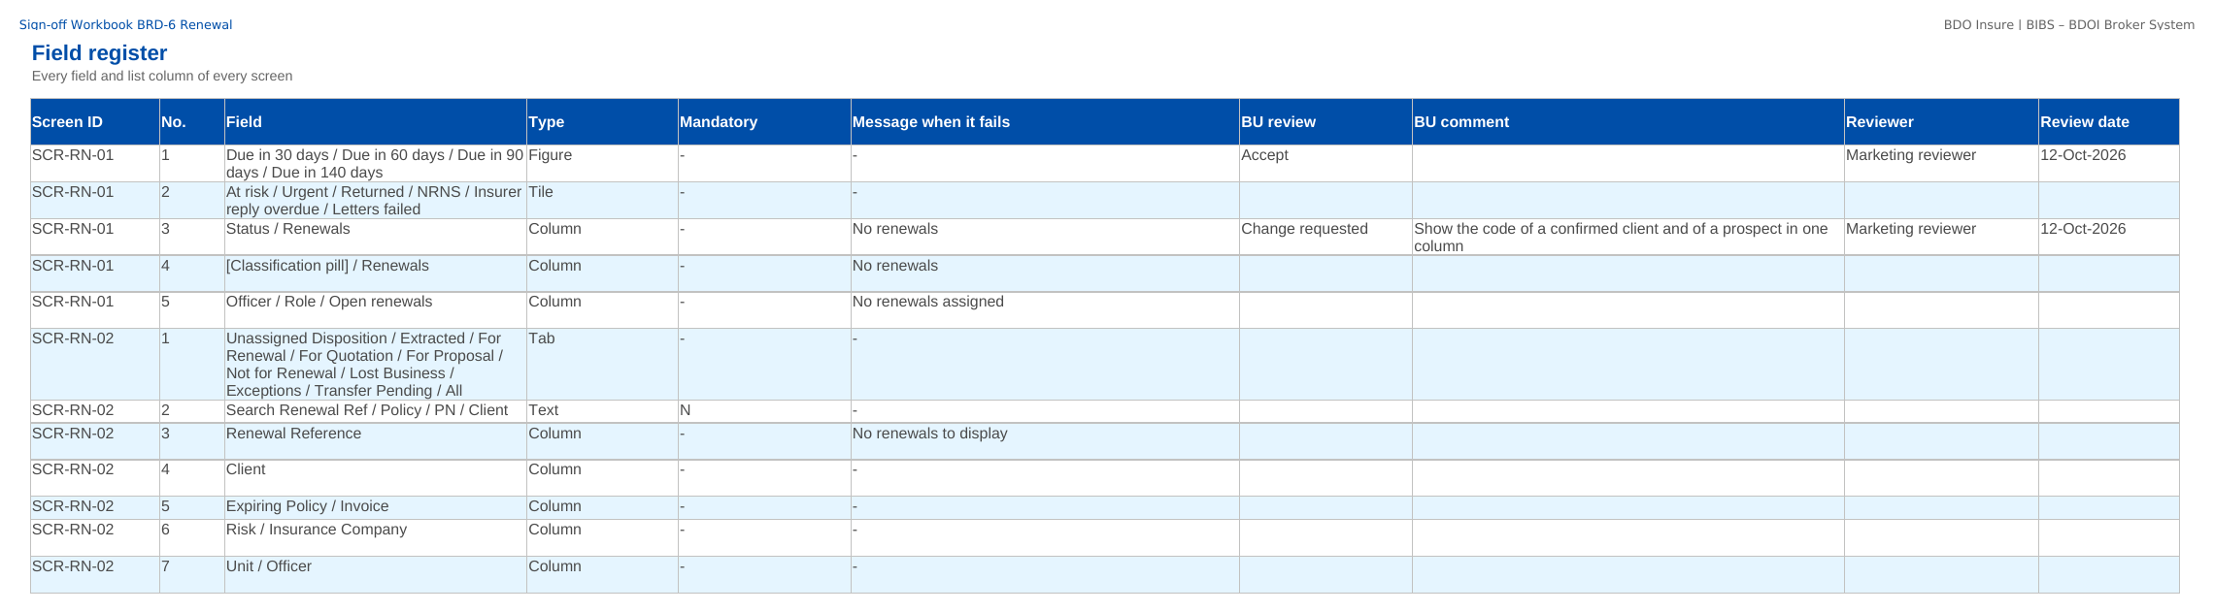
How to fill in the sign-off workbook
• Review the rows of your area on Screen standards, Screen catalogue, Field register, Business rules, Messages
• BU review: Accept, Change requested or Comment
• BU comment: the change asked for
• Reviewer and Review date
• Questions go to the Comments log
• Leave the other columns unchanged; one workbook per unit
Field register sheet of the sign-off workbook
Confidential – BDOI
Sign-off Pack Guide BRD-6 Renewal | v2.0
13
Notes:
The No. column is the numbered marker on the screenshot of the FRS, or the column number of a load template. The drop-down columns accept only the listed values. The Comments log, Meeting minutes and Version history sheets are kept by the project team; the Sign-off certificate is signed at the end.

Slide 14
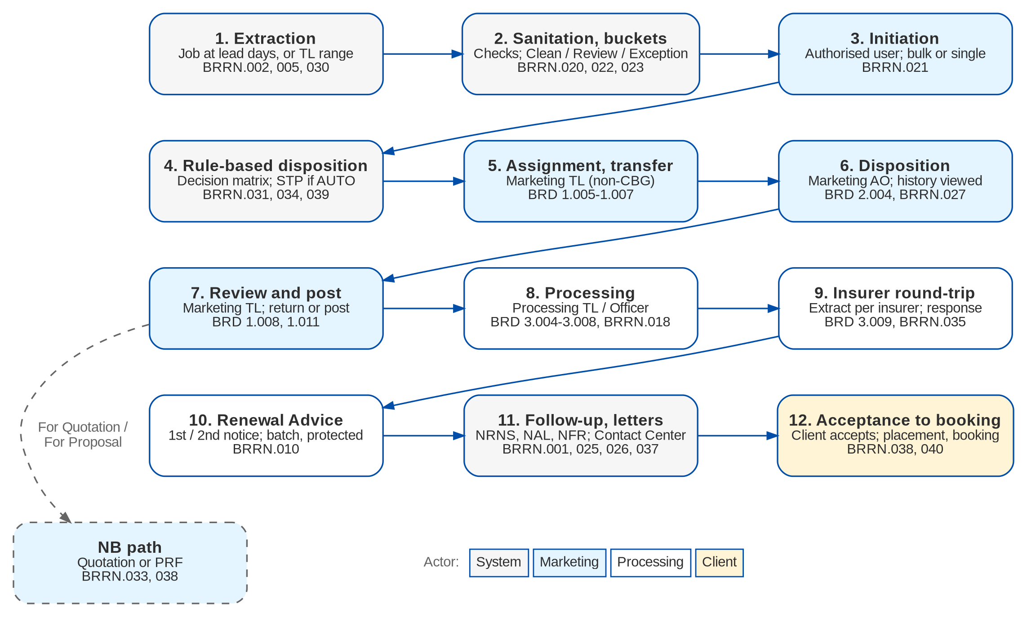
Renewal at a glance: process flow
BRD-6 process from the client to the booked invoice
Confidential – BDOI
Sign-off Pack Guide BRD-6 Renewal | v2.0
14
Notes:
The process runs from client onboarding and KYC, through the quotation or the PRF, the account, payment and placement, issuance and booking, to the hand-off to Operations and Accounting.

Slide 15
Renewal at a glance: personas and menus
Persona | SIT user | Screens | Menu sections
Marketing Team Leader | mkttl | 6 | Renewal
Marketing Account Officer (Account Broker) | ao | 5 | Renewal
Processing Team Leader | proctl | 6 | Renewal
Processing Officer (Broker) | proc | 6 | Renewal
Contact Center | contactc | 3 | Renewal
LAMD (loan status reports) | lamd | 3 | Renewal
Business Administrator | badmin | 3 | Renewal
System Administrator | admin | 0
Auditor | auditor | 2 | Renewal
Confidential – BDOI
Sign-off Pack Guide BRD-6 Renewal | v2.0
15
Notes:
Each persona sees only the menu entries of its role; the full menu of each persona is in FRS chapter 12 and on the Menu by persona sheet of the workbook.

Slide 16
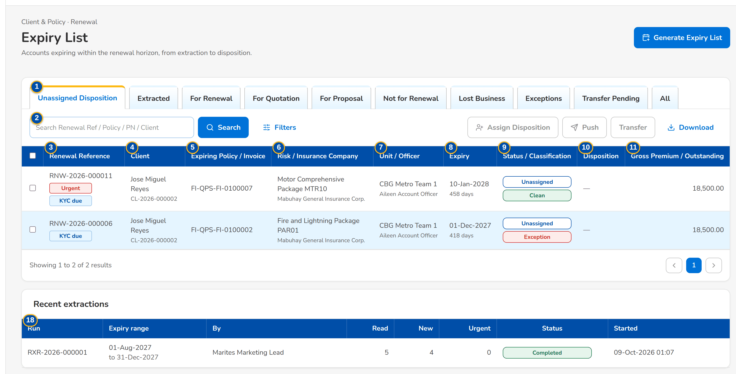
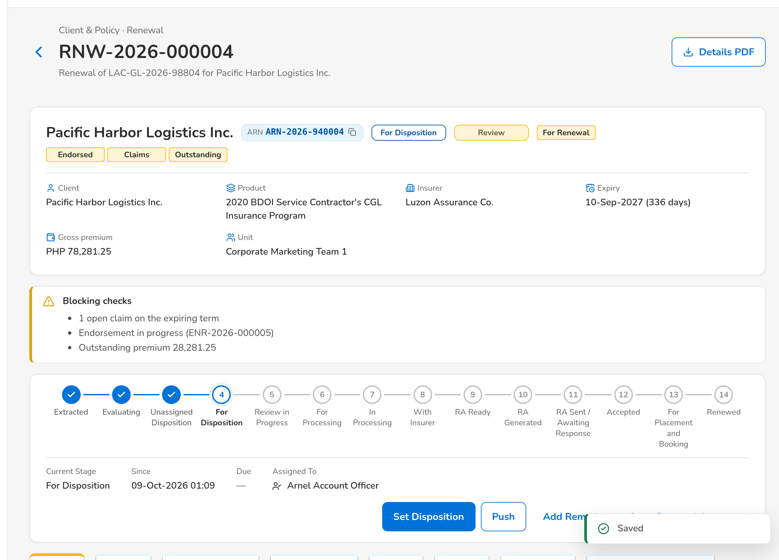
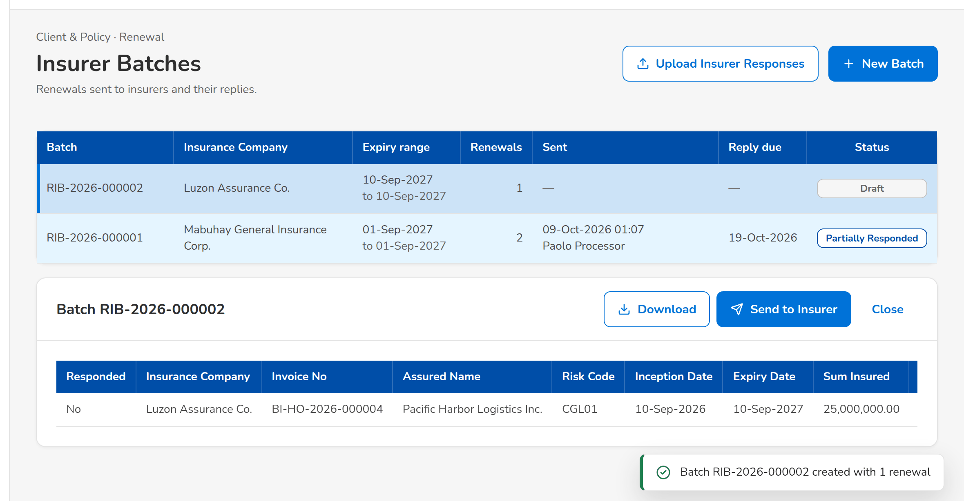
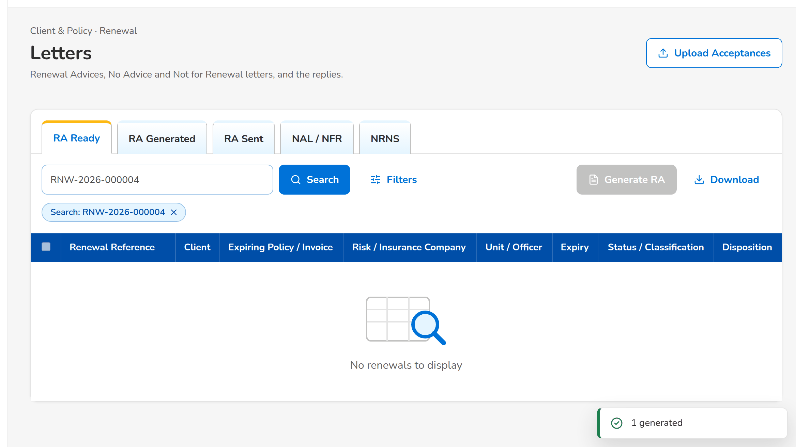
Renewal at a glance: key screens
Expiry List: the expiring accounts with their classification and flags
The disposition of the Account Officer after the account history
An insurer batch with the columns of the insurer extract
The Renewal Advice generated for the client
Confidential – BDOI
Sign-off Pack Guide BRD-6 Renewal | v2.0
16
Notes:
Screenshots of the SIT environment with seed data; every screen of the module is in FRS chapter 13.

Slide 17
Key business rules and validations
• The booked accounts expiring at the lead days (140 by default) are extracted every day, once per policy year; Generate Expiry List takes any range. Extraction does not start the renewal: it is initiated explicitly.
• On initiation the checks run (reference, PN, risk code, LAMD, claims, endorsements, outstanding premium, KYC and others): a failed check never gives the Clean classification; the decision matrix proposes the disposition, automatic for a Clean renewal when the rule says so.
• The Account Officer gives the disposition only after viewing the account history; Not for Renewal needs its reason. The Team Leader posts, returns or overrides with remarks.
• A renewal For Renewal or on the New Business path is not posted while a blocking check fails.
• Processing sends the renewals to the insurer in batches, protected; the insurer's response is captured once; Renew As Is with a match moves the renewal to the Renewal Advice without re-keying.
• The Renewal Advice is generated from the latest template and e-mailed protected; fewer than 30 days before expiry it needs a recorded confirmation; it locks the renewal on the Marketing side.
• The client's acceptance (e-mail, signed Renewal Advice or payment) moves the renewal account to placement and booking; it books as business type Renewal.
• Risk codes, checks and package mappings are maker-checker; the classification rules and the decision matrix are versions activated by another user.
  – Full list: FRS chapter 13 per screen, 59 rules on the Business rules sheet and 151 messages in FRS chapter 15 and on the Messages sheet
Confidential – BDOI
Sign-off Pack Guide BRD-6 Renewal | v2.0
17
Notes:
These are the rules the business units ask about most. Each rule is stated with its FR on the screen where it applies.

Slide 18
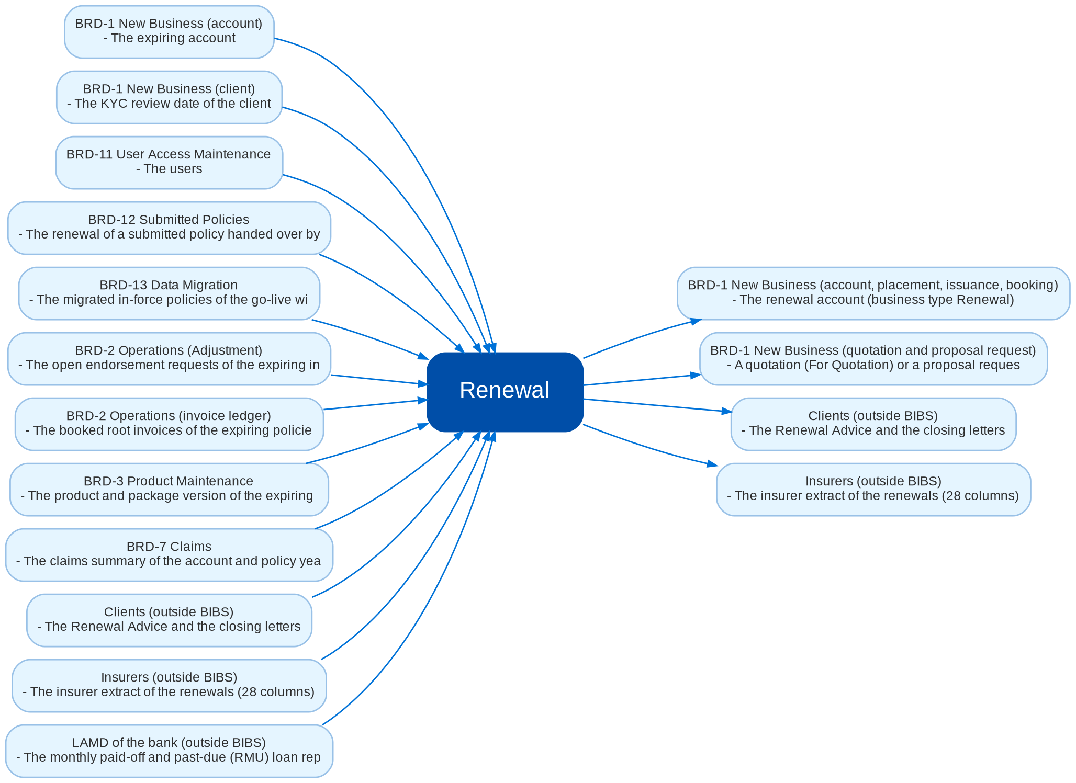
Cross-module dependencies and impacts
What Renewal takes from and hands to the other BRDs and systems (FRS chapter 19)
Confidential – BDOI
Sign-off Pack Guide BRD-6 Renewal | v2.0
18
Notes:
The contract is part of the signed set. A change of an exchange below is assessed with the owner of the other BRD; when it changes what the other BRD receives or shows, both owners approve it and the affected pages of both sets are signed again (delta sign-off).
IC-01 BRD-2 Operations (invoice ledger) (In): The booked root invoices of the expiring policies with their balances, payments and the endorsements booked in the term
IC-02 BRD-1 New Business (account) (In): The expiring account, client, policy, insurer, product, sales unit and account officer of each renewal
IC-03 BRD-1 New Business (account, placement, issuance, booking) (Out): The renewal account (business type Renewal), created from the expiring account; after acceptance it is fast-tracked to placement and booking, and booked through the New Business booking with the booking source Renewal
IC-04 BRD-1 New Business (quotation and proposal request) (Out): A quotation (For Quotation) or a proposal request (For Proposal) pre-filled from the expiring account, with the renewal reference
IC-05 BRD-3 Product Maintenance (In): The product and package version of the expiring account, whether it can be sold for renewal, and the BIBS package of a migrated policy
IC-06 BRD-2 Operations (Adjustment) (In): The open endorsement requests of the expiring invoice family
IC-07 BRD-7 Claims (In): The claims summary of the account and policy year (number and status of the claims)
IC-08 BRD-1 New Business (client) (In): The KYC review date of the client
IC-09 BRD-12 Submitted Policies (In): The renewal of a submitted policy handed over by Submitted Policies (free first year and mortgaged submitted policies)
IC-10 BRD-13 Data Migration (In): The migrated in-force policies of the go-live window with their legacy package, and the Renewal Advices sent by hand before go-live
IC-11 Insurers (outside BIBS) (Out / In): The insurer extract of the renewals (28 columns); the insurer's responses (Renew As Is, Revise, Reject)
IC-12 LAMD of the bank (outside BIBS) (In): The monthly paid-off and past-due (RMU) loan reports
IC-13 Clients (outside BIBS) (Out / In): The Renewal Advice and the closing letters; the client's acceptance (e-mail, signed Renewal Advice or payment)
IC-14 BRD-11 User Access Maintenance (In): The users, their roles and units (Account Officers, Team Leaders, Processing Officers, LAMD and Contact Center)

Slide 19
Caveats and possibilities
Topic | What can happen | How it is handled
Additional requirements | New needs can surface during the review, SIT or UAT. | In-scope clarification when the signed text already covers it; otherwise a change request with mandays.
Impacts on other modules | Renewal reads the Operations ledger and the New Business account, and hands the renewal back to New Business as an account of business type Renewal for placement and booking. A change of a disposition path or of the acceptance can change what New Business receives. | Each change is assessed against the cross-BRD contract (FRS chapter 19); when it touches another set, a delta sign-off of the affected pages of both sets.
Other BRDs change Renewal | New Business (account, booking), Operations (balances, endorsements), Product Maintenance (packages), Claims (claims summary), Submitted Policies (hand-off), User Access (roles) and Data Migration (go-live) can change what Renewal shows. | The change is raised against the other BRD and assessed against the contract; when it touches this set, a delta sign-off of the affected pages only.
Lists of values and rules still to confirm | The reasons for Not for Renewal, the return, transfer and override reasons, the follow-up channels and outcomes, the check severities, the classification rules and the decision matrix carry provisional values marked to confirm (RQ01, RQ24). | BDOI gives its lists and rules; they are loaded as configuration on Lists of Values and Renewal Setup, without a change request.
Letters and their wording | The Renewal Advice and the other letters use draft templates until BDOI gives its own wording (RQ26). | The templates are versioned on Document Templates; the new wording is a new version, without a change request.
Integrations pending BDOI IT specifications | Insurer responses and LAMD reports are uploaded until a channel is agreed; the approved domains of the Renewal Advice e-mails are to confirm (RQ16). | Uploads are in scope now; an automatic channel later is a change request. The technical detail is in the Technical Specification, reviewed by BDOI IT.
Open questions and assumptions | Open questions of FRS section 10.3 follow the assumptions of section 10.1; chapter 21 lists the proposed rules and clarifications for confirmation. | Answered as configuration where possible (lists of values, parameters, templates, rules); otherwise a change request; the assumption stands until then.
Confidential – BDOI
Sign-off Pack Guide BRD-6 Renewal | v2.0
19
Notes:
Three ways to handle a case: an in-scope clarification (no change to the signed set, answered in the comments log); a change request with mandays in the Change Management Register; a delta sign-off of the affected pages only.

Slide 20
Caveats: worked examples
Topic | Example and how it is handled
Additional requirements | A reviewer asks for the bank officer on the Expiry List: a new column, so a change request; asking which renewals the Exceptions tab shows is a clarification.
Impacts on other modules | Booking the renewal under its own business type changes the New Business booking screens: both owners confirm the delta.
Other BRDs change Renewal | Product Maintenance withdraws a package version: the product-renewable check fails for its renewals and they go to Review; signed as a delta.
Lists of values and rules still to confirm | BDOI adds the reason Client moved abroad: a list value, maintained by MBS.
Letters and their wording | Marketing adds the payment channels to the Renewal Advice: a new template version, approved by MBS.
Integrations pending BDOI IT specifications | LAMD sends its monthly report as a file; the LAMD user uploads it on LAMD Reports.
Open questions and assumptions | The lead days are 140 until BDOI confirms them; the answer is a parameter value.
Confidential – BDOI
Sign-off Pack Guide BRD-6 Renewal | v2.0
20
Notes:
Use these examples to agree the handling of a case during the review.

Slide 21
Entry and exit criteria, definition of done
Entry
Exit
Done
• Every screenshot of the set is taken on the SIT environment with seed data.
• Reviewers have their SIT users and the walkthrough sessions are held.
• The test plan is traced to the FRS and to the screens.
• The BRD-1 New Business walkthroughs are held (the expiring account and the renewal account are New Business screens).
• Every row of the workbook reviewed by its team (Accept, Change requested or Comment).
• Every comments log item closed: answered, corrected in v2.1, or raised as a change request.
• Open questions closed or accepted as assumptions.
• The sign-off certificate signed by every signatory of the Who signs what matrix: prepared, input, reviewed and approved as on the Renewal BRD approval sheets; the Product Owner approves the whole set.
• Signed certificate filed with the set; version history updated.
• Content frozen as signed; deltas listed in the Change Management Register with mandays.
• Test plan agreed for SIT and UAT.
Confidential – BDOI
Sign-off Pack Guide BRD-6 Renewal | v2.0
21
Notes:
The sign-off meeting starts when the exit criteria are met; the set is done when the certificate is signed and the content of the set is frozen.

Slide 22
After sign-off: readiness checklist
• ☐ Signed FRS, sign-off workbook and screens
• ☐ Open questions closed or accepted as assumptions
• ☐ Configuration inputs from the business: the reasons and lists of values of Renewal, the lead days and the other parameters, the check severities, the classification rules and the decision matrix, the non-renewable risk codes, the package map of the migrated policies, the letter templates, the insurers' renewal e-mail addresses, users and roles
• ☐ Agreed test plan
• ☐ Migration of the in-force policies of the go-live window and of the Renewal Advices sent before go-live signed (BRD-13)
  – After sign-off the content is frozen as signed and the approved deltas are scheduled.
Confidential – BDOI
Sign-off Pack Guide BRD-6 Renewal | v2.0
22
Notes:
After sign-off the content is frozen as signed and the approved deltas are scheduled.

Slide 23
Change control after sign-off
• A change to anything frozen is raised in the Change Management Register
  – The screen, field, rule or message concerned, the reason and the priority
• The project team assesses the mandays and the effect on the other BRDs through the cross-BRD contract
• The owners of every BRD concerned approve it
• Delivered as a new version of the set (v2.1, v2.2...) with the changed pages signed again (delta sign-off)
• Configuration values marked default change in BIBS without a change request
Confidential – BDOI
Sign-off Pack Guide BRD-6 Renewal | v2.0
23
Notes:
Nothing in a signed set changes without a request in the register.

Slide 24
Governance, contacts and next steps
Role | Who | Does
Business owner and approver | Shellah Marie C. Miranda, AVP, Product Owner | Accountable for the sign-off; chairs the sign-off meeting
Approvers | Jose Melvin Jarin, AVP, Product Owner; Mark Joseph C. Makalintal, SAVP, Unit Head - Combank and Corbank; Edmundante F. Ramirez, VP, and Roderick Lim, FVP, Retail and Corporate Marketing | Approve the set for their units
Reviewers | Rhommel Mark Galler, Marketing Business Services and System Support; the Marketing and Processing input providers of the BRD (Ma. Fides R. Rivera, Rose Marie Lique, Jackie Lyn Serrano and others) | Review their screens and rows; raise comments
BDOI IT | Information Technology Group (Angela Villamarzo Ramirez, Ma. Carmela Austria Morfe) | Reviews the scheduled runs, uploads, access and the Technical Specification
BRD owner | Dan Ace R. Cauton, Program Manager, and Zean C. Ibay, Roda Lyn D. Gallardo, Jane Tagle, Business Analysts, ESG-BPS | Traceability to the BRD; sign-off coordination
Delivery | iorta TechNXT Project Manager, Business Analysis, test lead | Sessions, answers, comments log, revisions, change requests
Confidential – BDOI
Sign-off Pack Guide BRD-6 Renewal | v2.0
24
Notes:
Next steps:
Kick-off and first SIT walkthrough on Wed 4-Nov-2026
Workbooks returned by Fri 20-Nov-2026; Q&A on Tue 24-Nov-2026; sign-off on Fri 27-Nov-2026
BRD-12 Submitted Policies, BRD-9 Customer Servicing Facility and BRD-10 Sanction Screening follow in the same window of November 2026

Slide 25
Next steps and the release order of the other BRD sets
• Kick-off and first SIT walkthrough on Wed 4-Nov-2026
• Workbooks returned by Fri 20-Nov-2026; Q&A on Tue 24-Nov-2026; sign-off on Fri 27-Nov-2026
• BRD-12 Submitted Policies, BRD-9 Customer Servicing Facility and BRD-10 Sanction Screening follow in the same window of November 2026
Confidential – BDOI
Sign-off Pack Guide BRD-6 Renewal | v2.0
25
Notes:
The other BRD sets follow the same pack, guide and steps.

