Slide 1


Sign-off Pack Guide: BRD-1 New Business
BRD-1 New Business business sign-off pack, release set v2.0
BIBS – BDOI Broker System
BDO Insurance and Reinsurance Brokers, Inc. | Version 2.0 | 1 October 2026 | Confidential
Prepared by
Notes:
This deck guides the business units through the BRD-1 New Business sign-off pack, release set v2.0. It explains what the pack is, how to read it, the steps up to sign-off and what happens after. It is presented at the kick-off and stays in the pack as file 01.

Slide 2
Purpose of the pack and what sign-off means
• The pack shows the proposed New Business of BIBS, screen by screen, so each business unit confirms what it will get
  – Content: 46 screens, 472 fields, 109 business rules, 526 messages
  – Every screen with numbered fields, the navigation per persona, three end-to-end walkthroughs
• Signing freezes the content, the screens and the navigation of the module
  – After sign-off a change goes through the Change Management Register with its mandays
  – Configuration values marked default (SLA hours, thresholds, list entries, templates) stay open
• The screenshots use fictitious seed data only, in the BDO theme
Confidential – BDOI
Sign-off Pack Guide BRD-1 New Business | v2.0
2
Notes:
Stress that the pack shows the screens, fields, rules and messages the business is asked to confirm.
Signing means: this is what we get; the look, feel, fields, rules, messages and navigation are frozen.
Data on the screenshots is seed data of the SIT environment; names and numbers are fictitious.

Slide 3
The pack at a glance (1 of 2)
File | What it is for | Who reads it | When
00_BIBS_StartHere_BRD-01_New_Business_v2.0.docx | Start Here: the map of the pack, who reads what, the steps and the dates | Everyone | First, on issue
01_BIBS_GuideDeck_BRD-01_New_Business_v2.0.pptx | Sign-off Pack Guide: purpose, approach, the module at a glance, caveats, entry and exit criteria, change control | Business owner, unit heads; presented at the kick-off | Kick-off session
02_BIBS_FRS_BRD-01_New_Business_v2.0.docx | Functional Requirements Specification v2.0: requirements, navigation, 46 screen specifications with screenshots, walkthroughs, messages, notifications, documents, uploads, cross-BRD contract | Business users of each area; Finance, Compliance and BDOI IT for their chapters | During the review, with the SIT walkthroughs
03_BIBS_Signoff_BRD-01_New_Business_v2.0.xlsx | Sign-off workbook: one row per screen, field, rule and message with the BU review columns; comments log, meeting minutes, version history, sign-off certificate | Every reviewer; the business owner signs it | During the review and at sign-off
04_BIBS_TestPlan_BRD-01_New_Business_v2.0.xlsx | Test plan workbook: the test cases traced to the FRs and to the screens, including one screen case and one message case per screen | Business users who will run UAT; BDOI IT | After the screens; used again in SIT and UAT
Confidential – BDOI
Sign-off Pack Guide BRD-1 New Business | v2.0
3
Notes:
The files are numbered in reading order so they sort that way in the BRD folder. 00 Start Here is the short version of this deck; 02 FRS and 03 workbook carry the same rows; 04 and 05 are the test plan traced to the screens; 07 to 09 are the UX screen documents for the BDOI UX Design team, taken from the same screens.

Slide 4
The pack at a glance (2 of 2)
File | What it is for | Who reads it | When
05_BIBS_TestPlan_BRD-01_New_Business_Summary_v2.0.docx | Test plan summary: scope, approach, coverage and the cases by area | Business owner, BDOI IT | Before sign-off
07_BIBS_UXDeck_BRD-01_New_Business_v2.0.pptx | UX Screen Deck for the BDOI UX Design team: design foundation, navigation and personas, every walkthrough step by step and every screen with all its states | BDOI UX Design team | From the issue, in parallel with the review; re-issued with each version of the set
08_BIBS_UXScreens_BRD-01_New_Business_v2.0.xlsx | UX screen register: one row per screen image with the screen, personas, walkthrough and step, state, FRS section and requirements, UXD status and comments, and the Changed in this issue flag | BDOI UX Design team | Kept by the UX Design team; the changed rows are flagged at each issue
09_BIBS_UXScreens_BRD-01_New_Business_v2.0.zip | Image package: every screen image at twice the screen resolution (PNG) and the register as CSV | BDOI UX Design team | Imported into the design tool at each issue
Confidential – BDOI
Sign-off Pack Guide BRD-1 New Business | v2.0
4
Notes:
The files are numbered in reading order so they sort that way in the BRD folder. 00 Start Here is the short version of this deck; 02 FRS and 03 workbook carry the same rows; 04 and 05 are the test plan traced to the screens; 07 to 09 are the UX screen documents for the BDOI UX Design team, taken from the same screens.

Slide 5
Where to start: reading order per role
Role | Read, in this order
Business owner (Product Owner, Head of MBS) | 00 Start Here; 01 Guide deck; FRS chapters 1-3 (context and personas), 14 (walkthroughs), 20 (sign-off) and 21 (proposed rules for confirmation); workbook Sign-off certificate
Business users (Marketing, TSU, Processing) | FRS chapter 12 (navigation) and the screens of your area in chapter 13; walkthroughs in chapter 14; messages in chapter 15; workbook Screen standards, Screen catalogue, Field register, Business rules and Messages
Finance (Comptrollership) | FRS Booking requirements (chapter 4) and generated documents (chapter 17: service invoice); walkthrough A steps 16-17; cross-BRD contract with Operations, Collections and Accounting (chapter 19); workbook Business rules of the booking screens
Compliance | Client onboarding and KYC screens (SCR-NB-01 to 04); sanction screening lines of the contract (chapter 19); retention rules; messages of the client screens
BDOI IT | Interfaces and integration (chapter 7), non-functional requirements (chapter 8), menu by persona (chapter 12), cross-BRD contract (chapter 19); integrations pending specifications (Guide deck, caveats)
BDOI UX Design team | 07 UX Screen Deck: design foundation and navigation first, then the personas, walkthroughs and screens of the design work; 08 UX screen register (filter Changed in this issue at each new issue); 09 image package in the design tool
iorta TechNXT project team | All documents; keeps the comments log, the meeting minutes and the version history of the workbook, answers every comment and keeps the traceability to SIT and UAT
Confidential – BDOI
Sign-off Pack Guide BRD-1 New Business | v2.0
5
Notes:
Nobody needs to read the whole FRS. Each role starts with its chapters and its sheets of the workbook; the walkthroughs in chapter 14 are the fastest way to see the whole process.

Slide 6
Approach: from issue to closure
1
Pack issued
2
Kick-off and screen walkthrough on SIT
3
Review with the workbook
4
Comments consolidated and a Q&A session
Release set v2.0 in the BRD-01 folder; invitations to the sessions
Screens shown live; first questions logged in the comments log; minutes
Every row marked Accept, Change requested or Comment; comments log entries
One consolidated comments log, each item typed (clarification, correction, change request) and answered; Q&A minutes
Day 0 (Mon 28-Sep-2026)
4 sessions, 1 to 6-Oct-2026
10 working days after the walkthroughs, until Fri 16-Oct-2026
3 working days, Q&A on Wed 21-Oct-2026
5
One revision cycle (v2.1)
6
Sign-off meeting and signature
7
Content freeze
8
Traceability into SIT and UAT
Release set v2.1 with the changed rows marked; change requests raised for the rest
Signed sign-off certificate; minutes; open items accepted as assumptions or change requests
Content frozen as signed; approved deltas scheduled in the Change Management Register
SIT and UAT runs traced to the signed screens, rules and messages; results against each row
2 working days, v2.1 on Fri 23-Oct-2026; check by the reviewers until Wed 28-Oct-2026
Fri 30-Oct-2026
From Mon 2-Nov-2026
SIT Jan - Jul 2027; UAT Aug - Dec 2027
Confidential – BDOI
Sign-off Pack Guide BRD-1 New Business | v2.0
6
Notes:
1. Pack issued: Day 0 (Mon 28-Sep-2026).
2. Kick-off and screen walkthrough on SIT: 4 sessions, 1 to 6-Oct-2026.
3. Review with the workbook: 10 working days after the walkthroughs, until Fri 16-Oct-2026.
4. Comments consolidated and a Q&A session: 3 working days, Q&A on Wed 21-Oct-2026.
5. One revision cycle (v2.1): 2 working days, v2.1 on Fri 23-Oct-2026; check by the reviewers until Wed 28-Oct-2026.
6. Sign-off meeting and signature: Fri 30-Oct-2026.
7. Content freeze: From Mon 2-Nov-2026.
8. Traceability into SIT and UAT: SIT Jan - Jul 2027; UAT Aug - Dec 2027.

Slide 7
Steps in detail (1 of 2): who, inputs, outputs, duration
Step | Who (R, A, C, I) | Inputs | Outputs | Duration
1. Pack issued | R: iorta TechNXT Project Manager; A: iorta TechNXT delivery lead; I: all reviewers | FRS v2.0, workbook, test plan, guide and deck | Release set v2.0 in the BRD-01 folder; invitations to the sessions | Day 0 (Mon 28-Sep-2026)
2. Kick-off and screen walkthrough on SIT | R: iorta TechNXT Business Analysis; A: BDOI Product Owner; C: unit heads; I: BDOI IT | Guide deck; SIT users with seed data; walkthroughs A, B and C | Screens shown live; first questions logged in the comments log; minutes | 4 sessions, 1 to 6-Oct-2026
3. Review with the workbook | R: business users of each unit; A: unit heads; C: iorta TechNXT (questions) | FRS chapters of the area; workbook sheets with the BU review columns | Every row marked Accept, Change requested or Comment; comments log entries | 10 working days after the walkthroughs, until Fri 16-Oct-2026
4. Comments consolidated and a Q&A session | R: iorta TechNXT Project Manager and Business Analysis; A: BDOI Product Owner; C: reviewers | Returned workbooks | One consolidated comments log, each item typed (clarification, correction, change request) and answered; Q&A minutes | 3 working days, Q&A on Wed 21-Oct-2026
Confidential – BDOI
Sign-off Pack Guide BRD-1 New Business | v2.0
7
Notes:
R responsible, A accountable, C consulted, I informed. The durations are indicative; the dates are those of the Start Here guide.

Slide 8
Steps in detail (2 of 2): who, inputs, outputs, duration
Step | Who (R, A, C, I) | Inputs | Outputs | Duration
5. One revision cycle (v2.1) | R: iorta TechNXT Business Analysis; A: iorta TechNXT delivery lead; C: reviewers who raised the items | Agreed clarifications and corrections | Release set v2.1 with the changed rows marked; change requests raised for the rest | 2 working days, v2.1 on Fri 23-Oct-2026; check by the reviewers until Wed 28-Oct-2026
6. Sign-off meeting and signature | R: iorta TechNXT Project Manager; A: BDOI Product Owner; C: unit heads, Finance, Compliance, BDOI IT | v2.1 (or v2.0 when no revision is needed); open items with their decision | Signed sign-off certificate; minutes; open items accepted as assumptions or change requests | Fri 30-Oct-2026
7. Content freeze | R: iorta TechNXT delivery lead; A: BDOI Product Owner; I: BDOI IT, other BRD owners | Signed set; change requests with mandays | Content frozen as signed; approved deltas scheduled in the Change Management Register | From Mon 2-Nov-2026
8. Traceability into SIT and UAT | R: iorta TechNXT test lead; A: BDOI Product Owner; C: business users | Signed FRS rows and test plan | SIT and UAT runs traced to the signed screens, rules and messages; results against each row | SIT Jan - Jul 2027; UAT Aug - Dec 2027
Confidential – BDOI
Sign-off Pack Guide BRD-1 New Business | v2.0
8
Notes:
R responsible, A accountable, C consulted, I informed. The durations are indicative; the dates are those of the Start Here guide.

Slide 9
Who signs what: parts of the set (1 of 2)
Part of the set | Prepares | Provides input | Reviews | Approves
Screens and fields (FRS screen specifications; workbook Screen catalogue, Field register) | iorta TechNXT | MBS, TSU | Program Manager (BPS) | Product Owner, UH Processing, UH Combank and Corbank, Head Retail Marketing, Head Institutional Banking
Business rules and validations | iorta TechNXT | MBS, TSU, BA (BPS) | Program Manager (BPS), Compliance | Product Owner, UH Processing, UH Combank and Corbank, Head Retail Marketing, Head Institutional Banking, Head Comptrollership
Messages and notifications | iorta TechNXT | MBS | Program Manager (BPS) | Product Owner
Documents and reports (slips, advices, service invoices, reports) | iorta TechNXT | MBS, TSU | Program Manager (BPS) | Product Owner, UH Processing, Head Comptrollership
Walkthroughs (end-to-end, screen by screen) | iorta TechNXT | MBS, TSU | Program Manager (BPS) | Product Owner
Confidential – BDOI
Sign-off Pack Guide BRD-1 New Business | v2.0
9
Notes:
The set holds business content only: screens, fields, rules, messages, notifications, documents, walkthroughs and reports. Business users sign the business content; BDOI IT reviews the interfaces, the user access and the Technical Specification, a separate document that holds the technical content; the Program Manager of Business Project Services reviews the traceability and the completeness; the Product Owner approves the whole set; iorta TechNXT prepares it.
The roles are those of the BRD approval sheet (BRD-1 approval sheets: Fire and Motor BRD ID consolidation p.128-129; Workshop Addendum p.22 (copy p.44)).

Slide 10
Who signs what: parts of the set (2 of 2)
Part of the set | Prepares | Provides input | Reviews | Approves
Proposed business rules and clarifications for confirmation | iorta TechNXT | BA (BPS), MBS | Program Manager (BPS) | Product Owner
Interfaces, user access and menus by persona | iorta TechNXT | MBS | BDOI IT | Product Owner
Test plan (04 workbook, 05 summary) | iorta TechNXT | MBS, TSU | Program Manager (BPS), BDOI IT | Product Owner
Technical Specification (separate document, not part of the business sign-off) | iorta TechNXT | BDOI IT | BDOI IT | BDOI IT
Confidential – BDOI
Sign-off Pack Guide BRD-1 New Business | v2.0
10
Notes:
The set holds business content only: screens, fields, rules, messages, notifications, documents, walkthroughs and reports. Business users sign the business content; BDOI IT reviews the interfaces, the user access and the Technical Specification, a separate document that holds the technical content; the Program Manager of Business Project Services reviews the traceability and the completeness; the Product Owner approves the whole set; iorta TechNXT prepares it.
The roles are those of the BRD approval sheet (BRD-1 approval sheets: Fire and Motor BRD ID consolidation p.128-129; Workshop Addendum p.22 (copy p.44)).

Slide 11
Who signs what: signatories (1 of 2)
Capacity | Role | Confirms by signing
Prepared by | iorta TechNXT project team: Project Manager, Business Analysis, test lead (iorta TechNXT) | The set is complete and consistent as issued, traced to the BRD and to the screens; every comment is answered in the comments log
Prepared by | Business Analyst, Enterprise Services Group - Business Project Services (BPS) (BDO Unibank ESG) | The set states the BRD requirements as written; every departure is listed in the proposed rules and clarifications
Input provided by | Marketing Business Services and System Support (MBS), BU representatives (BDOI) | The screens, fields, rules and messages of New Business match the business input
Input provided by | Technical Support Unit (TSU), BU representatives (BDOI) | The PRF, quotation slip, insurer terms and proposal slip screens match the business input
Reviewed by | Program Manager, Enterprise Services Group - Business Project Services (BPS) (BDO Unibank ESG) | Traceability of every BRD requirement to the set and completeness of the set
Reviewed by | BDOI Information Technology Group (BDOI IT) (BDOI) | Interfaces, user access and menus, and the Technical Specification (a separate document); not the business screens
Reviewed by | Compliance Officer (BDOI) | KYC, the screening hand-off and record retention
Confidential – BDOI
Sign-off Pack Guide BRD-1 New Business | v2.0
11
Notes:
The certificate sheet of the workbook lists the same signatories in the same order: prepared by, input provided by, reviewed by, approved by, as on the BRD approval sheet. A role the set adds to the approval sheet is marked there.
iorta TechNXT project team: Project Manager, Business Analysis, test lead: Added for this set (author of the FRS set).
Business Analyst, Enterprise Services Group - Business Project Services (BPS): Prepared by (p.128).
Marketing Business Services and System Support (MBS), BU representatives: p.128; reviewer of the Workshop Addendum (p.22).
Technical Support Unit (TSU), BU representatives: Added for this set (BU input named in the BRD revision log).
Program Manager, Enterprise Services Group - Business Project Services (BPS): Reviewed by (p.22); Approved by (p.129).
BDOI Information Technology Group (BDOI IT): Reviewed by (p.128).
Compliance Officer: Added for this set.

Slide 12
Who signs what: signatories (2 of 2)
Capacity | Role | Confirms by signing
Approved by | Product Owner, Marketing Business System (BDOI) | Owns the set and approves all of its contents
Approved by | Unit Head - Processing (BDOI) | Payment, placement, issuance and booking
Approved by | Unit Head - Combank and Corbank (BDOI) | Clients, quotations, PRFs and accounts of Combank and Corbank
Approved by | Head - Retail Marketing (BDOI) | Clients, quotations and accounts of Retail Marketing
Approved by | Head of Institutional Banking, SM and BDO Accounts (BDOI) | Clients, quotations and accounts of the institutional accounts
Approved by | Head - Comptrollership (BDOI) | Booking entries, service invoices and the hand-off to Accounting
Confidential – BDOI
Sign-off Pack Guide BRD-1 New Business | v2.0
12
Notes:
The certificate sheet of the workbook lists the same signatories in the same order: prepared by, input provided by, reviewed by, approved by, as on the BRD approval sheet. A role the set adds to the approval sheet is marked there.
Product Owner, Marketing Business System: Approved by (p.129, p.22).
Unit Head - Processing: Approved by (p.22).
Unit Head - Combank and Corbank: Approved by (p.129, p.22).
Head - Retail Marketing: Approved by (p.129, p.22).
Head of Institutional Banking, SM and BDO Accounts: Approved by (p.129).
Head - Comptrollership: Approved by (p.129).

Slide 13
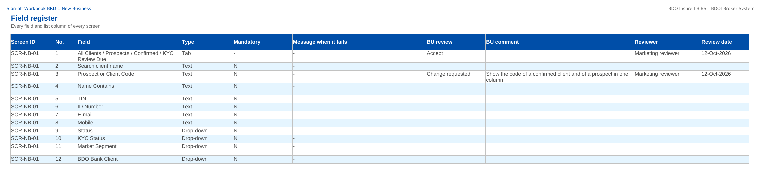
How to fill in the sign-off workbook
• Review the rows of your area on Screen standards, Screen catalogue, Field register, Business rules, Messages
• BU review: Accept, Change requested or Comment
• BU comment: the change asked for
• Reviewer and Review date
• Questions go to the Comments log
• Leave the other columns unchanged; one workbook per unit
Field register sheet of the sign-off workbook
Confidential – BDOI
Sign-off Pack Guide BRD-1 New Business | v2.0
13
Notes:
The No. column is the numbered marker on the screenshot of the FRS, or the column number of a load template. The drop-down columns accept only the listed values. The Comments log, Meeting minutes and Version history sheets are kept by the project team; the Sign-off certificate is signed at the end.

Slide 14
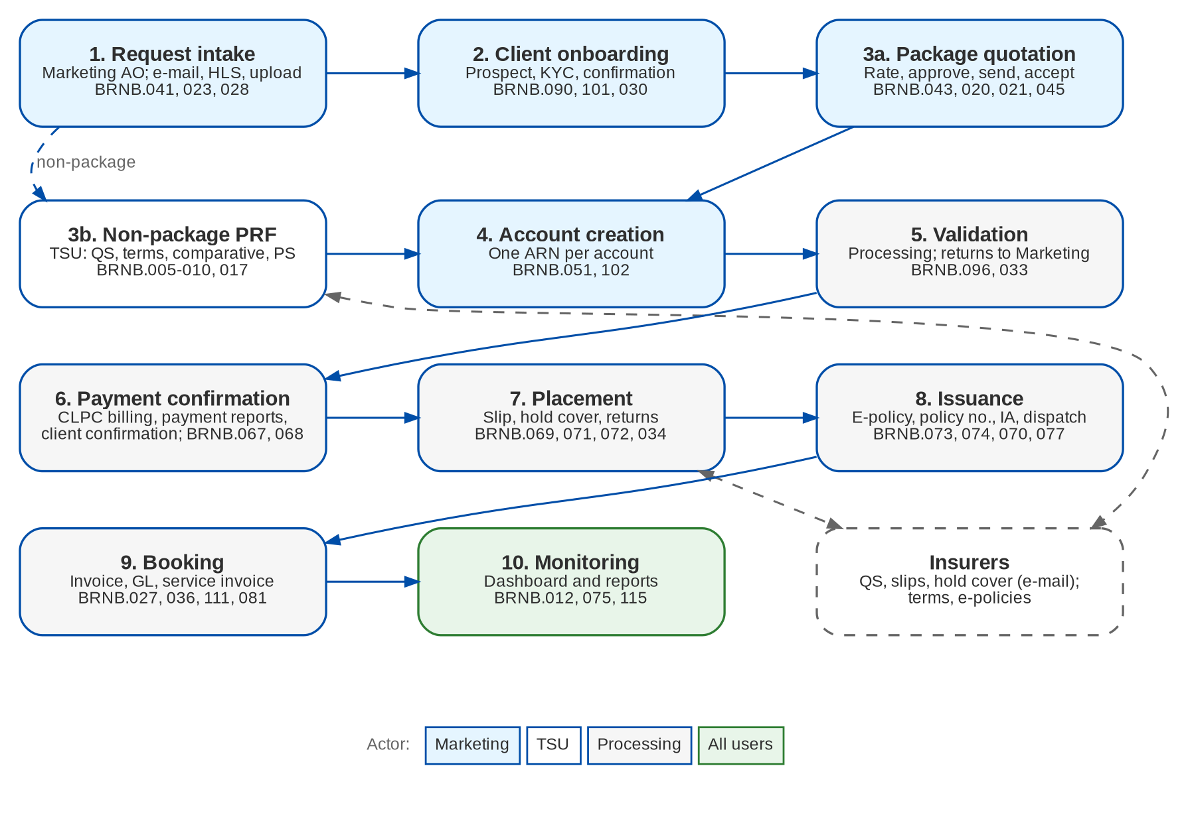
New Business at a glance: process flow
BRD-1 process from the client to the booked invoice
Confidential – BDOI
Sign-off Pack Guide BRD-1 New Business | v2.0
14
Notes:
The process runs from client onboarding and KYC, through the quotation or the PRF, the account, payment and placement, issuance and booking, to the hand-off to Operations and Accounting.

Slide 15
New Business at a glance: personas and menus
Persona | SIT user | Screens | Menu sections
Marketing Account Officer | ao | 20 | New Business Dashboard, My Work, Clients, Quotation / Proposal, Accounts & Placement, Non-Package Management, Placement & Booking, Policy Issuance, Bulk Processing, New Business Reports
Marketing TL / TH / UH | mkttl | 21 | New Business Dashboard, My Work, Clients, Quotation / Proposal, Accounts & Placement, Non-Package Management, Placement & Booking, Policy Issuance, Bulk Processing, New Business Reports
Technical Support Unit | tsu | 16 | New Business Dashboard, My Work, Clients, Quotation / Proposal, Accounts & Placement, Non-Package Management, Placement & Booking, Policy Issuance, New Business Reports
Processing | proc | 24 | New Business Dashboard, My Work, Clients, Quotation / Proposal, Accounts & Placement, Placement & Booking, Policy Issuance, Booking, Bulk Processing, New Business Reports
Processing Team Leader | proctl | 25 | New Business Dashboard, My Work, Clients, Quotation / Proposal, Accounts & Placement, Placement & Booking, Policy Issuance, Booking, Bulk Processing, New Business Reports
New Business Approver | approver | 19 | New Business Dashboard, My Work, Clients, Quotation / Proposal, Accounts & Placement, Placement & Booking, Policy Issuance, Booking, New Business Reports, Broking Setup
E-policy Sender | epol | 13 | New Business Dashboard, My Work, Clients, Accounts & Placement, Placement & Booking, Policy Issuance, New Business Reports
Adjustment | adjust | 18 | New Business Dashboard, My Work, Clients, Accounts & Placement, Placement & Booking, Policy Issuance, Booking, Bulk Processing, New Business Reports
Business Administrator | badmin | 10 | New Business Dashboard, My Work, Booking, Bulk Processing, New Business Reports, Broking Setup
System Administrator | admin | 10 | New Business Dashboard, My Work, Booking, Bulk Processing, New Business Reports, Broking Setup
Auditor | auditor | 19 | New Business Dashboard, My Work, Clients, Quotation / Proposal, Accounts & Placement, Placement & Booking, Policy Issuance, Booking, New Business Reports, Broking Setup
Confidential – BDOI
Sign-off Pack Guide BRD-1 New Business | v2.0
15
Notes:
Each persona sees only the menu entries of its role; the full menu of each persona is in FRS chapter 12 and on the Menu by persona sheet of the workbook.

Slide 16
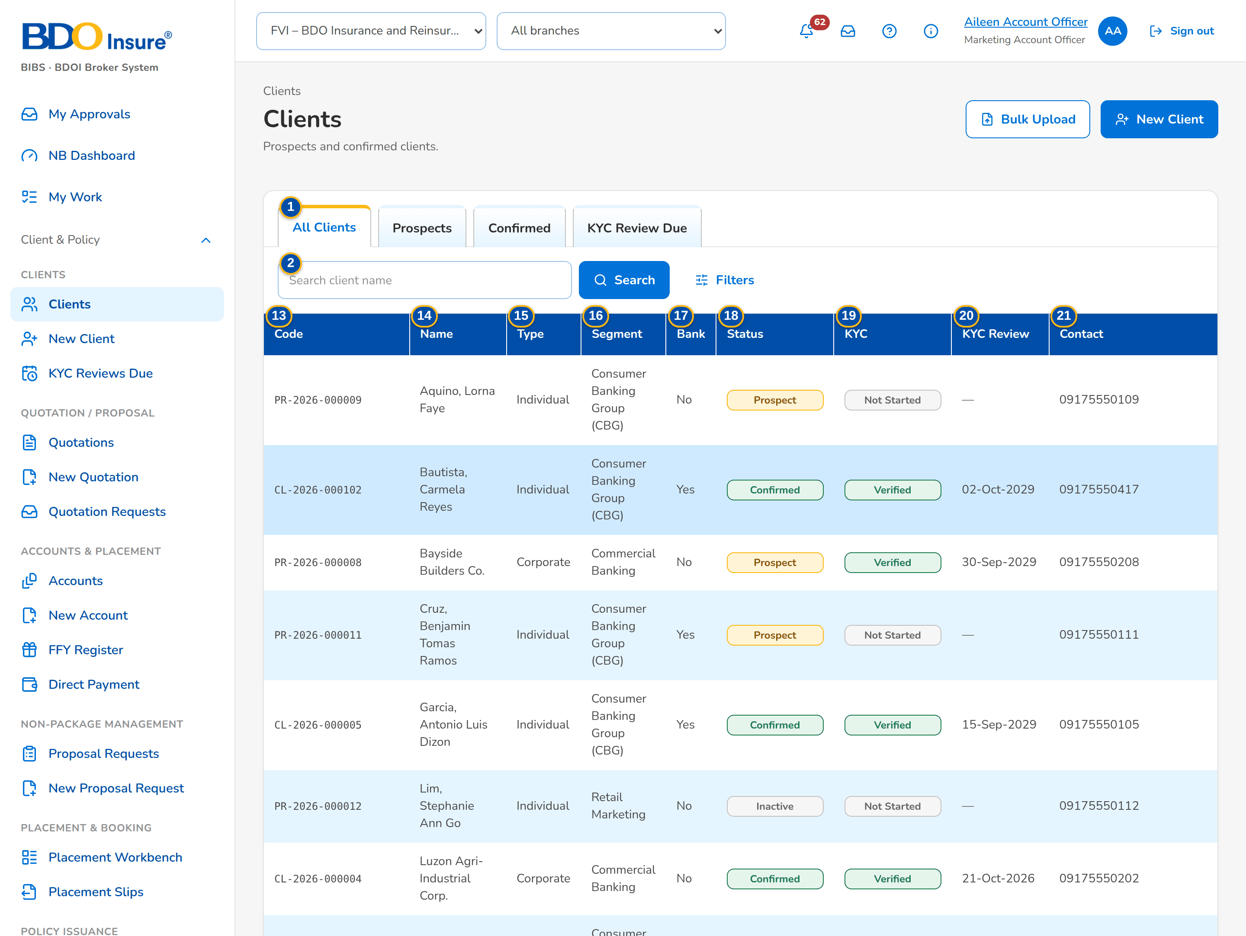
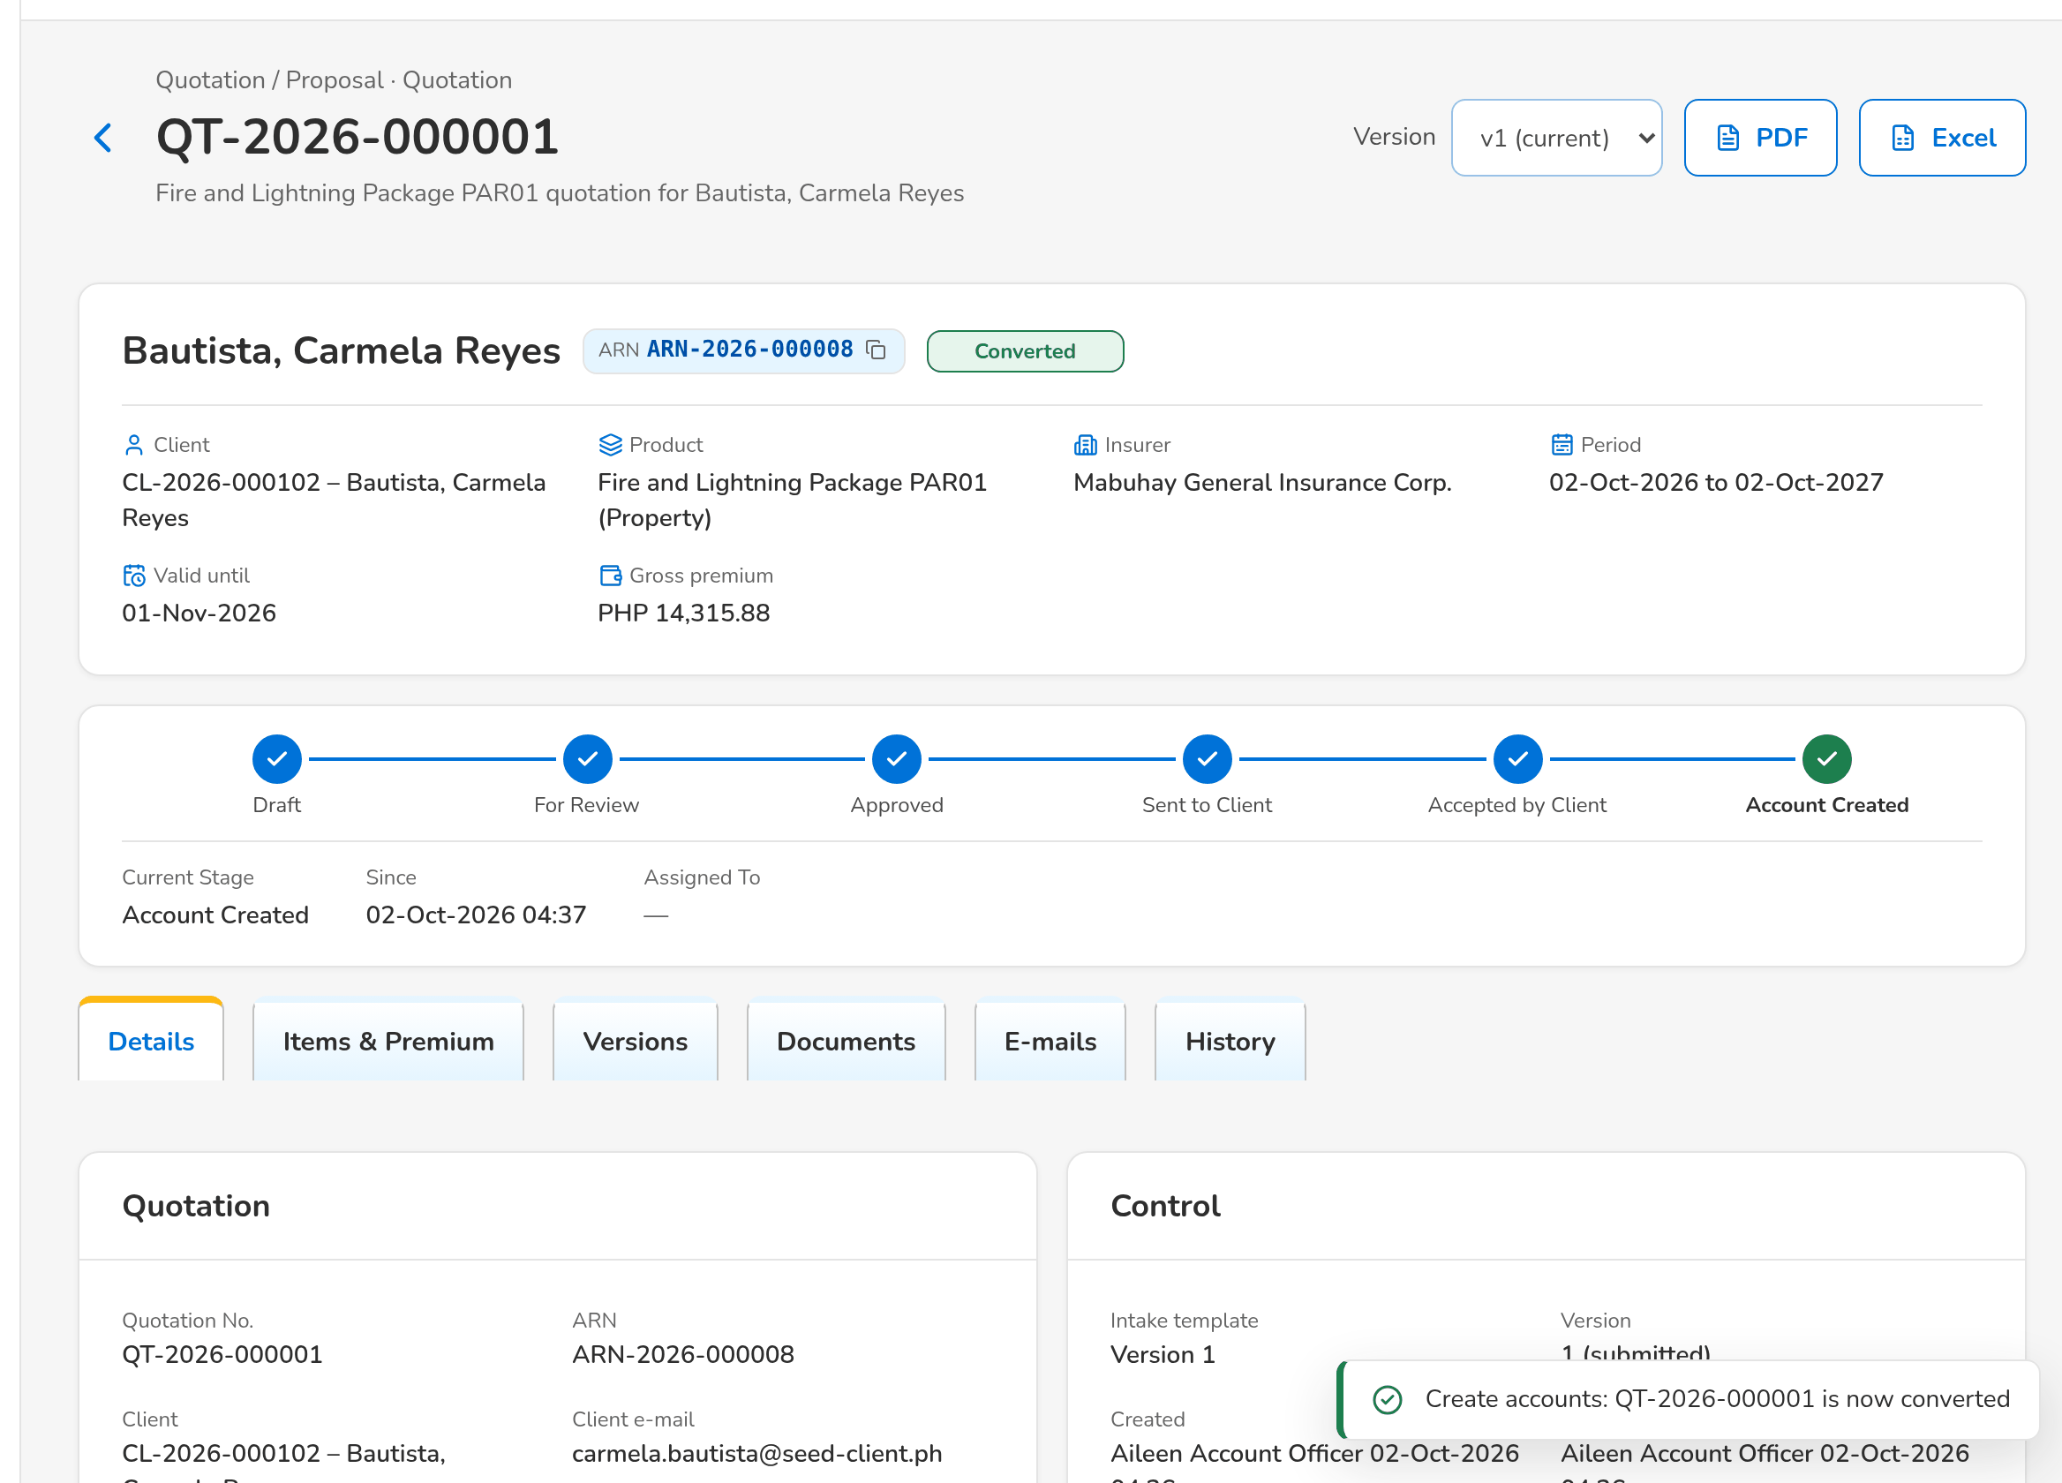
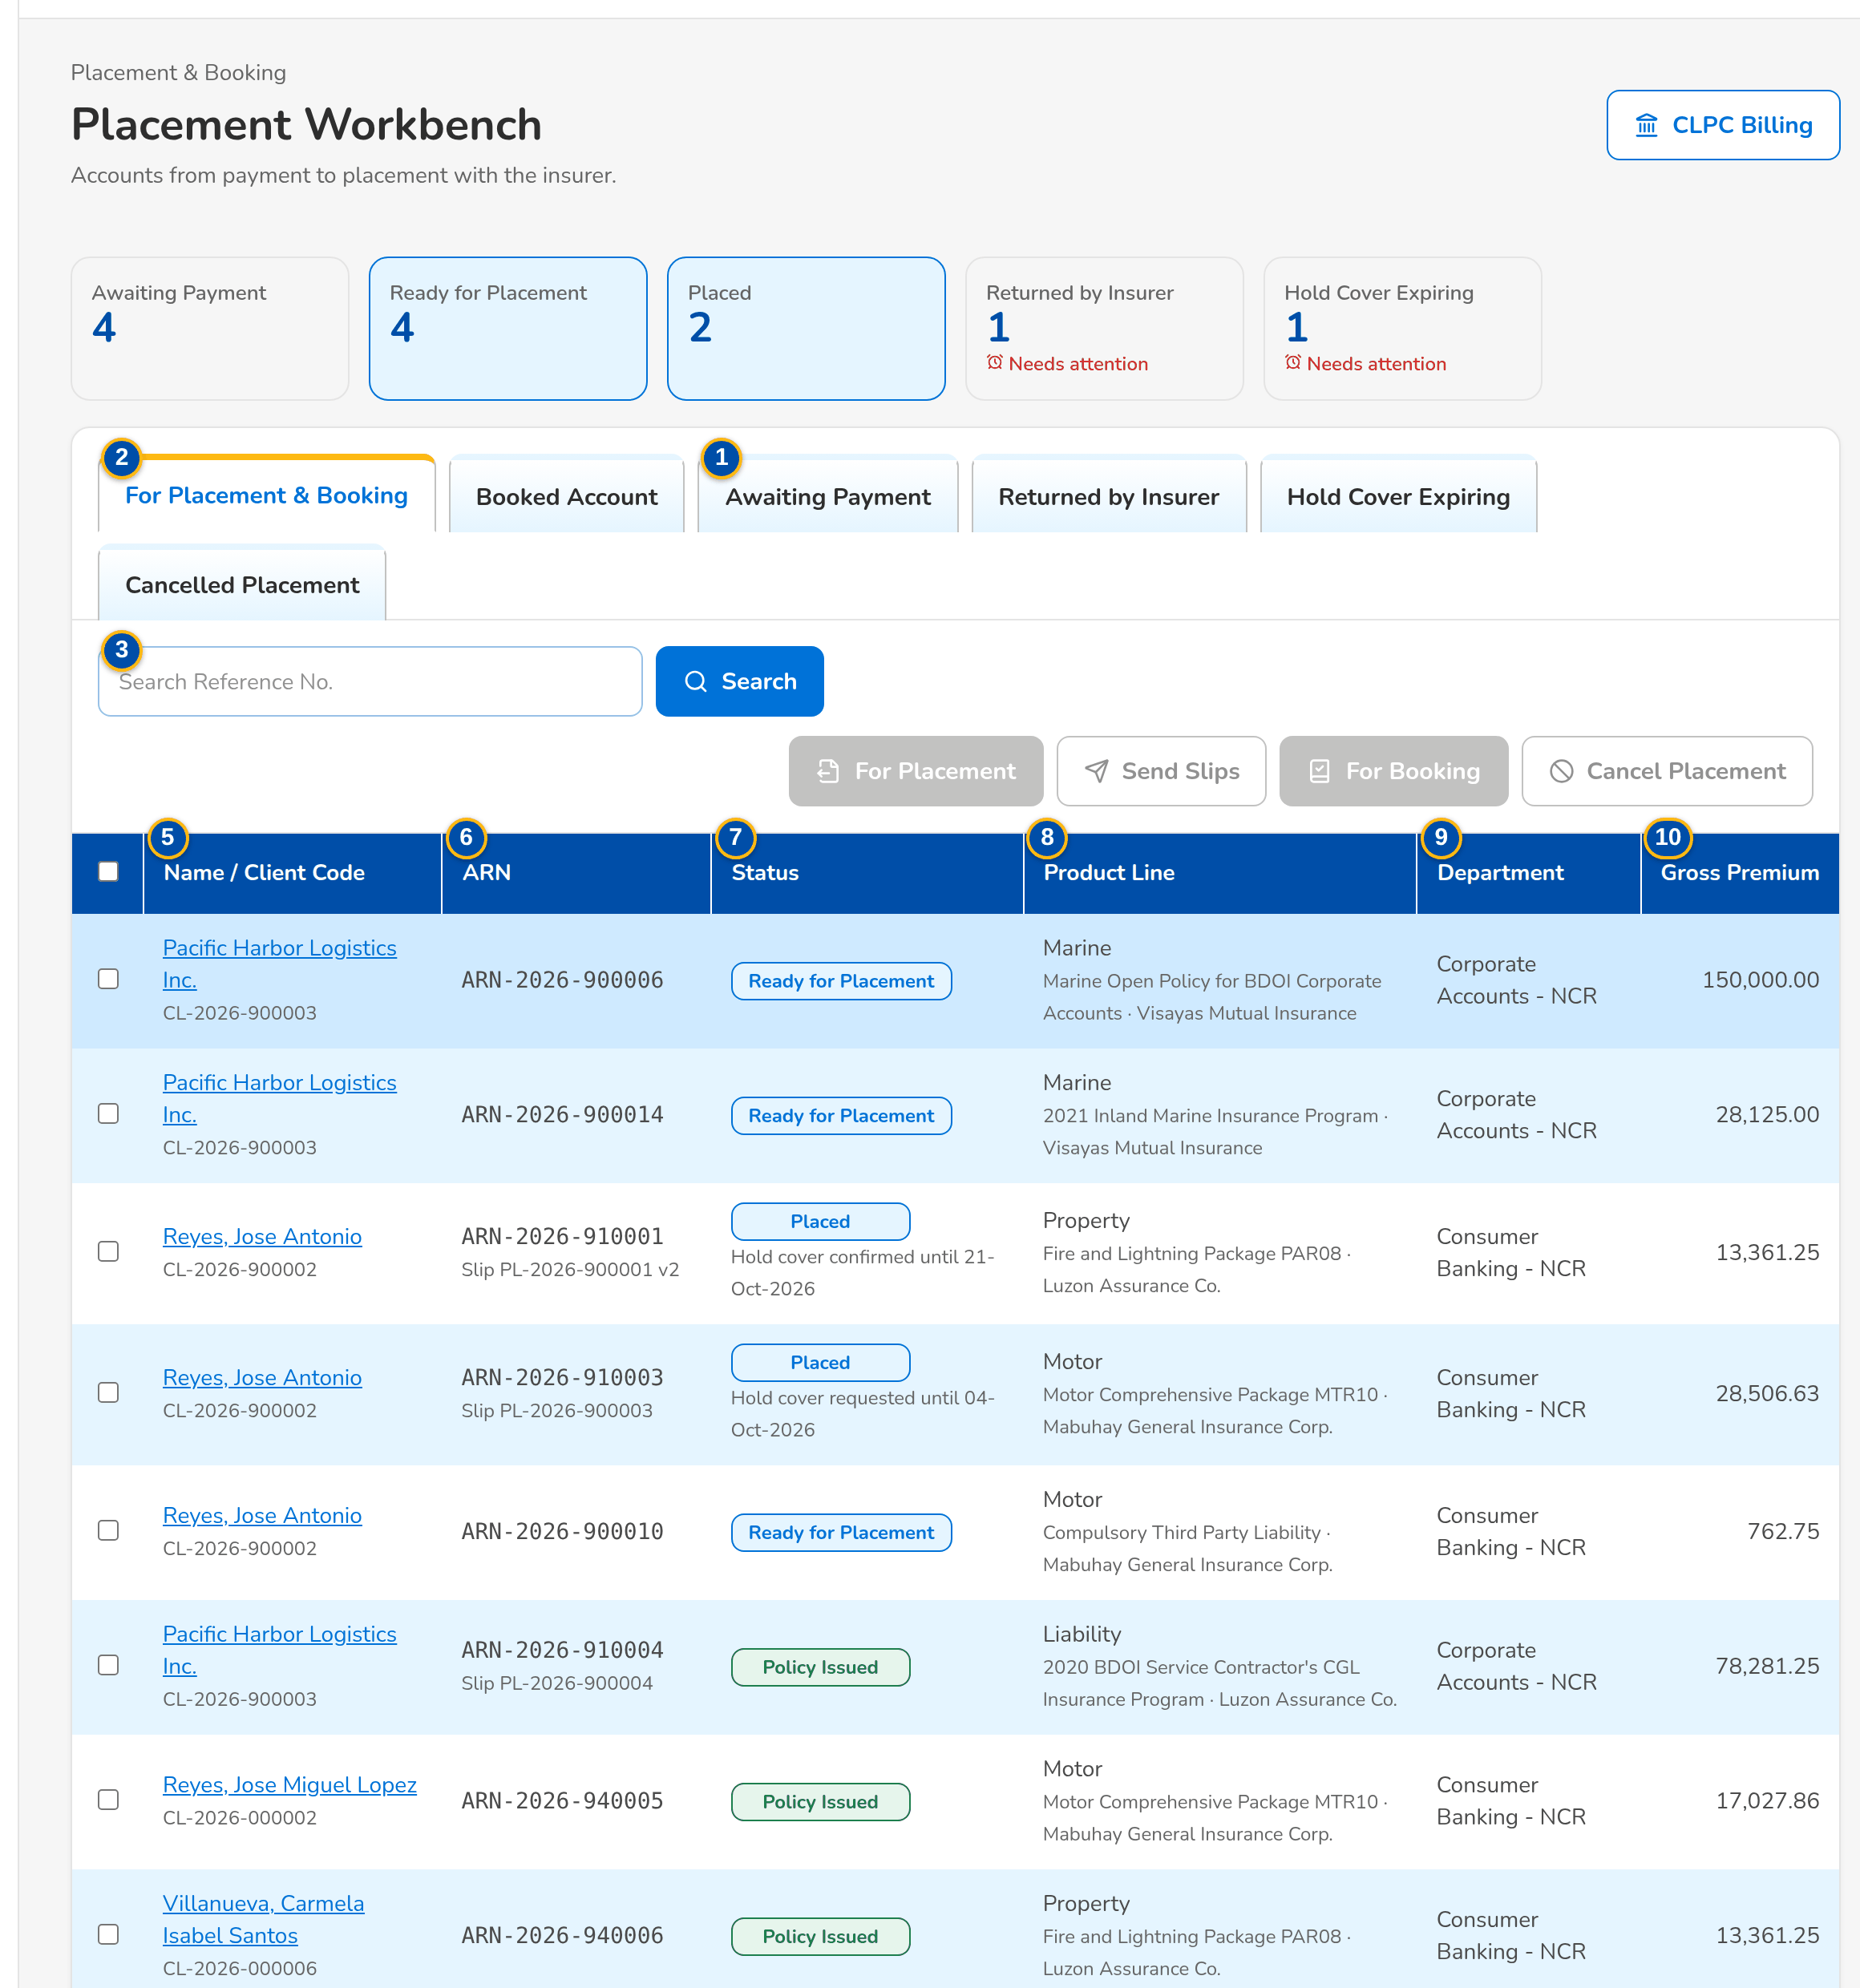
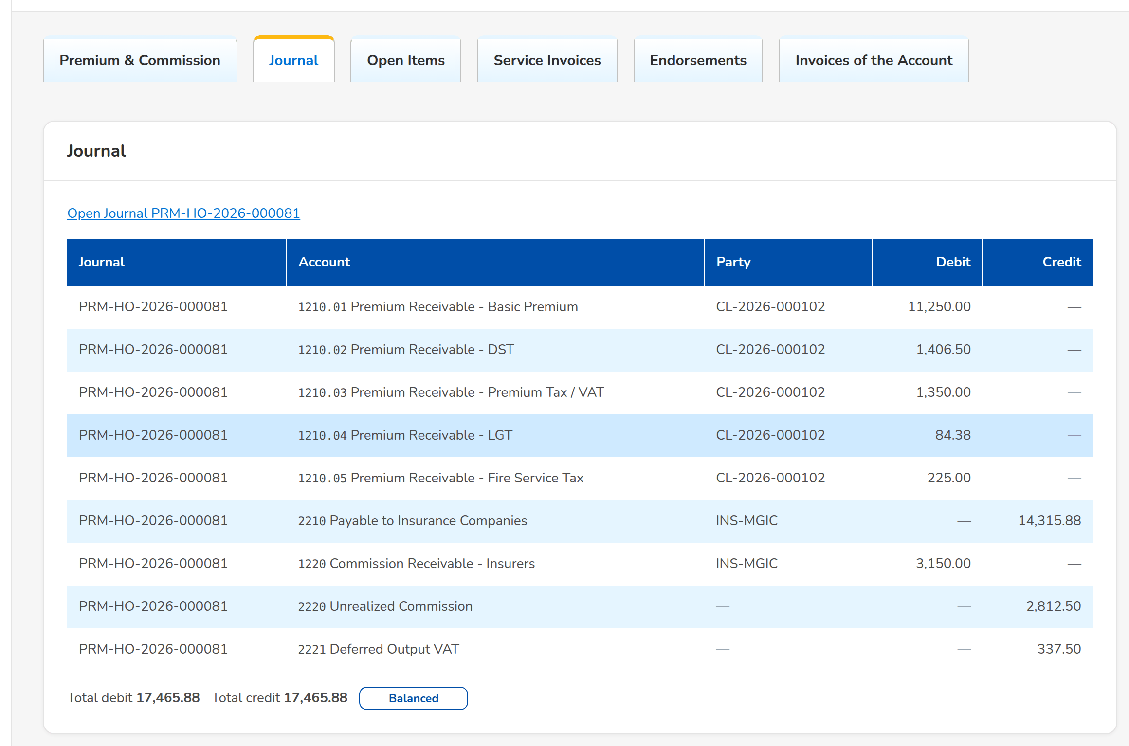
New Business at a glance: key screens
Clients work list
Quotation converted into an account
Placement Workbench
Booked invoice with its journal
Confidential – BDOI
Sign-off Pack Guide BRD-1 New Business | v2.0
16
Notes:
Screenshots of the SIT environment with seed data; every screen of the module is in FRS chapter 13.

Slide 17
Key business rules and validations
• A prospect needs only its type and name; the KYC documents and minimum fields are needed before the KYC is submitted, and a second user verifies it.
• Clients are checked for duplicates on TIN, ID and name with birth date (blocking) and on e-mail, mobile and corporate name (warning).
• A quotation or PRF is approved by someone other than its maker; a quotation is sent only once approved and still valid.
• An account needs a confirmed client; Processing validates it only when every mandatory field and document of the product is there.
• A risk is insured on one live account only (vehicle identifiers; client, location and item for property).
• Placement needs the payment gate open: CLPC payment matched for CBG Fire, payment or client confirmation for the other lines, or the direct-payment tag.
• Booking posts the journal (receivable, payable to the insurer, commission) and the service invoice; cancellations and endorsements follow the same rules.
• Bulk uploads validate every row before anything is saved; rejected rows come back in the error file.
  – Full list: FRS chapter 13 per screen, 109 rules on the Business rules sheet and 526 messages in FRS chapter 15 and on the Messages sheet
Confidential – BDOI
Sign-off Pack Guide BRD-1 New Business | v2.0
17
Notes:
These are the rules the business units ask about most. Each rule is stated with its FR on the screen where it applies.

Slide 18
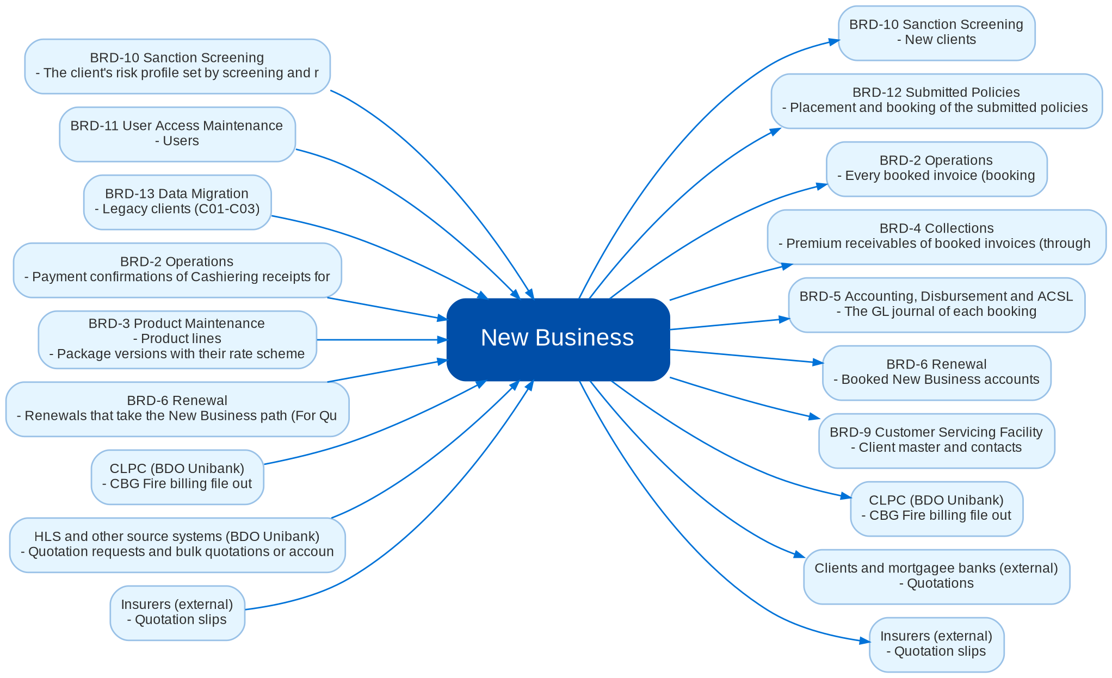
Cross-module dependencies and impacts
What New Business takes from and hands to the other BRDs and systems (FRS chapter 19)
Confidential – BDOI
Sign-off Pack Guide BRD-1 New Business | v2.0
18
Notes:
The contract is part of the signed set. This contract is part of the signed BRD-1 set. A later change in BRD-2, BRD-3, BRD-4, BRD-5, BRD-6, BRD-9, BRD-10, BRD-11, BRD-12 or BRD-13, or in an external interface, that changes what New Business takes or hands over as listed here is raised as a change request against this signed set through the Change Management Register, with its effort in man-days, before it is delivered.
IC-01 BRD-3 Product Maintenance (In): Product lines, cover types and products with their flags (package, direct payment eligible, FFY eligible, multi-year and maximum term, mortgagee applicable, fleet)
IC-02 BRD-3 Product Maintenance (In): Package versions with their rate scheme, rate exceptions approved for a transaction, rates and taxes, short-period table, motor limits
IC-03 BRD-3 Product Maintenance (In): Field rules and mandatory documents per product, TSU routing rules, incentive criteria
IC-04 BRD-10 Sanction Screening (Out): New clients, changes of a client's identity and accounts submitted to Processing
IC-05 BRD-10 Sanction Screening (In): The client's risk profile set by screening and risk profiling (KYC risk rating) and the tags Politically exposed person and Watchlist review
IC-06 BRD-11 User Access Maintenance (In): Users, roles, permissions and the persona menus; sign-in, password, lock-out and session rules; access requests and their approval
IC-07 BRD-2 Operations (Out): Every booked invoice (booking, endorsement, cancellation) with its premium components, commission, DTIP, insurer shares and parties
IC-08 BRD-2 Operations (In): Payment confirmations of Cashiering receipts for accounts awaiting payment
IC-09 BRD-4 Collections (Out): Premium receivables of booked invoices (through the Operations invoice ledger) and the direct-payment accounts whose commission BDOI collects from the insurer
IC-10 BRD-5 Accounting, Disbursement and ACSL (Out): The GL journal of each booking, endorsement and cancellation (event BROKER_BOOKING), the sub-ledger open items, service invoices and the cost center dimension
IC-11 BRD-6 Renewal (Out): Booked New Business accounts, their policy years, FFY tag and expiry, as the source of renewal candidates
IC-12 BRD-6 Renewal (In): Renewals that take the New Business path (For Quotation, For Proposal) and renewal accounts to place and book
IC-13 BRD-9 Customer Servicing Facility (Out): Client master and contacts, accounts with ARN and PN numbers, loan application numbers, policy numbers and e-policies
IC-14 BRD-12 Submitted Policies (Out): Placement and booking of the submitted policies converted to accounts
IC-15 BRD-13 Data Migration (In): Legacy clients (C01-C03), accounts and policies, open invoices loaded into the New Business structures at cut-over
IC-16 Insurers (external) (Out / In): Quotation slips, placement slips, hold cover requests and service invoices by e-mail; insurer terms, confirmations and e-policies received by e-mail and keyed in or uploaded
IC-17 CLPC (BDO Unibank) (Out / In): CBG Fire billing file out; payment report back
IC-18 HLS and other source systems (BDO Unibank) (In): Quotation requests and bulk quotations or accounts
IC-19 Clients and mortgagee banks (external) (Out): Quotations, proposals, e-policies and Insurance Advices by e-mail, password protected, with the password in a separate e-mail

Slide 19
Caveats and possibilities
Topic | What can happen | How it is handled
Additional requirements | New needs can surface during the review, SIT or UAT. | In-scope clarification when the signed text already covers it; otherwise a change request with mandays.
Other BRDs change New Business | Product Maintenance, Sanction Screening, User Access, Operations, Collections, Accounting, Renewal, CSF, Submitted Policies, Data Migration and the Core Replacement can change what New Business takes or hands over. | The change is raised against the other BRD and assessed against the cross-BRD contract; when it touches this set, a delta sign-off of the affected pages only.
Integrations pending BDOI IT specifications | HLS, CLPC transport, electronic channels to insurers (file transfer or system-to-system), directory sign-in and the mail relay depend on specifications from BDOI IT. | A manual or file-based step until the specification arrives; the interface is then a change request.
Open questions and assumptions | Open questions of FRS section 10.3 (product matrix, approval chain, document layouts, TSU thresholds and others) follow the assumptions of section 10.1; chapter 21 lists the proposed rules for confirmation. | Answered as configuration where possible (lists, parameters, templates); otherwise a change request; the assumption stands until then.
Confidential – BDOI
Sign-off Pack Guide BRD-1 New Business | v2.0
19
Notes:
Three ways to handle a case: an in-scope clarification (no change to the signed set, answered in the comments log); a change request with mandays in the Change Management Register; a delta sign-off of the affected pages only.

Slide 20
Caveats: worked examples
Topic | Example and how it is handled
Additional requirements | A reviewer asks for the KYC risk rating on the Clients list: a new column, so a change request; asking which statuses the list shows is a clarification.
Other BRDs change New Business | BRD-3 adds a mandatory field to a product: the account field rules change; the affected screen specification pages are re-issued and signed as a delta.
Integrations pending BDOI IT specifications | CLPC billing is a download and an upload today; an automatic transfer is added when the CLPC layout and transport are agreed.
Open questions and assumptions | The approval chain is one approval stage; a two-level chain for large premiums, once BDOI states the limits, is a change request.
Confidential – BDOI
Sign-off Pack Guide BRD-1 New Business | v2.0
20
Notes:
Use these examples to agree the handling of a case during the review.

Slide 21
Entry and exit criteria, definition of done
Entry
Exit
Done
• Every screenshot of the set is taken on the SIT environment with seed data.
• Reviewers have their SIT users and the walkthrough sessions are held.
• The test plan is traced to the FRS and to the screens.
• Every row of the workbook reviewed by its unit (Accept, Change requested or Comment).
• Every comments log item closed: answered, corrected in v2.1, or raised as a change request.
• Open questions closed or accepted as assumptions.
• The sign-off certificate signed by every signatory of the Who signs what matrix: prepared, input, reviewed and approved as on the BRD approval sheet; the Product Owner approves the whole set.
• Signed certificate filed with the set; version history updated.
• Content frozen as signed; deltas listed in the Change Management Register with mandays.
• Test plan agreed for SIT and UAT.
Confidential – BDOI
Sign-off Pack Guide BRD-1 New Business | v2.0
21
Notes:
The sign-off meeting starts when the exit criteria are met; the set is done when the certificate is signed and the content of the set is frozen.

Slide 22
After sign-off: readiness checklist
• ☐ Signed FRS, sign-off workbook and screens
• ☐ Open questions closed or accepted as assumptions
• ☐ Configuration inputs from the business: lists of values, parameters, document templates, products, users and roles
• ☐ Agreed test plan
• ☐ Migration mapping of the New Business objects signed (BRD-13)
  – After sign-off the content is frozen as signed and the approved deltas are scheduled.
Confidential – BDOI
Sign-off Pack Guide BRD-1 New Business | v2.0
22
Notes:
After sign-off the content is frozen as signed and the approved deltas are scheduled.

Slide 23
Change control after sign-off
• A change to anything frozen is raised in the Change Management Register
  – The screen, field, rule or message concerned, the reason and the priority
• The project team assesses the mandays and the effect on the other BRDs through the cross-BRD contract
• The owners of every BRD concerned approve it
• Delivered as a new version of the set (v2.1, v2.2...) with the changed pages signed again (delta sign-off)
• Configuration values marked default change in BIBS without a change request
Confidential – BDOI
Sign-off Pack Guide BRD-1 New Business | v2.0
23
Notes:
Nothing in a signed set changes without a request in the register.

Slide 24
Governance, contacts and next steps
Role | Who | Does
Business owner and approver | BDOI Product Owner | Accountable for the sign-off; chairs the sign-off meeting
Input provider | Marketing Business Services and System Support (MBS); TSU | Coordinates the units' review; signs for the business input (BRD approval sheet: input)
Reviewers | Marketing, TSU, Processing, Comptrollership | Review their screens and rows; raise comments
Finance, Compliance, BDOI IT | Comptrollership, Compliance, BDOI IT | Comptrollership approves booking and accounting; Compliance reviews KYC and screening; BDOI IT reviews interfaces, access and the Technical Specification
BRD owner | Business Project Services, BDO Unibank ESG | Business Analyst: the BRD as written; Program Manager: traceability and completeness; sign-off coordination
Delivery | iorta TechNXT Project Manager, Business Analysis, test lead | Sessions, answers, comments log, revisions, change requests
Confidential – BDOI
Sign-off Pack Guide BRD-1 New Business | v2.0
24
Notes:
Next steps:
Kick-off and first SIT walkthrough on Thu 1-Oct-2026
Workbooks returned by Fri 16-Oct-2026; Q&A on Wed 21-Oct-2026; sign-off on Fri 30-Oct-2026
Next release sets: BRD-3 Product Maintenance and BRD-11 User Access (Nov 2026), then BRD-10, 12, 6, 9, then BRD-2, 4, 5, then BRD-13, then BRD-7 and BRD-8

Slide 25
Next steps and the release order of the other BRD sets
• Kick-off and first SIT walkthrough on Thu 1-Oct-2026
• Workbooks returned by Fri 16-Oct-2026; Q&A on Wed 21-Oct-2026; sign-off on Fri 30-Oct-2026
• Next release sets: BRD-3 Product Maintenance and BRD-11 User Access (Nov 2026), then BRD-10, 12, 6, 9, then BRD-2, 4, 5, then BRD-13, then BRD-7 and BRD-8
Confidential – BDOI
Sign-off Pack Guide BRD-1 New Business | v2.0
25
Notes:
The other BRD sets follow the same pack, guide and steps.

