Slide 1


Sign-off Pack Guide: BRD-3 Product Maintenance
BRD-3 Product Maintenance business sign-off pack, release set v2.0
BIBS – BDOI Broker System
BDO Insurance and Reinsurance Brokers, Inc. | Version 2.0 | 27 September 2026 | Confidential
Prepared by
Notes:
This deck guides the business units through the BRD-3 Product Maintenance sign-off pack, release set v2.0. It explains what the pack is, how to read it, the steps up to sign-off and what happens after. It is presented at the kick-off and stays in the pack as file 01.

Slide 2
Purpose of the pack and what sign-off means
• The pack shows the proposed Product Maintenance of BIBS, screen by screen, so each business unit confirms what it will get
  – Content: 22 screens, 325 fields, 84 business rules, 276 messages
  – Every screen with numbered fields, the navigation per persona, three end-to-end walkthroughs
• Signing freezes the content, the screens and the navigation of the module
  – After sign-off a change goes through the Change Management Register with its mandays
  – Configuration values marked default (SLA hours, thresholds, list entries, templates) stay open
• The screenshots use fictitious seed data only, in the BDO theme
Confidential – BDOI
Sign-off Pack Guide BRD-3 Product Maintenance | v2.0
2
Notes:
Stress that the pack shows the screens, fields, rules and messages the business is asked to confirm.
Signing means: this is what we get; the look, feel, fields, rules, messages and navigation are frozen.
Data on the screenshots is seed data of the SIT environment; names and numbers are fictitious.

Slide 3
The pack at a glance (1 of 2)
File | What it is for | Who reads it | When
00_BIBS_StartHere_BRD-03_Product_Maintenance_v2.0.docx | Start Here: the map of the pack, who reads what, the steps and the dates | Everyone | First, on issue
01_BIBS_GuideDeck_BRD-03_Product_Maintenance_v2.0.pptx | Sign-off Pack Guide: purpose, approach, the module at a glance, caveats, entry and exit criteria, change control | Business owner, unit heads; presented at the kick-off | Kick-off session
02_BIBS_FRS_BRD-03_Product_Maintenance_v2.0.docx | Functional Requirements Specification v2.0: requirements, navigation, 22 screen specifications with screenshots, walkthroughs, messages, notifications, documents, uploads, configuration inputs, cross-BRD contract | MBS, TSU and Marketing for their screens; Finance and BDOI IT for their chapters | During the review, with the SIT walkthroughs
03_BIBS_Signoff_BRD-03_Product_Maintenance_v2.0.xlsx | Sign-off workbook: one row per screen, field, rule and message with the BU review columns; comments log, meeting minutes, version history, sign-off certificate | Every reviewer; the business owner signs it | During the review and at sign-off
04_BIBS_TestPlan_BRD-03_Product_Maintenance_v2.0.xlsx | Test plan workbook: the test cases traced to the FRs and to the screens, including one screen case and one message case per screen | Business users who will run UAT; BDOI IT | After the screens; used again in SIT and UAT
Confidential – BDOI
Sign-off Pack Guide BRD-3 Product Maintenance | v2.0
3
Notes:
The files are numbered in reading order so they sort that way in the BRD folder. 00 Start Here is the short version of this deck; 02 FRS and 03 workbook carry the same rows; 04 and 05 are the test plan traced to the screens; 07 to 09 are the UX screen documents for the BDOI UX Design team, taken from the same screens.

Slide 4
The pack at a glance (2 of 2)
File | What it is for | Who reads it | When
05_BIBS_TestPlan_BRD-03_Product_Maintenance_Summary_v2.0.docx | Test plan summary: scope, approach, coverage and the cases by area | Business owner, BDOI IT | Before sign-off
06_BIBS_Templates_BRD-03_Configuration_Inputs_v2.0.xlsx | Configuration input templates: product catalogue, coverages and rules, clauses, rate tables, insurers, packages in force, package map, document templates, lists of values, incentive criteria | MBS, TSU, Operations, Comptrollership (who provide the content) | During the review; filled in for the data migration mocks and the map freeze
07_BIBS_UXDeck_BRD-03_Product_Maintenance_v2.0.pptx | UX Screen Deck for the BDOI UX Design team: design foundation, navigation and personas, every flow step by step and every screen with all its states | BDOI UX Design team | From the issue, in parallel with the review; re-issued with each version of the set
08_BIBS_UXScreens_BRD-03_Product_Maintenance_v2.0.xlsx | UX screen register: one row per screen image with the screen, personas, flow and step, state, FRS section and requirements, UXD status and comments, and the Changed in this issue flag | BDOI UX Design team | Kept by the UX Design team; the changed rows are flagged at each issue
09_BIBS_UXScreens_BRD-03_Product_Maintenance_v2.0.zip | Image package: every screen image at twice the screen resolution (PNG), the component crops and the register as CSV | BDOI UX Design team | Imported into the design tool at each issue
Confidential – BDOI
Sign-off Pack Guide BRD-3 Product Maintenance | v2.0
4
Notes:
The files are numbered in reading order so they sort that way in the BRD folder. 00 Start Here is the short version of this deck; 02 FRS and 03 workbook carry the same rows; 04 and 05 are the test plan traced to the screens; 07 to 09 are the UX screen documents for the BDOI UX Design team, taken from the same screens.

Slide 5
Where to start: reading order per role
Role | Read, in this order
Business owner (Product Owner, Marketing Business System) | 00 Start Here; 01 Guide deck; FRS chapters 1-3 (context and personas), 22 (proposed rules for confirmation), 14 (walkthroughs), 19 (configuration inputs) and 21 (sign-off); workbook Sign-off certificate
MBS (set-up, versions, masters, incentive criteria) | FRS chapter 12 (navigation); chapter 13 screens SCR-PM-08 and SCR-PM-11 to SCR-PM-20; walkthrough A steps 1-2 and 15-19; chapter 19 templates CI-01 to CI-06, CI-09 and CI-10; workbook Screen catalogue, Field register, Business rules and Messages of those screens
TSU (requests, negotiation, requirements, advisories, expiry) | FRS chapter 13 screens SCR-PM-01 to SCR-PM-10; walkthroughs A (steps 5-14 and 20) and B; chapter 17 (documents); chapter 19 template CI-07 (package map); workbook rows of those screens
Marketing (requests, approval, client-specific terms, pricing) | FRS chapter 13 screens SCR-PM-02 to SCR-PM-04, SCR-PM-21 and SCR-PM-22; walkthrough A steps 3-4 and 21-24; chapter 20 lines IC-01 to IC-03
Finance (Comptrollership) | Rates & Taxes (SCR-PM-19), Insurer record commission rates (SCR-PM-18), Incentive Criteria (SCR-PM-16); contract lines IC-10 and IC-11 (chapter 20); templates CI-04 and CI-10
BDOI IT | Interfaces and integration (chapter 7), non-functional requirements (chapter 8), menu by persona (chapter 12), cross-BRD contract (chapter 20); product master feed pending specifications (Guide deck, caveats)
BDOI UX Design team | 07 UX Screen Deck: design foundation and navigation first, then the personas, flows and screens of the design work; 08 UX screen register (filter Changed in this issue at each new issue); 09 image package in the design tool
iorta TechNXT project team | All documents; keeps the comments log, the meeting minutes and the version history of the workbook, answers every comment and keeps the traceability to SIT and UAT
Confidential – BDOI
Sign-off Pack Guide BRD-3 Product Maintenance | v2.0
5
Notes:
Nobody needs to read the whole FRS. Each role starts with its chapters and its sheets of the workbook; the walkthroughs in chapter 14 are the fastest way to see the whole process.

Slide 6
Approach: from issue to closure
1
Pack issued
2
Kick-off and screen walkthrough on SIT
3
Review with the workbook; configuration inputs started
4
Comments consolidated and a Q&A session
Release set v2.0 in the BRD-03 folder of Drop 0; invitations to the sessions
Screens shown live; first questions logged in the comments log; minutes
Every row marked Accept, Change requested or Comment; comments log entries; first drafts of the templates
One consolidated comments log, each item typed (clarification, correction, change request) and answered; Q&A minutes
Day 0 (Mon 2-Nov-2026)
3 sessions, 4 to 6-Nov-2026
8 working days after the walkthroughs, until Wed 18-Nov-2026
3 working days, Q&A on Mon 23-Nov-2026
5
One revision cycle (v2.1)
6
Sign-off meeting and signature
7
Content freeze; configuration and migration inputs
8
Traceability into SIT and UAT
Release set v2.1 with the changed rows marked; change requests raised for the rest
Signed sign-off certificate; minutes; open items accepted as assumptions or change requests
Content frozen as signed; approved deltas scheduled in the Change Management Register; templates handed to the data migration mocks
SIT and UAT runs traced to the signed screens, rules and messages; results against each row
v2.1 on Wed 25-Nov-2026; check by the reviewers until Fri 27-Nov-2026
Mon 30-Nov-2026
From Tue 1-Dec-2026; templates final at the map freeze
SIT Apr - Jul 2027; UAT Aug - Oct 2027
Confidential – BDOI
Sign-off Pack Guide BRD-3 Product Maintenance | v2.0
6
Notes:
1. Pack issued: Day 0 (Mon 2-Nov-2026).
2. Kick-off and screen walkthrough on SIT: 3 sessions, 4 to 6-Nov-2026.
3. Review with the workbook; configuration inputs started: 8 working days after the walkthroughs, until Wed 18-Nov-2026.
4. Comments consolidated and a Q&A session: 3 working days, Q&A on Mon 23-Nov-2026.
5. One revision cycle (v2.1): v2.1 on Wed 25-Nov-2026; check by the reviewers until Fri 27-Nov-2026.
6. Sign-off meeting and signature: Mon 30-Nov-2026.
7. Content freeze; configuration and migration inputs: From Tue 1-Dec-2026; templates final at the map freeze.
8. Traceability into SIT and UAT: SIT Apr - Jul 2027; UAT Aug - Oct 2027.

Slide 7
Steps in detail (1 of 2): who, inputs, outputs, duration
Step | Who (R, A, C, I) | Inputs | Outputs | Duration
1. Pack issued | R: iorta TechNXT Project Manager; A: iorta TechNXT delivery lead; I: all reviewers | FRS v2.0, workbook, test plan, configuration input templates, guide and deck | Release set v2.0 in the BRD-03 folder of Drop 0; invitations to the sessions | Day 0 (Mon 2-Nov-2026)
2. Kick-off and screen walkthrough on SIT | R: iorta TechNXT Business Analysis; A: BDOI Product Owner; C: MBS, TSU and Marketing heads; I: BDOI IT | Guide deck; SIT users with seed data; walkthroughs A and B | Screens shown live; first questions logged in the comments log; minutes | 3 sessions, 4 to 6-Nov-2026
3. Review with the workbook; configuration inputs started | R: business users of MBS, TSU and Marketing; A: unit heads; C: iorta TechNXT (questions) | FRS chapters of the area; workbook sheets with the BU review columns; the configuration input templates | Every row marked Accept, Change requested or Comment; comments log entries; first drafts of the templates | 8 working days after the walkthroughs, until Wed 18-Nov-2026
4. Comments consolidated and a Q&A session | R: iorta TechNXT Project Manager and Business Analysis; A: BDOI Product Owner; C: reviewers | Returned workbooks | One consolidated comments log, each item typed (clarification, correction, change request) and answered; Q&A minutes | 3 working days, Q&A on Mon 23-Nov-2026
Confidential – BDOI
Sign-off Pack Guide BRD-3 Product Maintenance | v2.0
7
Notes:
R responsible, A accountable, C consulted, I informed. The durations are indicative; the dates are those of the Start Here guide.

Slide 8
Steps in detail (2 of 2): who, inputs, outputs, duration
Step | Who (R, A, C, I) | Inputs | Outputs | Duration
5. One revision cycle (v2.1) | R: iorta TechNXT Business Analysis; A: iorta TechNXT delivery lead; C: reviewers who raised the items | Agreed clarifications and corrections | Release set v2.1 with the changed rows marked; change requests raised for the rest | v2.1 on Wed 25-Nov-2026; check by the reviewers until Fri 27-Nov-2026
6. Sign-off meeting and signature | R: iorta TechNXT Project Manager; A: BDOI Product Owner; C: MBS, TSU, Marketing, Finance, BDOI IT | v2.1 (or v2.0 when no revision is needed); open items with their decision | Signed sign-off certificate; minutes; open items accepted as assumptions or change requests | Mon 30-Nov-2026
7. Content freeze; configuration and migration inputs | R: iorta TechNXT delivery lead; A: BDOI Product Owner; I: BDOI IT, other BRD owners, Data Migration working group | Signed set; change requests with mandays; filled configuration input templates | Content frozen as signed; approved deltas scheduled in the Change Management Register; templates handed to the data migration mocks | From Tue 1-Dec-2026; templates final at the map freeze
8. Traceability into SIT and UAT | R: iorta TechNXT test lead; A: BDOI Product Owner; C: business users | Signed FRS rows and test plan | SIT and UAT runs traced to the signed screens, rules and messages; results against each row | SIT Apr - Jul 2027; UAT Aug - Oct 2027
Confidential – BDOI
Sign-off Pack Guide BRD-3 Product Maintenance | v2.0
8
Notes:
R responsible, A accountable, C consulted, I informed. The durations are indicative; the dates are those of the Start Here guide.

Slide 9
Who signs what: parts of the set (1 of 2)
Part of the set | Prepares | Provides input | Reviews | Approves
Screens and fields (FRS screen specifications; workbook Screen catalogue, Field register) | iorta TechNXT | TSU, MBS | MBS, Program Manager (BPS) | Product Owner, UH Claims and TU, UH Combank and Corbank, Head Retail Marketing, Head Corporate and Retail Marketing
Business rules and validations | iorta TechNXT | TSU, MBS, BA (BPS) | MBS, Program Manager (BPS) | Product Owner, UH Claims and TU, Head Comptrollership
Messages and notifications | iorta TechNXT | TSU, MBS | Program Manager (BPS) | Product Owner
Documents and reports (quotation slip, comparative, advisories, catalogue reports) | iorta TechNXT | TSU, MBS | Program Manager (BPS) | Product Owner, UH Claims and TU
Walkthroughs (end-to-end, screen by screen) | iorta TechNXT | TSU, MBS | Program Manager (BPS) | Product Owner
UX screen deck, UX screen register and image package (07 to 09, for the BDOI UX Design team; the screens as specified in this set) | iorta TechNXT | TSU, MBS | Program Manager (BPS) | Product Owner
Confidential – BDOI
Sign-off Pack Guide BRD-3 Product Maintenance | v2.0
9
Notes:
The set holds business content only: screens, fields, rules, messages, notifications, documents, walkthroughs and reports. Business users sign the business content; BDOI IT reviews the interfaces, the user access and the Technical Specification, a separate document that holds the technical content; the Program Manager of Business Project Services reviews the traceability and the completeness; the Product Owner approves the whole set; iorta TechNXT prepares it.
The roles are those of the BRD approval sheet (BRD-3 approval sheets: main BRD p.34-35; Workshop Addendum p.8-9).

Slide 10
Who signs what: parts of the set (2 of 2)
Part of the set | Prepares | Provides input | Reviews | Approves
Proposed business rules and clarifications for confirmation | iorta TechNXT | BA (BPS), MBS, TSU | Program Manager (BPS) | Product Owner
Interfaces, user access and menus by persona | iorta TechNXT | MBS | BDOI IT | Product Owner
Test plan (04 workbook, 05 summary) | iorta TechNXT | TSU, MBS | Program Manager (BPS), BDOI IT | Product Owner
Configuration inputs (06 templates, Drop 0) | iorta TechNXT | MBS, TSU | MBS, Program Manager (BPS) | Product Owner, Head Comptrollership
Technical Specification (separate document, not part of the business sign-off) | iorta TechNXT | BDOI IT | BDOI IT | BDOI IT
Confidential – BDOI
Sign-off Pack Guide BRD-3 Product Maintenance | v2.0
10
Notes:
The set holds business content only: screens, fields, rules, messages, notifications, documents, walkthroughs and reports. Business users sign the business content; BDOI IT reviews the interfaces, the user access and the Technical Specification, a separate document that holds the technical content; the Program Manager of Business Project Services reviews the traceability and the completeness; the Product Owner approves the whole set; iorta TechNXT prepares it.
The roles are those of the BRD approval sheet (BRD-3 approval sheets: main BRD p.34-35; Workshop Addendum p.8-9).

Slide 11
Who signs what: signatories (1 of 2)
Capacity | Role | Confirms by signing
Prepared by | iorta TechNXT project team: Project Manager, Business Analysis, test lead (iorta TechNXT) | The set is complete and consistent as issued, traced to the BRD and to the screens; every comment is answered in the comments log
Prepared by | Business Analyst, Enterprise Services Group - Business Project Services (BPS) (BDO Unibank ESG) | The set states the BRD requirements as written; every departure is listed in the proposed rules and clarifications
Input provided by | Technical Support Unit (TSU), BU representatives (BDOI) | The package request, negotiation, requirements, advisory and expiry screens match the business input
Input provided by | Marketing Business System (MBS), BU representatives (BDOI) | The set-up, version, master and incentive screens and the configuration inputs match the business input
Reviewed by | Program Manager, Enterprise Services Group - Business Project Services (BPS) (BDO Unibank ESG) | Traceability of every BRD requirement to the set and completeness of the set
Reviewed by | BDOI Information Technology Group (BDOI IT) (BDOI) | Interfaces, user access and menus, and the Technical Specification (a separate document); not the business screens
Confidential – BDOI
Sign-off Pack Guide BRD-3 Product Maintenance | v2.0
11
Notes:
The certificate sheet of the workbook lists the same signatories in the same order: prepared by, input provided by, reviewed by, approved by, as on the BRD approval sheet. A role the set adds to the approval sheet is marked there.
iorta TechNXT project team: Project Manager, Business Analysis, test lead: Added for this set (author of the FRS set).
Business Analyst, Enterprise Services Group - Business Project Services (BPS): Prepared by (p.34, p.8).
Technical Support Unit (TSU), BU representatives: Input provided by (p.34, p.8).
Marketing Business System (MBS), BU representatives: Input provided by and Reviewed by (p.34, p.8).
Program Manager, Enterprise Services Group - Business Project Services (BPS): Reviewed by (p.34, p.9).
BDOI Information Technology Group (BDOI IT): Added for this set.

Slide 12
Who signs what: signatories (2 of 2)
Capacity | Role | Confirms by signing
Approved by | Product Owner, Marketing Business System (BDOI) | Owns the set and approves all of its contents
Approved by | Unit Head - Claims, Analytics, Risk Management, Reinsurance and Technical Underwriting (BDOI) | The TSU part: package requests, negotiation, requirements, advisories and expiry
Approved by | Unit Head - Combank and Corbank (BDOI) | Package requests, approvals and pricing for Combank and Corbank
Approved by | Head - Retail Marketing (BDOI) | Package requests, approvals and pricing for Retail Marketing
Approved by | Head - Corporate and Retail Marketing (BDOI) | Package requests, approvals and pricing for Corporate Marketing
Approved by | Head - Comptrollership (BDOI) | Rates and taxes, commission rates and incentive criteria
Confidential – BDOI
Sign-off Pack Guide BRD-3 Product Maintenance | v2.0
12
Notes:
The certificate sheet of the workbook lists the same signatories in the same order: prepared by, input provided by, reviewed by, approved by, as on the BRD approval sheet. A role the set adds to the approval sheet is marked there.
Product Owner, Marketing Business System: Approved by (p.34, p.9).
Unit Head - Claims, Analytics, Risk Management, Reinsurance and Technical Underwriting: Approved by (p.35, p.9).
Unit Head - Combank and Corbank: Approved by (p.35, p.9).
Head - Retail Marketing: Approved by (p.35, p.9).
Head - Corporate and Retail Marketing: Approved by (p.35).
Head - Comptrollership: Approved by (p.35; marked not required on the addendum, p.9).

Slide 13
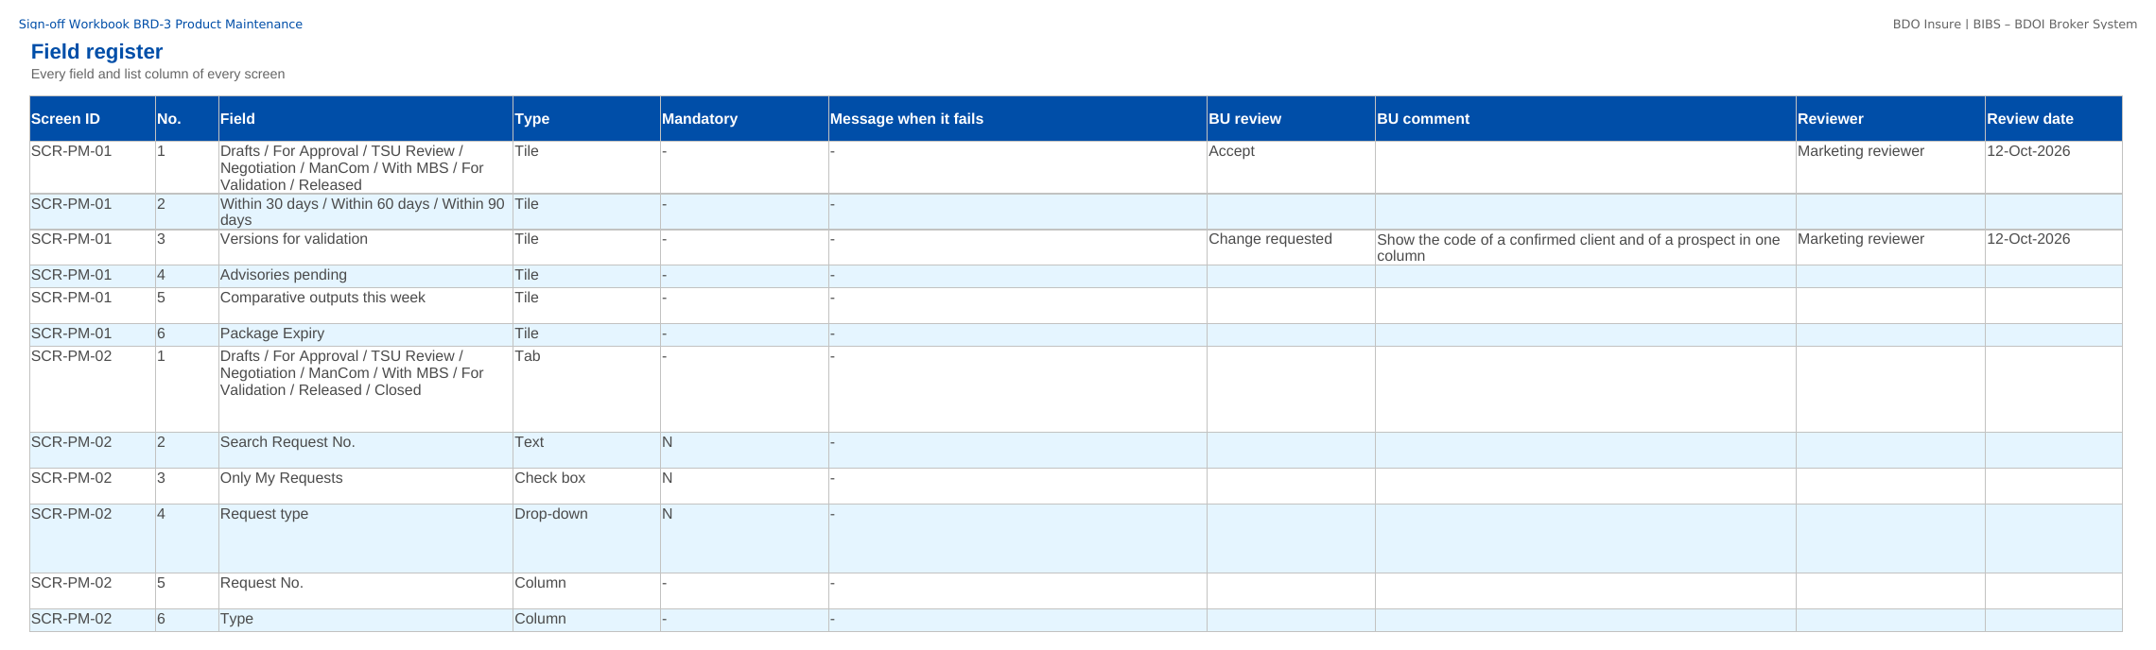
How to fill in the sign-off workbook
• Review the rows of your area on Screen standards, Screen catalogue, Field register, Business rules, Messages
• BU review: Accept, Change requested or Comment
• BU comment: the change asked for
• Reviewer and Review date
• Questions go to the Comments log
• Leave the other columns unchanged; one workbook per unit
Field register sheet of the sign-off workbook
Confidential – BDOI
Sign-off Pack Guide BRD-3 Product Maintenance | v2.0
13
Notes:
The No. column is the numbered marker on the screenshot of the FRS, or the column number of a load template. The drop-down columns accept only the listed values. The Comments log, Meeting minutes and Version history sheets are kept by the project team; the Sign-off certificate is signed at the end.

Slide 14
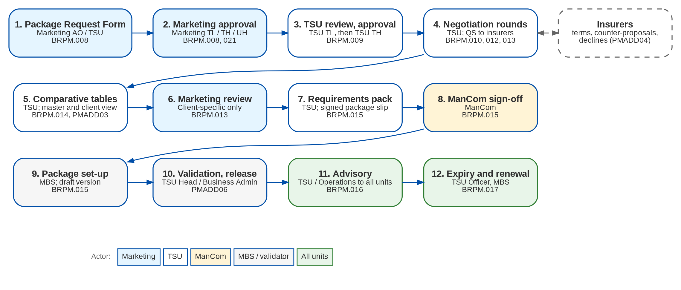
Product Maintenance at a glance: process flow
BRD-3 process from the client to the booked invoice
Confidential – BDOI
Sign-off Pack Guide BRD-3 Product Maintenance | v2.0
14
Notes:
The process runs from client onboarding and KYC, through the quotation or the PRF, the account, payment and placement, issuance and booking, to the hand-off to Operations and Accounting.

Slide 15
Product Maintenance at a glance: personas and menus
Persona | SIT user | Screens | Menu sections
Marketing Account Officer | ao | 6 | Product Maintenance
Marketing TL / TH / UH | mkttl | 7 | Product Maintenance
TSU Officer | tsu | 8 | Product Maintenance
TSU Team Lead | tsulead | 7 | Product Maintenance
TSU Head | tsuhead | 8 | Product Maintenance
Marketing Business Services | mbs | 9 | Product Maintenance
ManCom member | mancom | 5 | Product Maintenance
Business Administrator | badmin | 10 | Product Maintenance
New Business Approver | approver | 9 | Product Maintenance
System Administrator | admin | 8 | Product Maintenance
Auditor | auditor | 10 | Product Maintenance
Confidential – BDOI
Sign-off Pack Guide BRD-3 Product Maintenance | v2.0
15
Notes:
Each persona sees only the menu entries of its role; the full menu of each persona is in FRS chapter 12 and on the Menu by persona sheet of the workbook.

Slide 16
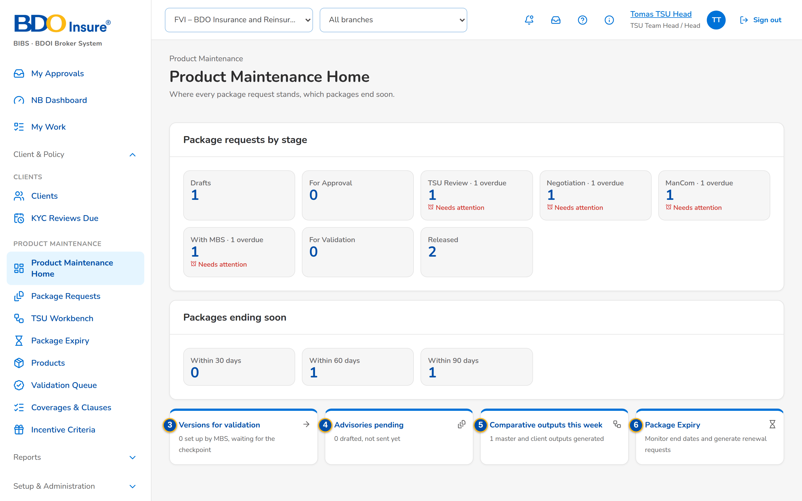
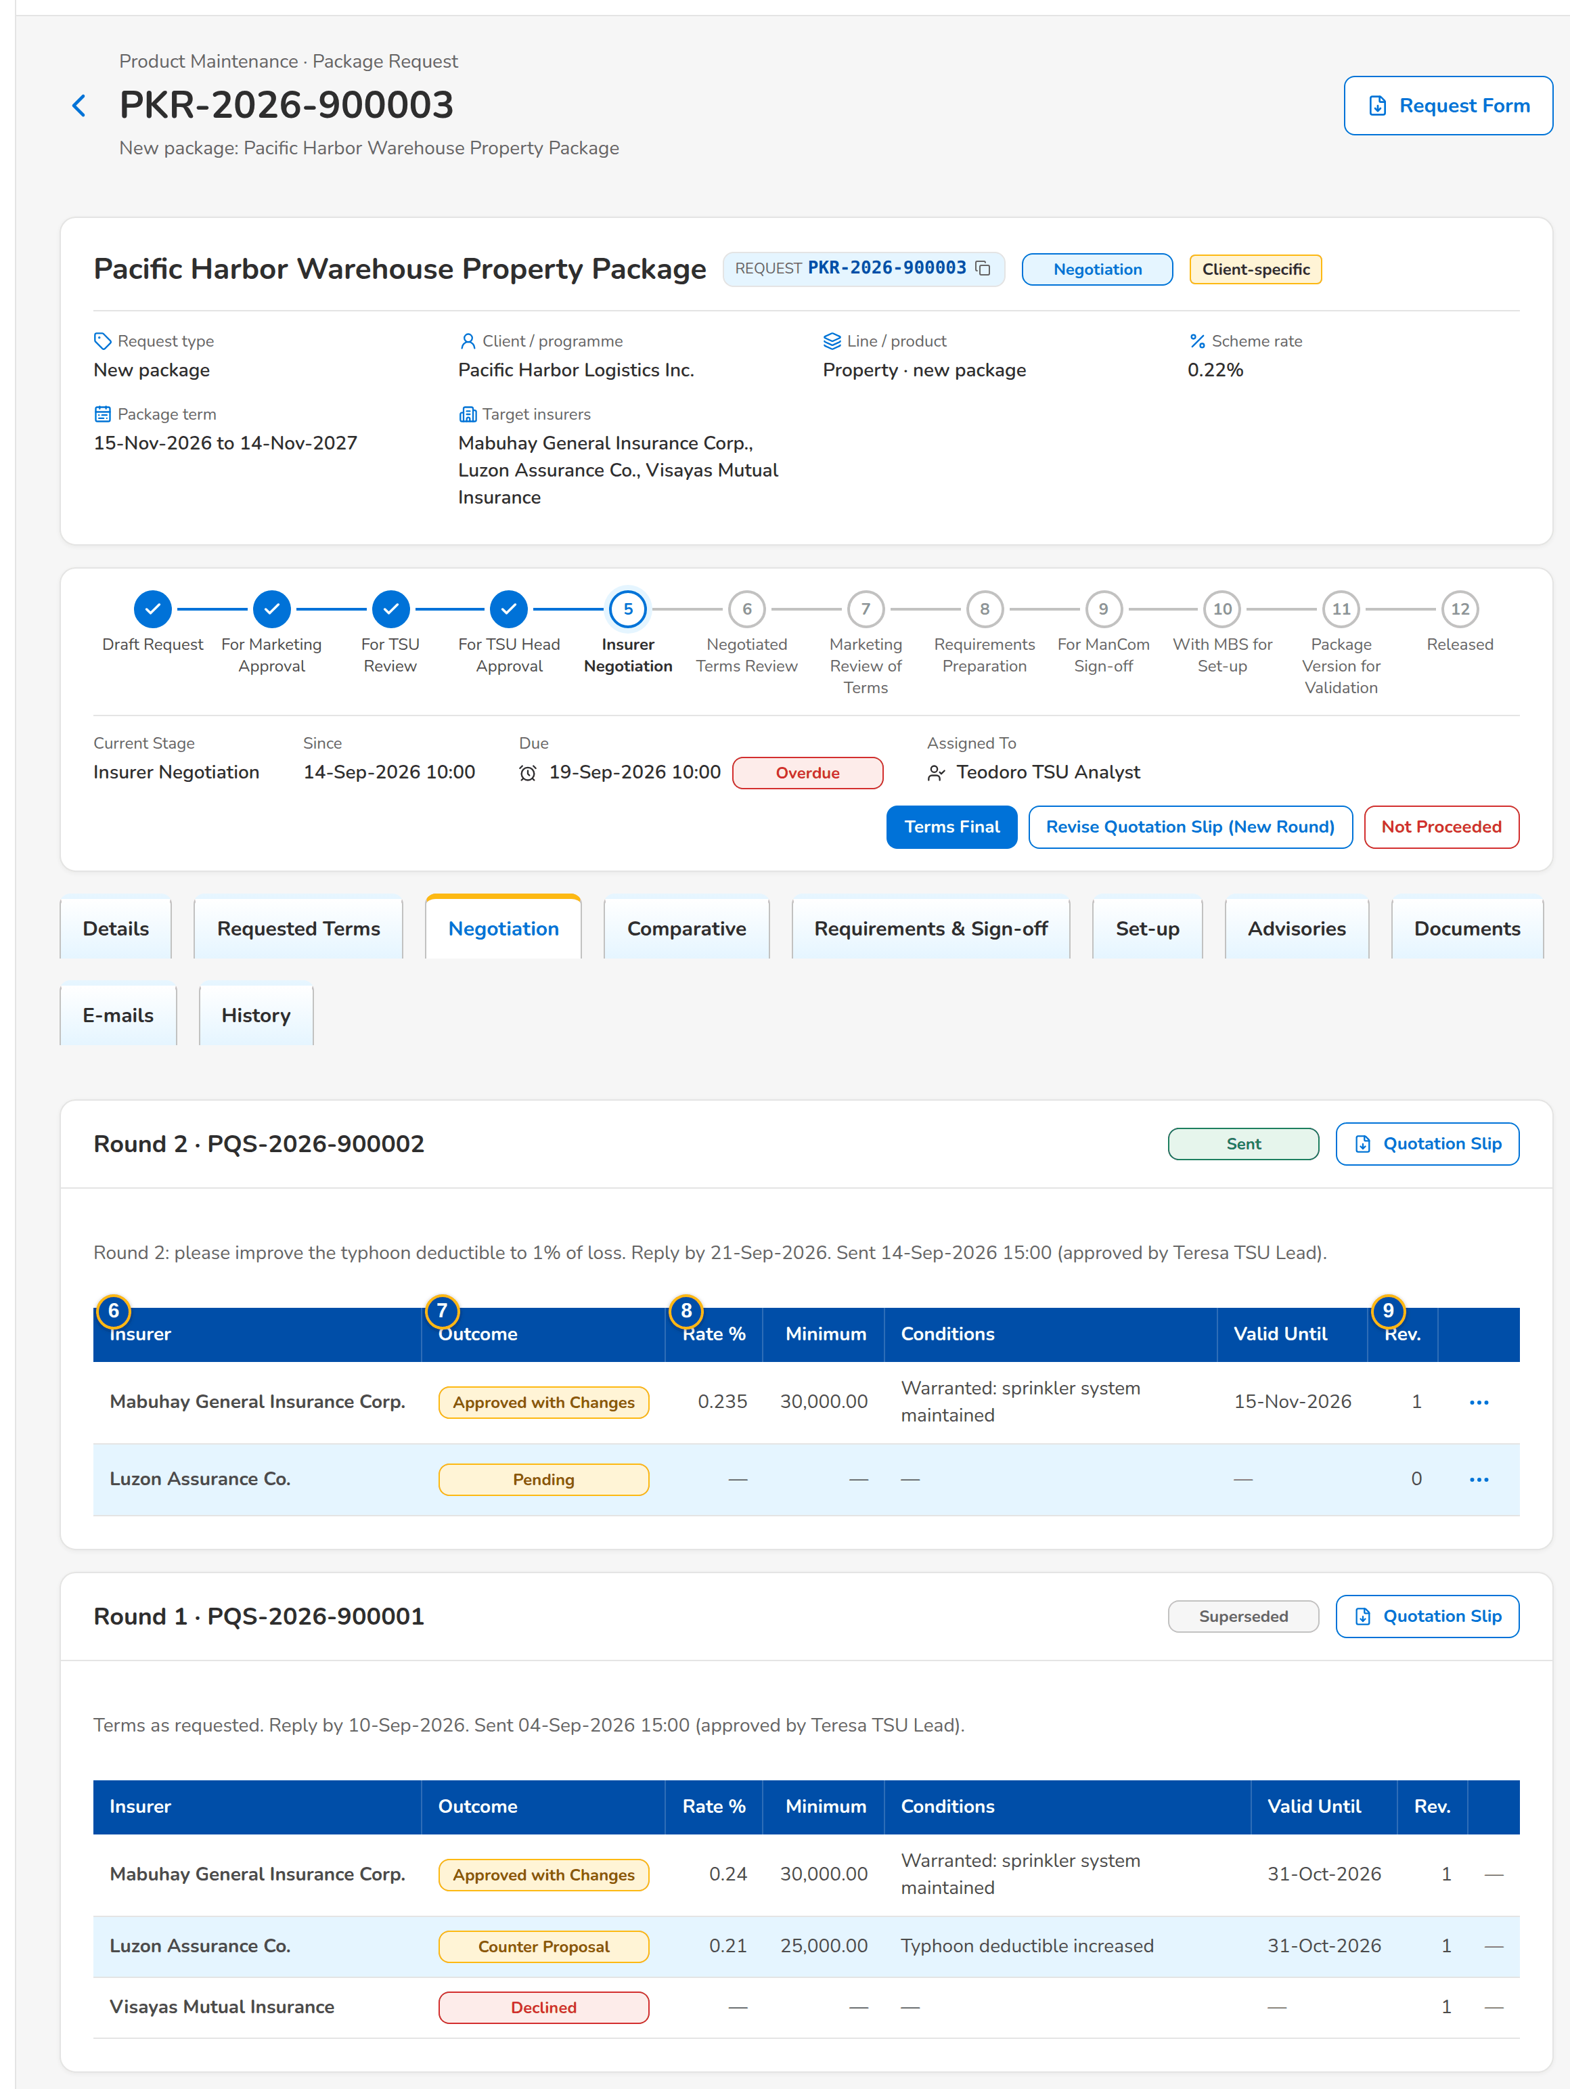
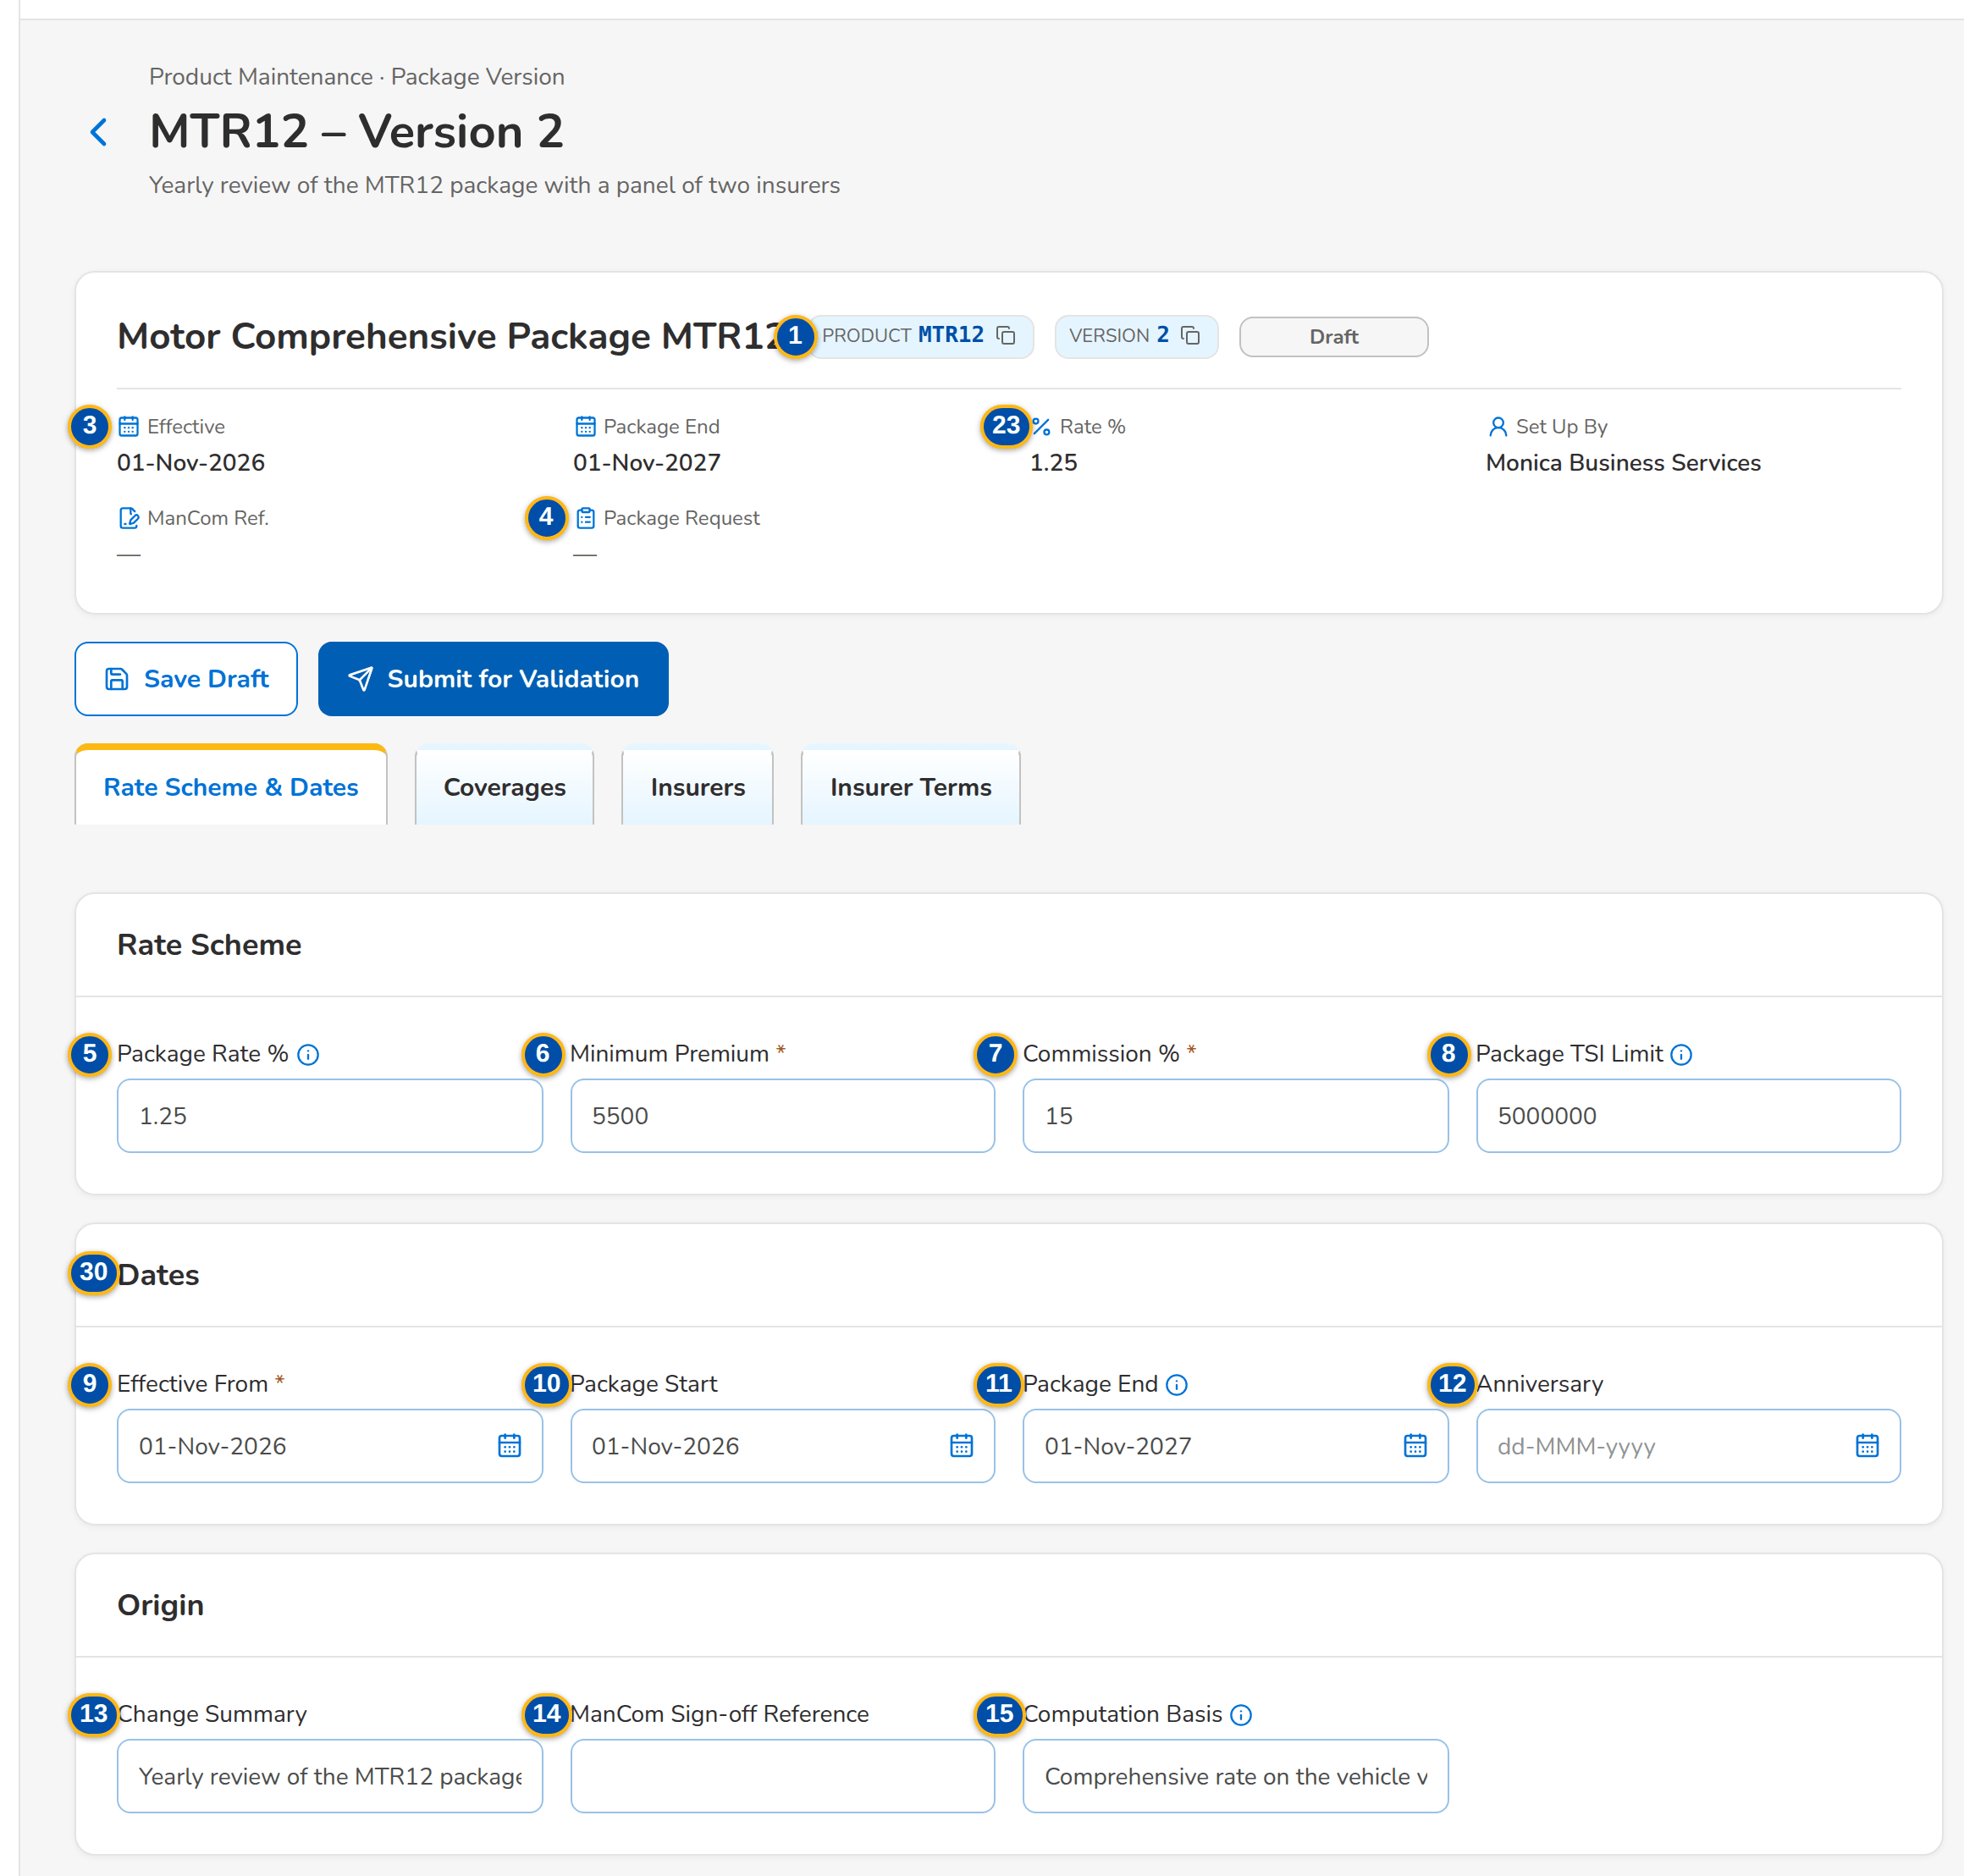
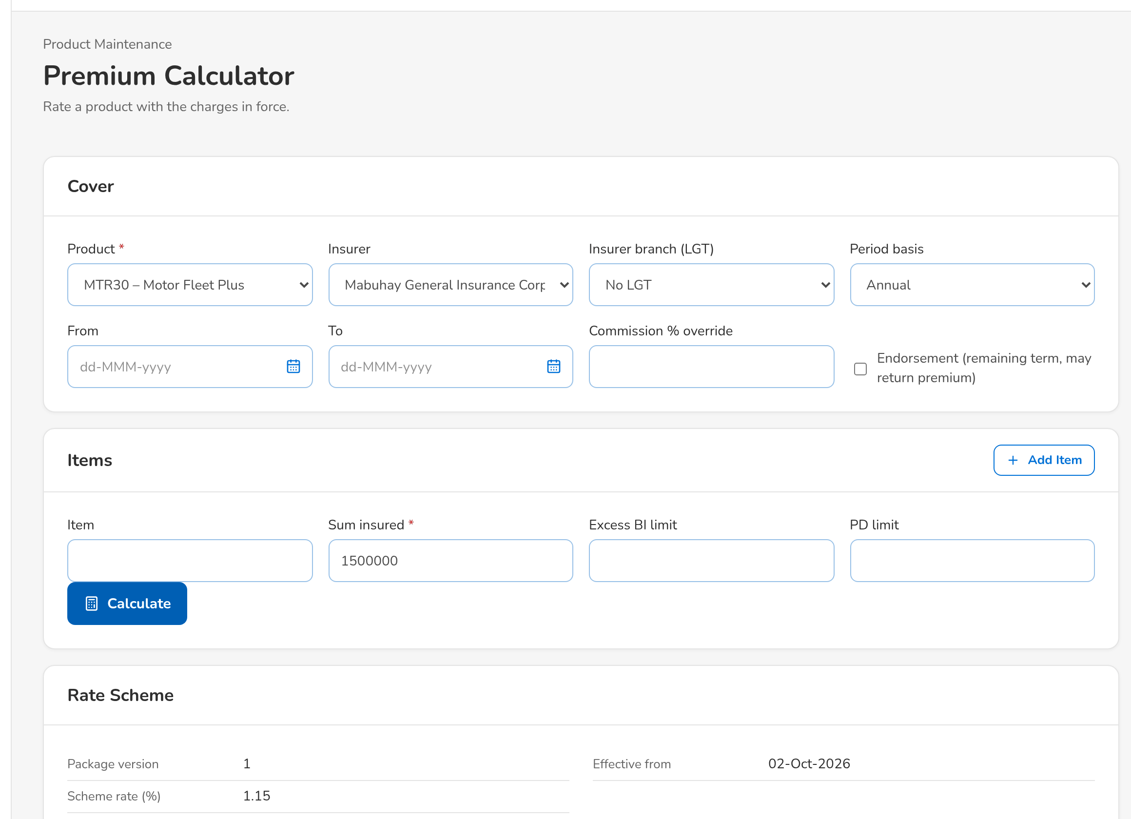
Product Maintenance at a glance: key screens
Product Maintenance Home
Negotiation with the insurers, round by round
Package version: rate scheme, coverages, panel insurers
New business priced on the released version
Confidential – BDOI
Sign-off Pack Guide BRD-3 Product Maintenance | v2.0
16
Notes:
Screenshots of the SIT environment with seed data; every screen of the module is in FRS chapter 13.

Slide 17
Key business rules and validations
• A package request is approved by Marketing, recommended by the TSU Team Lead and approved by the TSU Head, never by its maker, and the TSU Head never approves his own recommendation.
• A quotation slip is approved by a TSU Team Lead or a co-officer, never its preparer, and goes to each insurer by protected e-mail.
• Terms are final only when every insurer of the latest round has an outcome; co-insurance shares total 100.
• ManCom signs off a complete requirements pack with the signed package slip; the slips then lock.
• A package version is validated by the TSU Head or the Business Administrator, never its maker or submitter, with a five-point checklist and a test premium.
• New business is priced on the version in force on the transaction date; a different rate needs an approved rate exception.
• Every product master is maker-checker and never deleted; expired and retired packages stay readable.
• An advisory is sent only with the signed package slip and the ManCom sign-off attached.
  – Full list: FRS chapter 13 per screen, 84 rules on the Business rules sheet and 276 messages in FRS chapter 15 and on the Messages sheet
Confidential – BDOI
Sign-off Pack Guide BRD-3 Product Maintenance | v2.0
17
Notes:
These are the rules the business units ask about most. Each rule is stated with its FR on the screen where it applies.

Slide 18
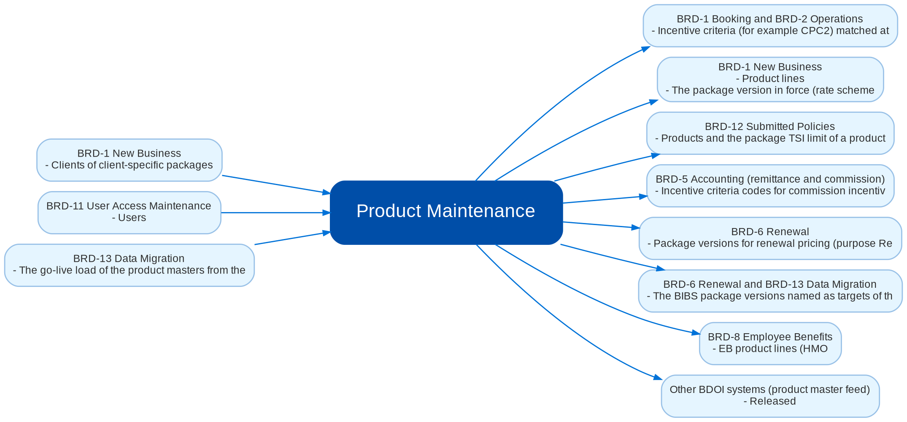
Cross-module dependencies and impacts
What Product Maintenance takes from and hands to the other BRDs and systems (FRS chapter 19)
Confidential – BDOI
Sign-off Pack Guide BRD-3 Product Maintenance | v2.0
18
Notes:
The contract is part of the signed set. Product Maintenance is the source of the products, package versions and rate schemes that every selling and servicing BRD prices on. A later change in any of those BRDs that touches a line of this contract (a new product attribute, a different version rule, another rating purpose, a new incentive criterion basis) is raised as a change request against this signed set in the Change Management Register, assessed with its mandays and approved by the owners of both BRDs; the affected pages of this set are then re-issued and signed as a delta.
IC-01 BRD-1 New Business (Out): Product lines, cover types and products (risk codes) with their flags (package, fleet, mortgage related, direct payment allowed, multi-year and maximum term, Free First Year), market segments, payment gate and TSU review setting
IC-02 BRD-1 New Business (Out): The package version in force (rate scheme, minimum premium, commission, TSI limit, panel insurers with their own rates) for new business pricing; the version number is stored on the quotation, the account and the booked invoice
IC-03 BRD-1 New Business (Out): Rate exceptions approved for one transaction (quotation number or ARN)
IC-04 BRD-1 New Business (Out): Field rules and document rules per product (presence, list of values, number range, format), TSU routing rules and the package TSI limit
IC-05 BRD-1 New Business (In): Clients of client-specific packages; the Document Templates screen that holds the package templates; the workflow, documents, e-mail and report platform
IC-06 BRD-6 Renewal (Out): Package versions for renewal pricing (purpose Renewal) and the sellable check of a product at renewal
IC-07 BRD-6 Renewal and BRD-13 Data Migration (Out): The BIBS package versions named as targets of the package map (legacy package and version to BIBS package version) that the data migration loads (object R06) and the Renewal sanitation check PACKAGE_REMAP reads
IC-08 BRD-8 Employee Benefits (Out): EB product lines (HMO, group life, group personal accident), EB products and HMO providers as panel insurers with commission rates
IC-09 BRD-12 Submitted Policies (Out): Products and the package TSI limit of a product
IC-10 BRD-1 Booking and BRD-2 Operations (Out): Incentive criteria (for example CPC2) matched at booking; the package version of the account for endorsements and adjustments
IC-11 BRD-5 Accounting (remittance and commission) (Out): Incentive criteria codes for commission incentive schemes and the CPC2 remittance incentive; insurer commission rates
IC-12 BRD-11 User Access Maintenance (In): Users, roles and the role-to-action matrix of Product Maintenance; role-permission change requests
IC-13 BRD-13 Data Migration (In): The go-live load of the product masters from the legacy systems (QPS, EBIX) - lists of values (R01), sales organisation (R03), insurers and branches (R04), product lines, cover types and products (R05), commission rates (R07) - through the catalog services under maker-checker; the package map (R06) as in IC-07
IC-14 Other BDOI systems (product master feed) (Out): Released, expired and retired package versions

Slide 19
Caveats and possibilities
Topic | What can happen | How it is handled
Additional requirements | New needs can surface during the review, SIT or UAT. | In-scope clarification when the signed text already covers it; otherwise a change request with mandays.
Other BRDs change Product Maintenance | New Business, Renewal, Employee Benefits, Submitted Policies, Operations, Accounting and Data Migration read the products and package versions. | The change is raised against the other BRD and assessed against the cross-BRD contract; when it touches this set, a delta sign-off of the affected pages only.
Items that belong to other sets | The package map (data migration object R06) and the Renewal sanitation check PACKAGE_REMAP belong to the Data Migration and Renewal sets. | Product Maintenance provides the package versions the map names; the map is signed with the Data Migration and Renewal sets.
Integrations pending BDOI IT specifications | The product master feed to other BDOI systems waits for their specification (PQ16). | BIBS records each change for the transfer; the transfer is a change request once the specification arrives.
Open questions and assumptions | Open questions of FRS section 10.3 (product matrix, approval chain, ManCom quorum, validator role, CPC2) follow the assumptions of section 10.1; chapter 22 lists the proposed rules for confirmation. | Answered as configuration where possible (lists, parameters, templates, the product matrix itself); otherwise a change request; the assumption stands until then.
Confidential – BDOI
Sign-off Pack Guide BRD-3 Product Maintenance | v2.0
19
Notes:
Three ways to handle a case: an in-scope clarification (no change to the signed set, answered in the comments log); a change request with mandays in the Change Management Register; a delta sign-off of the affected pages only.

Slide 20
Caveats: worked examples
Topic | Example and how it is handled
Additional requirements | A reviewer asks for a two-level ManCom approval: a new stage, so a change request; asking which documents the advisory checks is a clarification.
Other BRDs change Product Maintenance | Renewal asks to renew accounts of an expired package on a new version: the rating purpose changes; the version pages are re-issued and signed as a delta.
Items that belong to other sets | The template CI-07 of this set is the layout TSU prepares; it is loaded with the data migration.
Integrations pending BDOI IT specifications | When BDOI names the receiving system, each released version is sent to it; the screens do not change.
Open questions and assumptions | The service level hours of each stage are parameters: a changed answer to PQ08 is a configuration change, not a change request.
Confidential – BDOI
Sign-off Pack Guide BRD-3 Product Maintenance | v2.0
20
Notes:
Use these examples to agree the handling of a case during the review.

Slide 21
Entry and exit criteria, definition of done
Entry
Exit
Done
• Every screenshot of the set is taken on the SIT environment with seed data.
• Reviewers have their SIT users and the walkthrough sessions are held.
• The test plan is traced to the FRS and to the screens.
• Every row of the workbook reviewed by its unit (Accept, Change requested or Comment).
• Every comments log item closed: answered, corrected in v2.1, or raised as a change request.
• Open questions closed or accepted as assumptions.
• The sign-off certificate signed by every signatory of the Who signs what matrix: prepared, input, reviewed and approved as on the BRD approval sheet; the Product Owner approves the whole set.
• Signed certificate filed with the set; version history updated.
• Content frozen as signed; deltas listed in the Change Management Register with mandays.
• Configuration input templates owned and scheduled for the data migration mocks.
• Test plan agreed for SIT and UAT.
Confidential – BDOI
Sign-off Pack Guide BRD-3 Product Maintenance | v2.0
21
Notes:
The sign-off meeting starts when the exit criteria are met; the set is done when the certificate is signed and the content of the set is frozen.

Slide 22
After sign-off: readiness checklist
• ☐ Signed FRS, sign-off workbook and screens
• ☐ Open questions closed or accepted as assumptions
• ☐ Configuration inputs from the business: product catalogue, coverages and rules, clauses, rate tables, insurers, packages in force, package map, document templates, lists of values, incentive criteria
• ☐ Agreed test plan
• ☐ Migration mapping of the product objects (R01, R03-R07) signed with BRD-13
  – After sign-off the content is frozen as signed, the approved deltas are scheduled and the configuration inputs are loaded.
Confidential – BDOI
Sign-off Pack Guide BRD-3 Product Maintenance | v2.0
22
Notes:
After sign-off the content is frozen as signed, the approved deltas are scheduled and the configuration inputs are loaded.

Slide 23
Change control after sign-off
• A change to anything frozen is raised in the Change Management Register
  – The screen, field, rule or message concerned, the reason and the priority
• The project team assesses the mandays and the effect on the other BRDs through the cross-BRD contract
• The owners of every BRD concerned approve it
• Delivered as a new version of the set (v2.1, v2.2...) with the changed pages signed again (delta sign-off)
• Configuration values marked default change in BIBS without a change request
Confidential – BDOI
Sign-off Pack Guide BRD-3 Product Maintenance | v2.0
23
Notes:
Nothing in a signed set changes without a request in the register.

Slide 24
Governance, contacts and next steps
Role | Who | Does
Business owner and approver | Product Owner, Marketing Business System | Accountable for the sign-off; chairs the sign-off meeting
Input provider and reviewer | Marketing Business System (MBS) | Coordinates the MBS review and the configuration inputs; signs for the business input and its review (BRD approval sheet)
Reviewers | TSU, Marketing, MBS | Review their screens and rows; raise comments; provide the templates they own
Finance and BDOI IT | Comptrollership, BDOI IT | Comptrollership approves rates, commission and incentives; BDOI IT reviews interfaces, access and the Technical Specification, not the business screens
BRD owner | Business Project Services, BDO Unibank ESG | Business Analyst: the BRD as written; Program Manager: traceability and completeness; sign-off coordination
Delivery | iorta TechNXT Project Manager, Business Analysis, test lead | Sessions, answers, comments log, revisions, change requests
Confidential – BDOI
Sign-off Pack Guide BRD-3 Product Maintenance | v2.0
24
Notes:
Next steps:
Kick-off and first SIT walkthrough on Wed 4-Nov-2026
Workbooks returned by Wed 18-Nov-2026; Q&A on Mon 23-Nov-2026; sign-off on Mon 30-Nov-2026
Configuration input templates filled in for the data migration mocks; final at the map freeze

Slide 25
Next steps and the release order of the other BRD sets
• Kick-off and first SIT walkthrough on Wed 4-Nov-2026
• Workbooks returned by Wed 18-Nov-2026; Q&A on Mon 23-Nov-2026; sign-off on Mon 30-Nov-2026
• Configuration input templates filled in for the data migration mocks; final at the map freeze
Confidential – BDOI
Sign-off Pack Guide BRD-3 Product Maintenance | v2.0
25
Notes:
The other BRD sets follow the same pack, guide and steps.

