Slide 1


Sign-off Pack Guide: BRD-13 Data Migration
BRD-13 Data Migration business sign-off pack, release set v2.0
BIBS – BDOI Broker System
BDO Insurance and Reinsurance Brokers, Inc. | Version 2.0 | 5 October 2026 | Confidential
Prepared by
Notes:
This deck guides the business units through the BRD-13 Data Migration sign-off pack, release set v2.0. It explains what the pack is, how to read it, the steps up to sign-off and what happens after. It is presented at the kick-off and stays in the pack as file 01.

Slide 2
Purpose of the pack and what sign-off means
• The pack shows the proposed Data Migration of BIBS, screen by screen, so each business unit confirms what it will get
  – Content: 20 screens, 189 fields, 67 business rules, 216 messages
  – Every screen of the Migration Console with numbered fields, the migration catalogue (objects, load templates, code maps, rules, owners), the cut-over plan and the reconciliation sign-off
• Signing freezes the content, the screens and the navigation of the module
  – After sign-off a change goes through the Change Management Register with its mandays
  – Configuration values marked default (SLA hours, thresholds, list entries, templates) stay open
• The screenshots use fictitious seed data only, in the BDO theme
Confidential – BDOI
Sign-off Pack Guide BRD-13 Data Migration | v2.0
2
Notes:
Stress that the pack shows the screens, fields, rules and messages the business is asked to confirm.
Signing means: this is what we get; the look, feel, fields, rules, messages and navigation are frozen.
Data on the screenshots is seed data of the SIT environment; names and numbers are fictitious.

Slide 3
The pack at a glance
File | What it is for | Who reads it | When
00_BIBS_StartHere_BRD-13_Data_Migration_v2.0.docx | Start Here: the map of the set, who reads what, the steps up to sign-off and the dates | Everyone | First, on issue
01_BIBS_GuideDeck_BRD-13_Data_Migration_v2.0.pptx | Guide deck: the migration approach, the objects and decisions, roles and data owners, trial migrations and dress rehearsal, sign-off gates, cut-over and go / no-go, migrated and new data, caveats, entry and exit criteria, handover | Business owner, data owners, Comptrollership, BDOI IT; presented at the kick-off | Kick-off session
02_BIBS_Handbook_BRD-13_Data_Migration_v2.0.docx | Data Migration Handbook: A strategy and approach; B functional specification of the Migration Console with screenshots, fields, actions, rules and messages, the markers of migrated data and the legacy batches; C reconciliation and the sign-off gates per object; D the cut-over runbook, run-off and decommissioning; the proposed rules for confirmation | Data owners and Comptrollership for their objects and parts; BDOI IT; the Renewal processing team | During the review, with the console walkthroughs
03_BIBS_Workbook_BRD-13_Data_Migration_v2.0.xlsx | Migration Workbook: object catalogue and decisions, extract planning, the load templates (one sheet per layout), code maps, validation rules, data owners, cut-over task plan, reconciliation sign-off per object, proposed rules with the BDOI decision, the screens; comments log, meeting minutes, version history, sign-off certificate | Every reviewer; the signatories sign it | During the review and at sign-off
04_BIBS_TestPlan_BRD-13_Data_Migration_v2.0.xlsx | Test plan workbook: the test cases traced to the requirements and to the screens, with the trial migration, reconciliation, rollback, rerun and cut-over rehearsal scenarios | Data owners who verify the trial migrations; BDOI IT | After the handbook; used again in the trial migrations
05_BIBS_TestPlan_BRD-13_Data_Migration_Summary_v2.0.docx | Test plan summary: scope, approach, coverage and the cases by area | Business owner, BDOI IT | Before sign-off
Confidential – BDOI
Sign-off Pack Guide BRD-13 Data Migration | v2.0
3
Notes:
The files are numbered 00 to 05 so they sort in reading order in the BRD folder. 00 Start Here is the short version of this deck; 02 Data Migration Handbook and 03 workbook carry the same rows; 04 and 05 are the test plan traced to the screens.

Slide 4
Where to start: reading order per role
Role | Read, in this order
Approver (Product Owner, Marketing Business System) and Program Manager, Business Project Services | 00 Start Here; 01 Guide deck; Handbook Part A (approach, objects and decisions, cycles, cut-over) and the chapter Proposed business rules and clarifications for confirmation; workbook sheets Object catalogue, Proposed rules and Sign-off certificate
Data owners per object: Marketing Business System (R01, R05, R06, C01, C03); Heads of Retail and Corporate Marketing (R03, C01); Operations (R04, R07, P01, F01-F04, F06); Comptrollership (R02, R08, F01, F02, G01, G03); Disbursement (R09, C03); Compliance and Analytics (C04, H01, H02); Renewal processing team (P03) | Handbook Part A chapter 3 (objects and decisions) and chapter 6 (templates and mapping); the load template sheets of your objects, Code maps and Validation rules; Part C chapters 32 and 34 for the reconciliation and the samples you verify; workbook sheets Object catalogue, Data owners, Extract planning, Reconciliation sign-off
Comptrollership | Handbook Part A chapter 7 (legacy invoices and sub-ledgers) and chapter 11 (cut-over strategy); Part D chapter 44 (year-end cut-over); Part B screens Reconciliation and Opening-Balance Adjustments; Part C chapter 33 (Migration Clearing and the adjustment reconciliation); the proposed rules PR-DM-01, 02, 06, 10 and 14; workbook sheets G01, G03, G03D, F01C and Reconciliation sign-off
Renewal processing team | Handbook Part A chapter 8 (renewal-driven transition); Part B Batches (resubmissions of the RA-sent file); Part D tasks of the go-live renewal extraction and the day-1 queue; workbook sheet P03 and the load template workbook of P03 exported by the console
BDOI IT | Handbook Part A chapter 6 (templates, secure transfer, masking) and chapter 12 (data security); Part B Extracts and Layouts and Rules; Part D (freeze, final extracts, rollback, decommissioning); proposed rules PR-DM-03 and PR-DM-04; workbook sheets File rules, Load templates, Control file, Cut-over tasks
iorta TechNXT project team | All documents; keeps the comments log, the meeting minutes and the version history of the workbook, answers every comment and keeps the traceability to the trial migrations, SIT and UAT
Confidential – BDOI
Sign-off Pack Guide BRD-13 Data Migration | v2.0
4
Notes:
Nobody needs to read the whole Data Migration Handbook. Each role starts with its chapters and its sheets of the workbook; the trial migrations of Handbook Part A, chapter 10 are the fastest way to see the whole process.

Slide 5
Approach: from issue to closure
1
Set issued
2
Kick-off and walkthrough of the Migration Console on SIT
3
Review with the workbook; decisions on the proposed rules
4
Comments consolidated and a Q&A session
Release set v2.0 in the BRD-13 folder of Drop 0; invitations to the sessions
Console shown live; first questions logged in the comments log; minutes
Every row marked Accept, Change requested or Comment; decisions on the rules needed by 16-Oct-2026 (M1); comments log entries
One consolidated comments log, each item typed (clarification, correction, change request) and answered; Q&A minutes
Day 0 (Mon 5-Oct-2026)
3 sessions, 7 to 9-Oct-2026
Until Wed 21-Oct-2026 (M1 rules by Fri 16-Oct-2026)
3 working days, Q&A on Mon 26-Oct-2026
5
One revision cycle (v2.1)
6
Sign-off meeting and signature
7
Handover to the migration runs
8
Traceability into the trial migrations, SIT and UAT
Release set v2.1 with the changed rows marked and the decided rules applied; change requests raised for the rest
Signed sign-off certificate; minutes; objects decided (G1) and layouts frozen, version 1 (M2)
Decisions and owners entered in the Migration Console; first full extracts in the templates by 29-Jan-2027 (M3)
Trial migrations 1 to 4 and the dress rehearsal run and signed against the set; results against each row
v2.1 on Wed 28-Oct-2026; check by the reviewers until Thu 29-Oct-2026
Fri 30-Oct-2026 (M2)
From Mon 2-Nov-2026
Trial migrations Apr - Oct 2027; dress rehearsal Nov 2027; cut-over Jan 2028
Confidential – BDOI
Sign-off Pack Guide BRD-13 Data Migration | v2.0
5
Notes:
1. Set issued: Day 0 (Mon 5-Oct-2026).
2. Kick-off and walkthrough of the Migration Console on SIT: 3 sessions, 7 to 9-Oct-2026.
3. Review with the workbook; decisions on the proposed rules: Until Wed 21-Oct-2026 (M1 rules by Fri 16-Oct-2026).
4. Comments consolidated and a Q&A session: 3 working days, Q&A on Mon 26-Oct-2026.
5. One revision cycle (v2.1): v2.1 on Wed 28-Oct-2026; check by the reviewers until Thu 29-Oct-2026.
6. Sign-off meeting and signature: Fri 30-Oct-2026 (M2).
7. Handover to the migration runs: From Mon 2-Nov-2026.
8. Traceability into the trial migrations, SIT and UAT: Trial migrations Apr - Oct 2027; dress rehearsal Nov 2027; cut-over Jan 2028.

Slide 6
Steps in detail (1 of 2): who, inputs, outputs, duration
Step | Who (R, A, C, I) | Inputs | Outputs | Duration
1. Set issued | R: iorta TechNXT Project Manager; A: iorta TechNXT delivery lead; I: all reviewers | Handbook, Migration Workbook, test plan, guide and deck | Release set v2.0 in the BRD-13 folder of Drop 0; invitations to the sessions | Day 0 (Mon 5-Oct-2026)
2. Kick-off and walkthrough of the Migration Console on SIT | R: iorta TechNXT Business Analysis; A: Program Manager; C: data owners, Comptrollership, BDOI IT, Renewal processing team | Guide deck; SIT users with seed data; one object from extract to acceptance | Console shown live; first questions logged in the comments log; minutes | 3 sessions, 7 to 9-Oct-2026
3. Review with the workbook; decisions on the proposed rules | R: data owners and their stewards, Comptrollership, BDOI IT; A: Program Manager; C: iorta TechNXT (questions) | Handbook parts of each role; workbook sheets with the BU review columns; the proposed rules | Every row marked Accept, Change requested or Comment; decisions on the rules needed by 16-Oct-2026 (M1); comments log entries | Until Wed 21-Oct-2026 (M1 rules by Fri 16-Oct-2026)
4. Comments consolidated and a Q&A session | R: iorta TechNXT Project Manager and Business Analysis; A: Program Manager; C: reviewers | Returned workbooks | One consolidated comments log, each item typed (clarification, correction, change request) and answered; Q&A minutes | 3 working days, Q&A on Mon 26-Oct-2026
Confidential – BDOI
Sign-off Pack Guide BRD-13 Data Migration | v2.0
6
Notes:
R responsible, A accountable, C consulted, I informed. The durations are indicative; the dates are those of the Start Here guide.

Slide 7
Steps in detail (2 of 2): who, inputs, outputs, duration
Step | Who (R, A, C, I) | Inputs | Outputs | Duration
5. One revision cycle (v2.1) | R: iorta TechNXT Business Analysis; A: iorta TechNXT delivery lead; C: reviewers who raised the items | Agreed clarifications and corrections; decisions on the proposed rules | Release set v2.1 with the changed rows marked and the decided rules applied; change requests raised for the rest | v2.1 on Wed 28-Oct-2026; check by the reviewers until Thu 29-Oct-2026
6. Sign-off meeting and signature | R: iorta TechNXT Project Manager; A: Product Owner, Marketing Business System; C: Program Manager, data owners, Comptrollership, BDOI IT | v2.1 (or v2.0 when no revision is needed); open decisions with their date | Signed sign-off certificate; minutes; objects decided (G1) and layouts frozen, version 1 (M2) | Fri 30-Oct-2026 (M2)
7. Handover to the migration runs | R: iorta TechNXT delivery lead; A: Program Manager; I: BDOI IT, other BRD owners | Signed set; decided objects; frozen layouts; named owners and stewards | Decisions and owners entered in the Migration Console; first full extracts in the templates by 29-Jan-2027 (M3) | From Mon 2-Nov-2026
8. Traceability into the trial migrations, SIT and UAT | R: iorta TechNXT test lead; A: Program Manager; C: data owners | Signed handbook, workbook and test plan | Trial migrations 1 to 4 and the dress rehearsal run and signed against the set; results against each row | Trial migrations Apr - Oct 2027; dress rehearsal Nov 2027; cut-over Jan 2028
Confidential – BDOI
Sign-off Pack Guide BRD-13 Data Migration | v2.0
7
Notes:
R responsible, A accountable, C consulted, I informed. The durations are indicative; the dates are those of the Start Here guide.

Slide 8
Who signs what: parts of the set (1 of 2)
Part of the set | Prepares | Provides input | Reviews | Approves
Migration objects, decisions and extract planning (Handbook Part A; workbook Objects, Extract planning) | iorta TechNXT | Data Migration Lead, Data owners | Program Manager (BPS), MBS | Product Owner (MBS), PO Disbursement, PO FRBS and ACSL, Operations, Head Operations, UH Analytics and Risk Management, UH Claims and TU, UH Combank and Corbank, Head Comptrollership, Head Retail Marketing, Head Corporate and Retail Marketing
Load templates, code maps and data-quality rules (the columns BDOI fills in) | iorta TechNXT | Data owners, BDOI IT | MBS, Program Manager (BPS) | Product Owner (MBS), Head Comptrollership, Head Operations
Screens and fields of the Migration Console and Legacy Inquiry (Handbook Part B) | iorta TechNXT | Data Migration Lead | Program Manager (BPS) | Product Owner (MBS)
Business rules, validations, messages and notifications | iorta TechNXT | Data Migration Lead, Data owners | Program Manager (BPS) | Product Owner (MBS)
Reconciliation and migration reports | iorta TechNXT | Data owners | Program Manager (BPS) | Product Owner (MBS), Head Comptrollership, PO FRBS and ACSL
Confidential – BDOI
Sign-off Pack Guide BRD-13 Data Migration | v2.0
8
Notes:
The set holds business content only: screens, fields, rules, messages, notifications, documents, walkthroughs and reports. Business users sign the business content; BDOI IT reviews the interfaces, the user access and the Technical Specification, a separate document that holds the technical content; the Program Manager of Business Project Services reviews the traceability and the completeness; the Product Owner approves the whole set; iorta TechNXT prepares it.
The roles are those of the BRD approval sheet (BRD-13 approval pages p.15-16 (draft V0.01, not yet signed)).

Slide 9
Who signs what: parts of the set (2 of 2)
Part of the set | Prepares | Provides input | Reviews | Approves
Cut-over plan, go / no-go and rollback | iorta TechNXT | Data Migration Lead, BDOI IT | Program Manager (BPS), BDOI IT | Product Owner (MBS), Head Comptrollership, Head Operations
Proposed business rules and clarifications for confirmation; open decisions | iorta TechNXT | Program Manager (BPS), Data Migration Lead | Program Manager (BPS) | Product Owner (MBS)
Test plan (04 workbook, 05 summary) | iorta TechNXT | Data Migration Lead, Data owners | Program Manager (BPS), BDOI IT | Product Owner (MBS)
Technical Specification (separate document: extract transfer, environments, backup and restore) | iorta TechNXT | BDOI IT | BDOI IT | BDOI IT
Confidential – BDOI
Sign-off Pack Guide BRD-13 Data Migration | v2.0
9
Notes:
The set holds business content only: screens, fields, rules, messages, notifications, documents, walkthroughs and reports. Business users sign the business content; BDOI IT reviews the interfaces, the user access and the Technical Specification, a separate document that holds the technical content; the Program Manager of Business Project Services reviews the traceability and the completeness; the Product Owner approves the whole set; iorta TechNXT prepares it.
The roles are those of the BRD approval sheet (BRD-13 approval pages p.15-16 (draft V0.01, not yet signed)).

Slide 10
Who signs what: signatories (1 of 2)
Capacity | Role | Confirms by signing
Prepared by | iorta TechNXT project team: Project Manager, Business Analysis, Migration Lead, test lead (iorta TechNXT) | The set is complete and consistent as issued, traced to the BRD and to the Migration Console; every comment is answered in the comments log
Prepared by | Program Manager, Enterprise Services Group - Business Project Services (BPS) (BDO Unibank ESG) | The set states the BRD requirements as written (author of the BRD); traceability of every BRD requirement and completeness of the set; chairs the go / no-go board
Input provided by | Data Migration Lead (BDOI) | The object decisions, the trial migrations, the gates and the cut-over plan match the business input
Input provided by | Data owners of the objects (department representatives named per object) (BDOI) | Their objects, load templates, code maps and reconciliation
Reviewed by | Marketing Business System (MBS) (BDOI) | The lists of values, products, packages, clients and payout accounts and their code maps
Reviewed by | BDOI Information Technology Group (BDOI IT) (BDOI) | Extracts and their transfer, the legacy freeze and read-only access, decommissioning, and the Technical Specification (a separate document); not the business content
Approved by | Product Owner, Marketing Business System (BDOI) | Owns the set and approves all of its contents
Approved by | Product Owner - Comptrollership - Disbursement (BDOI) | Payees and open disbursements
Approved by | Product Owner - Comptrollership - FRBS and ACSL (BDOI) | GL opening, legacy accounts and the subsidiary ledger
Confidential – BDOI
Sign-off Pack Guide BRD-13 Data Migration | v2.0
10
Notes:
The certificate sheet of the workbook lists the same signatories in the same order: prepared by, input provided by, reviewed by, approved by, as on the BRD approval sheet. A role the set adds to the approval sheet is marked there.
iorta TechNXT project team: Project Manager, Business Analysis, Migration Lead, test lead: Added for this set (author of the Handbook and the Migration Workbook).
Program Manager, Enterprise Services Group - Business Project Services (BPS): Prepared by (p.15).
Data Migration Lead: Added for this set.
Data owners of the objects (department representatives named per object): Added for this set (named per object in the Migration Workbook).
Marketing Business System (MBS): Reviewed by (p.15).
BDOI Information Technology Group (BDOI IT): Added for this set.
Product Owner, Marketing Business System: Approved by (p.15).
Product Owner - Comptrollership - Disbursement: Approved by (p.15).
Product Owner - Comptrollership - FRBS and ACSL: Approved by (p.15).

Slide 11
Who signs what: signatories (2 of 2)
Capacity | Role | Confirms by signing
Approved by | Operations: Financial Transactions and Processing (BDOI) | Open invoices, unapplied payments, collection state and remittance
Approved by | Head - Operations (BDOI) | Insurers, commission rates and policy headers
Approved by | Unit Head - Analytics and Risk Management (BDOI) | KYC documents, the archive, Legacy Inquiry and its access log
Approved by | Unit Head - Claims, Analytics, Risk Management, Reinsurance and Technical Underwriting (BDOI) | The renewal advices already sent and the day-1 renewal queue
Approved by | Unit Head - Combank and Corbank (BDOI) | Clients and the sales organisation of Combank and Corbank
Approved by | Head - Comptrollership (BDOI) | Open items, GL opening, reconciliation and the opening-balance adjustments
Approved by | Head - Retail Marketing (BDOI) | Clients and the sales organisation of Retail Marketing
Approved by | Head - Corporate and Retail Marketing (BDOI) | Clients and the sales organisation of Corporate Marketing
Confidential – BDOI
Sign-off Pack Guide BRD-13 Data Migration | v2.0
11
Notes:
The certificate sheet of the workbook lists the same signatories in the same order: prepared by, input provided by, reviewed by, approved by, as on the BRD approval sheet. A role the set adds to the approval sheet is marked there.
Operations: Financial Transactions and Processing: Approved by (p.15).
Head - Operations: Approved by (p.15).
Unit Head - Analytics and Risk Management: Approved by (p.15).
Unit Head - Claims, Analytics, Risk Management, Reinsurance and Technical Underwriting: Approved by (p.16).
Unit Head - Combank and Corbank: Approved by (p.16).
Head - Comptrollership: Approved by (p.16).
Head - Retail Marketing: Approved by (p.16).
Head - Corporate and Retail Marketing: Approved by (p.16).

Slide 12
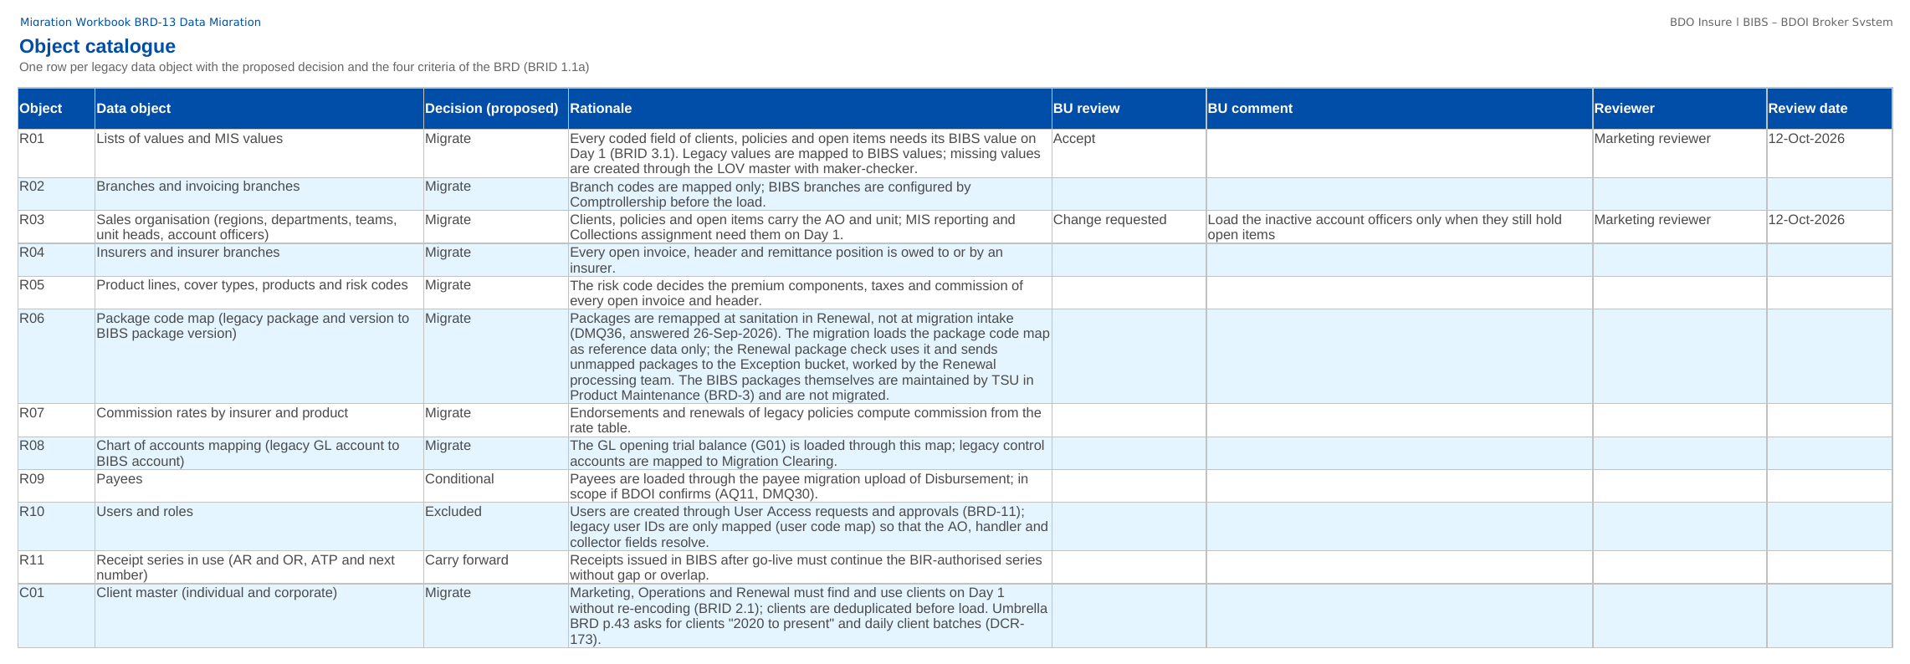
How to fill in the sign-off workbook
• Review the rows of your objects: Object catalogue, Data owners, Code maps, Validation rules, Cut-over tasks, Reconciliation sign-off
• Load templates: in load order; on each template sheet the BU review rows sit above the columns
• BU review: Accept, Change requested or Comment
• BU comment: the change asked for
• Proposed rules: the BDOI decision on each rule
• Questions go to the Comments log
• Leave the other columns unchanged; one workbook per unit
Object catalogue sheet of the Migration Workbook
Confidential – BDOI
Sign-off Pack Guide BRD-13 Data Migration | v2.0
12
Notes:
The No. column is the numbered marker on the screenshot of the Data Migration Handbook, or the column number of a load template. The drop-down columns accept only the listed values. The Comments log, Meeting minutes and Version history sheets are kept by the project team; the Sign-off certificate is signed at the end.

Slide 13
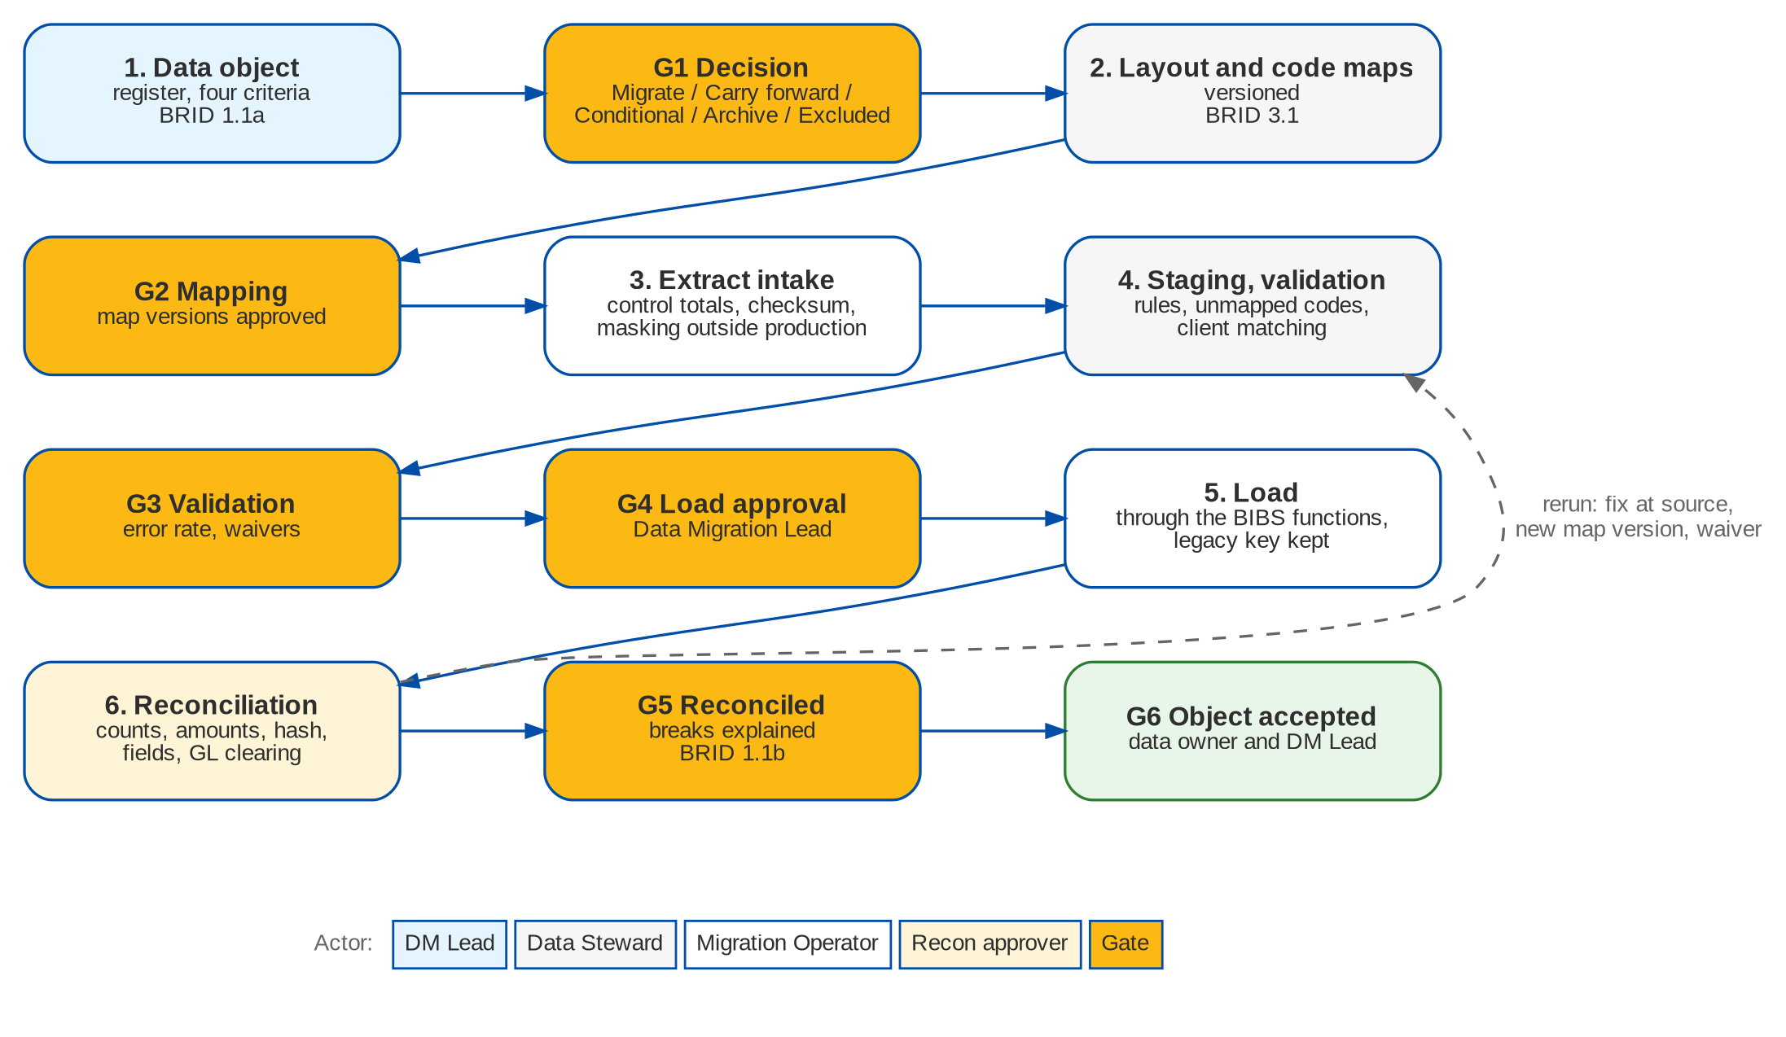
Data Migration at a glance: process flow
The way of every data object: from its decision to its acceptance, with the gates G1 to G6
Confidential – BDOI
Sign-off Pack Guide BRD-13 Data Migration | v2.0
13
Notes:
Each object goes through the same steps in every trial migration, the dress rehearsal and the production cut-over. The gates are signed in the Migration Console; a break sends the batch back to validation with a fix at source, a new code map version or a waiver. Gate G7 is the go / no-go of the whole cut-over.

Slide 14
Data Migration at a glance: personas and menus
Persona | SIT user | Screens | Menu sections
Data Migration Lead | miglead | 10 | Data Migration
Data Steward | migsteward | 11 | Data Migration
Data owner (business owner of an object) | migowner | 10 | Data Migration
Migration Operator | migops | 11 | Data Migration
Reconciliation approver (Head of Comptrollership) | migrecon | 10 | Data Migration
Go / no-go board | miggonogo | 10 | Data Migration
Comptrollership GL lead | comptrol | 10 | Data Migration
Audit / Compliance user | legacyaudit | 1 | Legacy Inquiry
Compliance reviewer of the access log | legacyrev | 1 | Legacy Inquiry
Cashiering user | cashier | 0
Cashiering team lead | cashtl | 0
Top management approver | topmgmt | 0
Commission user | commrec | 0
Commission team lead | commtl | 0
Marketing Account Officer | ao | 0
Confidential – BDOI
Sign-off Pack Guide BRD-13 Data Migration | v2.0
14
Notes:
Each persona sees only the menu entries of its role; the full menu of each persona is in Handbook Part B, chapter 17 and on the Menu by persona sheet of the workbook.

Slide 15
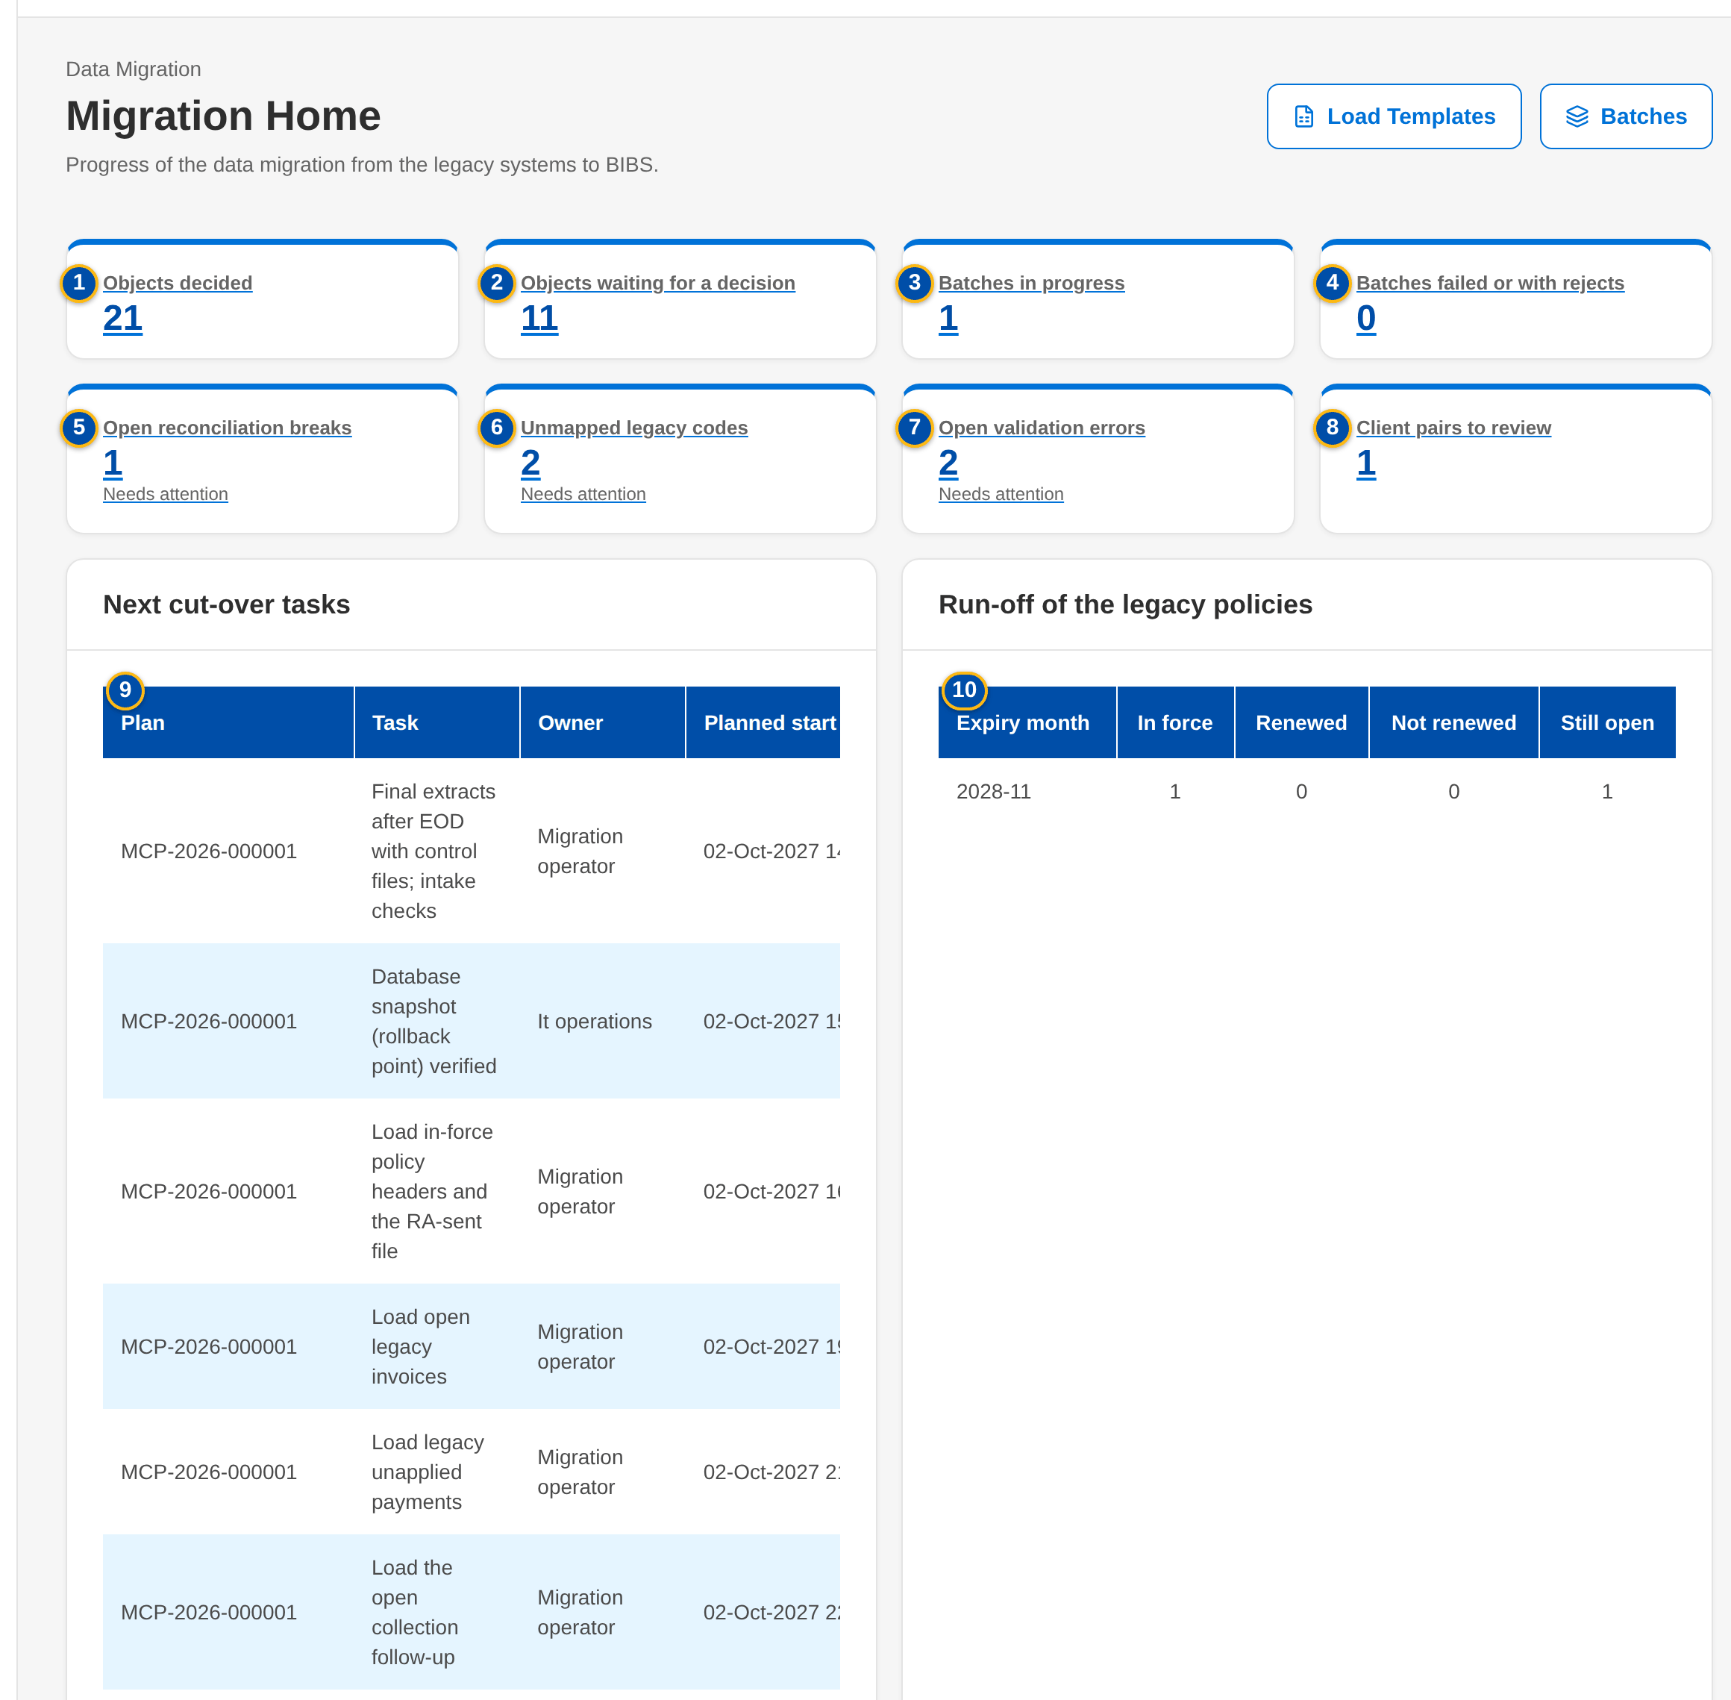
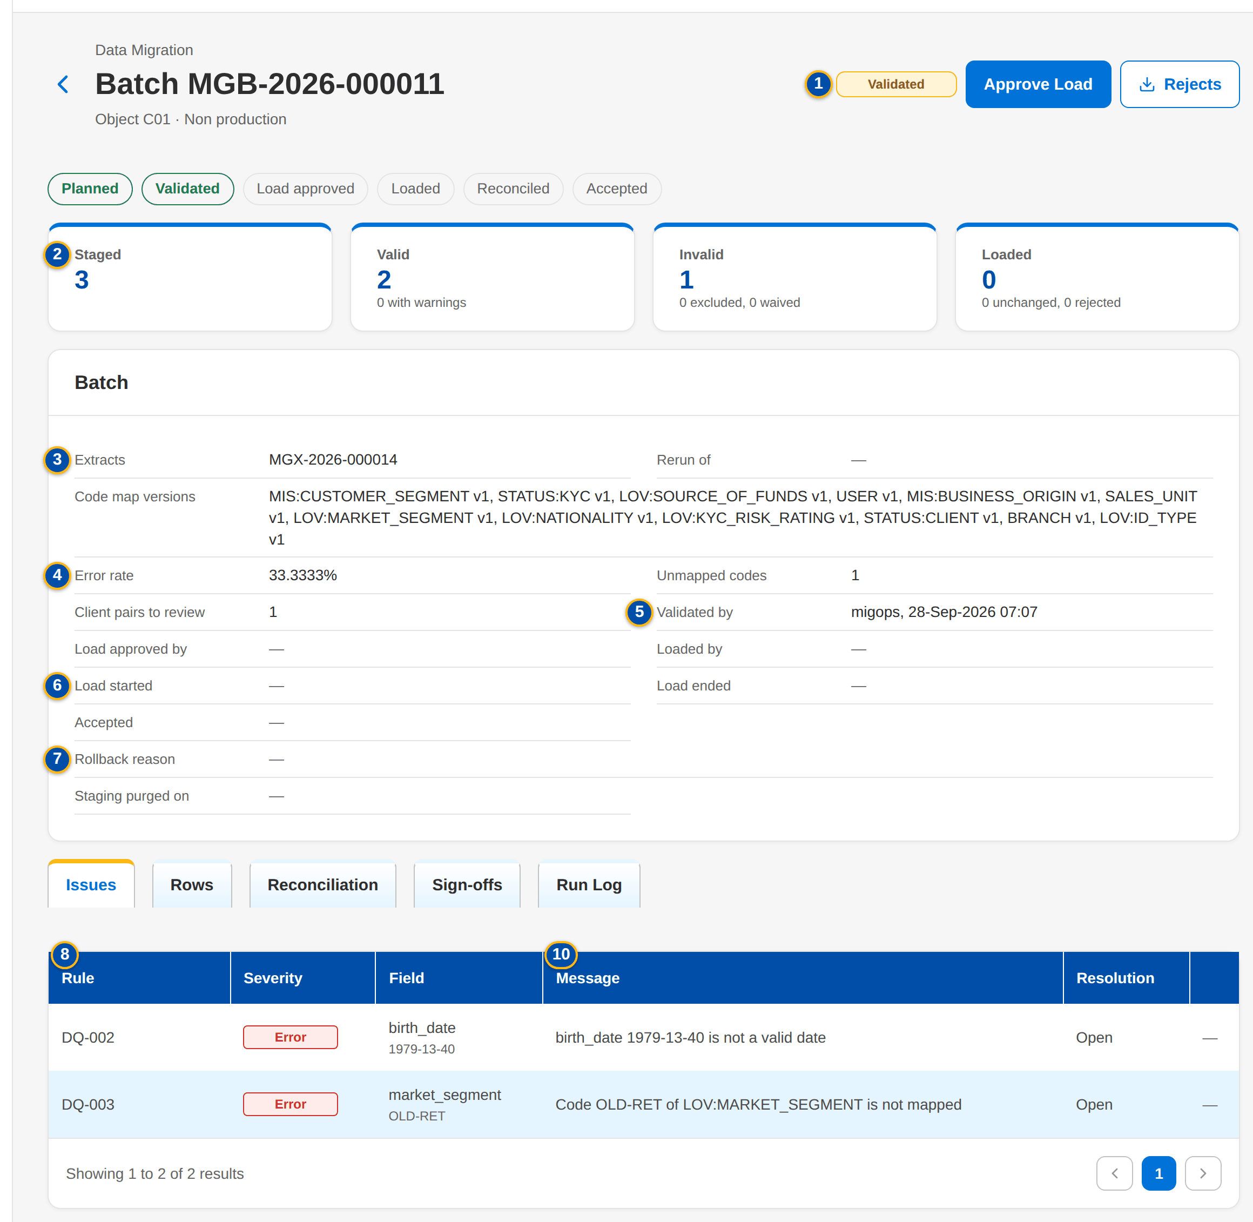
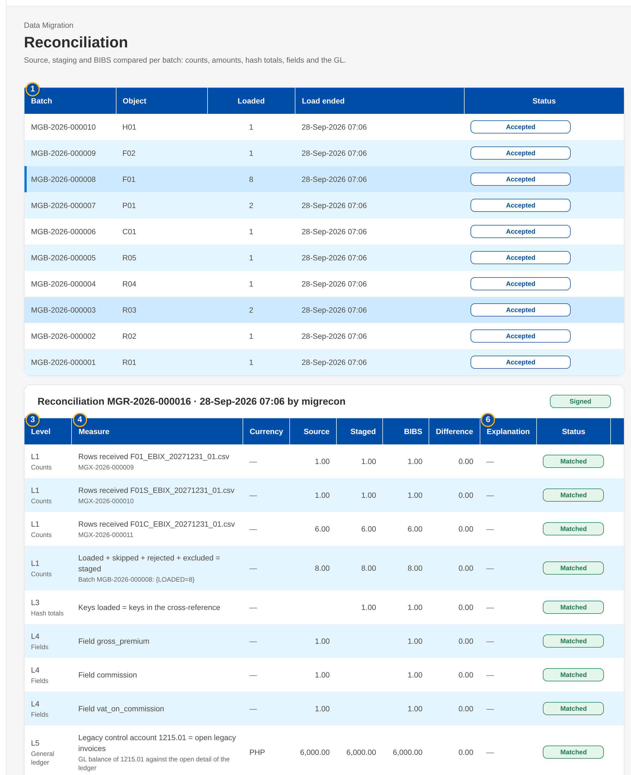
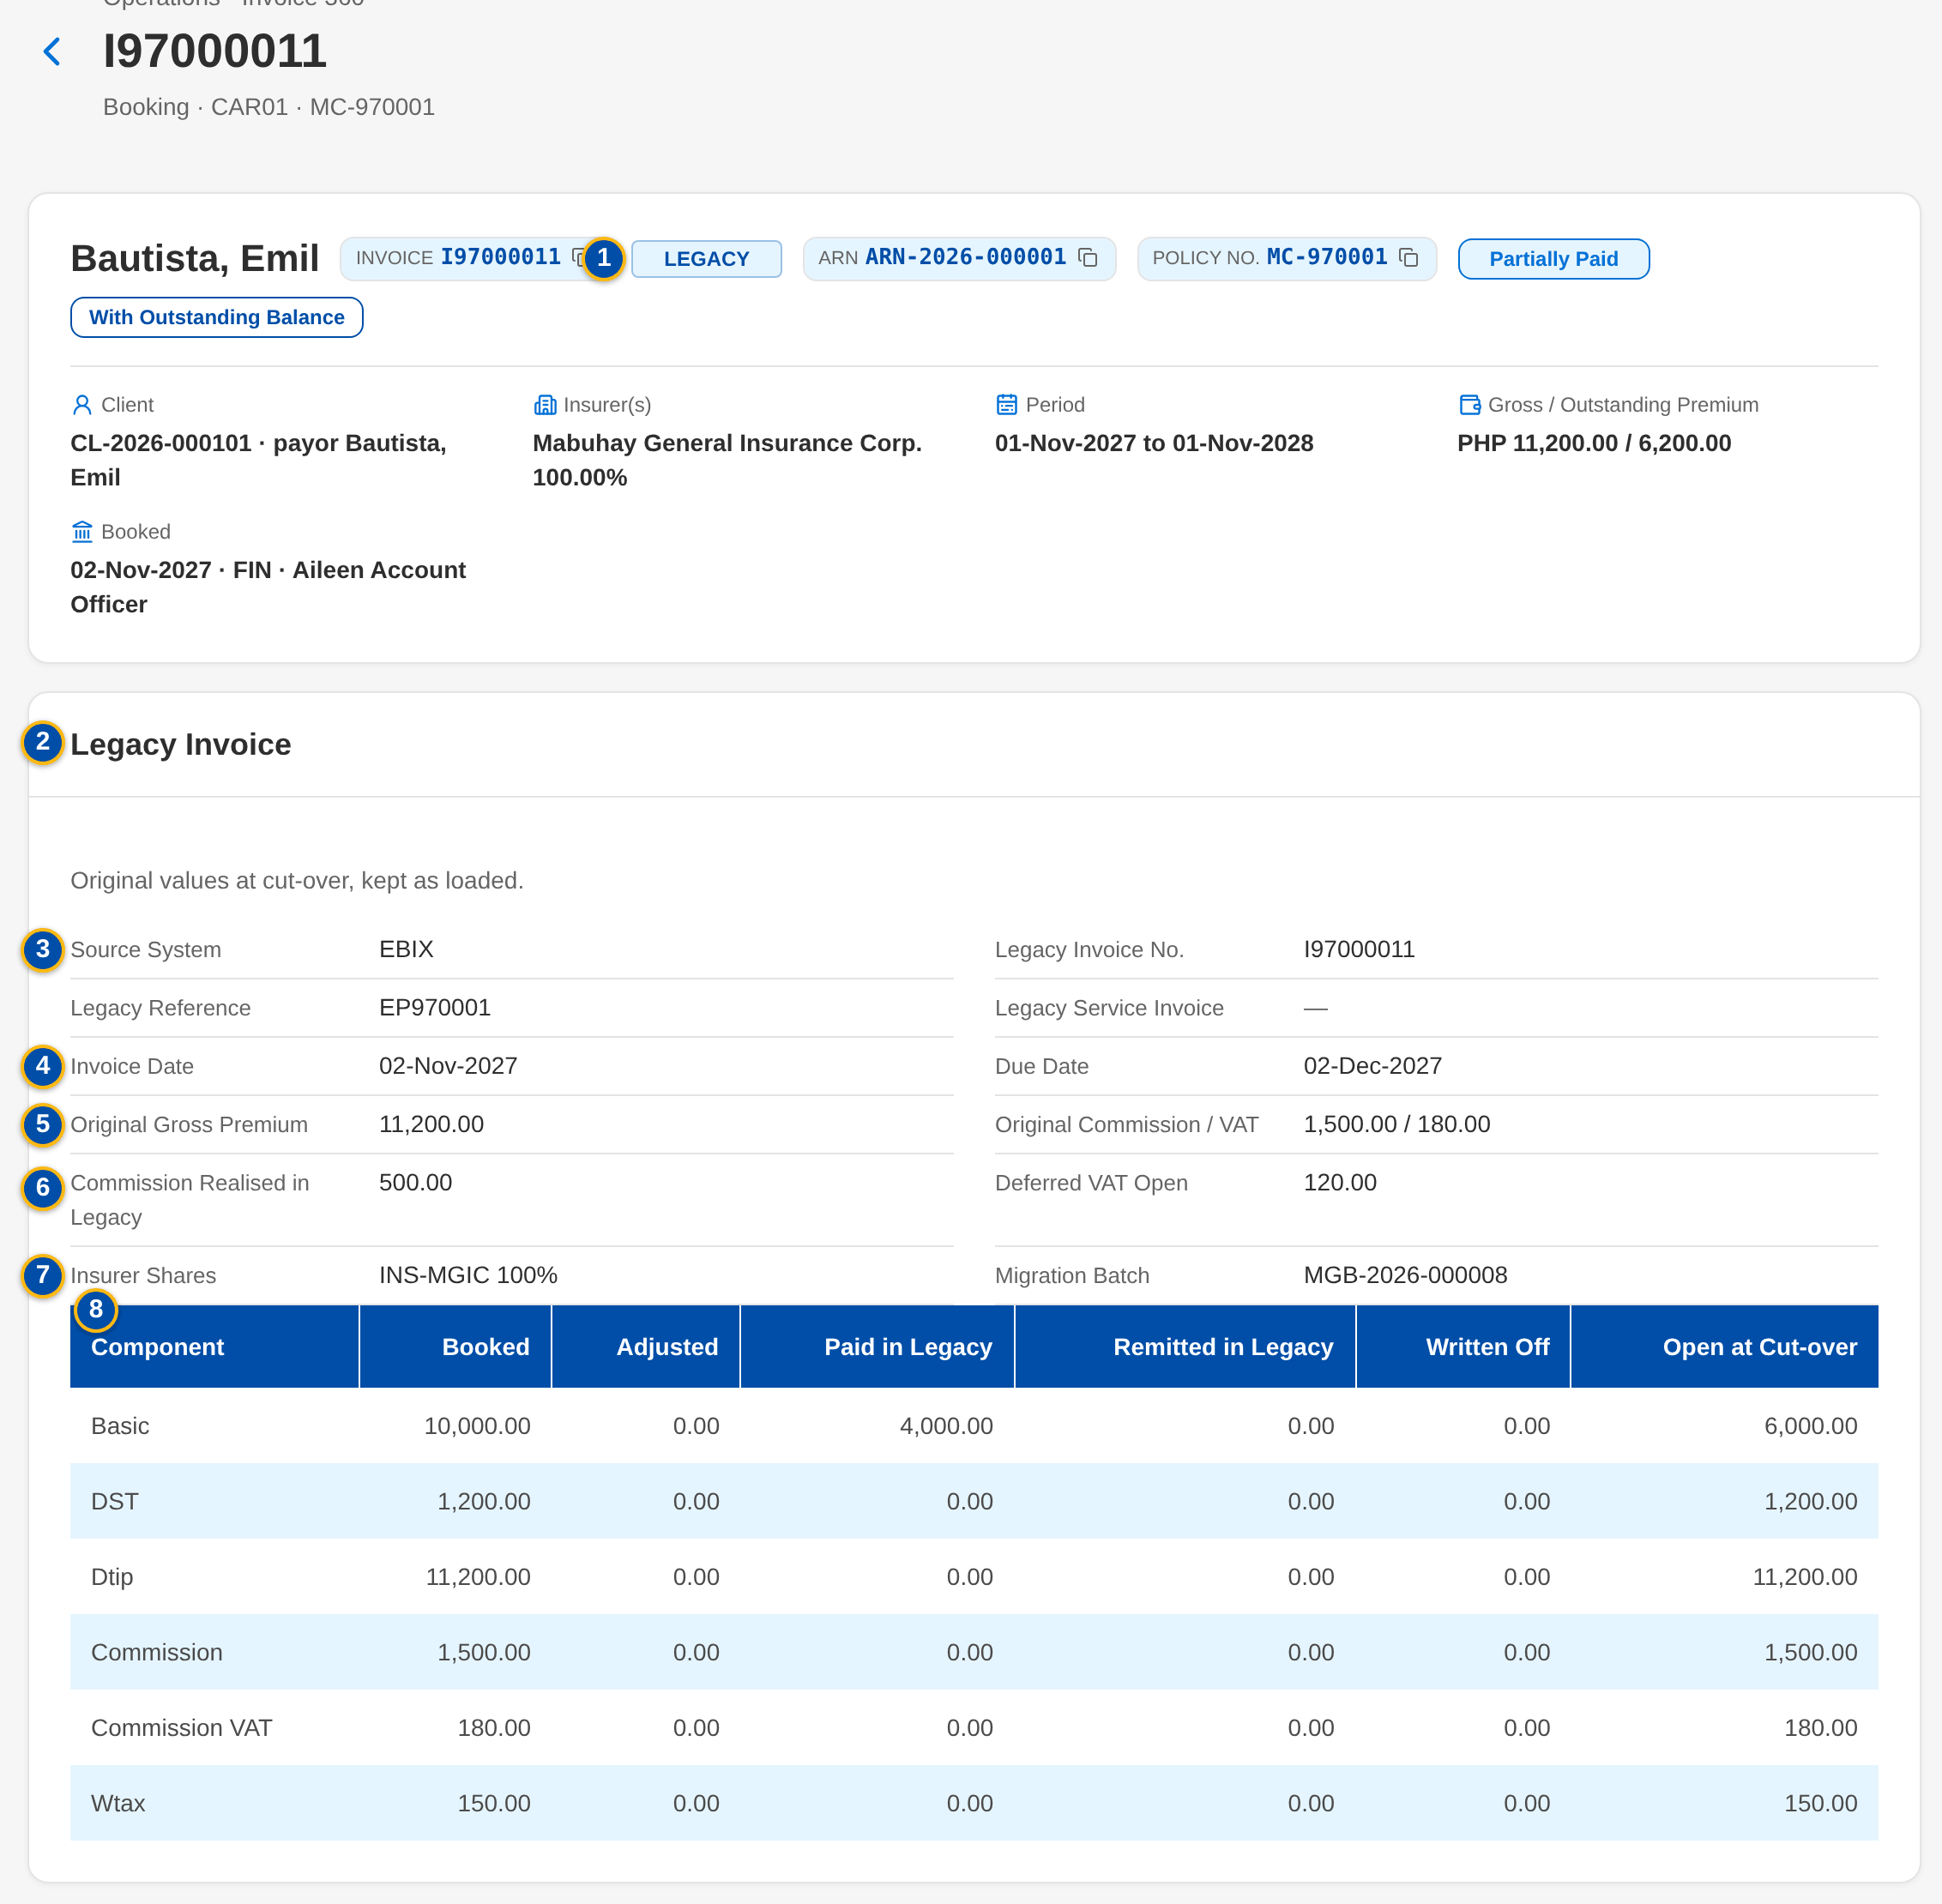
Data Migration at a glance: key screens
Migration Home
A batch from validation to acceptance
Reconciliation by level
A legacy invoice on Invoice 360
Confidential – BDOI
Sign-off Pack Guide BRD-13 Data Migration | v2.0
15
Notes:
Screenshots of the SIT environment with seed data; every screen of the module is in Handbook Part B, chapter 19.

Slide 16
The migration approach
• Selective, not a conversion: each legacy object gets one decision
  – Master and reference data are migrated; open items are carried forward; history stays in read-only legacy or the BIBS archive
• Load through the BIBS services, so every BIBS rule, audit entry and accounting entry applies
• Reconcile everything and keep the evidence: counts, amounts, hash totals, fields, GL
• Rehearse before production: four trial migrations and a dress rehearsal on masked data
• One processing system per item from the freeze; no parallel run
• Go-live Monday 3 January 2028 at the year-end boundary (option A, for Comptrollership to confirm)
Confidential – BDOI
Sign-off Pack Guide BRD-13 Data Migration | v2.0
16
Notes:
The approach follows the BRD: a stable Day-1 with clean master data and the open positions carried forward. History is not converted into BIBS transactions.

Slide 17
The data objects and their decisions
Decision (proposed) | Objects
Migrate | R01 Lists of values and MIS values; R02 Branches and invoicing branches; R03 Sales organisation; R04 Insurers and insurer branches; R05 Product lines, cover types, products and risk codes; R06 Package code map; R07 Commission rates by insurer and product; R08 Chart of accounts mapping; C01 Client master; C03 Client payout accounts; P03 Renewal advices already sent before go-live; G01 GL trial balance per account, branch and currency; G03 FY2027 opening-balance true-ups
Conditional | R09 Payees; P01 In-force policy headers; P04 Submitted-policy masterlists; P05 Employee Benefits programmes; F04 Remittance in flight; F06 PDCs in the warehouse, check pick-ups and refunds in process; F07 Open claims
Excluded | R10 Users and roles; C05 Screening results and risk ratings
Carry forward | R11 Receipt series in use; F01 Open legacy invoices; F02 Unapplied premium payments; F03 Open collection state; F05 DP billing in process and DP commission receivable
Archive | C04 KYC documents and IDs; P02 Expired policies and policy history; G02 GL history; H01 Closed transactions; H02 Legacy documents
Confidential – BDOI
Sign-off Pack Guide BRD-13 Data Migration | v2.0
17
Notes:
The decisions are proposals that each business owner confirms at gate G1 in the Migration Console. Conditional objects wait for BDOI's decision (proposed rule PR-DM-05).

Slide 18
Roles and the named data owners
Role | Who | Does
Approver of the set | Product Owner, Marketing Business System | Owns the set and approves all of its contents, with the approvers of the BRD-13 approval pages
Author of the BRD; cut-over | Program Manager, Business Project Services | Reviews the traceability and the completeness; accountable for the cut-over; chairs the go / no-go board
Data Migration Lead | BDOI (to name) | Object register and decisions, load approvals (G4), acceptance with the owners (G6), cut-over plan
Data owners | Department heads per object (workbook sheet Data owners) | Decide the class (G1), approve the code maps (G2), waivers, accept the object (G6)
Data stewards | Named staff per object | Profiling review, cleansing at source, code maps, client match review
Reconciliation approver | Head, Comptrollership (financial objects) | Signs the reconciliation (G5); approves breaks, rollbacks and the opening-balance adjustments
BDOI IT | Legacy system owners | Extracts and control files, transfer, freeze and read-only mode, decommissioning
iorta TechNXT | Project Manager, Migration Lead, Migration Operator | Loads, reconciliation runs, profiling, the console, the rehearsals
Confidential – BDOI
Sign-off Pack Guide BRD-13 Data Migration | v2.0
18
Notes:
BDOI names the owners and stewards by 30 October 2026 (M2). The workbook sheet Data owners has the columns for the names.

Slide 19
Trial migrations and the dress rehearsal
Run | When and where | What it proves
Trial migration 1 | 19-30 Apr 2027, SIT | Reference data and clients first, then policy headers and the RA-sent file; timings; profiling report to the owners
Trial migration 2 | 5-16 Jul 2027, SIT | All objects end to end; L1-L5 reconciled; Migration Clearing 0.00
Trial migration 3 | 2-13 Aug 2027, UAT | Business verification on screen; the Drop 1 UAT runs on migrated data
Trial migration 4 | 4-15 Oct 2027, UAT | Timed as a cut-over; go-live renewal extraction; a test opening-balance adjustment
Dress rehearsal | 15-26 Nov 2027, production-sized | Full volume within the window with 20 percent margin; rollback rehearsed
Confidential – BDOI
Sign-off Pack Guide BRD-13 Data Migration | v2.0
19
Notes:
Each run uses fresh masked extracts, so every fix is proven with new data. The production cut-over repeats the rehearsed plan.

Slide 20
The sign-off gates of every object
Gate | What is signed | By
G1 Decision | The class of the object with the four criteria | Business owner
G2 Mapping | Layouts frozen; the code maps used approved | Business owner
G3 Validation | Error rate within the limit; waivers approved; no pair to review | Data Steward (waivers by the owner)
G4 Load approval | The batch may be loaded | Data Migration Lead; Head of Comptrollership for an adjustment
G5 Reconciliation | L1-L5 matched or explained | Reconciliation approver
G6 Acceptance | Samples verified on the BIBS screens | Business owner and Data Migration Lead
G7 Go-live | Day-1 objects accepted; the twelve criteria met | Go / no-go board
Confidential – BDOI
Sign-off Pack Guide BRD-13 Data Migration | v2.0
20
Notes:
The maker of a batch cannot sign its reconciliation or acceptance, and one person cannot sign two gates of one batch.

Slide 21
Cut-over and go / no-go
Before the freeze
Cut-over weekend
Go-live
• Pre-load of reference data and clients from 20 Dec 2027
• Daily client deltas
• Code map freeze 27 Dec
• December soft close by 20 Dec
• Legacy freeze Fri 31 Dec 22:00
• Final extracts and loads Sat 1 Jan
• Reconciliation, samples, smoke test Sun 2 Jan
• Go / no-go Sun 2 Jan 18:00
• Renewal extraction Mon 3 Jan 04:00
• BIBS open 08:00
• Point of no return 18:00
• Hypercare to the January close
Confidential – BDOI
Sign-off Pack Guide BRD-13 Data Migration | v2.0
21
Notes:
Until the go / no-go decision the rollback restores the snapshot taken before the production load and legacy reopens. After the point of no return issues are fixed forward in BIBS.

Slide 22
How migrated and new data are told apart
• LEGACY badge next to the number on the lists and records, with the source system, legacy reference and batch in its tooltip
• Origin filter on the lists that hold migrated records: All origins, BIBS, Migrated
• Legacy numbers stay searchable: clients, policies and invoices are found by their legacy numbers
• Invoice 360 of a legacy invoice shows the values at cut-over, never changed after the load
• Legacy invoices and unapplied payments post to the legacy accounts until they are settled
• Migrated records raise no notification to clients or insurers
Confidential – BDOI
Sign-off Pack Guide BRD-13 Data Migration | v2.0
22
Notes:
Users work migrated and new records on the same screens. The report Changes to Legacy Invoices shows every change made in BIBS to a legacy invoice.

Slide 23
Key business rules and validations
• Every object has one decision (migrate, carry forward, conditional, archive, excluded) approved by its business owner (G1).
• Only approved code map versions are used; a batch with an unmapped code in a mandatory column is not loaded.
• Master data loads with at most 0.5 percent of rows failing or waived; open items and the trial balance with none.
• Records are created through the BIBS services, never written directly; migrated records carry the origin Migrated and raise no notification.
• Every object is reconciled at up to five levels; a break is explained and approved before the reconciliation is signed (G5).
• The maker never approves: decisions, code maps, loads, rollbacks, adjustments, resubmissions and legacy batches.
• Migration Clearing is 0.00 per branch and currency at go-live; the go-live decision is taken on twelve measured criteria.
• A legacy invoice keeps its number, is processed with the BIBS screens and posts to the legacy accounts until it is settled.
  – Full list: Handbook Part B, chapter 19 per screen, 67 rules on the Business rules sheet and 216 messages in Handbook Part B, chapter 21 and on the Messages sheet
Confidential – BDOI
Sign-off Pack Guide BRD-13 Data Migration | v2.0
23
Notes:
These are the rules the business units ask about most. Each rule is stated with its FR on the screen where it applies.

Slide 24
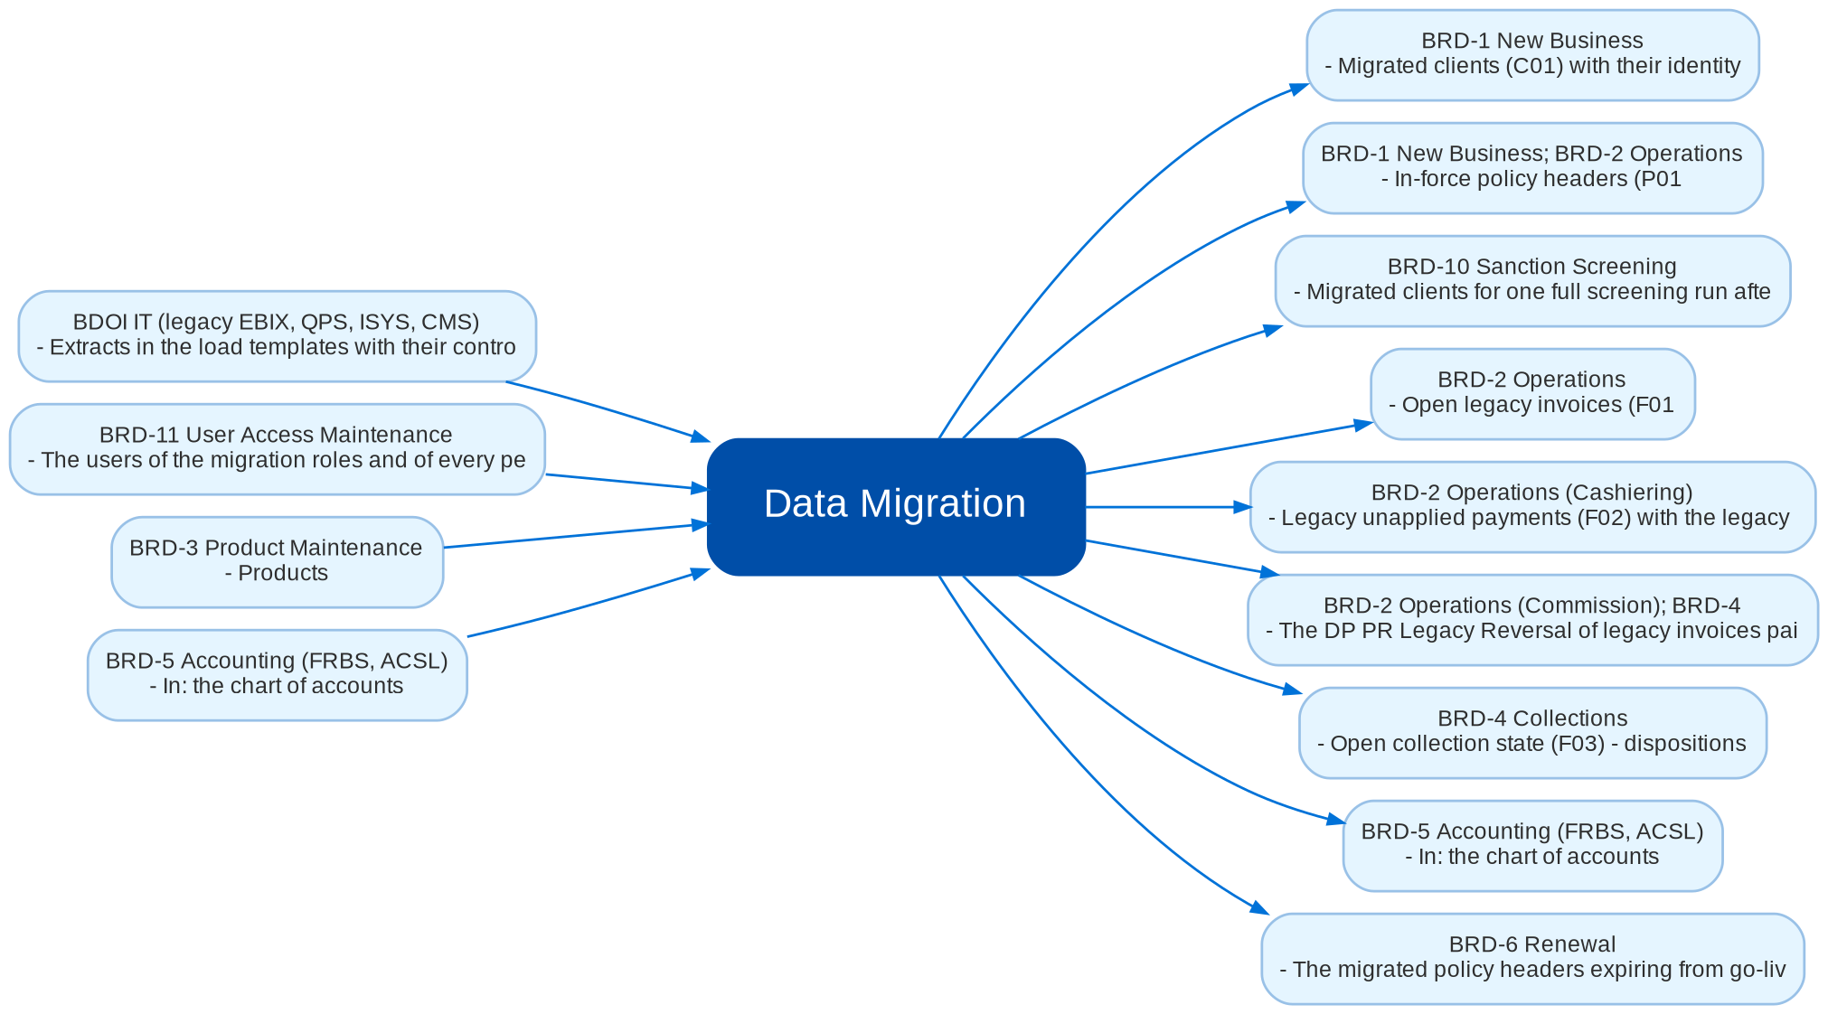
Cross-module dependencies and impacts
What Data Migration takes from and hands to the other BRDs and systems (Handbook Part B, chapter 28)
Confidential – BDOI
Sign-off Pack Guide BRD-13 Data Migration | v2.0
24
Notes:
The contract is part of the signed set. Data Migration loads every object through the module that owns it and hands the open items to Operations, Collections, Cashiering, Commission, Remittance, Accounting and Renewal, which process them after go-live. A later change in any of those BRDs that touches a line of this contract (a new mandatory field of a client, account or invoice, another accounting rule for the legacy items, another renewal lead time) is raised as a change request against this signed set in the Change Management Register, assessed for its effect on the layouts, the code maps, the reconciliation and the cut-over plan, and approved by the owners of both BRDs; the affected pages and layouts of this set are then re-issued and signed as a delta.
IC-01 BRD-1 New Business (Out): Migrated clients (C01) with their identity, contacts, addresses, segment, AO and KYC status; payout accounts (C03); one BIBS client per matched cluster, found by any legacy client number
IC-02 BRD-1 New Business; BRD-2 Operations (Out): In-force policy headers (P01, P01S) as booked accounts of origin Migrated with the legacy package as given; the legacy invoices link to them
IC-03 BRD-2 Operations (Out): Open legacy invoices (F01, F01S, F01C) in the Operations ledger with their components, insurer shares and values at cut-over; endorsements of legacy invoices booked in the legacy context
IC-04 BRD-2 Operations (Cashiering) (Out): Legacy unapplied payments (F02) with the legacy AR, references and disposition in progress; the Unapplied to Income and Legacy PR 2307 Reversal batches
IC-05 BRD-4 Collections (Out): Open collection state (F03) - dispositions, promises to pay, instalment plans and collector assignments of the open legacy invoices, carried as the legacy follow-up of the worklist item; tags "DP PR for reversal"
IC-06 BRD-2 Operations (Commission); BRD-4 (Out): The DP PR Legacy Reversal of legacy invoices paid directly to the insurer
IC-07 BRD-5 Accounting (FRBS, ACSL) (In and Out): In: the chart of accounts, the legacy control accounts and Migration Clearing, and the accounting rules of the legacy components (set up by Comptrollership). Out: the provisional GL opening (G01), the opening entries of the invoices and unapplied payments, the opening-balance adjustments (G03); the legacy context of the GL to sub-ledger reconciliation
IC-08 BRD-6 Renewal (Out): The migrated policy headers expiring from go-live to 31 May 2028 and the renewal advices already sent (P03) for the go-live renewal extraction; the package code map (R06) for the package check at sanitation; the migrated headers for the daily extraction from 1 June 2028
IC-09 BRD-3 Product Maintenance (In): Products, package versions, insurers and commission rates of BIBS, which the code maps target; values created from the migration (CREATE entries) are authorised in their masters
IC-10 BRD-10 Sanction Screening (Out): Migrated clients for one full screening run after the client load (no screening per client during the load)
IC-11 BRD-11 User Access Maintenance (In): The users of the migration roles and of every persona, created through User Access requests; legacy user IDs are only mapped (user code map)
IC-12 BDOI IT (legacy EBIX, QPS, ISYS, CMS) (In): Extracts in the load templates with their control files; the legacy freeze and read-only mode; the document transfer folder; the read-only addresses of the legacy applications

Slide 25
Caveats and possibilities
Topic | What can happen | How it is handled
Additional requirements | New needs can surface during the review, the trial migrations or UAT. | In-scope clarification when the signed text already covers it; otherwise a change request with mandays.
Decisions still open | The year-end option, the codes of the legacy accounts, the conditional objects and the approvers of the legacy batches wait for BDOI. | Each is a proposed rule with its decision date; the proposal stands until BDOI decides, and most answers are configuration.
Legacy data quality | Profiling of the first full extracts may show fewer components, shares or references than expected. | Cleansing at source by the stewards; code maps; waivers within the thresholds; open-balance mode for invoices without their original amounts.
Other BRDs change the migrated objects | Operations, Collections, Accounting, Renewal and Product Maintenance own the records the migration creates. | The change is raised against the other BRD and assessed against the cross-BRD contract of this set; a delta sign-off of the affected layouts.
Items that depend on BDOI IT | The secure file drop, the legacy document folder and the read-only links wait for BDOI IT. | Until named, files are uploaded on the Extracts screen and documents are loaded with their index; nothing else changes.
Confidential – BDOI
Sign-off Pack Guide BRD-13 Data Migration | v2.0
25
Notes:
Three ways to handle a case: an in-scope clarification (no change to the signed set, answered in the comments log); a change request with mandays in the Change Management Register; a delta sign-off of the affected pages only.

Slide 26
Caveats: worked examples
Topic | Example and how it is handled
Additional requirements | A data owner asks for an extra column in the client template: a new layout version, so a change request; asking which rule rejects a row is a clarification.
Decisions still open | If Comptrollership chooses option B, go-live moves to April 2028 and the opening loads the year-to-date P&L: a change request with its mandays.
Legacy data quality | Legacy cannot give paid and remitted per component: invoices load with their open balance and the Legacy Invoice card says so.
Other BRDs change the migrated objects | Renewal adds a mandatory field to the policy header: the P01 layout gets a new version, signed as a delta.
Items that depend on BDOI IT | When BDOI IT names the secure file drop, extracts arrive there instead of the upload; the checks and templates stay the same.
Confidential – BDOI
Sign-off Pack Guide BRD-13 Data Migration | v2.0
26
Notes:
Use these examples to agree the handling of a case during the review.

Slide 27
Entry and exit criteria, definition of done
Entry
Exit
Done
• The set is issued with the screenshots of the Migration Console taken on the SIT environment with seed data.
• Reviewers have their SIT users and the walkthrough sessions are held.
• The test plan is traced to the handbook and to the screens.
• Every row of the workbook reviewed by its unit (Accept, Change requested or Comment).
• Every proposed rule decided, or accepted as the working assumption with its decision date.
• Every comments log item closed: answered, corrected in v2.1, or raised as a change request.
• The sign-off certificate signed as on the BRD-13 approval pages: prepared by iorta TechNXT and the Program Manager, input from the Data Migration Lead and the data owners, reviewed by MBS and BDOI IT, approved by the Product Owner and the approvers.
• Signed certificate filed with the set; version history updated.
• Objects decided (G1) and layouts frozen, version 1, in the Migration Console (M2).
• Owners and stewards named per object; deltas listed in the Change Management Register with mandays.
• Test plan agreed for the trial migrations, SIT and UAT.
Confidential – BDOI
Sign-off Pack Guide BRD-13 Data Migration | v2.0
27
Notes:
The sign-off meeting starts when the exit criteria are met; the set is done when the certificate is signed and the content of the set is frozen.

Slide 28
After sign-off: readiness checklist
• ☐ Signed handbook, Migration Workbook and screens
• ☐ Decisions of the objects entered in the Migration Console (G1)
• ☐ Layouts frozen, version 1; templates issued to BDOI IT
• ☐ Owners and stewards named per object
• ☐ Proposed rules decided or accepted as assumptions
• ☐ Agreed test plan and trial migration calendar
  – Handover means the objects are decided, the layouts are frozen and the first full extracts are prepared for 29 January 2027.
Confidential – BDOI
Sign-off Pack Guide BRD-13 Data Migration | v2.0
28
Notes:
Handover means the objects are decided, the layouts are frozen and the first full extracts are prepared for 29 January 2027.

Slide 29
Change control after sign-off
• A change to anything frozen is raised in the Change Management Register
  – The screen, field, rule or message concerned, the reason and the priority
• The project team assesses the mandays and the effect on the other BRDs through the cross-BRD contract
• The owners of every BRD concerned approve it
• Delivered as a new version of the set (v2.1, v2.2...) with the changed pages signed again (delta sign-off)
• Configuration values marked default change in BIBS without a change request
Confidential – BDOI
Sign-off Pack Guide BRD-13 Data Migration | v2.0
29
Notes:
Nothing in a signed set changes without a request in the register.

Slide 30
Governance, contacts and next steps
Role | Who | Does
Approver | Product Owner, Marketing Business System, with the approvers of the BRD-13 approval pages | Owns the set and approves all of its contents; chairs the sign-off meeting
BRD author and cut-over owner | Program Manager, Business Project Services | Reviews the traceability and the completeness; accountable for the cut-over; chairs the go / no-go board
Data owners | Department heads per object | Review and sign their objects, templates, code maps and reconciliation
Comptrollership | Head, Comptrollership | Legacy accounts, GL opening, reconciliation approver, opening-balance adjustments
BDOI IT | Head, BDOI IT | Extracts, transfer, freeze, read-only access, decommissioning
Compliance | Compliance; Analytics and Risk Management | Masking, archive, Legacy Inquiry and its access log
Delivery | iorta TechNXT Project Manager, Business Analysis, Migration Lead, test lead | Sessions, answers, comments log, revisions, change requests, the migration runs
Confidential – BDOI
Sign-off Pack Guide BRD-13 Data Migration | v2.0
30
Notes:
Next steps:
Kick-off and first console walkthrough on Wed 7-Oct-2026
Decisions on the M1 rules by Fri 16-Oct-2026; workbooks returned by Wed 21-Oct-2026
Q&A on Mon 26-Oct-2026; sign-off on Fri 30-Oct-2026 (M2)
First full extracts in the templates by Fri 29-Jan-2027 (M3); Trial migration 1 from 19-Apr-2027

Slide 31
Next steps and the release order of the other BRD sets
• Kick-off and first console walkthrough on Wed 7-Oct-2026
• Decisions on the M1 rules by Fri 16-Oct-2026; workbooks returned by Wed 21-Oct-2026
• Q&A on Mon 26-Oct-2026; sign-off on Fri 30-Oct-2026 (M2)
• First full extracts in the templates by Fri 29-Jan-2027 (M3); Trial migration 1 from 19-Apr-2027
Confidential – BDOI
Sign-off Pack Guide BRD-13 Data Migration | v2.0
31
Notes:
The other BRD sets follow the same pack, guide and steps.

