Slide 1
What causes job satisfaction in Computer Science?
William Pembleton

Slide 2
Abstract
Supposed to write this last

Slide 3
Abstract (cont.)
Writing this last again

Slide 4
Background
This question is a supervised learning problem, meaning that I can use an algorithm like ID3.
Supervised learning problems are problems

Slide 5
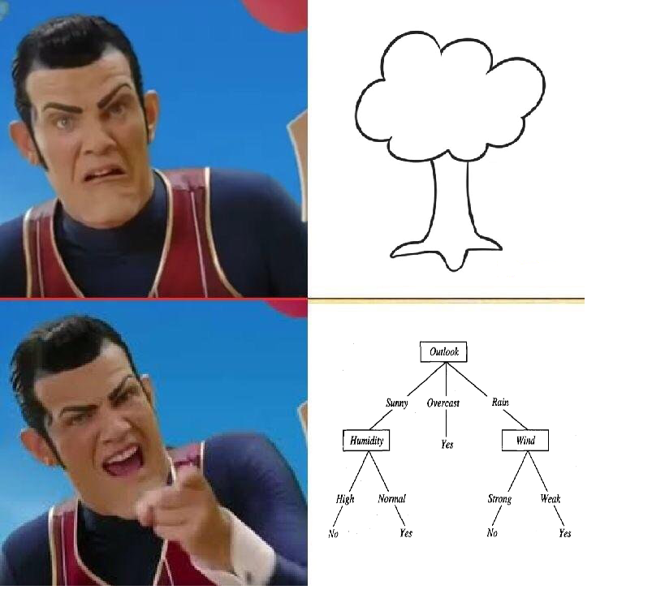
What’s ID3
ID3 is a decision tree learning algorithm. It can take in a dataset and produce trees

Slide 6

Where’d I get my data from?
Stack Overflow is a Q&A website where developers can learn from each other

Slide 7
About that data?
Stack Overflow also does surveys of their developers yearly
What kind of developer are you? (Full stack, back end, mobile)
How satisfied are you with your current job?
What languages do you use?
What IDE do you use?

Slide 8
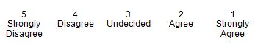
Methodological (Preprocessing)
Likert scale
I converted the csv so that if it says something like undecided I made it into a 3
Mostly did this to make the tree easier to read and easier to calculate averages later on

Slide 9
Methodological (Preprocessing)
Data for columns like DevType came in as Full Stack;Database Adminstrator;DevOps
Separated each of these out into their own column
DevType.Full Stack | DevType.Database Adminstrator | DevType.Devops
Yes | Yes | Yes
Yes | No | Yes

Slide 10
Methodological (Preprocessing)
There was a few questions on the survey that asked participants to rank (for instance what benefits are important to you in a job) from 1-10
Same thing as past slide Benefits.Industry
Lots of people didn’t answer this question so I made their values NaN

Slide 11
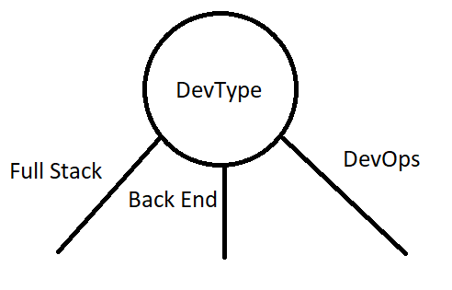
Methodological (Algorithm changes)
Within the code I took in stuff like DevType.FullStack and made it so that when it prints out the tree it outputs

Slide 12
Methodological (Algorithm changes)
In the code I changed the piece that returns how likely it is to be true to returning what it thinks the average satisfaction is

Slide 13
Results (Job Satisfaction)
Imagine a very pretty tree

Slide 14
Results (Language)
Pretty tree #2

Slide 15
Results (Open Source)
I think get the idea

