Slide 1
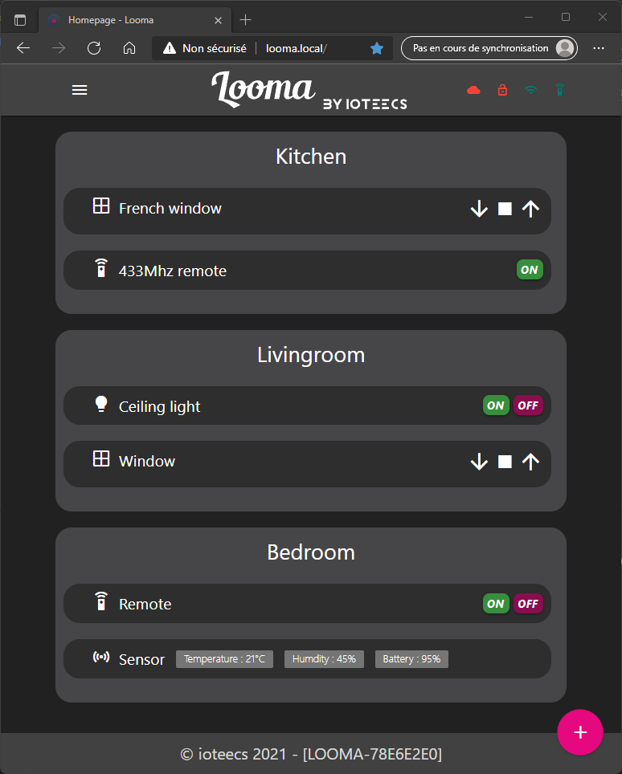
Looma status
Navigation menu
(burger or icons)
Room
Device
Looma’s id
Add device button

