Slide 1
LAB 5
Write code to simulate rolling three six-sided dice
Print Triple, Double
srand(), rand()
srand(8987)
int a = rand()
Ask user first enter a "seed" value
Demo
void roll_three(int* one, int* two, int* three)

Slide 2
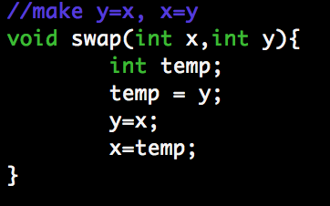
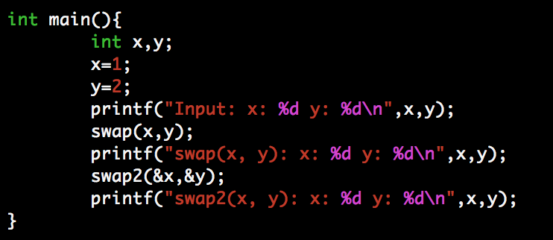
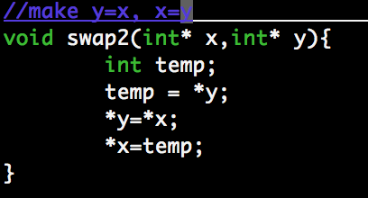
Pointer
Swap example
What is the output value?

Slide 3
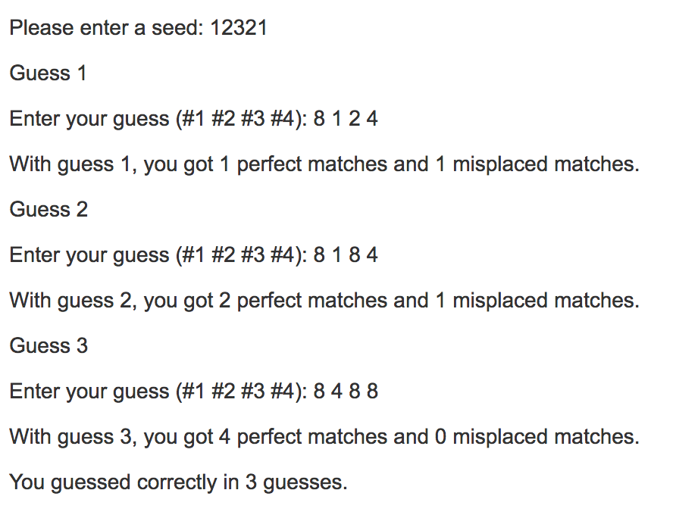
MP 5
Code breaker (Guess the four hidden integer solutions)
Perfect matches: number of the guess that appear in the same place in the solution code
Misplaced matches: number of values that appear somewhere in the solution but in a different place
Solution 8 4 8 8

Slide 4
set_seed
int set_seed (const char seed_str[]);
If input is valid, set seed return 1
Else print "set_seed: invalid seed\n” return 0
‘123’ - valid
‘123vvv’ -invalid
‘123 34’ –invalid
‘hello’ – invalid
int sscanf (seed_str, "%d%1s", &seed, post))

Slide 5
sscanf <stdio.h>
int seed;
char post[2];
int sscanf (seed_str, "%d%1s", &seed, post))
seed_str: C string that the function processes as its source to retrieve the data
"%d%1s”: one int, one string
seed: store the integer
post: store the string
return: number of items were read
seed_str = “123abc“
seed_str = ”123“

Slide 6
start_game
void start_game (int* one, int* two, int* three, int* four)
Set the four solutions
one = rand() % 8 + 1

Slide 7
make_guess
int make_guess (const char guess_str[], int* one, int* two, int* three, int* four);
Check valid guess, store guess to one, two, three, four
If invalid print "make_guess: invalid guess\n” return 0
1 <= *one, *two, *three, *four <=8, exactly four guesses
Compare *one, *two, *three, *four with the solutions to get n_perfect_match and n_of_misplacement_match

Slide 8
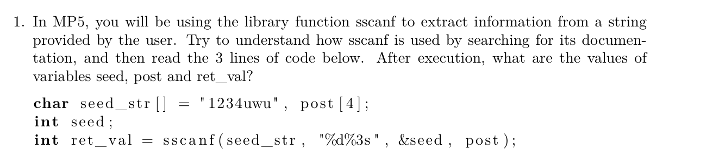
Worksheet

Slide 9
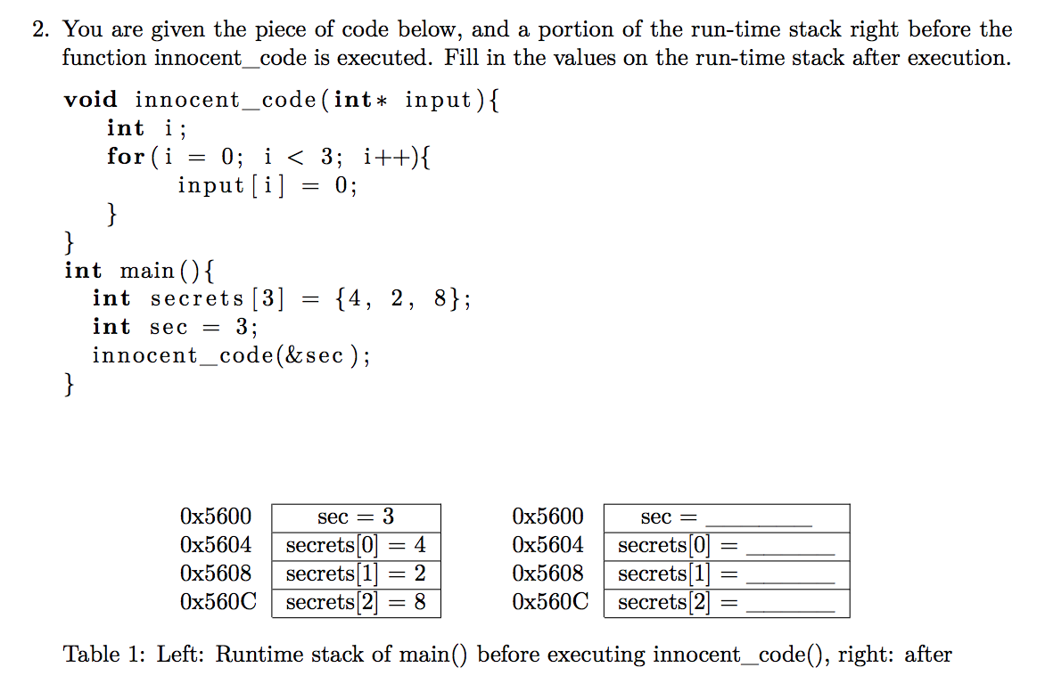
Worksheet

