Slide 1
ECE 220 Lab2A

Slide 2
Stack
A first in, last out structure
Two operations: PUSH, POP
1,2,3
PUSH →
3
PUSH →
2
2
PUSH →
1
1
1

Slide 3
3
2
1
POP →
3
2
POP →
2
1
1
POP →
1
POP? →
Underflow!

Slide 4
LAB2A Bracket Balance
( ( ) ) \n
( ( )\n
Idea:
`(‘ → PUSH
`)’ → POP, check underflow
If underflow: unbalance
\n → check if stack empty
Empty: balance
Non-empty: unbalance

Slide 5
Idea:
`(‘ → PUSH
`)’ → POP, check underflow
If underflow: unbalance
\n → check if stack empty
Empty: balance
Non-empty
Ex. ( ( ) ) \n
(
(
(
(
POP
(
POP
(
Empty!

Slide 6
Idea:
`(‘ → PUSH
`)’ → POP, check underflow
If underflow: unbalance
\n → check if stack empty
Empty: balance
Non-empty
Ex. ( ( ) \n
(
(
(
(
POP
(
(
NOT Empty!

Slide 7
Idea:
`(‘ → PUSH
`)’ → POP, check underflow
If underflow: unbalance
\n → check if stack empty
Empty: balance
Non-empty
Ex. ( ) ) \n
(
(
POP
POP
Underflow!!

Slide 8
MP2 Stack Calculator
Postfix Expression: An operator always comes after number. Apply the operator to the most recent two numbers
3 4 – 5 + → (3 - 4) + 5
1 2 3 + - 5 + → (1 - (2 + 3) )+ 5
Evaluate postfix expression using stack

Slide 9
MP2 Stack Calculator
Idea:
Number → PUSH
Operator → POP x 2, compute, PUSH the results

Slide 10
Idea:
Number → PUSH
Operator → POP x 2, compute, PUSH the results
EX 1 2 3 + - 5 + =
PUSH →
3
PUSH →
2
2
PUSH →
1
1
1
2 + 3
3
POP X 2
2
PUSH →
5
1
1
1

Slide 11
Idea:
Number → PUSH
Operator → POP x 2, compute, PUSH the results
EX 1 2 3 + - 5 + =
1 - 5
POP X 2
5
5
1
1
PUSH →
-4
12++=
-4 + 5
POP X 2
PUSH →
5
5
-4
-4
PUSH →
1

Slide 12
Loop
R0 Read data
if R0 is operator
R1 ← JSR POP
R2 ← JSR POP
R0 ← R1 + R2 (-, x, /, ^)
JSR PUSH(R0)
else if R0 is a number
JSR PUSH(R0)
endif
endloop

Slide 13
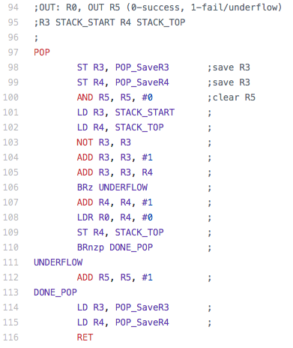
Worksheet

Slide 14
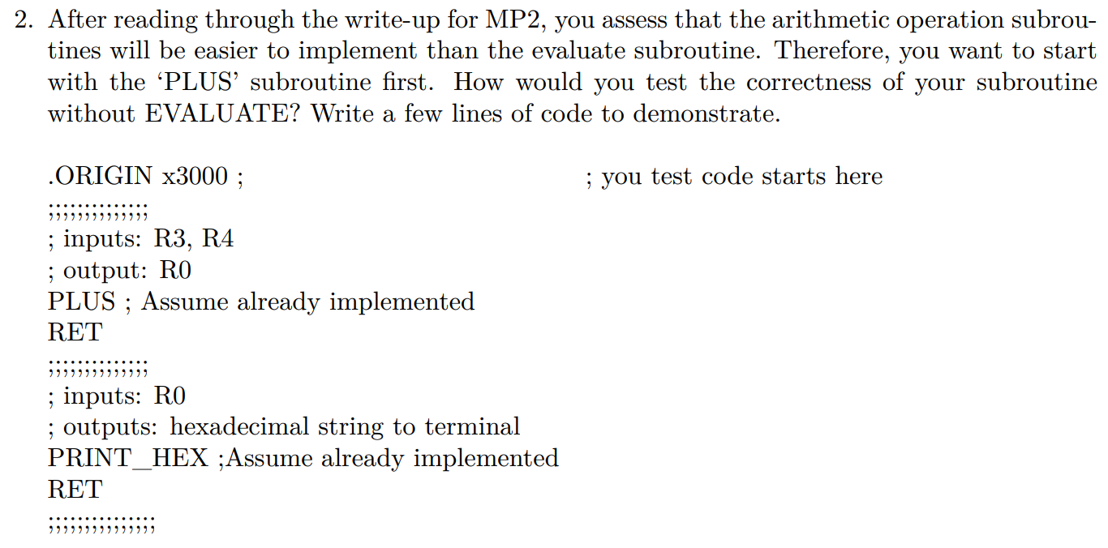
Worksheet
LD R3 TEST_VAL1
LD R4 TEST_VAL2
JSR PLUS
JSR PRINT_HEX
HALT
.END
TEST_VAL1 .FILL #5
TEST_VAL2 .FILL #6

