Slide 1
LAB12

Slide 2
C++ Class
//box.h
Class Box {
public:
Box(int l, int w, int h);
int get_l();
private:
int l_, w_, h_;
}
//box.c
#include “box.h”
Box::Box(int l, int w, int h){
l_ = l;
w_ = w;
h_ = h;
}
Int Box::get_l(){
return l_;
}
Box b(2,3,4);
int var = b.l_;
// a. 2
// b. 3
// c. error
b.get_l()

Slide 3
MP12 Inheritance
Shape
Circle
Rectangle
Sphere
`Shape’ is the base class
`Circle’, `Rectangle’, `Sphere’ are derived classes
Public inheritance represents a “is a” relationship

Slide 4
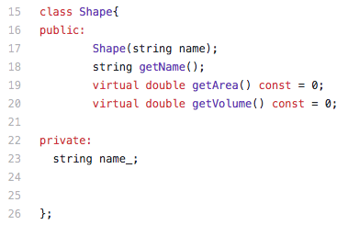
Base Class
A virtual function is a member function which is declared within base class and is re-defined (Overridden) by derived class.

Slide 5
Derived Class
class Rectangle : public Shape{
public:
Rectangle(double width = 0, double length = 0);
virtual double getArea() const{
return width_ * length_
}
virtual double getVolume() const;
Rectangle operator + (const Rectangle& rec);
Rectangle operator - (const Rectangle& rec);
double getWidth() const;
double getLength() const;
private:
double width_;
double length_;
};
Rectangle* ptr1 = new Rectangle(2,3)
Rectangle r1 = Rectangle(2, 3)

Slide 6
Operator Overloading
Rectangles Given R3 = R1 + R2: it follows that length R3 = length R1 + length R2 width R3 = width R1 + width R2
Rectangle R1 = Rectangle(1, 2)
Rectangle R2 = Rectangle(2, 3)
Rectangle R3 = R1 + R2
Rectangle Rectangle::operator + (const Rectangle& rhs){
return Rectangle(this->width_ + rhs.getWidth(), this->length_ + rhs.getLength());}

Slide 7
Polymorphism
The word polymorphism means having many forms.
Typically, polymorphism occurs when there is a hierarchy of class and they are related by inheritance.
C++ polymorphism means that a call to a member function will cause a different function to be executed depending on the type of object that invokes the function.
Base pointer can point to any derived class object

Slide 8
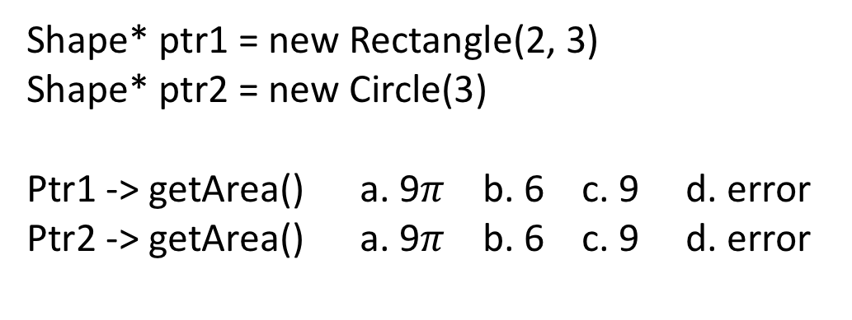
Polymorphism
Base pointer can point to any derived class object
Shape* ptr1 = new Rectangle(2, 3)
Shape* ptr2 = new Circle(3)
Ptr1 -> getArea() a. 9$π$ b. 6 c. 9 d. error
Ptr2 -> getArea() a. 9$π$ b. 6 c. 9 d. error

Slide 9
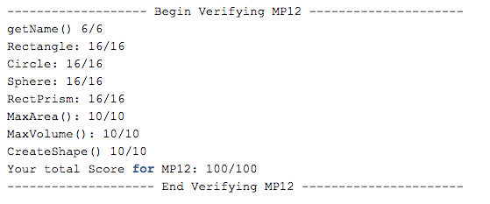

Slide 10
