Slide 1
LAB 10
Linked List

Slide 2
Linked list
head
next_ptr
next_ptr
next_ptr
data
data
data
NULL
A linked list consists of nodes where each node contains a data field and a reference(link) to the next node in the list

Slide 3
Reverse a linked list
head
1
2
3
NULL
head
1
2
3
NULL

Slide 4
void Reverse (node**head)
node* prev = NULL
node* cur = *head
node* next = NULL
while (cur != NULL)
next = cur→next
cur→next = prev
prev = cur
cur = next
head* ← prev
head
1
2
3
NULL

Slide 5
void Reverse (node**head)
node* prev = NULL
node* cur = *head
node* next = NULL
while (cur != NULL)
next = cur→next
cur→next = prev
prev = cur
cur = next
head* ← prev
head
1
2
3
NULL
prev → NULL
next → NULL
cur

Slide 6
void Reverse (node**head)
node* prev = NULL
node* cur = *head
node* next = NULL
while (cur != NULL)
next = cur→next
cur→next = prev
prev = cur
cur = next
head* ← prev
head
1
2
3
NULL
prev → NULL
next → NULL
cur

Slide 7
void Reverse (node**head)
node* prev = NULL
node* cur = *head
node* next = NULL
while (cur != NULL)
next = cur→next
cur→next = prev
prev = cur
cur = next
head* ← prev
head
1
2
3
NULL
prev → NULL
cur
next

Slide 8
void Reverse (node**head)
node* prev = NULL
node* cur = *head
node* next = NULL
while (cur != NULL)
next = cur→next
cur→next = prev
prev = cur
cur = next
head* ← prev
head
1
NULL
2
3
NULL
prev → NULL
cur
next

Slide 9
void Reverse (node**head)
node* prev = NULL
node* cur = *head
node* next = NULL
while (cur != NULL)
next = cur→next
cur→next = prev
prev = cur
cur = next
head* ← prev
head
1
NULL
2
3
NULL
cur
prev
next

Slide 10
void Reverse (node**head)
node* prev = NULL
node* cur = *head
node* next = NULL
while (cur != NULL)
next = cur→next
cur→next = prev
prev = cur
cur = next
head* ← prev
head
1
NULL
2
3
NULL
prev
next
cur

Slide 11
void Reverse (node**head)
node* prev = NULL
node* cur = *head
node* next = NULL
while (cur != NULL)
next = cur→next
cur→next = prev
prev = cur
cur = next
head* ← prev
head
1
NULL
2
3
NULL
prev
next
cur

Slide 12
void Reverse (node**head)
node* prev = NULL
node* cur = *head
node* next = NULL
while (cur != NULL)
next = cur→next
cur→next = prev
prev = cur
cur = next
head* ← prev
head
1
NULL
2
3
NULL
prev
cur
next

Slide 13
void Reverse (node**head)
node* prev = NULL
node* cur = *head
node* next = NULL
while (cur != NULL)
next = cur→next
cur→next = prev
prev = cur
cur = next
head* ← prev
head
1
NULL
2
3
NULL
prev
cur
next

Slide 14
void Reverse (node**head)
node* prev = NULL
node* cur = *head
node* next = NULL
while (cur != NULL)
next = cur→next
cur→next = prev
prev = cur
cur = next
head* ← prev
head
1
NULL
2
3
NULL
prev
cur
next

Slide 15
void Reverse (node**head)
node* prev = NULL
node* cur = *head
node* next = NULL
while (cur != NULL)
next = cur→next
cur→next = prev
prev = cur
cur = next
head* ← prev
head
1
NULL
2
3
NULL
prev
next
cur

Slide 16
void Reverse (node**head)
node* prev = NULL
node* cur = *head
node* next = NULL
while (cur != NULL)
next = cur→next
cur→next = prev
prev = cur
cur = next
head* ← prev
head
1
NULL
2
3
NULL
prev
next
cur

Slide 17
void Reverse (node**head)
node* prev = NULL
node* cur = *head
node* next = NULL
while (cur != NULL)
next = cur→next
cur→next = prev
prev = cur
cur = next
head* ← prev
head
1
NULL
2
3
NULL
next → NULL
prev
cur

Slide 18
void Reverse (node**head)
node* prev = NULL
node* cur = *head
node* next = NULL
while (cur != NULL)
next = cur→next
cur→next = prev
prev = cur
cur = next
head* ← prev
head
1
NULL
2
3
next → NULL
prev
cur

Slide 19
void Reverse (node**head)
node* prev = NULL
node* cur = *head
node* next = NULL
while (cur != NULL)
next = cur→next
cur→next = prev
prev = cur
cur = next
head* ← prev
head
1
NULL
2
3
next → NULL
prev
cur

Slide 20
void Reverse (node**head)
node* prev = NULL
node* cur = *head
node* next = NULL
while (cur != NULL)
next = cur→next
cur→next = prev
prev = cur
cur = next
head* ← prev
head
1
NULL
2
3
next → NULL
cur → NULL
prev

Slide 21
void Reverse (node**head)
node* prev = NULL
node* cur = *head
node* next = NULL
while (cur != NULL)
next = cur→next
cur→next = prev
prev = cur
cur = next
head* ← prev
head
1
NULL
2
3
next → NULL
cur → NULL
prev

Slide 22
void Reverse (node** head)
node* prev = NULL
node* cur = *head
node* next = NULL
while (cur != NULL)
next = cur→next
cur→next = prev
prev = cur
cur = next
head* ← prev
head
1
NULL
2
3
next → NULL
cur → NULL
prev

Slide 23
Remove Duplicate
1
2
2
3
cur
 temp = cur → next → next
 free (cur → next)
● cur → next = temp

Slide 24
MP 10
Sparse Matrix
Difficult. Start early.

Slide 25
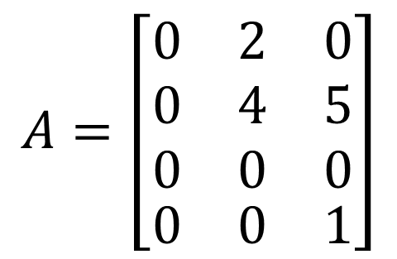
Sparse Matrix
$$A=\left[\begin{aligned}&\begin{matrix}0 & 2 & 0 \\ 0 & 4 & 5 \\ 0 & 0 & 0\end{matrix} \\ &\begin{matrix}0 & 0 & 1\end{matrix}\end{aligned}\right]$$
(row, col, val)
(0, 1, 2)
(1, 1, 4)
(1, 2, 5)
(3, 2, 1)
gv_tuples (mat, row, col)
gv_tuples (mat, 1, 2) 5
gv_tuples (mat, 0, 2) 0
head

Slide 26
Set_tuples(mat, row, col, val)
If val == 0
delete(mat, row, col)
else
case 1. Insert before head
case 2. Values exists at head
case 3. look for nodes to insert
(a) node already exists → replace the old val
(b) node doesn’t exist → insert a new node

Slide 27
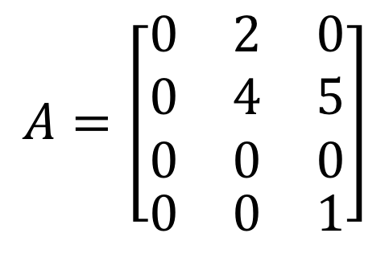
$$A=\left[\begin{aligned}&\begin{matrix}0 & 2 & 0 \\ 0 & 4 & 5 \\ 0 & 0 & 0\end{matrix} \\ &\begin{matrix}0 & 0 & 1\end{matrix}\end{aligned}\right]$$
(0, 1, 2)
(1, 1, 4)
(1, 2, 5)
(3, 2, 1)
head

Slide 28
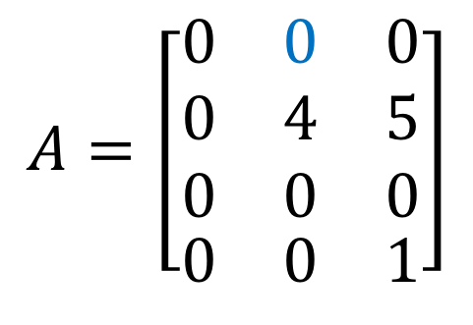
$$A=\left[\begin{aligned}&\begin{matrix}0 & 0 & 0 \\ 0 & 4 & 5 \\ 0 & 0 & 0\end{matrix} \\ &\begin{matrix}0 & 0 & 1\end{matrix}\end{aligned}\right]$$
set_tuples (row=0, col=1, val=0)
(0, 1, 2)
(1, 1, 4)
(1, 2, 5)
(3, 2, 1)
head
(1, 1, 4)
(1, 2, 5)
(3, 2, 1)
head

Slide 29
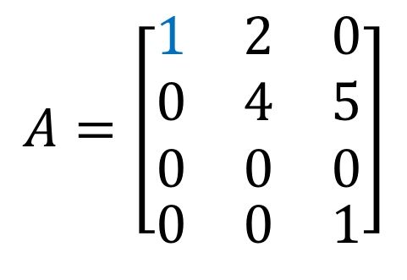
$$A=\left[\begin{aligned}&\begin{matrix}1 & 2 & 0 \\ 0 & 4 & 5 \\ 0 & 0 & 0\end{matrix} \\ &\begin{matrix}0 & 0 & 1\end{matrix}\end{aligned}\right]$$
set_tuples (row=0, col=0, val=1)
(0, 1, 2)
(1, 1, 4)
(1, 2, 5)
(3, 2, 1)
head
(0, 1, 2)
(1, 1, 4)
(1, 2, 5)
(3, 2, 1)
(0, 0, 1)
head

Slide 30

$$A=\left[\begin{aligned}&\begin{matrix}0 & 4 & 0 \\ 0 & 4 & 5 \\ 0 & 0 & 0\end{matrix} \\ &\begin{matrix}0 & 0 & 1\end{matrix}\end{aligned}\right]$$
set_tuples (row=0, col=1, val=4)
(0, 1, 2)
(1, 1, 4)
(1, 2, 5)
(3, 2, 1)
head
(0, 1, 4)
(1, 1, 4)
(1, 2, 5)
(3, 2, 1)
head

Slide 31
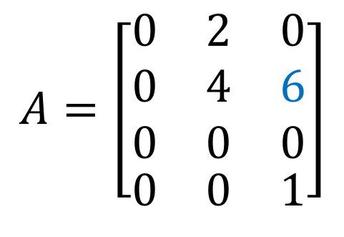
$$A=\left[\begin{aligned}&\begin{matrix}0 & 2 & 0 \\ 0 & 4 & 6 \\ 0 & 0 & 0\end{matrix} \\ &\begin{matrix}0 & 0 & 1\end{matrix}\end{aligned}\right]$$
set_tuples (row=1, col=2, val=6)
(0, 1, 2)
(1, 1, 4)
(1, 2, 5)
(3, 2, 1)
head
(0, 1, 2)
(1, 1, 4)
(1, 2, 6)
(3, 2, 1)
head

Slide 32
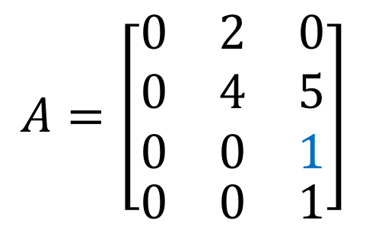
$$A=\left[\begin{aligned}&\begin{matrix}0 & 2 & 0 \\ 0 & 4 & 5 \\ 0 & 0 & 1\end{matrix} \\ &\begin{matrix}0 & 0 & 1\end{matrix}\end{aligned}\right]$$
set_tuples (row=2, col=2, val=1)
(0, 1, 2)
(1, 1, 4)
(1, 2, 5)
(3, 2, 1)
head
(0, 1, 2)
(1, 1, 4)
(1, 2, 5)
(3, 2, 1)
head
(2, 2, 1)

Slide 33
sp_tuples * load_tuples(char* input_file);
load_tuples should open a file with the name 'input_file', read the data from the file, and return a matrix of the list of tuples type.
Use set_tuple in load_tuple!
8 4
0 2 0.265300
0 3 -0.055200
1 3 1.552000
2 1 -0.991600
4 2 0.874500
5 0 -2.076500
7 0 -2.014300
7 3 -0.806300

Slide 34
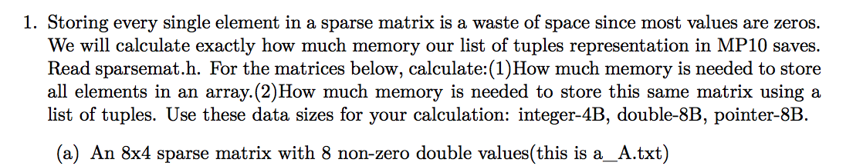
// sparsemat.h
typedef struct sp_tuples_node
{
double value;
int row;
int col;
struct sp_tuples_node * next;
} sp_tuples_node;
Array: 8x4 x 8B
List: 8 x (sizeof(tuple)) = 8 x (8 + 4 + 4 + 8) B
Array: 10,000 x 10,000 x 8B ~= 762MB
List: 10,000 x sizeof(tuple) = 10,000 x (8 + 4 + 4 + 8)B ~= 0.2MB

Slide 35
Download slides at
https://github.com/IouJenLiu/ece220_lab

