Slide 1
LAB11: Lowest Common Ancestor of Binary Search Tree

Slide 2
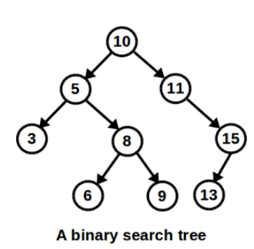
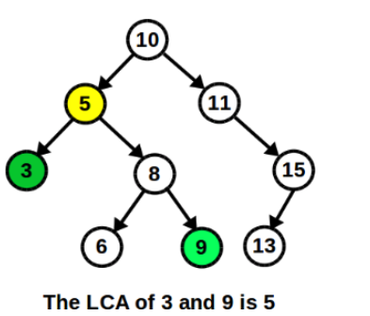
BST
- A BST consists of nodes and each node has a value, a left subtree and a right subtree. (subtree can be empty if the node is a leaf node)
- For each node, the values of nodes in its left subtree are smaller that its value, while the values of nodes in its right subtree are larger than its value.

Slide 3
LCA
- A LCA of two nodes is the lowest node in BST that has the two nodes as descendants (A node is also a descendant of itself).

Slide 4

Hint 1: Suppose the two numbers are a, b and a < b, the LCA of a, b must be some number c in [a, b]
Hint 2: Traverse the BST from root.
lowest_common_ancestor (NODE* root , int first_number , int second_number )
If root->d >= a and root-> <= b
return root;
else if (root->d > b)
….

Slide 5
MP11: Floorplanner

Slide 6
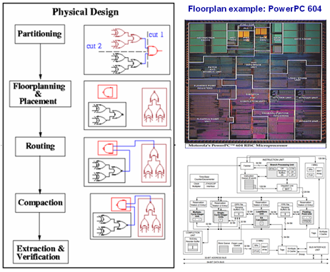
Design Flow of Integrated Circuits (IC)
Notes:
6

Slide 7
1
2
3
Goal: small bounding box
1
2
3

Slide 8
Floorplan Model – Slicing Floorplan
4
5
4
5
4
5
2
3
2
3
2
3
1
V
1
H
1
H
4
5
4
5
H: Horizontal cut
V: Vertical cut
2
3
2
3
V
1
1
Notes:
8

Slide 9
Floorplan Model – Non-slicing Floorplan
2
4
?
3
5
1
A non-slicing floorplan.
Notes:
9

Slide 10
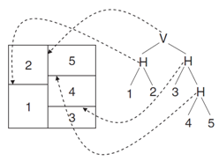
Slicing Tree Representation of Slicing Floorplan
Properties
A binary tree (complete)
Modules on leave nodes & Cutlines on internal nodes
1D expression by postfix traversal
Postfix expression: 12H345HHV
Notes:
10

Slide 11
Packing from a Postfix Expression
Binary operator
H: maximum on width and summation on height
V: maximum on height and summation on width
W₁₂
2
W₃₄
H
H₁₂
V
1
H₃₄
3
1
2
4
3
4
W₁₂= max(W₁ , W₂)
H₁₂= H₁ + H₂
W₃₄ = W₃ + W₄
H₃₄ = max(H₃ , H₄)
(a) Postfix expression: 12H
(b) Postfix expression: 34V
Notes:
11

Slide 12
Packing Two Sub-floorplans Recursively (I)
Binary operator
H: maximum on width and summation on height
V: maximum on height and summation on width
W₁₂₃₄
V
2
H₁₂₃₄
H
V
1
3
4
1
2
3
4
W₁₂₃₄ = W₁₂ + W₃₄
H₁₂₃₄ = max(H₁₂ , H₃₄)
(c) Postfix expression: 12H34VV
Notes:
12

Slide 13
Packing Two Sub-floorplans Recursively (II)
Binary operator
H: maximum on width and summation on height
V: maximum on height and summation on width
W₁₂₃₄
H
3
4
H
V
2
H₁₂₃₄
1
2
3
4
1
(d) Postfix expression: 12H34VH
W₁₂₃₄ = max(W₁₂, W₃₄)
H₁₂₃₄ = H₁₂ + H₃₄
Notes:
13

Slide 14
Floorplan Optimization
Area minimization is the top priority!
Simulated Annealing (SA)
Randomly modify the slicing tree and select the one with the minimum floorplan area
We have provided you this optimization engine
1. Generate an initial slicing tree T
2. Calculate the area of the slicing tree T
3. Generate a random neighboring solution by changing the tree
4. Calculate the cost of the new neighboring solution
5. Compare them:
if new_area < old_area, then move to the new solution
else accept the new solution with a user-defined probability
6. Repeat steps 3-5 above until an acceptable solution is found
Notes:
14

Slide 15
TODO Task 1: Generating an Initial Slicing Tree
0x10
V
init_slicing_tree
Initialize a left-skewed slicing tree
0x20
V
1
0x30
typedef struct NODE {
module_t* module;
cutline_t cutline;
struct NODE* parent;
struct NODE* left;
struct NODE* right;
}node_t;
0x40
V
2
0x50
0x60
4
3
0x70
Node address | left | right | parent | module | cutline
0x10 | 0x20 | 0x30 | NULL | NULL | V
0x20 | 0x40 | 0x50 | 0x10 | NULL | V
0x30 | NULL | NULL | 0x10 | 1 | UNDEFINED_CUTLINE
0x40 | 0x60 | 0x70 | 0x20 | NULL | V
0x50 | NULL | NULL | 0x20 | 2 | UNDEFINED_CUTLINE
Notes:
15

Slide 16

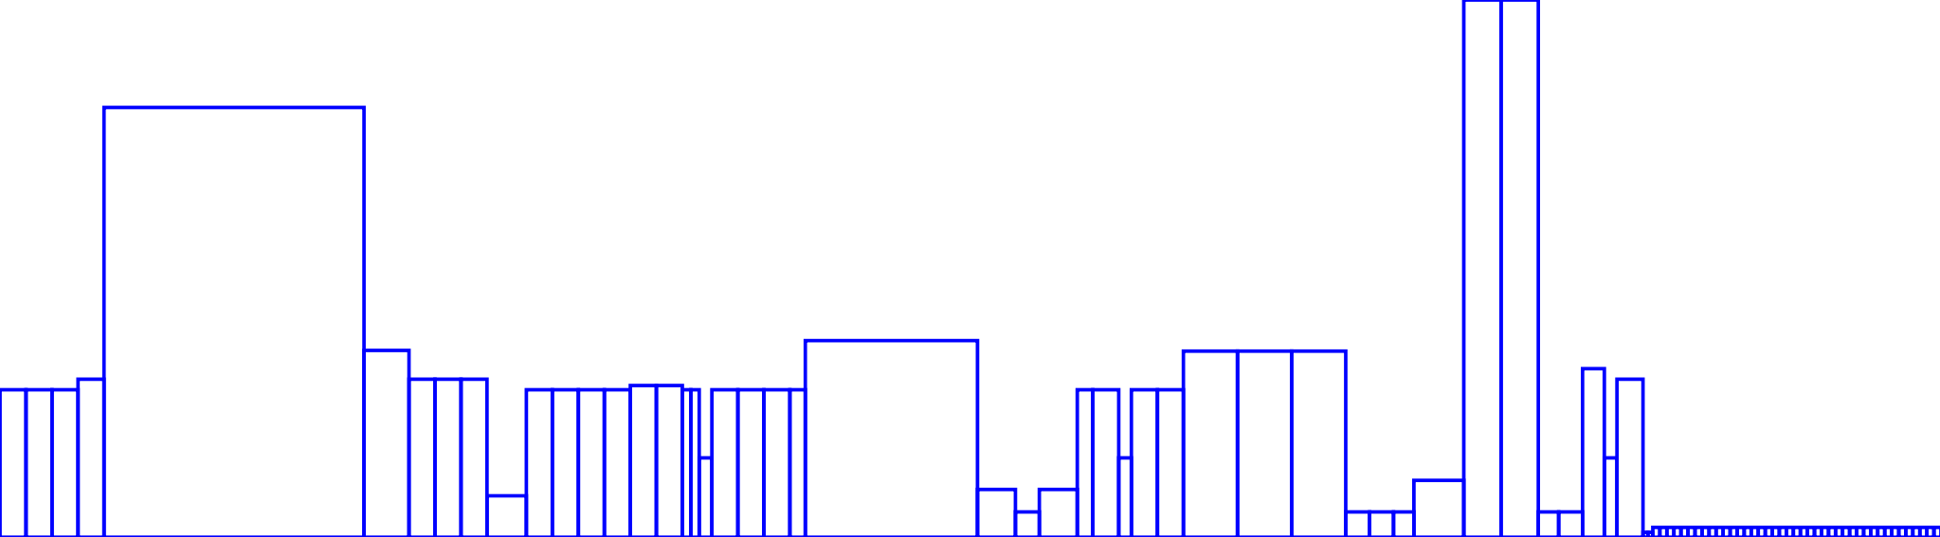
Initial Floorplan
(a) circuit1.txt
(b) circuit4.txt
(e) circuit5.txt

Slide 17
TODO Task 2: Postfix Traversal Algorithm
Postfix traversal algorithm
1. Traverse the left subtree by recursively calling the Postfix function.
2. Traverse the right subtree by recursively calling the Postfix function.
3. Process the data part of root element (or current element).
nth | 0 | 1 | 2 | 3 | 4 | 5 | 6
Expression unit
Node address | 0x40 | 0x50 | 0x20 | 0x60 | 0x70 | 0x30 | 0x10
V
0x10
get_expression
Perform the postfix traversal
Get the postfix expression of the slicing tree
0x20
H
0x30
V
1
2
3
4
0x40
0x50
0x60
0x70

Slide 18
TODO Task 3: Calculate Total Resource Usage
Traverse entire tree to sum all the modules’ resource usage
Return the Total Sum
V
Total Resource Usage:
5+7+9+10 = 31
H
V
1
R:5
2
R:7
3
R:9
4
R:10

Slide 19
TODO Task 4: Tree Modifier – rotate and recut
rotate
Swap the height and the width of a module from a leave node
recut
Change the cutline of an internal node
V
H
H
V
H
V
1
2
3
4
1
2
3
4
Operation: recut
Notes:
19

Slide 20
TODO Task 4: Tree Modifier – swap_module
swap_module
Swap two modules from two leave nodes
Simply swap the pointer value
Do not modify the node links
V
V
H
V
H
V
1
2
3
4
1
4
3
2
Operation: swap_module
Notes:
20

Slide 21
TODO Task 5: Tree Modifier – swap_topology
swap_topology
Swap two subtrees rooted at two given node pointers
Modify the node links appropriately
V
V
H
V
H
2
1
2
3
4
1
V
3
4
Operation: swap_topology
Notes:
21

Slide 22
Example of swap_topology
V
0x10
V
0x10
swap_topology
(0x40, 0x30)
0x20
H
1
0x20
H
V
0x30
0x40
0x30
V
2
1
2
3
4
0x50
0x40
0x50
0x60
0x70
3
4
0x60
0x70
Node address | left | right | parent | module | cutline
0x10 | 0x20 | 0x40 | NULL | NULL | V
0x20 | 0x30 | 0x50 | 0x10 | NULL | H
0x30 | 0x60 | 0x70 | 0x20 | NULL | V
0x40 | NULL | NULL | 0x10 | 1 | UNDEFINED_CUTLINE
0x60 | NULL | NULL | 0x30 | 3 | UNDEFINED_CUTLINE
Notes:
22

Slide 23
Example of a Sequence of Tree Modifiers
V
H
recut
H
V
H
V
1
2
3
4
1
2
3
4
H
swap_module
H
H
4
swap_topology
H
V
1
V
1
4
3
2
3
2
Notes:
23

Slide 24
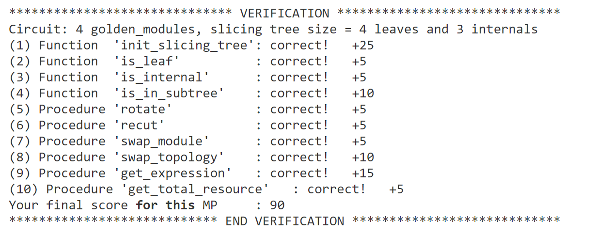

Slide 25
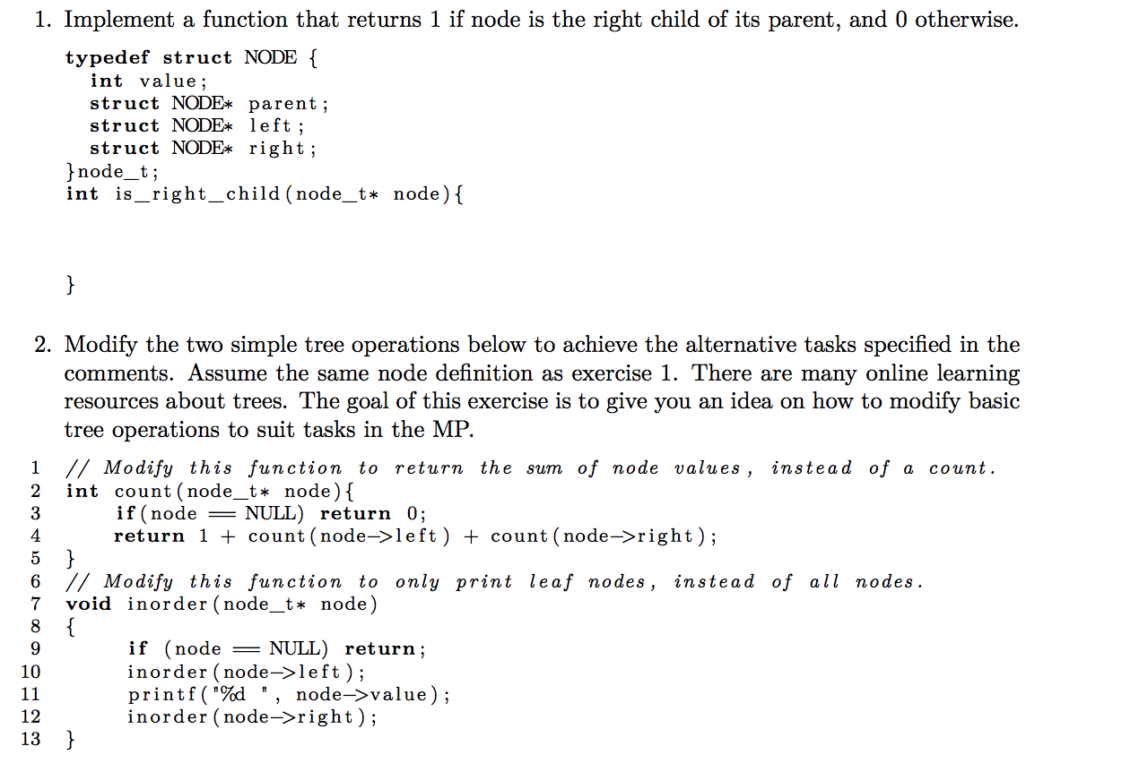
Worksheet
return node->parent->right == node;
node.val + …..
Add if (node->left == NULL && node->right == NULL) before line 11

