Slide 1
ECE 220 Lab3

Slide 2
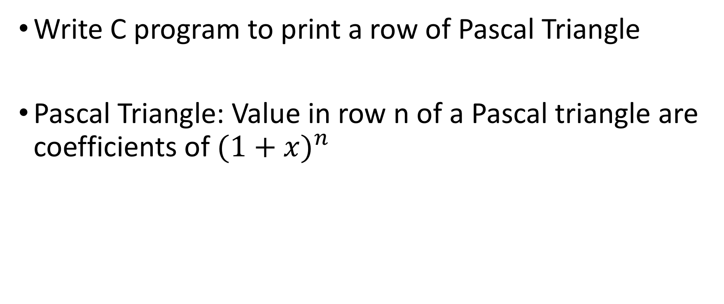
MP3
Write C program to print a row of Pascal Triangle
Pascal Triangle: Value in row n of a Pascal triangle are coefficients of ${(1+x)}^{n}$

Slide 3
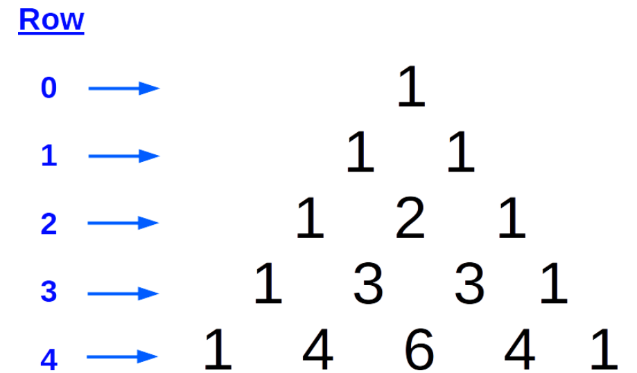
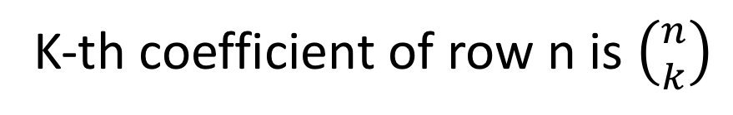





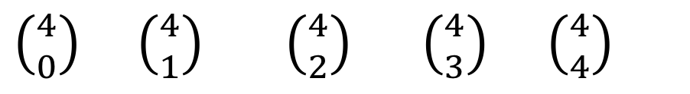
${(1+x)}^{0}$ = 1
${(1+x)}^{1}$ = $1+x$
$${(1+x)}^{2}=x^{2}+2x+1$$
$${(1+x)}^{3}=x^{3}+3x^{2}+3x+1$$
$${(1+x)}^{4}=x^{4}+4x^{3}+{6x}^{2}+4x+1$$
$\left({4 \atop 0}\right) \left({4 \atop 1}\right)$ $\left({4 \atop 2}\right)$ $\left({4 \atop 3}\right)$ $\left({4 \atop 4}\right)$
K-th coefficient of row n is $\left({n \atop k}\right)$

Slide 4

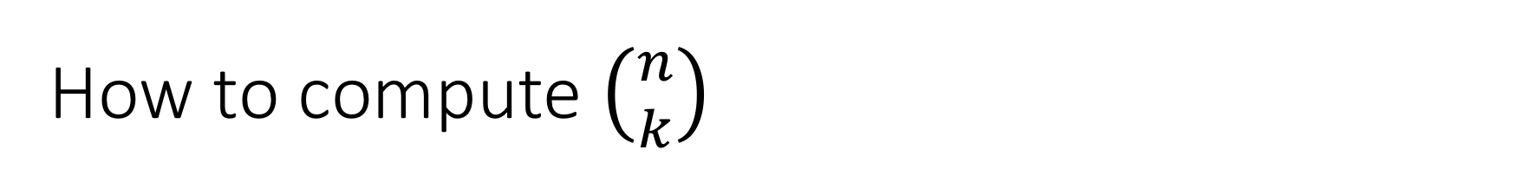
How to compute $\left({n \atop k}\right)$
n! leads to overflow

Slide 5
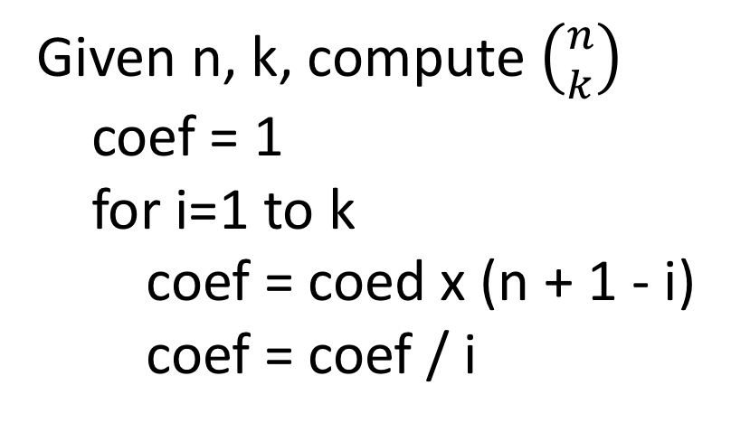
Given n, k, compute $\left({n \atop k}\right)$
coef = 1
for i=1 to k
coef = coed x (n + 1 - i)
coef = coef / i

Slide 6
printf, scanf
int a = 10;
int b;
(OUT)
printf(“a is %d “, a) → “a is 10”
(GETC)
scanf(“%d”, &b)

Slide 7
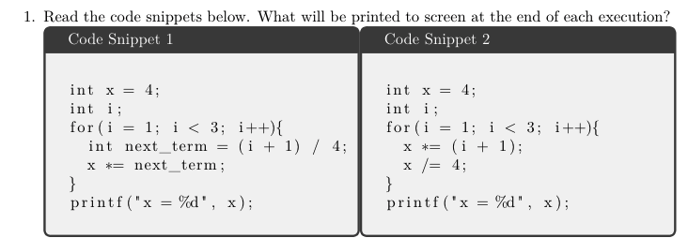
WorkSheet

