Slide 1
LAB4

Slide 2
Lab4
Prime number: a natural number greater than 1 that is not a product of two smaller natural numbers
2, 3, 5, 7….
int is_prime(int number) { int i; for(i = 2; i < number ;i++) { if(number % i == 0) return 0 ; } return 1;}

Slide 3
MP4 Semi-Prime (GDB)
A semiprime is a positive integer that is a product of two prime numbers (the prime numbers can be identical)
Number | is a semiprime ?
2 | No. 2 = 2 x 1
4 | Yes. 4 = 2 x 2
6 | Yes. 6 = 2 x 3
12 | No. 12 = 4 x 3 = 2 x 6
22 | Yes. 22 = 2 x 11

Slide 4
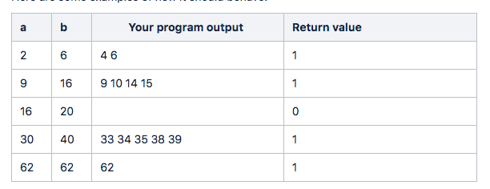
MP4 Semi-Prime (GDB)
The program is supposed to read two inputs a, b (assume both are positive integers and a≤b) and then print all the semiprimes in the range [a,b] (including a and b).
It then returns 1 if there are semiprimes in the provided range (including a and b), and 0 if there are none.

Slide 5
DEMO

Slide 6
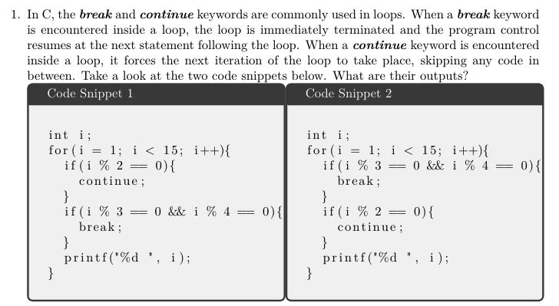
Worksheet

